Slide 1



In-DRAM True Random Number Generation
Using Simultaneous Multiple-Row Activation
An Experimental Study of Real DRAM Chips
İsmail Emir Yüksel
A. Olgun F. N. Bostancı O. Canpolat
G. F. Oliveira M. Sadrosadati A. G. Yağlıkçı O. Mutlu

Slide 2
Outline
Motivation & Goal
Generating Random Numbers via SiMRA
Testing Infrastructure
Real DRAM Chip Results
SiMRA-TRNG
Conclusion

Slide 3
Outline
Motivation & Goal
Generating Random Numbers via SiMRA
Testing Infrastructure
Real DRAM Chip Results
SiMRA-TRNG
Conclusion

Slide 4

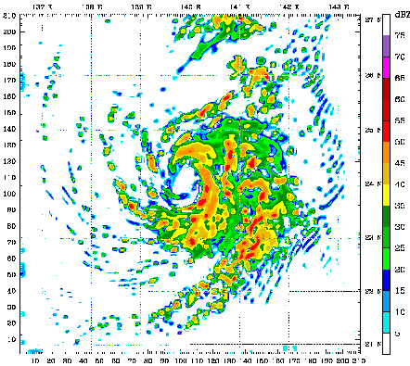
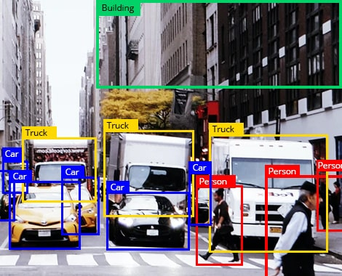
Use Cases of True Random Numbers
High-quality true random numbers
are critical to many applications
True random numbers can only be obtained
by sampling random physical processes
Unfortunately, not all computing systems are equipped with true random number generator (TRNG) hardware
Notes:
True random numbers are essential to many applications, such as
[CLICK] Cryptography, like key generation
[CLICK] Scientific simulations
[CLICK] Statistical sampling and randomized algorithms
[CLICK] And these true random numbers can only be obtained by sampling physical processes, such as thermal noise and clock jitter
[CLICK] However, not all computing systems have dedicated hardware/circuitry to generate true random numbers

Slide 5
DRAM-Based TRNGs
DRAM chips are ubiquitous in modern
computing platforms
DRAM-based TRNGs enable true random number generation within DRAM chips
Low-cost: No specialized circuitry for RNG
Beneficial for constrained systems
High-throughput: > Gb/s throughput
Open application space that require
high-throughput TRNG
Notes:
And we can solve the dependency on dedicated TRNG using DRAM-based TRNGs
[CLICK] Because DRAM chips are widely-used in modern computing platforms as a main memory
[CLICK] DRAM-based TRNGs generates true random numbers within DRAM chips using analog operational properties of DRAM circuitry
[CLICK] This approach is low cost: as I mentioned no specialized circuitry for random number generation
[CLICK] And as prior work has shown DRAM-based TRNGs provides random numbers with very high-throughput (more than Gb/s)

Slide 6


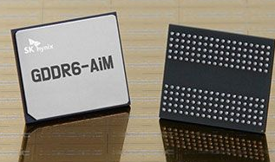
Synergy with Processing-in-Memory
Processing-in-Memory (PIM) Systems
Perform computation directly near/within a memory chip
Improve system performance by avoiding off-chip data movement
True random number generation within DRAM
Enables PIM workloads to sample true random numbers
directly within the memory chip
Avoids inefficient communication to other
possible off-chip TRNG sources, enhances security & privacy
[Samsung]
[UPMEM]
[SK hynix]
Notes:
DRAM-based TRNGs are also very important for processing-in-memory systems
[CLICK] PIM performs computation near or within a memory chip
[CLICK] And reduces the data movement bottleneck caused by frequent data movement between main memory and processing units
[CLICK] And DRAM-based TRNGs
[CLICK] can enable PIM workloads to use true random numbers directly within the memory chip
[CLICK] This approach avoids inefficient communication to other possible off-chip TRNG sources and enhances security & privacy as true random numbers stays in the memory chip and are not transferred using off-chip link

Slide 7

DRAM Organization
DRAM Module
DRAM
Chip
Subarray
DRAM Cell
Bank
…
Wordline
Chip I/O
Row Decoder
DRAM Row
Bitline
…
Sense Amps.
DRAM Chip
DRAM Bank
DRAM Subarray
Notes:
[CLICKx2] Each chip contains multiple banks
[CLICK] Each bank is composed of multiple subarrays and sense amplifiers
[CLICK] And within each subarray, there is a two dimensional array of DRAM cells.
[CLICK] These cells are organized into rows that are selected using wordlines
[CLICK] And the cells are connected to a row of sense amplifiers via bitlines

Slide 8
DRAM Operation
DRAM Subarray
1
ACTIVATE (ACT):
Fetch the row’s content
into the sense amplifiers
2
Column Access (RD/WR):
Read/Write the target
column and drive to I/O
Sense
Amplifiers
3
PRECHARGE (PRE):
Prepare the bank
for a new ACTIVATE
I/O Circuitry
Notes:
Data is internally accessed in a row granularity. To access data,
[CLICK] the memory controller first needs to activate the row that contains the data and fetch the row’s content into the sense amplifiers
[CLICK] Then, column accesses are serviced from the sense amplifiers
[CLICK] Finally, the subarray needs to be precharged to get ready for the next row activation

Slide 9
Processing-using-DRAM (PuD)
Processing-using-DRAM uses the analog operational principles of
DRAM cells to perform computation
Simultaneous multiple-row activation (SiMRA) is a key technique
to realize many PuD operations (e.g., AND and OR)
DRAM
(e.g., 3D-Stacked Memory)
DRAM Bank
Vault
Controller
Processing-
Using-DRAM
DRAM Vault
PHY
…
…
Notes:
One type of PIM is Processing-using-DRAM
Processing-using-DRAM architectures alleviate data movement bottlenecks using the analog operating principles of the DRAM cells to perform computation, in what is called processing-using-memory
Many PuD operations involves a key technique called multiple-row activation

Slide 10

Simultaneous Multiple-Row Activation
Activating two rows in quick succession
in COTS DRAM chips simultaneously activates multiple rows in a subarray
36ns
14ns
ACT Row A
PRE
ACT Row B
3ns
3ns
Subarray X
ACT
Row A
…
ACT
Row B
DRAM Bank
Notes:
Now let’s see how SiMRA works
[CLICK] The key observation is activating two rows in quick succession can simultaneously activate many rows in a subarray
[CLICK] In this pictorial example Row A and Row B is in Subarray X.
[CLICK] When we respect to the timing parameters between ACT and PRE and PRE and ACT
[CLICK] we activate a single row at a time.
[CLICK] However, when we greatly violate these timing parameters,
we can activate many rows at once in the same subarray

Slide 11
Our Goal
Experimentally understand
the capability of SiMRA as a source of entropy
in COTS DRAM chips
Experimentally analyze & characterize
such capability
under various operating conditions
Notes:
Our goal is to
[CLICK] Experimentally understand the computational capability of off-the-shelf DRAM chips beyond what prior works have demonstrated
[CLICK] And experimentally analyze the robustness of such capability under various operating conditions

Slide 12
Outline
Motivation & Goal
Generating Random Numbers via SiMRA
Testing Infrastructure
Real DRAM Chip Results
SiMRA-TRNG
Conclusion
Notes:
Here is the outline of my talk

Slide 13
Generating Random Values via SiMRA
Simultaneously activating N rows with
half storing logic-1 and half storing logic-0
V_{DD}/2
R1
V_{DD}
R2
V_{TH}
R3
0
Logic-1
Voltage Difference
…
…
-V_{TH}
Ready to Sense
Voltage Level
RN
Sense Amplifier
-V_{DD}
Time
Enable
V_{DD}/2
Notes:
Now let's see how we can generate random number using simultaneous multiple-row activation
[CLICK] Here, we have four cells connected to a sense amplifier via the same bitline. I
[CLICK] Initially, two cells are initialized with logic-1 and remaning two with logic-0
[CLICK] And the bank is precharged: bitlines are at precharged voltage: VDD/2
[CLICK] Here on the right side we have the voltage difference between two end of sense amplifier.
[CLICK] Since both bitlines are at VDD/2, there is no voltage difference and VTH shows a safe voltage level that sense amplifier can understand the difference and amplify the bitline voltage to either 1 or 0

Slide 14

Generating Random Values via SiMRA
Simultaneously activating N rows with
half storing logic-1 and half storing logic-0
V_{DD}/2
+ $ε$
R1
V_{DD}
R2
RN
activated
All N cells
activated
V_{TH}
R3
0
Voltage Difference
…
…
-V_{TH}
RN
Sense Amplifier
-V_{DD}
Time
Enable
ACT
PRE
ACT
V_{DD}/2
Notes:
We first start by issuing ACT command and assume that
[CLICK] we activate R0 here
[CLICK] This will perturb the bitline and starts increasing the bitline voltage
[CLICK] And we issue PRE and ACT commands in quick succession, which activates all cells in this example.
Since two cells try to reduce the voltage while remaining two try to increase the voltage,
bitline voltage difference is almost at the same level of VDD/2

Slide 15

Generating Random Values via SiMRA
Simultaneously activating N rows with
half storing logic-1 and half storing logic-0
V_{DD}/2
+ $ε$
R1
V_{DD}
Random Perturbation
R2
V_{TH}
R3
0
Voltage Difference
…
…
-V_{TH}
RN
Sense Amplifier
-V_{DD}
Time
Enable
ACT
PRE
ACT
Enable Sense Amplifiers
V_{DD}/2
Notes:
And sense amplifier is enabled and tries to amplify the voltage difference between bitlines
[CLICK] However, since the voltage difference is almost zero, sense amplifier amplifies the voltage to randomly either to logic-1 or logic-0
In this study, we leverage this random amplification of sense amplifier to generate random values in real DRAM chips

Slide 16
Outline
Motivation & Goal
Generating Random Numbers via SiMRA
Testing Infrastructure
Real DRAM Chip Results
SiMRA-TRNG
Conclusion
Notes:
Now, let's see how we characterize this behavior in real DRAM chips

Slide 17
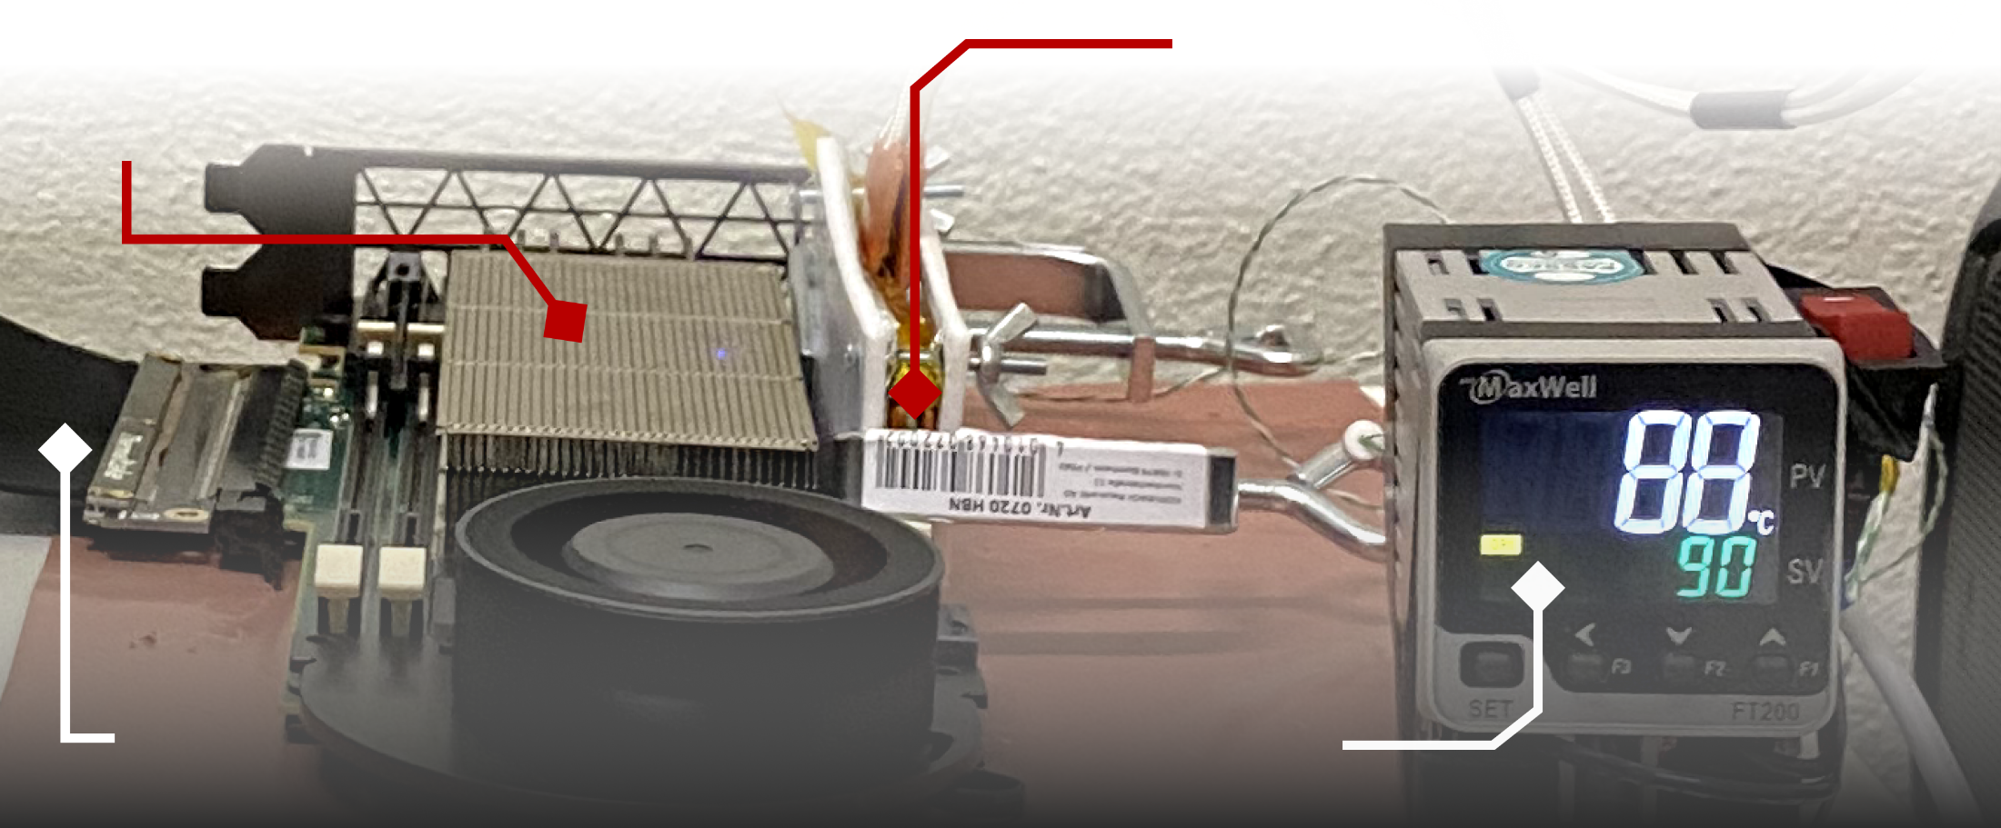
DDR4 DRAM Testing Infrastructure
  DRAM Bender on a Xilinx Virtex UltraScale+ XCU200
Xilinx Alveo U200 FPGA Board
(programmed with DRAM Bender*)
DRAM Module with Heaters
PCIe
Host Interface
MaxWell FT200 Temperature Controller
Fine-grained control over DRAM commands,
timing parameters (±1.5ns), and temperature (±0.5°C )
*Olgun et al., "DRAM Bender: An Extensible and Versatile FPGA-Based Infrastructure to Easily Test
State-of-the-Art DRAM Chips,” TCAD, 2023. [GitHub: https://github.com/CMU-SAFARI/DRAM-Bender]
Notes:
We use a DDR4 testing infrasturcture called DRAM Bender. It enables us to test DDR4 DRAM modules
[CLICK]
with fine-grained control over DRAM commands, timing parameters, and temperature

Slide 18
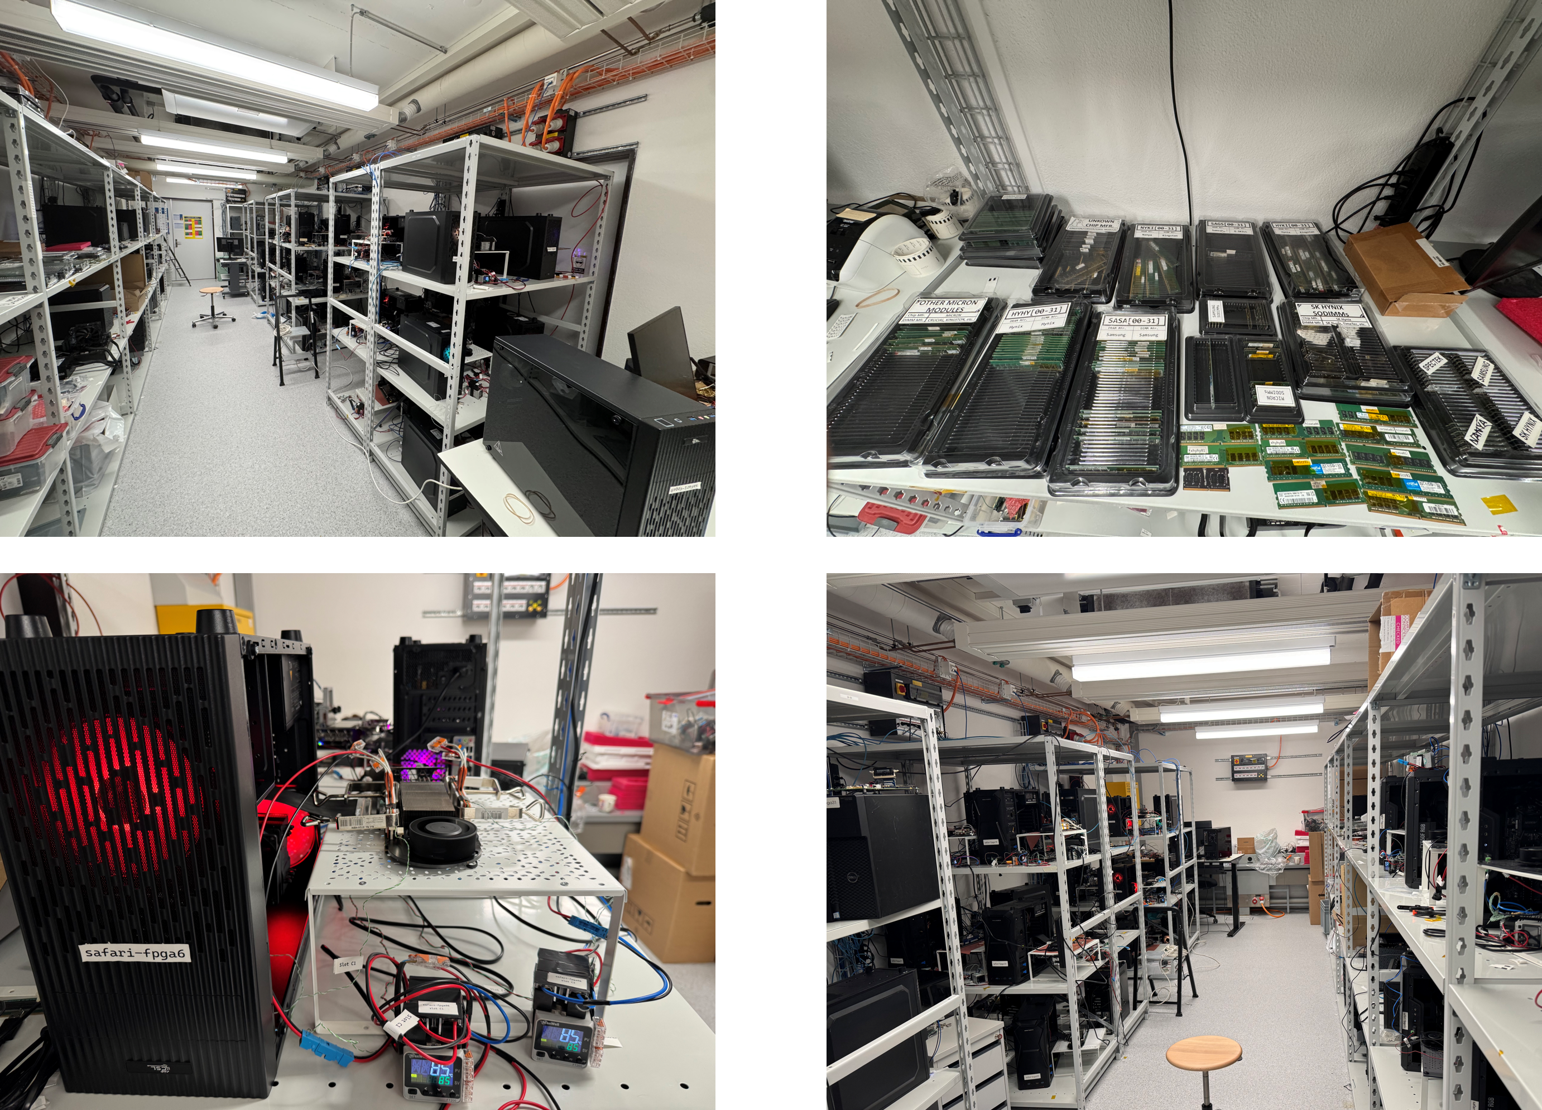
Laboratory for Understanding Memory
Notes:
And in our lab, we have many machines to test many DRAM modules and chips

Slide 19
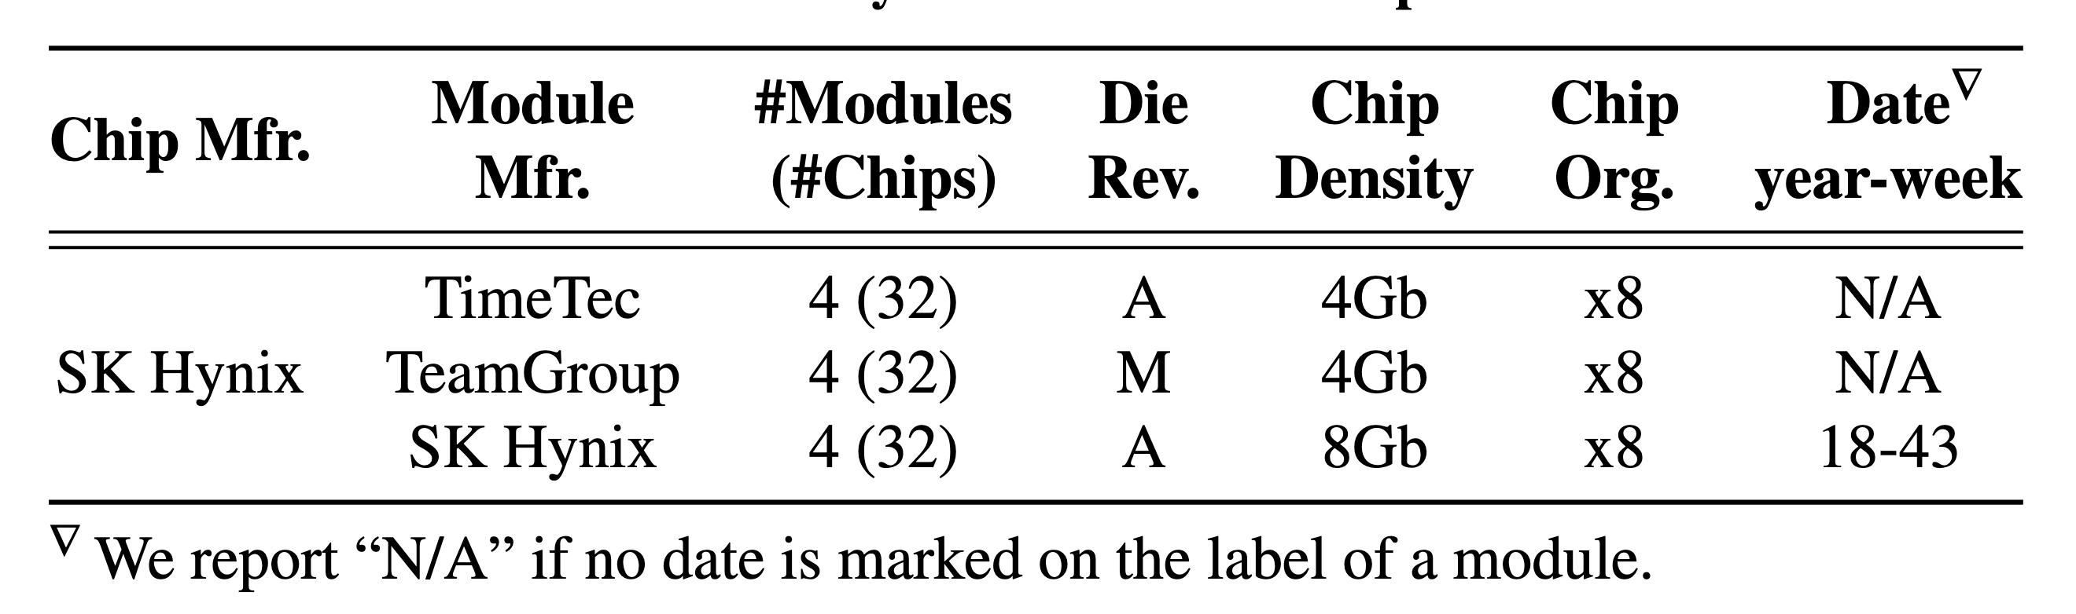
Tested DRAM Chips
96 real DDR4 chips from SK Hynix
Covering multiple die revision & chip density
Notes:
In this study, we test a total of 96 real off-the-shelf DDR4 chips from Sk hynix covering
[CLICK] various die density and die revisions.

Slide 20


Characterization Methodology
Carefully sweep
    Row addresses: Row A and Row B (>3M row pairs)
    Timing parameters: Between ACT → PRE and PRE → ACT
    Data Pattern: 0x00, 0xFF, and random
    Temperature (◦C): 50, 60, 70, and 80
All rows in Subarray X
Temperature
ACT Row A
PRE
ACT Row B
Subarray X
ACT
Row A
…
ACT
Row B
50 ◦C
80 ◦C
DRAM Bank
Notes:
To characterize the SiMRA’s entropy
[CLICK] We carefully sweep four parameters: Row addresses: Row A and Row B
[CLICK] Timing parameters between prechrage to activate command
[CLICK] Data pattern
[CLICK] And temperature

Slide 21
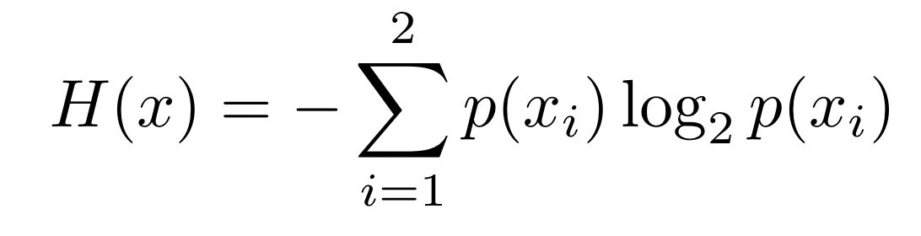
Randomness Metric - I
Measure randomness of bitstreams using
Shannon Entropy (SE)
Sample each bitline following SiMRA 1000 times and calculate the bitline’s Shannon Entropy
SE(1111…111) = 0
0 < SE(1001…010) < 1
Calculating probabilities:
Proportion of logic-1 and
logic-0 values in the random bitstream
Notes:
We use Shannon Entropy to measure the entropy
[CLICKx2] Here is the equation but let me give you the intuition behind this shortly
[CLICK] We sample each bitline (means sense amp) following SiMRA 1000 times and calculate each bitline's Shannon Entropy
How?
[CLICK] Basically, if all the sampled bits have the same value the entropy is 0, which indicates no randomness
[CLICK] Ideally, you would want a value very close to 1, but at least greater than 0

Slide 22
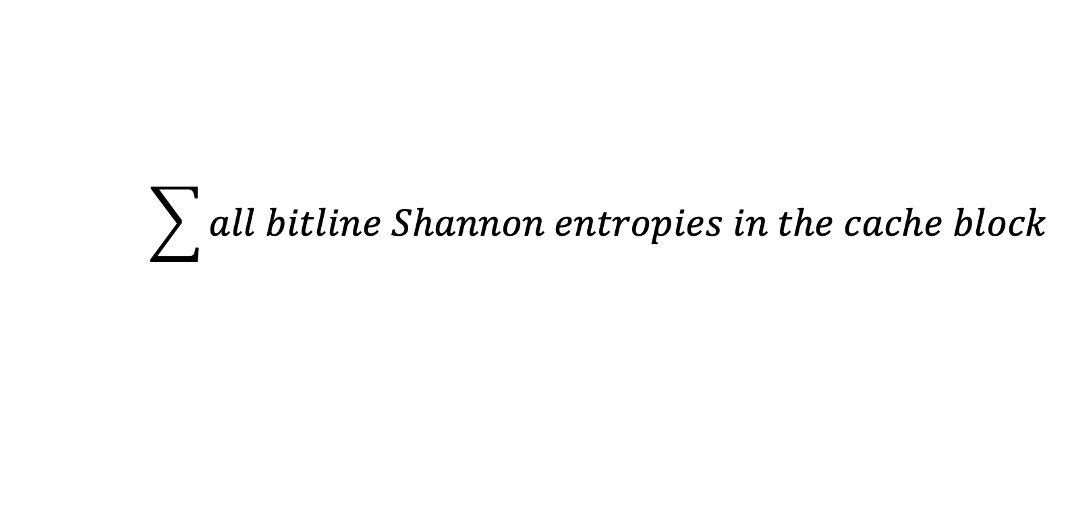
Randomness Metric - II
Calculate cache block (512-bit) entropy
Average cache block entropy
    Average entropy
    across all cache blocks in a module
$$\sum{all bitline Shannon entropies in the cache block}$$
Notes:
We use the Shannon Entropy to calculate each cache block's entropy in sense amplifiers basically 512-bits
[CLICK] By summing up all entropy in the corresponding 512 bitlines, which means the highest value you can get is 512
[CLICK] And we define a metric called average cache block entropy
[CLICK] Represents average entropy across all cache blocks in each tested DRAM module

Slide 23
Outline
Motivation & Goal
Generating Random Numbers via SiMRA
Testing Infrastructure
Real DRAM Chip Results
SiMRA-TRNG
Conclusion
Notes:
Here is the outline of my talk

Slide 24
Key Takeaways from Major Characterization Experiments
Takeaway 1
SiMRA’s entropy generally increases as
the number of simultaneously activated rows increases.
This trend varies across DRAM microarchitectures
Takeaway 2
Data pattern significantly affects
SiMRA’s average cache block entropy
Takeaway 3
DRAM chip temperature significantly affects
SiMRA’s average cache block entropy
Notes:
We have three key takeaways from major characterization experiments

Slide 25
Key Takeaways from Major Characterization Experiments
Takeaway 1
SiMRA’s entropy generally increases as
the number of simultaneously activated rows increases.
This trend varies across DRAM microarchitectures
Takeaway 2
Data pattern significantly affects
SiMRA’s average cache block entropy
Takeaway 3
DRAM chip temperature significantly affects
SiMRA’s average cache block entropy
Notes:
We have three key takeaways from major characterization experiments

Slide 26
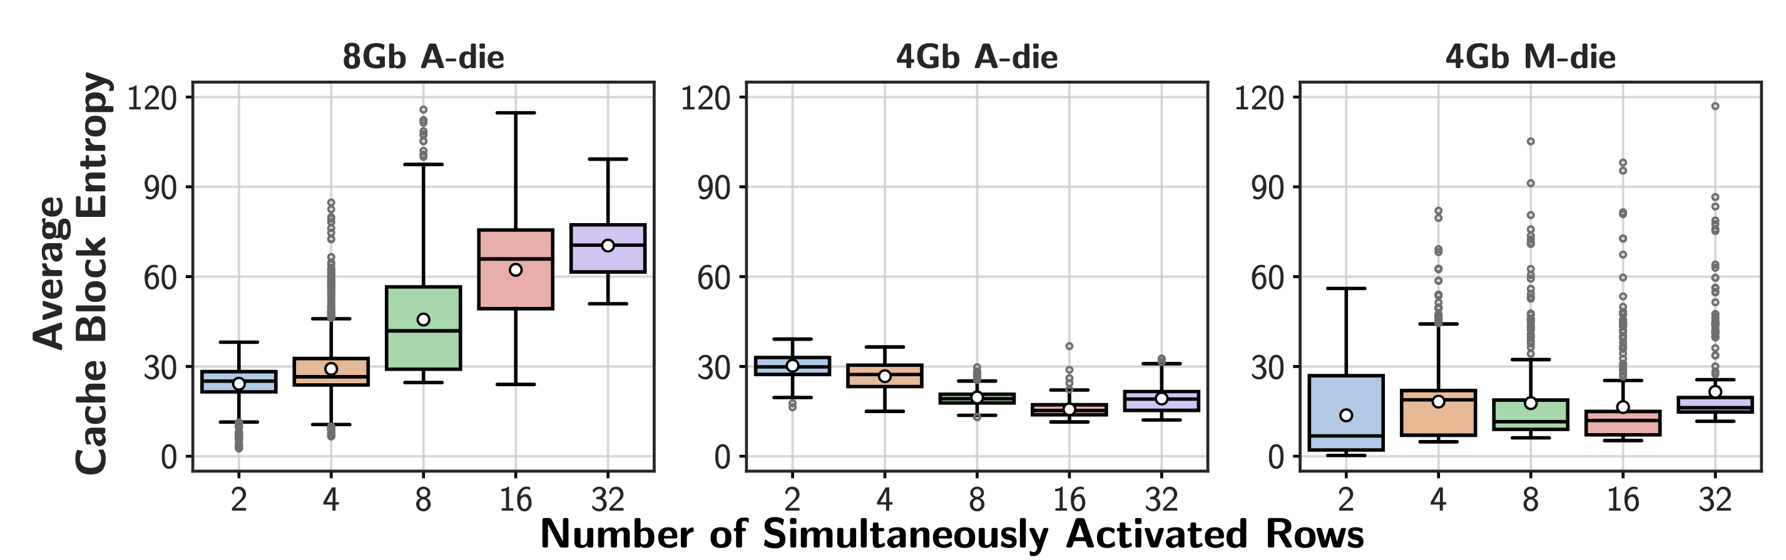
Average Entropy for All DRAM Chips
SiMRA generates random values with
all tested numbers of simultaneously activated rows
This trend is consistent
across all tested chip density & die revision pairs
Notes:
Here we show the first result that lead us to first takeaway: y-axis shows the average cache block entropy
and X-axis shows the DRAM number of simultaneously activated rows to generate random values
[CLICK] and each subplot is dedicated to different die revision and chip density
[CLICK] Let's first focus on the leftmost graph, as we can see, entropy is between 30-90, much greater than zero
[CLICK] So, we conclude that SiMRa generates [..]
[CLICK] And this trend is consistent across all tested [..]

Slide 27
Average Entropy for All DRAM Chips
2.9x
1.4x
In most of the tested chips, entropy increases
as the number of simultaneously activated rows increases
However, not all chip density & die revision pairs
have the same trend
Notes:
For the second observation, let's again focus on the leftmost plot
[CLICK] We observe that as the number of simultaneously activated rows increases, the entropy also increases
[CLICK] This also the same case for 4Gb M-die chips
[CLICK] We conclude that in most of the tested chips, entropy increases with number of simultaneously activated rows
[CLICK] However, not for all chips, for example in 4Gb A-die chips the trend seems that there is almost no correlation between entropy and number of simultaneously activated rows

Slide 28
Key Takeaways from Major Characterization Experiments
Takeaway 1
SiMRA’s entropy generally increases as
the number of simultaneously activated rows increases.
This trend varies across DRAM microarchitectures
Takeaway 2
Data pattern significantly affects
SiMRA’s average cache block entropy
Takeaway 3
DRAM chip temperature significantly affects
SiMRA’s average cache block entropy
Notes:
We have three key takeaways from major characterization experiments

Slide 29
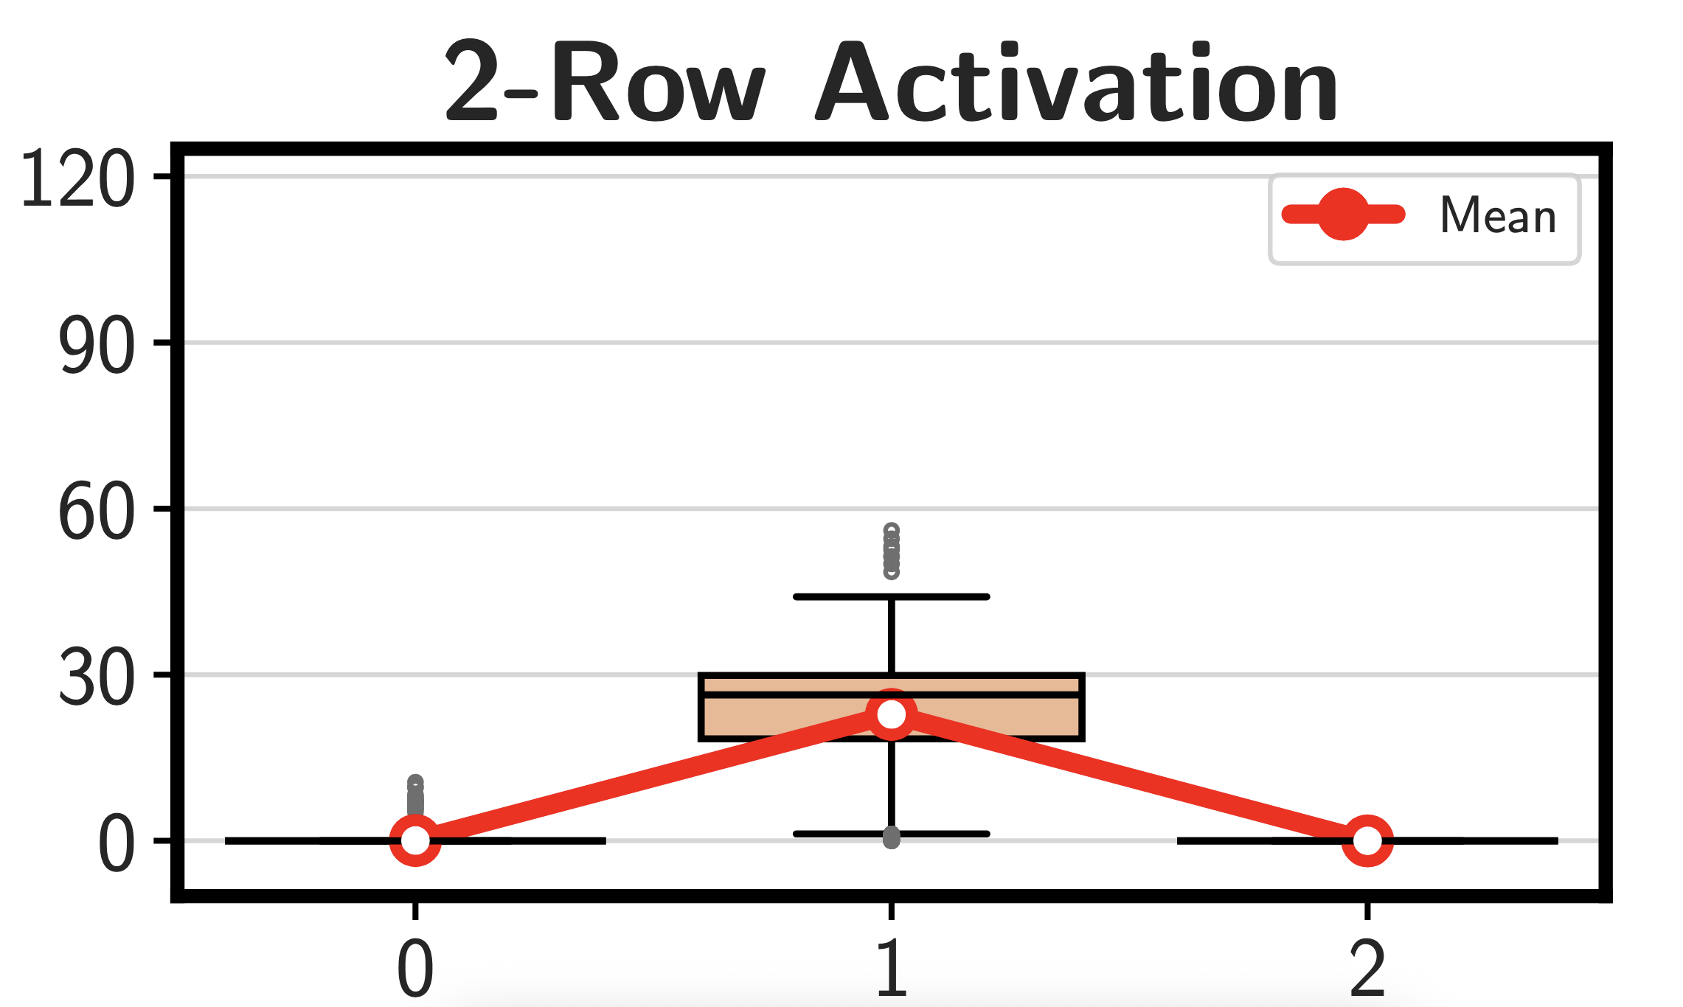


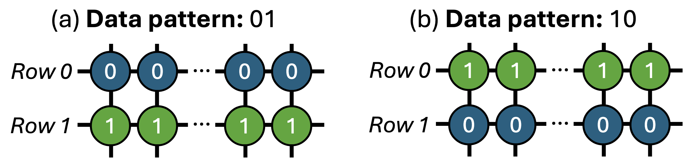
Effect of Data Pattern
Notes:
Here, let's first check the results for 2-row activation, y-axis is the same and this time in the x-axis, we have number of logic-1s in the data pattern
[CLICK] For example having one logic-1 in a data pattern means first row has all-0 while second row has all-1 which is 01 and the other data pattern is 10

Slide 30
Effect of Data Pattern
446x
Entropy significantly varies across tested number of logic-1s
Notes:
Here is the result
[CLICK] And we observe that having one logic-1 in a data pattern significantly generates more entropy than other data points
[CLICK] We conclude that entropy significantly varies with data pattern

Slide 31
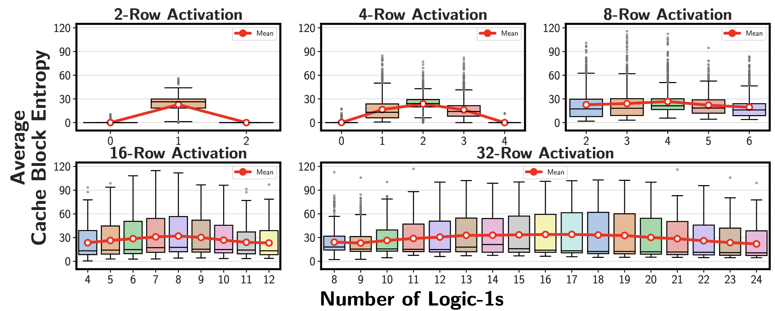
Effect of Data Pattern
This observation is consistent for every number of
simultaneous multiple row activations
Notes:
And this observation is consistent for every number of simultaneous multiple row activations

Slide 32
Key Takeaways from Major Characterization Experiments
Takeaway 1
SiMRA’s entropy generally increases as
the number of simultaneously activated rows increases.
This trend varies across DRAM microarchitectures
Takeaway 2
Data pattern significantly affects
SiMRA’s average cache block entropy
Takeaway 3
DRAM chip temperature significantly affects
SiMRA’s average cache block entropy
Notes:
The third key takeaway is …
As the interest of time I am inviting you to check the paper for more detail

Slide 33
Outline
Motivation & Goal
Generating Random Numbers via SiMRA
Testing Infrastructure
Real DRAM Chip Results
SiMRA-TRNG
Conclusion
Notes:
Here is the outline of my talk

Slide 34
SiMRA-TRNG
Key Idea: Leverage random values on sense amplifiers generated by SiMRA operations as source of entropy
Simultaneously Activated DRAM Rows
Sense Amplifiers
Step 1
Initialize
Step 2
SiMRA
Random Values
Logic-1
Logic-0
Notes:
The key idea behind SiMRA-TRNG is to leverage random values generated by SiMRA
[CLICK] As an example, here we have four rows simultaneously activated
[CLICK] And sense amplifiers
[CLICK] The first step is to initialize the rows
[CLICK] Then we perform SiMRA
[CLICK] Which activates these four rows simul;taneously
[CLICK] As a result, we now have random values in the sense amplifiers

Slide 35
SiMRA-TRNG
Key Idea: Leverage random values on sense amplifiers generated by SiMRA operations as source of entropy
256-bit Shannon Entropy Blocks
Sense Amplifiers
Memory Controller
SHA-256
256-bit TRN
Step 1
Initialize
Step 2
SiMRA
Step 3
Read
Step 4
Post-Process
Notes:
[CLICK] Now, the third step is reading those random values
[CLICK] We read the whole sense amplifiers and construct entropy blocks that contain 256-bits of Shannon. Entropy,
This is the amount of entropy needed to generate true random numbers
[CLICK] We then feed the entropy blocks to SHA-256 as a fourth step
[CLICK] And finally generate true random numbers

Slide 36
SiMRA-TRNG: Quality and Latency
SiMRA-TRNG’s Quality
SiMRA-TRNG reliably produces high-quality true random bitstreams
    Evaluated using NIST Statistical Test Suite (NIST STS) tests
      SiMRA-TRNG passes all 15 NIST STS tests for all N for SiMRA-N
SiMRA-TRNG’s Latency
    {2, 4, 8, 16, 32}-row-based SiMRA-TRNG has
    165ns, 255ns, 435ns, 795ns, and 1.51us of latency, respectively
    Measured latency of each SiMRA-TRNG step
      Initialization, SiMRA, Read, Post-Process
Notes:
We evalaute SiMRA-TRNG's quality, latency, and throughput.
[CLICK] Let's start with Quality
[CLICK] We observe that SiMRA-TRNG reliably produces high-quality true random numbers
[CLICK] We use NIST Statistical Test Suite tests to evaluate the quality
[CLICK] For the latency,
[CLICK] We observe that depending on the number of activated rows, SiMRA-TRNG has a latency of between 165ns to 1.5 microseconds latency

Slide 37
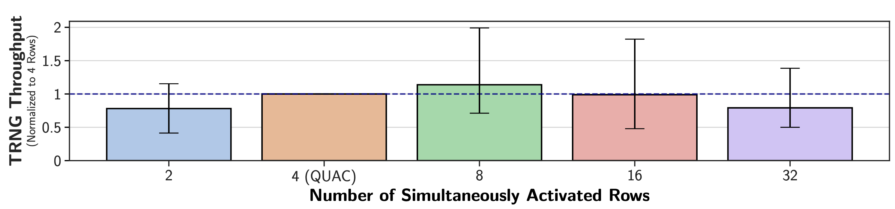
SiMRA-TRNG: Throughput
1.99x
1.82x
1.15x
1.39x
State-of-the-art DRAM-based TRNG
SiMRA-based TRNG designs outperform
the state-of-the-art DRAM-based TRNG
Notes:
Moving onto the throughput results
Here on the y-axis we have the TRNG throughput normalized to the state-of-the-art DRAM-based TRNG
[CLICK] which is four row activation
[CLICK] Here is the result
[CLICK] And we observe that SiMRA-TRNG achieves up to 2 times higher throughput than the state-of-the-art
[CLICK] We conclude that SiMRA-based TRNG designs outperforms the state-of-the-art DRAM-based TRNG

Slide 38
More in the Paper
More characterization results
    Effect of temperature
    Spatial variation across DRAM subarrays
    Many hypotheses based on the empirical observations
Details and analyses on SiMRA-TRNG
    Quality
    Latency
    Throughput
Discussion on the limitations of testing real DRAM chips
Notes:
We have more content in the paper, including
…

Slide 39
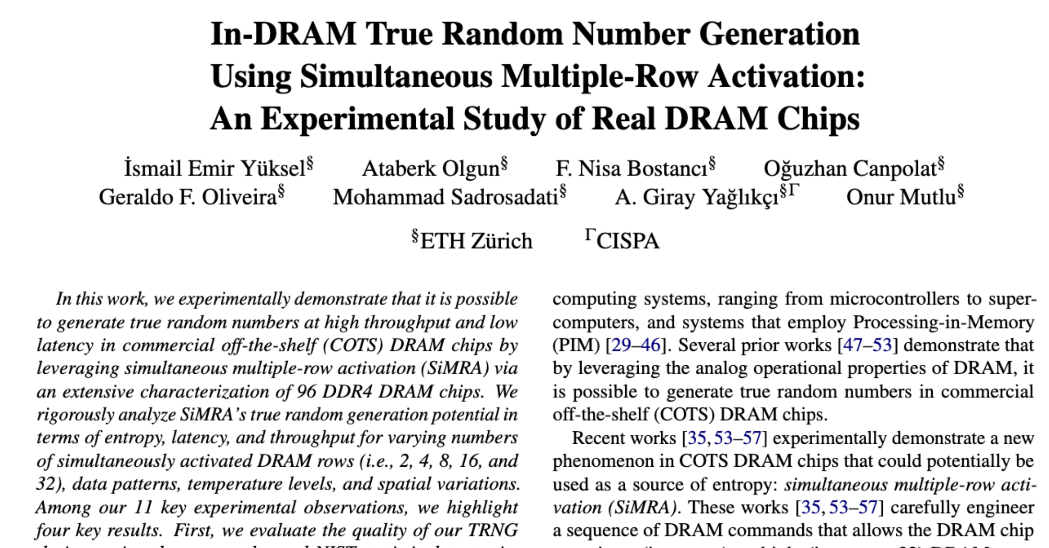
Available on arXiv
https://arxiv.org/pdf/2510.20269
Notes:
The extended version of our study is available on arxiv

Slide 40
Outline
Motivation & Goal
Generating Random Numbers via SiMRA
Testing Infrastructure
Real DRAM Chip Results
SiMRA-TRNG
Conclusion
Notes:
And now let me conclude my talk

Slide 41
Conclusion
We demonstrate and extensively study the potential of
using simultaneous multiple-row activation (SiMRA)
to generate true random numbers
We characterize 96 off-the-shelf DDR4 DRAM chips
SiMRA generates random values in all tested DRAM chips
Data pattern significantly affects SiMRA’s entropy
Temperature has a significant impact on SiMRA’s entropy
We develop a new DRAM-based TRNG: SiMRA-TRNG
Passes all NIST STS tests and generates true random numbers
Outperforms the state-of-the-art DRAM-based TRNG
We hope these empirical results demonstrate
the promising potential of using DRAM as a TRNG substrate
https://github.com/CMU-SAFARI/SiMRA-TRNG

Slide 42
In-DRAM True Random Number Generation
Using Simultaneous Multiple-Row Activation
An Experimental Study of Real DRAM Chips
İsmail Emir Yüksel
A. Olgun F. N. Bostancı O. Canpolat
G. F. Oliveira M. Sadrosadati A. G. Yağlıkçı O. Mutlu
Notes:
Hello, I am Ismail Emir Yuksel.
I will be presenting our work, In-DRAM [..]

Slide 43
In-DRAM True Random Number Generation
Using Simultaneous Multiple-Row Activation
An Experimental Study of Real DRAM Chips
Backup Slides
İsmail Emir Yüksel
A. Olgun F. N. Bostancı O. Canpolat
G. F. Oliveira M. Sadrosadati A. G. Yağlıkçı O. Mutlu
Notes:
Hello, I am Ismail Emir Yuksel.
I will be presenting our work, In-DRAM [..]

Slide 44
Limitations of Tested COTS DRAM Chips (I)
Some COTS DRAM chips do not support all in-DRAM operations
    We do not observe simultaneous multiple-row activation
    in tested 64 Samsung & Micron chips
    Hypothesis
      Internal DRAM circuitry ignores the PRE command or
      the second ACT command when the timing parameters are greatly violated
    If such a limitation were not imposed,
    we believe these DRAM chips are also
    fundamentally capable of performing the operations
    we examine in this work

Slide 45
Limitations of Tested COTS DRAM Chips (II)
Tested COTS DRAM chips support only
consecutive two row activation and
simultaneous activation of 2, 4, 8, 16, and 32 rows
    Hypothesis
      This is due to our current infrastructure limitations,
      where we can issue DRAM commands at intervals of only 1.5ns.
      Having fine-grained control on timing would allow us to deassert/assert desired intermediate signals
      in the row decoder circuitry

Slide 46
Hypothesis: Row Decoder Circuitry
Simultaneous many-row activation is possible
due to the hierarchical DRAM row decoder design
DRAM Subarray
Row Address
Wordline
Row Decoder
Row Address (RA)
2x4
Stage 1
Decoder
Stage 2
Decoder
Stage 3
Decoder
Stage 4
Decoder
Stage 5
Decoder
Notes:
We hypothesize that simultaneous many-row activation is possible due to the hierarchical DRAM row decoder design
[CLICK] Let’s recall a DRAM subarray where we have rows, sense amplifiers and row decoder circuitry
[CLICK] Row decoder circuitry decodes the row address that is sent with activate command and assert the corresponding wordline
[CLICK] As we mentioned, row decoder circuitry is hierarchical and has multiple stages of decoders
[CLICK] Each decoder stage takes some parts of the row address and asserts intermediate signals that are essentially drives the wordline using such intermediate signals

Slide 47
Row Decoder: A Tree Example
We can visualize the hierarchical row decoder circuitry as a tree
Decoder Output
...
...
...
...
...
Wordline A
...
...
...
...
...
...
...
...
Wordline B
...
...
...
2x4
Stage 1
Decoder
Stage 5
Decoder
Notes:
To explain it in a higher abstraction level,
[CLICK] We can visualize the row decoder as a tree which
[CLICK] Each level of the tree represents a decoder stage
[CLICK] each node represents a decoder output

Slide 48
Activating a Single Row
36ns
ACT Row A
PRE
1. Decode
Row A address
...
...
...
...
Wordline A
...
Wordline A
2. Assert
corresponding signals
...
...
...
...
3. Follow
asserted nodes path from root to leaf
...
...
...
...
4. Assert wordline
...
Wordline B
...
...
Notes:
Let’s see an example when we activate a single row
[CLICK] Assume that we issue ACT Row A command, which will essentially assert the Wordline A signal
[CLICK] After issuing the activation command, the row decoder circuitry decodes Row A address
[CLICK] And assert corresponding signals in the tree
[CLICK] After the decoding completed, row decoder follows the asserted nodes path from root to leaf
[CLICK] As a result, it asserts wordline, in this it is Wordline A
[CLICK] After a successful activation we can issue PRE command which deasserts every asserted signals in the row decoder circuitry including the wordline

Slide 49
Activating Many Rows: A Walkthrough
Back-to-back ACT commands with violated timings
asserts many more signals in the row decoder
36ns
14ns
ACT Row A
PRE
ACT Row B
<3ns
<3ns
...
...
...
1. Keep the previously asserted signals active
...
Wordline A
...
Wordline A
...
2. Decode Row B &
assert corresponding signals
...
...
...
...
3. Follow
newly asserted nodes’ path
...
...
...
4. Simultaneously
activate many rows
Wordline B
...
Wordline B
...
...
Notes:
So that was an activation of a single row, now let’s see a simultaneous activation of many rows.
[CLICK] Our hypothesis is back-to-back ACT commands with violated timings asserts many more signals in the circuitry

Slide 50
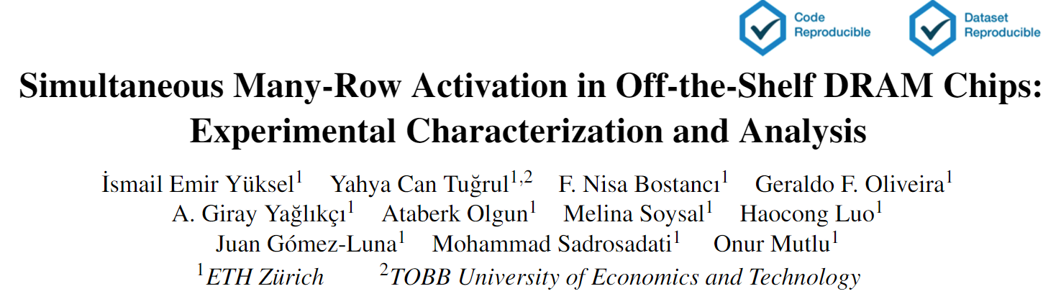
Hypothesis: Row Decoder Circuitry
(More discussions & hypotheses in the paper)
https://arxiv.org/pdf/2405.06081
Notes:
As our time limited, I would like to refer you to our paper for more detailed circuitry and discussions about row decoder circuitry

Slide 51
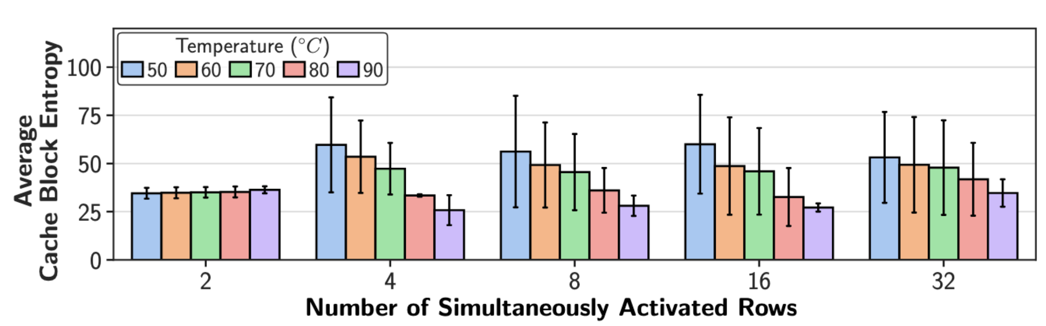
Effect of Temperature
1.5x
As temperature increases
SiMRA’s entropy tends to decrease
This observation is consistent across most of the number of simultaneously activated rows (except 2-row activation)
Notes:
Here in the y-axis we have again entropy and in the x-axis we have number of simultaneously activated rows
[CLICK] Each color will represent a different temperature level from 50 degree celcius to 90 degree celcius
[CLICK] Let's first focus on 32 row activation
[CLICK] We observe that from 50C to 90C, entropy decreases by 1.5 times on average.
We conclude that as temperature increases SiMRA's entropy tends to decrease
[CLICK] This observation is mostly consistent across different row activation, except 2-row activation where we observe slight increase

Slide 52
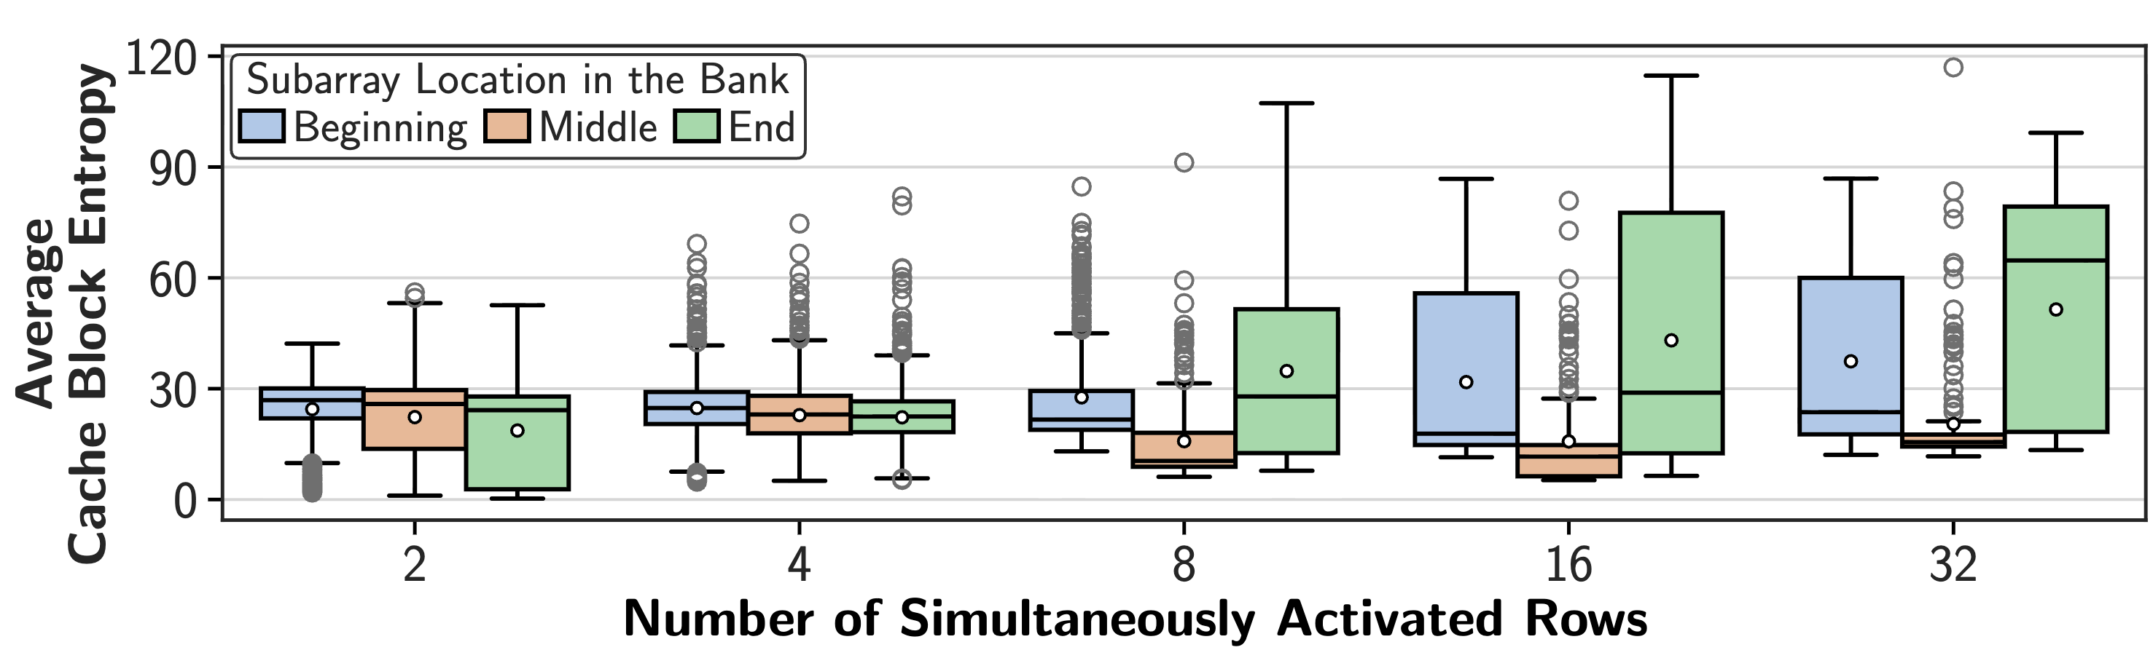
Spatial Variation
SiMRA’s entropy significantly varies
based on the subarray’s location in a bank
Each number of row activations has
a different entropy variation trend

Slide 53
SiMRA-TRNG: Quality Evaluation
Methodology: Use NIST Statistical Test Suite
(NIST STS) tests (15 tests)
    Extract a 1Gb bitstream by repeatedly performing SiMRA
    Post process the bitstream with SHA-256
Results:
    All tested number of simultaneously activated rows
    (2-, 4-, 8-, 16-, and 32-row activation)
    pass all 15 NIST STS tests
SiMRA-TRNG reliably produces
high-quality true random bitstreams

Slide 54
SiMRA-TRNG: Latency Evaluation
Measured each step of SiMRA-TRNG design
    Step 1: Initialize
      Performing N RowClone operation for N-row activation
    Step 2: SiMRA
      Executing DRAM commands that
      activates N rows simultaneously (ACT – PRE – ACT)
    Step 3: Read
      Reading random values from sense amplifiers
    Step 4: Post-processing
      Post processing the random bitstream using SHA-256
Latencies of SiMRA-TRNG designs based on
2-, 4-, 8-, 16-, and 32-row activation are
165ns, 255ns, 435ns, 795ns, and 1.51us, respectively

Slide 55
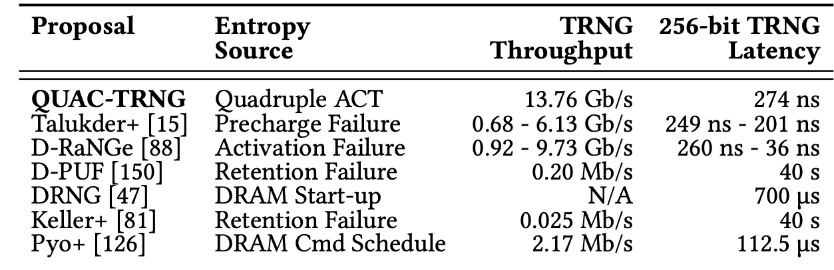
Throughput & Latency Comparison

