Slide 1




In-DRAM Signature Generation Using
Simultaneous Multiple-Row Activation
An Experimental Study of
Off-The-Shelf DRAM Chips
Umut Başer
İsmail Emir Yüksel F. Nisa Bostancı Konstantinos Sgouras
Ataberk Olgun Emre H. Demirli Zhiheng Yue Harsh Songara
Oğuz Ergin Onur Mutlu
Notes:
Hello, I am Umut Baser.
I will be presenting our work, In-DRAM Signature Generation Using Simultaneous Multiple-Row Activation: An Experimental Study of Off-The-Shelf DRAM Chips

Slide 2
Outline
Motivation
DRAM Organization & Operation
SiMRA-PUF
Testing Methodology
Real DRAM Chip Results
Conclusion
Notes:
Let’s start with the Motivation

Slide 3
Physical Unclonable Functions (PUFs)
A PUF uses unique physical variations of the device to generate unique signatures (responses)
Same device, same challenge → same response
Any other device, same challenge → different response
Device A
0 1 1 0 …
(Response A)
Input X
(Challenge)
Device B
Chip B
1 0 1 0 …
0 0 1 0 …
(Response B)
Notes:
A PUF uses the unique physical variations of a device that induced during manufacturing to generate device specific signatures.
As a pictural example here we have two devices
[click] Device A queried with a challenge it returns with a response
[click] and it always returns with the same reponse each time we ask for the same challenge. So, when Same device gets the same challenge it gives the same response.
[click] However, when any other Device is queried with the same challenge; it returns a different response to the same challenge.
[click] As responses are generated using the manufacturing process variation, no other device can generate the same response.

Slide 4


Physical Unclonable Functions (PUFs)
These properties make PUFs suitable for many applications:
Device Authentication
Device A
Response X
Device A
Response Y
…
…
Device B
Response X
Device A
Device ?
Challenge_{X}
Output:
PUF Response_{X}
Trusted Device
Notes:
These properties make PUFs to be suitable for many security tasks
lets look at the example of device authentication
[click] when a device wants to be authenticated, a trusted device sends a challenge that already knows how Device A would respond
[click] device A evaluates the given challenge
[click]and sends the response back
[click]trusted device compares the response with the expected response and
decides whether to authenticate the device or not

Slide 5
Physical Unclonable Functions (PUFs)
These properties make PUFs suitable for many applications:
Device Authentication
Cryptographic Key Generation
Intellectual Property Protection
Hardware Obfuscation
…
Due to these applications,
many different PUFs have been proposed
by both industry and academia
Notes:
These properties enable PUFs to be also suitable for
cryptographic key generation
[click] IP protection
[click] hardware obfuscation and many other applications.
[click] These applications make PUFs desirable. Therefore many PUFs have been proposed by both industry and academia.

Slide 6
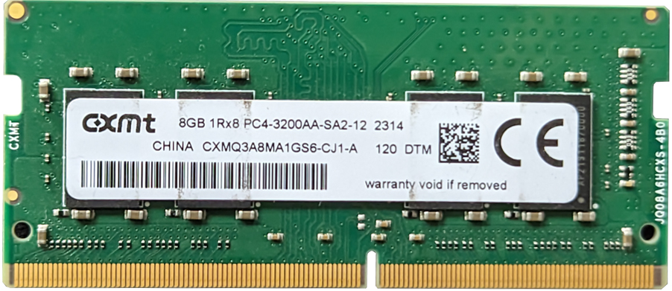
DRAM-Based PUFs
DRAM-based PUFs enable generating PUF responses within DRAM chips
DRAM is ubiquitous in modern computing platforms
Low Cost: No specialized hardware needed for PUFs
Notes:
One type of these PUF proposals are DRAM-based PUFs. They generate PUF responses directly within DRAM chips.
[click] Since DRAM is the dominant main memory technology and [clickx2]
Already in a wide range of modern computing platforms,
[click] DRAM-based PUFs require no additional hardware

Slide 7
DRAM-Based PUFs
Prior work exploits different sources of manufacturing variations to develop DRAM-based PUFs by:
Using start-up values
Disabling DRAM refresh
Violating timing parameters
Storing and sensing fractional voltage levels
…
We propose using a recently discovered phenomenon called Simultaneous Multiple-Row Activation (SiMRA)
to generate device-specific signatures
Notes:
Prior work exploit different sources of manufacturing variations to develope DRAM-based PUFs by
Using start-up values
[click] disabling dram refresh
[click] Violating timing parameters
[click] Storing and sensing fractional voltage levels
[click] and more
[click] We propose using a recently discovered phenomenon called Simultaneous Multiple Row Activation to generate device specific signatures.
Now lets continue with DRAM background to understand this phenomenon.

Slide 8
Outline
Motivation
DRAM Organization & Operation
SiMRA-PUF
Testing Methodology
Real DRAM Chip Results
Conclusion

Slide 9
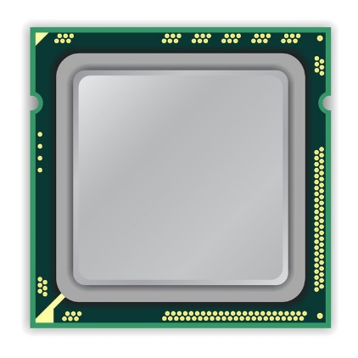
DRAM Organization
DRAM Module
Memory
Channel
CPU
Notes:
In a typical DRAM-based computing system,
DRAM is connected to the CPU over the off-chip memory channel [CLICK]

Slide 10

DRAM Organization
DRAM Module
DRAM
Chip
Subarray
DRAM Cell
Bank
…
Wordline
Chip I/O
Row Decoder
DRAM Row
Bitline
…
Sense Amps.
DRAM Chip
DRAM Bank
DRAM Subarray
Notes:
[CLICKx2] A DRAM module consists of multiple chips that operate in lockstep
[CLICK] Each chip contains multiple banks
[CLICK] Each bank is composed of multiple subarrays
[CLICK] And within each subarray, there is a two dimensional array of DRAM cells. Which stores one bit of data as electrical charge on a capacitor
[CLICK] These cells are organized into rows that are selected using wordlines
[CLICK] And the cells are connected to a row of sense amplifiers via bitlines
Make sense amps bigger all bold

Slide 11
Accessing a DRAM Cell
wordline
capacitor
bitline
access transistor
Sense Amp
enable
bitline
[Seshadri+ MICRO’17]
Notes:
Now, let's look at a DRAM cell
[click] A DRAM cell is composed of one capacitor and one access transistor.
[click] access transistor is controlled by the wordline
[click] and connects the capacitor to the bitline;
[click] each bitline is connected to a sense amplifier
[clickx2] and sense amplifier has an enable signal which is fired internally by the DRAM

Slide 12
Accessing a DRAM Cell
4
deviation in bitline voltage
enable wordline
wordline
1
½ V_{DD} + δ
V_{DD}
½ V_{DD}
capacitor
bitline
access transistor
2
connects cell to bitline
3
cell charge restored
cell loses charge to bitline
6
Sense Amp
enable sense amp
enable
5
bitline
½ V_{DD}
0
[Seshadri+ MICRO’17]
Notes:
Now let’s see how DRAM cells operate
Before any activation the bitline and bitline bar is precharged to V_dd/2.
[click] after wordline is enabled
[click] Access transistor connects cell to the bitline, which starts the charge sharing process.
[click] Since the DRAM cell in this example is charged; it loses some charge to the bitline
[click] causing a deviation in the bitline voltage
[click] after sometime sense amplifier kicks in
[click] and the deviation in the bitline becomes sensed and amplified to V_dd or 0, in this example it gets amplified to V_dd.
[click] and cell charge is restored.

Slide 13
DRAM Operation
Cache line
…
Wordline Drivers
…
…
…
…
…
Sense Amplifiers
Sense Amplifiers
Sense Amplifiers
READ
READ
READ
READ
READ
READ
tRAS
(Activation Latency)
tRP
(Precharge Latency)
DRAM Command Sequence
ACT R0
RD
RD
RD
PRE R0
ACT R1
RD
RD
RD
time
[Kim+ HPCA’19]
Notes:
Now let’s look at how dram operates at the scope of a single subarray
[click] Since memory controllers typically access dram cells in the granularity of a cacheline we combine consecutive DRAM cells to form cachelines
[click] on the bottom we have the timeline of DRAM commands.
[click]First memory controller activates the first row to copy its cache lines to the sense amplifiers.[click] At this point memory can read data in cache line granularity from the sense amplifiers. [clickx3]
[click]To access another row, memory controller needs to precharge the dram bank. Which closes the open row and sets the bitline voltage to half vdd.
[click] And now MC can activate the second row to read data from it.[click x3]
[click]To ensure correct operation MC must obey some timing parameters.We highlight two important timing parameters for our work
[click] tRAS is the time required for the charge to become restored in the capacitors on the open row. It dictates the time between successive activate and precharge commands.
[click]tRP is the precharge latency which denotes time it takes for a bitline voltage to be restored to half vdd, such that a new activate command can be issued to the DRAM bank

Slide 14

Simultaneous Multiple-Row Activation
Activating two rows in quick succession
in COTS DRAM chips simultaneously activates multiple rows in a subarray
36ns
14ns
tRAS
tRP
ACT Row A
PRE
ACT Row B
< 3ns
< 3ns
Subarray X
ACT
Row A
…
ACT
Row B
DRAM Bank
Notes:
Now let’s see look at the SiMRA phenomenon
[CLICK] The key observation is activating two rows in quick succession can simultaneously activate many rows in a subarray
[CLICK] In this pictorial example Row A and Row B is in Subarray X.
[CLICK] When the memory controller respect to tRAS and tRP timing parameters
[CLICK] it activate a single row at a time.
[CLICK] However, if the MC greatly violates these timing parameters,
it can activate many rows at once in the same subarray

Slide 15
Our Goal
Experimentally understand the capability of SiMRA to generate PUF responses
in real DRAM chips
Experimentally characterize this capability
under different designs & operating conditions
Notes:
Our goal in this work is two-fold:
[click] First, we experimentally evaluate the capability of SiMRA to generate PUF responses in COTS DRAM chips.
[click] Second, we characterize how this capability changes under different design and operating conditions.

Slide 16
Outline
Motivation
DRAM Organization & Operation
SiMRA-PUF
Testing Methodology
Real DRAM Chip Results
Conclusion
Notes:
Now let’s see how SiMRA-PUF works

Slide 17
Key Idea
Exploit simultaneous row activation
to generate device-specific signatures
Notes:
[Click] The key idea of this work is to exploit the charge-sharing process of simultaneous row activation to generate device-specific signatures

Slide 18
Generating Signatures via SiMRA
Simultaneously activate N rows with
half storing logic-1 and half storing logic-0
R3
R2
R1
Logic-1
R0
SA
SA
SA
SA
SA
Notes:
Let me give the key idea here by showing four rows.
[click] first we store all logic-1 in two of the rows and we store logic-0 in the remaining two rows.
[no-click] then we activate these rows simultaneously to generate signatures
[no-click] lets zoom into an example bitline and see why this operation generates unique signatures

Slide 19
Generating Signatures via SiMRA
V_{DD}/2
R3
V_{dd}
R2
V_{TH}
R1
Bitline Voltage
V_{DD}/2
R0
-V_{TH}
Ready to Sense
Voltage Level
Sense Amplifier
0
Enable
Time
V_{DD}/2
Notes:
[clickx2]on the left side we see 4 cells that are connected to the same sense amplifier with the same bitline
[CLICK] Here on the right side we have the bitline’s voltage over time.
[click] Before any rows are activated, the bitline has a voltage of VDD/2.

Slide 20

Generating Signatures via SiMRA
V_{DD}/2
+ $ε$
R3
V_{dd}
R2
V_{TH}
R1
Bitline Voltage
V_{DD}/2
R0
-V_{TH}
Sense Amplifier
0
Enable
ACT
R0
PRE
ACT R3
Time
V_{DD}/2
Notes:
Then we issue the ACT-PRE-ACT sequence.
[CLICK] we first activate the R0 here
[CLICKx2] Which causes a perturbation on the bitline
[CLICK] Then we issue PRE and [click] ACT commands in quick succession [click], which activates all rows in this example.
Since half of the the cells tries to pull up and half of the cells tries to pull down the voltage,in an ideal chip they would cancel exactly and the bitline would stay at VDD/2. However, due to design and manufacturing process-induced variatons, each cell and each bitline differ. Therefore the bitline voltage settles near half of Vdd offseted by an epsilon

Slide 21
Generating Signatures via SiMRA
V_{DD}/2
+ $ε$
R3
V_{dd}
R2
V_{TH}
R1
Bitline Voltage
V_{DD}/2
R0
-V_{TH}
Sense Amplifier
0
Enable
ACT
R0
PRE
ACT R3
Time
Enable Sense Amplifiers
V_{DD}/2
Notes:
For some bitlines epsilon happened to be positive and large enough;
[clickx2 slow] the sense amplifier amplifies [click] it's voltage to V_DD

Slide 22
Generating Signatures via SiMRA
V_{DD}/2
+ $ε$
R3
V_{dd}
R2
V_{TH}
R1
Bitline Voltage
V_{DD}/2
R0
-V_{TH}
Sense Amplifier
0
Enable
ACT
R0
PRE
ACT R3
Time
Enable Sense Amplifiers
V_{DD}/2
Notes:
For some bitlines epsilon happened to be negative and large enough;
[click] the sense amplifier amplifies [click] it to 0
We leverage these amplified values to generate PUF responses

Slide 23
SiMRA-PUF Designs
Number of simultaneously activated rows:
    2/4/8/16/32
Challenge-Response Definition:
    Challenge = (Bank_{ID}, Subarray_{ID})
      One representative
      simultaneously activated row group (SAR) per subarray
      One balanced data pattern per module
    Response = Signature generated by SiMRA
Bank 1, Subarray 3
0 1 1 0 …
Notes:
Before going to testing methodology and real chip results lets look at the different designs of simra-puf; and
We define each SiMRA-PUF design with the number of simultaneously activated rows that it use. We use 2,4,8,16 and 32 row activations
[click]For each design of different number of simultaneously activated rows:
We define our challenges as Bank_id, Subarray_id pairs.
[click]For each bank_id, subarray_id pair we select one representative SAR
[click]And for each design we select a module-wide data pattern
[click]and our responses are the signatures generated by simra

Slide 24
Outline
Motivation
DRAM Organization & Operation
SiMRA-PUF
Testing Methodology
Real DRAM Chip Results
Conclusion

Slide 25
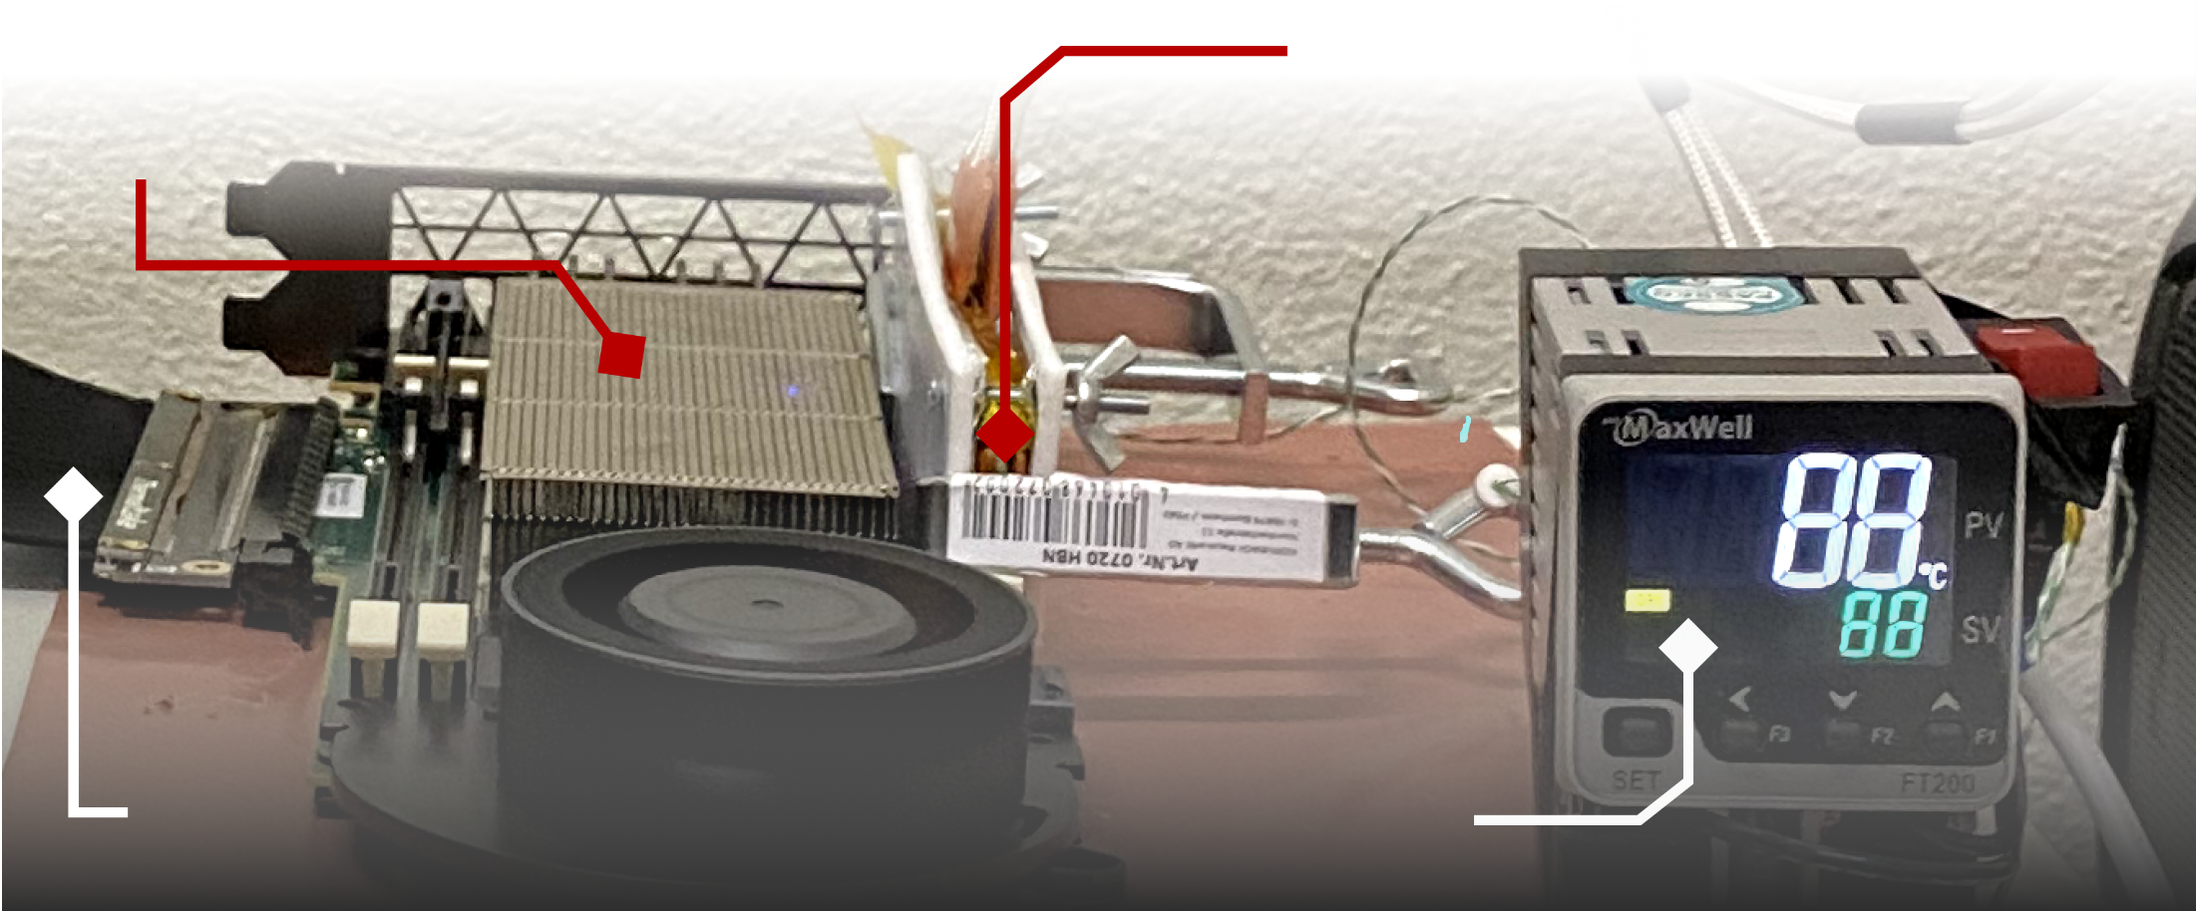
DDR4 DRAM Testing Infrastructure
  DRAM Bender* on a Xilinx Alveo U200
Xilinx Alveo U200 FPGA Board
(programmed with DRAM Bender*)
DRAM Module with Heaters
Host Interface
MaxWell FT200 Temperature Controller
Fine-grained control over DRAM commands,
timing parameters and temperature
*Olgun et al., TCAD, 2023
https://github.com/CMU-SAFARI/DRAM-Bender
Notes:
We use a DDR4 DRAM testing infrasturcture called DRAM Bender. It enables us to test DDR4 DRAM modules
[CLICK]
with fine-grained control over DRAM commands, timing parameters, and temperature

Slide 26
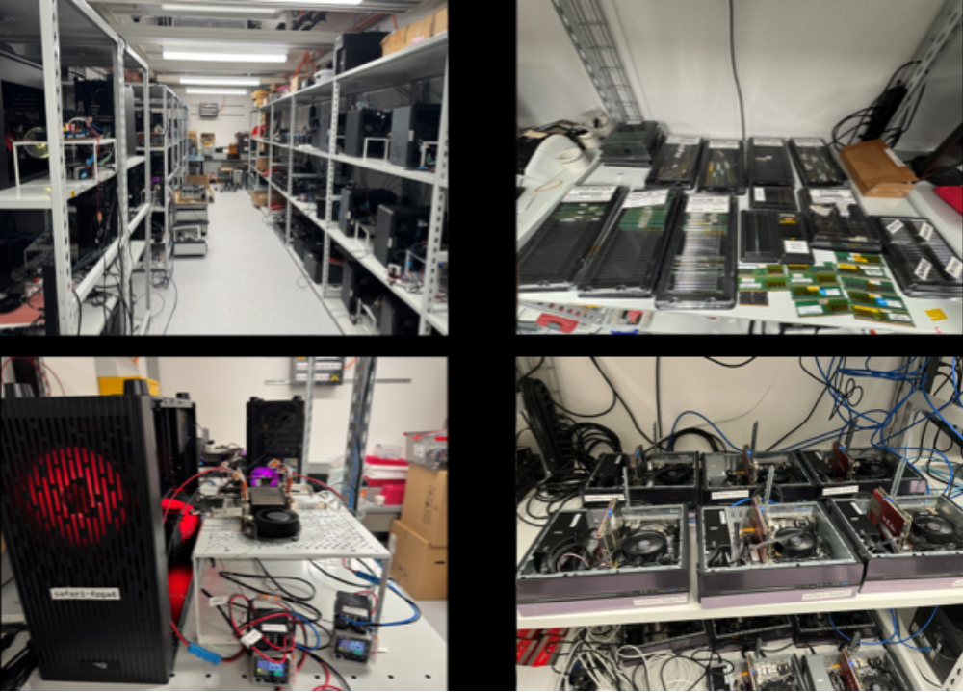
Laboratory for Understanding Memory
*Olgun et al., arXiv, 2026 https://arxiv.org/abs/2606.13725
Notes:
Here are some pictures of our memory-testing laboratory, which contains many DDR4 and HBM2 testing platforms.

Slide 27
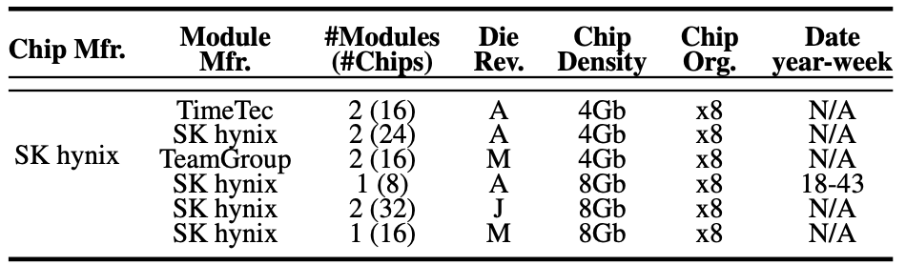
Tested DRAM Chips
112 real DDR4 chips from SK hynix
Covering multiple die revisions & chip densities
Notes:
In this study, we test a total of 112 off-the-shelf DDR4 chips from Sk hynix
[CLICK] covering various die revisions and chip densities.

Slide 28
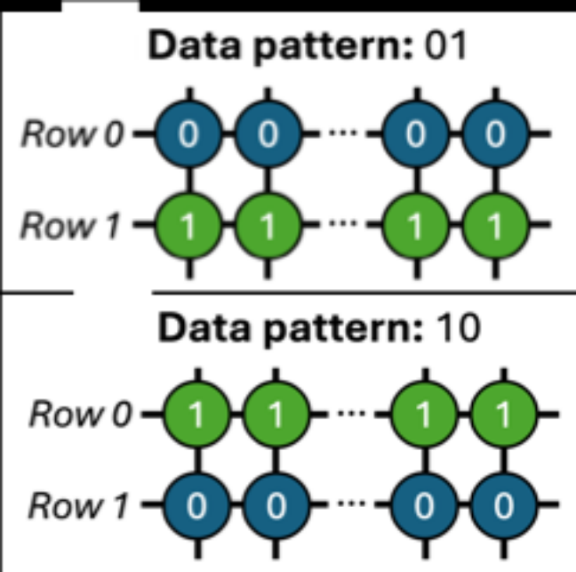

Characterization Methodology
  Data Pattern: Up to 100 data patterns with an equal number of all-0 and all-1 rows, for each activation count (278 in total)
  SAR Group Selection: Most stable SAR group within 10 randomly selected SAR groups in a subarray
  Temperature (◦C): 50, 55, 60, 70, and 85
10 randomly selected SARs
ACT Row A
Temperature
PRE
ACT Row B
Subarray X
ACT
Row A
…
ACT
Row B
50◦C
85◦C
DRAM Bank
Notes:
To characterize the SiMRA’s signature generation capabilities we test up to 100 data patterns for each activation count
[click] we randomly sample 10 SAR groups for each subarray and we select the most stable one to be used for that subarray.
[click] we collect our responses at 50C and to evaluate their repeatability we re-evaluate them at 55/60/70 and 85C against 50C baseline.

Slide 29

PUF Quality Metric
We use Jaccard Index to measure the similarity of responses
    Uniqueness of two responses to different challenges
    (Inter-Jaccard)
    Repeatability of two responses to the same challenge
    (Intra-Jaccard)
Inter-Jaccard
Intra-Jaccard
0.0
0.5
1.0
Jaccard Index
lower similarity
higher similarity
Notes:
[click] We use Jaccard Indices to measure the similarity
[click x2] We define the uniqueness as the similarity between two responses to different challenges and we denote it by inter-jaccard. We show its distribution it with orange
[click] we define the repeatability as the similarity of two responses to the same challenge and we denote it by intra-jaccard we show its distribution with blue
[click] A jaccard index of 0 indicates two responses are disjoint, and a jaccard index of 1 indicates two responses are identical
A PUF ideally should have close to 0 inter-jaccard indices so responses to the different challenges are disjoint
And should have close to 1 intra jaccard indices so responses to the same challenge is repeatable.

Slide 30
Outline
Motivation
DRAM Organization & Operation
SiMRA-PUF
Testing Methodology
Real DRAM Chip Results
Conclusion
Notes:
Lets look at the real dram chip results

Slide 31
Major Characterization Results
Effect of Simultaneously Activated Row Count
SiMRA-PUF generates unique and repeatable responses across all numbers of simultaneously activated row counts
Effect of Chip Density & Die Revision
DRAM chip density & die revision significantly affect
the uniqueness of responses
Effect of Temperature
DRAM chip temperature significantly affects
the similarity of PUF responses
Notes:
We highlight three Major Characterization Results

Slide 32
Major Characterization Results
Effect of Simultaneously Activated Row Count
SiMRA-PUF generates unique and repeatable responses across all numbers of simultaneously activated row counts
Effect of Chip Density & Die Revision
DRAM chip density & die revision significantly affect
the uniqueness of responses
Effect of Temperature
DRAM chip temperature significantly affects
the reliability of PUF responses
Notes:
First, lets look at the Effect of Simultaneously Activated Row Count of PUF responses generated by SiMRA

Slide 33
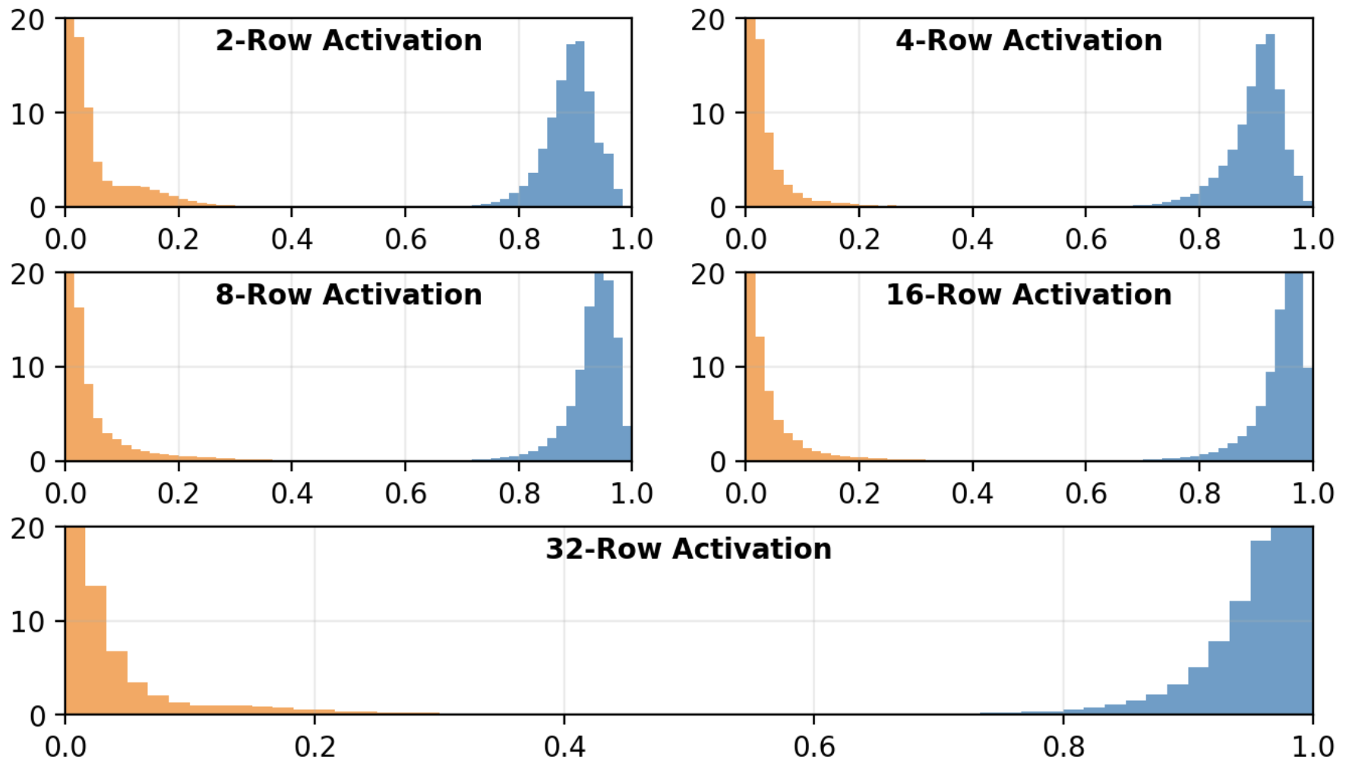


Effect of Simultaneously Activated Row Count
Inter-Jaccard index
close to 0
Intra-Jaccard index
close to 1
Notes:
[click] In this plot again X-axis shows the Jaccard Indices, and Y-axis shows the probability
Here we show the inter and intra-Jaccard indices obtained from 2-row activation-based SiMRA-PUF.
[click] We observe that 2-row activation based SiMRA-PUF generate repsonses with inter jaccard indices close to 0 indicating different challenges generate not similar responses
[click] and it generates responses with intra jaccard indices close to 1 indicating that responses to the same challenges are similar

Slide 34
Effect of Simultaneously Activated Row Count
SiMRA-PUF generates unique and repeatable PUF responses at all tested numbers of simultaneously activated rows
Notes:
Now we see the results for all simra-puf designs.
[click] We observe that all designs provide close to 0 inter jaccard indices, and close to 1 intra jaccard indices.
[click] We conclude that all SiMRA-PUF designs generate unique and repeatable PUF responses.

Slide 35
Effect of Simultaneously Activated Row Count
Response repeatability increases as
the number of simultaneously activated rows increases
Notes:
When we compare the intra-jaccard indices of different number of simultaneously activated rows, we observe that increasing the number of simultaneously activated rows increases the jaccard index.
[wait] We conclude increasing the number of simultaneously activated rows increases the Simra-puf response repeatability.

Slide 36
Major Characterization Results
Effect of Simultaneously Activated Row Count
SiMRA-PUF generates unique and repeatable responses across all numbers of simultaneously activated row counts
Effect of Chip Density & Die Revision
DRAM chip density & die revision significantly affect
the uniqueness of responses
Effect of Temperature
DRAM chip temperature significantly affects
the reliability of PUF responses
Notes:
Now lets look at the how DRAM chip density & die revision affects the response quality

Slide 37
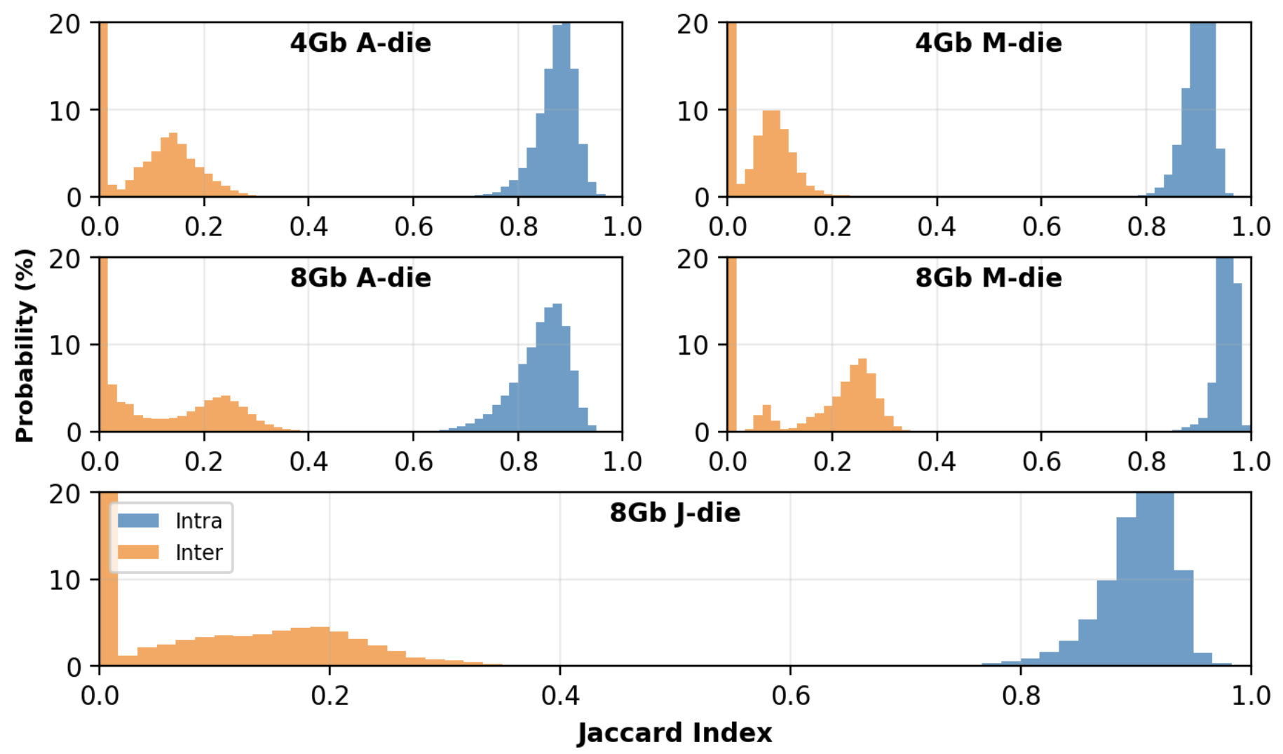
Effect of Chip Density & Die Revision
DRAM chip density & die revision significantly affect the
similarity of responses to different challenges
Notes:
In this plot, we report the inter and intra jaccard distributions observed for two example different chip density and die revision pairs for 2-row activation based SiMRA-PUF.
[click] we observe that inter-Jaccard indices observed for 4Gb M-die are significantly smaller than [click] those of the 8Gb M-die.
[click] therefore we conclude that DRAM chip density and die revision significantly affect the simra-puf's response similarity to the same challenge

Slide 38
Major Characterization Results
Effect of Simultaneously Activated Row Count
SiMRA-PUF generates unique and repeatable responses across all numbers of simultaneously activated row counts
Effect of Chip Density & Die Revision
DRAM chip density & die revision significantly affect
the uniqueness of responses
Effect of Temperature
Changes in DRAM chip temperature significantly affects
the similarity of PUF responses
Notes:
Now lets look at how temperature changes affect the reliability of PUF responses

Slide 39
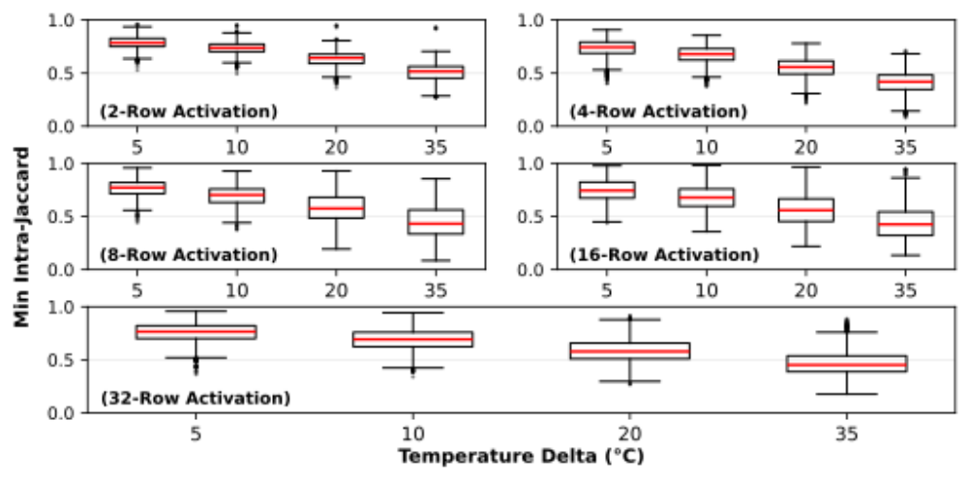
Effect of Temperature
higher similarity
Notes:
To evaluate how temperature affects SiMRA-PUF response repeatability, we generate many responses on the same module at four evaluation temperatures (55◦C, 60◦C, 70◦C, and 85◦C) and compare them
against an enrollment baseline collected at 50◦C
X-axis shows the temperature difference between the evaluations and y-axis shows the minimum intra-Jaccard indices we observed for each individual challenges across many evaluations at different temperature deltas
[click] as the temperature difference grows, the worst-case similarity significantly decreases.

Slide 40
Effect of Temperature
Response similarity strictly decreases as
temperature delta across evaluations increases
Notes:
And the same trend holds for each design:
[click] response similarity strictly decreases as the temperature delta between evaluations increases;
Showing that to ensure correct operation SiMRA-PUF must be enrolled at different temperatures

Slide 41
Latency Evaluation
Measured each step of SiMRA-PUF design
    Step 1: Initialize
      Perform N RowClone* operations for N-row activation
Simultaneously Activated Rows
Logic-1
Logic-0
Sense
Amplifiers
*Seshadri et al., MICRO, 2013
Notes:
Now lets look at the latency of SiMRA-PUF. We evaluate the latency of simra-puf by measuring the time required for three steps
[click] The first step is initialization. We measure the latency of performing N rowclone operations to write the balanced pattern to the SAR group
[click] The second step is the SiMRA operation: The latency of the ACT-PRE-ACT sequence used to activate N rows simultaneously
[click] The third step is reading the response from the sense amplifiers

Slide 42
Latency Evaluation
Measured each step of SiMRA-PUF design
    Step 2: SiMRA
      Execute DRAM commands that
      activate N rows simultaneously (ACT – PRE – ACT)
Logic-1
Logic-0
Sense
Amplifiers
*Seshadri et al., MICRO, 2013
Notes:
Now lets look at the latency of SiMRA-PUF. We evaluate the latency of simra-puf by measuring the time required for three steps
[click] The first step is initialization. We measure the latency of performing N rowclone operations to write the balanced pattern to the SAR group
[click] The second step is the SiMRA operation: The latency of the ACT-PRE-ACT sequence used to activate N rows simultaneously
[click] The third step is reading the response from the sense amplifiers

Slide 43
Latency Evaluation
Measured each step of SiMRA-PUF design
    Step 3: Read
      Read the response from sense amplifiers
Logic-1
Logic-0
Sense
Amplifiers
*Seshadri et al., MICRO, 2013
Notes:
Now lets look at the latency of SiMRA-PUF. We evaluate the latency of simra-puf by measuring the time required for three steps
[click] The first step is initialization. We measure the latency of performing N rowclone operations to write the balanced pattern to the SAR group
[click] The second step is the SiMRA operation: The latency of the ACT-PRE-ACT sequence used to activate N rows simultaneously
[click] The third step is reading the response from the sense amplifiers

Slide 44
Latency Evaluation
Latency (ns)
2-row activation-based SiMRA-PUF design has 5.75%
lower latency compared to state-of-the-art
State-of-the-art DRAM-based PUF
Latency increases as the
number of simultaneously activated rows increases
Notes:
Now lets look at the latency of different SiMRA-PUF designs.
[click] Our baseline is the latency-wise state-of-the-art DRAM-based PUF. Which generates responses by storing and sensing fractional voltage levels in DRAM cells
[click] our 2-row activation-based SiMRA-PUF design has 5.75% lower evaluation latency than the state-of-the-art.
[click] And as higher number of row activations requires more RowClone operations, different number of simultaneously activated row counts increase the latency.

Slide 45
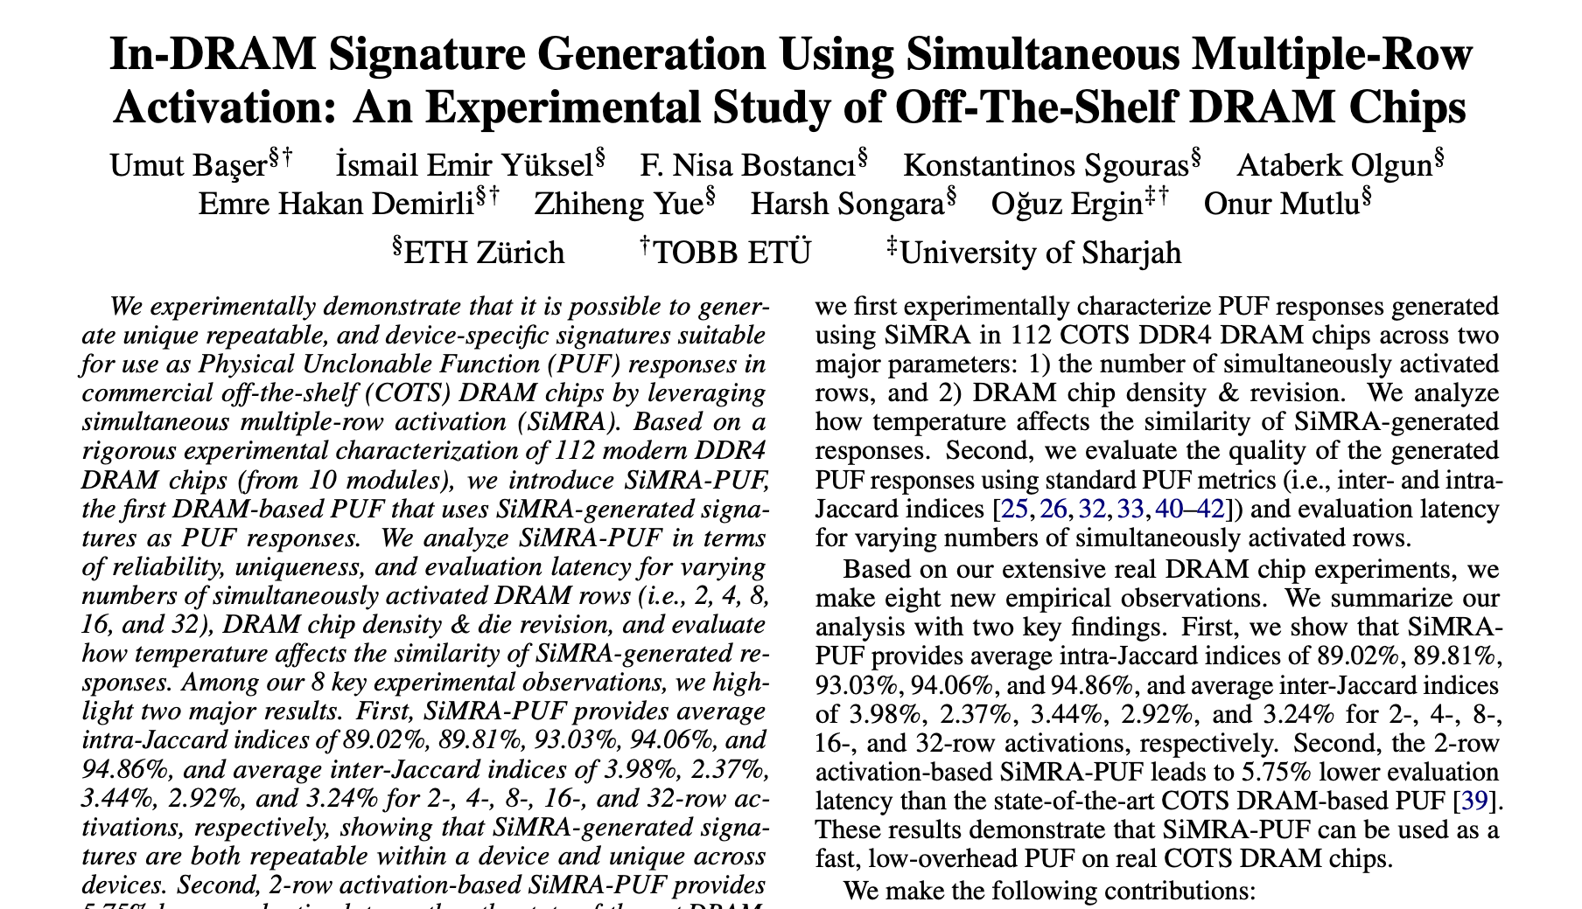
Available on arXiv
https://arxiv.org/pdf/2606.15470
Notes:
The extended version of our study is available on arxiv

Slide 46
Outline
Motivation
DRAM Organization & Operation
SiMRA-PUF
Testing Methodology
Real DRAM Chip Results
Conclusion
Notes:
To conclude

Slide 47
Conclusion
We experimentally demonstrate the potential of
simultaneous multiple-row activation (SiMRA)
to generate PUF responses
We characterize 112 off-the-shelf DDR4 DRAM chips
DRAM chip density & die revision significantly affect
the uniqueness of responses
Increase in the temperature difference between evaluations degrades response similarity
SiMRA-PUF provides unique, repeatable, and fast PUF responses
5.75% lower evaluation latency compared to
the state-of-the-art DRAM-based PUF
Notes:
We demonstrate potential of using simultaneous multiple-row activation to generate PUF responses
[click] We characterize 112 off-the-shelf DDR4 DRAM chips: Showing that DRAM chip density & die revision significantly affect the uniqueness of responses
[click] And the temperature difference between evaluations strictly degrades the response similarity
[click] Overall, SiMRA provides unique, repeatable and fast PUF responses:
[click] lastly, 2-row activation-based SiMRA-PUF design provide 5.75% lower evaluation latency than the state-of-the-art DRAM-based PUF

Slide 48
In-DRAM Signature Generation Using
Simultaneous Multiple-Row Activation
An Experimental Study of
Off-The-Shelf DRAM Chips
Umut Başer
İsmail Emir Yüksel F. Nisa Bostancı Konstantinos Sgouras
Ataberk Olgun Emre H. Demirli Zhiheng Yue Harsh Songara
Oğuz Ergin Onur Mutlu
Notes:
Thank you for your attention. I’d be happy to take any questions.

Slide 49
In-DRAM Signature Generation Using
Simultaneous Multiple-Row Activation
An Experimental Study of
Off-The-Shelf DRAM Chips
Backup Slides
Umut Başer
İsmail Emir Yüksel F. Nisa Bostancı Konstantinos Sgouras
Ataberk Olgun Emre H. Demirli Zhiheng Yue Harsh Songara
Oğuz Ergin Onur Mutlu
Notes:
Hello, I am Umut Baser.
I will be presenting our work, In-DRAM Signature Generation Using Simultaneous Multiple-Row Activation: An Experimental Study of Off-The-Shelf DRAM Chips

Slide 50
Future Work
Understand the sources of similarities between different challenges on the same device
Enable the use of multiple SAR groups within a single subarray to expand the challenge-response space
Test more DRAM chips

Slide 51
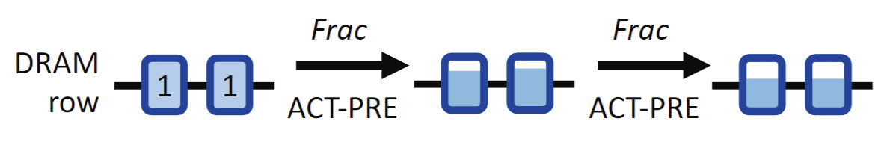
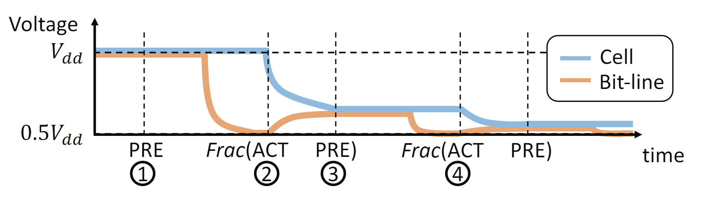
Frac-based PUF

Slide 52
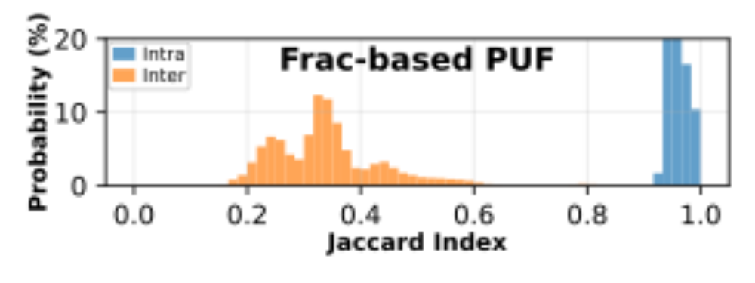
Frac-based PUF Results

Slide 53
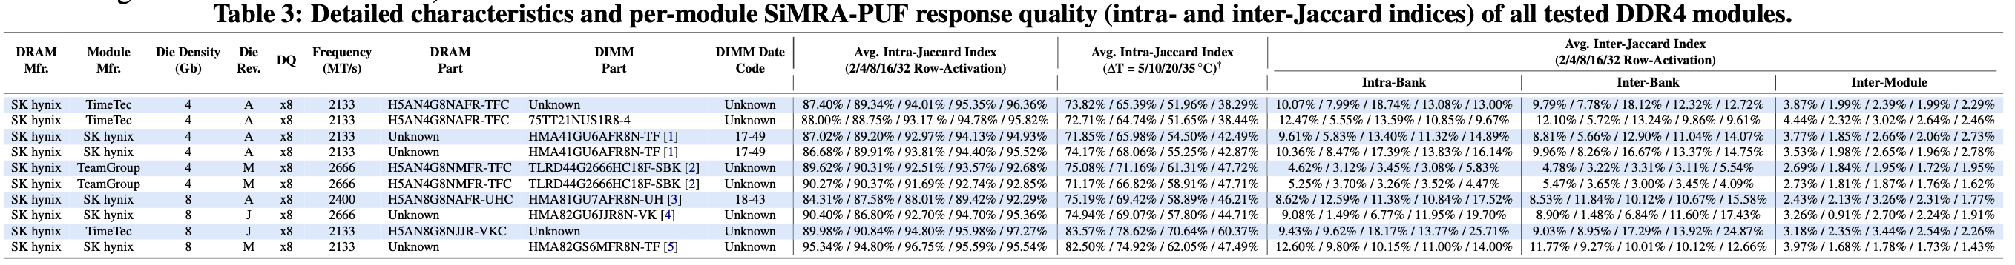
Tested DRAM Modules
Detailed characteristics and per-module SiMRA-PUF Response Quality
Notes:
Tested DRAM Modules detailed

Slide 54
Simultaneous Multiple-Row Activation
Recent works experimentally demonstrate
a new phenomenon called SiMRA to realize operations in-DRAM
Carefully engineered sequence of DRAM commands allows DRAM to exhibit out-of-spec behavior
Prior work shows that SiMRA can be used to perform
many operations
    Data copy & initialization
    Bulk bitwise operations
    True random number generation
    …
Notes:
SiMRA general
However, no prior work evaluated the PUF response generation capabilities of a recent phenomenon called SiMRA.
[click] Which is a key technique to realize many operations in off-the-shelf DRAM chips
[click] A carefully engineered sequence can activate multiple rows (which we will mention shortly on how it works)
[click] Prior work shows that SiMRA can be used to perform many operations (e.g., bulk bitwise operations, Multi-RowCopy, TRNG) and more

Slide 55

Generating Signatures via SiMRA
V_{DD}/2
+ $ε$
R1
Bitline
V_{DD}
R2
V_{TH}
R3
V_{DD}/2
…
…
-V_{TH}
RN
Sense Amplifier
0
Time
Enable
ACT
PRE
ACT
V_{DD}/2
Enable Sense Amplifiers
Notes:
Random bitlines
For some bitlines, the epsilon is not large enough to reach the reliable sensing margin. [CLICK] For these bitlines, the outcome is random from trial to trial.
Which prior work use to generate true random numbers

Slide 56
Generating Signatures via SiMRA
V_{DD}
V_{TH}
V_{DD}/2
-V_{TH}
0
Time
ACT
PRE
ACT
Enable Sense Amplifiers
Notes:
Stable and Random bitlines together
[click] So we can conclude that, despite some simultaneously activated cells reach reliable sensing margins
[click] some other cells gets random values from trial to trial

Slide 57
Limitations of Tested COTS DRAM Chips
Some COTS DRAM chips do not support all in-DRAM operations
    We do not observe simultaneous multiple-row activation
    in 32 tested Samsung & Micron chips
    Hypothesis
      Internal DRAM circuitry ignores the PRE command or
      the second ACT command when the timing parameters are greatly violated
    If such a limitation were not imposed,
    we believe these DRAM chips would also be
    fundamentally capable of performing the operations
    we examine in this work

Slide 58
Hypothesis: Row Decoder Circuitry
Simultaneous many-row activation is possible
due to the hierarchical DRAM row decoder design
DRAM Subarray
Row Address
Wordline
Row Decoder
Row Address (RA)
2x4
Stage 1
Decoder
Stage 2
Decoder
Stage 3
Decoder
Stage 4
Decoder
Stage 5
Decoder

Slide 59
Row Decoder: A Tree Example
We can visualize the hierarchical row decoder circuitry as a tree
Decoder Output
...
...
...
...
...
Wordline A
...
...
...
...
...
...
...
...
Wordline B
...
...
...
2x4
Stage 1
Decoder
Stage 5
Decoder
Notes:
To explain it in a higher abstraction level,
[CLICK] We can visualize the row decoder as a tree which
[CLICK] Each level of the tree represents a decoder stage
[CLICK] each node represents a decoder output

Slide 60
Activating a Single Row
36ns
ACT Row A
PRE
1. Decode
Row A address
...
...
...
...
Wordline A
...
Wordline A
2. Assert
corresponding signals
...
...
...
...
3. Follow
asserted nodes path from root to leaf
...
...
...
...
4. Assert wordline
...
Wordline B
...
...
Notes:
Let’s see an example when we activate a single row
[CLICK] Assume that we issue ACT Row A command, which will essentially assert the Wordline A signal
[CLICK] After issuing the activation command, the row decoder circuitry decodes Row A address
[CLICK] And assert corresponding signals in the tree
[CLICK] After the decoding completed, row decoder follows the asserted nodes path from root to leaf
[CLICK] As a result, it asserts wordline, in this it is Wordline A
[CLICK] After a successful activation we can issue PRE command which deasserts every asserted signals in the row decoder circuitry including the wordline

Slide 61
Activating Many Rows: A Walkthrough
Back-to-back ACT commands with violated timings
asserts many more signals in the row decoder
36ns
14ns
ACT Row A
PRE
ACT Row B
<3ns
<3ns
...
...
...
1. Keep the previously asserted signals active
...
Wordline A
...
Wordline A
...
2. Decode Row B &
assert corresponding signals
...
...
...
...
3. Follow
newly asserted nodes’ path
...
...
...
4. Simultaneously
activate many rows
Wordline B
...
Wordline B
...
...
Notes:
So that was an activation of a single row, now let’s see a simultaneous activation of many rows.
[CLICK] Our hypothesis is back-to-back ACT commands with violated timings asserts many more signals in the circuitry

Slide 62
Simultaneous Multiple-Row Activation
1
Row 0
0
½ V_{DD} + δ₂
V_{DD}
½ V_{DD} + δ₁
½ V_{DD}
ACT Row 0
1
0
< 3ns
Simultaneously Activated Row
(SAR) Group
1
0
PRE
< 3ns
1
Row 3
0
ACT Row 3
Sense Amp
1
0
enable sense amp
[Seshadri+ MICRO’17]
Notes:
SiMRA cell level ambit’s style
Now lets see what happens when multiple cells that are connected to the same sense amplifier activated simultaneously. Before any DRAM operation is performed, the bitline is precharged to Vdd/2
[click x2] We send an activate command to row 0,
[click] causing a perturbation on the bitline, by greatly violating the timing parameters we issue precharge
[click] and activate row 3 commands in quick succession. Which causes the activation of row 1, 2 and 3 at the same time.
then sense amplifier kicks in and senses the voltage. in this example amplifies it to Vdd
[click] we call these rows simultaneously activated row groups

