Slide 1


PuDHammer
Experimental Analysis of Read Disturbance Effects of Processing-using-DRAM in Real DRAM Chips
İsmail Emir Yüksel
Akash Sood Ataberk Olgun Oğuzhan Canpolat Haocong Luo
Nisa Bostancı Mohammad Sadrosadati Giray Yağlıkçı Onur Mutlu
Notes:
Hello, I am Ismail Emir Yuksel.
I will be presenting our work, PuDHammer [..]

Slide 2
Executive Summary
Motivation: Processing-using-DRAM (PuD) alleviates data movement bottlenecks
DRAM can perform many PuD operations by activating multiple DRAM rows
in quick succession or simultaneously (i.e., multiple-row activation)
Modern DRAM is subject to read disturbance (e.g., RowHammer)
    Repeatedly activating even a single row induces bitflips in unaccessed rows
Problem: No prior work studies the read disturbance effects of multiple-row activation
Goal: Understand and analyze read disturbance effects of multiple-row activation
Experimental Study: 316 COTS DDR4 chips from four major manufacturers to study
read disturbance effects of multiple-row activation, which we call PuDHammer
PuDHammer significantly exacerbates DRAM read disturbance,
causing up to 158.58x reduction in min. hammer count to induce first bitflip
PuDHammer bypasses in-DRAM RowHammer mitigation in DDR4 and
induces 11340x more bitflips than RowHammer
Mitigation: We adapt Per Row Activation Counting (PRAC) for PuDHammer
Adapted PRAC solution incurs an average system performance overhead of 48.26%

Slide 3
Outline
Background
Problem & Goal
Testing Infrastructure
Read Disturbance Effect of CoMRA
Read Disturbance Effect of SiMRA
Mitigating PuDHammer
Conclusion
Notes:
Here is the outline of my talk

Slide 4
Outline
Background
Problem & Goal
Testing Infrastructure
Read Disturbance Effect of CoMRA
Read Disturbance Effect of SiMRA
Mitigating PuDHammer
Conclusion
Notes:
Here is the outline of my talk

Slide 5

DRAM Organization
DRAM Module
DRAM
Chip
Subarray
DRAM Cell
Bank
…
Wordline
Chip I/O
Row Decoder
DRAM Row
Bitline
…
Sense Amps.
DRAM Chip
DRAM Bank
DRAM Subarray
Notes:
DRAM is used as the main memory in many computing systems.
[CLICK] a DRAM module consists of multiple DRAM chips
[CLICK]Each chip contains multiple banks
[CLICK] Each bank is composed of multiple subarrays and sense amplifiers
[CLICK] And within each subarray, there is a two dimensional array of DRAM cells.
[CLICK] These cells are organized into rows that are selected using wordlines
[CLICK] And the cells are connected to a row of sense amplifiers via bitlines

Slide 6
DRAM Operation
DRAM Subarray
1
ACTIVATE (ACT):
Fetch the row’s content
into the sense amplifiers
2
Column Access (RD/WR):
Read/Write the target
column and drive to I/O
Sense
Amplifiers
3
PRECHARGE (PRE):
Prepare the bank
for a new ACTIVATE
I/O Circuitry
Notes:
Data is internally accessed in a row granularity. To access data,
[CLICK] the memory controller first needs to activate the row that contains the data and fetch the row’s content into the sense amplifiers
[CLICK] Then, column accesses are serviced from the sense amplifiers
[CLICK] Finally, the subarray needs to be precharged to get ready for the next row activation

Slide 7

Data Movement Bottleneck
Today’s computing systems are processor centric
All data is processed in the processor → at great system cost
Computing Unit
(CPU, GPU, FPGA, Accelerators)
Main Memory
(DRAM)
Memory
Channel
More than 60% of the total system energy is spent on data movement¹
¹ A. Boroumand et al., “Google Workloads for Consumer Devices: Mitigating Data Movement Bottlenecks,” ASPLOS, 2018
Notes:
As we see until now, DRAM is just used to store data
[CLICK] As today’s computing systems are processor centric
[CLICK] All data needs to be processed in the processor
[CLICK] As a result, we need to move data very frequently
[CLICK] Prior work shows that more than 60% of the total energy is spent on this data movement

Slide 8
Processing-using-DRAM (PuD)
Processing-using-DRAM uses the analog operational principles of
DRAM cells to perform computation
Multiple-row activation is a key technique to realize many PuD operations (e.g., AND and OR)
DRAM
(e.g., 3D-Stacked Memory)
DRAM Bank
Vault
Controller
Processing-
Using-DRAM
DRAM Vault
PHY
…
…
Notes:
Processing-in-Memory architectures alleviate data movement bottlenecks using the analog operating principles of the memory cells to perform computation, in what is called processing-using-memory
Many PuD operations involves a key technique called multiple-row activation

Slide 9
Processing-using-DRAM (PuD)
Multiple-row activation is a key technique to realize many PuD operations
1. Consecutive Multiple-Row Activation (CoMRA)
Multiple-row activation is a key technique to realize many PuD operations
2. Simultaneous Multiple-Row Activation (SiMRA)
DRAM
(e.g., 3D-Stacked Memory)
DRAM Bank
Vault
Controller
Processing-
Using-DRAM
Processing-
Using-DRAM
DRAM Vault
PHY
…
…
…
…
Notes:
We categorize multiple-row activation into two categories
First, consecutive multiple-row activation, CoMRA
Second, simultaneous multiple-row activatio,, SiMRA
Now, let me dive deeper into these two and give their key ideas

Slide 10
Consecutive Multiple-Row Activation
Violating timing of PRE command greatly
in COTS DRAM chips
activates two rows consecutively
Notes:
First, Consecutive Multiple-Row Activation.
[CLICK] The key observation is that violating timing of PRE command greatly can activate two rows consecutively

Slide 11

Consecutive Multiple-Row Activation
Violating timing of PRE command greatly
in COTS DRAM chips
activates two rows consecutively
36ns
14ns
ACT src
PRE
ACT dst
<9ns
d
s
t
s
r
c
d
s
t
d
s
t
s
r
c
Notes:
Let’s see how CoMRA works with an example: Here we have two rows source, src, and destination, dst.
[CLICK] If we obey the DRAM timing parameters while issuing this command sequence
[CLICK] We will only activate a single DRAM row at once, firstly source and then destination

Slide 12
Consecutive Multiple-Row Activation
Violating timing of PRE command greatly
in COTS DRAM chips
activates two rows consecutively
36ns
14ns
ACT src
PRE
ACT dst
<9ns
d
s
t
s
r
c
src’s content
is copied to dst
s
r
c
d
s
t
s
r
c
Notes:
However, if we violate the timing between PRE and ACT dst
[CLICK] We can activate destination row without deactivating sense amplifier and keeping the bitlines at source voltage level
[CLICK] As a result of this, we can perform in-dram row copy operation: source row can be copied to destination row

Slide 13
Simultaneous Multiple-Row Activation
Activating two rows in quick succession
in COTS DRAM chips simultaneously activates multiple rows in a subarray
36ns
14ns
ACT Row A
PRE
ACT Row B
<3ns
<3ns
Subarray X
ACT
Row A
…
ACT
Row B
DRAM Bank
Notes:
Now let’s see how SiMRA works
[CLICK] The key observation is activating two rows in quick succession can simultaneously activate many rows in a subarray
[CLICK] In this pictorial example Row A and Row B is in Subarray X.
[CLICK] When we respect to the timing parameters between ACT and PRE and PRE and ACT
[CLICK] we activate a single row at a time.
[CLICK] However, when we greatly violate these timing parameters,
we can activate many rows at once in the same subarray

Slide 14
Example: In-DRAM Majority-of-Three (MAJ3)
<3ns
<3ns
ACT
PRE
ACT
a
a
a
Three rows perturb bitlines simultaneously
Assert three rows’ wordlines
b
b
b
b
b
b
d
s
t
b
b
b
Sense amplifiers sample the output of majority
[Seshadri+ MICRO’17, Gao+ MICRO’19]
Notes:
One example of SiMRA is In-DRAM MAJ3 operation
[CLICK] Assume ACT-PRE-ACT with violated timnigs will activate three rows simultaneously that contain a,b, and b values, respectively.
[CLICK] By activating three rows simultaneously, DRAM will assert these rows’ wordlines
[CLICK] After that these activated rows perturb bitlines simultaneously
[CLICK] After some time, sense amplifier amplifies the perturbation on the bitline and sample the output of majority of the values stored in activated rows, which is b in this example

Slide 15
Read Disturbance in DRAM
Unfortunately, even activating a single DRAM row
disturbs the data integrity of other unaccessed DRAM rows
Prominent example: RowHammer
DRAM Subarray
Row 1
Row 1
Row 1
Victim Row
Row 2
Row 2
Row 2
Row 2
Row 2
Row 2
open
open
Aggressor Row
closed
open
closed
Row 3
Row 3
Row 3
Victim Row
Repeatedly opening (activating) and closing a DRAM row
many times causes RowHammer bitflips in adjacent rows
[Kim+, ISCA’14]
Notes:
Read disturbance bitflips have significant system-level implications because they break memory isolation.
[CLICK] Even activating a single DRAM row disturbs the data integrity of ther unaccessed DRAM rows.
[CLICK] A prominent example of read disturbance is RowHammer.
[CLICKx9] Repeatedly activating and closing a DRAM row many times causes RowHammer bitflips in adjacent rows
We call the repeatedly activated row the aggressor row and the rows that have bitflips victim rows.

Slide 16
Outline
Background
Problem & Goal
Testing Infrastructure
Read Disturbance Effect of CoMRA
Read Disturbance Effect of SiMRA
Combined Effect of CoMRA, SiMRA, and RowHammer
Conclusion
Notes:
This phenomenon brings us to the problem and the goal of this paper

Slide 17
Problem & Goal
Problem
No prior work investigates the read disturbance effects of multiple-row activation
Goal
Understand how multiple-row activation
affects read disturbance vulnerability in DRAM

Slide 18
Outline
Background
Problem & Goal
Real DRAM Chip Testing Infrastructure
Read Disturbance Effect of CoMRA
Read Disturbance Effect of SiMRA
Mitigating PuDHammer
Conclusion
Notes:
To experiment with DRAM chips, we build a real DRAM chip testing infrastructure

Slide 19
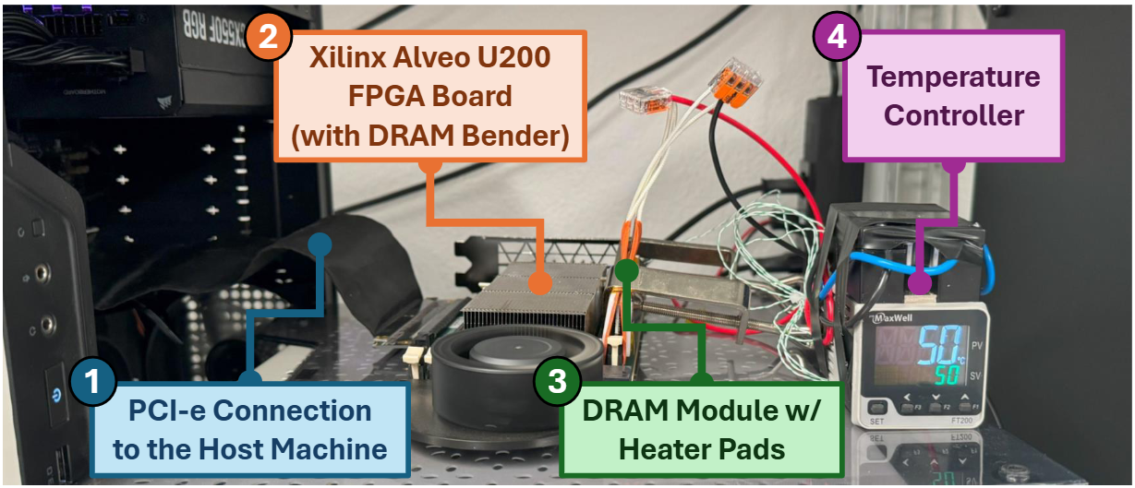
DRAM Bender: DRAM Testing Infrastructure
Fine-grained control over DRAM commands, timings,
temperature, and voltage
Olgun et al., "DRAM Bender: An Extensible and Versatile FPGA-based Infrastructure to Easily Test State-of-the-art DRAM Chips," TCAD, 2023.
Notes:
This infrastucture
[CLICK] enables fine-grained control over DRAM commands, timings, temperature and voltage
This picture shows one setup that contains one module and a host machine

Slide 20
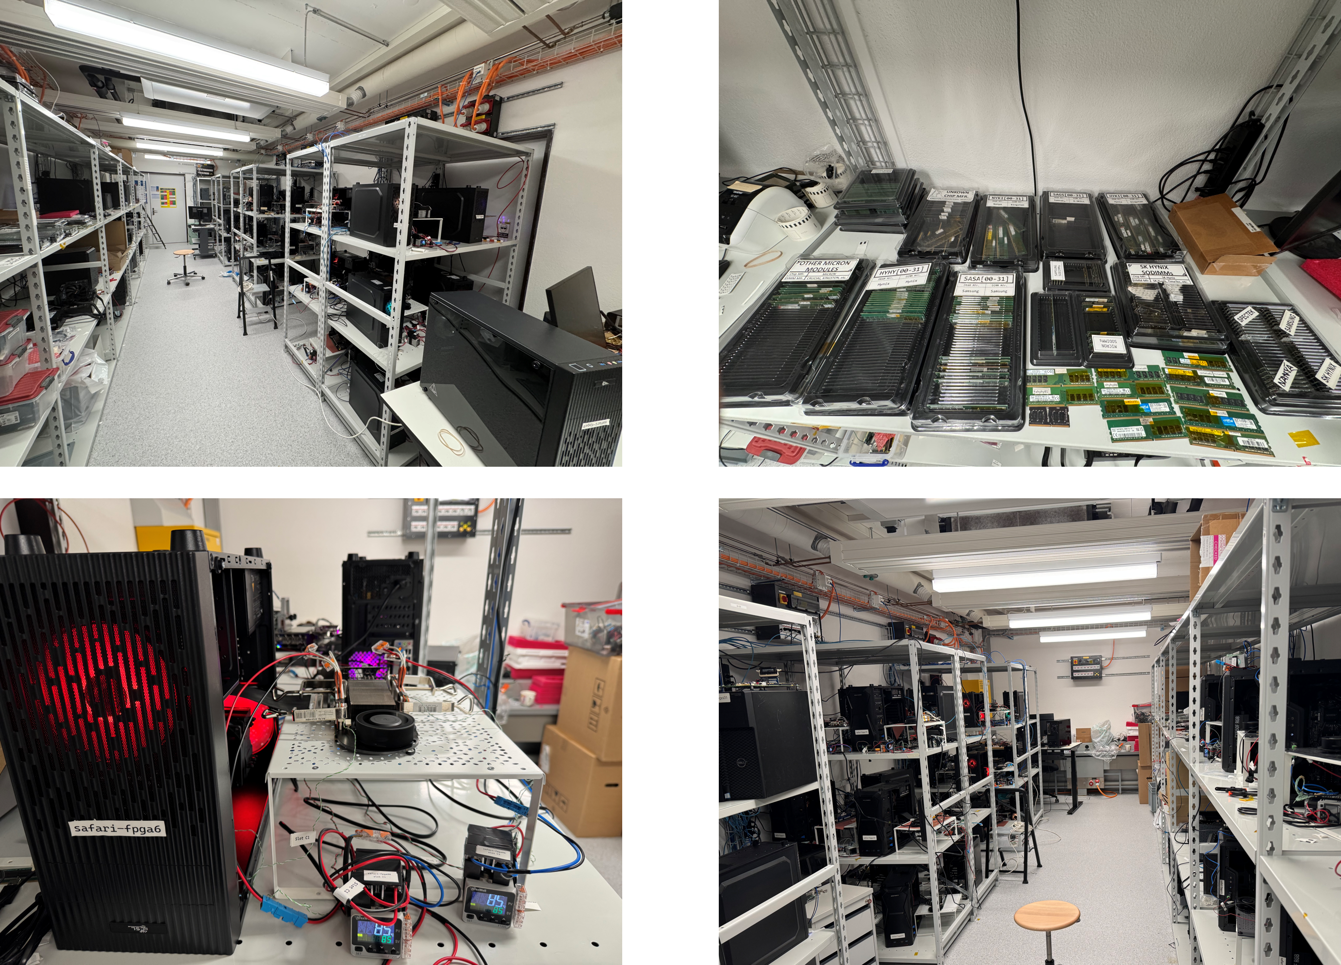
Laboratory for Understanding Memory
Notes:
And in our lab, we have many machines to test many DRAM modules and chips

Slide 21
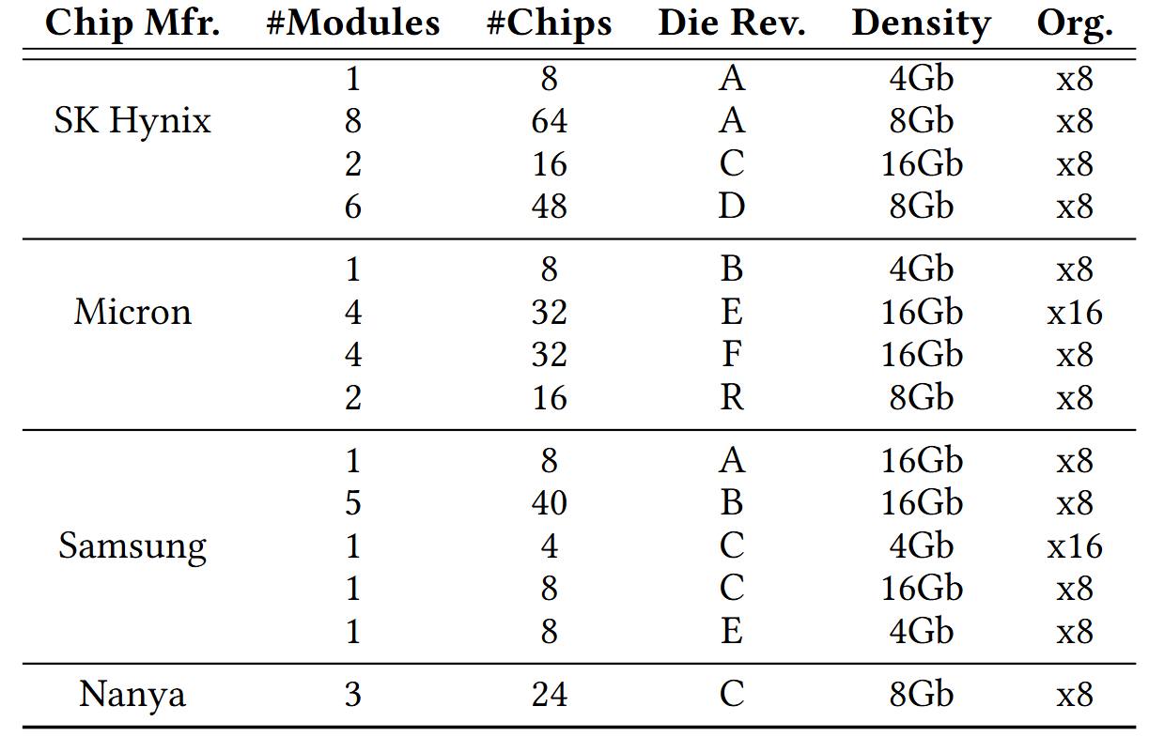
DRAM Chips Tested
316 DDR4 chips from four major DRAM manufacturers
Covers different die revisions and chip densities
Notes:
[CLICK] We test 316 DDR4 chips from four major DRAM manufacturers,
[CLICK] covering different die densities and revisions

Slide 22
Outline
Background
Problem & Goal
Testing Infrastructure
Read Disturbance Effect of CoMRA
Read Disturbance Effect of SiMRA
Mitigating PuDHammer
Conclusion
Notes:
Now, let’s move onto our first analysis

Slide 23
Consecutive Multiple-Row Activation
Violating timing of PRE command greatly
in COTS DRAM chips
activates two rows consecutively
36ns
14ns
ACT src
PRE
ACT dst
<9ns
d
s
t
s
r
c
src’s content
is copied to dst
s
r
c
d
s
t
s
r
c
Notes:
Let’s recall that CoMRA violates PRE to ACT to activate two rows consecutively, which allows to perform in-DRAM row copy operation

Slide 24


Hammering with CoMRA
ACT src
PRE
ACT dst
36ns
7.5ns
Double-Sided
Single-Sided
victim
.
.
.
src
aggressor
src
aggressor
victim
victim
.
.
.
dst
aggressor
victim
.
.
.
dst
aggressor
victim
DRAM Subarray
DRAM Subarray
Notes:
To hammer using CoMRA access pattern, we use two versions of hammering:
[CLICK] First, double-sided where we sandwich a victim row
[CLICK] We adapt CoMRA to perform copy operation to sandwich a victim row for double-sided
[CLICK] Second, single-sided where a single aggressor row disturbs its neighboring victim rows
[CLICK] To perform single-sided CoMRA, we perform the copy operation between two rows that are far away from each other

Slide 25

Characterization Methodology
Carefully sweep
    Row addresses: src and dst
    Timing parameters: Between PRE → ACT
    Data Pattern: 0x00, 0xFF, 0xAA, and 0x55
    Temperature (◦C): 50, 60, 70, and 80
ACT src
PRE
ACT dst
Temperature
DRAM Subarray
.
.
.
ACT
aggressor
src
victim
ACT
aggressor
dst
.
.
.
50 ◦C
80 ◦C
DRAM Bank
Notes:
To characterize the read disturbance effects of CoMRA
[CLICK] We carefully sweep four parameters: Row addresses: Row A and Row B
[CLICK] Timing parameters between prechrage to activate command
[CLICK] Data pattern
[CLICK] And temperature

Slide 26

Read Disturbance Vulnerability Metric: HC_{first}
The minimum hammer count
required to induce the first bitflip
Lower is worse
1 Hammer
Aggressor Row (src)
ACT src
Record bitflips
in victim
PRE
Victim Row
PRE
Aggressor Row (dst)
ACT dst
Notes:
To evaluate the read disturbance vulnerability of DRAM chips, we use widely-adopted metric called Hcfirst
[CLICK] which is the minimum hammer count required to induce the first bitflip and lower the Hcfirst worse the read disturbance is
[CLICK] Here we have a double sided scenario where we sandwich a victim row
[CLICK] We count one CoMRa operation, ACT-PRE-ACT as 1 Hammer and we record bitflips in victim

Slide 27
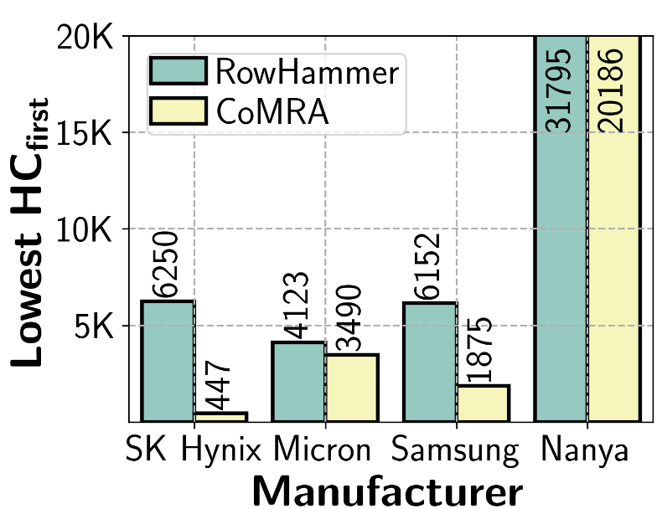
Double-Sided CoMRA vs. RowHammer (I)
1.58x
13.98x
3.28x
1.18x
Double-sided CoMRA decreases lowest HC_{first} by 13.98x
compared to double-sided RowHammer
Lowest HC_{first} reduction trend consistent across all four manufacturer

Slide 28
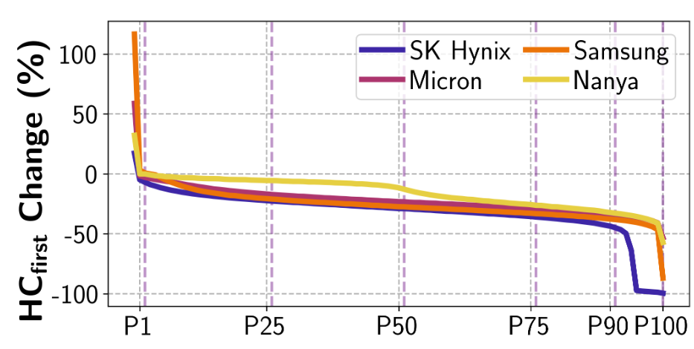
Double-Sided CoMRA vs. RowHammer (II)
Represents 99% of tested victim rows
Represents 50% of tested victim rows
CoMRA reduces HC_{first}
HC_{first} reduction of 50%
DRAM Rows (sorted by reducing HC_{first} changes)
RowHammer HC_{first} = 100
CoMRA HC_{first} = 50
Notes:
In this experiment,
[CLICK]
we investigate how much Hcfirst changes when we perform CoMRA compared to RowHammer
[CLICK] across all the tested DRAM rows sorted by reducing Hcfirst changes value on the x-axis.
[CLICK] Each curve in this plot represents a different DRAM vendor
Now let me walk through what this plot represents
[CLICK] X-axis from P1 to P100 shows 99% of the tested rows
[CLICK] Similarly, from P50 to P100 represents 50% of the tested rows
[CLICK] Hcfirst change of -50 means Hcfirst reduction of 50%
For example, a victim row has Hcfirst of 100 for RowHammer while having 50 for CoMRA

Slide 29
Double-Sided CoMRA vs. RowHammer (II)
>99% of tested victim rows
experience lower HC_{first}
Double-sided CoMRA decreases HC_{first} for a large fraction of rows
compared to double-sided RowHammer

Slide 30
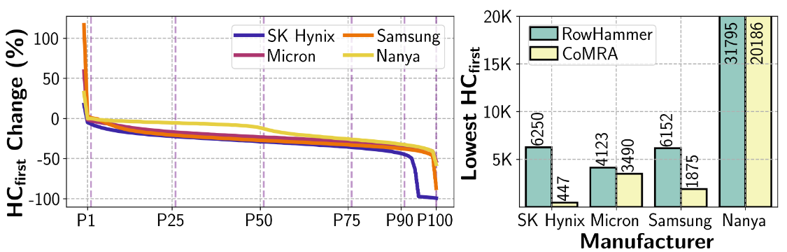
Double-Sided CoMRA vs. RowHammer
HCFirst Compared to RH (%)
Key Takeaway
CoMRA exacerbates DRAM’s vulnerability
to read disturbance in all four major manufacturers

Slide 31
Outline
Background
Problem & Goal
Testing Infrastructure
Read Disturbance Effect of CoMRA
Read Disturbance Effect of SiMRA
Mitigating PuDHammer
Conclusion
Notes:
Here is the outline of my talk

Slide 32
Recall: SiMRA
Activating two rows in quick succession
in COTS DRAM chips simultaneously activates multiple rows in a subarray
36ns
14ns
ACT Row A
PRE
ACT Row B
<3ns
<3ns
Subarray X
ACT
Row A
…
ACT
Row B
DRAM Bank
Notes:
Our key observation is activating two rows in quick succession can simultaneously activate many rows in a subarray
[CLICK] You may remember this pictorial example where Row A and Row B is in Subarray X.
[CLICK] When we respect to the timing parameters between ACT and PRE and PRE and ACT
[CLICK] we activate a single row at a time.
[CLICK] However, when we greatly violate these timing parameters, we observe that we can activate many rows at once in the same subarray

Slide 33
Characterization Methodology
Carefully sweep
    Row addresses: Row A and Row B
    Timing parameters: Between ACT → PRE and PRE → ACT
    Data Pattern: 0x00, 0xFF, 0xAA, and 0x55
    Temperature (◦C): 50, 60, 70, and 80
Temperature
ACT Row A
PRE
ACT Row B
Subarray X
ACT
Row A
…
ACT
Row B
DRAM Bank
50 ◦C
80 ◦C
Notes:
[CLICK] In this study, we focus on individual subarrays, here denoted as Subarray X
[CLICK] We perform our experiment using the following command sequence: Activate Row A, Precharge, and Activate Row B, where Row A and Row B in the same subarray
[CLICK] We carefully sweep four parameters: Row addresses: Row A and Row B
[CLICK] Timing parameters between ACT Row A and Precharge and between Precharge and ACT Row B

Slide 34
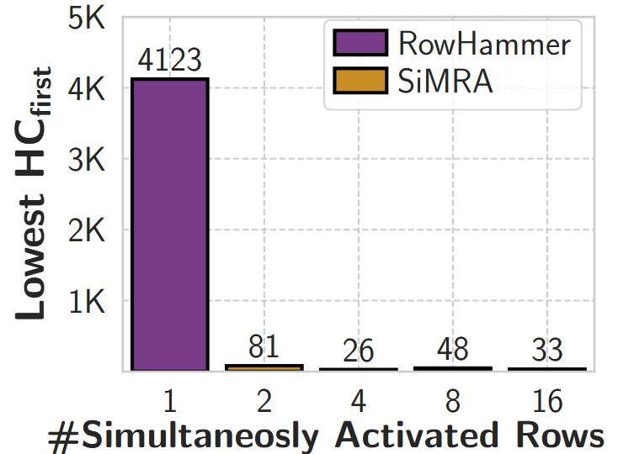
Double-Sided SiMRA vs. RowHammer (I)
51x
159x
86x
125x
Min. hammer count to induce first bitflip
#Simultaneously Activated Rows
Double-sided SiMRA decreases lowest HC_{first} by 159x
compared to double-sided RowHammer
Lowest HC_{first} reduction trend consistent
across all tested number of simultaneously activated rows

Slide 35
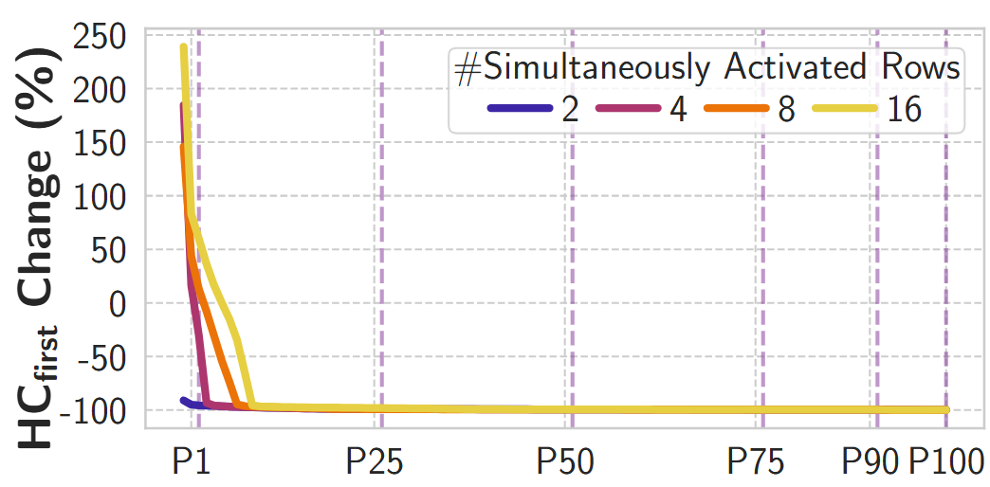
Double-Sided SiMRA vs. RowHammer (II)
>99% of tested victim rows
experience lower HCfirst
at least 25.19% of tested victim rows experience >99% HCfirst reduction

Slide 36
Double-Sided SiMRA vs. RowHammer (II)
Double-sided SiMRA
significantly decreases HC_{first} for a majority of rows
compared to double-sided RowHammer

Slide 37
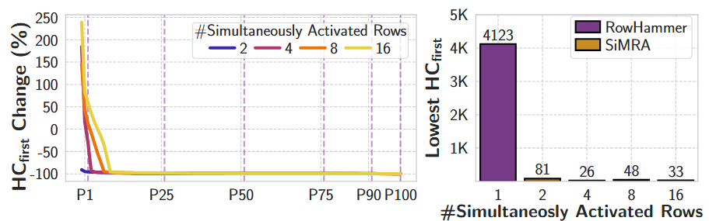
Double-sided SiMRA vs. RowHammer
Key Takeaway
SiMRA drastically exacerbates
DRAM’s vulnerability to read disturbance

Slide 38
Outline
Background
Problem & Goal
Testing Infrastructure
Read Disturbance Effect of CoMRA
Read Disturbance Effect of SiMRA
Mitigating PuDHammer
Conclusion
Notes:
Here is the outline of my talk

Slide 39
Mitigating PuDHammer
1
Analyze the effectiveness of existing in-DRAM RowHammer mitigation against PuDHammer
2
Adapt RowHammer mitigations
to account for PuDHammer

Slide 40
Mitigating PuDHammer
1
Analyze the effectiveness of existing in-DRAM RowHammer mitigation against PuDHammer
2
Adapt RowHammer mitigations
to account for PuDHammer

Slide 41


Target Row Refresh (TRR)
DRAM vendors equip their DRAM chips with a proprietary
mitigation mechanisms known as Target Row Refresh (TRR)
Key Idea: TRR refreshes nearby rows upon detecting an aggressor row
TRR-equipped DRAM Chip
Memory
Controller
REF
Row 0
TRR
Row 1
aggressor
Row 2
Row 3
Aggressor detected: Row 2
Row 4
Refresh neighbor rows
TRR-induced refreshes
Notes:
To protect their DRAM chips against RowHammer, DRAM vendors currently implement proprietary RowHammer mitigation mechanisms typically called Target Row Refresh or (TRR)
[CLICK] The key idea of TRR is to refresh nearby rows upon detecting an aggressor row
[CLICK] We demonstrate how TRR operates at a high-level.
[CLICK] The TRR mechanism detects [CLICK] an aggressor row as a result of [CLICK] repeatedly activating and precharging the same row. [CLICK]
[CLICK] To protect the neighbor victim rows from experiencing RowHammer bit flips, [CLICK] TRR refreshes the victim rows by performing TRR-induced refresh operations. TRR refreshes victim rows by piggybacking TRR-induced refreshes to the REFRESH commands that the memory controller periodically issues.

Slide 42
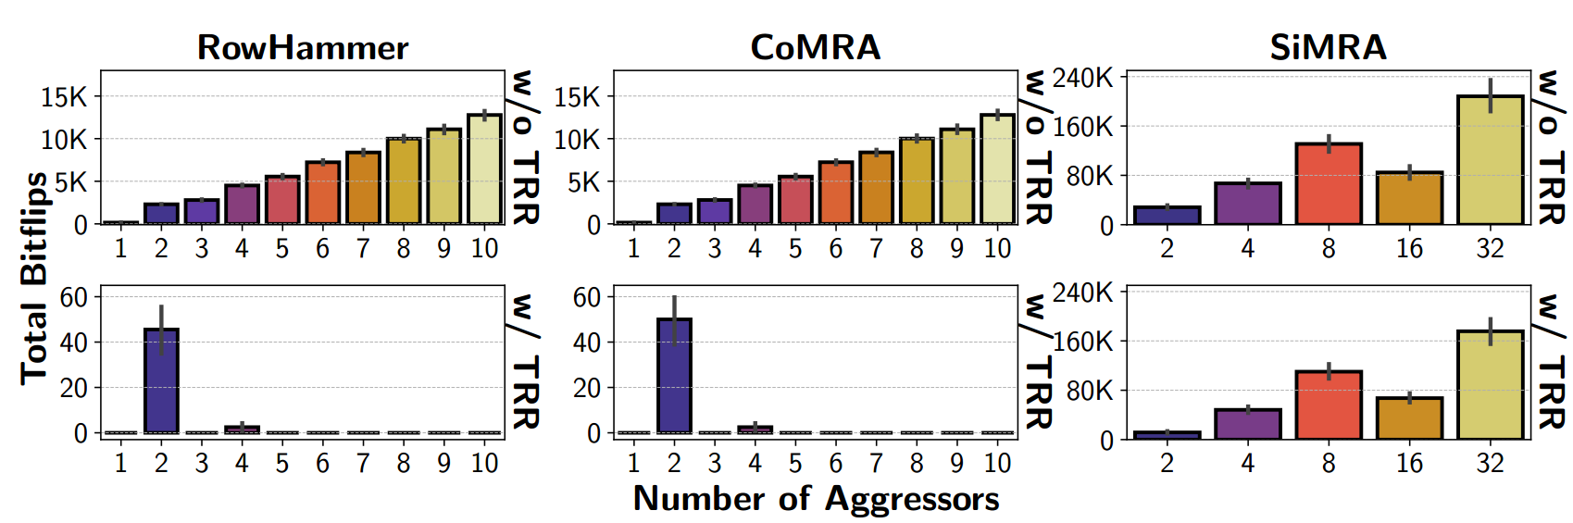
Real DRAM Chip Results
>10K bitflips
<60
bitflips
>10K bitflips
~60
bitflips
CoMRA induces 1.10x more bitflips than RowHammer
on average in the presence of TRR

Slide 43
Real DRAM Chip Results
>10K bitflips
<60
bitflips
~240K
bitflips
~180K
bitflips
SiMRA induces 11340x more bitflips than RowHammer
on average in the presence of TRR

Slide 44
Mitigating PuDHammer
1
Analyze the effectiveness of existing in-DRAM RowHammer mitigation against PuDHammer
2
Adapt RowHammer mitigations
to account for PuDHammer

Slide 45
Adapting PRAC for PuDHammer
A Naïve Approach (PRAC-Naïve)
Reducing RowHammer threshold
to SiMRA’s lowest observed HCfirst
Weighted Counting (PRAC-WC)
Increase counters based on the vulnerability
caused by the operation (RH, CoMRA, and SiMRA)

Slide 46
Methodology
Environment: Cycle-level DRAM simulator Ramulator2 [Kim+ CAL'15, Luo+ CAL'23]
System Configuration:
  Processor 4-core, out-of-order, 4.2GHz clock frequency
  DRAM DDR5, 1 channel, 2 rank/channel, 8 bank groups,
  4 banks/bank group, 128K rows/bank
  Memory Ctrl. 64-entry read and write requests queues,
  Scheduling policy: FR-FCFS with a column cap of 4
  PRAC 4 RFMs per Back-off
  PIM Unit 1-core, issues CoMRA & SiMRA operations with a fixed invertal
Workloads:
    60 five-core multiprogrammed workload mixes.
    Each mix is composed of
      four workloads from five major benchmark suites and
      one synthetic workload that periodically performs back-to-back one SiMRA with 32-row activation and one CoMRA operation

Slide 47
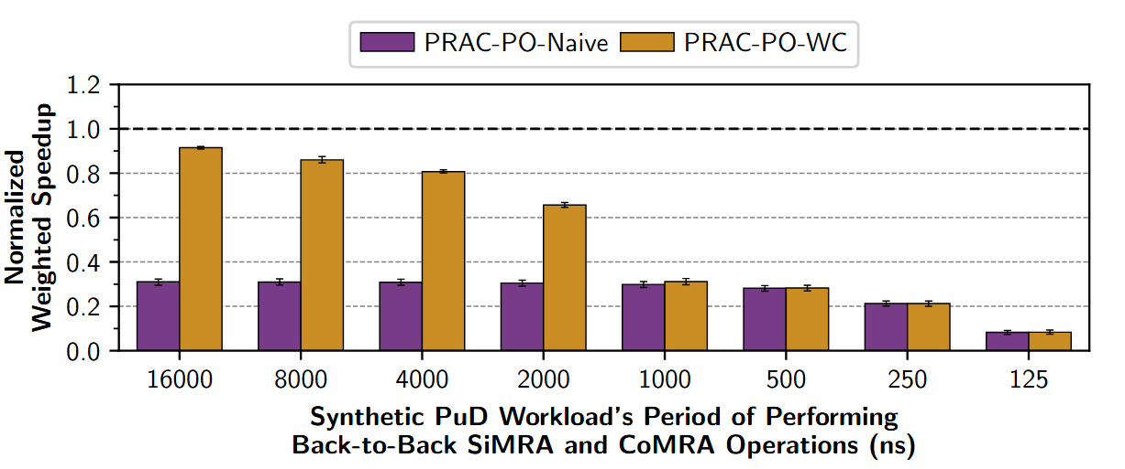
Weighted Speedup Results
PRAC-Naïve
PRAC-WC
PRAC-Naïve
PRAC-WC
Normalized
to no RH mitigation
DRAM performs PuD operations in every 125ns

Slide 48
Weighted Speedup Results
PRAC-Naïve
PRAC-WC
PRAC-WC greatly outperforms PRAC-Naïve until 2us
PRAC-WC incurs an average (maximum)
performance overhead of 48.26% (98.83%)

Slide 49
More in the Paper
More characterization results
    Temperature, spatial variation, timing parameters, access pattern,
    data pattern, aggressor row on time analyses for CoMRA and SiMRA
    Combined Read Disturbance Effect of RowHammer with PuD
      Combined pattern is more effective than RowHammer alone
      (e.g., 1.66x reduction in HCfirst on average)
Details and analyses on mitigating PuDHammer
    Discussion on how modifying DRAM chips could help mitigating PuDHammer
    More details on PRAC adaptation
      Challenges on adapting for PuDHammer
      An area-efficient PRAC solution
      ..
Notes:
We have more content in the paper, including
…

Slide 50
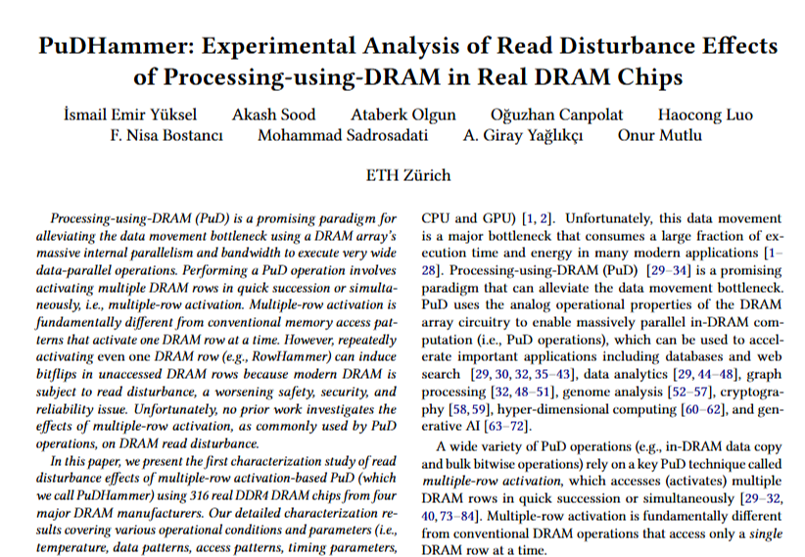
Available on arXiv
https://arxiv.org/pdf/2506.12947
Notes:
The extended version of our study is available on arxiv

Slide 51
Outline
Background
Problem & Goal
Testing Infrastructure
Read Disturbance Effect of CoMRA
Read Disturbance Effect of SiMRA
Mitigating PuDHammer
Conclusion
Notes:
Here is the outline of my talk

Slide 52
Conclusion
We extensively study the interaction between read disturbance and multiple-row activation-based Processing-using-DRAM operations
We characterize 316 DDR4 chips from four major manufacturers
PuDHammer significantly exacerbates the read disturbance vulnerability
(e.g., HCfirst reduces from 4K to 26)
PuDHammer bypasses in-DRAM RowHammer mitigation (TRR)
and induces 11340x more bitflips than RowHammer
We adapt Per Row Activation Counting (PRAC) for PuDHammer
Incurs 48.26% performance overhead on average
across 60 multiprogrammed workload mixes
We hope our findings guide system-level and architectural solutions
to enable read-disturbance-resilient future PuD systems
Notes:
In this study,
[CLICK] We experimentally demonstrate that off-the-shelf DRAM chips can simultaneously activate up to 32 DRAM rows
[CLICK] perform MAJ3, MAJ5, MAJ7, and MAJ9 operations
[CLICK] and copy one row’s content into up to 31 different rows simultaneously
[CLICK] We characterize the success rate of in-DRAM operations on 120 DDR4 chips from two major manufacturers And we highlight three key results
[CLICK] By storing multiple copies of majority’s input operands, we can increase the success rate of majority operations
[CLICK] and operating conditions can significantly affect the robustness of in-DRAM operations
[CLICK] We conclude that these empirical results demonstrate the promising potential of using DRAM as a computation substrate

Slide 53
PuDHammer
Experimental Analysis of Read Disturbance Effects of Processing-using-DRAM in Real DRAM Chips
İsmail Emir Yüksel
Akash Sood Ataberk Olgun Oğuzhan Canpolat Haocong Luo
Nisa Bostancı Mohammad Sadrosadati Giray Yağlıkçı Onur Mutlu
Notes:
Hello, I am Ismail Emir Yuksel.
I will be presenting our work, Simultaneous Many-Row Activation in Off-the-Shelf DRAM Chips

Slide 54
PuDHammer
Experimental Analysis of Read Disturbance Effects of Processing-using-DRAM in Real DRAM Chips
Backup Slides
İsmail Emir Yüksel
Akash Sood Ataberk Olgun Oğuzhan Canpolat Haocong Luo
Nisa Bostancı Mohammad Sadrosadati Giray Yağlıkçı Onur Mutlu
Notes:
Hello, I am Ismail Emir Yuksel.
I will be presenting our work, Simultaneous Many-Row Activation in Off-the-Shelf DRAM Chips

Slide 55
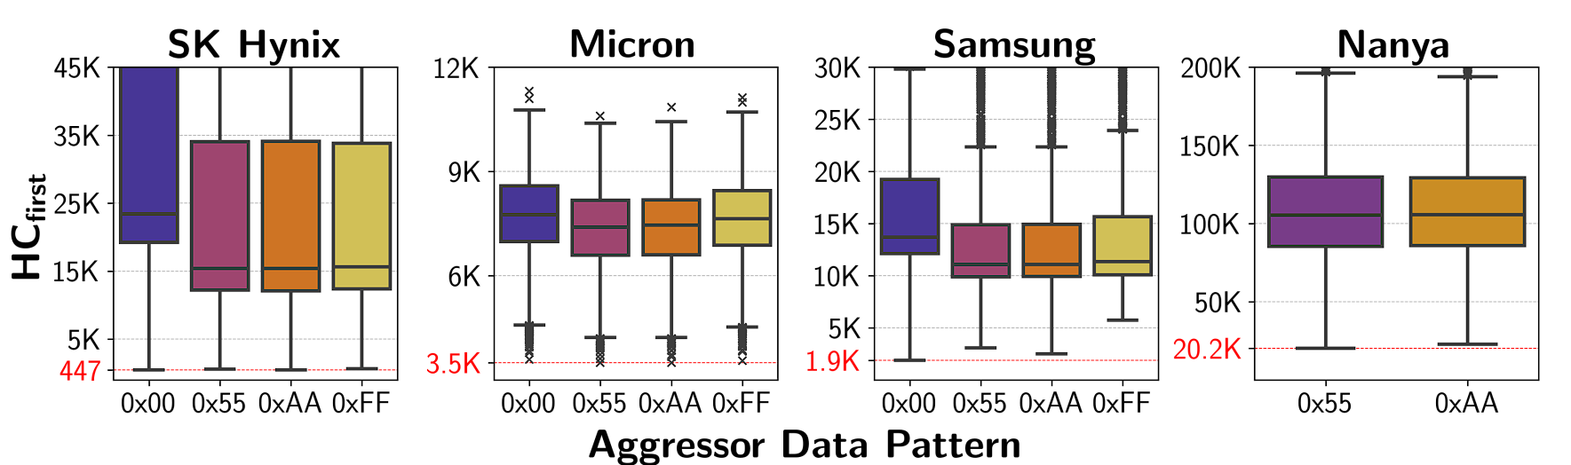
CoMRA – Data Pattern
CheckerBoard pattern (i.e., 0x55/0xAA) is, in general, the most effective data pattern among the ones tested.

Slide 56
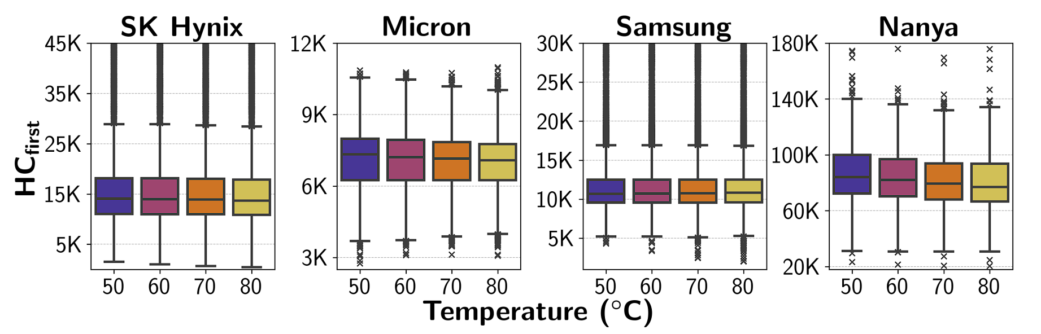
CoMRA – Temperature
Read disturbance effects of hammering with double-sided CoMRA
tend to get worse as temperature increases.

Slide 57
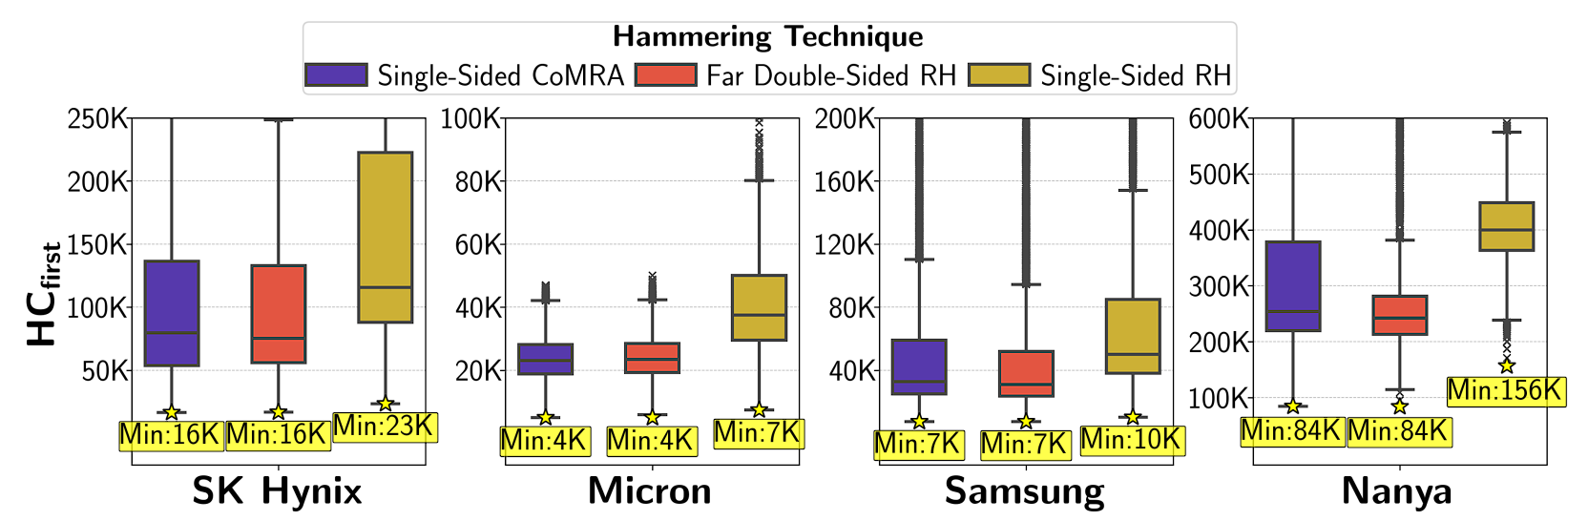
Single-Sided CoMRA vs. RowHammer
Single-sided CoMRA decreases HCfirst
compared to single-sided RowHammer
Single-sided CoMRA exhibits similar HCfirst distribution
with far double-sided RowHammer.

Slide 58
CoMRA (w/ increased tAggOn)
Hammering with CoMRA
ACT src
PRE
ACT dst
36ns
7.5ns
PRE
36ns
Pressing with CoMRA
ACT src
PRE
ACT dst
36ns
7.5ns
PRE
tAggOn
(more than 36ns)

Slide 59
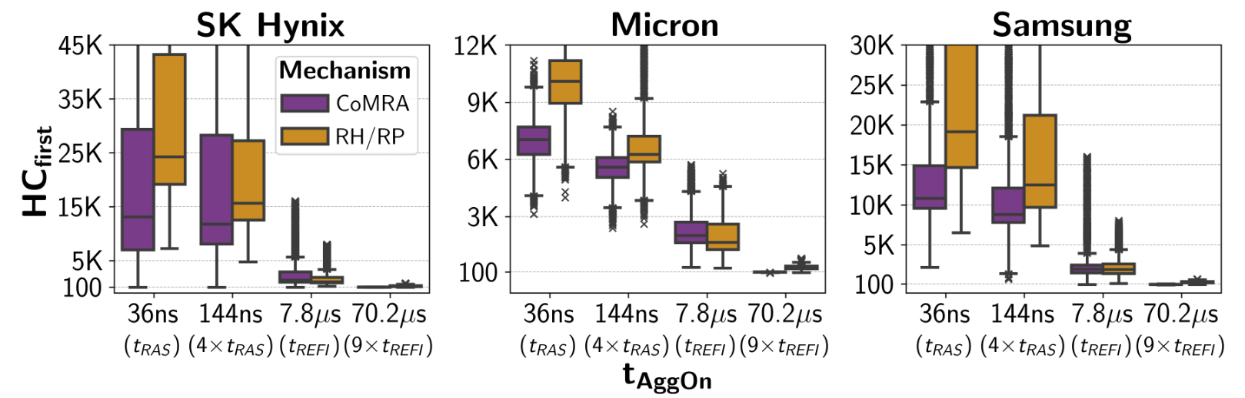
CoMRA (w/ Aggressor Row On Time) vs RowPress
For CoMRA
From 36ns to 70.2us
79x reduction
For RH/RP
From 36ns to 70.2us
31x reduction

Slide 60
CoMRA (w/ Aggressor Row On Time) vs RowPress
Trend consistent across all four manufacturer:
Increasing tAggOn significantly reduces HCfirst
for both CoMRA and RH/RP

Slide 61
CoMRA (w/ Aggressor Row On Time) vs RowPress
Key Takeaway 2
Pressing with CoMRA is more effective than hammering with CoMRA

Slide 62
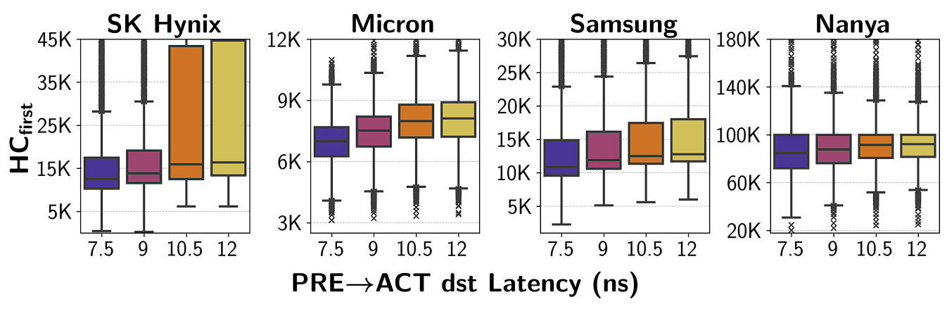
CoMRA – Timing Delay
HCfirst increases as the latency
of PRE→ACT dst increases

Slide 63
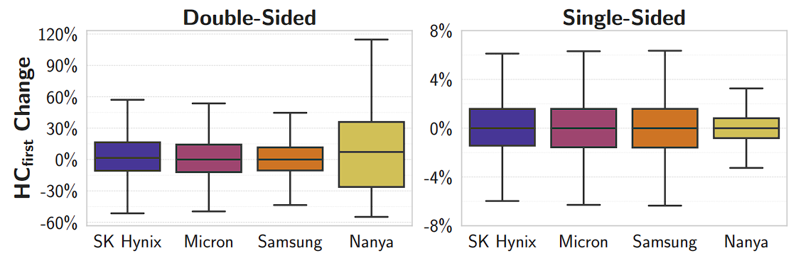
CoMRA – Copy Direction
In most cases, copy direction
has a small effect on HCfirst.

Slide 64
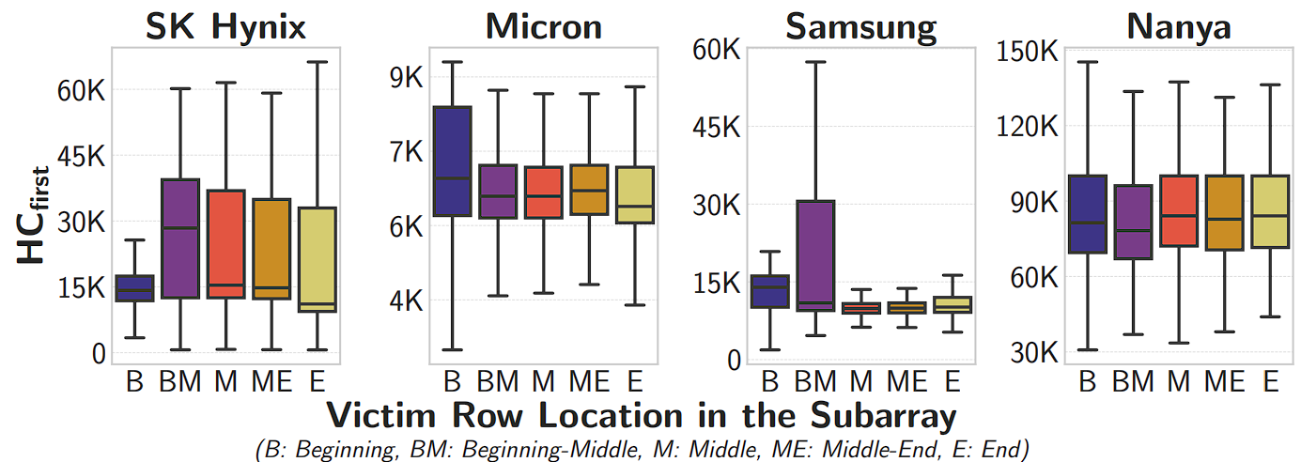
CoMRA – Spatial Variation
HCfirst varies based on
the victim row’s location in a subarray

Slide 65
SiMRA Results

Slide 66
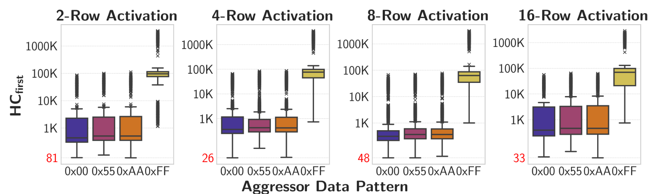
SiMRA -- Impact of the Data Pattern
Aggressor Rows = 0xFF..FF
Victim Rows = 0x00..00
(Victim has negated data pattern)

Slide 67
SiMRA -- Impact of the Data Pattern
58x
(Victim has negated data pattern)
Initializing victim rows with 0x00
increases avg. HCfirst by 58x
Dominant bitflip direction for SiMRA
1->0
Dominant bitflip direction for RH*
0->1
*not shown in the figure

Slide 68
SiMRA -- Impact of the Data Pattern
Trend consistent across all tested number
of simultaneously activated rows
Key Takeaway
SiMRA is significantly affected by data pattern and
directionality of SiMRA and RowHammer bitflips
are opposite

Slide 69
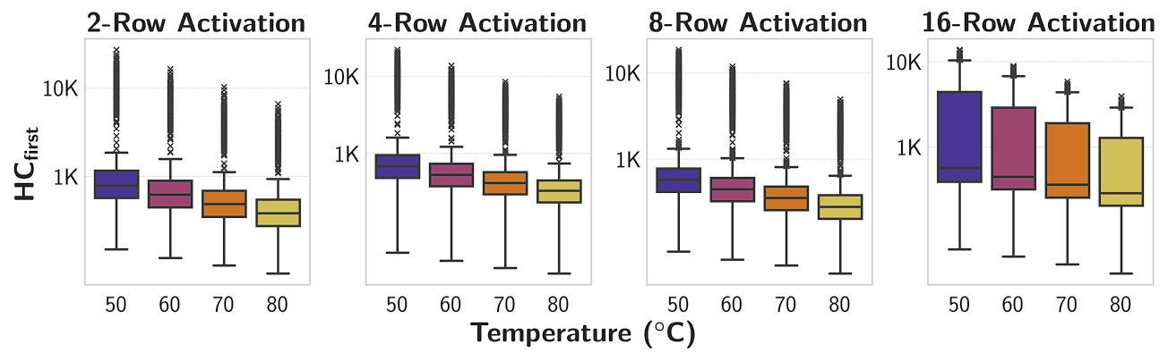
SiMRA – Temperature
HCfirst decreases as temperature increases

Slide 70
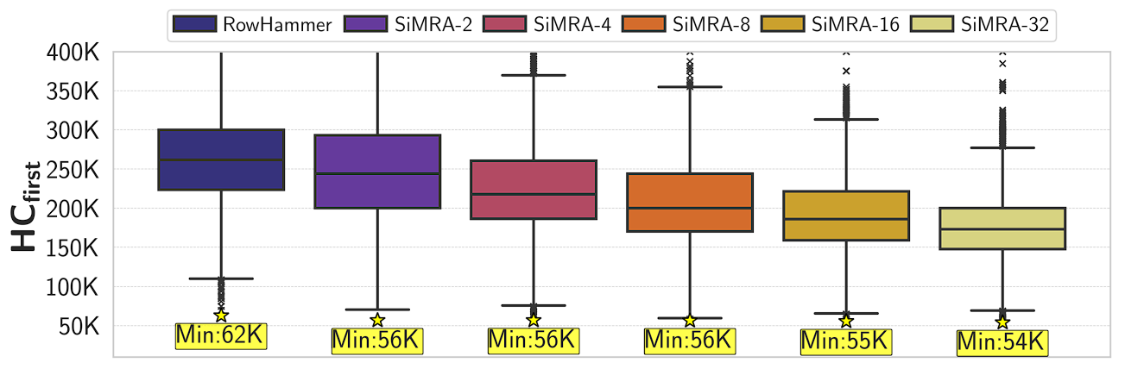
Single-Sided SiMRA vs. RowHammer
HCfirst consistently decreases as the number of simultaneously activated rows increases when performing single-sided SiMRA.

Slide 71
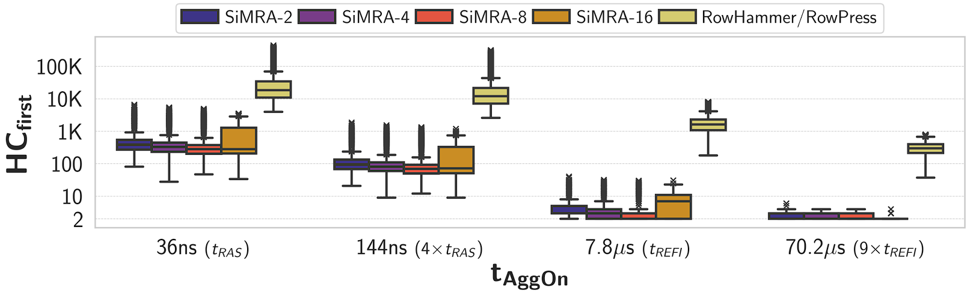
SiMRA vs. RowPress
HCfirst decreases greatly as tAggOn increases

Slide 72
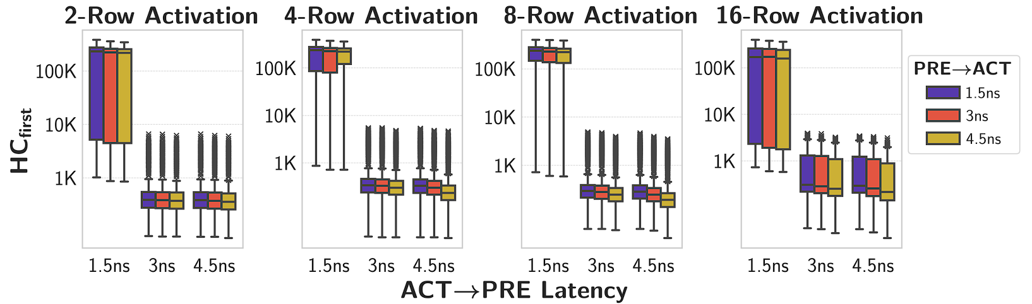
SiMRA -- Timing Delay
HCfirst decreases greatly as tAggOn increases

Slide 73
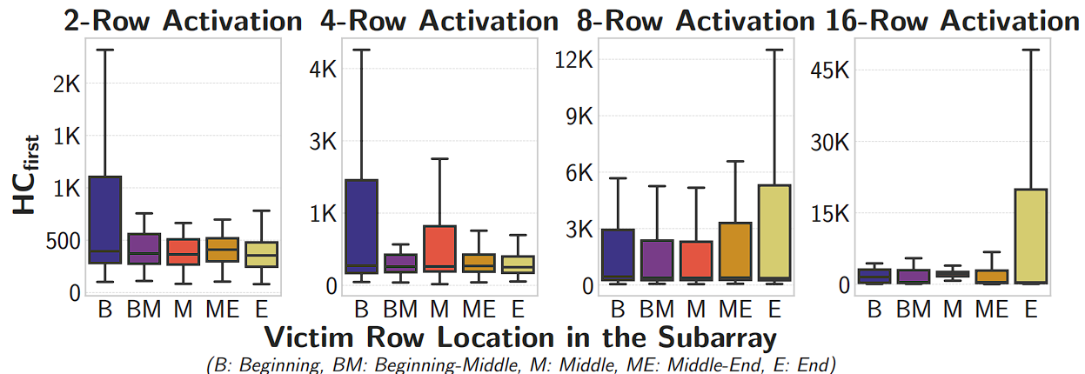
SiMRA – Spatial Variation
The effectiveness of SiMRA
depends on the victim row’s location in a subarray.

Slide 74
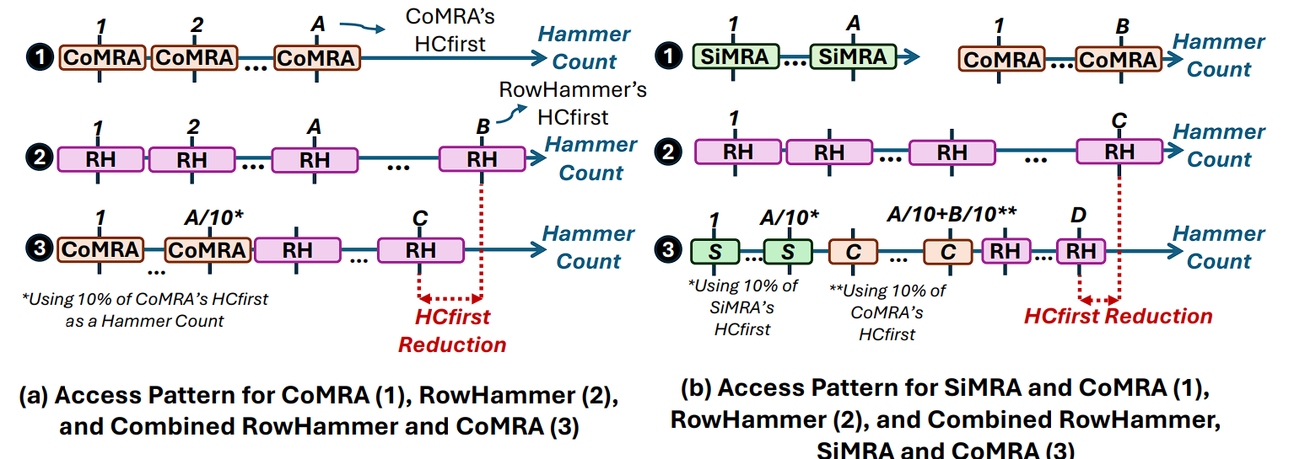
Combined PuDHammer, RH & RP

Slide 75
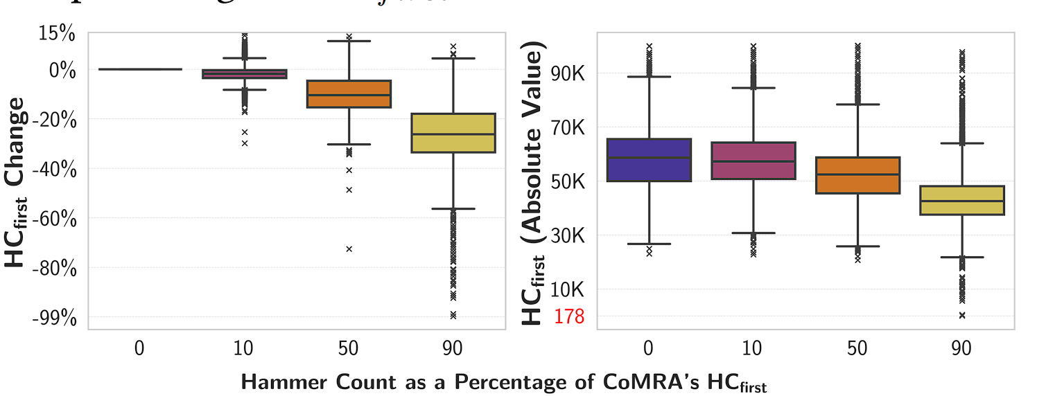
Combined CoMRA & RH
DRAM rows experience significantly lower HCfirst when performing combined RowHammer and CoMRA.

Slide 76
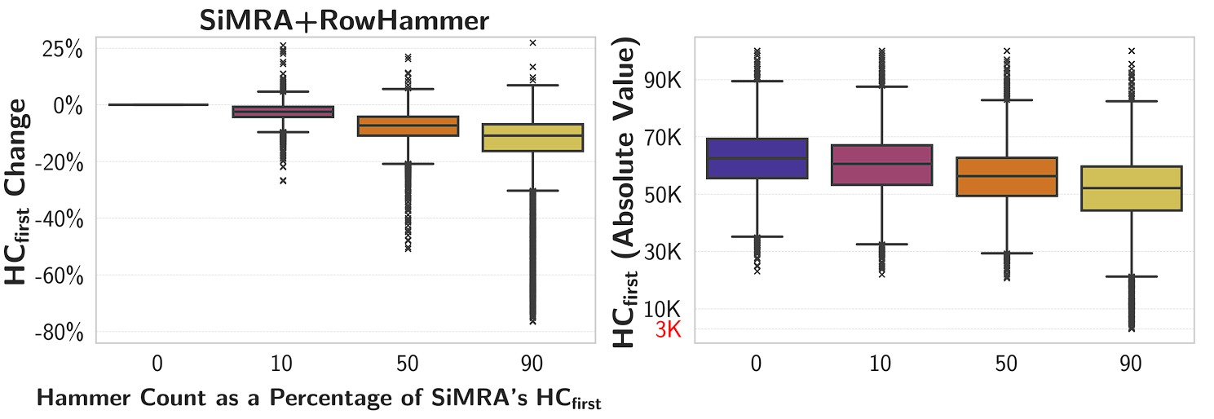
Combined SiMRA & RH
DRAM rows tend to experience lower HCfirst
when performing combined RowHammer and SiMRA.

Slide 77
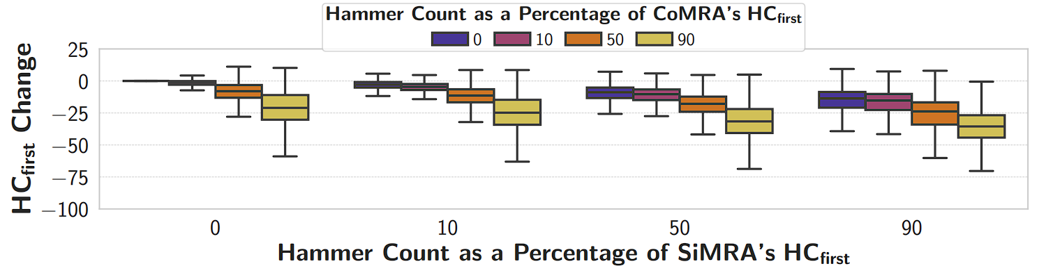
Combined CoMRA, SiMRA & RH
Combined RowHammer with CoMRA & SiMRA together
is the most effective combined access pattern
to decrease HCfirst.

Slide 78
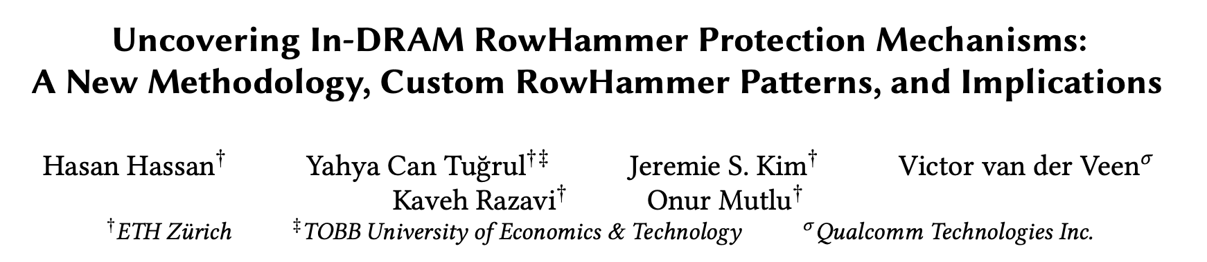
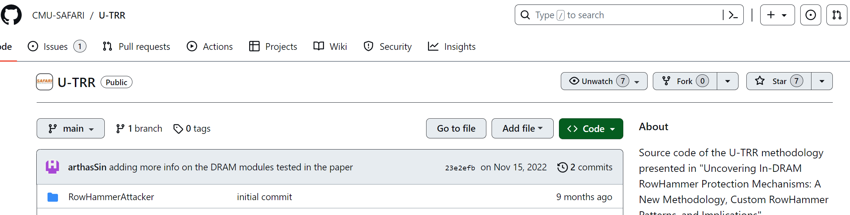
Reverse Engineering TRR in Real DRAM
Key idea: Use data retention failures as a side channel
to detect when a row is refreshed by on-die mitigation
Notes:
We use the methodology presented in this paper
[CLICK] Where the key idea is to use data retention failures as a side channel to detect when a row is refreshed by the on-die mitigation mechanism
[CLICK] We re-use the source code that is publicly available on this Github page.

Slide 79
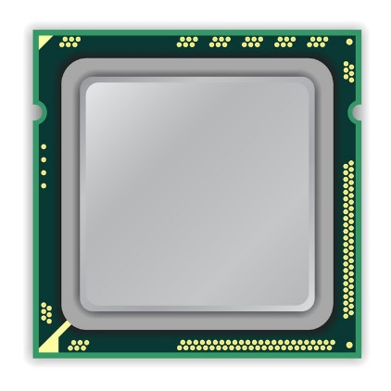
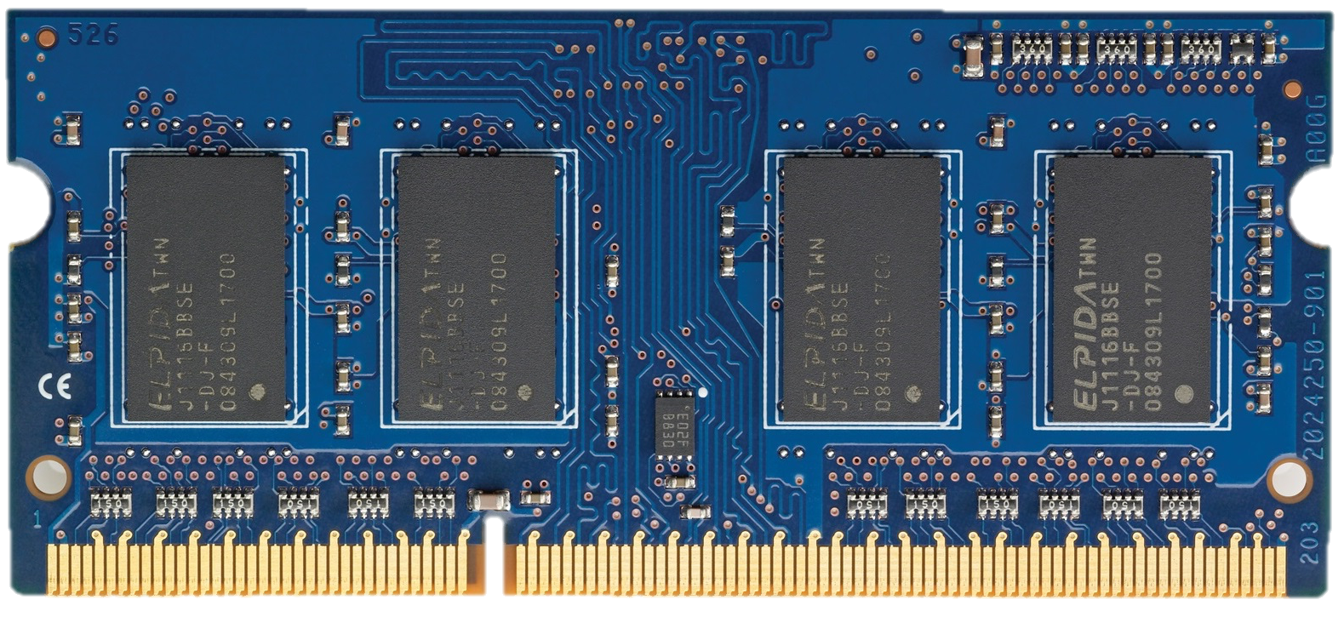

Per Row Activation Counting in DDR5 (April 2024)
RFM
ACT A
ACT A
ACT A
Back-off
PRAC Counters
DRAM Rows
0xA
back-off threshold
continue to
send commands
N_{BO}
1
accurately tracks
activation counts
of each row
2
requires
preventive
action
allocates a fixed time for preventive refresh
Back-off
...
ACT A
ACT A
ACT A
RFM
ACT
DRAM Command Timeline

Slide 80
A Naïve Approach (PRAC-Naïve)
Lowest HCfirst for tested DRAM chips
RH: ~4K
CoMRA: ~400
SiMRA: ~20
N_{BO}=20
...
ACT A
SiMRA
CoMRA
DRAM Command Timeline
PRAC Counters
DRAM Rows
0xA
N_{BO}
1
2

Slide 81
Weighted Counting (PRAC-WC)
Threshold is set to 4K (RH Threshold)
Each operation increases counters by
RH (ACT): 1
CoMRA: 10
SiMRA: 200
N_{BO}=4K
...
ACT A
SiMRA
CoMRA
DRAM Command Timeline
PRAC Counters
DRAM Rows
0xA
N_{BO}
201
1

Slide 82
Updating Multiple Counters in PRAC
SiMRA operation activates multiple rows simultaneously
    Which requires updating multiple PRAC row activation counters simultaneously
However, PRAC is designed to update only one counter upon an ACT command
    We need to modify the counter organization
    and operation in PRAC to support updating multiple counters.
Assuming we can activate up to N rows simultaneously
    Simultaneous access to N different counter values
    N incrementer circuits to update all the counters simultaneously

Slide 83
A Solution: Chronus + N Incrementers
Chronus concurrently updates counters while serving accesses
Row Decoder
Counter 0
Counter N-1
Counter
Subarray
Row N
Row 0
Updates
Counter
Counter N+1
Counter 2N-1
Increment
Row Buffer
Counter 0
Counter N-1
Row Decoder
Open Row
Row 0
Row 0
Regular
Subarray
Serves
Regular
Accesses
Row N-1
Row Buffer
Row 0
Row Decoder
Row N
Row N
Regular
Subarray
Row 2N-1
Row Buffer
ACT 0
PRE
ACT N
Time

Slide 84
Limitations of Tested COTS DRAM Chips
Some COTS DRAM chips do not support SiMRA
    We do not observe SiMRA in all tested Samsung/Micron chips
    Hypothesis
      Internal DRAM circuitry ignores the PRE command or
      the second ACT command when the timing parameters are greatly violated
    If such a limitation were not imposed, we believe these DRAM chips are also fundamentally capable of performing the operations
    we examine in this work

Slide 85
In-DRAM Row-Copy (RowClone)
ACT src
36ns
Fetch src’s content
into the sense amplifiers
d
s
t
s
r
c
Assert the src’s wordline
d
s
t
s
r
c
Notes:
[CLICK] To perform RowClone, we first activate the source row by issuing ACT src command. This will assert the src’s wordline
[CLICK] and then fetch src’s content into the sense amplifiers

Slide 86
In-DRAM Row-Copy (RowClone)
ACT src
PRE
ACT dst
36ns
7.5ns
Activates dst row
Bitlines are still at src voltage
s
r
c
d
s
t
src’s content
is copied to dst
s
r
c
sense amplifier is still enabled
d
s
t
s
r
c
Notes:
After that, we activate
[CLICK] the destination row without performing precharge operation in between two activate commands
[CLICK] By doing that DRAM will keep the bitlines at src voltage
[CLICK] and keep the sense amplifier enabled
[CLICK] As a result, after some time, the source row’s content is copied to the destination row

Slide 87
Aggressor Row On Time & RowPress
RowHammer
Aggressor Row
Open
Close
Minimum allowed row on time
(t_{RASmin})
hammer count = 2
RowPress
Aggressor Row
Open
Close
Aggressor row on time
(t_{AggON})
Instead of using a high hammer count,
☞ increase the time that the aggressor row stays open
[Luo+, ISCA’23]
Notes:
In contrast, RowPress, instead of a high activation count, [CLICK] increases the time the that aggressor stays open.
Doing so disturbs adjacent rows enough to cause bitflips without having very high activation count.

