Slide 1

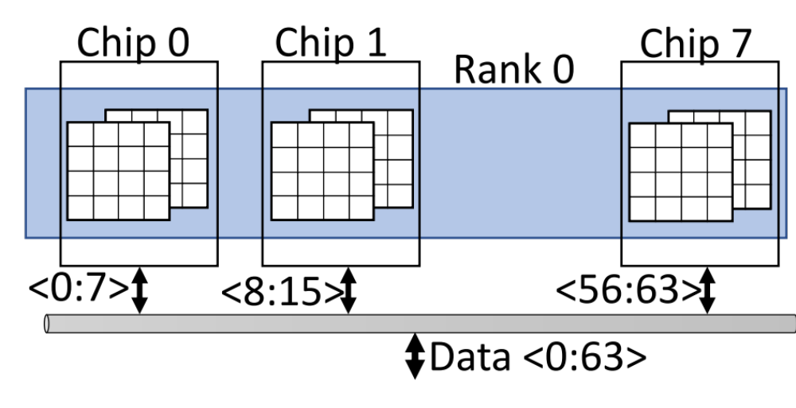
PALP: Enabling and Exploiting Partition-Level Parallelism in Phase Change Memories
Shihao Song, Anup Das, Onur Mutlu and Nagarajan Kandasamy
Background: Bank Conflicts
Key Observations
Goals
PCM devices can serve multiple requests in parallel using bank-level parallelism
1st key observation: On average, 43% of PCM requests in SPEC 2017 workloads generate bank conflicts
1
Analyze parallelism in PCM bank’s partition through detailed circuit analysis
2
Analyze the potential performance impact of enabling parallelism in a bank’s partitions
    Resolve read-read and read-write PCM bank conflicts to improve PCM performance
3
Requests to the same bank have to be served serially, known as bank conflict
Our Contributions
  Bank conflicts occur due temporal and spatial access locality in a workload that lead to repeated access to multiple memory rows that map to the same bank
1
New mechanism to resolve read-write PCM bank conflicts using a new PCM command called
READ-WITH-WRITE (RWW)
Memory bank conflicts reduce system performance by lowering bank utilization, causing CPU cores to stall
  2nd key observation: A PCM bank is implemented as a collection of partitions that operate mostly independently; sharing the sense amplifiers (to read) and
  the write drivers (to write)
2
Simple circuit modification to resolve read-read PCM bank conflicts using a new PCM command called READ-WITH-READ (RWR)
Decoupled Write Driver
3
New memory access scheduling to prioritize PCM requests that exploit a PCM bank’s partition-level parallelism, over other requests, including
the long outstanding ones
The peripheral structures in PCM banks allow to read and program 128 PCM cells in parallel
Enabling and Exploiting Partition-Level Parallelism in PCM
Performance Improvement vs. Baseline
1
2
PCM Commands
Performance improvement 27%
Performance improvement 21%
ACTIVATE(A): activate the wordline and enable the access device for the PCM cells to be accessed
READ(R)/WRITE(W): drive read or write current through the PCM cell. After this command executes, the data stored in the PCM cell is available at the output terminal of the sense amplifier, or the write data is programmed to the PCM cell
PRECHARGE(P): deactivate the wordline and bitline, and prepare the bank for the next access
Evaluation
Evaluation Methodology
Gem5 frontend to simulate ARMv8-A (aarch64) with 8 cores
Hybrid DRAM-PCM memory system
In-house cycle-level PCM simulator for 8GB, 16GB, and 32GB PCM with DDR4 interface
We introduce the following new commands
Baseline: Arjomand et al. “Boosting access parallelism to PCM-based main memory” in ISCA 2016
MultiPartition: Zhou et al., “An efficient parallel scheduling scheme on multi-partition PCM architecture” in ISLPED 2016
READ-WITH-WRITE (RWW): connect the PCM bank’s sense amplifiers and write drivers to the two decoded partitions
READ-WITH-READ (RWR): connect the sense amplifiers and verify logic of the write drivers to the two decoded partitions
DECOUPLE (D): set M4 = OFF
TRANSFER (T): sets M5 = ON and M6 = OFF
PCM Access Scheduling
Both average and peak PCM power consumption of PALP is within the RAPL limit
The average PCM power is at least 0.08pJ/access lower than the RAPL limit while the peak PCM power is at least 0.03pJ/access lower than the RAPL limit
On average, execution time reduces by
51% vs. Baseline and 28% vs. MultiPartition
On average, critical path delay increases by 25.3%
On average, power consumption increases by 17%
Open source tool
https://github.com/drexel-DISCO/PALP
On average, execution time reduces by
33% with DDR2 and 51% with DDR4

