Slide 1

Transforming
Server Architectures
Onur Mutlu
omutlu@gmail.com
https://people.inf.ethz.ch/omutlu
30 June 2022
DataCenter Summit Keynote

Slide 2
The Problem
Computing
is Bottlenecked by Data

Slide 3
Data is Key for AI, ML, Genomics, …
Important workloads are all data intensive
They require rapid and efficient processing of large amounts of data
Data is increasing
  We can generate more than we can process

Slide 4
Huge Demand for Performance & Efficiency
Source: https://youtu.be/Bh13Idwcb0Q?t=283

Slide 5
Data is Key for Future Workloads
In-memory Databases
[Mao+, EuroSys’12;
Clapp+ (Intel), IISWC’15]
Graph/Tree Processing
[Xu+, IISWC’12; Umuroglu+, FPL’15]
In-Memory Data Analytics
[Clapp+ (Intel), IISWC’15;
Awan+, BDCloud’15]
Datacenter Workloads
[Kanev+ (Google), ISCA’15]

Slide 6
Data Overwhelms Modern Machines
In-memory Databases
[Mao+, EuroSys’12;
Clapp+ (Intel), IISWC’15]
Graph/Tree Processing
[Xu+, IISWC’12; Umuroglu+, FPL’15]
Data → performance & energy bottleneck
In-Memory Data Analytics
[Clapp+ (Intel), IISWC’15;
Awan+, BDCloud’15]
Datacenter Workloads
[Kanev+ (Google), ISCA’15]

Slide 7

Data is Key for Future Workloads
  Chrome
TensorFlow Mobile
    Google’s web browser
Google’s machine learning framework
  Video Playback
  Video Capture
Google’s video codec
Google’s video codec
Notes:
In this work, we take a look at widely-used google consumer workloads, to figure out the major sources of energy consumption.
We look at Google Chrome web brower. We take a look at Tensorflow, Google’s machine learning framework, and we also take a look at two important video related workloads, video playback and video capture, both rely on Google’s vp9 codec technology.

Slide 8
Data Overwhelms Modern Machines
  Chrome
TensorFlow Mobile
    Google’s web browser
Google’s machine learning framework
Data → performance & energy bottleneck
  Video Playback
  Video Capture
Google’s video codec
Google’s video codec
Notes:
In this work, we take a look at widely-used google consumer workloads, to figure out the major sources of energy consumption.
We look at Google Chrome web brower. We take a look at Tensorflow, Google’s machine learning framework, and we also take a look at two important video related workloads, video playback and video capture, both rely on Google’s vp9 codec technology.

Slide 9
Data is Key for Future Workloads
development of high-throughput sequencing (HTS) technologies
Number of Genomes Sequenced
http://www.economist.com/news/21631808-so-much-genetic-data-so-many-uses-genes-unzipped
Notes:
However, since the development of high throughput sequencing (HTS) technologies, the cost of genome sequencing has fallen off a cliff (<< 1,000$) making it viable for almost everyone's use.

Slide 10
1
Sequencing
Genome Analysis
Read Mapping
2
Data → performance & energy bottleneck
Variant Calling
Scientific Discovery
3
4
Notes:
Genome analysis starts with sequencing random short DNA fragments of copies of the original molecule.
Unfortunately, these reads lack information about their order and which part of genome they are originated from.
Hence the second step is to map these reads to a long reference genome.

Slide 11
New Genome Sequencing Technologies
Oxford Nanopore MinION
Senol Cali+, “Nanopore Sequencing Technology and Tools for Genome
Assembly: Computational Analysis of the Current State, Bottlenecks
and Future Directions,” Briefings in Bioinformatics, 2018.
[Open arxiv.org version]

Slide 12
New Genome Sequencing Technologies
Oxford Nanopore MinION
Senol Cali+, “Nanopore Sequencing Technology and Tools for Genome
Assembly: Computational Analysis of the Current State, Bottlenecks
and Future Directions,” Briefings in Bioinformatics, 2018.
[Preliminary arxiv.org version]
Data → performance & energy bottleneck

Slide 13
One Problem with (Genome) Analysis Today
Special-Purpose Machine
for Sequencing
General-Purpose Machine
for Analysis
FAST SLOW
Slow and inefficient processing capability
This picture is similar for many “data generators & analyzers” today

Slide 14
Accelerating Genome Analysis [IEEE MICRO 2020]
Mohammed Alser, Zulal Bingol, Damla Senol Cali, Jeremie Kim, Saugata Ghose, Can Alkan, and Onur Mutlu,
"Accelerating Genome Analysis: A Primer on an Ongoing Journey"
IEEE Micro (IEEE MICRO), Vol. 40, No. 5, pages 65-75, September/October 2020.
[Slides (pptx)(pdf)]
[Talk Video (1 hour 2 minutes)]

Slide 15
FPGA-based Near-Memory Analytics
Gagandeep Singh, Mohammed Alser, Damla Senol Cali, Dionysios Diamantopoulos, Juan Gómez-Luna, Henk Corporaal, and Onur Mutlu,
"FPGA-based Near-Memory Acceleration of Modern Data-Intensive Applications"
IEEE Micro (IEEE MICRO), 2021.

Slide 16
Near-Memory Acceleration using FPGAs
OCAPI
Source: IBM
Source: AlphaData
IBM POWER9 CPU
HBM-based FPGA board
Near-HBM FPGA-based accelerator
Two communication technologies: CAPI2 and OCAPI
Two memory technologies: DDR4 and HBM
Two workloads: Weather Modeling and Genome Analysis
Notes:
To this end we build a [CLICK] near-HBM FPGA based accelerator which is connected to a server-grade IBM POWER9-based CPU system

Slide 17
Performance & Energy Greatly Improve
5-27× performance vs. a 16-core (64-thread) IBM POWER9 CPU
12-133× energy efficiency vs. a 16-core (64-thread) IBM POWER9 CPU
HBM alleviates memory bandwidth contention vs. DDR4
Notes:
[CLICK]

Slide 18
GenASM Framework [MICRO 2020]
Damla Senol Cali, Gurpreet S. Kalsi, Zulal Bingol, Can Firtina, Lavanya Subramanian, Jeremie S. Kim, Rachata Ausavarungnirun, Mohammed Alser, Juan Gomez-Luna, Amirali Boroumand, Anant Nori, Allison Scibisz, Sreenivas Subramoney, Can Alkan, Saugata Ghose, and Onur Mutlu,
"GenASM: A High-Performance, Low-Power Approximate String Matching Acceleration Framework for Genome Sequence Analysis"
Proceedings of the 53rd International Symposium on Microarchitecture (MICRO), Virtual, October 2020.
[Lighting Talk Video (1.5 minutes)]
[Lightning Talk Slides (pptx) (pdf)]
[Talk Video (18 minutes)]
[Slides (pptx) (pdf)]

Slide 19
In-Storage Genome Filtering [ASPLOS 2022]
Nika Mansouri Ghiasi, Jisung Park, Harun Mustafa, Jeremie Kim, Ataberk Olgun, Arvid Gollwitzer, Damla Senol Cali, Can Firtina, Haiyu Mao, Nour Almadhoun Alserr, Rachata Ausavarungnirun, Nandita Vijaykumar, Mohammed Alser, and Onur Mutlu,
"GenStore: A High-Performance and Energy-Efficient In-Storage Computing System for Genome Sequence Analysis"
Proceedings of the 27th International Conference on Architectural Support for Programming Languages and Operating Systems (ASPLOS), Virtual, February-March 2022.
[Talk Slides (pptx) (pdf)]
[Lightning Talk Slides (pptx) (pdf)]
[Lightning Talk Video (90 seconds)]
[Talk Video (17 minutes)]

Slide 20
Accelerating Sequence-to-Graph Mapping
Damla Senol Cali, Konstantinos Kanellopoulos, Joel Lindegger, Zulal Bingol, Gurpreet S. Kalsi, Ziyi Zuo, Can Firtina, Meryem Banu Cavlak, Jeremie Kim, Nika MansouriGhiasi, Gagandeep Singh, Juan Gomez-Luna, Nour Almadhoun Alserr, Mohammed Alser, Sreenivas Subramoney, Can Alkan, Saugata Ghose, and Onur Mutlu,
"SeGraM: A Universal Hardware Accelerator for Genomic Sequence-to-Graph and Sequence-to-Sequence Mapping"
Proceedings of the 49th International Symposium on Computer Architecture (ISCA), New York, June 2022.
[arXiv version]
https://arxiv.org/pdf/2205.05883.pdf

Slide 21
Future of Genome Sequencing & Analysis
Mohammed Alser, Zülal Bingöl, Damla Senol Cali, Jeremie Kim, Saugata Ghose, Can Alkan, Onur Mutlu
“Accelerating Genome Analysis: A Primer on an Ongoing Journey” IEEE Micro, August 2020.
MinION from ONT
SmidgION from ONT

Slide 22
More on Fast & Efficient Genome Analysis …
Onur Mutlu,
"Accelerating Genome Analysis: A Primer on an Ongoing Journey"
Invited Lecture at Technion, Virtual, 26 January 2021.
[Slides (pptx) (pdf)]
[Talk Video (1 hour 37 minutes, including Q&A)]
[Related Invited Paper (at IEEE Micro, 2020)]
https://www.youtube.com/watch?v=r7sn41lH-4A

Slide 23
Detailed Lectures on Genome Analysis
Computer Architecture, Fall 2020, Lecture 3a
  Introduction to Genome Sequence Analysis (ETH Zürich, Fall 2020)
  https://www.youtube.com/watch?v=CrRb32v7SJc&list=PL5Q2soXY2Zi9xidyIgBxUz7xRPS-wisBN&index=5
Computer Architecture, Fall 2020, Lecture 8
  Intelligent Genome Analysis (ETH Zürich, Fall 2020)
  https://www.youtube.com/watch?v=ygmQpdDTL7o&list=PL5Q2soXY2Zi9xidyIgBxUz7xRPS-wisBN&index=14
Computer Architecture, Fall 2020, Lecture 9a
  GenASM: Approx. String Matching Accelerator (ETH Zürich, Fall 2020)
  https://www.youtube.com/watch?v=XoLpzmN-Pas&list=PL5Q2soXY2Zi9xidyIgBxUz7xRPS-wisBN&index=15
Accelerating Genomics Project Course, Fall 2020, Lecture 1
  Accelerating Genomics (ETH Zürich, Fall 2020)
  https://www.youtube.com/watch?v=rgjl8ZyLsAg&list=PL5Q2soXY2Zi9E2bBVAgCqLgwiDRQDTyId
https://www.youtube.com/onurmutlulectures

Slide 24
Increasingly Demanding Applications
Dream…
More will come…
As applications push boundaries, computing platforms will become increasingly strained

Slide 25
Data Overwhelms Modern Machines …
Storage/memory capability
Communication capability
Computation capability
Greatly impacts robustness, energy, performance, cost

Slide 26
A Computing System
Three key components
Computation
Communication
Storage/memory
Burks, Goldstein, von Neumann, “Preliminary discussion of the
logical design of an electronic computing instrument,” 1946.
Image source: https://lbsitbytes2010.wordpress.com/2013/03/29/john-von-neumann-roll-no-15/

Slide 27
Perils of Processor-Centric Design
Most of the system is dedicated to storing and moving data
Yet, system is still bottlenecked by memory

Slide 28
Deeper and Larger Memory Hierarchies
Core Count:
8 cores/16 threads
L1 Caches:
32 KB per core
L2 Caches:
512 KB per core
L3 Cache:
32 MB shared
AMD Ryzen 5000, 2020
https://wccftech.com/amd-ryzen-5000-zen-3-vermeer-undressed-high-res-die-shots-close-ups-pictured-detailed/

Slide 29
AMD’s 3D Last Level Cache (2021)
AMD increases the L3 size of their 8-core Zen 3 processors from 32 MB to 96 MB
Additional 64 MB L3 cache die stacked on top of the processor die
- Connected using Through Silicon Vias (TSVs)
- Total of 96 MB L3 cache
https://community.microcenter.com/discussion/5134/comparing-zen-3-to-zen-2
https://youtu.be/gqAYMx34euU
https://www.tech-critter.com/amd-keynote-computex-2021/
Notes:
CCD = Core Chiplet Die
Structural silicon is used to equalize the height and facilitate heat dissipation from the cores.

Slide 30
Deeper and Larger Memory Hierarchies
IBM POWER10,
2020
Cores:
15-16 cores,
8 threads/core
L2 Caches:
2 MB per core
L3 Cache:
120 MB shared
https://www.it-techblog.de/ibm-power10-prozessor-mehr-speicher-mehr-tempo-mehr-sicherheit/09/2020/

Slide 31
Data Overwhelms Modern Machines
  Chrome
TensorFlow Mobile
    Google’s web browser
Google’s machine learning framework
Data → performance & energy bottleneck
  Video Playback
  Video Capture
Google’s video codec
Google’s video codec
Notes:
In this work, we take a look at widely-used google consumer workloads, to figure out the major sources of energy consumption.
We look at Google Chrome web brower. We take a look at Tensorflow, Google’s machine learning framework, and we also take a look at two important video related workloads, video playback and video capture, both rely on Google’s vp9 codec technology.

Slide 32
Data Movement Overwhelms Modern Machines
Amirali Boroumand, Saugata Ghose, Youngsok Kim, Rachata Ausavarungnirun, Eric Shiu, Rahul Thakur, Daehyun Kim, Aki Kuusela, Allan Knies, Parthasarathy Ranganathan, and Onur Mutlu,
"Google Workloads for Consumer Devices: Mitigating Data Movement Bottlenecks"
Proceedings of the 23rd International Conference on Architectural Support for Programming Languages and Operating Systems (ASPLOS), Williamsburg, VA, USA, March 2018.
62.7% of the total system energy
is spent on data movement

Slide 33
Axiom
An Intelligent Architecture
Handles Data Well

Slide 34
How to Handle Data Well
Ensure data does not overwhelm the components
  via intelligent algorithms
  via intelligent architectures
  via whole system designs: algorithm-architecture-devices
Take advantage of vast amounts of data and metadata
  to improve architectural & system-level decisions
Understand and exploit properties of (different) data
  to improve algorithms & architectures in various metrics

Slide 35
Corollaries: Architectures Today …
Architectures are terrible at dealing with data
  Designed to mainly store and move data vs. to compute
  They are processor-centric as opposed to data-centric
Architectures are terrible at taking advantage of vast amounts of data (and metadata) available to them
  Designed to make simple decisions, ignoring lots of data
  They make human-driven decisions vs. data-driven
Architectures are terrible at knowing and exploiting different properties of application data
  Designed to treat all data as the same
  They make component-aware decisions vs. data-aware

Slide 36
Fundamentally Better Architectures
Data-centric
Data-driven
Data-aware

Slide 37
We Need to Revisit the Entire Stack
Problem
Algorithm
Program/Language
System Software
SW/HW Interface
Micro-architecture
Logic
Devices
Electrons
We can get there step by step

Slide 38
Axiom
To achieve the highest energy efficiency and performance:
we must take an expanded view
of computer architecture
Problem
Algorithm
Program/Language
System Software
Co-design across the hierarchy:
Algorithms to devices
SW/HW Interface
Micro-architecture
Logic
Specialize as much as possible
within the design goals
Devices
Electrons

Slide 39
Fundamentally Better Architectures
Data-centric
Data-driven
Data-aware

Slide 40
A Blueprint for Fundamentally Better Architectures
Onur Mutlu,
"Intelligent Architectures for Intelligent Computing Systems"
Invited Paper in Proceedings of the Design, Automation, and Test in Europe Conference (DATE), Virtual, February 2021.
[Slides (pptx) (pdf)]
[IEDM Tutorial Slides (pptx) (pdf)]
[Short DATE Talk Video (11 minutes)]
[Longer IEDM Tutorial Video (1 hr 51 minutes)]

Slide 41
Data-Centric (Memory-Centric) Architectures

Slide 42
Data-Centric Architectures: Properties
Process data where it resides (where it makes sense)
  Processing in and near memory structures
Low-latency and low-energy data access
  Low latency memory
  Low energy memory
Low-cost data storage and processing
  High capacity memory at low cost: hybrid memory, compression
Intelligent data management
  Intelligent controllers handling robustness, security, cost, perf.

Slide 43
Processing Data
Where It Makes Sense

Slide 44
Processing in/near Memory: An Old Idea
Kautz, “Cellular Logic-in-Memory Arrays”, IEEE TC 1969.
https://doi.org/10.1109/T-C.1969.222754

Slide 45
Processing in/near Memory: An Old Idea
Stone, “A Logic-in-Memory Computer,” IEEE TC 1970.
https://safari.ethz.ch/architecture/fall2020/lib/exe/fetch.php?media=stone_logic_in_memory_1970.pdf

Slide 46
Why In-Memory Computation Today?
Push from Technology
  DRAM Scaling at jeopardy
  → Controllers close to DRAM
  → Industry open to new memory architectures

Slide 47
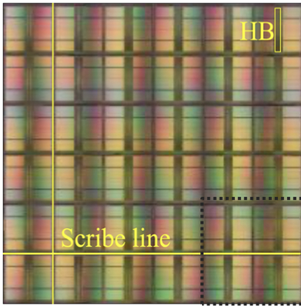
Why In-Memory Computation Today?
[Samsung 2021]
[Alibaba 2022]
[SK Hynix 2022]
[Samsung 2021]
[UPMEM 2019]
And, many other experimental chips and startups

Slide 48
Memory Scaling Issues Were Real
Onur Mutlu,
"Memory Scaling: A Systems Architecture Perspective"
Proceedings of the 5th International Memory Workshop (IMW), Monterey, CA, May 2013. Slides (pptx) (pdf)
EETimes Reprint
https://people.inf.ethz.ch/omutlu/pub/memory-scaling_memcon13.pdf

Slide 49
As Memory Scales, It Becomes Unreliable
Data from all of Facebook’s servers worldwide
Meza+, “Revisiting Memory Errors in Large-Scale Production Data Centers,” DSN’15.
Intuition:
quadratic
increase in
capacity

Slide 50
A Curious Phenomenon [Kim et al., ISCA 2014]
One can
predictably induce errors
in most DRAM memory chips
Kim+, “Flipping Bits in Memory Without Accessing Them: An Experimental Study of DRAM Disturbance Errors,” ISCA 2014.

Slide 51
Notes:
Picture from the article:
http://thehackernews.com/2015/03/dram-rowhammer-vulnerability.html

Slide 52
Modern Memory is Prone to Disturbance Errors
Row of Cells
Wordline
Row
Victim Row
Row
Hammered Row
V_{LOW}
Opened
V_{HIGH}
Closed
Row
Victim Row
Row
Repeatedly reading a row enough times (before memory gets refreshed) induces disturbance errors in adjacent rows in most real DRAM chips you can buy today
Flipping Bits in Memory Without Accessing Them: An Experimental Study of DRAM Disturbance Errors, (Kim et al., ISCA 2014)

Slide 53
Most DRAM Modules Are Vulnerable
A company
B company
C company
86%
(37/43)
83%
(45/54)
88%
(28/32)
Up to
1.0×10⁷
errors
Up to
2.7×10⁶
errors
Up to
3.3×10⁵
errors
Flipping Bits in Memory Without Accessing Them: An Experimental Study of DRAM Disturbance Errors, (Kim et al., ISCA 2014)

Slide 54
The RowHammer Vulnerability
A simple hardware failure mechanism
can create a widespread
system security vulnerability

Slide 55
10 Years of RowHammer in 20 Minutes
Onur Mutlu,
"The Story of RowHammer"
Invited Talk at the Workshop on Robust and Safe Software 2.0 (RSS2), held with the 27th International Conference on Architectural Support for Programming Languages and Operating Systems (ASPLOS), Virtual, 28 February 2022.
[Slides (pptx) (pdf)]
https://www.youtube.com/watch?v=ctKTRyi96Bk

Slide 56
Memory Scaling Issues Are Real
Yoongu Kim, Ross Daly, Jeremie Kim, Chris Fallin, Ji Hye Lee, Donghyuk Lee, Chris Wilkerson, Konrad Lai, and Onur Mutlu,
"Flipping Bits in Memory Without Accessing Them: An Experimental Study of DRAM Disturbance Errors"
Proceedings of the 41st International Symposium on Computer Architecture (ISCA), Minneapolis, MN, June 2014.
[Slides (pptx) (pdf)] [Lightning Session Slides (pptx) (pdf)] [Source Code and Data] [Lecture Video (1 hr 49 mins), 25 September 2020]
One of the 7 papers of 2012-2017 selected as Top Picks in Hardware and Embedded Security for IEEE TCAD (link).

Slide 57
Memory Scaling Issues Are Real
Onur Mutlu,
"The RowHammer Problem and Other Issues We May Face as Memory Becomes Denser"
Invited Paper in Proceedings of the Design, Automation, and Test in Europe Conference (DATE), Lausanne, Switzerland, March 2017.
[Slides (pptx) (pdf)]
https://people.inf.ethz.ch/omutlu/pub/rowhammer-and-other-memory-issues_date17.pdf

Slide 58
Memory Scaling Issues Are Real
Onur Mutlu and Jeremie Kim,
"RowHammer: A Retrospective"
IEEE Transactions on Computer-Aided Design of Integrated Circuits and Systems (TCAD) Special Issue on Top Picks in Hardware and Embedded Security, 2019.
[Preliminary arXiv version]
[Slides from COSADE 2019 (pptx)]
[Slides from VLSI-SOC 2020 (pptx) (pdf)]
[Talk Video (1 hr 15 minutes, with Q&A)]

Slide 59
Hybrid Memory Enables Better Scaling
CPU
Meza+, “Enabling Efficient and Scalable Hybrid Memories,” IEEE Comp. Arch. Letters, 2012.
Yoon+, “Row Buffer Locality Aware Caching Policies for Hybrid Memories,” ICCD 2012 Best Paper Award.
DRAMCtrl
PCM Ctrl
DRAM
Phase Change Memory (or Tech. X)
Fast, durable
Small,
leaky, volatile,
high-cost
Large, non-volatile, low-cost
Slow, wears out, high active energy
Hardware/software manage data allocation & movement
to achieve the best of multiple technologies

Slide 60
The Push from Circuits and Devices
Main Memory Needs
Intelligent Controllers

Slide 61
An Example Intelligent Controller
A. Giray Yaglikci, Minesh Patel, Jeremie S. Kim, Roknoddin Azizi, Ataberk Olgun, Lois Orosa, Hasan Hassan, Jisung Park, Konstantinos Kanellopoulos, Taha Shahroodi, Saugata Ghose, and Onur Mutlu,
"BlockHammer: Preventing RowHammer at Low Cost by Blacklisting Rapidly-Accessed DRAM Rows"
Proceedings of the 27th International Symposium on High-Performance Computer Architecture (HPCA), Virtual, February-March 2021.
[Slides (pptx) (pdf)]
[Short Talk Slides (pptx) (pdf)]
[Talk Video (22 minutes)]
[Short Talk Video (7 minutes)]

Slide 62
Industry Is Writing Papers About It, Too

Slide 63
Call for Intelligent Memory Controllers

Slide 64
Another Example Intelligent Controller
Minesh Patel, Geraldo F. de Oliveira Jr., and Onur Mutlu,
"HARP: Practically and Effectively Identifying Uncorrectable Errors in Memory Chips That Use On-Die Error-Correcting Codes"
Proceedings of the 54th International Symposium on Microarchitecture (MICRO), Virtual, October 2021.
[Slides (pptx) (pdf)]
[Short Talk Slides (pptx) (pdf)]
[Lightning Talk Slides (pptx) (pdf)]
[Talk Video (20 minutes)]
[Lightning Talk Video (1.5 minutes)]
[HARP Source Code (Officially Artifact Evaluated with All Badges)]

Slide 65
Aside: Intelligent Storage Controllers
USB Daughter Board
USB Jack
HAPS-52 Mother Board
Virtex-II Pro
(USB controller)
1x-nm
NAND Flash
Virtex-V FPGA
(NAND Controller)
[DATE 2012, ICCD 2012, DATE 2013, ITJ 2013, ICCD 2013, SIGMETRICS 2014, HPCA 2015, DSN 2015, MSST 2015, JSAC 2016, HPCA 2017, DFRWS 2017,
PIEEE 2017, HPCA 2018, SIGMETRICS 2018]
NAND Daughter Board
Cai+, “Error Characterization, Mitigation, and Recovery in Flash Memory Based Solid State Drives,” Proc. IEEE 2017.

Slide 66

Intelligent Storage Controllers [PIEEE’17]
Proceedings of the IEEE, Sept. 2017
https://arxiv.org/pdf/1706.08642

Slide 67
Emerging Memories Also Need Intelligent Controllers
Benjamin C. Lee, Engin Ipek, Onur Mutlu, and Doug Burger,
"Architecting Phase Change Memory as a Scalable DRAM Alternative"
Proceedings of the 36th International Symposium on Computer Architecture (ISCA), pages 2-13, Austin, TX, June 2009. Slides (pdf)
One of the 13 computer architecture papers of 2009 selected as Top Picks by IEEE Micro. Selected as a CACM Research Highlight. 2022 Persistent Impact Prize.

Slide 68
The Takeaway
Intelligent
Memory Controllers
Can Avoid Many Failures
& Enable Better Scaling

Slide 69
The Push from Circuits and Devices
Main Memory Needs
Intelligent Controllers

Slide 70
Why In-Memory Computation Today?
Push from Technology
  DRAM Scaling at jeopardy
  → Controllers close to DRAM
  → Industry open to new memory architectures
Pull from Systems and Applications
  Data access is a major system and application bottleneck
  Systems are energy limited
  Data movement much more energy-hungry than computation

Slide 71
Three Key Systems & Application Trends
1. Data access is a major bottleneck
  Applications are increasingly data hungry
2. Energy consumption is a key limiter
3. Data movement energy dominates compute
  Especially true for off-chip to on-chip movement

Slide 72
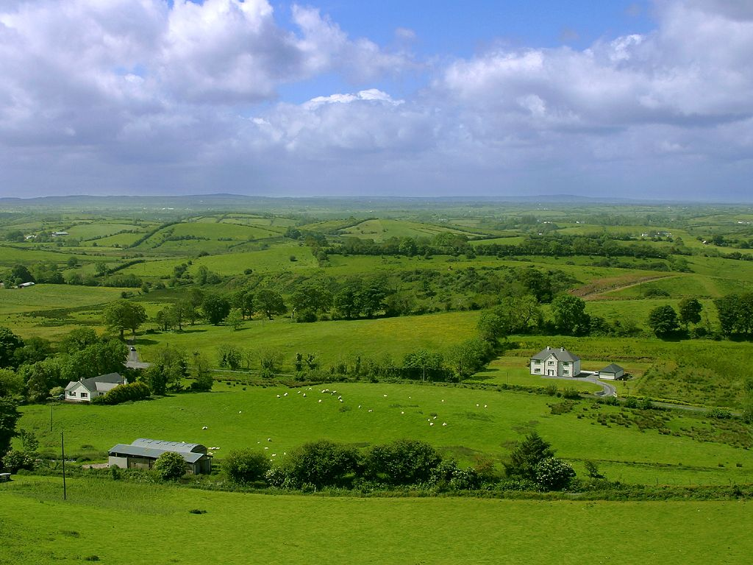
Do We Want This?
Source: V. Milutinovic

Slide 73
Or This?
Source: V. Milutinovic

Slide 74
Challenge and Opportunity for Future
High Performance,
Energy Efficient,
Sustainable
(All at the Same Time)

Slide 75
The Problem
Data access is the major performance and energy bottleneck
Our current
design principles
cause great energy waste
(and great performance loss)

Slide 76
The Problem
Processing of data
is performed
far away from the data

Slide 77
A Computing System
Three key components
Computation
Communication
Storage/memory
Burks, Goldstein, von Neumann, “Preliminary discussion of the
logical design of an electronic computing instrument,” 1946.
Image source: https://lbsitbytes2010.wordpress.com/2013/03/29/john-von-neumann-roll-no-15/

Slide 78
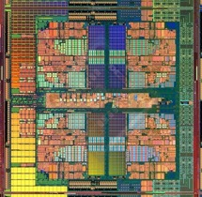

A Computing System
Three key components
Computation
Communication
Storage/memory
Burks, Goldstein, von Neumann, “Preliminary discussion of the
logical design of an electronic computing instrument,” 1946.
Image source: https://lbsitbytes2010.wordpress.com/2013/03/29/john-von-neumann-roll-no-15/

Slide 79
Today’s Computing Systems
Are overwhelmingly processor centric
All data processed in the processor → at great system cost
Processor is heavily optimized and is considered the master
Data storage units are dumb and are largely unoptimized

Slide 80
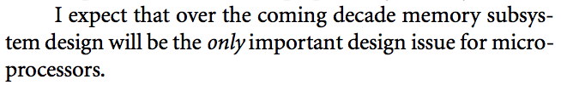
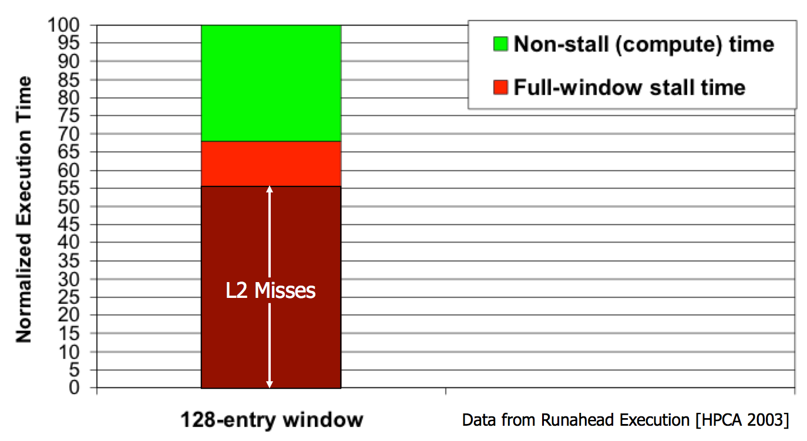
Yet …
“It’s the Memory, Stupid!” (Richard Sites, MPR, 1996)
Mutlu+, “Runahead Execution: An Alternative to Very Large Instruction Windows for Out-of-Order Processors,” HPCA 2003.

Slide 81
The Performance Perspective
Onur Mutlu, Jared Stark, Chris Wilkerson, and Yale N. Patt,
"Runahead Execution: An Alternative to Very Large Instruction Windows for Out-of-order Processors"
Proceedings of the 9th International Symposium on High-Performance Computer Architecture (HPCA), pages 129-140, Anaheim, CA, February 2003. Slides (pdf)
  One of the 15 computer arch. papers of 2003 selected as Top Picks by IEEE Micro.
  HPCA Test of Time Award (awarded in 2021).

Slide 82
The Performance Perspective (Today)
All of Google’s Data Center Workloads (2015):
Kanev+, “Profiling a Warehouse-Scale Computer,” ISCA 2015.

Slide 83
The Performance Perspective (Today)
All of Google’s Data Center Workloads (2015):
Kanev+, “Profiling a Warehouse-Scale Computer,” ISCA 2015.

Slide 84
Perils of Processor-Centric Design
Grossly-imbalanced systems
  Processing done only in one place
  All else just stores and moves data: data moves a lot
  → Energy inefficient
  → Low performance
  → Complex
Overly complex and bloated processor (and accelerators)
  To tolerate data access from memory
  Complex hierarchies and mechanisms
  → Energy inefficient
  → Low performance
  → Complex

Slide 85
Perils of Processor-Centric Design
Most of the system is dedicated to storing and moving data
Yet, system is still bottlenecked by memory

Slide 86
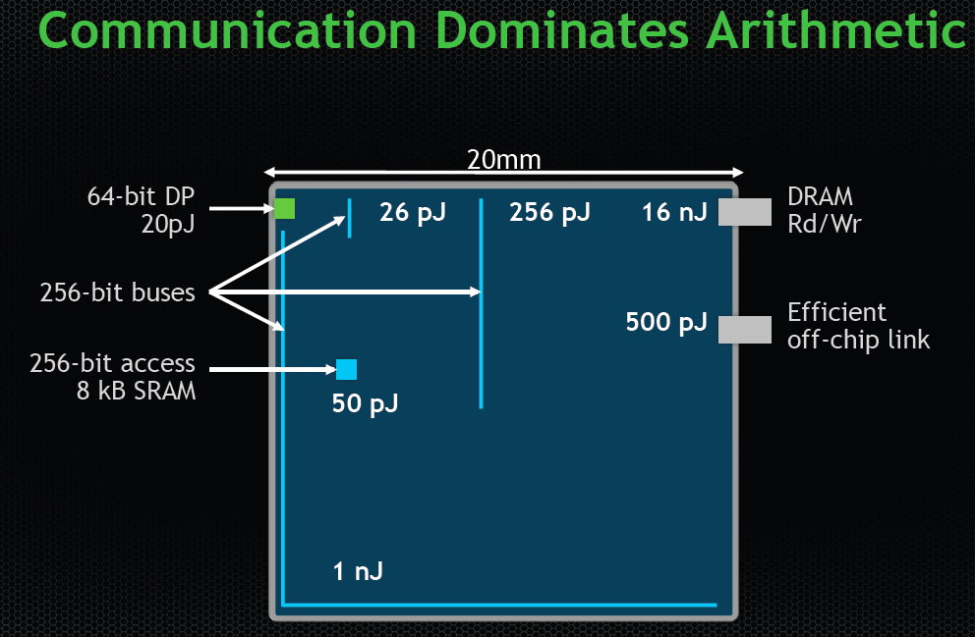
The Energy Perspective
Dally, HiPEAC 2015

Slide 87
Data Movement vs. Computation Energy
Dally, HiPEAC 2015
A memory access consumes ~100-1000X
the energy of a complex addition

Slide 88
Data Movement vs. Computation Energy
Han+, “EIE: Efficient Inference Engine on Compressed Deep Neural Network,” ISCA 2016.

Slide 89
Data Movement vs. Computation Energy
6400X
A memory access consumes 6400X
the energy of a simple integer addition
Han+, “EIE: Efficient Inference Engine on Compressed Deep Neural Network,” ISCA 2016.

Slide 90
Data Movement vs. Computation Energy
Data movement is a major system energy bottleneck
  Comprises 41% of mobile system energy during web browsing [2]
  Costs ~115 times as much energy as an ADD operation [1, 2]
[1]: Reducing data Movement Energy via Online Data Clustering and Encoding (MICRO’16)
[2]: Quantifying the energy cost of data movement for emerging smart phone workloads on mobile platforms (IISWC’14)

Slide 91
Energy Waste in Mobile Devices
Amirali Boroumand, Saugata Ghose, Youngsok Kim, Rachata Ausavarungnirun, Eric Shiu, Rahul Thakur, Daehyun Kim, Aki Kuusela, Allan Knies, Parthasarathy Ranganathan, and Onur Mutlu,
"Google Workloads for Consumer Devices: Mitigating Data Movement Bottlenecks"
Proceedings of the 23rd International Conference on Architectural Support for Programming Languages and Operating Systems (ASPLOS), Williamsburg, VA, USA, March 2018.
62.7% of the total system energy
is spent on data movement

Slide 92
We Do Not Want to Move Data!
Dally, HiPEAC 2015
A memory access consumes ~100-1000X
the energy of a complex addition

Slide 93
We Need A Paradigm Shift To …
Enable computation with minimal data movement
Compute where it makes sense (where data resides)
Make computing architectures more data-centric

Slide 94
Goal: Processing Inside Memory
Many questions … How do we design the:
  compute-capable memory & controllers?
  processors & communication units?
  software & hardware interfaces?
  system software, compilers, languages?
  algorithms & theoretical foundations?
Memory
Processor
Core
Database
Graphs
Media
Cache
Query
Interconnect
Problem
Results
Algorithm
Program/Language
System Software
SW/HW Interface
Micro-architecture
Logic
Devices
Electrons

Slide 95
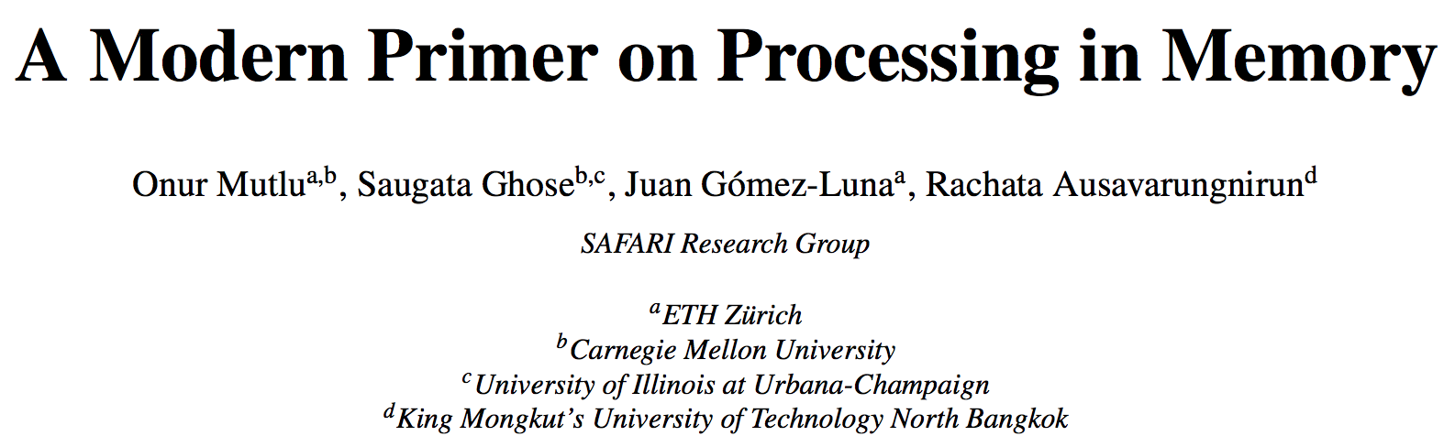
PIM Review and Open Problems
Onur Mutlu, Saugata Ghose, Juan Gomez-Luna, and Rachata Ausavarungnirun,
"A Modern Primer on Processing in Memory"
Invited Book Chapter in Emerging Computing: From Devices to Systems - Looking Beyond Moore and Von Neumann, Springer, to be published in 2021.
https://arxiv.org/pdf/1903.03988.pdf

Slide 96
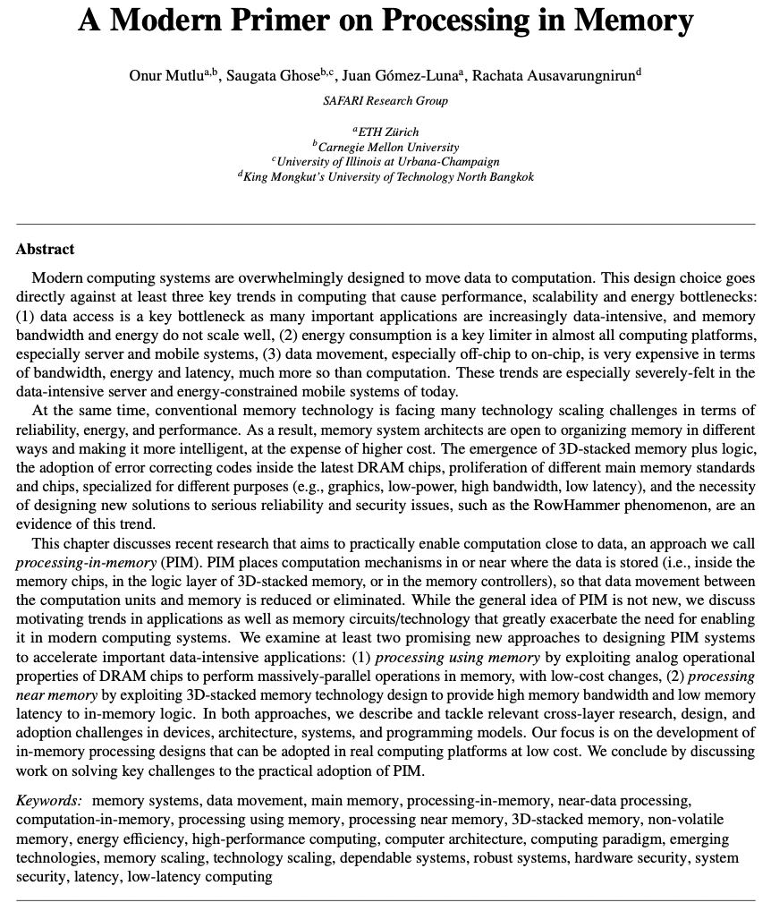

Slide 97
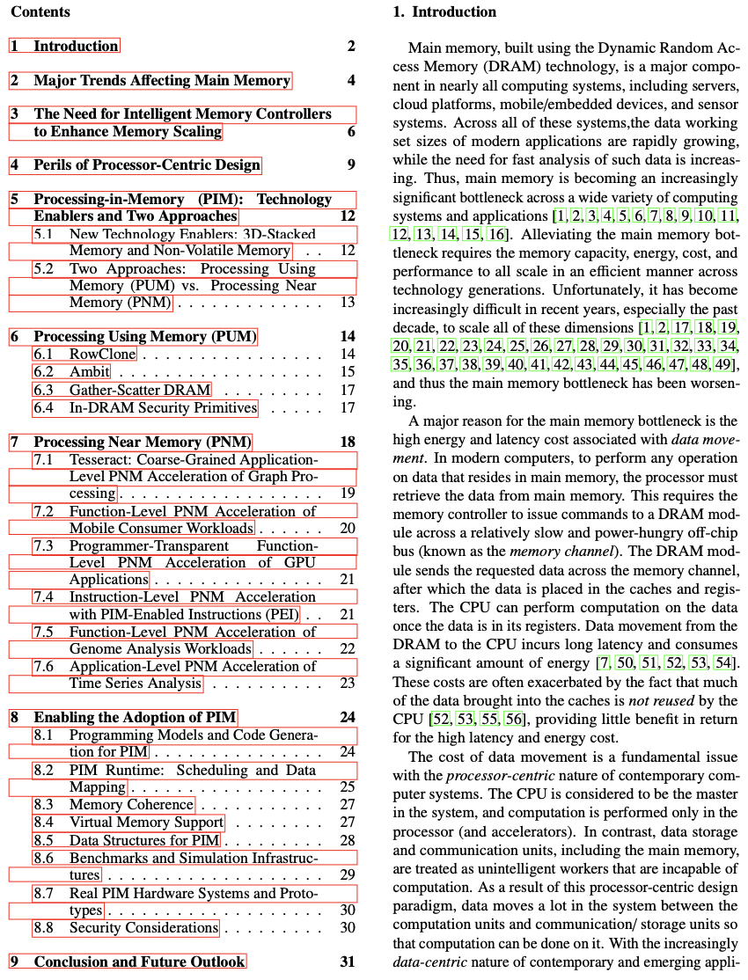

Slide 98
System Desirables
Self-managing, independent components
All components intelligent & equal partners
Easy collaboration & partitioning across all components
Fine-grained communication of data & tasks
Seamless caching & translation & protection anywhere
Execution anywhere without rewriting code
Flexibility, adaptability, self-optimization
Open minds

Slide 99
We Need to Think Differently from the Past Approaches

Slide 100
Processing in Memory:
Two Approaches
1. Processing using Memory
2. Processing near Memory

Slide 101
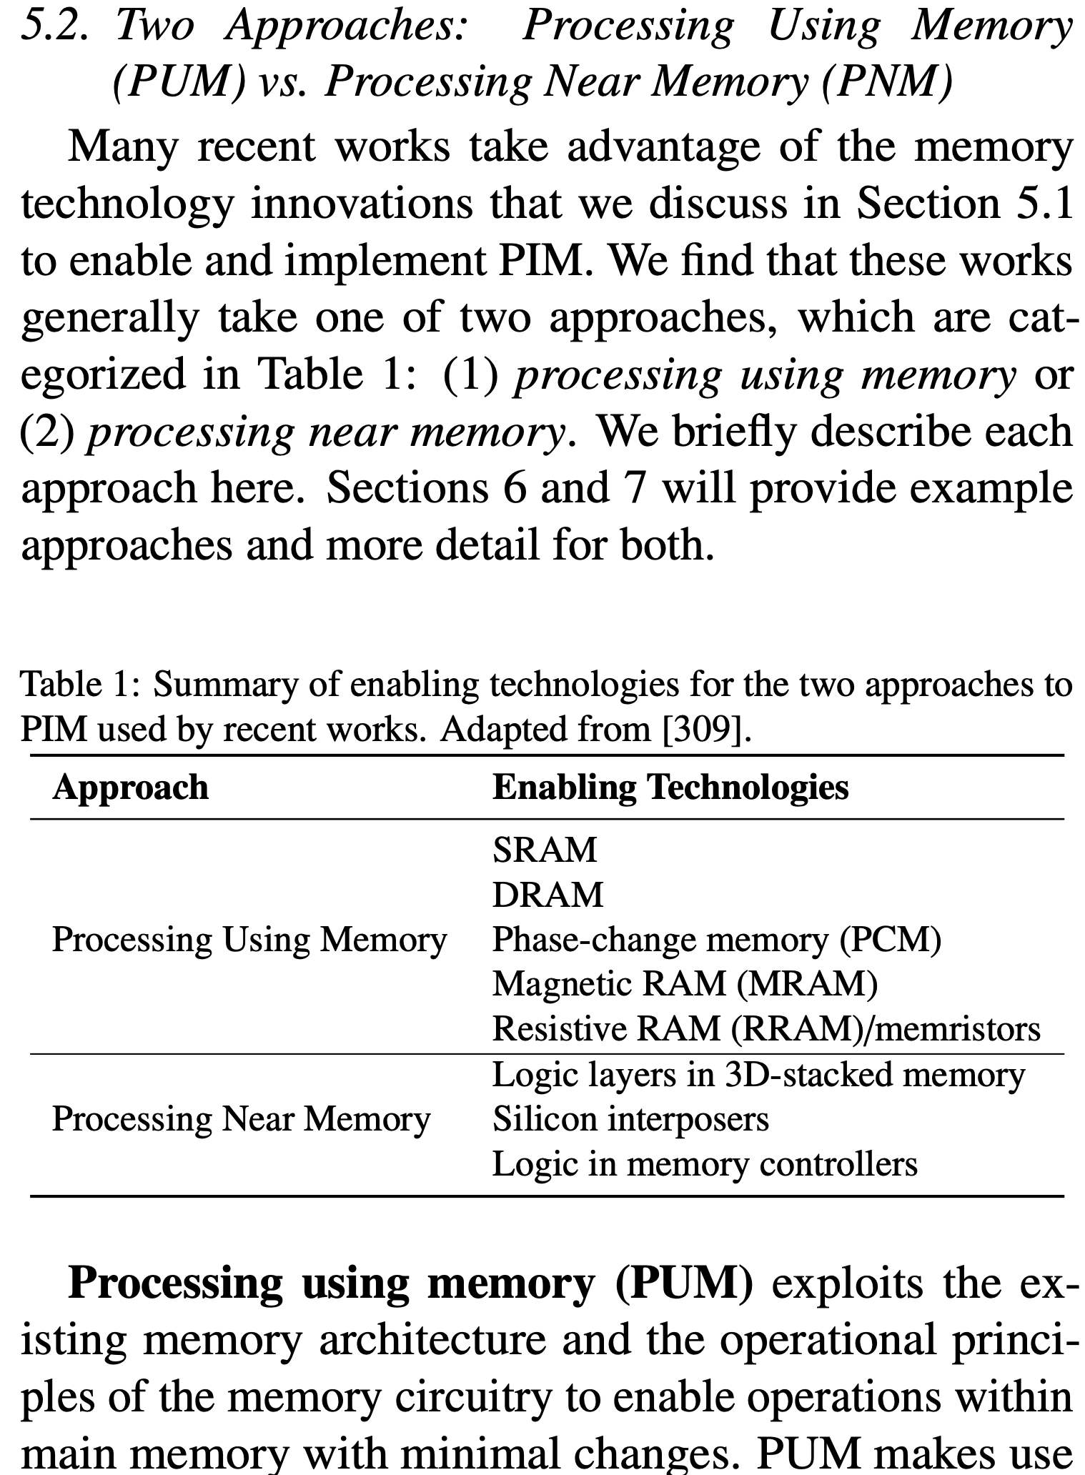
Two PIM Approaches
Onur Mutlu, Saugata Ghose, Juan Gomez-Luna, and Rachata Ausavarungnirun,
"A Modern Primer on Processing in Memory"
Invited Book Chapter in Emerging Computing: From Devices to Systems - Looking Beyond Moore and Von Neumann, Springer, to be published in 2021.
[Tutorial Video on "Memory-Centric Computing Systems" (1 hour 51 minutes)]
https://people.inf.ethz.ch/omutlu/pub/ModernPrimerOnPIM_springer-emerging-computing-bookchapter21.pdf

Slide 102
Mindset: Memory as an Accelerator
CPU
core
CPU
core
mini-CPU
core
GPU
(throughput)
core
GPU
(throughput)
core
video
core
GPU
(throughput)
core
GPU
(throughput)
core
CPU
core
CPU
core
Memory
imaging
core
LLC
Specialized
compute-capability
in memory
Memory Controller
Memory Bus
Memory similar to a “conventional” accelerator

Slide 103
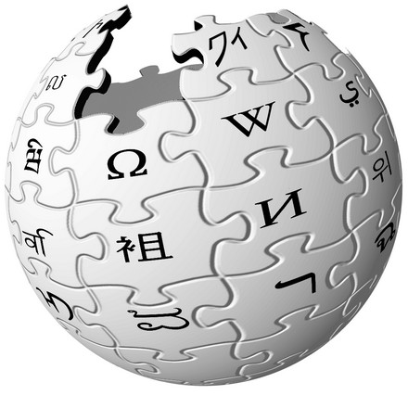



Specialization: In-Memory Graph Processing
Large graphs are everywhere (circa 2015)
Scalable large-scale graph processing is challenging
36 Million
Wikipedia Pages
1.4 Billion
Facebook Users
300 Million
Twitter Users
30 Billion
Instagram Photos

Slide 104
Key Bottlenecks in Graph Processing
for (v: graph.vertices) {
for (w: v.successors) {
w.next_rank += weight * v.rank;
}
}
1. Frequent random memory accesses
v
&w
w.rank
w.next_rank
w.edges
weight * v.rank
w
…
2. Little amount of computation

Slide 105
Opportunity: 3D-Stacked Logic+Memory
Memory
Logic
Other “True 3D” technologies
under development

Slide 106
Tesseract System for Graph Processing
Interconnected set of 3D-stacked memory+logic chips with simple cores
Host Processor
Memory
Memory-Mapped
Accelerator Interface
(Noncacheable, Physically Addressed)
Logic
In-Order Core
DRAM Controller
…
…
LP
PF Buffer
Crossbar Network
…
MTP
…
Message Queue
NI
Ahn+, “A Scalable Processing-in-Memory Accelerator for Parallel Graph Processing” ISCA 2015.

Slide 107
Tesseract System for Graph Processing
Host Processor
Memory
Memory-Mapped
Accelerator Interface
(Noncacheable, Physically Addressed)
Logic
In-Order Core
DRAM Controller
…
…
Communications via
Remote Function Calls
LP
PF Buffer
Crossbar Network
…
MTP
…
Message Queue
NI

Slide 108
Tesseract System for Graph Processing
Host Processor
Memory
Memory-Mapped
Accelerator Interface
(Noncacheable, Physically Addressed)
Logic
Prefetching
In-Order Core
DRAM Controller
…
…
LP
PF Buffer
Crossbar Network
…
MTP
…
Message Queue
NI

Slide 109
Evaluated Systems
DDR3-OoO
HMC-OoO
HMC-MC
Tesseract
32 Tesseract Cores
8 OoO
4GHz
8 OoO
4GHz
8 OoO
4GHz
8 OoO
4GHz
128
In-Order
2GHz
128
In-Order
2GHz
8 OoO
4GHz
8 OoO
4GHz
8 OoO
4GHz
8 OoO
4GHz
128
In-Order
2GHz
128
In-Order
2GHz
102.4GB/s
640GB/s
640GB/s
8TB/s
Ahn+, “A Scalable Processing-in-Memory Accelerator for Parallel Graph Processing” ISCA 2015.

Slide 110
Tesseract Graph Processing Performance
>13X Performance Improvement
On five graph processing algorithms
Ahn+, “A Scalable Processing-in-Memory Accelerator for Parallel Graph Processing” ISCA 2015.

Slide 111
Tesseract Graph Processing System Energy
> 8X Energy Reduction
Ahn+, “A Scalable Processing-in-Memory Accelerator for Parallel Graph Processing” ISCA 2015.

Slide 112
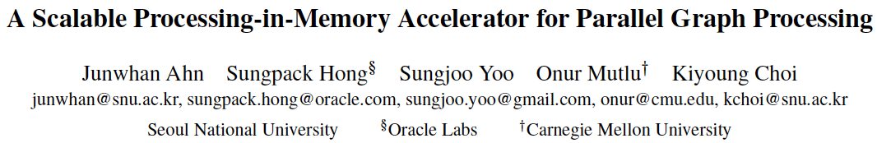
More on Tesseract
Junwhan Ahn, Sungpack Hong, Sungjoo Yoo, Onur Mutlu, and Kiyoung Choi,
"A Scalable Processing-in-Memory Accelerator for Parallel Graph Processing"
Proceedings of the 42nd International Symposium on Computer Architecture (ISCA), Portland, OR, June 2015.
[Slides (pdf)] [Lightning Session Slides (pdf)]

Slide 113
In-Storage Genomic Data Filtering [ASPLOS 2022]
Nika Mansouri Ghiasi, Jisung Park, Harun Mustafa, Jeremie Kim, Ataberk Olgun, Arvid Gollwitzer, Damla Senol Cali, Can Firtina, Haiyu Mao, Nour Almadhoun Alserr, Rachata Ausavarungnirun, Nandita Vijaykumar, Mohammed Alser, and Onur Mutlu,
"GenStore: A High-Performance and Energy-Efficient In-Storage Computing System for Genome Sequence Analysis"
Proceedings of the 27th International Conference on Architectural Support for Programming Languages and Operating Systems (ASPLOS), Virtual, February-March 2022.
[Lightning Talk Slides (pptx) (pdf)]
[Lightning Talk Video (90 seconds)]

Slide 114

Genome Sequence Analysis
Data Movement from Storage
Alignment
Storage
System
Main
Memory
Cache
Computation
Unit
(CPU or Accelerator)
AAGCTTCCATGG
CGTTCCTTGGCA
GGGCCAGAATG
CCTTTGGGTCCA
AAAATTCCATGG
GAATGGGGCCA
TTTTTTCCAAAA
TCCCCGGGGCCA
GCTTCCAGAATG
Computation overhead
Data movement overhead
Notes:
Read mapping performs alignment on large genomic datasets, containing millions of reads. [CLICK]
Therefore, read mapping is both computationally expensive [CLICK]
And incurs high data movement overhead [CLICK]

Slide 115



Accelerating Genome Sequence Analysis
Heuristics
Accelerators
Filters
Storage
System
Main
Memory
Cache
Computation
Unit
(CPU or Accelerator)
AAGCTTCCATGG
CGTTCCTTGGCA
GGGCCAGAATG
CCTTTGGGTCCA
AAAATTCCATGG
GAATGGGGCCA
TTTTTTCCAAAA
TCCCCGGGGCCA
GCTTCCAGAATG
✓
Computation overhead
Data movement overhead
Notes:
There has been significant effort into improving read mapping performance [CLICK]
Through efficient heuristics [CLICK]
hardware accelerators [CLICK]
and various filters that prune reads that do not require expensive computation [CLICK].
While these approaches address the computation overhead in read mapping [CLICK]
[While Reads Move] None of them alleviate the data movement overhead from storage, whose impact becomes even larger when the computation overhead gets alleviated [CLICK]

Slide 116

Key Idea
Filter reads that do not require alignment
inside the storage system
Storage
System
Main
Memory
Cache
Computation
Unit
(CPU or Accelerator)
AAGCTTCCATGG
CGTTCCTTGGCA
GGGCCAGAATG
CCTTTGGGTCCA
AAAATTCCATGG
GAATGGGGCCA
TTTTTTCCAAAA
TCCCCGGGGCCA
GCTTCCAGAATG
Filtered Reads
Exactly-matching reads
Do not need expensive approximate string matching during alignment
Non-matching reads
Do not have potential matching locations and can skip alignment
Notes:
Our key idea is to filter reads that do not require the expensive alignment computation in the storage system [CLICK] …
[While Reads Move] To fundamentally reduce the data movement overhead of read mapping
Examples of the reads that not require the costlt alignment step
Exactly-matching reads to the reference genome that do not need approximate string matching performed during alignment
Non-matching reads that have no potential matching locations in the reference genome hence skip the alignemt step

Slide 117
GenStore
Filter reads that do not require alignment
inside the storage system
GenStore-Enabled
Storage
System
Main
Memory
Cache
Computation
Unit
(CPU or Accelerator)
✓
Computation overhead
✓
Data movement overhead
  GenStore provides significant speedup (1.4x - 33.6x) and
  energy reduction (3.9x – 29.2x) at low cost
Notes:
We propose GenStore, the first in-storage processing system designed for genome sequence analysis. [CLICK]
To reduce both the computation [CLICK]
And the data movement overhead [CLICK]
GenStore provides high-performance and energy benefits compared to state-of-the-art HW and SW baselines [CLICK]

Slide 118
In-Storage Genomic Data Filtering [ASPLOS 2022]
Nika Mansouri Ghiasi, Jisung Park, Harun Mustafa, Jeremie Kim, Ataberk Olgun, Arvid Gollwitzer, Damla Senol Cali, Can Firtina, Haiyu Mao, Nour Almadhoun Alserr, Rachata Ausavarungnirun, Nandita Vijaykumar, Mohammed Alser, and Onur Mutlu,
"GenStore: A High-Performance and Energy-Efficient In-Storage Computing System for Genome Sequence Analysis"
Proceedings of the 27th International Conference on Architectural Support for Programming Languages and Operating Systems (ASPLOS), Virtual, February-March 2022.
[Lightning Talk Slides (pptx) (pdf)]
[Lightning Talk Video (90 seconds)]

Slide 119





Google Workloads for Consumer Devices:
Mitigating Data Movement Bottlenecks
Amirali Boroumand
Saugata Ghose, Youngsok Kim, Rachata Ausavarungnirun,
Eric Shiu, Rahul Thakur, Daehyun Kim, Aki Kuusela,
Allan Knies, Parthasarathy Ranganathan, Onur Mutlu

Slide 120
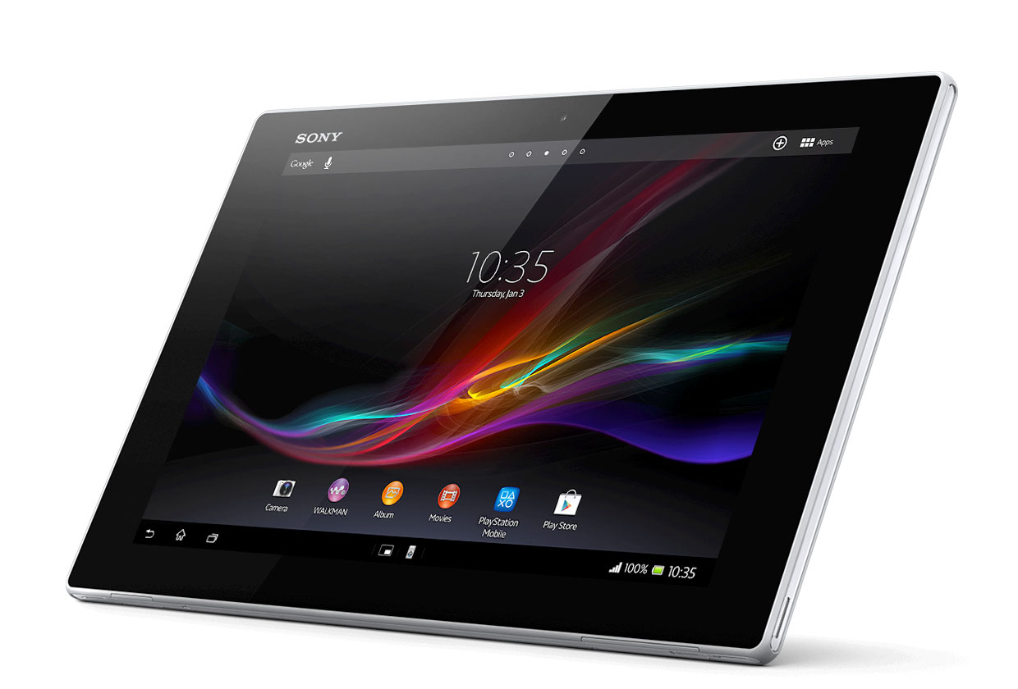
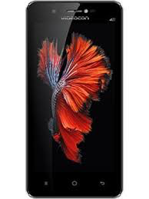
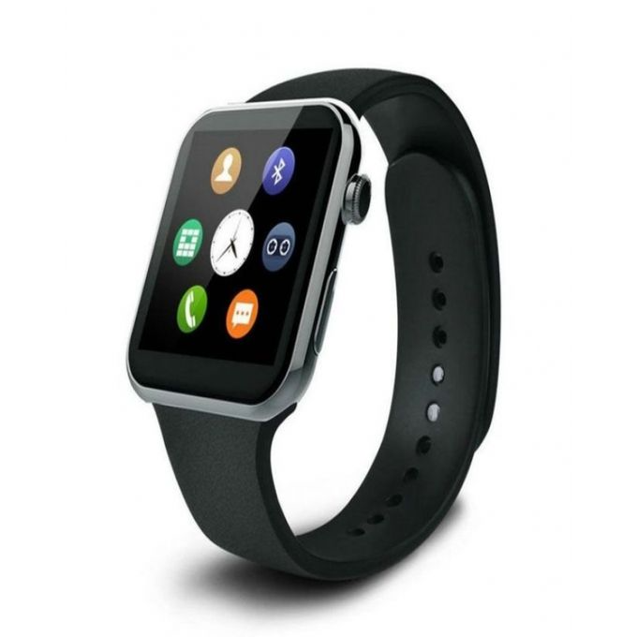

Consumer Devices
Consumer devices are everywhere!
Energy consumption is
a first-class concern in consumer devices
Notes:
Consumer devices like tablets smartphone and wearable are now everywhere and used by billions of people.
One of the major challenge in these devices is battery limitation which makes the energy consumption a critical concern …

Slide 121





Popular Consumer Workloads
  Chrome
TensorFlow Mobile
    Google’s web browser
Google’s machine learning framework
  Video Playback
  Video Capture
Google’s video codec
Google’s video codec
Notes:
In this work, we take a look at widely-used google consumer workloads, to figure out the major sources of energy consumption.
We look at Google Chrome web brower. We take a look at Tensorflow, Google’s machine learning framework, and we also take a look at two important video related workloads, video playback and video capture, both rely on Google’s vp9 codec technology.

Slide 122
Energy Cost of Data Movement
1st key observation: 62.7% of the total system energy is spent on data movement
Data Movement
SoC
DRAM
CPU
L2
CPU
L1
CPU
CPU
Compute Unit
Processing-In-Memory (PIM)
  Potential solution: move computation close to data
  Challenge: limited area and energy budget
Notes:
Throughout our analysis, we make a key observation that out of all sources of energy consumption, data movement is a major contributor to the total system energy. We find that across all of the workloads, on average around 62.7% of total system energy is spent on data movement.
One way to reduce data movement cost is to move computation close to data, or …
One potential solution to address this cost it do move computation close to data, or in other words, do procesing in memory. However, the challenge is that these devices.
One potential solution to mitigate data movement cost and reduce total system energy is to execute data-movement heavy portions of application close to data, or in other words, do processing in memory. However, consumer devices are extermely limited in terms of area and power budget. So the question is can we move part of the data movement heavy portion given the limited area and energy budget. Our

Slide 123
Using PIM to Reduce Data Movement
  2nd key observation: a significant fraction of the
  data movement often comes from simple functions
We can design lightweight logic to implement
these simple functions in memory
Small embedded
low-power core
Small fixed-function accelerators
PIM Core
PIM Accelerator
PIM Accelerator
PIM Accelerator
  Offloading to PIM logic reduces energy and improves performance, on average, by 2.3X and 2.2X
Notes:
To figure out if we can use processing in memory, we dig deeper into our analysis and we make another key observation that majority of data movement often comes form simple functions and pritmitives. We find that these simple function can be implemented in memory as either a small embedded core, or group of small fixed function accelerators. Our result shows that offloading these function to PIM logic can significantly reduce data movement for each function and reduce energy on average around 55% and improve perforamcne around 54%.
our PIM core can reduce significant portion of data movement, reduce enregy by 49.1% for each function and improve performance up to 2.2X. While using group of fixed function accelerator reduce energy by 55.4% and improve performance by up to 2.5X.
Or use Saugata’s approach : Reduces total system energy by an average of 55.4%
Reduces execution time by an average of 54.2%
Our result show that both of them can significantly reduce the data movement for each function.
Feedback: talk about result more
Don’t talk about specific detail like MemCopy, MemSet stuff like that
Main take away: data movement come from simple functions that are simple enough to implement in PIM
We find that these functions and primitves can be implemented as PIM logic using either (1) a small low-power general-purpose embedded core or (2) a group of small fixed-function accelerators (PIM accelerators). Our Analysis shows that both are cost-feasible to use in consumer devices. We find that they eliminate a significant fraction of dat amovement, and reduce energy consumption for each of these operation on average by 49 and 55%.

Slide 124
Workload Analysis
  Chrome
TensorFlow Mobile
    Google’s web browser
Google’s machine learning framework
  Video Playback
  Video Capture
Google’s video codec
Google’s video codec
Notes:
In this work, we take a look at widely-used google consumer workloads, to figure out the major sources of energy consumption.
We look at Google Chrome web brower. We take a look at Tensorflow, Google’s machine learning framework, and we also take a look at two important video related workloads, video playback and video capture, both rely on Google’s vp9 codec technology.

Slide 125

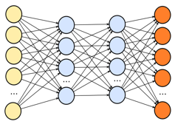
TensorFlow Mobile
Inference
Prediction
57.3% of the inference energy is spent on
data movement
54.4% of the data movement energy comes from
packing/unpacking and quantization

Slide 126
More on PIM for Mobile Devices
Amirali Boroumand, Saugata Ghose, Youngsok Kim, Rachata Ausavarungnirun, Eric Shiu, Rahul Thakur, Daehyun Kim, Aki Kuusela, Allan Knies, Parthasarathy Ranganathan, and Onur Mutlu,
"Google Workloads for Consumer Devices: Mitigating Data Movement Bottlenecks"
Proceedings of the 23rd International Conference on Architectural Support for Programming Languages and Operating Systems (ASPLOS), Williamsburg, VA, USA, March 2018.
[Slides (pptx) (pdf)] [Lightning Session Slides (pptx) (pdf)] [Poster (pptx) (pdf)]
[Lightning Talk Video (2 minutes)]
[Full Talk Video (21 minutes)]

Slide 127
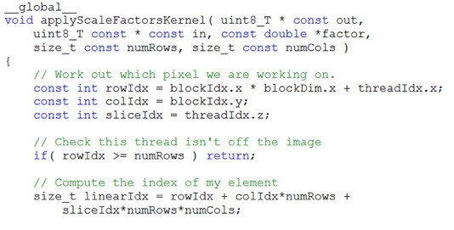
Truly Distributed GPU Processing with PIM
3D-stacked memory
(memory stack)
SM (Streaming Multiprocessor)
Logic layer
Logic layer SM
Main GPU
Crossbar switch
Vault Ctrl
….
Vault Ctrl

Slide 128
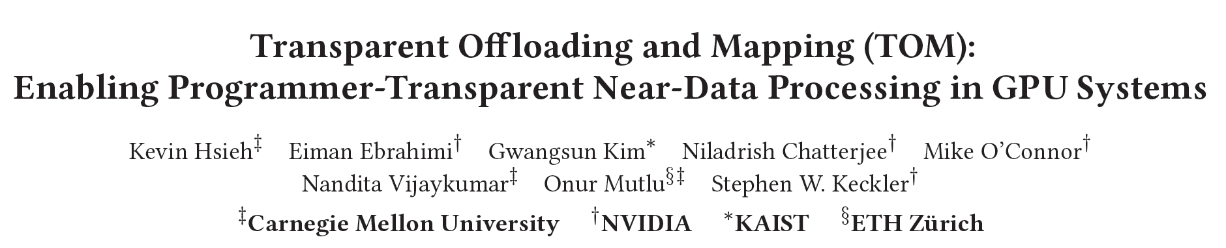
Accelerating GPU Execution with PIM (I)
Kevin Hsieh, Eiman Ebrahimi, Gwangsun Kim, Niladrish Chatterjee, Mike O'Connor, Nandita Vijaykumar, Onur Mutlu, and Stephen W. Keckler,
"Transparent Offloading and Mapping (TOM): Enabling Programmer-Transparent Near-Data Processing in GPU Systems"
Proceedings of the 43rd International Symposium on Computer Architecture (ISCA), Seoul, South Korea, June 2016.
[Slides (pptx) (pdf)]
[Lightning Session Slides (pptx) (pdf)]

Slide 129
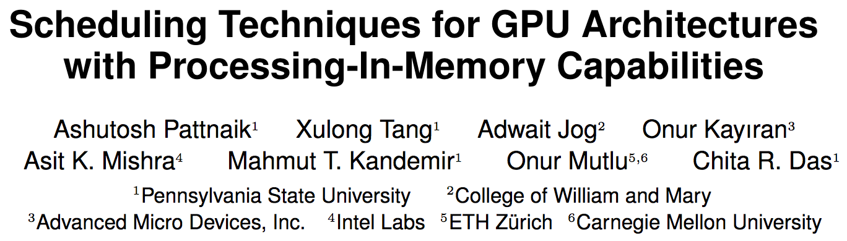
Accelerating GPU Execution with PIM (II)
Ashutosh Pattnaik, Xulong Tang, Adwait Jog, Onur Kayiran, Asit K. Mishra, Mahmut T. Kandemir, Onur Mutlu, and Chita R. Das,
"Scheduling Techniques for GPU Architectures with Processing-In-Memory Capabilities"
Proceedings of the 25th International Conference on Parallel Architectures and Compilation Techniques (PACT), Haifa, Israel, September 2016.

Slide 130
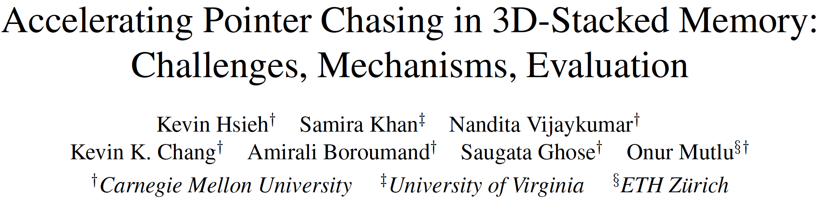
Accelerating Linked Data Structures
Kevin Hsieh, Samira Khan, Nandita Vijaykumar, Kevin K. Chang, Amirali Boroumand, Saugata Ghose, and Onur Mutlu,
"Accelerating Pointer Chasing in 3D-Stacked Memory: Challenges, Mechanisms, Evaluation"
Proceedings of the 34th IEEE International Conference on Computer Design (ICCD), Phoenix, AZ, USA, October 2016.

Slide 131
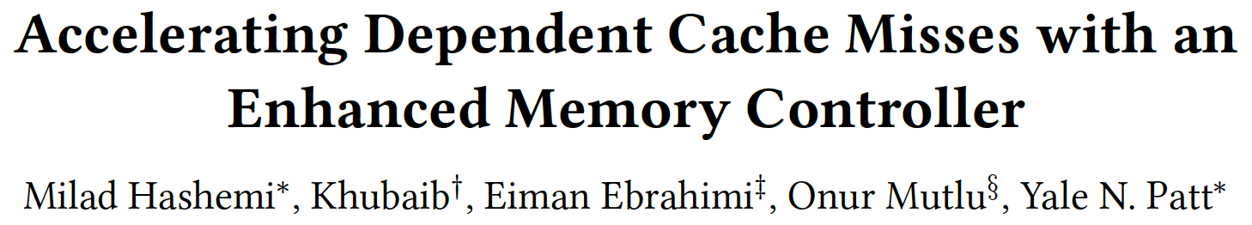
Accelerating Dependent Cache Misses
Milad Hashemi, Khubaib, Eiman Ebrahimi, Onur Mutlu, and Yale N. Patt,
"Accelerating Dependent Cache Misses with an Enhanced Memory Controller"
Proceedings of the 43rd International Symposium on Computer Architecture (ISCA), Seoul, South Korea, June 2016.
[Slides (pptx) (pdf)]
[Lightning Session Slides (pptx) (pdf)]

Slide 132
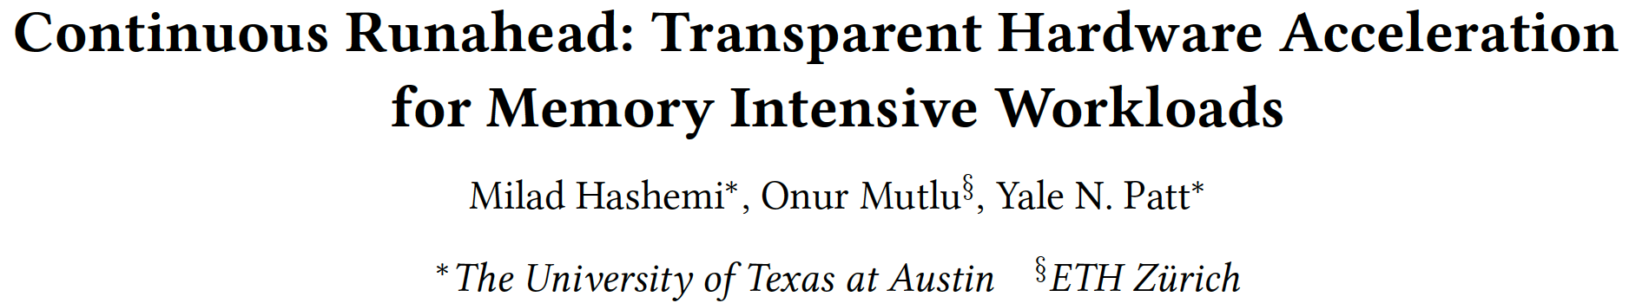
Accelerating Runahead Execution
Milad Hashemi, Onur Mutlu, and Yale N. Patt,
"Continuous Runahead: Transparent Hardware Acceleration for Memory Intensive Workloads"
Proceedings of the 49th International Symposium on Microarchitecture (MICRO), Taipei, Taiwan, October 2016.
[Slides (pptx) (pdf)] [Lightning Session Slides (pdf)] [Poster (pptx) (pdf)]

Slide 133
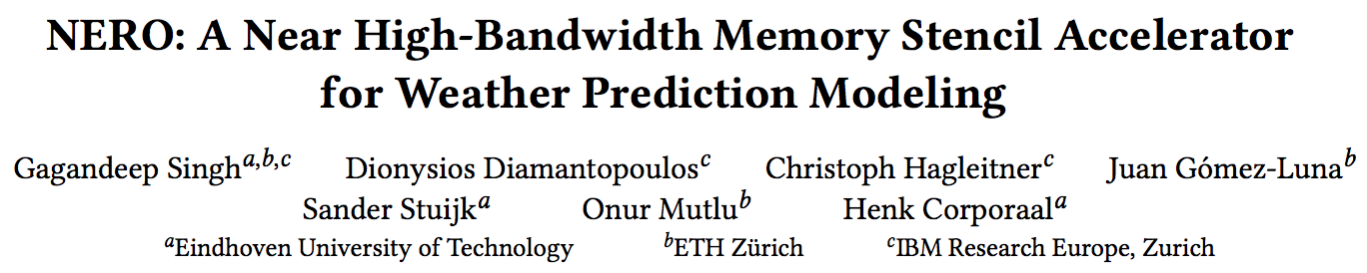
Accelerating Climate Modeling
Gagandeep Singh, Dionysios Diamantopoulos, Christoph Hagleitner, Juan Gómez-Luna, Sander Stuijk, Onur Mutlu, and Henk Corporaal,
"NERO: A Near High-Bandwidth Memory Stencil Accelerator for Weather Prediction Modeling"
Proceedings of the 30th International Conference on Field-Programmable Logic and Applications (FPL), Gothenburg, Sweden, September 2020.
[Slides (pptx) (pdf)]
[Lightning Talk Slides (pptx) (pdf)]
[Talk Video (23 minutes)]
Nominated for the Stamatis Vassiliadis Memorial Award.

Slide 134
Accelerating Approximate String Matching
Damla Senol Cali, Gurpreet S. Kalsi, Zulal Bingol, Can Firtina, Lavanya Subramanian, Jeremie S. Kim, Rachata Ausavarungnirun, Mohammed Alser, Juan Gomez-Luna, Amirali Boroumand, Anant Nori, Allison Scibisz, Sreenivas Subramoney, Can Alkan, Saugata Ghose, and Onur Mutlu,
"GenASM: A High-Performance, Low-Power Approximate String Matching Acceleration Framework for Genome Sequence Analysis"
Proceedings of the 53rd International Symposium on Microarchitecture (MICRO), Virtual, October 2020.
[Lighting Talk Video (1.5 minutes)]
[Lightning Talk Slides (pptx) (pdf)]
[Talk Video (18 minutes)]
[Slides (pptx) (pdf)]

Slide 135
Accelerating Sequence-to-Graph Mapping
Damla Senol Cali, Konstantinos Kanellopoulos, Joel Lindegger, Zulal Bingol, Gurpreet S. Kalsi, Ziyi Zuo, Can Firtina, Meryem Banu Cavlak, Jeremie Kim, Nika MansouriGhiasi, Gagandeep Singh, Juan Gomez-Luna, Nour Almadhoun Alserr, Mohammed Alser, Sreenivas Subramoney, Can Alkan, Saugata Ghose, and Onur Mutlu,
"SeGraM: A Universal Hardware Accelerator for Genomic Sequence-to-Graph and Sequence-to-Sequence Mapping"
Proceedings of the 49th International Symposium on Computer Architecture (ISCA), New York, June 2022.
[arXiv version]
https://arxiv.org/pdf/2205.05883.pdf

Slide 136
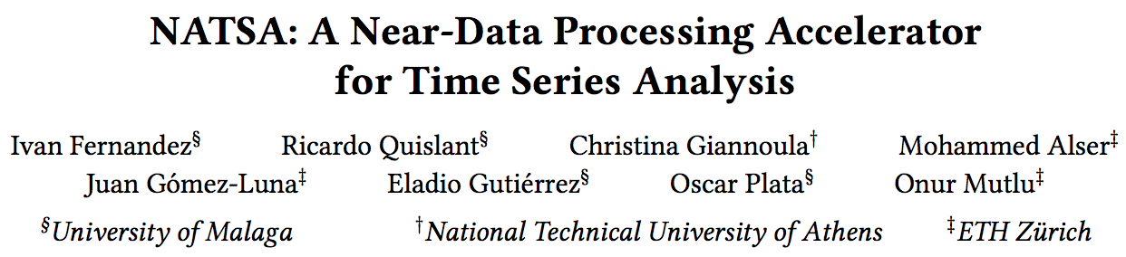
Accelerating Time Series Analysis
Ivan Fernandez, Ricardo Quislant, Christina Giannoula, Mohammed Alser, Juan Gómez-Luna, Eladio Gutiérrez, Oscar Plata, and Onur Mutlu,
"NATSA: A Near-Data Processing Accelerator for Time Series Analysis"
Proceedings of the 38th IEEE International Conference on Computer Design (ICCD), Virtual, October 2020.
[Slides (pptx) (pdf)]
[Talk Video (10 minutes)]
[Source Code]

Slide 137
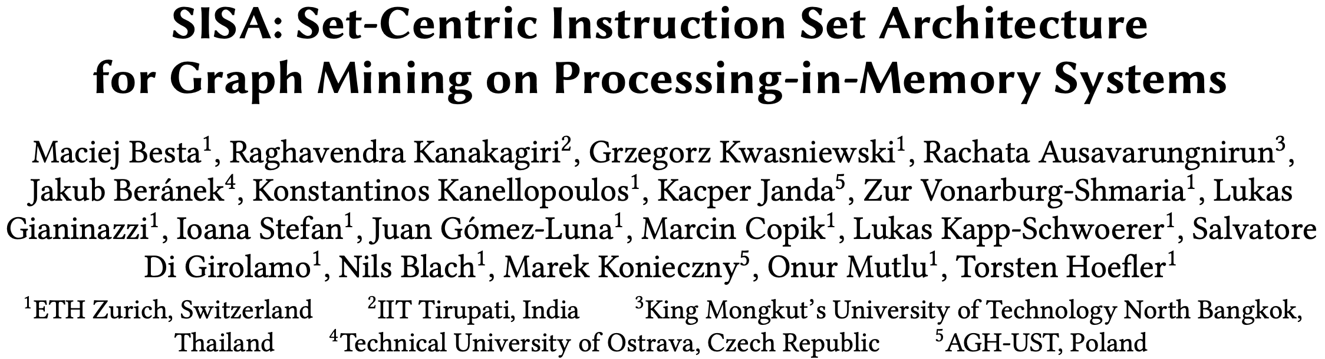
Accelerating Graph Pattern Mining
Maciej Besta, Raghavendra Kanakagiri, Grzegorz Kwasniewski, Rachata Ausavarungnirun, Jakub Beránek, Konstantinos Kanellopoulos, Kacper Janda, Zur Vonarburg-Shmaria, Lukas Gianinazzi, Ioana Stefan, Juan Gómez-Luna, Marcin Copik, Lukas Kapp-Schwoerer, Salvatore Di Girolamo, Nils Blach, Marek Konieczny, Onur Mutlu, and Torsten Hoefler,
"SISA: Set-Centric Instruction Set Architecture for Graph Mining on Processing-in-Memory Systems"
Proceedings of the 54th International Symposium on Microarchitecture (MICRO), Virtual, October 2021.
[Slides (pdf)]
[Talk Video (22 minutes)]
[Lightning Talk Video (1.5 minutes)]
[Full arXiv version]

Slide 138
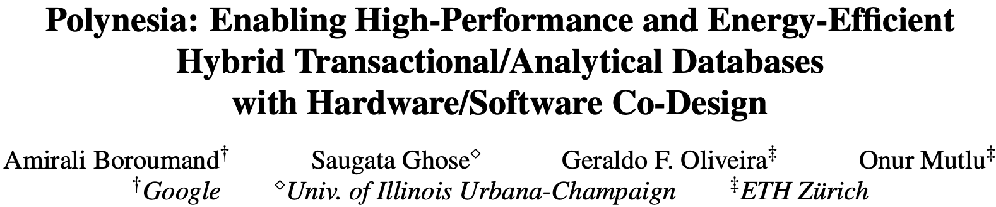
Accelerating HTAP Database Systems
Amirali Boroumand, Saugata Ghose, Geraldo F. Oliveira, and Onur Mutlu,
"Polynesia: Enabling High-Performance and Energy-Efficient Hybrid Transactional/Analytical Databases with Hardware/Software Co-Design"
Proceedings of the 38th International Conference on Data Engineering (ICDE), Virtual, May 2022.
[arXiv version]
[Slides (pptx) (pdf)]
[Short Talk Slides (pptx) (pdf)]
https://arxiv.org/pdf/2204.11275.pdf

Slide 139
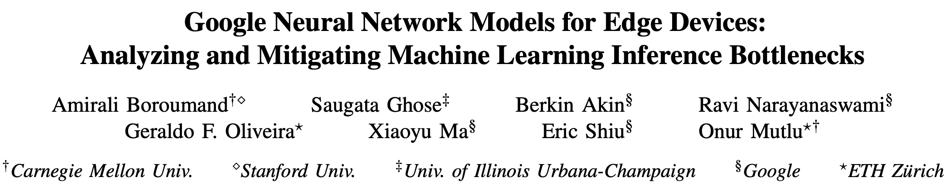
Accelerating Neural Network Inference
Amirali Boroumand, Saugata Ghose, Berkin Akin, Ravi Narayanaswami, Geraldo F. Oliveira, Xiaoyu Ma, Eric Shiu, and Onur Mutlu,
"Google Neural Network Models for Edge Devices: Analyzing and Mitigating Machine Learning Inference Bottlenecks"
Proceedings of the 30th International Conference on Parallel Architectures and Compilation Techniques (PACT), Virtual, September 2021.
[Slides (pptx) (pdf)]
[Talk Video (14 minutes)]

Slide 140



Google Neural Network Models for Edge Devices:
Analyzing and Mitigating
Machine Learning Inference Bottlenecks
Amirali Boroumand Saugata Ghose Berkin Akin
Ravi Narayanaswami Geraldo F. Oliveira Xiaoyu Ma
Eric Shiu Onur Mutlu
PACT 2021
Notes:
Hi, I’m Geraldo, a PhD Student at ETH Zurich.
Today I will present our work “Google Neural Network Models for Edge Devices: Analyzing and Mitigating Machine Learning Inference Bottlenecks”
This work was lead by Amirali Boroumand during his internship at Google.

Slide 141
Executive Summary
Context: We extensively analyze a state-of-the-art edge ML accelerator (Google Edge TPU) using 24 Google edge models
  Wide range of models (CNNs, LSTMs, Transducers, RCNNs)
Problem: The Edge TPU accelerator suffers from three challenges:
  It operates significantly below its peak throughput
  It operates significantly below its theoretical energy efficiency
  It inefficiently handles memory accesses
  Key Insight: These shortcomings arise from the monolithic design of the Edge TPU accelerator
  The Edge TPU accelerator design does not account for layer heterogeneity
  Key Mechanism: A new framework called Mensa
  Mensa consists of heterogeneous accelerators whose dataflow and hardware are specialized for specific families of layers
  Key Results: We design a version of Mensa for Google edge ML models
  Mensa improves performance and energy by 3.0X and 3.1X
  Mensa reduces cost and improves area efficiency
Notes:
First, I will give an overview of this work.
[CLICK] In this work, we extensively analyze 24 edge NN models from Google while running inference on the Google Edge TPU accelerator for various types of NN models
[CLICK] We identify that while running NN inference, the accelerator suffers from three main challenges
[CLICK] it operates significantly below its peak throughput
[CLICK] it operates significantly below its theorical peak energy efficiency
[CLICK] and its memory system is not efficient
[CLICK] Our analysis leads to the key insight that these challenges arrive due to the monolithic one-size-fit-all design of the accelerators, which does not account for heterogeneity across different NN layers
[CLICK] To solve this issue, we propose Mensa, a framework that maps the execution of a particular NN layer to its most appropriate hardware accelerator
[CLICK] We extensively evaluate Mensa for Google NN models and we observe that it improves performance and energy efficiency by 3.0x and 3.1x compared to the baseline Edge TPU accelerator while reducing area and cost across 24 edge ML models
[NEXT]

Slide 142


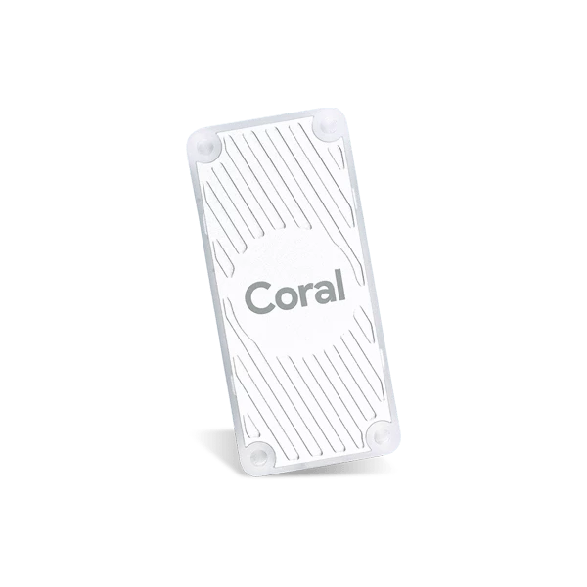


Google Edge Neural Network Models
  We analyze inference execution using 24 edge NN models
6 RNN
Transducers
2 LSTMs
Speech Recognition
Language Translation
13 CNN
3 RCNN
Google Edge TPU
Face Detection
Image Captioning
Notes:
[CLICK] We analyze inference execution on the accelerator using 24 edge NN models that serve as internal benchmarks for the Google Edge TPU, including
[CLICK] 6 RNN Transducers, used for applications such as automatic speech recognition.
[CLICK] 13 convolutional neural networks (CNNs), typically used for applications such as image classification and object detection
[CLICK] 2 long short-term memories (LSTMs), used for applications such as language translation and and handwriting recognition, and
[CLICK] 3 recurrent convolutional neural networks (RCNNs), used for applications such as image captioning
[NEXT]

Slide 143
Diversity Across the Models
Insight 1: there is significant variation in terms of
layer characteristics across the models
Layers from
CNNs and RCNNs
Layers from
LSTMs and Transducers
Notes:
We draw key two insights from our model analysis
[CLICK] First, we observe a large variation in terms of layer characteristics across different models.
[CLICK] To illustrate, the figure shows the total parameter footprint vs. the FLOP/B ratio (or reuse) across the layers of representative CNNs, LSTMs, and Transducers
[CLICK] We observe from the figure that that layers from LSTMs and Transducers have larger parameter footprints and lower reuse than layers from CNNs.
[NEXT]

Slide 144
Diversity Within the Models
Insight 2: even within each model, layers exhibit
significant variation in terms of layer characteristics
For example, our analysis of edge CNN models shows:
1
2
Variation in MAC intensity: up to 200x across layers
Variation in FLOP/Byte: up to 244x across layers
Notes:
[CLICK] Second, even within a single model, layers show variation in terms of layer characteristics
[CLICK] For example, we observe that layers in a single CNN models show
[CLICK] a varying MAC intensity of up to 200x across different layers
and
[CLICK] a varying flop/byte ratio of up to 244x across different layers
[NEXT]

Slide 145
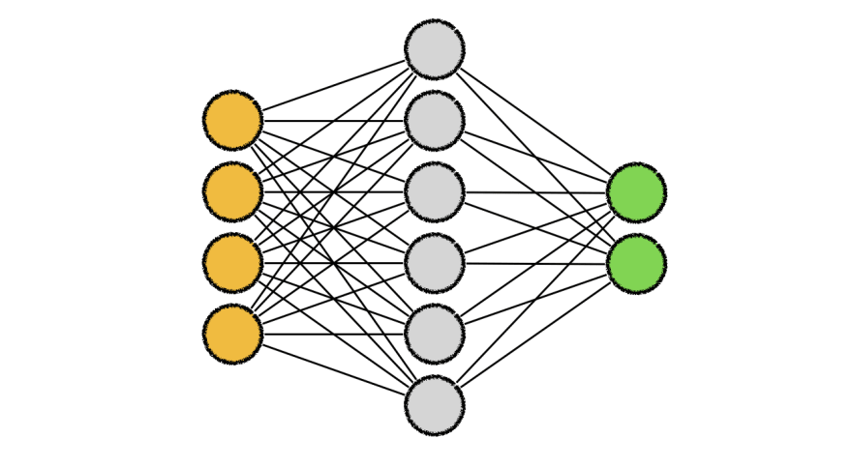
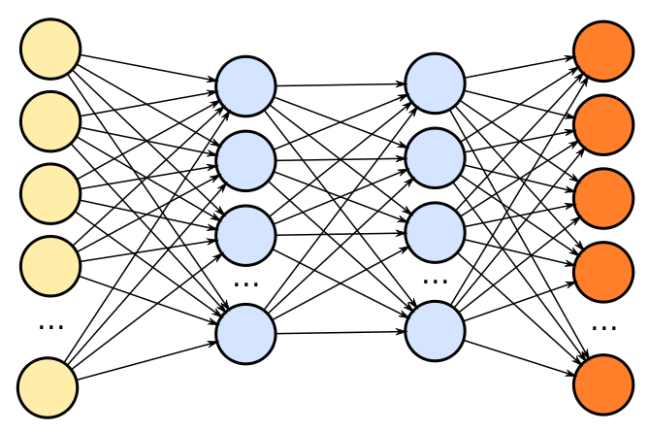
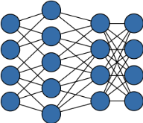
Mensa High-Level Overview
Edge TPU Accelerator
Mensa
Model A
Model B
Model C
Model A
Model B
Model C
Runtime
Family 1
Family 2
Family 3
PE
PE
PE
PE
PE
PE
PE
PE
PE
PE
PE
PE
PE
PE
PE
PE
Buffer
PE
PE
PE
PE
PE
PE
PE
PE
NoC
PE
PE
PE
PE
PE
PE
PE
PE
PE
PE
PE
PE
PE
PE
PE
PE
PE
PE
PE
PE
PE
PE
PE
PE
PE
PE
PE
PE
PE
PE
PE
PE
Buffer
PE
PE
PE
PE
PE
PE
PE
PE
Buffer
PE
PE
PE
PE
PE
PE
PE
PE
Buffer
PE
PE
PE
PE
PE
PE
PE
PE
PE
PE
PE
PE
PE
PE
PE
PE
PE
PE
PE
PE
PE
PE
PE
PE
PE
PE
PE
PE
PE
PE
PE
PE
PE
PE
PE
PE
PE
PE
PE
PE
NoC
NoC
NoC
PE
PE
PE
PE
PE
PE
PE
PE
PE
PE
PE
PE
PE
PE
PE
PE
PE
PE
PE
PE
PE
PE
PE
PE
PE
PE
PE
PE
PE
PE
PE
PE
PE
PE
PE
PE
PE
PE
PE
PE
PE
PE
PE
PE
PE
PE
PE
PE
Monolithic Accelerator
PE
PE
PE
PE
PE
PE
PE
PE
PE
PE
PE
PE
PE
PE
PE
PE
PE
PE
PE
PE
PE
PE
PE
PE
PE
PE
PE
PE
PE
PE
PE
PE
PE
PE
PE
PE
PE
PE
PE
PE
PE
PE
PE
PE
PE
PE
PE
PE
PE
PE
PE
PE
PE
PE
PE
PE
PE
PE
PE
PE
PE
PE
PE
PE
PE
PE
PE
PE
PE
PE
PE
PE
PE
PE
PE
PE
PE
PE
PE
PE
PE
PE
PE
PE
PE
PE
PE
PE
PE
PE
PE
PE
PE
PE
PE
PE
Acc. 1
Acc. 2
Acc. 3
Notes:
[CLICK ] In a baseline system, different machine learning models are execute in a single, monolithic edge accelerator, which leads to performance and energy issues.
[CLICK] On the other hand, Mensa distributes the layers from an NN model using a runtime scheduler across a collection of smaller hardware accelerators that are catered the properties of different layer types. By specializing each accelerator to a subset of layers, Mensa avoids the shortcomings of current monolithic edge ML accelerators, resulting in a highly-efficient and high-performance accelerator with a much smaller area.
Next I will give an brief overview of Mensa’s ruy
[NEXT]

Slide 146
Mensa: Highly-Efficient ML Inference
Amirali Boroumand, Saugata Ghose, Berkin Akin, Ravi Narayanaswami, Geraldo F. Oliveira, Xiaoyu Ma, Eric Shiu, and Onur Mutlu,
"Google Neural Network Models for Edge Devices: Analyzing and Mitigating Machine Learning Inference Bottlenecks"
Proceedings of the 30th International Conference on Parallel Architectures and Compilation Techniques (PACT), Virtual, September 2021.
[Slides (pptx) (pdf)]
[Talk Video (14 minutes)]

Slide 147
FPGA-based Processing Near Memory
Gagandeep Singh, Mohammed Alser, Damla Senol Cali, Dionysios Diamantopoulos, Juan Gómez-Luna, Henk Corporaal, and Onur Mutlu,
"FPGA-based Near-Memory Acceleration of Modern Data-Intensive Applications"
IEEE Micro (IEEE MICRO), 2021.

Slide 148
Near-Memory Acceleration Using FPGAs
OCAPI
Source: IBM
Source: AlphaData
IBM POWER9 CPU
HBM-based FPGA board
Near-HBM FPGA-based accelerator
Two communication technologies: CAPI2 and OCAPI
Two memory technologies: DDR4 and HBM
Two workloads: Weather Modeling and Genome Analysis
Notes:
To this end we build a [CLICK] near-HBM FPGA based accelerator which is connected to a server-grade IBM POWER9-based CPU system

Slide 149
Performance & Energy Greatly Improve
5-27× performance vs. a 16-core (64-thread) IBM POWER9 CPU
12-133× energy efficiency vs. a 16-core (64-thread) IBM POWER9 CPU
HBM alleviates memory bandwidth contention vs. DDR4
Notes:
[CLICK]

Slide 150
We Need to Revisit the Entire Stack
Problem
Algorithm
Program/Language
System Software
SW/HW Interface
Micro-architecture
Logic
Devices
Electrons
We can get there step by step

Slide 151
PIM Review and Open Problems
Onur Mutlu, Saugata Ghose, Juan Gomez-Luna, and Rachata Ausavarungnirun,
"A Modern Primer on Processing in Memory"
Invited Book Chapter in Emerging Computing: From Devices to Systems - Looking Beyond Moore and Von Neumann, Springer, to be published in 2021.
https://arxiv.org/pdf/1903.03988.pdf

Slide 152
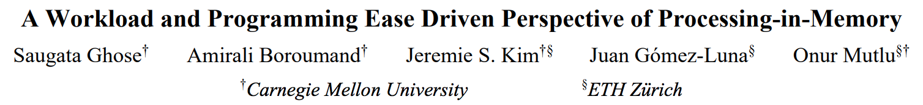
PIM Review and Open Problems (II)
Saugata Ghose, Amirali Boroumand, Jeremie S. Kim, Juan Gomez-Luna, and Onur Mutlu,
"Processing-in-Memory: A Workload-Driven Perspective"
Invited Article in IBM Journal of Research & Development, Special Issue on Hardware for Artificial Intelligence, to appear in November 2019.
[Preliminary arXiv version]
https://arxiv.org/pdf/1907.12947.pdf

Slide 153
Processing in Memory:
Two Approaches
1. Processing using Memory
2. Processing near Memory

Slide 154
Approach: Processing Using Memory
Take advantage of operational principles of memory to perform bulk data movement and computation in memory
  Can exploit internal connectivity to move data
  Can exploit analog computation capability
  …
Examples: RowClone, In-DRAM AND/OR, Gather/Scatter DRAM
  RowClone: Fast and Efficient In-DRAM Copy and Initialization of Bulk Data (Seshadri et al., MICRO 2013)
  Fast Bulk Bitwise AND and OR in DRAM (Seshadri et al., IEEE CAL 2015)
  Gather-Scatter DRAM: In-DRAM Address Translation to Improve the Spatial Locality of Non-unit Strided Accesses (Seshadri et al., MICRO 2015)
  "Ambit: In-Memory Accelerator for Bulk Bitwise Operations Using Commodity DRAM Technology” (Seshadri et al., MICRO 2017)

Slide 155
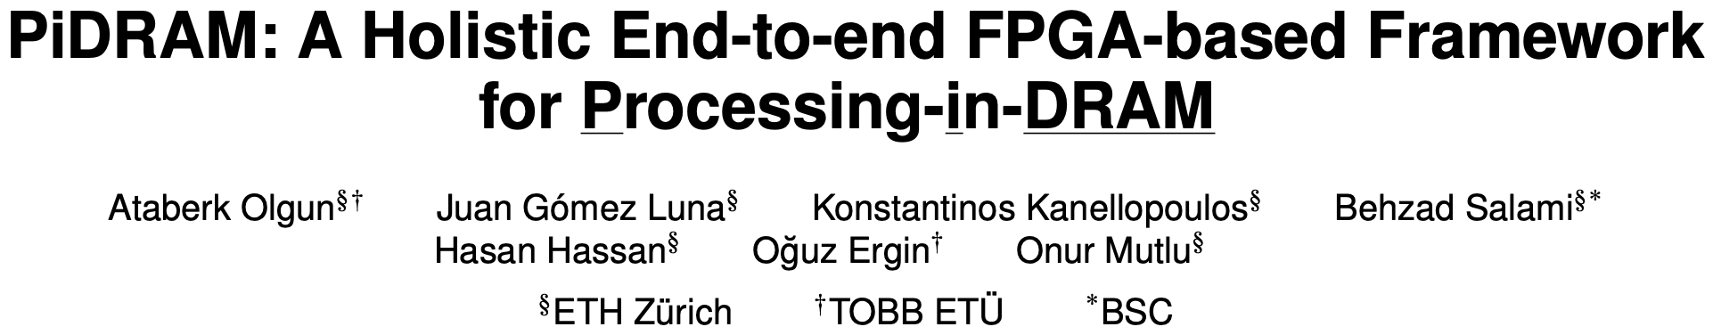
Real Processing Using Memory Prototype
https://arxiv.org/pdf/2111.00082.pdf
https://github.com/cmu-safari/pidram

Slide 156
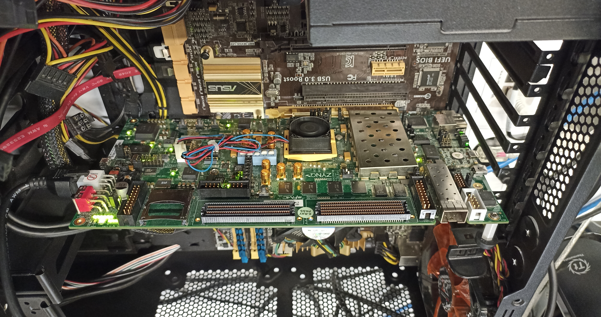
Real Processing Using Memory Prototype
https://arxiv.org/pdf/2111.00082.pdf
https://github.com/cmu-safari/pidram
Host Machine
FPGA Board
RISC-V System
PiM-Enabled DIMM

Slide 157
Mindset: Memory as an Accelerator
CPU
core
CPU
core
mini-CPU
core
GPU
(throughput)
core
GPU
(throughput)
core
video
core
GPU
(throughput)
core
GPU
(throughput)
core
CPU
core
CPU
core
Memory
imaging
core
LLC
Specialized
compute-capability
in memory
Memory Controller
Memory Bus
Memory similar to a “conventional” accelerator

Slide 158

Accelerating Data Copy and Initialization
  memmove & memcpy: 5% cycles in Google’s datacenter [Kanev+ ISCA’15]
000000000000000
Zero initialization
(e.g., security)
Forking
Checkpointing
Many more
VM Cloning
Deduplication
Page Migration

Slide 159
Data Copy Latency and Energy Savings
11.6x
74x
Seshadri et al., “RowClone: Fast and Efficient In-DRAM Copy and Initialization of Bulk Data,” MICRO 2013.

Slide 160
(Truly) In-Memory Computation
We can support in-DRAM AND, OR, NOT, MAJ
At low cost
Using analog computation capability of DRAM
  Idea: activating multiple rows performs computation
30-60X performance and energy improvement
  Seshadri+, “Ambit: In-Memory Accelerator for Bulk Bitwise Operations Using Commodity DRAM Technology,” MICRO 2017.
New memory technologies enable even more opportunities
  Memristors, resistive RAM, phase change mem, STT-MRAM, …
  Can operate on data with minimal movement

Slide 161
Acceleration of Bulk Bitwise Operations
[1] Li and Patel, BitWeaving, SIGMOD 2013
[2] Goodwin+, BitFunnel, SIGIR 2017

Slide 162
In-DRAM Acceleration of Database Queries
>4-12X Performance Improvement
Seshadri+, “Ambit: In-Memory Accelerator for Bulk Bitwise Operations using Commodity DRAM Technology,” MICRO 2017.

Slide 163
In-DRAM Bulk Bitwise Execution
Vivek Seshadri, Donghyuk Lee, Thomas Mullins, Hasan Hassan, Amirali Boroumand, Jeremie Kim, Michael A. Kozuch, Onur Mutlu, Phillip B. Gibbons, and Todd C. Mowry,
"Ambit: In-Memory Accelerator for Bulk Bitwise Operations Using Commodity DRAM Technology"
Proceedings of the 50th International Symposium on Microarchitecture (MICRO), Boston, MA, USA, October 2017.
[Slides (pptx) (pdf)] [Lightning Session Slides (pptx) (pdf)] [Poster (pptx) (pdf)]

Slide 164
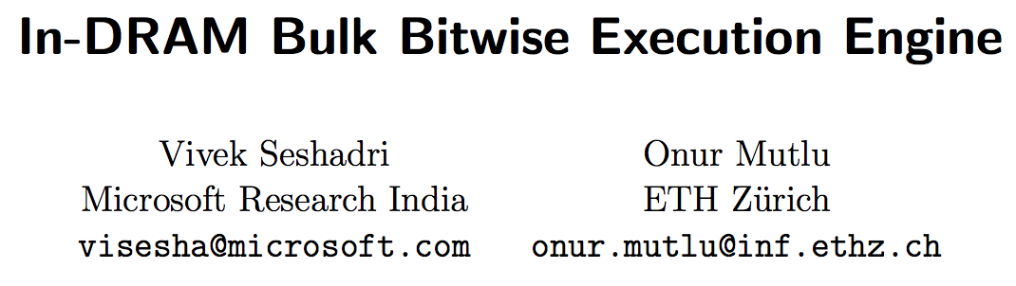
In-DRAM Bulk Bitwise Execution
Vivek Seshadri and Onur Mutlu,
"In-DRAM Bulk Bitwise Execution Engine"
Invited Book Chapter in Advances in Computers, to appear in 2020.
[Preliminary arXiv version]

Slide 165
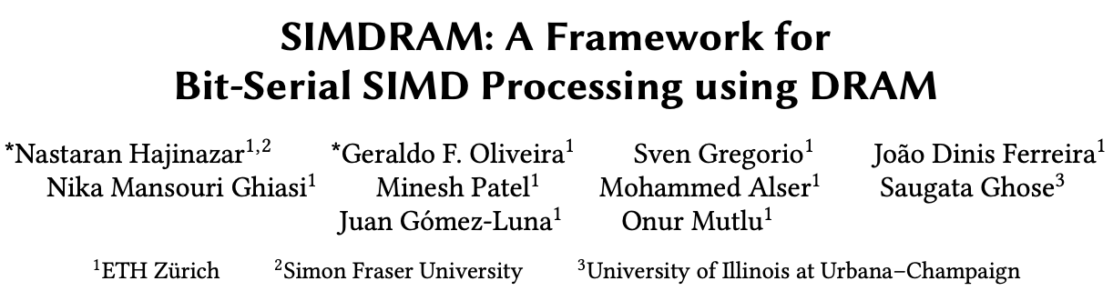
SIMDRAM Framework for Programmability
Nastaran Hajinazar, Geraldo F. Oliveira, Sven Gregorio, Joao Dinis Ferreira, Nika Mansouri Ghiasi, Minesh Patel, Mohammed Alser, Saugata Ghose, Juan Gomez-Luna, and Onur Mutlu,
"SIMDRAM: An End-to-End Framework for Bit-Serial SIMD Computing in DRAM"
Proceedings of the 26th International Conference on Architectural Support for Programming Languages and Operating Systems (ASPLOS), Virtual, March-April 2021.
[2-page Extended Abstract]
[Short Talk Slides (pptx) (pdf)]
[Talk Slides (pptx) (pdf)]
[Short Talk Video (5 mins)]
[Full Talk Video (27 mins)]

Slide 166
SIMDRAM Framework: Overview
User Input
Step 1: Generate
MAJ logic
Step 2: Generate
sequence of
DRAM commands
SIMDRAM Output
Desired operation
New SIMDRAM $μ$Program
ACT/PRE
ACT/PRE
ACT/PRE
ACT/ACT/PRE
done
$$μProgram$$
$$μProgram$$
MAJ
Main memory
AND/OR/NOT logic
MAJ/NOT logic
bbop_new
New SIMDRAM
instruction
ISA
$μ$Program
User Input
Step 3: Execution according to $μ$Program
SIMDRAM Output
SIMDRAM-enabled application
Instruction result
in memory
foo () {
bbop_new
}
ACT/PRE
ACT/PRE
ACT/PRE
ACT/PRE/PRE
done
ACT/PRE
Control Unit
$μ$Program
Memory Controller

Slide 167
SIMDRAM Key Results
Evaluated on:
  16 complex in-DRAM operations
  7 commonly-used real-world applications
SIMDRAM provides:
88× and 5.8× the throughput of a CPU and a high-end GPU, respectively, over 16 operations
257× and 31× the energy efficiency of a CPU and a high-end GPU, respectively, over 16 operations
21× and 2.1× the performance of a CPU an a high-end GPU, over seven real-world applications

Slide 168
SIMDRAM Framework for Programmability
Nastaran Hajinazar, Geraldo F. Oliveira, Sven Gregorio, Joao Dinis Ferreira, Nika Mansouri Ghiasi, Minesh Patel, Mohammed Alser, Saugata Ghose, Juan Gomez-Luna, and Onur Mutlu,
"SIMDRAM: An End-to-End Framework for Bit-Serial SIMD Computing in DRAM"
Proceedings of the 26th International Conference on Architectural Support for Programming Languages and Operating Systems (ASPLOS), Virtual, March-April 2021.
[2-page Extended Abstract]
[Short Talk Slides (pptx) (pdf)]
[Talk Slides (pptx) (pdf)]
[Short Talk Video (5 mins)]
[Full Talk Video (27 mins)]

Slide 169
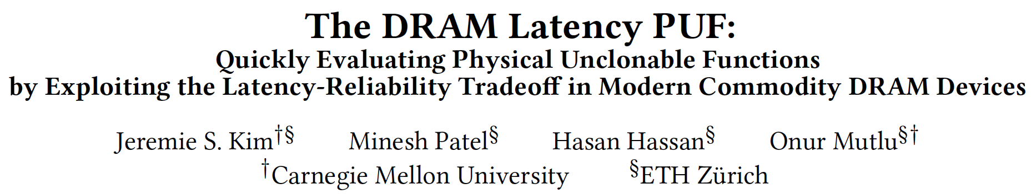
In-DRAM Physical Unclonable Functions
Jeremie S. Kim, Minesh Patel, Hasan Hassan, and Onur Mutlu,
"The DRAM Latency PUF: Quickly Evaluating Physical Unclonable Functions by Exploiting the Latency-Reliability Tradeoff in Modern DRAM Devices"
Proceedings of the 24th International Symposium on High-Performance Computer Architecture (HPCA), Vienna, Austria, February 2018.
[Lightning Talk Video]
[Slides (pptx) (pdf)] [Lightning Session Slides (pptx) (pdf)]
[Full Talk Lecture Video (28 minutes)]

Slide 170
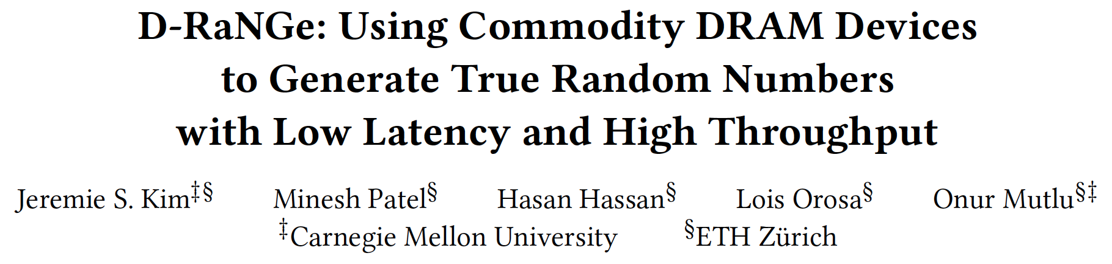
In-DRAM True Random Number Generation
Jeremie S. Kim, Minesh Patel, Hasan Hassan, Lois Orosa, and Onur Mutlu,
"D-RaNGe: Using Commodity DRAM Devices to Generate True Random Numbers with Low Latency and High Throughput"
Proceedings of the 25th International Symposium on High-Performance Computer Architecture (HPCA), Washington, DC, USA, February 2019.
[Slides (pptx) (pdf)]
[Full Talk Video (21 minutes)]
[Full Talk Lecture Video (27 minutes)]
Top Picks Honorable Mention by IEEE Micro.

Slide 171
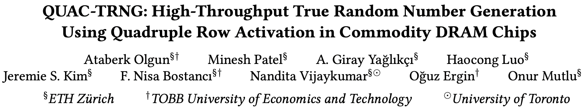
In-DRAM True Random Number Generation
Ataberk Olgun, Minesh Patel, A. Giray Yaglikci, Haocong Luo, Jeremie S. Kim, F. Nisa Bostanci, Nandita Vijaykumar, Oguz Ergin, and Onur Mutlu,
"QUAC-TRNG: High-Throughput True Random Number Generation Using Quadruple Row Activation in Commodity DRAM Chips"
Proceedings of the 48th International Symposium on Computer Architecture (ISCA), Virtual, June 2021.
[Slides (pptx) (pdf)]
[Short Talk Slides (pptx) (pdf)]
[Talk Video (25 minutes)]
[SAFARI Live Seminar Video (1 hr 26 mins)]

Slide 172
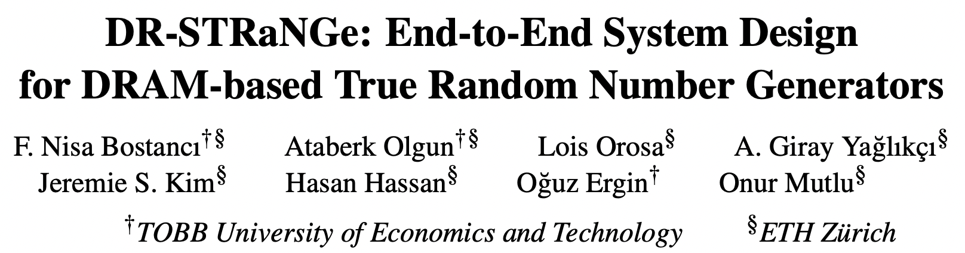
In-DRAM True Random Number Generation
F. Nisa Bostanci, Ataberk Olgun, Lois Orosa, A. Giray Yaglikci, Jeremie S. Kim, Hasan Hassan, Oguz Ergin, and Onur Mutlu,
"DR-STRaNGe: End-to-End System Design for DRAM-based True Random Number Generators"
Proceedings of the 28th International Symposium on High-Performance Computer Architecture (HPCA), Virtual, April 2022.
[Slides (pptx) (pdf)]
[Short Talk Slides (pptx) (pdf)]
https://arxiv.org/pdf/2201.01385.pdf

Slide 173
Processing in Memory:
Adoption Challenges
1. Processing using Memory
2. Processing near Memory

Slide 174
Eliminating the Adoption Barriers
How to Enable Adoption of Processing in Memory

Slide 175
Potential Barriers to Adoption of PIM
1. Applications & software for PIM
2. Ease of programming (interfaces and compiler/HW support)
3. System and security support: coherence, synchronization, virtual memory, isolation, communication interfaces, …
4. Runtime and compilation systems for adaptive scheduling, data mapping, access/sharing control, …
5. Infrastructures to assess benefits and feasibility
All can be solved with change of mindset

Slide 176
We Need to Revisit the Entire Stack
Problem
Algorithm
Program/Language
System Software
SW/HW Interface
Micro-architecture
Logic
Devices
Electrons
We can get there step by step

Slide 177
Adoption: Accelerating Key Applications (I)
Mohammed Alser, Zulal Bingol, Damla Senol Cali, Jeremie Kim, Saugata Ghose, Can Alkan, and Onur Mutlu,
"Accelerating Genome Analysis: A Primer on an Ongoing Journey"
IEEE Micro (IEEE MICRO), Vol. 40, No. 5, pages 65-75, September/October 2020.
[Slides (pptx)(pdf)]
[Talk Video (1 hour 2 minutes)]

Slide 178
Adoption: Accelerating Key Applications (II)
Nika Mansouri Ghiasi, Jisung Park, Harun Mustafa, Jeremie Kim, Ataberk Olgun, Arvid Gollwitzer, Damla Senol Cali, Can Firtina, Haiyu Mao, Nour Almadhoun Alserr, Rachata Ausavarungnirun, Nandita Vijaykumar, Mohammed Alser, and Onur Mutlu,
"GenStore: A High-Performance and Energy-Efficient In-Storage Computing System for Genome Sequence Analysis"
Proceedings of the 27th International Conference on Architectural Support for Programming Languages and Operating Systems (ASPLOS), Virtual, February-March 2022.
[Lightning Talk Slides (pptx) (pdf)]
[Lightning Talk Video (90 seconds)]

Slide 179
Adoption: Accelerating Key Applications (III)
Junwhan Ahn, Sungpack Hong, Sungjoo Yoo, Onur Mutlu, and Kiyoung Choi,
"A Scalable Processing-in-Memory Accelerator for Parallel Graph Processing"
Proceedings of the 42nd International Symposium on Computer Architecture (ISCA), Portland, OR, June 2015.
[Slides (pdf)] [Lightning Session Slides (pdf)]

Slide 180
Adoption: Accelerating Key Applications (IV)
Maciej Besta, Raghavendra Kanakagiri, Grzegorz Kwasniewski, Rachata Ausavarungnirun, Jakub Beránek, Konstantinos Kanellopoulos, Kacper Janda, Zur Vonarburg-Shmaria, Lukas Gianinazzi, Ioana Stefan, Juan Gómez-Luna, Marcin Copik, Lukas Kapp-Schwoerer, Salvatore Di Girolamo, Nils Blach, Marek Konieczny, Onur Mutlu, and Torsten Hoefler,
"SISA: Set-Centric Instruction Set Architecture for Graph Mining on Processing-in-Memory Systems"
Proceedings of the 54th International Symposium on Microarchitecture (MICRO), Virtual, October 2021.
[Slides (pdf)]
[Talk Video (22 minutes)]
[Lightning Talk Video (1.5 minutes)]
[Full arXiv version]

Slide 181
Adoption: Accelerating Key Applications (V)
Amirali Boroumand, Saugata Ghose, Berkin Akin, Ravi Narayanaswami, Geraldo F. Oliveira, Xiaoyu Ma, Eric Shiu, and Onur Mutlu,
"Google Neural Network Models for Edge Devices: Analyzing and Mitigating Machine Learning Inference Bottlenecks"
Proceedings of the 30th International Conference on Parallel Architectures and Compilation Techniques (PACT), Virtual, September 2021.
[Slides (pptx) (pdf)]
[Talk Video (14 minutes)]

Slide 182
Adoption: Accelerating Key Applications (VI)
Gagandeep Singh, Dionysios Diamantopoulos, Christoph Hagleitner, Juan Gómez-Luna, Sander Stuijk, Onur Mutlu, and Henk Corporaal,
"NERO: A Near High-Bandwidth Memory Stencil Accelerator for Weather Prediction Modeling"
Proceedings of the 30th International Conference on Field-Programmable Logic and Applications (FPL), Gothenburg, Sweden, September 2020.
[Slides (pptx) (pdf)]
[Lightning Talk Slides (pptx) (pdf)]
[Talk Video (23 minutes)]
Nominated for the Stamatis Vassiliadis Memorial Award.

Slide 183
Adoption: Accelerating Key Applications (VII)
Ivan Fernandez, Ricardo Quislant, Christina Giannoula, Mohammed Alser, Juan Gómez-Luna, Eladio Gutiérrez, Oscar Plata, and Onur Mutlu,
"NATSA: A Near-Data Processing Accelerator for Time Series Analysis"
Proceedings of the 38th IEEE International Conference on Computer Design (ICCD), Virtual, October 2020.
[Slides (pptx) (pdf)]
[Talk Video (10 minutes)]
[Source Code]

Slide 184
Adoption: Accelerating Key Applications (VIII)
Damla Senol Cali, Gurpreet S. Kalsi, Zulal Bingol, Can Firtina, Lavanya Subramanian, Jeremie S. Kim, Rachata Ausavarungnirun, Mohammed Alser, Juan Gomez-Luna, Amirali Boroumand, Anant Nori, Allison Scibisz, Sreenivas Subramoney, Can Alkan, Saugata Ghose, and Onur Mutlu,
"GenASM: A High-Performance, Low-Power Approximate String Matching Acceleration Framework for Genome Sequence Analysis"
Proceedings of the 53rd International Symposium on Microarchitecture (MICRO), Virtual, October 2020.
[Lighting Talk Video (1.5 minutes)]
[Lightning Talk Slides (pptx) (pdf)]
[Talk Video (18 minutes)]
[Slides (pptx) (pdf)]

Slide 185
Adoption: Accelerating Key Applications (IX)
Damla Senol Cali, Konstantinos Kanellopoulos, Joel Lindegger, Zulal Bingol, Gurpreet S. Kalsi, Ziyi Zuo, Can Firtina, Meryem Banu Cavlak, Jeremie Kim, Nika MansouriGhiasi, Gagandeep Singh, Juan Gomez-Luna, Nour Almadhoun Alserr, Mohammed Alser, Sreenivas Subramoney, Can Alkan, Saugata Ghose, and Onur Mutlu,
"SeGraM: A Universal Hardware Accelerator for Genomic Sequence-to-Graph and Sequence-to-Sequence Mapping"
Proceedings of the 49th International Symposium on Computer Architecture (ISCA), New York, June 2022.
[arXiv version]
https://arxiv.org/pdf/2205.05883.pdf

Slide 186
Adoption: Accelerating Key Applications (X)
Amirali Boroumand, Saugata Ghose, Geraldo F. Oliveira, and Onur Mutlu,
"Polynesia: Enabling High-Performance and Energy-Efficient Hybrid Transactional/Analytical Databases with Hardware/Software Co-Design"
Proceedings of the 38th International Conference on Data Engineering (ICDE), Virtual, May 2022.
[arXiv version]
[Slides (pptx) (pdf)]
[Short Talk Slides (pptx) (pdf)]
https://arxiv.org/pdf/2204.11275.pdf

Slide 187
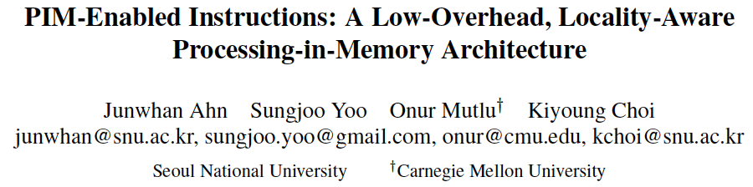
Adoption: How to Keep It Simple?
Junwhan Ahn, Sungjoo Yoo, Onur Mutlu, and Kiyoung Choi,
"PIM-Enabled Instructions: A Low-Overhead, Locality-Aware Processing-in-Memory Architecture"
Proceedings of the 42nd International Symposium on Computer Architecture (ISCA), Portland, OR, June 2015.
[Slides (pdf)] [Lightning Session Slides (pdf)]

Slide 188
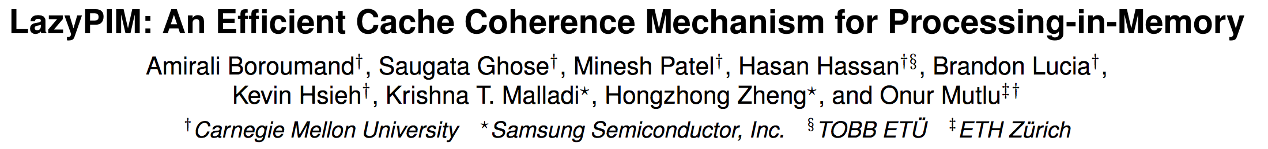
Adoption: How to Maintain Coherence? (I)
Amirali Boroumand, Saugata Ghose, Minesh Patel, Hasan Hassan, Brandon Lucia, Kevin Hsieh, Krishna T. Malladi, Hongzhong Zheng, and Onur Mutlu,
"LazyPIM: An Efficient Cache Coherence Mechanism for Processing-in-Memory"
IEEE Computer Architecture Letters (CAL), June 2016.

Slide 189
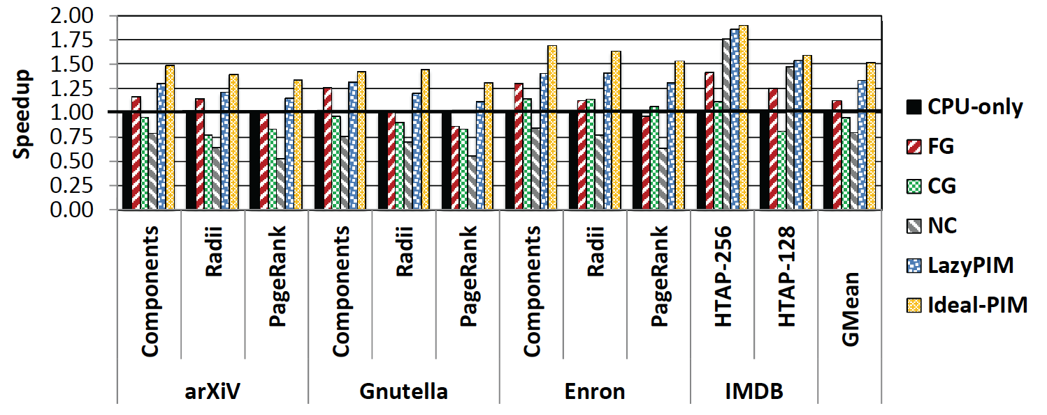
Challenge: Coherence for Hybrid CPU-PIM Apps
Traditional
coherence
No coherence
overhead

Slide 190
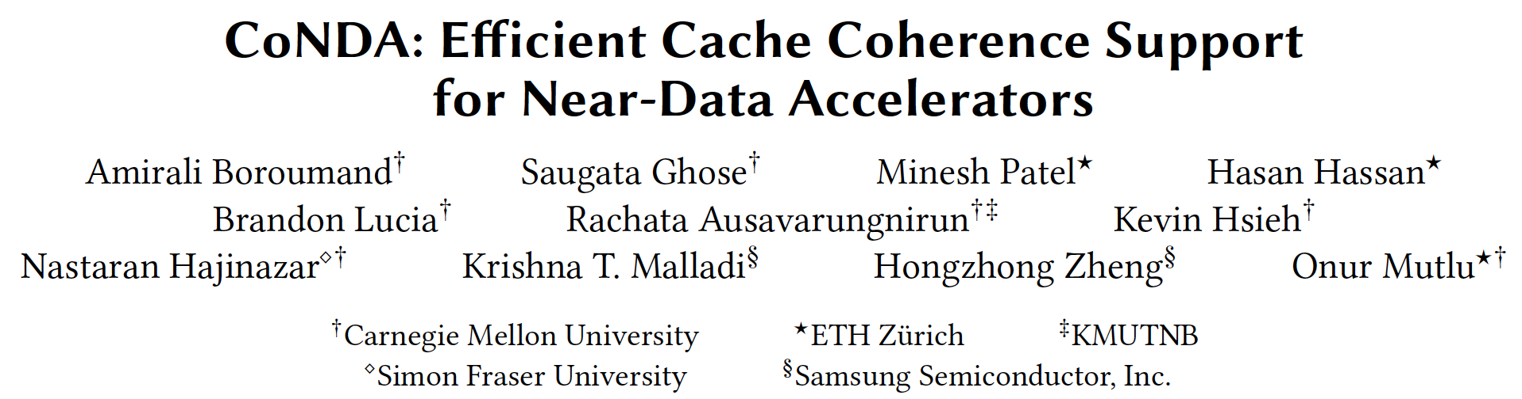
Adoption: How to Maintain Coherence? (II)
Amirali Boroumand, Saugata Ghose, Minesh Patel, Hasan Hassan, Brandon Lucia, Kevin Hsieh, Krishna T. Malladi, Hongzhong Zheng, and Onur Mutlu,
"CoNDA: Efficient Cache Coherence Support for Near-Data Accelerators"
Proceedings of the 46th International Symposium on Computer Architecture (ISCA), Phoenix, AZ, USA, June 2019.

Slide 191
Adoption: How to Support Synchronization?
Christina Giannoula, Nandita Vijaykumar, Nikela Papadopoulou, Vasileios Karakostas, Ivan Fernandez, Juan Gómez-Luna, Lois Orosa, Nectarios Koziris, Georgios Goumas, Onur Mutlu,
"SynCron: Efficient Synchronization Support for Near-Data-Processing Architectures"
Proceedings of the 27th International Symposium on High-Performance Computer Architecture (HPCA), Virtual, February-March 2021.
[Slides (pptx) (pdf)]
[Short Talk Slides (pptx) (pdf)]
[Talk Video (21 minutes)]
[Short Talk Video (7 minutes)]

Slide 192
Adoption: How to Support Virtual Memory?
Kevin Hsieh, Samira Khan, Nandita Vijaykumar, Kevin K. Chang, Amirali Boroumand, Saugata Ghose, and Onur Mutlu,
"Accelerating Pointer Chasing in 3D-Stacked Memory: Challenges, Mechanisms, Evaluation"
Proceedings of the 34th IEEE International Conference on Computer Design (ICCD), Phoenix, AZ, USA, October 2016.

Slide 193
Eliminating the Adoption Barriers
Processing-in-Memory
in the Real World

Slide 194
Processing-in-Memory Landscape Today
[Samsung 2021]
[Alibaba 2022]
[SK Hynix 2022]
[Samsung 2021]
[UPMEM 2019]
This does not include many experimental chips and startups

Slide 195
UPMEM Processing-in-DRAM Engine (2019)
Processing in DRAM Engine
Includes standard DIMM modules, with a large number of DPU processors combined with DRAM chips.
Replaces standard DIMMs
  DDR4 R-DIMM modules
    8GB+128 DPUs (16 PIM chips)
    Standard 2x-nm DRAM process
  Large amounts of compute & memory bandwidth
https://www.anandtech.com/show/14750/hot-chips-31-analysis-inmemory-processing-by-upmem
https://www.upmem.com/video-upmem-presenting-its-true-processing-in-memory-solution-hot-chips-2019/

Slide 196
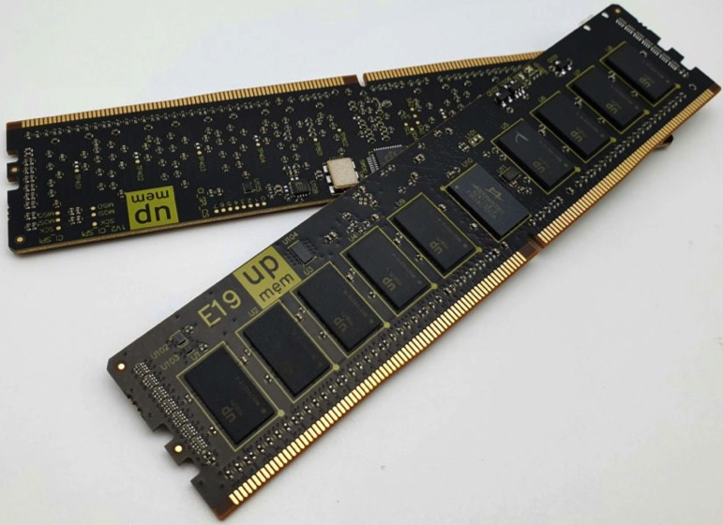
UPMEM Memory Modules
E19: 8 chips DIMM (1 rank). DPUs @ 267 MHz
P21: 16 chips DIMM (2 ranks). DPUs @ 350 MHz
www.upmem.com

Slide 197
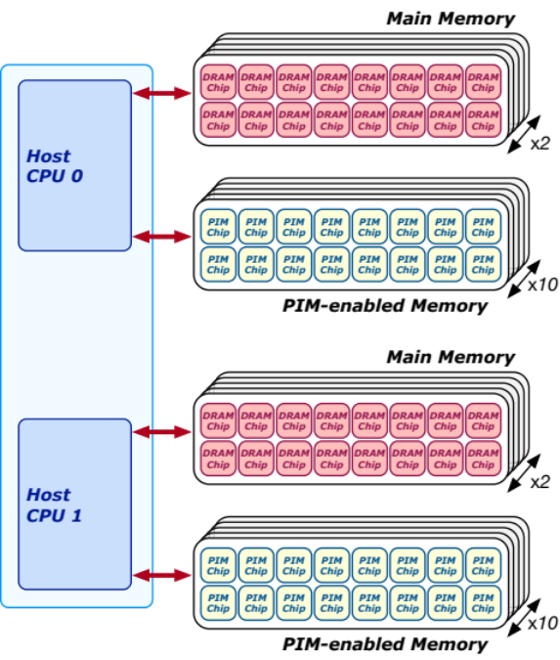
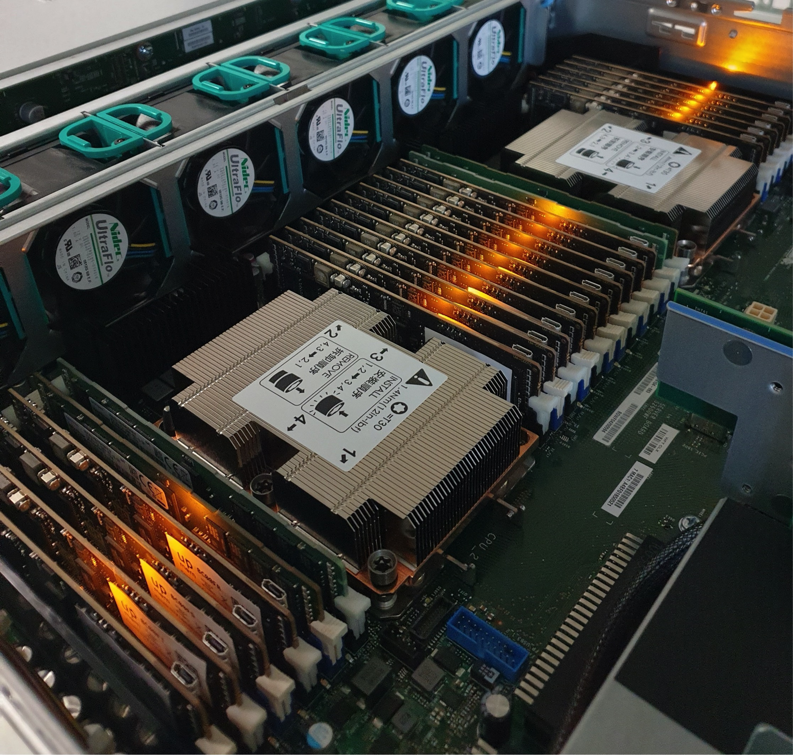
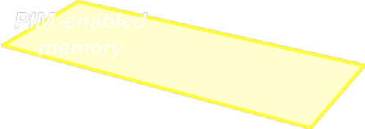
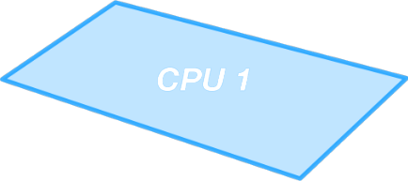
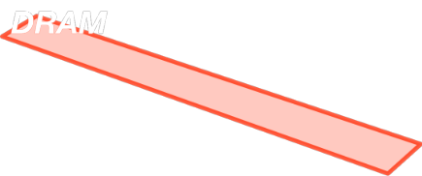






2,560-DPU Processing-in-Memory System
https://arxiv.org/pdf/2105.03814.pdf

Slide 198

More on the UPMEM PIM System
https://www.youtube.com/watch?v=Sscy1Wrr22A&list=PL5Q2soXY2Zi9xidyIgBxUz7xRPS-wisBN&index=26

Slide 199
Experimental Analysis of the UPMEM PIM Engine
https://arxiv.org/pdf/2105.03814.pdf

Slide 200

UPMEM PIM System Summary & Analysis
Juan Gomez-Luna, Izzat El Hajj, Ivan Fernandez, Christina Giannoula, Geraldo F. Oliveira, and Onur Mutlu,
"Benchmarking Memory-Centric Computing Systems: Analysis of Real Processing-in-Memory Hardware"
Invited Paper at Workshop on Computing with Unconventional Technologies (CUT), Virtual, October 2021.
[arXiv version]
[PrIM Benchmarks Source Code]
[Slides (pptx) (pdf)]
[Talk Video (37 minutes)]
[Lightning Talk Video (3 minutes)]

Slide 201
PrIM Benchmarks: Application Domains
Domain | Benchmark | Short name
Dense linear algebra | Vector Addition | VA
 | Matrix-Vector Multiply | GEMV
Sparse linear algebra | Sparse Matrix-Vector Multiply | SpMV
Databases | Select | SEL
 | Unique | UNI
Data analytics | Binary Search | BS
 | Time Series Analysis | TS
Graph processing | Breadth-First Search | BFS
Neural networks | Multilayer Perceptron | MLP
Bioinformatics | Needleman-Wunsch | NW
Image processing | Image histogram (short) | HST-S
 | Image histogram (large) | HST-L
Parallel primitives | Reduction | RED
 | Prefix sum (scan-scan-add) | SCAN-SSA
 | Prefix sum (reduce-scan-scan) | SCAN-RSS
 | Matrix transposition | TRNS

Slide 202

PrIM Benchmarks are Open Source
All microbenchmarks, benchmarks, and scripts
https://github.com/CMU-SAFARI/prim-benchmarks

Slide 203

Understanding a Modern PIM Architecture
https://arxiv.org/pdf/2105.03814.pdf
https://github.com/CMU-SAFARI/prim-benchmarks

Slide 204

Understanding a Modern PIM Architecture
https://www.youtube.com/watch?v=D8Hjy2iU9l4&list=PL5Q2soXY2Zi_tOTAYm--dYByNPL7JhwR9

Slide 205

More on Analysis of the UPMEM PIM Engine
https://www.youtube.com/watch?v=D8Hjy2iU9l4&list=PL5Q2soXY2Zi_tOTAYm--dYByNPL7JhwR9

Slide 206

More on Analysis of the UPMEM PIM Engine
https://www.youtube.com/watch?v=Pp9jSU2b9oM&list=PL5Q2soXY2Zi8_VVChACnON4sfh2bJ5IrD&index=159

Slide 207
More on PRIM Benchmarks
Juan Gomez-Luna, Izzat El Hajj, Ivan Fernandez, Christina Giannoula, Geraldo F. Oliveira, and Onur Mutlu,
"Benchmarking a New Paradigm: An Experimental Analysis of a Real Processing-in-Memory Architecture"
Preprint in arXiv, 9 May 2021.
[arXiv preprint]
[PrIM Benchmarks Source Code]
[Slides (pptx) (pdf)]
[Long Talk Slides (pptx) (pdf)]
[Short Talk Slides (pptx) (pdf)]
[SAFARI Live Seminar Slides (pptx) (pdf)]
[SAFARI Live Seminar Video (2 hrs 57 mins)]
[Lightning Talk Video (3 minutes)]

Slide 208
UPMEM PIM System Summary & Analysis
Juan Gomez-Luna, Izzat El Hajj, Ivan Fernandez, Christina Giannoula, Geraldo F. Oliveira, and Onur Mutlu,
"Benchmarking Memory-Centric Computing Systems: Analysis of Real Processing-in-Memory Hardware"
Invited Paper at Workshop on Computing with Unconventional Technologies (CUT), Virtual, October 2021.
[arXiv version]
[PrIM Benchmarks Source Code]
[Slides (pptx) (pdf)]
[Talk Video (37 minutes)]
[Lightning Talk Video (3 minutes)]

Slide 209
FPGA-based Processing Near Memory
Gagandeep Singh, Mohammed Alser, Damla Senol Cali, Dionysios Diamantopoulos, Juan Gómez-Luna, Henk Corporaal, and Onur Mutlu,
"FPGA-based Near-Memory Acceleration of Modern Data-Intensive Applications"
IEEE Micro (IEEE MICRO), to appear, 2021.

Slide 210

DAMOV Analysis Methodology & Workloads
https://arxiv.org/pdf/2105.03725.pdf

Slide 211
When to Employ Near-Data Processing?
Mobile consumer workloads
(GoogleWL²)
Graph processing
(Tesseract¹)
Neural networks
(GoogleWL²)
Near-Data
Processing
Databases
(Polynesia⁵)
DNA
sequence mapping
(GenASM³; GRIM-Filter⁴)
Time series analysis
(NATSA⁶)
...
[1] Ahn+, “A Scalable Processing-in-Memory Accelerator for Parallel Graph Processing," ISCA, 2015
[2] Boroumand+, "Google Workloads for Consumer Devices: Mitigating Data Movement Bottlenecks,” ASPLOS, 2018
[3] Cali+, "GenASM: A High-Performance, Low-Power Approximate String Matching Acceleration Framework for Genome Sequence Analysis,” MICRO, 2020
[4] Kim+, "GRIM-Filter: Fast Seed Location Filtering in DNA Read Mapping Using Processing-in-Memory Technologies,” BMC Genomics, 2018
[5] Boroumand+, "Polynesia: Enabling Effective Hybrid Transactional/Analytical Databases with Specialized Hardware/Software Co-Design,” arXiv:2103.00798 [cs.AR], 2021
[6] Fernandez+, “NATSA: A Near-Data Processing Accelerator for Time Series Analysis,” ICCD, 2020
Notes:
[CLICK] Many recent works explore how NDP can benefit various application domains like
[CLICK] Graph processing,
[CLICK] mobile consumer workloads
[CLICK] neural networks
[CLICK] DNA sequence mapping
[CLICK] Databases
[CLICK] Time series analysis
[CLICK] and more
[NEXT]

Slide 212

Step 1: Application Profiling
We analyze 345 applications from distinct domains:
Graph Processing
Deep Neural Networks
Physics
High-Performance Computing
Genomics
Machine Learning
Databases
Data Reorganization
Image Processing
Map-Reduce
Benchmarking
Linear Algebra
…
Signal processing
Machine learning
Data mining
Data analytics
Genomics
Deep Neural Networks
Security
Linear algebra
Image processing
Data reorganization
Graph processing
Database
Physics
Notes:
In this work, we analyzed 345 applications from distinct domains, from
[CLICK] GRAPH Processing [CLICK] Neural Networks
[CLICK] Physics [CLICK] High-performance computing
[CLICK]Genomics [CLICK] And more
[NEXT]

Slide 213
Step 3: Memory Bottleneck Analysis
Memory Bottleneck Class
High
Low
1a: DRAM Bandwidth
High
AI
MPKI
Low
1b: DRAM Latency
AI
Low
Low
  Six classes of
  data movement bottlenecks:
  each class ↔ data movement
  mitigation mechanism
LFMR
Low
Low
1c: L1/L2
Cache Capacity
Decreasing
MPKI
AI
Temporal Locality
Increasing
Low
Low
2a: L3 Cache Contention
MPKI
AI
LFMR
Low
2b: L1 Cache Capacity
High
MPKI
AI
Low
Low
2c: Compute-Bound
High
Notes:
[CLICK] With such classification, we analyze how the functions in each class correlates with different data movement mitigation mechanisms in terms of performance and energy using our scalability analysis.
[NEXT]

Slide 214

DAMOV is Open Source
We open-source our benchmark suite and our toolchain
DAMOV-SIM
DAMOV
Benchmarks
Notes:
We open source DAMOV to facilitate further research in mitigating data movement bottlenecks, including in near data processing.
[CLICK] In our DAMOV repository, we provide
[CLICK] The complete set of 144 application functions that compose our benchmark suite
[CLICK] And our DAMOV-SIM simulator
[NEXT]

Slide 215
DAMOV is Open Source
We open-source our benchmark suite and our toolchain
Get DAMOV at:
https://github.com/CMU-SAFARI/DAMOV
DAMOV-SIM
DAMOV
Benchmarks
Notes:
We open source DAMOV to facilitate further research in mitigating data movement bottlenecks, including in near data processing.
[CLICK] In our DAMOV repository, we provide
[CLICK] The complete set of 144 application functions that compose our benchmark suite
[CLICK] And our DAMOV-SIM simulator
[NEXT]

Slide 216

More on DAMOV Analysis Methodology & Workloads
https://www.youtube.com/watch?v=GWideVyo0nM&list=PL5Q2soXY2Zi_tOTAYm--dYByNPL7JhwR9&index=3

Slide 217

More on DAMOV Methods & Benchmarks
Geraldo F. Oliveira, Juan Gomez-Luna, Lois Orosa, Saugata Ghose, Nandita Vijaykumar, Ivan fernandez, Mohammad Sadrosadati, and Onur Mutlu,
"DAMOV: A New Methodology and Benchmark Suite for Evaluating Data Movement Bottlenecks"
IEEE Access, 8 September 2021.
Preprint in arXiv, 8 May 2021.
[arXiv preprint]
[IEEE Access version]
[DAMOV Suite and Simulator Source Code]
[SAFARI Live Seminar Video (2 hrs 40 mins)]
[Short Talk Video (21 minutes)]

Slide 218

SpMV on Real PIM Systems
Appears in SIGMETRICS 2022
https://arxiv.org/pdf/2201.05072.pdf
https://github.com/CMU-SAFARI/SparseP

Slide 219

SpMV on Real PIM Systems
https://www.youtube.com/watch?v=5kaOsJKlGrE

Slide 220

Samsung Function-in-Memory DRAM (2021)
https://news.samsung.com/global/samsung-develops-industrys-first-high-bandwidth-memory-with-ai-processing-power

Slide 221


Samsung Function-in-Memory DRAM (2021)

Slide 222

Samsung Function-in-Memory DRAM (2021)

Slide 223

Samsung Function-in-Memory DRAM (2021)

Slide 224

Samsung Function-in-Memory DRAM (2021)

Slide 225



Samsung AxDIMM (2021)
DDRx-PIM
  DLRM recommendation system
Baseline System
AxDIMM System
Ke et al. "Near-Memory Processing in Action: Accelerating Personalized Recommendation with AxDIMM", IEEE Micro (2021)

Slide 226


SK Hynix Accelerator-in-Memory (2022)
https://news.skhynix.com/sk-hynix-develops-pim-next-generation-ai-accelerator/

Slide 227



AliBaba PIM Recommendation System (2022)

Slide 228

Future: Enable New Medical/Health Platforms
Oxford Nanopore MinION
Senol Cali+, “Nanopore Sequencing Technology and Tools for Genome
Assembly: Computational Analysis of the Current State, Bottlenecks
and Future Directions,” Briefings in Bioinformatics, 2018.
[Preliminary arxiv.org version]

Slide 229
Future of Genome Sequencing & Analysis
Mohammed Alser, Zülal Bingöl, Damla Senol Cali, Jeremie Kim, Saugata Ghose, Can Alkan, Onur Mutlu
“Accelerating Genome Analysis: A Primer on an Ongoing Journey” IEEE Micro, August 2020.
MinION from ONT
SmidgION from ONT

Slide 230
Detailed Lectures on PIM (I)
Computer Architecture, Fall 2020, Lecture 6
  Computation in Memory (ETH Zürich, Fall 2020)
  https://www.youtube.com/watch?v=oGcZAGwfEUE&list=PL5Q2soXY2Zi9xidyIgBxUz7xRPS-wisBN&index=12
Computer Architecture, Fall 2020, Lecture 7
  Near-Data Processing (ETH Zürich, Fall 2020)
  https://www.youtube.com/watch?v=j2GIigqn1Qw&list=PL5Q2soXY2Zi9xidyIgBxUz7xRPS-wisBN&index=13
Computer Architecture, Fall 2020, Lecture 11a
  Memory Controllers (ETH Zürich, Fall 2020)
  https://www.youtube.com/watch?v=TeG773OgiMQ&list=PL5Q2soXY2Zi9xidyIgBxUz7xRPS-wisBN&index=20
Computer Architecture, Fall 2020, Lecture 12d
  Real Processing-in-DRAM with UPMEM (ETH Zürich, Fall 2020)
  https://www.youtube.com/watch?v=Sscy1Wrr22A&list=PL5Q2soXY2Zi9xidyIgBxUz7xRPS-wisBN&index=25
https://www.youtube.com/onurmutlulectures

Slide 231
Detailed Lectures on PIM (II)
Computer Architecture, Fall 2020, Lecture 15
  Emerging Memory Technologies (ETH Zürich, Fall 2020)
  https://www.youtube.com/watch?v=AlE1rD9G_YU&list=PL5Q2soXY2Zi9xidyIgBxUz7xRPS-wisBN&index=28
Computer Architecture, Fall 2020, Lecture 16a
  Opportunities & Challenges of Emerging Memory Technologies (ETH Zürich, Fall 2020)
  https://www.youtube.com/watch?v=pmLszWGmMGQ&list=PL5Q2soXY2Zi9xidyIgBxUz7xRPS-wisBN&index=29
Computer Architecture, Fall 2020, Guest Lecture
  In-Memory Computing: Memory Devices & Applications (ETH Zürich, Fall 2020)
  https://www.youtube.com/watch?v=wNmqQHiEZNk&list=PL5Q2soXY2Zi9xidyIgBxUz7xRPS-wisBN&index=41
https://www.youtube.com/onurmutlulectures

Slide 232
Latest Longer & Detailed Tutorial on PIM
Onur Mutlu,
"Memory-Centric Computing"
Education Class at Embedded Systems Week (ESWEEK), Virtual, 9 October 2021.
[Slides (pptx) (pdf)]
[Abstract (pdf)]
[Talk Video (2 hours, including Q&A)]
[Invited Paper at DATE 2021]
["A Modern Primer on Processing in Memory" paper]
https://www.youtube.com/watch?v=N1Ac1ov1JOM
https://www.youtube.com/onurmutlulectures

Slide 233

Latest Longer & Detailed Tutorial on PIM
Onur Mutlu,
"Memory-Centric Computing"
Education Class at Embedded Systems Week (ESWEEK), Virtual, 9 October 2021.
[Slides (pptx) (pdf)]
[Abstract (pdf)]
[Talk Video (2 hours, including Q&A)]
[Invited Paper at DATE 2021]
["A Modern Primer on Processing in Memory" paper]
https://www.youtube.com/watch?v=N1Ac1ov1JOM&list=PL5Q2soXY2Zi8D_5MGV6EnXEJHnV2YFBJl&index=65
https://www.youtube.com/watch?v=N1Ac1ov1JOM
https://www.youtube.com/onurmutlulectures

Slide 234
Challenge and Opportunity for Future
Fundamentally
Energy-Efficient
(Data-Centric)
Computing Architectures

Slide 235
Challenge and Opportunity for Future
Fundamentally
High-Performance
(Data-Centric)
Computing Architectures

Slide 236
Challenge and Opportunity for Future
Computing Architectures
with
Minimal Data Movement

Slide 237
Unfortunately, No Time for the Next Two Parts

Slide 238
Challenge and Opportunity for Future
Data-Driven
(Self-Optimizing)
Computing Architectures

Slide 239
Challenge and Opportunity for Future
Data-Aware
(Expressive)
Computing Architectures

Slide 240
More Info in This Longer Tutorial…
Onur Mutlu,
"Memory-Centric Computing Systems"
Invited Tutorial at 66th International Electron Devices Meeting (IEDM), Virtual, 12 December 2020.
[Slides (pptx) (pdf)]
[Executive Summary Slides (pptx) (pdf)]
[Tutorial Video (1 hour 51 minutes)]
[Executive Summary Video (2 minutes)]
[Abstract and Bio]
[Related Keynote Paper from VLSI-DAT 2020]
[Related Review Paper on Processing in Memory]
https://www.youtube.com/watch?v=H3sEaINPBOE
https://www.youtube.com/onurmutlulectures

Slide 241

A Tutorial on PIM
Onur Mutlu,
"Memory-Centric Computing Systems"
Invited Tutorial at 66th International Electron Devices Meeting (IEDM), Virtual, 12 December 2020.
[Slides (pptx) (pdf)]
[Executive Summary Slides (pptx) (pdf)]
[Tutorial Video (1 hour 51 minutes)]
[Executive Summary Video (2 minutes)]
[Abstract and Bio]
[Related Keynote Paper from VLSI-DAT 2020]
[Related Review Paper on Processing in Memory]
https://www.youtube.com/watch?v=H3sEaINPBOE
https://www.youtube.com/watch?v=H3sEaINPBOE
https://www.youtube.com/onurmutlulectures

Slide 242
Concluding Remarks

Slide 243
Concluding Remarks
We must design systems to be truly balanced, high-performance, and energy-efficient → intelligent systems
  Data-centric, data-driven, data-aware
Enable computation capability inside and close to memory
This can
  Lead to orders-of-magnitude improvements
  Enable new applications & computing platforms
  Enable better understanding of nature
  …
Future of truly memory-centric computing is bright
  We need to do research & design across the computing stack
Notes:
Perhaps we have taken processor-centric system design a bit too far

Slide 244
Fundamentally Better Architectures
Data-centric
Data-driven
Data-aware

Slide 245

Source: http://spectrum.ieee.org/image/MjYzMzAyMg.jpeg

Slide 246
We Need to Revisit the Entire Stack
Problem
Algorithm
Program/Language
System Software
SW/HW Interface
Micro-architecture
Logic
Devices
Electrons
We can get there step by step

Slide 247
We Need to Exploit Good Principles
Data-centric system design
All components intelligent
Better (cross-layer) communication, better interfaces
Better-than-worst-case design
Heterogeneity
Flexibility, adaptability
Open minds

Slide 248
A Blueprint for Fundamentally Better Architectures
Onur Mutlu,
"Intelligent Architectures for Intelligent Computing Systems"
Invited Paper in Proceedings of the Design, Automation, and Test in Europe Conference (DATE), Virtual, February 2021.
[Slides (pptx) (pdf)]
[IEDM Tutorial Slides (pptx) (pdf)]
[Short DATE Talk Video (11 minutes)]
[Longer IEDM Tutorial Video (1 hr 51 minutes)]

Slide 249
Funding Acknowledgments
Alibaba, AMD, ASML, Google, Facebook, Hi-Silicon, HP Labs, Huawei, IBM, Intel, Microsoft, Nvidia, Oracle, Qualcomm, Rambus, Samsung, Seagate, VMware, Xilinx
NSF
NIH
GSRC
SRC
CyLab
EFCL

Slide 250

Acknowledgments
Think BIG, Aim HIGH!
https://safari.ethz.ch

Slide 251


Onur Mutlu’s SAFARI Research Group
Computer architecture, HW/SW, systems, bioinformatics, security, memory
https://safari.ethz.ch/safari-newsletter-january-2021/
40+ Researchers
Think BIG, Aim HIGH!
https://safari.ethz.ch

Slide 252

SAFARI Newsletter December 2021 Edition
https://safari.ethz.ch/safari-newsletter-december-2021/

Slide 253
Referenced Papers, Talks, Artifacts
All are available at
  https://people.inf.ethz.ch/omutlu/projects.htm
  https://www.youtube.com/onurmutlulectures
  https://github.com/CMU-SAFARI/

Slide 254


Open Source Artifacts: SAFARI GitHub
https://github.com/CMU-SAFARI/

Slide 255

Comp Arch (Fall’21)
Fall 2021 Edition:
  https://safari.ethz.ch/architecture/fall2021/doku.php?id=schedule
Fall 2020 Edition:
  https://safari.ethz.ch/architecture/fall2020/doku.php?id=schedule
Youtube Livestream (2021):
  https://www.youtube.com/watch?v=4yfkM_5EFgo&list=PL5Q2soXY2Zi-Mnk1PxjEIG32HAGILkTOF
Youtube Livestream (2020):
  https://www.youtube.com/watch?v=c3mPdZA-Fmc&list=PL5Q2soXY2Zi9xidyIgBxUz7xRPS-wisBN
Master’s level course
  Taken by Bachelor’s/Masters/PhD students
  Cutting-edge research topics + fundamentals in Computer Architecture
  5 Simulator-based Lab Assignments
  Potential research exploration
  Many research readings
https://www.youtube.com/onurmutlulectures

Slide 256

DDCA (Spring 2022)
Spring 2022 Edition:
  https://safari.ethz.ch/digitaltechnik/spring2022/doku.php?id=schedule
Spring 2021 Edition:
  https://safari.ethz.ch/digitaltechnik/spring2021/doku.php?id=schedule
Youtube Livestream (Spring 2022):
  https://www.youtube.com/watch?v=cpXdE3HwvK0&list=PL5Q2soXY2Zi97Ya5DEUpMpO2bbAoaG7c6
Youtube Livestream (Spring 2021):
  https://www.youtube.com/watch?v=LbC0EZY8yw4&list=PL5Q2soXY2Zi_uej3aY39YB5pfW4SJ7LlN
Bachelor’s course
  2nd semester at ETH Zurich
  Rigorous introduction into “How Computers Work”
  Digital Design/Logic
  Computer Architecture
  10 FPGA Lab Assignments
https://www.youtube.com/onurmutlulectures

Slide 257

PIM Course (Fall’21)
Fall 2021 Edition:
  https://safari.ethz.ch/projects_and_seminars/fall2021/doku.php?id=processing_in_memory
Youtube Livestream:
  https://www.youtube.com/watch?v=9e4Chnwdovo&list=PL5Q2soXY2Zi-841fUYYUK9EsXKhQKRPyX
Project course
  Taken by Bachelor’s/Master’s students
  Processing-in-Memory lectures
  Hands-on research exploration
  Many research readings

Slide 258

PIM Course (Current)
Spring 2022 Edition:
  https://safari.ethz.ch/projects_and_seminars/spring2022/doku.php?id=processing_in_memory
Youtube Livestream:
  https://www.youtube.com/watch?v=9e4Chnwdovo&list=PL5Q2soXY2Zi-841fUYYUK9EsXKhQKRPyX
Project course
  Taken by Bachelor’s/Master’s students
  Processing-in-Memory lectures
  Hands-on research exploration
  Many research readings

Slide 259

Genomics (Spring 2022)
Fall 2021 Edition:
  https://safari.ethz.ch/projects_and_seminars/spring2022/doku.php?id=bioinformatics
Youtube Livestream:
  https://www.youtube.com/playlist?list=PL5Q2soXY2Zi8NrPDgOR1yRU_Cxxjw-u18
Project course
  Taken by Bachelor’s/Master’s students
  Genomics lectures
  Hands-on research exploration
  Many research readings

Slide 260
Genomics (Fall 2021)
Fall 2021 Edition:
  https://safari.ethz.ch/projects_and_seminars/fall2021/doku.php?id=bioinformatics
Youtube Livestream:
  https://www.youtube.com/watch?v=MnogTeMjY8k&list=PL5Q2soXY2Zi8sngH-TrNZnDhDkPq55J9J
Project course
  Taken by Bachelor’s/Master’s students
  Genomics lectures
  Hands-on research exploration
  Many research readings

Slide 261

Hetero. Systems (Fall’21)
Fall 2021 Edition:
  https://safari.ethz.ch/projects_and_seminars/fall2021/doku.php?id=heterogeneous_systems
Youtube Livestream:
  https://www.youtube.com/watch?v=QY_bjwzsfMM&list=PL5Q2soXY2Zi_OwkTgEyA6tk3UsoPBH737
Project course
  Taken by Bachelor’s/Master’s students
  GPU and Parallelism lectures
  Hands-on research exploration
  Many research readings

Slide 262


HW/SW Co-Design (Spring 2022)
Spring 2022 Edition:
  https://safari.ethz.ch/projects_and_seminars/spring2022/doku.php?id=hw_sw_codesign
Youtube Livestream:
  https://youtube.com/playlist?list=PL5Q2soXY2Zi8nH7un3ghD2nutKWWDk-NK
Project course
  Taken by Bachelor’s/Master’s students
  HW/SW co-design lectures
  Hands-on research exploration
  Many research readings

Slide 263


SSD Course (Spring 2022)
Spring 2022 Edition:
  https://safari.ethz.ch/projects_and_seminars/spring2022/doku.php?id=modern_ssds
Youtube Livestream:
  https://www.youtube.com/watch?v=_q4rm71DsY4&list=PL5Q2soXY2Zi8vabcse1kL22DEcgMl2RAq
Project course
  Taken by Bachelor’s/Master’s students
  SSD Basics and Advanced Topics
  Hands-on research exploration
  Many research readings

Slide 264
Acknowledgments
Think BIG, Aim HIGH!
https://safari.ethz.ch

Slide 265
Transforming
Server Architectures
Onur Mutlu
omutlu@gmail.com
https://people.inf.ethz.ch/omutlu
30 June 2022
DataCenter Summit Keynote

