Slide 1

Memory-Centric
Computing
Onur Mutlu
omutlu@gmail.com
https://people.inf.ethz.ch/omutlu
27 September 2022
Microsoft Azure AHA Learning Session 2022

Slide 2
The Problem
Computing
is Bottlenecked by Data

Slide 3
Data is Key for AI, ML, Genomics, …
Important workloads are all data intensive
They require rapid and efficient processing of large amounts of data
Data is increasing
  We can generate more than we can process

Slide 4
Huge Demand for Performance & Efficiency
https://www.youtube.com/watch?v=x2-qB0J7KHw

Slide 5
Data is Key for Future Workloads
In-memory Databases
[Mao+, EuroSys’12;
Clapp+ (Intel), IISWC’15]
Graph/Tree Processing
[Xu+, IISWC’12; Umuroglu+, FPL’15]
In-Memory Data Analytics
[Clapp+ (Intel), IISWC’15;
Awan+, BDCloud’15]
Datacenter Workloads
[Kanev+ (Google), ISCA’15]

Slide 6
Data Overwhelms Modern Machines
In-memory Databases
[Mao+, EuroSys’12;
Clapp+ (Intel), IISWC’15]
Graph/Tree Processing
[Xu+, IISWC’12; Umuroglu+, FPL’15]
Data → performance & energy bottleneck
In-Memory Data Analytics
[Clapp+ (Intel), IISWC’15;
Awan+, BDCloud’15]
Datacenter Workloads
[Kanev+ (Google), ISCA’15]

Slide 7
Data is Key for Future Workloads
  Chrome
TensorFlow Mobile
    Google’s web browser
Google’s machine learning framework
  Video Playback
  Video Capture
Google’s video codec
Google’s video codec
Notes:
In this work, we take a look at widely-used google consumer workloads, to figure out the major sources of energy consumption.
We look at Google Chrome web brower. We take a look at Tensorflow, Google’s machine learning framework, and we also take a look at two important video related workloads, video playback and video capture, both rely on Google’s vp9 codec technology.

Slide 8
Data Overwhelms Modern Machines
  Chrome
TensorFlow Mobile
    Google’s web browser
Google’s machine learning framework
Data → performance & energy bottleneck
  Video Playback
  Video Capture
Google’s video codec
Google’s video codec
Notes:
In this work, we take a look at widely-used google consumer workloads, to figure out the major sources of energy consumption.
We look at Google Chrome web brower. We take a look at Tensorflow, Google’s machine learning framework, and we also take a look at two important video related workloads, video playback and video capture, both rely on Google’s vp9 codec technology.

Slide 9

Data is Key for Future Workloads
development of high-throughput sequencing (HTS) technologies
Number of Genomes Sequenced
http://www.economist.com/news/21631808-so-much-genetic-data-so-many-uses-genes-unzipped
Notes:
However, since the development of high throughput sequencing (HTS) technologies, the cost of genome sequencing has fallen off a cliff (<< 1,000$) making it viable for almost everyone's use.

Slide 10
1
Sequencing
Genome Analysis
Read Mapping
2
Data → performance & energy bottleneck
Variant Calling
Scientific Discovery
3
4
Notes:
Genome analysis starts with sequencing random short DNA fragments of copies of the original molecule.
Unfortunately, these reads lack information about their order and which part of genome they are originated from.
Hence the second step is to map these reads to a long reference genome.

Slide 11
New Genome Sequencing Technologies
Oxford Nanopore MinION
Senol Cali+, “Nanopore Sequencing Technology and Tools for Genome
Assembly: Computational Analysis of the Current State, Bottlenecks
and Future Directions,” Briefings in Bioinformatics, 2018.
[Open arxiv.org version]

Slide 12
New Genome Sequencing Technologies
Oxford Nanopore MinION
Senol Cali+, “Nanopore Sequencing Technology and Tools for Genome
Assembly: Computational Analysis of the Current State, Bottlenecks
and Future Directions,” Briefings in Bioinformatics, 2018.
[Preliminary arxiv.org version]
Data → performance & energy bottleneck

Slide 13
One Problem with (Genome) Analysis Today
Special-Purpose Machine
for Data Generation
General-Purpose Machine
for Data Analysis
FAST SLOW
Slow and inefficient processing capability
This picture is similar for many “data generators & analyzers” today

Slide 14
Accelerating Genome Analysis [IEEE MICRO 2020]
Mohammed Alser, Zulal Bingol, Damla Senol Cali, Jeremie Kim, Saugata Ghose, Can Alkan, and Onur Mutlu,
"Accelerating Genome Analysis: A Primer on an Ongoing Journey"
IEEE Micro (IEEE MICRO), Vol. 40, No. 5, pages 65-75, September/October 2020.
[Slides (pptx)(pdf)]
[Talk Video (1 hour 2 minutes)]

Slide 15
FPGA-based Near-Memory Analytics
Gagandeep Singh, Mohammed Alser, Damla Senol Cali, Dionysios Diamantopoulos, Juan Gómez-Luna, Henk Corporaal, and Onur Mutlu,
"FPGA-based Near-Memory Acceleration of Modern Data-Intensive Applications"
IEEE Micro (IEEE MICRO), 2021.

Slide 16
Data Overwhelms Modern Machines …
Storage/memory capability
Communication capability
Computation capability
Greatly impacts robustness, energy, performance, cost

Slide 17
A Computing System
Three key components
Computation
Communication
Storage/memory
Burks, Goldstein, von Neumann, “Preliminary discussion of the
logical design of an electronic computing instrument,” 1946.
Image source: https://lbsitbytes2010.wordpress.com/2013/03/29/john-von-neumann-roll-no-15/

Slide 18
Perils of Processor-Centric Design
Most of the system is dedicated to storing and moving data
Yet, system is still bottlenecked by memory

Slide 19
Deeper and Larger Memory Hierarchies
Core Count:
8 cores/16 threads
L1 Caches:
32 KB per core
L2 Caches:
512 KB per core
L3 Cache:
32 MB shared
AMD Ryzen 5000, 2020
https://wccftech.com/amd-ryzen-5000-zen-3-vermeer-undressed-high-res-die-shots-close-ups-pictured-detailed/

Slide 20
AMD’s 3D Last Level Cache (2021)
AMD increases the L3 size of their 8-core Zen 3 processors from 32 MB to 96 MB
Additional 64 MB L3 cache die stacked on top of the processor die
- Connected using Through Silicon Vias (TSVs)
- Total of 96 MB L3 cache
https://community.microcenter.com/discussion/5134/comparing-zen-3-to-zen-2
https://youtu.be/gqAYMx34euU
https://www.tech-critter.com/amd-keynote-computex-2021/
Notes:
CCD = Core Chiplet Die
Structural silicon is used to equalize the height and facilitate heat dissipation from the cores.

Slide 21
Deeper and Larger Memory Hierarchies
IBM POWER10,
2020
Cores:
15-16 cores,
8 threads/core
L2 Caches:
2 MB per core
L3 Cache:
120 MB shared
https://www.it-techblog.de/ibm-power10-prozessor-mehr-speicher-mehr-tempo-mehr-sicherheit/09/2020/

Slide 22
Deeper and Larger Memory Hierarchies
A lot of
SRAM
Storage
DRAM
DRAM
Storage
Apple M1 Ultra System (2022)
https://www.gsmarena.com/apple_announces_m1_ultra_with_20core_cpu_and_64core_gpu-news-53481.php

Slide 23
Data Overwhelms Modern Machines
  Chrome
TensorFlow Mobile
    Google’s web browser
Google’s machine learning framework
Data → performance & energy bottleneck
  Video Playback
  Video Capture
Google’s video codec
Google’s video codec
Notes:
In this work, we take a look at widely-used google consumer workloads, to figure out the major sources of energy consumption.
We look at Google Chrome web brower. We take a look at Tensorflow, Google’s machine learning framework, and we also take a look at two important video related workloads, video playback and video capture, both rely on Google’s vp9 codec technology.

Slide 24
Data Movement Overwhelms Modern Machines
Amirali Boroumand, Saugata Ghose, Youngsok Kim, Rachata Ausavarungnirun, Eric Shiu, Rahul Thakur, Daehyun Kim, Aki Kuusela, Allan Knies, Parthasarathy Ranganathan, and Onur Mutlu,
"Google Workloads for Consumer Devices: Mitigating Data Movement Bottlenecks"
Proceedings of the 23rd International Conference on Architectural Support for Programming Languages and Operating Systems (ASPLOS), Williamsburg, VA, USA, March 2018.
62.7% of the total system energy
is spent on data movement

Slide 25
Axiom
An Intelligent Architecture
Handles Data Well

Slide 26
How to Handle Data Well
Ensure data does not overwhelm the components
  via intelligent algorithms
  via intelligent architectures
  via whole system designs: algorithm-architecture-devices
Take advantage of vast amounts of data and metadata
  to improve architectural & system-level decisions
Understand and exploit properties of (different) data
  to improve algorithms & architectures in various metrics

Slide 27
Corollaries: Computing Systems Today …
Are processor-centric vs. data-centric
Make designer-dictated decisions vs. data-driven
Make component-based myopic decisions vs. data-aware

Slide 28
Architectures for Intelligent Machines
Data-centric
Data-driven
Data-aware

Slide 29
A Blueprint for Fundamentally Better Architectures
Onur Mutlu,
"Intelligent Architectures for Intelligent Computing Systems"
Invited Paper in Proceedings of the Design, Automation, and Test in Europe Conference (DATE), Virtual, February 2021.
[Slides (pptx) (pdf)]
[IEDM Tutorial Slides (pptx) (pdf)]
[Short DATE Talk Video (11 minutes)]
[Longer IEDM Tutorial Video (1 hr 51 minutes)]

Slide 30
We Need to Revisit the Entire Stack
Problem
Algorithm
Program/Language
System Software
SW/HW Interface
Micro-architecture
Logic
Devices
Electrons
We can get there step by step

Slide 31
Data-Centric (Memory-Centric) Architectures

Slide 32
Data-Centric Architectures: Properties
Process data where it resides (where it makes sense)
  Processing in and near memory structures
Low-latency and low-energy data access
  Low latency memory
  Low energy memory
Low-cost data storage and processing
  High capacity memory at low cost: hybrid memory, compression
Intelligent data management
  Intelligent controllers handling robustness, security, cost, perf.

Slide 33
Processing Data
Where It Makes Sense

Slide 34
Process Data Where It Makes Sense
Sensors
A lot of
SRAM
Storage
DRAM
DRAM
Storage
Apple M1 Ultra System (2022)
https://www.gsmarena.com/apple_announces_m1_ultra_with_20core_cpu_and_64core_gpu-news-53481.php

Slide 35
Processing in Memory: An Old Idea
Kautz, “Cellular Logic-in-Memory Arrays”, IEEE TC 1969.
https://doi.org/10.1109/T-C.1969.222754

Slide 36
Processing in Memory: An Old Idea
Stone, “A Logic-in-Memory Computer,” IEEE TC 1970.
https://safari.ethz.ch/architecture/fall2020/lib/exe/fetch.php?media=stone_logic_in_memory_1970.pdf

Slide 37
Why In-Memory Computation Today?
Push from Technology
  Memory technology scaling is not going well (e.g., RowHammer)
  Many scaling issues demand intelligence in memory
Pull from Applications & Systems
  Data access is the major bottleneck
  Systems are energy & power limited
  Data movement much more energy-hungry than computation
  Need all at the same time: performance, energy, sustainability
  We can improve all metrics by minimizing data movement
Designs are squeezed in the middle

Slide 38
Processing-in-Memory Landscape Today
[Samsung 2021]
[Alibaba 2022]
[SK Hynix 2022]
[Samsung 2021]
[UPMEM 2019]
And, many other experimental chips and startups

Slide 39
Memory Scaling Issues Are Real
Onur Mutlu,
"Memory Scaling: A Systems Architecture Perspective"
Proceedings of the 5th International Memory Workshop (IMW), Monterey, CA, May 2013. Slides (pptx) (pdf)
EETimes Reprint
https://people.inf.ethz.ch/omutlu/pub/memory-scaling_memcon13.pdf

Slide 40
Memory Scaling Issues Are Real
Onur Mutlu,
"The RowHammer Problem and Other Issues We May Face as Memory Becomes Denser"
Invited Paper in Proceedings of the Design, Automation, and Test in Europe Conference (DATE), Lausanne, Switzerland, March 2017.
[Slides (pptx) (pdf)]
https://people.inf.ethz.ch/omutlu/pub/rowhammer-and-other-memory-issues_date17.pdf

Slide 41
Memory Scaling Issues Are Real
Onur Mutlu and Jeremie Kim,
"RowHammer: A Retrospective"
IEEE Transactions on Computer-Aided Design of Integrated Circuits and Systems (TCAD) Special Issue on Top Picks in Hardware and Embedded Security, 2019.
[Preliminary arXiv version]
[Slides from COSADE 2019 (pptx)]
[Slides from VLSI-SOC 2020 (pptx) (pdf)]
[Talk Video (1 hr 15 minutes, with Q&A)]

Slide 42
The Story of RowHammer Tutorial …
Onur Mutlu,
"Security Aspects of DRAM: The Story of RowHammer"
Invited Tutorial at 14th IEEE Electron Devices Society International Memory Workshop (IMW), Dresden, Germany, May 2022.
[Slides (pptx)(pdf)]
[Tutorial Video (57 minutes)]
https://www.youtube.com/watch?v=37hWglkQRG0

Slide 43
10 Years of RowHammer in 20 Minutes
Onur Mutlu,
"The Story of RowHammer"
Invited Talk at the Workshop on Robust and Safe Software 2.0 (RSS2), held with the 27th International Conference on Architectural Support for Programming Languages and Operating Systems (ASPLOS), Virtual, 28 February 2022.
[Slides (pptx) (pdf)]
https://www.youtube.com/watch?v=ctKTRyi96Bk

Slide 44
The Push from Circuits and Devices
Main Memory Needs
Intelligent Controllers

Slide 45
Emerging Memories Also Need Intelligent Controllers
Benjamin C. Lee, Engin Ipek, Onur Mutlu, and Doug Burger,
"Architecting Phase Change Memory as a Scalable DRAM Alternative"
Proceedings of the 36th International Symposium on Computer Architecture (ISCA), pages 2-13, Austin, TX, June 2009. Slides (pdf)
One of the 13 computer architecture papers of 2009 selected as Top Picks by IEEE Micro. Selected as a CACM Research Highlight. 2022 Persistent Impact Prize.

Slide 46
The Takeaway
Intelligent
Memory Controllers
Can Avoid Many Failures
& Enable Better Scaling

Slide 47
Three Key Systems & Application Trends
1. Data access is the major bottleneck
  Applications are increasingly data hungry
2. Energy consumption is a key limiter
3. Data movement energy dominates compute
  Especially true for off-chip to on-chip movement

Slide 48
Do We Want This?
Source: V. Milutinovic

Slide 49
Or This?
Source: V. Milutinovic

Slide 50
Challenge and Opportunity for Future
High Performance,
Energy Efficient,
Sustainable
(All at the Same Time)

Slide 51
The Problem
Data access is the major performance and energy bottleneck
Our current
design principles
cause great energy waste
(and great performance loss)

Slide 52
The Problem
Processing of data
is performed
far away from the data

Slide 53
A Computing System
Three key components
Computation
Communication
Storage/memory
Burks, Goldstein, von Neumann, “Preliminary discussion of the
logical design of an electronic computing instrument,” 1946.
Image source: https://lbsitbytes2010.wordpress.com/2013/03/29/john-von-neumann-roll-no-15/

Slide 54
A Computing System
Three key components
Computation
Communication
Storage/memory
Burks, Goldstein, von Neumann, “Preliminary discussion of the
logical design of an electronic computing instrument,” 1946.
Image source: https://lbsitbytes2010.wordpress.com/2013/03/29/john-von-neumann-roll-no-15/

Slide 55
Today’s Computing Systems
Processor centric
All data processed in the processor → at great system cost

Slide 56
Yet …
“It’s the Memory, Stupid!” (Richard Sites, MPR, 1996)
Mutlu+, “Runahead Execution: An Alternative to Very Large Instruction Windows for Out-of-Order Processors,” HPCA 2003.

Slide 57
The Performance Perspective
Onur Mutlu, Jared Stark, Chris Wilkerson, and Yale N. Patt,
"Runahead Execution: An Alternative to Very Large Instruction Windows for Out-of-order Processors"
Proceedings of the 9th International Symposium on High-Performance Computer Architecture (HPCA), pages 129-140, Anaheim, CA, February 2003. Slides (pdf)
  One of the 15 computer arch. papers of 2003 selected as Top Picks by IEEE Micro.
  HPCA Test of Time Award (awarded in 2021).

Slide 58
The Performance Perspective (Today)
All of Google’s Data Center Workloads (2015):
Kanev+, “Profiling a Warehouse-Scale Computer,” ISCA 2015.

Slide 59
The Energy Perspective
Dally, HiPEAC 2015

Slide 60
Data Movement vs. Computation Energy
Dally, HiPEAC 2015
A memory access consumes ~100-1000X
the energy of a complex addition

Slide 61
Data Movement vs. Computation Energy
Han+, “EIE: Efficient Inference Engine on Compressed Deep Neural Network,” ISCA 2016.

Slide 62
Data Movement vs. Computation Energy
6400X
A memory access consumes 6400X
the energy of a simple integer addition
Han+, “EIE: Efficient Inference Engine on Compressed Deep Neural Network,” ISCA 2016.

Slide 63
Energy Waste in Mobile Devices
Amirali Boroumand, Saugata Ghose, Youngsok Kim, Rachata Ausavarungnirun, Eric Shiu, Rahul Thakur, Daehyun Kim, Aki Kuusela, Allan Knies, Parthasarathy Ranganathan, and Onur Mutlu,
"Google Workloads for Consumer Devices: Mitigating Data Movement Bottlenecks"
Proceedings of the 23rd International Conference on Architectural Support for Programming Languages and Operating Systems (ASPLOS), Williamsburg, VA, USA, March 2018.
62.7% of the total system energy
is spent on data movement

Slide 64
We Do Not Want to Move Data!
Dally, HiPEAC 2015
A memory access consumes ~100-1000X
the energy of a complex addition

Slide 65
We Need A Paradigm Shift To …
Enable computation with minimal data movement
Compute where it makes sense (where data resides)
Make computing architectures more data-centric

Slide 66
Goal: Processing Inside Memory
Many questions … How do we design the:
  compute-capable memory & controllers?
  processors & communication units?
  software & hardware interfaces?
  system software, compilers, languages?
  algorithms & theoretical foundations?
Memory
Processor
Core
Database
Graphs
Media
Cache
Query
Interconnect
Problem
Results
Algorithm
Program/Language
System Software
SW/HW Interface
Micro-architecture
Logic
Devices
Electrons

Slide 67
PIM Review and Open Problems
Onur Mutlu, Saugata Ghose, Juan Gomez-Luna, and Rachata Ausavarungnirun,
"A Modern Primer on Processing in Memory"
Invited Book Chapter in Emerging Computing: From Devices to Systems - Looking Beyond Moore and Von Neumann, Springer, to be published in 2021.
https://arxiv.org/pdf/1903.03988.pdf

Slide 68
We Need to Think Differently from the Past Approaches

Slide 69
Processing in Memory:
Two Approaches
1. Processing near Memory
2. Processing using Memory

Slide 70
Mindset: Memory as an Accelerator
CPU
core
CPU
core
mini-CPU
core
GPU
(throughput)
core
GPU
(throughput)
core
video
core
GPU
(throughput)
core
GPU
(throughput)
core
CPU
core
CPU
core
Memory
imaging
core
LLC
Specialized
compute-capability
in memory
Memory Controller
Memory Bus
Memory similar to a “conventional” accelerator

Slide 71

Accelerating In-Memory Graph Processing
Large graphs are everywhere (circa 2015)
Scalable large-scale graph processing is challenging
36 Million
Wikipedia Pages
1.4 Billion
Facebook Users
300 Million
Twitter Users
30 Billion
Instagram Photos

Slide 72
Key Bottlenecks in Graph Processing
for (v: graph.vertices) {
for (w: v.successors) {
w.next_rank += weight * v.rank;
}
}
1. Frequent random memory accesses
v
&w
w.rank
w.next_rank
w.edges
weight * v.rank
w
…
2. Little amount of computation

Slide 73
Opportunity: 3D-Stacked Logic+Memory
Memory
Logic
Other “True 3D” technologies
under development

Slide 74
Tesseract System for Graph Processing
Interconnected set of 3D-stacked memory+logic chips with simple cores
Host Processor
Memory
Memory-Mapped
Accelerator Interface
(Noncacheable, Physically Addressed)
Logic
In-Order Core
DRAM Controller
…
…
LP
PF Buffer
Crossbar Network
…
MTP
…
Message Queue
NI
Ahn+, “A Scalable Processing-in-Memory Accelerator for Parallel Graph Processing” ISCA 2015.

Slide 75
Tesseract System for Graph Processing
Host Processor
Memory
Memory-Mapped
Accelerator Interface
(Noncacheable, Physically Addressed)
Logic
In-Order Core
DRAM Controller
…
…
Communications via
Remote Function Calls
LP
PF Buffer
Crossbar Network
…
MTP
…
Message Queue
NI

Slide 76
Tesseract System for Graph Processing
Host Processor
Memory
Memory-Mapped
Accelerator Interface
(Noncacheable, Physically Addressed)
Logic
Prefetching
In-Order Core
DRAM Controller
…
…
LP
PF Buffer
Crossbar Network
…
MTP
…
Message Queue
NI

Slide 77
Evaluated Systems
DDR3-OoO
HMC-OoO
HMC-MC
Tesseract
32 Tesseract Cores
8 OoO
4GHz
8 OoO
4GHz
8 OoO
4GHz
8 OoO
4GHz
128
In-Order
2GHz
128
In-Order
2GHz
8 OoO
4GHz
8 OoO
4GHz
8 OoO
4GHz
8 OoO
4GHz
128
In-Order
2GHz
128
In-Order
2GHz
102.4GB/s
640GB/s
640GB/s
8TB/s
Ahn+, “A Scalable Processing-in-Memory Accelerator for Parallel Graph Processing” ISCA 2015.

Slide 78
Tesseract Graph Processing Performance
>13X Performance Improvement
On five graph processing algorithms
Ahn+, “A Scalable Processing-in-Memory Accelerator for Parallel Graph Processing” ISCA 2015.

Slide 79
Tesseract Graph Processing System Energy
> 8X Energy Reduction
Ahn+, “A Scalable Processing-in-Memory Accelerator for Parallel Graph Processing” ISCA 2015.

Slide 80
More on Tesseract
Junwhan Ahn, Sungpack Hong, Sungjoo Yoo, Onur Mutlu, and Kiyoung Choi,
"A Scalable Processing-in-Memory Accelerator for Parallel Graph Processing"
Proceedings of the 42nd International Symposium on Computer Architecture (ISCA), Portland, OR, June 2015.
[Slides (pptx) (pdf)] [Lightning Session Slides (pptx) (pdf)]
Top Picks Honorable Mention by IEEE Micro.

Slide 81
In-Storage Genomic Data Filtering [ASPLOS 2022]
Nika Mansouri Ghiasi, Jisung Park, Harun Mustafa, Jeremie Kim, Ataberk Olgun, Arvid Gollwitzer, Damla Senol Cali, Can Firtina, Haiyu Mao, Nour Almadhoun Alserr, Rachata Ausavarungnirun, Nandita Vijaykumar, Mohammed Alser, and Onur Mutlu,
"GenStore: A High-Performance and Energy-Efficient In-Storage Computing System for Genome Sequence Analysis"
Proceedings of the 27th International Conference on Architectural Support for Programming Languages and Operating Systems (ASPLOS), Virtual, February-March 2022.
[Lightning Talk Slides (pptx) (pdf)]
[Lightning Talk Video (90 seconds)] [Talk Video (17 minutes)]

Slide 82
Eliminating the Adoption Barriers
Processing-in-Memory
in the Real World

Slide 83
Processing-in-Memory Landscape Today
[Samsung 2021]
[Alibaba 2022]
[SK Hynix 2022]
[Samsung 2021]
[UPMEM 2019]
This does not include many experimental chips and startups

Slide 84
UPMEM Processing-in-DRAM Engine (2019)
Processing in DRAM Engine
Includes standard DIMM modules, with a large number of DPU processors combined with DRAM chips.
Replaces standard DIMMs
  DDR4 R-DIMM modules
    8GB+128 DPUs (16 PIM chips)
    Standard 2x-nm DRAM process
  Large amounts of compute & memory bandwidth
https://www.anandtech.com/show/14750/hot-chips-31-analysis-inmemory-processing-by-upmem
https://www.upmem.com/video-upmem-presenting-its-true-processing-in-memory-solution-hot-chips-2019/

Slide 85
UPMEM Memory Modules
E19: 8 chips DIMM (1 rank). DPUs @ 267 MHz
P21: 16 chips DIMM (2 ranks). DPUs @ 350 MHz
www.upmem.com

Slide 86
2,560-DPU Processing-in-Memory System
https://arxiv.org/pdf/2105.03814.pdf

Slide 87
More on the UPMEM PIM System
https://www.youtube.com/watch?v=Sscy1Wrr22A&list=PL5Q2soXY2Zi9xidyIgBxUz7xRPS-wisBN&index=26

Slide 88
Experimental Analysis of the UPMEM PIM Engine
https://arxiv.org/pdf/2105.03814.pdf

Slide 89
Understanding a Modern Processing-in-Memory Architecture:
Benchmarking and Experimental Characterization
Juan Gómez Luna, Izzat El Hajj,
Ivan Fernandez, Christina Giannoula,
Geraldo F. Oliveira, Onur Mutlu
https://arxiv.org/pdf/2105.03814.pdf
https://github.com/CMU-SAFARI/prim-benchmarks

Slide 90
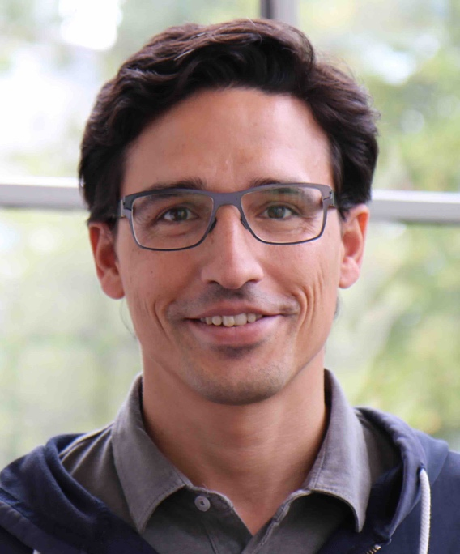
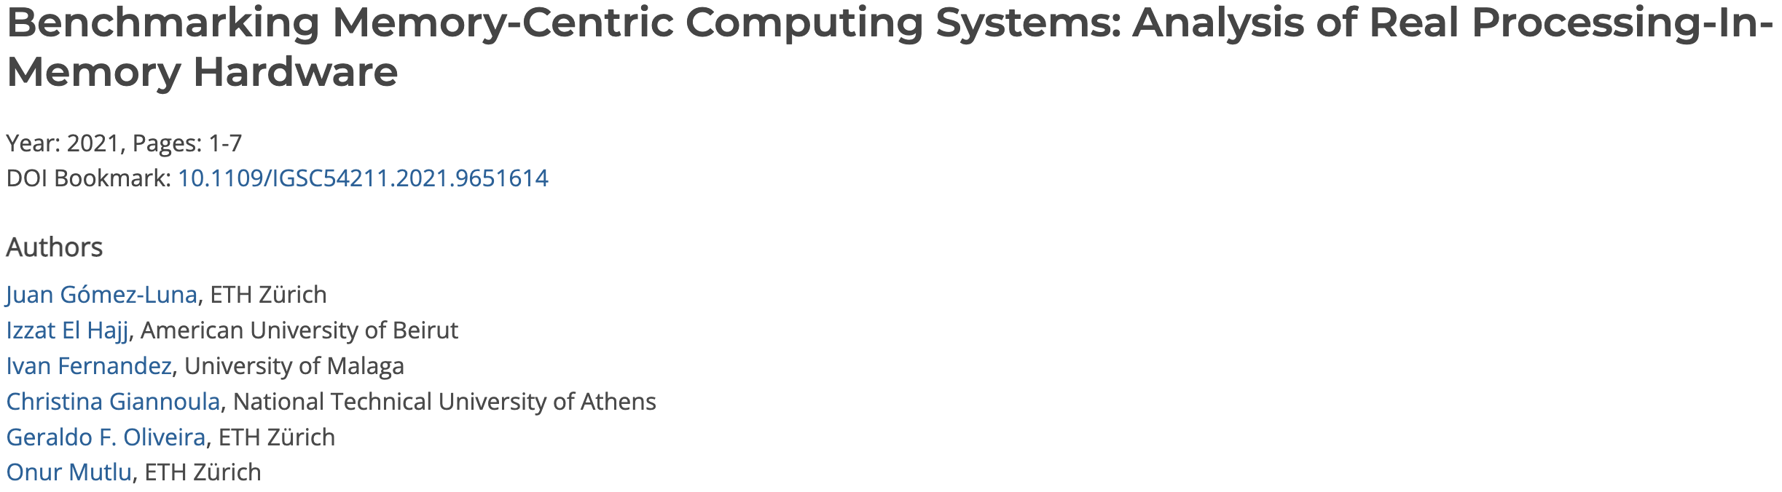
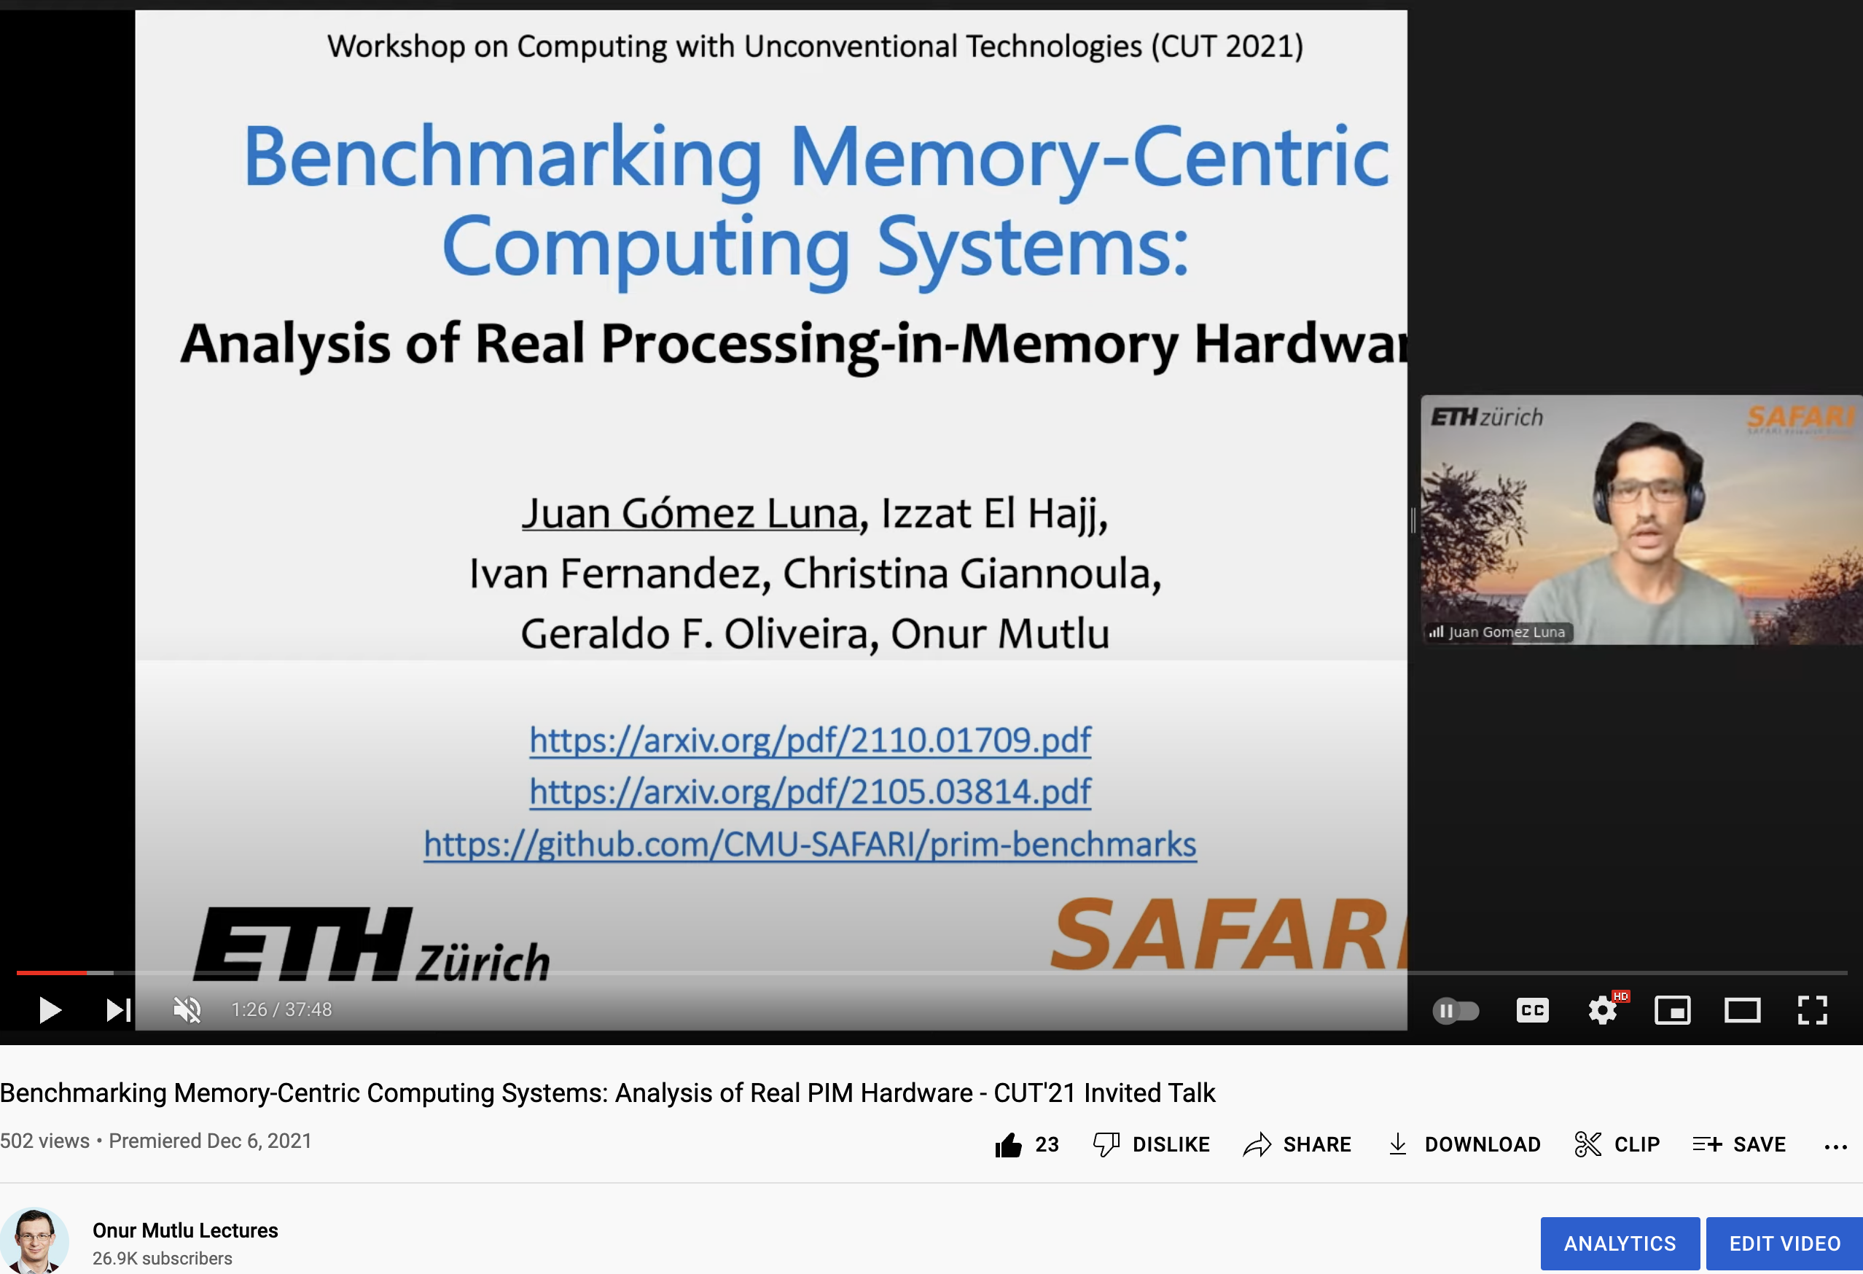
SRC TECHCON Presentation
Dr. Juan Gomez-Luna
  Benchmarking Memory-Centric Computing Systems: Analysis of Real Processing-in-Memory Hardware
  Based on two major works
    https://arxiv.org/pdf/2105.03814.pdf
    https://arxiv.org/pdf/2207.07886.pdf
https://www.youtube.com/watch?v=nphV36SrysA

Slide 91
Key Takeaway 1
The throughput saturation point is as low as ¼ OP/B,
i.e., 1 integer addition per every 32-bit element fetched
Memory-bound region
Compute-bound region
KEY TAKEAWAY 1
The UPMEM PIM architecture is fundamentally compute bound.
As a result, the most suitable workloads are memory-bound.

Slide 92
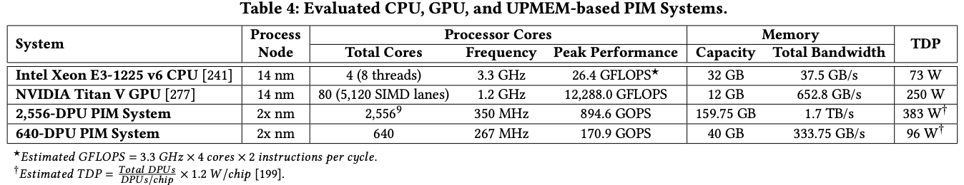
Key Takeaway 2
KEY TAKEAWAY 2
The most well-suited workloads for the UPMEM PIM architecture use no arithmetic operations or use only simple operations (e.g., bitwise operations and integer addition/subtraction).

Slide 93
Key Takeaway 3
KEY TAKEAWAY 3
The most well-suited workloads for the UPMEM PIM architecture require little or no communication across DPUs (inter-DPU communication).

Slide 94
Understanding a Modern Processing-in-Memory Architecture:
Benchmarking and Experimental Characterization
Juan Gómez Luna, Izzat El Hajj,
Ivan Fernandez, Christina Giannoula,
Geraldo F. Oliveira, Onur Mutlu
el1goluj@gmail.com
https://arxiv.org/pdf/2105.03814.pdf
https://github.com/CMU-SAFARI/prim-benchmarks

Slide 95
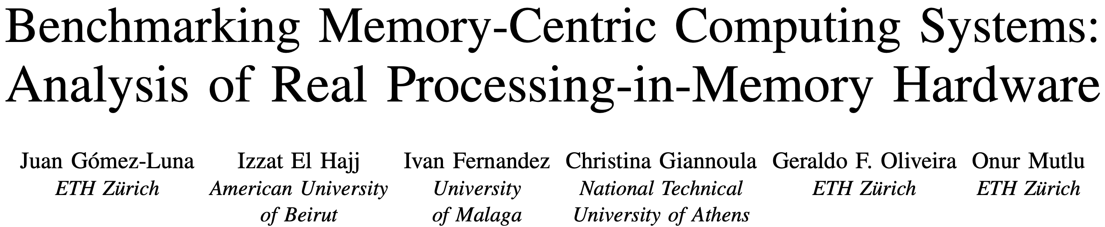
UPMEM PIM System Summary & Analysis
Juan Gomez-Luna, Izzat El Hajj, Ivan Fernandez, Christina Giannoula, Geraldo F. Oliveira, and Onur Mutlu,
"Benchmarking Memory-Centric Computing Systems: Analysis of Real Processing-in-Memory Hardware"
Invited Paper at Workshop on Computing with Unconventional Technologies (CUT), Virtual, October 2021.
[arXiv version]
[PrIM Benchmarks Source Code]
[Slides (pptx) (pdf)]
[Talk Video (37 minutes)]
[Lightning Talk Video (3 minutes)]

Slide 96
PrIM Benchmarks: Application Domains
Domain | Benchmark | Short name
Dense linear algebra | Vector Addition | VA
 | Matrix-Vector Multiply | GEMV
Sparse linear algebra | Sparse Matrix-Vector Multiply | SpMV
Databases | Select | SEL
 | Unique | UNI
Data analytics | Binary Search | BS
 | Time Series Analysis | TS
Graph processing | Breadth-First Search | BFS
Neural networks | Multilayer Perceptron | MLP
Bioinformatics | Needleman-Wunsch | NW
Image processing | Image histogram (short) | HST-S
 | Image histogram (large) | HST-L
Parallel primitives | Reduction | RED
 | Prefix sum (scan-scan-add) | SCAN-SSA
 | Prefix sum (reduce-scan-scan) | SCAN-RSS
 | Matrix transposition | TRNS

Slide 97
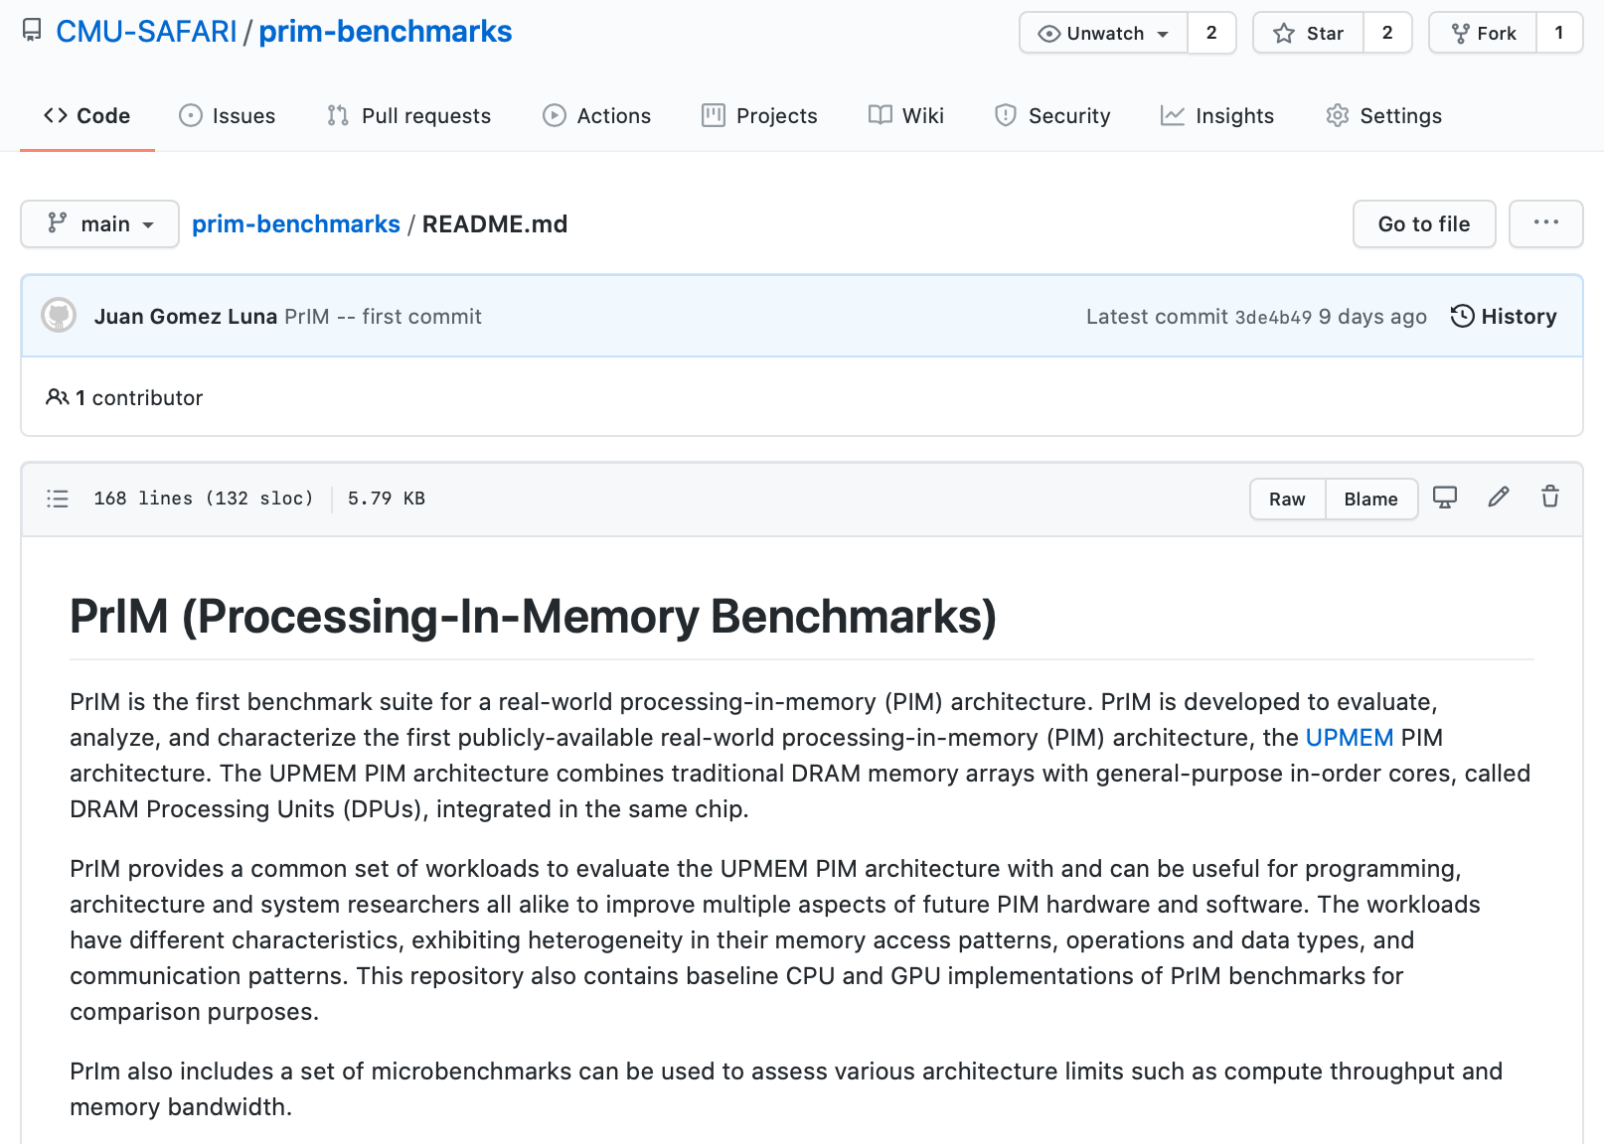
PrIM Benchmarks are Open Source
All microbenchmarks, benchmarks, and scripts
https://github.com/CMU-SAFARI/prim-benchmarks

Slide 98
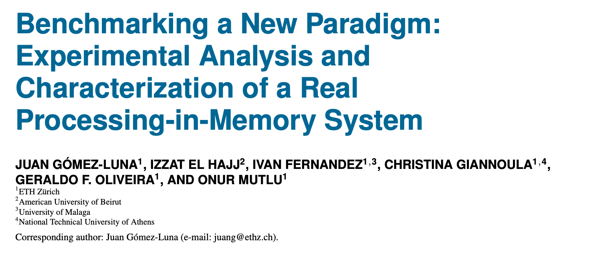
Understanding a Modern PIM Architecture
https://arxiv.org/pdf/2105.03814.pdf
https://github.com/CMU-SAFARI/prim-benchmarks

Slide 99
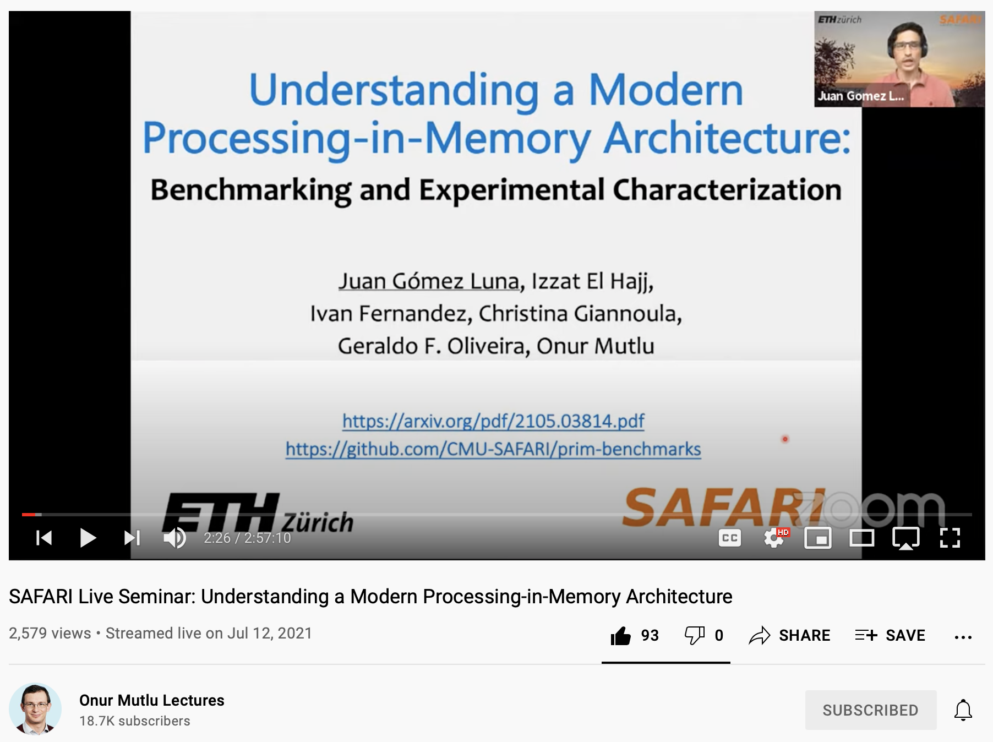
Understanding a Modern PIM Architecture
https://www.youtube.com/watch?v=D8Hjy2iU9l4&list=PL5Q2soXY2Zi_tOTAYm--dYByNPL7JhwR9

Slide 100
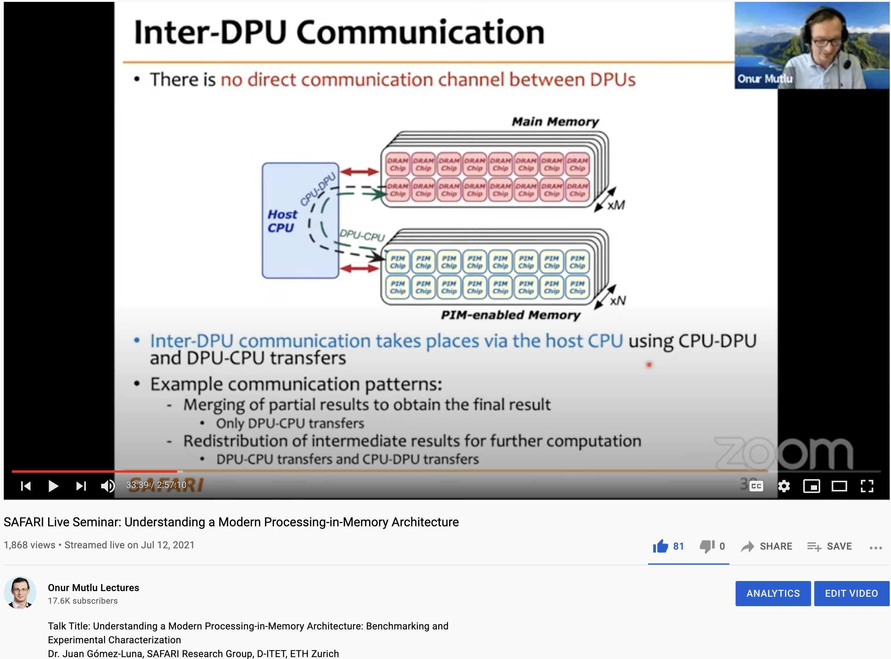
More on Analysis of the UPMEM PIM Engine
https://www.youtube.com/watch?v=D8Hjy2iU9l4&list=PL5Q2soXY2Zi_tOTAYm--dYByNPL7JhwR9

Slide 101
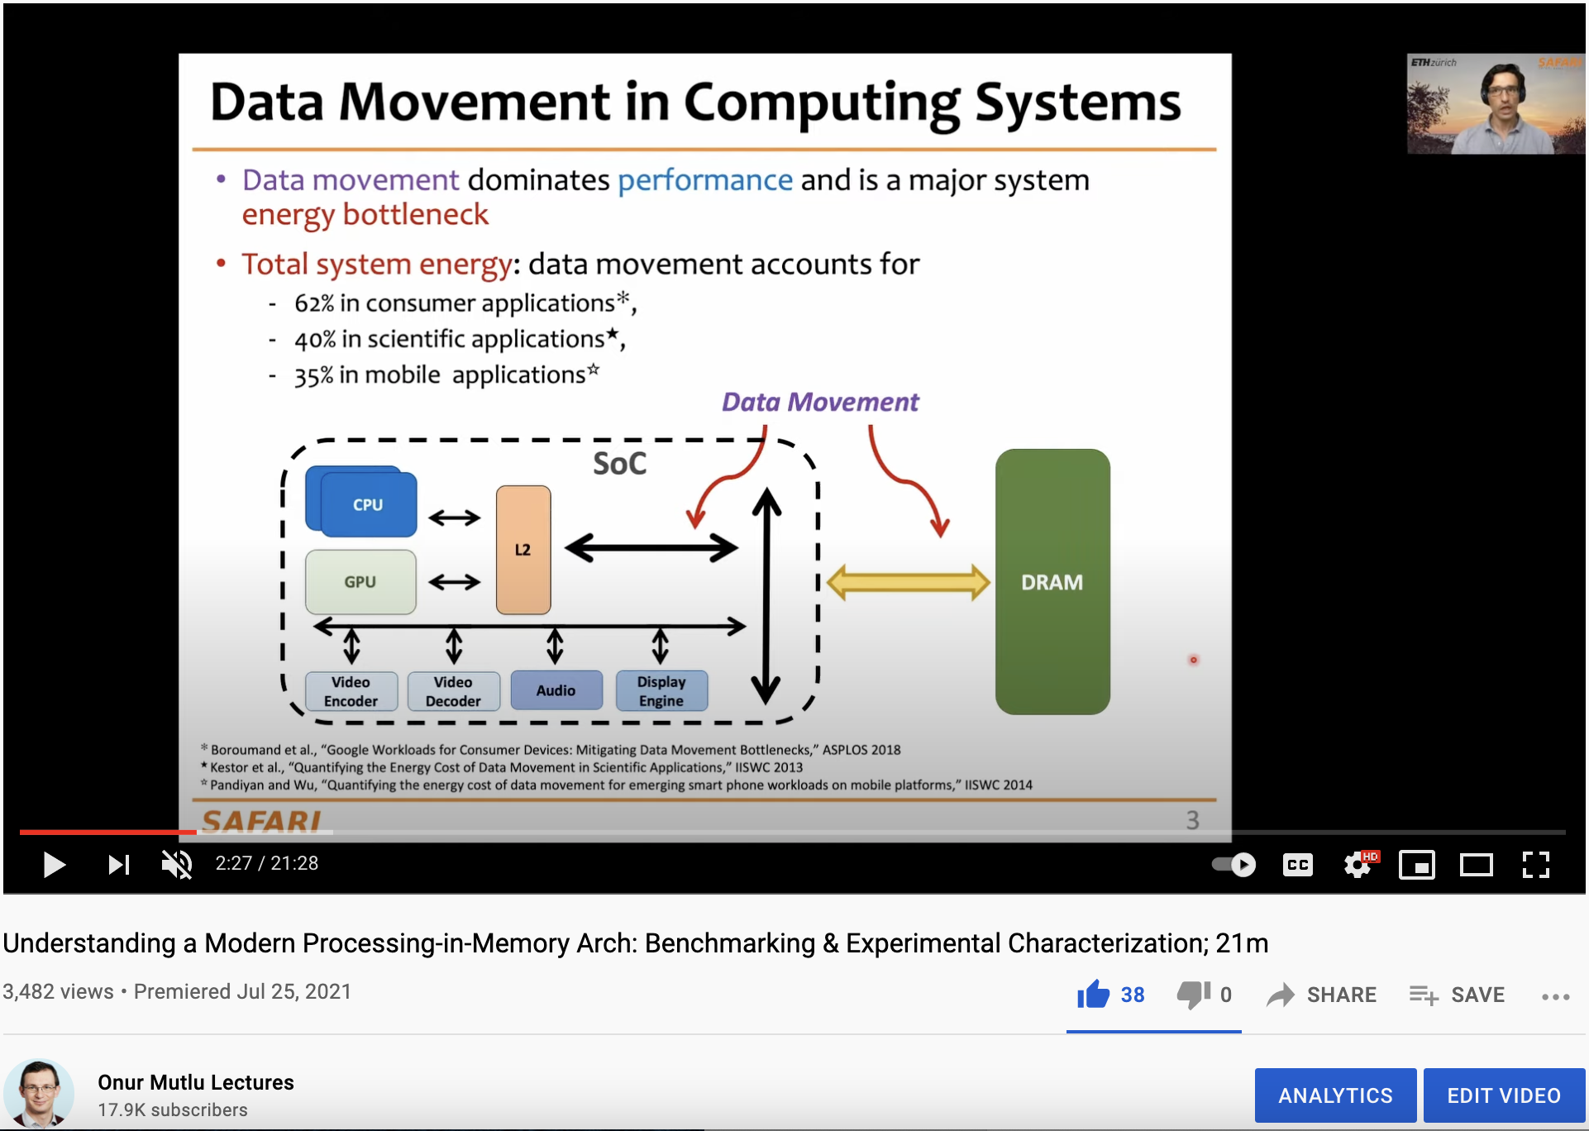
More on Analysis of the UPMEM PIM Engine
https://www.youtube.com/watch?v=Pp9jSU2b9oM&list=PL5Q2soXY2Zi8_VVChACnON4sfh2bJ5IrD&index=159

Slide 102
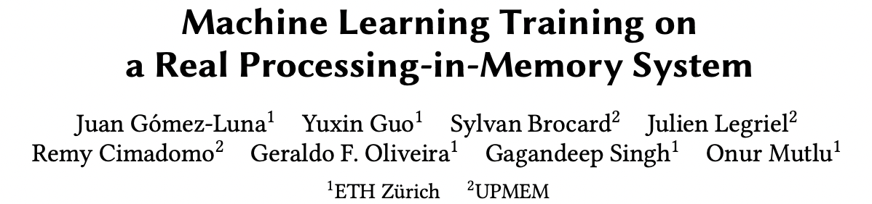
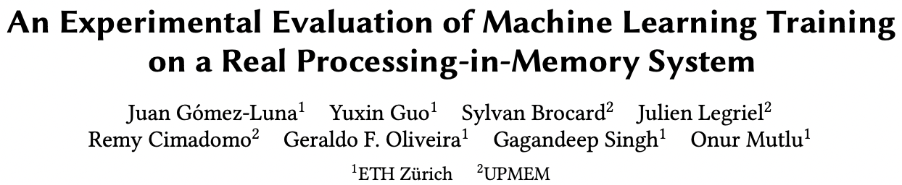
ML Training on a Real PIM System
Short version: https://arxiv.org/pdf/2206.06022.pdf
Long version: https://arxiv.org/pdf/2207.07886.pdf
https://www.youtube.com/watch?v=qeukNs5XI3g&t=11226s

Slide 103
ML Training on a Real PIM System
Need to optimize data representation
  (1) fixed-point
  (2) quantization
  (3) hybrid precision
Use lookup tables (LUTs) to implement complex functions (e.g., sigmoid)
Optimize data placement & layout for streaming
Large speedups: 2.8X/27X vs. CPU, 1.3x/3.2x vs. GPU

Slide 104
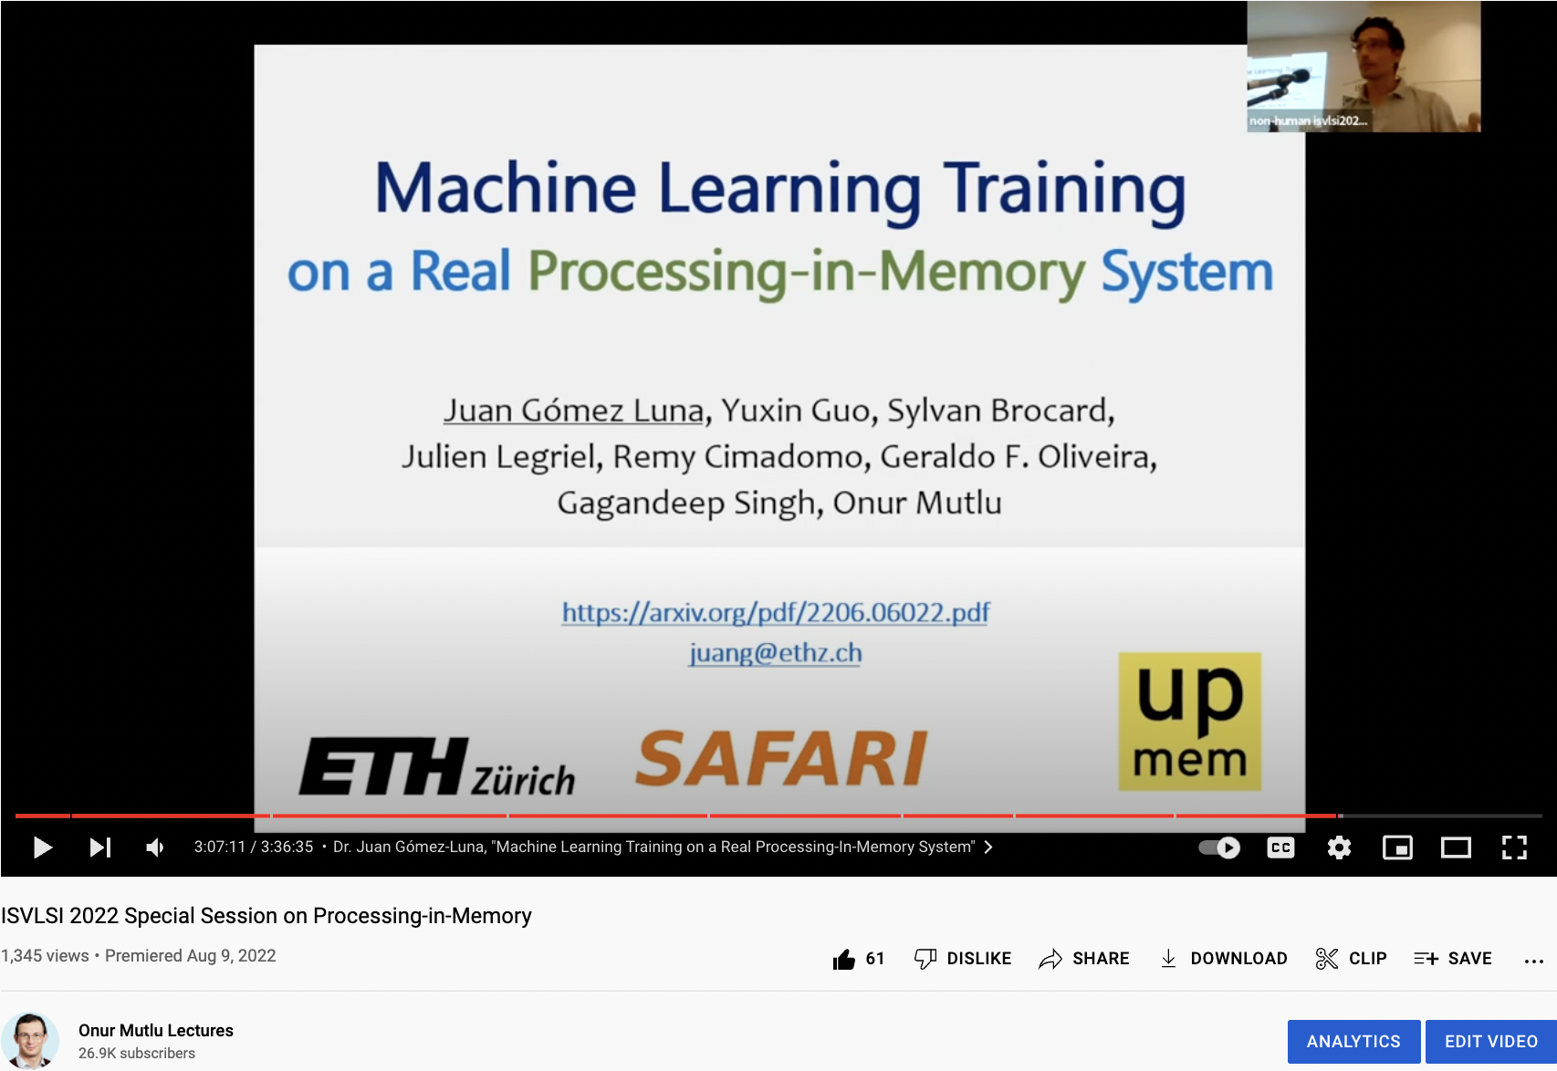
ML Training on Real PIM Talk Video
https://www.youtube.com/watch?v=qeukNs5XI3g&t=11226s

Slide 105
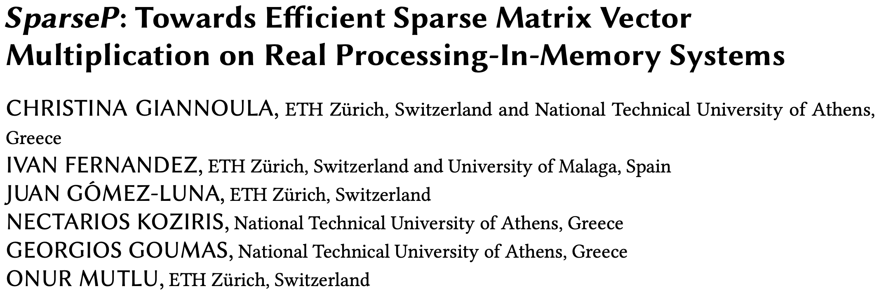
SpMV Multiplication on Real PIM Systems
Appears in SIGMETRICS 2022
https://arxiv.org/pdf/2201.05072.pdf
https://github.com/CMU-SAFARI/SparseP
https://www.youtube.com/watch?v=5kaOsJKlGrE

Slide 106






SparseP
Towards Efficient Sparse Matrix Vector Multiplication
on Real Processing-In-Memory Architectures
Christina Giannoula
Ivan Fernandez, Juan Gomez-Luna,
Nectarios Koziris, Georgios Goumas, Onur Mutlu

Slide 107

SparseP: Key Contributions
Efficient SpMV kernels for current & future PIM systems
  SparseP library = 25 SpMV kernels
    Compression, data types, data partitioning, synchronization, load balancing
Comprehensive analysis of SpMV on the first commercially-available real PIM system
  26 sparse matrices
  Comparisons to state-of-the-art CPU and GPU systems
  Recommendations for software, system and hardware designers
SparseP is Open-Source
SparseP: https://github.com/CMU-SAFARI/SparseP
Recommendations for Architects and Programmers
Full Paper: https://arxiv.org/pdf/2201.05072.pdf

Slide 108
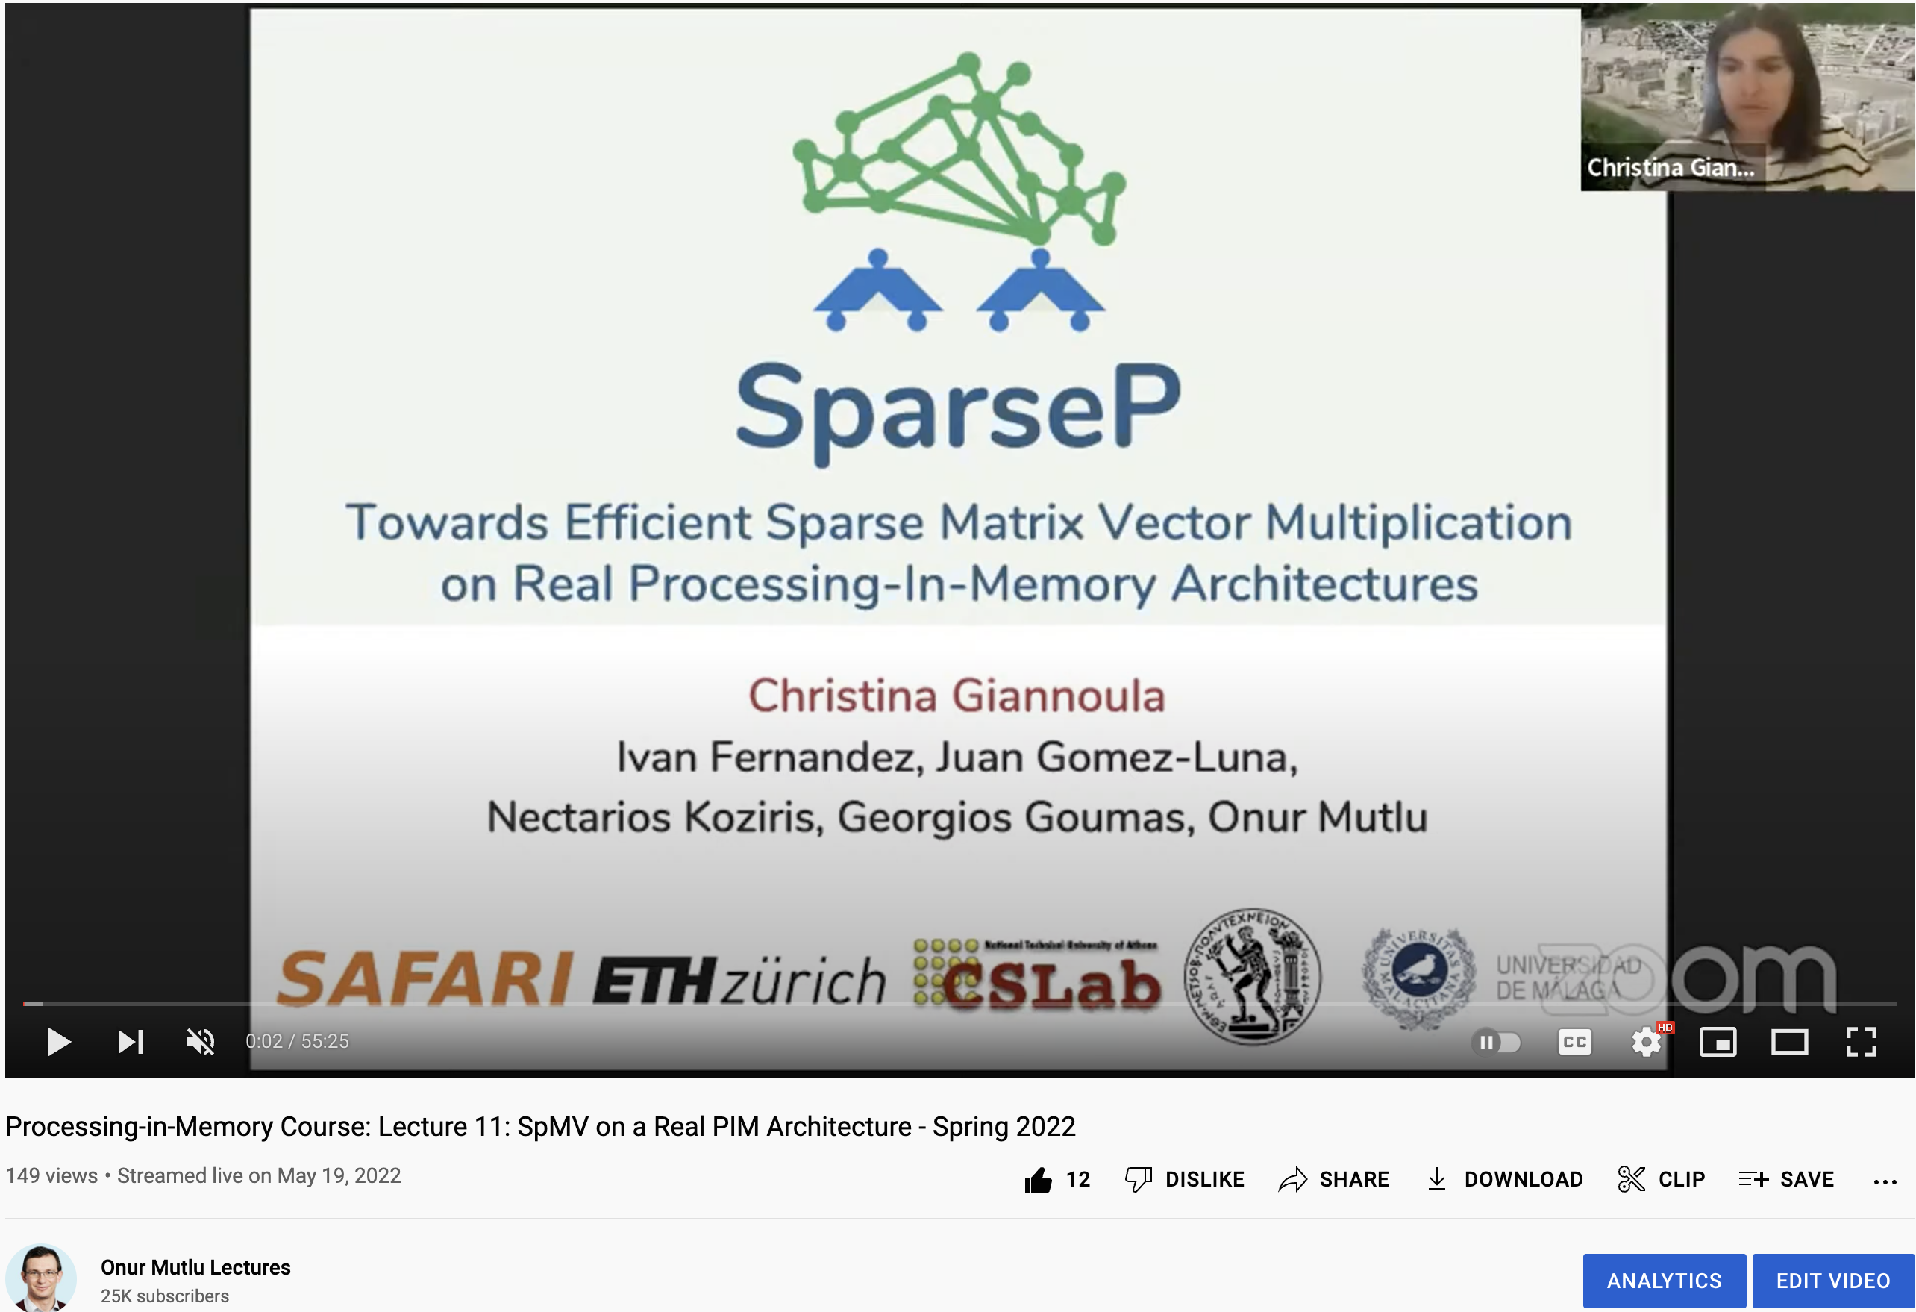
SparseP Talk Video
https://www.youtube.com/watch?v=5kaOsJKlGrE

Slide 109
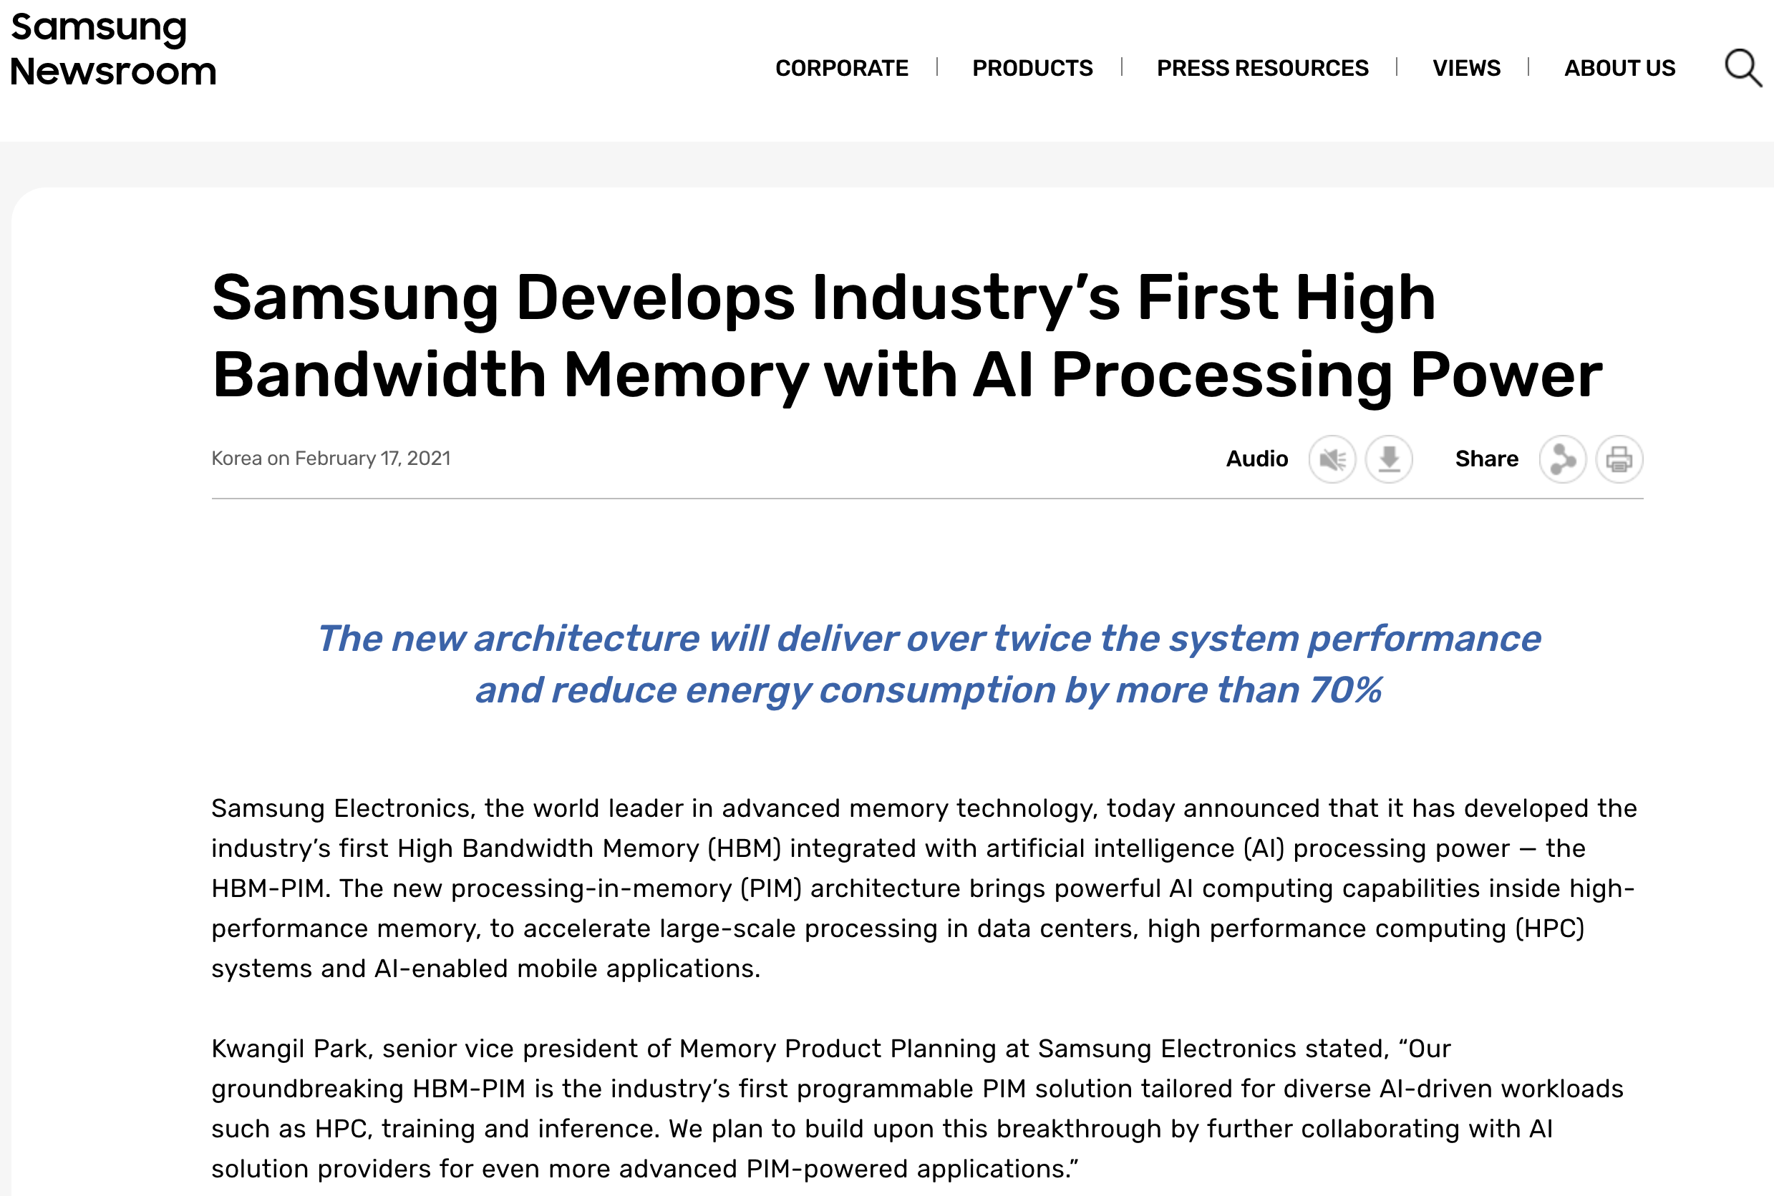
Samsung Function-in-Memory DRAM (2021)
https://news.samsung.com/global/samsung-develops-industrys-first-high-bandwidth-memory-with-ai-processing-power

Slide 110
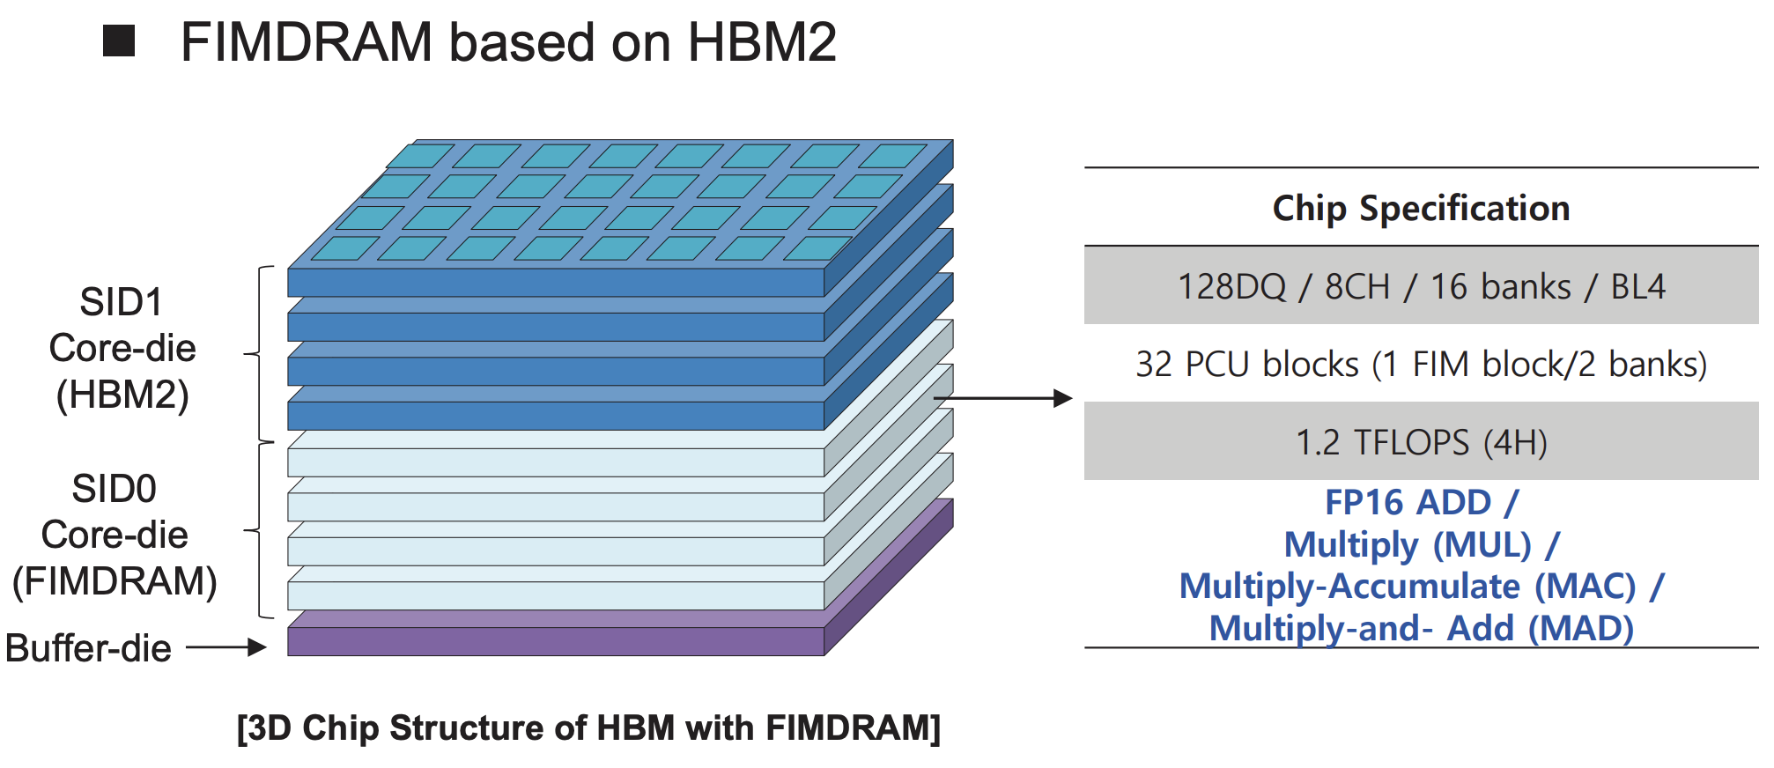
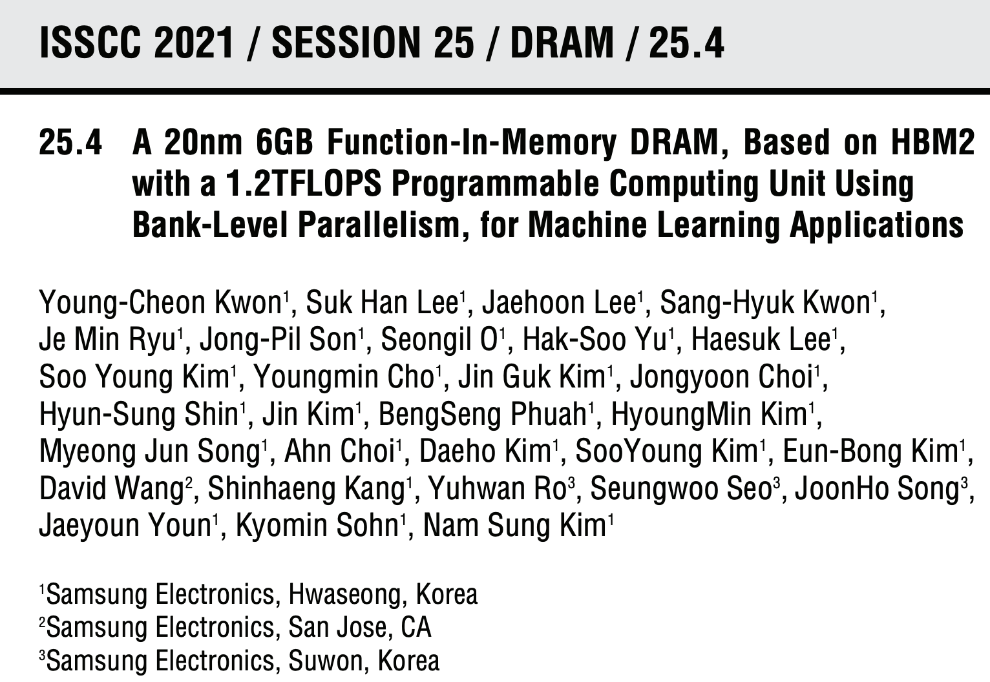
Samsung Function-in-Memory DRAM (2021)

Slide 111
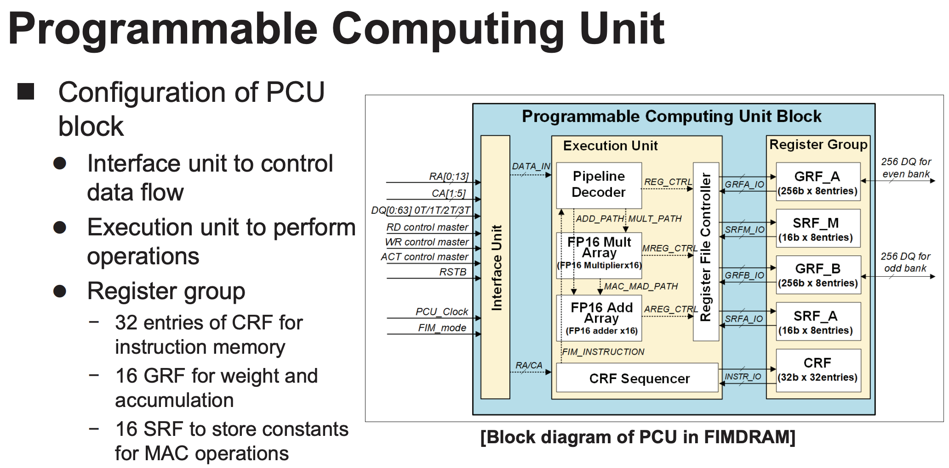
Samsung Function-in-Memory DRAM (2021)

Slide 112
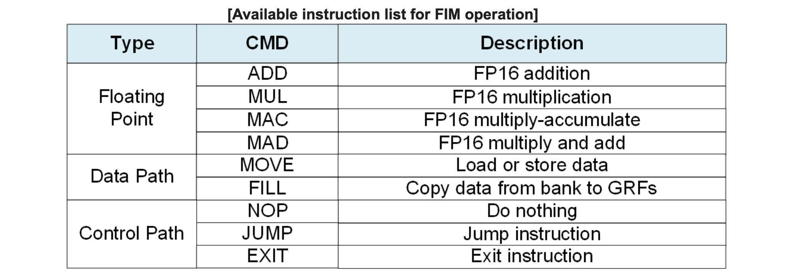
Samsung Function-in-Memory DRAM (2021)

Slide 113
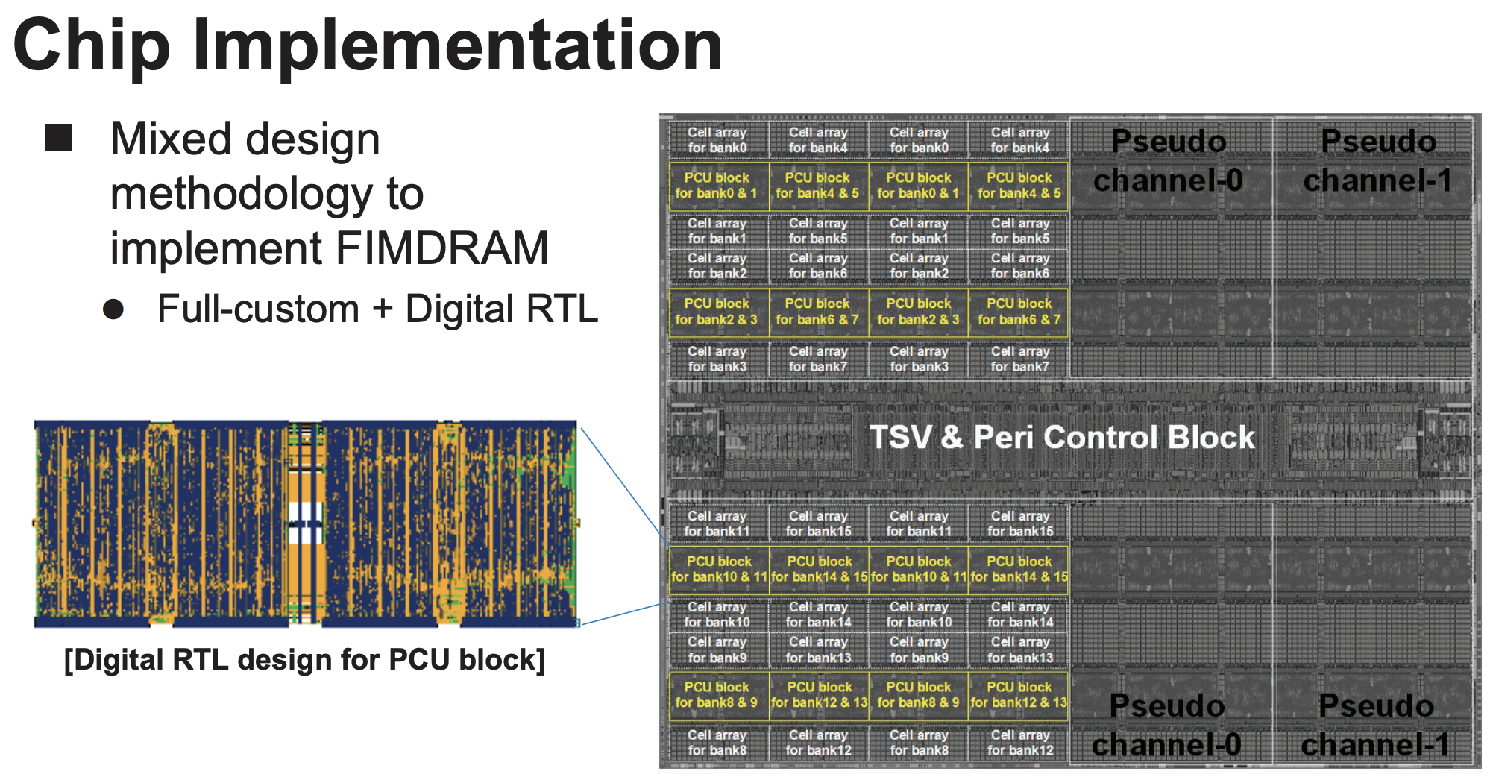
Samsung Function-in-Memory DRAM (2021)

Slide 114
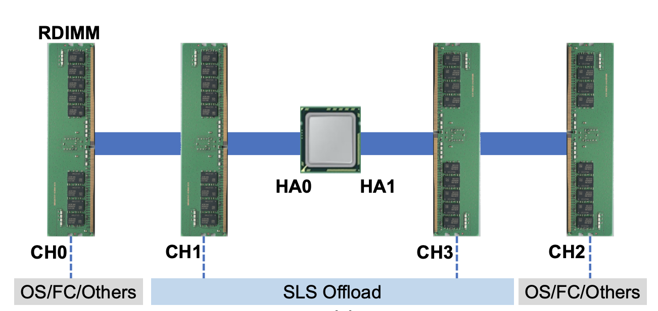
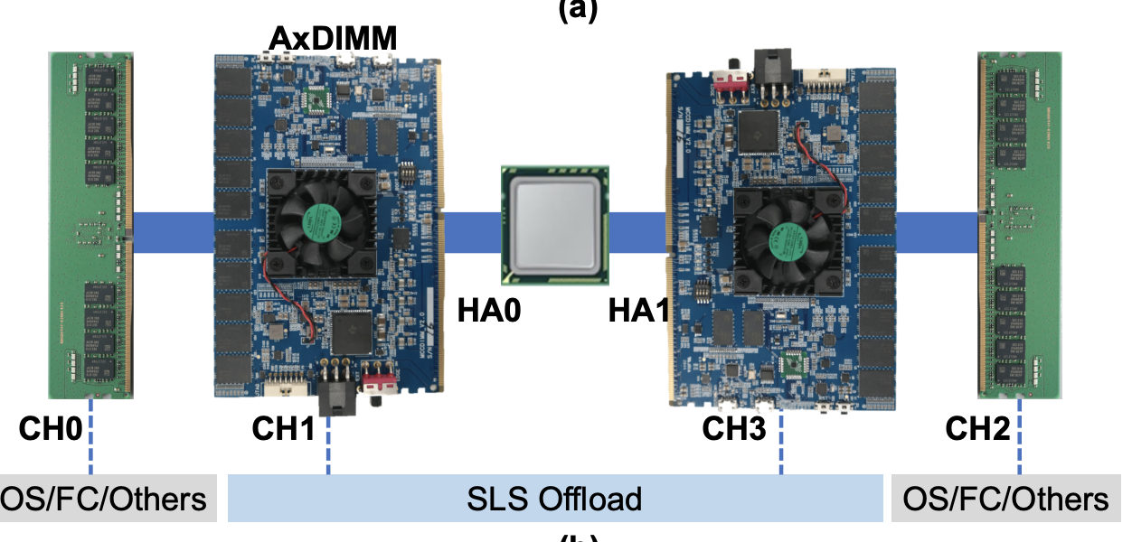
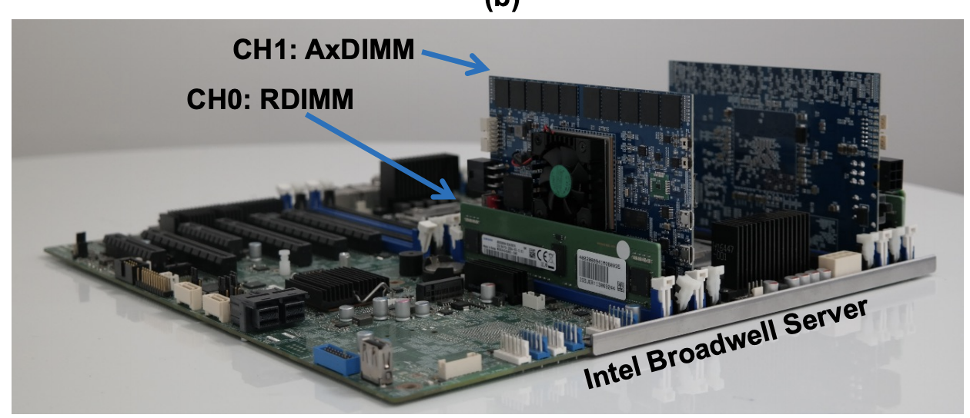
Samsung AxDIMM (2021)
DDRx-PIM
  Deep learning recommendation system
Baseline System
AxDIMM System
Ke et al. "Near-Memory Processing in Action: Accelerating Personalized Recommendation with AxDIMM", IEEE Micro (2021)

Slide 115
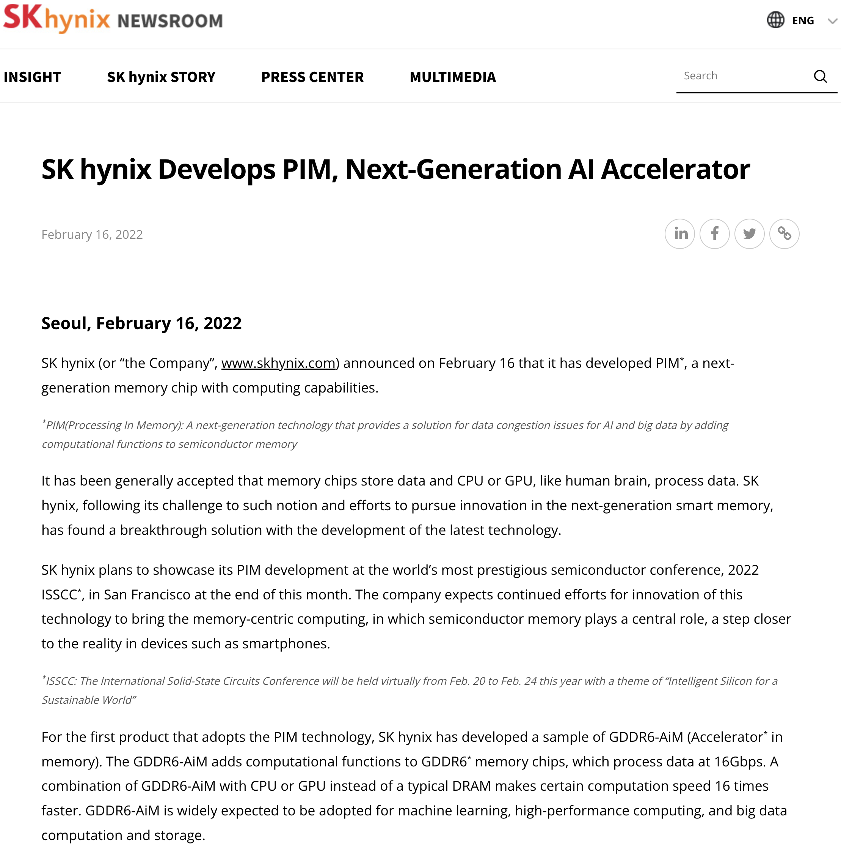
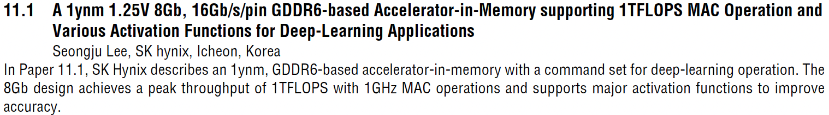
SK Hynix Accelerator-in-Memory (2022)
https://news.skhynix.com/sk-hynix-develops-pim-next-generation-ai-accelerator/

Slide 116
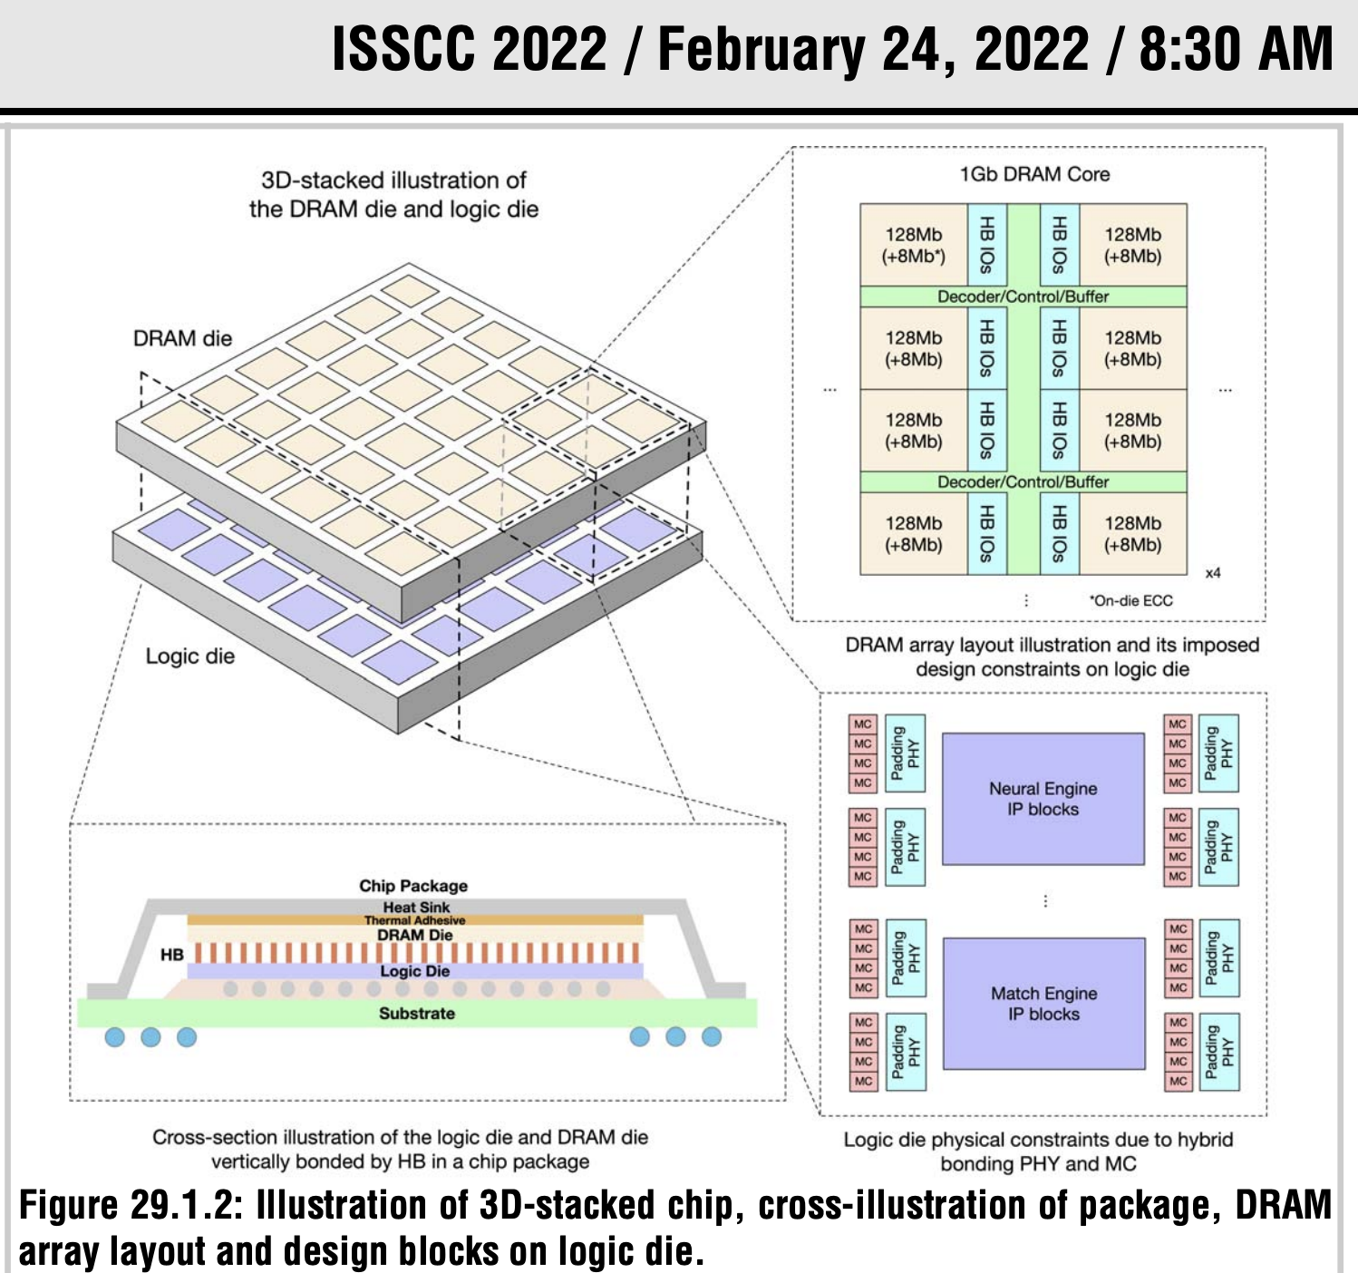
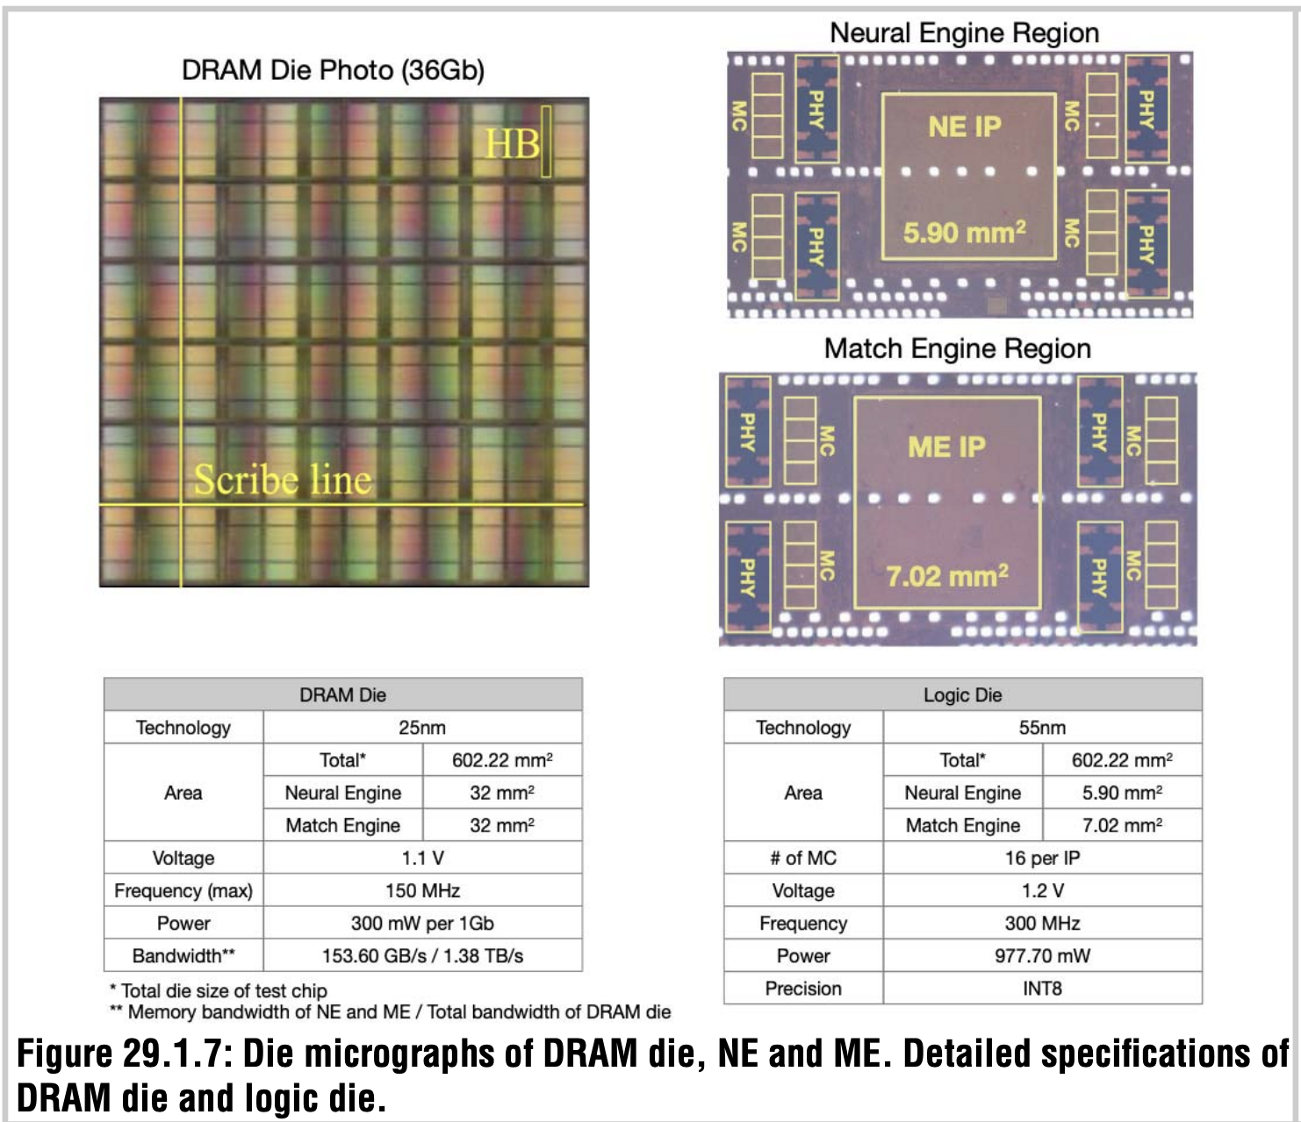
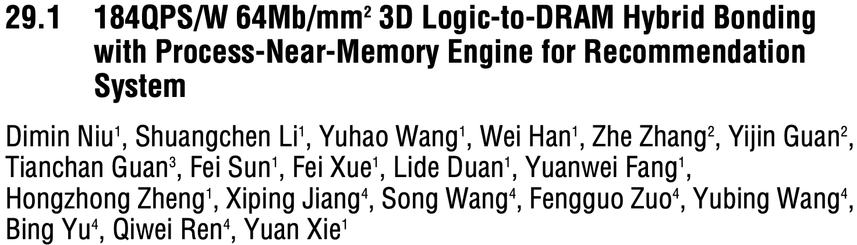
AliBaba PIM Recommendation System (2022)

Slide 117
Eliminating the Adoption Barriers
Processing-in-Memory
in the Real World

Slide 118
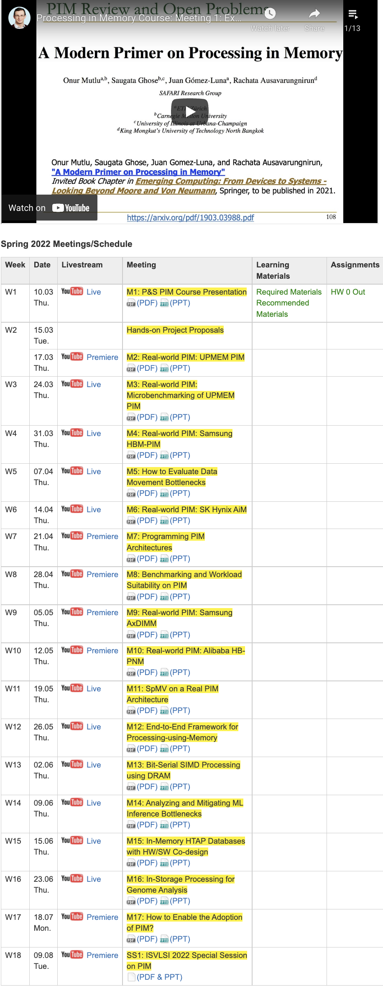
PIM Course (Spring 2022)
Spring 2022 Edition:
  https://safari.ethz.ch/projects_and_seminars/spring2022/doku.php?id=processing_in_memory
Youtube Livestream:
  https://www.youtube.com/watch?v=9e4Chnwdovo&list=PL5Q2soXY2Zi-841fUYYUK9EsXKhQKRPyX
Project course
  Taken by Bachelor’s/Master’s students
  Processing-in-Memory lectures
  Hands-on research exploration
  Many research readings
https://www.youtube.com/onurmutlulectures

Slide 119
Processing in Memory:
Two Approaches
1. Processing near Memory
2. Processing using Memory

Slide 120
Mindset: Memory as an Accelerator
CPU
core
CPU
core
mini-CPU
core
GPU
(throughput)
core
GPU
(throughput)
core
video
core
GPU
(throughput)
core
GPU
(throughput)
core
CPU
core
CPU
core
Memory
imaging
core
LLC
Specialized
compute-capability
in memory
Memory Controller
Memory Bus
Memory similar to a “conventional” accelerator

Slide 121

Starting Simple: Data Copy and Initialization
  memmove & memcpy: 5% cycles in Google’s datacenter [Kanev+ ISCA’15]
000000000000000
Zero initialization
(e.g., security)
Forking
Checkpointing
Many more
VM Cloning
Deduplication
Page Migration

Slide 122
Future Systems: In-Memory Copy
3) No cache pollution
1) Low latency
Memory
L3
CPU
L2
L1
MC
2) Low bandwidth utilization
4) No unwanted data movement
1046ns, 3.6uJ
→ 90ns, 0.04uJ

Slide 123
RowClone: In-DRAM Row Copy
Idea: Two consecutive ACTivates
4 Kbytes
Negligible HW cost
Step 1: Activate row A
Step 2: Activate row B
Transfer row
DRAM subarray
Transfer
row
Row Buffer (4 Kbytes)
8 bits
Data Bus
Notes:
copy

Slide 124
RowClone: Latency and Energy Savings
11.6x
74x
Seshadri et al., “RowClone: Fast and Efficient In-DRAM Copy and Initialization of Bulk Data,” MICRO 2013.

Slide 125
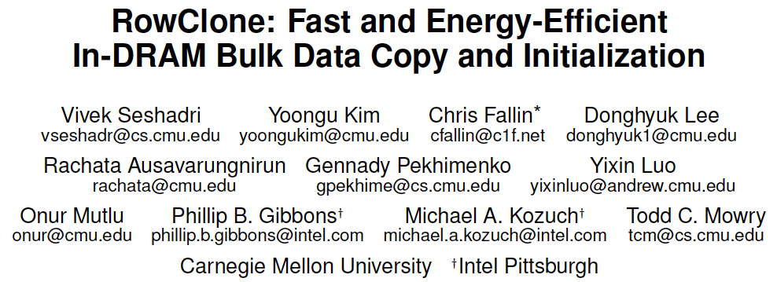
More on RowClone
Vivek Seshadri, Yoongu Kim, Chris Fallin, Donghyuk Lee, Rachata Ausavarungnirun, Gennady Pekhimenko, Yixin Luo, Onur Mutlu, Michael A. Kozuch, Phillip B. Gibbons, and Todd C. Mowry,
"RowClone: Fast and Energy-Efficient In-DRAM Bulk Data Copy and Initialization"
Proceedings of the 46th International Symposium on Microarchitecture (MICRO), Davis, CA, December 2013. [Slides (pptx) (pdf)] [Lightning Session Slides (pptx) (pdf)] [Poster (pptx) (pdf)]

Slide 126
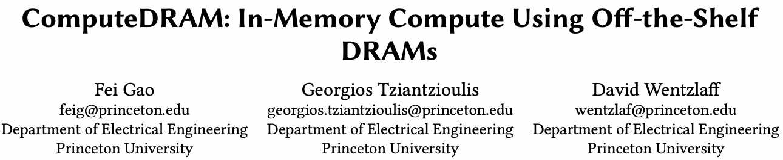
RowClone in Off-the-Shelf DRAM Chips
Idea: Violate DRAM timing parameters to mimic RowClone
https://parallel.princeton.edu/papers/micro19-gao.pdf

Slide 127
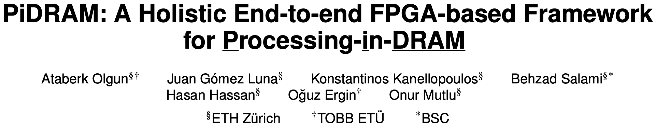
Real Processing Using Memory Prototype
End-to-end RowClone & TRNG using off-the-shelf DRAM chips
Idea: Violate DRAM timing parameters to mimic RowClone
https://arxiv.org/pdf/2111.00082.pdf
https://github.com/cmu-safari/pidram
https://www.youtube.com/watch?v=qeukNs5XI3g&t=4192s

Slide 128
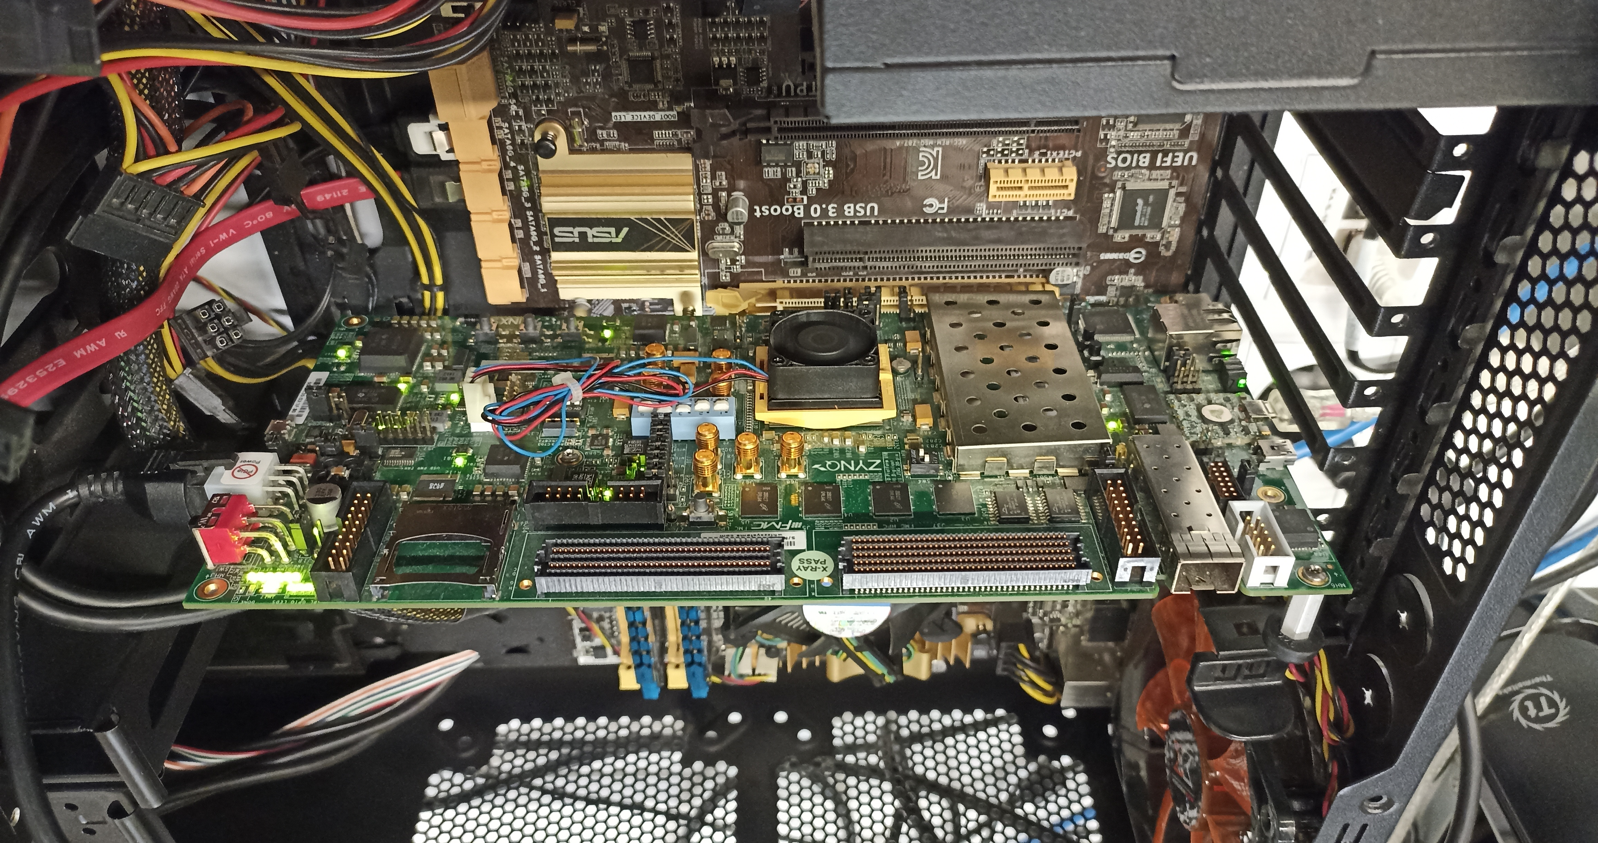
Real Processing Using Memory Prototype
https://arxiv.org/pdf/2111.00082.pdf
https://github.com/cmu-safari/pidram
https://www.youtube.com/watch?v=qeukNs5XI3g&t=4192s
Host Machine
FPGA Board
RISC-V System
PiM-Enabled DIMM

Slide 129
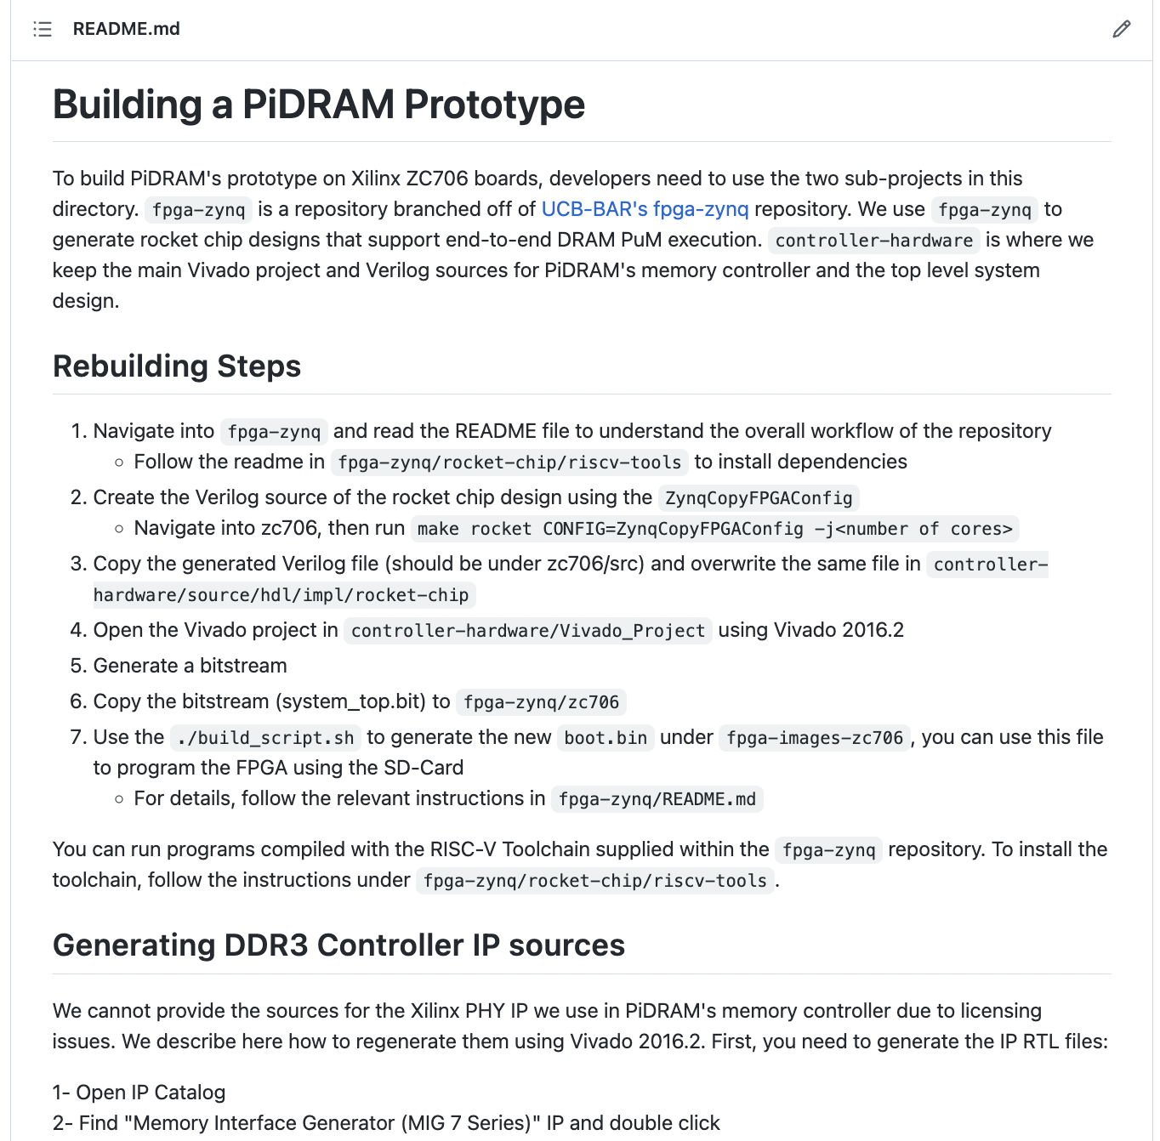
Real Processing Using Memory Prototype
https://arxiv.org/pdf/2111.00082.pdf
https://github.com/cmu-safari/pidram
https://www.youtube.com/watch?v=qeukNs5XI3g&t=4192s

Slide 130
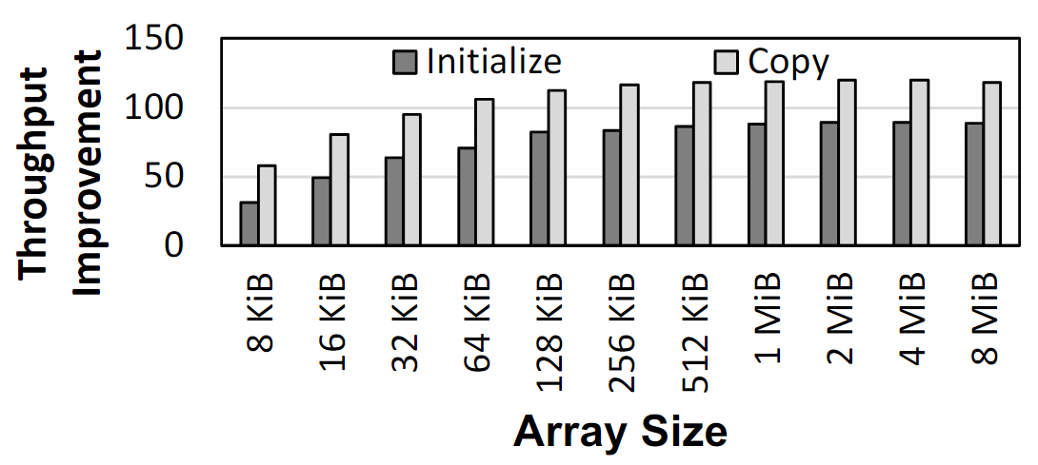
Microbenchmark Copy/Initialization Throughput
In-DRAM Copy and Initialization
improve throughput by 119x and 89x
Notes:
This plot shows the throughput improvement provided by in-DRAM copy operations for bulk data initialization and copy over CPU-based copy and initialization using LOAD and STORE instructions. We do not execute any CLFLUSH instructions and assume that the data is up to date in DRAM and there are no cached copies.
The x-axis shows the size of the arrays that we copy or initialize. The dark gray bar shows the improvement for initialization operations, and the bright gray bar shows the improvement for copy operations.
[CLICK] We observe that in-DRAM copy and initialization operations improve copy and initialization throughput by 119x and 89x including the overheads of system support required for RowClone operations

Slide 131
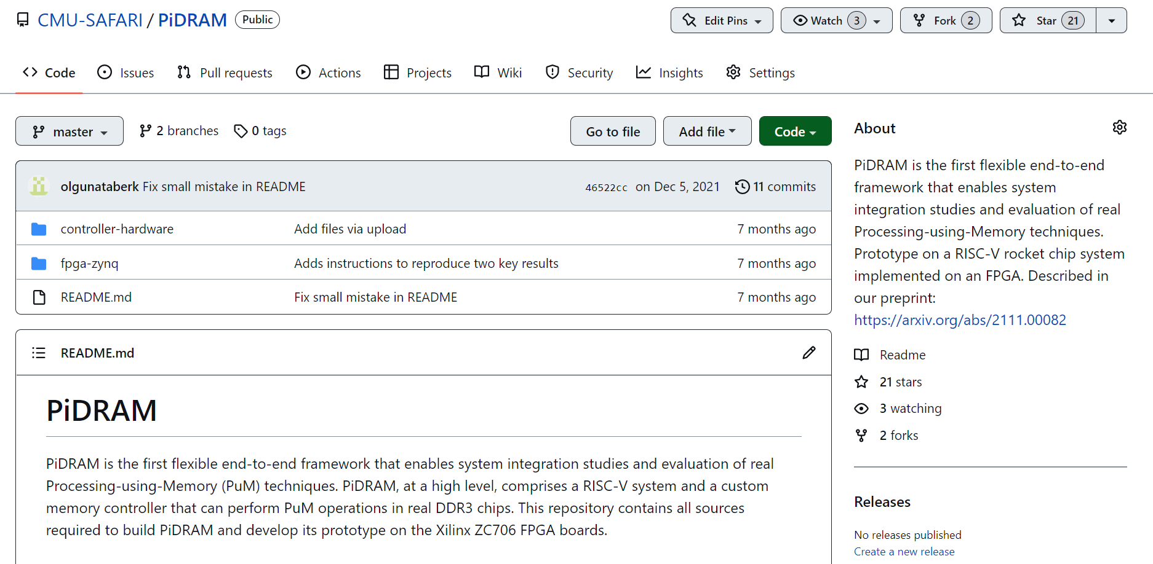
PiDRAM is Open Source
https://github.com/CMU-SAFARI/PiDRAM
Notes:
PiDRAM is openly and freely available on Github. If you are interested in PiDRAM, please use it and feel free to contribute to it.

Slide 132
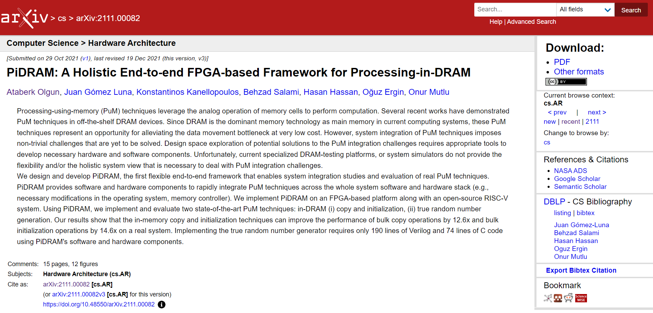
Extended Version on ArXiv
https://arxiv.org/abs/2111.00082
Notes:
An extended version of our conference paper is available on arXiv on this link where we discuss our framework in more detail.

Slide 133
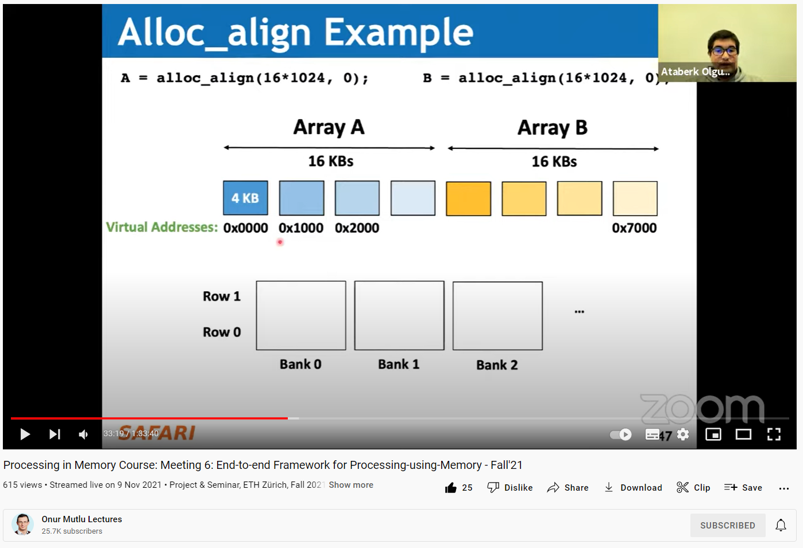
Long Talk + Tutorial on Youtube
https://youtu.be/s_z_S6FYpC8
Notes:
I also describe PiDRAM in more detail and give a tutorial on how to use our framework in this SAFARI live seminar talk.

Slide 134
(Truly) In-Memory Computation
We can support in-DRAM AND, OR, NOT, MAJ
At low cost
Using analog computation capability of DRAM
  Idea: activating multiple rows performs computation
30-60X performance and energy improvement
  Seshadri+, “Ambit: In-Memory Accelerator for Bulk Bitwise Operations Using Commodity DRAM Technology,” MICRO 2017.
New memory technologies enable even more opportunities
  Memristors, resistive RAM, phase change mem, STT-MRAM, …
  Can operate on data with minimal movement

Slide 135
In-DRAM AND/OR: Triple Row Activation
½V_{DD}
½V_{DD}+δ
V_{DD}
A
Final State
AB + BC + AC
B
C
C(A + B) + ~C(AB)
dis
en
0
½V_{DD}
Seshadri+, “Fast Bulk Bitwise AND and OR in DRAM”, IEEE CAL 2015.

Slide 136
Bulk Bitwise Operations in Workloads
[1] Li and Patel, BitWeaving, SIGMOD 2013
[2] Goodwin+, BitFunnel, SIGIR 2017

Slide 137
In-DRAM Acceleration of Database Queries
>4-12X Performance Improvement
Seshadri+, “Ambit: In-Memory Accelerator for Bulk Bitwise Operations using Commodity DRAM Technology,” MICRO 2017.

Slide 138
More on Ambit
Vivek Seshadri, Donghyuk Lee, Thomas Mullins, Hasan Hassan, Amirali Boroumand, Jeremie Kim, Michael A. Kozuch, Onur Mutlu, Phillip B. Gibbons, and Todd C. Mowry,
"Ambit: In-Memory Accelerator for Bulk Bitwise Operations Using Commodity DRAM Technology"
Proceedings of the 50th International Symposium on Microarchitecture (MICRO), Boston, MA, USA, October 2017.
[Slides (pptx) (pdf)] [Lightning Session Slides (pptx) (pdf)] [Poster (pptx) (pdf)]

Slide 139
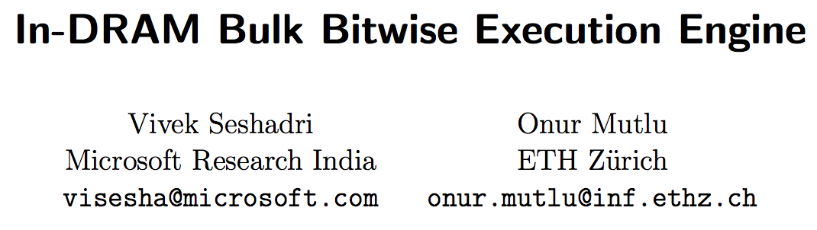
In-DRAM Bulk Bitwise Execution
Vivek Seshadri and Onur Mutlu,
"In-DRAM Bulk Bitwise Execution Engine"
Invited Book Chapter in Advances in Computers, to appear in 2020.
[Preliminary arXiv version]

Slide 140
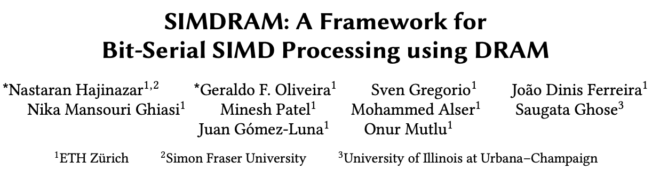
SIMDRAM Framework
Nastaran Hajinazar, Geraldo F. Oliveira, Sven Gregorio, Joao Dinis Ferreira, Nika Mansouri Ghiasi, Minesh Patel, Mohammed Alser, Saugata Ghose, Juan Gomez-Luna, and Onur Mutlu,
"SIMDRAM: An End-to-End Framework for Bit-Serial SIMD Computing in DRAM"
Proceedings of the 26th International Conference on Architectural Support for Programming Languages and Operating Systems (ASPLOS), Virtual, March-April 2021.
[2-page Extended Abstract]
[Short Talk Slides (pptx) (pdf)]
[Talk Slides (pptx) (pdf)]
[Short Talk Video (5 mins)]
[Full Talk Video (27 mins)]

Slide 141
SIMDRAM Framework: Overview
User Input
Step 1: Generate
MAJ logic
Step 2: Generate
sequence of
DRAM commands
SIMDRAM Output
Desired operation
New SIMDRAM $μ$Program
ACT/PRE
ACT/PRE
ACT/PRE
ACT/ACT/PRE
done
$$μProgram$$
$$μProgram$$
MAJ
Main memory
AND/OR/NOT logic
MAJ/NOT logic
bbop_new
New SIMDRAM
instruction
ISA
$μ$Program
User Input
Step 3: Execution according to $μ$Program
SIMDRAM Output
SIMDRAM-enabled application
Instruction result
in memory
foo () {
bbop_new
}
ACT/PRE
ACT/PRE
ACT/PRE
ACT/PRE/PRE
done
ACT/PRE
Control Unit
$μ$Program
Memory Controller

Slide 142
SIMDRAM Key Results
Evaluated on:
  16 complex in-DRAM operations
  7 commonly-used real-world applications
SIMDRAM provides:
88× and 5.8× the throughput of a CPU and a high-end GPU, respectively, over 16 operations
257× and 31× the energy efficiency of a CPU and a high-end GPU, respectively, over 16 operations
21× and 2.1× the performance of a CPU an a high-end GPU, over seven real-world applications

Slide 143
More on SIMDRAM
Nastaran Hajinazar, Geraldo F. Oliveira, Sven Gregorio, Joao Dinis Ferreira, Nika Mansouri Ghiasi, Minesh Patel, Mohammed Alser, Saugata Ghose, Juan Gomez-Luna, and Onur Mutlu,
"SIMDRAM: An End-to-End Framework for Bit-Serial SIMD Computing in DRAM"
Proceedings of the 26th International Conference on Architectural Support for Programming Languages and Operating Systems (ASPLOS), Virtual, March-April 2021.
[2-page Extended Abstract]
[Short Talk Slides (pptx) (pdf)]
[Talk Slides (pptx) (pdf)]
[Short Talk Video (5 mins)]
[Full Talk Video (27 mins)]

Slide 144
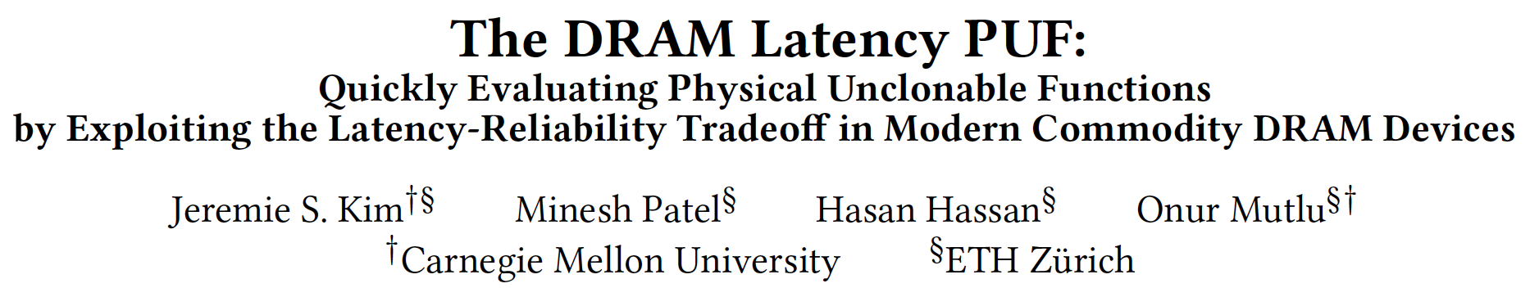
In-DRAM Physical Unclonable Functions
Jeremie S. Kim, Minesh Patel, Hasan Hassan, and Onur Mutlu,
"The DRAM Latency PUF: Quickly Evaluating Physical Unclonable Functions by Exploiting the Latency-Reliability Tradeoff in Modern DRAM Devices"
Proceedings of the 24th International Symposium on High-Performance Computer Architecture (HPCA), Vienna, Austria, February 2018.
[Lightning Talk Video]
[Slides (pptx) (pdf)] [Lightning Session Slides (pptx) (pdf)]
[Full Talk Lecture Video (28 minutes)]

Slide 145
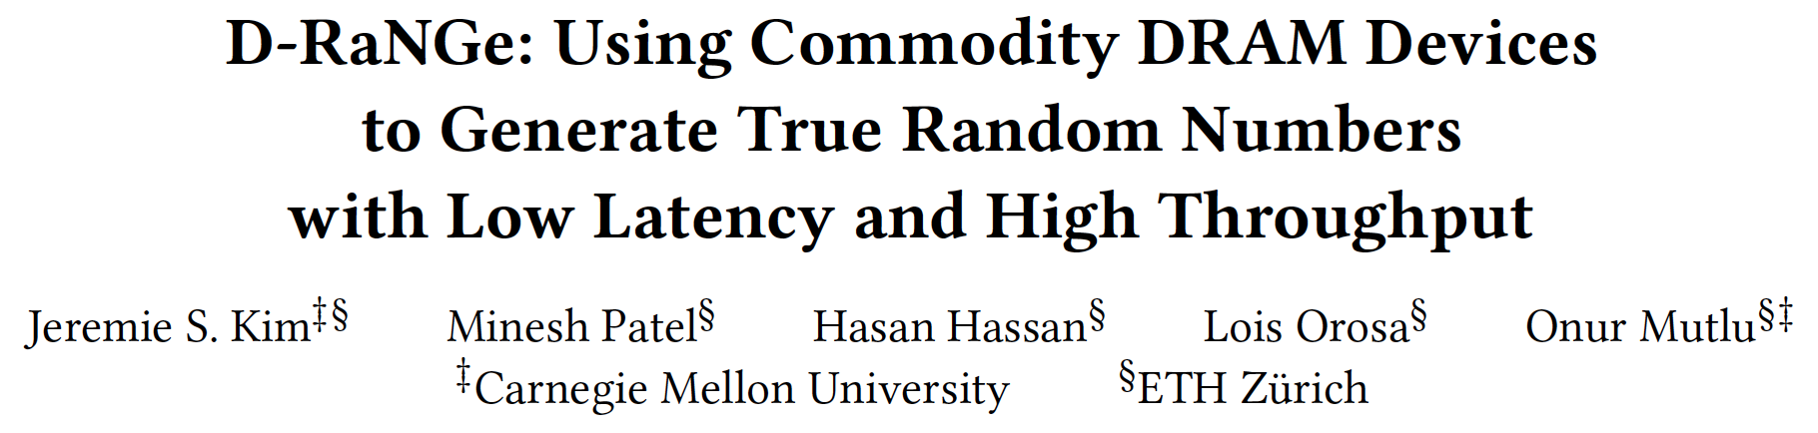
In-DRAM True Random Number Generation
Jeremie S. Kim, Minesh Patel, Hasan Hassan, Lois Orosa, and Onur Mutlu,
"D-RaNGe: Using Commodity DRAM Devices to Generate True Random Numbers with Low Latency and High Throughput"
Proceedings of the 25th International Symposium on High-Performance Computer Architecture (HPCA), Washington, DC, USA, February 2019.
[Slides (pptx) (pdf)]
[Full Talk Video (21 minutes)]
[Full Talk Lecture Video (27 minutes)]
Top Picks Honorable Mention by IEEE Micro.

Slide 146
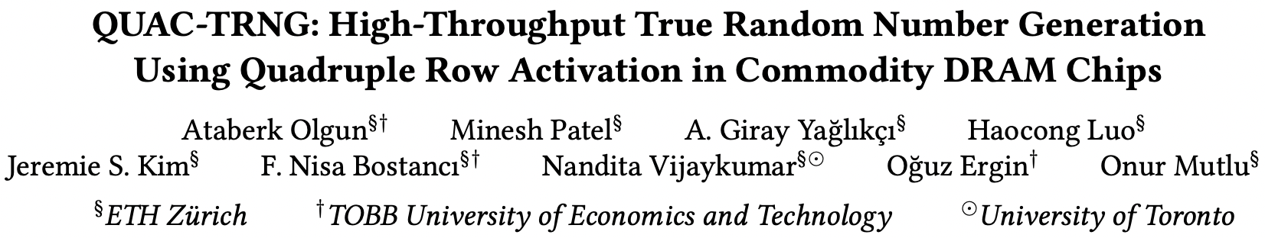
In-DRAM True Random Number Generation
Ataberk Olgun, Minesh Patel, A. Giray Yaglikci, Haocong Luo, Jeremie S. Kim, F. Nisa Bostanci, Nandita Vijaykumar, Oguz Ergin, and Onur Mutlu,
"QUAC-TRNG: High-Throughput True Random Number Generation Using Quadruple Row Activation in Commodity DRAM Chips"
Proceedings of the 48th International Symposium on Computer Architecture (ISCA), Virtual, June 2021.
[Slides (pptx) (pdf)]
[Short Talk Slides (pptx) (pdf)]
[Talk Video (25 minutes)]
[SAFARI Live Seminar Video (1 hr 26 mins)]

Slide 147
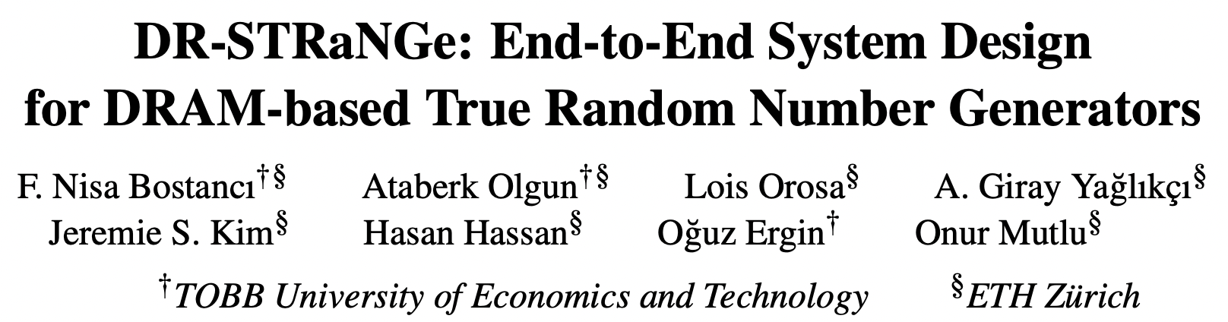
In-DRAM True Random Number Generation
F. Nisa Bostanci, Ataberk Olgun, Lois Orosa, A. Giray Yaglikci, Jeremie S. Kim, Hasan Hassan, Oguz Ergin, and Onur Mutlu,
"DR-STRaNGe: End-to-End System Design for DRAM-based True Random Number Generators"
Proceedings of the 28th International Symposium on High-Performance Computer Architecture (HPCA), Virtual, April 2022.
[Slides (pptx) (pdf)]
[Short Talk Slides (pptx) (pdf)]
https://arxiv.org/pdf/2201.01385.pdf

Slide 148
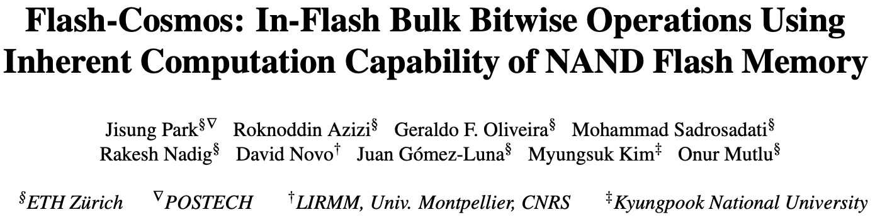
In-Flash Bulk Bitwise Execution
To appear at MICRO 2022
https://arxiv.org/pdf/2209.05566.pdf

Slide 149
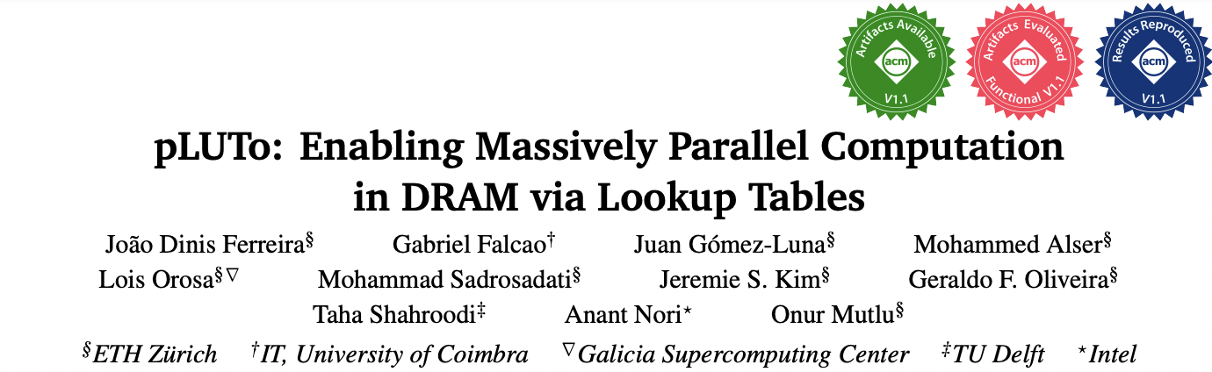
In-DRAM Lookup-Table Based Execution
To appear at MICRO 2022
https://arxiv.org/pdf/2104.07699.pdf

Slide 150
Processing in Memory:
Adoption Challenges
1. Processing near Memory
2. Processing using Memory

Slide 151
Eliminating the Adoption Barriers
How to Enable Adoption of Processing in Memory

Slide 152
Potential Barriers to Adoption of PIM
1. Applications & software for PIM
2. Ease of programming (interfaces and compiler/HW support)
3. System and security support: coherence, synchronization, virtual memory, isolation, communication interfaces, …
4. Runtime and compilation systems for adaptive scheduling, data mapping, access/sharing control, …
5. Infrastructures to assess benefits and feasibility
All can be solved with change of mindset

Slide 153
We Need to Revisit the Entire Stack
Problem
Algorithm
Program/Language
System Software
SW/HW Interface
Micro-architecture
Logic
Devices
Electrons
We can get there step by step

Slide 154
Challenge and Opportunity for Future
Fundamentally
Energy-Efficient
(Data-Centric)
Computing Architectures

Slide 155
Challenge and Opportunity for Future
Fundamentally
High-Performance
(Data-Centric)
Computing Architectures

Slide 156
Challenge and Opportunity for Future
Computing Architectures
with
Minimal Data Movement

Slide 157
Concluding Remarks
We must design systems to be balanced, high-performance, energy-efficient (all at the same time) → intelligent systems
  Data-centric, data-driven, data-aware
Enable computation capability inside and close to memory
This can
  Lead to orders-of-magnitude improvements
  Enable new applications & computing platforms
  Enable better understanding of nature
  …
Future of truly memory-centric computing is bright
  We need to do research & design across the computing stack
Notes:
Perhaps we have taken processor-centric system design a bit too far

Slide 158
Fundamentally Better Architectures
Data-centric
Data-driven
Data-aware

Slide 159
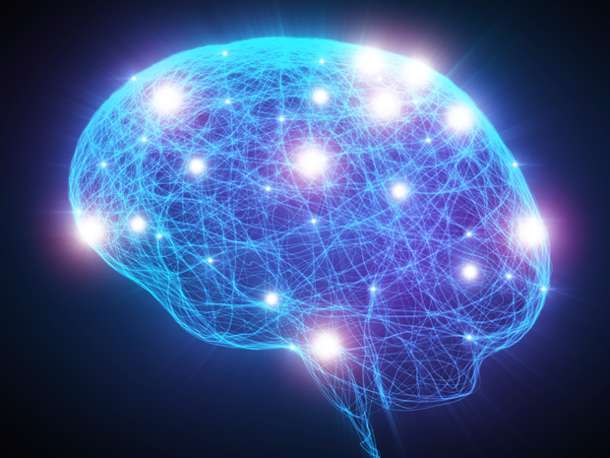
Source: http://spectrum.ieee.org/image/MjYzMzAyMg.jpeg

Slide 160
We Need to Revisit the Entire Stack
Problem
Algorithm
Program/Language
System Software
SW/HW Interface
Micro-architecture
Logic
Devices
Electrons
We can get there step by step

Slide 161
We Need to Exploit Good Principles
Data-centric system design
All components intelligent
Better (cross-layer) communication, better interfaces
Better-than-worst-case design
Heterogeneity
Flexibility, adaptability
Open minds

Slide 162
PIM Review and Open Problems
Onur Mutlu, Saugata Ghose, Juan Gomez-Luna, and Rachata Ausavarungnirun,
"A Modern Primer on Processing in Memory"
Invited Book Chapter in Emerging Computing: From Devices to Systems - Looking Beyond Moore and Von Neumann, Springer, to be published in 2021.
https://arxiv.org/pdf/1903.03988.pdf

Slide 163
Funding Acknowledgments
Alibaba, AMD, ASML, Google, Facebook, Hi-Silicon, HP Labs, Huawei, IBM, Intel, Microsoft, Nvidia, Oracle, Qualcomm, Rambus, Samsung, Seagate, VMware, Xilinx
NSF
NIH
GSRC
SRC
CyLab
EFCL
Thank you!

Slide 164

Acknowledgments
Think BIG, Aim HIGH!
https://safari.ethz.ch

Slide 165
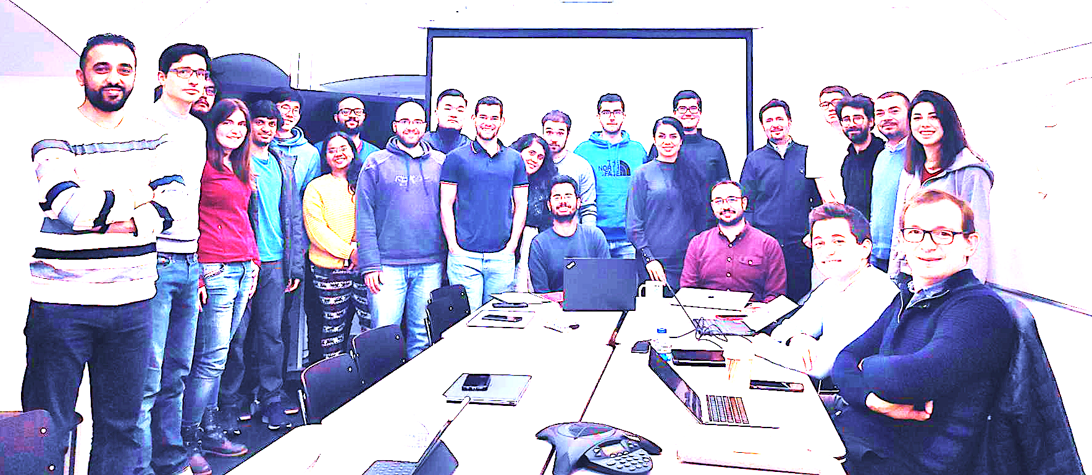

Onur Mutlu’s SAFARI Research Group
Computer architecture, HW/SW, systems, bioinformatics, security, memory
https://safari.ethz.ch/safari-newsletter-january-2021/
40+ Researchers
Think BIG, Aim HIGH!
https://safari.ethz.ch

Slide 166
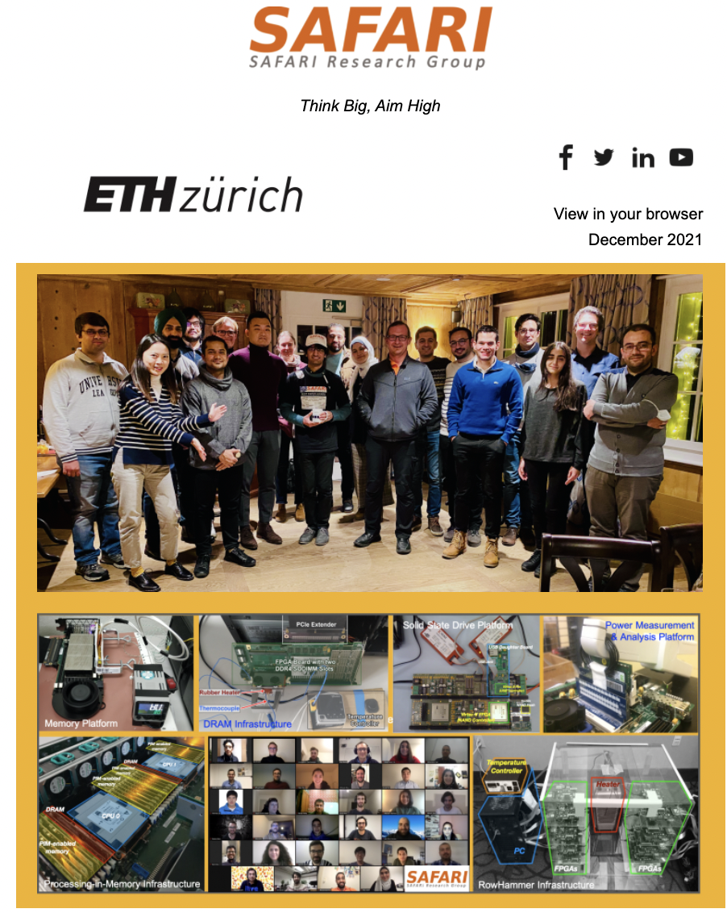
SAFARI Newsletter December 2021 Edition
https://safari.ethz.ch/safari-newsletter-december-2021/

Slide 167
Referenced Papers, Talks, Artifacts
All are available at
  https://people.inf.ethz.ch/omutlu/projects.htm
  https://www.youtube.com/onurmutlulectures
  https://github.com/CMU-SAFARI/

Slide 168


Open Source Tools: SAFARI GitHub
https://github.com/CMU-SAFARI/

Slide 169

Special Research Sessions & Courses
Special Session at ISVLSI 2022: 9 cutting-edge talks
https://www.youtube.com/watch?v=qeukNs5XI3g

Slide 170

Comp Arch (Fall 2021)
Fall 2021 Edition:
  https://safari.ethz.ch/architecture/fall2021/doku.php?id=schedule
Fall 2020 Edition:
  https://safari.ethz.ch/architecture/fall2020/doku.php?id=schedule
Youtube Livestream (2021):
  https://www.youtube.com/watch?v=4yfkM_5EFgo&list=PL5Q2soXY2Zi-Mnk1PxjEIG32HAGILkTOF
Youtube Livestream (2020):
  https://www.youtube.com/watch?v=c3mPdZA-Fmc&list=PL5Q2soXY2Zi9xidyIgBxUz7xRPS-wisBN
Master’s level course
  Taken by Bachelor’s/Masters/PhD students
  Cutting-edge research topics + fundamentals in Computer Architecture
  5 Simulator-based Lab Assignments
  Potential research exploration
  Many research readings
https://www.youtube.com/onurmutlulectures

Slide 171

DDCA (Spring 2022)
Spring 2022 Edition:
  https://safari.ethz.ch/digitaltechnik/spring2022/doku.php?id=schedule
Spring 2021 Edition:
  https://safari.ethz.ch/digitaltechnik/spring2021/doku.php?id=schedule
Youtube Livestream (Spring 2022):
  https://www.youtube.com/watch?v=cpXdE3HwvK0&list=PL5Q2soXY2Zi97Ya5DEUpMpO2bbAoaG7c6
Youtube Livestream (Spring 2021):
  https://www.youtube.com/watch?v=LbC0EZY8yw4&list=PL5Q2soXY2Zi_uej3aY39YB5pfW4SJ7LlN
Bachelor’s course
  2nd semester at ETH Zurich
  Rigorous introduction into “How Computers Work”
  Digital Design/Logic
  Computer Architecture
  10 FPGA Lab Assignments
https://www.youtube.com/onurmutlulectures

Slide 172
PIM Course (Spring 2022)
Spring 2022 Edition:
  https://safari.ethz.ch/projects_and_seminars/spring2022/doku.php?id=processing_in_memory
Youtube Livestream:
  https://www.youtube.com/watch?v=9e4Chnwdovo&list=PL5Q2soXY2Zi-841fUYYUK9EsXKhQKRPyX
Project course
  Taken by Bachelor’s/Master’s students
  Processing-in-Memory lectures
  Hands-on research exploration
  Many research readings
https://www.youtube.com/onurmutlulectures

Slide 173

Genomics (Spring 2022)
Spring 2022 Edition:
  https://safari.ethz.ch/projects_and_seminars/spring2022/doku.php?id=bioinformatics
Youtube Livestream:
  https://www.youtube.com/watch?v=DEL_5A_Y3TI&list=PL5Q2soXY2Zi8NrPDgOR1yRU_Cxxjw-u18
Project course
  Taken by Bachelor’s/Master’s students
  Genomics lectures
  Hands-on research exploration
  Many research readings
https://www.youtube.com/onurmutlulectures

Slide 174

Hetero. Systems (Spring’22)
Spring 2022 Edition:
  https://safari.ethz.ch/projects_and_seminars/spring2022/doku.php?id=heterogeneous_systems
Youtube Livestream:
  https://www.youtube.com/watch?v=oFO5fTrgFIY&list=PL5Q2soXY2Zi9XrgXR38IM_FTjmY6h7Gzm
Project course
  Taken by Bachelor’s/Master’s students
  GPU and Parallelism lectures
  Hands-on research exploration
  Many research readings
https://www.youtube.com/onurmutlulectures

Slide 175


HW/SW Co-Design (Spring 2022)
Spring 2022 Edition:
  https://safari.ethz.ch/projects_and_seminars/spring2022/doku.php?id=hw_sw_codesign
Youtube Livestream:
  https://youtube.com/playlist?list=PL5Q2soXY2Zi8nH7un3ghD2nutKWWDk-NK
Project course
  Taken by Bachelor’s/Master’s students
  HW/SW co-design lectures
  Hands-on research exploration
  Many research readings
https://www.youtube.com/onurmutlulectures

Slide 176


SSD Course (Spring 2022)
Spring 2022 Edition:
  https://safari.ethz.ch/projects_and_seminars/spring2022/doku.php?id=modern_ssds
Youtube Livestream:
  https://www.youtube.com/watch?v=_q4rm71DsY4&list=PL5Q2soXY2Zi8vabcse1kL22DEcgMl2RAq
Project course
  Taken by Bachelor’s/Master’s students
  SSD Basics and Advanced Topics
  Hands-on research exploration
  Many research readings
https://www.youtube.com/onurmutlulectures

Slide 177

Projects & Seminars: SoftMC
FPGA-Based Exploration of DRAM and RowHammer (Fall 2022)
Fall 2022 Edition:
  https://safari.ethz.ch/projects_and_seminars/fall2022/doku.php?id=softmc
Spring 2022 Edition:
  https://safari.ethz.ch/projects_and_seminars/spring2022/doku.php?id=softmc
Youtube Livestream (Spring 2022):
  https://www.youtube.com/watch?v=r5QxuoJWttg&list=PL5Q2soXY2Zi_1trfCckr6PTN8WR72icUO
Bachelor’s course
  Elective at ETH Zurich
  Introduction to DRAM organization & operation
  Tutorial on using FPGA-based infrastructure
  Verilog & C++
  Potential research exploration
https://www.youtube.com/onurmutlulectures

Slide 178

Projects & Seminars: Ramulator
Exploration of Emerging Memory Systems (Fall 2022)
Fall 2022 Edition:
  https://safari.ethz.ch/projects_and_seminars/fall2022/doku.php?id=ramulator
Spring 2022 Edition:
  https://safari.ethz.ch/projects_and_seminars/spring2022/doku.php?id=ramulator
Youtube Livestream (Spring 2022):
  https://www.youtube.com/watch?v=aM-llXRQd3s&list=PL5Q2soXY2Zi_TlmLGw_Z8hBo2925ZApqV
Bachelor’s course
  Elective at ETH Zurich
  Introduction to memory system simulation
  Tutorial on using Ramulator
  C++
  Potential research exploration
https://www.youtube.com/onurmutlulectures

Slide 179
Memory-Centric
Computing
Onur Mutlu
omutlu@gmail.com
https://people.inf.ethz.ch/omutlu
27 September 2022
Microsoft Azure AHA Learning Session 2022

Slide 180
Backup Slides

Slide 181
In-Storage Genomic Data Filtering [ASPLOS 2022]
Nika Mansouri Ghiasi, Jisung Park, Harun Mustafa, Jeremie Kim, Ataberk Olgun, Arvid Gollwitzer, Damla Senol Cali, Can Firtina, Haiyu Mao, Nour Almadhoun Alserr, Rachata Ausavarungnirun, Nandita Vijaykumar, Mohammed Alser, and Onur Mutlu,
"GenStore: A High-Performance and Energy-Efficient In-Storage Computing System for Genome Sequence Analysis"
Proceedings of the 27th International Conference on Architectural Support for Programming Languages and Operating Systems (ASPLOS), Virtual, February-March 2022.
[Lightning Talk Slides (pptx) (pdf)]
[Lightning Talk Video (90 seconds)]

Slide 182

Genome Sequence Analysis
Data Movement from Storage
Alignment
Storage
System
Main
Memory
Cache
Computation
Unit
(CPU or Accelerator)
AAGCTTCCATGG
CGTTCCTTGGCA
GGGCCAGAATG
CCTTTGGGTCCA
AAAATTCCATGG
GAATGGGGCCA
TTTTTTCCAAAA
TCCCCGGGGCCA
GCTTCCAGAATG
Computation overhead
Data movement overhead
Notes:
Read mapping performs alignment on large genomic datasets, containing millions of reads. [CLICK]
Therefore, read mapping is both computationally expensive [CLICK]
And incurs high data movement overhead [CLICK]

Slide 183



Accelerating Genome Sequence Analysis
Heuristics
Accelerators
Filters
Storage
System
Main
Memory
Cache
Computation
Unit
(CPU or Accelerator)
AAGCTTCCATGG
CGTTCCTTGGCA
GGGCCAGAATG
CCTTTGGGTCCA
AAAATTCCATGG
GAATGGGGCCA
TTTTTTCCAAAA
TCCCCGGGGCCA
GCTTCCAGAATG
✓
Computation overhead
Data movement overhead
Notes:
There has been significant effort into improving read mapping performance [CLICK]
Through efficient heuristics [CLICK]
hardware accelerators [CLICK]
and various filters that prune reads that do not require expensive computation [CLICK].
While these approaches address the computation overhead in read mapping [CLICK]
[While Reads Move] None of them alleviate the data movement overhead from storage, whose impact becomes even larger when the computation overhead gets alleviated [CLICK]

Slide 184

Key Idea
Filter reads that do not require alignment
inside the storage system
Storage
System
Main
Memory
Cache
Computation
Unit
(CPU or Accelerator)
AAGCTTCCATGG
CGTTCCTTGGCA
GGGCCAGAATG
CCTTTGGGTCCA
AAAATTCCATGG
GAATGGGGCCA
TTTTTTCCAAAA
TCCCCGGGGCCA
GCTTCCAGAATG
Filtered Reads
Exactly-matching reads
Do not need expensive approximate string matching during alignment
Non-matching reads
Do not have potential matching locations and can skip alignment
Notes:
Our key idea is to filter reads that do not require the expensive alignment computation in the storage system [CLICK] …
[While Reads Move] To fundamentally reduce the data movement overhead of read mapping
Examples of the reads that not require the costlt alignment step
Exactly-matching reads to the reference genome that do not need approximate string matching performed during alignment
Non-matching reads that have no potential matching locations in the reference genome hence skip the alignemt step

Slide 185
GenStore
Filter reads that do not require alignment
inside the storage system
GenStore-Enabled
Storage
System
Main
Memory
Cache
Computation
Unit
(CPU or Accelerator)
✓
Computation overhead
✓
Data movement overhead
  GenStore provides significant speedup (1.4x - 33.6x) and
  energy reduction (3.9x – 29.2x) at low cost
Notes:
We propose GenStore, the first in-storage processing system designed for genome sequence analysis. [CLICK]
To reduce both the computation [CLICK]
And the data movement overhead [CLICK]
GenStore provides high-performance and energy benefits compared to state-of-the-art HW and SW baselines [CLICK]

Slide 186

GenStore Talk Video
https://www.youtube.com/watch?v=kIU44FxjbFk

Slide 187
In-Storage Genomic Data Filtering [ASPLOS 2022]
Nika Mansouri Ghiasi, Jisung Park, Harun Mustafa, Jeremie Kim, Ataberk Olgun, Arvid Gollwitzer, Damla Senol Cali, Can Firtina, Haiyu Mao, Nour Almadhoun Alserr, Rachata Ausavarungnirun, Nandita Vijaykumar, Mohammed Alser, and Onur Mutlu,
"GenStore: A High-Performance and Energy-Efficient In-Storage Computing System for Genome Sequence Analysis"
Proceedings of the 27th International Conference on Architectural Support for Programming Languages and Operating Systems (ASPLOS), Virtual, February-March 2022.
[Lightning Talk Slides (pptx) (pdf)]
[Lightning Talk Video (90 seconds)]

Slide 188





Google Workloads for Consumer Devices:
Mitigating Data Movement Bottlenecks
Amirali Boroumand
Saugata Ghose, Youngsok Kim, Rachata Ausavarungnirun,
Eric Shiu, Rahul Thakur, Daehyun Kim, Aki Kuusela,
Allan Knies, Parthasarathy Ranganathan, Onur Mutlu

Slide 189




Consumer Devices
Consumer devices are everywhere!
Energy consumption is
a first-class concern in consumer devices
Notes:
Consumer devices like tablets smartphone and wearable are now everywhere and used by billions of people.
One of the major challenge in these devices is battery limitation which makes the energy consumption a critical concern …

Slide 190





Popular Consumer Workloads
  Chrome
TensorFlow Mobile
    Google’s web browser
Google’s machine learning framework
  Video Playback
  Video Capture
Google’s video codec
Google’s video codec
Notes:
In this work, we take a look at widely-used google consumer workloads, to figure out the major sources of energy consumption.
We look at Google Chrome web brower. We take a look at Tensorflow, Google’s machine learning framework, and we also take a look at two important video related workloads, video playback and video capture, both rely on Google’s vp9 codec technology.

Slide 191
Energy Cost of Data Movement
1st key observation: 62.7% of the total system energy is spent on data movement
Data Movement
SoC
DRAM
CPU
L2
CPU
L1
CPU
CPU
Compute Unit
Processing-In-Memory (PIM)
  Potential solution: move computation close to data
  Challenge: limited area and energy budget
Notes:
Throughout our analysis, we make a key observation that out of all sources of energy consumption, data movement is a major contributor to the total system energy. We find that across all of the workloads, on average around 62.7% of total system energy is spent on data movement.
One way to reduce data movement cost is to move computation close to data, or …
One potential solution to address this cost it do move computation close to data, or in other words, do procesing in memory. However, the challenge is that these devices.
One potential solution to mitigate data movement cost and reduce total system energy is to execute data-movement heavy portions of application close to data, or in other words, do processing in memory. However, consumer devices are extermely limited in terms of area and power budget. So the question is can we move part of the data movement heavy portion given the limited area and energy budget. Our

Slide 192
Using PIM to Reduce Data Movement
  2nd key observation: a significant fraction of the
  data movement often comes from simple functions
We can design lightweight logic to implement
these simple functions in memory
Small embedded
low-power core
Small fixed-function accelerators
PIM Core
PIM Accelerator
PIM Accelerator
PIM Accelerator
  Offloading to PIM logic reduces energy and improves performance, on average, by 2.3X and 2.2X
Notes:
To figure out if we can use processing in memory, we dig deeper into our analysis and we make another key observation that majority of data movement often comes form simple functions and pritmitives. We find that these simple function can be implemented in memory as either a small embedded core, or group of small fixed function accelerators. Our result shows that offloading these function to PIM logic can significantly reduce data movement for each function and reduce energy on average around 55% and improve perforamcne around 54%.
our PIM core can reduce significant portion of data movement, reduce enregy by 49.1% for each function and improve performance up to 2.2X. While using group of fixed function accelerator reduce energy by 55.4% and improve performance by up to 2.5X.
Or use Saugata’s approach : Reduces total system energy by an average of 55.4%
Reduces execution time by an average of 54.2%
Our result show that both of them can significantly reduce the data movement for each function.
Feedback: talk about result more
Don’t talk about specific detail like MemCopy, MemSet stuff like that
Main take away: data movement come from simple functions that are simple enough to implement in PIM
We find that these functions and primitves can be implemented as PIM logic using either (1) a small low-power general-purpose embedded core or (2) a group of small fixed-function accelerators (PIM accelerators). Our Analysis shows that both are cost-feasible to use in consumer devices. We find that they eliminate a significant fraction of dat amovement, and reduce energy consumption for each of these operation on average by 49 and 55%.

Slide 193
Workload Analysis
  Chrome
TensorFlow Mobile
    Google’s web browser
Google’s machine learning framework
  Video Playback
  Video Capture
Google’s video codec
Google’s video codec
Notes:
In this work, we take a look at widely-used google consumer workloads, to figure out the major sources of energy consumption.
We look at Google Chrome web brower. We take a look at Tensorflow, Google’s machine learning framework, and we also take a look at two important video related workloads, video playback and video capture, both rely on Google’s vp9 codec technology.

Slide 194


TensorFlow Mobile
Inference
Prediction
57.3% of the inference energy is spent on
data movement
54.4% of the data movement energy comes from
packing/unpacking and quantization

Slide 195
More on PIM for Mobile Devices
Amirali Boroumand, Saugata Ghose, Youngsok Kim, Rachata Ausavarungnirun, Eric Shiu, Rahul Thakur, Daehyun Kim, Aki Kuusela, Allan Knies, Parthasarathy Ranganathan, and Onur Mutlu,
"Google Workloads for Consumer Devices: Mitigating Data Movement Bottlenecks"
Proceedings of the 23rd International Conference on Architectural Support for Programming Languages and Operating Systems (ASPLOS), Williamsburg, VA, USA, March 2018.
[Slides (pptx) (pdf)] [Lightning Session Slides (pptx) (pdf)] [Poster (pptx) (pdf)]
[Lightning Talk Video (2 minutes)]
[Full Talk Video (21 minutes)]

Slide 196

Truly Distributed GPU Processing with PIM
3D-stacked memory
(memory stack)
SM (Streaming Multiprocessor)
Logic layer
Logic layer SM
Main GPU
Crossbar switch
Vault Ctrl
….
Vault Ctrl

Slide 197

Accelerating GPU Execution with PIM (I)
Kevin Hsieh, Eiman Ebrahimi, Gwangsun Kim, Niladrish Chatterjee, Mike O'Connor, Nandita Vijaykumar, Onur Mutlu, and Stephen W. Keckler,
"Transparent Offloading and Mapping (TOM): Enabling Programmer-Transparent Near-Data Processing in GPU Systems"
Proceedings of the 43rd International Symposium on Computer Architecture (ISCA), Seoul, South Korea, June 2016.
[Slides (pptx) (pdf)]
[Lightning Session Slides (pptx) (pdf)]

Slide 198

Accelerating GPU Execution with PIM (II)
Ashutosh Pattnaik, Xulong Tang, Adwait Jog, Onur Kayiran, Asit K. Mishra, Mahmut T. Kandemir, Onur Mutlu, and Chita R. Das,
"Scheduling Techniques for GPU Architectures with Processing-In-Memory Capabilities"
Proceedings of the 25th International Conference on Parallel Architectures and Compilation Techniques (PACT), Haifa, Israel, September 2016.

Slide 199

Accelerating Linked Data Structures
Kevin Hsieh, Samira Khan, Nandita Vijaykumar, Kevin K. Chang, Amirali Boroumand, Saugata Ghose, and Onur Mutlu,
"Accelerating Pointer Chasing in 3D-Stacked Memory: Challenges, Mechanisms, Evaluation"
Proceedings of the 34th IEEE International Conference on Computer Design (ICCD), Phoenix, AZ, USA, October 2016.

Slide 200

Accelerating Dependent Cache Misses
Milad Hashemi, Khubaib, Eiman Ebrahimi, Onur Mutlu, and Yale N. Patt,
"Accelerating Dependent Cache Misses with an Enhanced Memory Controller"
Proceedings of the 43rd International Symposium on Computer Architecture (ISCA), Seoul, South Korea, June 2016.
[Slides (pptx) (pdf)]
[Lightning Session Slides (pptx) (pdf)]

Slide 201

Accelerating Runahead Execution
Milad Hashemi, Onur Mutlu, and Yale N. Patt,
"Continuous Runahead: Transparent Hardware Acceleration for Memory Intensive Workloads"
Proceedings of the 49th International Symposium on Microarchitecture (MICRO), Taipei, Taiwan, October 2016.
[Slides (pptx) (pdf)] [Lightning Session Slides (pdf)] [Poster (pptx) (pdf)]

Slide 202

Accelerating Climate Modeling
Gagandeep Singh, Dionysios Diamantopoulos, Christoph Hagleitner, Juan Gómez-Luna, Sander Stuijk, Onur Mutlu, and Henk Corporaal,
"NERO: A Near High-Bandwidth Memory Stencil Accelerator for Weather Prediction Modeling"
Proceedings of the 30th International Conference on Field-Programmable Logic and Applications (FPL), Gothenburg, Sweden, September 2020.
[Slides (pptx) (pdf)]
[Lightning Talk Slides (pptx) (pdf)]
[Talk Video (23 minutes)]
Nominated for the Stamatis Vassiliadis Memorial Award.

Slide 203

Accelerating Approximate String Matching
Damla Senol Cali, Gurpreet S. Kalsi, Zulal Bingol, Can Firtina, Lavanya Subramanian, Jeremie S. Kim, Rachata Ausavarungnirun, Mohammed Alser, Juan Gomez-Luna, Amirali Boroumand, Anant Nori, Allison Scibisz, Sreenivas Subramoney, Can Alkan, Saugata Ghose, and Onur Mutlu,
"GenASM: A High-Performance, Low-Power Approximate String Matching Acceleration Framework for Genome Sequence Analysis"
Proceedings of the 53rd International Symposium on Microarchitecture (MICRO), Virtual, October 2020.
[Lighting Talk Video (1.5 minutes)]
[Lightning Talk Slides (pptx) (pdf)]
[Talk Video (18 minutes)]
[Slides (pptx) (pdf)]

Slide 204

Accelerating Sequence-to-Graph Mapping
Damla Senol Cali, Konstantinos Kanellopoulos, Joel Lindegger, Zulal Bingol, Gurpreet S. Kalsi, Ziyi Zuo, Can Firtina, Meryem Banu Cavlak, Jeremie Kim, Nika MansouriGhiasi, Gagandeep Singh, Juan Gomez-Luna, Nour Almadhoun Alserr, Mohammed Alser, Sreenivas Subramoney, Can Alkan, Saugata Ghose, and Onur Mutlu,
"SeGraM: A Universal Hardware Accelerator for Genomic Sequence-to-Graph and Sequence-to-Sequence Mapping"
Proceedings of the 49th International Symposium on Computer Architecture (ISCA), New York, June 2022.
[arXiv version]
https://arxiv.org/pdf/2205.05883.pdf

Slide 205

Accelerating Basecalling + Read Mapping
To appear at MICRO 2022
https://arxiv.org/pdf/2209.08600.pdf

Slide 206

Accelerating Time Series Analysis
Ivan Fernandez, Ricardo Quislant, Christina Giannoula, Mohammed Alser, Juan Gómez-Luna, Eladio Gutiérrez, Oscar Plata, and Onur Mutlu,
"NATSA: A Near-Data Processing Accelerator for Time Series Analysis"
Proceedings of the 38th IEEE International Conference on Computer Design (ICCD), Virtual, October 2020.
[Slides (pptx) (pdf)]
[Talk Video (10 minutes)]
[Source Code]

Slide 207

Accelerating Graph Pattern Mining
Maciej Besta, Raghavendra Kanakagiri, Grzegorz Kwasniewski, Rachata Ausavarungnirun, Jakub Beránek, Konstantinos Kanellopoulos, Kacper Janda, Zur Vonarburg-Shmaria, Lukas Gianinazzi, Ioana Stefan, Juan Gómez-Luna, Marcin Copik, Lukas Kapp-Schwoerer, Salvatore Di Girolamo, Nils Blach, Marek Konieczny, Onur Mutlu, and Torsten Hoefler,
"SISA: Set-Centric Instruction Set Architecture for Graph Mining on Processing-in-Memory Systems"
Proceedings of the 54th International Symposium on Microarchitecture (MICRO), Virtual, October 2021.
[Slides (pdf)]
[Talk Video (22 minutes)]
[Lightning Talk Video (1.5 minutes)]
[Full arXiv version]

Slide 208

Accelerating HTAP Database Systems
Amirali Boroumand, Saugata Ghose, Geraldo F. Oliveira, and Onur Mutlu,
"Polynesia: Enabling High-Performance and Energy-Efficient Hybrid Transactional/Analytical Databases with Hardware/Software Co-Design"
Proceedings of the 38th International Conference on Data Engineering (ICDE), Virtual, May 2022.
[arXiv version]
[Slides (pptx) (pdf)]
[Short Talk Slides (pptx) (pdf)]
https://arxiv.org/pdf/2204.11275.pdf

Slide 209

Accelerating Neural Network Inference
Amirali Boroumand, Saugata Ghose, Berkin Akin, Ravi Narayanaswami, Geraldo F. Oliveira, Xiaoyu Ma, Eric Shiu, and Onur Mutlu,
"Google Neural Network Models for Edge Devices: Analyzing and Mitigating Machine Learning Inference Bottlenecks"
Proceedings of the 30th International Conference on Parallel Architectures and Compilation Techniques (PACT), Virtual, September 2021.
[Slides (pptx) (pdf)]
[Talk Video (14 minutes)]

Slide 210


Google Neural Network Models for Edge Devices:
Analyzing and Mitigating
Machine Learning Inference Bottlenecks
Amirali Boroumand Saugata Ghose Berkin Akin
Ravi Narayanaswami Geraldo F. Oliveira Xiaoyu Ma
Eric Shiu Onur Mutlu
PACT 2021
Notes:
Hi, I’m Geraldo, a PhD Student at ETH Zurich.
Today I will present our work “Google Neural Network Models for Edge Devices: Analyzing and Mitigating Machine Learning Inference Bottlenecks”
This work was lead by Amirali Boroumand during his internship at Google.

Slide 211
Executive Summary
Context: We extensively analyze a state-of-the-art edge ML accelerator (Google Edge TPU) using 24 Google edge models
  Wide range of models (CNNs, LSTMs, Transducers, RCNNs)
Problem: The Edge TPU accelerator suffers from three challenges:
  It operates significantly below its peak throughput
  It operates significantly below its theoretical energy efficiency
  It inefficiently handles memory accesses
  Key Insight: These shortcomings arise from the monolithic design of the Edge TPU accelerator
  The Edge TPU accelerator design does not account for layer heterogeneity
  Key Mechanism: A new framework called Mensa
  Mensa consists of heterogeneous accelerators whose dataflow and hardware are specialized for specific families of layers
  Key Results: We design a version of Mensa for Google edge ML models
  Mensa improves performance and energy by 3.0X and 3.1X
  Mensa reduces cost and improves area efficiency
Notes:
First, I will give an overview of this work.
[CLICK] In this work, we extensively analyze 24 edge NN models from Google while running inference on the Google Edge TPU accelerator for various types of NN models
[CLICK] We identify that while running NN inference, the accelerator suffers from three main challenges
[CLICK] it operates significantly below its peak throughput
[CLICK] it operates significantly below its theorical peak energy efficiency
[CLICK] and its memory system is not efficient
[CLICK] Our analysis leads to the key insight that these challenges arrive due to the monolithic one-size-fit-all design of the accelerators, which does not account for heterogeneity across different NN layers
[CLICK] To solve this issue, we propose Mensa, a framework that maps the execution of a particular NN layer to its most appropriate hardware accelerator
[CLICK] We extensively evaluate Mensa for Google NN models and we observe that it improves performance and energy efficiency by 3.0x and 3.1x compared to the baseline Edge TPU accelerator while reducing area and cost across 24 edge ML models
[NEXT]

Slide 212





Google Edge Neural Network Models
  We analyze inference execution using 24 edge NN models
6 RNN
Transducers
2 LSTMs
Speech Recognition
Language Translation
13 CNN
3 RCNN
Google Edge TPU
Face Detection
Image Captioning
Notes:
[CLICK] We analyze inference execution on the accelerator using 24 edge NN models that serve as internal benchmarks for the Google Edge TPU, including
[CLICK] 6 RNN Transducers, used for applications such as automatic speech recognition.
[CLICK] 13 convolutional neural networks (CNNs), typically used for applications such as image classification and object detection
[CLICK] 2 long short-term memories (LSTMs), used for applications such as language translation and and handwriting recognition, and
[CLICK] 3 recurrent convolutional neural networks (RCNNs), used for applications such as image captioning
[NEXT]

Slide 213
Diversity Across the Models
Insight 1: there is significant variation in terms of
layer characteristics across the models
Layers from
CNNs and RCNNs
Layers from
LSTMs and Transducers
Notes:
We draw key two insights from our model analysis
[CLICK] First, we observe a large variation in terms of layer characteristics across different models.
[CLICK] To illustrate, the figure shows the total parameter footprint vs. the FLOP/B ratio (or reuse) across the layers of representative CNNs, LSTMs, and Transducers
[CLICK] We observe from the figure that that layers from LSTMs and Transducers have larger parameter footprints and lower reuse than layers from CNNs.
[NEXT]

Slide 214
Diversity Within the Models
Insight 2: even within each model, layers exhibit
significant variation in terms of layer characteristics
For example, our analysis of edge CNN models shows:
1
2
Variation in MAC intensity: up to 200x across layers
Variation in FLOP/Byte: up to 244x across layers
Notes:
[CLICK] Second, even within a single model, layers show variation in terms of layer characteristics
[CLICK] For example, we observe that layers in a single CNN models show
[CLICK] a varying MAC intensity of up to 200x across different layers
and
[CLICK] a varying flop/byte ratio of up to 244x across different layers
[NEXT]

Slide 215



Mensa High-Level Overview
Edge TPU Accelerator
Mensa
Model A
Model B
Model C
Model A
Model B
Model C
Runtime
Family 1
Family 2
Family 3
CPU
3D-Stacked DRAM
PE
PE
PE
PE
PE
PE
PE
PE
PE
PE
PE
PE
PE
PE
PE
PE
Buffer
PE
PE
PE
PE
PE
PE
PE
PE
NoC
PE
PE
PE
PE
PE
PE
PE
PE
PE
PE
PE
PE
PE
PE
PE
PE
NoC
PE
PE
PE
PE
PE
PE
PE
PE
NoC
NoC
PE
PE
PE
PE
PE
PE
PE
PE
PE
PE
PE
PE
PE
PE
PE
PE
Monolithic Accelerator
Buffer
Buffer
Buffer
Acc. 1
Acc. 2
Acc. 3
Heterogeneous Accelerators
Notes:
[CLICK ] In a baseline system, different machine learning models are execute in a single, monolithic edge accelerator, which leads to performance and energy issues.
[CLICK] On the other hand, Mensa distributes the layers from an NN model using a runtime scheduler across a collection of smaller hardware accelerators that are catered the properties of different layer types. By specializing each accelerator to a subset of layers, Mensa avoids the shortcomings of current monolithic edge ML accelerators, resulting in a highly-efficient and high-performance accelerator with a much smaller area.
Next I will give an brief overview of Mensa’s ruy
[NEXT]

Slide 216
Identifying Layer Families
  Key observation: the majority of layers group into
  a small number of layer families
Family 1
Family 1
Family 2
Family 5
Family 2
Family 4
Family 5
Family 3
Family 3
Family 4
  Families 1 & 2: low parameter footprint, high data reuse and MAC intensity
  → compute-centric layers
  Families 3, 4 & 5: high parameter footprint, low data reuse and MAC intensity
  → data-centric layers
Introduction | TPU and Model Characterization | Mensa Framework | Mensa-G | Evaluation | Conclusion
● ● ● | ● ● ● ● ● ● ● ● ● ● | ● ● ● | ● ● ● ● ● | ● ● | ●
Notes:
First, we need to decide how many accelerators we need based on the key characteristics of our NN models.
[CLICK] We make a key observation that the majority of the layers we target fall into five major families in terms key characteristics that impact hardware design
[CLICK] First, we find two Families of layers (families 1 and 2) that have low parameter footprint and high data reuse and MAC intensity. We call such layers compute-centric layers.
[CLICK] Second, we find three families of layers (families, 3, 4 and 5) that have high parameter footprint , low data reuse and MAC intensity. We call such layers data-centric layers.
[NEXT]

Slide 217
Mensa: Energy Reduction
Mensa-G reduces energy consumption by 3.0X
compared to the baseline Edge TPU
Notes:
[CLICK] Fist, Mensa-G placement of accelerators and careful dataflow design enables to reduce the energy consumed by on-chip and off-chip parameter traffic by 15.3x on average compared to the baseline.
[CLICK] Second, Mensa-G reduces the dynamic energy of on-chip buffers and Noc by almost 50x compared to the Baseline system with high bw memory.
[CLICK] We conclude that Mensa-G reduces energy by 66% and improves inference energy efficiency by 3.0x compared to the baseline edge TPU.
[NEXT]

Slide 218
Mensa: Throughput Improvement
Mensa-G improves inference throughput by 3.1X
compared to the baseline Edge TPU
Notes:
[CLICK] We also analyze Mensa-G’s throughput compared to the Baseline edge TPU and Baseline edge TPU with the high bandwidth off-chip memory
[CLICK] We observe that Mensa-G’s improve throughput compared to the baseline edge TPU by 3.1X on average
[NEXT]

Slide 219
Mensa: Highly-Efficient ML Inference
Amirali Boroumand, Saugata Ghose, Berkin Akin, Ravi Narayanaswami, Geraldo F. Oliveira, Xiaoyu Ma, Eric Shiu, and Onur Mutlu,
"Google Neural Network Models for Edge Devices: Analyzing and Mitigating Machine Learning Inference Bottlenecks"
Proceedings of the 30th International Conference on Parallel Architectures and Compilation Techniques (PACT), Virtual, September 2021.
[Slides (pptx) (pdf)]
[Talk Video (14 minutes)]

Slide 220
FPGA-based Processing Near Memory
Gagandeep Singh, Mohammed Alser, Damla Senol Cali, Dionysios Diamantopoulos, Juan Gómez-Luna, Henk Corporaal, and Onur Mutlu,
"FPGA-based Near-Memory Acceleration of Modern Data-Intensive Applications"
IEEE Micro (IEEE MICRO), 2021.

Slide 221


Near-Memory Acceleration Using FPGAs
OCAPI
Source: IBM
Source: AlphaData
IBM POWER9 CPU
HBM-based FPGA board
Near-HBM FPGA-based accelerator
Two communication technologies: CAPI2 and OCAPI
Two memory technologies: DDR4 and HBM
Two workloads: Weather Modeling and Genome Analysis
Notes:
To this end we build a [CLICK] near-HBM FPGA based accelerator which is connected to a server-grade IBM POWER9-based CPU system

Slide 222
Performance & Energy Greatly Improve
5-27× performance vs. a 16-core (64-thread) IBM POWER9 CPU
12-133× energy efficiency vs. a 16-core (64-thread) IBM POWER9 CPU
HBM alleviates memory bandwidth contention vs. DDR4
Notes:
[CLICK]

Slide 223
We Need to Revisit the Entire Stack
Problem
Algorithm
Program/Language
System Software
SW/HW Interface
Micro-architecture
Logic
Devices
Electrons
We can get there step by step

Slide 224
PIM Review and Open Problems
Onur Mutlu, Saugata Ghose, Juan Gomez-Luna, and Rachata Ausavarungnirun,
"A Modern Primer on Processing in Memory"
Invited Book Chapter in Emerging Computing: From Devices to Systems - Looking Beyond Moore and Von Neumann, Springer, to be published in 2021.
https://arxiv.org/pdf/1903.03988.pdf

Slide 225

PIM Review and Open Problems (II)
Saugata Ghose, Amirali Boroumand, Jeremie S. Kim, Juan Gomez-Luna, and Onur Mutlu,
"Processing-in-Memory: A Workload-Driven Perspective"
Invited Article in IBM Journal of Research & Development, Special Issue on Hardware for Artificial Intelligence, to appear in November 2019.
[Preliminary arXiv version]
https://arxiv.org/pdf/1907.12947.pdf

Slide 226
Processing in Memory:
Adoption Challenges
1. Processing using Memory
2. Processing near Memory

Slide 227
Eliminating the Adoption Barriers
How to Enable Adoption of Processing in Memory

Slide 228
Potential Barriers to Adoption of PIM
1. Applications & software for PIM
2. Ease of programming (interfaces and compiler/HW support)
3. System and security support: coherence, synchronization, virtual memory, isolation, communication interfaces, …
4. Runtime and compilation systems for adaptive scheduling, data mapping, access/sharing control, …
5. Infrastructures to assess benefits and feasibility
All can be solved with change of mindset

Slide 229
We Need to Revisit the Entire Stack
Problem
Algorithm
Program/Language
System Software
SW/HW Interface
Micro-architecture
Logic
Devices
Electrons
We can get there step by step

Slide 230
Adoption: Accelerating Key Applications (I)
Mohammed Alser, Zulal Bingol, Damla Senol Cali, Jeremie Kim, Saugata Ghose, Can Alkan, and Onur Mutlu,
"Accelerating Genome Analysis: A Primer on an Ongoing Journey"
IEEE Micro (IEEE MICRO), Vol. 40, No. 5, pages 65-75, September/October 2020.
[Slides (pptx)(pdf)]
[Talk Video (1 hour 2 minutes)]

Slide 231
Adoption: Accelerating Key Applications (II)
Nika Mansouri Ghiasi, Jisung Park, Harun Mustafa, Jeremie Kim, Ataberk Olgun, Arvid Gollwitzer, Damla Senol Cali, Can Firtina, Haiyu Mao, Nour Almadhoun Alserr, Rachata Ausavarungnirun, Nandita Vijaykumar, Mohammed Alser, and Onur Mutlu,
"GenStore: A High-Performance and Energy-Efficient In-Storage Computing System for Genome Sequence Analysis"
Proceedings of the 27th International Conference on Architectural Support for Programming Languages and Operating Systems (ASPLOS), Virtual, February-March 2022.
[Lightning Talk Slides (pptx) (pdf)]
[Lightning Talk Video (90 seconds)]

Slide 232
Adoption: Accelerating Key Applications (III)
Junwhan Ahn, Sungpack Hong, Sungjoo Yoo, Onur Mutlu, and Kiyoung Choi,
"A Scalable Processing-in-Memory Accelerator for Parallel Graph Processing"
Proceedings of the 42nd International Symposium on Computer Architecture (ISCA), Portland, OR, June 2015.
[Slides (pptx) (pdf)] [Lightning Session Slides (pptx) (pdf)]
Top Picks Honorable Mention by IEEE Micro.

Slide 233
Adoption: Accelerating Key Applications (IV)
Maciej Besta, Raghavendra Kanakagiri, Grzegorz Kwasniewski, Rachata Ausavarungnirun, Jakub Beránek, Konstantinos Kanellopoulos, Kacper Janda, Zur Vonarburg-Shmaria, Lukas Gianinazzi, Ioana Stefan, Juan Gómez-Luna, Marcin Copik, Lukas Kapp-Schwoerer, Salvatore Di Girolamo, Nils Blach, Marek Konieczny, Onur Mutlu, and Torsten Hoefler,
"SISA: Set-Centric Instruction Set Architecture for Graph Mining on Processing-in-Memory Systems"
Proceedings of the 54th International Symposium on Microarchitecture (MICRO), Virtual, October 2021.
[Slides (pdf)]
[Talk Video (22 minutes)]
[Lightning Talk Video (1.5 minutes)]
[Full arXiv version]

Slide 234
Adoption: Accelerating Key Applications (V)
Amirali Boroumand, Saugata Ghose, Berkin Akin, Ravi Narayanaswami, Geraldo F. Oliveira, Xiaoyu Ma, Eric Shiu, and Onur Mutlu,
"Google Neural Network Models for Edge Devices: Analyzing and Mitigating Machine Learning Inference Bottlenecks"
Proceedings of the 30th International Conference on Parallel Architectures and Compilation Techniques (PACT), Virtual, September 2021.
[Slides (pptx) (pdf)]
[Talk Video (14 minutes)]

Slide 235
Adoption: Accelerating Key Applications (VI)
Gagandeep Singh, Dionysios Diamantopoulos, Christoph Hagleitner, Juan Gómez-Luna, Sander Stuijk, Onur Mutlu, and Henk Corporaal,
"NERO: A Near High-Bandwidth Memory Stencil Accelerator for Weather Prediction Modeling"
Proceedings of the 30th International Conference on Field-Programmable Logic and Applications (FPL), Gothenburg, Sweden, September 2020.
[Slides (pptx) (pdf)]
[Lightning Talk Slides (pptx) (pdf)]
[Talk Video (23 minutes)]
Nominated for the Stamatis Vassiliadis Memorial Award.

Slide 236
Adoption: Accelerating Key Applications (VII)
Ivan Fernandez, Ricardo Quislant, Christina Giannoula, Mohammed Alser, Juan Gómez-Luna, Eladio Gutiérrez, Oscar Plata, and Onur Mutlu,
"NATSA: A Near-Data Processing Accelerator for Time Series Analysis"
Proceedings of the 38th IEEE International Conference on Computer Design (ICCD), Virtual, October 2020.
[Slides (pptx) (pdf)]
[Talk Video (10 minutes)]
[Source Code]

Slide 237
Adoption: Accelerating Key Applications (VIII)
Damla Senol Cali, Gurpreet S. Kalsi, Zulal Bingol, Can Firtina, Lavanya Subramanian, Jeremie S. Kim, Rachata Ausavarungnirun, Mohammed Alser, Juan Gomez-Luna, Amirali Boroumand, Anant Nori, Allison Scibisz, Sreenivas Subramoney, Can Alkan, Saugata Ghose, and Onur Mutlu,
"GenASM: A High-Performance, Low-Power Approximate String Matching Acceleration Framework for Genome Sequence Analysis"
Proceedings of the 53rd International Symposium on Microarchitecture (MICRO), Virtual, October 2020.
[Lighting Talk Video (1.5 minutes)]
[Lightning Talk Slides (pptx) (pdf)]
[Talk Video (18 minutes)]
[Slides (pptx) (pdf)]

Slide 238
Adoption: Accelerating Key Applications (IX)
Damla Senol Cali, Konstantinos Kanellopoulos, Joel Lindegger, Zulal Bingol, Gurpreet S. Kalsi, Ziyi Zuo, Can Firtina, Meryem Banu Cavlak, Jeremie Kim, Nika MansouriGhiasi, Gagandeep Singh, Juan Gomez-Luna, Nour Almadhoun Alserr, Mohammed Alser, Sreenivas Subramoney, Can Alkan, Saugata Ghose, and Onur Mutlu,
"SeGraM: A Universal Hardware Accelerator for Genomic Sequence-to-Graph and Sequence-to-Sequence Mapping"
Proceedings of the 49th International Symposium on Computer Architecture (ISCA), New York, June 2022.
[arXiv version]
https://arxiv.org/pdf/2205.05883.pdf

Slide 239
Adoption: Accelerating Key Applications (X)
Amirali Boroumand, Saugata Ghose, Geraldo F. Oliveira, and Onur Mutlu,
"Polynesia: Enabling High-Performance and Energy-Efficient Hybrid Transactional/Analytical Databases with Hardware/Software Co-Design"
Proceedings of the 38th International Conference on Data Engineering (ICDE), Virtual, May 2022.
[arXiv version]
[Slides (pptx) (pdf)]
[Short Talk Slides (pptx) (pdf)]
https://arxiv.org/pdf/2204.11275.pdf

Slide 240
Adoption: Accelerating Key Applications (XI)
To appear at MICRO 2022
https://arxiv.org/pdf/2209.08600.pdf

Slide 241

Adoption: How to Keep It Simple?
Junwhan Ahn, Sungjoo Yoo, Onur Mutlu, and Kiyoung Choi,
"PIM-Enabled Instructions: A Low-Overhead, Locality-Aware Processing-in-Memory Architecture"
Proceedings of the 42nd International Symposium on Computer Architecture (ISCA), Portland, OR, June 2015.
[Slides (pdf)] [Lightning Session Slides (pdf)]

Slide 242

Adoption: How to Maintain Coherence? (I)
Amirali Boroumand, Saugata Ghose, Minesh Patel, Hasan Hassan, Brandon Lucia, Kevin Hsieh, Krishna T. Malladi, Hongzhong Zheng, and Onur Mutlu,
"LazyPIM: An Efficient Cache Coherence Mechanism for Processing-in-Memory"
IEEE Computer Architecture Letters (CAL), June 2016.

Slide 243

Challenge: Coherence for Hybrid CPU-PIM Apps
Traditional
coherence
No coherence
overhead

Slide 244

Adoption: How to Maintain Coherence? (II)
Amirali Boroumand, Saugata Ghose, Minesh Patel, Hasan Hassan, Brandon Lucia, Kevin Hsieh, Krishna T. Malladi, Hongzhong Zheng, and Onur Mutlu,
"CoNDA: Efficient Cache Coherence Support for Near-Data Accelerators"
Proceedings of the 46th International Symposium on Computer Architecture (ISCA), Phoenix, AZ, USA, June 2019.

Slide 245
Adoption: How to Support Synchronization?
Christina Giannoula, Nandita Vijaykumar, Nikela Papadopoulou, Vasileios Karakostas, Ivan Fernandez, Juan Gómez-Luna, Lois Orosa, Nectarios Koziris, Georgios Goumas, Onur Mutlu,
"SynCron: Efficient Synchronization Support for Near-Data-Processing Architectures"
Proceedings of the 27th International Symposium on High-Performance Computer Architecture (HPCA), Virtual, February-March 2021.
[Slides (pptx) (pdf)]
[Short Talk Slides (pptx) (pdf)]
[Talk Video (21 minutes)]
[Short Talk Video (7 minutes)]

Slide 246
Adoption: How to Support Virtual Memory?
Kevin Hsieh, Samira Khan, Nandita Vijaykumar, Kevin K. Chang, Amirali Boroumand, Saugata Ghose, and Onur Mutlu,
"Accelerating Pointer Chasing in 3D-Stacked Memory: Challenges, Mechanisms, Evaluation"
Proceedings of the 34th IEEE International Conference on Computer Design (ICCD), Phoenix, AZ, USA, October 2016.

Slide 247

DAMOV Analysis Methodology & Workloads
https://arxiv.org/pdf/2105.03725.pdf

Slide 248
When to Employ Near-Data Processing?
Mobile consumer workloads
(GoogleWL²)
Graph processing
(Tesseract¹)
Neural networks
(GoogleWL²)
Near-Data
Processing
Databases
(Polynesia⁵)
DNA
sequence mapping
(GenASM³; GRIM-Filter⁴)
Time series analysis
(NATSA⁶)
...
[1] Ahn+, “A Scalable Processing-in-Memory Accelerator for Parallel Graph Processing," ISCA, 2015
[2] Boroumand+, "Google Workloads for Consumer Devices: Mitigating Data Movement Bottlenecks,” ASPLOS, 2018
[3] Cali+, "GenASM: A High-Performance, Low-Power Approximate String Matching Acceleration Framework for Genome Sequence Analysis,” MICRO, 2020
[4] Kim+, "GRIM-Filter: Fast Seed Location Filtering in DNA Read Mapping Using Processing-in-Memory Technologies,” BMC Genomics, 2018
[5] Boroumand+, "Polynesia: Enabling Effective Hybrid Transactional/Analytical Databases with Specialized Hardware/Software Co-Design,” arXiv:2103.00798 [cs.AR], 2021
[6] Fernandez+, “NATSA: A Near-Data Processing Accelerator for Time Series Analysis,” ICCD, 2020
Notes:
[CLICK] Many recent works explore how NDP can benefit various application domains like
[CLICK] Graph processing,
[CLICK] mobile consumer workloads
[CLICK] neural networks
[CLICK] DNA sequence mapping
[CLICK] Databases
[CLICK] Time series analysis
[CLICK] and more
[NEXT]

Slide 249

Step 1: Application Profiling
We analyze 345 applications from distinct domains:
Graph Processing
Deep Neural Networks
Physics
High-Performance Computing
Genomics
Machine Learning
Databases
Data Reorganization
Image Processing
Map-Reduce
Benchmarking
Linear Algebra
…
Signal processing
Machine learning
Data mining
Data analytics
Genomics
Deep Neural Networks
Security
Linear algebra
Image processing
Data reorganization
Graph processing
Database
Physics
Notes:
In this work, we analyzed 345 applications from distinct domains, from
[CLICK] GRAPH Processing [CLICK] Neural Networks
[CLICK] Physics [CLICK] High-performance computing
[CLICK]Genomics [CLICK] And more
[NEXT]

Slide 250
Step 3: Memory Bottleneck Analysis
Memory Bottleneck Class
High
Low
1a: DRAM Bandwidth
High
AI
MPKI
Low
1b: DRAM Latency
AI
Low
Low
  Six classes of
  data movement bottlenecks:
  each class ↔ data movement
  mitigation mechanism
LFMR
Low
Low
1c: L1/L2
Cache Capacity
Decreasing
MPKI
AI
Temporal Locality
Increasing
Low
Low
2a: L3 Cache Contention
MPKI
AI
LFMR
Low
2b: L1 Cache Capacity
High
MPKI
AI
Low
Low
2c: Compute-Bound
High
Notes:
[CLICK] With such classification, we analyze how the functions in each class correlates with different data movement mitigation mechanisms in terms of performance and energy using our scalability analysis.
[NEXT]

Slide 251

DAMOV is Open Source
We open-source our benchmark suite and our toolchain
DAMOV-SIM
DAMOV
Benchmarks
Notes:
We open source DAMOV to facilitate further research in mitigating data movement bottlenecks, including in near data processing.
[CLICK] In our DAMOV repository, we provide
[CLICK] The complete set of 144 application functions that compose our benchmark suite
[CLICK] And our DAMOV-SIM simulator
[NEXT]

Slide 252
DAMOV is Open Source
We open-source our benchmark suite and our toolchain
Get DAMOV at:
https://github.com/CMU-SAFARI/DAMOV
DAMOV-SIM
DAMOV
Benchmarks
Notes:
We open source DAMOV to facilitate further research in mitigating data movement bottlenecks, including in near data processing.
[CLICK] In our DAMOV repository, we provide
[CLICK] The complete set of 144 application functions that compose our benchmark suite
[CLICK] And our DAMOV-SIM simulator
[NEXT]

Slide 253

More on DAMOV Analysis Methodology & Workloads
https://www.youtube.com/watch?v=GWideVyo0nM&list=PL5Q2soXY2Zi_tOTAYm--dYByNPL7JhwR9&index=3

Slide 254

More on DAMOV Methods & Benchmarks
Geraldo F. Oliveira, Juan Gomez-Luna, Lois Orosa, Saugata Ghose, Nandita Vijaykumar, Ivan fernandez, Mohammad Sadrosadati, and Onur Mutlu,
"DAMOV: A New Methodology and Benchmark Suite for Evaluating Data Movement Bottlenecks"
IEEE Access, 8 September 2021.
Preprint in arXiv, 8 May 2021.
[arXiv preprint]
[IEEE Access version]
[DAMOV Suite and Simulator Source Code]
[SAFARI Live Seminar Video (2 hrs 40 mins)]
[Short Talk Video (21 minutes)]

