Slide 1



Memory Systems and Memory-Centric Computing Systems
Lecture 1: Trends & Reliability/Security
Onur Mutlu
omutlu@gmail.com
https://people.inf.ethz.ch/omutlu
29 January 2019
UT Austin ECE Endowed Lecture Series

Slide 2
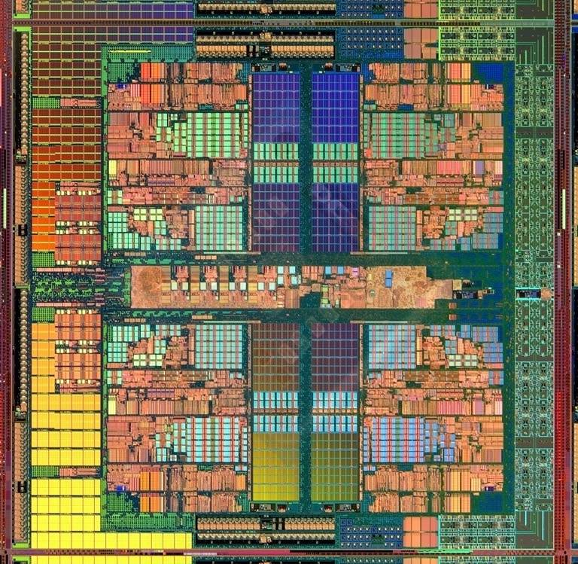
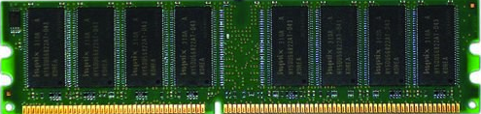
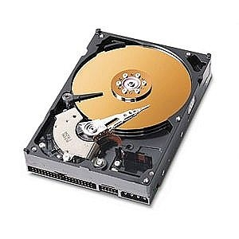
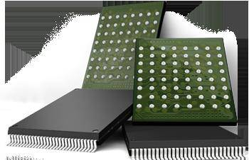
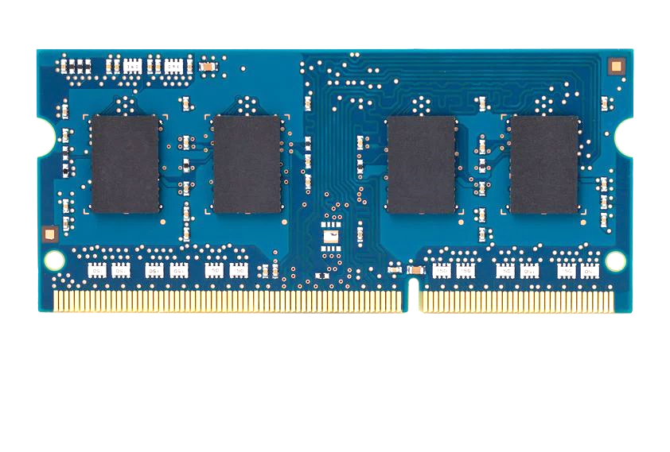
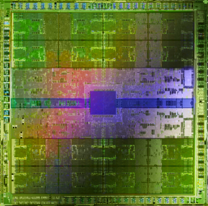
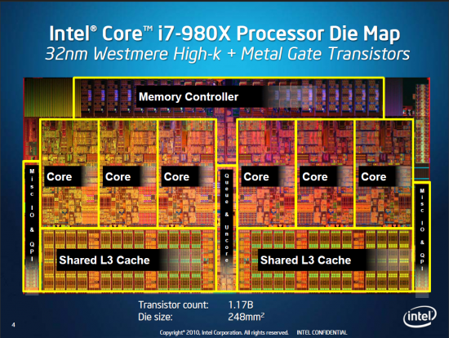
Current Research Focus Areas
Research Focus: Computer architecture, HW/SW, bioinformatics, security
Memory and storage (DRAM, flash, emerging), interconnects
Heterogeneous & parallel systems, GPUs, systems for data analytics
System/architecture interaction, new execution models, new interfaces
Hardware security, energy efficiency, fault tolerance, performance
Genome sequence analysis & assembly algorithms and architectures
Biologically inspired systems & system design for bio/medicine
Hybrid Main Memory
Heterogeneous
Processors and
Accelerators
Persistent Memory/Storage
Broad research
spanning apps, systems, logic
with architecture at the center
Graphics and Vision Processing
Notes:
Professor Mutlu’s research focus is all aspects of computer architecture, HW/SW interaction and bioinformatics.
He is looking for students to perform research in these areas.
He and his group, SAFARI, solve fundamental problems spanning:
Memory, memory, memory, storage, interconnects
Parallel architectures, heterogeneous architectures, GP-GPUs
System/architecture interaction, new execution models
Energy efficiency, fault tolerance, hardware security
Genome sequence analysis and assembly
His group does broad research spanning systems to logic with architecture at center

Slide 3
Four Key Directions
Fundamentally Secure/Reliable/Safe Architectures
Fundamentally Energy-Efficient Architectures
  Memory-centric (Data-centric) Architectures
Fundamentally Low-Latency Architectures
Architectures for Genomics, Medicine, Health

Slide 4
Four Key Directions
Fundamentally Secure/Reliable/Safe Architectures
Fundamentally Energy-Efficient Architectures
  Memory-centric (Data-centric) Architectures
Fundamentally Low-Latency Architectures
Architectures for Genomics, Medicine, Health

Slide 5
A Motivating Detour:
Genome Sequence Analysis

Slide 6
Our Dream
An embedded device that can perform comprehensive genome analysis in real time (within a minute)
  Which of these DNAs does this DNA segment match with?
  What is the likely genetic disposition of this patient to this drug?
  . . .

Slide 7
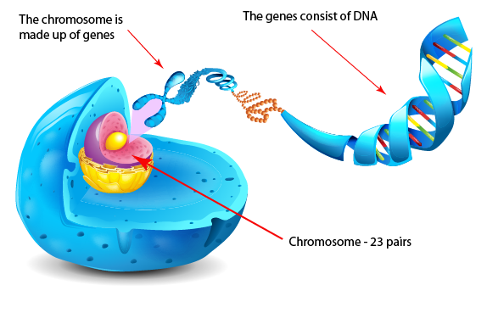
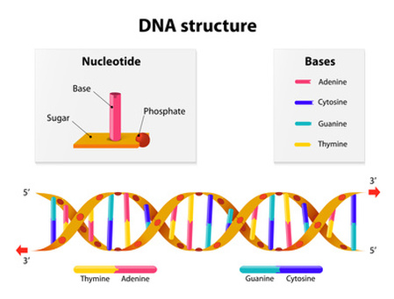
What Is a Genome Made Of?
Cell
Nucleus
The discovery of DNA’s double-helical structure (Watson+, 1953)
Notes:
Unlocking the life’s code requires diving into the nucleus of our body cells, where the double-stranded genome resides. Genome is literally the 'code of life' - it is the set of instructions for making everything from you to zebras, strawberries, and even yeast.
since the discovery of dna’s double-helical structure (watson et al. 1953)

Slide 8
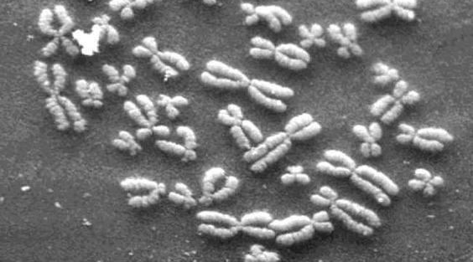
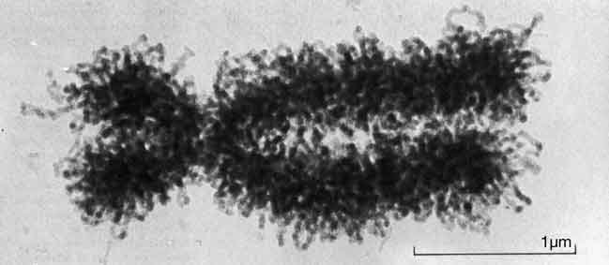
DNA Under Electron Microscope
human chromosome #12
from HeLa’s cell
Notes:
Henrietta Lacks,

Slide 9
DNA Sequencing
Goal:
  Find the complete sequence of A, C, G, T’s in DNA.
Challenge:
  There is no machine that takes long DNA as an input, and gives the complete sequence as output
  All sequencing machines chop DNA into pieces and identify relatively small pieces (but not how they fit together)

Slide 10
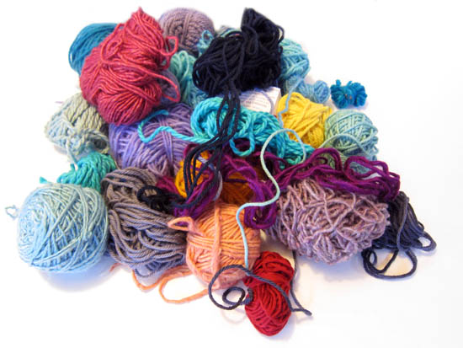
Untangling Yarn Balls & DNA Sequencing
Notes:
untangling yarn ball

Slide 11
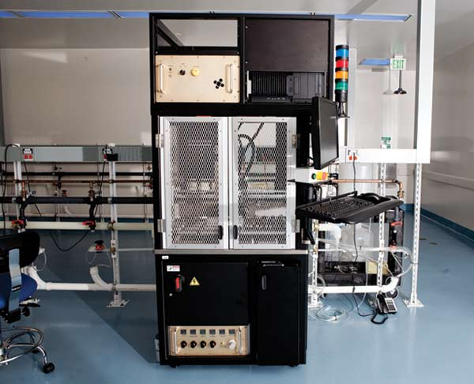
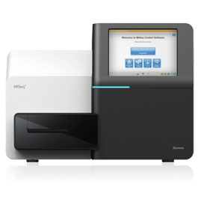
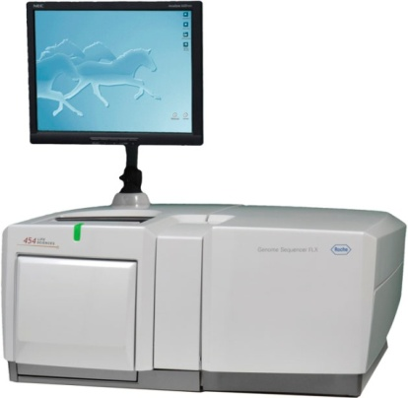
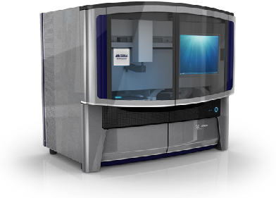
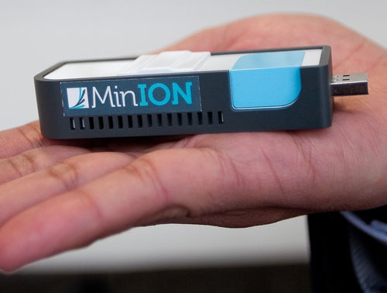
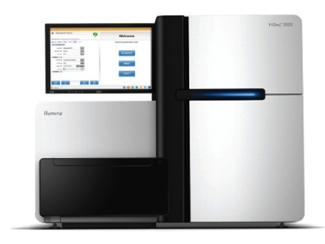
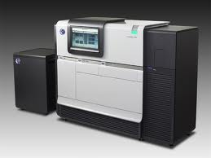
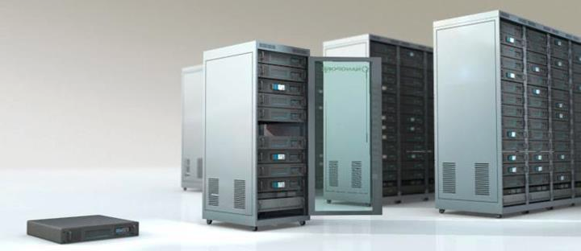
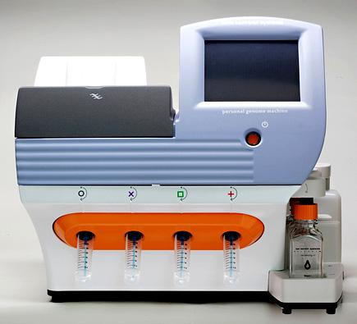
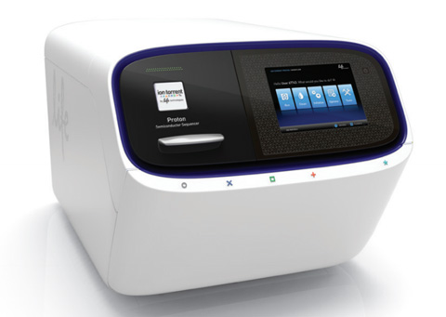
Genome Sequencers
Illumina MiSeq
Complete
Genomics
Roche/454
AB SOLiD
Oxford Nanopore MinION
Illumina
NovaSeq
6000
Illumina HiSeq2000
Pacific Biosciences RS
Oxford Nanopore GridION
Ion Torrent PGM
… and more! All produce data with different properties.
Ion Torrent Proton

Slide 12
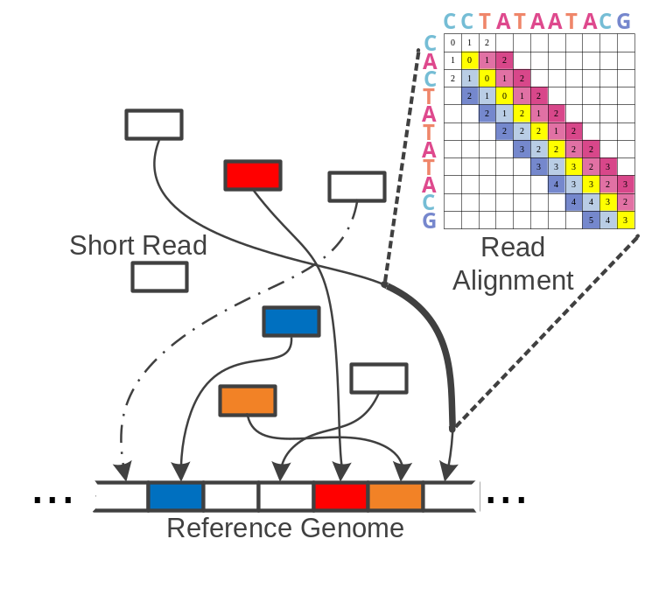
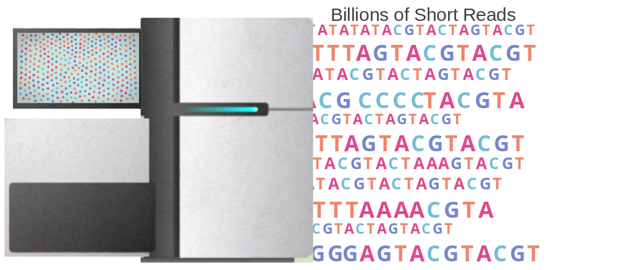
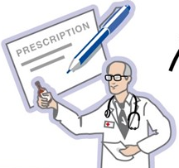
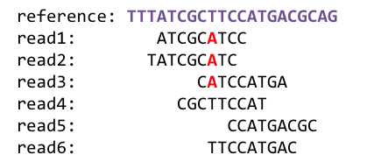
1
Sequencing
Genome Analysis
Read Mapping
2
Variant Calling
Scientific Discovery
3
4
Notes:
Genome analysis starts with sequencing random short DNA fragments of copies of the original molecule.
Unfortunately, these reads lack information about their order and which part of genome they are originated from.
Hence the second step is to map these reads to a long reference genome.

Slide 13
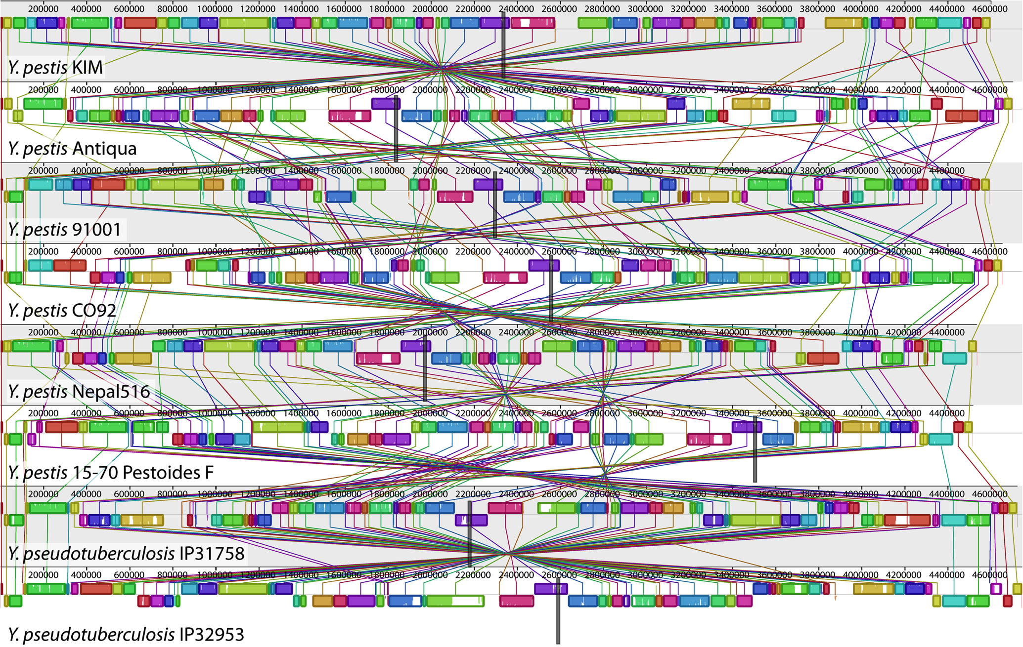
Genome Sequence Alignment: Example
Source: By Aaron E. Darling, István Miklós, Mark A. Ragan - Figure 1 from Darling AE, Miklós I, Ragan MA (2008).
"Dynamics of Genome Rearrangement in Bacterial Populations". PLOS Genetics. DOI:10.1371/journal.pgen.1000128., CC BY 2.5, https://commons.wikimedia.org/w/index.php?curid=30550950

Slide 14
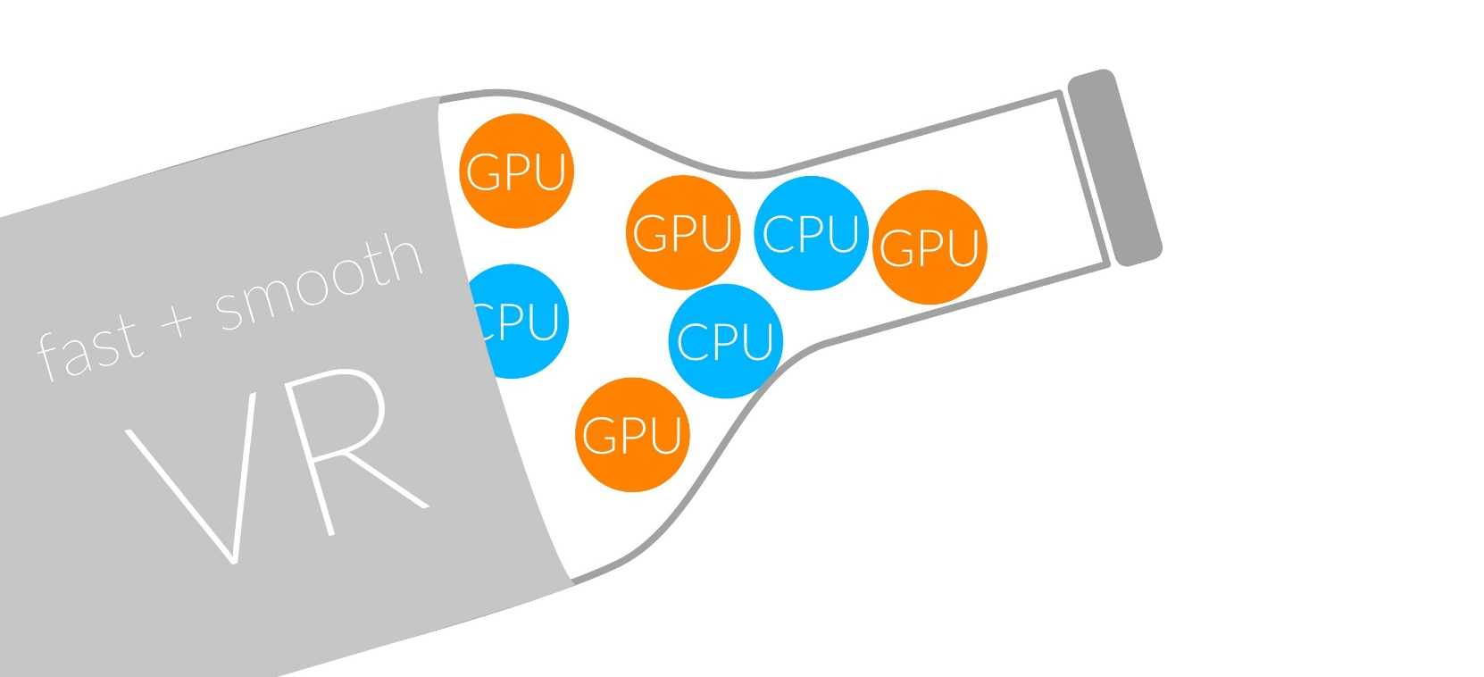
1
Sequencing
Read Mapping
2
Bottlenecked in Mapping!!
Illumina HiSeq4000
on average
GAGTCAGAATTTGAC
2 M
bases/min
300 M
bases/min
GAGTCAGAATTTGAC
GAGTCAGAATTTGAC
GAGTCAGAATTTGAC
GAGTCAGAATTTGAC
GAGTCAGAATTTGAC
GAGTCAGAATTTGAC
GAGTCAGAATTTGAC
GAGTCAGAATTTGAC
GAGTCAGAATTTGAC
GAGTCAGAATTTGAC
GAGTCAGAATTTGAC
GAGTCAGAATTTGAC
GAGTCAGAATTTGAC
GAGTCAGAATTTGAC
(0.6%)
Variant Calling
Scientific Discovery
3
4
Notes:
Typical sequencer machine generates a flood of reads, for example, Illumina HiSeq4000 generates 300 million bases/minute.
However, existing computer alignment algorithms can only process 0.6% of these reads in the same amount of time.
This gap is widening as more advanced sequencers are made available in the market.

Slide 15
Hash Table Based Read Mappers
+ Guaranteed to find all mappings → sensitive
+ Can tolerate up to e errors
http://mrfast.sourceforge.net/
Alkan+, "Personalized copy number and segmental duplication
maps using next-generation sequencing”, Nature Genetics 2009.
Notes:
It turned out the Hash Table based mappers solve the first 2 challenges pretty well. They guarantee to find all mappings with no more than e errors present.

Slide 16
Read Mapping Execution Time Breakdown
Notes:
An overwhelming majority of the read mapper’s execution time is spent in read alignment.

Slide 17
Idea
Filter fast before you align
Minimize costly
“approximate string comparisons”

Slide 18
Our First Filter: Pure Software Approach
Download the source code and try for yourself
  Download link to FastHASH

Slide 19
Shifted Hamming Distance: SIMD Acceleration
https://github.com/CMU-SAFARI/Shifted-Hamming-Distance
Xin+, "Shifted Hamming Distance: A Fast and Accurate SIMD-friendly Filter
to Accelerate Alignment Verification in Read Mapping”, Bioinformatics 2015.

Slide 20
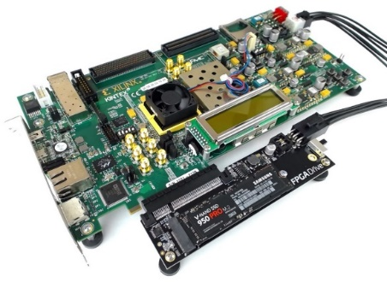
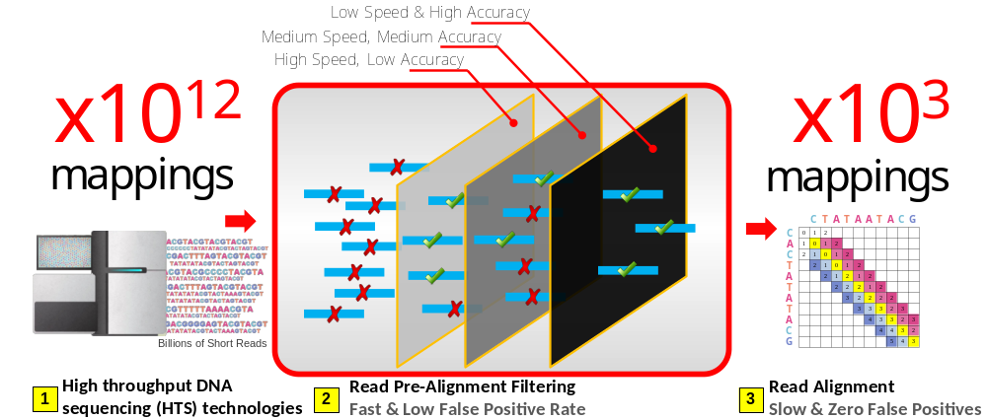
GateKeeper: FPGA-Based Alignment Filtering
1
st
Alignment Filter
FPGA-based Alignment Filter.
Notes:
To bridge the widening gap between the sequencer & the mapper, we propose the concept of pre-alignment filtering. We added a new examination step before the accurate alignment step. The main objective of this step is to detect the incorrect mappings accurately and rapidly. Only the mappings that pass our filter are examined by the alignment step. We also explore exploiting todays’ hardware accelerators to further boost the filtering speed of such filters.

Slide 21
GateKeeper: FPGA-Based Alignment Filtering
Mohammed Alser, Hasan Hassan, Hongyi Xin, Oguz Ergin, Onur Mutlu, and Can Alkan
"GateKeeper: A New Hardware Architecture for Accelerating Pre-Alignment in DNA Short Read Mapping"
Bioinformatics, [published online, May 31], 2017.
[Source Code]
[Online link at Bioinformatics Journal]

Slide 22
DNA Read Mapping & Filtering
Problem: Heavily bottlenecked by Data Movement
GateKeeper FPGA performance limited by DRAM bandwidth [Alser+, Bioinformatics 2017]
Ditto for SHD on SIMD [Xin+, Bioinformatics 2015]
Solution: Processing-in-memory can alleviate the bottleneck
However, we need to design mapping & filtering algorithms to fit processing-in-memory

Slide 23
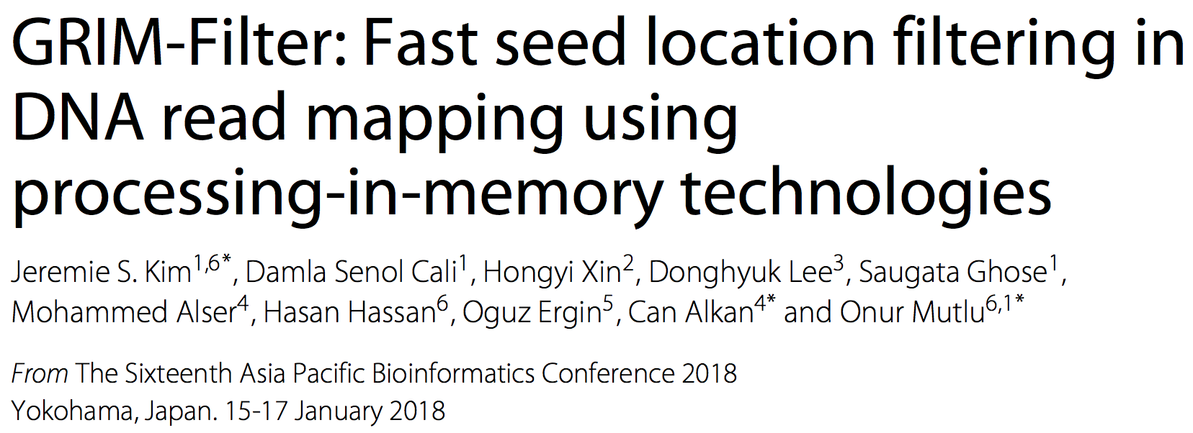
In-Memory DNA Sequence Analysis
Jeremie S. Kim, Damla Senol Cali, Hongyi Xin, Donghyuk Lee, Saugata Ghose, Mohammed Alser, Hasan Hassan, Oguz Ergin, Can Alkan, and Onur Mutlu,
"GRIM-Filter: Fast Seed Location Filtering in DNA Read Mapping Using Processing-in-Memory Technologies"
BMC Genomics, 2018.
Proceedings of the 16th Asia Pacific Bioinformatics Conference (APBC), Yokohama, Japan, January 2018.
arxiv.org Version (pdf)

Slide 24
Quick Note: Key Principles and Results
Two key principles:
  Exploit the structure of the genome to minimize computation
  Morph and exploit the structure of the underlying hardware to maximize performance and efficiency
Algorithm-architecture co-design for DNA read mapping
  Speeds up read mapping by ~200X (sometimes more)
  Improves accuracy of read mapping in the presence of errors
Xin et al., “Accelerating Read Mapping with FastHASH,” BMC Genomics 2013.
Xin et al., “Shifted Hamming Distance: A Fast and Accurate SIMD-friendly Filter to Accelerate
Alignment Verification in Read Mapping,” Bioinformatics 2015.
Alser et al., “GateKeeper: A New Hardware Architecture for Accelerating Pre-Alignment in DNA
Short Read Mapping,” Bioinformatics 2017.
Kim et al., “Genome Read In-Memory (GRIM) Filter,” BMC Genomics 2018.

Slide 25
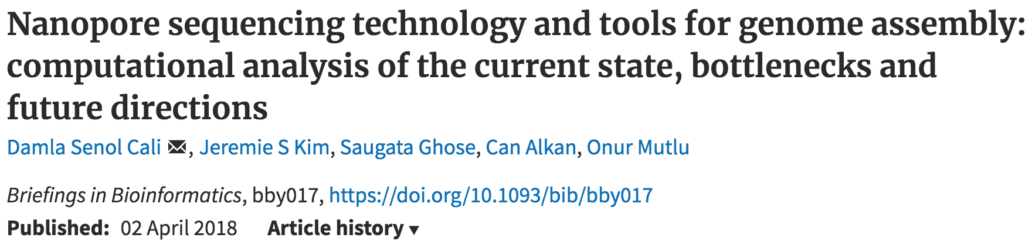
New Genome Sequencing Technologies
Oxford Nanopore MinION
Senol Cali+, “Nanopore Sequencing Technology and Tools for Genome
Assembly: Computational Analysis of the Current State, Bottlenecks
and Future Directions,” Briefings in Bioinformatics, 2018.
[Preliminary arxiv.org version]

Slide 26
Nanopore Genome Assembly Pipeline
Senol Cali+, “Nanopore Sequencing Technology and Tools for Genome
Assembly,” Briefings in Bioinformatics, 2018.

Slide 27

More on Genome Analysis: Another Talk

Slide 28
Recall Our Dream
An embedded device that can perform comprehensive genome analysis in real time (within a minute)
Still a long ways to go
  Energy efficiency
  Performance (latency)
  Security
  Huge memory bottleneck

Slide 29
Four Key Directions
Fundamentally Secure/Reliable/Safe Architectures
Fundamentally Energy-Efficient Architectures
  Memory-centric (Data-centric) Architectures
Fundamentally Low-Latency Architectures
Architectures for Genomics, Medicine, Health

Slide 30
Memory & Storage

Slide 31
The Main Memory System
Main memory is a critical component of all computing systems: server, mobile, embedded, desktop, sensor
Main memory system must scale (in size, technology, efficiency, cost, and management algorithms) to maintain performance growth and technology scaling benefits
Processors
and caches
Main Memory
Storage (SSD/HDD)

Slide 32
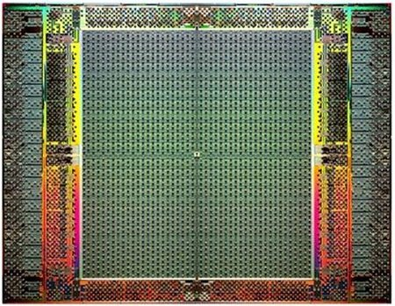
The Main Memory System
Main memory is a critical component of all computing systems: server, mobile, embedded, desktop, sensor
Main memory system must scale (in size, technology, efficiency, cost, and management algorithms) to maintain performance growth and technology scaling benefits
FPGAs
Main Memory
Storage (SSD/HDD)

Slide 33
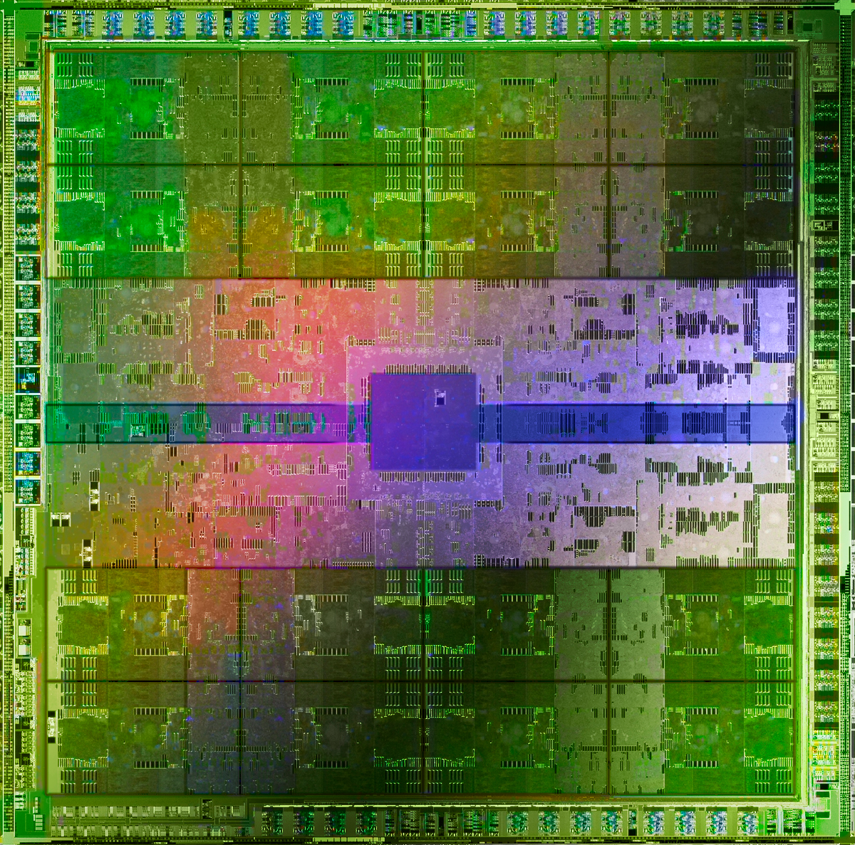
The Main Memory System
Main memory is a critical component of all computing systems: server, mobile, embedded, desktop, sensor
Main memory system must scale (in size, technology, efficiency, cost, and management algorithms) to maintain performance growth and technology scaling benefits
GPUs
Main Memory
Storage (SSD/HDD)

Slide 34
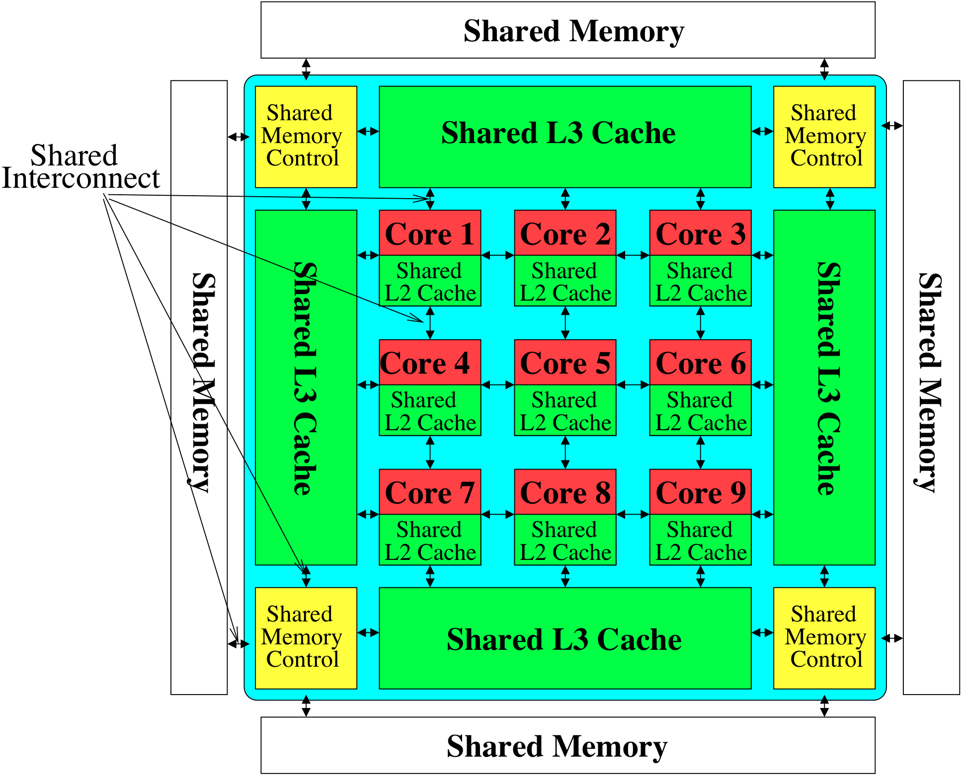
Memory System: A Shared Resource View
Storage
Most of the system is dedicated to storing and moving data

Slide 35
State of the Main Memory System
Recent technology, architecture, and application trends
  lead to new requirements
  exacerbate old requirements
DRAM and memory controllers, as we know them today, are (will be) unlikely to satisfy all requirements
Some emerging non-volatile memory technologies (e.g., PCM) enable new opportunities: memory+storage merging
We need to rethink the main memory system
  to fix DRAM issues and enable emerging technologies
  to satisfy all requirements

Slide 36
Agenda
Major Trends Affecting Main Memory
Key Challenges and Solution Directions
  Robustness: Reliability and Security
  Energy and Performance: In-Memory Computation
  Low Latency/Energy and Latency/Energy/Reliability Tradeoffs
  Scalability and More: Enabling Emerging Technologies
Solution Principles
Concluding Remarks

Slide 37
Major Trends Affecting Main Memory (I)
Need for main memory capacity, bandwidth, QoS increasing
Main memory energy/power is a key system design concern
DRAM technology scaling is ending

Slide 38
Major Trends Affecting Main Memory (II)
Need for main memory capacity, bandwidth, QoS increasing
  Multi-core: increasing number of cores/agents
  Data-intensive applications: increasing demand/hunger for data
  Consolidation: cloud computing, GPUs, mobile, heterogeneity
Main memory energy/power is a key system design concern
DRAM technology scaling is ending

Slide 39
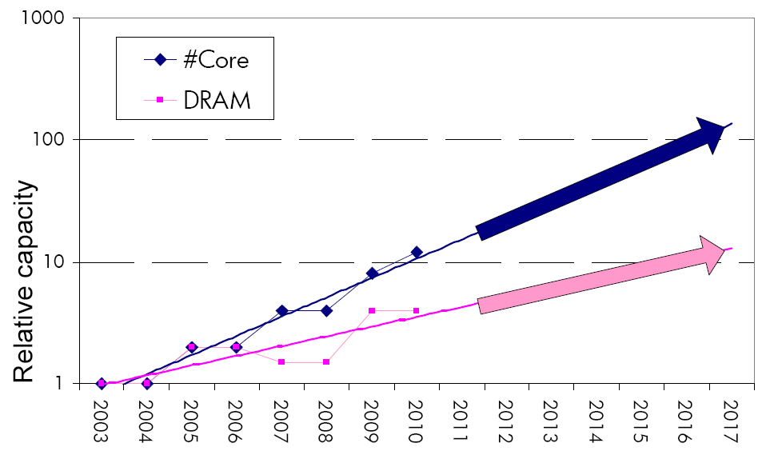
Example: The Memory Capacity Gap
Core count doubling ~ every 2 years
DRAM DIMM capacity doubling ~ every 3 years
Memory capacity per core expected to drop by 30% every two years
Trends worse for memory bandwidth per core!
Lim et al., ISCA 2009

Slide 40
DRAM Capacity, Bandwidth, Latency Trends
128x
20x
1.3x
Memory latency remains almost constant

Slide 41


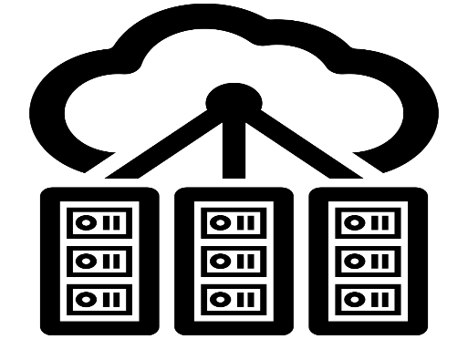

DRAM Is Critical for Performance
In-memory Databases
[Mao+, EuroSys’12;
Clapp+ (Intel), IISWC’15]
Graph/Tree Processing
[Xu+, IISWC’12; Umuroglu+, FPL’15]
In-Memory Data Analytics
[Clapp+ (Intel), IISWC’15;
Awan+, BDCloud’15]
Datacenter Workloads
[Kanev+ (Google), ISCA’15]

Slide 42
DRAM Is Critical for Performance
In-memory Databases
[Mao+, EuroSys’12;
Clapp+ (Intel), IISWC’15]
Graph/Tree Processing
[Xu+, IISWC’12; Umuroglu+, FPL’15]
Memory → performance bottleneck
In-Memory Data Analytics
[Clapp+ (Intel), IISWC’15;
Awan+, BDCloud’15]
Datacenter Workloads
[Kanev+ (Google), ISCA’15]

Slide 43





Popular Consumer Workloads
  Chrome
TensorFlow Mobile
    Google’s web browser
Google’s machine learning framework
  Video Playback
  Video Capture
Google’s video codec
Google’s video codec
Notes:
In this work, we take a look at widely-used google consumer workloads, to figure out the major sources of energy consumption.
We look at Google Chrome web brower. We take a look at Tensorflow, Google’s machine learning framework, and we also take a look at two important video related workloads, video playback and video capture, both rely on Google’s vp9 codec technology.

Slide 44
Popular Consumer Workloads
  Chrome
TensorFlow Mobile
    Google’s web browser
Google’s machine learning framework
Memory → performance bottleneck
  Video Playback
  Video Capture
Google’s video codec
Google’s video codec
Notes:
In this work, we take a look at widely-used google consumer workloads, to figure out the major sources of energy consumption.
We look at Google Chrome web brower. We take a look at Tensorflow, Google’s machine learning framework, and we also take a look at two important video related workloads, video playback and video capture, both rely on Google’s vp9 codec technology.

Slide 45
Major Trends Affecting Main Memory (III)
Need for main memory capacity, bandwidth, QoS increasing
Main memory energy/power is a key system design concern
  ~40-50% energy spent in off-chip memory hierarchy [Lefurgy, IEEE Computer’03] >40% power in DRAM [Ware, HPCA’10][Paul,ISCA’15]
  DRAM consumes power even when not used (periodic refresh)
DRAM technology scaling is ending

Slide 46
Energy Waste in Mobile Devices
Amirali Boroumand, Saugata Ghose, Youngsok Kim, Rachata Ausavarungnirun, Eric Shiu, Rahul Thakur, Daehyun Kim, Aki Kuusela, Allan Knies, Parthasarathy Ranganathan, and Onur Mutlu,
"Google Workloads for Consumer Devices: Mitigating Data Movement Bottlenecks"
Proceedings of the 23rd International Conference on Architectural Support for Programming Languages and Operating Systems (ASPLOS), Williamsburg, VA, USA, March 2018.
62.7% of the total system energy
is spent on data movement

Slide 47
Major Trends Affecting Main Memory (IV)
Need for main memory capacity, bandwidth, QoS increasing
Main memory energy/power is a key system design concern
DRAM technology scaling is ending
  ITRS projects DRAM will not scale easily below X nm
  Scaling has provided many benefits:
    higher capacity (density), lower cost, lower energy

Slide 48
Major Trends Affecting Main Memory (V)
DRAM scaling has already become increasingly difficult
  Increasing cell leakage current, reduced cell reliability, increasing manufacturing difficulties [Kim+ ISCA 2014],
  [Liu+ ISCA 2013], [Mutlu IMW 2013], [Mutlu DATE 2017]
  Difficult to significantly improve capacity, energy
Emerging memory technologies are promising
3D-Stacked DRAM | higher bandwidth | smaller capacity
Reduced-Latency DRAM (e.g., RLDRAM, TL-DRAM) | lower latency | higher cost
Low-Power DRAM (e.g., LPDDR3, LPDDR4) | lower power | higher latency higher cost
Non-Volatile Memory (NVM) (e.g., PCM, STTRAM, ReRAM, 3D Xpoint) | larger capacity | higher latency higher dynamic power lower endurance

Slide 49
Major Trends Affecting Main Memory (V)
DRAM scaling has already become increasingly difficult
  Increasing cell leakage current, reduced cell reliability, increasing manufacturing difficulties [Kim+ ISCA 2014],
  [Liu+ ISCA 2013], [Mutlu IMW 2013], [Mutlu DATE 2017]
  Difficult to significantly improve capacity, energy
Emerging memory technologies are promising
3D-Stacked DRAM | higher bandwidth | smaller capacity
Reduced-Latency DRAM (e.g., RL/TL-DRAM, FLY-RAM) | lower latency | higher cost
Low-Power DRAM (e.g., LPDDR3, LPDDR4, Voltron) | lower power | higher latency higher cost
Non-Volatile Memory (NVM) (e.g., PCM, STTRAM, ReRAM, 3D Xpoint) | larger capacity | higher latency higher dynamic power lower endurance

Slide 50
Major Trend: Hybrid Main Memory
CPU
Meza+, “Enabling Efficient and Scalable Hybrid Memories,” IEEE Comp. Arch. Letters, 2012.
Yoon+, “Row Buffer Locality Aware Caching Policies for Hybrid Memories,” ICCD 2012 Best Paper Award.
DRAMCtrl
PCM Ctrl
DRAM
Phase Change Memory (or Tech. X)
Fast, durable
Small,
leaky, volatile,
high-cost
Large, non-volatile, low-cost
Slow, wears out, high active energy
Hardware/software manage data allocation and movement
to achieve the best of multiple technologies

Slide 51
One Foreshadowing
Main Memory Needs
Intelligent Controllers

Slide 52
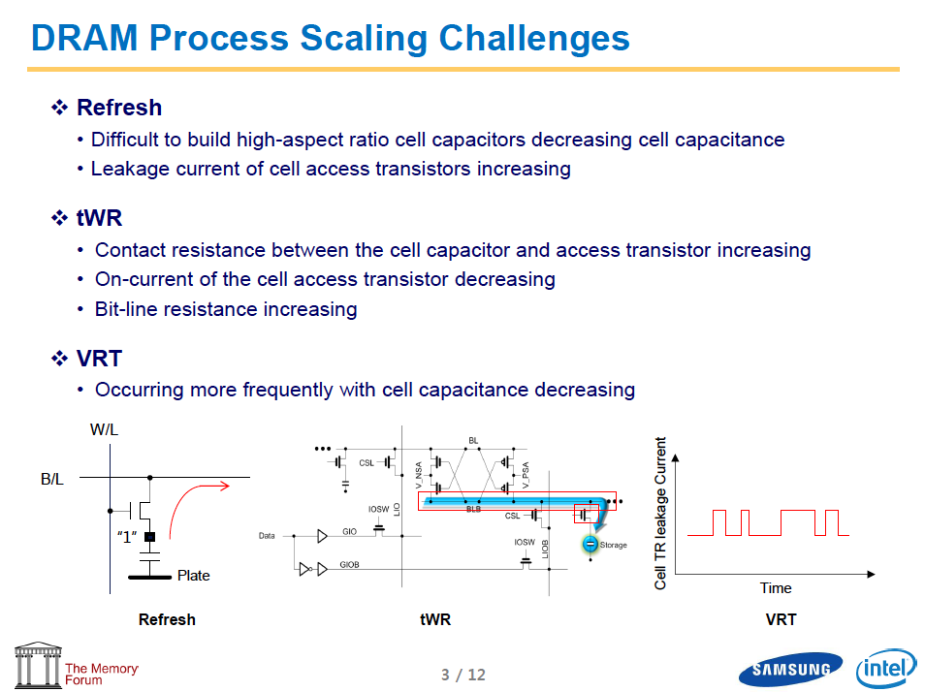
Industry Is Writing Papers About It, Too

Slide 53
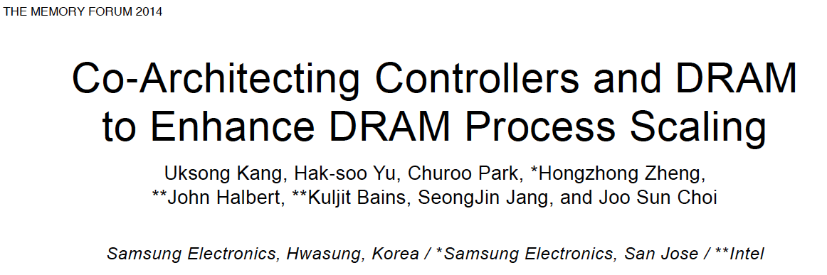
Call for Intelligent Memory Controllers

Slide 54
Agenda
Major Trends Affecting Main Memory
Key Challenges and Solution Directions
  Robustness: Reliability and Security
  Energy and Performance: In-Memory Computation
  Low Latency/Energy and Latency/Energy/Reliability Tradeoffs
  Scalability and More: Enabling Emerging Technologies
Solution Principles
Concluding Remarks

Slide 55
Four Key Issues in Future Platforms
Fundamentally Secure/Reliable/Safe Architectures
Fundamentally Energy-Efficient Architectures
  Memory-centric (Data-centric) Architectures
Fundamentally Low-Latency Architectures
Architectures for Genomics, Medicine, Health

Slide 56
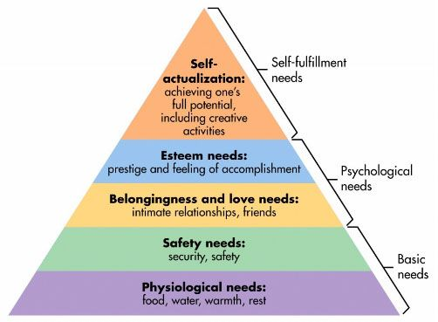
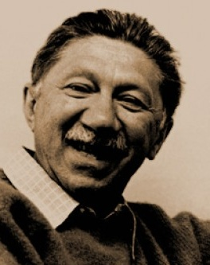
Maslow’s (Human) Hierarchy of Needs
Maslow, “A Theory of Human Motivation,”
Psychological Review, 1943.
Maslow, “A Theory of Human Motivation,”
Psychological Review, 1943.
Maslow, “Motivation and Personality,”
Book, 1954-1970.
We need to start with reliability and security…
Source: https://www.simplypsychology.org/maslow.html
Source: By User:Factoryjoe - Mazlow's Hierarchy of Needs.svg, CC BY-SA 3.0, https://commons.wikimedia.org/w/index.php?curid=7964065

Slide 57
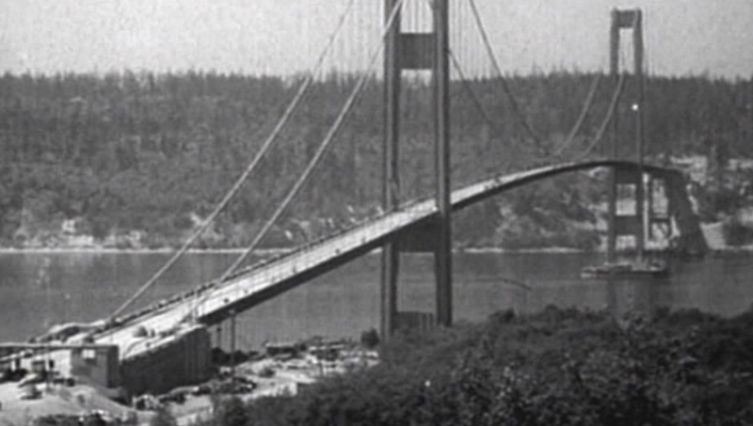
How Reliable/Secure/Safe is This Bridge?
Source: http://www.technologystudent.com/struct1/tacom1.png

Slide 58
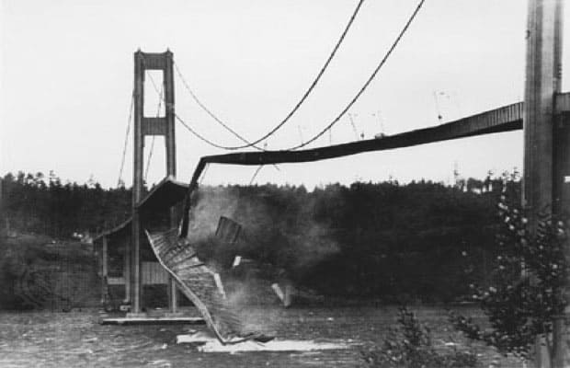
Collapse of the “Galloping Gertie”
Source: AP
http://www.wsdot.wa.gov/tnbhistory/connections/connections3.htm

Slide 59
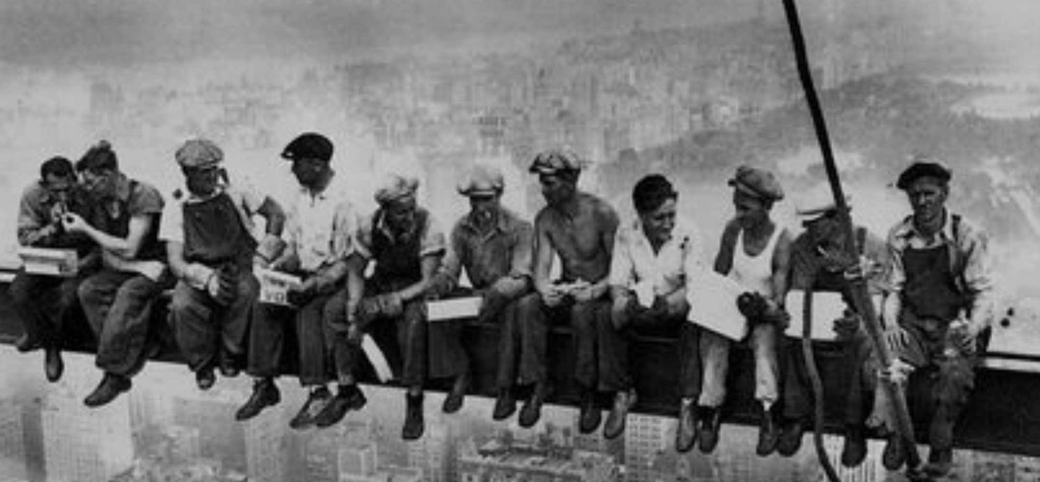
How Secure Are These People?
Security is about preventing unforeseen consequences
Source: https://s-media-cache-ak0.pinimg.com/originals/48/09/54/4809543a9c7700246a0cf8acdae27abf.jpg

Slide 60
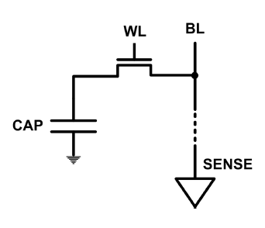
The DRAM Scaling Problem
DRAM stores charge in a capacitor (charge-based memory)
  Capacitor must be large enough for reliable sensing
  Access transistor should be large enough for low leakage and high retention time
  Scaling beyond 40-35nm (2013) is challenging [ITRS, 2009]
DRAM capacity, cost, and energy/power hard to scale

Slide 61
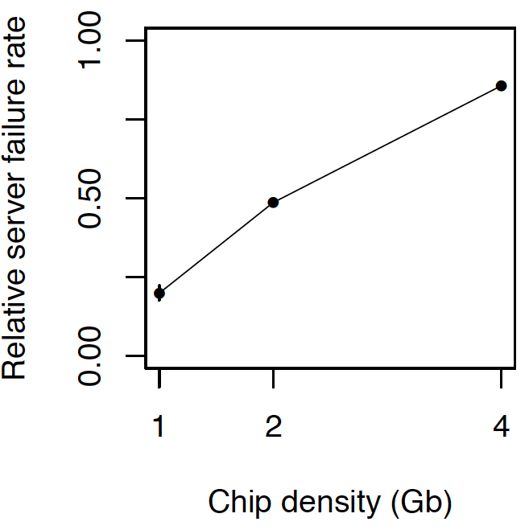
As Memory Scales, It Becomes Unreliable
Data from all of Facebook’s servers worldwide
Meza+, “Revisiting Memory Errors in Large-Scale Production Data Centers,” DSN’15.
Intuition:
quadratic
increase in
capacity

Slide 62
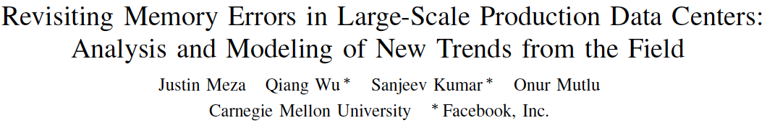
Large-Scale Failure Analysis of DRAM Chips
Analysis and modeling of memory errors found in all of Facebook’s server fleet
Justin Meza, Qiang Wu, Sanjeev Kumar, and Onur Mutlu,
"Revisiting Memory Errors in Large-Scale Production Data Centers: Analysis and Modeling of New Trends from the Field"
Proceedings of the 45th Annual IEEE/IFIP International Conference on Dependable Systems and Networks (DSN), Rio de Janeiro, Brazil, June 2015.
[Slides (pptx) (pdf)] [DRAM Error Model]

Slide 63
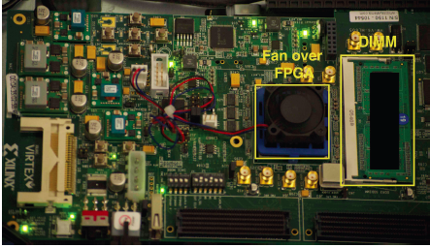
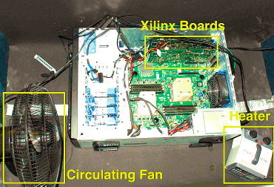
Infrastructures to Understand Such Issues
  An Experimental Study of Data Retention Behavior in Modern DRAM Devices: Implications for Retention Time Profiling Mechanisms (Liu et al., ISCA 2013)
  The Efficacy of Error Mitigation Techniques for DRAM Retention Failures: A Comparative Experimental Study
  (Khan et al., SIGMETRICS 2014)
  Flipping Bits in Memory Without Accessing Them: An Experimental Study of DRAM Disturbance Errors (Kim et al., ISCA 2014)
  Adaptive-Latency DRAM: Optimizing DRAM Timing for the Common-Case (Lee et al., HPCA 2015)
  AVATAR: A Variable-Retention-Time (VRT) Aware Refresh for DRAM Systems (Qureshi et al., DSN 2015)

Slide 64
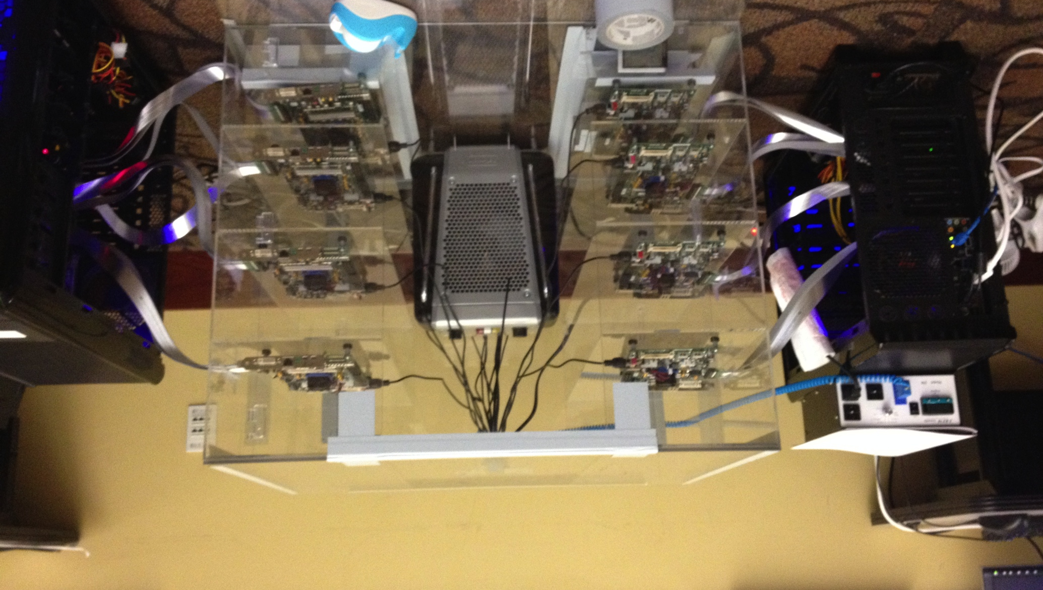
Infrastructures to Understand Such Issues
Temperature
Controller
FPGAs
Heater
FPGAs
PC
  Kim+, “Flipping Bits in Memory Without Accessing Them: An Experimental Study of DRAM Disturbance Errors,” ISCA 2014.

Slide 65


SoftMC: Open Source DRAM Infrastructure
Hasan Hassan et al., “SoftMC: A Flexible and Practical Open-Source Infrastructure for Enabling Experimental DRAM Studies,” HPCA 2017.
Flexible
Easy to Use (C++ API)
Open-source
github.com/CMU-SAFARI/SoftMC

Slide 66

SoftMC
https://github.com/CMU-SAFARI/SoftMC

Slide 67

Data Retention in Memory [Liu et al., ISCA 2013]
Retention Time Profile of DRAM looks like this:
Location dependent
Stored value pattern dependent
Time dependent
Liu+, “RAIDR: Retention-Aware Intelligent DRAM Refresh,” ISCA 2012.

Slide 68
Takeaway
Main Memory Needs
Intelligent Controllers

Slide 69
A Curious Discovery [Kim et al., ISCA 2014]
One can
predictably induce errors
in most DRAM memory chips

Slide 70

DRAM RowHammer
A simple hardware failure mechanism
can create a widespread
system security vulnerability

Slide 71
Modern DRAM is Prone to Disturbance Errors
Row of Cells
Wordline
Row
Victim Row
Row
Hammered Row
V_{LOW}
Opened
V_{HIGH}
Closed
Row
Victim Row
Row
Repeatedly reading a row enough times (before memory gets refreshed) induces disturbance errors in adjacent rows in most real DRAM chips you can buy today
Flipping Bits in Memory Without Accessing Them: An Experimental Study of DRAM Disturbance Errors, (Kim et al., ISCA 2014)

Slide 72

Most DRAM Modules Are Vulnerable
A company
B company
C company
86%
(37/43)
83%
(45/54)
88%
(28/32)
Up to
1.0×10⁷
errors
Up to
2.7×10⁶
errors
Up to
3.3×10⁵
errors
Flipping Bits in Memory Without Accessing Them: An Experimental Study of DRAM Disturbance Errors, (Kim et al., ISCA 2014)

Slide 73


Recent DRAM Is More Vulnerable
Notes:
In this figure, the x-axis is the module manufacture date. And the y-axis is the number of errors in a module, normalized to one billion cells. In 2008 and 2009, there are no errors. But, in 2010, we first start to see errors in C modules. After 2010, the errors start to proliferate. For A and B modules, we first start to see errors in 2011. In particular, all modules from 2012 and 2013 are vulnerable.

Slide 74
Recent DRAM Is More Vulnerable
First
Appearance
Notes:
In this figure, the x-axis is the module manufacture date. And the y-axis is the number of errors in a module, normalized to one billion cells. In 2008 and 2009, there are no errors. But, in 2010, we first start to see errors in C modules. After 2010, the errors start to proliferate. For A and B modules, we first start to see errors in 2011. In particular, all modules from 2012 and 2013 are vulnerable.

Slide 75
Recent DRAM Is More Vulnerable
First
Appearance
All modules from 2012–2013 are vulnerable
Notes:
In this figure, the x-axis is the module manufacture date. And the y-axis is the number of errors in a module, normalized to one billion cells. In 2008 and 2009, there are no errors. But, in 2010, we first start to see errors in C modules. After 2010, the errors start to proliferate. For A and B modules, we first start to see errors in 2011. In particular, all modules from 2012 and 2013 are vulnerable.

Slide 76

A Simple Program Can Induce Many Errors
CPU
DRAM Module
loop:
mov (X), %eax
mov (Y), %ebx
clflush (X)
clflush (Y)
mfence
jmp loop
X
Y
  Download from: https://github.com/CMU-SAFARI/rowhammer
Notes:
We demonstrate the errors on multiple x86 systems. Shown to the bottom-left is a “disturbance kernel”. When executed, it forces two rows to be opened and closed one after the other – over and over again. Consequently, it induces many errors in the module.

Slide 77
A Simple Program Can Induce Many Errors
CPU
DRAM Module
Avoid cache hits
  Flush X from cache
Avoid row hits to X
  Read Y in another row
X
Y
  Download from: https://github.com/CMU-SAFARI/rowhammer
Notes:
We demonstrate the errors on multiple x86 systems. Shown to the bottom-left is a “disturbance kernel”. When executed, it forces two rows to be opened and closed one after the other – over and over again. Consequently, it induces many errors in the module.

Slide 78
A Simple Program Can Induce Many Errors
CPU
DRAM Module
loop:
mov (X), %eax
mov (Y), %ebx
clflush (X)
clflush (Y)
mfence
jmp loop
X
Y
  Download from: https://github.com/CMU-SAFARI/rowhammer
Notes:
We demonstrate the errors on multiple x86 systems. Shown to the bottom-left is a “disturbance kernel”. When executed, it forces two rows to be opened and closed one after the other – over and over again. Consequently, it induces many errors in the module.

Slide 79
A Simple Program Can Induce Many Errors
CPU
DRAM Module
loop:
mov (X), %eax
mov (Y), %ebx
clflush (X)
clflush (Y)
mfence
jmp loop
X
Y
  Download from: https://github.com/CMU-SAFARI/rowhammer
Notes:
We demonstrate the errors on multiple x86 systems. Shown to the bottom-left is a “disturbance kernel”. When executed, it forces two rows to be opened and closed one after the other – over and over again. Consequently, it induces many errors in the module.

Slide 80
A Simple Program Can Induce Many Errors
CPU
DRAM Module
loop:
mov (X), %eax
mov (Y), %ebx
clflush (X)
clflush (Y)
mfence
jmp loop
X
Y
  Download from: https://github.com/CMU-SAFARI/rowhammer
Notes:
We demonstrate the errors on multiple x86 systems. Shown to the bottom-left is a “disturbance kernel”. When executed, it forces two rows to be opened and closed one after the other – over and over again. Consequently, it induces many errors in the module.

Slide 81
Observed Errors in Real Systems
A real reliability & security issue
CPU Architecture | Errors | Access-Rate
Intel Haswell (2013) | 22.9K | 12.3M/sec
Intel Ivy Bridge (2012) | 20.7K | 11.7M/sec
Intel Sandy Bridge (2011) | 16.1K | 11.6M/sec
AMD Piledriver (2012) | 59 | 6.1M/sec
Kim+, “Flipping Bits in Memory Without Accessing Them: An Experimental Study of DRAM Disturbance Errors,” ISCA 2014.
Notes:
When we executed the code on four different processors, all four of them yielded errors. Intel Haswell has the most errors, at 23 thousand, because it has the highest rate of accessing DRAM.
Later on, I’ll show that we can induce as many as ten million disturbance errors in a more controlled environment.
From this, we conclude that disturbance errors are a serious reliability issue.

Slide 82



One Can Take Over an Otherwise-Secure System
Flipping Bits in Memory Without Accessing Them: An Experimental Study of DRAM Disturbance Errors (Kim et al., ISCA 2014)
Exploiting the DRAM rowhammer bug to gain kernel privileges (Seaborn, 2015)

Slide 83
RowHammer Security Attack Example
“Rowhammer” is a problem with some recent DRAM devices in which repeatedly accessing a row of memory can cause bit flips in adjacent rows (Kim et al., ISCA 2014).
  Flipping Bits in Memory Without Accessing Them: An Experimental Study of DRAM Disturbance Errors (Kim et al., ISCA 2014)
We tested a selection of laptops and found that a subset of them exhibited the problem.
We built two working privilege escalation exploits that use this effect.
  Exploiting the DRAM rowhammer bug to gain kernel privileges (Seaborn+, 2015)
One exploit uses rowhammer-induced bit flips to gain kernel privileges on x86-64 Linux when run as an unprivileged userland process.
When run on a machine vulnerable to the rowhammer problem, the process was able to induce bit flips in page table entries (PTEs).
It was able to use this to gain write access to its own page table, and hence gain read-write access to all of physical memory.
Exploiting the DRAM rowhammer bug to gain kernel privileges (Seaborn & Dullien, 2015)

Slide 84


Security Implications
Notes:
Picture from the article:
http://thehackernews.com/2015/03/dram-rowhammer-vulnerability.html

Slide 85

Security Implications
Notes:
Picture from the article:
http://thehackernews.com/2015/03/dram-rowhammer-vulnerability.html

Slide 86
Selected Readings on RowHammer (I)
Our first detailed study: Rowhammer analysis and solutions (June 2014)
  Yoongu Kim, Ross Daly, Jeremie Kim, Chris Fallin, Ji Hye Lee, Donghyuk Lee, Chris Wilkerson, Konrad Lai, and Onur Mutlu,
  "Flipping Bits in Memory Without Accessing Them: An Experimental Study of DRAM Disturbance Errors"
  Proceedings of the 41st International Symposium on Computer Architecture (ISCA), Minneapolis, MN, June 2014. [Slides (pptx) (pdf)] [Lightning Session Slides (pptx) (pdf)] [Source Code and Data]
Our Source Code to Induce Errors in Modern DRAM Chips (June 2014)
  https://github.com/CMU-SAFARI/rowhammer
Google Project Zero’s Attack to Take Over a System (March 2015)
  Exploiting the DRAM rowhammer bug to gain kernel privileges (Seaborn+, 2015)
  https://github.com/google/rowhammer-test
  Double-sided Rowhammer

Slide 87
Selected Readings on RowHammer (II)
Remote RowHammer Attacks via JavaScript (July 2015)
  http://arxiv.org/abs/1507.06955
  https://github.com/IAIK/rowhammerjs
  Gruss et al., DIMVA 2016.
  CLFLUSH-free Rowhammer
  “A fully automated attack that requires nothing but a website with JavaScript to trigger faults on remote hardware.”
  “We can gain unrestricted access to systems of website visitors.”
ANVIL: Software-Based Protection Against Next-Generation Rowhammer Attacks (March 2016)
  http://dl.acm.org/citation.cfm?doid=2872362.2872390
  Aweke et al., ASPLOS 2016
  CLFLUSH-free Rowhammer
  Software based monitoring for rowhammer detection

Slide 88
Selected Readings on RowHammer (III)
Dedup Est Machina: Memory Deduplication as an Advanced Exploitation Vector (May 2016)
  https://www.ieee-security.org/TC/SP2016/papers/0824a987.pdf
  Bosman et al., IEEE S&P 2016.
  Exploits Rowhammer and Memory Deduplication to overtake a browser
  “We report on the first reliable remote exploit for the Rowhammer vulnerability running entirely in Microsoft Edge.”
  “[an attacker] … can reliably “own” a system with all defenses up, even if the software is entirely free of bugs.”

Slide 89
Selected Readings on RowHammer (IV)
Flip Feng Shui: Hammering a Needle in the Software Stack (August 2016)
  https://www.usenix.org/system/files/conference/usenixsecurity16/sec16_paper_razavi.pdf
  Razavi et al., USENIX Security 2016.
  Combines memory deduplication and RowHammer
  “A malicious VM can gain unauthorized access to a co-hosted VM running OpenSSH.”
  Breaks OpenSSH public key authentication
Drammer: Deterministic Rowhammer Attacks on Mobile Platforms (October 2016)
  http://dl.acm.org/citation.cfm?id=2976749.2978406
  Van Der Veen et al., CCS 2016
  Can take over an ARM-based Android system deterministically
  Exploits predictable physical memory allocator behavior
    Can deterministically place security-sensitive data (e.g., page table) in an attacker-chosen, vulnerable location in memory

Slide 90
Selected Readings on RowHammer (V)
Grand Pwning Unit: Accelerating Microarchitectural Attacks with the GPU (May 2018)
  https://www.vusec.net/wp-content/uploads/2018/05/glitch.pdf
  Frigo et al., IEEE S&P 2018.
  The first end-to-end remote Rowhammer exploit on mobile platforms that use our GPU-based primitives in orchestration to compromise browsers on mobile devices in under two minutes.
Throwhammer: Rowhammer Attacks over the Network and Defenses (July 2018)
  https://www.cs.vu.nl/~herbertb/download/papers/throwhammer_atc18.pdf
  Tatar et al., USENIX ATC 2018.
  “[We] show that an attacker can trigger and exploit Rowhammer bit flips directly from a remote machine by only sending network packets.”

Slide 91
Selected Readings on RowHammer (VI)
Nethammer: Inducing Rowhammer Faults through Network Requests (July 2018)
  https://arxiv.org/pdf/1805.04956.pdf
  Lipp et al., arxiv.org 2018.
  “Nethammer is the first truly remote Rowhammer attack, without a single attacker-controlled line of code on the targeted system.”

Slide 92

More Security Implications (I)
“We can gain unrestricted access to systems of website visitors.”
Rowhammer.js: A Remote Software-Induced Fault Attack in JavaScript (DIMVA’16)
Source: https://lab.dsst.io/32c3-slides/7197.html

Slide 93

More Security Implications (II)
  “Can gain control of a smart phone deterministically”
Drammer: Deterministic Rowhammer Attacks on Mobile Platforms, CCS’16
Source: https://fossbytes.com/drammer-rowhammer-attack-android-root-devices/

Slide 94


More Security Implications (III)
Using an integrated GPU in a mobile system to remotely escalate privilege via the WebGL interface

Slide 95


More Security Implications (IV)
Rowhammer over RDMA (I)

Slide 96



More Security Implications (V)
Rowhammer over RDMA (II)

Slide 97

More Security Implications?

Slide 98
Some Potential Solutions
Cost
Make better DRAM chips
Power, Performance
Refresh frequently
Cost, Power
Sophisticated ECC
Cost, Power, Complexity
Access counters
Notes:
Here is a list of four potential solutions to disturbance errors: making better DRAM chips, refreshing more frequently, employing sophisticated ECC schemes, and using hardware counters to track the number of accesses to different rows.
However, all of these solutions incur a large overhead in terms cost, power, performance, and/or complexity.

Slide 99

Apple’s Patch for RowHammer
https://support.apple.com/en-gb/HT204934
HP, Lenovo, and other vendors released similar patches

Slide 100
Our Solution to RowHammer
PARA: Probabilistic Adjacent Row Activation
Key Idea
  After closing a row, we activate (i.e., refresh) one of its neighbors with a low probability: p = 0.005
Reliability Guarantee
  When p=0.005, errors in one year: 9.4×10⁻¹⁴
  By adjusting the value of p, we can vary the strength of protection against errors
Notes:
We provide a more efficient solution, called PARA, which stands for probabilistic adjacent row activation.
The key idea is thus: after closing a row, we activate (i.e., refresh) one of its neighbors with a low probability, for example, p equal to 0.005.
PARA provides a strong reliability guarantee even under the worst-case access patterns to DRAM. When we set p to 0.005, the expected number of errors in one year is 9.4 times 10 to the negative 14. This probability is much lower the failure rate of other hardware components, for example, the hard-disk drive.
And by adjusting the value of p, PARA can provide an arbitrarily strong-degree of protection against errors.

Slide 101
Advantages of PARA
PARA refreshes rows infrequently
  Low power
  Low performance-overhead
    Average slowdown: 0.20% (for 29 benchmarks)
    Maximum slowdown: 0.75%
PARA is stateless
  Low cost
  Low complexity
PARA is an effective and low-overhead solution to prevent disturbance errors
Notes:
PARA has many advantages. Since it refreshes row infrequently, it has low power and low performance-overhead. Simulated across 29 benchmarks, we saw an average of only 0.2% slowdown and a maximum of only 0.75% slowdown.
In addition, due to its stateless nature, PARA has low cost and complexity.
Therefore, PARA is an effective and low-overhead solution to prevent disturbance errors.

Slide 102
Requirements for PARA
If implemented in DRAM chip (done today)
  Enough slack in timing parameters
  Plenty of slack today:
    Lee et al., “Adaptive-Latency DRAM: Optimizing DRAM Timing for the Common Case,” HPCA 2015.
    Chang et al., “Understanding Latency Variation in Modern DRAM Chips,” SIGMETRICS 2016.
    Lee et al., “Design-Induced Latency Variation in Modern DRAM Chips,” SIGMETRICS 2017.
    Chang et al., “Understanding Reduced-Voltage Operation in Modern DRAM Devices,” SIGMETRICS 2017.
    Ghose et al., “What Your DRAM Power Models Are Not Telling You: Lessons from a Detailed Experimental Study,” SIGMETRICS 2018.
If implemented in memory controller
  Better coordination between memory controller and DRAM
  Memory controller should know which rows are physically adjacent

Slide 103

Probabilistic Activation in Real Life (I)
https://twitter.com/isislovecruft/status/1021939922754723841

Slide 104

Probabilistic Activation in Real Life (II)
https://twitter.com/isislovecruft/status/1021939922754723841

Slide 105

More on RowHammer Analysis
Yoongu Kim, Ross Daly, Jeremie Kim, Chris Fallin, Ji Hye Lee, Donghyuk Lee, Chris Wilkerson, Konrad Lai, and Onur Mutlu,
"Flipping Bits in Memory Without Accessing Them: An Experimental Study of DRAM Disturbance Errors"
Proceedings of the 41st International Symposium on Computer Architecture (ISCA), Minneapolis, MN, June 2014.
[Slides (pptx) (pdf)] [Lightning Session Slides (pptx) (pdf)] [Source Code and Data]

Slide 106

Future of Memory Reliability/Security
Onur Mutlu,
"The RowHammer Problem and Other Issues We May Face as Memory Becomes Denser"
Invited Paper in Proceedings of the Design, Automation, and Test in Europe Conference (DATE), Lausanne, Switzerland, March 2017.
[Slides (pptx) (pdf)]
https://people.inf.ethz.ch/omutlu/pub/rowhammer-and-other-memory-issues_date17.pdf

Slide 107
Industry Is Writing Papers About It, Too

Slide 108
Call for Intelligent Memory Controllers

Slide 109

Aside: Intelligent Controller for NAND Flash
USB Daughter Board
USB Jack
HAPS-52 Mother Board
Virtex-II Pro
(USB controller)
1x-nm
NAND Flash
Virtex-V FPGA
(NAND Controller)
[DATE 2012, ICCD 2012, DATE 2013, ITJ 2013, ICCD 2013, SIGMETRICS 2014, HPCA 2015, DSN 2015, MSST 2015, JSAC 2016, HPCA 2017, DFRWS 2017,
PIEEE 2017, HPCA 2018, SIGMETRICS 2018]
NAND Daughter Board
Cai+, “Error Characterization, Mitigation, and Recovery in Flash Memory Based Solid State Drives,” Proc. IEEE 2017.

Slide 110


Aside: Intelligent Controller for NAND Flash
Proceedings of the IEEE, Sept. 2017
https://arxiv.org/pdf/1706.08642

Slide 111
A Key Takeaway
Main Memory Needs
Intelligent Controllers

Slide 112
Challenge and Opportunity for Future
Fundamentally
Secure, Reliable, Safe
Computing Architectures

Slide 113
Future Memory Reliability/Security Challenges

Slide 114
Future of Main Memory
DRAM is becoming less reliable → more vulnerable

Slide 115
Large-Scale Failure Analysis of DRAM Chips
Analysis and modeling of memory errors found in all of Facebook’s server fleet
Justin Meza, Qiang Wu, Sanjeev Kumar, and Onur Mutlu,
"Revisiting Memory Errors in Large-Scale Production Data Centers: Analysis and Modeling of New Trends from the Field"
Proceedings of the 45th Annual IEEE/IFIP International Conference on Dependable Systems and Networks (DSN), Rio de Janeiro, Brazil, June 2015.
[Slides (pptx) (pdf)] [DRAM Error Model]

Slide 116
DRAM Reliability Reducing
Intuition:
quadratic
increase in
capacity
Meza+, “Revisiting Memory Errors in Large-Scale Production Data Centers,” DSN’15.

Slide 117

Aside: SSD Error Analysis in the Field
First large-scale field study of flash memory errors
Justin Meza, Qiang Wu, Sanjeev Kumar, and Onur Mutlu,
"A Large-Scale Study of Flash Memory Errors in the Field"
Proceedings of the ACM International Conference on Measurement and Modeling of Computer Systems (SIGMETRICS), Portland, OR, June 2015.
[Slides (pptx) (pdf)] [Coverage at ZDNet]

Slide 118
Future of Main Memory
DRAM is becoming less reliable → more vulnerable
Due to difficulties in DRAM scaling, other problems may also appear (or they may be going unnoticed)
Some errors may already be slipping into the field
  Read disturb errors (Rowhammer)
  Retention errors
  Read errors, write errors
  …
These errors can also pose security vulnerabilities

Slide 119
DRAM Data Retention Time Failures
Determining the data retention time of a cell/row is getting more difficult
Retention failures may already be slipping into the field

Slide 120

Analysis of Data Retention Failures [ISCA’13]
Jamie Liu, Ben Jaiyen, Yoongu Kim, Chris Wilkerson, and Onur Mutlu,
"An Experimental Study of Data Retention Behavior in Modern DRAM Devices: Implications for Retention Time Profiling Mechanisms"
Proceedings of the 40th International Symposium on Computer Architecture (ISCA), Tel-Aviv, Israel, June 2013. Slides (ppt) Slides (pdf)

Slide 121
Two Challenges to Retention Time Profiling
Data Pattern Dependence (DPD) of retention time
Variable Retention Time (VRT) phenomenon

Slide 122

Two Challenges to Retention Time Profiling
Challenge 1: Data Pattern Dependence (DPD)
  Retention time of a DRAM cell depends on its value and the values of cells nearby it
  When a row is activated, all bitlines are perturbed simultaneously

Slide 123
Data Pattern Dependence
Electrical noise on the bitline affects reliable sensing of a DRAM cell
The magnitude of this noise is affected by values of nearby cells via
  Bitline-bitline coupling → electrical coupling between adjacent bitlines
  Bitline-wordline coupling → electrical coupling between each bitline and the activated wordline
Notes:
If a cell has lost enough charge, this noise can be large enough to cause a failure on a read
(normally, there is enough noise margin to tolerate the coupling noise)

Slide 124
Data Pattern Dependence
Electrical noise on the bitline affects reliable sensing of a DRAM cell
The magnitude of this noise is affected by values of nearby cells via
  Bitline-bitline coupling → electrical coupling between adjacent bitlines
  Bitline-wordline coupling → electrical coupling between each bitline and the activated wordline
Retention time of a cell depends on data patterns stored in nearby cells
→ need to find the worst data pattern to find worst-case retention time
→ this pattern is location dependent
Notes:
If a cell has lost enough charge, this noise can be large enough to cause a failure on a read
(normally, there is enough noise margin to tolerate the coupling noise)

Slide 125
Two Challenges to Retention Time Profiling
Challenge 2: Variable Retention Time (VRT)
  Retention time of a DRAM cell changes randomly over time
    a cell alternates between multiple retention time states
  Leakage current of a cell changes sporadically due to a charge trap in the gate oxide of the DRAM cell access transistor
  When the trap becomes occupied, charge leaks more readily from the transistor’s drain, leading to a short retention time
    Called Trap-Assisted Gate-Induced Drain Leakage
  This process appears to be a random process [Kim+ IEEE TED’11]
  Worst-case retention time depends on a random process
    → need to find the worst case despite this

Slide 126

Modern DRAM Retention Time Distribution
NEWER
NEWER
OLDER
OLDER
Newer device families have more weak cells than older ones
Likely a result of technology scaling

Slide 127

An Example VRT Cell
A cell from E 2Gb chip family

Slide 128

Variable Retention Time
Many failing cells jump from
very high retention time to very low
Most failing cells
exhibit VRT
Min ret time = Max ret time
Expected if no VRT
A 2Gb chip family

Slide 129
More on Data Retention Failures [ISCA’13]
Jamie Liu, Ben Jaiyen, Yoongu Kim, Chris Wilkerson, and Onur Mutlu,
"An Experimental Study of Data Retention Behavior in Modern DRAM Devices: Implications for Retention Time Profiling Mechanisms"
Proceedings of the 40th International Symposium on Computer Architecture (ISCA), Tel-Aviv, Israel, June 2013. Slides (ppt) Slides (pdf)

Slide 130
Industry Is Writing Papers About It, Too

Slide 131
Industry Is Writing Papers About It, Too

Slide 132

Mitigation of Retention Issues [SIGMETRICS’14]
Samira Khan, Donghyuk Lee, Yoongu Kim, Alaa Alameldeen, Chris Wilkerson, and Onur Mutlu,
"The Efficacy of Error Mitigation Techniques for DRAM Retention Failures: A Comparative Experimental Study"
Proceedings of the ACM International Conference on Measurement and Modeling of Computer Systems (SIGMETRICS), Austin, TX, June 2014. [Slides (pptx) (pdf)] [Poster (pptx) (pdf)] [Full data sets]

Slide 133
Towards an Online Profiling System
Key Observations:
Testing alone cannot detect all possible failures
Combination of ECC and other mitigation techniques is much more effective
  But degrades performance
Testing can help to reduce the ECC strength
  Even when starting with a higher strength ECC
Khan+, “The Efficacy of Error Mitigation Techniques for DRAM Retention Failures: A Comparative Experimental Study,” SIGMETRICS 2014.
Notes:
Our high-level design for online profiling system is based to thee key observations:

Slide 134


Towards an Online Profiling System
Initially Protect DRAM
with Strong ECC
Periodically Test
Parts of DRAM
1
2
Test
ECC
Test
Test
Mitigate errors and
reduce ECC
3
Run tests periodically after a short interval
at smaller regions of memory
Notes:
Based on these observations, we propose that in an online profiling system,

Slide 135

Handling Variable Retention Time [DSN’15]
Moinuddin Qureshi, Dae Hyun Kim, Samira Khan, Prashant Nair, and Onur Mutlu,
"AVATAR: A Variable-Retention-Time (VRT) Aware Refresh for DRAM Systems"
Proceedings of the 45th Annual IEEE/IFIP International Conference on Dependable Systems and Networks (DSN), Rio de Janeiro, Brazil, June 2015.
[Slides (pptx) (pdf)]

Slide 136

Handling Data-Dependent Failures [DSN’16]
Samira Khan, Donghyuk Lee, and Onur Mutlu,
"PARBOR: An Efficient System-Level Technique to Detect Data-Dependent Failures in DRAM"
Proceedings of the 45th Annual IEEE/IFIP International Conference on Dependable Systems and Networks (DSN), Toulouse, France, June 2016.
[Slides (pptx) (pdf)]

Slide 137
Handling Data-Dependent Failures [MICRO’17]
Samira Khan, Chris Wilkerson, Zhe Wang, Alaa R. Alameldeen, Donghyuk Lee, and Onur Mutlu,
"Detecting and Mitigating Data-Dependent DRAM Failures by Exploiting Current Memory Content"
Proceedings of the 50th International Symposium on Microarchitecture (MICRO), Boston, MA, USA, October 2017.
[Slides (pptx) (pdf)] [Lightning Session Slides (pptx) (pdf)] [Poster (pptx) (pdf)]

Slide 138

Handling Both DPD and VRT [ISCA’17]
Minesh Patel, Jeremie S. Kim, and Onur Mutlu,
"The Reach Profiler (REAPER): Enabling the Mitigation of DRAM Retention Failures via Profiling at Aggressive Conditions"
Proceedings of the 44th International Symposium on Computer Architecture (ISCA), Toronto, Canada, June 2017.
[Slides (pptx) (pdf)]
[Lightning Session Slides (pptx) (pdf)]
First experimental analysis of (mobile) LPDDR4 chips
Analyzes the complex tradeoff space of retention time profiling
Idea: enable fast and robust profiling at higher refresh intervals & temperatures

Slide 139





The DRAM Latency PUF:
Quickly Evaluating Physical Unclonable Functions by Exploiting the Latency-Reliability Tradeoff in Modern Commodity DRAM Devices
Jeremie S. Kim Minesh Patel
Hasan Hassan Onur Mutlu
HPCA 2018
QR Code for the paper
https://people.inf.ethz.ch/omutlu/pub/dram-latency-puf_hpca18.pdf
Notes:
Please come to my talk at HPCA 2018, if you would like to learn more or have any questions. Thank you very much.

Slide 140
Keeping Future Memory Secure

Slide 141
How Do We Keep Memory Secure?
DRAM
Flash memory
Emerging Technologies
  Phase Change Memory
  STT-MRAM
  RRAM, memristors
  …

Slide 142
Solution Direction: Principled Designs
Design fundamentally secure
computing architectures
Predict and prevent
such safety issues

Slide 143
Recall: Collapse of the “Galloping Gertie”
Source: AP
http://www.wsdot.wa.gov/tnbhistory/connections/connections3.htm

Slide 144

Another Example (1994)
Source: By 최광모 - Own work, CC BY-SA 4.0, https://commons.wikimedia.org/w/index.php?curid=35197984

Slide 145

Yet Another Example (2007)
Source: Morry Gash/AP,
https://www.npr.org/2017/08/01/540669701/10-years-after-bridge-collapse-america-is-still-crumbling?t=1535427165809

Slide 146

A More Recent Example (2018)
Source: AFP / Valery HACHE, https://www.capitalfm.co.ke/news/2018/08/genoa-bridge-collapse-what-we-know/

Slide 147
Architecting for Security
Understand: Methods for vulnerability modeling & discovery
  Modeling and prediction based on real (device) data and analysis
  Understanding vulnerabilities
  Developing reliable metrics
Architect: Principled architectures with security as key concern
  Good partitioning of duties across the stack
  Cannot give up performance and efficiency
  Patch-ability in the field
Design & Test: Principled design, automation, (online) testing
  Design for security
  High coverage and good interaction with system reliability methods

Slide 148
Understand and Model with Experiments (DRAM)
Temperature
Controller
FPGAs
Heater
FPGAs
PC
  Kim+, “Flipping Bits in Memory Without Accessing Them: An Experimental Study of DRAM Disturbance Errors,” ISCA 2014.

Slide 149
Understand and Model with Experiments (Flash)
USB Daughter Board
USB Jack
HAPS-52 Mother Board
Virtex-II Pro
(USB controller)
1x-nm
NAND Flash
Virtex-V FPGA
(NAND Controller)
[DATE 2012, ICCD 2012, DATE 2013, ITJ 2013, ICCD 2013, SIGMETRICS 2014, HPCA 2015, DSN 2015, MSST 2015, JSAC 2016, HPCA 2017, DFRWS 2017,
PIEEE 2017, HPCA 2018, SIGMETRICS 2018]
NAND Daughter Board
Cai+, “Error Characterization, Mitigation, and Recovery in Flash Memory Based Solid State Drives,” Proc. IEEE 2017.

Slide 150
Understanding Flash Memory Reliability
Proceedings of the IEEE, Sept. 2017
https://arxiv.org/pdf/1706.08642

Slide 151

Understanding Flash Memory Reliability
Justin Meza, Qiang Wu, Sanjeev Kumar, and Onur Mutlu,
"A Large-Scale Study of Flash Memory Errors in the Field"
Proceedings of the ACM International Conference on Measurement and Modeling of Computer Systems (SIGMETRICS), Portland, OR, June 2015.
[Slides (pptx) (pdf)] [Coverage at ZDNet] [Coverage on The Register] [Coverage on TechSpot] [Coverage on The Tech Report]

Slide 152

NAND Flash Vulnerabilities [HPCA’17]
HPCA, Feb. 2017
https://people.inf.ethz.ch/omutlu/pub/flash-memory-programming-vulnerabilities_hpca17.pdf

Slide 153

3D NAND Flash Reliability I [HPCA’18]
Yixin Luo, Saugata Ghose, Yu Cai, Erich F. Haratsch, and Onur Mutlu,
"HeatWatch: Improving 3D NAND Flash Memory Device Reliability by Exploiting Self-Recovery and Temperature-Awareness"
Proceedings of the 24th International Symposium on High-Performance Computer Architecture (HPCA), Vienna, Austria, February 2018.
[Lightning Talk Video]
[Slides (pptx) (pdf)] [Lightning Session Slides (pptx) (pdf)]

Slide 154

3D NAND Flash Reliability II [SIGMETRICS’18]
Yixin Luo, Saugata Ghose, Yu Cai, Erich F. Haratsch, and Onur Mutlu,
"Improving 3D NAND Flash Memory Lifetime by Tolerating Early Retention Loss and Process Variation"
Proceedings of the ACM International Conference on Measurement and Modeling of Computer Systems (SIGMETRICS), Irvine, CA, USA, June 2018.
[Abstract]
[POMACS Journal Version (same content, different format)]
[Slides (pptx) (pdf)]

Slide 155
Another Talk: NAND Flash Memory Robustness
Yu Cai, Saugata Ghose, Erich F. Haratsch, Yixin Luo, and Onur Mutlu,
"Error Characterization, Mitigation, and Recovery in Flash Memory Based Solid State Drives"
to appear in Proceedings of the IEEE, 2017.
Cai+, “Error Patterns in MLC NAND Flash Memory: Measurement, Characterization, and Analysis,” DATE 2012.
Cai+, “Flash Correct-and-Refresh: Retention-Aware Error Management for Increased Flash Memory Lifetime,” ICCD 2012.
Cai+, “Threshold Voltage Distribution in MLC NAND Flash Memory: Characterization, Analysis and Modeling,” DATE 2013.
Cai+, “Error Analysis and Retention-Aware Error Management for NAND Flash Memory,” Intel Technology Journal 2013.
Cai+, “Program Interference in MLC NAND Flash Memory: Characterization, Modeling, and Mitigation,” ICCD 2013.
Cai+, “Neighbor-Cell Assisted Error Correction for MLC NAND Flash Memories,” SIGMETRICS 2014.
Cai+,”Data Retention in MLC NAND Flash Memory: Characterization, Optimization and Recovery,” HPCA 2015.
Cai+, “Read Disturb Errors in MLC NAND Flash Memory: Characterization and Mitigation,” DSN 2015.
Luo+, “WARM: Improving NAND Flash Memory Lifetime with Write-hotness Aware Retention Management,” MSST 2015.
Meza+, “A Large-Scale Study of Flash Memory Errors in the Field,” SIGMETRICS 2015.
Luo+, “Enabling Accurate and Practical Online Flash Channel Modeling for Modern MLC NAND Flash Memory,” IEEE JSAC 2016.
Cai+, “Vulnerabilities in MLC NAND Flash Memory Programming: Experimental Analysis, Exploits, and Mitigation Techniques,” HPCA 2017.
Fukami+, “Improving the Reliability of Chip-Off Forensic Analysis of NAND Flash Memory Devices,” DFRWS EU 2017.
Luo+, “HeatWatch: Improving 3D NAND Flash Memory Device Reliability by Exploiting Self-Recovery and Temperature-Awareness," HPCA 2018.
Luo+, “Improving 3D NAND Flash Memory Lifetime by Tolerating Early Retention Loss and Process Variation," SIGMETRICS 2018.
Cai+, “Error Characterization, Mitigation, and Recovery in Flash Memory Based Solid State Drives,” Proc. IEEE 2017.

Slide 156
There are Two Other Solution Directions
New Technologies: Replace or (more likely) augment DRAM with a different technology
  Non-volatile memories
Embracing Un-reliability:
Design memories with different reliability
and store data intelligently across them
[Luo+ DSN 2014]
…
Problem
Algorithm
Program/Language
System Software
SW/HW Interface
Micro-architecture
Logic
Devices
Electrons
Fundamental solutions to security require co-design across the hierarchy

Slide 157

Exploiting Memory Error Tolerance with Hybrid Memory Systems
Heterogeneous-Reliability Memory [DSN 2014]
Vulnerable data
Vulnerable data
Tolerant data
Tolerant data
Reliable memory
Low-cost memory
Vulnerable data
  On Microsoft’s Web Search workload
  Reduces server hardware cost by 4.7 %
  Achieves single server availability target of 99.90 %
ECC protected
Well-tested chips
Tolerant data
NoECC or Parity
Less-tested chips
Notes:
As we have shown earlier, either across or within applications, our characterization can identify data that are vulnerable to memory errors and data that are tolerant to memory errors.
To exploit this observation, we would like to map these different data onto different memory modules according to their memory error tolerance.
As an example here, we map vulnerable data to reliable memory to improve reliability, and map tolerant data to low-cost less-reliable memory to exploit its tolerance and lower the cost. We call this mechanism heterogeneous-reliability memory, HRM.
Reliable memory consists of … Low cost memory consists of …
As we will show later, HRM allows us to use weaker error protection in memory, and enables the use of less-tested memory chips to lower the cost of the memory system, while still achieving reasonable single-server reliability target.

Slide 158

More on Heterogeneous-Reliability Memory
Yixin Luo, Sriram Govindan, Bikash Sharma, Mark Santaniello, Justin Meza, Aman Kansal, Jie Liu, Badriddine Khessib, Kushagra Vaid, and Onur Mutlu,
"Characterizing Application Memory Error Vulnerability to Optimize Data Center Cost via Heterogeneous-Reliability Memory"
Proceedings of the 44th Annual IEEE/IFIP International Conference on Dependable Systems and Networks (DSN), Atlanta, GA, June 2014. [Summary] [Slides (pptx) (pdf)] [Coverage on ZDNet]

Slide 159
Conclusion

Slide 160
Summary: Memory Reliability and Security
Memory reliability is reducing
Reliability issues open up security vulnerabilities
  Very hard to defend against
Rowhammer is an example
  Its implications on system security research are tremendous & exciting
Good news: We have a lot more to do.
Understand: Solid methodologies for failure modeling and discovery
  Modeling based on real device data – small scale and large scale
Architect: Principled co-architecting of system and memory
  Good partitioning of duties across the stack
Design & Test: Principled electronic design, automation, testing
  High coverage and good interaction with system reliability methods

Slide 161
Challenge and Opportunity for Future
Fundamentally
Secure, Reliable, Safe
Computing Architectures

Slide 162
One Important Takeaway
Main Memory Needs
Intelligent Controllers

Slide 163
Memory Systems and Memory-Centric Computing Systems
Lecture 1: Trends & Reliability/Security
Onur Mutlu
omutlu@gmail.com
https://people.inf.ethz.ch/omutlu
29 January 2019
UT Austin ECE Endowed Lecture Series

Slide 164
Memory Systems and Memory-Centric Computing Systems
Lecture 2: Computation in Memory
Onur Mutlu
omutlu@gmail.com
https://people.inf.ethz.ch/omutlu
31 January 2019
UT Austin ECE Endowed Lecture Series

Slide 165
Agenda
Major Trends Affecting Main Memory
Key Challenges and Solution Directions
  Robustness: Reliability and Security
  Energy and Performance: In-Memory Computation
  Low Latency/Energy and Latency/Energy/Reliability Tradeoffs
  Scalability and More: Enabling Emerging Technologies
Solution Principles
Concluding Remarks

Slide 166
Sub-Agenda: In-Memory Computation
Major Trends Affecting Main Memory
The Need for Intelligent Memory Controllers
  Bottom Up: Push from Circuits and Devices
  Top Down: Pull from Systems and Applications
Processing in Memory: Two Directions
  Minimally Changing Memory Chips
  Exploiting 3D-Stacked Memory
How to Enable Adoption of Processing in Memory
Conclusion

Slide 167
Three Key Systems Trends
1. Data access is a major bottleneck
  Applications are increasingly data hungry
2. Energy consumption is a key limiter
3. Data movement energy dominates compute
  Especially true for off-chip to on-chip movement

Slide 168
Observation and Opportunity
High latency and high energy caused by data movement
  Long, energy-hungry interconnects
  Energy-hungry electrical interfaces
  Movement of large amounts of data
Opportunity: Minimize data movement by performing computation directly (near) where the data resides
  Processing in memory (PIM)
  In-memory computation/processing
  Near-data processing (NDP)
  General concept applicable to any data storage & movement unit (caches, SSDs, main memory, network, controllers)

Slide 169
Four Key Issues in Future Platforms
Fundamentally Secure/Reliable/Safe Architectures
Fundamentally Energy-Efficient Architectures
  Memory-centric (Data-centric) Architectures
Fundamentally Low-Latency Architectures
Architectures for Genomics, Medicine, Health

Slide 170
Maslow’s (Human) Hierarchy of Needs, Revisited
Maslow, “A Theory of Human Motivation,”
Psychological Review, 1943.
Maslow, “A Theory of Human Motivation,”
Psychological Review, 1943.
Maslow, “Motivation and Personality,”
Book, 1954-1970.
Everlasting energy
Source: https://www.simplypsychology.org/maslow.html

Slide 171

Do We Want This?
Source: V. Milutinovic

Slide 172

Or This?
Source: V. Milutinovic

Slide 173
Challenge and Opportunity for Future
Sustainable
and
Energy Efficient

Slide 174
The Problem
Data access is the major performance and energy bottleneck
Our current
design principles
cause great energy waste
(and great performance loss)

Slide 175
The Problem
Processing of data
is performed
far away from the data

Slide 176

A Computing System
Three key components
Computation
Communication
Storage/memory
Burks, Goldstein, von Neumann, “Preliminary discussion of the
logical design of an electronic computing instrument,” 1946.
Image source: https://lbsitbytes2010.wordpress.com/2013/03/29/john-von-neumann-roll-no-15/

Slide 177
A Computing System
Three key components
Computation
Communication
Storage/memory
Burks, Goldstein, von Neumann, “Preliminary discussion of the
logical design of an electronic computing instrument,” 1946.
Image source: https://lbsitbytes2010.wordpress.com/2013/03/29/john-von-neumann-roll-no-15/

Slide 178
Today’s Computing Systems
Are overwhelmingly processor centric
All data processed in the processor → at great system cost
Processor is heavily optimized and is considered the master
Data storage units are dumb and are largely unoptimized (except for some that are on the processor die)

Slide 179

Yet …
“It’s the Memory, Stupid!” (Richard Sites, MPR, 1996)
Mutlu+, “Runahead Execution: An Alternative to Very Large Instruction Windows for Out-of-Order Processors,” HPCA 2003.

Slide 180
The Performance Perspective
Onur Mutlu, Jared Stark, Chris Wilkerson, and Yale N. Patt,
"Runahead Execution: An Alternative to Very Large Instruction Windows for Out-of-order Processors"
Proceedings of the 9th International Symposium on High-Performance Computer Architecture (HPCA), pages 129-140, Anaheim, CA, February 2003. Slides (pdf)

Slide 181
The Performance Perspective (Today)
All of Google’s Data Center Workloads (2015):
Kanev+, “Profiling a Warehouse-Scale Computer,” ISCA 2015.

Slide 182
The Performance Perspective (Today)
All of Google’s Data Center Workloads (2015):
Kanev+, “Profiling a Warehouse-Scale Computer,” ISCA 2015.

Slide 183
Perils of Processor-Centric Design
Grossly-imbalanced systems
  Processing done only in one place
  Everything else just stores and moves data: data moves a lot
  → Energy inefficient
  → Low performance
  → Complex
Overly complex and bloated processor (and accelerators)
  To tolerate data access from memory
  Complex hierarchies and mechanisms
  → Energy inefficient
  → Low performance
  → Complex

Slide 184
Perils of Processor-Centric Design
Most of the system is dedicated to storing and moving data

Slide 185

The Energy Perspective
Dally, HiPEAC 2015

Slide 186
Data Movement vs. Computation Energy
Dally, HiPEAC 2015
A memory access consumes ~1000X
the energy of a complex addition

Slide 187
Data Movement vs. Computation Energy
Data movement is a major system energy bottleneck
  Comprises 41% of mobile system energy during web browsing [2]
  Costs ~115 times as much energy as an ADD operation [1, 2]
[1]: Reducing data Movement Energy via Online Data Clustering and Encoding (MICRO’16)
[2]: Quantifying the energy cost of data movement for emerging smart phone workloads on mobile platforms (IISWC’14)

Slide 188
Energy Waste in Mobile Devices
Amirali Boroumand, Saugata Ghose, Youngsok Kim, Rachata Ausavarungnirun, Eric Shiu, Rahul Thakur, Daehyun Kim, Aki Kuusela, Allan Knies, Parthasarathy Ranganathan, and Onur Mutlu,
"Google Workloads for Consumer Devices: Mitigating Data Movement Bottlenecks"
Proceedings of the 23rd International Conference on Architectural Support for Programming Languages and Operating Systems (ASPLOS), Williamsburg, VA, USA, March 2018.
62.7% of the total system energy
is spent on data movement

Slide 189
We Do Not Want to Move Data!
Dally, HiPEAC 2015
A memory access consumes ~1000X
the energy of a complex addition

Slide 190
We Need A Paradigm Shift To …
Enable computation with minimal data movement
Compute where it makes sense (where data resides)
Make computing architectures more data-centric

Slide 191
Goal: Processing Inside Memory
Many questions … How do we design the:
  compute-capable memory & controllers?
  processor chip and in-memory units?
  software and hardware interfaces?
  system software and languages?
  algorithms?
Memory
Processor
Core
Database
Graphs
Media
Cache
Query
Interconnect
Problem
Results
Algorithm
Program/Language
System Software
SW/HW Interface
Micro-architecture
Logic
Devices
Electrons

Slide 192



Why In-Memory Computation Today?
Dally, HiPEAC 2015
Push from Technology
  DRAM Scaling at jeopardy
  → Controllers close to DRAM
  → Industry open to new memory architectures
Pull from Systems and Applications
  Data access is a major system and application bottleneck
  Systems are energy limited
  Data movement much more energy-hungry than computation

Slide 193
Sub-Agenda: In-Memory Computation
Major Trends Affecting Main Memory
The Need for Intelligent Memory Controllers
  Bottom Up: Push from Circuits and Devices
  Top Down: Pull from Systems and Applications
Processing in Memory: Two Directions
  Minimally Changing Memory Chips
  Exploiting 3D-Stacked Memory
How to Enable Adoption of Processing in Memory
Conclusion

Slide 194
Processing in Memory:
Two Approaches
1. Minimally changing memory chips
2. Exploiting 3D-stacked memory

Slide 195
Approach 1: Minimally Changing DRAM
DRAM has great capability to perform bulk data movement and computation internally with small changes
  Can exploit internal connectivity to move data
  Can exploit analog computation capability
  …
Examples: RowClone, In-DRAM AND/OR, Gather/Scatter DRAM
  RowClone: Fast and Efficient In-DRAM Copy and Initialization of Bulk Data (Seshadri et al., MICRO 2013)
  Fast Bulk Bitwise AND and OR in DRAM (Seshadri et al., IEEE CAL 2015)
  Gather-Scatter DRAM: In-DRAM Address Translation to Improve the Spatial Locality of Non-unit Strided Accesses (Seshadri et al., MICRO 2015)
  "Ambit: In-Memory Accelerator for Bulk Bitwise Operations Using Commodity DRAM Technology” (Seshadri et al., MICRO 2017)

Slide 196
Starting Simple: Data Copy and Initialization
Bulk Data Copy
src
dst
Bulk Data Initialization
dst
val

Slide 197

Starting Simple: Data Copy and Initialization
  memmove & memcpy: 5% cycles in Google’s datacenter [Kanev+ ISCA’15]
000000000000000
Zero initialization
(e.g., security)
Forking
Checkpointing
Many more
VM Cloning
Deduplication
Page Migration

Slide 198
Today’s Systems: Bulk Data Copy
1) High latency
Memory
3) Cache pollution
L3
CPU
L2
L1
MC
2) High bandwidth utilization
4) Unwanted data movement
1046ns, 3.6uJ (for 4KB page copy via DMA)

Slide 199
Future Systems: In-Memory Copy
3) No cache pollution
1) Low latency
Memory
L3
CPU
L2
L1
MC
2) Low bandwidth utilization
4) No unwanted data movement
1046ns, 3.6uJ
→ 90ns, 0.04uJ

Slide 200
RowClone: In-DRAM Row Copy
Idea: Two consecutive ACTivates
4 Kbytes
Negligible HW cost
Step 1: Activate row A
Step 2: Activate row B
Transfer row
DRAM subarray
Transfer
row
Row Buffer (4 Kbytes)
8 bits
11.6X latency reduction, 74X energy reduction
Data Bus
Notes:
copy

Slide 201
RowClone: Inter-Bank
Chip I/O
Bank
Shared internal bus
Memory Channel
Overlap the latency of the read and the write
1.9X latency reduction, 3.2X energy reduction

Slide 202
Generalized RowClone
0.01% area cost
Inter Subarray Copy
(Use Inter-Bank Copy Twice)
Subarray
Chip I/O
Bank
Bank I/O
Memory Channel
Inter Bank Copy
(Pipelined
Internal RD/WR)
Intra Subarray
Copy (2 ACTs)

Slide 203
RowClone: Latency and Energy Savings
11.6x
74x
Seshadri et al., “RowClone: Fast and Efficient In-DRAM Copy and Initialization of Bulk Data,” MICRO 2013.

Slide 204

More on RowClone
Vivek Seshadri, Yoongu Kim, Chris Fallin, Donghyuk Lee, Rachata Ausavarungnirun, Gennady Pekhimenko, Yixin Luo, Onur Mutlu, Michael A. Kozuch, Phillip B. Gibbons, and Todd C. Mowry,
"RowClone: Fast and Energy-Efficient In-DRAM Bulk Data Copy and Initialization"
Proceedings of the 46th International Symposium on Microarchitecture (MICRO), Davis, CA, December 2013. [Slides (pptx) (pdf)] [Lightning Session Slides (pptx) (pdf)] [Poster (pptx) (pdf)]

Slide 205
In-Memory Bulk Bitwise Operations
We can support in-DRAM COPY, ZERO, AND, OR, NOT, MAJ
At low cost
Using analog computation capability of DRAM
  Idea: activating multiple rows performs computation
30-60X performance and energy improvement
  Seshadri+, “Ambit: In-Memory Accelerator for Bulk Bitwise Operations Using Commodity DRAM Technology,” MICRO 2017.
New memory technologies enable even more opportunities
  Memristors, resistive RAM, phase change mem, STT-MRAM, …
  Can operate on data with minimal movement

Slide 206
In-DRAM AND/OR: Triple Row Activation
½V_{DD}
½V_{DD}+δ
V_{DD}
A
Final State
AB + BC + AC
B
C
C(A + B) + ~C(AB)
dis
en
0
½V_{DD}
Seshadri+, “Fast Bulk Bitwise AND and OR in DRAM”, IEEE CAL 2015.

Slide 207
In-DRAM Bulk Bitwise AND/OR Operation
BULKAND A, B → C
Semantics: Perform a bitwise AND of two rows A and B and store the result in row C
R0 – reserved zero row, R1 – reserved one row
D1, D2, D3 – Designated rows for triple activation
1. RowClone A into D1
2. RowClone B into D2
3. RowClone R0 into D3
4. ACTIVATE D1,D2,D3
5. RowClone Result into C

Slide 208

In-DRAM NOT: Dual Contact Cell
Idea:
Feed the
negated value
in the sense amplifier
into a special row
Seshadri+, “Ambit: In-Memory Accelerator for Bulk Bitwise Operations using Commodity DRAM Technology,” MICRO 2017.

Slide 209
Performance: In-DRAM Bitwise Operations

Slide 210
Energy of In-DRAM Bitwise Operations
Seshadri+, “Ambit: In-Memory Accelerator for Bulk Bitwise Operations using Commodity DRAM Technology,” MICRO 2017.

Slide 211
Ambit vs. DDR3: Performance and Energy
32X
35X
Seshadri+, “Ambit: In-Memory Accelerator for Bulk Bitwise Operations using Commodity DRAM Technology,” MICRO 2017.

Slide 212
Bulk Bitwise Operations in Workloads
[1] Li and Patel, BitWeaving, SIGMOD 2013
[2] Goodwin+, BitFunnel, SIGIR 2017

Slide 213
Example Data Structure: Bitmap Index
Alternative to B-tree and its variants
Efficient for performing range queries and joins
Many bitwise operations to perform a query
age < 18
18 < age < 25
25 < age < 60
age > 60
Bitmap 1
Bitmap 2
Bitmap 3
Bitmap 4

Slide 214
Performance: Bitmap Index on Ambit
Seshadri+, “Ambit: In-Memory Accelerator for Bulk Bitwise Operations using Commodity DRAM Technology,” MICRO 2017.

Slide 215
Performance: BitWeaving on Ambit
>4-12X Performance Improvement
Seshadri+, “Ambit: In-Memory Accelerator for Bulk Bitwise Operations using Commodity DRAM Technology,” MICRO 2017.

Slide 216

More on In-DRAM Bulk AND/OR
Vivek Seshadri, Kevin Hsieh, Amirali Boroumand, Donghyuk Lee, Michael A. Kozuch, Onur Mutlu, Phillip B. Gibbons, and Todd C. Mowry,
"Fast Bulk Bitwise AND and OR in DRAM"
IEEE Computer Architecture Letters (CAL), April 2015.

Slide 217
More on In-DRAM Bitwise Operations
Vivek Seshadri et al., “Ambit: In-Memory Accelerator for Bulk Bitwise Operations Using Commodity DRAM Technology,” MICRO 2017.

Slide 218
Challenge: Intelligent Memory Device
Does memory
have to be
dumb?

Slide 219
Challenge and Opportunity for Future
Computing Architectures
with
Minimal Data Movement

Slide 220
Sub-Agenda: In-Memory Computation
Major Trends Affecting Main Memory
The Need for Intelligent Memory Controllers
  Bottom Up: Push from Circuits and Devices
  Top Down: Pull from Systems and Applications
Processing in Memory: Two Directions
  Minimally Changing Memory Chips
  Exploiting 3D-Stacked Memory
How to Enable Adoption of Processing in Memory
Conclusion

Slide 221
Processing in Memory:
Two Approaches
1. Minimally changing memory chips
2. Exploiting 3D-stacked memory

Slide 222
Opportunity: 3D-Stacked Logic+Memory
Memory
Logic
Other “True 3D” technologies
under development

Slide 223
DRAM Landscape (circa 2015)
  Kim+, “Ramulator: A Flexible and Extensible DRAM Simulator”, IEEE CAL 2015.

Slide 224
Several Questions in 3D-Stacked PIM
What are the performance and energy benefits of using 3D-stacked memory as a coarse-grained accelerator?
  By changing the entire system
  By performing simple function offloading
What is the minimal processing-in-memory support we can provide?
  With minimal changes to system and programming

Slide 225




Another Example: In-Memory Graph Processing
Large graphs are everywhere (circa 2015)
Scalable large-scale graph processing is challenging
36 Million
Wikipedia Pages
1.4 Billion
Facebook Users
300 Million
Twitter Users
30 Billion
Instagram Photos

Slide 226
Key Bottlenecks in Graph Processing
for (v: graph.vertices) {
for (w: v.successors) {
w.next_rank += weight * v.rank;
}
}
1. Frequent random memory accesses
v
&w
w.rank
w.next_rank
w.edges
weight * v.rank
w
…
2. Little amount of computation

Slide 227
Tesseract System for Graph Processing
Interconnected set of 3D-stacked memory+logic chips with simple cores
Host Processor
Memory
Memory-Mapped
Accelerator Interface
(Noncacheable, Physically Addressed)
Logic
In-Order Core
DRAM Controller
…
…
LP
PF Buffer
Crossbar Network
…
MTP
…
Message Queue
NI
Ahn+, “A Scalable Processing-in-Memory Accelerator for Parallel Graph Processing” ISCA 2015.

Slide 228
Tesseract System for Graph Processing
Host Processor
Memory
Memory-Mapped
Accelerator Interface
(Noncacheable, Physically Addressed)
Logic
In-Order Core
DRAM Controller
…
…
Communications via
Remote Function Calls
LP
PF Buffer
Crossbar Network
…
MTP
…
Message Queue
NI

Slide 229
Communications In Tesseract (I)

Slide 230
Communications In Tesseract (II)

Slide 231
Communications In Tesseract (III)

Slide 232
Remote Function Call (Non-Blocking)

Slide 233
Tesseract System for Graph Processing
Host Processor
Memory
Memory-Mapped
Accelerator Interface
(Noncacheable, Physically Addressed)
Logic
Prefetching
In-Order Core
DRAM Controller
…
…
LP
PF Buffer
Crossbar Network
…
MTP
…
Message Queue
NI

Slide 234
Evaluated Systems
DDR3-OoO
HMC-OoO
HMC-MC
Tesseract
32 Tesseract Cores
8 OoO
4GHz
8 OoO
4GHz
8 OoO
4GHz
8 OoO
4GHz
128
In-Order
2GHz
128
In-Order
2GHz
8 OoO
4GHz
8 OoO
4GHz
8 OoO
4GHz
8 OoO
4GHz
128
In-Order
2GHz
128
In-Order
2GHz
102.4GB/s
640GB/s
640GB/s
8TB/s
Ahn+, “A Scalable Processing-in-Memory Accelerator for Parallel Graph Processing” ISCA 2015.

Slide 235
Tesseract Graph Processing Performance
>13X Performance Improvement
On five graph processing algorithms
Ahn+, “A Scalable Processing-in-Memory Accelerator for Parallel Graph Processing” ISCA 2015.

Slide 236
Tesseract Graph Processing Performance

Slide 237
Effect of Bandwidth & Programming Model
HMC-MC Bandwidth (640GB/s)
Tesseract Bandwidth (8TB/s)
Programming Model
Bandwidth
(No Prefetching)

Slide 238
Tesseract Graph Processing System Energy
> 8X Energy Reduction
Ahn+, “A Scalable Processing-in-Memory Accelerator for Parallel Graph Processing” ISCA 2015.

Slide 239

More on Tesseract
Junwhan Ahn, Sungpack Hong, Sungjoo Yoo, Onur Mutlu, and Kiyoung Choi,
"A Scalable Processing-in-Memory Accelerator for Parallel Graph Processing"
Proceedings of the 42nd International Symposium on Computer Architecture (ISCA), Portland, OR, June 2015.
[Slides (pdf)] [Lightning Session Slides (pdf)]

Slide 240
Several Questions in 3D-Stacked PIM
What are the performance and energy benefits of using 3D-stacked memory as a coarse-grained accelerator?
  By changing the entire system
  By performing simple function offloading
What is the minimal processing-in-memory support we can provide?
  With minimal changes to system and programming

Slide 241
3D-Stacked PIM on Mobile Devices
Amirali Boroumand, Saugata Ghose, Youngsok Kim, Rachata Ausavarungnirun, Eric Shiu, Rahul Thakur, Daehyun Kim, Aki Kuusela, Allan Knies, Parthasarathy Ranganathan, and Onur Mutlu,
"Google Workloads for Consumer Devices: Mitigating Data Movement Bottlenecks"
Proceedings of the 23rd International Conference on Architectural Support for Programming Languages and Operating Systems (ASPLOS), Williamsburg, VA, USA, March 2018.

Slide 242





Google Workloads for Consumer Devices:
Mitigating Data Movement Bottlenecks
Amirali Boroumand
Saugata Ghose, Youngsok Kim, Rachata Ausavarungnirun,
Eric Shiu, Rahul Thakur, Daehyun Kim, Aki Kuusela,
Allan Knies, Parthasarathy Ranganathan, Onur Mutlu

Slide 243




Consumer Devices
Consumer devices are everywhere!
Energy consumption is
a first-class concern in consumer devices
Notes:
Consumer devices like tablets smartphone and wearable are now everywhere and used by billions of people.
One of the major challenge in these devices is battery limitation which makes the energy consumption a critical concern …

Slide 244
Popular Google Consumer Workloads
  Chrome
TensorFlow Mobile
    Google’s web browser
Google’s machine learning framework
  Video Playback
  Video Capture
Google’s video codec
Google’s video codec
Notes:
In this work, we take a look at widely-used google consumer workloads, to figure out the major sources of energy consumption.
We look at Google Chrome web brower. We take a look at Tensorflow, Google’s machine learning framework, and we also take a look at two important video related workloads, video playback and video capture, both rely on Google’s vp9 codec technology.

Slide 245
Energy Cost of Data Movement
1st key observation: 62.7% of the total system energy is spent on data movement
Data Movement
SoC
DRAM
CPU
L2
CPU
L1
CPU
CPU
Compute Unit
Processing-In-Memory (PIM)
  Potential solution: move computation close to data
  Challenge: limited area and energy budget
Notes:
Throughout our analysis, we make a key observation that out of all sources of energy consumption, data movement is a major contributor to the total system energy. We find that across all of the workloads, on average around 62.7% of total system energy is spent on data movement.
One way to reduce data movement cost is to move computation close to data, or …
One potential solution to address this cost it do move computation close to data, or in other words, do procesing in memory. However, the challenge is that these devices.
One potential solution to mitigate data movement cost and reduce total system energy is to execute data-movement heavy portions of application close to data, or in other words, do processing in memory. However, consumer devices are extermely limited in terms of area and power budget. So the question is can we move part of the data movement heavy portion given the limited area and energy budget. Our

Slide 246
Using PIM to Reduce Data Movement
  2nd key observation: a significant fraction of the
  data movement often comes from simple functions
We can design lightweight logic to implement
these simple functions in memory
Small embedded
low-power core
Small fixed-function accelerators
PIM Core
PIM Accelerator
PIM Accelerator
PIM Accelerator
  Offloading to PIM logic reduces energy and improves performance, on average, by 55.4% and 54.2%
Notes:
To figure out if we can use processing in memory, we dig deeper into our analysis and we make another key observation that majority of data movement often comes form simple functions and pritmitives. We find that these simple function can be implemented in memory as either a small embedded core, or group of small fixed function accelerators. Our result shows that offloading these function to PIM logic can significantly reduce data movement for each function and reduce energy on average around 55% and improve perforamcne around 54%.
our PIM core can reduce significant portion of data movement, reduce enregy by 49.1% for each function and improve performance up to 2.2X. While using group of fixed function accelerator reduce energy by 55.4% and improve performance by up to 2.5X.
Or use Saugata’s approach : Reduces total system energy by an average of 55.4%
Reduces execution time by an average of 54.2%
Our result show that both of them can significantly reduce the data movement for each function.
Feedback: talk about result more
Don’t talk about specific detail like MemCopy, MemSet stuff like that
Main take away: data movement come from simple functions that are simple enough to implement in PIM
We find that these functions and primitves can be implemented as PIM logic using either (1) a small low-power general-purpose embedded core or (2) a group of small fixed-function accelerators (PIM accelerators). Our Analysis shows that both are cost-feasible to use in consumer devices. We find that they eliminate a significant fraction of dat amovement, and reduce energy consumption for each of these operation on average by 49 and 55%.

Slide 247
Goals
1
Understand the data movement related bottlenecks in modern consumer workloads
2
Analyze opportunities to mitigate data movement by using processing-in-memory (PIM)
3
    Design PIM logic that can maximize energy efficiency given the limited area and energy budget in consumer devices

Slide 248
Workload Analysis
  Chrome
TensorFlow Mobile
    Google’s web browser
Google’s machine learning framework
  Video Playback
  Video Capture
Google’s video codec
Google’s video codec
Notes:
In this work, we take a look at widely-used google consumer workloads, to figure out the major sources of energy consumption.
We look at Google Chrome web brower. We take a look at Tensorflow, Google’s machine learning framework, and we also take a look at two important video related workloads, video playback and video capture, both rely on Google’s vp9 codec technology.

Slide 249

TensorFlow Mobile
Inference
Prediction
57.3% of the inference energy is spent on
data movement
54.4% of the data movement energy comes from
packing/unpacking and quantization

Slide 250
Packing
Matrix
Packing
Packed Matrix
Reorders elements of matrices to minimize
cache misses during matrix multiplication
Up to 40% of the
inference energy and 31% of
inference execution time
Packing’s data movement accounts for up to
35.3% of the inference energy
A simple data reorganization process
that requires simple arithmetic

Slide 251
Quantization
floating point
Quantization
integer
Converts 32-bit floating point to 8-bit integers to improve inference execution time and energy consumption
Up to 16.8% of the inference energy
and 16.1% of
inference execution time
Majority of quantization energy comes from
data movement
A simple data conversion operation that requires shift, addition, and multiplication operations

Slide 252
Quantization
floating point
Quantization
integer
Converts 32-bit floating point to 8-bit integers to improve inference execution time and energy consumption
Based on our analysis, we conclude that:
Both functions are good candidates for PIM execution
It is feasible to implement them in PIM logic
Up to 16.8% of the inference energy
and 16.1% of
inference execution time
Majority of quantization energy comes from
data movement
A simple data conversion operation that requires shift, addition, and multiplication operations

Slide 253
Evaluation Methodology
System Configuration (gem5 Simulator)
  SoC: 4 OoO cores, 8-wide issue, 64 kB L1cache,
  2MB L2 cache
  PIM Core: 1 core per vault, 1-wide issue, 4-wide SIMD,
  32kB L1 cache
  3D-Stacked Memory: 2GB cube, 16 vaults per cube
    Internal Bandwidth: 256GB/S
    Off-Chip Channel Bandwidth: 32 GB/s
  Baseline Memory: LPDDR3, 2GB, FR-FCFS scheduler
We study each target in isolation and emulate each separately and run them in our simulator
Notes:
and then analyzing the benefit of PIM in our simulator

Slide 254
Normalized Energy
TensorFlow Mobile
Video Playback and Capture
77.7% and 82.6% of energy reduction for texture tiling and packing comes from eliminating data movement
Chrome Browser
PIM core and PIM accelerator reduces
energy consumption on average by 49.1% and 55.4%
Notes:
We make another obsrevation that using PIM accelerator provide limited energy reduction over PIM core, for some of these workloads, such as texture tiling. This is becase these kernels are data intensive and have low ocmputational compleity, and as a result, using fixed function accelerator does not provide significant energy reduction over the PIM core.

Slide 255
Normalized Runtime
Chrome Browser
Video Playback and Capture
TensorFlow Mobile
Offloading these kernels to PIM core and PIM accelerator improves performance on average by 44.6% and 54.2%
Notes:
PIM-Core and PIM-Acc significantly outperform CPU-Only across all kernels, improving performance by … This perfomance benefit come from higher bandwidth and lower access latency of 3D-stacked memory, because all of these kernels are data intensive.
Performance improvement of PIM-acc over PIM-core differes across different workloads. In some cases such as Texture Tiling, the performance improvement of PIM-Acc over PIM-Core is limited by the low computational complexity of these two kernels. But there are other cases, such as compression that benefit significantly from using PIM-Acc over PIM-Core in terms of performance, because these kernels are more compute-intensive and less data-intensive compared to texture tiling and.

Slide 256
Google Workloads for Consumer Devices:
Mitigating Data Movement Bottlenecks
Amirali Boroumand
Saugata Ghose, Youngsok Kim, Rachata Ausavarungnirun,
Eric Shiu, Rahul Thakur, Daehyun Kim, Aki Kuusela,
Allan Knies, Parthasarathy Ranganathan, Onur Mutlu
ASPLOS 2018
Notes:
Please drop by our talk during session 1 if you would like to learn more about data movement in Google workloads.

Slide 257
More on PIM for Mobile Devices
Amirali Boroumand, Saugata Ghose, Youngsok Kim, Rachata Ausavarungnirun, Eric Shiu, Rahul Thakur, Daehyun Kim, Aki Kuusela, Allan Knies, Parthasarathy Ranganathan, and Onur Mutlu,
"Google Workloads for Consumer Devices: Mitigating Data Movement Bottlenecks"
Proceedings of the 23rd International Conference on Architectural Support for Programming Languages and Operating Systems (ASPLOS), Williamsburg, VA, USA, March 2018.
62.7% of the total system energy
is spent on data movement

Slide 258

Truly Distributed GPU Processing with PIM?
3D-stacked memory
(memory stack)
SM (Streaming Multiprocessor)
Logic layer
Logic layer SM
Main GPU
Crossbar switch
Vault Ctrl
….
Vault Ctrl

Slide 259

Accelerating GPU Execution with PIM (I)
Kevin Hsieh, Eiman Ebrahimi, Gwangsun Kim, Niladrish Chatterjee, Mike O'Connor, Nandita Vijaykumar, Onur Mutlu, and Stephen W. Keckler,
"Transparent Offloading and Mapping (TOM): Enabling Programmer-Transparent Near-Data Processing in GPU Systems"
Proceedings of the 43rd International Symposium on Computer Architecture (ISCA), Seoul, South Korea, June 2016.
[Slides (pptx) (pdf)]
[Lightning Session Slides (pptx) (pdf)]

Slide 260

Accelerating GPU Execution with PIM (II)
Ashutosh Pattnaik, Xulong Tang, Adwait Jog, Onur Kayiran, Asit K. Mishra, Mahmut T. Kandemir, Onur Mutlu, and Chita R. Das,
"Scheduling Techniques for GPU Architectures with Processing-In-Memory Capabilities"
Proceedings of the 25th International Conference on Parallel Architectures and Compilation Techniques (PACT), Haifa, Israel, September 2016.

Slide 261

Accelerating Linked Data Structures
Kevin Hsieh, Samira Khan, Nandita Vijaykumar, Kevin K. Chang, Amirali Boroumand, Saugata Ghose, and Onur Mutlu,
"Accelerating Pointer Chasing in 3D-Stacked Memory: Challenges, Mechanisms, Evaluation"
Proceedings of the 34th IEEE International Conference on Computer Design (ICCD), Phoenix, AZ, USA, October 2016.

Slide 262

Accelerating Dependent Cache Misses
Milad Hashemi, Khubaib, Eiman Ebrahimi, Onur Mutlu, and Yale N. Patt,
"Accelerating Dependent Cache Misses with an Enhanced Memory Controller"
Proceedings of the 43rd International Symposium on Computer Architecture (ISCA), Seoul, South Korea, June 2016.
[Slides (pptx) (pdf)]
[Lightning Session Slides (pptx) (pdf)]

Slide 263
Several Questions in 3D-Stacked PIM
What are the performance and energy benefits of using 3D-stacked memory as a coarse-grained accelerator?
  By changing the entire system
  By performing simple function offloading
What is the minimal processing-in-memory support we can provide?
  With minimal changes to system and programming

Slide 264

PIM-Enabled Instructions
Junwhan Ahn, Sungjoo Yoo, Onur Mutlu, and Kiyoung Choi,
"PIM-Enabled Instructions: A Low-Overhead, Locality-Aware Processing-in-Memory Architecture"
Proceedings of the 42nd International Symposium on Computer Architecture (ISCA), Portland, OR, June 2015.
[Slides (pdf)] [Lightning Session Slides (pdf)]

Slide 265
PEI: PIM-Enabled Instructions (Ideas)
Goal: Develop mechanisms to get the most out of near-data processing with minimal cost, minimal changes to the system, no changes to the programming model
Key Idea 1: Expose each PIM operation as a cache-coherent, virtually-addressed host processor instruction (called PEI) that operates on only a single cache block
  e.g., __pim_add(&w.next_rank, value) → pim.add r1, (r2)
  No changes sequential execution/programming model
  No changes to virtual memory
  Minimal changes to cache coherence
  No need for data mapping: Each PEI restricted to a single memory module
Key Idea 2: Dynamically decide where to execute a PEI (i.e., the host processor or PIM accelerator) based on simple locality characteristics and simple hardware predictors
  Execute each operation at the location that provides the best performance

Slide 266


Simple PIM Operations as ISA Extensions (II)
for (v: graph.vertices) {
value = weight * v.rank;
for (w: v.successors) {
w.next_rank += value;
}
}
Host Processor
Main Memory
w.next_rank
w.next_rank
w.next_rank
w.next_rank
64 bytes in
64 bytes out
Conventional Architecture

Slide 267
Simple PIM Operations as ISA Extensions (III)
for (v: graph.vertices) {
value = weight * v.rank;
for (w: v.successors) {
__pim_add(&w.next_rank, value);
}
}
pim.add r1, (r2)
Host Processor
Main Memory
value
w.next_rank
w.next_rank
8 bytes in
0 bytes out
In-Memory Addition

Slide 268
Always Executing in Memory? Not A Good Idea
Increased
Memory Bandwidth Consumption
Caching very effective
Reduced Memory Bandwidth
Consumption due to
In-Memory Computation
More Vertices

Slide 269

PEI: PIM-Enabled Instructions (Example)
for (v: graph.vertices) {
value = weight * v.rank;
for (w: v.successors) {
__pim_add(&w.next_rank, value);
}
}
pfence();
pim.add r1, (r2)
pfence
Executed either in memory or in the processor: dynamic decision
  Low-cost locality monitoring for a single instruction
Cache-coherent, virtually-addressed, single cache block only
Atomic between different PEIs
Not atomic with normal instructions (use pfence for ordering)

Slide 270
PIM-Enabled Instructions
Key to practicality: single-cache-block restriction
  Each PEI can access at most one last-level cache block
  Similar restrictions exist in atomic instructions
Benefits
  Localization: each PEI is bounded to one memory module
  Interoperability: easier support for cache coherence and virtual memory
  Simplified locality monitoring: data locality of PEIs can be identified simply by the cache control logic

Slide 271

PEI: Initial Evaluation Results
Initial evaluations with 10 emerging data-intensive workloads
  Large-scale graph processing
  In-memory data analytics
  Machine learning and data mining
  Three input sets (small, medium, large) for each workload to analyze the impact of data locality
Pin-based cycle-level x86-64 simulation
  Performance Improvement and Energy Reduction:
    47% average speedup with large input data sets
    32% speedup with small input data sets
    25% avg. energy reduction in a single node with large input data sets

Slide 272
Evaluated Data-Intensive Applications
Ten emerging data-intensive workloads
  Large-scale graph processing
    Average teenage follower, BFS, PageRank, single-source shortest path, weakly connected components
  In-memory data analytics
    Hash join, histogram, radix partitioning
  Machine learning and data mining
    Streamcluster, SVM-RFE
Three input sets (small, medium, large) for each workload to show the impact of data locality

Slide 273
PEI Performance Delta: Large Data Sets
(Large Inputs, Baseline: Host-Only)

Slide 274
PEI Performance: Large Data Sets
(Large Inputs, Baseline: Host-Only)

Slide 275
PEI Performance Delta: Small Data Sets
(Small Inputs, Baseline: Host-Only)

Slide 276
PEI Performance: Small Data Sets
(Small Inputs, Baseline: Host-Only)

Slide 277
PEI Performance Delta: Medium Data Sets
(Medium Inputs, Baseline: Host-Only)

Slide 278
PEI Energy Consumption
Host-Only
PIM-Only
Locality-Aware

Slide 279
PEI: Advantages & Disadvantages
Advantages
+ Simple and low cost approach to PIM
+ No changes to programming model, virtual memory
+ Dynamically decides where to execute an instruction
Disadvantages
- Does not take full advantage of PIM potential
- Single cache block restriction is limiting

Slide 280
Simpler PIM: PIM-Enabled Instructions
Junwhan Ahn, Sungjoo Yoo, Onur Mutlu, and Kiyoung Choi,
"PIM-Enabled Instructions: A Low-Overhead, Locality-Aware Processing-in-Memory Architecture"
Proceedings of the 42nd International Symposium on Computer Architecture (ISCA), Portland, OR, June 2015.
[Slides (pdf)] [Lightning Session Slides (pdf)]

Slide 281
Automatic Code and Data Mapping
Kevin Hsieh, Eiman Ebrahimi, Gwangsun Kim, Niladrish Chatterjee, Mike O'Connor, Nandita Vijaykumar, Onur Mutlu, and Stephen W. Keckler,
"Transparent Offloading and Mapping (TOM): Enabling Programmer-Transparent Near-Data Processing in GPU Systems"
Proceedings of the 43rd International Symposium on Computer Architecture (ISCA), Seoul, South Korea, June 2016.
[Slides (pptx) (pdf)]
[Lightning Session Slides (pptx) (pdf)]

Slide 282
Automatic Offloading of Critical Code
Milad Hashemi, Khubaib, Eiman Ebrahimi, Onur Mutlu, and Yale N. Patt,
"Accelerating Dependent Cache Misses with an Enhanced Memory Controller"
Proceedings of the 43rd International Symposium on Computer Architecture (ISCA), Seoul, South Korea, June 2016.
[Slides (pptx) (pdf)]
[Lightning Session Slides (pptx) (pdf)]

Slide 283

Automatic Offloading of Prefetch Mechanisms
Milad Hashemi, Onur Mutlu, and Yale N. Patt,
"Continuous Runahead: Transparent Hardware Acceleration for Memory Intensive Workloads"
Proceedings of the 49th International Symposium on Microarchitecture (MICRO), Taipei, Taiwan, October 2016.
[Slides (pptx) (pdf)] [Lightning Session Slides (pdf)] [Poster (pptx) (pdf)]

Slide 284

Efficient Automatic Data Coherence Support
Amirali Boroumand, Saugata Ghose, Minesh Patel, Hasan Hassan, Brandon Lucia, Kevin Hsieh, Krishna T. Malladi, Hongzhong Zheng, and Onur Mutlu,
"LazyPIM: An Efficient Cache Coherence Mechanism for Processing-in-Memory"
IEEE Computer Architecture Letters (CAL), June 2016.

Slide 285
Challenge and Opportunity for Future
Fundamentally
Energy-Efficient
(Data-Centric)
Computing Architectures

Slide 286
Challenge and Opportunity for Future
Fundamentally
High-Performance
(Data-Centric)
Computing Architectures

Slide 287
Challenge and Opportunity for Future
Computing Architectures
with
Minimal Data Movement

Slide 288
Sub-Agenda: In-Memory Computation
Major Trends Affecting Main Memory
The Need for Intelligent Memory Controllers
  Bottom Up: Push from Circuits and Devices
  Top Down: Pull from Systems and Applications
Processing in Memory: Two Directions
  Minimally Changing Memory Chips
  Exploiting 3D-Stacked Memory
How to Enable Adoption of Processing in Memory
Conclusion

Slide 289
Eliminating the Adoption Barriers
How to Enable Adoption of Processing in Memory

Slide 290
Barriers to Adoption of PIM
1. Functionality of and applications for PIM
2. Ease of programming (interfaces and compiler/HW support)
3. System support: coherence & virtual memory
4. Runtime systems for adaptive scheduling, data mapping, access/sharing control
5. Infrastructures to assess benefits and feasibility

Slide 291
We Need to Revisit the Entire Stack
Problem
Algorithm
Program/Language
System Software
SW/HW Interface
Micro-architecture
Logic
Devices
Electrons

Slide 292

Open Problems: PIM Adoption
Saugata Ghose, Kevin Hsieh, Amirali Boroumand, Rachata Ausavarungnirun, Onur Mutlu,
"Enabling the Adoption of Processing-in-Memory: Challenges, Mechanisms, Future Research Directions"
Invited Book Chapter, to appear in 2018.
[Preliminary arxiv.org version]
https://arxiv.org/pdf/1802.00320.pdf

Slide 293
Key Challenge 1: Code Mapping
Challenge 1: Which operations should be executed in memory vs. in CPU?
?
3D-stacked memory
(memory stack)
SM (Streaming Multiprocessor)
?
Logic layer
Logic layer SM
Main GPU
Crossbar switch
Vault Ctrl
….
Vault Ctrl

Slide 294
Key Challenge 2: Data Mapping
Challenge 2: How should data be mapped to different 3D memory stacks?
3D-stacked memory
(memory stack)
SM (Streaming Multiprocessor)
Logic layer
Logic layer SM
Main GPU
Crossbar switch
Vault Ctrl
….
Vault Ctrl

Slide 295
How to Do the Code and Data Mapping?
Kevin Hsieh, Eiman Ebrahimi, Gwangsun Kim, Niladrish Chatterjee, Mike O'Connor, Nandita Vijaykumar, Onur Mutlu, and Stephen W. Keckler,
"Transparent Offloading and Mapping (TOM): Enabling Programmer-Transparent Near-Data Processing in GPU Systems"
Proceedings of the 43rd International Symposium on Computer Architecture (ISCA), Seoul, South Korea, June 2016.
[Slides (pptx) (pdf)]
[Lightning Session Slides (pptx) (pdf)]

Slide 296
How to Schedule Code?
Ashutosh Pattnaik, Xulong Tang, Adwait Jog, Onur Kayiran, Asit K. Mishra, Mahmut T. Kandemir, Onur Mutlu, and Chita R. Das,
"Scheduling Techniques for GPU Architectures with Processing-In-Memory Capabilities"
Proceedings of the 25th International Conference on Parallel Architectures and Compilation Techniques (PACT), Haifa, Israel, September 2016.

Slide 297

Challenge: Coherence for Hybrid CPU-PIM Apps
Traditional
coherence
No coherence
overhead

Slide 298
How to Maintain Coherence?
Amirali Boroumand, Saugata Ghose, Minesh Patel, Hasan Hassan, Brandon Lucia, Kevin Hsieh, Krishna T. Malladi, Hongzhong Zheng, and Onur Mutlu,
"LazyPIM: An Efficient Cache Coherence Mechanism for Processing-in-Memory"
IEEE Computer Architecture Letters (CAL), June 2016.

Slide 299
How to Support Virtual Memory?
Kevin Hsieh, Samira Khan, Nandita Vijaykumar, Kevin K. Chang, Amirali Boroumand, Saugata Ghose, and Onur Mutlu,
"Accelerating Pointer Chasing in 3D-Stacked Memory: Challenges, Mechanisms, Evaluation"
Proceedings of the 34th IEEE International Conference on Computer Design (ICCD), Phoenix, AZ, USA, October 2016.

Slide 300
How to Design Data Structures for PIM?
Zhiyu Liu, Irina Calciu, Maurice Herlihy, and Onur Mutlu,
"Concurrent Data Structures for Near-Memory Computing"
Proceedings of the 29th ACM Symposium on Parallelism in Algorithms and Architectures (SPAA), Washington, DC, USA, July 2017.
[Slides (pptx) (pdf)]

Slide 301

Simulation Infrastructures for PIM
Ramulator extended for PIM
  Flexible and extensible DRAM simulator
  Can model many different memory standards and proposals
  Kim+, “Ramulator: A Flexible and Extensible DRAM Simulator”, IEEE CAL 2015.
  https://github.com/CMU-SAFARI/ramulator

Slide 302
An FPGA-based Test-bed for PIM?
Hasan Hassan et al., SoftMC: A Flexible and Practical Open-Source Infrastructure for Enabling Experimental DRAM Studies HPCA 2017.
Flexible
Easy to Use (C++ API)
Open-source
github.com/CMU-SAFARI/SoftMC

Slide 303

Simulation Infrastructures for PIM (in SSDs)
Arash Tavakkol, Juan Gomez-Luna, Mohammad Sadrosadati, Saugata Ghose, and Onur Mutlu,
"MQSim: A Framework for Enabling Realistic Studies of Modern Multi-Queue SSD Devices"
Proceedings of the 16th USENIX Conference on File and Storage Technologies (FAST), Oakland, CA, USA, February 2018.
[Slides (pptx) (pdf)]
[Source Code]

Slide 304
New Applications and Use Cases for PIM
Jeremie S. Kim, Damla Senol Cali, Hongyi Xin, Donghyuk Lee, Saugata Ghose, Mohammed Alser, Hasan Hassan, Oguz Ergin, Can Alkan, and Onur Mutlu,
"GRIM-Filter: Fast Seed Location Filtering in DNA Read Mapping Using Processing-in-Memory Technologies"
BMC Genomics, 2018.
Proceedings of the 16th Asia Pacific Bioinformatics Conference (APBC), Yokohama, Japan, January 2018.
arxiv.org Version (pdf)

Slide 305

Genome Read In-Memory (GRIM) Filter:
Fast Seed Location Filtering in DNA Read Mapping using Processing-in-Memory Technologies
Jeremie Kim,
Damla Senol, Hongyi Xin, Donghyuk Lee,
Saugata Ghose, Mohammed Alser, Hasan Hassan,
Oguz Ergin, Can Alkan, and Onur Mutlu
Notes:
Hello, my name is Jeremie Kim and I will be presenting Genome Read In-Memory Filter which will also be referred to as GRIM-Filter for short.
[CLICK]

Slide 306
Executive Summary
Genome Read Mapping is a very important problem and is the first step in many types of genomic analysis
  Could lead to improved health care, medicine, quality of life
Read mapping is an approximate string matching problem
  Find the best fit of 100 character strings into a 3 billion character dictionary
  Alignment is currently the best method for determining the similarity between two strings, but is very expensive
We propose an in-memory processing algorithm GRIM-Filter for accelerating read mapping, by reducing the number of required alignments
We implement GRIM-Filter using in-memory processing within 3D-stacked memory and show up to 3.7x speedup.

Slide 307
Google Workloads for Consumer Devices:
Mitigating Data Movement Bottlenecks
Amirali Boroumand
Saugata Ghose, Youngsok Kim, Rachata Ausavarungnirun,
Eric Shiu, Rahul Thakur, Daehyun Kim, Aki Kuusela,
Allan Knies, Parthasarathy Ranganathan, Onur Mutlu

Slide 308
Open Problems: PIM Adoption
https://arxiv.org/pdf/1802.00320.pdf

Slide 309
Challenge and Opportunity for Future
Fundamentally
Energy-Efficient
(Data-Centric)
Computing Architectures

Slide 310
Challenge and Opportunity for Future
Fundamentally
High-Performance
(Data-Centric)
Computing Architectures

Slide 311
Challenge and Opportunity for Future
Computing Architectures
with
Minimal Data Movement

Slide 312
One Important Takeaway
Main Memory Needs
Intelligent Controllers

Slide 313
Sub-Agenda: In-Memory Computation
Major Trends Affecting Main Memory
The Need for Intelligent Memory Controllers
  Bottom Up: Push from Circuits and Devices
  Top Down: Pull from Systems and Applications
Processing in Memory: Two Directions
  Minimally Changing Memory Chips
  Exploiting 3D-Stacked Memory
How to Enable Adoption of Processing in Memory
Conclusion

Slide 314
Concluding Remarks
It is time to design principled system architectures to solve the memory problem
Design complete systems to be balanced, high-performance, and energy-efficient, i.e., data-centric (or memory-centric)
Enable computation capability inside and close to memory
This can
  Lead to orders-of-magnitude improvements
  Enable new applications & computing platforms
  Enable better understanding of nature
  …
Notes:
Perhaps we have taken processor-centric system design a bit too far

Slide 315
The Future of Processing in Memory is Bright
Regardless of challenges
  in underlying technology and overlying problems/requirements
Problem
Can enable:
- Orders of magnitude
improvements
- New applications and
computing systems
Yet, we have to
- Think across the stack
- Design enabling systems
Algorithm
Program/Language
System Software
SW/HW Interface
Micro-architecture
Logic
Devices
Electrons

Slide 316
If In Doubt, See Other Doubtful Technologies
A very “doubtful” emerging technology
  for at least two decades
Proceedings of the IEEE, Sept. 2017
https://arxiv.org/pdf/1706.08642

Slide 317
For Some Open Problems, See
Saugata Ghose, Kevin Hsieh, Amirali Boroumand, Rachata Ausavarungnirun, Onur Mutlu,
"Enabling the Adoption of Processing-in-Memory: Challenges, Mechanisms, Future Research Directions"
Invited Book Chapter, to appear in 2018.
[Preliminary arxiv.org version]
https://arxiv.org/pdf/1802.00320.pdf

Slide 318
Memory Systems and Memory-Centric Computing Systems
Lecture 2: Computation in Memory
Onur Mutlu
omutlu@gmail.com
https://people.inf.ethz.ch/omutlu
31 January 2019
UT Austin ECE Endowed Lecture Series

Slide 319
Memory Systems and Memory-Centric Computing Systems
Lecture 3: Low-Latency Memory
Onur Mutlu
omutlu@gmail.com
https://people.inf.ethz.ch/omutlu
1 February 2019
UT Austin ECE Endowed Lecture Series

Slide 320
Agenda
Major Trends Affecting Main Memory
Key Challenges and Solution Directions
  Robustness: Reliability and Security
  Energy and Performance: In-Memory Computation
  Low Latency/Energy and Latency/Energy/Reliability Tradeoffs
  Scalability and More: Enabling Emerging Technologies
Solution Principles
Concluding Remarks

Slide 321
Four Key Issues in Future Platforms
Fundamentally Secure/Reliable/Safe Architectures
Fundamentally Energy-Efficient Architectures
  Memory-centric (Data-centric) Architectures
Fundamentally Low-Latency Architectures
Architectures for Genomics, Medicine, Health

Slide 322

Solving the Hardest Problems
Source: http://spectrum.ieee.org/image/MjYzMzAyMg.jpeg

Slide 323
Maslow’s Hierarchy of Needs, A Third Time
Maslow, “A Theory of Human Motivation,”
Psychological Review, 1943.
Maslow, “Motivation and Personality,”
Book, 1954-1970.
Speed
Speed
Speed
Speed
Speed
Source: https://www.simplypsychology.org/maslow.html

Slide 324
Challenge and Opportunity for Future
Fundamentally
Low-Latency
Computing Architectures

Slide 325
Main Memory Latency Lags Behind
128x
20x
1.3x
Memory latency remains almost constant

Slide 326

A Closer Look …
Chang+, “Understanding Latency Variation in Modern DRAM Chips: Experimental
Characterization, Analysis, and Optimization",” SIGMETRICS 2016.

Slide 327
DRAM Latency Is Critical for Performance
In-memory Databases
[Mao+, EuroSys’12;
Clapp+ (Intel), IISWC’15]
Graph/Tree Processing
[Xu+, IISWC’12; Umuroglu+, FPL’15]
In-Memory Data Analytics
[Clapp+ (Intel), IISWC’15;
Awan+, BDCloud’15]
Datacenter Workloads
[Kanev+ (Google), ISCA’15]

Slide 328
DRAM Latency Is Critical for Performance
In-memory Databases
[Mao+, EuroSys’12;
Clapp+ (Intel), IISWC’15]
Graph/Tree Processing
[Xu+, IISWC’12; Umuroglu+, FPL’15]
Long memory latency → performance bottleneck
In-Memory Data Analytics
[Clapp+ (Intel), IISWC’15;
Awan+, BDCloud’15]
Datacenter Workloads
[Kanev+ (Google), ISCA’15]

Slide 329
The Memory Latency Problem
High memory latency is a significant limiter of system performance and energy-efficiency
It is becoming increasingly so with higher memory contention in multi-core and heterogeneous architectures
  Exacerbating the bandwidth need
  Exacerbating the QoS problem
It increases processor design complexity due to the mechanisms incorporated to tolerate memory latency

Slide 330
Retrospective: Conventional Latency Tolerance Techniques
Caching [initially by Wilkes, 1965]
  Widely used, simple, effective, but inefficient, passive
  Not all applications/phases exhibit temporal or spatial locality
Prefetching [initially in IBM 360/91, 1967]
  Works well for regular memory access patterns
  Prefetching irregular access patterns is difficult, inaccurate, and hardware-intensive
Multithreading [initially in CDC 6600, 1964]
  Works well if there are multiple threads
  Improving single thread performance using multithreading hardware is an ongoing research effort
Out-of-order execution [initially by Tomasulo, 1967]
  Tolerates cache misses that cannot be prefetched
  Requires extensive hardware resources for tolerating long latencies
None of These
Fundamentally Reduce
Memory Latency

Slide 331
Truly Reducing Memory Latency

Slide 332
Two Major Sources of Latency Inefficiency
Modern DRAM is not designed for low latency
  Main focus is cost-per-bit (capacity)
Modern DRAM latency is determined by worst case conditions and worst case devices
  Much of memory latency is unnecessary
Our Goal: Reduce Memory Latency at the Source of the Problem

Slide 333
Why the Long Memory Latency?
Reason 1: Design of DRAM Micro-architecture
  Goal: Maximize capacity/area, not minimize latency
Reason 2: “One size fits all” approach to latency specification
  Same latency parameters for all temperatures
  Same latency parameters for all DRAM chips (e.g., rows)
  Same latency parameters for all parts of a DRAM chip
  Same latency parameters for all supply voltage levels
  Same latency parameters for all application data
  …

Slide 334
Tackling the Fixed Latency Mindset
Reliable operation latency is actually very heterogeneous
  Across temperatures, chips, parts of a chip, voltage levels, …
Idea: Dynamically find out and use the lowest latency one can reliably access a memory location with
  Adaptive-Latency DRAM [HPCA 2015]
  Flexible-Latency DRAM [SIGMETRICS 2016]
  Design-Induced Variation-Aware DRAM [SIGMETRICS 2017]
  Voltron [SIGMETRICS 2017]
  DRAM Latency PUF [HPCA 2018]
  DRAM Latency True Random Number Generator [HPCA 2019]
  ...
We would like to find sources of latency heterogeneity and exploit them to minimize latency (or create other benefits)

Slide 335

Latency Variation in Memory Chips
Heterogeneous manufacturing & operating conditions →
latency variation in timing parameters
DRAM A
DRAM B
DRAM C
Slow cells
Low
High
DRAM Latency

Slide 336
Why is Latency High?
DRAM latency: Delay as specified in DRAM standards
  Doesn’t reflect true DRAM device latency
Imperfect manufacturing process → latency variation
High standard latency chosen to increase yield
DRAM A
DRAM B
DRAM C
Standard
Latency
Manufacturing
Variation
Low
High
DRAM Latency
Notes:
To understand the latency problem, we need to go into what defines latency.
DRAM latency is the total amnt of time that the underlying hw operations need <> to retrieve data.
The DRAM standards define a single fixed time for how long these ops should take in every DRAM chip.
However, this defined delay doesn’t actually reflect the latency of the individual DRAMs.
<Timeline illustration>
Because the manufacturing process is imperfect, it introduces variation in the production chips, resulting in latency variation across different chips.
This simple illustartion shows the difference b/w the average latency across 3 different dram chips, to convey the point of latency variation.
It’s important to note that not only does latency variation exists <across> chips, but also <inside> each dram chip itself.
<Blue standard>
Since we don’t want to throw away the chips with high variation, we tolerate them.
The simple way is to <slow> down the acceptable latency so that the majority of chips can all work reliably under this high standard latency.
as we can see, the high standard latency is a result of a trade-off made for higher DRAM production yield.
---
<> Operative word

Slide 337
What Causes the Long Memory Latency?
Conservative timing margins!
DRAM timing parameters are set to cover the worst case
Worst-case temperatures
  85 degrees vs. common-case
  to enable a wide range of operating conditions
Worst-case devices
  DRAM cell with smallest charge across any acceptable device
  to tolerate process variation at acceptable yield
This leads to large timing margins for the common case

Slide 338
Understanding and Exploiting
Variation in DRAM Latency

Slide 339
DRAM Characterization Infrastructure
Temperature
Controller
FPGAs
Heater
FPGAs
PC
  Kim+, “Flipping Bits in Memory Without Accessing Them: An Experimental Study of DRAM Disturbance Errors,” ISCA 2014.

Slide 340
DRAM Characterization Infrastructure
Hasan Hassan et al., SoftMC: A Flexible and Practical Open-Source Infrastructure for Enabling Experimental DRAM Studies, HPCA 2017.
Flexible
Easy to Use (C++ API)
Open-source
github.com/CMU-SAFARI/SoftMC

Slide 341
SoftMC: Open Source DRAM Infrastructure
https://github.com/CMU-SAFARI/SoftMC

Slide 342
Adaptive-Latency DRAM
Key idea
  Optimize DRAM timing parameters online
Two components
  DRAM manufacturer provides multiple sets of reliable DRAM timing parameters at different temperatures for each DIMM
  System monitors DRAM temperature & uses appropriate DRAM timing parameters
reliable DRAM timing parameters
DRAM temperature
Lee+, “Adaptive-Latency DRAM: Optimizing DRAM Timing for the Common-Case,” HPCA 2015.

Slide 343
Latency Reduction Summary of 115 DIMMs
Latency reduction for read & write (55°C)
  Read Latency: 32.7%
  Write Latency: 55.1%
Latency reduction for each timing parameter (55°C)
  Sensing: 17.3%
  Restore: 37.3% (read), 54.8% (write)
  Precharge: 35.2%
Lee+, “Adaptive-Latency DRAM: Optimizing DRAM Timing for the Common-Case,” HPCA 2015.

Slide 344


AL-DRAM: Real System Evaluation
System
  CPU: AMD 4386 ( 8 Cores, 3.1GHz, 8MB LLC)
  DRAM: 4GByte DDR3-1600 (800Mhz Clock)
  OS: Linux
  Storage: 128GByte SSD
Workload
  35 applications from SPEC, STREAM, Parsec, Memcached, Apache, GUPS

Slide 345
AL-DRAM: Single-Core Evaluation
Average
Improvement
6.7%
Performance Improvement
5.0%
1.4%
all-35-workload
AL-DRAM improves single-core performance
on a real system

Slide 346
AL-DRAM: Multi-Core Evaluation
Average
Improvement
14.0%
10.4%
Performance Improvement
2.9%
all-35-workload
AL-DRAM provides higher performance on
multi-programmed & multi-threaded workloads

Slide 347
Reducing Latency Also Reduces Energy
AL-DRAM reduces DRAM power consumption by 5.8%
Major reason: reduction in row activation time

Slide 348
AL-DRAM: Advantages & Disadvantages
Advantages
+ Simple mechanism to reduce latency
+ Significant system performance and energy benefits
+ Benefits higher at low temperature
+ Low cost, low complexity
Disadvantages
- Need to determine reliable operating latencies for different temperatures and different DIMMs → higher testing cost
(might not be that difficult for low temperatures)

Slide 349

More on Adaptive-Latency DRAM
Donghyuk Lee, Yoongu Kim, Gennady Pekhimenko, Samira Khan, Vivek Seshadri, Kevin Chang, and Onur Mutlu,
"Adaptive-Latency DRAM: Optimizing DRAM Timing for the Common-Case"
Proceedings of the 21st International Symposium on High-Performance Computer Architecture (HPCA), Bay Area, CA, February 2015.
[Slides (pptx) (pdf)] [Full data sets]

Slide 350
Different Types of Latency Variation
AL-DRAM exploits latency variation
  Across time (different temperatures)
  Across chips
Is there also latency variation within a chip?
  Across different parts of a chip

Slide 351

Spatial Locality of Activation Errors
One DIMM @ tRCD=7.5ns
Activation errors are concentrated
at certain columns of cells
Notes:
This fig is showing the prob. of seeing at least 1 bit error in each cache line from one DIMM under trcd = 7.5ns. The y-axis is the row # (in 000s) and the x-axis is the cl #.
The main observation is that errors exhibit spatial locality. In this DIMM, errors tend to cluster at certain columns of cache lines without errors in the majority of the remaining cl.
This is an imperative observation for our proposed mechanism, which I’ll discuss later.
Next, we investigate the impact of reading different data patterns stored in these cells.

Slide 352
Heterogeneous Latency within A Chip
Observation: DRAM timing errors (slow DRAM cells) are concentrated on certain regions
Flexible-LatencY (FLY) DRAM
  A software-transparent design that reduces latency
Key idea:
  1) Divide memory into regions of different latencies
  2) Memory controller: Use lower latency for regions without slow cells; higher latency for other regions
Chang+, “Understanding Latency Variation in Modern DRAM Chips: Experimental
Characterization, Analysis, and Optimization",” SIGMETRICS 2016.
Notes:
To summarize the observations so far, we find that dram timing errors due to shortened act and pre don’t occur in all cells and they are concentrated at certain regions.
So let’s go back to our second main goal which is on improving latency.
TO achieve this, we propose a software… design, called flex.. Dram or FLY for short, to reduce dram latency.
The key idea is the following:
We divide the dram up into different regions based on a latency variation profile.
Then We enable the mc to use different latency for diff regions.
For regions without slow cells, we are going to run it faster at a much lower latency.
For any region that has slow cells, we are going to operate at a higher latency.

Slide 353
FLY-DRAM Configurations
tRCD
99%
93%
12%
Profiles of 3 real DIMMs
tRP
99%
74%
13%
Chang+, “Understanding Latency Variation in Modern DRAM Chips: Experimental
Characterization, Analysis, and Optimization",” SIGMETRICS 2016.
Notes:
We evaluate FLY-DRAM with various configurations.
These 2 figures show the fraction of cells with different latencies for act and pre.
X-axis shows you the configurations that we have.
First, we evaluate a baseline dram system with the standardized latency at 13ns.
Then we use latency profiles that were collected from 3 real DIMMs. The percentage numbers show you the fraction of fast cells in each DIMM.
Note that Darker color means faster latency.
We also evalaute an upperbound configuration that has 100% fast cells under 7.5ns.

Slide 354
Heterogeneous Latency within A Chip
19.7%
19.5%
17.6%
13.3%
Chang+, “Understanding Latency Variation in Modern DRAM Chips: Experimental
Characterization, Analysis, and Optimization",” SIGMETRICS 2016.

Slide 355
FLY-DRAM: Advantages & Disadvantages
Advantages
+ Reduces latency significantly
+ Exploits significant within-chip latency variation
Disadvantages
- Need to determine reliable operating latencies for different parts of a chip → higher testing cost
- Slightly more complicated controller

Slide 356

Analysis of Latency Variation in DRAM Chips
Kevin Chang, Abhijith Kashyap, Hasan Hassan, Samira Khan, Kevin Hsieh, Donghyuk Lee, Saugata Ghose, Gennady Pekhimenko, Tianshi Li, and Onur Mutlu,
"Understanding Latency Variation in Modern DRAM Chips: Experimental Characterization, Analysis, and Optimization"
Proceedings of the ACM International Conference on Measurement and Modeling of Computer Systems (SIGMETRICS), Antibes Juan-Les-Pins, France, June 2016.
[Slides (pptx) (pdf)]
[Source Code]

Slide 357
Why Is There
Spatial Latency Variation
Within a Chip?

Slide 358
What Is Design-Induced Variation?
fast
slow
across column
inherently slow
distance from wordline driver
slow
across row
wordline drivers
distance from sense amplifier
fast
Inherently fast
sense amplifiers
Systematic variation in cell access times
caused by the physical organization of DRAM
Notes:
As we described, cells in a mat have different distances from peripheral logic.
Cells in different rows have different distance from the sense amplifiers.
Cells in different columns have different distance from the wordline drivers.
Therefore, some regions are inherently faster than other regions,
and some regions are inherently slower than other regions.
We call this architectural variation.

Slide 359
DIVA Online Profiling
Design-Induced-Variation-Aware
inherently slow
wordline driver
sense amplifier
Profile only slow regions to determine min. latency
→ Dynamic & low cost latency optimization
Notes:
We propoe AVA Online profiling.
The key idea is profiling only slow regions to determine latency, leading to low cost online DRAM test.

Slide 360
DIVA Online Profiling
Design-Induced-Variation-Aware
slow cells
inherently slow
process
variation
design-induced
variation
wordline driver
random error
localized error
error-correcting code
online profiling
sense amplifier
Combine error-correcting codes & online profiling
→ Reliably reduce DRAM latency
Notes:
However, due to the process variation, some cells are more vulnerable than other cells, as the figure show.
These cells are randomly distributed while cells in the slow regions cause localized error.
To address both type of cells,
We integrate conventional ECC to correct the process variation induced errors.
Therefore, combining ECC and online profiling leads to reliably reducing DRAM latency.

Slide 361
DIVA-DRAM Reduces Latency
Read
Write
Latency Reduction
DIVA
DIVA
DIVA
DIVA
DIVA-DRAM reduces latency more aggressively
and uses ECC to correct random slow cells
Notes:
The figure compares latency reduction by using AL-DRAM, AVA Profiling, and both AVA Profiling and Shuffling.
As we can, using AVA profiling and shuffling enables more latency reduction compared to AL-DRAM.
This is mainly because ECC corrects the worst cells in a DRAM module, reducing more latency.
Therefore, we conclude that AVA-DRAM reduces latency significantly.

Slide 362
DIVA-DRAM: Advantages & Disadvantages
Advantages
++ Automatically finds the lowest reliable operating latency at system runtime (lower production-time testing cost)
+ Reduces latency more than prior methods (w/ ECC)
+ Reduces latency at high temperatures as well
Disadvantages
- Requires knowledge of inherently-slow regions
- Requires ECC (Error Correcting Codes)
- Imposes overhead during runtime profiling

Slide 363

Design-Induced Latency Variation in DRAM
Donghyuk Lee, Samira Khan, Lavanya Subramanian, Saugata Ghose, Rachata Ausavarungnirun, Gennady Pekhimenko, Vivek Seshadri, and Onur Mutlu,
"Design-Induced Latency Variation in Modern DRAM Chips: Characterization, Analysis, and Latency Reduction Mechanisms"
Proceedings of the ACM International Conference on Measurement and Modeling of Computer Systems (SIGMETRICS), Urbana-Champaign, IL, USA, June 2017.

Slide 364
Understanding & Exploiting the
Voltage-Latency-Reliability Relationship

Slide 365


High DRAM Power Consumption
Problem: High DRAM (memory) power in today’s systems
>40% in POWER7 (Ware+, HPCA’10)
  >40% in GPU (Paul+, ISCA’15)

Slide 366
Executive Summary
DRAM (memory) power is significant in today’s systems
  Existing low-voltage DRAM reduces voltage conservatively
Goal: Understand and exploit the reliability and latency behavior of real DRAM chips under aggressive reduced-voltage operation
Key experimental observations:
  Huge voltage margin -- Errors occur beyond some voltage
  Errors exhibit spatial locality
  Higher operation latency mitigates voltage-induced errors
Voltron: A new DRAM energy reduction mechanism
  Reduce DRAM voltage without introducing errors
  Use a regression model to select voltage that does not degrade performance beyond a chosen target → 7.3% system energy reduction

Slide 367

Custom Testing Platform
SoftMC [Hassan+, HPCA’17]: FPGA testing platform to
1) Adjust supply voltage to DRAM modules
2) Schedule DRAM commands to DRAM modules
  Existing systems: DRAM commands not exposed to users
DRAM
module
Voltage
controller
FPGA
https://github.com/CMU-SAFARI/DRAM-Voltage-Study

Slide 368

Reliability Worsens with Lower Voltage
Errors induced by
reduced-voltage operation
Min. voltage (V_{min}) without errors
Nominal
Voltage
Reducing voltage below V_{min} causes
an increasing number of errors

Slide 369

Source of Errors
Detailed circuit simulations (SPICE) of a DRAM cell array to model the behavior of DRAM operations
https://github.com/CMU-SAFARI/DRAM-Voltage-Study
Nominal
Voltage
Circuit model
Reliable low-voltage operation requires higher latency

Slide 370

Higher Access Latency → Fewer Errors
Measured minimum latency that does not cause errors in DRAM modules
40% of modules
14
Distribution of latency in the total population
100% of modules
Measured Minimum
Activate Latency (ns)
12
10
8
DRAM requires longer latency to access data without errors at lower voltage
Lower bound of latency as our latency adjustment granularity is 2.5ns

Slide 371

Spatial Locality of Errors
A module under 1.175V (12% voltage reduction)
Errors concentrate in certain regions

Slide 372



Voltron Overview
Voltron
User specifies the performance loss target
Select the minimum DRAM voltage without violating the target
How do we predict performance loss due to increased latency under low DRAM voltage?

Slide 373

Linear Model to Predict Performance
Voltron
User specifies the performance loss target
Select the minimum DRAM voltage without violating the target
Application’s characteristics
Min.
Voltage
Final
Voltage
[-1%, -3%, …]
Predicted performance loss
[1.3V, 1.25V, …]
Target
DRAM Voltage
Linear regression model

Slide 374
Energy Savings with Bounded Performance
[David+, ICAC’11]
Meets performance target
7.3%
More savings for
high bandwidth applications
-1.6%
-1.8%
3.2%
Performance Target

Slide 375
Voltron: Advantages & Disadvantages
Advantages
+ Can trade-off between voltage and latency to improve energy or performance
+ Can exploit the high voltage margin present in DRAM
Disadvantages
- Requires finding the reliable operating voltage for each chip → higher testing cost

Slide 376

Analysis of Latency-Voltage in DRAM Chips
Kevin Chang, A. Giray Yaglikci, Saugata Ghose, Aditya Agrawal, Niladrish Chatterjee, Abhijith Kashyap, Donghyuk Lee, Mike O'Connor, Hasan Hassan, and Onur Mutlu,
"Understanding Reduced-Voltage Operation in Modern DRAM Devices: Experimental Characterization, Analysis, and Mechanisms"
Proceedings of the ACM International Conference on Measurement and Modeling of Computer Systems (SIGMETRICS), Urbana-Champaign, IL, USA, June 2017.

Slide 377
And, What If …
… we can sacrifice reliability of some data to access it with even lower latency?

Slide 378
The DRAM Latency PUF:
Quickly Evaluating Physical Unclonable Functions by Exploiting the Latency-Reliability Tradeoff in Modern Commodity DRAM Devices
Jeremie S. Kim Minesh Patel
Hasan Hassan Onur Mutlu
Notes:
Hello, my name is Jeremie Kim and I will be talking about the DRAM Latency PUF.

Slide 379
Motivation
A PUF is function that generates a signature unique to a given device
Used in a Challenge-Response Protocol
  Each device generates a unique PUF response depending the inputs
  A trusted server authenticates a device if it generates the expected PUF response
Notes:
[CLICK] A PUF is a function that generates a signature that is unique to a given device. [CLICK] PUFs are often used in a challenge-response protocol where [CLICK] a trusted server issues a set of input parameters to a device, and the device generates the PUF response depending on the input parameters. [CLICK] The trusted server then receives the PUF response and can authenticate the device.

Slide 380
DRAM Latency Characterization of 223 LPDDR4 DRAM Devices
Latency failures come from accessing DRAM with reduced timing parameters.
Key Observations:
  A cell’s latency failure probability is determined by random process variation
  Latency failure patterns are repeatable and unique to a device
Notes:
In this work, we show results from a detailed experimental characterization of 223 state-of-the-art LPDDR4 DRAM devices. [CLICK] We characterize DRAM latency by observing the effects of accessing DRAM with DRAM timing parameters reduced below manufacturer-recommended values.
[CLICK] We make two key observations. [CLICK] first, a cell’s probability to fail, when accessed with reduced timing parameters, is directly correlated with random variations that arise from process manufacturing. [CLICK] secondly, We note that these error patterns from inducing DRAM latency errors are unique to a device and highly repeatable.

Slide 381
DRAM Latency PUF Key Idea
High % chance to fail with reduced t_{RCD}
Low % chance to fail with reduced t_{RCD}
Row Decoder
SA
SA
SA
SA
SA
SA
SA
Notes:
Here is a cartoon showing the manufacturing variation across a region of DRAM. When accessed with a reduced timing parameter, [CLICK] some cells have a high percentage chance of failing, while others [CLICK] have a low percentage chance of failing.

Slide 382
DRAM Accesses and Failures
wordline
V_{dd}
access
transistor
V_{min}
Ready to Access
Voltage Level
bitline
Process variation during manufacturing leads to cells having unique characteristics
Bitline Voltage
Bitline Charge Sharing
capacitor
SA
0.5 V_{dd}
Time
ACTIVATE
SA Enable
READ
t_{RCD}
Notes:
[CLICK] A DRAM cell holds its charge in a capacitor and gets read out by the sense amplifier via the bitline. [CLICK][CLICK] Initially the bitline is kept at Vdd/2. [CLICK] When the wordline is driven high or activated, [CLICK] the capacitor begins to share charge with the bitline. The sense amplifier is then enabled and [CLICK] the voltage differential on the bitline is amplified to an I/O readable value. [CLICK] In order to ensure correctness of operation, the memory controller can only read data tRCD time after the activation. [CLICK] We could read this data earlier, when it reaches a readable voltage threshold, [CLICK] but other cells, that are weaker due to process variation, might fail. [CLICK]

Slide 383
DRAM Accesses and Failures
wordline
V_{dd}
access
transistor
V_{min}
Ready to Access
Voltage Level
bitline
weaker cells have a higher probability to fail
Bitline Voltage
capacitor
SA
0.5 V_{dd}
Time
ACTIVATE
SA Enable
READ
t_{RCD}
Notes:
Our method of inducing latency errors is to [CLICK] reduce tRCD below manufacturer-recommended values. Cells that are read when their bitline’s voltage is lower than the threshold, have a probability of failure. This probability increases as you read further below the voltage threshold.

Slide 384
The DRAM Latency PUF Evaluation
We generate PUF responses using latency errors in a region of DRAM
The latency error patterns satisfy PUF requirements
The DRAM Latency PUF generates PUF responses in 88.2ms
Notes:
[CLICK] The DRAM latency PUF generates a PUF response by inducing latency errors in a region of DRAM. [CLICK] We find that the error patterns from latency errors in a DRAM region satisfy the requirements for an effective PUF quite well. [CLICK] The DRAM latency PUF can generate a PUF response in 88.2ms.

Slide 385

Results
DL-PUF is orders of magnitude faster than prior DRAM PUFs & temperature independent
Notes:
[CLICK] We show by direct comparison that this is orders of magnitudes faster than the previous best DRAM PUF.

Slide 386
The DRAM Latency PUF:
Quickly Evaluating Physical Unclonable Functions by Exploiting the Latency-Reliability Tradeoff in Modern Commodity DRAM Devices
Jeremie S. Kim Minesh Patel
Hasan Hassan Onur Mutlu
QR Code for the paper
https://people.inf.ethz.ch/omutlu/pub/dram-latency-puf_hpca18.pdf
Notes:
Please come to my talk at HPCA 2018, if you would like to learn more or have any questions. Thank you very much.

Slide 387

DRAM Latency PUFs
Jeremie S. Kim, Minesh Patel, Hasan Hassan, and Onur Mutlu,
"The DRAM Latency PUF: Quickly Evaluating Physical Unclonable Functions by Exploiting the Latency-Reliability Tradeoff in Modern DRAM Devices"
Proceedings of the 24th International Symposium on High-Performance Computer Architecture (HPCA), Vienna, Austria, February 2018.
[Lightning Talk Video]
[Slides (pptx) (pdf)] [Lightning Session Slides (pptx) (pdf)]

Slide 388
D-RaNGe: Using Commodity DRAM Devices to Generate True Random Numbers with Low Latency and High Throughput
Jeremie S. Kim Minesh Patel
Hasan Hassan Lois Orosa Onur Mutlu
HPCA 2019

Slide 389
DRAM Latency Characterization of 282 LPDDR4 DRAM Devices
Latency failures come from accessing DRAM with reduced timing parameters.
Key Observations:
  A cell’s latency failure probability is determined by random process variation
  Some cells fail randomly
Notes:
In this work, we show results from a detailed experimental characterization of 282 state-of-the-art LPDDR4 DRAM devices. [CLICK] We characterize DRAM latency by observing the effects of accessing DRAM with DRAM timing parameters reduced below manufacturer-recommended values.
[CLICK] We make two key observations. [CLICK] first, a cell’s probability to fail, when accessed with reduced timing parameters, is directly correlated with random variations that arise from process manufacturing. [CLICK] secondly, We note that some cells fail randomly when accessed with a reduced tRCD.

Slide 390
D-RaNGe Key Idea
Low % chance to fail with reduced t_{RCD}
High % chance to fail with reduced t_{RCD}
Row Decoder
SA
SA
SA
SA
SA
SA
SA
Fails randomly
with reduced t_{RCD}
Notes:
Here is a cartoon showing the manufacturing variation across a region of DRAM. When accessed with a reduced timing parameter, [CLICK] some cells have a high percentage chance of failing, while others [CLICK] have a low percentage chance of failing. [CLICK} Some cells fail randomly when accessed with a reduced tRCD.

Slide 391
D-RaNGe Key Idea
Low % chance to fail with reduced t_{RCD}
High % chance to fail with reduced t_{RCD}
We refer to cells that fail randomly
when accessed with a reduced t_{RCD}
as RNG cells
Row Decoder
SA
SA
SA
SA
SA
SA
SA
Fails randomly
with reduced t_{RCD}
Notes:
We refer to cells that fail randomly when accessed with a reduced tRCD as RNG cells

Slide 392
Our D-RaNGe Evaluation
We generate random values by repeatedly accessing RNG cells and aggregating the data read
The random data satisfies the NIST statistical test suite for randomness
The D-RaNGE generates random numbers
  Throughput: 717.4 Mb/s
  Latency: 64 bits in <1us
  Power: 4.4 nJ/bit

Slide 393
D-RaNGe: Using Commodity DRAM Devices to Generate True Random Numbers with Low Latency and High Throughput
Jeremie S. Kim Minesh Patel
Hasan Hassan Lois Orosa Onur Mutlu
HPCA 2019

Slide 394

DRAM Latency True Random Number Generator
Jeremie S. Kim, Minesh Patel, Hasan Hassan, Lois Orosa, and Onur Mutlu,
"D-RaNGe: Using Commodity DRAM Devices to Generate True Random Numbers with Low Latency and High Throughput"
Proceedings of the 25th International Symposium on High-Performance Computer Architecture (HPCA), Washington, DC, USA, February 2019.

Slide 395
Other Ideas on
Reducing DRAM Latency

Slide 396

Solar-DRAM: Exploiting Spatial Variation
Jeremie S. Kim, Minesh Patel, Hasan Hassan, and Onur Mutlu,
"Solar-DRAM: Reducing DRAM Access Latency by Exploiting the Variation in Local Bitlines"
Proceedings of the 36th IEEE International Conference on Computer Design (ICCD), Orlando, FL, USA, October 2018.

Slide 397

ChargeCache: Exploiting Access Patterns
Hasan Hassan, Gennady Pekhimenko, Nandita Vijaykumar, Vivek Seshadri, Donghyuk Lee, Oguz Ergin, and Onur Mutlu,
"ChargeCache: Reducing DRAM Latency by Exploiting Row Access Locality"
Proceedings of the 22nd International Symposium on High-Performance Computer Architecture (HPCA), Barcelona, Spain, March 2016.
[Slides (pptx) (pdf)]
[Source Code]

Slide 398

Reducing Refresh Latency
Anup Das, Hasan Hassan, and Onur Mutlu,
"VRL-DRAM: Improving DRAM Performance via Variable Refresh Latency"
Proceedings of the 55th Design Automation Conference (DAC), San Francisco, CA, USA, June 2018.

Slide 399
Why the Long Memory Latency?
Reason 1: Design of DRAM Micro-architecture
  Goal: Maximize capacity/area, not minimize latency
Reason 2: “One size fits all” approach to latency specification
  Same latency parameters for all temperatures
  Same latency parameters for all DRAM chips (e.g., rows)
  Same latency parameters for all parts of a DRAM chip
  Same latency parameters for all supply voltage levels
  Same latency parameters for all application data
  …

Slide 400

Tiered-Latency DRAM
Donghyuk Lee, Yoongu Kim, Vivek Seshadri, Jamie Liu, Lavanya Subramanian, and Onur Mutlu,
"Tiered-Latency DRAM: A Low Latency and Low Cost DRAM Architecture"
Proceedings of the 19th International Symposium on High-Performance Computer Architecture (HPCA), Shenzhen, China, February 2013. Slides (pptx)

Slide 401
LISA: Low-cost Inter-linked Subarrays
Kevin K. Chang, Prashant J. Nair, Saugata Ghose, Donghyuk Lee, Moinuddin K. Qureshi, and Onur Mutlu,
"Low-Cost Inter-Linked Subarrays (LISA): Enabling Fast Inter-Subarray Data Movement in DRAM"
Proceedings of the 22nd International Symposium on High-Performance Computer Architecture (HPCA), Barcelona, Spain, March 2016.
[Slides (pptx) (pdf)]
[Source Code]

Slide 402
Tiered Latency DRAM

Slide 403
What Causes the Long Latency?
DRAM Chip
DRAM Chip
cell array
subarray
Subarray
I/O
I/O
I/O
channel
channel
DRAM Latency = Subarray Latency + I/O Latency
DRAM Latency = Subarray Latency + I/O Latency
Dominant
Notes:
To understand what causes the long latency, let me take a look at the DRAM organization.
DRAM consists of two components, the cell array and the I/O circuitry. The cell array consists of multiple subarrays.
To read from a DRAM chip, the data is first accessed from the subarray and then the data is transferred over the channel by the I/O circuitry.
So, the DRAM latency is the sum of the subarray latency and the I/O latency.
We observed that the subarray latency is much higher than the I/O latency.
As a result, subarray is the dominant source of the DRAM latency as we explained in the paper.

Slide 404
Why is the Subarray So Slow?
Subarray
Cell
cell
wordline
bitline: 512 cells
access
row decoder
row decoder
transistor
capacitor
sense amplifier
bitline
sense amplifier
large sense amplifier
Long bitline
  Amortizes sense amplifier cost → Small area
  Large bitline capacitance → High latency & power
Notes:
The cell’s capacitor is small and can store only a small amount of charge.
That is why a subarray also has sense-amplifiers, which are specialized circuits that can detect the small amount of charge.
Unfortunately, a sense-amplifier size is about *100* times the cell size.
So, to amortize the area of the sense-amplifiers,
hundreds of cells share the same sense-amplifier through a long bitline.
However, a long bitline has a large capacitance that increases latency and power consumption.
Therefore, the long bitline is one of the dominant sources of high latency and high power consumption.
To understand why the subarray is so slow,
let me take a look at the subarray organization.

Slide 405
Trade-Off: Area (Die Size) vs. Latency
Long Bitline
Short Bitline
Faster
Smaller
Trade-Off: Area vs. Latency
Notes:
A naïve way to reduce the DRAM latency is to have short bitlines that have lower latency.
Unfortunately, short bitlines significantly increase the DRAM area.
Therefore, the bitline length exposes an important trade-off between area and latency.

Slide 406
Trade-Off: Area (Die Size) vs. Latency
32
Fancy DRAM
Short Bitline
Commodity DRAM
Long Bitline
64
Cheaper
128
256
512 cells/bitline
GOAL
Faster
Notes:
This figure shows the trade-off between DRAM area and latency as we change the bitline length.
Y-axis is the normalized DRAM area compared to a DRAM using 512 cells/bitline. A lower value is cheaper.
X-axis shows the latency in terms of tRC, an important DRAM timing constraint. A lower value is faster.
Commodity DRAM chips use long bitlines to minimize area cost. On the other hand, shorter bitlines achieve lower latency at higher cost.
Our goal is to achieve the best of both worlds: low latency and low area cost.

Slide 407
Approximating the Best of Both Worlds
Long Bitline
Long Bitline
Our Proposal
Short Bitline
Short Bitline
Small Area
Large Area
Small Area
High Latency
Low Latency
Low Latency
Need Isolation
Add Isolation Transistors
Short Bitline ➔ Fast
Notes:
To sum up, both long and short bitline do not achieve small area and low latency.
Long bitline has small area but has high latency while short bitline has low latency but has large area.
To achieve the best of both worlds, we first start from long bitline, which has small area.
After that, to achieve the low latency of short bitline, we divide the long bitline into two smaller segments.
The bitline length of the segment nearby the sense-amplifier is same as the length of short bitline.
Therefore, the latency of the segment is as low as the latency of the short bitline.
To isolate this fast segment from the other segment, we add isolation transistors that selectively connect the two segments.

Slide 408
Approximating the Best of Both Worlds
Long Bitline
Tiered-Latency DRAM
Our Proposal
Short Bitline
Long Bitline
Short Bitline
Small Area
Small Area
Large Area
High Latency
Low Latency
Low Latency
Small area using long bitline
Low Latency
Notes:
This way, our proposed approach achieves small area and low latency.
We call this new DRAM architecture as Tiered-Latency DRAM

Slide 409
Commodity DRAM vs. TL-DRAM [HPCA 2013]
DRAM Latency (tRC)
DRAM Power
  +49%
  +23%
  (52.5ns)
Latency
Power
  –56%
  –51%
  Near Far
  Near Far
  Commodity DRAM
  Commodity DRAM
  TL-DRAM
  TL-DRAM
DRAM Area Overhead
  ~3%: mainly due to the isolation transistors
Notes:
This figure compares the latency.
Y-axis is normalized latency.
Compared to commodity DRAM, TL-DRAM’s near segment has 56% lower latency, while the far segment has 23% higher latency.
The right figure compares the power.
Y-axis is normalized power.
Compared to commodity DRAM, TL-DRAM’s near segment has 51% lower power consumption and the far segment has 49% higher power consumption.
Lastly, mainly due to the isolation transistor, Tiered-latency DRAM increases the die-size by about 3%.

Slide 410
Trade-Off: Area (Die-Area) vs. Latency
32
64
Cheaper
128
256
512 cells/bitline
Near Segment
Far Segment
GOAL
Faster
Notes:
Again, the figure shows the trade-off between area and latency in existing DRAM.
Unlike existing DRAM, TL-DRAM achieves low latency using the near segment while increasing the area by only 3%.
Although the far segment has higher latency than commodity DRAM, we show that efficient use of the near segment enables TL-DRAM to achieve high system performance.

Slide 411
Leveraging Tiered-Latency DRAM
TL-DRAM is a substrate that can be leveraged by the hardware and/or software
Many potential uses
  Use near segment as hardware-managed inclusive cache to far segment
  Use near segment as hardware-managed exclusive cache to far segment
  Profile-based page mapping by operating system
  Simply replace DRAM with TL-DRAM
Lee+, “Tiered-Latency DRAM: A Low Latency and Low Cost DRAM Architecture,” HPCA 2013.
Notes:
There are multiple ways to leverage the TL-DRAM substrate by hardware or software.
In this slide, I describe many such ways.
First, the near segment can be used as a hardware-managed inclusive cache to the far segment.
Second, the near segment can be used as a hardware-managed exclusive cache to the far segment.
Third, the operating system can intelligently allocate frequently-accessed pages to the near segment.
Forth mechanism is to simple replace DRAM with TL-DRAM without any near segment handling
While our paper provides detailed explanations and evaluations of first three mechanism,
in this talk, we will focus on the first approach, which is to use the near segment as a hardware managed cache for the far segment.

Slide 412
Near Segment as Hardware-Managed Cache
TL-DRAM
far segment
subarray
main
memory
near segment
cache
sense amplifier
I/O
channel
Challenge 1: How to efficiently migrate a row between segments?
Challenge 2: How to efficiently manage the cache?
Notes:
This diagram shows TL-DRAM organization.
Each subarray consists of the sense amplifier, near segment and far segment.
In this particular approach, only the far segment capacity is exposed to the operating system and the memory controller caches the frequently accessed rows in each subarray to the corresponding near segment.
This approach has two challenges.
First, how to migrate a row between segments efficiently?
Second, how to manage the near segment cache efficiently?
Let me first address first challenge.

Slide 413
Performance & Power Consumption
12.4%
11.5%
10.7%
–23%
–24%
–26%
Normalized Performance
Normalized Power
Core-Count (Channel)
Core-Count (Channel)
Using near segment as a cache improves performance and reduces power consumption
Lee+, “Tiered-Latency DRAM: A Low Latency and Low Cost DRAM Architecture,” HPCA 2013.
Notes:
This figure shows the IPC improvement of our three caching mechanisms over commodity DRAM.
All of them improve performance and benefit-based caching shows maximum performance improvement by 12.7%.
The right figure shows the normalized power reduction of our three caching mechanisms over commodity DRAM.
All of them reduce power consumption and benefit-based caching shows maximum power reduction by 23%.
Therefore, using near segment as a cache improves performance and reduces power consumption at the cost of 3% area overhead.

Slide 414
More on TL-DRAM
Donghyuk Lee, Yoongu Kim, Vivek Seshadri, Jamie Liu, Lavanya Subramanian, and Onur Mutlu,
"Tiered-Latency DRAM: A Low Latency and Low Cost DRAM Architecture"
Proceedings of the 19th International Symposium on High-Performance Computer Architecture (HPCA), Shenzhen, China, February 2013. Slides (pptx)

Slide 415
LISA: Low-Cost Inter-Linked Subarrays
[HPCA 2016]

Slide 416
Problem: Inefficient Bulk Data Movement
Bulk data movement is a key operation in many applications
  memmove & memcpy: 5% cycles in Google’s datacenter [Kanev+ ISCA’15]
Core
Core
LLC
Memory Controller
src
Channel
Core
Core
64 bits
dst
CPU
Memory
Long latency and high energy

Slide 417
Moving Data Inside DRAM?
8Kb
Bank
512
rows
Subarray 1
Bank
DRAM
cell
Subarray 2
Bank
Subarray 3
…
…
Bank
Subarray N
DRAM
Internal
Data Bus (64b)
Low connectivity in DRAM is the fundamental bottleneck for bulk data movement
Goal: Provide a new substrate to enable
wide connectivity between subarrays

Slide 418

Key Idea and Applications
Low-cost Inter-linked subarrays (LISA)
  Fast bulk data movement between subarrays
  Wide datapath via isolation transistors: 0.8% DRAM chip area
LISA is a versatile substrate → new applications
Subarray 1
…
Subarray 2
  Fast bulk data copy: Copy latency 1.363ms→0.148ms (9.2x)
  → 66% speedup, -55% DRAM energy
  In-DRAM caching: Hot data access latency 48.7ns→21.5ns (2.2x)
  → 5% speedup
  Fast precharge: Precharge latency 13.1ns→5.0ns (2.6x)
  → 8% speedup

Slide 419
3. Linked Precharge (LIP)
Problem: The precharge time is limited by the strength of one precharge unit
Linked Precharge (LIP): LISA precharges a subarray using multiple precharge units
S
S
S
S
S
S
S
S
on
P
P
P
P
P
P
P
P
Activated row
Reduces precharge latency by 2.6x
(43% guardband)
Precharging
Linked
Precharging
S
S
S
S
on
S
S
S
S
on
P
P
P
P
P
P
P
P
Conventional DRAM
LISA DRAM

Slide 420
More on LISA
Kevin K. Chang, Prashant J. Nair, Saugata Ghose, Donghyuk Lee, Moinuddin K. Qureshi, and Onur Mutlu,
"Low-Cost Inter-Linked Subarrays (LISA): Enabling Fast Inter-Subarray Data Movement in DRAM"
Proceedings of the 22nd International Symposium on High-Performance Computer Architecture (HPCA), Barcelona, Spain, March 2016.
[Slides (pptx) (pdf)]
[Source Code]

Slide 421
Summary: Low-Latency Memory

Slide 422
Summary: Tackling Long Memory Latency
Reason 1: Design of DRAM Micro-architecture
  Goal: Maximize capacity/area, not minimize latency
Reason 2: “One size fits all” approach to latency specification
  Same latency parameters for all temperatures
  Same latency parameters for all DRAM chips (e.g., rows)
  Same latency parameters for all parts of a DRAM chip
  Same latency parameters for all supply voltage levels
  Same latency parameters for all application data
  …

Slide 423
Challenge and Opportunity for Future
Fundamentally
Low-Latency
Computing Architectures

Slide 424
One Important Takeaway
Main Memory Needs
Intelligent Controllers

Slide 425
On DRAM Power Consumption

Slide 426

VAMPIRE DRAM Power Model
Saugata Ghose, A. Giray Yaglikci, Raghav Gupta, Donghyuk Lee, Kais Kudrolli, William X. Liu, Hasan Hassan, Kevin K. Chang, Niladrish Chatterjee, Aditya Agrawal, Mike O'Connor, and Onur Mutlu,
"What Your DRAM Power Models Are Not Telling You: Lessons from a Detailed Experimental Study"
Proceedings of the ACM International Conference on Measurement and Modeling of Computer Systems (SIGMETRICS), Irvine, CA, USA, June 2018.
[Abstract]

Slide 427
Memory Systems and Memory-Centric Computing Systems
Lecture 3: Low-Latency Memory
Onur Mutlu
omutlu@gmail.com
https://people.inf.ethz.ch/omutlu
1 February 2019
UT Austin ECE Endowed Lecture Series

Slide 428
Memory Systems and Memory-Centric Computing Systems
Lecture X: Emerging Memory Technology
Onur Mutlu
omutlu@gmail.com
https://people.inf.ethz.ch/omutlu
Not Covered
UT Austin ECE Endowed Lecture Series

Slide 429
Agenda: Emerging Tech. for Another Time
Major Trends Affecting Main Memory
Key Challenges and Solution Directions
  Robustness: Reliability and Security
  Energy and Performance: In-Memory Computation
  Low Latency/Energy and Latency/Energy/Reliability Tradeoffs
  Scalability and More: Enabling Emerging Technologies
Solution Principles
Concluding Remarks

Slide 430
Maslow’s Hierarchy of Needs, A Final Time
Maslow, “A Theory of Human Motivation,”
Psychological Review, 1943.
Maslow, “Motivation and Personality,”
Book, 1954-1970.
Source: https://www.simplypsychology.org/maslow.html

Slide 431
Challenge and Opportunity for Future
Fundamentally
(More) Scalable
Computing Architectures

Slide 432

Scaling Limits of Charge Memory
Difficult charge placement and control
  Flash: floating gate charge
  DRAM: capacitor charge, transistor leakage
Reliable sensing becomes difficult as charge storage unit size reduces

Slide 433

Solution: New Memory Technologies
Some emerging resistive memory technologies seem more scalable than DRAM (and they are non-volatile)
Example: Phase Change Memory
  Data stored by changing phase of material
  Data read by detecting material’s resistance
  Expected to scale to 9nm (2022 [ITRS 2009])
  Prototyped at 20nm (Raoux+, IBM JRD 2008)
  Expected to be denser than DRAM: can store multiple bits/cell
But, emerging technologies have (many) shortcomings
  Can they be enabled to replace/augment/surpass DRAM?
Notes:
Even if DRAM continues to scale there could be benefits to examining and enabling these new technologies.

Slide 434
Charge vs. Resistive Memories
Charge Memory (e.g., DRAM, Flash)
  Write data by capturing charge Q
  Read data by detecting voltage V
Resistive Memory (e.g., PCM, STT-MRAM, memristors)
  Write data by pulsing current dQ/dt
  Read data by detecting resistance R

Slide 435
Promising Resistive Memory Technologies
PCM
  Inject current to change material phase
  Resistance determined by phase
STT-MRAM
  Inject current to change magnet polarity
  Resistance determined by polarity
Memristors/RRAM/ReRAM
  Inject current to change atomic structure
  Resistance determined by atom distance
. . .

Slide 436

What is Phase Change Memory?
Phase change material (chalcogenide glass) exists in two states:
  Amorphous: Low optical reflexivity and high electrical resistivity
  Crystalline: High optical reflexivity and low electrical resistivity
PCM is resistive memory: High resistance (0), Low resistance (1)
PCM cell can be switched between states reliably and quickly

Slide 437
Phase Change Memory Properties
Surveyed prototypes from 2003-2008 (ITRS, IEDM, VLSI, ISSCC)
Derived PCM parameters for F=90nm
Lee, Ipek, Mutlu, Burger, “Architecting Phase Change Memory as a Scalable DRAM Alternative,” ISCA 2009.
Lee et al., “Phase Change Technology and the Future of Main Memory,” IEEE Micro Top Picks 2010.

Slide 438


Slide 439

Phase Change Memory Properties: Latency
Latency comparable to, but slower than DRAM
Read Latency
  50ns: 4x DRAM, 10⁻³x NAND Flash
Write Latency
  150ns: 12x DRAM
Write Bandwidth
  5-10 MB/s: 0.1x DRAM, 1x NAND Flash
Qureshi+, “Scalable high performance main memory system using phase-change memory technology,” ISCA 2009.

Slide 440
Phase Change Memory Properties
Dynamic Energy
  40 uA Rd, 150 uA Wr
  2-43x DRAM, 1x NAND Flash
Endurance
  Writes induce phase change at 650C
  Contacts degrade from thermal expansion/contraction
  10⁸ writes per cell
  10⁻⁸x DRAM, 10³x NAND Flash
Cell Size
  9-12F² using BJT, single-level cells
  1.5x DRAM, 2-3x NAND (will scale with feature size, MLC)

Slide 441
Phase Change Memory: Pros and Cons
Pros over DRAM
  Better technology scaling (capacity and cost)
  Non volatile → Persistent
  Low idle power (no refresh)
Cons
  Higher latencies: ~4-15x DRAM (especially write)
  Higher active energy: ~2-50x DRAM (especially write)
  Lower endurance (a cell dies after ~10⁸ writes)
  Reliability issues (resistance drift)
Challenges in enabling PCM as DRAM replacement/helper:
  Mitigate PCM shortcomings
  Find the right way to place PCM in the system

Slide 442


PCM-based Main Memory (I)
How should PCM-based (main) memory be organized?
Hybrid PCM+DRAM [Qureshi+ ISCA’09, Dhiman+ DAC’09]:
  How to partition/migrate data between PCM and DRAM

Slide 443
PCM-based Main Memory (II)
How should PCM-based (main) memory be organized?
Pure PCM main memory [Lee et al., ISCA’09, Top Picks’10]:
  How to redesign entire hierarchy (and cores) to overcome PCM shortcomings

Slide 444

An Initial Study: Replace DRAM with PCM
Lee, Ipek, Mutlu, Burger, “Architecting Phase Change Memory as a Scalable DRAM Alternative,” ISCA 2009.
  Surveyed prototypes from 2003-2008 (e.g. IEDM, VLSI, ISSCC)
  Derived “average” PCM parameters for F=90nm

Slide 445

Results: Naïve Replacement of DRAM with PCM
Replace DRAM with PCM in a 4-core, 4MB L2 system
PCM organized the same as DRAM: row buffers, banks, peripherals
1.6x delay, 2.2x energy, 500-hour average lifetime
Lee, Ipek, Mutlu, Burger, “Architecting Phase Change Memory as a Scalable DRAM Alternative,” ISCA 2009.

Slide 446

Architecting PCM to Mitigate Shortcomings
Idea 1: Use multiple narrow row buffers in each PCM chip
    → Reduces array reads/writes → better endurance, latency, energy
Idea 2: Write into array at
cache block or word
granularity
→ Reduces unnecessary wear
DRAM
PCM

Slide 447

Results: Architected PCM as Main Memory
1.2x delay, 1.0x energy, 5.6-year average lifetime
Scaling improves energy, endurance, density
Caveat 1: Worst-case lifetime is much shorter (no guarantees)
Caveat 2: Intensive applications see large performance and energy hits
Caveat 3: Optimistic PCM parameters?

Slide 448

More on PCM as Main Memory (I)
Benjamin C. Lee, Engin Ipek, Onur Mutlu, and Doug Burger,
"Architecting Phase Change Memory as a Scalable DRAM Alternative"
Proceedings of the 36th International Symposium on Computer Architecture (ISCA), pages 2-13, Austin, TX, June 2009. Slides (pdf)

Slide 449

More on PCM as Main Memory (II)
Benjamin C. Lee, Ping Zhou, Jun Yang, Youtao Zhang, Bo Zhao, Engin Ipek, Onur Mutlu, and Doug Burger,
"Phase Change Technology and the Future of Main Memory"
IEEE Micro, Special Issue: Micro's Top Picks from 2009 Computer Architecture Conferences (MICRO TOP PICKS), Vol. 30, No. 1, pages 60-70, January/February 2010.

Slide 450

More on PCM as Main Memory (III)
HanBin Yoon, Justin Meza, Naveen Muralimanohar, Norman P. Jouppi, and Onur Mutlu,
"Efficient Data Mapping and Buffering Techniques for Multi-Level Cell Phase-Change Memories"
ACM Transactions on Architecture and Code Optimization (TACO), Vol. 11, No. 4, December 2014. [Slides (ppt) (pdf)]
Presented at the 10th HiPEAC Conference in 2015. [Slides (ppt) (pdf)]

Slide 451
STT-MRAM as Main Memory
Magnetic Tunnel Junction (MTJ) device
  Reference layer: Fixed magnetic orientation
  Free layer: Parallel or anti-parallel
Magnetic orientation of the free layer determines logical state of device
  High vs. low resistance
Write: Push large current through MTJ to change orientation of free layer
Read: Sense current flow
Kultursay et al., “Evaluating STT-RAM as an Energy-Efficient Main Memory Alternative,” ISPASS 2013.
Logical 0
Reference Layer
Barrier
Free Layer
Logical 1
Reference Layer
Barrier
Free Layer
Word Line
MTJ
Access
Transistor
Bit Line
Sense Line
Notes:
Moving from DRAM to STT-RAM, instead of a capacitor that stores charge, now we have a magnetic tunnel junction that has one reference layer with a fixed magnetic orientation, and a free layer that can be parallel or anti parallel to the reference layer; which determines the resistance, and in turn, the data stored in the MTJ. In addition to the MTJ, the cell, again, has an access transistor.
Reading requires a small voltage to be applied across the bitline and sense line; and the current is sensed. This current varies depending on the resistance of MTJ. To write data, we push a large current into the MTJ, which re-aligns the free layer. The direction of the current determines whether it becomes parallel or anti-parallel; i.e. logical 0 or 1.

Slide 452
STT-MRAM: Pros and Cons
Pros over DRAM
  Better technology scaling (capacity and cost)
  Non volatile → Persistent
  Low idle power (no refresh)
Cons
  Higher write latency
  Higher write energy
  Poor density (currently)
  Reliability?
Another level of freedom
  Can trade off non-volatility for lower write latency/energy (by reducing the size of the MTJ)

Slide 453
Architected STT-MRAM as Main Memory
4-core, 4GB main memory, multiprogrammed workloads
~6% performance loss, ~60% energy savings vs. DRAM
Kultursay+, “Evaluating STT-RAM as an Energy-Efficient Main Memory Alternative,” ISPASS 2013.

Slide 454

More on STT-MRAM as Main Memory
Emre Kultursay, Mahmut Kandemir, Anand Sivasubramaniam, and Onur Mutlu,
"Evaluating STT-RAM as an Energy-Efficient Main Memory Alternative"
Proceedings of the 2013 IEEE International Symposium on Performance Analysis of Systems and Software (ISPASS), Austin, TX, April 2013. Slides (pptx) (pdf)

Slide 455
A More Viable Approach: Hybrid Memory Systems
CPU
Meza+, “Enabling Efficient and Scalable Hybrid Memories,” IEEE Comp. Arch. Letters, 2012.
Yoon+, “Row Buffer Locality Aware Caching Policies for Hybrid Memories,” ICCD 2012 Best Paper Award.
DRAMCtrl
PCM Ctrl
DRAM
Phase Change Memory (or Tech. X)
Fast, durable
Small,
leaky, volatile,
high-cost
Large, non-volatile, low-cost
Slow, wears out, high active energy
Hardware/software manage data allocation and movement
to achieve the best of multiple technologies

Slide 456
Challenge and Opportunity
Providing the Best of
Multiple Metrics
with
Multiple Memory Technologies

Slide 457
Challenge and Opportunity
Heterogeneous,
Configurable,
Programmable
Memory Systems

Slide 458
Hybrid Memory Systems: Issues
Cache vs. Main Memory
Granularity of Data Move/Manage-ment: Fine or Coarse
Hardware vs. Software vs. HW/SW Cooperative
When to migrate data?
How to design a scalable and efficient large cache?
…

Slide 459
One Option: DRAM as a Cache for PCM
PCM is main memory; DRAM caches memory rows/blocks
  Benefits: Reduced latency on DRAM cache hit; write filtering
Memory controller hardware manages the DRAM cache
  Benefit: Eliminates system software overhead
Three issues:
  What data should be placed in DRAM versus kept in PCM?
  What is the granularity of data movement?
  How to design a low-cost hardware-managed DRAM cache?
Two idea directions:
  Locality-aware data placement [Yoon+ , ICCD 2012]
  Cheap tag stores and dynamic granularity [Meza+, IEEE CAL 2012]

Slide 460
Data Placement in Hybrid Memory
Cores/Caches
Memory Controllers
Channel A
IDLE
Channel B
Memory A
Memory B
(Fast, Small)
(Large, Slow)
Page 1
Page 2
Which memory do we place each page in,
to maximize system performance?
Memory A is fast, but small
Load should be balanced on both channels?
Page migrations have performance and energy overhead

Slide 461
Data Placement Between DRAM and PCM
Idea: Characterize data access patterns and guide data placement in hybrid memory
Streaming accesses: As fast in PCM as in DRAM
Random accesses: Much faster in DRAM
Idea: Place random access data with some reuse in DRAM; streaming data in PCM
Yoon+, “Row Buffer Locality-Aware Data Placement in Hybrid Memories,” ICCD 2012 Best Paper Award.

Slide 462

More on Hybrid Memory Data Placement
HanBin Yoon, Justin Meza, Rachata Ausavarungnirun, Rachael Harding, and Onur Mutlu,
"Row Buffer Locality Aware Caching Policies for Hybrid Memories"
Proceedings of the 30th IEEE International Conference on Computer Design (ICCD), Montreal, Quebec, Canada, September 2012. Slides (pptx) (pdf)

Slide 463
Utility-Based Hybrid Memory Management
Yang Li, Saugata Ghose, Jongmoo Choi, Jin Sun, Hui Wang, and Onur Mutlu,
"Utility-Based Hybrid Memory Management"
Proceedings of the 19th IEEE Cluster Conference (CLUSTER), Honolulu, Hawaii, USA, September 2017.
[Slides (pptx) (pdf)]

Slide 464

On Large DRAM Cache Design
Justin Meza, Jichuan Chang, HanBin Yoon, Onur Mutlu, and Parthasarathy Ranganathan,
"Enabling Efficient and Scalable Hybrid Memories Using Fine-Granularity DRAM Cache Management"
IEEE Computer Architecture Letters (CAL), February 2012.

Slide 465
HW/SW Cooperative DRAM Cache Design
Xiangyao Yu, Christopher J. Hughes, Nadathur Satish, Onur Mutlu, and Srinivas Devadas,
"Banshee: Bandwidth-Efficient DRAM Caching via Software/Hardware Cooperation"
Proceedings of the 50th International Symposium on Microarchitecture (MICRO), Boston, MA, USA, October 2017.

Slide 466
Other Opportunities with Emerging Technologies
Merging of memory and storage
  e.g., a single interface to manage all data
New applications
  e.g., ultra-fast checkpoint and restore
More robust system design
  e.g., reducing data loss
Processing tightly-coupled with memory
  e.g., enabling efficient search and filtering

Slide 467



TWO-LEVEL STORAGE MODEL
CPU
Ld/St
VOLATILE
MEMORY
FAST
DRAM
BYTE ADDR
FILE
I/O
STORAGE
NONVOLATILE
SLOW
BLOCK ADDR
Notes:
If we look at our system’s today, we have a two-level storage model where memory is directly accessed by ld/st instructions, but storage is accesses by system calls. Disk stores the persistent data, but is slow and can only be accessed as a block. So we transfer data to DRAM, which is fast and byte addressable.

Slide 468

TWO-LEVEL STORAGE MODEL
CPU
Ld/St
VOLATILE
MEMORY
FAST
DRAM
BYTE ADDR
FILE
I/O
NVM
STORAGE
PCM, STT-RAM
NONVOLATILE
SLOW
BLOCK ADDR
Non-volatile memories combine characteristics of memory and storage
Notes:
However, now we have these emerging non-volatile memories which actually combine the characteristics of both memory and storage. They are fast and byte addressable like DRAM, but also can persist data as storage

Slide 469
Two-Level Memory/Storage Model
The traditional two-level storage model is a bottleneck with NVM
  Volatile data in memory → a load/store interface
  Persistent data in storage → a file system interface
  Problem: Operating system (OS) and file system (FS) code to locate, translate, buffer data become performance and energy bottlenecks with fast NVM stores
Two-Level Store
Load/Store
fopen, fread, fwrite, …
Virtual memory
Operating system
and file system
Processor
and caches
Address translation
Persistent (e.g., Phase-Change)
Memory
Main Memory
Storage (SSD/HDD)

Slide 470
Unified Memory and Storage with NVM
Goal: Unify memory and storage management in a single unit to eliminate wasted work to locate, transfer, and translate data
  Improves both energy and performance
  Simplifies programming model as well
Unified Memory/Storage
Persistent Memory
Manager
Processor
and caches
Load/Store
Feedback
Persistent (e.g., Phase-Change) Memory
Meza+, “A Case for Efficient Hardware-Software Cooperative Management of Storage and Memory,” WEED 2013.

Slide 471
PERSISTENT MEMORY
CPU
Ld/St
PERSISTENTMEMORY
NVM
Provides an opportunity to manipulate persistent data directly
Notes:
NVM provides an unique opportunity to manipulate persistent data directly in the main memory.

Slide 472

The Persistent Memory Manager (PMM)
Persistent objects
PMM uses access and hint information to allocate, locate, migrate and access data in the heterogeneous array of devices
Notes:
And to tie everything together, here is how a persistent memory would operate. Code allocates persistent objects and accesses them using loads and stores – no different than persistent memory in today’s machines. Optionally, the software can provide hints as to the types of access patterns or requirements of the software.
Then, a Persistent Memory Manager uses this access information and software hints to allocate, locate, migrate, and access data among the heterogeneous array of devices present on the system, attempting to strike a balance between application-level guarantees, like persistence and security, and performance and energy efficiency.

Slide 473
The Persistent Memory Manager (PMM)
Exposes a load/store interface to access persistent data
  Applications can directly access persistent memory → no conversion, translation, location overhead for persistent data
Manages data placement, location, persistence, security
  To get the best of multiple forms of storage
Manages metadata storage and retrieval
  This can lead to overheads that need to be managed
Exposes hooks and interfaces for system software
  To enable better data placement and management decisions
Meza+, “A Case for Efficient Hardware-Software Cooperative Management of Storage and Memory,” WEED 2013.
Notes:
Let’s take a closer look at the high-level design goals for a Persistent Memory Manager, or PMM.
[click] The most noticeable feature of the PMM – from the system software perspective – is the fact that it exposes a load/store interface to access all persistent data in the system. This means that applications can allocate portions of persistent memory, just as they would allocate portions of volatile DRAM memory in today’s systems.
[click] Of course, with a diverse array of devices managed by a persistent memory, it will be important for the PMM to leverage each of their strengths – and mitigate each of their weaknesses – as much as possible. To this end, the PMM is responsible for managing how volatile and persistent are placed among devices, to ensure data can be efficiently located, persistence guarantees met, and any security rules enforced.
[click] The PMM is also responsible for managing metadata storage and retrieval. We will later evaluate how such overheads affect system performance.
[click] In addition, to achieve the best performance and energy efficiency for the applications running on a system, it will be necessary for the system software to provide hints to the hardware to be used to make more efficient data placement decisions.

Slide 474

Performance Benefits of a Single-Level Store
~24X
~5X
Meza+, “A Case for Efficient Hardware-Software Cooperative Management of Storage and Memory,” WEED 2013.

Slide 475

Energy Benefits of a Single-Level Store
~16X
~5X
Meza+, “A Case for Efficient Hardware-Software Cooperative Management of Storage and Memory,” WEED 2013.

Slide 476

On Persistent Memory Benefits & Challenges
Justin Meza, Yixin Luo, Samira Khan, Jishen Zhao, Yuan Xie, and Onur Mutlu,
"A Case for Efficient Hardware-Software Cooperative Management of Storage and Memory"
Proceedings of the 5th Workshop on Energy-Efficient Design (WEED), Tel-Aviv, Israel, June 2013. Slides (pptx) Slides (pdf)

Slide 477
Challenge and Opportunity
Combined
Memory & Storage

Slide 478
Challenge and Opportunity
A Unified Interface to All Data

Slide 479
Another Key Challenge in Persistent Memory
Programming Ease
to Exploit Persistence

Slide 480

Enabling Crash Consistency
Jinglei Ren, Jishen Zhao, Samira Khan, Jongmoo Choi, Yongwei Wu, and Onur Mutlu,
"ThyNVM: Enabling Software-Transparent Crash Consistency in Persistent Memory Systems"
Proceedings of the 48th International Symposium on Microarchitecture (MICRO), Waikiki, Hawaii, USA, December 2015.
[Slides (pptx) (pdf)] [Lightning Session Slides (pptx) (pdf)] [Poster (pptx) (pdf)]
[Source Code]

Slide 481

Enabling Storage Consistency
Youyou Lu, Jiwu Shu, Long Sun, and Onur Mutlu,
"Loose-Ordering Consistency for Persistent Memory"
Proceedings of the 32nd IEEE International Conference on Computer Design (ICCD), Seoul, South Korea, October 2014. [Slides (pptx) (pdf)]

Slide 482
Tools/Libraries to Help Programmers
Himanshu Chauhan, Irina Calciu, Vijay Chidambaram, Eric Schkufza, Onur Mutlu, and Pratap Subrahmanyam,
"NVMove: Helping Programmers Move to Byte-Based Persistence"
Proceedings of the 4th Workshop on Interactions of NVM/Flash with Operating Systems and Workloads (INFLOW), Savannah, GA, USA, November 2016.
[Slides (pptx) (pdf)]

Slide 483

Persistent Memory Control Infrastructure
Jishen Zhao, Onur Mutlu, and Yuan Xie,
"FIRM: Fair and High-Performance Memory Control for Persistent Memory Systems"
Proceedings of the 47th International Symposium on Microarchitecture (MICRO), Cambridge, UK, December 2014. [Slides (pptx) (pdf)] [Lightning Session Slides (pptx) (pdf)] [Poster (pptx) (pdf)]

Slide 484
The Future of Emerging Technologies is Bright
Regardless of challenges
  in underlying technology and overlying problems/requirements
Problem
Can enable:
- Orders of magnitude
improvements
- New applications and
computing systems
Yet, we have to
- Think across the stack
- Design enabling systems
Algorithm
Program/Language
System Software
SW/HW Interface
Micro-architecture
Logic
Devices
Electrons

Slide 485
Challenge and Opportunity for Future
Fundamentally
(More) Scalable
Computing Architectures

Slide 486
Memory Systems and Memory-Centric Computing Systems
Lecture X: Emerging Memory Technology
Onur Mutlu
omutlu@gmail.com
https://people.inf.ethz.ch/omutlu
Not Covered
UT Austin ECE Endowed Lecture Series

Slide 487
Memory Systems and Memory-Centric Computing Systems
Lecture 3: Principles and Conclusion
Onur Mutlu
omutlu@gmail.com
https://people.inf.ethz.ch/omutlu
1 February 2019
UT Austin ECE Endowed Lecture Series

Slide 488
Agenda
Major Trends Affecting Main Memory
Key Challenges and Solution Directions
  Robustness: Reliability and Security
  Energy and Performance: In-Memory Computation
  Low Latency/Energy and Latency/Energy/Reliability Tradeoffs
  Scalability and More: Enabling Emerging Technologies
Solution Principles
Concluding Remarks

Slide 489
Some Solution Principles (So Far)
Data-centric system design & intelligence spread around
  Do not center everything around traditional computation units
Better cooperation across layers of the system
  Careful co-design of components and layers: system/arch/device
  Better, richer, more expressive and flexible interfaces
Better-than-worst-case design
  Do not optimize for the worst case
  Worst case should not determine the common case
Heterogeneity in design (specialization, asymmetry)
  Enables a more efficient design (No one size fits all)

Slide 490
Some Solution Principles (More Compact)
Data-centric design
All components intelligent
Better cross-layer communication, better interfaces
Better-than-worst-case design
Heterogeneity
Flexibility, adaptability
Open minds

Slide 491
Agenda
Major Trends Affecting Main Memory
Key Challenges and Solution Directions
  Robustness: Reliability and Security
  Energy and Performance: In-Memory Computation
  Low Latency/Energy and Latency/Energy/Reliability Tradeoffs
  Scalability and More: Enabling Emerging Technologies
Solution Principles
Concluding Remarks

Slide 492
Concluding Remarks

Slide 493

A Quote from A Famous Architect
“architecture […] based upon principle, and not upon precedent”

Slide 494

Precedent-Based Design?
“architecture […] based upon principle, and not upon precedent”

Slide 495

Principled Design
“architecture […] based upon principle, and not upon precedent”

Slide 496


Slide 497


The Overarching Principle

Slide 498

Another Example: Precedent-Based Design
Source: http://cookiemagik.deviantart.com/art/Train-station-207266944

Slide 499

Principled Design
Source: By Toni_V, CC BY-SA 2.0, https://commons.wikimedia.org/w/index.php?curid=4087256

Slide 500


Another Principled Design
Source: By Martín Gómez Tagle - Lisbon, Portugal, CC BY-SA 3.0, https://commons.wikimedia.org/w/index.php?curid=13764903
Source: http://www.arcspace.com/exhibitions/unsorted/santiago-calatrava/

Slide 501

Another Principled Design
Source: CC BY-SA 3.0, https://commons.wikimedia.org/w/index.php?curid=172107

Slide 502


Principle Applied to Another Structure
Source: By 準建築人手札網站 Forgemind ArchiMedia - Flickr: IMG_2489.JPG, CC BY 2.0,
https://commons.wikimedia.org/w/index.php?curid=31493356, https://en.wikipedia.org/wiki/Santiago_Calatrava
Source: https://www.dezeen.com/2016/08/29/santiago-calatrava-oculus-world-trade-center-transportation-hub-new-york-photographs-hufton-crow/

Slide 503


The Overarching Principle

Slide 504
Overarching Principle for Computing?
Source: http://spectrum.ieee.org/image/MjYzMzAyMg.jpeg

Slide 505
Concluding Remarks
It is time to design principled system architectures to solve the memory problem
Discover design principles for fundamentally secure and reliable computer architectures
Design complete systems to be balanced and energy-efficient, i.e., low latency and data-centric (or memory-centric)
Enable new and emerging memory architectures
This can
  Lead to orders-of-magnitude improvements
  Enable new applications & computing platforms
  Enable better understanding of nature
  …
Notes:
Perhaps we have taken processor-centric system design a bit too far

Slide 506
We Need to Think Across the Stack
Problem
Algorithm
Program/Language
System Software
SW/HW Interface
Micro-architecture
Logic
Devices
Electrons

Slide 507
If In Doubt, See Other Doubtful Technologies
A very “doubtful” emerging technology
  for at least two decades
Proceedings of the IEEE, Sept. 2017
https://arxiv.org/pdf/1706.08642

Slide 508
Accelerated Memory Course (~6.5 hours)
ACACES 2018
  Memory Systems and Memory-Centric Computing Systems
  Taught by Onur Mutlu July 9-13, 2018
  ~6.5 hours of lectures
Website for the Course including Videos, Slides, Papers
  https://people.inf.ethz.ch/omutlu/acaces2018.html
  https://www.youtube.com/playlist?list=PL5Q2soXY2Zi-HXxomthrpDpMJm05P6J9x
All Papers are at:
  https://people.inf.ethz.ch/omutlu/projects.htm
  Final lecture notes and readings (for all topics)

Slide 509
Memory Systems and Memory-Centric Computing Systems
Lecture 3: Principles and Conclusion
Onur Mutlu
omutlu@gmail.com
https://people.inf.ethz.ch/omutlu
1 February 2019
UT Austin ECE Endowed Lecture Series

Slide 510
Acknowledgments
My current and past students and postdocs
  Rachata Ausavarungnirun, Abhishek Bhowmick, Amirali Boroumand, Rui Cai, Yu Cai, Kevin Chang, Saugata Ghose, Kevin Hsieh, Tyler Huberty, Ben Jaiyen, Samira Khan, Jeremie Kim, Yoongu Kim, Yang Li, Jamie Liu, Lavanya Subramanian, Donghyuk Lee, Yixin Luo, Justin Meza, Gennady Pekhimenko, Vivek Seshadri, Lavanya Subramanian, Nandita Vijaykumar, HanBin Yoon, Jishen Zhao, …
My collaborators
  Can Alkan, Chita Das, Phil Gibbons, Sriram Govindan, Norm Jouppi, Mahmut Kandemir, Mike Kozuch, Konrad Lai, Ken Mai, Todd Mowry, Yale Patt, Moinuddin Qureshi, Partha Ranganathan, Bikash Sharma, Kushagra Vaid, Chris Wilkerson, …

Slide 511
Funding Acknowledgments
NSF
GSRC
SRC
CyLab
Alibaba, AMD, Google, Facebook, HP Labs, Huawei, IBM, Intel, Microsoft, Nvidia, Oracle, Qualcomm, Rambus, Samsung, Seagate, VMware

Slide 512
Slides Not Covered
But Could Be Useful

Slide 513
Readings, Videos, Reference Materials

Slide 514
Accelerated Memory Course (~6.5 hours)
ACACES 2018
  Memory Systems and Memory-Centric Computing Systems
  Taught by Onur Mutlu July 9-13, 2018
  ~6.5 hours of lectures
Website for the Course including Videos, Slides, Papers
  https://people.inf.ethz.ch/omutlu/acaces2018.html
  https://www.youtube.com/playlist?list=PL5Q2soXY2Zi-HXxomthrpDpMJm05P6J9x
All Papers are at:
  https://people.inf.ethz.ch/omutlu/projects.htm
  Final lecture notes and readings (for all topics)

Slide 515
Reference Overview Paper I
Saugata Ghose, Kevin Hsieh, Amirali Boroumand, Rachata Ausavarungnirun, Onur Mutlu,
"Enabling the Adoption of Processing-in-Memory: Challenges, Mechanisms, Future Research Directions"
Invited Book Chapter, to appear in 2018.
[Preliminary arxiv.org version]
https://arxiv.org/pdf/1802.00320.pdf

Slide 516

Reference Overview Paper II
Onur Mutlu and Lavanya Subramanian,
"Research Problems and Opportunities in Memory Systems"
Invited Article in Supercomputing Frontiers and Innovations (SUPERFRI), 2014/2015.
https://people.inf.ethz.ch/omutlu/pub/memory-systems-research_superfri14.pdf

Slide 517
Reference Overview Paper III
Onur Mutlu,
"The RowHammer Problem and Other Issues We May Face as Memory Becomes Denser"
Invited Paper in Proceedings of the Design, Automation, and Test in Europe Conference (DATE), Lausanne, Switzerland, March 2017.
[Slides (pptx) (pdf)]
https://people.inf.ethz.ch/omutlu/pub/rowhammer-and-other-memory-issues_date17.pdf

Slide 518

Reference Overview Paper IV
Onur Mutlu,
"Memory Scaling: A Systems Architecture Perspective"
Technical talk at MemCon 2013 (MEMCON), Santa Clara, CA, August 2013. [Slides (pptx) (pdf)]
[Video] [Coverage on StorageSearch]
https://people.inf.ethz.ch/omutlu/pub/memory-scaling_memcon13.pdf

Slide 519
Reference Overview Paper V
Proceedings of the IEEE, Sept. 2017
https://arxiv.org/pdf/1706.08642

Slide 520
Related Videos and Course Materials (I)
Undergraduate Computer Architecture Course Lecture Videos (2015, 2014, 2013)
Undergraduate Computer Architecture Course Materials (2015, 2014, 2013)
Graduate Computer Architecture Course Lecture Videos (2017, 2015, 2013)
Graduate Computer Architecture Course Materials (2017, 2015, 2013)
Parallel Computer Architecture Course Materials (Lecture Videos)

Slide 521
Related Videos and Course Materials (II)
Freshman Digital Circuits and Computer Architecture Course Lecture Videos (2018, 2017)
Freshman Digital Circuits and Computer Architecture Course Materials (2018)
Memory Systems Short Course Materials
(Lecture Video on Main Memory and DRAM Basics)

Slide 522
Some Open Source Tools (I)
Rowhammer – Program to Induce RowHammer Errors
  https://github.com/CMU-SAFARI/rowhammer
Ramulator – Fast and Extensible DRAM Simulator
  https://github.com/CMU-SAFARI/ramulator
MemSim – Simple Memory Simulator
  https://github.com/CMU-SAFARI/memsim
NOCulator – Flexible Network-on-Chip Simulator
  https://github.com/CMU-SAFARI/NOCulator
SoftMC – FPGA-Based DRAM Testing Infrastructure
  https://github.com/CMU-SAFARI/SoftMC
Other open-source software from my group
  https://github.com/CMU-SAFARI/
  http://www.ece.cmu.edu/~safari/tools.html

Slide 523
Some Open Source Tools (II)
MQSim – A Fast Modern SSD Simulator
  https://github.com/CMU-SAFARI/MQSim
Mosaic – GPU Simulator Supporting Concurrent Applications
  https://github.com/CMU-SAFARI/Mosaic
IMPICA – Processing in 3D-Stacked Memory Simulator
  https://github.com/CMU-SAFARI/IMPICA
SMLA – Detailed 3D-Stacked Memory Simulator
  https://github.com/CMU-SAFARI/SMLA
HWASim – Simulator for Heterogeneous CPU-HWA Systems
  https://github.com/CMU-SAFARI/HWASim
Other open-source software from my group
  https://github.com/CMU-SAFARI/
  http://www.ece.cmu.edu/~safari/tools.html

Slide 524

More Open Source Tools (III)
A lot more open-source software from my group
  https://github.com/CMU-SAFARI/
  http://www.ece.cmu.edu/~safari/tools.html

Slide 525
Referenced Papers
All are available at
  https://people.inf.ethz.ch/omutlu/projects.htm
  http://scholar.google.com/citations?user=7XyGUGkAAAAJ&hl=en
  https://people.inf.ethz.ch/omutlu/acaces2018.html

Slide 526
Ramulator: A Fast and Extensible DRAM Simulator
[IEEE Comp Arch Letters’15]

Slide 527

Ramulator Motivation
DRAM and Memory Controller landscape is changing
Many new and upcoming standards
Many new controller designs
A fast and easy-to-extend simulator is very much needed

Slide 528

Ramulator
Provides out-of-the box support for many DRAM standards:
  DDR3/4, LPDDR3/4, GDDR5, WIO1/2, HBM, plus new proposals (SALP, AL-DRAM, TLDRAM, RowClone, and SARP)
~2.5X faster than fastest open-source simulator
Modular and extensible to different standards

Slide 529


Case Study: Comparison of DRAM Standards
Across 22 workloads, simple CPU model

Slide 530
Ramulator Paper and Source Code
Yoongu Kim, Weikun Yang, and Onur Mutlu,
"Ramulator: A Fast and Extensible DRAM Simulator"
IEEE Computer Architecture Letters (CAL), March 2015.
[Source Code]
Source code is released under the liberal MIT License
  https://github.com/CMU-SAFARI/ramulator

Slide 531
End of Backup Slides

Slide 532

Brief Self Introduction
Onur Mutlu
  Full Professor @ ETH Zurich CS, since September 2015 (officially May 2016)
  Strecker Professor @ Carnegie Mellon University ECE/CS, 2009-2016, 2016-…
  PhD from UT-Austin, worked at Google, VMware, Microsoft Research, Intel, AMD
  https://people.inf.ethz.ch/omutlu/
  omutlu@gmail.com (Best way to reach me)
  https://people.inf.ethz.ch/omutlu/projects.htm
Research and Teaching in:
  Computer architecture, computer systems, hardware security, bioinformatics
  Memory and storage systems
  Hardware security, safety, predictability
  Fault tolerance
  Hardware/software cooperation
  Architectures for bioinformatics, health, medicine
  …

