Slide 1

Memory-Centric
Computing Systems
Onur Mutlu
omutlu@gmail.com
https://people.inf.ethz.ch/omutlu
7 October 2021
Korea Computing Industry Association PIM SW Workshop Invited Talk

Slide 2
The Problem
Computing
is Bottlenecked by Data

Slide 3
Data is Key for AI, ML, Genomics, …
Important workloads are all data intensive
They require rapid and efficient processing of large amounts of data
Data is increasing
  We can generate more than we can process

Slide 4
Data is Key for Future Workloads
In-memory Databases
[Mao+, EuroSys’12;
Clapp+ (Intel), IISWC’15]
Graph/Tree Processing
[Xu+, IISWC’12; Umuroglu+, FPL’15]
In-Memory Data Analytics
[Clapp+ (Intel), IISWC’15;
Awan+, BDCloud’15]
Datacenter Workloads
[Kanev+ (Google), ISCA’15]

Slide 5
Data Overwhelms Modern Machines
In-memory Databases
[Mao+, EuroSys’12;
Clapp+ (Intel), IISWC’15]
Graph/Tree Processing
[Xu+, IISWC’12; Umuroglu+, FPL’15]
Data → performance & energy bottleneck
In-Memory Data Analytics
[Clapp+ (Intel), IISWC’15;
Awan+, BDCloud’15]
Datacenter Workloads
[Kanev+ (Google), ISCA’15]

Slide 6
Data is Key for Future Workloads
  Chrome
TensorFlow Mobile
    Google’s web browser
Google’s machine learning framework
  Video Playback
  Video Capture
Google’s video codec
Google’s video codec
Notes:
In this work, we take a look at widely-used google consumer workloads, to figure out the major sources of energy consumption.
We look at Google Chrome web brower. We take a look at Tensorflow, Google’s machine learning framework, and we also take a look at two important video related workloads, video playback and video capture, both rely on Google’s vp9 codec technology.

Slide 7
Data Overwhelms Modern Machines
  Chrome
TensorFlow Mobile
    Google’s web browser
Google’s machine learning framework
Data → performance & energy bottleneck
  Video Playback
  Video Capture
Google’s video codec
Google’s video codec
Notes:
In this work, we take a look at widely-used google consumer workloads, to figure out the major sources of energy consumption.
We look at Google Chrome web brower. We take a look at Tensorflow, Google’s machine learning framework, and we also take a look at two important video related workloads, video playback and video capture, both rely on Google’s vp9 codec technology.

Slide 8
Data is Key for Future Workloads
development of high-throughput sequencing (HTS) technologies
Number of Genomes Sequenced
http://www.economist.com/news/21631808-so-much-genetic-data-so-many-uses-genes-unzipped
Notes:
However, since the development of high throughput sequencing (HTS) technologies, the cost of genome sequencing has fallen off a cliff (<< 1,000$) making it viable for almost everyone's use.

Slide 9
1
Sequencing
Genome Analysis
Read Mapping
2
Data → performance & energy bottleneck
Variant Calling
Scientific Discovery
3
4
Notes:
Genome analysis starts with sequencing random short DNA fragments of copies of the original molecule.
Unfortunately, these reads lack information about their order and which part of genome they are originated from.
Hence the second step is to map these reads to a long reference genome.

Slide 10
New Genome Sequencing Technologies
Oxford Nanopore MinION
Senol Cali+, “Nanopore Sequencing Technology and Tools for Genome
Assembly: Computational Analysis of the Current State, Bottlenecks
and Future Directions,” Briefings in Bioinformatics, 2018.
[Open arxiv.org version]

Slide 11
New Genome Sequencing Technologies
Oxford Nanopore MinION
Senol Cali+, “Nanopore Sequencing Technology and Tools for Genome
Assembly: Computational Analysis of the Current State, Bottlenecks
and Future Directions,” Briefings in Bioinformatics, 2018.
[Preliminary arxiv.org version]
Data → performance & energy bottleneck

Slide 12
Accelerating Genome Analysis [IEEE MICRO 2020]
Mohammed Alser, Zulal Bingol, Damla Senol Cali, Jeremie Kim, Saugata Ghose, Can Alkan, and Onur Mutlu,
"Accelerating Genome Analysis: A Primer on an Ongoing Journey"
IEEE Micro (IEEE MICRO), Vol. 40, No. 5, pages 65-75, September/October 2020.
[Slides (pptx)(pdf)]
[Talk Video (1 hour 2 minutes)]

Slide 13
GenASM Framework [MICRO 2020]
Damla Senol Cali, Gurpreet S. Kalsi, Zulal Bingol, Can Firtina, Lavanya Subramanian, Jeremie S. Kim, Rachata Ausavarungnirun, Mohammed Alser, Juan Gomez-Luna, Amirali Boroumand, Anant Nori, Allison Scibisz, Sreenivas Subramoney, Can Alkan, Saugata Ghose, and Onur Mutlu,
"GenASM: A High-Performance, Low-Power Approximate String Matching Acceleration Framework for Genome Sequence Analysis"
Proceedings of the 53rd International Symposium on Microarchitecture (MICRO), Virtual, October 2020.
[Lighting Talk Video (1.5 minutes)]
[Lightning Talk Slides (pptx) (pdf)]
[Talk Video (18 minutes)]
[Slides (pptx) (pdf)]

Slide 14
Future of Genome Sequencing & Analysis
MinION from ONT
SmidgION from ONT
Alser+, "Accelerating Genome Analysis: A Primer on an Ongoing Journey”, IEEE Micro 2020.

Slide 15
More on Fast & Efficient Genome Analysis …
Onur Mutlu,
"Accelerating Genome Analysis: A Primer on an Ongoing Journey"
Invited Lecture at Technion, Virtual, 26 January 2021.
[Slides (pptx) (pdf)]
[Talk Video (1 hour 37 minutes, including Q&A)]
[Related Invited Paper (at IEEE Micro, 2020)]
https://www.youtube.com/watch?v=r7sn41lH-4A

Slide 16
Detailed Lectures on Genome Analysis
Computer Architecture, Fall 2020, Lecture 3a
  Introduction to Genome Sequence Analysis (ETH Zürich, Fall 2020)
  https://www.youtube.com/watch?v=CrRb32v7SJc&list=PL5Q2soXY2Zi9xidyIgBxUz7xRPS-wisBN&index=5
Computer Architecture, Fall 2020, Lecture 8
  Intelligent Genome Analysis (ETH Zürich, Fall 2020)
  https://www.youtube.com/watch?v=ygmQpdDTL7o&list=PL5Q2soXY2Zi9xidyIgBxUz7xRPS-wisBN&index=14
Computer Architecture, Fall 2020, Lecture 9a
  GenASM: Approx. String Matching Accelerator (ETH Zürich, Fall 2020)
  https://www.youtube.com/watch?v=XoLpzmN-Pas&list=PL5Q2soXY2Zi9xidyIgBxUz7xRPS-wisBN&index=15
Accelerating Genomics Project Course, Fall 2020, Lecture 1
  Accelerating Genomics (ETH Zürich, Fall 2020)
  https://www.youtube.com/watch?v=rgjl8ZyLsAg&list=PL5Q2soXY2Zi9E2bBVAgCqLgwiDRQDTyId
https://www.youtube.com/onurmutlulectures

Slide 17
Data Overwhelms Modern Machines …
Storage/memory capability
Communication capability
Computation capability
Greatly impacts robustness, energy, performance, cost

Slide 18
A Computing System
Three key components
Computation
Communication
Storage/memory
Burks, Goldstein, von Neumann, “Preliminary discussion of the
logical design of an electronic computing instrument,” 1946.
Image source: https://lbsitbytes2010.wordpress.com/2013/03/29/john-von-neumann-roll-no-15/

Slide 19
Perils of Processor-Centric Design
Most of the system is dedicated to storing and moving data

Slide 20
Data Overwhelms Modern Machines
  Chrome
TensorFlow Mobile
    Google’s web browser
Google’s machine learning framework
Data → performance & energy bottleneck
  Video Playback
  Video Capture
Google’s video codec
Google’s video codec
Notes:
In this work, we take a look at widely-used google consumer workloads, to figure out the major sources of energy consumption.
We look at Google Chrome web brower. We take a look at Tensorflow, Google’s machine learning framework, and we also take a look at two important video related workloads, video playback and video capture, both rely on Google’s vp9 codec technology.

Slide 21
Data Movement Overwhelms Modern Machines
Amirali Boroumand, Saugata Ghose, Youngsok Kim, Rachata Ausavarungnirun, Eric Shiu, Rahul Thakur, Daehyun Kim, Aki Kuusela, Allan Knies, Parthasarathy Ranganathan, and Onur Mutlu,
"Google Workloads for Consumer Devices: Mitigating Data Movement Bottlenecks"
Proceedings of the 23rd International Conference on Architectural Support for Programming Languages and Operating Systems (ASPLOS), Williamsburg, VA, USA, March 2018.
62.7% of the total system energy
is spent on data movement

Slide 22
Axiom
An Intelligent Architecture
Handles Data Well

Slide 23
How to Handle Data Well
Ensure data does not overwhelm the components
  via intelligent algorithms
  via intelligent architectures
  via whole system designs: algorithm-architecture-devices
Take advantage of vast amounts of data and metadata
  to improve architectural & system-level decisions
Understand and exploit properties of (different) data
  to improve algorithms & architectures in various metrics

Slide 24
Corollaries: Architectures Today …
Architectures are terrible at dealing with data
  Designed to mainly store and move data vs. to compute
  They are processor-centric as opposed to data-centric
Architectures are terrible at taking advantage of vast amounts of data (and metadata) available to them
  Designed to make simple decisions, ignoring lots of data
  They make human-driven decisions vs. data-driven
Architectures are terrible at knowing and exploiting different properties of application data
  Designed to treat all data as the same
  They make component-aware decisions vs. data-aware

Slide 25
Fundamentally Better Architectures
Data-centric
Data-driven
Data-aware

Slide 26
We Need to Revisit the Entire Stack
Problem
Algorithm
Program/Language
System Software
SW/HW Interface
Micro-architecture
Logic
Devices
Electrons
We can get there step by step

Slide 27
Axiom
To achieve the highest energy efficiency and performance:
we must take the expanded view
of computer architecture
Problem
Algorithm
Program/Language
System Software
Co-design across the hierarchy:
Algorithms to devices
SW/HW Interface
Micro-architecture
Logic
Specialize as much as possible
within the design goals
Devices
Electrons

Slide 28
Historical: Opportunities at the Bottom
https://en.wikipedia.org/wiki/There%27s_Plenty_of_Room_at_the_Bottom

Slide 29
Historical: Opportunities at the Bottom (II)
https://en.wikipedia.org/wiki/There%27s_Plenty_of_Room_at_the_Bottom

Slide 30
Historical: Opportunities at the Top
https://science.sciencemag.org/content/368/6495/eaam9744

Slide 31
Axiom, Revisited
There is plenty of room both at the top and at the bottom
but much more so
when you
communicate well between and optimize across
the top and the bottom

Slide 32
Hence the Expanded View
Problem
Algorithm
Program/Language
System Software
Computer Architecture (expanded view)
SW/HW Interface
Micro-architecture
Logic
Devices
Electrons

Slide 33
Fundamentally Better Architectures
Data-centric
Data-driven
Data-aware

Slide 34
Data-Centric (Memory-Centric) Architectures

Slide 35
Data-Centric Architectures: Properties
Process data where it resides (where it makes sense)
  Processing in and near memory structures
Low-latency and low-energy data access
  Low latency memory
  Low energy memory
Low-cost data storage and processing
  High capacity memory at low cost: hybrid memory, compression
Intelligent data management
  Intelligent controllers handling robustness, security, cost

Slide 36
Processing Data
Where It Makes Sense

Slide 37
Processing in/near Memory: An Old Idea
Kautz, “Cellular Logic-in-Memory Arrays”, IEEE TC 1969.
https://doi.org/10.1109/T-C.1969.222754

Slide 38
Processing in/near Memory: An Old Idea
Stone, “A Logic-in-Memory Computer,” IEEE TC 1970.

Slide 39
Why In-Memory Computation Today?
Push from Technology
  DRAM Scaling at jeopardy
  → Controllers close to DRAM
  → Industry open to new memory architectures

Slide 40

Why In-Memory Computation Today?
Push from Technology
  DRAM Scaling at jeopardy
  → Controllers close to DRAM
  → Industry open to new memory architectures

Slide 41
Memory Scaling Issues Were Real
Onur Mutlu,
"Memory Scaling: A Systems Architecture Perspective"
Proceedings of the 5th International Memory Workshop (IMW), Monterey, CA, May 2013. Slides (pptx) (pdf)
EETimes Reprint
https://people.inf.ethz.ch/omutlu/pub/memory-scaling_memcon13.pdf

Slide 42
As Memory Scales, It Becomes Unreliable
Data from all of Facebook’s servers worldwide
Meza+, “Revisiting Memory Errors in Large-Scale Production Data Centers,” DSN’15.
Intuition:
quadratic
increase in
capacity

Slide 43
Large-Scale Failure Analysis of DRAM Chips
Analysis and modeling of memory errors found in all of Facebook’s server fleet
Justin Meza, Qiang Wu, Sanjeev Kumar, and Onur Mutlu,
"Revisiting Memory Errors in Large-Scale Production Data Centers: Analysis and Modeling of New Trends from the Field"
Proceedings of the 45th Annual IEEE/IFIP International Conference on Dependable Systems and Networks (DSN), Rio de Janeiro, Brazil, June 2015.
[Slides (pptx) (pdf)] [DRAM Error Model]

Slide 44
Infrastructures to Understand Such Issues
  An Experimental Study of Data Retention Behavior in Modern DRAM Devices: Implications for Retention Time Profiling Mechanisms (Liu et al., ISCA 2013)
  The Efficacy of Error Mitigation Techniques for DRAM Retention Failures: A Comparative Experimental Study
  (Khan et al., SIGMETRICS 2014)
  Flipping Bits in Memory Without Accessing Them: An Experimental Study of DRAM Disturbance Errors (Kim et al., ISCA 2014)
  Adaptive-Latency DRAM: Optimizing DRAM Timing for the Common-Case (Lee et al., HPCA 2015)
  AVATAR: A Variable-Retention-Time (VRT) Aware Refresh for DRAM Systems (Qureshi et al., DSN 2015)

Slide 45
Infrastructures to Understand Such Issues
Temperature
Controller
FPGAs
Heater
FPGAs
PC
  Kim+, “Flipping Bits in Memory Without Accessing Them: An Experimental Study of DRAM Disturbance Errors,” ISCA 2014.

Slide 46
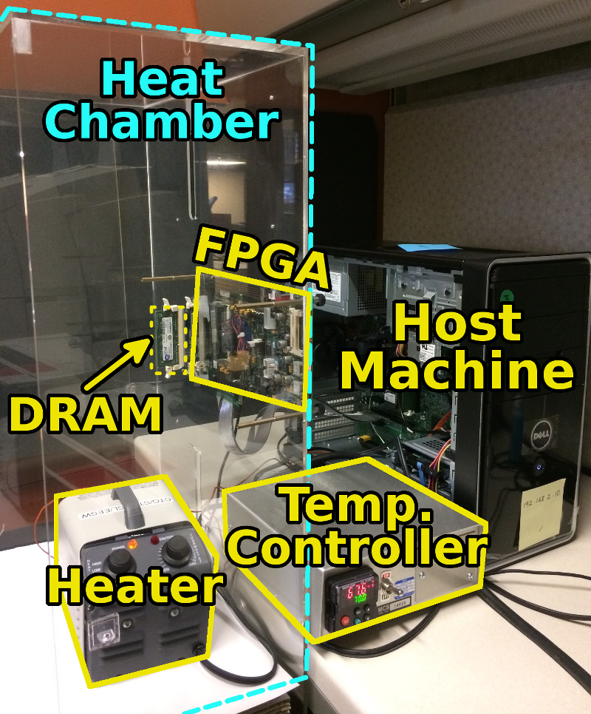
SoftMC: Open Source DRAM Infrastructure
Hasan Hassan et al., “SoftMC: A Flexible and Practical Open-Source Infrastructure for Enabling Experimental DRAM Studies,” HPCA 2017.
Flexible
Easy to Use (C++ API)
Open-source
github.com/CMU-SAFARI/SoftMC

Slide 47
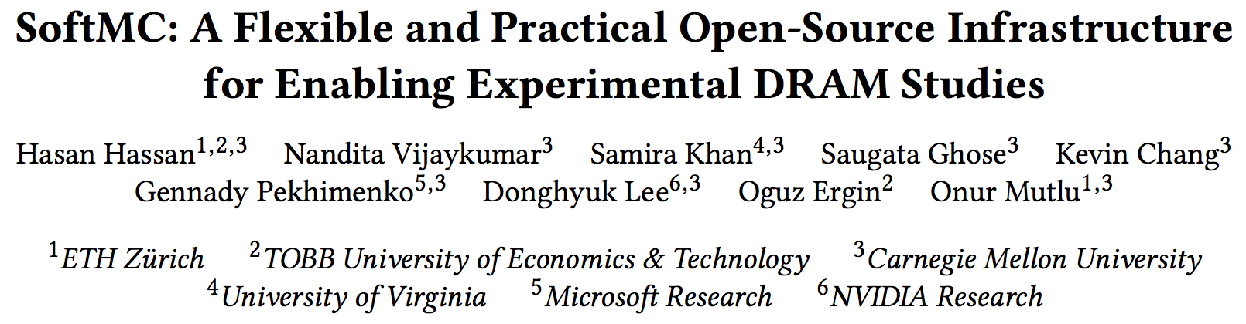
SoftMC
https://github.com/CMU-SAFARI/SoftMC

Slide 48
A Curious Discovery [Kim et al., ISCA 2014]
One can
predictably induce errors
in most DRAM memory chips

Slide 49
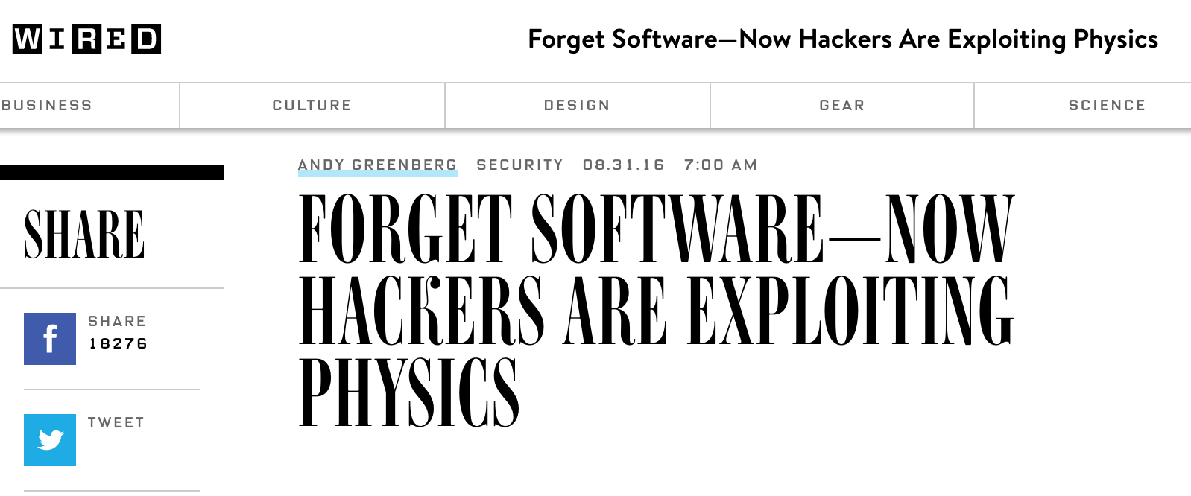
The Story of RowHammer
One can predictably induce bit flips in commodity DRAM chips
  >80% of the tested DRAM chips are vulnerable
First example of how a simple hardware failure mechanism can create a widespread system security vulnerability

Slide 50
Modern DRAM is Prone to Disturbance Errors
Row of Cells
Wordline
Row
Victim Row
Row
Hammered Row
V_{LOW}
Opened
V_{HIGH}
Closed
Row
Victim Row
Row
Repeatedly reading a row enough times (before memory gets refreshed) induces disturbance errors in adjacent rows in most real DRAM chips you can buy today
Flipping Bits in Memory Without Accessing Them: An Experimental Study of DRAM Disturbance Errors, (Kim et al., ISCA 2014)

Slide 51
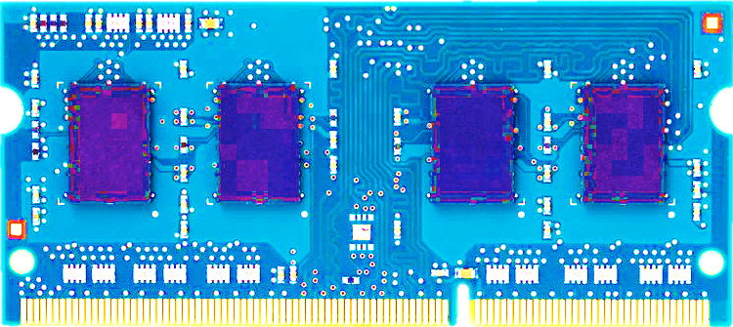
Most DRAM Modules Are Vulnerable
A company
B company
C company
86%
(37/43)
83%
(45/54)
88%
(28/32)
Up to
1.0×10⁷
errors
Up to
2.7×10⁶
errors
Up to
3.3×10⁵
errors
Flipping Bits in Memory Without Accessing Them: An Experimental Study of DRAM Disturbance Errors, (Kim et al., ISCA 2014)

Slide 52
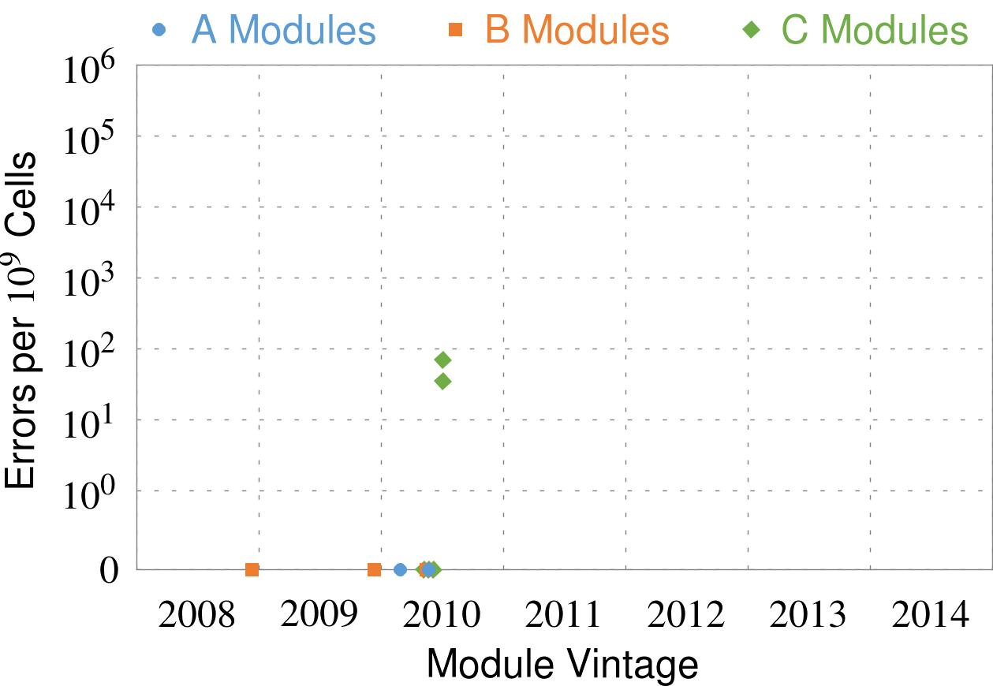
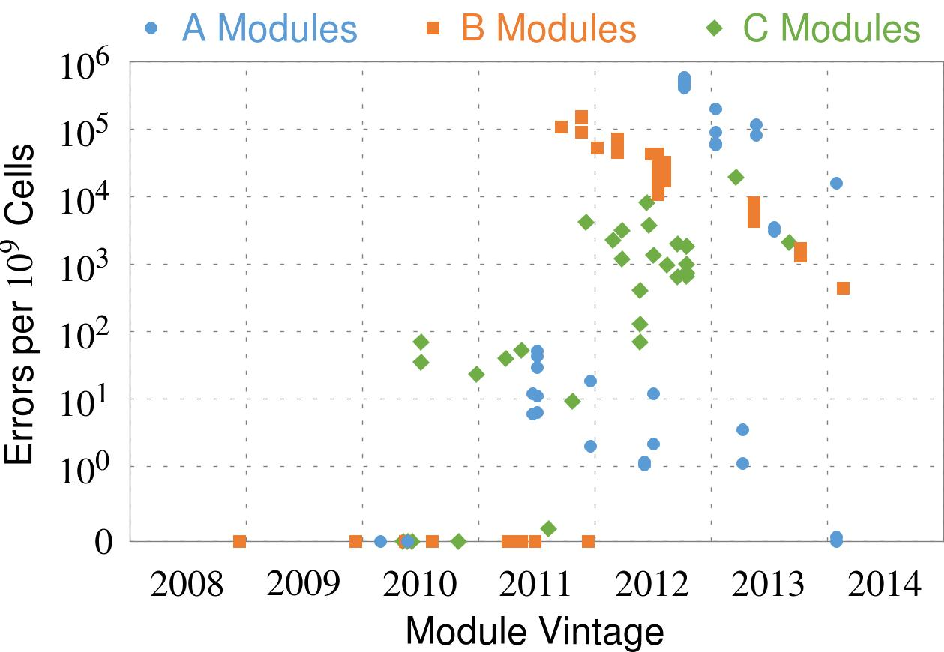
Recent DRAM Is More Vulnerable
First
Appearance
All modules from 2012–2013 are vulnerable
Notes:
In this figure, the x-axis is the module manufacture date. And the y-axis is the number of errors in a module, normalized to one billion cells. In 2008 and 2009, there are no errors. But, in 2010, we first start to see errors in C modules. After 2010, the errors start to proliferate. For A and B modules, we first start to see errors in 2011. In particular, all modules from 2012 and 2013 are vulnerable.

Slide 53


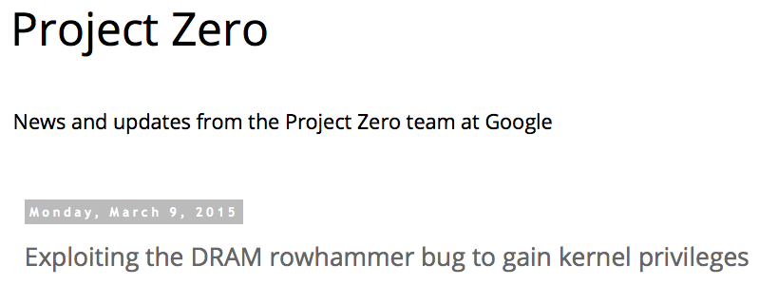
One Can Take Over an Otherwise-Secure System
Flipping Bits in Memory Without Accessing Them: An Experimental Study of DRAM Disturbance Errors (Kim et al., ISCA 2014)
Exploiting the DRAM rowhammer bug to gain kernel privileges (Seaborn, 2015)

Slide 54
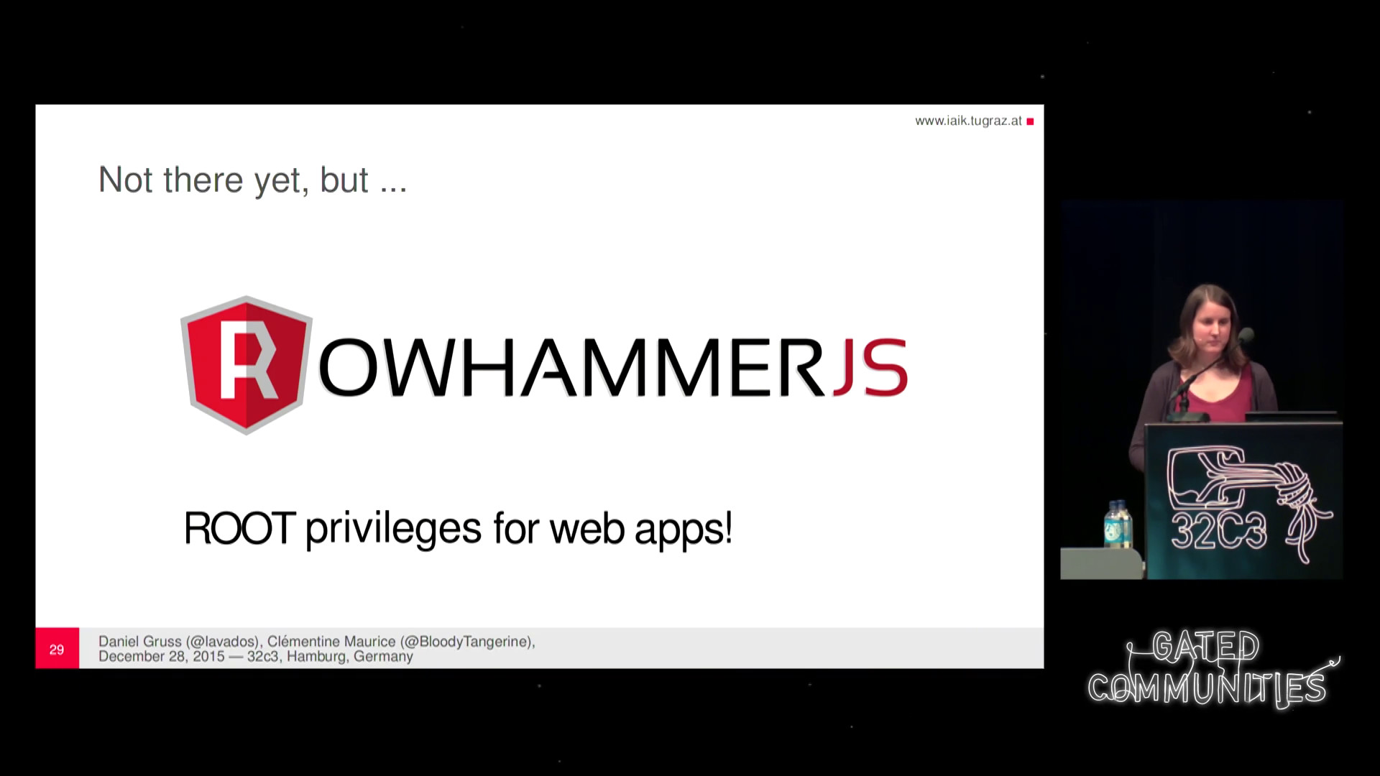
More Security Implications (I)
“We can gain unrestricted access to systems of website visitors.”
Rowhammer.js: A Remote Software-Induced Fault Attack in JavaScript (DIMVA’16)
Source: https://lab.dsst.io/32c3-slides/7197.html

Slide 55
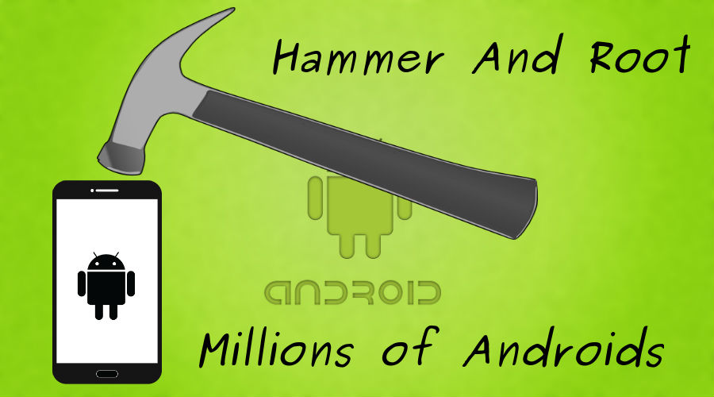
More Security Implications (II)
  “Can gain control of a smart phone deterministically”
Drammer: Deterministic Rowhammer Attacks on Mobile Platforms, CCS’16
Source: https://fossbytes.com/drammer-rowhammer-attack-android-root-devices/

Slide 56
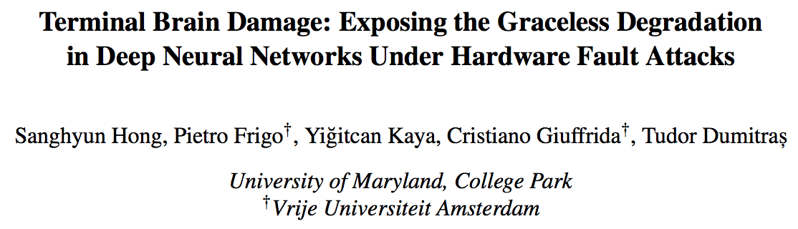
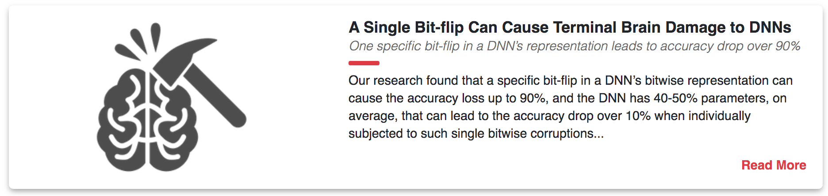
More Security Implications (VII)
USENIX Security 2019

Slide 57
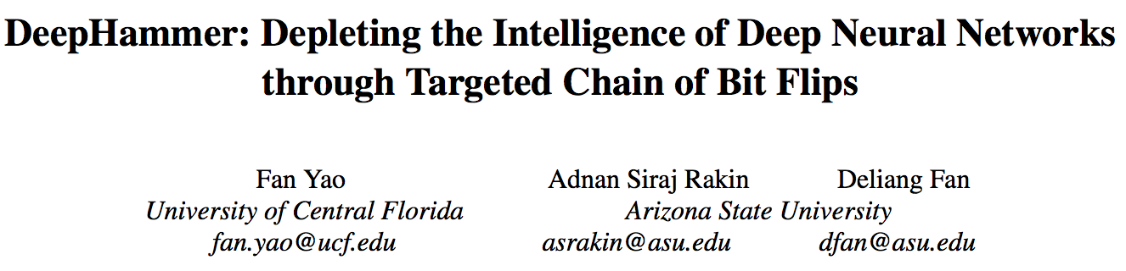
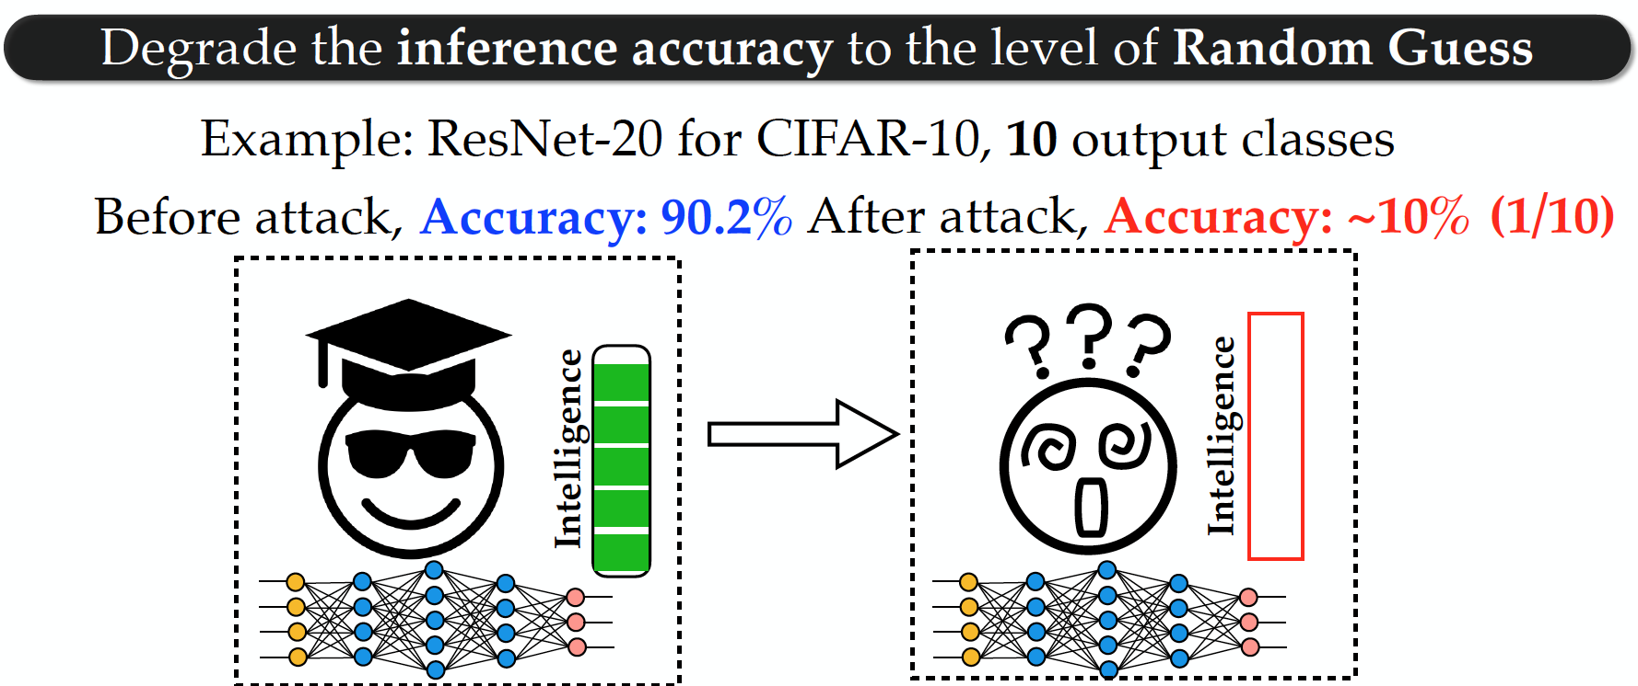
More Security Implications (VIII)
USENIX Security 2020

Slide 58
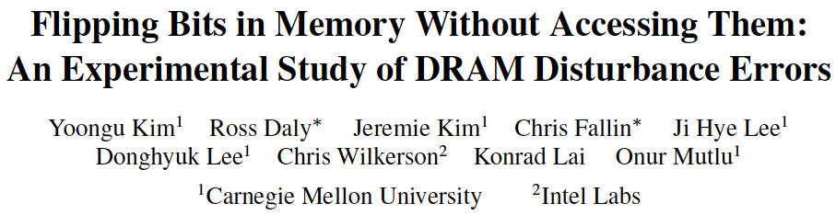
Memory Scaling Issues Are Real
Yoongu Kim, Ross Daly, Jeremie Kim, Chris Fallin, Ji Hye Lee, Donghyuk Lee, Chris Wilkerson, Konrad Lai, and Onur Mutlu,
"Flipping Bits in Memory Without Accessing Them: An Experimental Study of DRAM Disturbance Errors"
Proceedings of the 41st International Symposium on Computer Architecture (ISCA), Minneapolis, MN, June 2014.
[Slides (pptx) (pdf)] [Lightning Session Slides (pptx) (pdf)] [Source Code and Data]

Slide 59
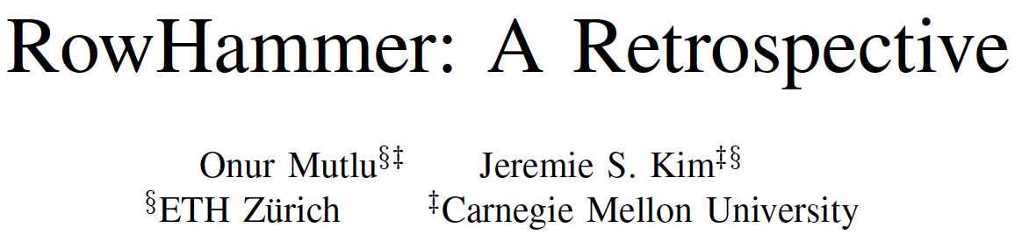
Memory Scaling Issues Are Real
Onur Mutlu and Jeremie Kim,
"RowHammer: A Retrospective"
IEEE Transactions on Computer-Aided Design of Integrated Circuits and Systems (TCAD) Special Issue on Top Picks in Hardware and Embedded Security, 2019.
[Preliminary arXiv version]
[Slides from COSADE 2019 (pptx)]
[Slides from VLSI-SOC 2020 (pptx) (pdf)]
[Talk Video (1 hr 15 minutes, with Q&A)]

Slide 60
The Push from Circuits and Devices
Main Memory Needs
Intelligent Controllers

Slide 61
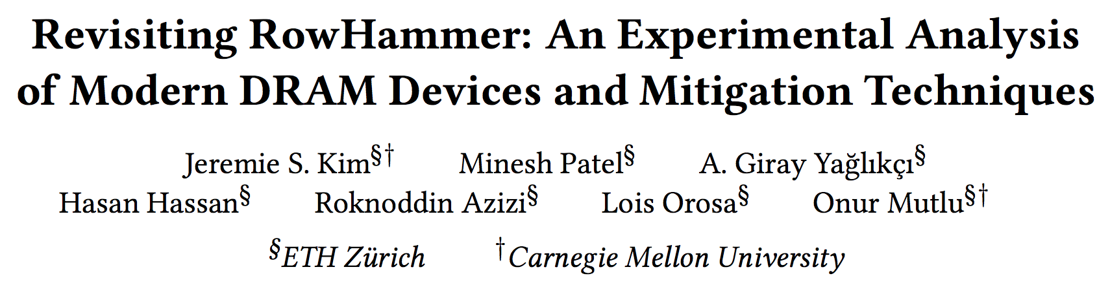
RowHammer in 2020 (I)
Jeremie S. Kim, Minesh Patel, A. Giray Yaglikci, Hasan Hassan, Roknoddin Azizi, Lois Orosa, and Onur Mutlu,
"Revisiting RowHammer: An Experimental Analysis of Modern Devices and Mitigation Techniques"
Proceedings of the 47th International Symposium on Computer Architecture (ISCA), Valencia, Spain, June 2020.
[Slides (pptx) (pdf)]
[Lightning Talk Slides (pptx) (pdf)]
[Talk Video (20 minutes)]
[Lightning Talk Video (3 minutes)]

Slide 62
Key Takeaways from 1580 Chips
Newer DRAM chips are more vulnerable to RowHammer
There are chips today whose weakest cells fail after only 4800 hammers
Chips of newer DRAM technology nodes can exhibit RowHammer bit flips 1) in more rows and 2) farther away from the victim row.
Existing mitigation mechanisms are NOT effective
Notes:
To reiterate our three key takeaways from our experimental characterization, we find that
[CLICK] First, chips of newer DRAM technology nodes are more vulnerable to RowHammer
[CLICK] Second, there are chips today whose weakest cells fail after only 4800 hammers
[CLICK] Third, chips of newer DRAM technology nodes can exhibit RowHammer bit flips in more rows and farther away from the victim row
================

Slide 63
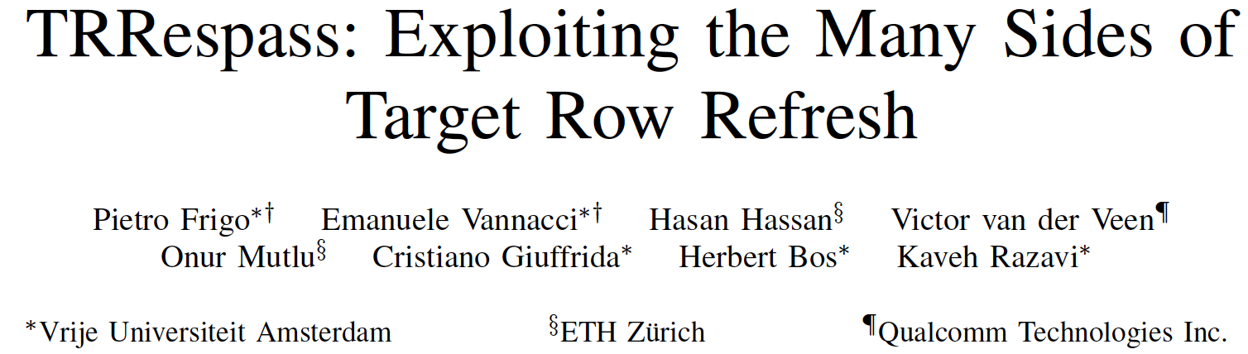
RowHammer in 2020 (II)
Pietro Frigo, Emanuele Vannacci, Hasan Hassan, Victor van der Veen, Onur Mutlu, Cristiano Giuffrida, Herbert Bos, and Kaveh Razavi,
"TRRespass: Exploiting the Many Sides of Target Row Refresh"
Proceedings of the 41st IEEE Symposium on Security and Privacy (S&P), San Francisco, CA, USA, May 2020.
[Slides (pptx) (pdf)]
[Lecture Slides (pptx) (pdf)]
[Talk Video (17 minutes)]
[Lecture Video (59 minutes)]
[Source Code]
[Web Article]
Best paper award.
Pwnie Award 2020 for Most Innovative Research. Pwnie Awards 2020

Slide 64
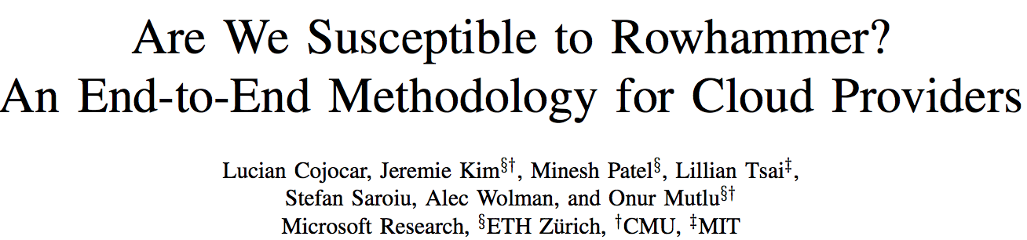
RowHammer in 2020 (III)
Lucian Cojocar, Jeremie Kim, Minesh Patel, Lillian Tsai, Stefan Saroiu, Alec Wolman, and Onur Mutlu,
"Are We Susceptible to Rowhammer? An End-to-End Methodology for Cloud Providers"
Proceedings of the 41st IEEE Symposium on Security and Privacy (S&P), San Francisco, CA, USA, May 2020.
[Slides (pptx) (pdf)]
[Talk Video (17 minutes)]

Slide 65
BlockHammer Solution in 2021
A. Giray Yaglikci, Minesh Patel, Jeremie S. Kim, Roknoddin Azizi, Ataberk Olgun, Lois Orosa, Hasan Hassan, Jisung Park, Konstantinos Kanellopoulos, Taha Shahroodi, Saugata Ghose, and Onur Mutlu,
"BlockHammer: Preventing RowHammer at Low Cost by Blacklisting Rapidly-Accessed DRAM Rows"
Proceedings of the 27th International Symposium on High-Performance Computer Architecture (HPCA), Virtual, February-March 2021.
[Slides (pptx) (pdf)]
[Short Talk Slides (pptx) (pdf)]
[Talk Video (22 minutes)]
[Short Talk Video (7 minutes)]

Slide 66
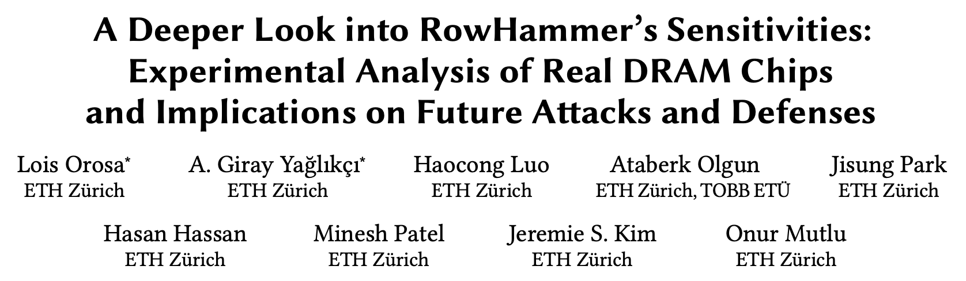
Two Upcoming RowHammer Papers at MICRO 2021
Lois Orosa, Abdullah Giray Yaglikci, Haocong Luo, Ataberk Olgun, Jisung Park, Hasan Hassan, Minesh Patel, Jeremie S. Kim, Onur Mutlu,
  "A Deeper Look into RowHammer's Sensitivities: Experimental Analysis of Real DRAM Chips and Implications on Future Attacks and Defenses"
  MICRO 2021

Slide 67
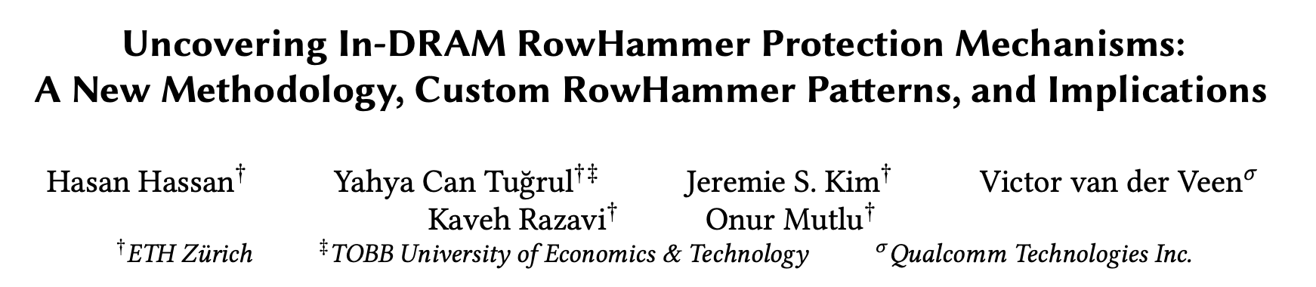
Two Upcoming RowHammer Papers at MICRO 2021
Hasan Hassan, Yahya Can Tugrul, Jeremie S. Kim, Victor van der Veen, Kaveh Razavi, Onur Mutlu,
  "Uncovering In-DRAM RowHammer Protection Mechanisms: A New Methodology, Custom RowHammer Patterns, and Implications"
  MICRO 2021

Slide 68
Detailed Lectures on RowHammer
Computer Architecture, Fall 2020, Lecture 4b
  RowHammer (ETH Zürich, Fall 2020)
  https://www.youtube.com/watch?v=KDy632z23UE&list=PL5Q2soXY2Zi9xidyIgBxUz7xRPS-wisBN&index=8
Computer Architecture, Fall 2020, Lecture 5a
  RowHammer in 2020: TRRespass (ETH Zürich, Fall 2020)
  https://www.youtube.com/watch?v=pwRw7QqK_qA&list=PL5Q2soXY2Zi9xidyIgBxUz7xRPS-wisBN&index=9
Computer Architecture, Fall 2020, Lecture 5b
  RowHammer in 2020: Revisiting RowHammer (ETH Zürich, Fall 2020)
  https://www.youtube.com/watch?v=gR7XR-Eepcg&list=PL5Q2soXY2Zi9xidyIgBxUz7xRPS-wisBN&index=10
Computer Architecture, Fall 2020, Lecture 5c
  Secure and Reliable Memory (ETH Zürich, Fall 2020)
  https://www.youtube.com/watch?v=HvswnsfG3oQ&list=PL5Q2soXY2Zi9xidyIgBxUz7xRPS-wisBN&index=11
https://www.youtube.com/onurmutlulectures

Slide 69
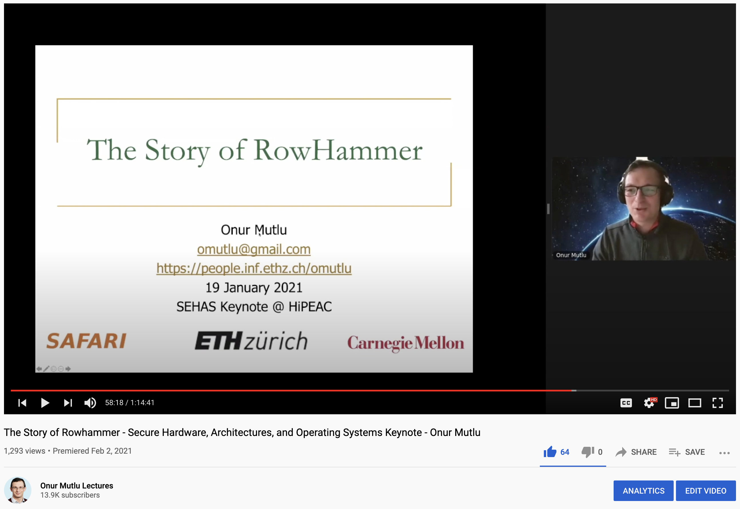
The Story of RowHammer Lecture …
Onur Mutlu,
"The Story of RowHammer"
Keynote Talk at Secure Hardware, Architectures, and Operating Systems Workshop (SeHAS), held with HiPEAC 2021 Conference, Virtual, 19 January 2021.
[Slides (pptx) (pdf)]
[Talk Video (1 hr 15 minutes, with Q&A)]
https://www.youtube.com/watch?v=sgd7PHQQ1AI

Slide 70
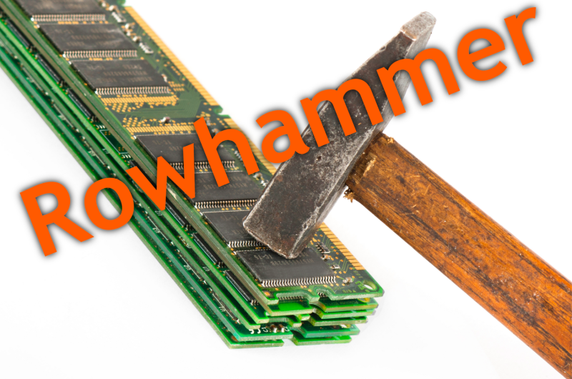
Notes:
Picture from the article:
http://thehackernews.com/2015/03/dram-rowhammer-vulnerability.html

Slide 71
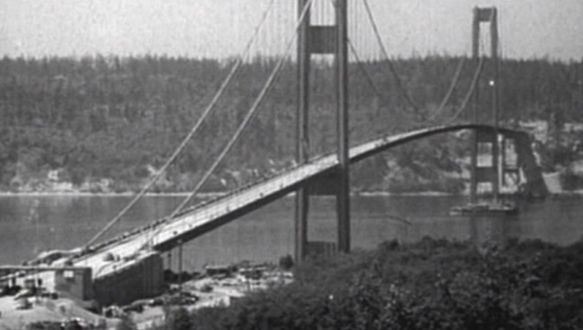
How Reliable/Secure/Safe is This Bridge?
Source: http://www.technologystudent.com/struct1/tacom1.png

Slide 72
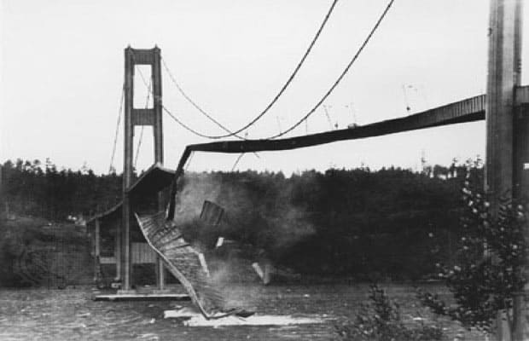
Collapse of the “Galloping Gertie” (1940)
Source: AP
http://www.wsdot.wa.gov/tnbhistory/connections/connections3.htm

Slide 73
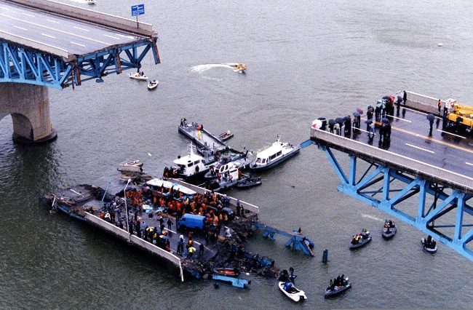
Another Example (1994)
Source: By 최광모 - Own work, CC BY-SA 4.0, https://commons.wikimedia.org/w/index.php?curid=35197984

Slide 74
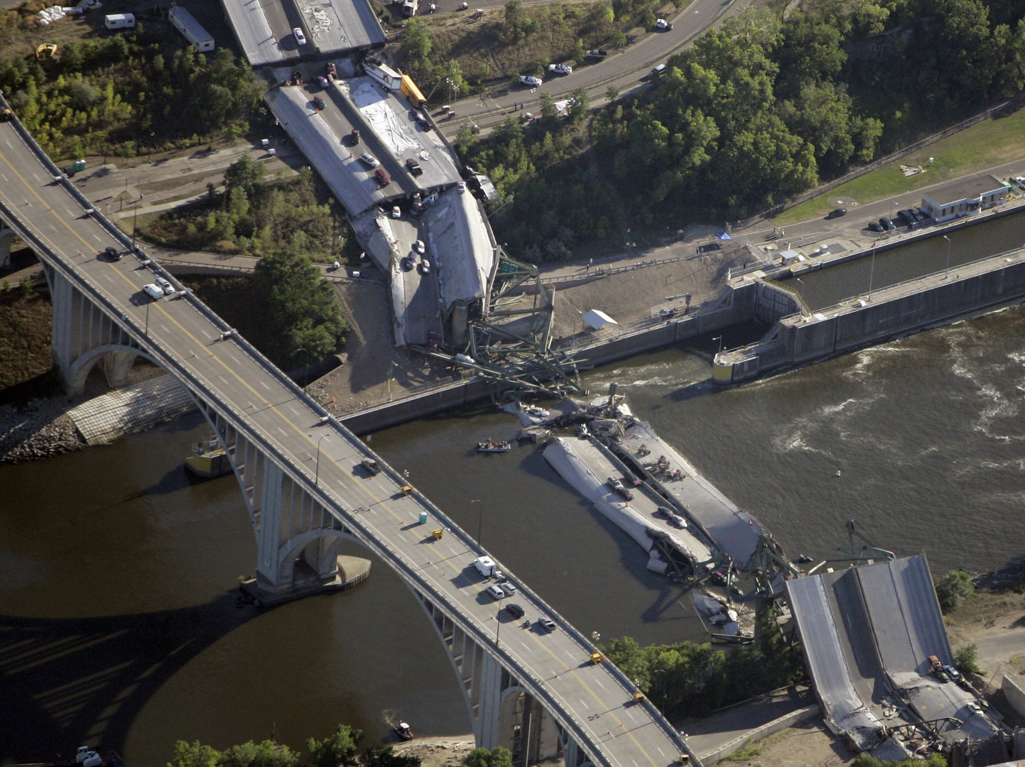
Yet Another Example (2007)
Source: Morry Gash/AP,
https://www.npr.org/2017/08/01/540669701/10-years-after-bridge-collapse-america-is-still-crumbling?t=1535427165809

Slide 75
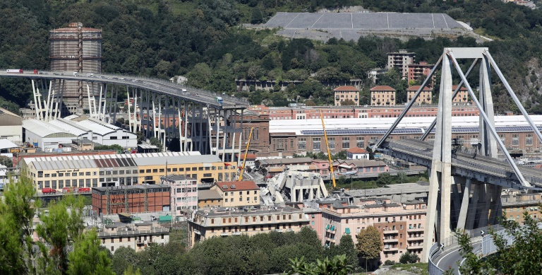
A More Recent Example (2018)
Source: AFP / Valery HACHE, https://www.capitalfm.co.ke/news/2018/08/genoa-bridge-collapse-what-we-know/

Slide 76
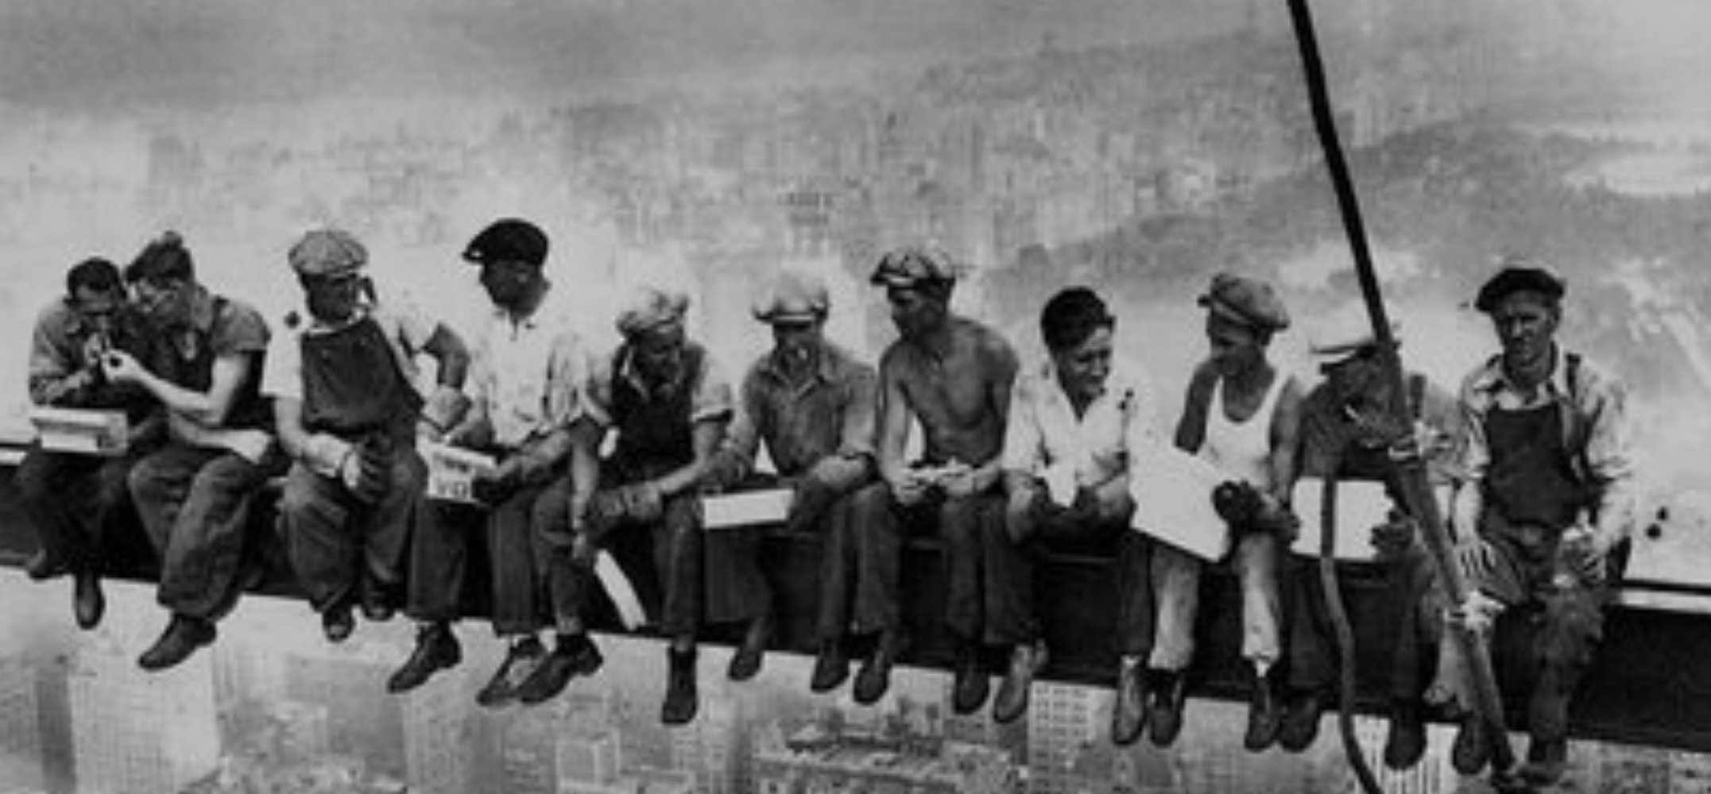
How Safe & Secure Is This Platform?
Security is about preventing unforeseen consequences
Source: https://s-media-cache-ak0.pinimg.com/originals/48/09/54/4809543a9c7700246a0cf8acdae27abf.jpg

Slide 77

How Safe & Secure Is This Platform?
Source: https://taxistartup.com/wp-content/uploads/2015/03/UK-Self-Driving-Cars.jpg

Slide 78
Challenge and Opportunity for Future
Fundamentally
Secure, Reliable, Safe
Computing Architectures

Slide 79
Solution Direction: Principled Designs
Design fundamentally secure
computing architectures
Predict and prevent
safety & security issues

Slide 80
The Push from Circuits and Devices
Computing Systems Need
Intelligent Memories

Slide 81
The Takeaway, Again
In-Field Patch-ability
(Intelligent Memory)
Can Avoid Many Failures

Slide 82
Why In-Memory Computation Today?
Push from Technology
  DRAM Scaling at jeopardy
  → Controllers close to DRAM
  → Industry open to new memory architectures
Pull from Systems and Applications
  Data access is a major system and application bottleneck
  Systems are energy limited
  Data movement much more energy-hungry than computation

Slide 83
Three Key Systems & Application Trends
1. Data access is a major bottleneck
  Applications are increasingly data hungry
2. Energy consumption is a key limiter
3. Data movement energy dominates compute
  Especially true for off-chip to on-chip movement

Slide 84
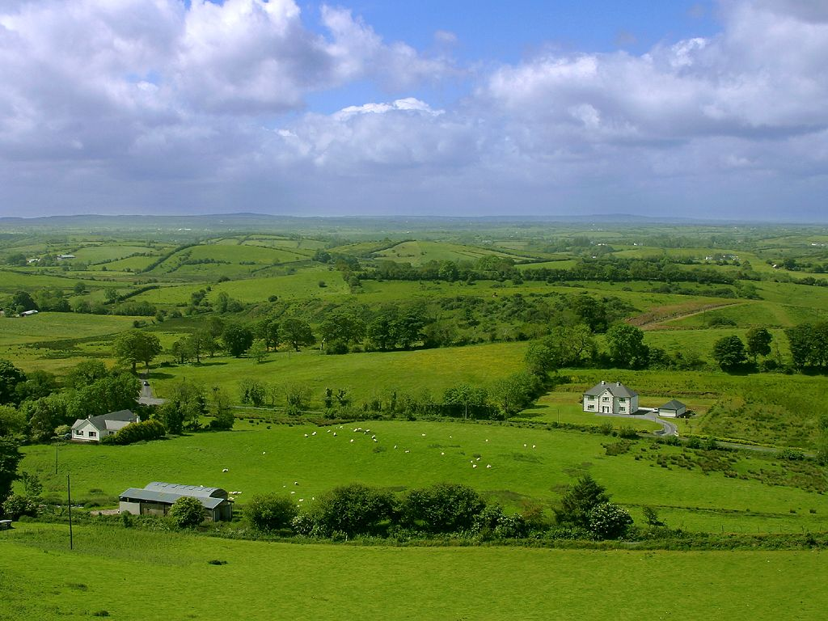
Do We Want This?
Source: V. Milutinovic

Slide 85
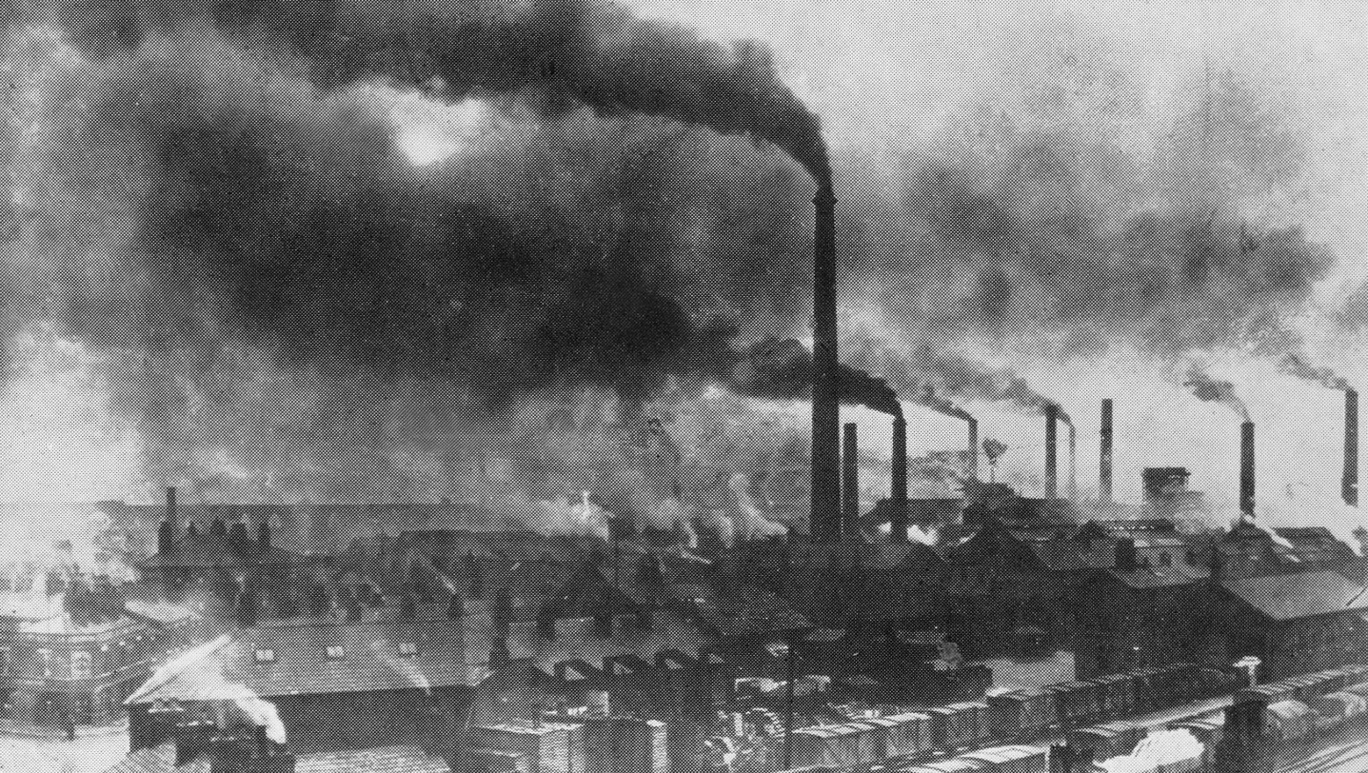
Or This?
Source: V. Milutinovic

Slide 86
Challenge and Opportunity for Future
High Performance,
Energy Efficient,
Sustainable

Slide 87
The Problem
Data access is the major performance and energy bottleneck
Our current
design principles
cause great energy waste
(and great performance loss)

Slide 88
The Problem
Processing of data
is performed
far away from the data

Slide 89
A Computing System
Three key components
Computation
Communication
Storage/memory
Burks, Goldstein, von Neumann, “Preliminary discussion of the
logical design of an electronic computing instrument,” 1946.
Image source: https://lbsitbytes2010.wordpress.com/2013/03/29/john-von-neumann-roll-no-15/

Slide 90
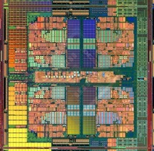

A Computing System
Three key components
Computation
Communication
Storage/memory
Burks, Goldstein, von Neumann, “Preliminary discussion of the
logical design of an electronic computing instrument,” 1946.
Image source: https://lbsitbytes2010.wordpress.com/2013/03/29/john-von-neumann-roll-no-15/

Slide 91
Today’s Computing Systems
Are overwhelmingly processor centric
All data processed in the processor → at great system cost
Processor is heavily optimized and is considered the master
Data storage units are dumb and are largely unoptimized (except for some that are on the processor die)

Slide 92
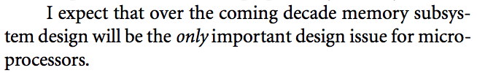
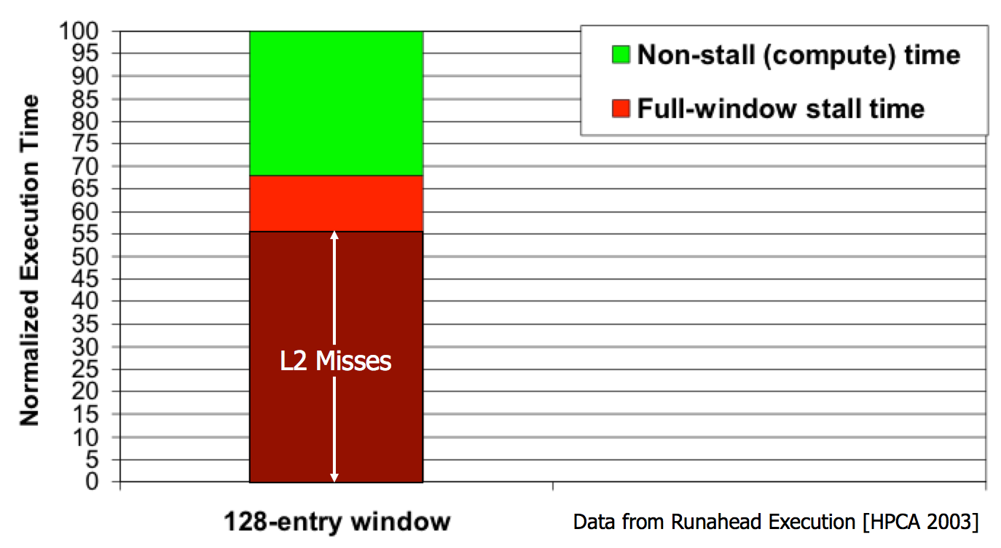
Yet …
“It’s the Memory, Stupid!” (Richard Sites, MPR, 1996)
Mutlu+, “Runahead Execution: An Alternative to Very Large Instruction Windows for Out-of-Order Processors,” HPCA 2003.

Slide 93
The Performance Perspective
Onur Mutlu, Jared Stark, Chris Wilkerson, and Yale N. Patt,
"Runahead Execution: An Alternative to Very Large Instruction Windows for Out-of-order Processors"
Proceedings of the 9th International Symposium on High-Performance Computer Architecture (HPCA), pages 129-140, Anaheim, CA, February 2003. Slides (pdf)
  One of the 15 computer arch. papers of 2003 selected as Top Picks by IEEE Micro.
  HPCA Test of Time Award (awarded in 2021).

Slide 94
The Performance Perspective (Today)
All of Google’s Data Center Workloads (2015):
Kanev+, “Profiling a Warehouse-Scale Computer,” ISCA 2015.

Slide 95
The Performance Perspective (Today)
All of Google’s Data Center Workloads (2015):
Kanev+, “Profiling a Warehouse-Scale Computer,” ISCA 2015.

Slide 96
Perils of Processor-Centric Design
Grossly-imbalanced systems
  Processing done only in one place
  Everything else just stores and moves data: data moves a lot
  → Energy inefficient
  → Low performance
  → Complex
Overly complex and bloated processor (and accelerators)
  To tolerate data access from memory
  Complex hierarchies and mechanisms
  → Energy inefficient
  → Low performance
  → Complex

Slide 97
Perils of Processor-Centric Design
Most of the system is dedicated to storing and moving data

Slide 98
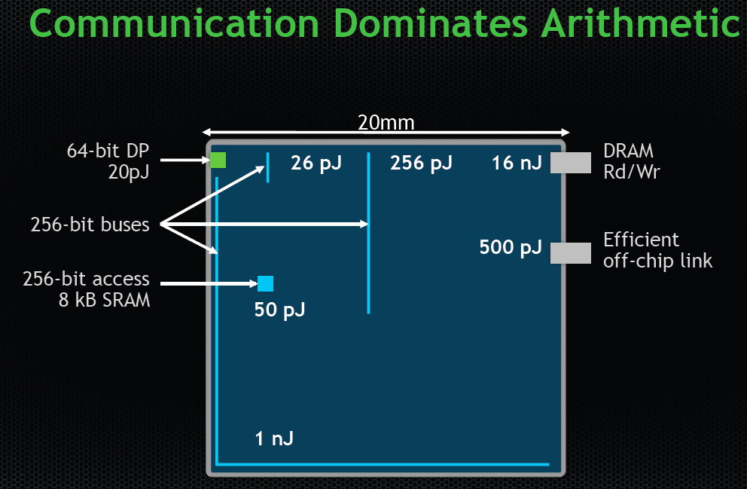
The Energy Perspective
Dally, HiPEAC 2015

Slide 99
Data Movement vs. Computation Energy
Dally, HiPEAC 2015
A memory access consumes ~100-1000X
the energy of a complex addition

Slide 100
Data Movement vs. Computation Energy
Data movement is a major system energy bottleneck
  Comprises 41% of mobile system energy during web browsing [2]
  Costs ~115 times as much energy as an ADD operation [1, 2]
[1]: Reducing data Movement Energy via Online Data Clustering and Encoding (MICRO’16)
[2]: Quantifying the energy cost of data movement for emerging smart phone workloads on mobile platforms (IISWC’14)

Slide 101
Energy Waste in Mobile Devices
Amirali Boroumand, Saugata Ghose, Youngsok Kim, Rachata Ausavarungnirun, Eric Shiu, Rahul Thakur, Daehyun Kim, Aki Kuusela, Allan Knies, Parthasarathy Ranganathan, and Onur Mutlu,
"Google Workloads for Consumer Devices: Mitigating Data Movement Bottlenecks"
Proceedings of the 23rd International Conference on Architectural Support for Programming Languages and Operating Systems (ASPLOS), Williamsburg, VA, USA, March 2018.
62.7% of the total system energy
is spent on data movement

Slide 102
We Do Not Want to Move Data!
Dally, HiPEAC 2015
A memory access consumes ~100-1000X
the energy of a complex addition

Slide 103
We Need A Paradigm Shift To …
Enable computation with minimal data movement
Compute where it makes sense (where data resides)
Make computing architectures more data-centric

Slide 104
Goal: Processing Inside Memory
Many questions … How do we design the:
  compute-capable memory & controllers?
  processor chip and in-memory units?
  software and hardware interfaces?
  system software, compilers, languages?
  algorithms and theoretical foundations?
Memory
Processor
Core
Database
Graphs
Media
Cache
Query
Interconnect
Problem
Results
Algorithm
Program/Language
System Software
SW/HW Interface
Micro-architecture
Logic
Devices
Electrons

Slide 105
Processing in Memory:
Two Approaches
1. Processing using Memory
2. Processing near Memory

Slide 106

Starting Simple: Data Copy and Initialization
  memmove & memcpy: 5% cycles in Google’s datacenter [Kanev+ ISCA’15]
000000000000000
Zero initialization
(e.g., security)
Forking
Checkpointing
Many more
VM Cloning
Deduplication
Page Migration

Slide 107
Today’s Systems: Bulk Data Copy
1) High latency
Memory
3) Cache pollution
L3
CPU
L2
L1
MC
2) High bandwidth utilization
4) Unwanted data movement
1046ns, 3.6uJ (for 4KB page copy via DMA)

Slide 108
Future Systems: In-Memory Copy
3) No cache pollution
1) Low latency
Memory
L3
CPU
L2
L1
MC
2) Low bandwidth utilization
4) No unwanted data movement
1046ns, 3.6uJ
→ 90ns, 0.04uJ

Slide 109
RowClone: In-DRAM Row Copy
Idea: Two consecutive ACTivates
4 Kbytes
Negligible HW cost
Step 1: Activate row A
Step 2: Activate row B
Transfer row
DRAM subarray
Transfer
row
Row Buffer (4 Kbytes)
8 bits
Data Bus
Notes:
copy

Slide 110
RowClone: Latency and Energy Savings
11.6x
74x
Seshadri et al., “RowClone: Fast and Efficient In-DRAM Copy and Initialization of Bulk Data,” MICRO 2013.

Slide 111
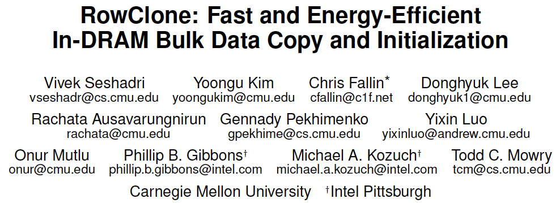
More on RowClone
Vivek Seshadri, Yoongu Kim, Chris Fallin, Donghyuk Lee, Rachata Ausavarungnirun, Gennady Pekhimenko, Yixin Luo, Onur Mutlu, Michael A. Kozuch, Phillip B. Gibbons, and Todd C. Mowry,
"RowClone: Fast and Energy-Efficient In-DRAM Bulk Data Copy and Initialization"
Proceedings of the 46th International Symposium on Microarchitecture (MICRO), Davis, CA, December 2013. [Slides (pptx) (pdf)] [Lightning Session Slides (pptx) (pdf)] [Poster (pptx) (pdf)]

Slide 112
RowClone Extensions and Follow-Up Work
Can we do faster inter-subarray copy?
  Yes, see LISA [Chang et al., HPCA 2016]
Can we enable data movement at smaller granularities within a bank?
  Yes, see FIGARO [Wang et al., MICRO 2020]
Can we do better inter-bank copy?
  Yes, see Network-on-Memory [CAL 2020]
Can similar ideas and DRAM properties be used to perform computation on data?
  Yes, see Ambit [Seshadri et al., CAL 2015, MICRO 2017]

Slide 113
LISA: Increasing Connectivity in DRAM
Kevin K. Chang, Prashant J. Nair, Saugata Ghose, Donghyuk Lee, Moinuddin K. Qureshi, and Onur Mutlu,
"Low-Cost Inter-Linked Subarrays (LISA): Enabling Fast Inter-Subarray Data Movement in DRAM"
Proceedings of the 22nd International Symposium on High-Performance Computer Architecture (HPCA), Barcelona, Spain, March 2016.
[Slides (pptx) (pdf)]
[Source Code]

Slide 114
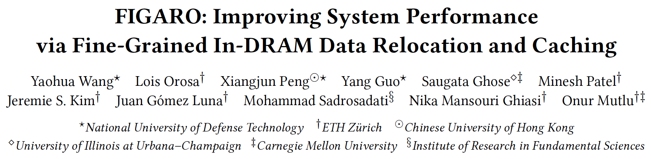
FIGARO: Fine-Grained In-DRAM Copy
Yaohua Wang, Lois Orosa, Xiangjun Peng, Yang Guo, Saugata Ghose, Minesh Patel, Jeremie S. Kim, Juan Gómez Luna, Mohammad Sadrosadati, Nika Mansouri Ghiasi, and Onur Mutlu,
"FIGARO: Improving System Performance via Fine-Grained In-DRAM Data Relocation and Caching"
Proceedings of the 53rd International Symposium on Microarchitecture (MICRO), Virtual, October 2020.

Slide 115
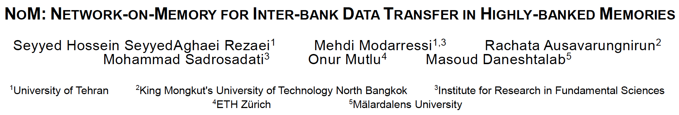
Network-On-Memory: Fast Inter-Bank Copy
Seyyed Hossein SeyyedAghaei Rezaei, Mehdi Modarressi, Rachata Ausavarungnirun, Mohammad Sadrosadati, Onur Mutlu, and Masoud Daneshtalab,
"NoM: Network-on-Memory for Inter-Bank Data Transfer in Highly-Banked Memories"
IEEE Computer Architecture Letters (CAL), to appear in 2020.

Slide 116
Memory as an Accelerator
CPU
core
CPU
core
mini-CPU
core
GPU
(throughput)
core
GPU
(throughput)
core
video
core
GPU
(throughput)
core
GPU
(throughput)
core
CPU
core
CPU
core
Memory
imaging
core
LLC
Specialized
compute-capability
in memory
Memory Controller
Memory Bus
Memory similar to a “conventional” accelerator

Slide 117
(Truly) In-Memory Computation
We can support in-DRAM AND, OR, NOT, MAJ
At low cost
Using analog computation capability of DRAM
  Idea: activating multiple rows performs computation
30-60X performance and energy improvement
  Seshadri+, “Ambit: In-Memory Accelerator for Bulk Bitwise Operations Using Commodity DRAM Technology,” MICRO 2017.
New memory technologies enable even more opportunities
  Memristors, resistive RAM, phase change mem, STT-MRAM, …
  Can operate on data with minimal movement

Slide 118
In-DRAM AND/OR: Triple Row Activation
½V_{DD}
½V_{DD}+δ
V_{DD}
A
Final State
AB + BC + AC
B
C
C(A + B) + ~C(AB)
dis
en
0
½V_{DD}
Seshadri+, “Fast Bulk Bitwise AND and OR in DRAM”, IEEE CAL 2015.

Slide 119
In-DRAM Acceleration of Database Queries
>4-12X Performance Improvement
Seshadri+, “Ambit: In-Memory Accelerator for Bulk Bitwise Operations using Commodity DRAM Technology,” MICRO 2017.

Slide 120
More on Ambit
Vivek Seshadri, Donghyuk Lee, Thomas Mullins, Hasan Hassan, Amirali Boroumand, Jeremie Kim, Michael A. Kozuch, Onur Mutlu, Phillip B. Gibbons, and Todd C. Mowry,
"Ambit: In-Memory Accelerator for Bulk Bitwise Operations Using Commodity DRAM Technology"
Proceedings of the 50th International Symposium on Microarchitecture (MICRO), Boston, MA, USA, October 2017.
[Slides (pptx) (pdf)] [Lightning Session Slides (pptx) (pdf)] [Poster (pptx) (pdf)]

Slide 121
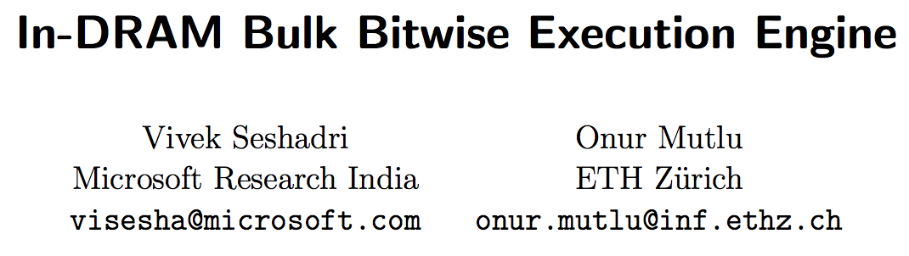
In-DRAM Bulk Bitwise Execution
Vivek Seshadri and Onur Mutlu,
"In-DRAM Bulk Bitwise Execution Engine"
Invited Book Chapter in Advances in Computers, to appear in 2020.
[Preliminary arXiv version]

Slide 122
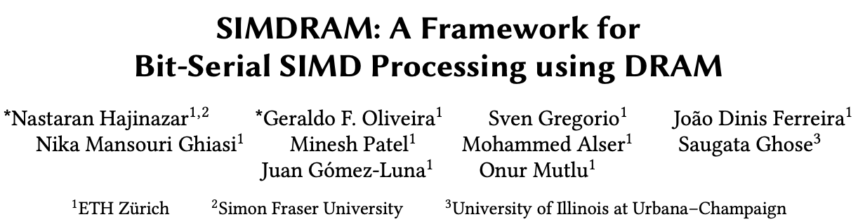
SIMDRAM Framework
Nastaran Hajinazar, Geraldo F. Oliveira, Sven Gregorio, Joao Dinis Ferreira, Nika Mansouri Ghiasi, Minesh Patel, Mohammed Alser, Saugata Ghose, Juan Gomez-Luna, and Onur Mutlu,
"SIMDRAM: An End-to-End Framework for Bit-Serial SIMD Computing in DRAM"
Proceedings of the 26th International Conference on Architectural Support for Programming Languages and Operating Systems (ASPLOS), Virtual, March-April 2021.
[2-page Extended Abstract]
[Short Talk Slides (pptx) (pdf)]
[Talk Slides (pptx) (pdf)]
[Short Talk Video (5 mins)]
[Full Talk Video (27 mins)]

Slide 123
SIMDRAM Key Idea
SIMDRAM: An end-to-end processing-using-DRAM framework that provides the programming interface, the ISA, and the hardware support for:
  Efficiently computing complex operations in DRAM
  Providing the ability to implement arbitrary operations as required
  Using an in-DRAM massively-parallel SIMD substrate that requires minimal changes to DRAM architecture
23

Slide 124
SIMDRAM Framework: Overview
User Input
Step 1: Generate
MAJ logic
Step 2: Generate
sequence of
DRAM commands
SIMDRAM Output
Desired operation
New SIMDRAM $μ$Program
ACT/PRE
ACT/PRE
ACT/PRE
ACT/ACT/PRE
done
$$μProgram$$
$$μProgram$$
MAJ
Main memory
AND/OR/NOT logic
MAJ/NOT logic
bbop_new
New SIMDRAM
instruction
ISA
$μ$Program
User Input
Step 3: Execution according to $μ$Program
SIMDRAM Output
SIMDRAM-enabled application
Instruction result
in memory
foo () {
bbop_new
}
ACT/PRE
ACT/PRE
ACT/PRE
ACT/PRE/PRE
done
ACT/PRE
Control Unit
$μ$Program
Memory Controller
27

Slide 125
SIMDRAM Key Results
Evaluated on:
  16 complex in-DRAM operations
  7 commonly-used real-world applications
SIMDRAM provides:
88× and 5.8× the throughput of a CPU and a high-end GPU, respectively, over 16 operations
257× and 31× the energy efficiency of a CPU and a high-end GPU, respectively, over 16 operations
21× and 2.1× the performance of a CPU an a high-end GPU, over seven real-world applications
125

Slide 126
SIMDRAM Conclusion
SIMDRAM:
  Enables efficient computation of a flexible set and wide range of operations in a PuM massively parallel SIMD substrate
  Provides the hardware, programming, and ISA support, to:
    Address key system integration challenges
    Allow programmers to define and employ new operations without hardware changes
More in the paper:
  Efficiently transposing data
  Programming interface
  Handling page faults, address translation, coherence, and interrupts
  Security implications
  Reliability evaluation
  Comparison to in-cache computing
  And more …
  SIMDRAM is a promising PuM framework
  Can ease the adoption of processing-using-DRAM architectures
  Improves the performance and efficiency of processing-using-memory architectures
126

Slide 127



SIMDRAM: A Framework for
Bit-Serial SIMD Processing using DRAM
Nastaran Hajinazar* Geraldo F. Oliveira*
Sven Gregorio Joao Ferreira Nika Mansouri Ghiasi
Minesh Patel Mohammed Alser Saugata Ghose
Juan Gómez–Luna Onur Mutlu

Slide 128
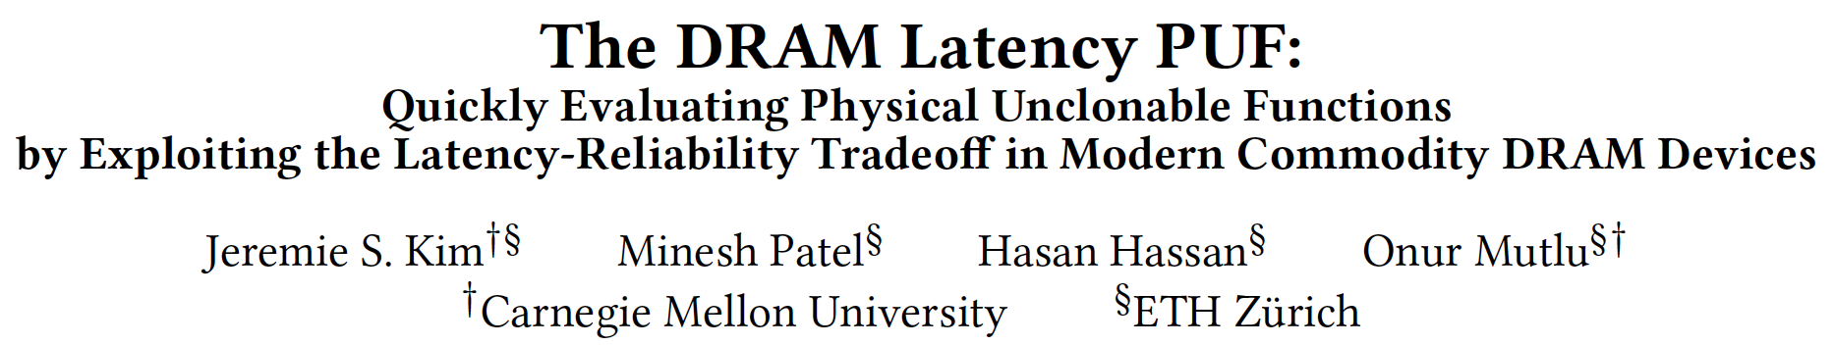
In-DRAM Physical Unclonable Functions
Jeremie S. Kim, Minesh Patel, Hasan Hassan, and Onur Mutlu,
"The DRAM Latency PUF: Quickly Evaluating Physical Unclonable Functions by Exploiting the Latency-Reliability Tradeoff in Modern DRAM Devices"
Proceedings of the 24th International Symposium on High-Performance Computer Architecture (HPCA), Vienna, Austria, February 2018.
[Lightning Talk Video]
[Slides (pptx) (pdf)] [Lightning Session Slides (pptx) (pdf)]
[Full Talk Lecture Video (28 minutes)]

Slide 129
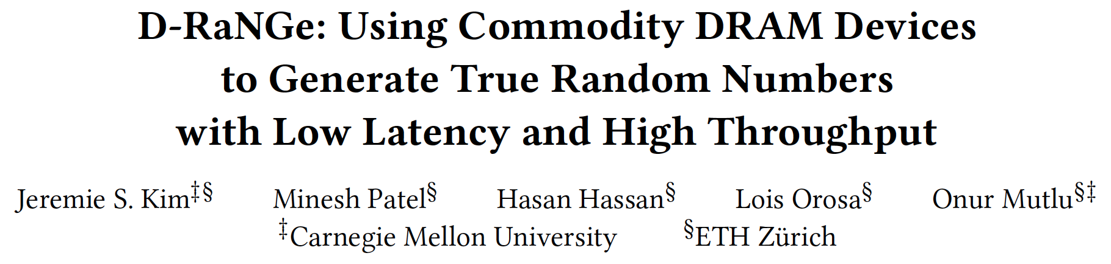
In-DRAM True Random Number Generation
Jeremie S. Kim, Minesh Patel, Hasan Hassan, Lois Orosa, and Onur Mutlu,
"D-RaNGe: Using Commodity DRAM Devices to Generate True Random Numbers with Low Latency and High Throughput"
Proceedings of the 25th International Symposium on High-Performance Computer Architecture (HPCA), Washington, DC, USA, February 2019.
[Slides (pptx) (pdf)]
[Full Talk Video (21 minutes)]
[Full Talk Lecture Video (27 minutes)]
Top Picks Honorable Mention by IEEE Micro.

Slide 130
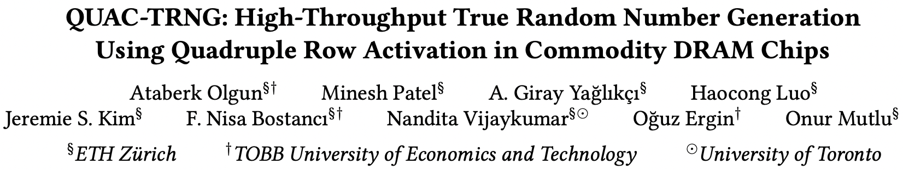
In-DRAM True Random Number Generation
Ataberk Olgun, Minesh Patel, A. Giray Yaglikci, Haocong Luo, Jeremie S. Kim, F. Nisa Bostanci, Nandita Vijaykumar, Oguz Ergin, and Onur Mutlu,
"QUAC-TRNG: High-Throughput True Random Number Generation Using Quadruple Row Activation in Commodity DRAM Chips"
Proceedings of the 48th International Symposium on Computer Architecture (ISCA), Virtual, June 2021.
[Slides (pptx) (pdf)]
[Short Talk Slides (pptx) (pdf)]
[Talk Video (25 minutes)]
[SAFARI Live Seminar Video (1 hr 26 mins)]

Slide 131
Processing in Memory:
Two Approaches
1. Processing using Memory
2. Processing near Memory

Slide 132
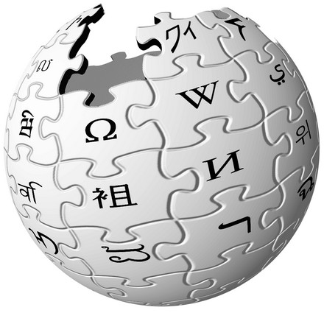



Another Example: In-Memory Graph Processing
Large graphs are everywhere (circa 2015)
Scalable large-scale graph processing is challenging
36 Million
Wikipedia Pages
1.4 Billion
Facebook Users
300 Million
Twitter Users
30 Billion
Instagram Photos

Slide 133
Key Bottlenecks in Graph Processing
for (v: graph.vertices) {
for (w: v.successors) {
w.next_rank += weight * v.rank;
}
}
1. Frequent random memory accesses
v
&w
w.rank
w.next_rank
w.edges
weight * v.rank
w
…
2. Little amount of computation

Slide 134
Opportunity: 3D-Stacked Logic+Memory
Memory
Logic
Other “True 3D” technologies
under development

Slide 135
Tesseract System for Graph Processing
Interconnected set of 3D-stacked memory+logic chips with simple cores
Host Processor
Memory
Memory-Mapped
Accelerator Interface
(Noncacheable, Physically Addressed)
Logic
In-Order Core
DRAM Controller
…
…
LP
PF Buffer
Crossbar Network
…
MTP
…
Message Queue
NI
Ahn+, “A Scalable Processing-in-Memory Accelerator for Parallel Graph Processing” ISCA 2015.

Slide 136
Tesseract System for Graph Processing
Host Processor
Memory
Memory-Mapped
Accelerator Interface
(Noncacheable, Physically Addressed)
Logic
In-Order Core
DRAM Controller
…
…
Communications via
Remote Function Calls
LP
PF Buffer
Crossbar Network
…
MTP
…
Message Queue
NI

Slide 137
Tesseract System for Graph Processing
Host Processor
Memory
Memory-Mapped
Accelerator Interface
(Noncacheable, Physically Addressed)
Logic
Prefetching
In-Order Core
DRAM Controller
…
…
LP
PF Buffer
Crossbar Network
…
MTP
…
Message Queue
NI

Slide 138
Evaluated Systems
DDR3-OoO
HMC-OoO
HMC-MC
Tesseract
32 Tesseract Cores
8 OoO
4GHz
8 OoO
4GHz
8 OoO
4GHz
8 OoO
4GHz
128
In-Order
2GHz
128
In-Order
2GHz
8 OoO
4GHz
8 OoO
4GHz
8 OoO
4GHz
8 OoO
4GHz
128
In-Order
2GHz
128
In-Order
2GHz
102.4GB/s
640GB/s
640GB/s
8TB/s
Ahn+, “A Scalable Processing-in-Memory Accelerator for Parallel Graph Processing” ISCA 2015.

Slide 139
Tesseract Graph Processing Performance
>13X Performance Improvement
On five graph processing algorithms
Ahn+, “A Scalable Processing-in-Memory Accelerator for Parallel Graph Processing” ISCA 2015.

Slide 140
Tesseract Graph Processing Performance

Slide 141
Tesseract Graph Processing System Energy
> 8X Energy Reduction
Ahn+, “A Scalable Processing-in-Memory Accelerator for Parallel Graph Processing” ISCA 2015.

Slide 142
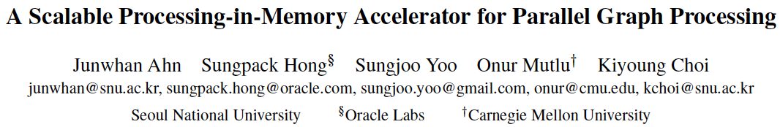
More on Tesseract
Junwhan Ahn, Sungpack Hong, Sungjoo Yoo, Onur Mutlu, and Kiyoung Choi,
"A Scalable Processing-in-Memory Accelerator for Parallel Graph Processing"
Proceedings of the 42nd International Symposium on Computer Architecture (ISCA), Portland, OR, June 2015.
[Slides (pdf)] [Lightning Session Slides (pdf)]

Slide 143





Google Workloads for Consumer Devices:
Mitigating Data Movement Bottlenecks
Amirali Boroumand
Saugata Ghose, Youngsok Kim, Rachata Ausavarungnirun,
Eric Shiu, Rahul Thakur, Daehyun Kim, Aki Kuusela,
Allan Knies, Parthasarathy Ranganathan, Onur Mutlu

Slide 144
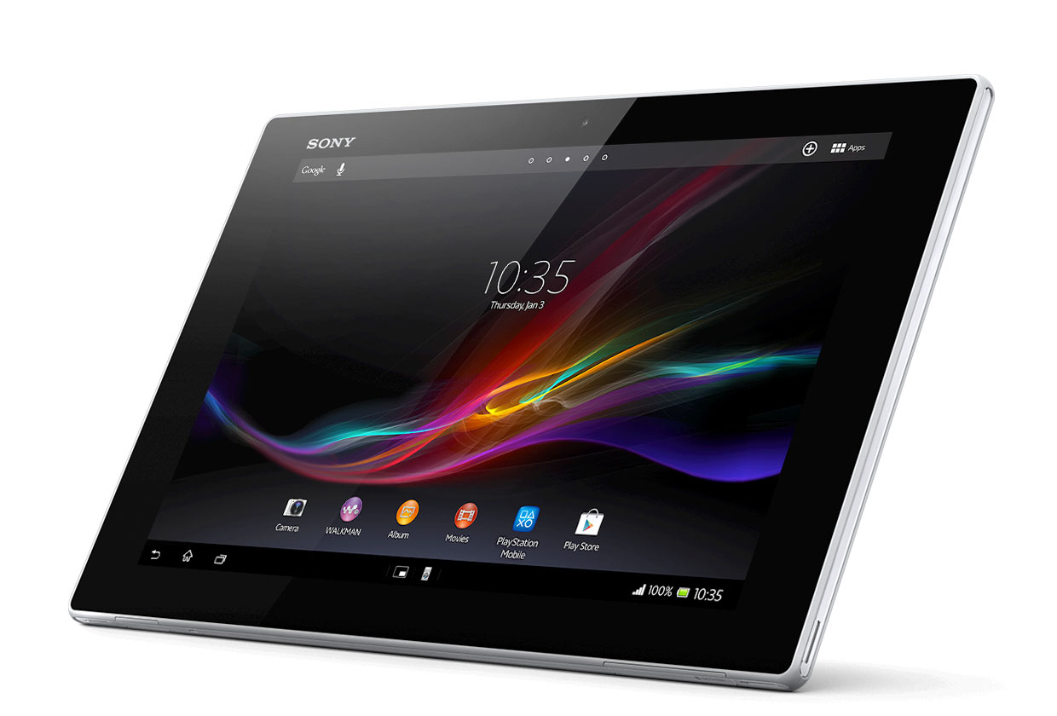
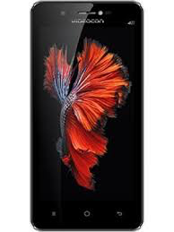
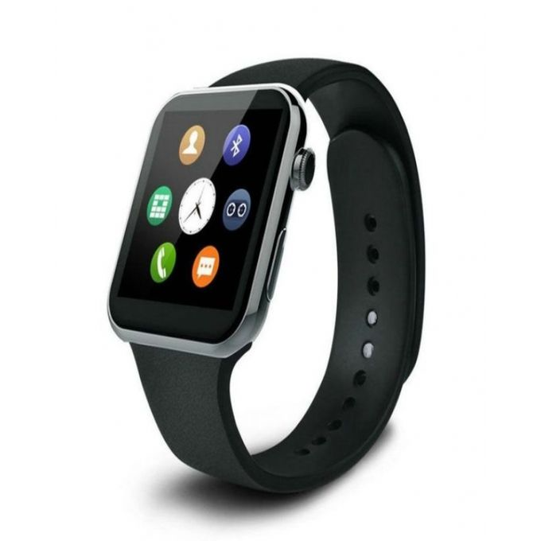

Consumer Devices
Consumer devices are everywhere!
Energy consumption is
a first-class concern in consumer devices
Notes:
Consumer devices like tablets smartphone and wearable are now everywhere and used by billions of people.
One of the major challenge in these devices is battery limitation which makes the energy consumption a critical concern …

Slide 145





Popular Consumer Workloads
  Chrome
TensorFlow Mobile
    Google’s web browser
Google’s machine learning framework
  Video Playback
  Video Capture
Google’s video codec
Google’s video codec
Notes:
In this work, we take a look at widely-used google consumer workloads, to figure out the major sources of energy consumption.
We look at Google Chrome web brower. We take a look at Tensorflow, Google’s machine learning framework, and we also take a look at two important video related workloads, video playback and video capture, both rely on Google’s vp9 codec technology.

Slide 146
Energy Cost of Data Movement
1st key observation: 62.7% of the total system energy is spent on data movement
Data Movement
SoC
DRAM
CPU
L2
CPU
L1
CPU
CPU
Compute Unit
Processing-In-Memory (PIM)
  Potential solution: move computation close to data
  Challenge: limited area and energy budget
Notes:
Throughout our analysis, we make a key observation that out of all sources of energy consumption, data movement is a major contributor to the total system energy. We find that across all of the workloads, on average around 62.7% of total system energy is spent on data movement.
One way to reduce data movement cost is to move computation close to data, or …
One potential solution to address this cost it do move computation close to data, or in other words, do procesing in memory. However, the challenge is that these devices.
One potential solution to mitigate data movement cost and reduce total system energy is to execute data-movement heavy portions of application close to data, or in other words, do processing in memory. However, consumer devices are extermely limited in terms of area and power budget. So the question is can we move part of the data movement heavy portion given the limited area and energy budget. Our

Slide 147
Using PIM to Reduce Data Movement
  2nd key observation: a significant fraction of the
  data movement often comes from simple functions
We can design lightweight logic to implement
these simple functions in memory
Small embedded
low-power core
Small fixed-function accelerators
PIM Core
PIM Accelerator
PIM Accelerator
PIM Accelerator
  Offloading to PIM logic reduces energy and improves performance, on average, by 2.3X and 2.2X
Notes:
To figure out if we can use processing in memory, we dig deeper into our analysis and we make another key observation that majority of data movement often comes form simple functions and pritmitives. We find that these simple function can be implemented in memory as either a small embedded core, or group of small fixed function accelerators. Our result shows that offloading these function to PIM logic can significantly reduce data movement for each function and reduce energy on average around 55% and improve perforamcne around 54%.
our PIM core can reduce significant portion of data movement, reduce enregy by 49.1% for each function and improve performance up to 2.2X. While using group of fixed function accelerator reduce energy by 55.4% and improve performance by up to 2.5X.
Or use Saugata’s approach : Reduces total system energy by an average of 55.4%
Reduces execution time by an average of 54.2%
Our result show that both of them can significantly reduce the data movement for each function.
Feedback: talk about result more
Don’t talk about specific detail like MemCopy, MemSet stuff like that
Main take away: data movement come from simple functions that are simple enough to implement in PIM
We find that these functions and primitves can be implemented as PIM logic using either (1) a small low-power general-purpose embedded core or (2) a group of small fixed-function accelerators (PIM accelerators). Our Analysis shows that both are cost-feasible to use in consumer devices. We find that they eliminate a significant fraction of dat amovement, and reduce energy consumption for each of these operation on average by 49 and 55%.

Slide 148
Workload Analysis
  Chrome
TensorFlow Mobile
    Google’s web browser
Google’s machine learning framework
  Video Playback
  Video Capture
Google’s video codec
Google’s video codec
Notes:
In this work, we take a look at widely-used google consumer workloads, to figure out the major sources of energy consumption.
We look at Google Chrome web brower. We take a look at Tensorflow, Google’s machine learning framework, and we also take a look at two important video related workloads, video playback and video capture, both rely on Google’s vp9 codec technology.

Slide 149

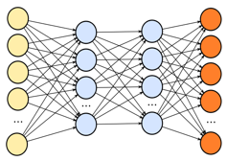
TensorFlow Mobile
Inference
Prediction
57.3% of the inference energy is spent on
data movement
54.4% of the data movement energy comes from
packing/unpacking and quantization

Slide 150
More on PIM for Mobile Devices
Amirali Boroumand, Saugata Ghose, Youngsok Kim, Rachata Ausavarungnirun, Eric Shiu, Rahul Thakur, Daehyun Kim, Aki Kuusela, Allan Knies, Parthasarathy Ranganathan, and Onur Mutlu,
"Google Workloads for Consumer Devices: Mitigating Data Movement Bottlenecks"
Proceedings of the 23rd International Conference on Architectural Support for Programming Languages and Operating Systems (ASPLOS), Williamsburg, VA, USA, March 2018.
[Slides (pptx) (pdf)] [Lightning Session Slides (pptx) (pdf)] [Poster (pptx) (pdf)]
[Lightning Talk Video (2 minutes)]
[Full Talk Video (21 minutes)]

Slide 151
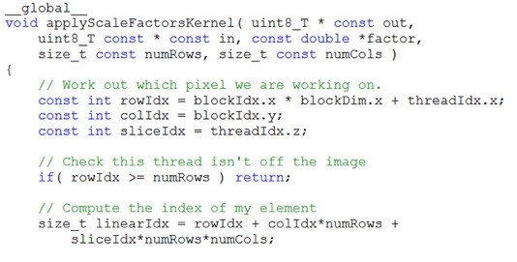
Truly Distributed GPU Processing with PIM
3D-stacked memory
(memory stack)
SM (Streaming Multiprocessor)
Logic layer
Logic layer SM
Main GPU
Crossbar switch
Vault Ctrl
….
Vault Ctrl

Slide 152
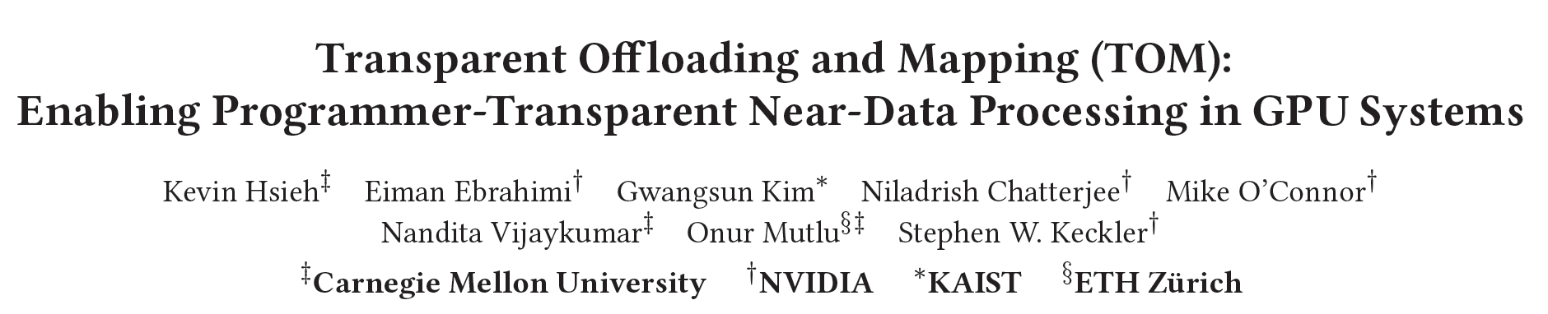
Accelerating GPU Execution with PIM (I)
Kevin Hsieh, Eiman Ebrahimi, Gwangsun Kim, Niladrish Chatterjee, Mike O'Connor, Nandita Vijaykumar, Onur Mutlu, and Stephen W. Keckler,
"Transparent Offloading and Mapping (TOM): Enabling Programmer-Transparent Near-Data Processing in GPU Systems"
Proceedings of the 43rd International Symposium on Computer Architecture (ISCA), Seoul, South Korea, June 2016.
[Slides (pptx) (pdf)]
[Lightning Session Slides (pptx) (pdf)]

Slide 153

Accelerating GPU Execution with PIM (II)
Ashutosh Pattnaik, Xulong Tang, Adwait Jog, Onur Kayiran, Asit K. Mishra, Mahmut T. Kandemir, Onur Mutlu, and Chita R. Das,
"Scheduling Techniques for GPU Architectures with Processing-In-Memory Capabilities"
Proceedings of the 25th International Conference on Parallel Architectures and Compilation Techniques (PACT), Haifa, Israel, September 2016.

Slide 154

Accelerating Linked Data Structures
Kevin Hsieh, Samira Khan, Nandita Vijaykumar, Kevin K. Chang, Amirali Boroumand, Saugata Ghose, and Onur Mutlu,
"Accelerating Pointer Chasing in 3D-Stacked Memory: Challenges, Mechanisms, Evaluation"
Proceedings of the 34th IEEE International Conference on Computer Design (ICCD), Phoenix, AZ, USA, October 2016.

Slide 155

Accelerating Dependent Cache Misses
Milad Hashemi, Khubaib, Eiman Ebrahimi, Onur Mutlu, and Yale N. Patt,
"Accelerating Dependent Cache Misses with an Enhanced Memory Controller"
Proceedings of the 43rd International Symposium on Computer Architecture (ISCA), Seoul, South Korea, June 2016.
[Slides (pptx) (pdf)]
[Lightning Session Slides (pptx) (pdf)]

Slide 156

Accelerating Runahead Execution
Milad Hashemi, Onur Mutlu, and Yale N. Patt,
"Continuous Runahead: Transparent Hardware Acceleration for Memory Intensive Workloads"
Proceedings of the 49th International Symposium on Microarchitecture (MICRO), Taipei, Taiwan, October 2016.
[Slides (pptx) (pdf)] [Lightning Session Slides (pdf)] [Poster (pptx) (pdf)]

Slide 157

Accelerating Climate Modeling
Gagandeep Singh, Dionysios Diamantopoulos, Christoph Hagleitner, Juan Gómez-Luna, Sander Stuijk, Onur Mutlu, and Henk Corporaal,
"NERO: A Near High-Bandwidth Memory Stencil Accelerator for Weather Prediction Modeling"
Proceedings of the 30th International Conference on Field-Programmable Logic and Applications (FPL), Gothenburg, Sweden, September 2020.
[Slides (pptx) (pdf)]
[Lightning Talk Slides (pptx) (pdf)]
[Talk Video (23 minutes)]
Nominated for the Stamatis Vassiliadis Memorial Award.

Slide 158
Accelerating Approximate String Matching
Damla Senol Cali, Gurpreet S. Kalsi, Zulal Bingol, Can Firtina, Lavanya Subramanian, Jeremie S. Kim, Rachata Ausavarungnirun, Mohammed Alser, Juan Gomez-Luna, Amirali Boroumand, Anant Nori, Allison Scibisz, Sreenivas Subramoney, Can Alkan, Saugata Ghose, and Onur Mutlu,
"GenASM: A High-Performance, Low-Power Approximate String Matching Acceleration Framework for Genome Sequence Analysis"
Proceedings of the 53rd International Symposium on Microarchitecture (MICRO), Virtual, October 2020.
[Lighting Talk Video (1.5 minutes)]
[Lightning Talk Slides (pptx) (pdf)]
[Talk Video (18 minutes)]
[Slides (pptx) (pdf)]

Slide 159

Accelerating Time Series Analysis
Ivan Fernandez, Ricardo Quislant, Christina Giannoula, Mohammed Alser, Juan Gómez-Luna, Eladio Gutiérrez, Oscar Plata, and Onur Mutlu,
"NATSA: A Near-Data Processing Accelerator for Time Series Analysis"
Proceedings of the 38th IEEE International Conference on Computer Design (ICCD), Virtual, October 2020.
[Slides (pptx) (pdf)]
[Talk Video (10 minutes)]
[Source Code]

Slide 160
Accelerating Approximate String Matching
Damla Senol Cali, Gurpreet S. Kalsi, Zulal Bingol, Can Firtina, Lavanya Subramanian, Jeremie S. Kim, Rachata Ausavarungnirun, Mohammed Alser, Juan Gomez-Luna, Amirali Boroumand, Anant Nori, Allison Scibisz, Sreenivas Subramoney, Can Alkan, Saugata Ghose, and Onur Mutlu,
"GenASM: A High-Performance, Low-Power Approximate String Matching Acceleration Framework for Genome Sequence Analysis"
Proceedings of the 53rd International Symposium on Microarchitecture (MICRO), Virtual, October 2020.
[Lighting Talk Video (1.5 minutes)]
[Lightning Talk Slides (pptx) (pdf)]
[Talk Video (18 minutes)]
[Slides (pptx) (pdf)]

Slide 161

FPGA-based Processing Near Memory
Gagandeep Singh, Mohammed Alser, Damla Senol Cali, Dionysios Diamantopoulos, Juan Gómez-Luna, Henk Corporaal, and Onur Mutlu,
"FPGA-based Near-Memory Acceleration of Modern Data-Intensive Applications"
IEEE Micro (IEEE MICRO), 2021.

Slide 162
We Need to Revisit the Entire Stack
Problem
Algorithm
Program/Language
System Software
SW/HW Interface
Micro-architecture
Logic
Devices
Electrons
We can get there step by step

Slide 163

PEI: Simple Processing in Memory
Junwhan Ahn, Sungjoo Yoo, Onur Mutlu, and Kiyoung Choi,
"PIM-Enabled Instructions: A Low-Overhead, Locality-Aware Processing-in-Memory Architecture"
Proceedings of the 42nd International Symposium on Computer Architecture (ISCA), Portland, OR, June 2015.
[Slides (pdf)] [Lightning Session Slides (pdf)]

Slide 164

PIM Review and Open Problems
Onur Mutlu, Saugata Ghose, Juan Gomez-Luna, and Rachata Ausavarungnirun,
"A Modern Primer on Processing in Memory"
Invited Book Chapter in Emerging Computing: From Devices to Systems - Looking Beyond Moore and Von Neumann, Springer, to be published in 2021.
https://arxiv.org/pdf/1903.03988.pdf

Slide 165

PIM Review and Open Problems (II)
Saugata Ghose, Amirali Boroumand, Jeremie S. Kim, Juan Gomez-Luna, and Onur Mutlu,
"Processing-in-Memory: A Workload-Driven Perspective"
Invited Article in IBM Journal of Research & Development, Special Issue on Hardware for Artificial Intelligence, to appear in November 2019.
[Preliminary arXiv version]
https://arxiv.org/pdf/1907.12947.pdf

Slide 166
UPMEM Processing-in-DRAM Engine (2019)
Processing in DRAM Engine
Includes standard DIMM modules, with a large number of DPU processors combined with DRAM chips.
Replaces standard DIMMs
  DDR4 R-DIMM modules
    8GB+128 DPUs (16 PIM chips)
    Standard 2x-nm DRAM process
  Large amounts of compute & memory bandwidth
https://www.anandtech.com/show/14750/hot-chips-31-analysis-inmemory-processing-by-upmem
https://www.upmem.com/video-upmem-presenting-its-true-processing-in-memory-solution-hot-chips-2019/

Slide 167

UPMEM Memory Modules
E19: 8 chips DIMM (1 rank). DPUs @ 267 MHz
P21: 16 chips DIMM (2 ranks). DPUs @ 350 MHz
www.upmem.com

Slide 168











2,560-DPU Processing-in-Memory System
https://arxiv.org/pdf/2105.03814.pdf

Slide 169

More on the UPMEM PIM System
https://www.youtube.com/watch?v=Sscy1Wrr22A&list=PL5Q2soXY2Zi9xidyIgBxUz7xRPS-wisBN&index=26

Slide 170
Experimental Analysis of the UPMEM PIM Engine
https://arxiv.org/pdf/2105.03814.pdf

Slide 171
PrIM Benchmarks: Application Domains
Domain | Benchmark | Short name
Dense linear algebra | Vector Addition | VA
 | Matrix-Vector Multiply | GEMV
Sparse linear algebra | Sparse Matrix-Vector Multiply | SpMV
Databases | Select | SEL
 | Unique | UNI
Data analytics | Binary Search | BS
 | Time Series Analysis | TS
Graph processing | Breadth-First Search | BFS
Neural networks | Multilayer Perceptron | MLP
Bioinformatics | Needleman-Wunsch | NW
Image processing | Image histogram (short) | HST-S
 | Image histogram (large) | HST-L
Parallel primitives | Reduction | RED
 | Prefix sum (scan-scan-add) | SCAN-SSA
 | Prefix sum (reduce-scan-scan) | SCAN-RSS
 | Matrix transposition | TRNS

Slide 172

PrIM Benchmarks are Open Source
All microbenchmarks, benchmarks, and scripts
https://github.com/CMU-SAFARI/prim-benchmarks

Slide 173

Understanding a Modern PIM Architecture
https://arxiv.org/pdf/2105.03814.pdf
https://github.com/CMU-SAFARI/prim-benchmarks

Slide 174

Understanding a Modern PIM Architecture
https://www.youtube.com/watch?v=D8Hjy2iU9l4&list=PL5Q2soXY2Zi_tOTAYm--dYByNPL7JhwR9

Slide 175

More on Analysis of the UPMEM PIM Engine
https://www.youtube.com/watch?v=D8Hjy2iU9l4&list=PL5Q2soXY2Zi_tOTAYm--dYByNPL7JhwR9

Slide 176

More on Analysis of the UPMEM PIM Engine
https://www.youtube.com/watch?v=Pp9jSU2b9oM&list=PL5Q2soXY2Zi8_VVChACnON4sfh2bJ5IrD&index=159

Slide 177
FPGA-based Processing Near Memory
Gagandeep Singh, Mohammed Alser, Damla Senol Cali, Dionysios Diamantopoulos, Juan Gómez-Luna, Henk Corporaal, and Onur Mutlu,
"FPGA-based Near-Memory Acceleration of Modern Data-Intensive Applications"
IEEE Micro (IEEE MICRO), to appear, 2021.

Slide 178

Samsung Function-in-Memory DRAM (2021)
https://news.samsung.com/global/samsung-develops-industrys-first-high-bandwidth-memory-with-ai-processing-power

Slide 179


Samsung Function-in-Memory DRAM (2021)

Slide 180

Samsung Function-in-Memory DRAM (2021)

Slide 181

Samsung Function-in-Memory DRAM (2021)

Slide 182

Samsung Function-in-Memory DRAM (2021)

Slide 183



Samsung AxDIMM (2021)
DDR5-PIM
  DLRM recommendation system
Baseline System
AxDIMM System
Ke et al. "Near-Memory Processing in Action: Accelerating Personalized Recommendation with AxDIMM", IEEE Micro (2021)

Slide 184
Detailed Lectures on PIM (I)
Computer Architecture, Fall 2020, Lecture 6
  Computation in Memory (ETH Zürich, Fall 2020)
  https://www.youtube.com/watch?v=oGcZAGwfEUE&list=PL5Q2soXY2Zi9xidyIgBxUz7xRPS-wisBN&index=12
Computer Architecture, Fall 2020, Lecture 7
  Near-Data Processing (ETH Zürich, Fall 2020)
  https://www.youtube.com/watch?v=j2GIigqn1Qw&list=PL5Q2soXY2Zi9xidyIgBxUz7xRPS-wisBN&index=13
Computer Architecture, Fall 2020, Lecture 11a
  Memory Controllers (ETH Zürich, Fall 2020)
  https://www.youtube.com/watch?v=TeG773OgiMQ&list=PL5Q2soXY2Zi9xidyIgBxUz7xRPS-wisBN&index=20
Computer Architecture, Fall 2020, Lecture 12d
  Real Processing-in-DRAM with UPMEM (ETH Zürich, Fall 2020)
  https://www.youtube.com/watch?v=Sscy1Wrr22A&list=PL5Q2soXY2Zi9xidyIgBxUz7xRPS-wisBN&index=25
https://www.youtube.com/onurmutlulectures

Slide 185
Detailed Lectures on PIM (II)
Computer Architecture, Fall 2020, Lecture 15
  Emerging Memory Technologies (ETH Zürich, Fall 2020)
  https://www.youtube.com/watch?v=AlE1rD9G_YU&list=PL5Q2soXY2Zi9xidyIgBxUz7xRPS-wisBN&index=28
Computer Architecture, Fall 2020, Lecture 16a
  Opportunities & Challenges of Emerging Memory Technologies (ETH Zürich, Fall 2020)
  https://www.youtube.com/watch?v=pmLszWGmMGQ&list=PL5Q2soXY2Zi9xidyIgBxUz7xRPS-wisBN&index=29
Computer Architecture, Fall 2020, Guest Lecture
  In-Memory Computing: Memory Devices & Applications (ETH Zürich, Fall 2020)
  https://www.youtube.com/watch?v=wNmqQHiEZNk&list=PL5Q2soXY2Zi9xidyIgBxUz7xRPS-wisBN&index=41
https://www.youtube.com/onurmutlulectures

Slide 186
A Longer & Detailed Tutorial on PIM
Onur Mutlu,
"Memory-Centric Computing Systems"
Invited Tutorial at 66th International Electron Devices Meeting (IEDM), Virtual, 12 December 2020.
[Slides (pptx) (pdf)]
[Executive Summary Slides (pptx) (pdf)]
[Tutorial Video (1 hour 51 minutes)]
[Executive Summary Video (2 minutes)]
[Abstract and Bio]
[Related Keynote Paper from VLSI-DAT 2020]
[Related Review Paper on Processing in Memory]
https://www.youtube.com/watch?v=H3sEaINPBOE
https://www.youtube.com/onurmutlulectures

Slide 187

A Tutorial on PIM
Onur Mutlu,
"Memory-Centric Computing Systems"
Invited Tutorial at 66th International Electron Devices Meeting (IEDM), Virtual, 12 December 2020.
[Slides (pptx) (pdf)]
[Executive Summary Slides (pptx) (pdf)]
[Tutorial Video (1 hour 51 minutes)]
[Executive Summary Video (2 minutes)]
[Abstract and Bio]
[Related Keynote Paper from VLSI-DAT 2020]
[Related Review Paper on Processing in Memory]
https://www.youtube.com/watch?v=H3sEaINPBOE
https://www.youtube.com/watch?v=H3sEaINPBOE
https://www.youtube.com/onurmutlulectures

Slide 188
Challenge and Opportunity for Future
Fundamentally
Energy-Efficient
(Data-Centric)
Computing Architectures

Slide 189
Challenge and Opportunity for Future
Fundamentally
High-Performance
(Data-Centric)
Computing Architectures

Slide 190
Challenge and Opportunity for Future
Computing Architectures
with
Minimal Data Movement

Slide 191
Eliminating the Adoption Barriers
How to Enable Adoption of Processing in Memory

Slide 192
Barriers to Adoption of PIM
1. Functionality and applications & software for PIM
2. Ease of programming (interfaces and compiler/HW support)
3. System support: coherence & virtual memory
4. Runtime and compilation systems for adaptive scheduling, data mapping, access/sharing control
5. Infrastructures to assess benefits and feasibility
All can be solved with change of mindset

Slide 193
We Need to Revisit the Entire Stack
Problem
Algorithm
Program/Language
System Software
SW/HW Interface
Micro-architecture
Logic
Devices
Electrons
We can get there step by step

Slide 194

DAMOV Analysis Methodology & Workloads
https://arxiv.org/pdf/2105.03725.pdf

Slide 195

More on DAMOV Analysis Methodology & Workloads
https://www.youtube.com/watch?v=GWideVyo0nM&list=PL5Q2soXY2Zi_tOTAYm--dYByNPL7JhwR9&index=3

Slide 196

DAMOV is Open Source
We open-source our benchmark suite and our toolchain
DAMOV-SIM
DAMOV
Benchmarks
44
Notes:
We open source DAMOV to facilitate further research in mitigating data movement bottlenecks, including in near data processing.
[CLICK] In our DAMOV repository, we provide
[CLICK] The complete set of 144 application functions that compose our benchmark suite
[CLICK] And our DAMOV-SIM simulator
[NEXT]

Slide 197

PIM Can Enable New Medical Platforms
Oxford Nanopore MinION
Senol Cali+, “Nanopore Sequencing Technology and Tools for Genome
Assembly: Computational Analysis of the Current State, Bottlenecks
and Future Directions,” Briefings in Bioinformatics, 2018.
[Preliminary arxiv.org version]

Slide 198
Future of Genome Sequencing & Analysis
MinION from ONT
SmidgION from ONT

Slide 199
Accelerating Genome Analysis: Overview
Mohammed Alser, Zulal Bingol, Damla Senol Cali, Jeremie Kim, Saugata Ghose, Can Alkan, and Onur Mutlu,
"Accelerating Genome Analysis: A Primer on an Ongoing Journey"
IEEE Micro (IEEE MICRO), Vol. 40, No. 5, pages 65-75, September/October 2020.
[Slides (pptx)(pdf)]
[Talk Video (1 hour 2 minutes)]

Slide 200
FPGA-based Processing Near Memory
Gagandeep Singh, Mohammed Alser, Damla Senol Cali, Dionysios Diamantopoulos, Juan Gómez-Luna, Henk Corporaal, and Onur Mutlu,
"FPGA-based Near-Memory Acceleration of Modern Data-Intensive Applications"
IEEE Micro (IEEE MICRO), to appear, 2021.

Slide 201
More on Fast & Efficient Genome Analysis …
Onur Mutlu,
"Accelerating Genome Analysis: A Primer on an Ongoing Journey"
Invited Lecture at Technion, Virtual, 26 January 2021.
[Slides (pptx) (pdf)]
[Talk Video (1 hour 37 minutes, including Q&A)]
[Related Invited Paper (at IEEE Micro, 2020)]
https://www.youtube.com/watch?v=r7sn41lH-4A

Slide 202
Detailed Lectures on Genome Analysis
Computer Architecture, Fall 2020, Lecture 3a
  Introduction to Genome Sequence Analysis (ETH Zürich, Fall 2020)
  https://www.youtube.com/watch?v=CrRb32v7SJc&list=PL5Q2soXY2Zi9xidyIgBxUz7xRPS-wisBN&index=5
Computer Architecture, Fall 2020, Lecture 8
  Intelligent Genome Analysis (ETH Zürich, Fall 2020)
  https://www.youtube.com/watch?v=ygmQpdDTL7o&list=PL5Q2soXY2Zi9xidyIgBxUz7xRPS-wisBN&index=14
Computer Architecture, Fall 2020, Lecture 9a
  GenASM: Approx. String Matching Accelerator (ETH Zürich, Fall 2020)
  https://www.youtube.com/watch?v=XoLpzmN-Pas&list=PL5Q2soXY2Zi9xidyIgBxUz7xRPS-wisBN&index=15
Accelerating Genomics Project Course, Fall 2020, Lecture 1
  Accelerating Genomics (ETH Zürich, Fall 2020)
  https://www.youtube.com/watch?v=rgjl8ZyLsAg&list=PL5Q2soXY2Zi9E2bBVAgCqLgwiDRQDTyId
https://www.youtube.com/onurmutlulectures

Slide 203
What We Have
Less Time For

Slide 204
Challenge and Opportunity for Future
Data-Driven
(Self-Optimizing)
Computing Architectures

Slide 205
Challenge and Opportunity for Future
Data-Aware
(Expressive)
Computing Architectures

Slide 206
More Info in This Longer Tutorial…
Onur Mutlu,
"Memory-Centric Computing Systems"
Invited Tutorial at 66th International Electron Devices Meeting (IEDM), Virtual, 12 December 2020.
[Slides (pptx) (pdf)]
[Executive Summary Slides (pptx) (pdf)]
[Tutorial Video (1 hour 51 minutes)]
[Executive Summary Video (2 minutes)]
[Abstract and Bio]
[Related Keynote Paper from VLSI-DAT 2020]
[Related Review Paper on Processing in Memory]
https://www.youtube.com/watch?v=H3sEaINPBOE
https://www.youtube.com/onurmutlulectures

Slide 207
A Tutorial on PIM
Onur Mutlu,
"Memory-Centric Computing Systems"
Invited Tutorial at 66th International Electron Devices Meeting (IEDM), Virtual, 12 December 2020.
[Slides (pptx) (pdf)]
[Executive Summary Slides (pptx) (pdf)]
[Tutorial Video (1 hour 51 minutes)]
[Executive Summary Video (2 minutes)]
[Abstract and Bio]
[Related Keynote Paper from VLSI-DAT 2020]
[Related Review Paper on Processing in Memory]
https://www.youtube.com/watch?v=H3sEaINPBOE
https://www.youtube.com/watch?v=H3sEaINPBOE
https://www.youtube.com/onurmutlulectures

Slide 208
Data-Driven Architectures

Slide 209
Corollaries: Architectures Today …
Architectures are terrible at dealing with data
  Designed to mainly store and move data vs. to compute
  They are processor-centric as opposed to data-centric
Architectures are terrible at taking advantage of vast amounts of data (and metadata) available to them
  Designed to make simple decisions, ignoring lots of data
  They make human-driven decisions vs. data-driven decisions
Architectures are terrible at knowing and exploiting different properties of application data
  Designed to treat all data as the same
  They make component-aware decisions vs. data-aware

Slide 210
Exploiting Data to Design Intelligent Architectures

Slide 211
System Architecture Design Today
Human-driven
  Humans design the policies (how to do things)
Many (too) simple, short-sighted policies all over the system
No automatic data-driven policy learning
(Almost) no learning: cannot take lessons from past actions
Can we design
fundamentally intelligent architectures?

Slide 212
An Intelligent Architecture
Data-driven
  Machine learns the “best” policies (how to do things)
Sophisticated, workload-driven, changing, far-sighted policies
Automatic data-driven policy learning
All controllers are intelligent data-driven agents
How do we start?

Slide 213
Self-Optimizing
Memory Controllers

Slide 214
Memory Controller
How to schedule requests to maximize system performance?
Resolves memory contention by scheduling requests
Core
Core
Memory Controller
Memory
Core
Core

Slide 215
Why are Memory Controllers Difficult to Design?
Need to obey DRAM timing constraints for correctness
  There are many (50+) timing constraints in DRAM
  tWTR: Minimum number of cycles to wait before issuing a read command after a write command is issued
  tRC: Minimum number of cycles between the issuing of two consecutive activate commands to the same bank
  …
Need to keep track of many resources to prevent conflicts
  Channels, banks, ranks, data bus, address bus, row buffers, …
Need to handle DRAM refresh
Need to manage power consumption
Need to optimize performance & QoS (in the presence of constraints)
  Reordering is not simple
  Fairness and QoS needs complicates the scheduling problem
…

Slide 216

Many Memory Timing Constraints
From Lee et al., “DRAM-Aware Last-Level Cache Writeback: Reducing Write-Caused Interference in Memory Systems,” HPS Technical Report, April 2010.

Slide 217

Many Memory Timing Constraints
Kim et al., “A Case for Exploiting Subarray-Level Parallelism (SALP) in DRAM,” ISCA 2012.
Lee et al., “Tiered-Latency DRAM: A Low Latency and Low Cost DRAM Architecture,” HPCA 2013.

Slide 218
Memory Controller Design Is Becoming More Difficult
CPU
CPU
CPU
CPU
GPU
HWA
HWA
Shared Cache
DRAM and Hybrid Memory Controllers
DRAM and Hybrid Memories
Heterogeneous agents: CPUs, GPUs, and HWAs
Main memory interference between CPUs, GPUs, HWAs
Many timing constraints for various memory types
Many goals at the same time: performance, fairness, QoS, energy efficiency, …

Slide 219
Reality and Dream
Reality: It difficult to design a policy that maximizes performance, QoS, energy-efficiency, …
  Too many things to think about
  Continuously changing workload and system behavior
Dream: Wouldn’t it be nice if the DRAM controller automatically found a good scheduling policy on its own?

Slide 220
Self-Optimizing DRAM Controllers
Problem: DRAM controllers are difficult to design
  It is difficult for human designers to design a policy that can adapt itself very well to different workloads and different system conditions
Idea: A memory controller that adapts its scheduling policy to workload behavior and system conditions using machine learning.
Observation: Reinforcement learning maps nicely to memory control.
Design: Memory controller is a reinforcement learning agent
  It dynamically and continuously learns and employs the best scheduling policy to maximize long-term performance.
Ipek+, “Self Optimizing Memory Controllers: A Reinforcement Learning Approach,” ISCA 2008.

Slide 221

Self-Optimizing DRAM Controllers
Engin Ipek, Onur Mutlu, José F. Martínez, and Rich Caruana,
"Self Optimizing Memory Controllers: A Reinforcement Learning Approach"
Proceedings of the 35th International Symposium on Computer Architecture (ISCA), pages 39-50, Beijing, China, June 2008.
Goal: Learn to choose actions to maximize r₀ + γr₁ + γ²r₂ + … ( 0 ≤ γ < 1)

Slide 222

Self-Optimizing DRAM Controllers
Dynamically adapt the memory scheduling policy via interaction with the system at runtime
  Associate system states and actions (commands) with long term reward values: each action at a given state leads to a learned reward
  Schedule command with highest estimated long-term reward value in each state
  Continuously update reward values for <state, action> pairs based on feedback from system

Slide 223

Self-Optimizing DRAM Controllers
Engin Ipek, Onur Mutlu, José F. Martínez, and Rich Caruana,
"Self Optimizing Memory Controllers: A Reinforcement Learning Approach"
Proceedings of the 35th International Symposium on Computer Architecture (ISCA), pages 39-50, Beijing, China, June 2008.

Slide 224
States, Actions, Rewards
Reward function
  +1 for scheduling Read and Write commands
  0 at all other times
  Goal is to maximize long-term data bus utilization
State attributes
  Number of reads, writes, and load misses in transaction queue
  Number of pending writes and ROB heads waiting for referenced row
  Request’s relative ROB order
Actions
  Activate
  Write
  Read - load miss
  Read - store miss
  Precharge - pending
  Precharge - preemptive
  NOP

Slide 225


Performance Results
Large, robust performance improvements
over many human-designed policies

Slide 226
Self Optimizing DRAM Controllers
+ Continuous learning in the presence of changing environment
+ Reduced designer burden in finding a good scheduling policy. Designer specifies:
1) What system variables might be useful
2) What target to optimize, but not how to optimize it
-- How to specify different objectives? (e.g., fairness, QoS, …)
-- Hardware complexity?
-- Design mindset and flow

Slide 227

More on Self-Optimizing DRAM Controllers
Engin Ipek, Onur Mutlu, José F. Martínez, and Rich Caruana,
"Self Optimizing Memory Controllers: A Reinforcement Learning Approach"
Proceedings of the 35th International Symposium on Computer Architecture (ISCA), pages 39-50, Beijing, China, June 2008.

Slide 228

Self-Optimizing Memory Prefetchers
To appear at MICRO 2021

Slide 229
An Intelligent Architecture
Data-driven
  Machine learns the “best” policies (how to do things)
Sophisticated, workload-driven, changing, far-sighted policies
Automatic data-driven policy learning
All controllers are intelligent data-driven agents
We need to rethink design
(of all controllers)

Slide 230
Challenge and Opportunity for Future
Data-Driven
(Self-Optimizing)
Computing Architectures

Slide 231
Data-Aware Architectures

Slide 232
Corollaries: Architectures Today …
Architectures are terrible at dealing with data
  Designed to mainly store and move data vs. to compute
  They are processor-centric as opposed to data-centric
Architectures are terrible at taking advantage of vast amounts of data (and metadata) available to them
  Designed to make simple decisions, ignoring lots of data
  They make human-driven decisions vs. data-driven decisions
Architectures are terrible at knowing and exploiting different properties of application data
  Designed to treat all data as the same
  They make component-aware decisions vs. data-aware

Slide 233
Data-Aware Architectures
A data-aware architecture understands what it can do with and to each piece of data
It makes use of different properties of data to improve performance, efficiency and other metrics
  Compressibility
  Approximability
  Locality
  Sparsity
  Criticality for Computation X
  Access Semantics
  …

Slide 234

One Problem: Limited Expressiveness

Slide 235

A Solution: More Expressive Interfaces

Slide 236

Expressive (Memory) Interfaces
Nandita Vijaykumar, Abhilasha Jain, Diptesh Majumdar, Kevin Hsieh, Gennady Pekhimenko, Eiman Ebrahimi, Nastaran Hajinazar, Phillip B. Gibbons and Onur Mutlu,
"A Case for Richer Cross-layer Abstractions: Bridging the Semantic Gap with Expressive Memory"
Proceedings of the 45th International Symposium on Computer Architecture (ISCA), Los Angeles, CA, USA, June 2018.
[Slides (pptx) (pdf)] [Lightning Talk Slides (pptx) (pdf)]
[Lightning Talk Video]

Slide 237

X-MeM Aids Many Optimizations

Slide 238

Expressive (Memory) Interfaces for GPUs
Nandita Vijaykumar, Eiman Ebrahimi, Kevin Hsieh, Phillip B. Gibbons and Onur Mutlu,
"The Locality Descriptor: A Holistic Cross-Layer Abstraction to Express Data Locality in GPUs"
Proceedings of the 45th International Symposium on Computer Architecture (ISCA), Los Angeles, CA, USA, June 2018.
[Slides (pptx) (pdf)] [Lightning Talk Slides (pptx) (pdf)]
[Lightning Talk Video]

Slide 239
An Example: Hybrid Memory Management
SoC
Meza+, “Enabling Efficient and Scalable Hybrid Memories,” IEEE Comp. Arch. Letters, 2012.
Yoon+, “Row Buffer Locality Aware Caching Policies for Hybrid Memories,” ICCD 2012 Best Paper Award.
DRAMCtrl
PCM Ctrl
DRAM
Phase Change Memory (or Tech. X)
Fast, durable
Small,
leaky, volatile,
high-cost
Large, non-volatile, low-cost
Slow, wears out, high active energy
Hardware/software manage data allocation and movement
to achieve the best of multiple technologies

Slide 240

An Example: Heterogeneous-Reliability Memory
Yixin Luo, Sriram Govindan, Bikash Sharma, Mark Santaniello, Justin Meza, Aman Kansal, Jie Liu, Badriddine Khessib, Kushagra Vaid, and Onur Mutlu,
"Characterizing Application Memory Error Vulnerability to Optimize Data Center Cost via Heterogeneous-Reliability Memory"
Proceedings of the 44th Annual IEEE/IFIP International Conference on Dependable Systems and Networks (DSN), Atlanta, GA, June 2014. [Summary] [Slides (pptx) (pdf)] [Coverage on ZDNet]

Slide 241

Exploiting Memory Error Tolerance with Hybrid Memory Systems
Heterogeneous-Reliability Memory [DSN 2014]
Vulnerable data
Vulnerable data
Tolerant data
Tolerant data
Reliable memory
Low-cost memory
Vulnerable data
  On Microsoft’s Web Search workload
  Reduces server hardware cost by 4.7 %
  Achieves single server availability target of 99.90 %
ECC protected
Well-tested chips
Tolerant data
NoECC or Parity
Less-tested chips
Notes:
As we have shown earlier, either across or within applications, our characterization can identify data that are vulnerable to memory errors and data that are tolerant to memory errors.
To exploit this observation, we would like to map these different data onto different memory modules according to their memory error tolerance.
As an example here, we map vulnerable data to reliable memory to improve reliability, and map tolerant data to low-cost less-reliable memory to exploit its tolerance and lower the cost. We call this mechanism heterogeneous-reliability memory, HRM.
Reliable memory consists of … Low cost memory consists of …
As we will show later, HRM allows us to use weaker error protection in memory, and enables the use of less-tested memory chips to lower the cost of the memory system, while still achieving reasonable single-server reliability target.

Slide 242
Heterogeneous-Reliability Memory
App 1 data A
App 1 data B
App 2 data A
App 2 data B
App 3 data A
App 3 data B
Step 1: Characterize and classify application memory error tolerance
App 1 data A
App 2 data A
App 2 data B
App 1 data B
App 3 data A
App 3 data B
Vulnerable
Tolerant
Step 2: Map application data to the HRM system enabled by SW/HW cooperative solutions
Reliable
Unreliable
Reliable memory
Parity memory
+ software recovery (Par+R)
Low-cost memory
Notes:
Now we have described the key idea of HRM and Par+R, let’s look at our mechanism to put them together.
First, we characterize and classify application data in terms of their memory error tolerance, rank them from vulnerable to tolerant.
Then, we map application data to HRM according to their error tolerance. As an example here, vulnerable data is mapped to reliable memory, tolerable data is mapped to low-cost memory, and recoverable data is mapped to parity memory with Par+R.

Slide 243
More on Heterogeneous-Reliability Memory
Yixin Luo, Sriram Govindan, Bikash Sharma, Mark Santaniello, Justin Meza, Aman Kansal, Jie Liu, Badriddine Khessib, Kushagra Vaid, and Onur Mutlu,
"Characterizing Application Memory Error Vulnerability to Optimize Data Center Cost via Heterogeneous-Reliability Memory"
Proceedings of the 44th Annual IEEE/IFIP International Conference on Dependable Systems and Networks (DSN), Atlanta, GA, June 2014. [Summary] [Slides (pptx) (pdf)] [Coverage on ZDNet]

Slide 244
Another Example: EDEN for DNNs
Deep Neural Network evaluation is very DRAM-intensive (especially for large networks)
1. Some data and layers in DNNs are very tolerant to errors
2. Reduce DRAM latency and voltage on such data and layers
3. While still achieving a user-specified DNN accuracy target by making training DRAM-error-aware
Data-aware management of DRAM latency and voltage for Deep Neural Network Inference

Slide 245

Example DNN Data Type to DRAM Mapping
Mapping example of ResNet-50:
<8% BER
<5% BER
<6% BER
4
2
3
<2% BER
1
Map more error-tolerant DNN layers
to DRAM partitions with lower voltage/latency
4 DRAM partitions with different error rates
Notes:
In contrast, using a DRAM chip partitioned into four voltage domains can use a many-to-four DNN to DRAM mapping, using four different voltage values with error rates indicated by the yellow, red, green, and blue lines

Slide 246

EDEN: Data-Aware Efficient DNN Inference
Skanda Koppula, Lois Orosa, A. Giray Yaglikci, Roknoddin Azizi, Taha Shahroodi, Konstantinos Kanellopoulos, and Onur Mutlu,
"EDEN: Enabling Energy-Efficient, High-Performance Deep Neural Network Inference Using Approximate DRAM"
Proceedings of the 52nd International Symposium on Microarchitecture (MICRO), Columbus, OH, USA, October 2019.
[Lightning Talk Slides (pptx) (pdf)]
[Lightning Talk Video (90 seconds)]

Slide 247

SMASH: SW/HW Indexing Acceleration
Konstantinos Kanellopoulos, Nandita Vijaykumar, Christina Giannoula, Roknoddin Azizi, Skanda Koppula, Nika Mansouri Ghiasi, Taha Shahroodi, Juan Gomez-Luna, and Onur Mutlu,
"SMASH: Co-designing Software Compression and Hardware-Accelerated Indexing for Efficient Sparse Matrix Operations"
Proceedings of the 52nd International Symposium on Microarchitecture (MICRO), Columbus, OH, USA, October 2019.
[Slides (pptx) (pdf)]
[Lightning Talk Slides (pptx) (pdf)]
[Poster (pptx) (pdf)]
[Lightning Talk Video (90 seconds)]
[Full Talk Lecture (30 minutes)]

Slide 248

Data-Aware Virtual Memory Framework
Nastaran Hajinazar, Pratyush Patel, Minesh Patel, Konstantinos Kanellopoulos, Saugata Ghose, Rachata Ausavarungnirun, Geraldo Francisco de Oliveira Jr., Jonathan Appavoo, Vivek Seshadri, and Onur Mutlu,
"The Virtual Block Interface: A Flexible Alternative to the Conventional Virtual Memory Framework"
Proceedings of the 47th International Symposium on Computer Architecture (ISCA), Virtual, June 2020.
[Slides (pptx) (pdf)]
[Lightning Talk Slides (pptx) (pdf)]
[ARM Research Summit Poster (pptx) (pdf)]
[Talk Video (26 minutes)]
[Lightning Talk Video (3 minutes)]
[Lecture Video (43 minutes)]

Slide 249
Challenge and Opportunity for Future
Data-Aware
(Expressive)
Computing Architectures

Slide 250
Concluding Remarks

Slide 251
Recap: Corollaries: Architectures Today …
Architectures are terrible at dealing with data
  Designed to mainly store and move data vs. to compute
  They are processor-centric as opposed to data-centric
Architectures are terrible at taking advantage of vast amounts of data (and metadata) available to them
  Designed to make simple decisions, ignoring lots of data
  They make human-driven decisions vs. data-driven
Architectures are terrible at knowing and exploiting different properties of application data
  Designed to treat all data as the same
  They make component-aware decisions vs. data-aware

Slide 252
Concluding Remarks
It is time to design principled system architectures to solve the data handling (i.e., memory/storage) problem
Design complete systems to be truly balanced, high-performance, and energy-efficient → intelligent systems
  Data-centric, data-driven, data-aware
Enable computation capability inside and close to memory
This can
  Lead to orders-of-magnitude improvements
  Enable new applications & computing platforms
  Enable better understanding of nature
  …
Notes:
Perhaps we have taken processor-centric system design a bit too far

Slide 253
Fundamentally Better Architectures
Data-centric
Data-driven
Data-aware

Slide 254

Source: http://spectrum.ieee.org/image/MjYzMzAyMg.jpeg

Slide 255
We Need to Revisit the Entire Stack
Problem
Algorithm
Program/Language
System Software
SW/HW Interface
Micro-architecture
Logic
Devices
Electrons
We can get there step by step

Slide 256
We Need to Exploit Good Principles
Data-centric system design
All components intelligent
Better cross-layer communication, better interfaces
Better-than-worst-case design
Heterogeneity
Flexibility, adaptability
Open minds

Slide 257
PIM Review and Open Problems
Onur Mutlu, Saugata Ghose, Juan Gomez-Luna, and Rachata Ausavarungnirun,
"A Modern Primer on Processing in Memory"
Invited Book Chapter in Emerging Computing: From Devices to Systems - Looking Beyond Moore and Von Neumann, Springer, to be published in 2021.
https://arxiv.org/pdf/1903.03988.pdf

Slide 258
PIM Review and Open Problems (II)
Saugata Ghose, Amirali Boroumand, Jeremie S. Kim, Juan Gomez-Luna, and Onur Mutlu,
"Processing-in-Memory: A Workload-Driven Perspective"
Invited Article in IBM Journal of Research & Development, Special Issue on Hardware for Artificial Intelligence, to appear in November 2019.
[Preliminary arXiv version]
https://arxiv.org/pdf/1907.12947.pdf

Slide 259
A Longer Tutorial Version of This Talk
Onur Mutlu,
"Memory-Centric Computing Systems"
Invited Tutorial at 66th International Electron Devices Meeting (IEDM), Virtual, 12 December 2020.
[Slides (pptx) (pdf)]
[Executive Summary Slides (pptx) (pdf)]
[Tutorial Video (1 hour 51 minutes)]
[Executive Summary Video (2 minutes)]
[Abstract and Bio]
[Related Keynote Paper from VLSI-DAT 2020]
[Related Review Paper on Processing in Memory]
https://www.youtube.com/watch?v=H3sEaINPBOE
https://www.youtube.com/onurmutlulectures

Slide 260
A Tutorial on PIM
Onur Mutlu,
"Memory-Centric Computing Systems"
Invited Tutorial at 66th International Electron Devices Meeting (IEDM), Virtual, 12 December 2020.
[Slides (pptx) (pdf)]
[Executive Summary Slides (pptx) (pdf)]
[Tutorial Video (1 hour 51 minutes)]
[Executive Summary Video (2 minutes)]
[Abstract and Bio]
[Related Keynote Paper from VLSI-DAT 2020]
[Related Review Paper on Processing in Memory]
https://www.youtube.com/watch?v=H3sEaINPBOE
https://www.youtube.com/watch?v=H3sEaINPBOE
https://www.youtube.com/onurmutlulectures

Slide 261
Funding Acknowledgments
Alibaba, AMD, ASML, Google, Facebook, Hi-Silicon, HP Labs, Huawei, IBM, Intel, Microsoft, Nvidia, Oracle, Qualcomm, Rambus, Samsung, Seagate, VMware
NSF
NIH
GSRC
SRC
CyLab
EFCL

Slide 262

Acknowledgments
Think BIG, Aim HIGH!
https://safari.ethz.ch

Slide 263


Onur Mutlu’s SAFARI Research Group
Computer architecture, HW/SW, systems, bioinformatics, security, memory
https://safari.ethz.ch/safari-newsletter-january-2021/
40+ Researchers
Think BIG, Aim HIGH!
https://safari.ethz.ch

Slide 264

SAFARI Newsletter April 2020 Edition
https://safari.ethz.ch/safari-newsletter-april-2020/

Slide 265

SAFARI Newsletter January 2021 Edition
https://safari.ethz.ch/safari-newsletter-january-2021/

Slide 266
Referenced Papers, Talks, Artifacts
All are available at
  https://people.inf.ethz.ch/omutlu/projects.htm
  https://www.youtube.com/onurmutlulectures
  https://github.com/CMU-SAFARI/

Slide 267
Memory-Centric
Computing Systems
Onur Mutlu
omutlu@gmail.com
https://people.inf.ethz.ch/omutlu
7 October 2021
Korea Computing Industry Association PIM SW Workshop Invited Talk

Slide 268
Backup Slides

Slide 269

A Quote from A Famous Architect
“architecture […] based upon principle, and not upon precedent”

Slide 270

Precedent-Based Design?
“architecture […] based upon principle, and not upon precedent”

Slide 271

Principled Design
“architecture […] based upon principle, and not upon precedent”

Slide 272


Slide 273


The Overarching Principle

Slide 274

Another Example: Precedent-Based Design
Source: http://cookiemagik.deviantart.com/art/Train-station-207266944

Slide 275

Principled Design
Source: By Toni_V, CC BY-SA 2.0, https://commons.wikimedia.org/w/index.php?curid=4087256

Slide 276


Another Principled Design
Source: By Martín Gómez Tagle - Lisbon, Portugal, CC BY-SA 3.0, https://commons.wikimedia.org/w/index.php?curid=13764903
Source: http://www.arcspace.com/exhibitions/unsorted/santiago-calatrava/

Slide 277

Another Principled Design
Source: CC BY-SA 3.0, https://commons.wikimedia.org/w/index.php?curid=172107

Slide 278


Principle Applied to Another Structure
Source: By 準建築人手札網站 Forgemind ArchiMedia - Flickr: IMG_2489.JPG, CC BY 2.0,
https://commons.wikimedia.org/w/index.php?curid=31493356, https://en.wikipedia.org/wiki/Santiago_Calatrava
Source: https://www.dezeen.com/2016/08/29/santiago-calatrava-oculus-world-trade-center-transportation-hub-new-york-photographs-hufton-crow/

Slide 279


The Overarching Principle

Slide 280
Overarching Principles for Computing?
Source: http://spectrum.ieee.org/image/MjYzMzAyMg.jpeg

Slide 281
Readings, Videos, Reference Materials

Slide 282
More on My Research & Teaching

Slide 283

Brief Self Introduction
Onur Mutlu
  Full Professor @ ETH Zurich ITET (INFK), since September 2015
  Strecker Professor @ Carnegie Mellon University ECE/CS, 2009-2016, 2016-…
  PhD from UT-Austin, worked at Google, VMware, Microsoft Research, Intel, AMD
  https://people.inf.ethz.ch/omutlu/
  omutlu@gmail.com (Best way to reach me)
  https://people.inf.ethz.ch/omutlu/projects.htm
Research and Teaching in:
  Computer architecture, computer systems, hardware security, bioinformatics
  Memory and storage systems
  Hardware security, safety, predictability
  Fault tolerance
  Hardware/software cooperation
  Architectures for bioinformatics, health, medicine
  …

Slide 284





Current Research Mission
Computer architecture, HW/SW, systems, bioinformatics, security
Hybrid Main Memory
Heterogeneous
Processors and
Accelerators
Persistent Memory/Storage
Graphics and Vision Processing
Build fundamentally better architectures
Notes:
Professor Mutlu’s research focus is all aspects of computer architecture, HW/SW interaction and bioinformatics.
He is looking for students to perform research in these areas.
He and his group, SAFARI, solve fundamental problems spanning:
Memory, memory, memory, storage, interconnects
Parallel architectures, heterogeneous architectures, GP-GPUs
System/architecture interaction, new execution models
Energy efficiency, fault tolerance, hardware security
Genome sequence analysis and assembly
His group does broad research spanning systems to logic with architecture at center

Slide 285
Four Key Current Directions
Fundamentally Secure/Reliable/Safe Architectures
Fundamentally Energy-Efficient Architectures
  Memory-centric (Data-centric) Architectures
Fundamentally Low-Latency and Predictable Architectures
Architectures for AI/ML, Genomics, Medicine, Health

Slide 286
The Transformation Hierarchy
Problem
Algorithm
Program/Language
System Software
Computer Architecture (expanded view)
SW/HW Interface
Computer Architecture (narrow view)
Micro-architecture
Logic
Devices
Electrons

Slide 287
Axiom
To achieve the highest energy efficiency and performance:
we must take the expanded view
of computer architecture
Problem
Algorithm
Program/Language
System Software
Co-design across the hierarchy:
Algorithms to devices
SW/HW Interface
Micro-architecture
Logic
Specialize as much as possible
within the design goals
Devices
Electrons

Slide 288
Current Research Mission & Major Topics
Build fundamentally better architectures
Data-centric arch. for low energy & high perf.
  Proc. in Mem/DRAM, NVM, unified mem/storage
Low-latency & predictable architectures
  Low-latency, low-energy yet low-cost memory
  QoS-aware and predictable memory systems
Fundamentally secure/reliable/safe arch.
  Tolerating all bit flips; patchable HW; secure mem
Architectures for ML/AI/Genomics/Health/Med
  Algorithm/arch./logic co-design; full heterogeneity
Data-driven and data-aware architectures
  ML/AI-driven architectural controllers and design
  Expressive memory and expressive systems
Problem
Algorithm
Program/Language
System Software
SW/HW Interface
Micro-architecture
Logic
Devices
Electrons
Broad research
spanning apps, systems, logic
with architecture at the center

Slide 289

SAFARI Research Group
Think BIG, Aim HIGH!
https://safari.ethz.ch

Slide 290


Onur Mutlu’s SAFARI Research Group
Computer architecture, HW/SW, systems, bioinformatics, security, memory
https://safari.ethz.ch/safari-newsletter-april-2020/
40+ Researchers
Think BIG, Aim HIGH!
https://safari.ethz.ch

Slide 291
SAFARI Newsletter January 2021 Edition
https://safari.ethz.ch/safari-newsletter-january-2021/

Slide 292
SAFARI PhD and Post-Doc Alumni
https://safari.ethz.ch/safari-alumni/
Damla Senol Cali (Bionano Genomics)
Nastaran Hajinazar (ETH Zurich)
Gagandeep Singh (ETH Zurich)
Amirali Boroumand (Stanford Univ)
Jeremie Kim (ETH Zurich)
Nandita Vijaykumar (Univ. of Toronto, Assistant Professor)
Kevin Hsieh (Microsoft Research, Senior Researcher)
Justin Meza (Facebook)
Mohammed Alser (ETH Zurich)
Yixin Luo (Google)
Kevin Chang (Facebook)
Rachata Ausavarungnirun (KMUNTB, Assistant Professor)
Gennady Pekhimenko (Univ. of Toronto, Assistant Professor)
Vivek Seshadri (Microsoft Research)
Donghyuk Lee (NVIDIA Research, Senior Researcher)
Yoongu Kim (Google)
Lavanya Subramanian (Intel Labs → Facebook)
Samira Khan (Univ. of Virginia, Assistant Professor)
Saugata Ghose (Univ. of Illinois, Assistant Professor)
Jawad Haj-Yahya (Huawei Research Zurich, Principal Researcher)

Slide 293
SAFARI Research Group: Introduction and Research
Onur Mutlu,
"SAFARI Research Group: Introduction & Research"
Talk at ETH Future Computing Laboratory Welcome Workshop (EFCL), Virtual, 6 July 2021.
[Slides (pptx) (pdf)]

Slide 294

A Talk on Impactful Research & Teaching
https://www.youtube.com/watch?v=83tlorht7Mc&list=PL5Q2soXY2Zi8D_5MGV6EnXEJHnV2YFBJl&index=54

Slide 295
Principle: Teaching and Research
…
Teaching drives Research
Research drives Teaching
…

Slide 296
Principle: Learning and Scholarship
Focus on
learning and scholarship

Slide 297
Principle: Insight and Ideas
Focus on Insight
Encourage New Ideas

Slide 298
Principle: Learning and Scholarship
The quality of your work defines your impact

Slide 299
Principle: Good Mindset, Goals & Focus
You can make a good impact on the world

Slide 300
Research & Teaching: Some Overview Talks
https://www.youtube.com/onurmutlulectures
Future Computing Architectures
  https://www.youtube.com/watch?v=kgiZlSOcGFM&list=PL5Q2soXY2Zi8D_5MGV6EnXEJHnV2YFBJl&index=1
Enabling In-Memory Computation
  https://www.youtube.com/watch?v=njX_14584Jw&list=PL5Q2soXY2Zi8D_5MGV6EnXEJHnV2YFBJl&index=16
Accelerating Genome Analysis
  https://www.youtube.com/watch?v=r7sn41lH-4A&list=PL5Q2soXY2Zi8D_5MGV6EnXEJHnV2YFBJl&index=41
Rethinking Memory System Design
  https://www.youtube.com/watch?v=F7xZLNMIY1E&list=PL5Q2soXY2Zi8D_5MGV6EnXEJHnV2YFBJl&index=3
Intelligent Architectures for Intelligent Machines
  https://www.youtube.com/watch?v=c6_LgzuNdkw&list=PL5Q2soXY2Zi8D_5MGV6EnXEJHnV2YFBJl&index=25
The Story of RowHammer
  https://www.youtube.com/watch?v=sgd7PHQQ1AI&list=PL5Q2soXY2Zi8D_5MGV6EnXEJHnV2YFBJl&index=39

Slide 301
Online Courses & Lectures
First Computer Architecture & Digital Design Course
  Digital Design and Computer Architecture
  Spring 2021 Livestream Edition: https://www.youtube.com/watch?v=LbC0EZY8yw4&list=PL5Q2soXY2Zi_uej3aY39YB5pfW4SJ7LlN
Advanced Computer Architecture Course
  Computer Architecture
  Falll 2020 Edition: https://www.youtube.com/watch?v=c3mPdZA-Fmc&list=PL5Q2soXY2Zi9xidyIgBxUz7xRPS-wisBN
https://www.youtube.com/onurmutlulectures

Slide 302

https://www.youtube.com/onurmutlulectures

Slide 303

DDCA (Spring 2021)
https://safari.ethz.ch/digitaltechnik/spring2021/doku.php?id=schedule
https://www.youtube.com/watch?v=LbC0EZY8yw4&list=PL5Q2soXY2Zi_uej3aY39YB5pfW4SJ7LlN
Bachelor’s course
  2nd semester at ETH Zurich
  Rigorous introduction into “How Computers Work”
  Digital Design/Logic
  Computer Architecture
  10 FPGA Lab Assignments

Slide 304

Comp Arch (Fall 2020)
https://safari.ethz.ch/architecture/fall2020/doku.php?id=schedule
https://www.youtube.com/watch?v=c3mPdZA-Fmc&list=PL5Q2soXY2Zi9xidyIgBxUz7xRPS-wisBN
Master’s level course
  Taken by Bachelor’s/Masters/PhD students
  Cutting-edge research topics + fundamentals in Computer Architecture
  5 Simulator-based Lab Assignments
  Potential research exploration
  Many research readings

Slide 305

Seminar (Spring’21)
https://safari.ethz.ch/architecture_seminar/spring2021/doku.php?id=schedule
https://www.youtube.com/watch?v=t3m93ZpLOyw&list=PL5Q2soXY2Zi_awYdjmWVIUegsbY7TPGW4
Critical analysis course
  Taken by Bachelor’s/Masters/PhD students
  Cutting-edge research topics + fundamentals in Computer Architecture
  20+ research papers, presentations, analyses

Slide 306

Hands-On Projects & Seminars Courses
https://safari.ethz.ch/projects_and_seminars/doku.php

Slide 307
A Talk on Impactful Research & Teaching
https://www.youtube.com/watch?v=83tlorht7Mc&list=PL5Q2soXY2Zi8D_5MGV6EnXEJHnV2YFBJl&index=54

Slide 308
More on the UPMEM PIM System
https://www.youtube.com/watch?v=Sscy1Wrr22A&list=PL5Q2soXY2Zi9xidyIgBxUz7xRPS-wisBN&index=26

Slide 309
More on Analysis of the UPMEM PIM Engine
https://www.youtube.com/watch?v=D8Hjy2iU9l4&list=PL5Q2soXY2Zi_tOTAYm--dYByNPL7JhwR9

Slide 310
SAFARI Live Seminars (Past Talks)
https://safari.ethz.ch/safari-seminar-series/

Slide 311

SAFARI Live Seminars (Upcoming Talk)
https://safari.ethz.ch/safari-seminar-series/

Slide 312
Open-Source Artifacts
https://github.com/CMU-SAFARI

Slide 313

Open Source Tools: SAFARI GitHub
https://github.com/CMU-SAFARI/

Slide 314
Some Open Source Tools (I)
Rowhammer – Program to Induce RowHammer Errors
  https://github.com/CMU-SAFARI/rowhammer
Ramulator – Fast and Extensible DRAM Simulator
  https://github.com/CMU-SAFARI/ramulator
MemSim – Simple Memory Simulator
  https://github.com/CMU-SAFARI/memsim
NOCulator – Flexible Network-on-Chip Simulator
  https://github.com/CMU-SAFARI/NOCulator
SoftMC – FPGA-Based DRAM Testing Infrastructure
  https://github.com/CMU-SAFARI/SoftMC
Other open-source software from my group
  https://github.com/CMU-SAFARI/

Slide 315
Some Open Source Tools (II)
MQSim – A Fast Modern SSD Simulator
  https://github.com/CMU-SAFARI/MQSim
Mosaic – GPU Simulator Supporting Concurrent Applications
  https://github.com/CMU-SAFARI/Mosaic
IMPICA – Processing in 3D-Stacked Memory Simulator
  https://github.com/CMU-SAFARI/IMPICA
SMLA – Detailed 3D-Stacked Memory Simulator
  https://github.com/CMU-SAFARI/SMLA
HWASim – Simulator for Heterogeneous CPU-HWA Systems
  https://github.com/CMU-SAFARI/HWASim
Other open-source software from my group
  https://github.com/CMU-SAFARI/

Slide 316
More Open Source Tools (III)
https://github.com/CMU-SAFARI/

Slide 317



Slide 318
An Interview on Research and Education
Computing Research and Education (@ ISCA 2019)
  https://www.youtube.com/watch?v=8ffSEKZhmvo&list=PL5Q2soXY2Zi_4oP9LdL3cc8G6NIjD2Ydz
Maurice Wilkes Award Speech (10 minutes)
  https://www.youtube.com/watch?v=tcQ3zZ3JpuA&list=PL5Q2soXY2Zi8D_5MGV6EnXEJHnV2YFBJl&index=15

Slide 319
More Thoughts and Suggestions
Onur Mutlu,
"Some Reflections (on DRAM)"
Award Speech for ACM SIGARCH Maurice Wilkes Award, at the ISCA Awards Ceremony, Phoenix, AZ, USA, 25 June 2019.
[Slides (pptx) (pdf)]
[Video of Award Acceptance Speech (Youtube; 10 minutes) (Youku; 13 minutes)]
[Video of Interview after Award Acceptance (Youtube; 1 hour 6 minutes) (Youku; 1 hour 6 minutes)]
[News Article on "ACM SIGARCH Maurice Wilkes Award goes to Prof. Onur Mutlu"]
Onur Mutlu,
"How to Build an Impactful Research Group"
57th Design Automation Conference Early Career Workshop (DAC), Virtual, 19 July 2020.
[Slides (pptx) (pdf)]

Slide 320
More Thoughts and Suggestions (II)
Onur Mutlu,
"Computer Architecture: Why Is It So Important and Exciting Today?"
Invited Lecture at Izmir Institute of Technology (IYTE) , Virtual, 16 October 2020.
[Slides (pptx) (pdf)]
[Talk Video (2 hours 12 minutes)]
Onur Mutlu,
"Applying to Graduate School & Doing Impactful Research"
Invited Panel Talk at the 3rd Undergraduate Mentoring Workshop, held with the 48th International Symposium on Computer Architecture (ISCA), Virtual, 18 June 2021.
[Slides (pptx) (pdf)]
[Talk Video (50 minutes)]

Slide 321
A Talk on Impactful Research & Teaching
https://www.youtube.com/watch?v=83tlorht7Mc&list=PL5Q2soXY2Zi8D_5MGV6EnXEJHnV2YFBJl&index=54

Slide 322
Papers, Talks, Videos, Artifacts
All are available at
  https://people.inf.ethz.ch/omutlu/projects.htm
  http://scholar.google.com/citations?user=7XyGUGkAAAAJ&hl=en
  https://www.youtube.com/onurmutlulectures
  https://github.com/CMU-SAFARI/

Slide 323
End of Backup Slides

