Slide 1



Computer Architecture
Why Is It So
Important and Exciting Today?
Onur Mutlu
omutlu@gmail.com
https://people.inf.ethz.ch/omutlu
16 October 2020
IYTE Guest Lecture

Slide 2
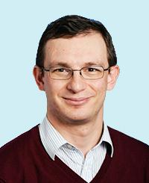
Brief Self Introduction
Onur Mutlu
  Full Professor @ ETH Zurich ITET (INFK), since September 2015
  Strecker Professor @ Carnegie Mellon University ECE/CS, 2009-2016, 2016-…
  PhD from UT-Austin, worked at Google, VMware, Microsoft Research, Intel, AMD
  https://people.inf.ethz.ch/omutlu/
  omutlu@gmail.com (Best way to reach me)
  https://people.inf.ethz.ch/omutlu/projects.htm
Research and Teaching in:
  Computer architecture, computer systems, hardware security, bioinformatics
  Memory and storage systems
  Hardware security, safety, predictability
  Fault tolerance
  Hardware/software cooperation
  Architectures for bioinformatics, health, medicine
  …

Slide 3
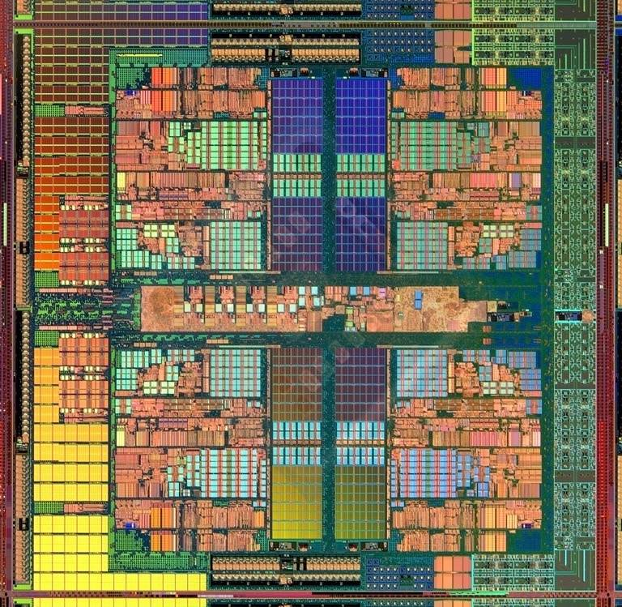
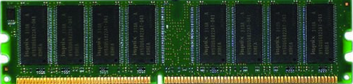
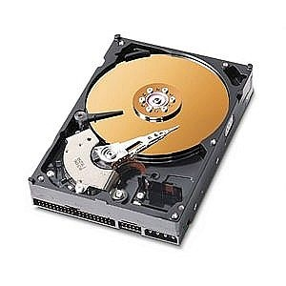
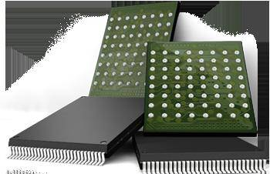
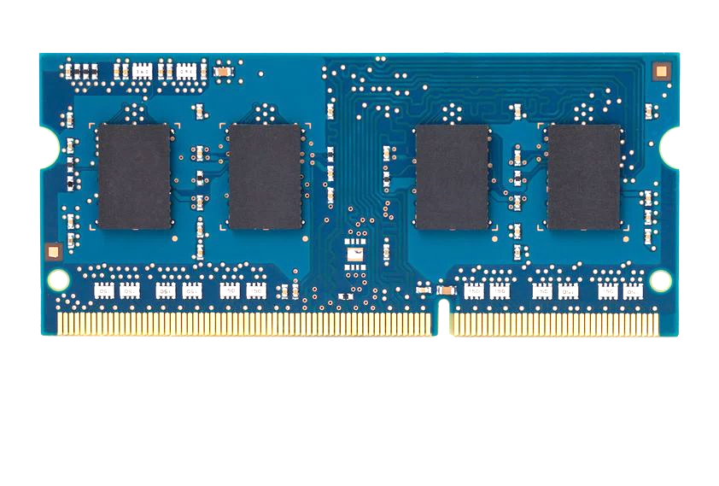
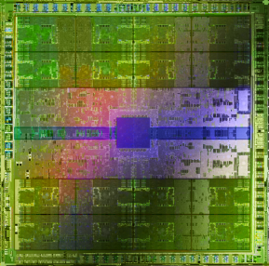
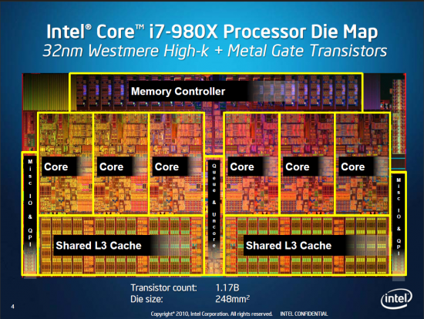
Current Research Mission
Computer architecture, HW/SW, systems, bioinformatics, security
Hybrid Main Memory
Heterogeneous
Processors and
Accelerators
Persistent Memory/Storage
Graphics and Vision Processing
Build fundamentally better architectures
Notes:
Professor Mutlu’s research focus is all aspects of computer architecture, HW/SW interaction and bioinformatics.
He is looking for students to perform research in these areas.
He and his group, SAFARI, solve fundamental problems spanning:
Memory, memory, memory, storage, interconnects
Parallel architectures, heterogeneous architectures, GP-GPUs
System/architecture interaction, new execution models
Energy efficiency, fault tolerance, hardware security
Genome sequence analysis and assembly
His group does broad research spanning systems to logic with architecture at center

Slide 4
Four Key Current Directions
Fundamentally Secure/Reliable/Safe Architectures
Fundamentally Energy-Efficient Architectures
  Memory-centric (Data-centric) Architectures
Fundamentally Low-Latency and Predictable Architectures
Architectures for AI/ML, Genomics, Medicine, Health

Slide 5
The Transformation Hierarchy
Problem
Algorithm
Program/Language
System Software
Computer Architecture (expanded view)
SW/HW Interface
Computer Architecture (narrow view)
Micro-architecture
Logic
Devices
Electrons

Slide 6
Axiom
To achieve the highest energy efficiency and performance:
we must take the expanded view
of computer architecture
Problem
Algorithm
Program/Language
System Software
Co-design across the hierarchy:
Algorithms to devices
SW/HW Interface
Micro-architecture
Logic
Specialize as much as possible
within the design goals
Devices
Electrons

Slide 7
Current Research Mission & Major Topics
Build fundamentally better architectures
Data-centric arch. for low energy & high perf.
  Proc. in Mem/DRAM, NVM, unified mem/storage
Low-latency & predictable architectures
  Low-latency, low-energy yet low-cost memory
  QoS-aware and predictable memory systems
Fundamentally secure/reliable/safe arch.
  Tolerating all bit flips; patchable HW; secure mem
Architectures for ML/AI/Genomics/Graph/Med
  Algorithm/arch./logic co-design; full heterogeneity
Data-driven and data-aware architectures
  ML/AI-driven architectural controllers and design
  Expressive memory and expressive systems
Problem
Algorithm
Program/Language
System Software
SW/HW Interface
Micro-architecture
Logic
Devices
Electrons
Broad research
spanning apps, systems, logic
with architecture at the center

Slide 8
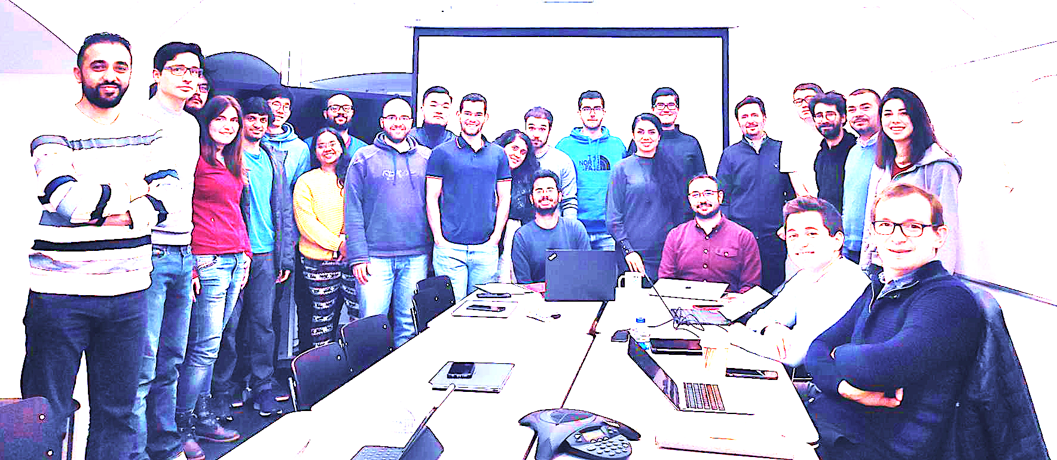

Onur Mutlu’s SAFARI Research Group
Computer architecture, HW/SW, systems, bioinformatics, security, memory
https://safari.ethz.ch/safari-newsletter-april-2020/
38+ Researchers
Think BIG, Aim HIGH!
https://safari.ethz.ch

Slide 9
Principle: Teaching and Research
…
Teaching drives Research
Research drives Teaching
…

Slide 10
Principle: Insight and Ideas
Focus on Insight
Encourage New Ideas

Slide 11
Research & Teaching: Some Overview Talks
https://www.youtube.com/onurmutlulectures
Future Computing Architectures
  https://www.youtube.com/watch?v=kgiZlSOcGFM&list=PL5Q2soXY2Zi8D_5MGV6EnXEJHnV2YFBJl&index=1
Enabling In-Memory Computation
  https://www.youtube.com/watch?v=njX_14584Jw&list=PL5Q2soXY2Zi8D_5MGV6EnXEJHnV2YFBJl&index=16
Accelerating Genome Analysis
  https://www.youtube.com/watch?v=hPnSmfwu2-A&list=PL5Q2soXY2Zi8D_5MGV6EnXEJHnV2YFBJl&index=9
Rethinking Memory System Design
  https://www.youtube.com/watch?v=F7xZLNMIY1E&list=PL5Q2soXY2Zi8D_5MGV6EnXEJHnV2YFBJl&index=3
Intelligent Architectures for Intelligent Machines
  https://www.youtube.com/watch?v=n8Aj_A0WSg8&list=PL5Q2soXY2Zi8D_5MGV6EnXEJHnV2YFBJl&index=22

Slide 12
An Interview on Research and Education
Computing Research and Education (@ ISCA 2019)
  https://www.youtube.com/watch?v=8ffSEKZhmvo&list=PL5Q2soXY2Zi_4oP9LdL3cc8G6NIjD2Ydz
Maurice Wilkes Award Speech (10 minutes)
  https://www.youtube.com/watch?v=tcQ3zZ3JpuA&list=PL5Q2soXY2Zi8D_5MGV6EnXEJHnV2YFBJl&index=15

Slide 13
More Thoughts and Suggestions
Onur Mutlu,
"Some Reflections (on DRAM)"
Award Speech for ACM SIGARCH Maurice Wilkes Award, at the ISCA Awards Ceremony, Phoenix, AZ, USA, 25 June 2019.
[Slides (pptx) (pdf)]
[Video of Award Acceptance Speech (Youtube; 10 minutes) (Youku; 13 minutes)]
[Video of Interview after Award Acceptance (Youtube; 1 hour 6 minutes) (Youku; 1 hour 6 minutes)]
[News Article on "ACM SIGARCH Maurice Wilkes Award goes to Prof. Onur Mutlu"]
Onur Mutlu,
"How to Build an Impactful Research Group"
57th Design Automation Conference Early Career Workshop (DAC), Virtual, 19 July 2020.
[Slides (pptx) (pdf)]

Slide 14
Why Study Computer Architecture?

Slide 15
Computer Architecture
is the science and art of designing computing platforms (hardware, interface, system SW, and programming model)
to achieve a set of design goals
  E.g., highest performance on earth on workloads X, Y, Z
  E.g., longest battery life at a form factor that fits in your pocket with cost < $$$ CHF
  E.g., best average performance across all known workloads at the best performance/cost ratio
  …
  Designing a supercomputer is different from designing a smartphone → But, many fundamental principles are similar

Slide 16
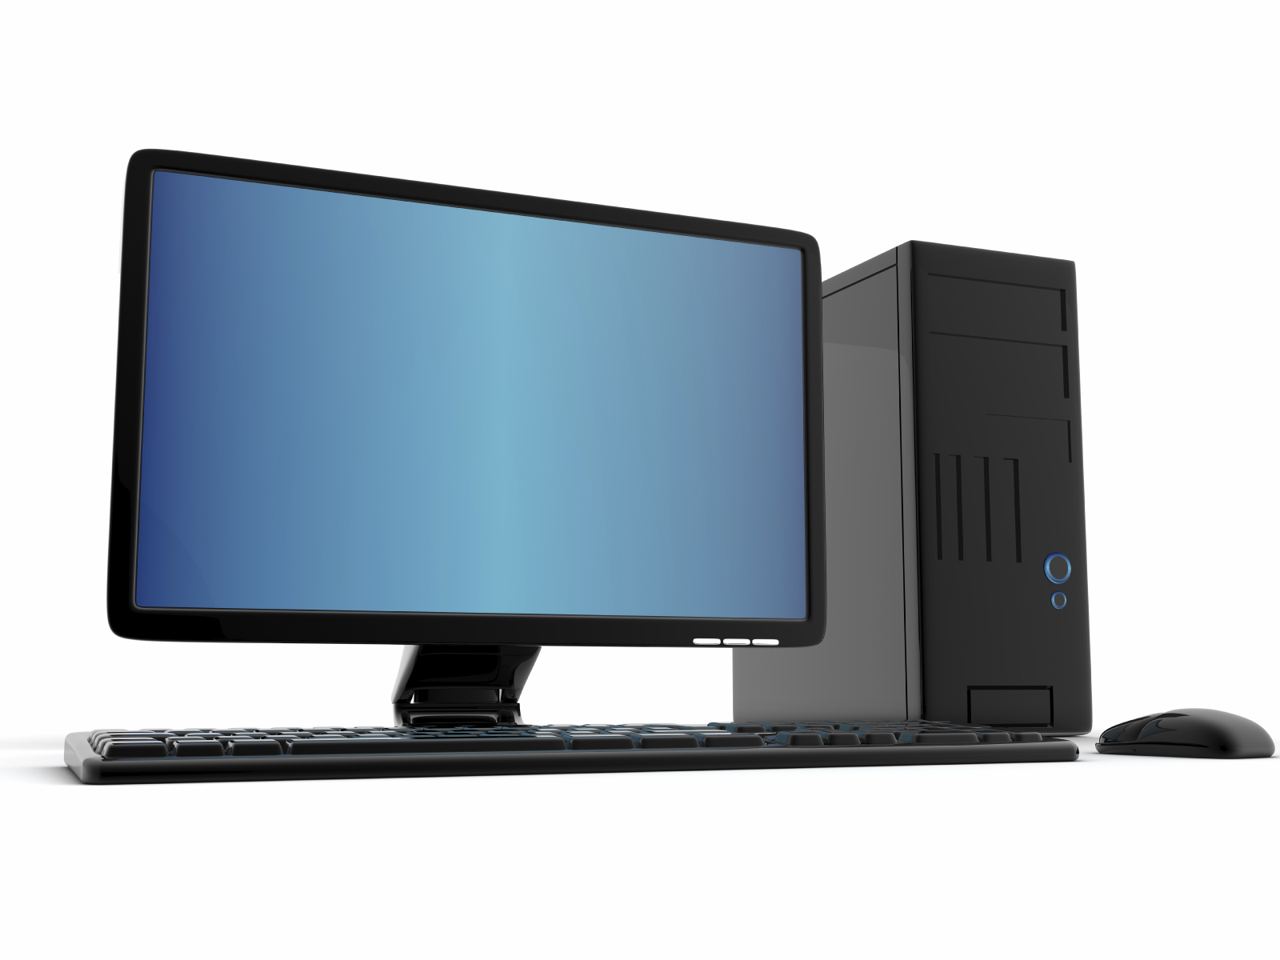
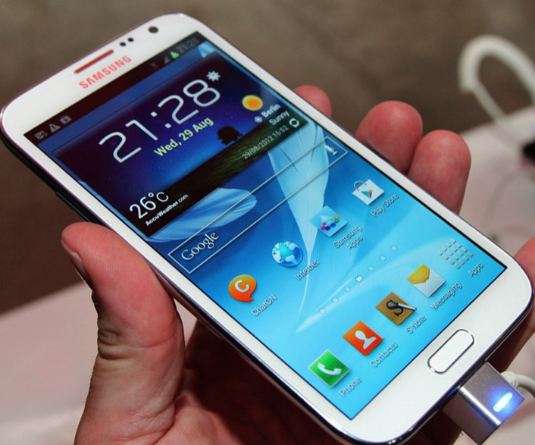
Different Platforms, Different Goals
Source: http://www.sia-online.org (semiconductor industry association)

Slide 17
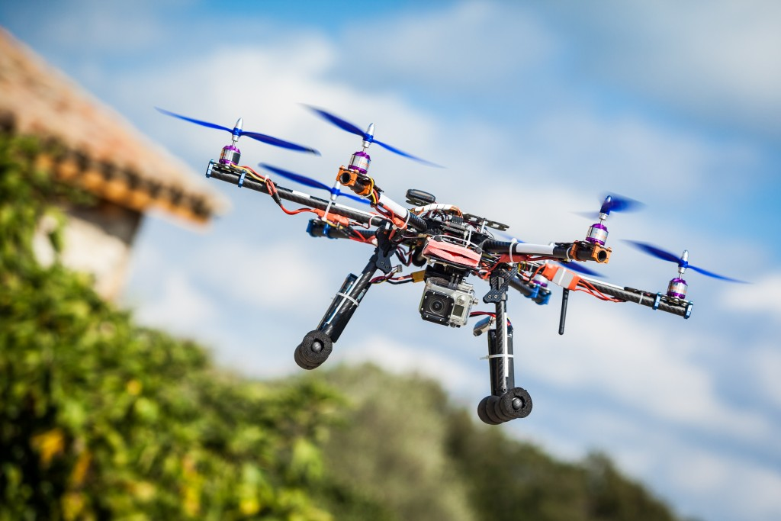
Different Platforms, Different Goals
Source: https://iq.intel.com/5-awesome-uses-for-drone-technology/

Slide 18
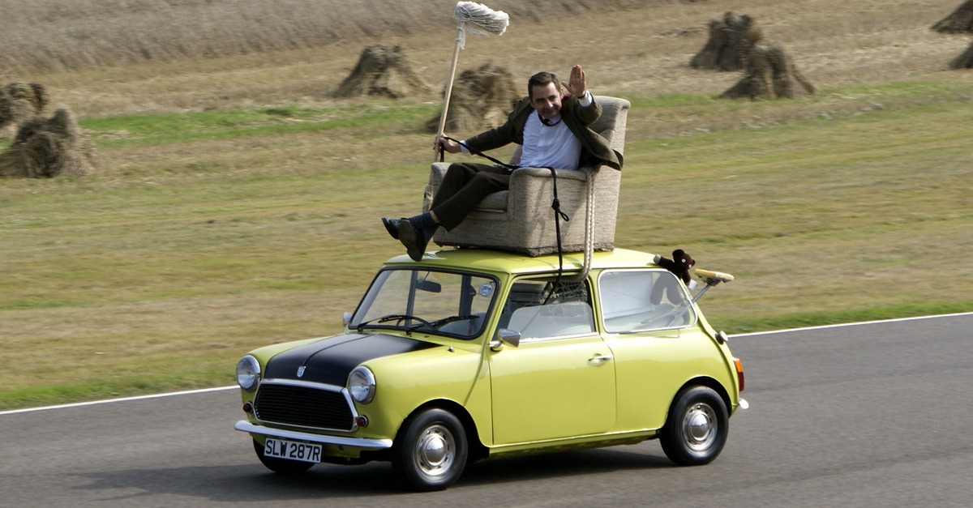
Different Platforms, Different Goals
Source: https://taxistartup.com/wp-content/uploads/2015/03/UK-Self-Driving-Cars.jpg

Slide 19
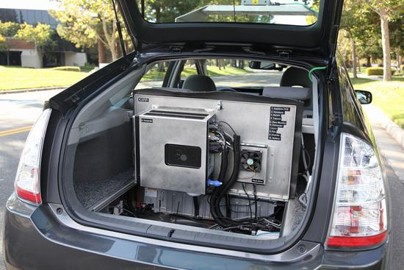
Different Platforms, Different Goals
Source: http://sm.pcmag.com/pcmag_uk/photo/g/google-self-driving-car-the-guts/google-self-driving-car-the-guts_dwx8.jpg

Slide 20
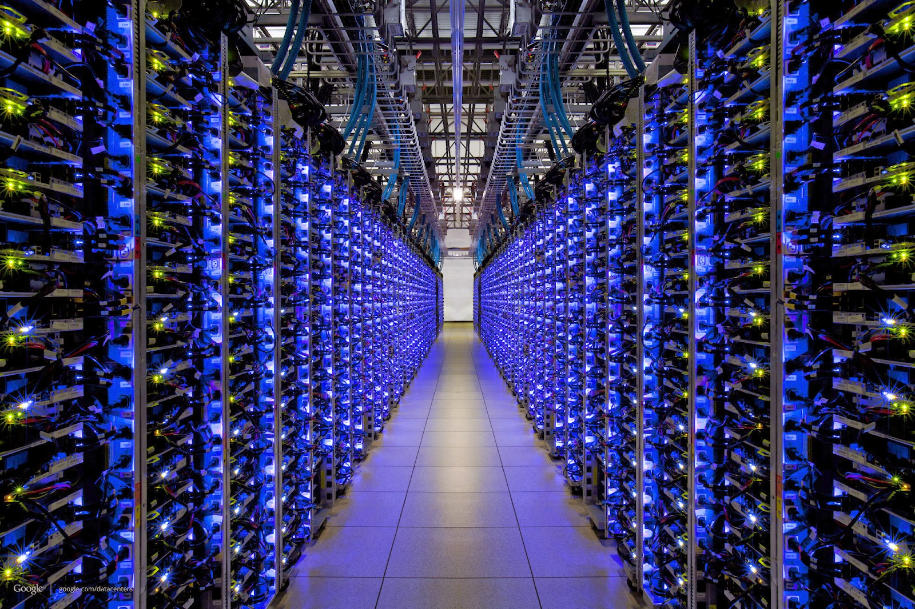
Different Platforms, Different Goals
Source: http://datacentervoice.com/wp-content/uploads/2015/10/data-center.jpg

Slide 21

Different Platforms, Different Goals
Source: https://fossbytes.com/wp-content/uploads/2015/06/Supercomputer-TIANHE2-china.jpg

Slide 22
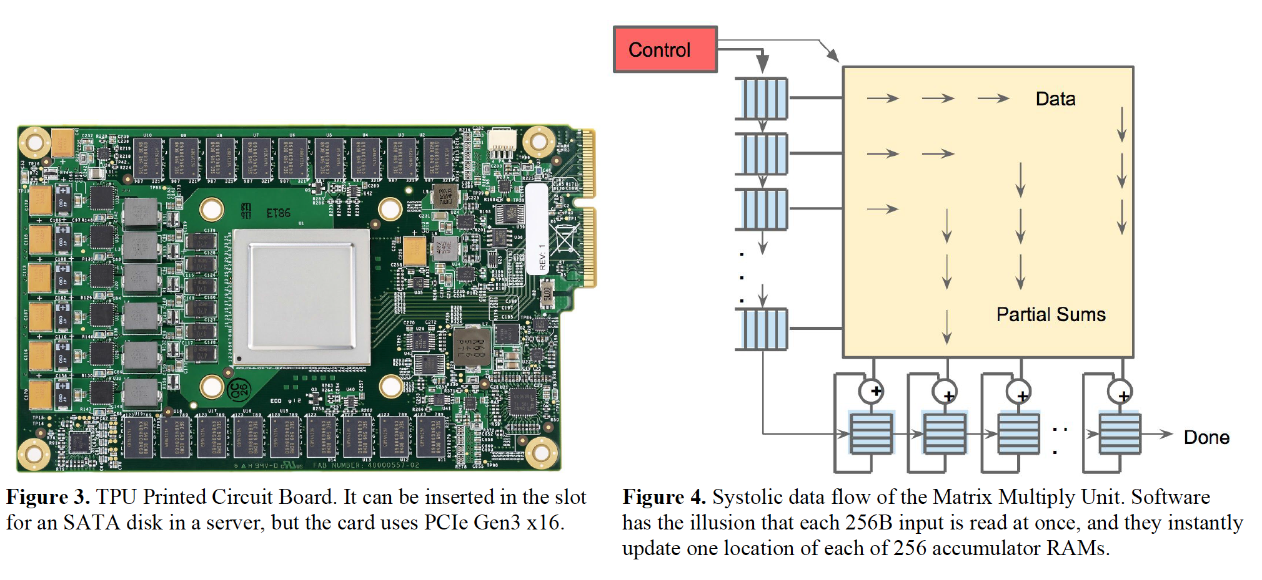
Different Platforms, Different Goals
Jouppi et al., “In-Datacenter Performance Analysis of a Tensor Processing Unit”, ISCA 2017.

Slide 23
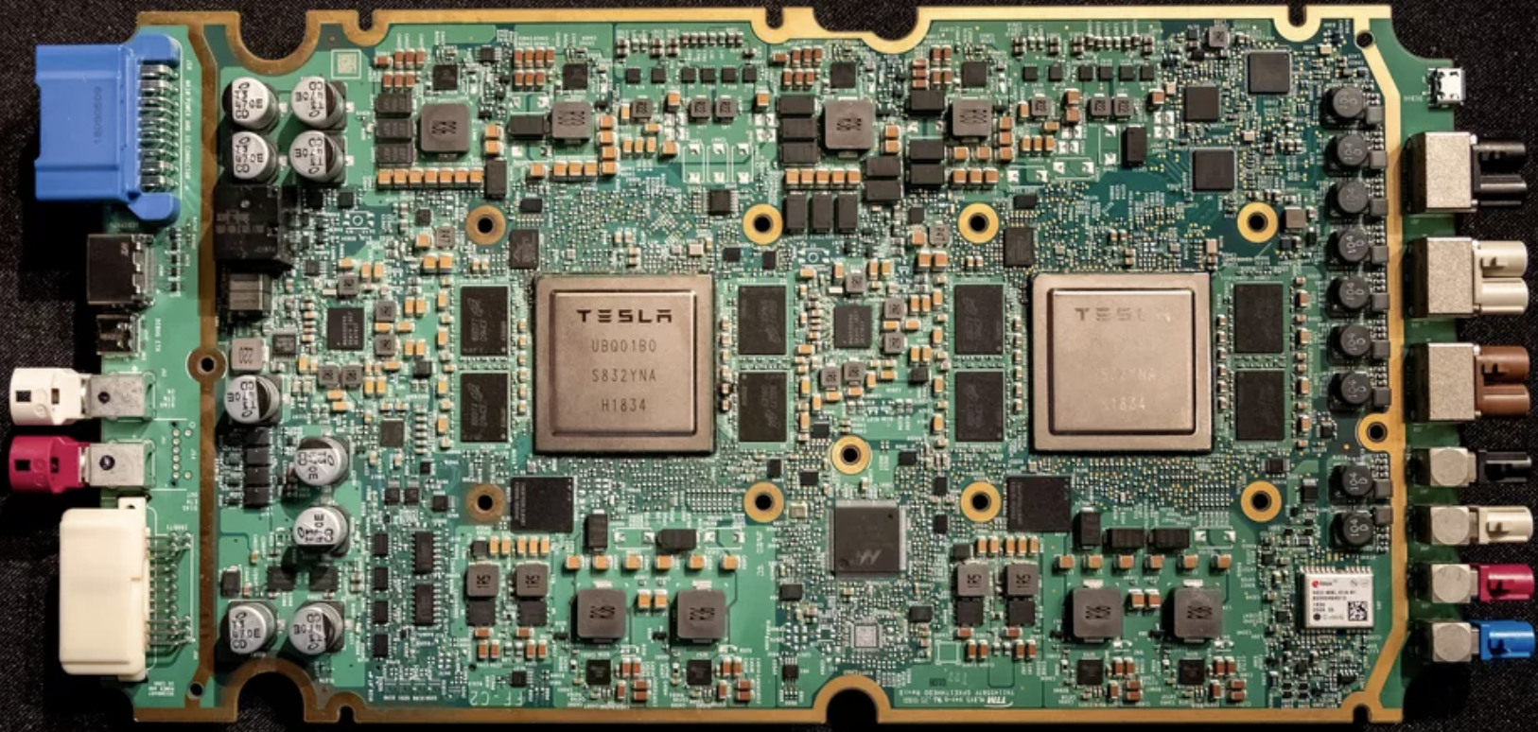
Different Platforms, Different Goals
ML accelerator: 260 mm², 6 billion transistors, 600 GFLOPS GPU, 12 ARM 2.2 GHz CPUs.
Two redundant chips for better safety.
https://youtu.be/Ucp0TTmvqOE?t=4236

Slide 24
What is Computer Architecture?
The science and art of designing, selecting, and interconnecting hardware components and designing the hardware/software interface to create a computing system that meets functional, performance, energy consumption, cost, and other specific goals.

Slide 25
The Transformation Hierarchy
Problem
Algorithm
Program/Language
System Software
Computer Architecture (expanded view)
SW/HW Interface
Computer Architecture (narrow view)
Micro-architecture
Logic
Devices
Electrons

Slide 26
Why Study Computer Architecture?
Enable better systems: make computers faster, cheaper, smaller, more reliable, …
  By exploiting advances and changes in underlying technology/circuits
Enable new applications
  Life-like 3D visualization 20 years ago? Virtual reality?
  Self-driving cars?
  Personalized genomics? Personalized medicine?
Enable better solutions to problems
  Software innovation is built on trends and changes in computer architecture
    > 50% performance improvement per year has enabled this innovation
Understand why computers work the way they do

Slide 27
Computer Architecture Today (I)
Today is a very exciting time to study computer architecture
Industry is in a large paradigm shift (to novel architectures) – many different potential system designs possible
Many difficult problems motivating and caused by the shift
  Huge hunger for data and new data-intensive applications
  Power/energy/thermal constraints
  Complexity of design
  Difficulties in technology scaling
  Memory bottleneck
  Reliability problems
  Programmability problems
  Security and privacy issues
No clear, definitive answers to these problems

Slide 28
Computer Architecture Today (II)
These problems affect all parts of the computing stack – if we do not change the way we design systems
No clear, definitive answers to these problems
Many new demands
from the top
(Look Up)
Problem
Algorithm
Program/Language
User
Fast changing
demands and
personalities
of users
(Look Up)
Runtime System
(VM, OS, MM)
ISA
Microarchitecture
Many new issues
at the bottom
(Look Down)
Logic
Circuits
Electrons

Slide 29
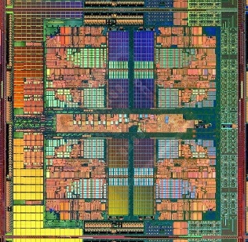

Computer Architecture Today (III)
Computing landscape is very different from 10-20 years ago
Both UP (software and humanity trends) and DOWN (technologies and their issues), FORWARD and BACKWARD, and the resulting requirements and constraints
Hybrid Main Memory
Heterogeneous
Processors and
Accelerators
Persistent Memory/Storage
Every component and its
interfaces, as well as
entire system designs
are being re-examined
General Purpose GPUs

Slide 30
Axiom
To achieve the highest energy efficiency and performance:
we must take the expanded view
of computer architecture
Problem
Algorithm
Program/Language
System Software
Co-design across the hierarchy:
Algorithms to devices
SW/HW Interface
Micro-architecture
Logic
Specialize as much as possible
within the design goals
Devices
Electrons

Slide 31
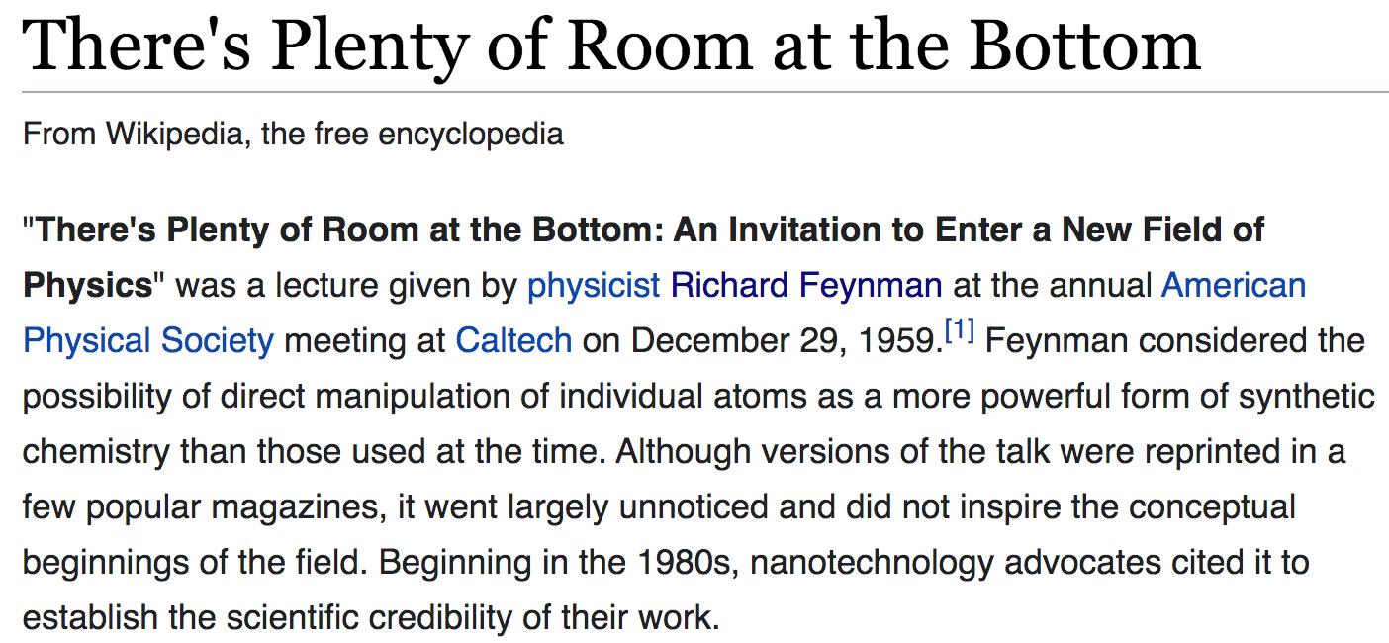
Historical: Opportunities at the Bottom
https://en.wikipedia.org/wiki/There%27s_Plenty_of_Room_at_the_Bottom

Slide 32
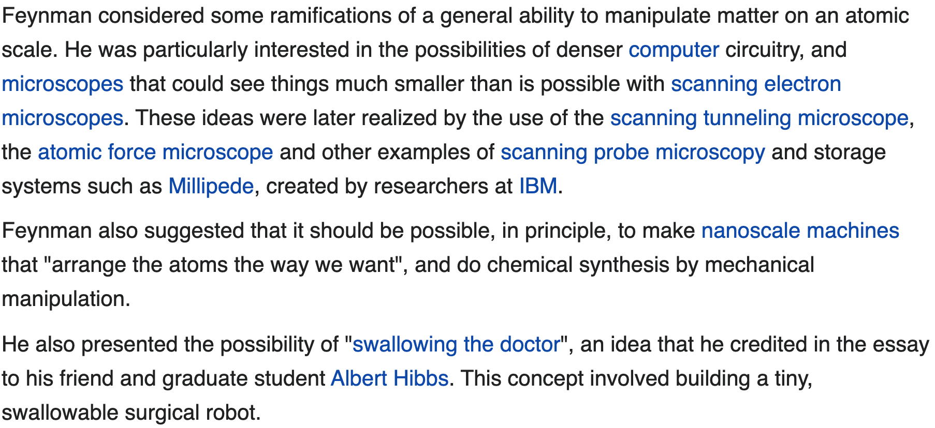
Historical: Opportunities at the Bottom (II)
https://en.wikipedia.org/wiki/There%27s_Plenty_of_Room_at_the_Bottom

Slide 33
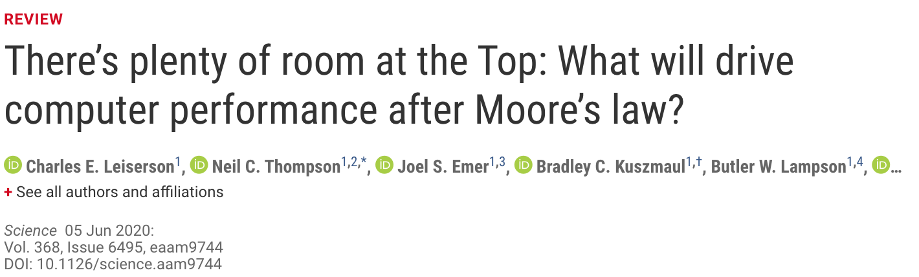
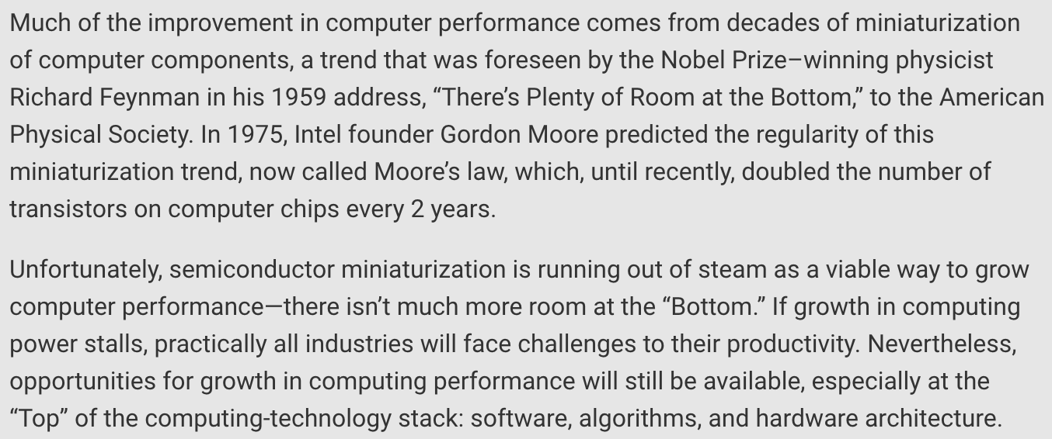
Historical: Opportunities at the Top
https://science.sciencemag.org/content/368/6495/eaam9744

Slide 34
Axiom, Revisited
There is plenty of room both at the top and at the bottom
but much more so
when you communicate well between and optimize across
the top and the bottom.

Slide 35
Hence the Expanded View
Problem
Algorithm
Program/Language
System Software
Computer Architecture (expanded view)
SW/HW Interface
Micro-architecture
Logic
Devices
Electrons

Slide 36
Some Cross-Layer Design Examples
(Foreshadowing)

Slide 37
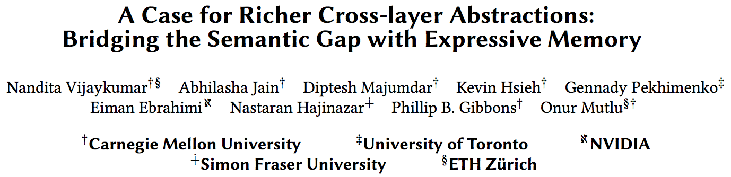
Expressive (Memory) Interfaces
Nandita Vijaykumar, Abhilasha Jain, Diptesh Majumdar, Kevin Hsieh, Gennady Pekhimenko, Eiman Ebrahimi, Nastaran Hajinazar, Phillip B. Gibbons and Onur Mutlu,
"A Case for Richer Cross-layer Abstractions: Bridging the Semantic Gap with Expressive Memory"
Proceedings of the 45th International Symposium on Computer Architecture (ISCA), Los Angeles, CA, USA, June 2018.
[Slides (pptx) (pdf)] [Lightning Talk Slides (pptx) (pdf)]
[Lightning Talk Video]

Slide 38
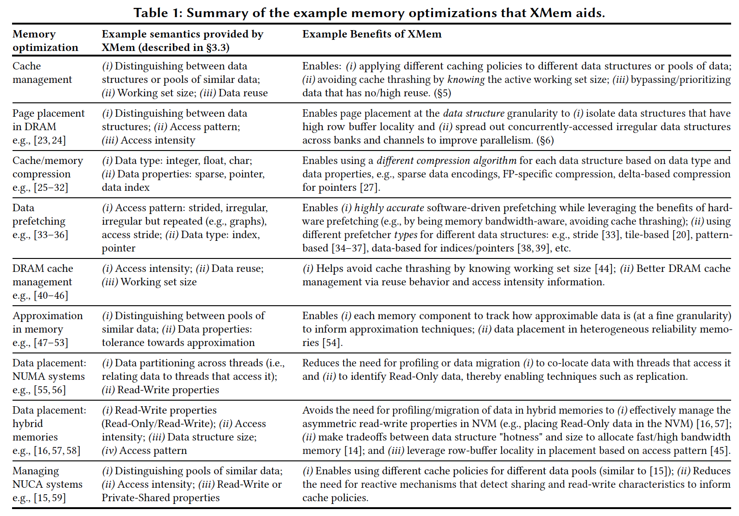
X-MeM Aids Many Optimizations

Slide 39
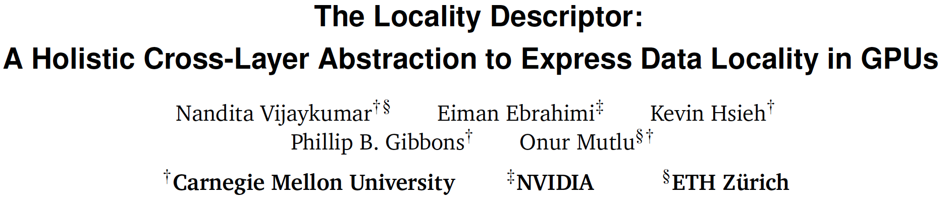
Expressive (Memory) Interfaces for GPUs
Nandita Vijaykumar, Eiman Ebrahimi, Kevin Hsieh, Phillip B. Gibbons and Onur Mutlu,
"The Locality Descriptor: A Holistic Cross-Layer Abstraction to Express Data Locality in GPUs"
Proceedings of the 45th International Symposium on Computer Architecture (ISCA), Los Angeles, CA, USA, June 2018.
[Slides (pptx) (pdf)] [Lightning Talk Slides (pptx) (pdf)]
[Lightning Talk Video]

Slide 40
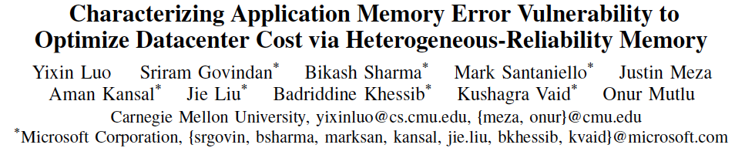
Heterogeneous-Reliability Memory
Yixin Luo, Sriram Govindan, Bikash Sharma, Mark Santaniello, Justin Meza, Aman Kansal, Jie Liu, Badriddine Khessib, Kushagra Vaid, and Onur Mutlu,
"Characterizing Application Memory Error Vulnerability to Optimize Data Center Cost via Heterogeneous-Reliability Memory"
Proceedings of the 44th Annual IEEE/IFIP International Conference on Dependable Systems and Networks (DSN), Atlanta, GA, June 2014. [Summary] [Slides (pptx) (pdf)] [Coverage on ZDNet]

Slide 41
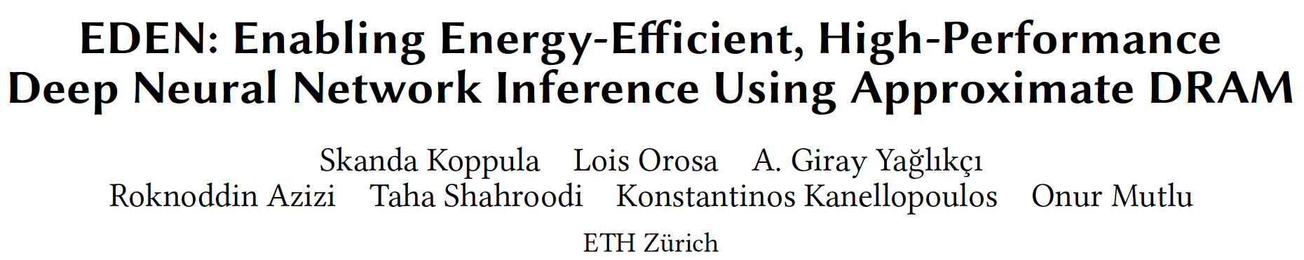
EDEN: Data-Aware Efficient DNN Inference
Skanda Koppula, Lois Orosa, A. Giray Yaglikci, Roknoddin Azizi, Taha Shahroodi, Konstantinos Kanellopoulos, and Onur Mutlu,
"EDEN: Enabling Energy-Efficient, High-Performance Deep Neural Network Inference Using Approximate DRAM"
Proceedings of the 52nd International Symposium on Microarchitecture (MICRO), Columbus, OH, USA, October 2019.
[Slides (pptx) (pdf)]
[Lightning Talk Slides (pptx) (pdf)]
[Poster (pptx) (pdf)]
[Lightning Talk Video (90 seconds)]
[Full Talk Lecture (38 minutes)]

Slide 42
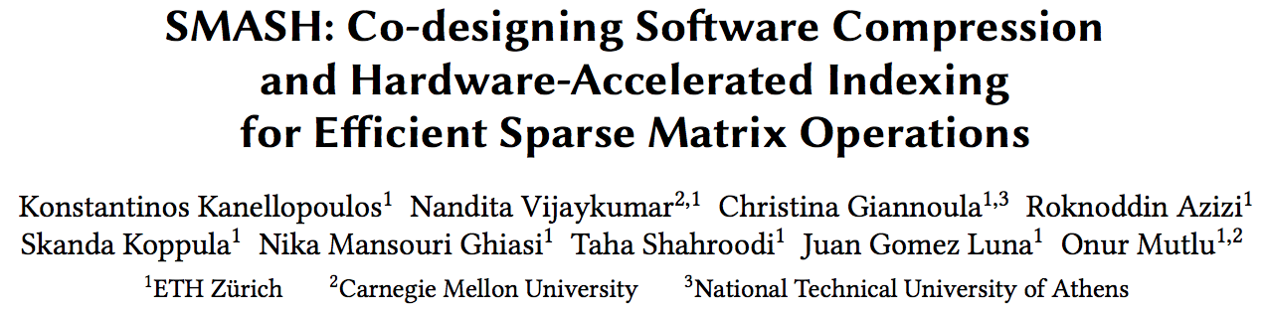
SMASH: SW/HW Indexing Acceleration
Konstantinos Kanellopoulos, Nandita Vijaykumar, Christina Giannoula, Roknoddin Azizi, Skanda Koppula, Nika Mansouri Ghiasi, Taha Shahroodi, Juan Gomez-Luna, and Onur Mutlu,
"SMASH: Co-designing Software Compression and Hardware-Accelerated Indexing for Efficient Sparse Matrix Operations"
Proceedings of the 52nd International Symposium on Microarchitecture (MICRO), Columbus, OH, USA, October 2019.
[Slides (pptx) (pdf)]
[Lightning Talk Slides (pptx) (pdf)]
[Poster (pptx) (pdf)]
[Lightning Talk Video (90 seconds)]
[Full Talk Lecture (30 minutes)]

Slide 43
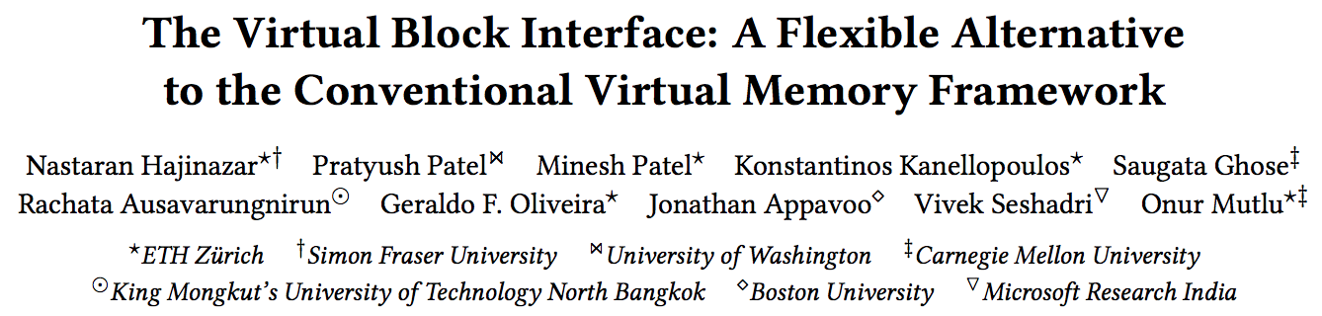
Rethinking Virtual Memory
Nastaran Hajinazar, Pratyush Patel, Minesh Patel, Konstantinos Kanellopoulos, Saugata Ghose, Rachata Ausavarungnirun, Geraldo Francisco de Oliveira Jr., Jonathan Appavoo, Vivek Seshadri, and Onur Mutlu,
"The Virtual Block Interface: A Flexible Alternative to the Conventional Virtual Memory Framework"
Proceedings of the 47th International Symposium on Computer Architecture (ISCA), Valencia, Spain, June 2020.
[Slides (pptx) (pdf)]
[Lightning Talk Slides (pptx) (pdf)]
[ARM Research Summit Poster (pptx) (pdf)]
[Talk Video (26 minutes)]
[Lightning Talk Video (3 minutes)]

Slide 44
Many Interesting Things
Are Happening Today in Computer Architecture

Slide 45
Many Interesting Things
Are Happening Today in Computer Architecture
Performance
and
Energy Efficiency

Slide 46
Intel Optane Persistent Memory (2019)
Non-volatile main memory
Based on 3D-XPoint Technology
https://www.storagereview.com/intel_optane_dc_persistent_memory_module_pmm

Slide 47
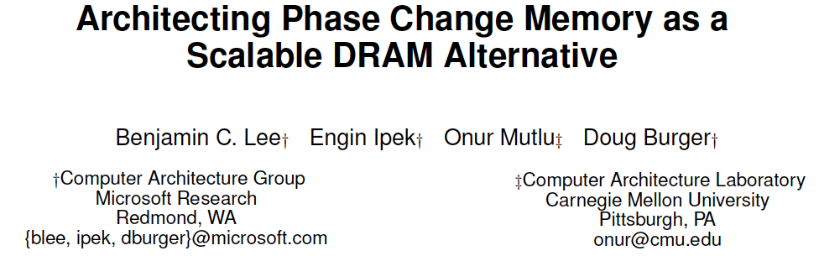
PCM as Main Memory: Idea in 2009
Benjamin C. Lee, Engin Ipek, Onur Mutlu, and Doug Burger,
"Architecting Phase Change Memory as a Scalable DRAM Alternative"
Proceedings of the 36th International Symposium on Computer Architecture (ISCA), pages 2-13, Austin, TX, June 2009. Slides (pdf)

Slide 48
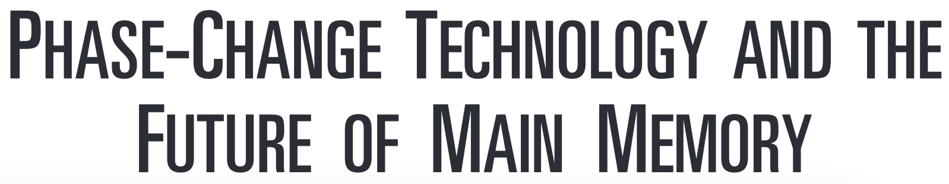
PCM as Main Memory: Idea in 2009
Benjamin C. Lee, Ping Zhou, Jun Yang, Youtao Zhang, Bo Zhao, Engin Ipek, Onur Mutlu, and Doug Burger,
"Phase Change Technology and the Future of Main Memory"
IEEE Micro, Special Issue: Micro's Top Picks from 2009 Computer Architecture Conferences (MICRO TOP PICKS), Vol. 30, No. 1, pages 60-70, January/February 2010.

Slide 49
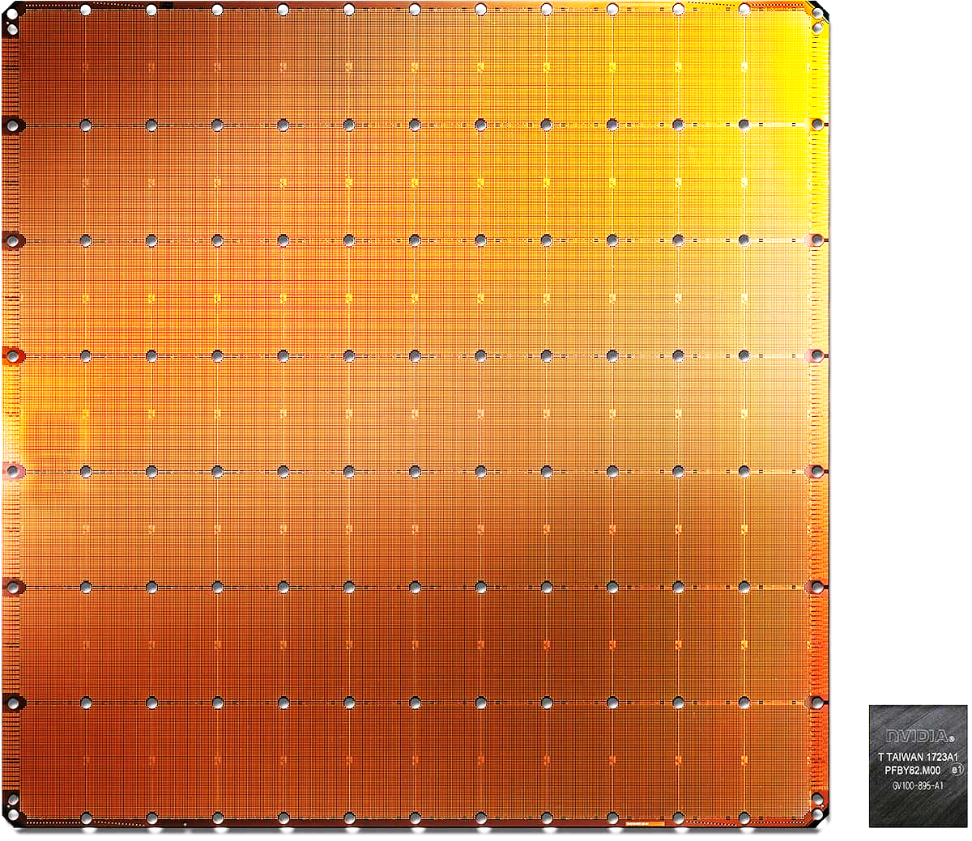
Cerebras’s Wafer Scale Engine (2019)
The largest ML
accelerator chip
400,000 cores
Cerebras WSE
1.2 Trillion transistors
46,225 mm²
Largest GPU
21.1 Billion transistors
815 mm²
NVIDIA TITAN V
https://www.anandtech.com/show/14758/hot-chips-31-live-blogs-cerebras-wafer-scale-deep-learning
https://www.cerebras.net/cerebras-wafer-scale-engine-why-we-need-big-chips-for-deep-learning/
Notes:
The Wafer-Scale Engine is the most massive AI chip ever produced and packs a whopping 400,000 cores in a 46,225mm2 footprint.

Slide 50
UPMEM Processing-in-DRAM Engine (2019)
Processing in DRAM Engine
Includes standard DIMM modules, with a large number of DPU processors combined with DRAM chips.
Replaces standard DIMMs
  DDR4 R-DIMM modules
    8GB+128 DPUs (16 PIM chips)
    Standard 2x-nm DRAM process
  Large amounts of compute & memory bandwidth
https://www.anandtech.com/show/14750/hot-chips-31-analysis-inmemory-processing-by-upmem
https://www.upmem.com/video-upmem-presenting-its-true-processing-in-memory-solution-hot-chips-2019/

Slide 51
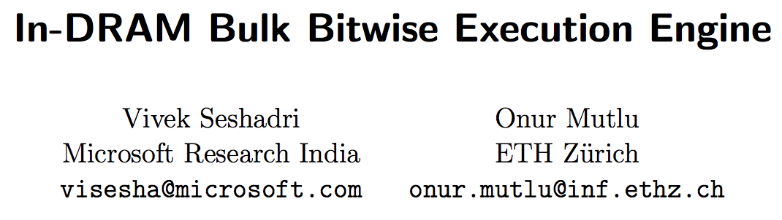
More on Processing in Memory (I)
Vivek Seshadri and Onur Mutlu,
"In-DRAM Bulk Bitwise Execution Engine"
Invited Book Chapter in Advances in Computers, to appear in 2020.
[Preliminary arXiv version]

Slide 52
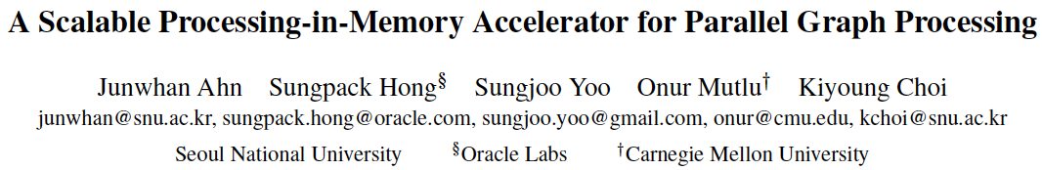
More on Processing in Memory (II)
Junwhan Ahn, Sungpack Hong, Sungjoo Yoo, Onur Mutlu, and Kiyoung Choi,
"A Scalable Processing-in-Memory Accelerator for Parallel Graph Processing"
Proceedings of the 42nd International Symposium on Computer Architecture (ISCA), Portland, OR, June 2015.
[Slides (pdf)] [Lightning Session Slides (pdf)]

Slide 53
More on Processing in Memory (III)
Amirali Boroumand, Saugata Ghose, Youngsok Kim, Rachata Ausavarungnirun, Eric Shiu, Rahul Thakur, Daehyun Kim, Aki Kuusela, Allan Knies, Parthasarathy Ranganathan, and Onur Mutlu,
"Google Workloads for Consumer Devices: Mitigating Data Movement Bottlenecks"
Proceedings of the 23rd International Conference on Architectural Support for Programming Languages and Operating Systems (ASPLOS), Williamsburg, VA, USA, March 2018.

Slide 54
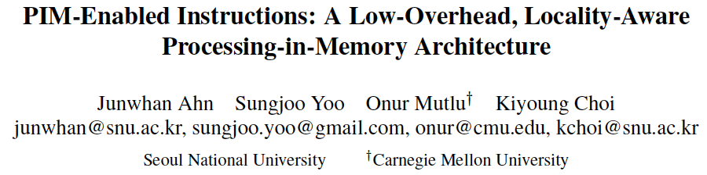
More on Processing in Memory (IV)
Junwhan Ahn, Sungjoo Yoo, Onur Mutlu, and Kiyoung Choi,
"PIM-Enabled Instructions: A Low-Overhead, Locality-Aware Processing-in-Memory Architecture"
Proceedings of the 42nd International Symposium on Computer Architecture (ISCA), Portland, OR, June 2015.
[Slides (pdf)] [Lightning Session Slides (pdf)]

Slide 55
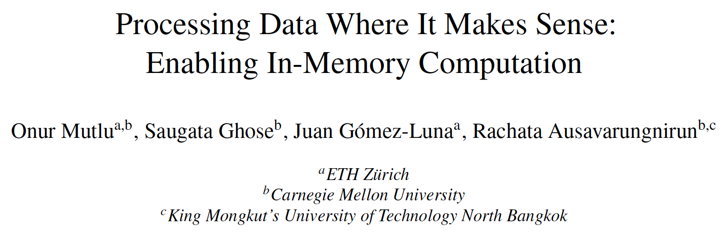
PIM Review and Open Problems (I)
Onur Mutlu, Saugata Ghose, Juan Gomez-Luna, and Rachata Ausavarungnirun,
"Processing Data Where It Makes Sense: Enabling In-Memory Computation"
Invited paper in Microprocessors and Microsystems (MICPRO), June 2019.
[arXiv version]
https://arxiv.org/pdf/1903.03988.pdf

Slide 56
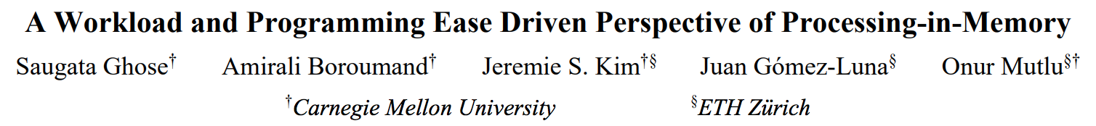
PIM Review and Open Problems (II)
Saugata Ghose, Amirali Boroumand, Jeremie S. Kim, Juan Gomez-Luna, and Onur Mutlu,
"Processing-in-Memory: A Workload-Driven Perspective"
Invited Article in IBM Journal of Research & Development, Special Issue on Hardware for Artificial Intelligence, to appear in November 2019.
[Preliminary arXiv version]
https://arxiv.org/pdf/1907.12947.pdf

Slide 57
TESLA Full Self-Driving Computer (2019)
ML accelerator: 260 mm², 6 billion transistors, 600 GFLOPS GPU, 12 ARM 2.2 GHz CPUs.
Two redundant chips for better safety.
https://youtu.be/Ucp0TTmvqOE?t=4236

Slide 58
Google TPU Generation I (~2016)
Jouppi et al., “In-Datacenter Performance Analysis of a Tensor Processing Unit”, ISCA 2017.

Slide 59
Google TPU Generation II (2017)
4 TPU chips
vs 1 chip in TPU1
High Bandwidth Memory
vs DDR3
Floating point operations
vs FP16
45 TFLOPS per chip
vs 23 TOPS
https://www.nextplatform.com/2017/05/17/first-depth-look-googles-new-second-generation-tpu/
Designed for training
and inference
vs only inference

Slide 60
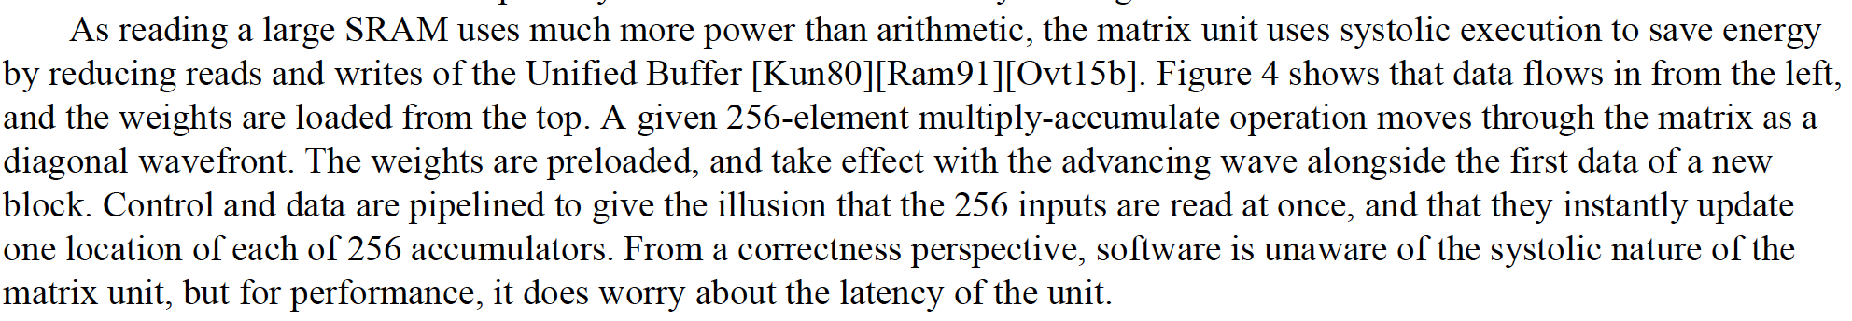
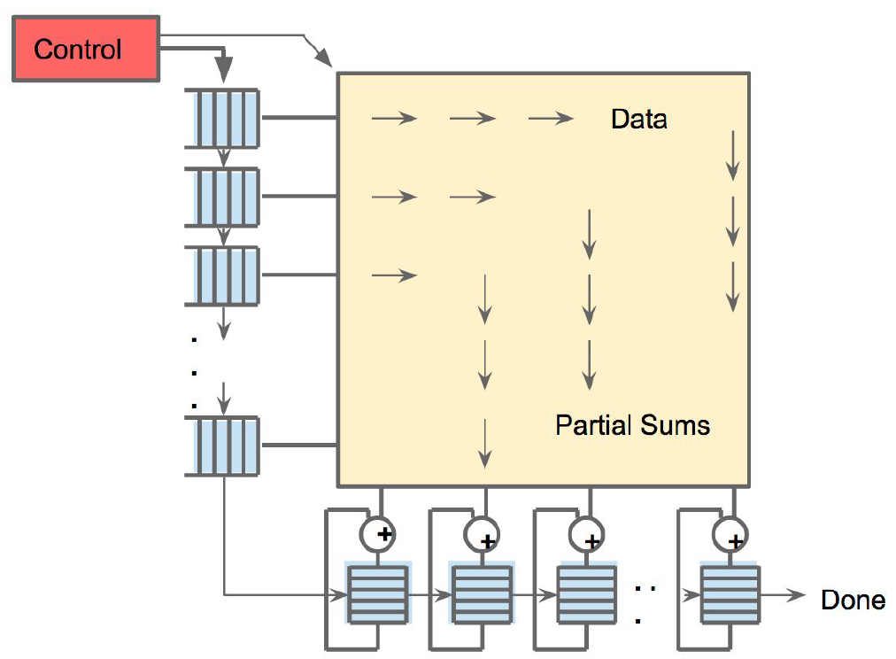
An Example Modern Systolic Array: TPU (II)
Jouppi et al., “In-Datacenter Performance Analysis of a Tensor Processing Unit”, ISCA 2017.

Slide 61
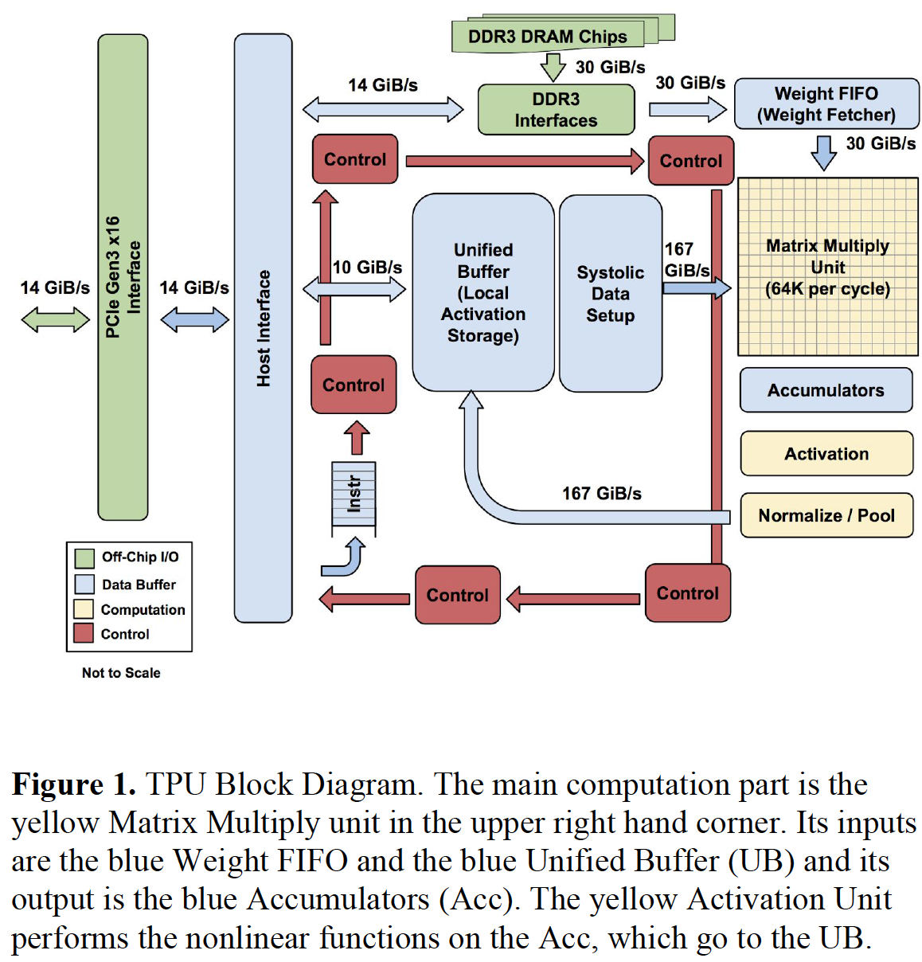
An Example Modern Systolic Array: TPU (III)

Slide 62
Many (Other) AI/ML Chips
Alibaba
Amazon
Facebook
Google
Huawei
Intel
Microsoft
NVIDIA
Tesla
Many Others and Many Startups…
Many More to Come…

Slide 63
Many (Other) AI/ML Chips
Alibaba
Amazon
Facebook
Google
Huawei
Microsoft
NVIDIA
Tesla
Many Startups…
Many More to Come…
https://basicmi.github.io/AI-Chip/

Slide 64
Many Interesting Things
Are Happening Today in Computer Architecture

Slide 65
Many Interesting Things
Are Happening Today in Computer Architecture
Reliability
and
Security

Slide 66
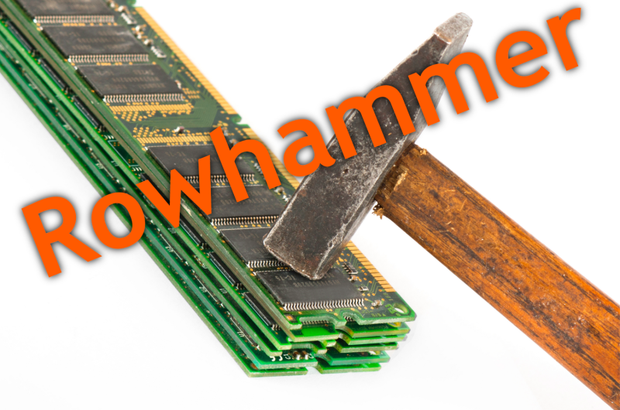
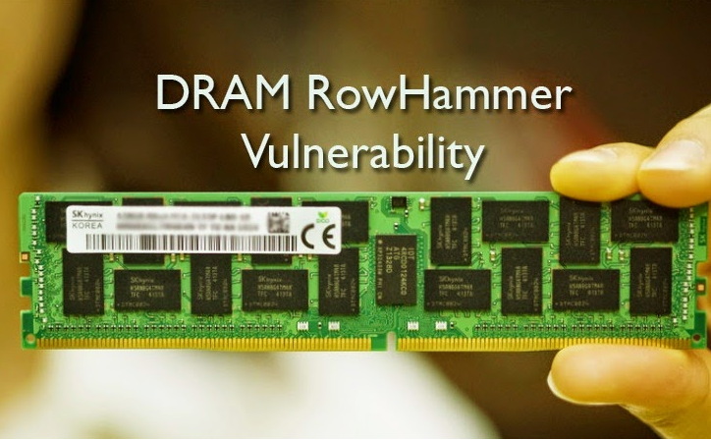
Security: RowHammer (2014)
Notes:
Picture from the article:
http://thehackernews.com/2015/03/dram-rowhammer-vulnerability.html

Slide 67
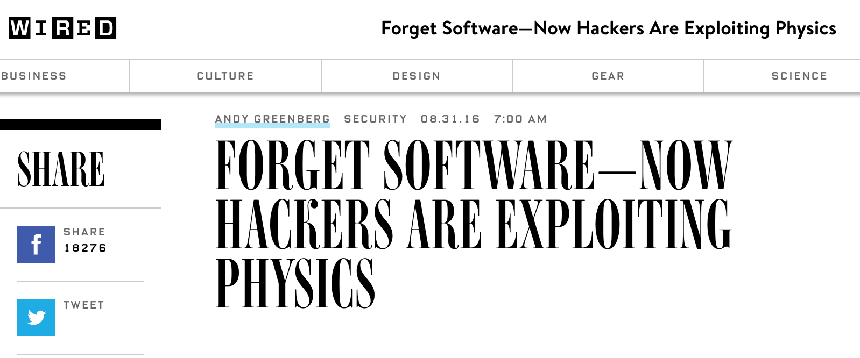
The Story of RowHammer
One can predictably induce bit flips in commodity DRAM chips
  >80% of the tested DRAM chips are vulnerable
First example of how a simple hardware failure mechanism can create a widespread system security vulnerability

Slide 68
Modern DRAM is Prone to Disturbance Errors
Row of Cells
Wordline
Row
Victim Row
Row
Hammered Row
V_{LOW}
Opened
V_{HIGH}
Closed
Row
Victim Row
Row
Repeatedly reading a row enough times (before memory gets refreshed) induces disturbance errors in adjacent rows in most real DRAM chips you can buy today
Flipping Bits in Memory Without Accessing Them: An Experimental Study of DRAM Disturbance Errors, (Kim et al., ISCA 2014)

Slide 69
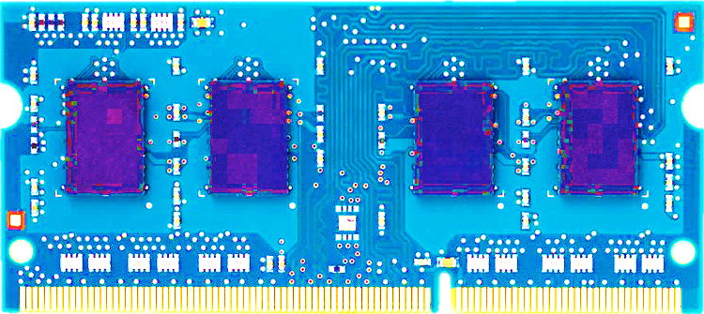
Most DRAM Modules Are Vulnerable
A company
B company
C company
86%
(37/43)
83%
(45/54)
88%
(28/32)
Up to
1.0×10⁷
errors
Up to
2.7×10⁶
errors
Up to
3.3×10⁵
errors
Flipping Bits in Memory Without Accessing Them: An Experimental Study of DRAM Disturbance Errors, (Kim et al., ISCA 2014)

Slide 70


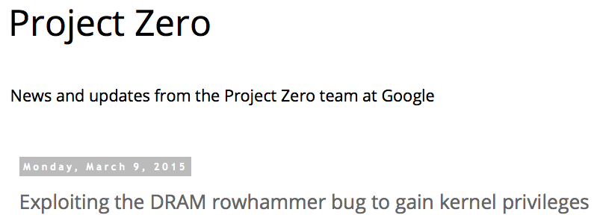
One Can Take Over an Otherwise-Secure System
Flipping Bits in Memory Without Accessing Them: An Experimental Study of DRAM Disturbance Errors (Kim et al., ISCA 2014)
Exploiting the DRAM rowhammer bug to gain kernel privileges (Seaborn, 2015)

Slide 71
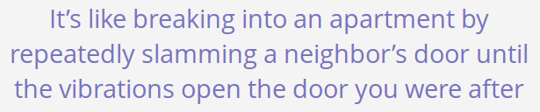
Security: RowHammer (2014)
Notes:
Picture from the article:
http://thehackernews.com/2015/03/dram-rowhammer-vulnerability.html

Slide 72
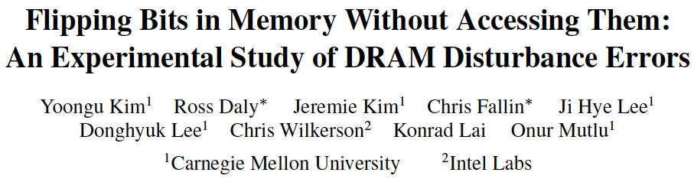
RowHammer: Five Years Ago…
Yoongu Kim, Ross Daly, Jeremie Kim, Chris Fallin, Ji Hye Lee, Donghyuk Lee, Chris Wilkerson, Konrad Lai, and Onur Mutlu,
"Flipping Bits in Memory Without Accessing Them: An Experimental Study of DRAM Disturbance Errors"
Proceedings of the 41st International Symposium on Computer Architecture (ISCA), Minneapolis, MN, June 2014.
[Slides (pptx) (pdf)] [Lightning Session Slides (pptx) (pdf)] [Source Code and Data]

Slide 73
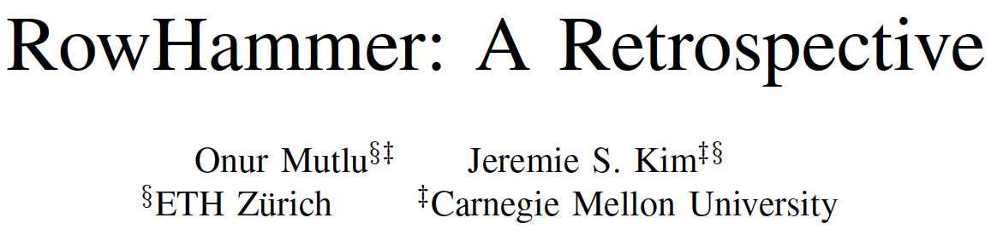
RowHammer: Now and Beyond…
Onur Mutlu and Jeremie Kim,
"RowHammer: A Retrospective"
IEEE Transactions on Computer-Aided Design of Integrated Circuits and Systems (TCAD) Special Issue on Top Picks in Hardware and Embedded Security, 2019.
[Preliminary arXiv version]

Slide 74
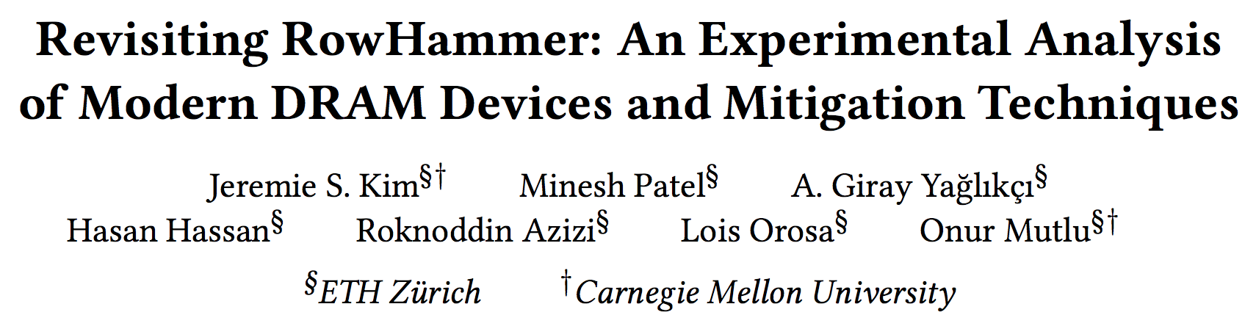
RowHammer in 2020 (I)
Jeremie S. Kim, Minesh Patel, A. Giray Yaglikci, Hasan Hassan, Roknoddin Azizi, Lois Orosa, and Onur Mutlu,
"Revisiting RowHammer: An Experimental Analysis of Modern Devices and Mitigation Techniques"
Proceedings of the 47th International Symposium on Computer Architecture (ISCA), Valencia, Spain, June 2020.
[Slides (pptx) (pdf)]
[Lightning Talk Slides (pptx) (pdf)]
[Talk Video (20 minutes)]
[Lightning Talk Video (3 minutes)]

Slide 75
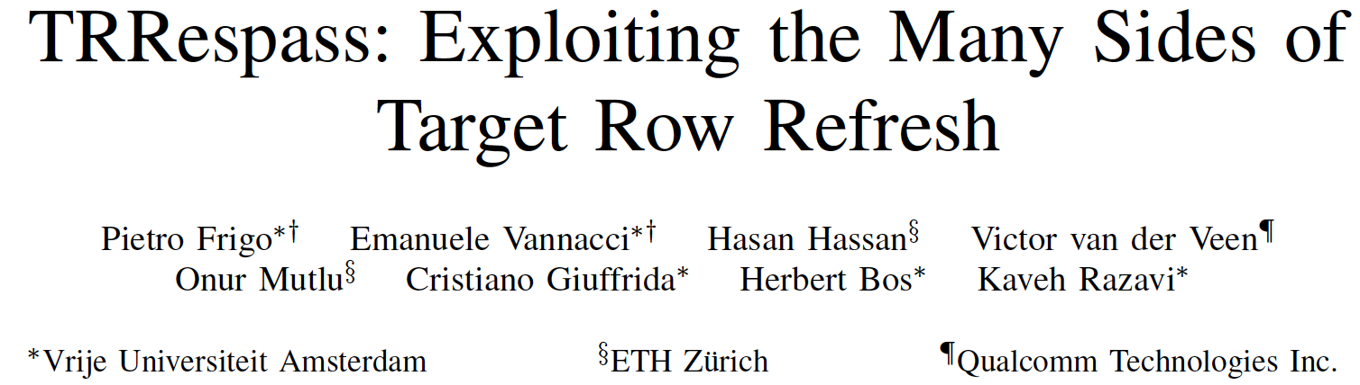
RowHammer in 2020 (II)
Pietro Frigo, Emanuele Vannacci, Hasan Hassan, Victor van der Veen, Onur Mutlu, Cristiano Giuffrida, Herbert Bos, and Kaveh Razavi,
"TRRespass: Exploiting the Many Sides of Target Row Refresh"
Proceedings of the 41st IEEE Symposium on Security and Privacy (S&P), San Francisco, CA, USA, May 2020.
[Slides (pptx) (pdf)]
[Talk Video (17 minutes)]
[Source Code]
[Web Article]
Best paper award.

Slide 76

RowHammer in 2020 (III)
Lucian Cojocar, Jeremie Kim, Minesh Patel, Lillian Tsai, Stefan Saroiu, Alec Wolman, and Onur Mutlu,
"Are We Susceptible to Rowhammer? An End-to-End Methodology for Cloud Providers"
Proceedings of the 41st IEEE Symposium on Security and Privacy (S&P), San Francisco, CA, USA, May 2020.
[Slides (pptx) (pdf)]
[Talk Video (17 minutes)]

Slide 77
Security: Meltdown and Spectre (2018)
Source: J. Masters, Redhat, FOSDEM 2018 keynote talk.

Slide 78
Meltdown and Spectre
Someone can steal secret data from the system even though
  your program and data are perfectly correct and
  your hardware behaves according to the specification and
  there are no software vulnerabilities/bugs
Why?
  Speculative execution leaves traces of secret data in the processor’s cache (internal storage)
    It brings data that is not supposed to be brought/accessed if there was no speculative execution
  A malicious program can inspect the contents of the cache to “infer” secret data that it is not supposed to access
  A malicious program can actually force another program to speculatively execute code that leaves traces of secret data

Slide 79
More on Meltdown/Spectre Vulnerabilities
Source: https://googleprojectzero.blogspot.ch/2018/01/reading-privileged-memory-with-side.html

Slide 80
Many Interesting Things
Are Happening Today in Computer Architecture

Slide 81
Many Interesting Things
Are Happening Today in Computer Architecture
More Demanding Workloads

Slide 82


New Genome Sequencing Technologies
Oxford Nanopore MinION
Senol Cali+, “Nanopore Sequencing Technology and Tools for Genome
Assembly: Computational Analysis of the Current State, Bottlenecks
and Future Directions,” Briefings in Bioinformatics, 2018.
[Preliminary arxiv.org version]
Data → performance & energy bottleneck

Slide 83


Why Do We Care? An Example
Source: https://nanoporetech.com/about-us/news/200-oxford-nanopore-sequencers-have-left-uk-china-support-rapid-near-sample

Slide 84




1
Sequencing
Genome Analysis
Read Mapping
2
Data → performance & energy bottleneck
Variant Calling
Scientific Discovery
3
4
Notes:
Genome analysis starts with sequencing random short DNA fragments of copies of the original molecule.
Unfortunately, these reads lack information about their order and which part of genome they are originated from.
Hence the second step is to map these reads to a long reference genome.

Slide 85


Future of Genome Sequencing & Analysis
MinION from ONT
SmidgION from ONT

Slide 86
GateKeeper: FPGA-Based Alignment Filtering
Mohammed Alser, Hasan Hassan, Hongyi Xin, Oguz Ergin, Onur Mutlu, and Can Alkan
"GateKeeper: A New Hardware Architecture for Accelerating Pre-Alignment in DNA Short Read Mapping"
Bioinformatics, [published online, May 31], 2017.
[Source Code]
[Online link at Bioinformatics Journal]

Slide 87

Shouji: Faster Algorithm-Hardware Co-Design
Mohammed Alser, Hasan Hassan, Akash Kumar, Onur Mutlu, and Can Alkan,
"Shouji: A Fast and Efficient Pre-Alignment Filter for Sequence Alignment"
Bioinformatics, [published online, March 28], 2019.
[Source Code]
[Online link at Bioinformatics Journal]

Slide 88

In-Memory DNA Sequence Analysis
Jeremie S. Kim, Damla Senol Cali, Hongyi Xin, Donghyuk Lee, Saugata Ghose, Mohammed Alser, Hasan Hassan, Oguz Ergin, Can Alkan, and Onur Mutlu,
"GRIM-Filter: Fast Seed Location Filtering in DNA Read Mapping Using Processing-in-Memory Technologies"
BMC Genomics, 2018.
Proceedings of the 16th Asia Pacific Bioinformatics Conference (APBC), Yokohama, Japan, January 2018.
arxiv.org Version (pdf)

Slide 89

GenASM: Fast Approximate String Matching
Damla Senol Cali, Gurpreet S. Kalsi, Zulal Bingol, Can Firtina, Lavanya Subramanian, Jeremie S. Kim, Rachata Ausavarungnirun, Mohammed Alser, Juan Gomez-Luna, Amirali Boroumand, Anant Nori, Allison Scibisz, Sreenivas Subramoney, Can Alkan, Saugata Ghose, and Onur Mutlu,
"GenASM: A High-Performance, Low-Power Approximate String Matching Acceleration Framework for Genome Sequence Analysis"
Proceedings of the 53rd International Symposium on Microarchitecture (MICRO), Virtual, October 2020.
[Lighting Talk Video (1.5 minutes)]
[Lightning Talk Slides (pptx) (pdf)]
[Talk Video (18 minutes)]
[Slides (pptx) (pdf)]

Slide 90

More on Genome Analysis: A Survey
Mohammed Alser, Zulal Bingol, Damla Senol Cali, Jeremie Kim, Saugata Ghose, Can Alkan, and Onur Mutlu,
"Accelerating Genome Analysis: A Primer on an Ongoing Journey"
IEEE Micro (IEEE MICRO), Vol. 40, No. 5, pages 65-75, September/October 2020.
[Slides (pptx)(pdf)]
[Talk Video (1 hour 2 minutes)]

Slide 91

More on Genome Analysis: Another Lecture
Onur Mutlu,
"Accelerating Genome Analysis: A Primer on an Ongoing Journey"
Keynote talk at 2nd Workshop on Accelerator Architecture in Computational Biology and Bioinformatics (AACBB), Washington, DC, USA, February 2019.
[Slides (pptx)(pdf)]
[Video]
https://www.youtube.com/watch?v=hPnSmfwu2-A

Slide 92

More on Genome Analysis: Another Lecture
https://www.youtube.com/watch?v=CrRb32v7SJc

Slide 93




Data Overwhelms Modern Machines
In-memory Databases
[Mao+, EuroSys’12;
Clapp+ (Intel), IISWC’15]
Graph/Tree Processing
[Xu+, IISWC’12; Umuroglu+, FPL’15]
Data → performance & energy bottleneck
In-Memory Data Analytics
[Clapp+ (Intel), IISWC’15;
Awan+, BDCloud’15]
Datacenter Workloads
[Kanev+ (Google), ISCA’15]

Slide 94





Data Overwhelms Modern Machines
  Chrome
TensorFlow Mobile
    Google’s web browser
Google’s machine learning framework
Data → performance & energy bottleneck
  Video Playback
  Video Capture
Google’s video codec
Google’s video codec
Notes:
In this work, we take a look at widely-used google consumer workloads, to figure out the major sources of energy consumption.
We look at Google Chrome web brower. We take a look at Tensorflow, Google’s machine learning framework, and we also take a look at two important video related workloads, video playback and video capture, both rely on Google’s vp9 codec technology.

Slide 95
Data Movement Overwhelms Modern Machines
Amirali Boroumand, Saugata Ghose, Youngsok Kim, Rachata Ausavarungnirun, Eric Shiu, Rahul Thakur, Daehyun Kim, Aki Kuusela, Allan Knies, Parthasarathy Ranganathan, and Onur Mutlu,
"Google Workloads for Consumer Devices: Mitigating Data Movement Bottlenecks"
Proceedings of the 23rd International Conference on Architectural Support for Programming Languages and Operating Systems (ASPLOS), Williamsburg, VA, USA, March 2018.
62.7% of the total system energy
is spent on data movement

Slide 96
Many Interesting Things
Are Happening Today in Computer Architecture

Slide 97
Many Novel Concepts Investigated Today
New Computing Paradigms (Rethinking the Full Stack)
  Processing in Memory, Processing Near Data
  Neuromorphic Computing
  Fundamentally Secure and Dependable Computers
New Accelerators (Algorithm-Hardware Co-Designs)
  Artificial Intelligence & Machine Learning
  Graph Analytics
  Genome Analysis
New Memories and Storage Systems
  Non-Volatile Main Memory
  Intelligent Memory

Slide 98
Increasingly Demanding Applications
Dream, and they will come

Slide 99

Increasingly Diverging/Complex Tradeoffs
Dally, HiPEAC 2015

Slide 100
Increasingly Diverging/Complex Tradeoffs
Dally, HiPEAC 2015
A memory access consumes ~1000X
the energy of a complex addition

Slide 101
Increasingly Complex Systems
Past systems
Microprocessor
Main Memory
Storage (SSD/HDD)

Slide 102

Increasingly Complex Systems
FPGAs
Modern systems
Hybrid Main Memory
Heterogeneous
Processors and
Accelerators
Persistent Memory/Storage
(General Purpose) GPUs

Slide 103
Computer Architecture Today
Computing landscape is very different from 10-20 years ago
Applications and technology both demand novel architectures
Hybrid Main Memory
Heterogeneous
Processors and
Accelerators
Persistent Memory/Storage
Every component and its
interfaces, as well as
entire system designs
are being re-examined
General Purpose GPUs

Slide 104
Computer Architecture Today (II)
You can revolutionize the way computers are built, if you understand both the hardware and the software (and change each accordingly)
You can invent new paradigms for computation, communication, and storage
Recommended book: Thomas Kuhn, “The Structure of Scientific Revolutions” (1962)
  Pre-paradigm science: no clear consensus in the field
  Normal science: dominant theory used to explain/improve things (business as usual); exceptions considered anomalies
  Revolutionary science: underlying assumptions re-examined

Slide 105



Computer Architecture Today (II)
You can revolutionize the way computers are built, if you understand both the hardware and the software (and change each accordingly)
You can invent new paradigms for computation, communication, and storage
Recommended book: Thomas Kuhn, “The Structure of Scientific Revolutions” (1962)
  Pre-paradigm science: no clear consensus in the field
  Normal science: dominant theory used to explain/improve things (business as usual); exceptions considered anomalies
  Revolutionary science: underlying assumptions re-examined

Slide 106
Takeaways
It is an exciting time to be understanding and designing computing architectures
Many challenging and exciting problems in platform design
  That no one has tackled (or thought about) before
  That can have huge impact on the world’s future
Driven by huge hunger for data (Big Data), new applications (ML/AI, graph analytics, genomics), ever-greater realism, …
  We can easily collect more data than we can analyze/understand
Driven by significant difficulties in keeping up with that hunger at the technology layer
  Five walls: Energy, reliability, complexity, security, scalability

Slide 107
You Can Watch the
Remaining Part of This Lecture Here: https://www.youtube.com/watch?v=3q8MnVenMMQ

Slide 108
Computer Architecture
Why Is It So
Important and Exciting Today?
Onur Mutlu
omutlu@gmail.com
https://people.inf.ethz.ch/omutlu
16 October 2020
IYTE Guest Lecture

Slide 109
Let’s Start with Some Fundamentals

Slide 110

Question: What Is This?
Source: By Toni_V, CC BY-SA 2.0, https://commons.wikimedia.org/w/index.php?curid=4087256

Slide 111


Answer: The First Major Piece of a Famous Architect
Bahnhof Stadelhofen: “The train station has several of the features that became signatures of his work; straight lines and right angles are rare.“
ETH Alumnus, PhD in Civil Engineering
Source: By 準建築人手札網站 Forgemind ArchiMedia - Flickr: IMG_2489.JPG, CC BY 2.0,
https://commons.wikimedia.org/w/index.php?curid=31493356, https://en.wikipedia.org/wiki/Santiago_Calatrava

Slide 112

Compare To This
Source: http://cookiemagik.deviantart.com/art/Train-station-207266944

Slide 113

Question 2: What Is This?
Source: https://www.dezeen.com/2016/08/29/santiago-calatrava-oculus-world-trade-center-transportation-hub-new-york-photographs-hufton-crow/

Slide 114

Answer: Masterpiece of a Famous Architect
Source: https://en.wikipedia.org/wiki/World_Trade_Center_station_(PATH)

Slide 115

Strengths and Praise
Source: https://en.wikipedia.org/wiki/World_Trade_Center_station_(PATH)

Slide 116

Design Constraints and Criticism
Source: https://en.wikipedia.org/wiki/World_Trade_Center_station_(PATH)

Slide 117


Source: https://en.wikipedia.org/wiki/Stegosaurus
Susannah Maidment et al. & Natural History Museum, London - Maidment SCR, Brassey C, Barrett PM (2015)
The Postcranial Skeleton of an Exceptionally Complete Individual of the Plated Dinosaur Stegosaurus stenops
(Dinosauria: Thyreophora) from the Upper Jurassic Morrison Formation of Wyoming, U.S.A. PLoS ONE 10(10):
e0138352. doi:10.1371/journal.pone.0138352

Slide 118
Design Constraints: Noone is Immune
Source: https://en.wikipedia.org/wiki/World_Trade_Center_station_(PATH)

Slide 119

Question: What Is This?

Slide 120


Slide 121


Answer: Masterpiece of Another Famous Architect
Source: https://en.wikipedia.org/wiki/Fallingwater

Slide 122
Your First Comp Arch Assignment
Go and visit Bahnhof Stadelhofen
  Extra credit: Repeat for Oculus
  Extra+ credit: Repeat for Fallingwater
Appreciate the beauty & out-of-the-box and creative thinking
Think about tradeoffs in the design of the Bahnhof
  Strengths, weaknesses, goals of design
Derive principles on your own for good design and innovation
Due date: Any time during this course
  Later during the course is better
  Apply what you have learned in this course
  Think out-of-the-box

Slide 123
But First, Today’s First Assignment
Find The Differences Of This and That

Slide 124
Find The Differences of
This and That

Slide 125
This
Source: By Toni_V from Zurich, Switzerland - Stadelhofen2, CC BY-SA 2.0, https://commons.wikimedia.org/w/index.php?curid=4087256

Slide 126
That
Source: http://cookiemagik.deviantart.com/art/Train-station-207266944

Slide 127
Many Tradeoffs Between Two Designs
You can list them after you complete the first assignment…

Slide 128
Aside: Evaluation Criteria for the Designs
Functionality (Does it meet the specification?)
Reliability
Space requirement
Cost
Expandability
Comfort level of users
Happiness level of users
Aesthetics
…
How to evaluate goodness of design is always a critical question.

Slide 129
A Key Question
How was Calavatra able to design especially his key buildings?
Can have many guesses
  (Ultra) hard work, perseverance, dedication (over decades)
  Experience
  Creativity, Out-of-the-box thinking
  A good understanding of past designs
  Good judgment and intuition
  Strong skill combination (math, architecture, art, engineering, …)
  Funding ($$$$), luck, initiative, entrepreneurialism
  Strong understanding of and commitment to fundamentals
  Principled design
  …
(You will be exposed to and hopefully develop/enhance many of these skills in this course)

Slide 130
Principled Design
“To me, there are two overriding principles to be found in nature which are most appropriate for building:
  one is the optimal use of material,
  the other the capacity of organisms to change shape, to grow, and to move.”
  Santiago Calatrava
“Calatrava's constructions are inspired by natural forms like plants, bird wings, and the human body.”
Source: http://www.arcspace.com/exhibitions/unsorted/santiago-calatrava/

Slide 131


Gare do Oriente, Lisbon, Revisited
Source: By Martín Gómez Tagle - Lisbon, Portugal, CC BY-SA 3.0, https://commons.wikimedia.org/w/index.php?curid=13764903
Source: http://www.arcspace.com/exhibitions/unsorted/santiago-calatrava/

Slide 132


A Principled Design

Slide 133

What Does This Remind You Of?
Source: https://www.dezeen.com/2016/08/29/santiago-calatrava-oculus-world-trade-center-transportation-hub-new-york-photographs-hufton-crow/

Slide 134

What About This?
Source: De Galván - Puente del Alamillo.jpg on Enciclopedia.us.es, GFDL, https://commons.wikimedia.org/w/index.php?curid=15026095

Slide 135

A Quote from The Other Famous Architect
“architecture […] based upon principle, and not upon precedent” (Frank Lloyd Wright)
Source: http://www.fallingwater.org/

Slide 136


A Principled Design

Slide 137

Another View
Source: https://roadtrippers.com/stories/falling-water

Slide 138

Yet Another View
Source: By Carol M. Highsmith - http://www.loc.gov/pictures/collection/highsm/item/2010630255/, Public Domain, https://commons.wikimedia.org/w/index.php?curid=29385254

Slide 140
Major High-Level Goals of This Course
Understand the principles
Understand the precedents
Based on such understanding:
  Enable you to evaluate tradeoffs of different designs and ideas
  Enable you to develop principled designs
  Enable you to develop novel, out-of-the-box designs
The focus is on:
  Principles, precedents, and how to use them for new designs
In Computer Architecture

Slide 141


Role of the (Computer) Architect
from Yale Patt’s lecture notes

Slide 142
Role of The (Computer) Architect
Look backward (to the past)
  Understand tradeoffs and designs, upsides/downsides, past workloads. Analyze and evaluate the past.
Look forward (to the future)
  Be the dreamer and create new designs. Listen to dreamers.
  Push the state of the art. Evaluate new design choices.
Look up (towards problems in the computing stack)
  Understand important problems and their nature.
  Develop architectures and ideas to solve important problems.
Look down (towards device/circuit technology)
  Understand the capabilities of the underlying technology.
  Predict and adapt to the future of technology (you are designing for N years ahead). Enable the future technology.

Slide 143
Takeaways
Being an architect is not easy
You need to consider many things in designing a new system + have good intuition/insight into ideas/tradeoffs
But, it is fun and can be very rewarding
And, enables a great future
  E.g., many scientific and everyday-life innovations would not have been possible without architectural innovation that enabled very high performance systems
  E.g., your mobile phones
  E.g., self-driving vehicles
This course will enable you to become a good computer architect

Slide 144
So, I Hope You Are Here for This
“C” as a model of computation
Comp. Systems
Programmer’s view of how
a computer system works
How does an assembly program end up executing as digital logic?
What happens in-between?
How is a computer designed using logic gates and wires to satisfy specific goals?
Architect/microarchitect’s view:
How to design a computer that
meets system design goals.
Choices critically affect both
the SW programmer and
the HW designer
HW designer’s view of how
a computer system works
Digital Design
Digital logic as a
model of computation
Notes:
How is the HW/SW interface designed

Slide 145

Levels of Transformation
“The purpose of computing is [to gain] insight” (Richard Hamming)
We gain and generate insight by solving problems
How do we ensure problems are solved by electrons?
Algorithm
Step-by-step procedure that is guaranteed to terminate where each step is precisely stated and can be carried out by a computer
Finiteness
Definiteness
Effective computability
Many algorithms for the same
problem
Problem
Algorithm
Program/Language
Runtime System
(VM, OS, MM)
ISA
(Instruction Set Architecture)
Interface/contract between SW and HW.
What the programmer assumes hardware will satisfy.
ISA (Architecture)
Microarchitecture
Logic
Devices
Electrons
Microarchitecture
An implementation of the ISA
Digital logic circuits
Building blocks of micro-arch (e.g., gates)
Notes:
ISA is the interface between hardware and software… It is a contract that the hardware promises to satisfy.
Algorithm: step by step procedure where each step is effectively computable (by a computer), is definite (precisely defined) – “do until fast” is not definite, and terminates
Hamming distance: number of locations in which the corresponding symbols of two equal-length strings is different
Hamming, Richard W. (1950), "Error detecting and error correcting codes", Bell System Technical Journal 29 (2): 147–160
Hamming codes

Slide 146
Aside: A Famous Work By Hamming
Hamming, “Error Detecting and Error Correcting Codes,” Bell System Technical Journal 1950.
Introduced the concept of Hamming distance
  number of locations in which the corresponding symbols of two equal-length strings is different
Developed a theory of codes used for error detection and correction
Also see:
  Hamming, “You and Your Research,” Talk at Bell Labs, 1986.
  http://www.cs.virginia.edu/~robins/YouAndYourResearch.html

Slide 147
Levels of Transformation, Revisited
A user-centric view: computer designed for users
The entire stack should be optimized for user
Problem
Algorithm
Program/Language
User
Runtime System
(VM, OS, MM)
ISA
Microarchitecture
Logic
Devices
Electrons
Notes:
ISA is the interface between hardware and software… It is a contract that the hardware promises to satisfy.

Slide 148
The Power of Abstraction
Levels of transformation create abstractions
  Abstraction: A higher level only needs to know about the interface to the lower level, not how the lower level is implemented
  E.g., high-level language programmer does not really need to know what the ISA is and how a computer executes instructions
Abstraction improves productivity
  No need to worry about decisions made in underlying levels
  E.g., programming in Java vs. C vs. assembly vs. binary vs. by specifying control signals of each transistor every cycle
Then, why would you want to know what goes on underneath or above?

Slide 149
Crossing the Abstraction Layers
As long as everything goes well, not knowing what happens underneath (or above) is not a problem.
What if
  The program you wrote is running slow?
  The program you wrote does not run correctly?
  The program you wrote consumes too much energy?
  Your system just shut down and you have no idea why?
  Someone just compromised your system and you have no idea how?
What if
  The hardware you designed is too hard to program?
  The hardware you designed is too slow because it does not provide the right primitives to the software?
What if
  You want to design a much more efficient and higher performance system?

Slide 150
Crossing the Abstraction Layers
Two key goals of this course are
  to understand how a processor works underneath the software layer and how decisions made in hardware affect the software/programmer
  to enable you to be comfortable in making design and optimization decisions that cross the boundaries of different layers and system components

Slide 151

An Example: Multi-Core Systems
Multi-Core
Chip
CORE 0
L2 CACHE 1
CORE 1
L2 CACHE 0
SHARED L3 CACHE
DRAM INTERFACE
DRAM MEMORY CONTROLLER
DRAM BANKS
L2 CACHE 2
CORE 3
CORE 2
L2 CACHE 3
*Die photo credit: AMD Barcelona

Slide 152
Computer Architecture
Why Is It So
Important and Exciting Today?
Onur Mutlu
omutlu@gmail.com
https://people.inf.ethz.ch/omutlu
16 October 2020
IYTE Guest Lecture

