Slide 1



Applying to Grad School
& Doing Impactful Research
Onur Mutlu
omutlu@gmail.com
https://people.inf.ethz.ch/omutlu
13 June 2021
Undergraduate Architecture Mentoring Workshop @ ISCA 2021

Slide 2
Intro & Research Group

Slide 3
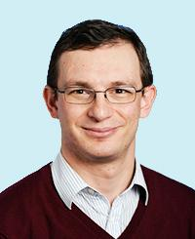
Brief Self Introduction
Onur Mutlu
  Full Professor @ ETH Zurich ITET (INFK), since September 2015
  Strecker Professor @ Carnegie Mellon University ECE/CS, 2009-2016, 2016-…
  PhD from UT-Austin, worked at Google, VMware, Microsoft Research, Intel, AMD
  https://people.inf.ethz.ch/omutlu/
  omutlu@gmail.com (Best way to reach me)
  https://people.inf.ethz.ch/omutlu/projects.htm
Research and Teaching in:
  Computer architecture, computer systems, hardware security, bioinformatics
  Memory and storage systems
  Hardware security, safety, predictability
  Fault tolerance
  Hardware/software cooperation
  Architectures for bioinformatics, health, medicine
  …

Slide 4
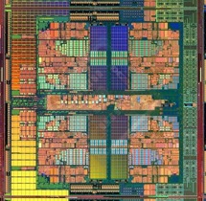

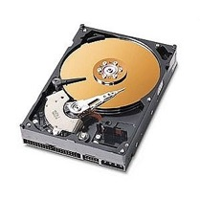
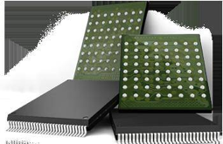
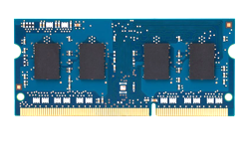
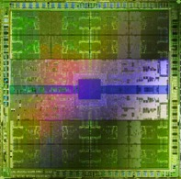
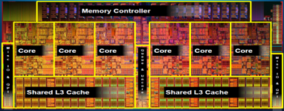
Current Research Mission
Computer architecture, HW/SW, systems, bioinformatics, security
Hybrid Main Memory
Heterogeneous
Processors and
Accelerators
Persistent Memory/Storage
Graphics and Vision Processing
Build fundamentally better architectures
Notes:
Professor Mutlu’s research focus is all aspects of computer architecture, HW/SW interaction and bioinformatics.
He is looking for students to perform research in these areas.
He and his group, SAFARI, solve fundamental problems spanning:
Memory, memory, memory, storage, interconnects
Parallel architectures, heterogeneous architectures, GP-GPUs
System/architecture interaction, new execution models
Energy efficiency, fault tolerance, hardware security
Genome sequence analysis and assembly
His group does broad research spanning systems to logic with architecture at center

Slide 5
Four Key Current Directions
Fundamentally Secure/Reliable/Safe Architectures
Fundamentally Energy-Efficient Architectures
  Memory-centric (Data-centric) Architectures
Fundamentally Low-Latency and Predictable Architectures
Architectures for AI/ML, Genomics, Medicine, Health

Slide 6
The Transformation Hierarchy
Problem
Algorithm
Program/Language
System Software
Computer Architecture (expanded view)
SW/HW Interface
Computer Architecture (narrow view)
Micro-architecture
Logic
Devices
Electrons

Slide 7
Axiom
To achieve the highest energy efficiency and performance:
we must take the expanded view
of computer architecture
Problem
Algorithm
Program/Language
System Software
Co-design across the hierarchy:
Algorithms to devices
SW/HW Interface
Micro-architecture
Logic
Specialize as much as possible
within the design goals
Devices
Electrons

Slide 8
Current Research Mission & Major Topics
Build fundamentally better architectures
Data-centric arch. for low energy & high perf.
  Proc. in Mem/DRAM, NVM, unified mem/storage
Low-latency & predictable architectures
  Low-latency, low-energy yet low-cost memory
  QoS-aware and predictable memory systems
Fundamentally secure/reliable/safe arch.
  Tolerating all bit flips; patchable HW; secure mem
Architectures for ML/AI/Genomics/Health/Med
  Algorithm/arch./logic co-design; full heterogeneity
Data-driven and data-aware architectures
  ML/AI-driven architectural controllers and design
  Expressive memory and expressive systems
Problem
Algorithm
Program/Language
System Software
SW/HW Interface
Micro-architecture
Logic
Devices
Electrons
Broad research
spanning apps, systems, logic
with architecture at the center

Slide 9

SAFARI Research Group
Think BIG, Aim HIGH!
https://safari.ethz.ch

Slide 10
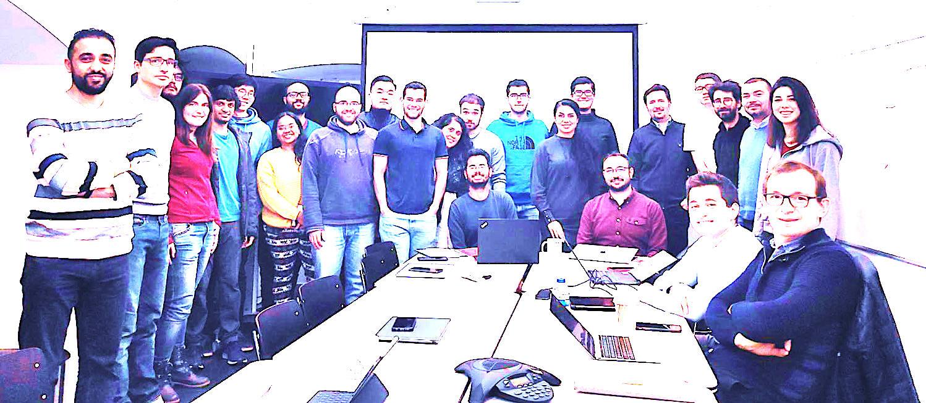

Onur Mutlu’s SAFARI Research Group
Computer architecture, HW/SW, systems, bioinformatics, security, memory
https://safari.ethz.ch/safari-newsletter-april-2020/
40+ Researchers
Think BIG, Aim HIGH!
https://safari.ethz.ch

Slide 11
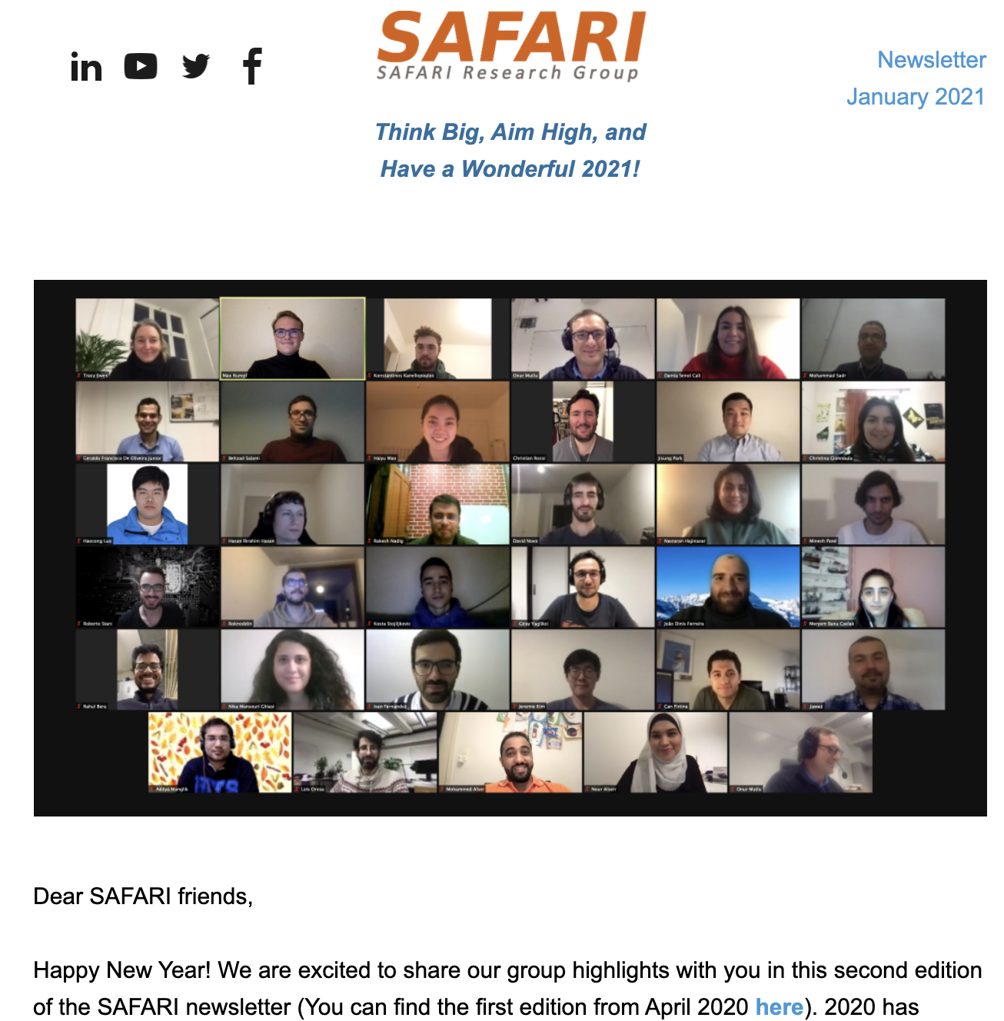
SAFARI Newsletter January 2021 Edition
https://safari.ethz.ch/safari-newsletter-january-2021/

Slide 12
SAFARI PhD and Post-Doc Alumni
https://safari.ethz.ch/safari-alumni/
Nastaran Hajinazar (ETH Zurich)
Gagandeep Singh (ETH Zurich)
Amirali Boroumand (Stanford Univ)
Jeremie Kim (ETH Zurich)
Nandita Vijaykumar (Univ. of Toronto, Assistant Professor)
Kevin Hsieh (Microsoft Research)
Justin Meza (Facebook)
Mohammed Alser (ETH Zurich)
Yixin Luo (Google)
Kevin Chang (Facebook)
Rachata Ausavarungnirun (KMUNTB, Assistant Professor)
Gennady Pekhimenko (Univ. of Toronto, Assistant Professor)
Vivek Seshadri (Microsoft Research)
Donghyuk Lee (NVIDIA Research)
Yoongu Kim (Google)
Lavanya Subramanian (Intel Labs → Facebook)
Samira Khan (Univ. of Virginia, Assistant Professor)
Saugata Ghose (Univ. of Illinois, Assistant Professor)

Slide 13
Principle: Teaching and Research
…
Teaching drives Research
Research drives Teaching
…

Slide 14
Principle: Learning and Scholarship
Focus on
learning and scholarship

Slide 15
Principle: Insight and Ideas
Focus on Insight
Encourage New Ideas

Slide 16
Principle: Learning and Scholarship
The quality of your work defines your impact

Slide 17
Principle: Good Mindset, Goals & Focus
You can make a good impact on the world

Slide 18
Research & Teaching: Some Overview Talks
https://www.youtube.com/onurmutlulectures
Future Computing Architectures
  https://www.youtube.com/watch?v=kgiZlSOcGFM&list=PL5Q2soXY2Zi8D_5MGV6EnXEJHnV2YFBJl&index=1
Enabling In-Memory Computation
  https://www.youtube.com/watch?v=njX_14584Jw&list=PL5Q2soXY2Zi8D_5MGV6EnXEJHnV2YFBJl&index=16
Accelerating Genome Analysis
  https://www.youtube.com/watch?v=r7sn41lH-4A&list=PL5Q2soXY2Zi8D_5MGV6EnXEJHnV2YFBJl&index=41
Rethinking Memory System Design
  https://www.youtube.com/watch?v=F7xZLNMIY1E&list=PL5Q2soXY2Zi8D_5MGV6EnXEJHnV2YFBJl&index=3
Intelligent Architectures for Intelligent Machines
  https://www.youtube.com/watch?v=c6_LgzuNdkw&list=PL5Q2soXY2Zi8D_5MGV6EnXEJHnV2YFBJl&index=25
The Story of RowHammer
  https://www.youtube.com/watch?v=sgd7PHQQ1AI&list=PL5Q2soXY2Zi8D_5MGV6EnXEJHnV2YFBJl&index=39

Slide 19
Online Courses & Lectures
First Computer Architecture & Digital Design Course
  Digital Design and Computer Architecture
  Spring 2021 Livestream Edition: https://www.youtube.com/watch?v=LbC0EZY8yw4&list=PL5Q2soXY2Zi_uej3aY39YB5pfW4SJ7LlN
Advanced Computer Architecture Course
  Computer Architecture
  Falll 2020 Edition: https://www.youtube.com/watch?v=c3mPdZA-Fmc&list=PL5Q2soXY2Zi9xidyIgBxUz7xRPS-wisBN
https://www.youtube.com/onurmutlulectures

Slide 20
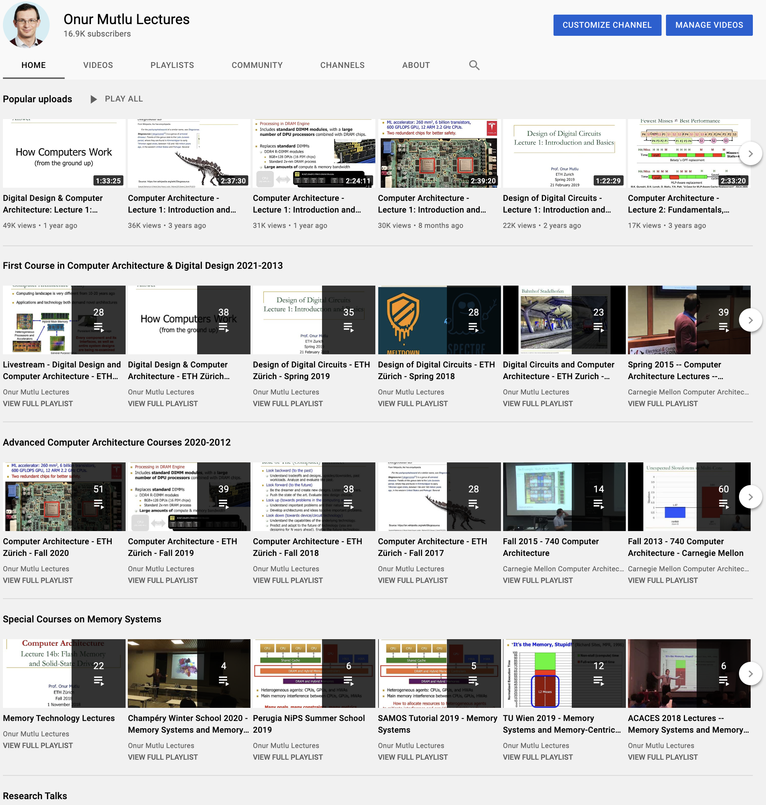
https://www.youtube.com/onurmutlulectures

Slide 21

DDCA (Spring 2021)
https://safari.ethz.ch/digitaltechnik/spring2021/doku.php?id=schedule
https://www.youtube.com/watch?v=LbC0EZY8yw4&list=PL5Q2soXY2Zi_uej3aY39YB5pfW4SJ7LlN
Bachelor’s course
  2nd semester at ETH Zurich
  Rigorous introduction into “How Computers Work”
  Digital Design/Logic
  Computer Architecture
  10 FPGA Lab Assignments

Slide 22
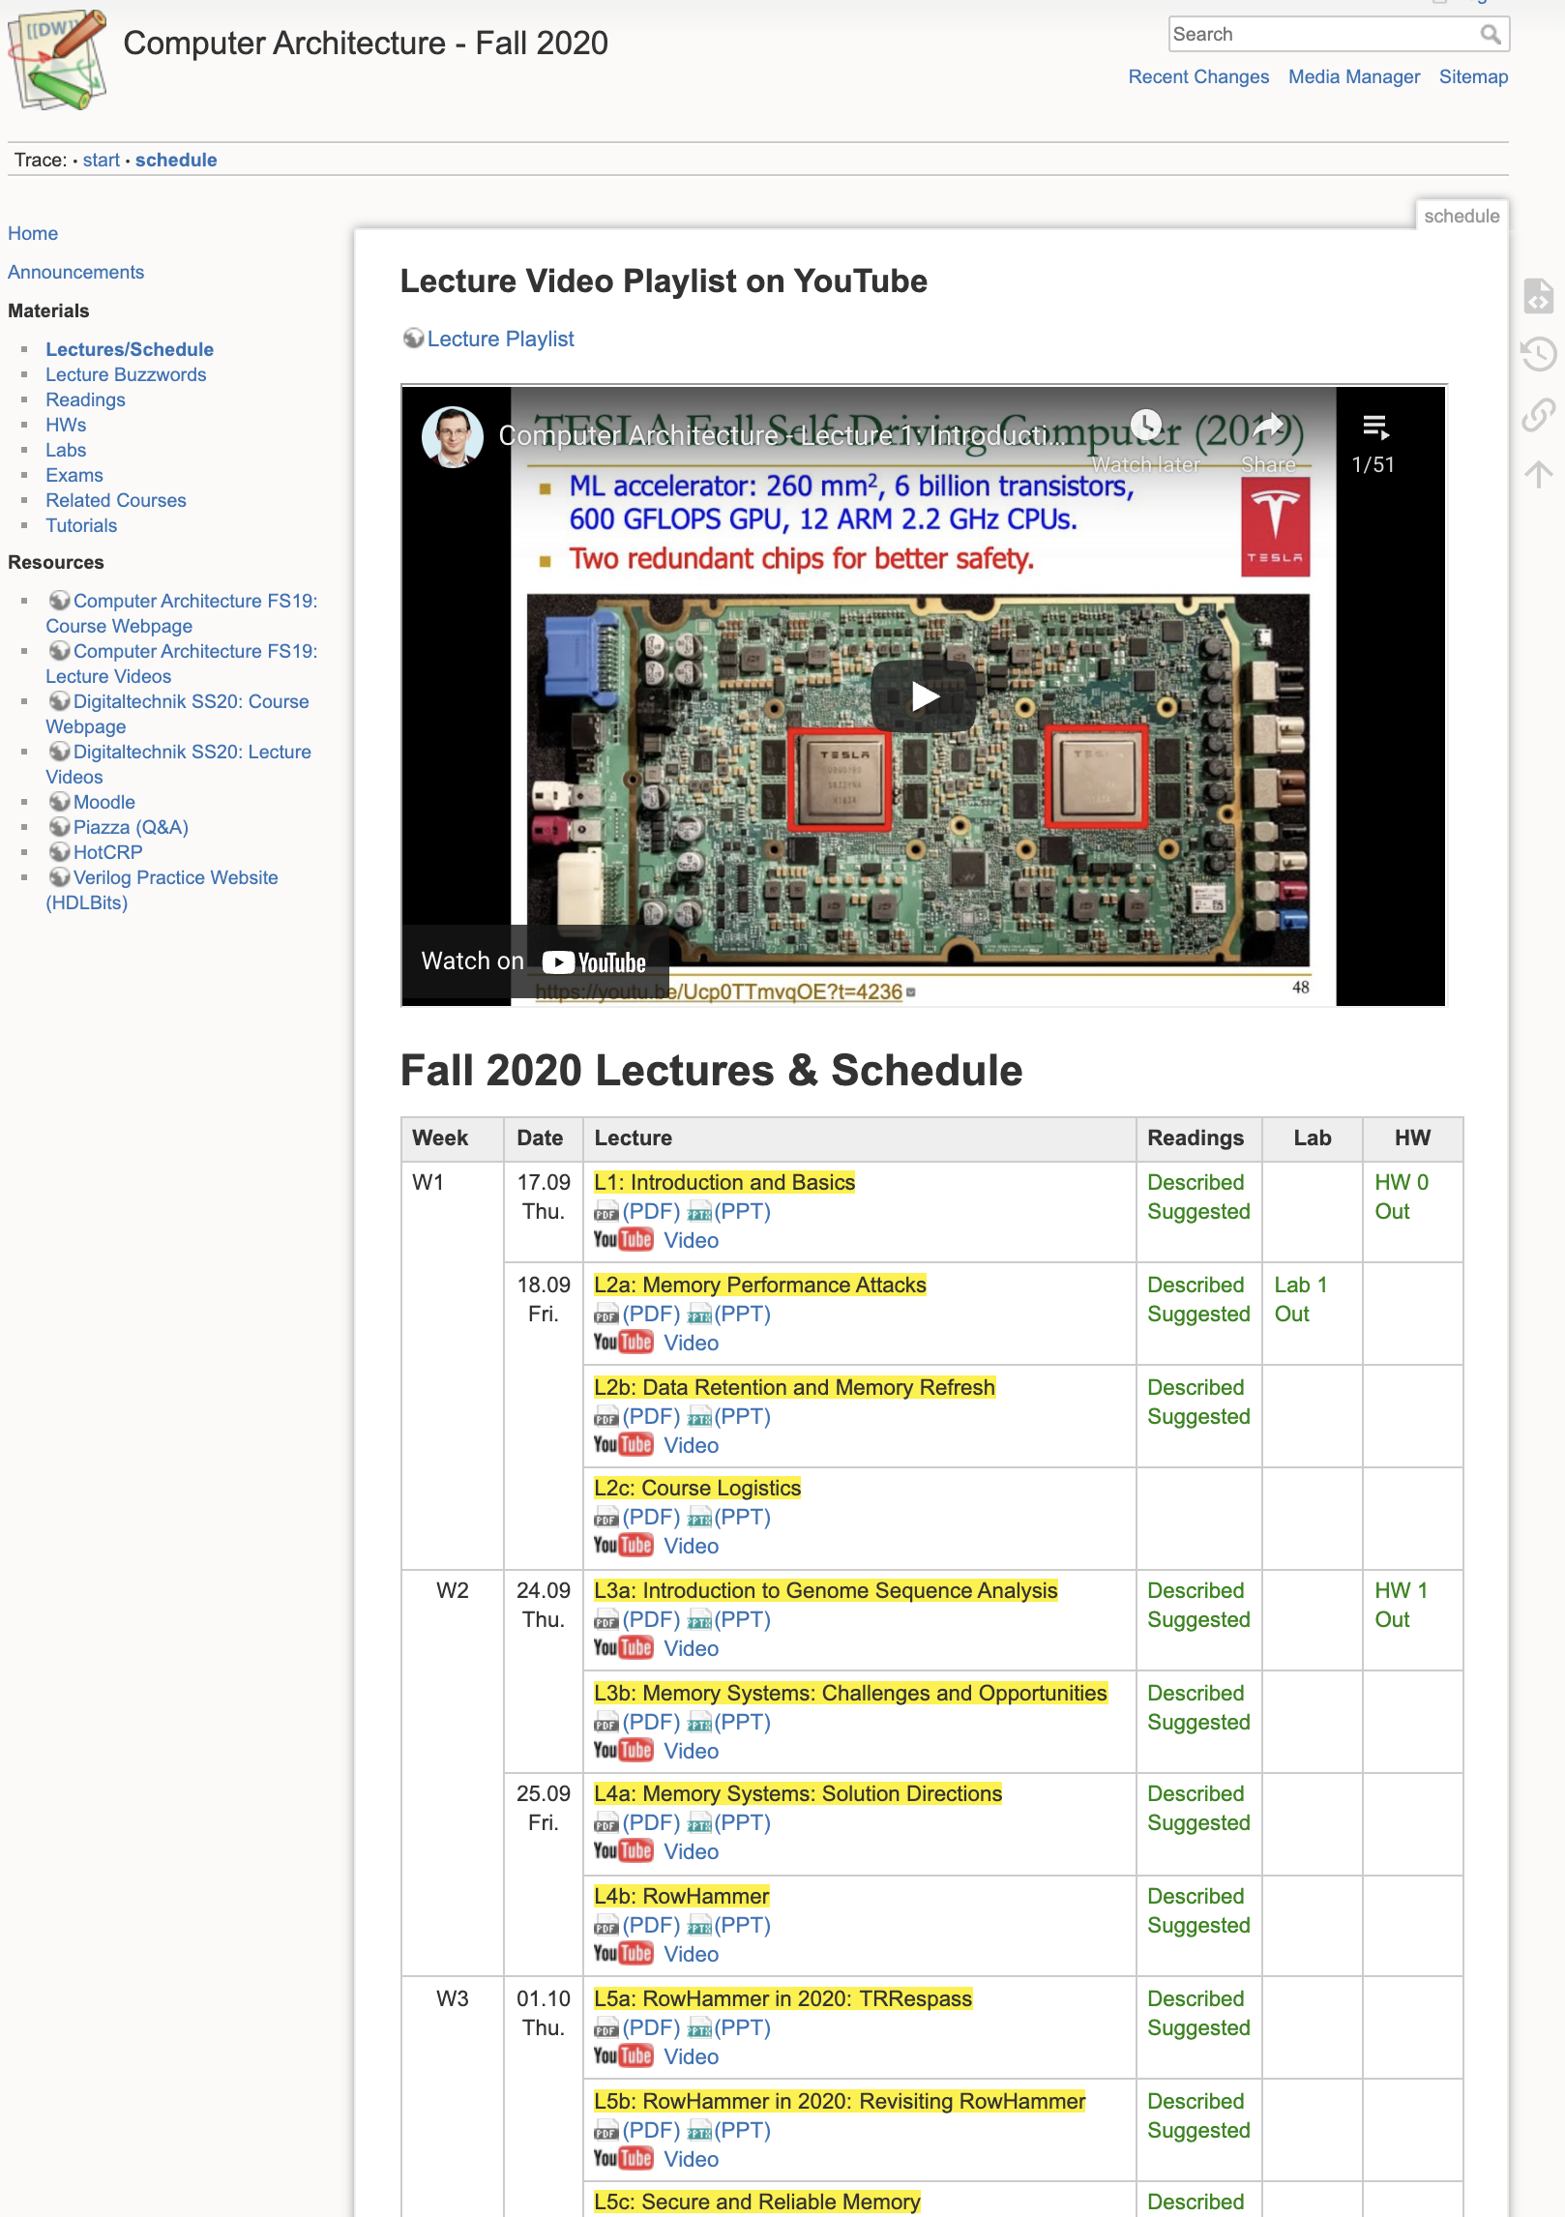
Comp Arch (Fall 2020)
https://safari.ethz.ch/architecture/fall2020/doku.php?id=schedule
https://www.youtube.com/watch?v=c3mPdZA-Fmc&list=PL5Q2soXY2Zi9xidyIgBxUz7xRPS-wisBN
Master’s level course
  Taken by Bachelor’s/Masters/PhD students
  Cutting-edge research topics + fundamentals in Computer Architecture
  5 Simulator-based Lab Assignments
  Potential research exploration
  Many research readings

Slide 23
An Interview on Research and Education
Computing Research and Education (@ ISCA 2019)
  https://www.youtube.com/watch?v=8ffSEKZhmvo&list=PL5Q2soXY2Zi_4oP9LdL3cc8G6NIjD2Ydz
Maurice Wilkes Award Speech (10 minutes)
  https://www.youtube.com/watch?v=tcQ3zZ3JpuA&list=PL5Q2soXY2Zi8D_5MGV6EnXEJHnV2YFBJl&index=15

Slide 24
More Thoughts and Suggestions
Onur Mutlu,
"Some Reflections (on DRAM)"
Award Speech for ACM SIGARCH Maurice Wilkes Award, at the ISCA Awards Ceremony, Phoenix, AZ, USA, 25 June 2019.
[Slides (pptx) (pdf)]
[Video of Award Acceptance Speech (Youtube; 10 minutes) (Youku; 13 minutes)]
[Video of Interview after Award Acceptance (Youtube; 1 hour 6 minutes) (Youku; 1 hour 6 minutes)]
[News Article on "ACM SIGARCH Maurice Wilkes Award goes to Prof. Onur Mutlu"]
Onur Mutlu,
"How to Build an Impactful Research Group"
57th Design Automation Conference Early Career Workshop (DAC), Virtual, 19 July 2020.
[Slides (pptx) (pdf)]

Slide 25
Papers, Talks, Videos, Artifacts
All are available at
  https://people.inf.ethz.ch/omutlu/projects.htm
  http://scholar.google.com/citations?user=7XyGUGkAAAAJ&hl=en
  https://www.youtube.com/onurmutlulectures
  https://github.com/CMU-SAFARI/

Slide 26
Example Research Topics:
Quick Overview

Slide 27
Current Research Mission
Computer architecture, HW/SW, systems, bioinformatics, security
Hybrid Main Memory
Heterogeneous
Processors and
Accelerators
Persistent Memory/Storage
Graphics and Vision Processing
Build fundamentally better architectures
Notes:
Professor Mutlu’s research focus is all aspects of computer architecture, HW/SW interaction and bioinformatics.
He is looking for students to perform research in these areas.
He and his group, SAFARI, solve fundamental problems spanning:
Memory, memory, memory, storage, interconnects
Parallel architectures, heterogeneous architectures, GP-GPUs
System/architecture interaction, new execution models
Energy efficiency, fault tolerance, hardware security
Genome sequence analysis and assembly
His group does broad research spanning systems to logic with architecture at center

Slide 28
Four Key Issues in Future Platforms
Fundamentally Secure/Reliable/Safe Architectures
Fundamentally Energy-Efficient Architectures
  Memory-centric (Data-centric) Architectures
Fundamentally Low-Latency and Predictable Architectures
Architectures for AI/ML, Genomics, Medicine, Health

Slide 29
Challenge and Opportunity for Future
High Performance
(to solve
the toughest & all problems)

Slide 30
Challenge and Opportunity for Future
Personalized and Private
(in every aspect of life:
health, medicine,
spaces, devices, robotics, …)

Slide 31
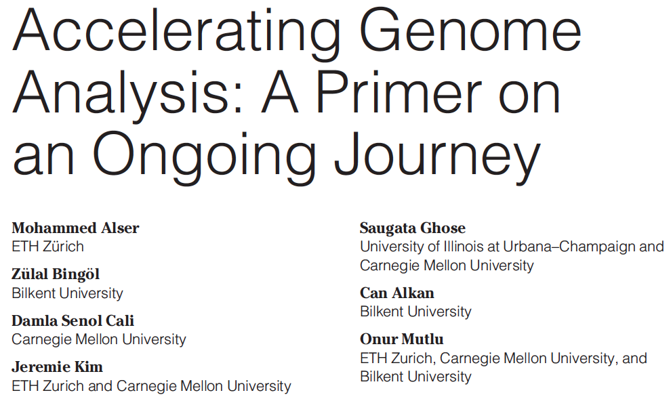
Accelerating Genome Analysis
Mohammed Alser, Zulal Bingol, Damla Senol Cali, Jeremie Kim, Saugata Ghose, Can Alkan, and Onur Mutlu,
"Accelerating Genome Analysis: A Primer on an Ongoing Journey"
IEEE Micro (IEEE MICRO), Vol. 40, No. 5, pages 65-75, September/October 2020.
[Slides (pptx)(pdf)]
[Talk Video (1 hour 2 minutes)]

Slide 32
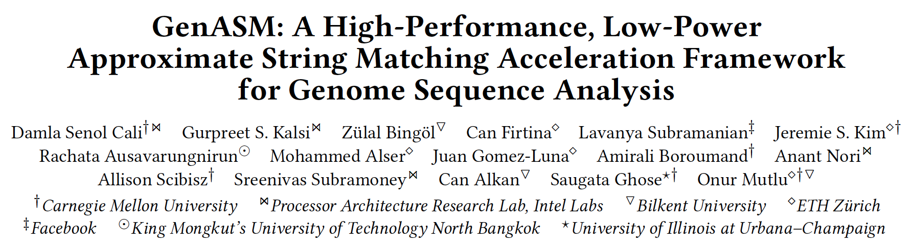
GenASM Framework [MICRO 2020]
Damla Senol Cali, Gurpreet S. Kalsi, Zulal Bingol, Can Firtina, Lavanya Subramanian, Jeremie S. Kim, Rachata Ausavarungnirun, Mohammed Alser, Juan Gomez-Luna, Amirali Boroumand, Anant Nori, Allison Scibisz, Sreenivas Subramoney, Can Alkan, Saugata Ghose, and Onur Mutlu,
"GenASM: A High-Performance, Low-Power Approximate String Matching Acceleration Framework for Genome Sequence Analysis"
Proceedings of the 53rd International Symposium on Microarchitecture (MICRO), Virtual, October 2020.
[Lighting Talk Video (1.5 minutes)]
[Lightning Talk Slides (pptx) (pdf)]
[Talk Video (18 minutes)]
[Slides (pptx) (pdf)]

Slide 33
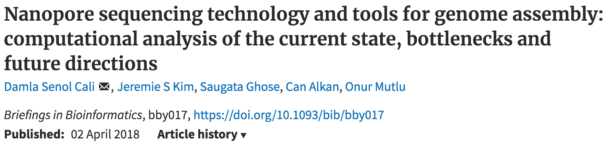
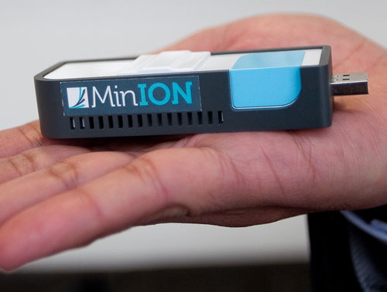
New Genome Sequencing Technologies
Oxford Nanopore MinION
Senol Cali+, “Nanopore Sequencing Technology and Tools for Genome
Assembly: Computational Analysis of the Current State, Bottlenecks
and Future Directions,” Briefings in Bioinformatics, 2018.
[Preliminary arxiv.org version]

Slide 34
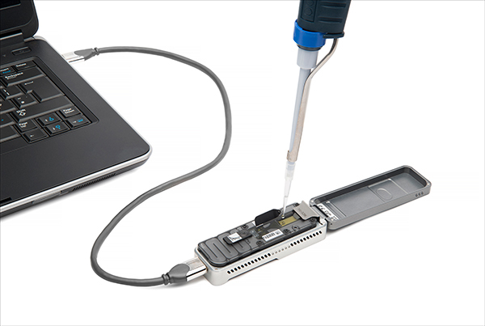
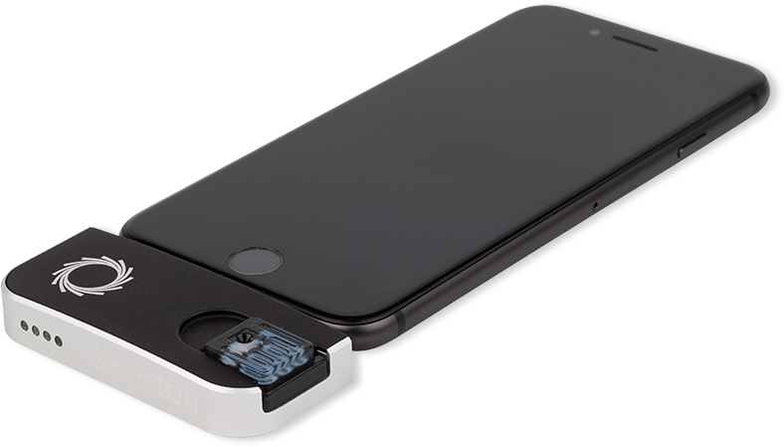
Future of Genome Sequencing & Analysis
MinION from ONT
SmidgION from ONT
Alser+, "Accelerating Genome Analysis: A Primer on an Ongoing Journey”, IEEE Micro 2020.

Slide 35
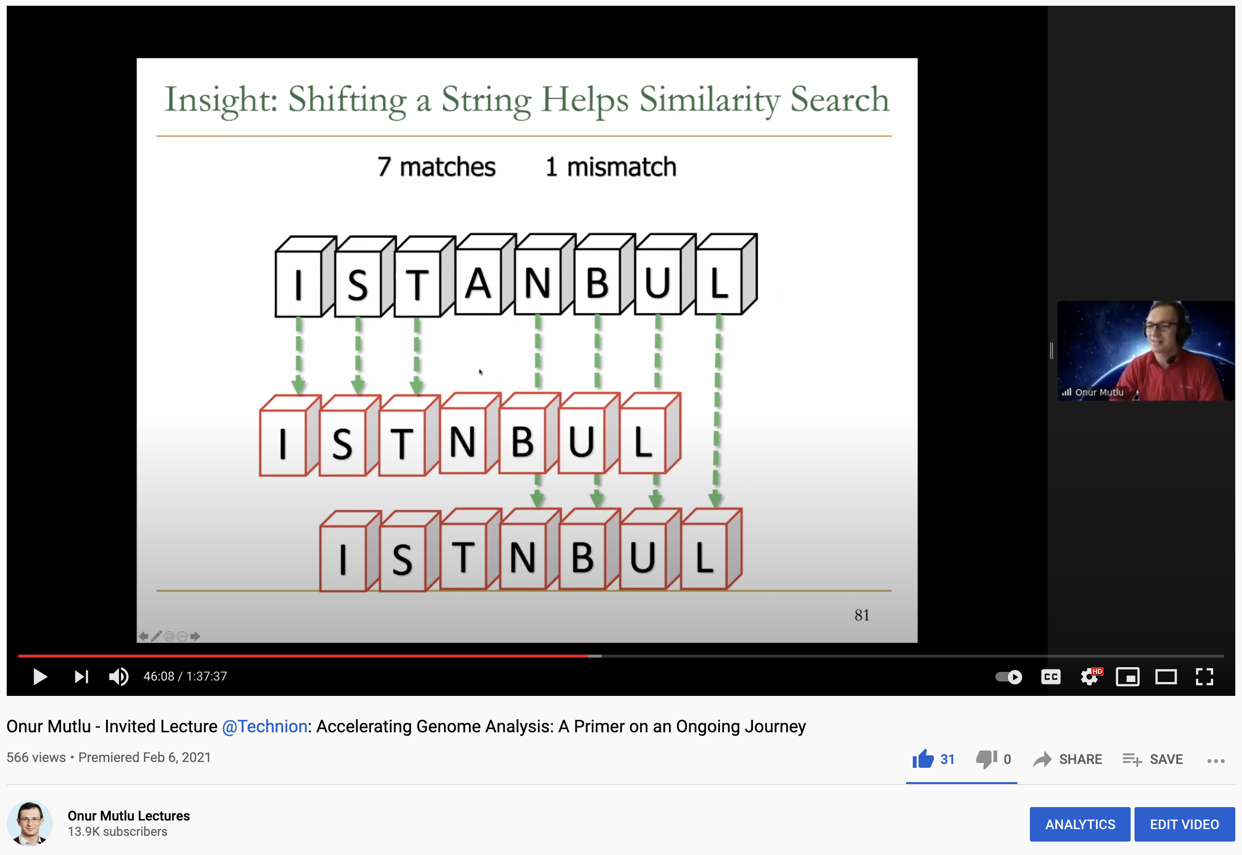
More on Fast & Efficient Genome Analysis
Onur Mutlu,
"Accelerating Genome Analysis: A Primer on an Ongoing Journey"
Invited Lecture at Technion, Virtual, 26 January 2021.
[Slides (pptx) (pdf)]
[Talk Video (1 hour 37 minutes, including Q&A)]
[Related Invited Paper (at IEEE Micro, 2020)]

Slide 36
Detailed Lectures on Genome Analysis
Computer Architecture, Fall 2020, Lecture 3a
  Introduction to Genome Sequence Analysis (ETH Zürich, Fall 2020)
  https://www.youtube.com/watch?v=CrRb32v7SJc&list=PL5Q2soXY2Zi9xidyIgBxUz7xRPS-wisBN&index=5
Computer Architecture, Fall 2020, Lecture 8
  Intelligent Genome Analysis (ETH Zürich, Fall 2020)
  https://www.youtube.com/watch?v=ygmQpdDTL7o&list=PL5Q2soXY2Zi9xidyIgBxUz7xRPS-wisBN&index=14
Computer Architecture, Fall 2020, Lecture 9a
  GenASM: Approx. String Matching Accelerator (ETH Zürich, Fall 2020)
  https://www.youtube.com/watch?v=XoLpzmN-Pas&list=PL5Q2soXY2Zi9xidyIgBxUz7xRPS-wisBN&index=15
Accelerating Genomics Project Course, Fall 2020, Lecture 1
  Accelerating Genomics (ETH Zürich, Fall 2020)
  https://www.youtube.com/watch?v=rgjl8ZyLsAg&list=PL5Q2soXY2Zi9E2bBVAgCqLgwiDRQDTyId
https://www.youtube.com/onurmutlulectures

Slide 37
The Problem
Computing
is Bottlenecked by Data

Slide 38
Realization
Modern Systems are Bottlenecked by
Data Storage
and Movement

Slide 39
Realization Reworded
Modern Systems are Bottlenecked by
Memory

Slide 40
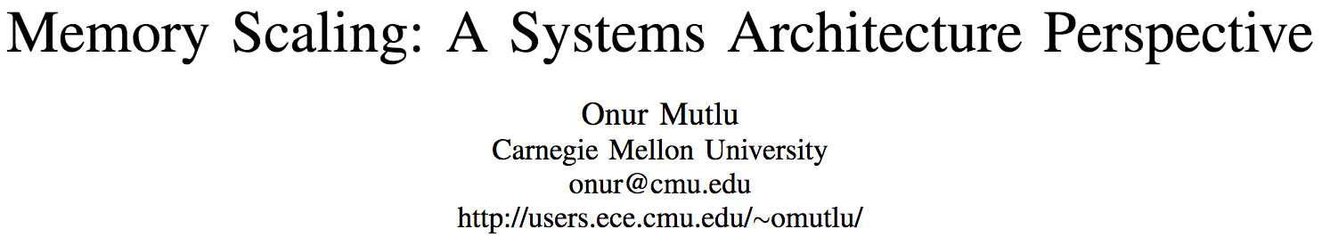
An “Early” Overview Paper…
Onur Mutlu,
"Memory Scaling: A Systems Architecture Perspective"
Proceedings of the 5th International Memory Workshop (IMW), Monterey, CA, May 2013. Slides (pptx) (pdf)
EETimes Reprint
https://people.inf.ethz.ch/omutlu/pub/memory-scaling_memcon13.pdf

Slide 41
Challenge and Opportunity for Future
Fundamentally
Secure, Reliable, Safe
Computing Architectures

Slide 42
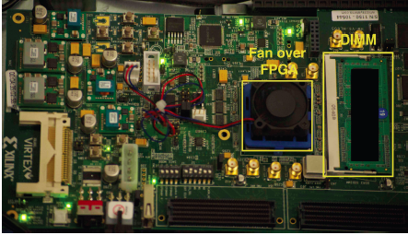
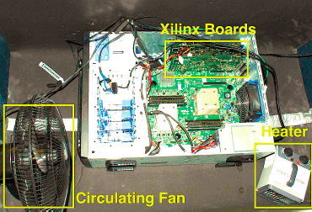
Infrastructures to Understand Such Issues
  An Experimental Study of Data Retention Behavior in Modern DRAM Devices: Implications for Retention Time Profiling Mechanisms (Liu et al., ISCA 2013)
  The Efficacy of Error Mitigation Techniques for DRAM Retention Failures: A Comparative Experimental Study
  (Khan et al., SIGMETRICS 2014)
  Flipping Bits in Memory Without Accessing Them: An Experimental Study of DRAM Disturbance Errors (Kim et al., ISCA 2014)
  Adaptive-Latency DRAM: Optimizing DRAM Timing for the Common-Case (Lee et al., HPCA 2015)
  AVATAR: A Variable-Retention-Time (VRT) Aware Refresh for DRAM Systems (Qureshi et al., DSN 2015)

Slide 43
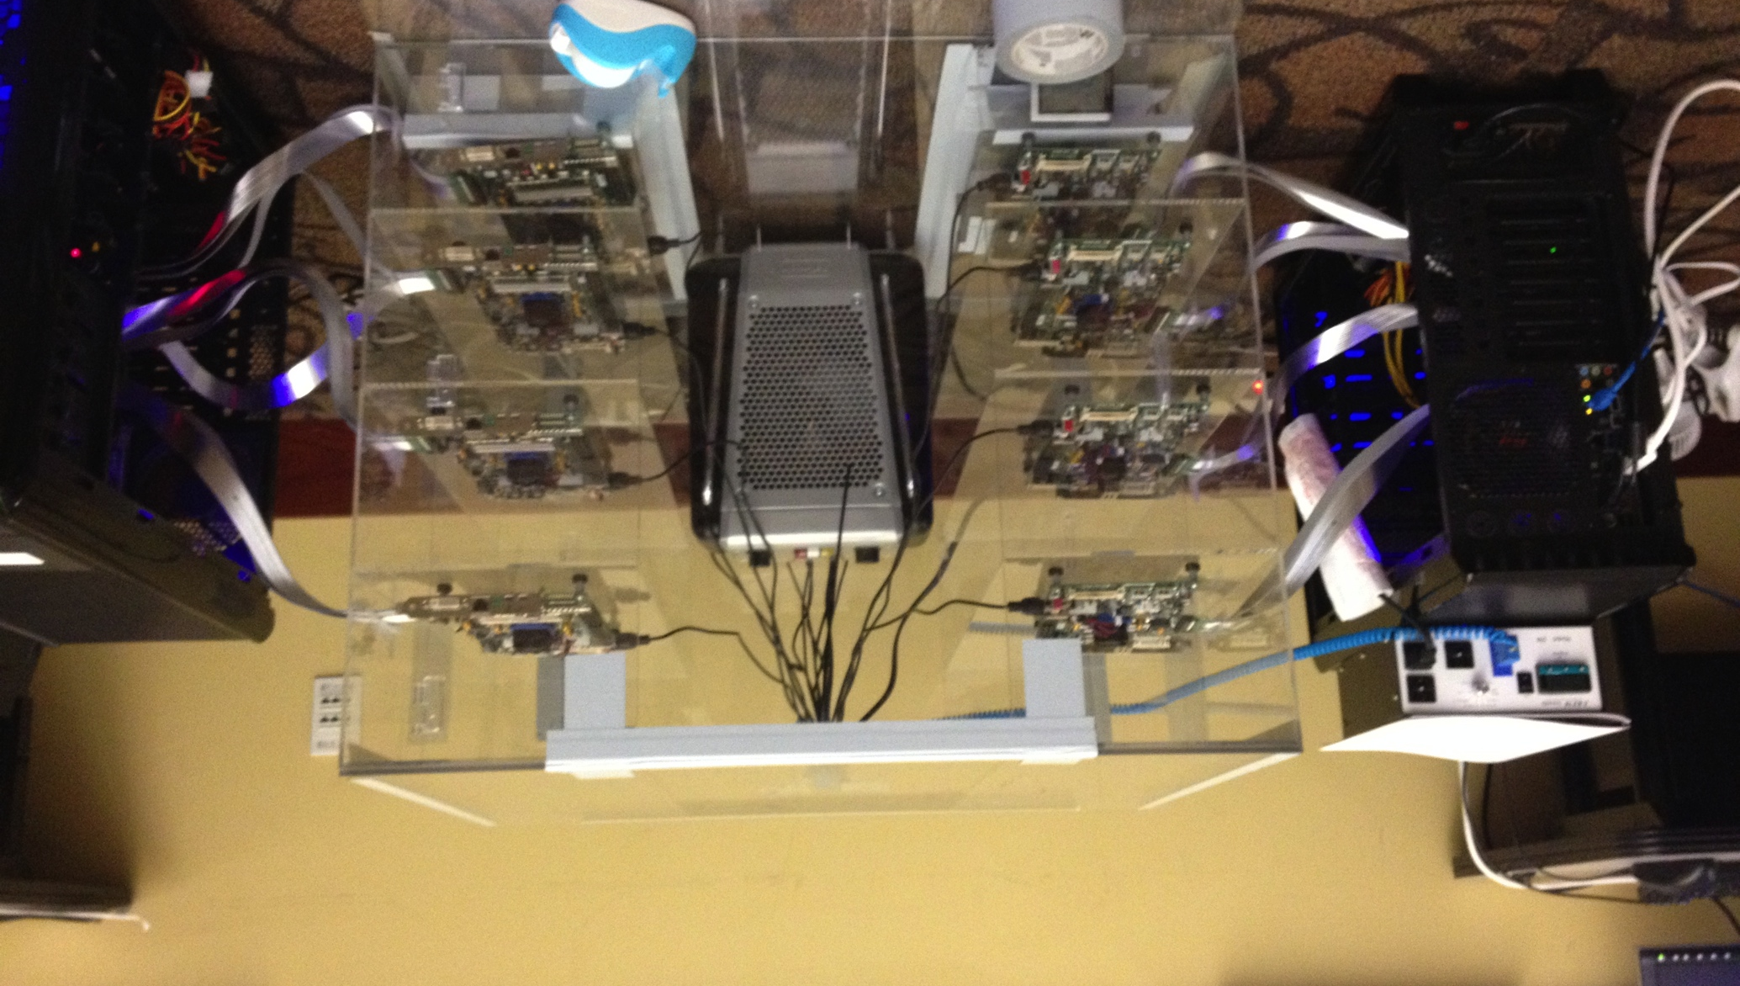
Infrastructures to Understand Such Issues
Temperature
Controller
FPGAs
Heater
FPGAs
PC
  Kim+, “Flipping Bits in Memory Without Accessing Them: An Experimental Study of DRAM Disturbance Errors,” ISCA 2014.

Slide 44
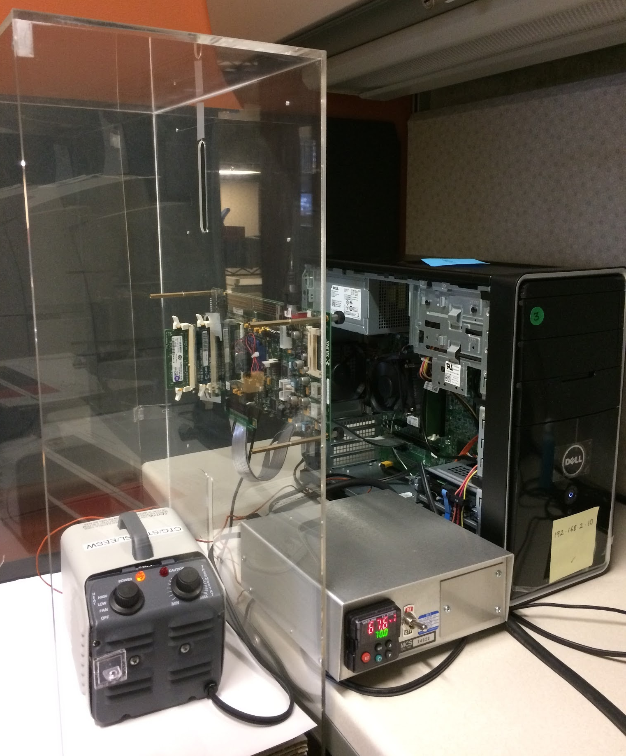
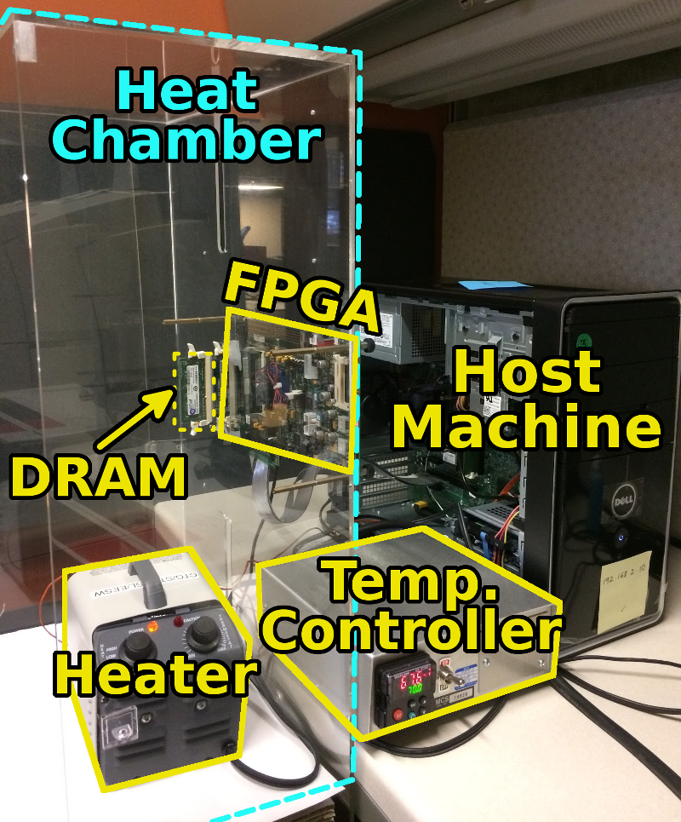
SoftMC: Open Source DRAM Infrastructure
Hasan Hassan et al., “SoftMC: A Flexible and Practical Open-Source Infrastructure for Enabling Experimental DRAM Studies,” HPCA 2017.
Flexible
Easy to Use (C++ API)
Open-source
github.com/CMU-SAFARI/SoftMC

Slide 45
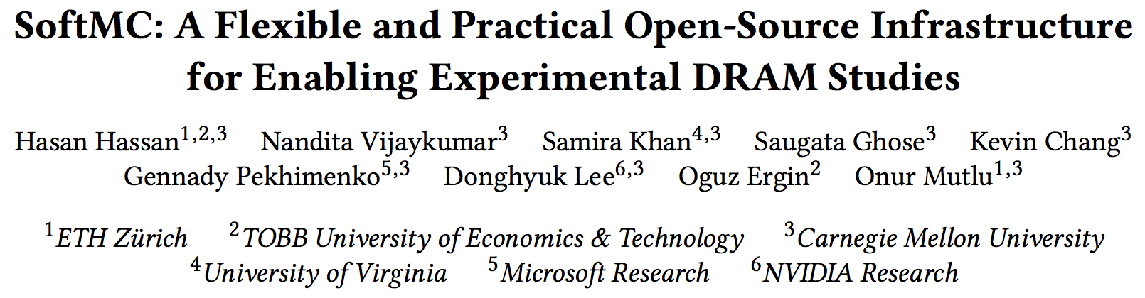
SoftMC
https://github.com/CMU-SAFARI/SoftMC

Slide 46
A Curious Discovery [Kim et al., ISCA 2014]
One can
predictably induce errors
in most DRAM memory chips

Slide 47
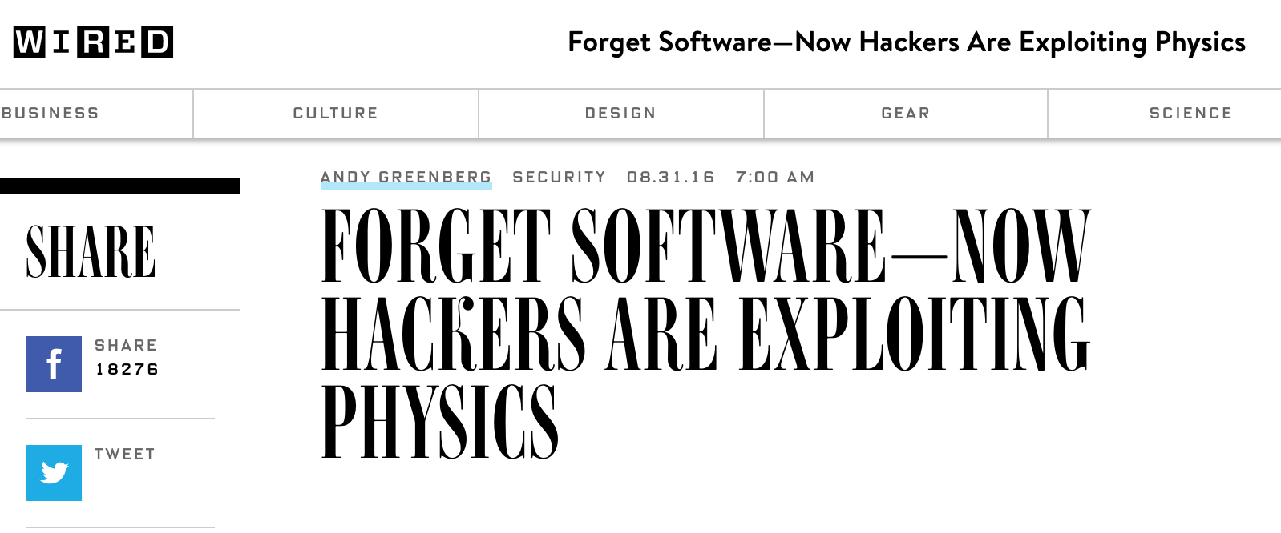
DRAM RowHammer
A simple hardware failure mechanism
can create a widespread
system security vulnerability

Slide 48


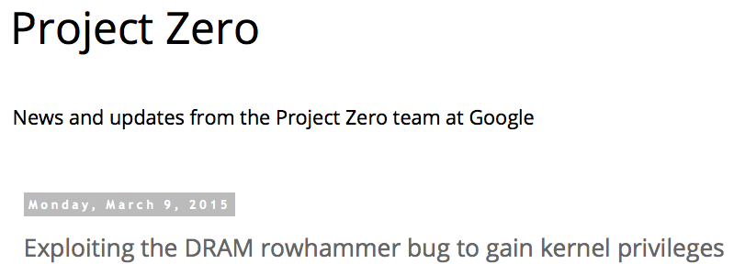
One Can Take Over an Otherwise-Secure System
Flipping Bits in Memory Without Accessing Them: An Experimental Study of DRAM Disturbance Errors (Kim et al., ISCA 2014)
Exploiting the DRAM rowhammer bug to gain kernel privileges (Seaborn+, 2015)

Slide 49
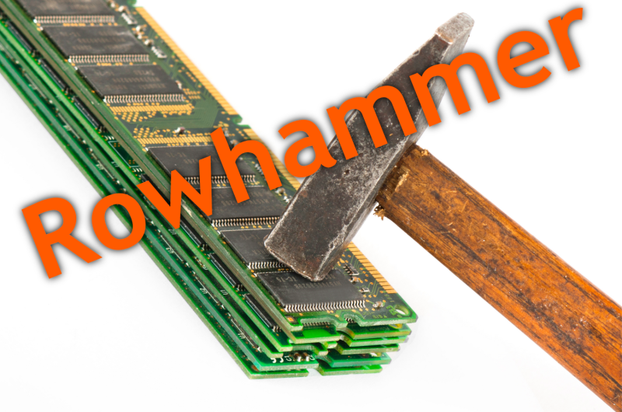
Notes:
Picture from the article:
http://thehackernews.com/2015/03/dram-rowhammer-vulnerability.html

Slide 50
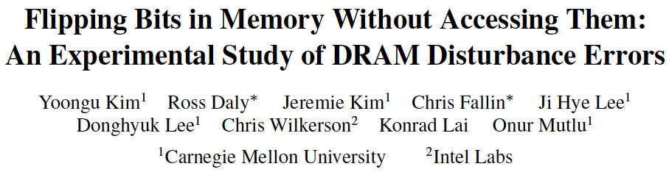
First RowHammer Analysis
Yoongu Kim, Ross Daly, Jeremie Kim, Chris Fallin, Ji Hye Lee, Donghyuk Lee, Chris Wilkerson, Konrad Lai, and Onur Mutlu,
"Flipping Bits in Memory Without Accessing Them: An Experimental Study of DRAM Disturbance Errors"
Proceedings of the 41st International Symposium on Computer Architecture (ISCA), Minneapolis, MN, June 2014.
[Slides (pptx) (pdf)] [Lightning Session Slides (pptx) (pdf)] [Source Code and Data]

Slide 51
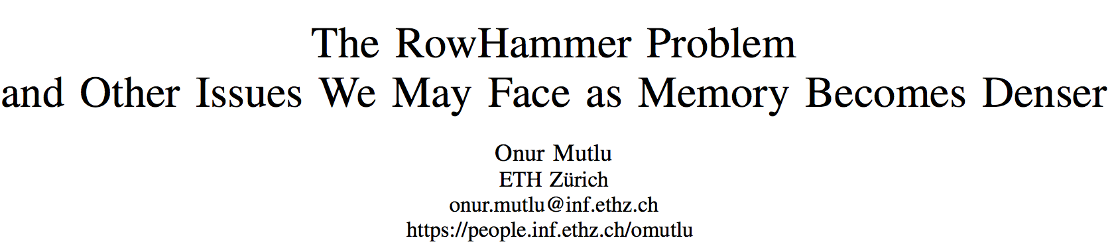
Future of Memory Reliability/Security
Onur Mutlu,
"The RowHammer Problem and Other Issues We May Face as Memory Becomes Denser"
Invited Paper in Proceedings of the Design, Automation, and Test in Europe Conference (DATE), Lausanne, Switzerland, March 2017.
[Slides (pptx) (pdf)]
https://people.inf.ethz.ch/omutlu/pub/rowhammer-and-other-memory-issues_date17.pdf

Slide 52
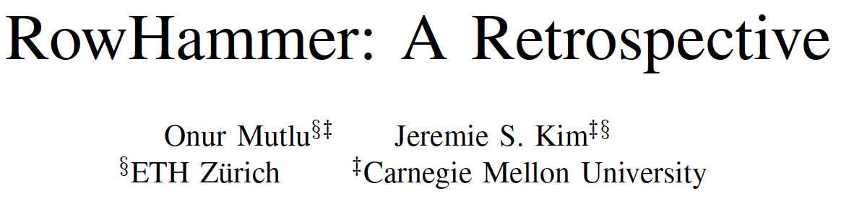
A More Recent RowHammer Retrospective
Onur Mutlu and Jeremie Kim,
"RowHammer: A Retrospective"
IEEE Transactions on Computer-Aided Design of Integrated Circuits and Systems (TCAD) Special Issue on Top Picks in Hardware and Embedded Security, 2019.
[Preliminary arXiv version]
[Slides from COSADE 2019 (pptx)]
[Slides from VLSI-SOC 2020 (pptx) (pdf)]
[Talk Video (30 minutes)]

Slide 53
RowHammer in 2020

Slide 54
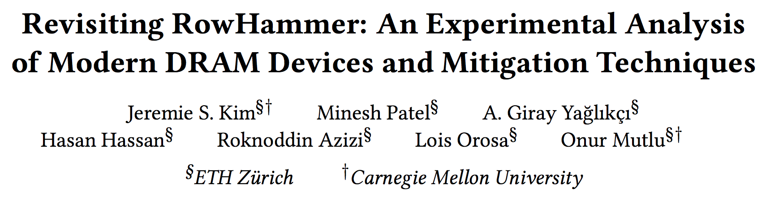
RowHammer in 2020 (I)
Jeremie S. Kim, Minesh Patel, A. Giray Yaglikci, Hasan Hassan, Roknoddin Azizi, Lois Orosa, and Onur Mutlu,
"Revisiting RowHammer: An Experimental Analysis of Modern Devices and Mitigation Techniques"
Proceedings of the 47th International Symposium on Computer Architecture (ISCA), Valencia, Spain, June 2020.
[Slides (pptx) (pdf)]
[Lightning Talk Slides (pptx) (pdf)]
[Talk Video (20 minutes)]
[Lightning Talk Video (3 minutes)]

Slide 55
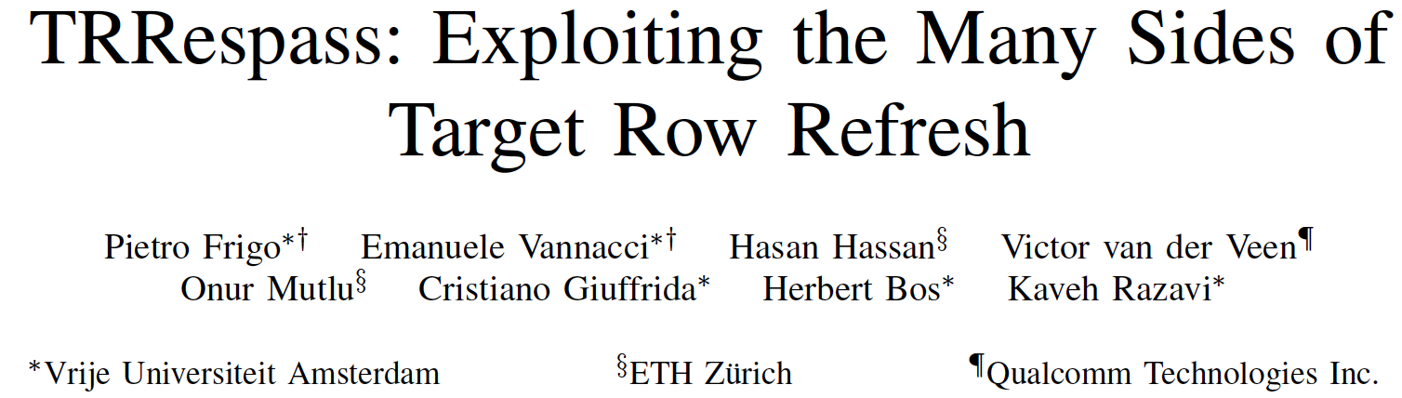
RowHammer in 2020 (II)
Pietro Frigo, Emanuele Vannacci, Hasan Hassan, Victor van der Veen, Onur Mutlu, Cristiano Giuffrida, Herbert Bos, and Kaveh Razavi,
"TRRespass: Exploiting the Many Sides of Target Row Refresh"
Proceedings of the 41st IEEE Symposium on Security and Privacy (S&P), San Francisco, CA, USA, May 2020.
[Slides (pptx) (pdf)]
[Lecture Slides (pptx) (pdf)]
[Talk Video (17 minutes)]
[Lecture Video (59 minutes)]
[Source Code]
[Web Article]
Best paper award.
Pwnie Award 2020 for Most Innovative Research. Pwnie Awards 2020

Slide 56
TRRespass Key Takeaways
RowHammer is still
an open problem
Security by obscurity
is likely not a good solution

Slide 57
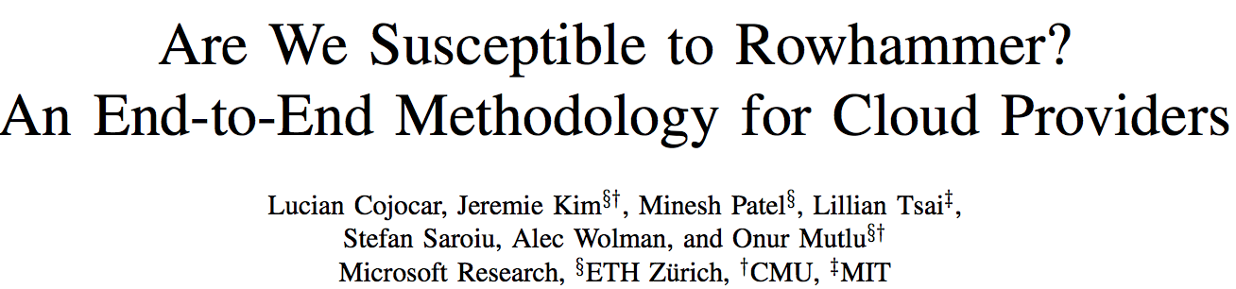
RowHammer in 2020 (III)
Lucian Cojocar, Jeremie Kim, Minesh Patel, Lillian Tsai, Stefan Saroiu, Alec Wolman, and Onur Mutlu,
"Are We Susceptible to Rowhammer? An End-to-End Methodology for Cloud Providers"
Proceedings of the 41st IEEE Symposium on Security and Privacy (S&P), San Francisco, CA, USA, May 2020.
[Slides (pptx) (pdf)]
[Talk Video (17 minutes)]

Slide 58
BlockHammer Solution in 2021
A. Giray Yaglikci, Minesh Patel, Jeremie S. Kim, Roknoddin Azizi, Ataberk Olgun, Lois Orosa, Hasan Hassan, Jisung Park, Konstantinos Kanellopoulos, Taha Shahroodi, Saugata Ghose, and Onur Mutlu,
"BlockHammer: Preventing RowHammer at Low Cost by Blacklisting Rapidly-Accessed DRAM Rows"
Proceedings of the 27th International Symposium on High-Performance Computer Architecture (HPCA), Virtual, February-March 2021.
[Slides (pptx) (pdf)]
[Short Talk Slides (pptx) (pdf)]
[Talk Video (22 minutes)]
[Short Talk Video (7 minutes)]

Slide 59
Detailed Lectures on RowHammer
Computer Architecture, Fall 2020, Lecture 4b
  RowHammer (ETH Zürich, Fall 2020)
  https://www.youtube.com/watch?v=KDy632z23UE&list=PL5Q2soXY2Zi9xidyIgBxUz7xRPS-wisBN&index=8
Computer Architecture, Fall 2020, Lecture 5a
  RowHammer in 2020: TRRespass (ETH Zürich, Fall 2020)
  https://www.youtube.com/watch?v=pwRw7QqK_qA&list=PL5Q2soXY2Zi9xidyIgBxUz7xRPS-wisBN&index=9
Computer Architecture, Fall 2020, Lecture 5b
  RowHammer in 2020: Revisiting RowHammer (ETH Zürich, Fall 2020)
  https://www.youtube.com/watch?v=gR7XR-Eepcg&list=PL5Q2soXY2Zi9xidyIgBxUz7xRPS-wisBN&index=10
Computer Architecture, Fall 2020, Lecture 5c
  Secure and Reliable Memory (ETH Zürich, Fall 2020)
  https://www.youtube.com/watch?v=HvswnsfG3oQ&list=PL5Q2soXY2Zi9xidyIgBxUz7xRPS-wisBN&index=11
https://www.youtube.com/onurmutlulectures

Slide 60
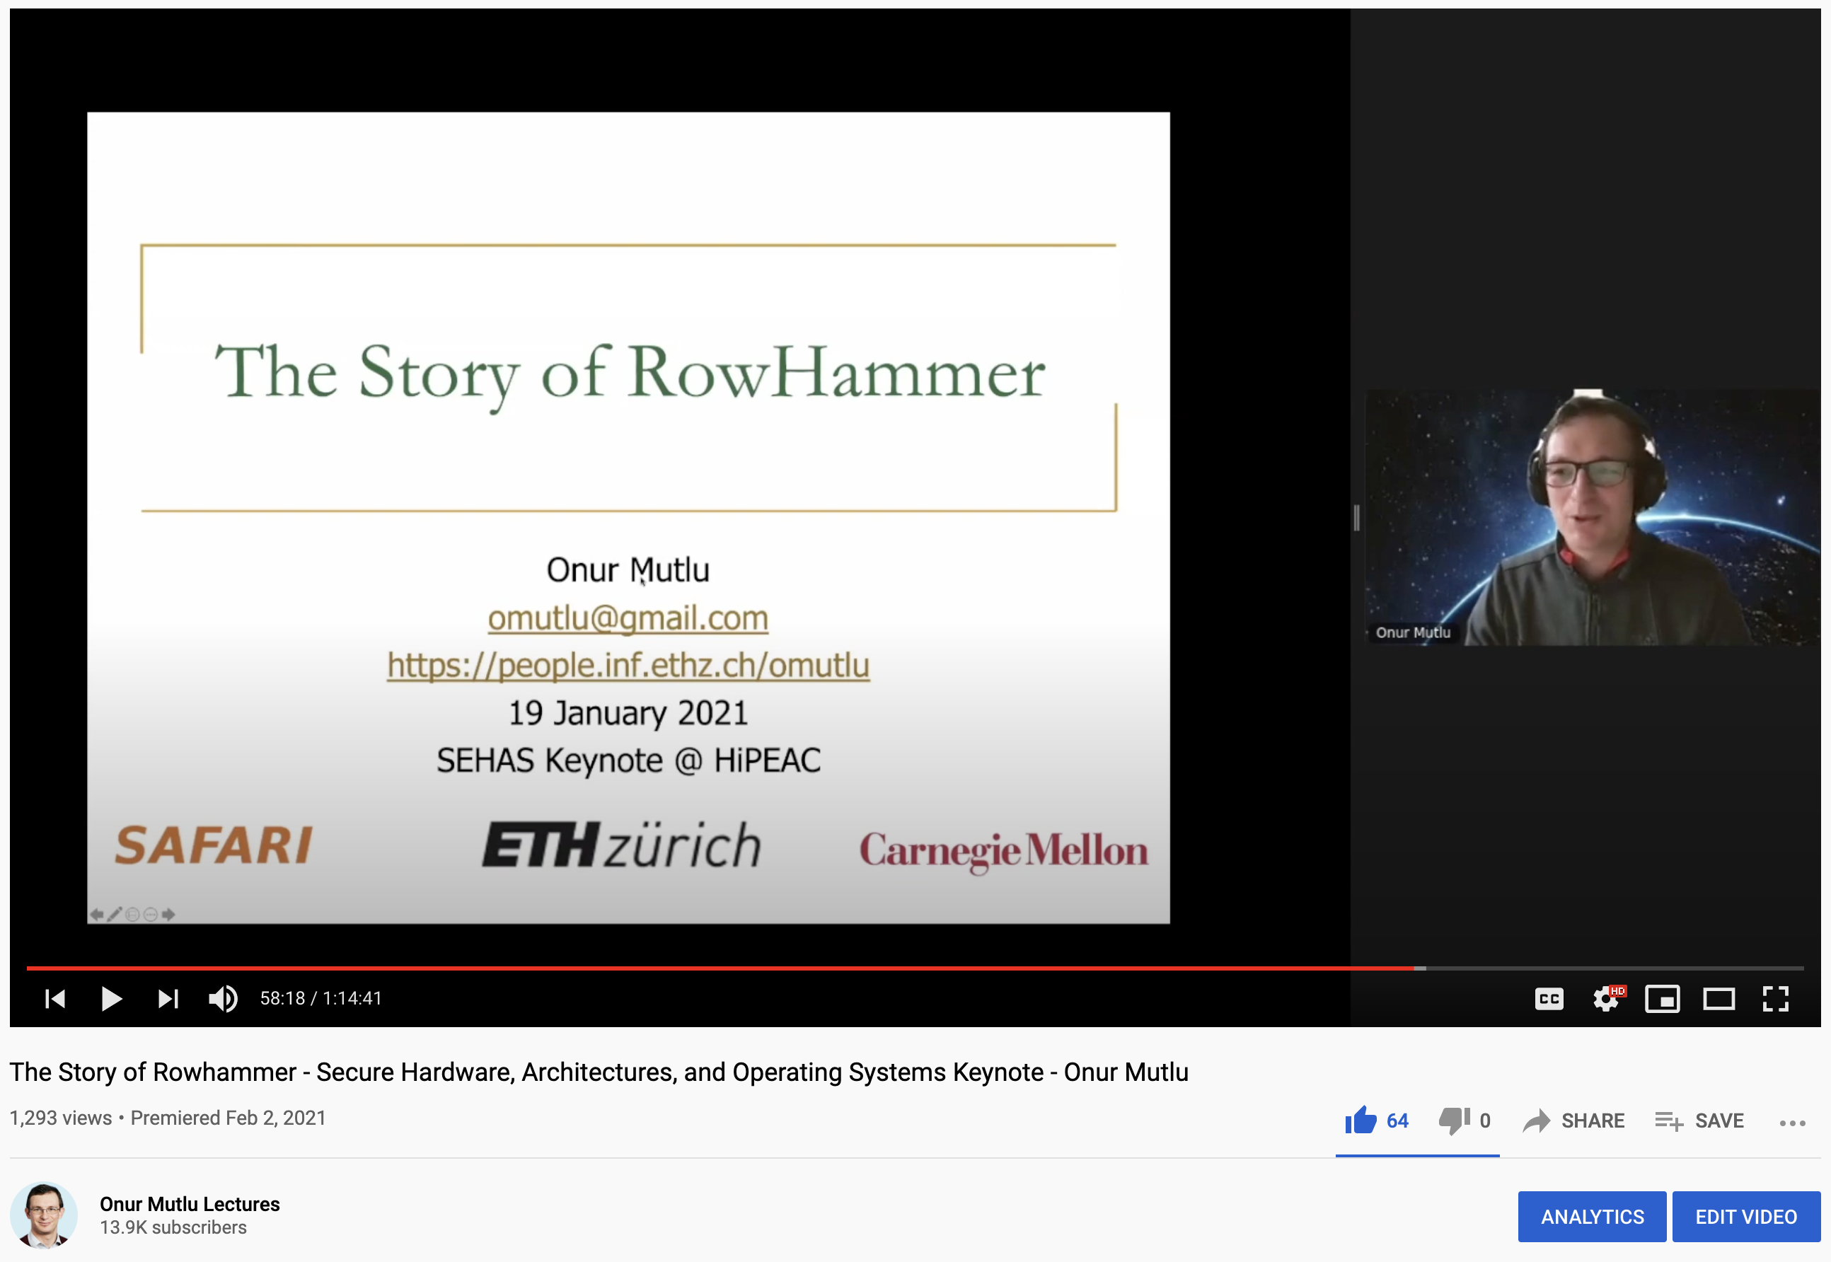
The Story of RowHammer Lecture …
Onur Mutlu,
"The Story of RowHammer"
Keynote Talk at Secure Hardware, Architectures, and Operating Systems Workshop (SeHAS), held with HiPEAC 2021 Conference, Virtual, 19 January 2021.
[Slides (pptx) (pdf)]
[Talk Video (1 hr 15 minutes, with Q&A)]

Slide 61
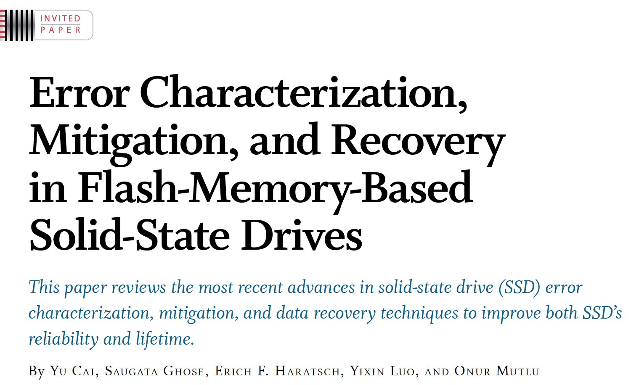
Understanding Flash Memory & SSD Reliability
Proceedings of the IEEE, Sept. 2017
https://arxiv.org/pdf/1706.08642

Slide 62
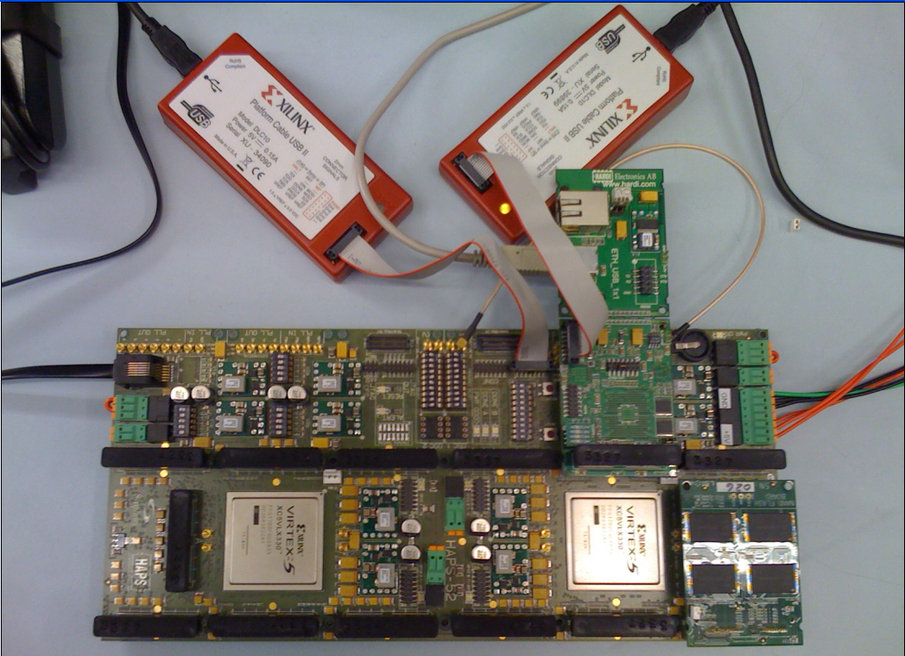
Understand and Model with Experiments (Flash)
USB Daughter Board
USB Jack
HAPS-52 Mother Board
Virtex-II Pro
(USB controller)
1x-nm
NAND Flash
Virtex-V FPGA
(NAND Controller)
[DATE 2012, ICCD 2012, DATE 2013, ITJ 2013, ICCD 2013, SIGMETRICS 2014, HPCA 2015, DSN 2015, MSST 2015, JSAC 2016, HPCA 2017, DFRWS 2017,
PIEEE 2017, HPCA 2018, SIGMETRICS 2018]
NAND Daughter Board
Cai+, “Error Characterization, Mitigation, and Recovery in Flash Memory Based Solid State Drives,” Proc. IEEE 2017.

Slide 63
One Important Takeaway
Main Memory Needs
Intelligent Controllers

Slide 64
Another Challenge and Opportunity
High Performance,
Energy Efficient,
Sustainable

Slide 65
The Problem
Processing of data
is performed
far away from the data

Slide 66
Energy Waste in Mobile Devices
Amirali Boroumand, Saugata Ghose, Youngsok Kim, Rachata Ausavarungnirun, Eric Shiu, Rahul Thakur, Daehyun Kim, Aki Kuusela, Allan Knies, Parthasarathy Ranganathan, and Onur Mutlu,
"Google Workloads for Consumer Devices: Mitigating Data Movement Bottlenecks"
Proceedings of the 23rd International Conference on Architectural Support for Programming Languages and Operating Systems (ASPLOS), Williamsburg, VA, USA, March 2018.
62.7% of the total system energy
is spent on data movement

Slide 67
The Problem
Data access is the major performance and energy bottleneck
Our current
design principles
cause great energy waste
(and great performance loss)

Slide 68
We Need A Paradigm Shift To …
Enable computation with minimal data movement
Compute where it makes sense (where data resides)
Make computing architectures more data-centric

Slide 69
Challenge and Opportunity for Future
Computing Architectures
with
Minimal Data Movement

Slide 70
Challenge and Opportunity for Future
Fundamentally
Energy-Efficient
(Data-Centric)
Computing Architectures

Slide 71
Challenge and Opportunity for Future
Fundamentally
High-Performance
(Data-Centric)
Computing Architectures

Slide 72
Goal: Processing Inside Memory
Many questions … How do we design the:
  compute-capable memory & controllers?
  processor chip and in-memory units?
  software and hardware interfaces?
  system software, compilers, languages?
  algorithms and theoretical foundations?
Memory
Processor
Core
Database
Graphs
Media
Cache
Query
Interconnect
Problem
Results
Algorithm
Program/Language
System Software
SW/HW Interface
Micro-architecture
Logic
Devices
Electrons

Slide 73
Memory as an Accelerator
CPU
core
CPU
core
mini-CPU
core
GPU
(throughput)
core
GPU
(throughput)
core
video
core
GPU
(throughput)
core
GPU
(throughput)
core
CPU
core
CPU
core
Memory
imaging
core
LLC
Specialized
compute-capability
in memory
Memory Controller
Memory Bus
Memory similar to a “conventional” accelerator

Slide 74
Processing in Memory:
Two Approaches
1. Processing using Memory
2. Processing near Memory

Slide 75
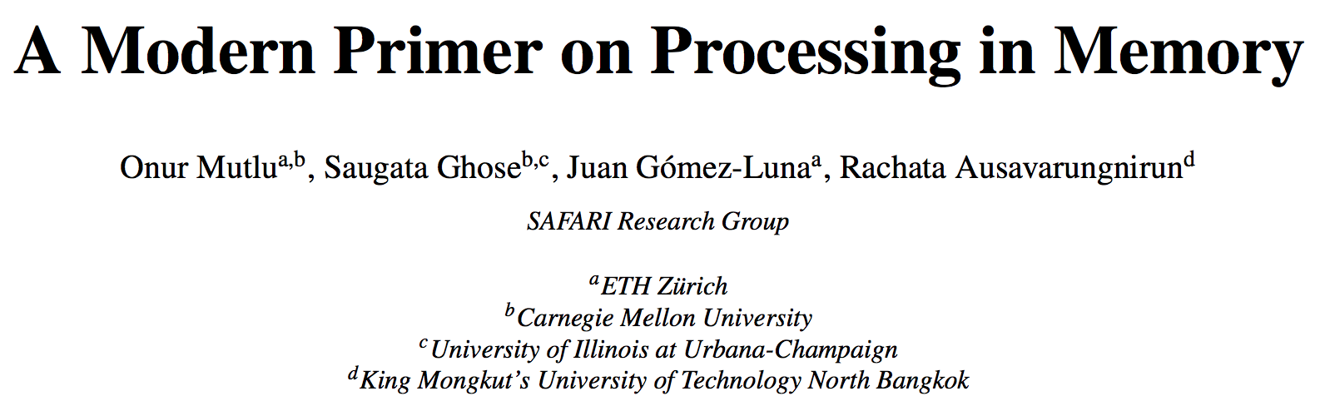
PIM Review and Open Problems
Onur Mutlu, Saugata Ghose, Juan Gomez-Luna, and Rachata Ausavarungnirun,
"A Modern Primer on Processing in Memory"
Invited Book Chapter in Emerging Computing: From Devices to Systems - Looking Beyond Moore and Von Neumann, Springer, to be published in 2021.
https://arxiv.org/pdf/1903.03988.pdf

Slide 76
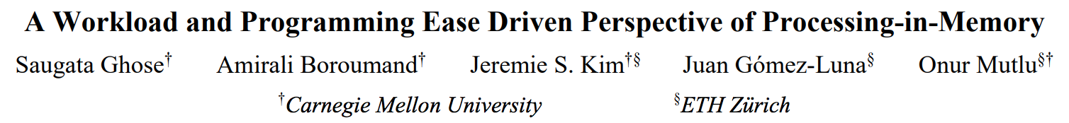
PIM Review and Open Problems (II)
Saugata Ghose, Amirali Boroumand, Jeremie S. Kim, Juan Gomez-Luna, and Onur Mutlu,
"Processing-in-Memory: A Workload-Driven Perspective"
Invited Article in IBM Journal of Research & Development, Special Issue on Hardware for Artificial Intelligence, to appear in November 2019.
[Preliminary arXiv version]
https://arxiv.org/pdf/1907.12947.pdf

Slide 77
More on Processing in Memory
Vivek Seshadri et al., “Ambit: In-Memory Accelerator for Bulk Bitwise Operations Using Commodity DRAM Technology,” MICRO 2017.

Slide 78
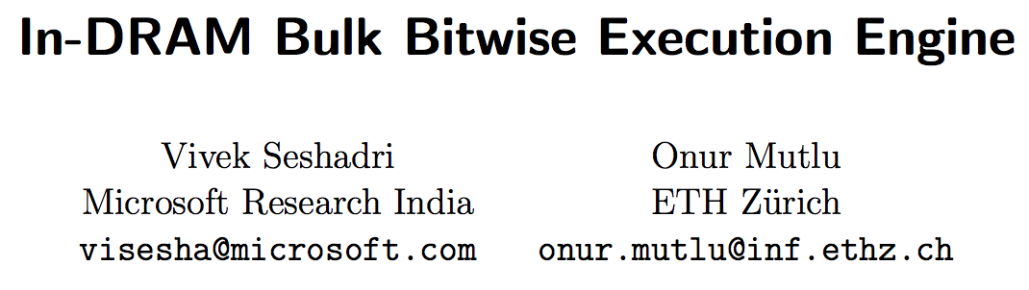
More on Processing in Memory
Vivek Seshadri and Onur Mutlu,
"In-DRAM Bulk Bitwise Execution Engine"
Invited Book Chapter in Advances in Computers, to appear in 2020.
[Preliminary arXiv version]

Slide 79
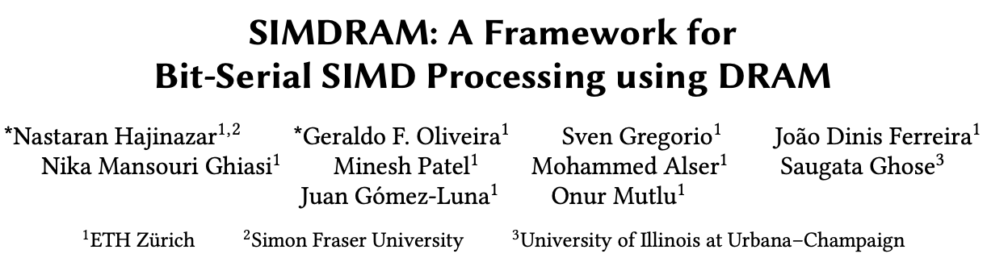
More on Processing in Memory (II)
Nastaran Hajinazar, Geraldo F. Oliveira, Sven Gregorio, Joao Dinis Ferreira, Nika Mansouri Ghiasi, Minesh Patel, Mohammed Alser, Saugata Ghose, Juan Gomez-Luna, and Onur Mutlu,
"SIMDRAM: An End-to-End Framework for Bit-Serial SIMD Computing in DRAM"
Proceedings of the 26th International Conference on Architectural Support for Programming Languages and Operating Systems (ASPLOS), Virtual, March-April 2021.
[2-page Extended Abstract]
[Short Talk Slides (pptx) (pdf)]
[Talk Slides (pptx) (pdf)]
[Short Talk Video (5 mins)]
[Full Talk Video (27 mins)]

Slide 80
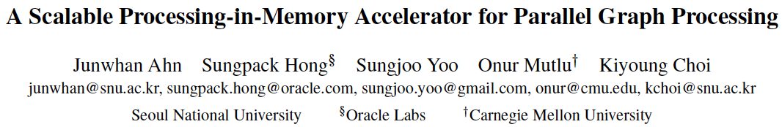
More on Processing in Memory (III)
Junwhan Ahn, Sungpack Hong, Sungjoo Yoo, Onur Mutlu, and Kiyoung Choi,
"A Scalable Processing-in-Memory Accelerator for Parallel Graph Processing"
Proceedings of the 42nd International Symposium on Computer Architecture (ISCA), Portland, OR, June 2015.
[Slides (pdf)] [Lightning Session Slides (pdf)]

Slide 81
More on Processing in Memory (IV)
Amirali Boroumand, Saugata Ghose, Youngsok Kim, Rachata Ausavarungnirun, Eric Shiu, Rahul Thakur, Daehyun Kim, Aki Kuusela, Allan Knies, Parthasarathy Ranganathan, and Onur Mutlu,
"Google Workloads for Consumer Devices: Mitigating Data Movement Bottlenecks"
Proceedings of the 23rd International Conference on Architectural Support for Programming Languages and Operating Systems (ASPLOS), Williamsburg, VA, USA, March 2018.

Slide 82
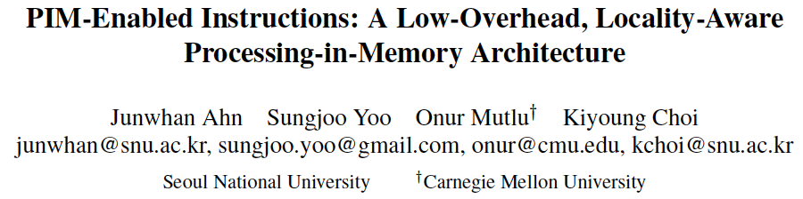
More on Processing in Memory (V)
Junwhan Ahn, Sungjoo Yoo, Onur Mutlu, and Kiyoung Choi,
"PIM-Enabled Instructions: A Low-Overhead, Locality-Aware Processing-in-Memory Architecture"
Proceedings of the 42nd International Symposium on Computer Architecture (ISCA), Portland, OR, June 2015.
[Slides (pdf)] [Lightning Session Slides (pdf)]

Slide 83
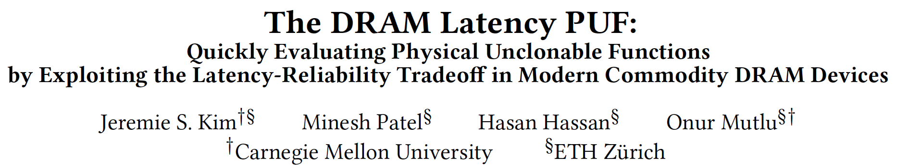
In-DRAM Physical Unclonable Functions
Jeremie S. Kim, Minesh Patel, Hasan Hassan, and Onur Mutlu,
"The DRAM Latency PUF: Quickly Evaluating Physical Unclonable Functions by Exploiting the Latency-Reliability Tradeoff in Modern DRAM Devices"
Proceedings of the 24th International Symposium on High-Performance Computer Architecture (HPCA), Vienna, Austria, February 2018.
[Lightning Talk Video]
[Slides (pptx) (pdf)] [Lightning Session Slides (pptx) (pdf)]
[Full Talk Lecture Video (28 minutes)]

Slide 84
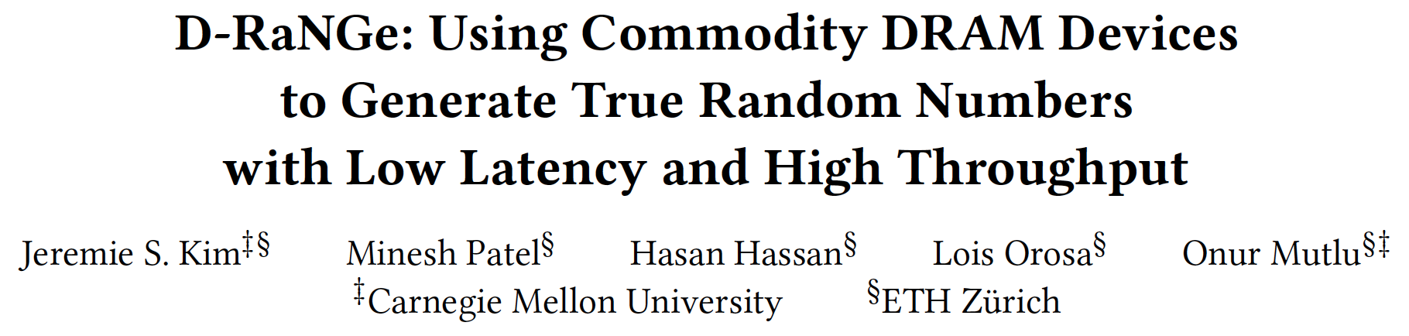
In-DRAM True Random Number Generation
Jeremie S. Kim, Minesh Patel, Hasan Hassan, Lois Orosa, and Onur Mutlu,
"D-RaNGe: Using Commodity DRAM Devices to Generate True Random Numbers with Low Latency and High Throughput"
Proceedings of the 25th International Symposium on High-Performance Computer Architecture (HPCA), Washington, DC, USA, February 2019.
[Slides (pptx) (pdf)]
[Full Talk Video (21 minutes)]
[Full Talk Lecture Video (27 minutes)]
Top Picks Honorable Mention by IEEE Micro.

Slide 85
Eliminating the Adoption Barriers
How to Enable Adoption of Processing in Memory

Slide 86
We Need to Revisit the Entire Stack
Problem
Algorithm
Program/Language
System Software
SW/HW Interface
Micro-architecture
Logic
Devices
Electrons
We can get there step by step

Slide 87
UPMEM Processing-in-DRAM Engine (2019)
Processing in DRAM Engine
Includes standard DIMM modules, with a large number of DPU processors combined with DRAM chips.
Replaces standard DIMMs
  DDR4 R-DIMM modules
    8GB+128 DPUs (16 PIM chips)
    Standard 2x-nm DRAM process
  Large amounts of compute & memory bandwidth
CPU
(x86, ARM, RV…)
DDR
Data bus
https://www.anandtech.com/show/14750/hot-chips-31-analysis-inmemory-processing-by-upmem
https://www.upmem.com/video-upmem-presenting-its-true-processing-in-memory-solution-hot-chips-2019/

Slide 88
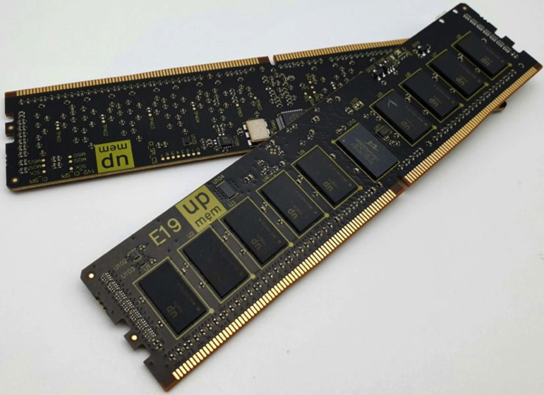
UPMEM Memory Modules
E19: 8 chips DIMM (1 rank). DPUs @ 267 MHz
P21: 16 chips DIMM (2 ranks). DPUs @ 350 MHz
www.upmem.com

Slide 89
PIM System Organization
UPMEM-based PIM system with 20 UPMEM memory modules of 16 chips each (40 ranks) → 2560 DPUs

Slide 90
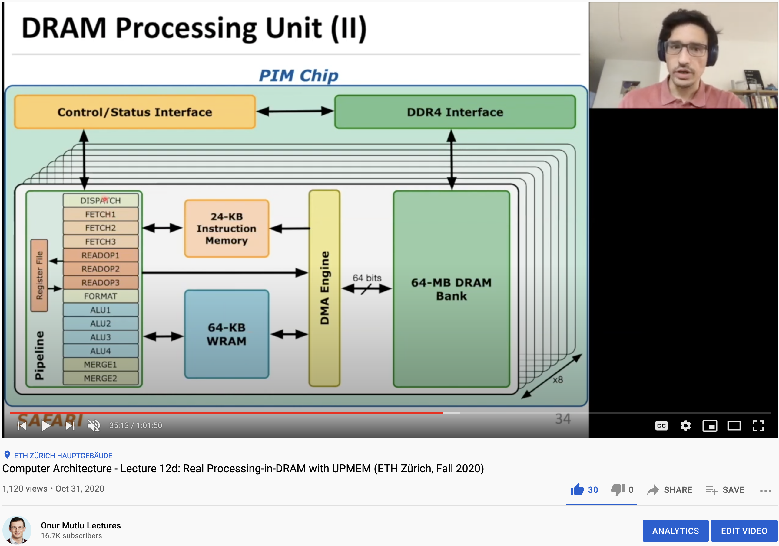
More on the UPMEM PIM System
https://www.youtube.com/watch?v=Sscy1Wrr22A&list=PL5Q2soXY2Zi9xidyIgBxUz7xRPS-wisBN&index=26

Slide 91
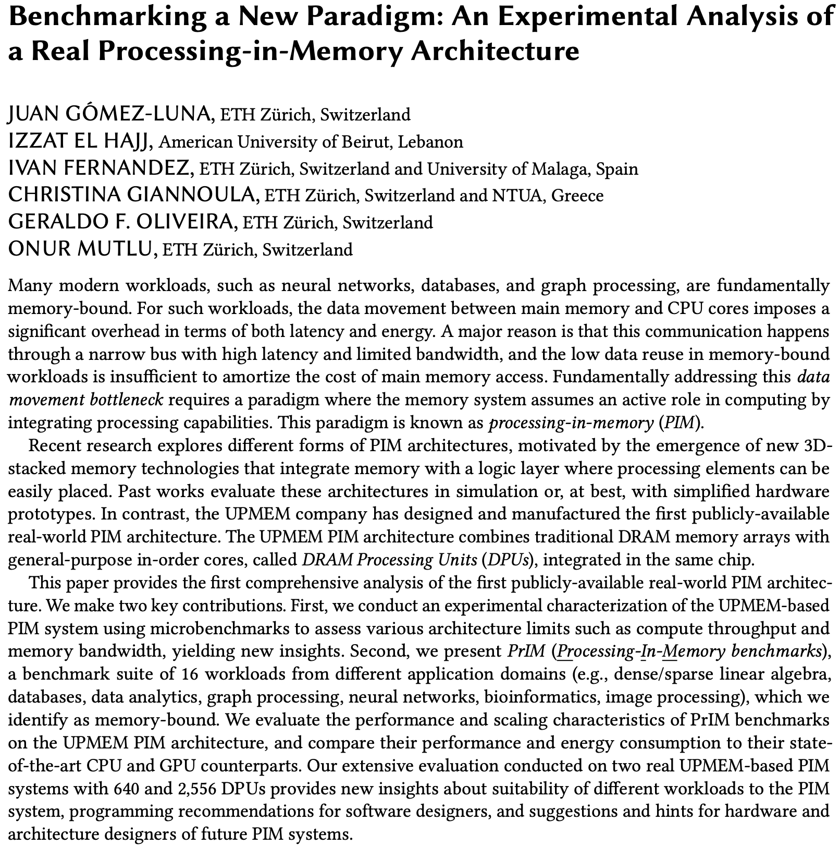
Experimental Analysis of the UPMEM PIM Engine
https://arxiv.org/pdf/2105.03814.pdf

Slide 92
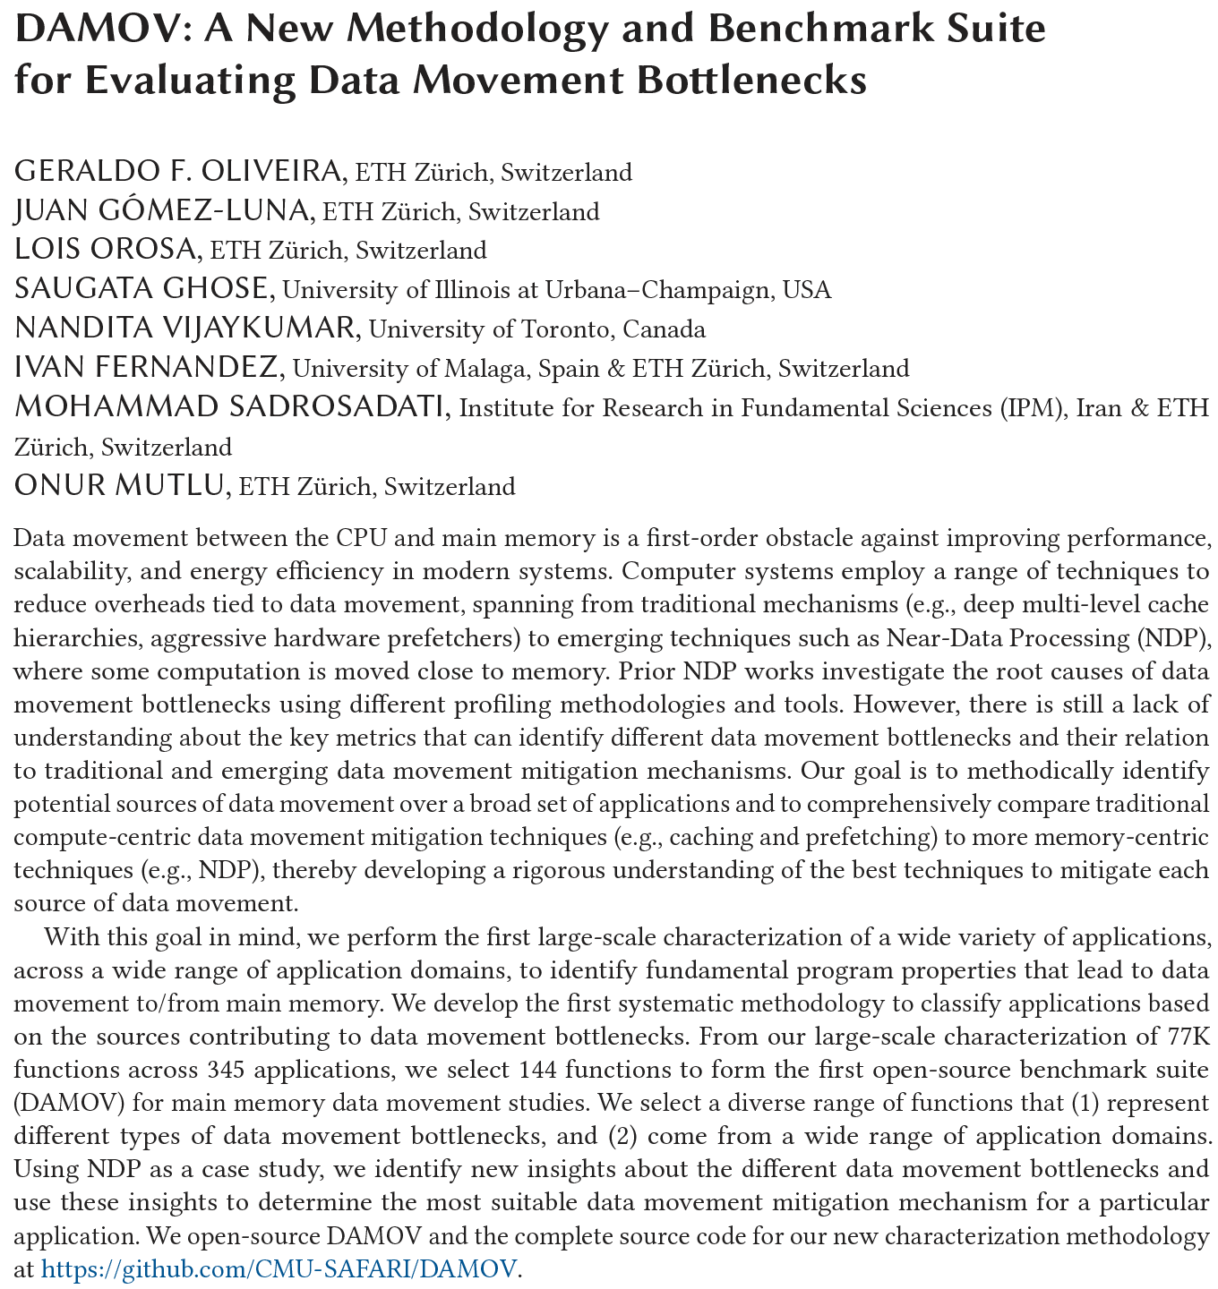
DAMOV Methodology & Workloads
https://arxiv.org/pdf/2105.03725.pdf

Slide 93
Detailed Lectures on PIM (I)
Computer Architecture, Fall 2020, Lecture 6
  Computation in Memory (ETH Zürich, Fall 2020)
  https://www.youtube.com/watch?v=oGcZAGwfEUE&list=PL5Q2soXY2Zi9xidyIgBxUz7xRPS-wisBN&index=12
Computer Architecture, Fall 2020, Lecture 7
  Near-Data Processing (ETH Zürich, Fall 2020)
  https://www.youtube.com/watch?v=j2GIigqn1Qw&list=PL5Q2soXY2Zi9xidyIgBxUz7xRPS-wisBN&index=13
Computer Architecture, Fall 2020, Lecture 11a
  Memory Controllers (ETH Zürich, Fall 2020)
  https://www.youtube.com/watch?v=TeG773OgiMQ&list=PL5Q2soXY2Zi9xidyIgBxUz7xRPS-wisBN&index=20
Computer Architecture, Fall 2020, Lecture 12d
  Real Processing-in-DRAM with UPMEM (ETH Zürich, Fall 2020)
  https://www.youtube.com/watch?v=Sscy1Wrr22A&list=PL5Q2soXY2Zi9xidyIgBxUz7xRPS-wisBN&index=25
https://www.youtube.com/onurmutlulectures

Slide 94
Detailed Lectures on PIM (II)
Computer Architecture, Fall 2020, Lecture 15
  Emerging Memory Technologies (ETH Zürich, Fall 2020)
  https://www.youtube.com/watch?v=AlE1rD9G_YU&list=PL5Q2soXY2Zi9xidyIgBxUz7xRPS-wisBN&index=28
Computer Architecture, Fall 2020, Lecture 16a
  Opportunities & Challenges of Emerging Memory Technologies (ETH Zürich, Fall 2020)
  https://www.youtube.com/watch?v=pmLszWGmMGQ&list=PL5Q2soXY2Zi9xidyIgBxUz7xRPS-wisBN&index=29
Computer Architecture, Fall 2020, Guest Lecture
  In-Memory Computing: Memory Devices & Applications (ETH Zürich, Fall 2020)
  https://www.youtube.com/watch?v=wNmqQHiEZNk&list=PL5Q2soXY2Zi9xidyIgBxUz7xRPS-wisBN&index=41
https://www.youtube.com/onurmutlulectures

Slide 95
A Tutorial on PIM
Onur Mutlu,
"Memory-Centric Computing Systems"
Invited Tutorial at 66th International Electron Devices Meeting (IEDM), Virtual, 12 December 2020.
[Slides (pptx) (pdf)]
[Executive Summary Slides (pptx) (pdf)]
[Tutorial Video (1 hour 51 minutes)]
[Executive Summary Video (2 minutes)]
[Abstract and Bio]
[Related Keynote Paper from VLSI-DAT 2020]
[Related Review Paper on Processing in Memory]
https://www.youtube.com/watch?v=H3sEaINPBOE
https://www.youtube.com/onurmutlulectures

Slide 96
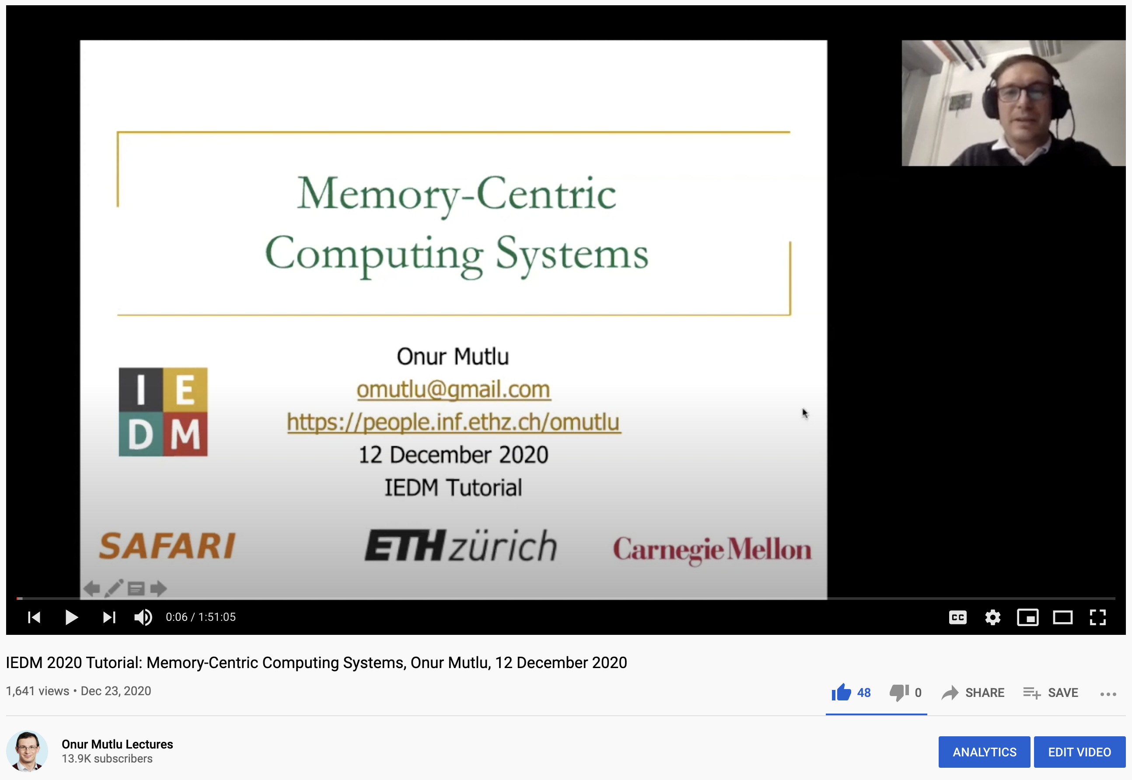
A Tutorial on PIM
Onur Mutlu,
"Memory-Centric Computing Systems"
Invited Tutorial at 66th International Electron Devices Meeting (IEDM), Virtual, 12 December 2020.
[Slides (pptx) (pdf)]
[Executive Summary Slides (pptx) (pdf)]
[Tutorial Video (1 hour 51 minutes)]
[Executive Summary Video (2 minutes)]
[Abstract and Bio]
[Related Keynote Paper from VLSI-DAT 2020]
[Related Review Paper on Processing in Memory]
https://www.youtube.com/watch?v=H3sEaINPBOE
https://www.youtube.com/onurmutlulectures

Slide 97
PIM Can Enable New Medical Platforms
Oxford Nanopore MinION
Senol Cali+, “Nanopore Sequencing Technology and Tools for Genome
Assembly: Computational Analysis of the Current State, Bottlenecks
and Future Directions,” Briefings in Bioinformatics, 2018.
[Preliminary arxiv.org version]

Slide 98
Future of Genome Sequencing & Analysis
MinION from ONT
SmidgION from ONT

Slide 99
Accelerating Genome Analysis: Overview
Mohammed Alser, Zulal Bingol, Damla Senol Cali, Jeremie Kim, Saugata Ghose, Can Alkan, and Onur Mutlu,
"Accelerating Genome Analysis: A Primer on an Ongoing Journey"
IEEE Micro (IEEE MICRO), Vol. 40, No. 5, pages 65-75, September/October 2020.
[Slides (pptx)(pdf)]
[Talk Video (1 hour 2 minutes)]

Slide 100
More on Fast Genome Analysis …
Onur Mutlu,
"Accelerating Genome Analysis: A Primer on an Ongoing Journey"
Invited Lecture at Technion, Virtual, 26 January 2021.
[Slides (pptx) (pdf)]
[Talk Video (1 hour 37 minutes, including Q&A)]
[Related Invited Paper (at IEEE Micro, 2020)]

Slide 101
Detailed Lectures on Genome Analysis
Computer Architecture, Fall 2020, Lecture 3a
  Introduction to Genome Sequence Analysis (ETH Zürich, Fall 2020)
  https://www.youtube.com/watch?v=CrRb32v7SJc&list=PL5Q2soXY2Zi9xidyIgBxUz7xRPS-wisBN&index=5
Computer Architecture, Fall 2020, Lecture 8
  Intelligent Genome Analysis (ETH Zürich, Fall 2020)
  https://www.youtube.com/watch?v=ygmQpdDTL7o&list=PL5Q2soXY2Zi9xidyIgBxUz7xRPS-wisBN&index=14
Computer Architecture, Fall 2020, Lecture 9a
  GenASM: Approx. String Matching Accelerator (ETH Zürich, Fall 2020)
  https://www.youtube.com/watch?v=XoLpzmN-Pas&list=PL5Q2soXY2Zi9xidyIgBxUz7xRPS-wisBN&index=15
Accelerating Genomics Project Course, Fall 2020, Lecture 1
  Accelerating Genomics (ETH Zürich, Fall 2020)
  https://www.youtube.com/watch?v=rgjl8ZyLsAg&list=PL5Q2soXY2Zi9E2bBVAgCqLgwiDRQDTyId
https://www.youtube.com/onurmutlulectures

Slide 102
Challenge and Opportunity for Future
Fundamentally
Low-Latency
Computing Architectures

Slide 103
Truly Reducing Memory Latency

Slide 104

Tiered-Latency DRAM
Donghyuk Lee, Yoongu Kim, Vivek Seshadri, Jamie Liu, Lavanya Subramanian, and Onur Mutlu,
"Tiered-Latency DRAM: A Low Latency and Low Cost DRAM Architecture"
Proceedings of the 19th International Symposium on High-Performance Computer Architecture (HPCA), Shenzhen, China, February 2013. Slides (pptx)

Slide 105

Adaptive-Latency DRAM
Donghyuk Lee, Yoongu Kim, Gennady Pekhimenko, Samira Khan, Vivek Seshadri, Kevin Chang, and Onur Mutlu,
"Adaptive-Latency DRAM: Optimizing DRAM Timing for the Common-Case"
Proceedings of the 21st International Symposium on High-Performance Computer Architecture (HPCA), Bay Area, CA, February 2015.
[Slides (pptx) (pdf)] [Full data sets]

Slide 106

Analysis of Latency Variation in DRAM Chips
Kevin Chang, Abhijith Kashyap, Hasan Hassan, Samira Khan, Kevin Hsieh, Donghyuk Lee, Saugata Ghose, Gennady Pekhimenko, Tianshi Li, and Onur Mutlu,
"Understanding Latency Variation in Modern DRAM Chips: Experimental Characterization, Analysis, and Optimization"
Proceedings of the ACM International Conference on Measurement and Modeling of Computer Systems (SIGMETRICS), Antibes Juan-Les-Pins, France, June 2016.
[Slides (pptx) (pdf)]
[Source Code]

Slide 107

Design-Induced Latency Variation in DRAM
Donghyuk Lee, Samira Khan, Lavanya Subramanian, Saugata Ghose, Rachata Ausavarungnirun, Gennady Pekhimenko, Vivek Seshadri, and Onur Mutlu,
"Design-Induced Latency Variation in Modern DRAM Chips: Characterization, Analysis, and Latency Reduction Mechanisms"
Proceedings of the ACM International Conference on Measurement and Modeling of Computer Systems (SIGMETRICS), Urbana-Champaign, IL, USA, June 2017.

Slide 108

Solar-DRAM: Putting It Together
Jeremie S. Kim, Minesh Patel, Hasan Hassan, and Onur Mutlu,
"Solar-DRAM: Reducing DRAM Access Latency by Exploiting the Variation in Local Bitlines"
Proceedings of the 36th IEEE International Conference on Computer Design (ICCD), Orlando, FL, USA, October 2018.
[Slides (pptx) (pdf)]
[Talk Video (16 minutes)]

Slide 109

CLR-DRAM: Capacity-Latency Reconfigurability
Haocong Luo, Taha Shahroodi, Hasan Hassan, Minesh Patel, A. Giray Yaglikci, Lois Orosa, Jisung Park, and Onur Mutlu,
"CLR-DRAM: A Low-Cost DRAM Architecture Enabling Dynamic Capacity-Latency Trade-Off"
Proceedings of the 47th International Symposium on Computer Architecture (ISCA), Valencia, Spain, June 2020.
[Slides (pptx) (pdf)]
[Lightning Talk Slides (pptx) (pdf)]
[Talk Video (20 minutes)]
[Lightning Talk Video (3 minutes)]

Slide 110

Low-Latency Solid-State Drives (SSDs)
Jisung Park, Myungsuk Kim, Myoungjun Chun, Lois Orosa, Jihong Kim, and Onur Mutlu,
"Reducing Solid-State Drive Read Latency by Optimizing Read-Retry"
Proceedings of the 26th International Conference on Architectural Support for Programming Languages and Operating Systems (ASPLOS), Virtual, March-April 2021.
[2-page Extended Abstract]
[Short Talk Slides (pptx) (pdf)]
[Full Talk Slides (pptx) (pdf)]
[Short Talk Video (5 mins)]
[Full Talk Video (19 mins)]

Slide 111
Lectures on Low-Latency Memory
Computer Architecture, Fall 2020, Lecture 10
  Low-Latency Memory (ETH Zürich, Fall 2020)
  https://www.youtube.com/watch?v=vQd1YgOH1Mw&list=PL5Q2soXY2Zi9xidyIgBxUz7xRPS-wisBN&index=19
Computer Architecture, Fall 2020, Lecture 12b
  Capacity-Latency Reconfigurable DRAM (ETH Zürich, Fall 2020)
  https://www.youtube.com/watch?v=DUtPFW3jxq4&list=PL5Q2soXY2Zi9xidyIgBxUz7xRPS-wisBN&index=23
Computer Architecture, Fall 2019, Lecture 11a
  DRAM Latency PUF (ETH Zürich, Fall 2019)
  https://www.youtube.com/watch?v=7gqnrTZpjxE&list=PL5Q2soXY2Zi-DyoI3HbqcdtUm9YWRR_z-&index=15
Computer Architecture, Fall 2019, Lecture 11b
  DRAM True Random Number Generator (ETH Zürich, Fall 2020)
  https://www.youtube.com/watch?v=Y3hPv1I5f8Y&list=PL5Q2soXY2Zi-DyoI3HbqcdtUm9YWRR_z-&index=16
https://www.youtube.com/onurmutlulectures

Slide 112

A Tutorial on Low-Latency Memory
https://www.youtube.com/onurmutlulectures

Slide 113
We Need to Revisit the Entire Stack
Problem
Algorithm
Program/Language
System Software
SW/HW Interface
Micro-architecture
Logic
Devices
Electrons
We can get there step by step

Slide 114
Open-Source Artifacts
https://github.com/CMU-SAFARI

Slide 115

https://github.com/CMU-SAFARI

Slide 116
Some Open Source Tools (I)
Rowhammer – Program to Induce RowHammer Errors
  https://github.com/CMU-SAFARI/rowhammer
Ramulator – Fast and Extensible DRAM Simulator
  https://github.com/CMU-SAFARI/ramulator
MemSim – Simple Memory Simulator
  https://github.com/CMU-SAFARI/memsim
NOCulator – Flexible Network-on-Chip Simulator
  https://github.com/CMU-SAFARI/NOCulator
SoftMC – FPGA-Based DRAM Testing Infrastructure
  https://github.com/CMU-SAFARI/SoftMC
Other open-source software from my group
  https://github.com/CMU-SAFARI/
  http://www.ece.cmu.edu/~safari/tools.html

Slide 117
Some Open Source Tools (II)
MQSim – A Fast Modern SSD Simulator
  https://github.com/CMU-SAFARI/MQSim
Mosaic – GPU Simulator Supporting Concurrent Applications
  https://github.com/CMU-SAFARI/Mosaic
IMPICA – Processing in 3D-Stacked Memory Simulator
  https://github.com/CMU-SAFARI/IMPICA
SMLA – Detailed 3D-Stacked Memory Simulator
  https://github.com/CMU-SAFARI/SMLA
HWASim – Simulator for Heterogeneous CPU-HWA Systems
  https://github.com/CMU-SAFARI/HWASim
Other open-source software from my group
  https://github.com/CMU-SAFARI/
  http://www.ece.cmu.edu/~safari/tools.html

Slide 118

More Open Source Tools (III)
A lot more open-source software from my group
  https://github.com/CMU-SAFARI/

Slide 119



Slide 120
Other Panel Questions

Slide 121
Question 1: Grad Application Process
What is the grad application process at your institution?
  (i.e., personal statement? standardized test scores? reference letters? interview?)

Slide 122
Application Process at ETH Zurich
PhD starts after a Master’s degree
  Except for few exceptions, you need to have a Master’s degree to apply
You can apply for a Master’s degree first
  And, then go for a PhD
Master’s admissions are centralized and handled by the department (D-ITET, D-INFK, …)
PhD admissions are de-centralized and handled by Professor + ETH Zurich Doctoral Office

Slide 123

Application Process for SAFARI
https://safari.ethz.ch/apply/

Slide 124
SAFARI Process
An internship with the group is very useful & desirable
  During Bachelor’s, Master’s degrees or at any other time
Familiarity with the research area + passion for research
Good personal statement
Good critical review of papers
Good interview with group & me
Good mindset, goals, effort
Good communication skills and communicativeness
…

Slide 125
Question 2: Candidate Characteristics
What do you look for in a candidate?
  What are a few things that stand out to you?

Slide 126
How to Select PhD Students & Researchers
Motivation and Mindset
Creativity
Resilience
Hard work
Boldness
Perseverance, commitment
Intellectual strength
Openness to feedback
Communicativeness, emotional intelligence
Ability to execute things until the end
…
A PhD is a long road. It is not for everyone. Commitment & resilience are critical.

Slide 127
How to Select Students
https://safari.ethz.ch/apply/

Slide 128
Question 3: GPA and GRE?
When looking at applications, how important are GPA and standardized test scores (e.g., GRE) to you?
GPA is part of the process but not important enough
  No decision or filtering made based on GPA
    We want insight not numbers
  Individual courses can be important
  Motivation, characteristics, skills & insight are very important
  GPA is not a predictor of great research
We do not require GRE scores
TOEFL/IELTS required for non-native English speakers

Slide 129
Question 4: Personal Statement
What do you look for in a personal statement?

Slide 130
How to Select PhD Students & Researchers
Motivation and Mindset
Creativity
Resilience
Hard work
Boldness
Perseverance, commitment
Intellectual strength
Openness to feedback
Communicativeness, emotional intelligence
Ability to execute things until the end
…
A PhD is a long road. It is not for everyone. Commitment & resilience are critical.

Slide 131
Principle: Continuous Growth
A PhD is About Continuous Growth
(Learning & Independence)

Slide 132
Principle: Personalized Methods
Find the methods
that work for you

Slide 133
Principle: Personal Growth
Doing so requires
many characteristics
(which one can learn)

Slide 134
Motivation & Mindset

Slide 135
Principle: Mindset and Motivation
Start out with
the right
motivation and mindset

Slide 136
Motivation Sets The Culture and Goals
Mindset 1: change the world positively, have high influence
Mindset 2: enable students to achieve a potential that they did not even think they could ever achieve
Not papers
Not fame
Not money
No quantitative measure, really
…
Motivation correction may be needed at times – be ready

Slide 137
Principle: Team of Excellence
Get motivated students
Build a team of excellence

Slide 138
Principle: Learning and Scholarship
Focus on
learning and scholarship

Slide 139
Principle: Environment of Freedom
Create an environment
that values
free exploration, openness, collaboration, hard work, creativity

Slide 140
What Is The Goal of Research?
To generate new insight
  that can enable what previously did not exist
Research is a hunt for insight that can eventually impact the world
Slides used in several of my courses: e.g., https://www.youtube.com/watch?v=M0y_Nvb9rGA

Slide 141
Principle: Insight and Ideas
Focus on Insight
Encourage New Ideas

Slide 142
Some Basic Advice for Good Research
Choose great problems to solve: Have great taste
  Difficult
  Important
  High impact
Read heavily and critically
Think big (out of the box)
  Do not restrain yourself to tweaks or constraints of today
  Yet, think about adoption issues
Aim high, be rigorous
Write and present extremely well
Slides used in several of my courses: e.g., https://www.youtube.com/watch?v=M0y_Nvb9rGA

Slide 143
Many Principles on the Previous Slide

Slide 144
Principle: Bar
Set the Bar High

Slide 145
Set the Bar High
The goal should be to enable students to achieve a potential that they did not even think they could ever achieve
“Think big, aim high, enable positive change”
Reward good, positive behavior that helps with this culture
Recommended reading:
  Hamming, “You and Your Research,” Talk at Bell Labs, 1986.
    https://www.cs.virginia.edu/~robins/YouAndYourResearch.html

Slide 146
Principle: Focus on Fundamentals
Fundamentals
and scholarship
are critical
(hypes come and go)

Slide 147
Principle: Focus on Big Problems
Choose Great Problems
and guide your group toward them
(but give them freedom)

Slide 148
Principle: Teaching and Research
…
Teaching drives Research
Research drives Teaching
…

Slide 149
More on Teaching and Research
Care about teaching immensely
Teaching and research are two sides of the same coin → scholarship
Both long-term and short-term is affected by teaching
Research motivates teaching motivates research
  I introduce RowHammer, Processing in Memory, Meltdown/Spectre, DRAM Refresh, Various Technology Scaling problems, and research examples in my Bachelor’s course:
    https://safari.ethz.ch/digitaltechnik/spring2021/
  All courses can have research examples

Slide 150
Principle: Focus on Communication
Emphasize
Clarity and Rigor
in Communication
(critical for high impact)

Slide 151
Principle: Collaboration
Foster collaboration
(within group)
(across groups)
(with companies)

Slide 152
Do Everything to Have High Impact
Engage with companies
Engage and collaborate with researchers who fit your mindset
  Collaborate, not fight
Strive for the highest excellence

Slide 153
Principle: Reach Out
Inspire and Reach Out

Slide 154
Principle: Reach Out
Give talks
Educate others on your work and research
Listen to everyone
  Especially your students
Teach, educate, collaborate

Slide 155
Principle: Feedback
Receive & Address Feedback
(but do not get derailed)

Slide 156
Principle: Receive & Address Feedback
Address reviewer feedback
  Take them positively
  They can be helpful
Feedback is not always right
  Need to apply corrections to it
Do not let rejection derail you – be ready for it
Remind and encourage your students:
  https://www.sciencealert.com/these-8-papers-were-rejected-before-going-on-to-win-the-nobel-prize

Slide 157
Principle: Resilience
Be Resilient

Slide 158
Principle: Passion
Follow Your Passion

Slide 159
Principle: Passion Extended
Follow Your Passion
(Do not get derailed
by naysayers)

Slide 160
Principle: Learning and Scholarship
The quality of your work defines your impact

Slide 161
Principle: Build Infrastructure
Build Infrastructure to Enable Your Passion
(Big Ideas & Projects)

Slide 162
Principle: Work Hard
Work Hard to Enable Your Passion

Slide 163
My Suggestions to You

Slide 164
Principle: Mindset and Motivation
Start out with
the right
motivation and mindset

Slide 165
Principle: Bar
Set Your Own Bar High
(Continuous Growth & Learning)

Slide 166
Principle: Think Big, Aim High
Think Big
Aim High

Slide 167
Suggestion to Researchers: Principle: Passion
Follow Your Passion
(Do not get derailed
by naysayers)

Slide 168
Principle: Build Infrastructure
Build Infrastructure to Enable Your Passion

Slide 169
Principle: Work Hard
Work Hard to Enable Your Passion

Slide 170
Suggestion to Researchers: Principle: Resilience
Be Resilient

Slide 171
Principle: Learning and Scholarship
Focus on
learning and scholarship

Slide 172
Principle: Learning and Scholarship
The quality of your work defines your impact

Slide 173
Principle: Good Mindset, Goals & Focus
You can make a good impact on the world

Slide 174
Food for Thought: Two Quotes
The reasonable man adapts himself to the world;
The unreasonable one persists in trying to adapt the world to himself.
Therefore, all progress depends on the unreasonable man.
George Bernard Shaw
Progress is impossible without change,
and those who cannot change their minds
cannot change anything.
Image: By Alvin Langdon Coburn - Illustrated London News, p. 575 (subscription required), PD-US, https://en.wikipedia.org/w/index.php?curid=49887931

Slide 175
Applying to Grad School
& Doing Impactful Research
Onur Mutlu
omutlu@gmail.com
https://people.inf.ethz.ch/omutlu
13 June 2021
Undergraduate Architecture Mentoring Workshop @ ISCA 2021

Slide 176
Backup Slides on
“Impactful Research”
Onur Mutlu,
"How to Build an Impactful Research Group"
57th Design Automation Conference Early Career Workshop (DAC), Virtual, 19 July 2020.
[Slides (pptx) (pdf)]

Slide 177
Question 1: Best Practices
Which are the best practices that you would suggest to your peers as the essential one for the success of an academic team?

Slide 178
Before I Start…
There is no single way of having impact.
The following is my way, methods and principles.
There definitely are other ways.
The critical thing is finding the way that works well for you and your goals.
  That you can own, cherish and optimize

Slide 179
Principle: Personalized Methods
Find the methods
that work for you

Slide 180
Motivation & Mindset

Slide 181
Principle: Mindset and Motivation
Start out with
the right
motivation and mindset

Slide 182
Motivation Sets The Culture and Goals
Mindset 1: change the world positively, have high influence
Mindset 2: enable students to achieve a potential that they did not even think they could ever achieve
Not papers
Not fame
Not money
No quantitative measure, really
…
Motivation correction may be needed at times – be ready

Slide 183
Principle: Team of Excellence
Get motivated students
Build a team of excellence

Slide 184
Principle: Learning and Scholarship
Focus on
learning and scholarship

Slide 185
Some Basics of Research
Slides used in several of my courses:
e.g., https://www.youtube.com/watch?v=M0y_Nvb9rGA

Slide 186
How To Do Research & Advanced Dev.
We will talk a lot about this in this course
Learning by example
  Reading and evaluating strong and seminal papers & designs
Learning by doing
  Semester-long research/design projects, masters’ projects, PhD thesis
Learning by open, critical discussions
  Paper reading groups, frequent brainstorming and discussions
  Design sessions
  Collaborations
Slides used in several of my courses: e.g., https://www.youtube.com/watch?v=M0y_Nvb9rGA

Slide 187
Principle: Environment of Freedom
Create an environment
that values
free exploration, openness, collaboration, hard work, creativity

Slide 188
What Is The Goal of Research?
To generate new insight
  that can enable what previously did not exist
Research is a hunt for insight that can eventually impact the world
Slides used in several of my courses: e.g., https://www.youtube.com/watch?v=M0y_Nvb9rGA

Slide 189
Principle: Insight and Ideas
Focus on Insight
Encourage New Ideas

Slide 190
Some Basic Advice for Good Research
Choose great problems to solve: Have great taste
  Difficult
  Important
  High impact
Read heavily and critically
Think big (out of the box)
  Do not restrain yourself to tweaks or constraints of today
  Yet, think about adoption issues
Aim high
Write and present extremely well
Slides used in several of my courses: e.g., https://www.youtube.com/watch?v=M0y_Nvb9rGA

Slide 191
Many Principles on the Previous Slide

Slide 192
Principle: Bar
Set the Bar High

Slide 193
Set the Bar High
The goal should be to enable students to achieve a potential that they did not even think they could ever achieve
“Think big, aim high, enable positive change”
Reward good, positive behavior that helps with this culture
Recommended reading:
  Hamming, “You and Your Research,” Talk at Bell Labs, 1986.
    https://www.cs.virginia.edu/~robins/YouAndYourResearch.html

Slide 194
Principle: Focus on Fundamentals
Fundamentals
and scholarship
are critical
(hypes come and go)

Slide 195
Principle: Focus on Big Problems
Choose Great Problems
and guide your group toward them
(but give them freedom)

Slide 196
Principle: Teaching and Research
…
Teaching drives Research
Research drives Teaching
…

Slide 197
More on Teaching and Research
Care about teaching immensely
Teaching and research are two sides of the same coin → scholarship
Both long-term and short-term is affected by teaching
Research motivates teaching motivates research
  I introduce RowHammer, Processing in Memory, Meltdown/Spectre, DRAM Refresh, Various Technology Scaling problems, and research examples in my Freshman course:
    https://safari.ethz.ch/digitaltechnik/spring2020/
  All courses can have research examples

Slide 198
Principle: Focus on Communication
Emphasize
Clarity and Rigor
in Communication
(critical for high impact)

Slide 199
Do Everything to Have High Impact
Engage with companies
Engage and collaborate with researchers who fit your mindset
  Collaborate, not fight
Strive for the highest excellence

Slide 200
Principle: Collaboration
Foster collaboration
(within group)
(across groups)
(with companies)

Slide 201
Principle: Reach Out
Inspire and Reach Out

Slide 202
Principle: Reach Out
Give talks
Educate others on your work and research
Listen to everyone
  Especially your students
Teach, educate, collaborate

Slide 203
Principle: Feedback
Receive & Address Feedback
(but do not get derailed)

Slide 204
Principle: Receive & Address Feedback
Address reviewer feedback
  Take them positively
  They can be helpful
Feedback is not always right
  Need to apply corrections to it
Do not let rejection derail you – be ready for it
Remind and encourage your students:
  https://www.sciencealert.com/these-8-papers-were-rejected-before-going-on-to-win-the-nobel-prize

Slide 205
Principle: Resilience
Be Resilient

Slide 206
Principle: Passion
Follow Your Passion

Slide 207
Principle: Passion Extended
Follow Your Passion
(Do not get derailed
by naysayers)

Slide 208
Principle: Learning and Scholarship
The quality of your work defines your impact

Slide 209
If In Doubt, See Other Doubtful Technologies
A very “doubtful” emerging technology
  for at least two decades
Proceedings of the IEEE, Sept. 2017
https://arxiv.org/pdf/1706.08642

Slide 210

Flash Memory Timeline (1967-2019)

Slide 211

Flash Memory Timeline (1967-2019)

Slide 212
Four Key Current Directions
Fundamentally Secure/Reliable/Safe Architectures
Fundamentally Energy-Efficient Architectures
  Memory-centric (Data-centric) Architectures
Fundamentally Low-Latency and Predictable Architectures
Architectures for AI/ML, Genomics, Medicine, Health

Slide 213
Our Dream (circa 2007)
An embedded device that can perform comprehensive genome analysis in real time (within a minute)
  Which of these DNAs does this DNA segment match with?
  What is the likely genetic disposition of this patient to this drug?
  . . .

Slide 214
New Genome Sequencing Technologies
Oxford Nanopore MinION
Senol Cali+, “Nanopore Sequencing Technology and Tools for Genome
Assembly: Computational Analysis of the Current State, Bottlenecks
and Future Directions,” Briefings in Bioinformatics, 2018.
[Preliminary arxiv.org version]

Slide 215
Nanopore Genome Assembly Pipeline
Senol Cali+, “Nanopore Sequencing Technology and Tools for Genome
Assembly,” Briefings in Bioinformatics, 2018.

Slide 216
GateKeeper: FPGA-Based Alignment Filtering
Mohammed Alser, Hasan Hassan, Hongyi Xin, Oguz Ergin, Onur Mutlu, and Can Alkan
"GateKeeper: A New Hardware Architecture for Accelerating Pre-Alignment in DNA Short Read Mapping"
Bioinformatics, [published online, May 31], 2017.
[Source Code]
[Online link at Bioinformatics Journal]

Slide 217

Shouji (障子) [Alser+, Bioinformatics 2019]
Mohammed Alser, Hasan Hassan, Akash Kumar, Onur Mutlu, and Can Alkan,
"Shouji: A Fast and Efficient Pre-Alignment Filter for Sequence Alignment"
Bioinformatics, [published online, March 28], 2019.
[Source Code]
[Online link at Bioinformatics Journal]

Slide 218

SneakySnake [Alser+, Bioinformatics 2020]
Mohammed Alser, Taha Shahroodi, Juan-Gomez Luna, Can Alkan, and Onur Mutlu,
"SneakySnake: A Fast and Accurate Universal Genome Pre-Alignment Filter for CPUs, GPUs, and FPGAs"
Bioinformatics, to appear in 2020.
[Source Code]
[Online link at Bioinformatics Journal]

Slide 219
GenASM Framework [MICRO 2020]
Damla Senol Cali, Gurpreet S. Kalsi, Zulal Bingol, Can Firtina, Lavanya Subramanian, Jeremie S. Kim, Rachata Ausavarungnirun, Mohammed Alser, Juan Gomez-Luna, Amirali Boroumand, Anant Nori, Allison Scibisz, Sreenivas Subramoney, Can Alkan, Saugata Ghose, and Onur Mutlu,
"GenASM: A High-Performance, Low-Power Approximate String Matching Acceleration Framework for Genome Sequence Analysis"
Proceedings of the 53rd International Symposium on Microarchitecture (MICRO), Virtual, October 2020.
[Lighting Talk Video (1.5 minutes)]
[Lightning Talk Slides (pptx) (pdf)]
[Talk Video (18 minutes)]
[Slides (pptx) (pdf)]

Slide 220

In-Memory DNA Sequence Analysis
Jeremie S. Kim, Damla Senol Cali, Hongyi Xin, Donghyuk Lee, Saugata Ghose, Mohammed Alser, Hasan Hassan, Oguz Ergin, Can Alkan, and Onur Mutlu,
"GRIM-Filter: Fast Seed Location Filtering in DNA Read Mapping Using Processing-in-Memory Technologies"
BMC Genomics, 2018.
Proceedings of the 16th Asia Pacific Bioinformatics Conference (APBC), Yokohama, Japan, January 2018.
[Slides (pptx) (pdf)]
[Source Code]
[arxiv.org Version (pdf)]
[Talk Video at AACBB 2019]

Slide 221
Future of Genome Sequencing & Analysis
MinION from ONT
SmidgION from ONT

Slide 222

COVID-19 Nanopore Sequencing (I)
From ONT (https://nanoporetech.com/covid-19/overview)

Slide 223

COVID-19 Nanopore Sequencing (II)
From ONT (https://nanoporetech.com/covid-19/overview)

Slide 224
Accelerating Genome Analysis: Overview
Mohammed Alser, Zulal Bingol, Damla Senol Cali, Jeremie Kim, Saugata Ghose, Can Alkan, and Onur Mutlu,
"Accelerating Genome Analysis: A Primer on an Ongoing Journey"
IEEE Micro (IEEE MICRO), Vol. 40, No. 5, pages 65-75, September/October 2020.
[Slides (pptx)(pdf)]
[Talk Video (1 hour 2 minutes)]

Slide 225
Principle: Passion
Follow Your Passion

Slide 226
Principle: Build Infrastructure
Build Infrastructure to Enable Your Passion
(Big Projects)

Slide 227
Example: Our DRAM Infrastructure (since 2012)
  An Experimental Study of Data Retention Behavior in Modern DRAM Devices: Implications for Retention Time Profiling Mechanisms (Liu et al., ISCA 2013)
  The Efficacy of Error Mitigation Techniques for DRAM Retention Failures: A Comparative Experimental Study
  (Khan et al., SIGMETRICS 2014)
  Flipping Bits in Memory Without Accessing Them: An Experimental Study of DRAM Disturbance Errors (Kim et al., ISCA 2014)
  Adaptive-Latency DRAM: Optimizing DRAM Timing for the Common-Case (Lee et al., HPCA 2015)
  AVATAR: A Variable-Retention-Time (VRT) Aware Refresh for DRAM Systems (Qureshi et al., DSN 2015)

Slide 228
Example: Our DRAM Infrastructure (since 2012)
Temperature
Controller
FPGAs
Heater
FPGAs
PC
  Kim+, “Flipping Bits in Memory Without Accessing Them: An Experimental Study of DRAM Disturbance Errors,” ISCA 2014.

Slide 229
SoftMC: Open Source DRAM Infrastructure
Hasan Hassan et al., “SoftMC: A Flexible and Practical Open-Source Infrastructure for Enabling Experimental DRAM Studies,” HPCA 2017.
Flexible
Easy to Use (C++ API)
Open-source
github.com/CMU-SAFARI/SoftMC

Slide 230
SoftMC [HPCA 2017]
https://github.com/CMU-SAFARI/SoftMC

Slide 231

Infrastructure Enabled Research: RowHammer
Notes:
Picture from the article:
http://thehackernews.com/2015/03/dram-rowhammer-vulnerability.html

Slide 232
Infrastructure Enabled Research: RowHammer
Yoongu Kim, Ross Daly, Jeremie Kim, Chris Fallin, Ji Hye Lee, Donghyuk Lee, Chris Wilkerson, Konrad Lai, and Onur Mutlu,
"Flipping Bits in Memory Without Accessing Them: An Experimental Study of DRAM Disturbance Errors"
Proceedings of the 41st International Symposium on Computer Architecture (ISCA), Minneapolis, MN, June 2014.
[Slides (pptx) (pdf)] [Lightning Session Slides (pptx) (pdf)] [Source Code and Data]

Slide 233
Infrastructure Enabled Research: RowHammer
Onur Mutlu and Jeremie Kim,
"RowHammer: A Retrospective"
IEEE Transactions on Computer-Aided Design of Integrated Circuits and Systems (TCAD) Special Issue on Top Picks in Hardware and Embedded Security, 2019.
[Preliminary arXiv version]
[Slides from COSADE 2019 (pptx)]
[Slides from VLSI-SOC 2020 (pptx) (pdf)]
[Talk Video (30 minutes)]

Slide 234
Infrastructure Enabled Research: RowHammer
Jeremie S. Kim, Minesh Patel, A. Giray Yaglikci, Hasan Hassan, Roknoddin Azizi, Lois Orosa, and Onur Mutlu,
"Revisiting RowHammer: An Experimental Analysis of Modern Devices and Mitigation Techniques"
Proceedings of the 47th International Symposium on Computer Architecture (ISCA), Valencia, Spain, June 2020.
[Slides (pptx) (pdf)]
[Lightning Talk Slides (pptx) (pdf)]
[Talk Video (20 minutes)]
[Lightning Talk Video (3 minutes)]

Slide 235
Infrastructure Enabled Research: RowHammer
Pietro Frigo, Emanuele Vannacci, Hasan Hassan, Victor van der Veen, Onur Mutlu, Cristiano Giuffrida, Herbert Bos, and Kaveh Razavi,
"TRRespass: Exploiting the Many Sides of Target Row Refresh"
Proceedings of the 41st IEEE Symposium on Security and Privacy (S&P), San Francisco, CA, USA, May 2020.
[Slides (pptx) (pdf)]
[Lecture Slides (pptx) (pdf)]
[Talk Video (17 minutes)]
[Lecture Video (59 minutes)]
[Source Code]
[Web Article]
Best paper award.
Pwnie Award 2020 for Most Innovative Research. Pwnie Awards 2020

Slide 236

Infrastructure Enabled Research: Refresh
Jamie Liu, Ben Jaiyen, Yoongu Kim, Chris Wilkerson, and Onur Mutlu,
"An Experimental Study of Data Retention Behavior in Modern DRAM Devices: Implications for Retention Time Profiling Mechanisms"
Proceedings of the 40th International Symposium on Computer Architecture (ISCA), Tel-Aviv, Israel, June 2013. Slides (ppt) Slides (pdf)

Slide 237
Infrastructure Enabled Research: Latency
Donghyuk Lee, Yoongu Kim, Gennady Pekhimenko, Samira Khan, Vivek Seshadri, Kevin Chang, and Onur Mutlu,
"Adaptive-Latency DRAM: Optimizing DRAM Timing for the Common-Case"
Proceedings of the 21st International Symposium on High-Performance Computer Architecture (HPCA), Bay Area, CA, February 2015.
[Slides (pptx) (pdf)] [Full data sets]

Slide 238

Infrastructure Enabled Research: Voltage
Kevin Chang, A. Giray Yaglikci, Saugata Ghose, Aditya Agrawal, Niladrish Chatterjee, Abhijith Kashyap, Donghyuk Lee, Mike O'Connor, Hasan Hassan, and Onur Mutlu,
"Understanding Reduced-Voltage Operation in Modern DRAM Devices: Experimental Characterization, Analysis, and Mechanisms"
Proceedings of the ACM International Conference on Measurement and Modeling of Computer Systems (SIGMETRICS), Urbana-Champaign, IL, USA, June 2017.
[Abstract] [POMACS Journal Version (same content, different format)]
[Slides (pptx) (pdf)]
[Full Lecture Video (33 minutes)]
[Full Data Sets and Circuit Model]

Slide 239

Infrastructure Enabled Research: ECC
Minesh Patel, Jeremie S. Kim, Hasan Hassan, and Onur Mutlu,
"Understanding and Modeling On-Die Error Correction in Modern DRAM: An Experimental Study Using Real Devices"
Proceedings of the 49th Annual IEEE/IFIP International Conference on Dependable Systems and Networks (DSN), Portland, OR, USA, June 2019.
[Slides (pptx) (pdf)]
[Talk Video (26 minutes)]
[Full Talk Lecture (29 minutes)]
[Source Code for EINSim, the Error Inference Simulator]
Best paper award.

Slide 240


Power Measurement Platform
Keysight 34134A
DC Current Probe
DDR3L
SO-DIMM
Virtex 6
FPGA
JET-5467A Riser Board
Notes:
50 SO-DIMMs -> 200 DRAM chips

Slide 241

Infrastructure Enabled Research: Power
Saugata Ghose, A. Giray Yaglikci, Raghav Gupta, Donghyuk Lee, Kais Kudrolli, William X. Liu, Hasan Hassan, Kevin K. Chang, Niladrish Chatterjee, Aditya Agrawal, Mike O'Connor, and Onur Mutlu,
"What Your DRAM Power Models Are Not Telling You: Lessons from a Detailed Experimental Study"
Proceedings of the ACM International Conference on Measurement and Modeling of Computer Systems (SIGMETRICS), Irvine, CA, USA, June 2018.
[Abstract]
[POMACS Journal Version (same content, different format)]
[Slides (pptx) (pdf)]
[VAMPIRE DRAM Power Model]

Slide 242
Infrastructure Enabled Research: PUF
Jeremie S. Kim, Minesh Patel, Hasan Hassan, and Onur Mutlu,
"The DRAM Latency PUF: Quickly Evaluating Physical Unclonable Functions by Exploiting the Latency-Reliability Tradeoff in Modern DRAM Devices"
Proceedings of the 24th International Symposium on High-Performance Computer Architecture (HPCA), Vienna, Austria, February 2018.
[Lightning Talk Video]
[Slides (pptx) (pdf)] [Lightning Session Slides (pptx) (pdf)]

Slide 243
Infrastructure Enabled Research: TRNG
Jeremie S. Kim, Minesh Patel, Hasan Hassan, Lois Orosa, and Onur Mutlu,
"D-RaNGe: Using Commodity DRAM Devices to Generate True Random Numbers with Low Latency and High Throughput"
Proceedings of the 25th International Symposium on High-Performance Computer Architecture (HPCA), Washington, DC, USA, February 2019.
[Slides (pptx) (pdf)]
[Full Talk Video (21 minutes)]
[Full Talk Lecture Video (27 minutes)]
Top Picks Honorable Mention by IEEE Micro.

Slide 244
Our NAND Flash Infrastructure
USB Daughter Board
USB Jack
HAPS-52 Mother Board
Virtex-II Pro
(USB controller)
1x-nm
NAND Flash
Virtex-V FPGA
(NAND Controller)
[DATE 2012, ICCD 2012, DATE 2013, ITJ 2013, ICCD 2013, SIGMETRICS 2014, HPCA 2015, DSN 2015, MSST 2015, JSAC 2016, HPCA 2017, DFRWS 2017,
PIEEE 2017, HPCA 2018, SIGMETRICS 2018]
NAND Daughter Board
Cai+, “Error Characterization, Mitigation, and Recovery in Flash Memory Based Solid State Drives,” Proc. IEEE 2017.

Slide 245

Infrastructure Enabled Research: SSD Errors
Proceedings of the IEEE, Sept. 2017
https://arxiv.org/pdf/1706.08642

Slide 246
Ramulator – DRAM Simulation Infrastructure
  Kim+, “Ramulator: A Flexible and Extensible DRAM Simulator”, IEEE CAL 2015.

Slide 247

Ramulator Paper and Source Code
Yoongu Kim, Weikun Yang, and Onur Mutlu,
"Ramulator: A Fast and Extensible DRAM Simulator"
IEEE Computer Architecture Letters (CAL), March 2015.
[Source Code]
Source code is released under the liberal MIT License
  https://github.com/CMU-SAFARI/ramulator

Slide 248

Ramulator-PIM Paper and Source Code
Gagandeep Singh, Juan Gomez-Luna, Giovanni Mariani, Geraldo F. Oliveira, Stefano Corda, Sander Stujik, Onur Mutlu, and Henk Corporaal,
"NAPEL: Near-Memory Computing Application Performance Prediction via Ensemble Learning"
Proceedings of the 56th Design Automation Conference (DAC), Las Vegas, NV, USA, June 2019.
[Slides (pptx) (pdf)]
[Poster (pptx) (pdf)]
[Source Code for Ramulator-PIM]
https://github.com/CMU-SAFARI/ramulator-pim

Slide 249
Infrastructure Enabled Research: PIM (I)
Amirali Boroumand, Saugata Ghose, Youngsok Kim, Rachata Ausavarungnirun, Eric Shiu, Rahul Thakur, Daehyun Kim, Aki Kuusela, Allan Knies, Parthasarathy Ranganathan, and Onur Mutlu,
"Google Workloads for Consumer Devices: Mitigating Data Movement Bottlenecks"
Proceedings of the 23rd International Conference on Architectural Support for Programming Languages and Operating Systems (ASPLOS), Williamsburg, VA, USA, March 2018.
[Slides (pptx) (pdf)] [Lightning Session Slides (pptx) (pdf)] [Poster (pptx) (pdf)]
[Lightning Talk Video (2 minutes)]
[Full Talk Video (21 minutes)]

Slide 250

Infrastructure Enabled Research: PIM (II)
Onur Mutlu, Saugata Ghose, Juan Gomez-Luna, and Rachata Ausavarungnirun,
"Processing Data Where It Makes Sense: Enabling In-Memory Computation"
Invited paper in Microprocessors and Microsystems (MICPRO), June 2019.
[arXiv version]

Slide 251
Infrastructure Enabled Research: PIM (III)
Saugata Ghose, Amirali Boroumand, Jeremie S. Kim, Juan Gomez-Luna, and Onur Mutlu,
"Processing-in-Memory: A Workload-Driven Perspective"
Invited Article in IBM Journal of Research & Development, Special Issue on Hardware for Artificial Intelligence, to appear in November 2019.
[Preliminary arXiv version]
https://arxiv.org/pdf/1907.12947.pdf

Slide 252
Infrastructure Enabled Research: PIM (IV)
Vivek Seshadri and Onur Mutlu,
"In-DRAM Bulk Bitwise Execution Engine"
Invited Book Chapter in Advances in Computers, to appear in 2020.
[Preliminary arXiv version]

Slide 253
Question 2: Heterogeneity & Inclusiveness
How much is important the heterogeneity of the group? What about the inclusion?

Slide 254
Principle: Diversity & Heterogeneity
Diversity is very important
No two people are the same -- everyone brings perspective
Critical to be diverse, accepting, inclusive, heterogeneous
  Age
  Gender
  Experience level
  Education level
  Geography (maybe natural in our field?)
Critical for open, expressive culture
Set a common goal and common culture

Slide 255
Principle: Environment of Freedom & Inclusion
Create an environment
that values
free exploration, openness, collaboration, hard work, creativity

Slide 256
Question 3: Choosing Students
Which are the main characteristics and skills one should take into account when choosing PhD students and researchers for new and (possibly) impactful research groups?

Slide 257
How to Select PhD Students & Researchers
Motivation and Mindset
Creativity
Resilience
Hard work
Boldness
Perseverance, commitment
Intellectual strength
Openness to feedback
Communicativeness
Ability to execute things until the end
…
A PhD is a long road. It is not for everyone. Commitment & resilience are critical.

Slide 258
How to Select Students
https://safari.ethz.ch/apply/

Slide 259
Question 4 and Answer: Mentoring
Can mentoring young students and managing a group be taught?
Answer: Yes (and, the mentoring process can be managed)
Mentoring is a critical part of a PhD

Slide 260
Question 5 and Answer: Emotional Intelligence
Emotional intelligence is considered today a key skill for managers and entrepreneurs. Do you believe that is it crucial also for research groups leaders?
Answer: Yes, absolutely
Communication, understanding, mindset are all critical
  And part of Emotional Intelligence

Slide 261
Question 6 and Answer: Hierarchy
How does the group's internal hierarchy impact work effectiveness? Is a strong hierarchy implying a reduction of diversity and heterogeneity or not?
Answer: Less hierarchy is better. Yet, tasks of different types of students are different (postdoc vs PhD students)
Openness and valuing of every single person and idea, regardless of level or experience
Valuing of mentorship
  Inexperienced folks learn from experienced ones
Everyone collaborates
No (artificial) barriers between people

Slide 262
Food for Thought: Three Quotes
The reasonable man adapts himself to the world;
The unreasonable one persists in trying to adapt the world to himself.
Therefore, all progress depends on the unreasonable man.
Progress is impossible without change,
and those who cannot change their minds
cannot change anything.
George Bernard Shaw
My heart is in the work.
Andrew Carnegie
Image: By Alvin Langdon Coburn - Illustrated London News, p. 575 (subscription required), PD-US, https://en.wikipedia.org/w/index.php?curid=49887931

Slide 263
Other Backup Slides

Slide 264
Some Resilience Examples from Our Research

Slide 265
Enabling DRAM to Compute at Low Cost

Slide 266

RowClone [MICRO’13]
Vivek Seshadri, Yoongu Kim, Chris Fallin, Donghyuk Lee, Rachata Ausavarungnirun, Gennady Pekhimenko, Yixin Luo, Onur Mutlu, Michael A. Kozuch, Phillip B. Gibbons, and Todd C. Mowry,
"RowClone: Fast and Energy-Efficient In-DRAM Bulk Data Copy and Initialization"
Proceedings of the 46th International Symposium on Microarchitecture (MICRO), Davis, CA, December 2013. [Slides (pptx) (pdf)] [Lightning Session Slides (pptx) (pdf)] [Poster (pptx) (pdf)]

Slide 267
Ambit [MICRO’17]
Vivek Seshadri et al., “Ambit: In-Memory Accelerator for Bulk Bitwise Operations Using Commodity DRAM Technology,” MICRO 2017.

Slide 268
Ambit
Vivek Seshadri and Onur Mutlu,
"In-DRAM Bulk Bitwise Execution Engine"
Invited Book Chapter in Advances in Computers, to appear in 2020.
[Preliminary arXiv version]

Slide 269
In-Memory Bulk Bitwise Operations
We can support in-DRAM COPY, ZERO, AND, OR, NOT, MAJ
At low cost
Using analog computation capability of DRAM
  Idea: activating multiple rows performs computation
30-74X performance and energy improvement
  Seshadri+, “Ambit: In-Memory Accelerator for Bulk Bitwise Operations Using Commodity DRAM Technology,” MICRO 2017.
New memory technologies enable even more opportunities

Slide 270

Ambit Sounds Good, No?
Review from ISCA 2016

Slide 271

Another Review
Another Review from ISCA 2016

Slide 272

Yet Another Review
Yet Another Review from ISCA 2016

Slide 273

RowClone & Bitwise Ops in Real DRAM Chips
https://parallel.princeton.edu/papers/micro19-gao.pdf

Slide 274

Pinatubo: RowClone and Bitwise Ops in PCM
https://cseweb.ucsd.edu/~jzhao/files/Pinatubo-dac2016.pdf

Slide 275
We Have a Mindset Issue…
There are many other similar examples from reviews…
  For many other papers…
And, we are not even talking about JEDEC yet…
How do we fix the mindset problem?
By doing more research, education, implementation in alternative processing paradigms
We need to work on enabling the better future…

Slide 276
Aside: A Recommended Book
Raj Jain, “The Art of
Computer Systems
Performance Analysis,”
Wiley, 1991.

Slide 277

Raj Jain, “The Art of
Computer Systems
Performance Analysis,”
Wiley, 1991.

Slide 278

Raj Jain, “The Art of
Computer Systems
Performance Analysis,”
Wiley, 1991.

Slide 279
Suggestions to Reviewers
Be fair; you do not know it all
Be open-minded; you do not know it all
Be accepting of diverse research methods: there is no single way of doing research
Be constructive, not destructive
Do not have double standards…
Do not block or delay scientific progress for non-reasons

Slide 280


Initial RowHammer Reviews

Slide 281



Missing the Point
Reviews from Micro 2013

Slide 282


Dismissing Science
Reviews from ISCA 2014

Slide 283


Final RowHammer Reviews

Slide 284
Suggestion to Community
We Need to Fix the Reviewer Accountability Problem

Slide 285
Suggestion to Community
Eliminate
Double Standards

Slide 286



Another Recommended Book

Slide 287
Computer Architecture Today
You can revolutionize the way computers are built, if you understand both the hardware and the software (and change each accordingly)
You can invent new paradigms for computation, communication, and storage
Recommended book: Thomas Kuhn, “The Structure of Scientific Revolutions” (1962)
  Pre-paradigm science: no clear consensus in the field
  Normal science: dominant theory used to explain/improve things (business as usual); exceptions considered anomalies
  Revolutionary science: underlying assumptions re-examined

Slide 288
Suggestion to Researchers: Principle: Passion
Follow Your Passion
(Do not get derailed
by naysayers)

Slide 289
Suggestion to Researchers: Principle: Resilience
Be Resilient

Slide 290
Principle: Learning and Scholarship
Focus on
learning and scholarship

Slide 291
Principle: Learning and Scholarship
The quality of your work defines your impact

Slide 292
More Thoughts and Suggestions
Onur Mutlu,
"Some Reflections (on DRAM)"
Award Speech for ACM SIGARCH Maurice Wilkes Award, at the ISCA Awards Ceremony, Phoenix, AZ, USA, 25 June 2019.
[Slides (pptx) (pdf)]
[Video of Award Acceptance Speech (Youtube; 10 minutes) (Youku; 13 minutes)]
[Video of Interview after Award Acceptance (Youtube; 1 hour 6 minutes) (Youku; 1 hour 6 minutes)]
[News Article on "ACM SIGARCH Maurice Wilkes Award goes to Prof. Onur Mutlu"]
Onur Mutlu,
"How to Build an Impactful Research Group"
Design Automation Conference Early Career Workshop, Las Vegas, NV, USA, June 2019.
[Slides (pptx) (pdf)]

Slide 293
Funding Acknowledgments
Alibaba, AMD, ASML, Google, Facebook, Hi-Silicon, HP Labs, Huawei, IBM, Intel, Microsoft, Nvidia, Oracle, Qualcomm, Rambus, Samsung, Seagate, VMware
NSF
NIH
GSRC
SRC
CyLab

