Slide 1



Intelligent Architectures for
Intelligent Machines
Onur Mutlu
omutlu@gmail.com
https://people.inf.ethz.ch/omutlu
1 October 2022
INSAIT Conference

Slide 2

How Intelligent Are Our Platforms?
Source: https://taxistartup.com/wp-content/uploads/2015/03/UK-Self-Driving-Cars.jpg

Slide 3
The Problem
Computing
is Bottlenecked by Data

Slide 4
Data is Key for AI, ML, Genomics, …
Important workloads are all data intensive
They require rapid and efficient processing of large amounts of data
Data is increasing
  We can generate more than we can process

Slide 5
Huge Demand for Performance & Efficiency
https://www.youtube.com/watch?v=x2-qB0J7KHw

Slide 6
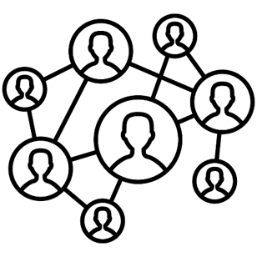



Data is Key for Future Workloads
In-memory Databases
[Mao+, EuroSys’12;
Clapp+ (Intel), IISWC’15]
Graph/Tree Processing
[Xu+, IISWC’12; Umuroglu+, FPL’15]
In-Memory Data Analytics
[Clapp+ (Intel), IISWC’15;
Awan+, BDCloud’15]
Datacenter Workloads
[Kanev+ (Google), ISCA’15]

Slide 7
Data Overwhelms Modern Machines
In-memory Databases
[Mao+, EuroSys’12;
Clapp+ (Intel), IISWC’15]
Graph/Tree Processing
[Xu+, IISWC’12; Umuroglu+, FPL’15]
Data → performance & energy bottleneck
In-Memory Data Analytics
[Clapp+ (Intel), IISWC’15;
Awan+, BDCloud’15]
Datacenter Workloads
[Kanev+ (Google), ISCA’15]

Slide 8








Data is Key for Future Workloads
  Chrome
TensorFlow Mobile
    Google’s web browser
Google’s machine learning framework
  Video Playback
  Video Capture
Google’s video codec
Google’s video codec
Notes:
In this work, we take a look at widely-used google consumer workloads, to figure out the major sources of energy consumption.
We look at Google Chrome web brower. We take a look at Tensorflow, Google’s machine learning framework, and we also take a look at two important video related workloads, video playback and video capture, both rely on Google’s vp9 codec technology.

Slide 9
Data Overwhelms Modern Machines
  Chrome
TensorFlow Mobile
    Google’s web browser
Google’s machine learning framework
Data → performance & energy bottleneck
  Video Playback
  Video Capture
Google’s video codec
Google’s video codec
Notes:
In this work, we take a look at widely-used google consumer workloads, to figure out the major sources of energy consumption.
We look at Google Chrome web brower. We take a look at Tensorflow, Google’s machine learning framework, and we also take a look at two important video related workloads, video playback and video capture, both rely on Google’s vp9 codec technology.

Slide 10
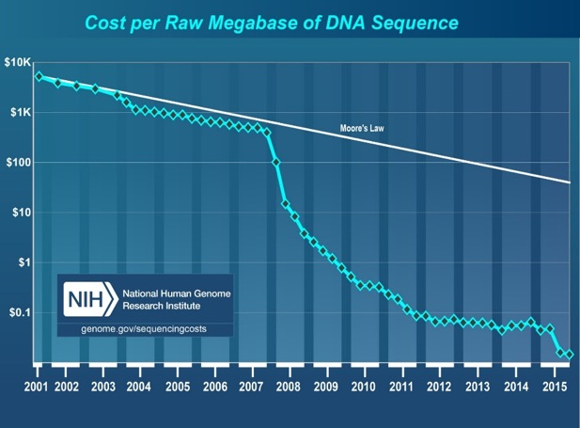
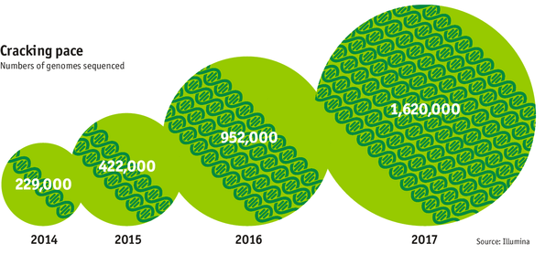

Data is Key for Future Workloads
development of high-throughput sequencing (HTS) technologies
Number of Genomes Sequenced
http://www.economist.com/news/21631808-so-much-genetic-data-so-many-uses-genes-unzipped
Notes:
However, since the development of high throughput sequencing (HTS) technologies, the cost of genome sequencing has fallen off a cliff (<< 1,000$) making it viable for almost everyone's use.

Slide 11
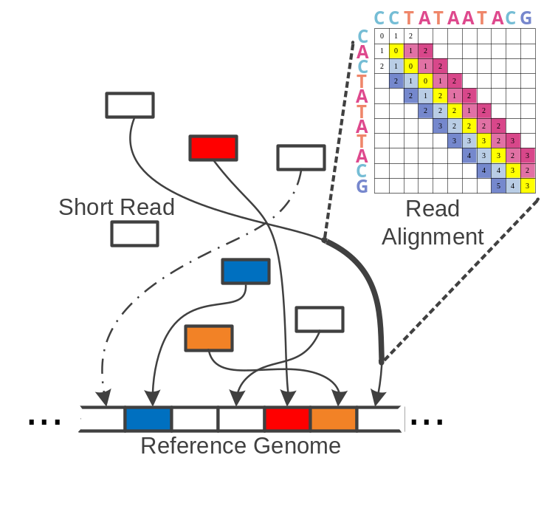
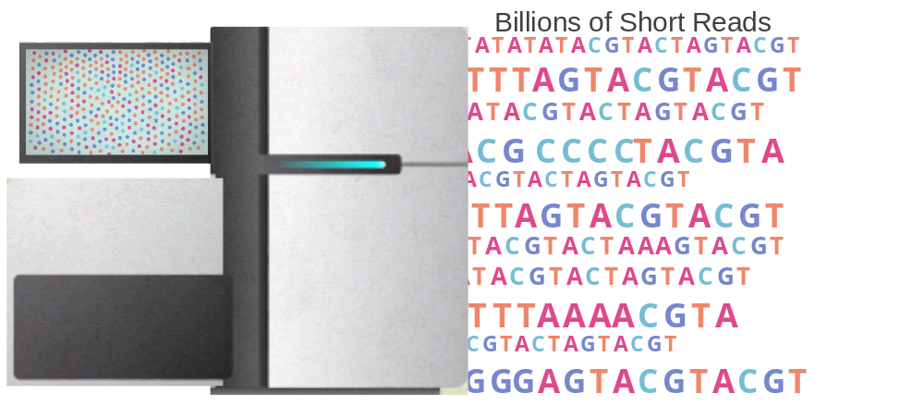

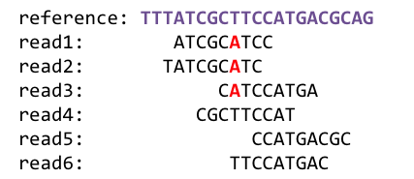
1
Sequencing
Genome Analysis
Read Mapping
2
Data → performance & energy bottleneck
Medical Treatment &
Scientific Discovery
3
Variant Calling
4
Notes:
Genome analysis starts with sequencing random short DNA fragments of copies of the original molecule.
Unfortunately, these reads lack information about their order and which part of genome they are originated from.
Hence the second step is to map these reads to a long reference genome.

Slide 12




We Need Faster & Scalable Genome Analysis
Understanding genetic variations, species, evolution, …
Predicting the presence and relative abundance of microbes in a sample
Rapid surveillance of disease outbreaks
Developing personalized medicine
And, many, many other applications …
Notes:
Knowing what organisms are present in a given environmental sample and how abundant are they

Slide 13
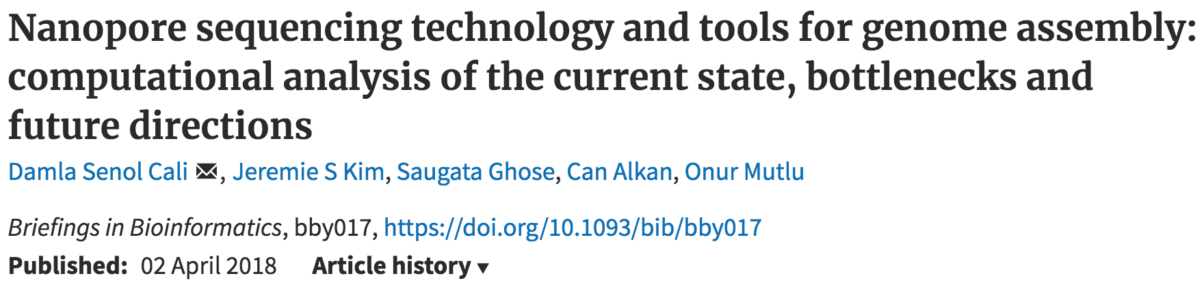
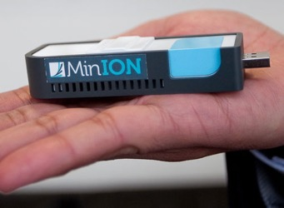
New Genome Sequencing Technologies
Oxford Nanopore MinION
Senol Cali+, “Nanopore Sequencing Technology and Tools for Genome
Assembly: Computational Analysis of the Current State, Bottlenecks
and Future Directions,” Briefings in Bioinformatics, 2018.
[Open arxiv.org version]

Slide 14
New Genome Sequencing Technologies
Oxford Nanopore MinION
Senol Cali+, “Nanopore Sequencing Technology and Tools for Genome
Assembly: Computational Analysis of the Current State, Bottlenecks
and Future Directions,” Briefings in Bioinformatics, 2018.
[Preliminary arxiv.org version]
Data → performance & energy bottleneck

Slide 15

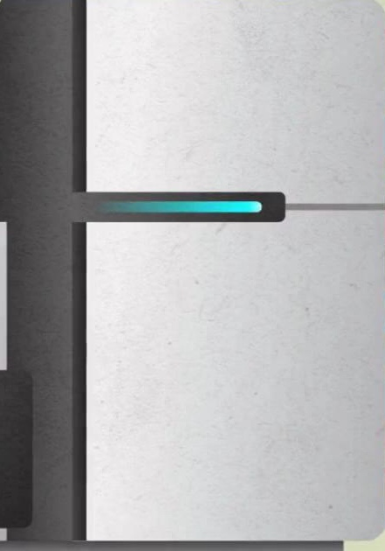

One Problem with (Genome) Analysis Today
Special-Purpose Machine
for Data Generation
General-Purpose Machine
for Data Analysis
FAST SLOW
Slow and inefficient processing capability
This picture is similar for many “data generators & analyzers” today

Slide 16
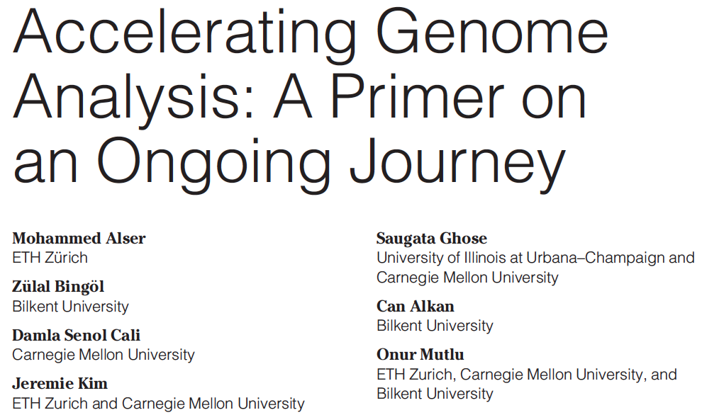
Accelerating Genome Analysis [IEEE MICRO 2020]
Mohammed Alser, Zulal Bingol, Damla Senol Cali, Jeremie Kim, Saugata Ghose, Can Alkan, and Onur Mutlu,
"Accelerating Genome Analysis: A Primer on an Ongoing Journey"
IEEE Micro (IEEE MICRO), Vol. 40, No. 5, pages 65-75, September/October 2020.
[Slides (pptx)(pdf)]
[Talk Video (1 hour 2 minutes)]

Slide 17
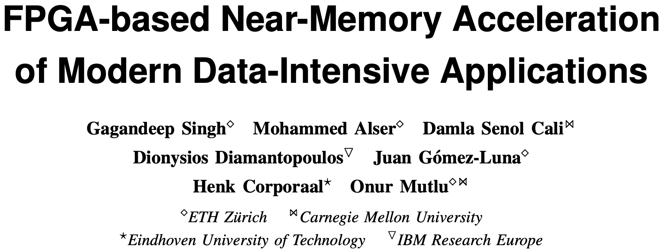
FPGA-based Near-Memory Analytics
Gagandeep Singh, Mohammed Alser, Damla Senol Cali, Dionysios Diamantopoulos, Juan Gómez-Luna, Henk Corporaal, and Onur Mutlu,
"FPGA-based Near-Memory Acceleration of Modern Data-Intensive Applications"
IEEE Micro (IEEE MICRO), 2021.

Slide 18
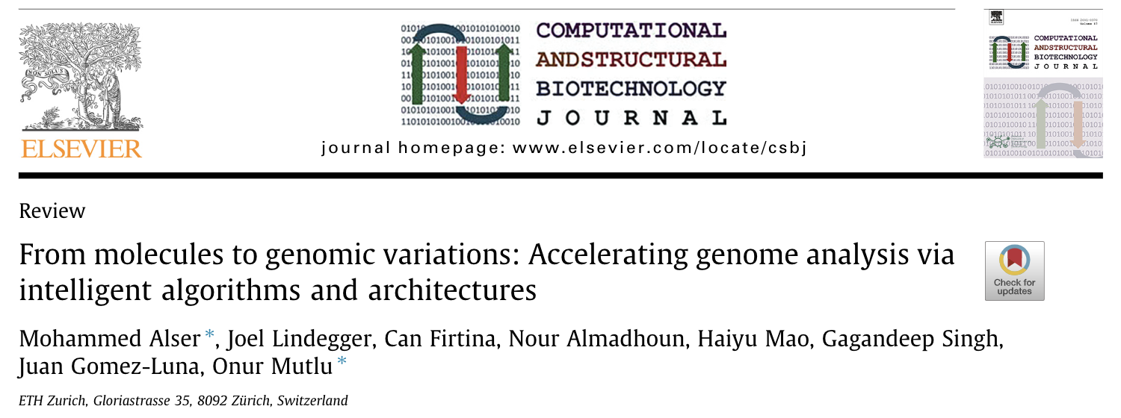
Beginner Reading on Genome Analysis
Mohammed Alser, Joel Lindegger, Can Firtina, Nour Almadhoun, Haiyu Mao, Gagandeep Singh, Juan Gomez-Luna, Onur Mutlu
“From Molecules to Genomic Variations to Scientific Discovery: Intelligent Algorithms and Architectures for Intelligent Genome Analysis”
Computational and Structural Biotechnology Journal, 2022
[Source code]
https://arxiv.org/pdf/2205.07957.pdf

Slide 19
Data Overwhelms Modern Machines …
Storage/memory capability
Communication capability
Computation capability
Greatly impacts robustness, energy, performance, cost

Slide 20
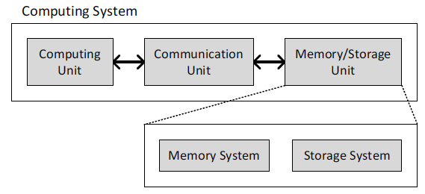
A Computing System
Three key components
Computation
Communication
Storage/memory
Burks, Goldstein, von Neumann, “Preliminary discussion of the
logical design of an electronic computing instrument,” 1946.
Image source: https://lbsitbytes2010.wordpress.com/2013/03/29/john-von-neumann-roll-no-15/

Slide 21
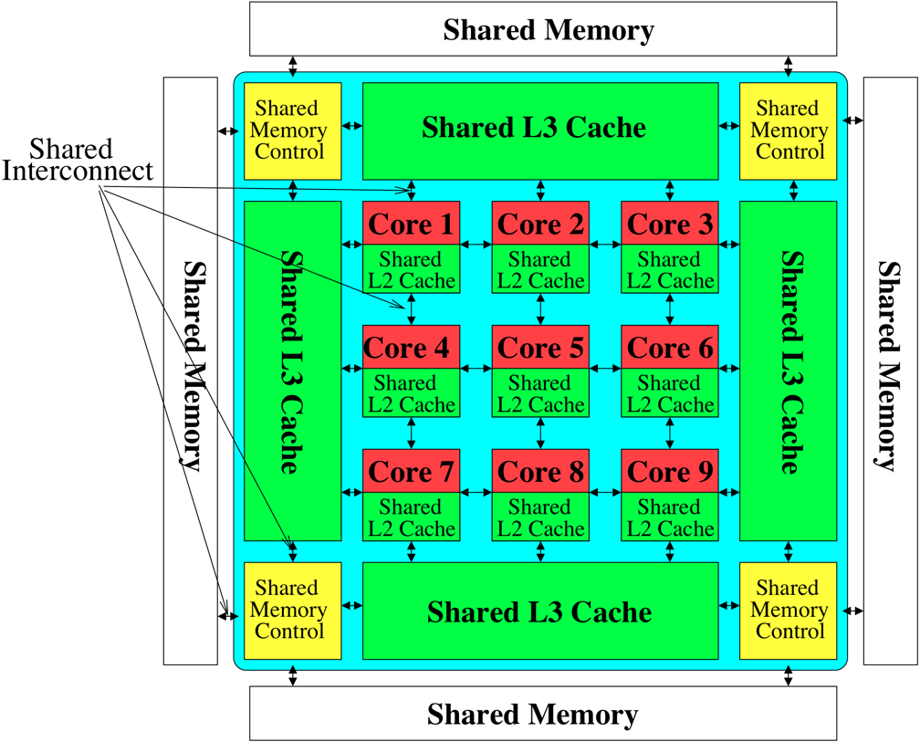
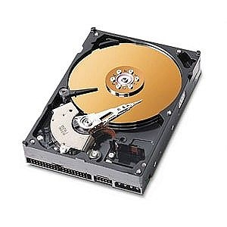
Perils of Processor-Centric Design
Most of the system is dedicated to storing and moving data
Yet, system is still bottlenecked by memory

Slide 22
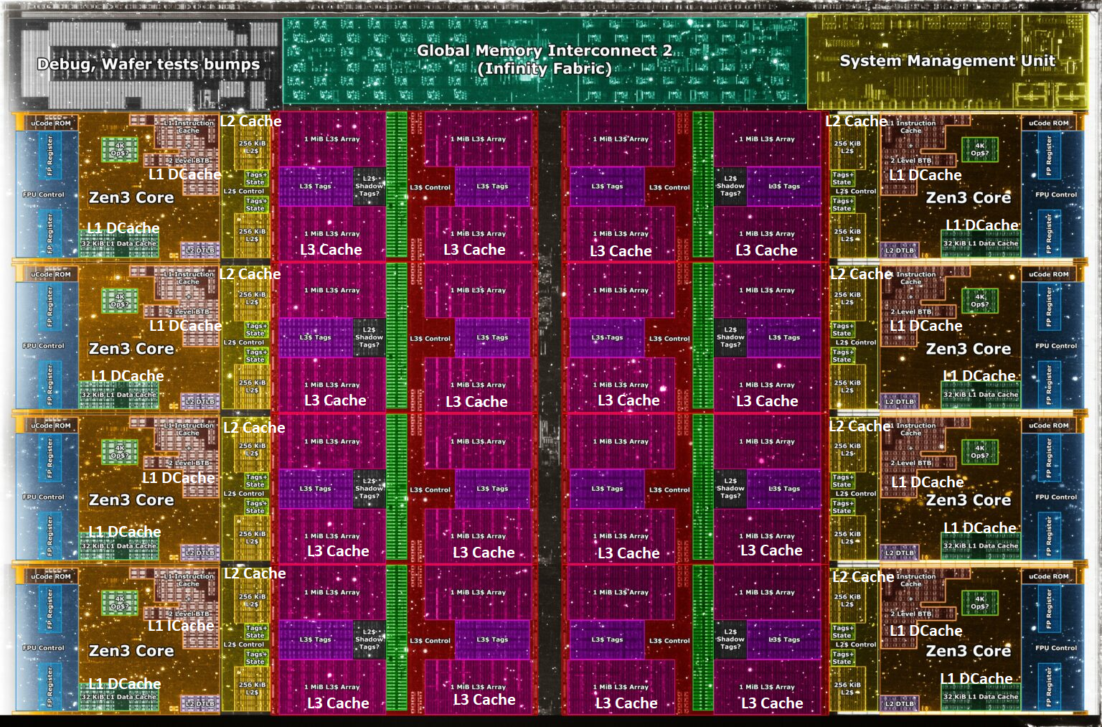
Deeper and Larger Memory Hierarchies
Core Count:
8 cores/16 threads
L1 Caches:
32 KB per core
L2 Caches:
512 KB per core
L3 Cache:
32 MB shared
AMD Ryzen 5000, 2020
https://wccftech.com/amd-ryzen-5000-zen-3-vermeer-undressed-high-res-die-shots-close-ups-pictured-detailed/

Slide 23
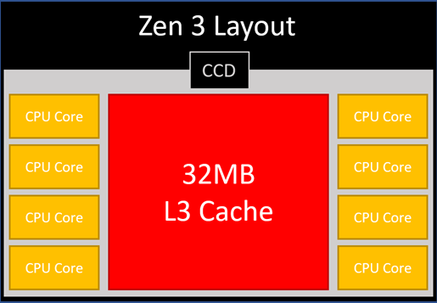
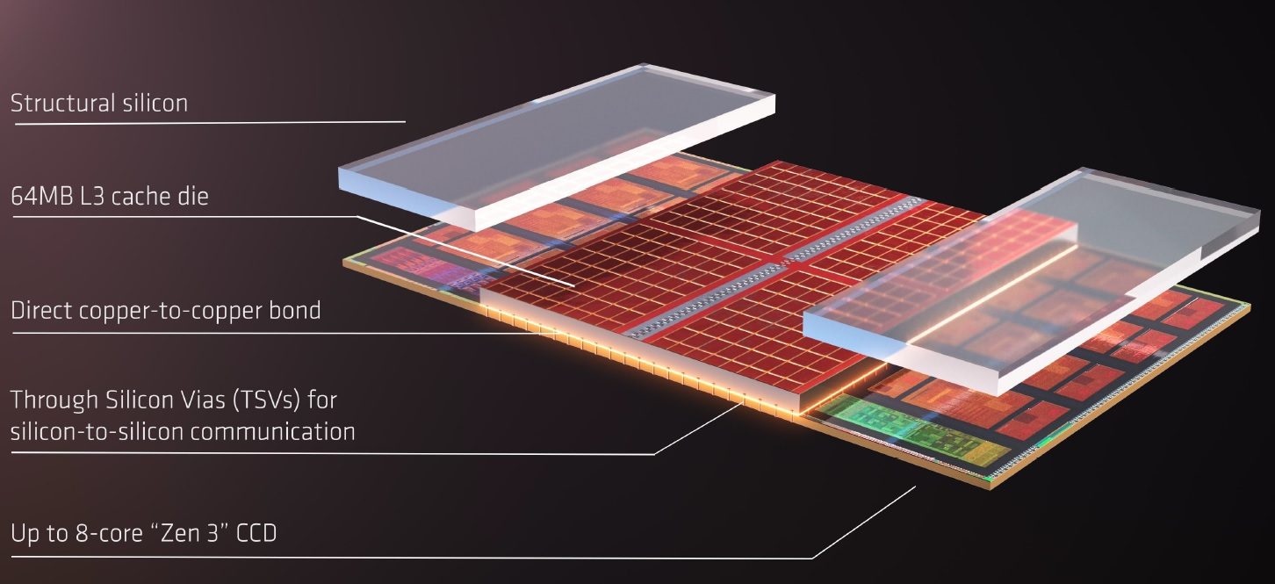
AMD’s 3D Last Level Cache (2021)
AMD increases the L3 size of their 8-core Zen 3 processors from 32 MB to 96 MB
Additional 64 MB L3 cache die stacked on top of the processor die
- Connected using Through Silicon Vias (TSVs)
- Total of 96 MB L3 cache
https://community.microcenter.com/discussion/5134/comparing-zen-3-to-zen-2
https://youtu.be/gqAYMx34euU
https://www.tech-critter.com/amd-keynote-computex-2021/
Notes:
CCD = Core Chiplet Die
Structural silicon is used to equalize the height and facilitate heat dissipation from the cores.

Slide 24
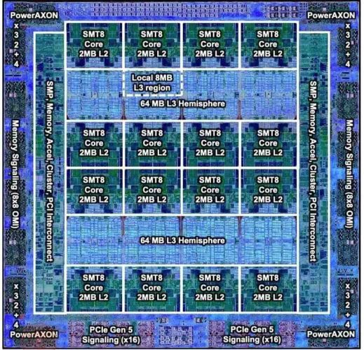
Deeper and Larger Memory Hierarchies
IBM POWER10,
2020
Cores:
15-16 cores,
8 threads/core
L2 Caches:
2 MB per core
L3 Cache:
120 MB shared
https://www.it-techblog.de/ibm-power10-prozessor-mehr-speicher-mehr-tempo-mehr-sicherheit/09/2020/

Slide 25
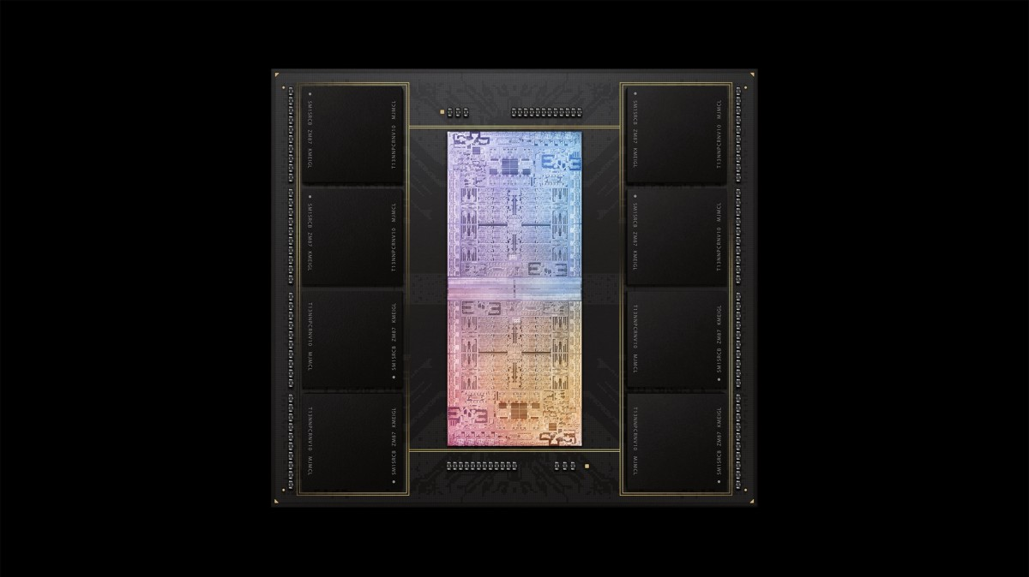
Deeper and Larger Memory Hierarchies
A lot of
Cache
Storage
DRAM
DRAM
Storage
Apple M1 Ultra System (2022)
https://www.gsmarena.com/apple_announces_m1_ultra_with_20core_cpu_and_64core_gpu-news-53481.php

Slide 26
Data Overwhelms Modern Machines
  Chrome
TensorFlow Mobile
    Google’s web browser
Google’s machine learning framework
Data → performance & energy bottleneck
  Video Playback
  Video Capture
Google’s video codec
Google’s video codec
Notes:
In this work, we take a look at widely-used google consumer workloads, to figure out the major sources of energy consumption.
We look at Google Chrome web brower. We take a look at Tensorflow, Google’s machine learning framework, and we also take a look at two important video related workloads, video playback and video capture, both rely on Google’s vp9 codec technology.

Slide 27
Data Movement Overwhelms Modern Machines
Amirali Boroumand, Saugata Ghose, Youngsok Kim, Rachata Ausavarungnirun, Eric Shiu, Rahul Thakur, Daehyun Kim, Aki Kuusela, Allan Knies, Parthasarathy Ranganathan, and Onur Mutlu,
"Google Workloads for Consumer Devices: Mitigating Data Movement Bottlenecks"
Proceedings of the 23rd International Conference on Architectural Support for Programming Languages and Operating Systems (ASPLOS), Williamsburg, VA, USA, March 2018.
62.7% of the total system energy
is spent on data movement

Slide 28
Axiom
An Intelligent Architecture
Handles Data Well

Slide 29
How to Handle Data Well
Ensure data does not overwhelm the components
  via intelligent algorithms, architectures & system designs: algorithm-architecture-devices
Take advantage of vast amounts of data and metadata
  to improve architectural & system-level decisions
Understand and exploit properties of (different) data
  to improve algorithms & architectures in various metrics

Slide 30
Corollaries: Computing Systems Today …
Are processor-centric vs. data-centric
Make designer-dictated decisions vs. data-driven
Make component-based myopic decisions vs. data-aware

Slide 31
Architectures for Intelligent Machines
Data-centric
Data-driven
Data-aware

Slide 32
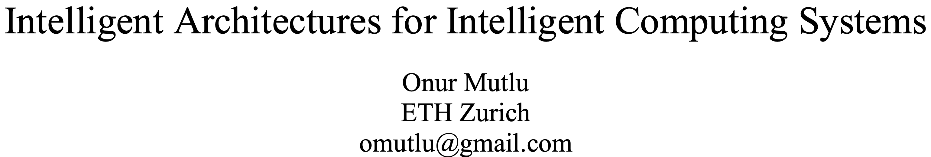
A Blueprint for Fundamentally Better Architectures
Onur Mutlu,
"Intelligent Architectures for Intelligent Computing Systems"
Invited Paper in Proceedings of the Design, Automation, and Test in Europe Conference (DATE), Virtual, February 2021.
[Slides (pptx) (pdf)]
[IEDM Tutorial Slides (pptx) (pdf)]
[Short DATE Talk Video (11 minutes)]
[Longer IEDM Tutorial Video (1 hr 51 minutes)]

Slide 33
We Need to Revisit the Entire Stack
Problem
Algorithm
Program/Language
System Software
SW/HW Interface
Micro-architecture
Logic
Devices
Electrons
We can get there step by step

Slide 34
Data-Centric (Memory-Centric) Architectures

Slide 35
Data-Centric Architectures: Properties
Process data where it resides (where it makes sense)
  Processing in and near memory & sensor structures
Low-latency & low-energy data access
Low-cost data storage & processing
Intelligent data management

Slide 36
Processing Data
Where It Makes Sense

Slide 37
Process Data Where It Makes Sense
Sensors
A lot of
Cache
Storage
DRAM
DRAM
Storage
Apple M1 Ultra System (2022)
https://www.gsmarena.com/apple_announces_m1_ultra_with_20core_cpu_and_64core_gpu-news-53481.php

Slide 38
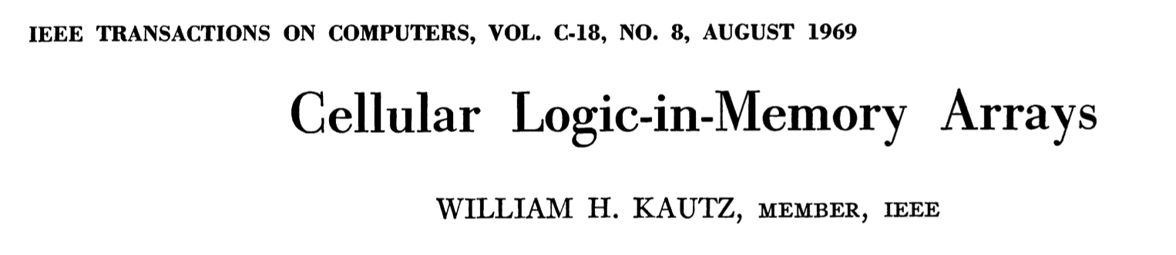
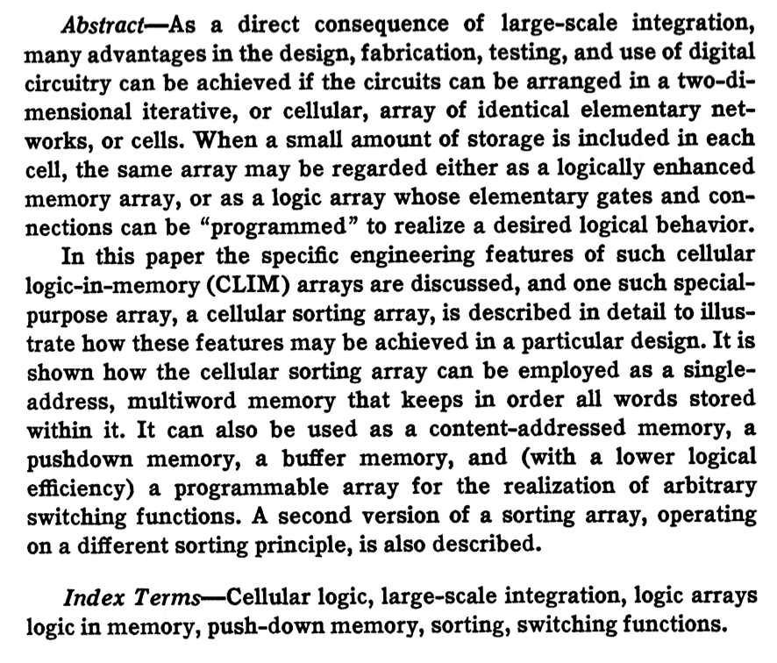
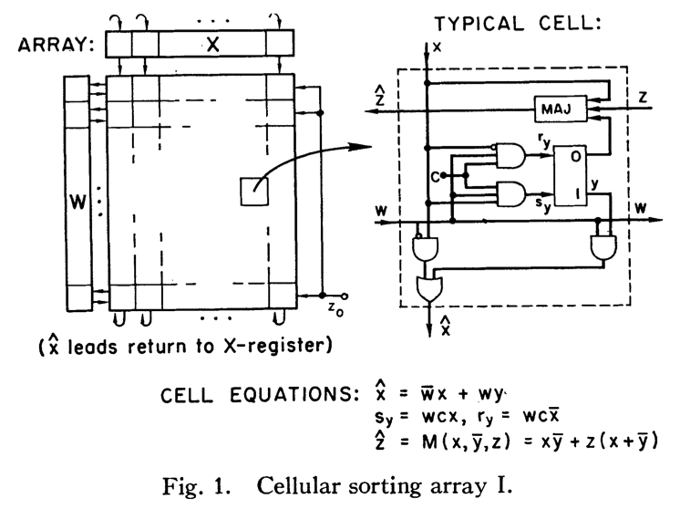
Processing in Memory: An Old Idea
Kautz, “Cellular Logic-in-Memory Arrays”, IEEE TC 1969.
https://doi.org/10.1109/T-C.1969.222754

Slide 39
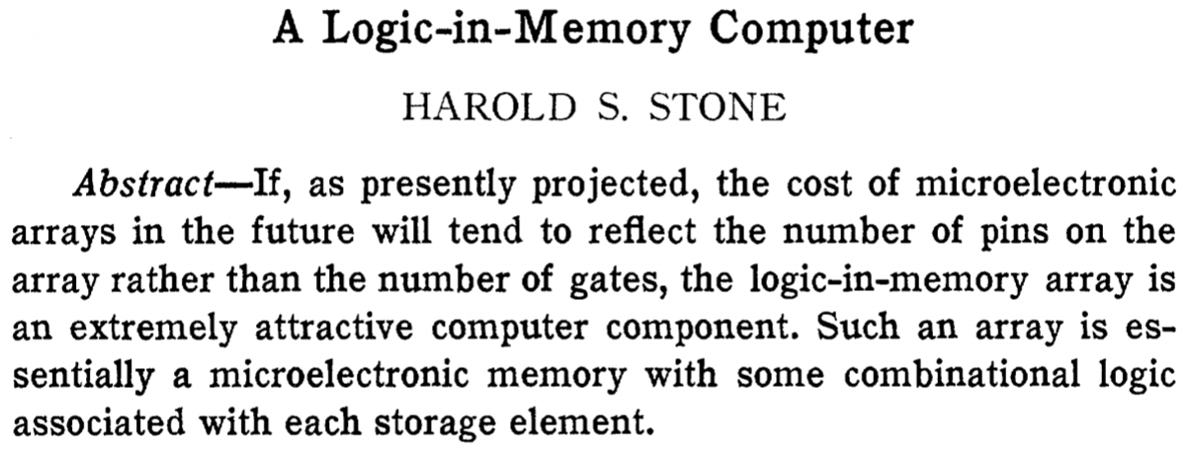
Processing in Memory: An Old Idea
Stone, “A Logic-in-Memory Computer,” IEEE TC 1970.
https://safari.ethz.ch/architecture/fall2020/lib/exe/fetch.php?media=stone_logic_in_memory_1970.pdf

Slide 40
Why In-Memory Computation Today?
Huge problems with Memory Technology
  Memory technology scaling is not going well (e.g., RowHammer)
  Many scaling issues demand intelligence in memory
Huge demand from Applications & Systems
  Data access bottleneck
  Energy & power bottlenecks
  Data movement energy dominates computation energy
  Need all at the same time: performance, energy, sustainability
  We can improve all metrics by minimizing data movement
Designs are squeezed in the middle

Slide 41
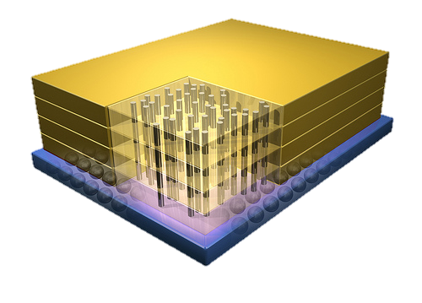


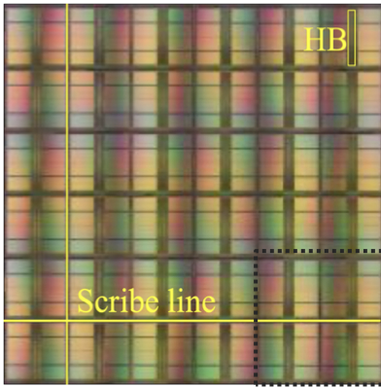
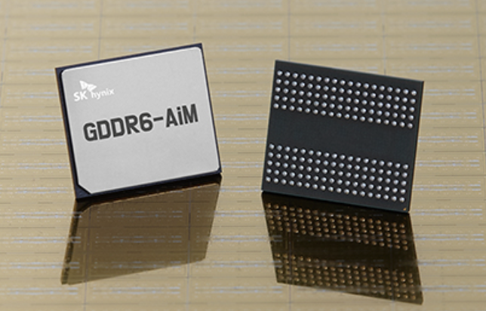
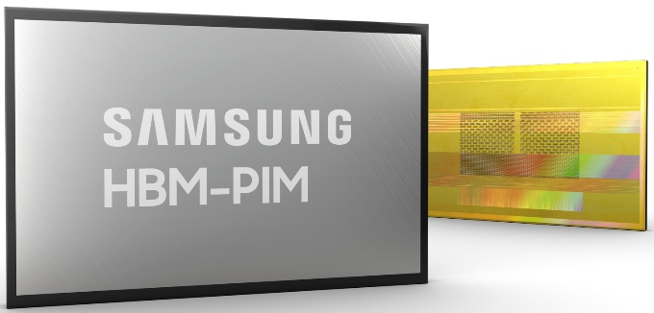
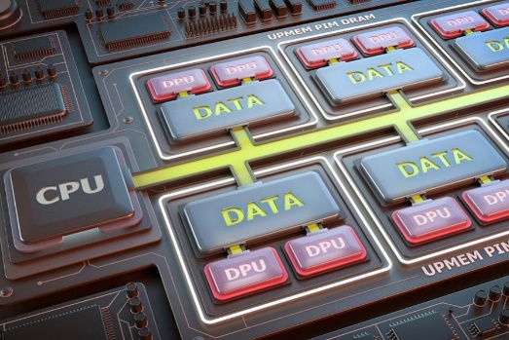
Processing-in-Memory Landscape Today
[Samsung 2021]
[Alibaba 2022]
[SK Hynix 2022]
[Samsung 2021]
[UPMEM 2019]
And, many other experimental chips and startups

Slide 42
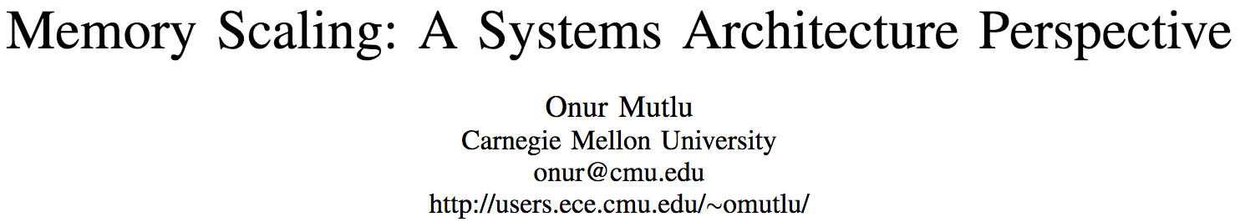
Memory Scaling Issues Are Real
Onur Mutlu,
"Memory Scaling: A Systems Architecture Perspective"
Proceedings of the 5th International Memory Workshop (IMW), Monterey, CA, May 2013. Slides (pptx) (pdf)
EETimes Reprint
https://people.inf.ethz.ch/omutlu/pub/memory-scaling_memcon13.pdf

Slide 43
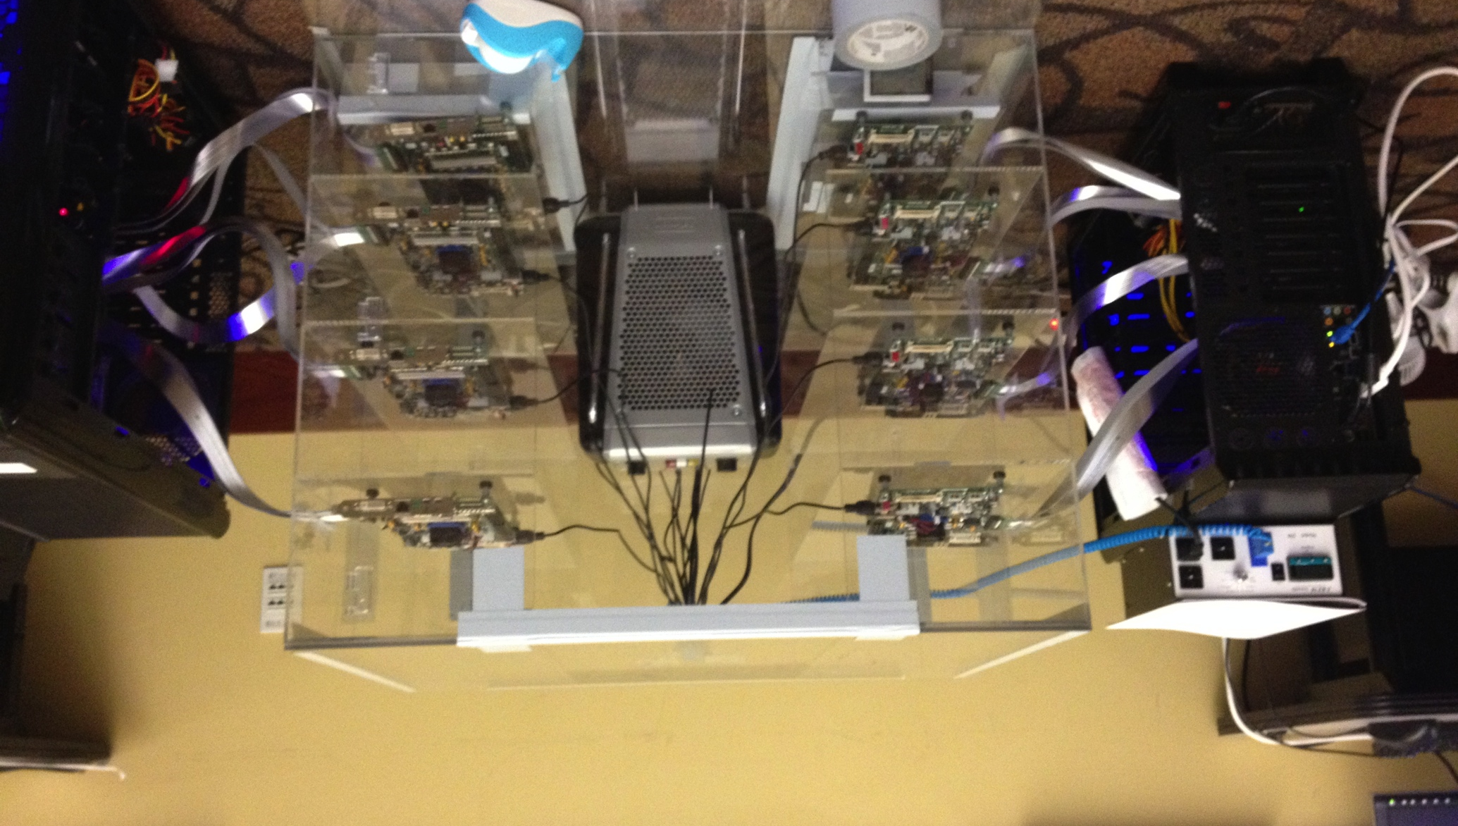
Infrastructures to Understand Such Issues
Temperature
Controller
FPGAs
Heater
FPGAs
PC
  Kim+, “Flipping Bits in Memory Without Accessing Them: An Experimental Study of DRAM Disturbance Errors,” ISCA 2014.

Slide 44
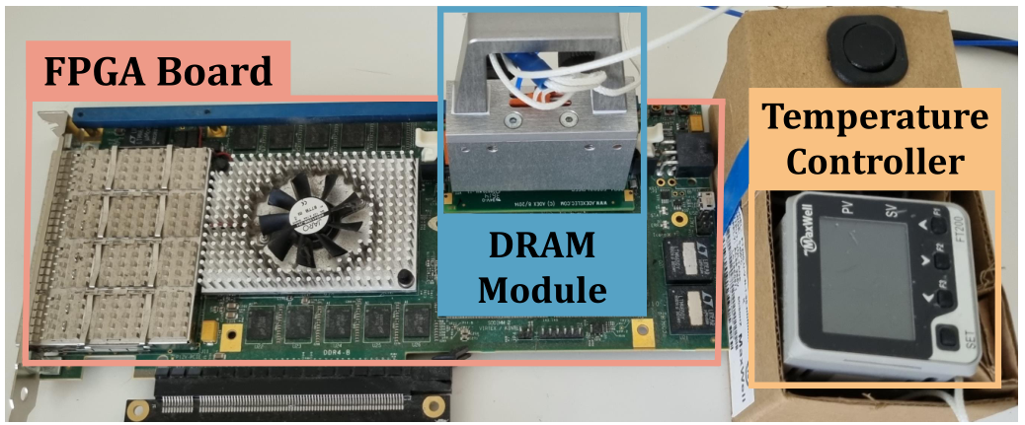
Memory Testing Infrastructures
* SoftMC [Hassan+, HPCA’17] enhanced for DDR4
Notes:
We implement U-TRR using SoftMC, an FPGA-based infrastructure with precise temperature control which we enhanced for DDR4

Slide 45
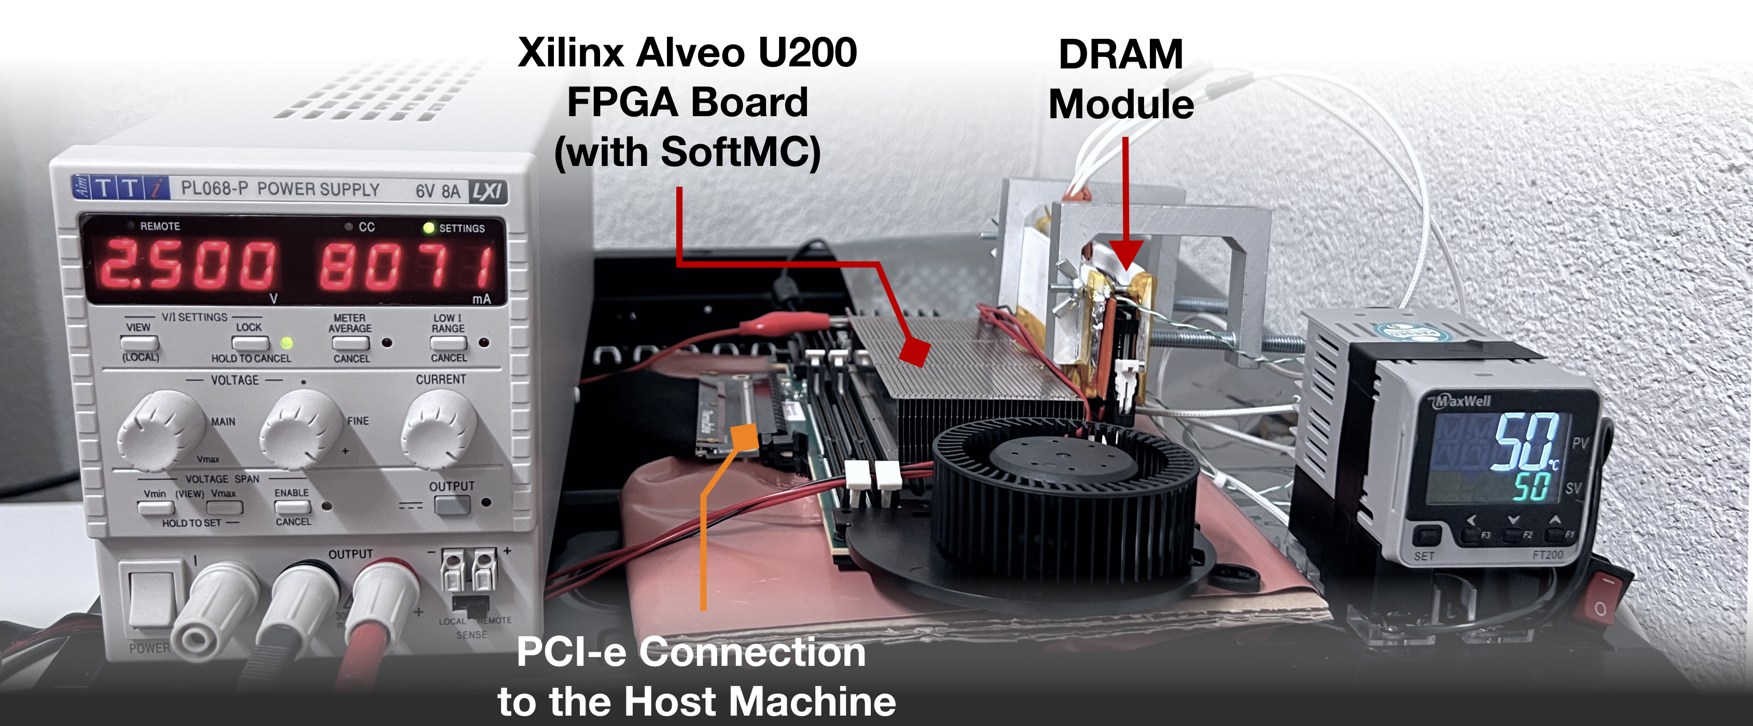
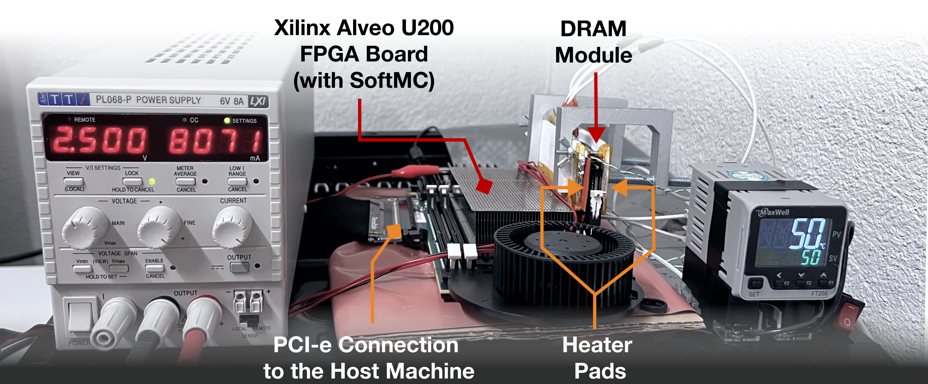
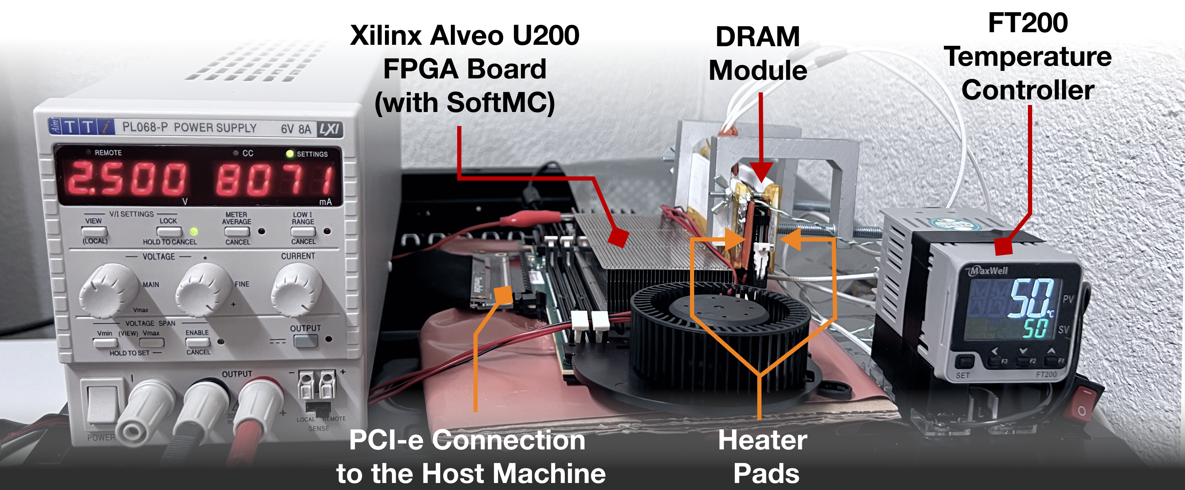
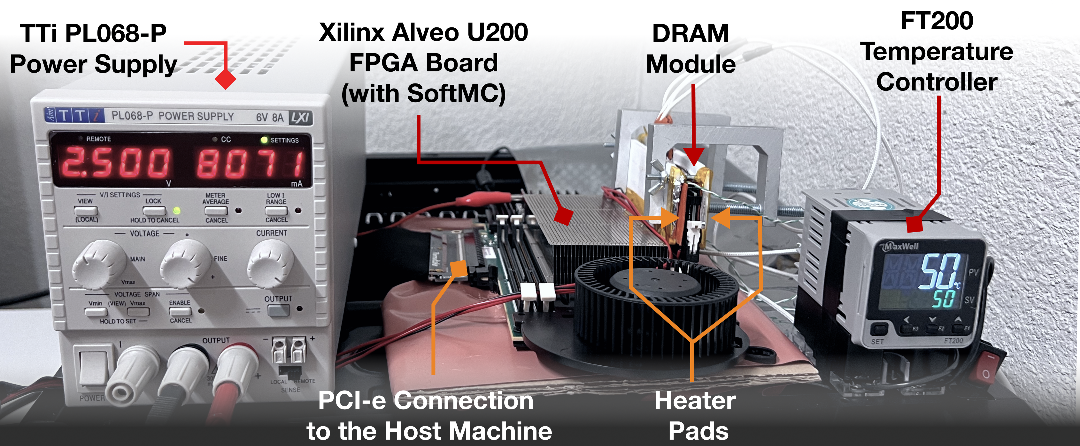
Updated Memory Testing Infrastructure
  FPGA-based SoftMC (Xilinx Virtex UltraScale+ XCU200)
*
Fine-grained control over DRAM commands,
timing (±1.5ns), temperature (±0.1°C ),
and voltage (±1mV)
*Hassan et al., "SoftMC: A Flexible and Practical Open-Source Infrastructure for Enabling Experimental DRAM Studies," in HPCA, 2017. [Available on GitHub: https://github.com/CMU-SAFARI/SoftMC]
Notes:
We use an FPGA-based experimental setup programmed with a modified version of SoftMC [CLICK]
We control the chip temperature using a pair of heaters [CLICK] connected to a temperature controller [CLICK]
We supply the wordline voltage using the VPP power rail from an external power supply [CLICK]
This infrastructure provides fine-grained control over DRAM commands, timing parameters, temperature, and wordline voltage [CLICK]
=======

Slide 46
A Curious Phenomenon [Kim et al., ISCA 2014]
One can
predictably induce errors
in most DRAM memory chips
Kim+, “Flipping Bits in Memory Without Accessing Them: An Experimental Study of DRAM Disturbance Errors,” ISCA 2014.

Slide 47
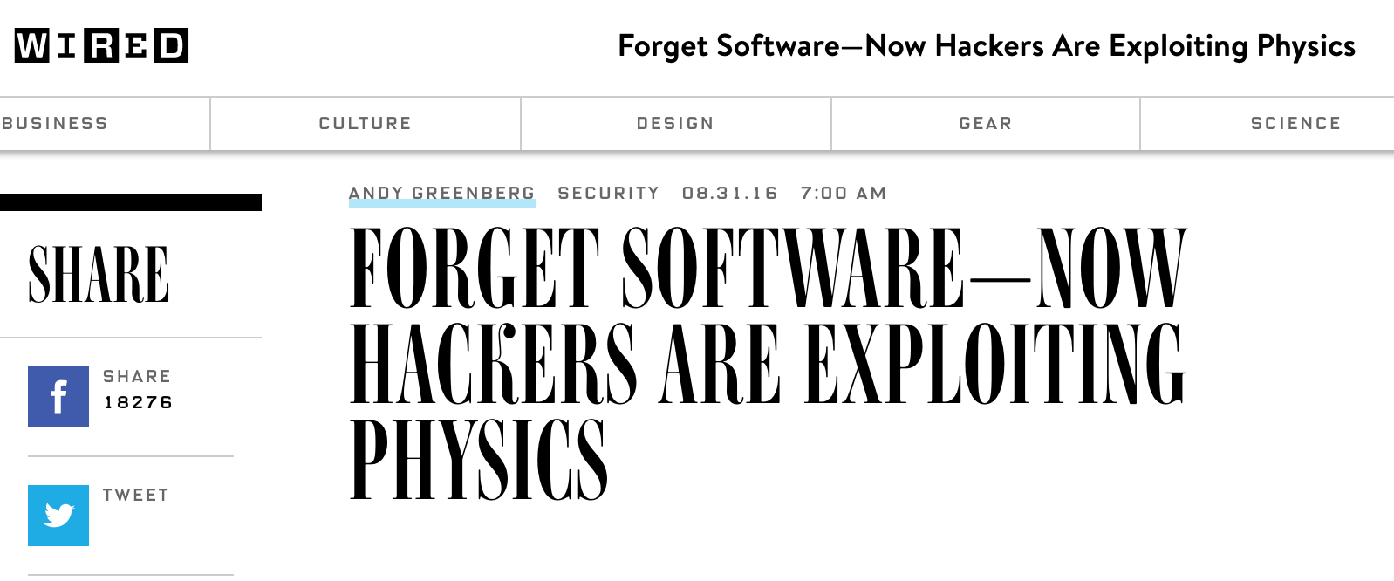
RowHammer
A simple hardware failure mechanism
can create a widespread
system security vulnerability

Slide 48
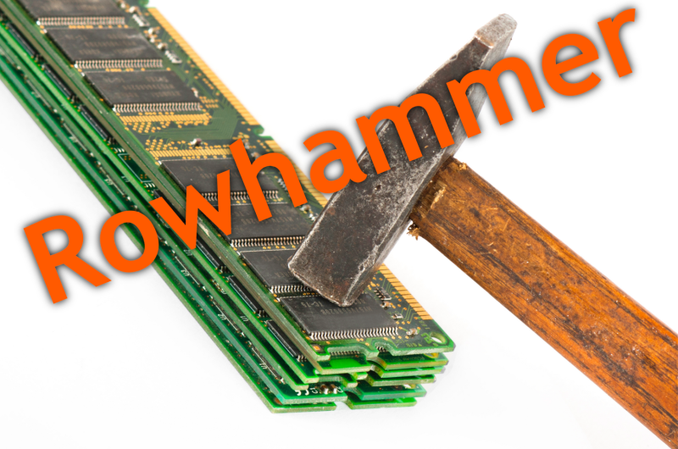
Notes:
Picture from the article:
http://thehackernews.com/2015/03/dram-rowhammer-vulnerability.html

Slide 49
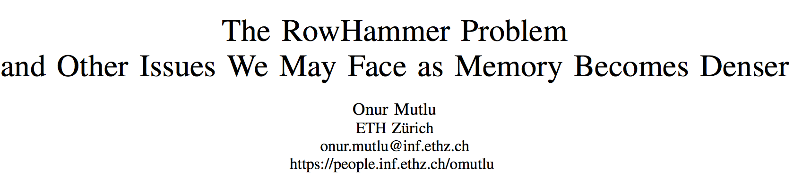
Memory Scaling Issues Are Real
Onur Mutlu,
"The RowHammer Problem and Other Issues We May Face as Memory Becomes Denser"
Invited Paper in Proceedings of the Design, Automation, and Test in Europe Conference (DATE), Lausanne, Switzerland, March 2017.
[Slides (pptx) (pdf)]
https://people.inf.ethz.ch/omutlu/pub/rowhammer-and-other-memory-issues_date17.pdf

Slide 50
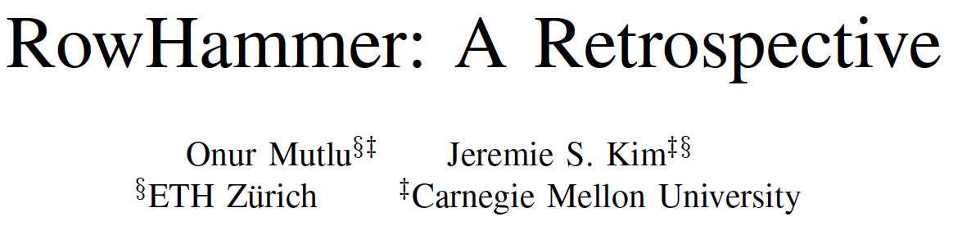
Memory Scaling Issues Are Real
Onur Mutlu and Jeremie Kim,
"RowHammer: A Retrospective"
IEEE Transactions on Computer-Aided Design of Integrated Circuits and Systems (TCAD) Special Issue on Top Picks in Hardware and Embedded Security, 2019.
[Preliminary arXiv version]
[Slides from COSADE 2019 (pptx)]
[Slides from VLSI-SOC 2020 (pptx) (pdf)]
[Talk Video (1 hr 15 minutes, with Q&A)]

Slide 51
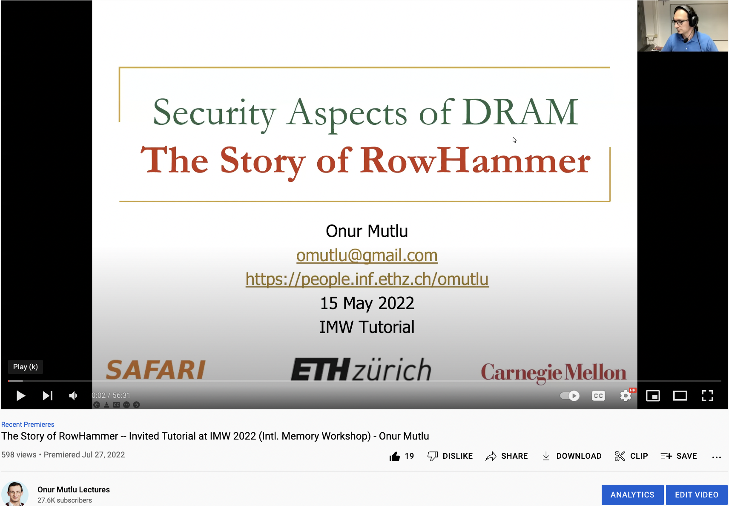
The Story of RowHammer Tutorial …
Onur Mutlu,
"Security Aspects of DRAM: The Story of RowHammer"
Invited Tutorial at 14th IEEE Electron Devices Society International Memory Workshop (IMW), Dresden, Germany, May 2022.
[Slides (pptx)(pdf)]
[Tutorial Video (57 minutes)]
https://www.youtube.com/watch?v=37hWglkQRG0

Slide 52
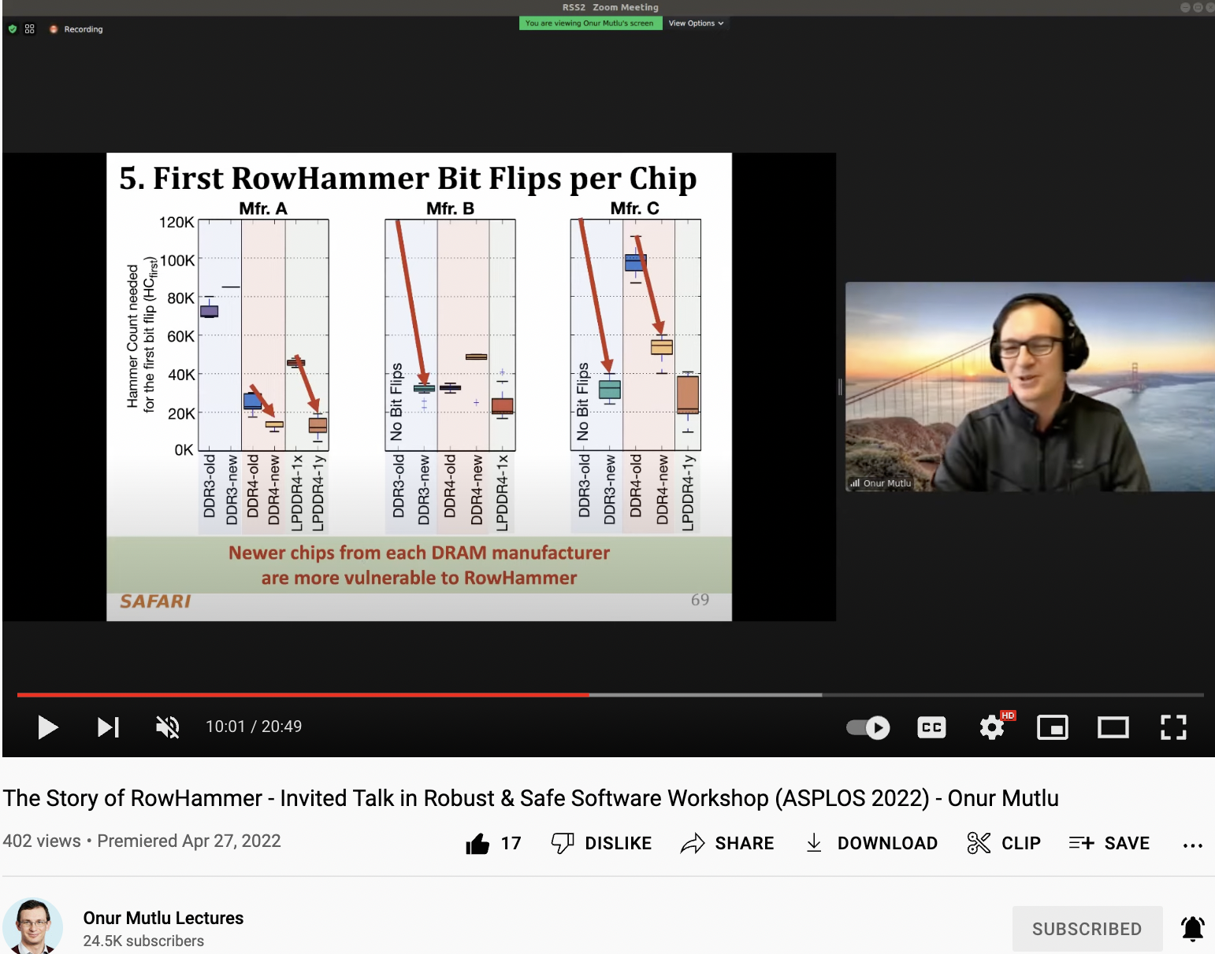
10 Years of RowHammer in 20 Minutes
Onur Mutlu,
"The Story of RowHammer"
Invited Talk at the Workshop on Robust and Safe Software 2.0 (RSS2), held with the 27th International Conference on Architectural Support for Programming Languages and Operating Systems (ASPLOS), Virtual, 28 February 2022.
[Slides (pptx) (pdf)]
https://www.youtube.com/watch?v=ctKTRyi96Bk

Slide 53
The Push from Circuits and Devices
Main Memory Needs
Intelligent Controllers

Slide 54
Intel Optane Persistent Memory (2019)
Non-volatile main memory
Based on 3D-XPoint Technology
https://www.storagereview.com/intel_optane_dc_persistent_memory_module_pmm

Slide 55
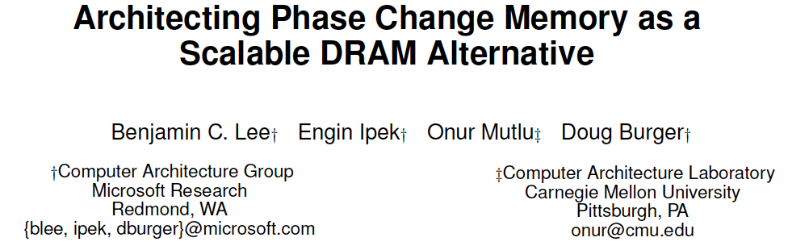
Emerging Memories Also Need Intelligent Controllers
Benjamin C. Lee, Engin Ipek, Onur Mutlu, and Doug Burger,
"Architecting Phase Change Memory as a Scalable DRAM Alternative"
Proceedings of the 36th International Symposium on Computer Architecture (ISCA), pages 2-13, Austin, TX, June 2009. Slides (pdf)
One of the 13 computer architecture papers of 2009 selected as Top Picks by IEEE Micro. Selected as a CACM Research Highlight. 2022 Persistent Impact Prize.

Slide 56
The Takeaway
Intelligent
Memory Controllers
Can Avoid Many Failures
& Enable Better Scaling

Slide 57
Three Key Systems & Application Trends
1. Data access is the major bottleneck
  Applications are increasingly data hungry
2. Energy consumption is a key limiter
3. Data movement energy dominates compute
  Especially true for off-chip to on-chip movement

Slide 58
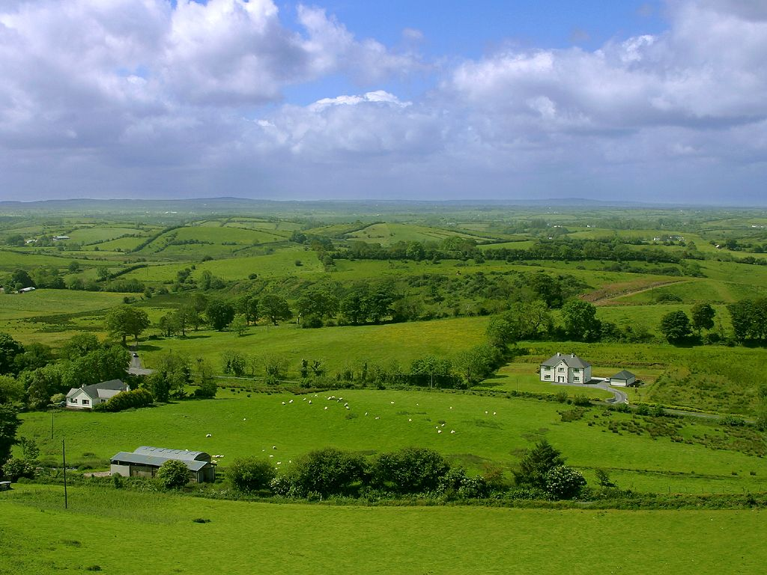
Do We Want This?
Source: V. Milutinovic

Slide 59
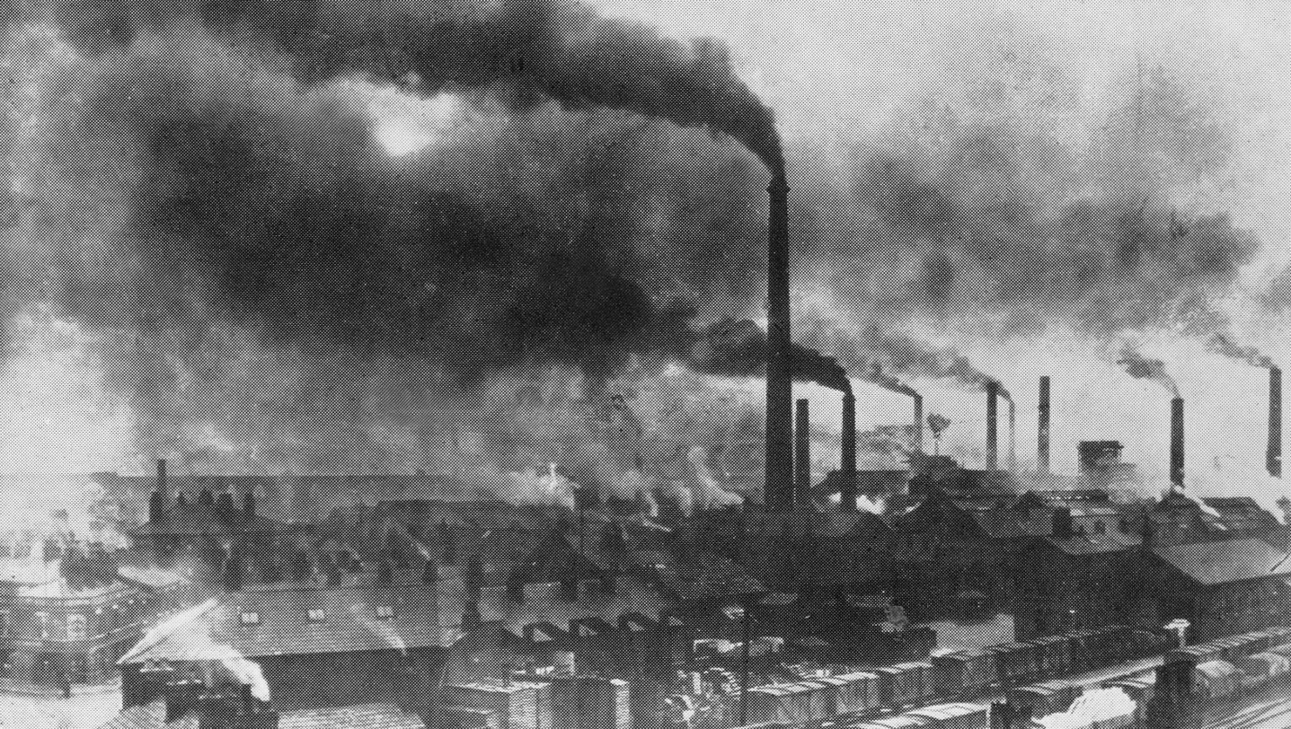
Or This?
Source: V. Milutinovic

Slide 60
Challenge and Opportunity for Future
High Performance,
Energy Efficient,
Sustainable
(All at the Same Time)

Slide 61
The Problem
Data access is the major performance and energy bottleneck
Our current
design principles
cause great energy waste
(and great performance loss)

Slide 62
The Problem
Processing of data
is performed
far away from the data

Slide 63
A Computing System
Three key components
Computation
Communication
Storage/memory
Burks, Goldstein, von Neumann, “Preliminary discussion of the
logical design of an electronic computing instrument,” 1946.
Image source: https://lbsitbytes2010.wordpress.com/2013/03/29/john-von-neumann-roll-no-15/

Slide 64
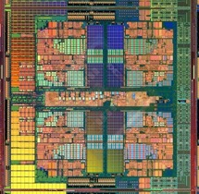

A Computing System
Three key components
Computation
Communication
Storage/memory
Burks, Goldstein, von Neumann, “Preliminary discussion of the
logical design of an electronic computing instrument,” 1946.
Image source: https://lbsitbytes2010.wordpress.com/2013/03/29/john-von-neumann-roll-no-15/

Slide 65
Today’s Computing Systems
Processor centric
All data processed in the processor → at great system cost

Slide 66
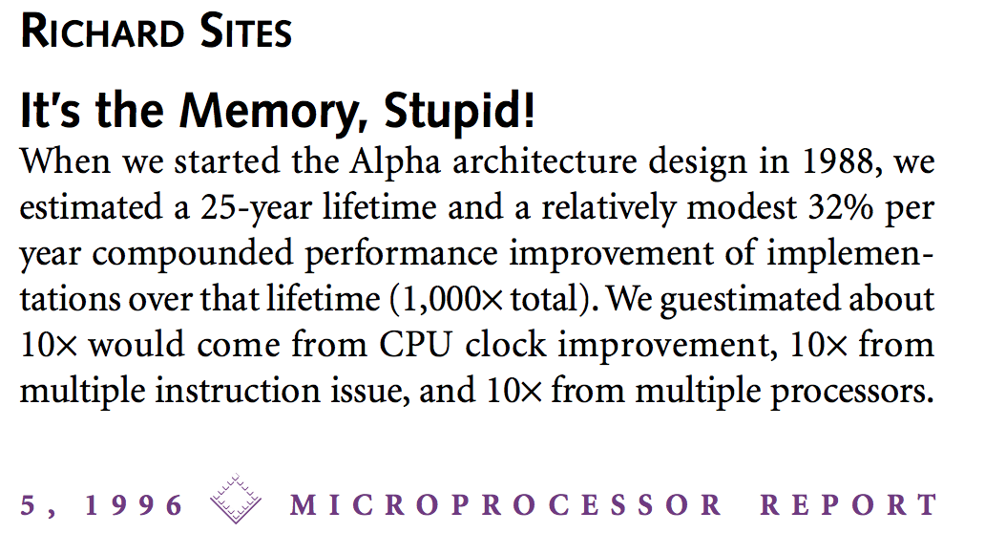
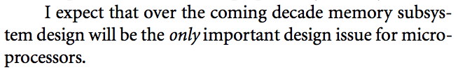
It’s the Memory, Stupid!
“It’s the Memory, Stupid!” (Richard Sites, MPR, 1996)
http://cva.stanford.edu/classes/cs99s/papers/architects_look_to_future.pdf

Slide 67
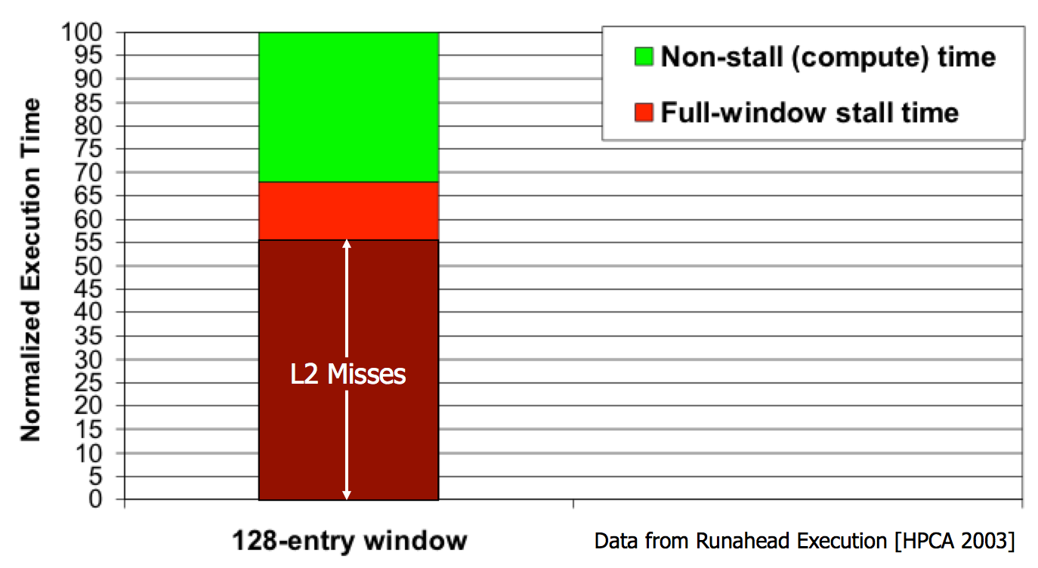
The Performance Perspective
Mutlu+, “Runahead Execution: An Alternative to Very Large Instruction Windows for Out-of-Order Processors,” HPCA 2003.

Slide 68
The Performance Perspective
Onur Mutlu, Jared Stark, Chris Wilkerson, and Yale N. Patt,
"Runahead Execution: An Alternative to Very Large Instruction Windows for Out-of-order Processors"
Proceedings of the 9th International Symposium on High-Performance Computer Architecture (HPCA), pages 129-140, Anaheim, CA, February 2003. Slides (pdf)
  One of the 15 computer arch. papers of 2003 selected as Top Picks by IEEE Micro.
  HPCA Test of Time Award (awarded in 2021).

Slide 69
The Performance Perspective (Today)
All of Google’s Data Center Workloads (2015):
Kanev+, “Profiling a Warehouse-Scale Computer,” ISCA 2015.

Slide 70

The Energy Perspective
Dally, HiPEAC 2015

Slide 71
Data Movement vs. Computation Energy
Dally, HiPEAC 2015
A memory access consumes ~100-1000X
the energy of a complex addition

Slide 72
Data Movement vs. Computation Energy
Han+, “EIE: Efficient Inference Engine on Compressed Deep Neural Network,” ISCA 2016.

Slide 73
Data Movement vs. Computation Energy
6400X
A memory access consumes 6400X
the energy of a simple integer addition
Han+, “EIE: Efficient Inference Engine on Compressed Deep Neural Network,” ISCA 2016.

Slide 74
Energy Waste in Mobile Devices
Amirali Boroumand, Saugata Ghose, Youngsok Kim, Rachata Ausavarungnirun, Eric Shiu, Rahul Thakur, Daehyun Kim, Aki Kuusela, Allan Knies, Parthasarathy Ranganathan, and Onur Mutlu,
"Google Workloads for Consumer Devices: Mitigating Data Movement Bottlenecks"
Proceedings of the 23rd International Conference on Architectural Support for Programming Languages and Operating Systems (ASPLOS), Williamsburg, VA, USA, March 2018.
62.7% of the total system energy
is spent on data movement

Slide 75
We Do Not Want to Move Data!
Dally, HiPEAC 2015
A memory access consumes ~100-1000X
the energy of a complex addition

Slide 76
We Need A Paradigm Shift To …
Enable computation with minimal data movement
Compute where it makes sense (where data resides)
Make computing architectures more data-centric

Slide 77
Goal: Processing Inside Memory
Many questions … How do we design the:
  compute-capable memory & controllers?
  processors & communication units?
  software & hardware interfaces?
  system software, compilers, languages?
  algorithms & theoretical foundations?
Memory
Processor
Core
Database
Graphs
Media
Cache
Query
Interconnect
Problem
Results
Algorithm
Program/Language
System Software
SW/HW Interface
Micro-architecture
Logic
Devices
Electrons

Slide 78

PIM Review and Open Problems
Onur Mutlu, Saugata Ghose, Juan Gomez-Luna, and Rachata Ausavarungnirun,
"A Modern Primer on Processing in Memory"
Invited Book Chapter in Emerging Computing: From Devices to Systems - Looking Beyond Moore and Von Neumann, Springer, to be published in 2021.
https://arxiv.org/pdf/1903.03988.pdf

Slide 79
We Need to Think Differently from the Past Approaches

Slide 80
Processing in Memory:
Two Approaches
1. Processing near Memory
2. Processing using Memory

Slide 81
Mindset: Memory as an Accelerator
CPU
core
CPU
core
mini-CPU
core
GPU
(throughput)
core
GPU
(throughput)
core
video
core
GPU
(throughput)
core
GPU
(throughput)
core
CPU
core
CPU
core
Memory
imaging
core
LLC
Specialized
compute-capability
in memory
Memory Controller
Memory Bus
Memory similar to a “conventional” accelerator

Slide 82




Accelerating In-Memory Graph Analytics
Large graphs are everywhere (circa 2015)
Scalable large-scale graph processing is challenging
36 Million
Wikipedia Pages
1.4 Billion
Facebook Users
300 Million
Twitter Users
30 Billion
Instagram Photos

Slide 83
Key Bottlenecks in Graph Processing
for (v: graph.vertices) {
for (w: v.successors) {
w.next_rank += weight * v.rank;
}
}
1. Frequent random memory accesses
v
&w
w.rank
w.next_rank
w.edges
weight * v.rank
w
…
2. Little amount of computation

Slide 84
Opportunity: 3D-Stacked Logic+Memory
Memory
Logic
Other “True 3D” technologies
under development

Slide 85
Tesseract System for Graph Processing
Interconnected set of 3D-stacked memory+logic chips with simple cores
Host Processor
Memory
Memory-Mapped
Accelerator Interface
(Noncacheable, Physically Addressed)
Logic
In-Order Core
DRAM Controller
…
…
LP
PF Buffer
Crossbar Network
…
MTP
…
Message Queue
NI
Ahn+, “A Scalable Processing-in-Memory Accelerator for Parallel Graph Processing” ISCA 2015.

Slide 86
Tesseract System for Graph Processing
Host Processor
Memory
Memory-Mapped
Accelerator Interface
(Noncacheable, Physically Addressed)
Logic
In-Order Core
DRAM Controller
…
…
Communications via
Remote Function Calls
LP
PF Buffer
Crossbar Network
…
MTP
…
Message Queue
NI

Slide 87
Tesseract System for Graph Processing
Host Processor
Memory
Memory-Mapped
Accelerator Interface
(Noncacheable, Physically Addressed)
Logic
Prefetching
In-Order Core
DRAM Controller
…
…
LP
PF Buffer
Crossbar Network
…
MTP
…
Message Queue
NI

Slide 88
Evaluated Systems
DDR3-OoO
HMC-OoO
HMC-MC
Tesseract
32 Tesseract Cores
8 OoO
4GHz
8 OoO
4GHz
8 OoO
4GHz
8 OoO
4GHz
128
In-Order
2GHz
128
In-Order
2GHz
8 OoO
4GHz
8 OoO
4GHz
8 OoO
4GHz
8 OoO
4GHz
128
In-Order
2GHz
128
In-Order
2GHz
102.4GB/s
640GB/s
640GB/s
8TB/s
Ahn+, “A Scalable Processing-in-Memory Accelerator for Parallel Graph Processing” ISCA 2015.

Slide 89
Tesseract Graph Processing Performance
>13X Performance Improvement
On five graph processing algorithms
Ahn+, “A Scalable Processing-in-Memory Accelerator for Parallel Graph Processing” ISCA 2015.

Slide 90
Tesseract Graph Processing System Energy
> 8X Energy Reduction
Ahn+, “A Scalable Processing-in-Memory Accelerator for Parallel Graph Processing” ISCA 2015.

Slide 91

More on Tesseract
Junwhan Ahn, Sungpack Hong, Sungjoo Yoo, Onur Mutlu, and Kiyoung Choi,
"A Scalable Processing-in-Memory Accelerator for Parallel Graph Processing"
Proceedings of the 42nd International Symposium on Computer Architecture (ISCA), Portland, OR, June 2015.
[Slides (pptx) (pdf)] [Lightning Session Slides (pptx) (pdf)]
Top Picks Honorable Mention by IEEE Micro.

Slide 92

In-Storage Genomic Data Filtering [ASPLOS 2022]
Nika Mansouri Ghiasi, Jisung Park, Harun Mustafa, Jeremie Kim, Ataberk Olgun, Arvid Gollwitzer, Damla Senol Cali, Can Firtina, Haiyu Mao, Nour Almadhoun Alserr, Rachata Ausavarungnirun, Nandita Vijaykumar, Mohammed Alser, and Onur Mutlu,
"GenStore: A High-Performance and Energy-Efficient In-Storage Computing System for Genome Sequence Analysis"
Proceedings of the 27th International Conference on Architectural Support for Programming Languages and Operating Systems (ASPLOS), Virtual, February-March 2022.
[Lightning Talk Slides (pptx) (pdf)]
[Lightning Talk Video (90 seconds)] [Talk Video (17 minutes)]

Slide 93

Genome Sequence Analysis
Data Movement from Storage
Alignment
Storage
System
Main
Memory
Cache
Computation
Unit
(CPU or Accelerator)
AAGCTTCCATGG
CGTTCCTTGGCA
GGGCCAGAATG
CCTTTGGGTCCA
AAAATTCCATGG
GAATGGGGCCA
TTTTTTCCAAAA
TCCCCGGGGCCA
GCTTCCAGAATG
Computation overhead
Data movement overhead
Notes:
Read mapping performs alignment on large genomic datasets, containing millions of reads. [CLICK]
Therefore, read mapping is both computationally expensive [CLICK]
And incurs high data movement overhead [CLICK]

Slide 94



Accelerating Genome Sequence Analysis
Heuristics
Accelerators
Filters
Storage
System
Main
Memory
Cache
Computation
Unit
(CPU or Accelerator)
AAGCTTCCATGG
CGTTCCTTGGCA
GGGCCAGAATG
CCTTTGGGTCCA
AAAATTCCATGG
GAATGGGGCCA
TTTTTTCCAAAA
TCCCCGGGGCCA
GCTTCCAGAATG
✓
Computation overhead
Data movement overhead
Notes:
There has been significant effort into improving read mapping performance [CLICK]
Through efficient heuristics [CLICK]
hardware accelerators [CLICK]
and various filters that prune reads that do not require expensive computation [CLICK].
While these approaches address the computation overhead in read mapping [CLICK]
[While Reads Move] None of them alleviate the data movement overhead from storage, whose impact becomes even larger when the computation overhead gets alleviated [CLICK]

Slide 95

Key Idea
Filter reads that do not require alignment
inside the storage system
Storage
System
Main
Memory
Cache
Computation
Unit
(CPU or Accelerator)
AAGCTTCCATGG
CGTTCCTTGGCA
GGGCCAGAATG
CCTTTGGGTCCA
AAAATTCCATGG
GAATGGGGCCA
TTTTTTCCAAAA
TCCCCGGGGCCA
GCTTCCAGAATG
Filtered Reads
Filter out Exactly-matching reads
Filter out Non-matching reads
Notes:
Our key idea is to filter reads that do not require the expensive alignment computation in the storage system [CLICK] …
[While Reads Move] To fundamentally reduce the data movement overhead of read mapping
Examples of the reads that not require the costlt alignment step
Exactly-matching reads to the reference genome that do not need approximate string matching performed during alignment
Non-matching reads that have no potential matching locations in the reference genome hence skip the alignemt step

Slide 96
GenStore
Filter reads that do not require alignment
inside the storage system
GenStore-Enabled
Storage
System
Main
Memory
Cache
Computation
Unit
(CPU or Accelerator)
✓
Computation overhead
✓
Data movement overhead
  GenStore provides significant speedup (1.4x - 33.6x) and
  energy reduction (3.9x – 29.2x) at low cost
Notes:
We propose GenStore, the first in-storage processing system designed for genome sequence analysis. [CLICK]
To reduce both the computation [CLICK]
And the data movement overhead [CLICK]
GenStore provides high-performance and energy benefits compared to state-of-the-art HW and SW baselines [CLICK]

Slide 97

GenStore Talk Video
https://www.youtube.com/watch?v=kIU44FxjbFk

Slide 98
In-Storage Genomic Data Filtering [ASPLOS 2022]
Nika Mansouri Ghiasi, Jisung Park, Harun Mustafa, Jeremie Kim, Ataberk Olgun, Arvid Gollwitzer, Damla Senol Cali, Can Firtina, Haiyu Mao, Nour Almadhoun Alserr, Rachata Ausavarungnirun, Nandita Vijaykumar, Mohammed Alser, and Onur Mutlu,
"GenStore: A High-Performance and Energy-Efficient In-Storage Computing System for Genome Sequence Analysis"
Proceedings of the 27th International Conference on Architectural Support for Programming Languages and Operating Systems (ASPLOS), Virtual, February-March 2022.
[Lightning Talk Slides (pptx) (pdf)]
[Lightning Talk Video (90 seconds)]

Slide 99
Eliminating the Adoption Barriers
Processing-in-Memory
in the Real World

Slide 100
Processing-in-Memory Landscape Today
[Samsung 2021]
[Alibaba 2022]
[SK Hynix 2022]
[Samsung 2021]
[UPMEM 2019]
This does not include many experimental chips and startups

Slide 101

UPMEM Processing in Memory Modules
E19: 8 chips DIMM (1 rank). DRAM PUs @ 267 MHz
P21: 16 chips DIMM (2 ranks). DRAM PUs @ 350 MHz
www.upmem.com

Slide 102











2,560-DPU Processing-in-Memory System
https://arxiv.org/pdf/2105.03814.pdf

Slide 103

More on the UPMEM PIM System
https://www.youtube.com/watch?v=Sscy1Wrr22A&list=PL5Q2soXY2Zi9xidyIgBxUz7xRPS-wisBN&index=26

Slide 104

UPMEM PIM System Summary & Analysis
Juan Gomez-Luna, Izzat El Hajj, Ivan Fernandez, Christina Giannoula, Geraldo F. Oliveira, and Onur Mutlu,
"Benchmarking Memory-Centric Computing Systems: Analysis of Real Processing-in-Memory Hardware"
Invited Paper at Workshop on Computing with Unconventional Technologies (CUT), Virtual, October 2021.
[arXiv version]
[PrIM Benchmarks Source Code]
[Slides (pptx) (pdf)]
[Talk Video (37 minutes)]
[Lightning Talk Video (3 minutes)]

Slide 105
PrIM Benchmarks: Application Domains
Domain | Benchmark | Short name
Dense linear algebra | Vector Addition | VA
 | Matrix-Vector Multiply | GEMV
Sparse linear algebra | Sparse Matrix-Vector Multiply | SpMV
Databases | Select | SEL
 | Unique | UNI
Data analytics | Binary Search | BS
 | Time Series Analysis | TS
Graph processing | Breadth-First Search | BFS
Neural networks | Multilayer Perceptron | MLP
Bioinformatics | Needleman-Wunsch | NW
Image processing | Image histogram (short) | HST-S
 | Image histogram (large) | HST-L
Parallel primitives | Reduction | RED
 | Prefix sum (scan-scan-add) | SCAN-SSA
 | Prefix sum (reduce-scan-scan) | SCAN-RSS
 | Matrix transposition | TRNS

Slide 106

PrIM Benchmarks are Open Source
All microbenchmarks, benchmarks, and scripts
https://github.com/CMU-SAFARI/prim-benchmarks

Slide 107

Understanding a Modern PIM Architecture
https://arxiv.org/pdf/2105.03814.pdf
https://github.com/CMU-SAFARI/prim-benchmarks

Slide 108


ML Training on a Real PIM System
Short version: https://arxiv.org/pdf/2206.06022.pdf
Long version: https://arxiv.org/pdf/2207.07886.pdf
https://www.youtube.com/watch?v=qeukNs5XI3g&t=11226s

Slide 109
ML Training on a Real PIM System
Need to optimize data representation
  (1) fixed-point
  (2) quantization
  (3) hybrid precision
Use lookup tables (LUTs) to implement complex functions (e.g., sigmoid)
Optimize data placement & layout for streaming access
Large speedups: 2.8X/27X vs. CPU, 1.3x/3.2x vs. GPU

Slide 110

ML Training on Real PIM Talk Video
https://www.youtube.com/watch?v=qeukNs5XI3g&t=11226s

Slide 111

Samsung Function-in-Memory DRAM (2021)
https://news.samsung.com/global/samsung-develops-industrys-first-high-bandwidth-memory-with-ai-processing-power

Slide 112


Samsung Function-in-Memory DRAM (2021)

Slide 113

Samsung Function-in-Memory DRAM (2021)

Slide 114

Samsung Function-in-Memory DRAM (2021)

Slide 115



Samsung & Meta AxDIMM (2021)
DDRx-PIM
  Deep learning recommendation system
Baseline System
AxDIMM System
Ke et al. "Near-Memory Processing in Action: Accelerating Personalized Recommendation with AxDIMM", IEEE Micro (2021)

Slide 116


SK Hynix Accelerator-in-Memory (2022)
https://news.skhynix.com/sk-hynix-develops-pim-next-generation-ai-accelerator/

Slide 117



AliBaba PIM Recommendation System (2022)

Slide 118
Eliminating the Adoption Barriers
Processing-in-Memory
in the Real World

Slide 119

PIM Course (Spring 2022)
Spring 2022 Edition:
  https://safari.ethz.ch/projects_and_seminars/spring2022/doku.php?id=processing_in_memory
Youtube Livestream:
  https://www.youtube.com/watch?v=9e4Chnwdovo&list=PL5Q2soXY2Zi-841fUYYUK9EsXKhQKRPyX
Project course
  Taken by Bachelor’s/Master’s students
  Processing-in-Memory lectures
  Hands-on research exploration
  Many research readings
https://www.youtube.com/onurmutlulectures

Slide 120
Processing in Memory:
Two Approaches
1. Processing near Memory
2. Processing using Memory

Slide 121
Eliminating the Adoption Barriers
How to Enable Adoption of Processing in Memory

Slide 122
Potential Barriers to Adoption of PIM
1. Applications & software for PIM
2. Ease of programming (interfaces and compiler/HW support)
3. System and security support: coherence, synchronization, virtual memory, isolation, communication interfaces, …
4. Runtime and compilation systems for adaptive scheduling, data mapping, access/sharing control, …
5. Infrastructures to assess benefits and feasibility
All can be solved with change of mindset

Slide 123
We Need to Revisit the Entire Stack
Problem
Algorithm
Program/Language
System Software
SW/HW Interface
Micro-architecture
Logic
Devices
Electrons
We can get there step by step

Slide 124
Challenge and Opportunity for Future
Fundamentally
Energy-Efficient
(Data-Centric)
Computing Architectures

Slide 125
Challenge and Opportunity for Future
Fundamentally
High-Performance
(Data-Centric)
Computing Architectures

Slide 126
Challenge and Opportunity for Future
Computing Architectures
with
Minimal Data Movement

Slide 127
Concluding Remarks
We must design systems to be balanced, high-performance, energy-efficient (all at the same time) → intelligent systems
  Data-centric, data-driven, data-aware
Enable computation capability inside and close to memory
This can
  Lead to orders-of-magnitude improvements
  Enable new applications & computing platforms
  Enable better understanding of nature
  …
Future of truly memory-centric computing is bright
  We need to do research & design across the computing stack
Notes:
Perhaps we have taken processor-centric system design a bit too far

Slide 128
Fundamentally Better Architectures
Data-centric
Data-driven
Data-aware

Slide 129

Source: http://spectrum.ieee.org/image/MjYzMzAyMg.jpeg

Slide 130
Funding Acknowledgments
Alibaba, AMD, ASML, Google, Facebook, Hi-Silicon, HP Labs, Huawei, IBM, Intel, Microsoft, Nvidia, Oracle, Qualcomm, Rambus, Samsung, Seagate, VMware, Xilinx
NSF
NIH
GSRC
SRC
CyLab
EFCL
Thank you!

Slide 131

Acknowledgments
Think BIG, Aim HIGH!
https://safari.ethz.ch

Slide 132


Onur Mutlu’s SAFARI Research Group
Computer architecture, HW/SW, systems, bioinformatics, security, memory
https://safari.ethz.ch/safari-newsletter-january-2021/
40+ Researchers
Think BIG, Aim HIGH!
https://safari.ethz.ch

Slide 133

SAFARI Newsletter December 2021 Edition
https://safari.ethz.ch/safari-newsletter-december-2021/

Slide 134
Referenced Papers, Talks, Artifacts
All are available at
  https://people.inf.ethz.ch/omutlu/projects.htm
  https://www.youtube.com/onurmutlulectures
  https://github.com/CMU-SAFARI/

Slide 135


Open Source Tools: SAFARI GitHub
https://github.com/CMU-SAFARI/

Slide 136

Special Research Sessions & Courses
Special Session at ISVLSI 2022: 9 cutting-edge talks
https://www.youtube.com/watch?v=qeukNs5XI3g

Slide 137

Comp Arch (Fall 2021)
Fall 2021 Edition:
  https://safari.ethz.ch/architecture/fall2021/doku.php?id=schedule
Fall 2020 Edition:
  https://safari.ethz.ch/architecture/fall2020/doku.php?id=schedule
Youtube Livestream (2021):
  https://www.youtube.com/watch?v=4yfkM_5EFgo&list=PL5Q2soXY2Zi-Mnk1PxjEIG32HAGILkTOF
Youtube Livestream (2020):
  https://www.youtube.com/watch?v=c3mPdZA-Fmc&list=PL5Q2soXY2Zi9xidyIgBxUz7xRPS-wisBN
Master’s level course
  Taken by Bachelor’s/Masters/PhD students
  Cutting-edge research topics + fundamentals in Computer Architecture
  5 Simulator-based Lab Assignments
  Potential research exploration
  Many research readings
https://www.youtube.com/onurmutlulectures

Slide 138

DDCA (Spring 2022)
Spring 2022 Edition:
  https://safari.ethz.ch/digitaltechnik/spring2022/doku.php?id=schedule
Spring 2021 Edition:
  https://safari.ethz.ch/digitaltechnik/spring2021/doku.php?id=schedule
Youtube Livestream (Spring 2022):
  https://www.youtube.com/watch?v=cpXdE3HwvK0&list=PL5Q2soXY2Zi97Ya5DEUpMpO2bbAoaG7c6
Youtube Livestream (Spring 2021):
  https://www.youtube.com/watch?v=LbC0EZY8yw4&list=PL5Q2soXY2Zi_uej3aY39YB5pfW4SJ7LlN
Bachelor’s course
  2nd semester at ETH Zurich
  Rigorous introduction into “How Computers Work”
  Digital Design/Logic
  Computer Architecture
  10 FPGA Lab Assignments
https://www.youtube.com/onurmutlulectures

Slide 139
PIM Course (Spring 2022)
Spring 2022 Edition:
  https://safari.ethz.ch/projects_and_seminars/spring2022/doku.php?id=processing_in_memory
Youtube Livestream:
  https://www.youtube.com/watch?v=9e4Chnwdovo&list=PL5Q2soXY2Zi-841fUYYUK9EsXKhQKRPyX
Project course
  Taken by Bachelor’s/Master’s students
  Processing-in-Memory lectures
  Hands-on research exploration
  Many research readings
https://www.youtube.com/onurmutlulectures

Slide 140

Genomics (Spring 2022)
Spring 2022 Edition:
  https://safari.ethz.ch/projects_and_seminars/spring2022/doku.php?id=bioinformatics
Youtube Livestream:
  https://www.youtube.com/watch?v=DEL_5A_Y3TI&list=PL5Q2soXY2Zi8NrPDgOR1yRU_Cxxjw-u18
Project course
  Taken by Bachelor’s/Master’s students
  Genomics lectures
  Hands-on research exploration
  Many research readings
https://www.youtube.com/onurmutlulectures

Slide 141

Hetero. Systems (Spring’22)
Spring 2022 Edition:
  https://safari.ethz.ch/projects_and_seminars/spring2022/doku.php?id=heterogeneous_systems
Youtube Livestream:
  https://www.youtube.com/watch?v=oFO5fTrgFIY&list=PL5Q2soXY2Zi9XrgXR38IM_FTjmY6h7Gzm
Project course
  Taken by Bachelor’s/Master’s students
  GPU and Parallelism lectures
  Hands-on research exploration
  Many research readings
https://www.youtube.com/onurmutlulectures

Slide 142


HW/SW Co-Design (Spring 2022)
Spring 2022 Edition:
  https://safari.ethz.ch/projects_and_seminars/spring2022/doku.php?id=hw_sw_codesign
Youtube Livestream:
  https://youtube.com/playlist?list=PL5Q2soXY2Zi8nH7un3ghD2nutKWWDk-NK
Project course
  Taken by Bachelor’s/Master’s students
  HW/SW co-design lectures
  Hands-on research exploration
  Many research readings
https://www.youtube.com/onurmutlulectures

Slide 143


Solid-State Drives (Spring 2022)
Spring 2022 Edition:
  https://safari.ethz.ch/projects_and_seminars/spring2022/doku.php?id=modern_ssds
Youtube Livestream:
  https://www.youtube.com/watch?v=_q4rm71DsY4&list=PL5Q2soXY2Zi8vabcse1kL22DEcgMl2RAq
Project course
  Taken by Bachelor’s/Master’s students
  SSD Basics and Advanced Topics
  Hands-on research exploration
  Many research readings
https://www.youtube.com/onurmutlulectures

Slide 144

RowHammer & DRAM Exploration (Fall 2022)
Fall 2022 Edition:
  https://safari.ethz.ch/projects_and_seminars/fall2022/doku.php?id=softmc
Spring 2022 Edition:
  https://safari.ethz.ch/projects_and_seminars/spring2022/doku.php?id=softmc
Youtube Livestream (Spring 2022):
  https://www.youtube.com/watch?v=r5QxuoJWttg&list=PL5Q2soXY2Zi_1trfCckr6PTN8WR72icUO
Bachelor’s course
  Elective at ETH Zurich
  Introduction to DRAM organization & operation
  Tutorial on using FPGA-based infrastructure
  Verilog & C++
  Potential research exploration
https://www.youtube.com/onurmutlulectures

Slide 145

Exploration of Emerging Memory Systems (Fall 2022)
Fall 2022 Edition:
  https://safari.ethz.ch/projects_and_seminars/fall2022/doku.php?id=ramulator
Spring 2022 Edition:
  https://safari.ethz.ch/projects_and_seminars/spring2022/doku.php?id=ramulator
Youtube Livestream (Spring 2022):
  https://www.youtube.com/watch?v=aM-llXRQd3s&list=PL5Q2soXY2Zi_TlmLGw_Z8hBo2925ZApqV
Bachelor’s course
  Elective at ETH Zurich
  Introduction to memory system simulation
  Tutorial on using Ramulator
  C++
  Potential research exploration
https://www.youtube.com/onurmutlulectures

Slide 146
Intelligent Architectures for
Intelligent Machines
Onur Mutlu
omutlu@gmail.com
https://people.inf.ethz.ch/omutlu
1 October 2022
INSAIT Conference

Slide 147
Processing Using Memory: Extra Slides

Slide 148
Mindset: Memory as an Accelerator
CPU
core
CPU
core
mini-CPU
core
GPU
(throughput)
core
GPU
(throughput)
core
video
core
GPU
(throughput)
core
GPU
(throughput)
core
CPU
core
CPU
core
Memory
imaging
core
LLC
Specialized
compute-capability
in memory
Memory Controller
Memory Bus
Memory similar to a “conventional” accelerator

Slide 149

Starting Simple: Data Copy and Initialization
  memmove & memcpy: 5% cycles in Google’s datacenter [Kanev+ ISCA’15]
000000000000000
Zero initialization
(e.g., security)
Forking
Checkpointing
Many more
VM Cloning
Deduplication
Page Migration

Slide 150
Future Systems: In-Memory Copy
3) No cache pollution
1) Low latency
Memory
L3
CPU
L2
L1
MC
2) Low bandwidth utilization
4) No unwanted data movement
1046ns, 3.6uJ
→ 90ns, 0.04uJ

Slide 151
RowClone: In-DRAM Row Copy
Idea: Two consecutive ACTivates
4 Kbytes
Negligible HW cost
Step 1: Activate row A
Step 2: Activate row B
Transfer row
DRAM subarray
Transfer
row
Row Buffer (4 Kbytes)
8 bits
Data Bus
Notes:
copy

Slide 152
RowClone: Latency and Energy Savings
11.6x
74x
Seshadri et al., “RowClone: Fast and Efficient In-DRAM Copy and Initialization of Bulk Data,” MICRO 2013.

Slide 153

More on RowClone
Vivek Seshadri, Yoongu Kim, Chris Fallin, Donghyuk Lee, Rachata Ausavarungnirun, Gennady Pekhimenko, Yixin Luo, Onur Mutlu, Michael A. Kozuch, Phillip B. Gibbons, and Todd C. Mowry,
"RowClone: Fast and Energy-Efficient In-DRAM Bulk Data Copy and Initialization"
Proceedings of the 46th International Symposium on Microarchitecture (MICRO), Davis, CA, December 2013. [Slides (pptx) (pdf)] [Lightning Session Slides (pptx) (pdf)] [Poster (pptx) (pdf)]

Slide 154

RowClone in Off-the-Shelf DRAM Chips
Idea: Violate DRAM timing parameters to mimic RowClone
https://parallel.princeton.edu/papers/micro19-gao.pdf

Slide 155

Real Processing Using Memory Prototype
End-to-end RowClone & TRNG using off-the-shelf DRAM chips
Idea: Violate DRAM timing parameters to mimic RowClone
https://arxiv.org/pdf/2111.00082.pdf
https://github.com/cmu-safari/pidram
https://www.youtube.com/watch?v=qeukNs5XI3g&t=4192s

Slide 156

Real Processing Using Memory Prototype
https://arxiv.org/pdf/2111.00082.pdf
https://github.com/cmu-safari/pidram
https://www.youtube.com/watch?v=qeukNs5XI3g&t=4192s
Host Machine
FPGA Board
RISC-V System
PiM-Enabled DIMM

Slide 157

Real Processing Using Memory Prototype
https://arxiv.org/pdf/2111.00082.pdf
https://github.com/cmu-safari/pidram
https://www.youtube.com/watch?v=qeukNs5XI3g&t=4192s

Slide 158

Microbenchmark Copy/Initialization Throughput
In-DRAM Copy and Initialization
improve throughput by 119x and 89x
Notes:
This plot shows the throughput improvement provided by in-DRAM copy operations for bulk data initialization and copy over CPU-based copy and initialization using LOAD and STORE instructions. We do not execute any CLFLUSH instructions and assume that the data is up to date in DRAM and there are no cached copies.
The x-axis shows the size of the arrays that we copy or initialize. The dark gray bar shows the improvement for initialization operations, and the bright gray bar shows the improvement for copy operations.
[CLICK] We observe that in-DRAM copy and initialization operations improve copy and initialization throughput by 119x and 89x including the overheads of system support required for RowClone operations

Slide 159

PiDRAM is Open Source
https://github.com/CMU-SAFARI/PiDRAM
Notes:
PiDRAM is openly and freely available on Github. If you are interested in PiDRAM, please use it and feel free to contribute to it.

Slide 160

Extended Version on ArXiv
https://arxiv.org/abs/2111.00082
Notes:
An extended version of our conference paper is available on arXiv on this link where we discuss our framework in more detail.

Slide 161

Long Talk + Tutorial on Youtube
https://youtu.be/s_z_S6FYpC8
Notes:
I also describe PiDRAM in more detail and give a tutorial on how to use our framework in this SAFARI live seminar talk.

Slide 162
(Truly) In-Memory Computation
We can support in-DRAM AND, OR, NOT, MAJ
At low cost
Using analog computation capability of DRAM
  Idea: activating multiple rows performs computation
30-60X performance and energy improvement
  Seshadri+, “Ambit: In-Memory Accelerator for Bulk Bitwise Operations Using Commodity DRAM Technology,” MICRO 2017.
New memory technologies enable even more opportunities
  Memristors, resistive RAM, phase change mem, STT-MRAM, …
  Can operate on data with minimal movement

Slide 163
In-DRAM AND/OR: Triple Row Activation
½V_{DD}
½V_{DD}+δ
V_{DD}
A
Final State
AB + BC + AC
B
C
C(A + B) + ~C(AB)
dis
en
0
½V_{DD}
Seshadri+, “Fast Bulk Bitwise AND and OR in DRAM”, IEEE CAL 2015.

Slide 164
Bulk Bitwise Operations in Workloads
[1] Li and Patel, BitWeaving, SIGMOD 2013
[2] Goodwin+, BitFunnel, SIGIR 2017

Slide 165
In-DRAM Acceleration of Database Queries
>4-12X Performance Improvement
Seshadri+, “Ambit: In-Memory Accelerator for Bulk Bitwise Operations using Commodity DRAM Technology,” MICRO 2017.

Slide 166
More on Ambit
Vivek Seshadri, Donghyuk Lee, Thomas Mullins, Hasan Hassan, Amirali Boroumand, Jeremie Kim, Michael A. Kozuch, Onur Mutlu, Phillip B. Gibbons, and Todd C. Mowry,
"Ambit: In-Memory Accelerator for Bulk Bitwise Operations Using Commodity DRAM Technology"
Proceedings of the 50th International Symposium on Microarchitecture (MICRO), Boston, MA, USA, October 2017.
[Slides (pptx) (pdf)] [Lightning Session Slides (pptx) (pdf)] [Poster (pptx) (pdf)]

Slide 167

In-DRAM Bulk Bitwise Execution
Vivek Seshadri and Onur Mutlu,
"In-DRAM Bulk Bitwise Execution Engine"
Invited Book Chapter in Advances in Computers, to appear in 2020.
[Preliminary arXiv version]

Slide 168

SIMDRAM Framework
Nastaran Hajinazar, Geraldo F. Oliveira, Sven Gregorio, Joao Dinis Ferreira, Nika Mansouri Ghiasi, Minesh Patel, Mohammed Alser, Saugata Ghose, Juan Gomez-Luna, and Onur Mutlu,
"SIMDRAM: An End-to-End Framework for Bit-Serial SIMD Computing in DRAM"
Proceedings of the 26th International Conference on Architectural Support for Programming Languages and Operating Systems (ASPLOS), Virtual, March-April 2021.
[2-page Extended Abstract]
[Short Talk Slides (pptx) (pdf)]
[Talk Slides (pptx) (pdf)]
[Short Talk Video (5 mins)]
[Full Talk Video (27 mins)]

Slide 169
SIMDRAM Framework: Overview
User Input
Step 1: Generate
MAJ logic
Step 2: Generate
sequence of
DRAM commands
SIMDRAM Output
Desired operation
New SIMDRAM $μ$Program
ACT/PRE
ACT/PRE
ACT/PRE
ACT/ACT/PRE
done
$$μProgram$$
$$μProgram$$
MAJ
Main memory
AND/OR/NOT logic
MAJ/NOT logic
bbop_new
New SIMDRAM
instruction
ISA
$μ$Program
User Input
Step 3: Execution according to $μ$Program
SIMDRAM Output
SIMDRAM-enabled application
Instruction result
in memory
foo () {
bbop_new
}
ACT/PRE
ACT/PRE
ACT/PRE
ACT/PRE/PRE
done
ACT/PRE
Control Unit
$μ$Program
Memory Controller

Slide 170
SIMDRAM Key Results
Evaluated on:
  16 complex in-DRAM operations
  7 commonly-used real-world applications
SIMDRAM provides:
88× and 5.8× the throughput of a CPU and a high-end GPU, respectively, over 16 operations
257× and 31× the energy efficiency of a CPU and a high-end GPU, respectively, over 16 operations
21× and 2.1× the performance of a CPU an a high-end GPU, over seven real-world applications

Slide 171
More on SIMDRAM
Nastaran Hajinazar, Geraldo F. Oliveira, Sven Gregorio, Joao Dinis Ferreira, Nika Mansouri Ghiasi, Minesh Patel, Mohammed Alser, Saugata Ghose, Juan Gomez-Luna, and Onur Mutlu,
"SIMDRAM: An End-to-End Framework for Bit-Serial SIMD Computing in DRAM"
Proceedings of the 26th International Conference on Architectural Support for Programming Languages and Operating Systems (ASPLOS), Virtual, March-April 2021.
[2-page Extended Abstract]
[Short Talk Slides (pptx) (pdf)]
[Talk Slides (pptx) (pdf)]
[Short Talk Video (5 mins)]
[Full Talk Video (27 mins)]

Slide 172

In-DRAM Physical Unclonable Functions
Jeremie S. Kim, Minesh Patel, Hasan Hassan, and Onur Mutlu,
"The DRAM Latency PUF: Quickly Evaluating Physical Unclonable Functions by Exploiting the Latency-Reliability Tradeoff in Modern DRAM Devices"
Proceedings of the 24th International Symposium on High-Performance Computer Architecture (HPCA), Vienna, Austria, February 2018.
[Lightning Talk Video]
[Slides (pptx) (pdf)] [Lightning Session Slides (pptx) (pdf)]
[Full Talk Lecture Video (28 minutes)]

Slide 173

In-DRAM True Random Number Generation
Jeremie S. Kim, Minesh Patel, Hasan Hassan, Lois Orosa, and Onur Mutlu,
"D-RaNGe: Using Commodity DRAM Devices to Generate True Random Numbers with Low Latency and High Throughput"
Proceedings of the 25th International Symposium on High-Performance Computer Architecture (HPCA), Washington, DC, USA, February 2019.
[Slides (pptx) (pdf)]
[Full Talk Video (21 minutes)]
[Full Talk Lecture Video (27 minutes)]
Top Picks Honorable Mention by IEEE Micro.

Slide 174

In-DRAM True Random Number Generation
Ataberk Olgun, Minesh Patel, A. Giray Yaglikci, Haocong Luo, Jeremie S. Kim, F. Nisa Bostanci, Nandita Vijaykumar, Oguz Ergin, and Onur Mutlu,
"QUAC-TRNG: High-Throughput True Random Number Generation Using Quadruple Row Activation in Commodity DRAM Chips"
Proceedings of the 48th International Symposium on Computer Architecture (ISCA), Virtual, June 2021.
[Slides (pptx) (pdf)]
[Short Talk Slides (pptx) (pdf)]
[Talk Video (25 minutes)]
[SAFARI Live Seminar Video (1 hr 26 mins)]

Slide 175

In-DRAM True Random Number Generation
F. Nisa Bostanci, Ataberk Olgun, Lois Orosa, A. Giray Yaglikci, Jeremie S. Kim, Hasan Hassan, Oguz Ergin, and Onur Mutlu,
"DR-STRaNGe: End-to-End System Design for DRAM-based True Random Number Generators"
Proceedings of the 28th International Symposium on High-Performance Computer Architecture (HPCA), Virtual, April 2022.
[Slides (pptx) (pdf)]
[Short Talk Slides (pptx) (pdf)]
https://arxiv.org/pdf/2201.01385.pdf

Slide 176

In-Flash Bulk Bitwise Execution
To appear at MICRO 2022
https://arxiv.org/pdf/2209.05566.pdf

Slide 177

In-DRAM Lookup-Table Based Execution
To appear at MICRO 2022
https://arxiv.org/pdf/2104.07699.pdf

