Slide 1



Memory-Centric Computing
Recent Advances in Processing-in-DRAM
Onur Mutlu
omutlu@gmail.com
https://people.inf.ethz.ch/omutlu
9 December 2024
IEDM Invited Talk

Slide 2
Problem
Computing
is Bottlenecked by Data

Slide 3
Data is Key for AI, ML, Genomics, …
Important workloads are all data intensive
They require rapid and efficient processing of large amounts of data
Data is increasing
  We can generate more than we can process
  We need to perform more sophisticated analyses on more data

Slide 4
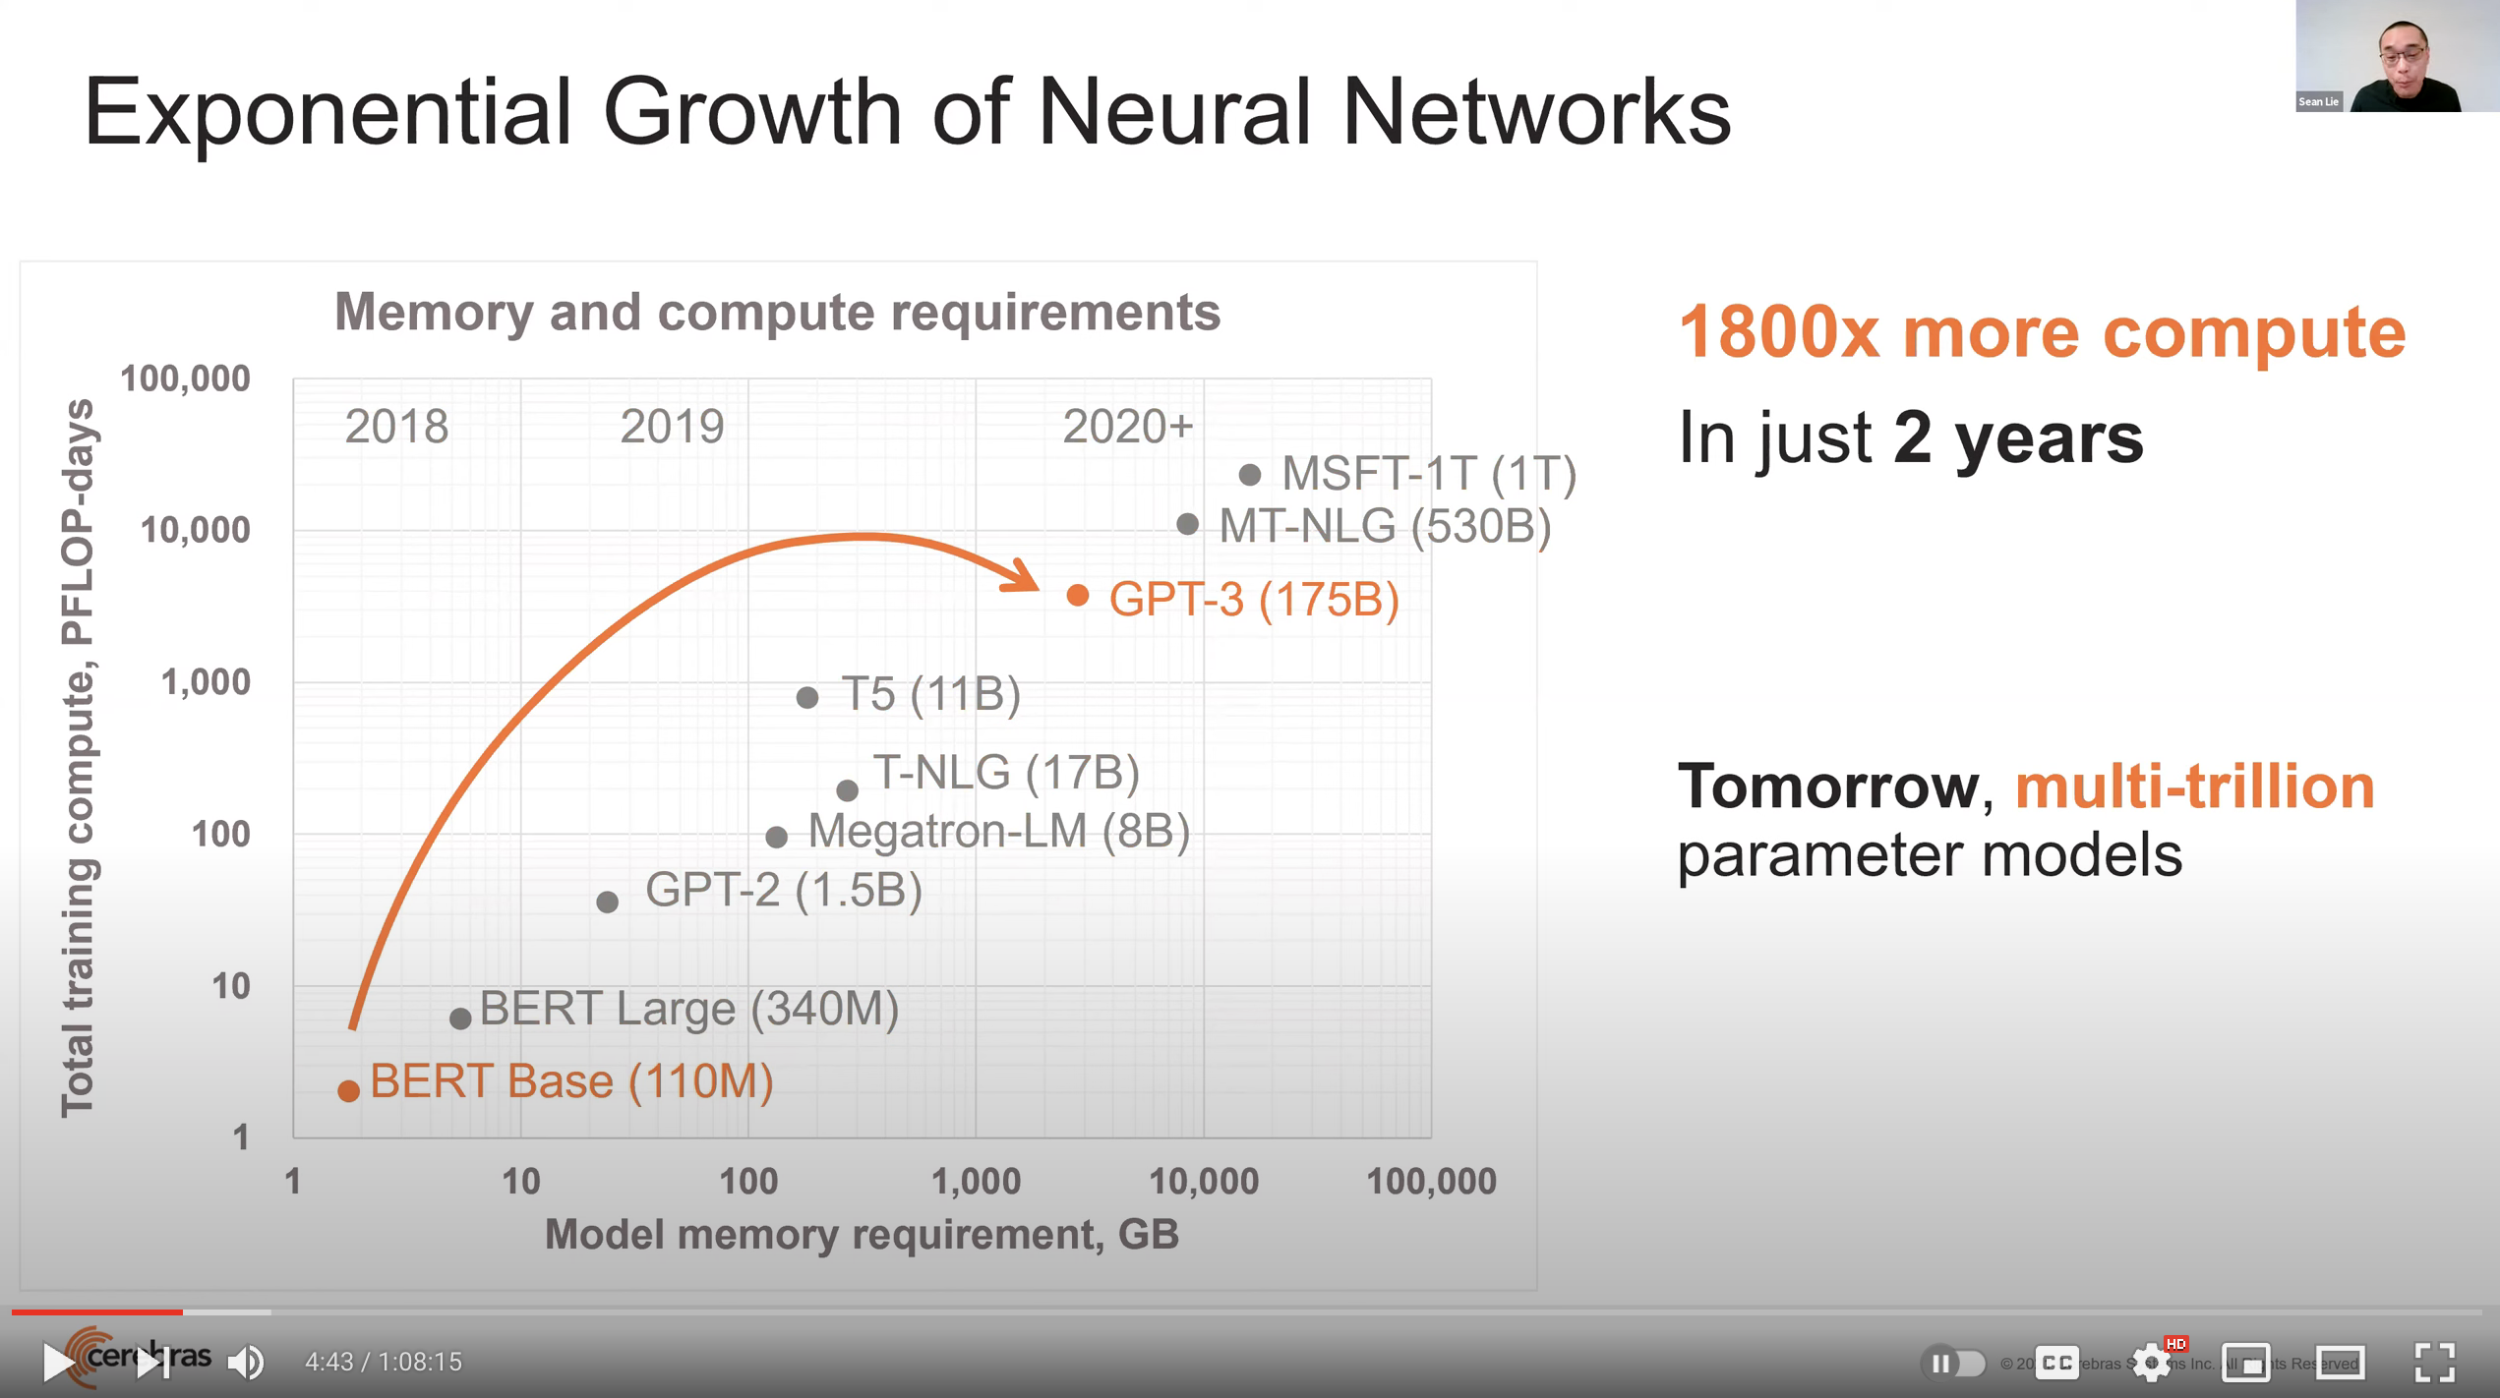
Huge Demand for Performance & Efficiency
~4 orders of magnitude increase in memory requirement
in just a few years!
Source: https://youtu.be/Bh13Idwcb0Q?t=283

Slide 5
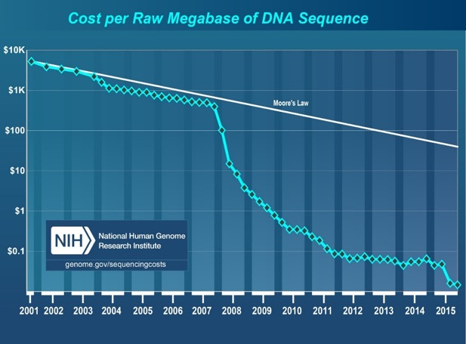
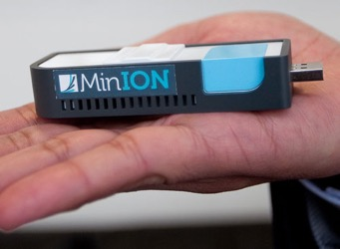
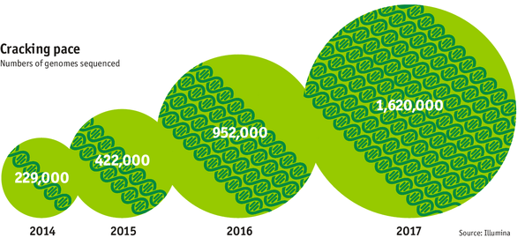

Huge Demand for Performance & Efficiency
development of new
sequencing technologies
Oxford Nanopore MinION
Number of Genomes Sequenced
http://www.economist.com/news/21631808-so-much-genetic-data-so-many-uses-genes-unzipped
Notes:
However, since the development of high throughput sequencing (HTS) technologies, the cost of genome sequencing has fallen off a cliff (<< 1,000$) making it viable for almost everyone's use.

Slide 6
The Problem
Data access is the major performance and energy bottleneck
Our current
design principles
cause great energy waste
(and great performance loss)

Slide 7
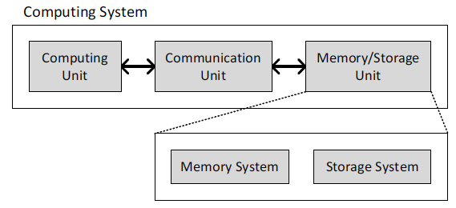
Today’s Computing Systems
Processor centric
All data processed in the processor → at great system cost

Slide 8
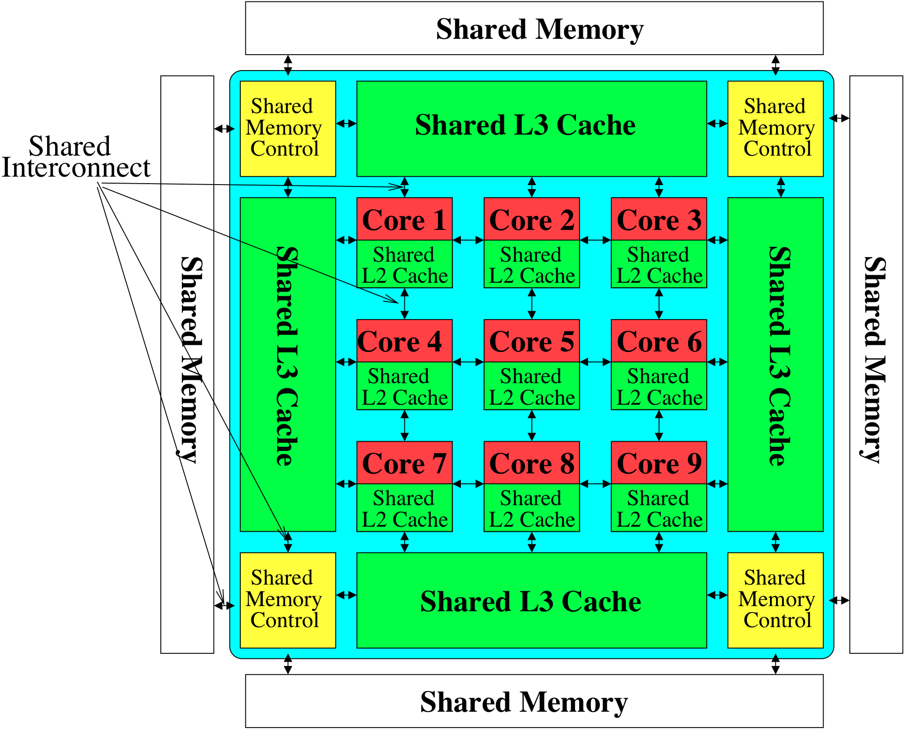
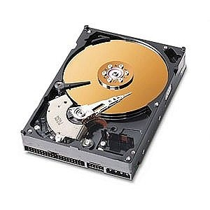
Perils of Processor-Centric Design
Most of the system is dedicated to storing and moving data
Yet, system is still bottlenecked by memory

Slide 9
Processor-Centric System Performance
All of Google’s Data Center Workloads (2015):
Kanev+, “Profiling a Warehouse-Scale Computer,” ISCA 2015.

Slide 10
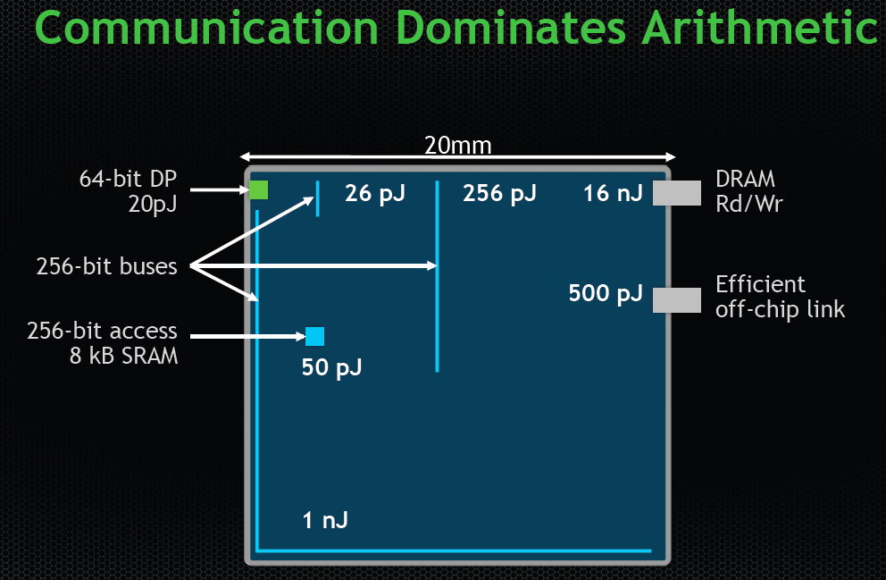
Data Movement vs. Computation Energy
Dally, HiPEAC 2015
A memory access consumes ~100-1000X
the energy of a complex addition

Slide 11
Data Movement vs. Computation Energy
Han+, “EIE: Efficient Inference Engine on Compressed Deep Neural Network,” ISCA 2016.

Slide 12
Data Movement vs. Computation Energy
6400X
A memory access consumes 6400X
the energy of a simple integer addition
Han+, “EIE: Efficient Inference Engine on Compressed Deep Neural Network,” ISCA 2016.

Slide 13
Energy Waste in Mobile Devices
Amirali Boroumand, Saugata Ghose, Youngsok Kim, Rachata Ausavarungnirun, Eric Shiu, Rahul Thakur, Daehyun Kim, Aki Kuusela, Allan Knies, Parthasarathy Ranganathan, and Onur Mutlu,
"Google Workloads for Consumer Devices: Mitigating Data Movement Bottlenecks"
Proceedings of the 23rd International Conference on Architectural Support for Programming Languages and Operating Systems (ASPLOS), Williamsburg, VA, USA, March 2018.
62.7% of the total system energy
is spent on data movement

Slide 14
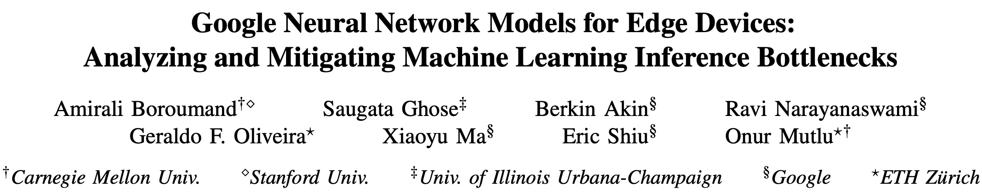
Energy Waste in Accelerators
Amirali Boroumand, Saugata Ghose, Berkin Akin, Ravi Narayanaswami, Geraldo F. Oliveira, Xiaoyu Ma, Eric Shiu, and Onur Mutlu,
"Google Neural Network Models for Edge Devices: Analyzing and Mitigating Machine Learning Inference Bottlenecks"
Proceedings of the 30th International Conference on Parallel Architectures and Compilation Techniques (PACT), Virtual, September 2021.
[Slides (pptx) (pdf)]
[Talk Video (14 minutes)]
> 90% of the total system energy
is spent on memory in large ML models

Slide 15
Energy Wasted on Data Movement
In LSTMs and Transducers used by Google,
>90% energy spent on off-chip interconnect and DRAM
https://arxiv.org/pdf/2109.14320

Slide 16
Fundamental Problem
Processing of data
is performed
far away from the data

Slide 17
We Need A Paradigm Shift To …
Enable computation with minimal data movement
Compute where it makes sense (where data resides)
Make computing architectures more data-centric

Slide 18
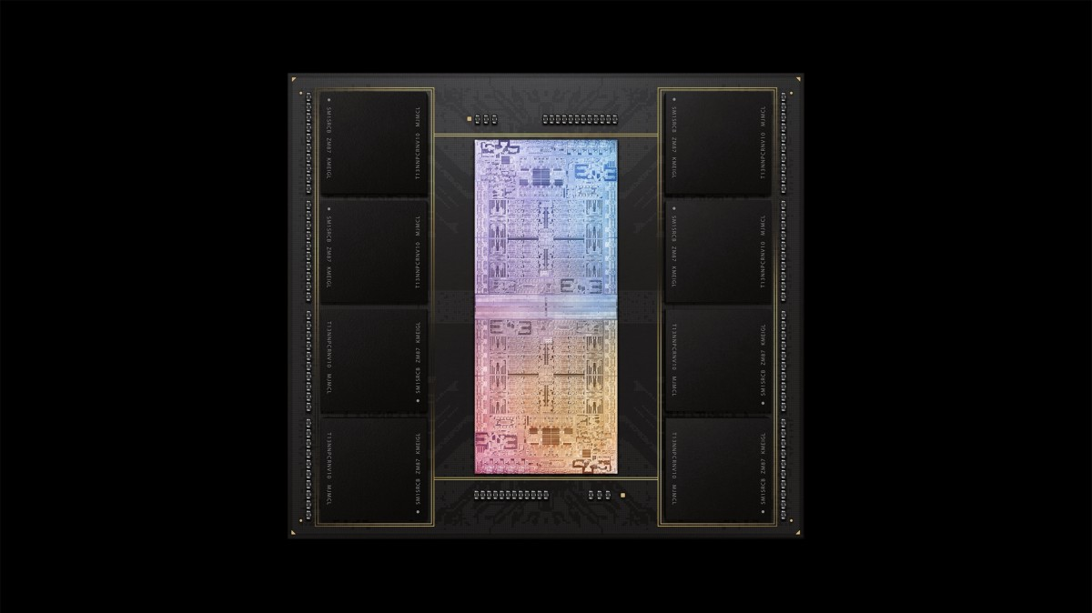
Process Data Where It Makes Sense
Sensors
A lot of
SRAM
Storage
DRAM
DRAM
Storage
Apple M1 Ultra System (2022)
https://www.gsmarena.com/apple_announces_m1_ultra_with_20core_cpu_and_64core_gpu-news-53481.php

Slide 19
Memory as an Accelerator
CPU
core
CPU
core
mini-CPU
core
GPU
(throughput)
core
GPU
(throughput)
core
video
core
GPU
(throughput)
core
GPU
(throughput)
core
CPU
core
CPU
core
Memory
imaging
core
LLC
Specialized
compute-capability
in memory
Memory Controller
Memory Bus
Memory similar to a “conventional” accelerator

Slide 20
Goal: Processing Inside Memory/Storage
Many questions … How do we design the:
  compute-capable memory & controllers?
  processors & communication units?
  software & hardware interfaces?
  system software, compilers, languages?
  algorithms & theoretical foundations?
Database
Graphs
Media
ML Model
Memory/Storage
Processor
Core
Cache
Query
Interconnect
Problem
Results
Algorithm
Program/Language
System Software
SW/HW Interface
Micro-architecture
Logic
Devices
Electrons

Slide 21
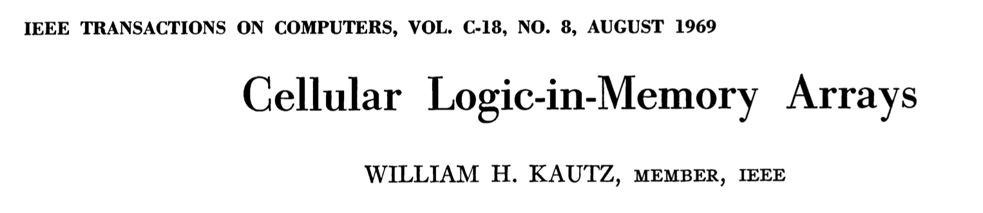
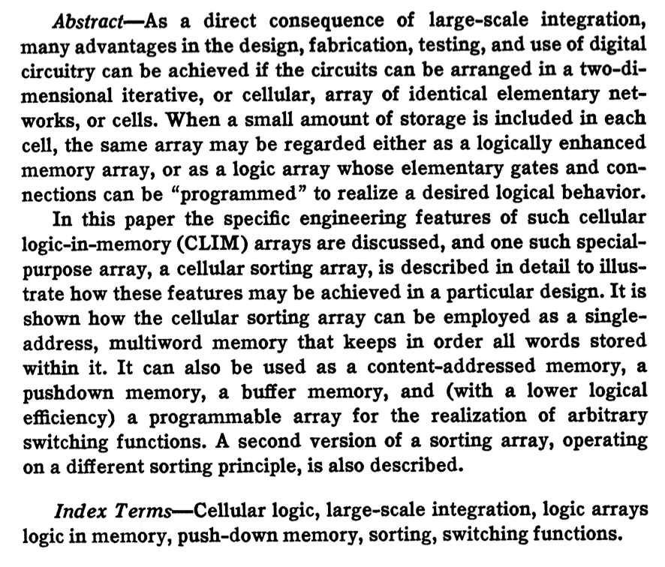
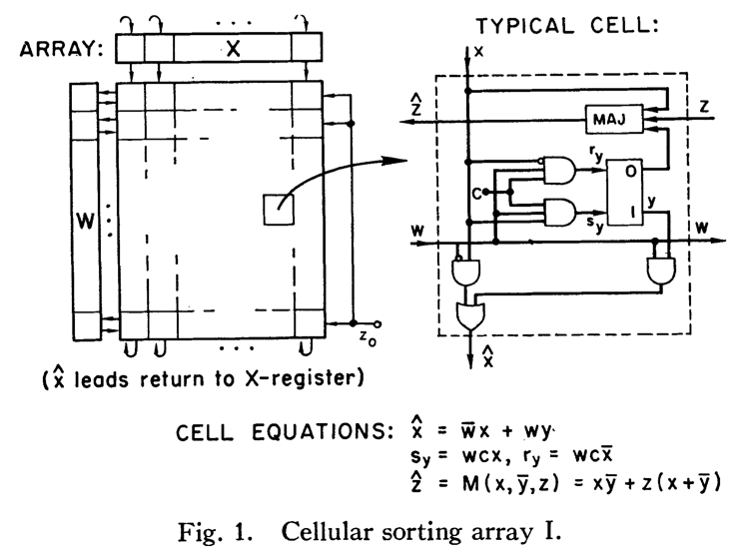
Processing in/near Memory: An Old Idea
Kautz, “Cellular Logic-in-Memory Arrays”, IEEE TC 1969.
https://doi.org/10.1109/T-C.1969.222754

Slide 22
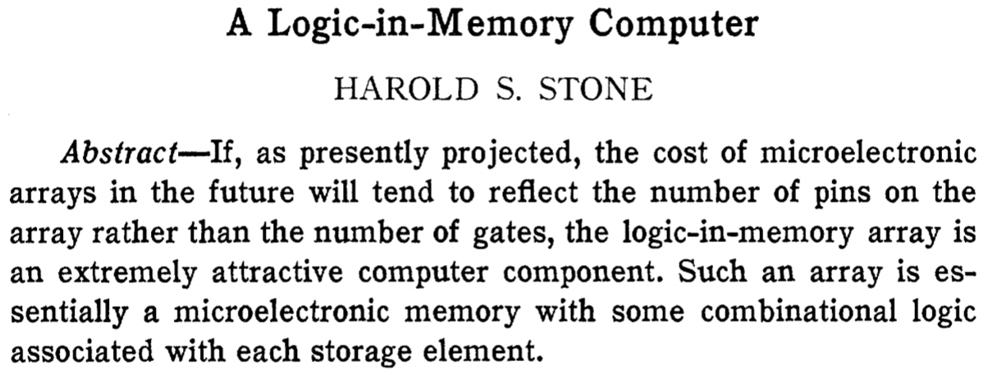
Processing in/near Memory: An Old Idea
Stone, “A Logic-in-Memory Computer,” IEEE TC 1970.
https://safari.ethz.ch/architecture/fall2020/lib/exe/fetch.php?media=stone_logic_in_memory_1970.pdf

Slide 23
Why In-Memory Computation Today?
Huge demand from Applications & Systems
  Data access bottleneck
  Energy & power bottlenecks
  Data movement energy dominates computation energy
  Need all at the same time: performance, energy, sustainability
  We can improve all metrics by minimizing data movement
Huge problems with Memory Technology
  Memory technology scaling is not going well (e.g., RowHammer)
  Many scaling issues demand intelligence in memory
  Emerging technologies can enable new functions in memory
Designs are squeezed in the middle

Slide 24
Processing in Memory:
Two Types
1. Processing near Memory
2. Processing using Memory

Slide 25
Processing-in-Memory: Two Types
1
Processing-Near-Memory: Computation logic is added to the same die as memory or to the logic layer of 3D-stacked memory
2
Processing-Using-Memory: uses the operational principles of
memory cells & circuitry to perform computation
DRAM
(e.g., 3D-Stacked Memory)
DRAM Bank
Vault
Controller
Processing-
Using-DRAM
DRAM Vault
…
PHY
Processing-Near-Vault
…
Processing-Near-Bank
Notes:
Processing-in-Memory architectures alleviate data movement bottlenecks by moving computation to where the data resides. Such architectures can be implemented
[CLICK] by adding logic near the memory arrays, in what is called processing-near-memory or
[CLICK] by using the analog operating principles of the memory cells to perform computation, in what is called processing-using-memory
[NEXT]

Slide 26
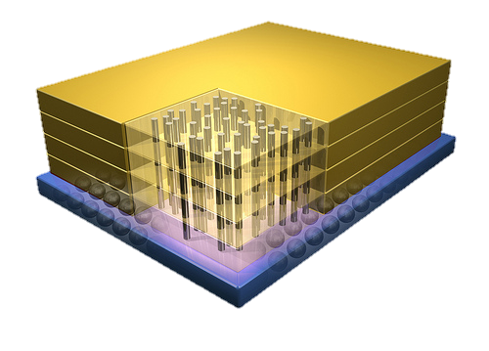


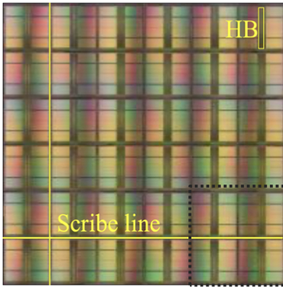
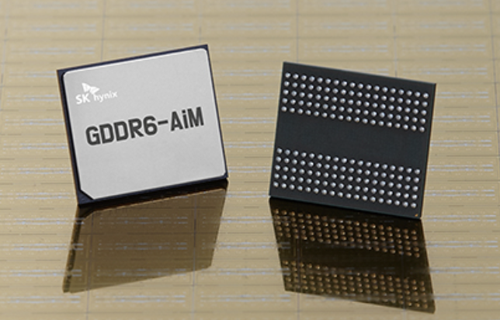
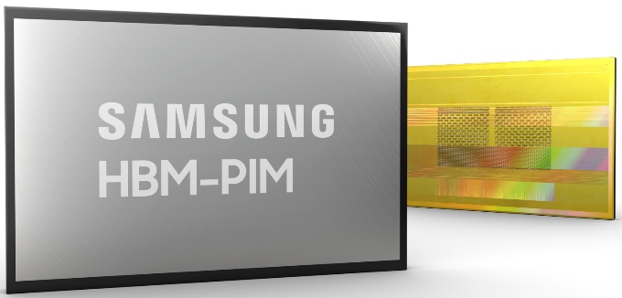
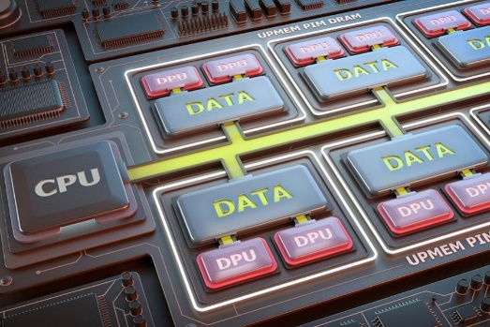
Processing-in-Memory Landscape Today
[Samsung 2021]
[Alibaba 2022]
[SK Hynix 2022]
[Samsung 2021]
[UPMEM 2019]
And, many other experimental chips and startups

Slide 27
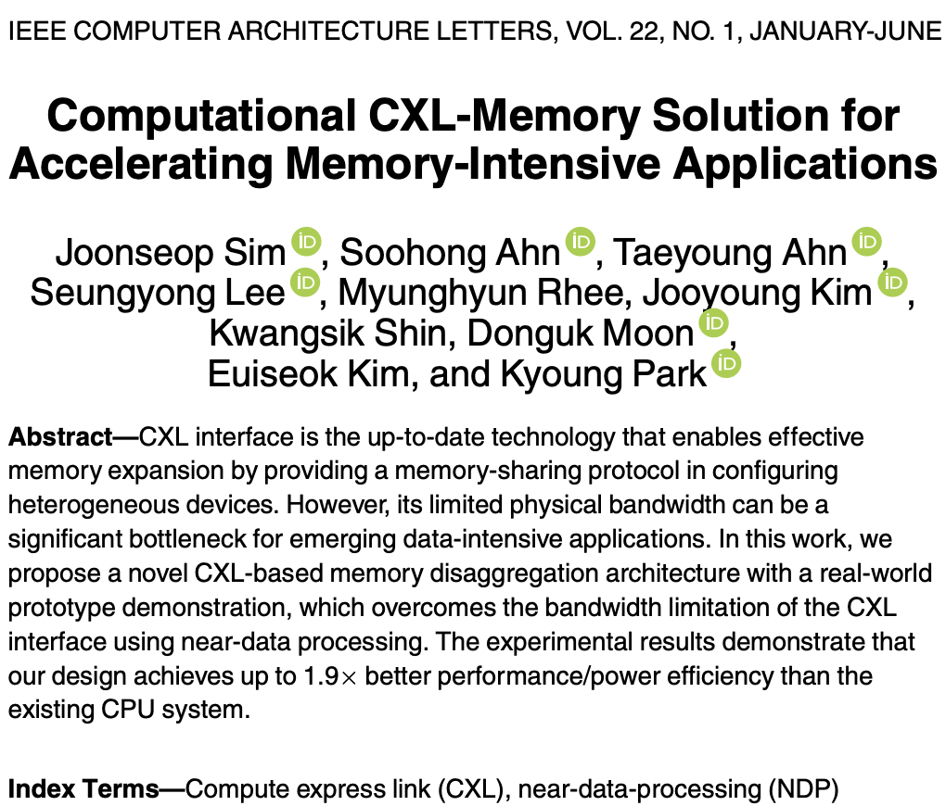
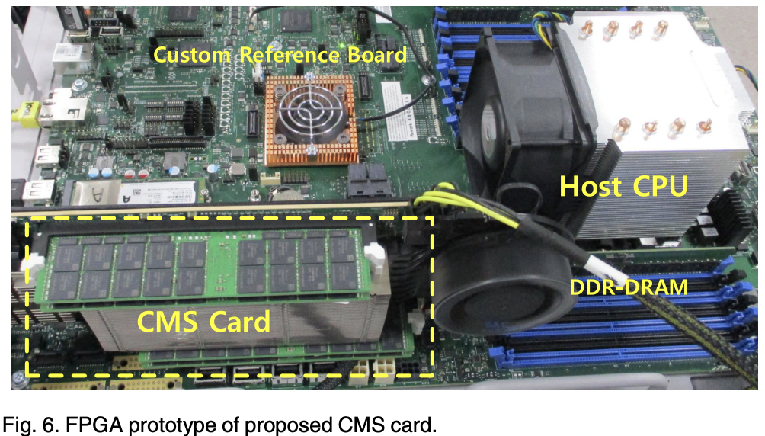
Processing-in-Memory Landscape Today

Slide 28
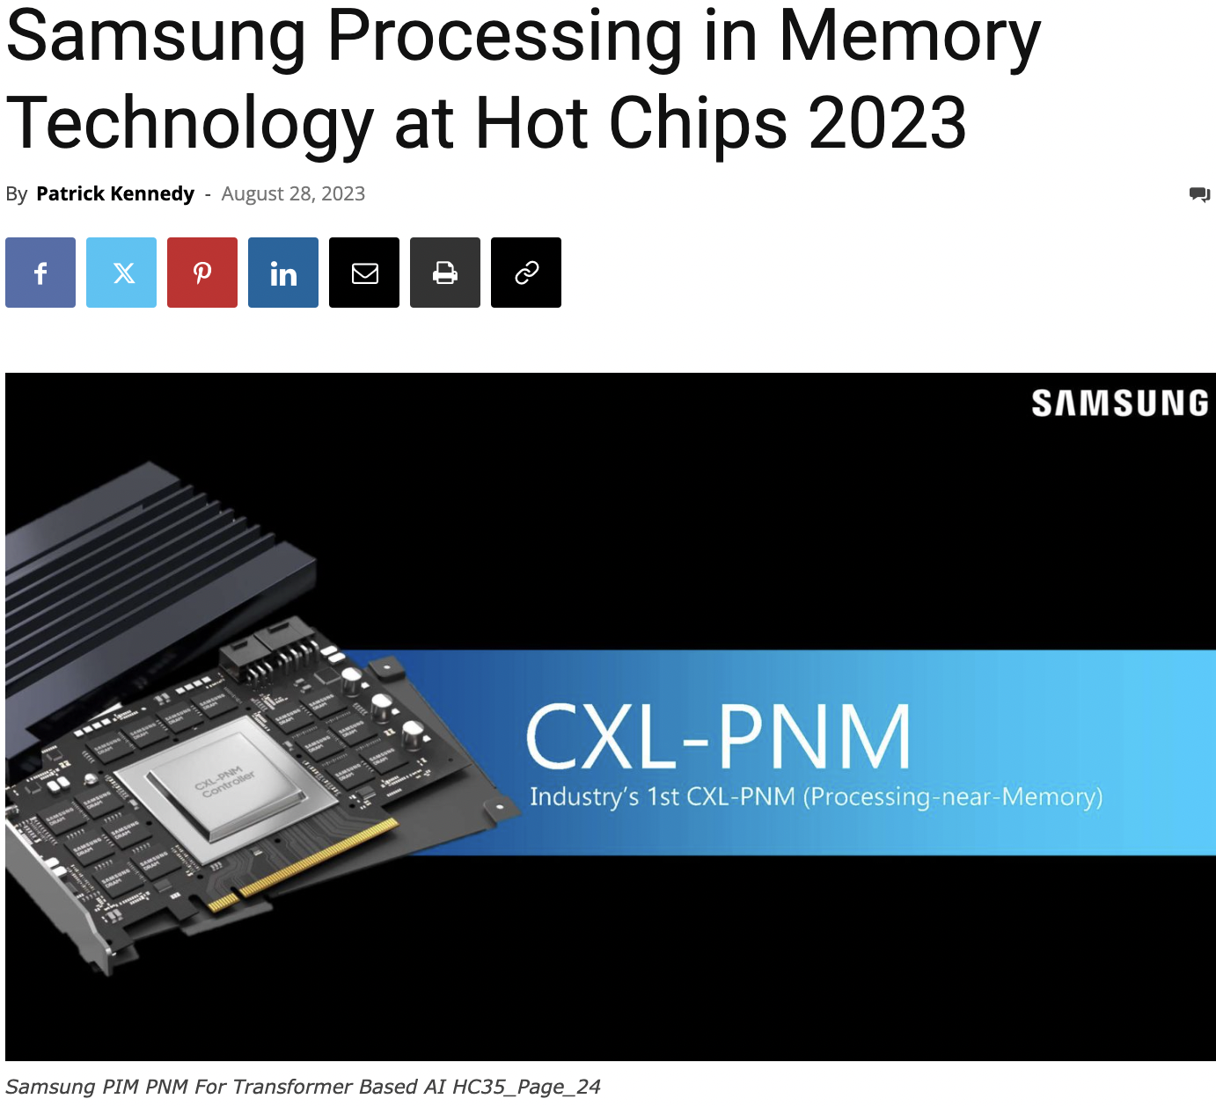
Processing-in-Memory Landscape Today
https://www.servethehome.com/samsung-processing-in-memory-technology-at-hot-chips-2023/

Slide 29
Opportunity: 3D-Stacked Logic+Memory
Memory
Logic
Other “True 3D” technologies
under development

Slide 30
Tesseract System for Graph Processing
Interconnected set of 3D-stacked memory+logic chips with simple cores
Host Processor
Memory
Memory-Mapped
Accelerator Interface
(Noncacheable, Physically Addressed)
Logic
In-Order Core
DRAM Controller
…
…
LP
PF Buffer
Crossbar Network
…
MTP
…
Message Queue
NI
Ahn+, “A Scalable Processing-in-Memory Accelerator for Parallel Graph Processing” ISCA 2015.

Slide 31
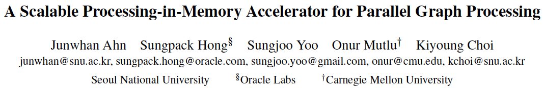
More on Tesseract
Junwhan Ahn, Sungpack Hong, Sungjoo Yoo, Onur Mutlu, and Kiyoung Choi,
"A Scalable Processing-in-Memory Accelerator for Parallel Graph Processing"
Proceedings of the 42nd International Symposium on Computer Architecture (ISCA), Portland, OR, June 2015.
[Slides (pptx) (pdf)] [Lightning Session Slides (pptx) (pdf)]
Top Picks Honorable Mention by IEEE Micro.
Selected to the ISCA-50 25-Year Retrospective Issue covering 1996-2020 in 2023 (Retrospective (pdf) Full Issue).

Slide 32
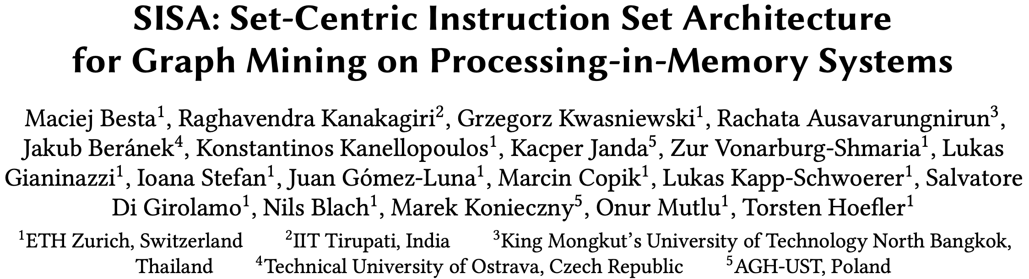
Accelerating Graph Pattern Mining
Maciej Besta, Raghavendra Kanakagiri, Grzegorz Kwasniewski, Rachata Ausavarungnirun, Jakub Beránek, Konstantinos Kanellopoulos, Kacper Janda, Zur Vonarburg-Shmaria, Lukas Gianinazzi, Ioana Stefan, Juan Gómez-Luna, Marcin Copik, Lukas Kapp-Schwoerer, Salvatore Di Girolamo, Nils Blach, Marek Konieczny, Onur Mutlu, and Torsten Hoefler,
"SISA: Set-Centric Instruction Set Architecture for Graph Mining on Processing-in-Memory Systems"
Proceedings of the 54th International Symposium on Microarchitecture (MICRO), Virtual, October 2021.
[Slides (pdf)]
[Talk Video (22 minutes)]
[Lightning Talk Video (1.5 minutes)]
[Full arXiv version]

Slide 33
Accelerating Machine Learning Inference
Amirali Boroumand, Saugata Ghose, Berkin Akin, Ravi Narayanaswami, Geraldo F. Oliveira, Xiaoyu Ma, Eric Shiu, and Onur Mutlu,
"Google Neural Network Models for Edge Devices: Analyzing and Mitigating Machine Learning Inference Bottlenecks"
Proceedings of the 30th International Conference on Parallel Architectures and Compilation Techniques (PACT), Virtual, September 2021.
[Slides (pptx) (pdf)]
[Talk Video (14 minutes)]

Slide 34
Accelerating Mobile Workloads
Amirali Boroumand, Saugata Ghose, Youngsok Kim, Rachata Ausavarungnirun, Eric Shiu, Rahul Thakur, Daehyun Kim, Aki Kuusela, Allan Knies, Parthasarathy Ranganathan, and Onur Mutlu,
"Google Workloads for Consumer Devices: Mitigating Data Movement Bottlenecks"
Proceedings of the 23rd International Conference on Architectural Support for Programming Languages and Operating Systems (ASPLOS), Williamsburg, VA, USA, March 2018.
[Slides (pptx) (pdf)] [Lightning Session Slides (pptx) (pdf)] [Poster (pptx) (pdf)]
[Lightning Talk Video (2 minutes)]
[Full Talk Video (21 minutes)]

Slide 35
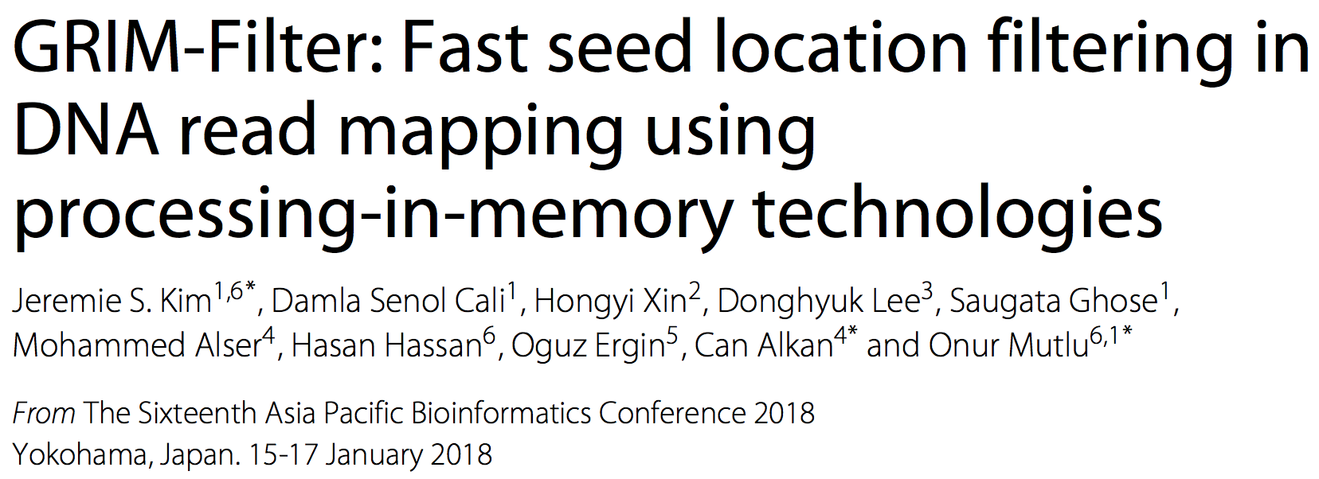
Accelerating DNA Read Mapping
Jeremie S. Kim, Damla Senol Cali, Hongyi Xin, Donghyuk Lee, Saugata Ghose, Mohammed Alser, Hasan Hassan, Oguz Ergin, Can Alkan, and Onur Mutlu,
"GRIM-Filter: Fast Seed Location Filtering in DNA Read Mapping Using Processing-in-Memory Technologies"
BMC Genomics, 2018.
Proceedings of the 16th Asia Pacific Bioinformatics Conference (APBC), Yokohama, Japan, January 2018.
[Slides (pptx) (pdf)]
[Source Code]
[arxiv.org Version (pdf)]
[Talk Video at AACBB 2019]

Slide 36
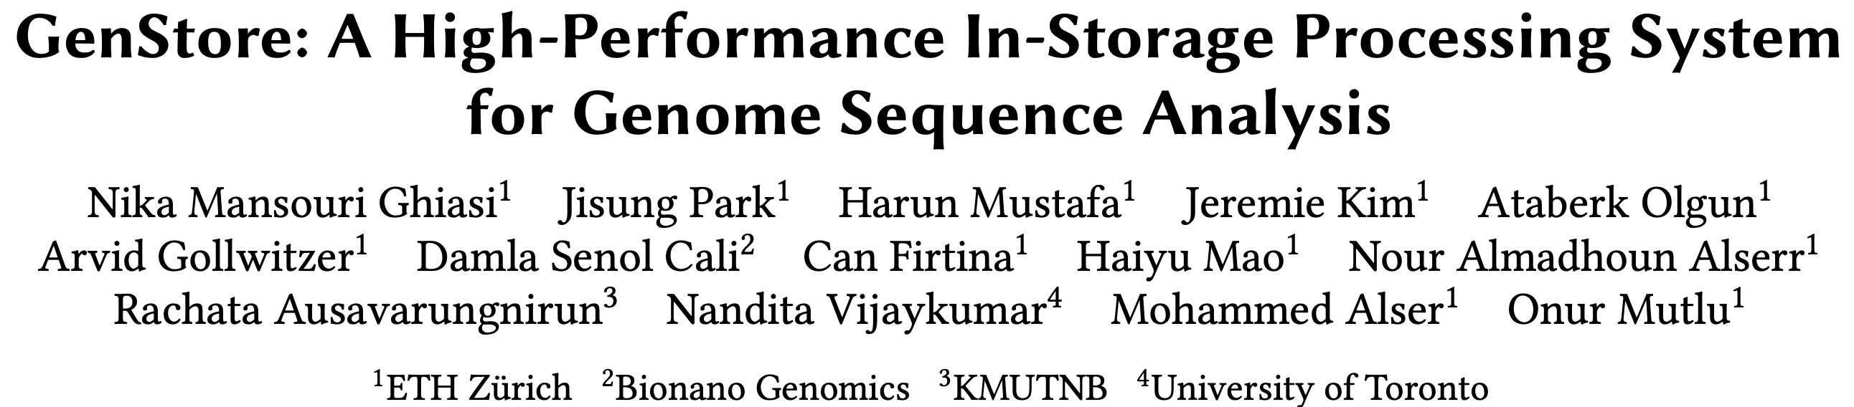
In-Storage Genomic Data Filtering [ASPLOS 2022]
Nika Mansouri Ghiasi, Jisung Park, Harun Mustafa, Jeremie Kim, Ataberk Olgun, Arvid Gollwitzer, Damla Senol Cali, Can Firtina, Haiyu Mao, Nour Almadhoun Alserr, Rachata Ausavarungnirun, Nandita Vijaykumar, Mohammed Alser, and Onur Mutlu,
"GenStore: A High-Performance and Energy-Efficient In-Storage Computing System for Genome Sequence Analysis"
Proceedings of the 27th International Conference on Architectural Support for Programming Languages and Operating Systems (ASPLOS), Virtual, February-March 2022.
[Lightning Talk Slides (pptx) (pdf)]
[Lightning Talk Video (90 seconds)]

Slide 37
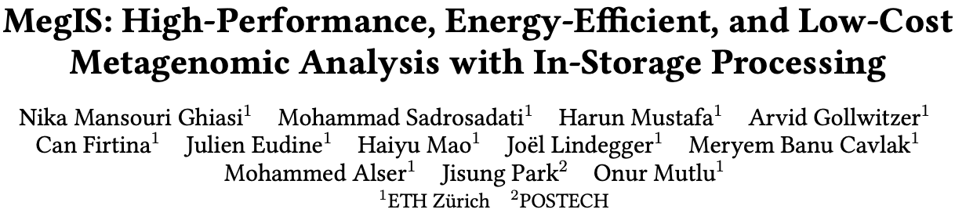
In-Storage Metagenomics [ISCA 2024]
Nika Mansouri Ghiasi, Mohammad Sadrosadati, Harun Mustafa, Arvid Gollwitzer, Can Firtina, Julien Eudine, Haiyu Mao, Joel Lindegger, Meryem Banu Cavlak, Mohammed Alser, Jisung Park, and Onur Mutlu,
"MegIS: High-Performance and Low-Cost Metagenomic Analysis with In-Storage Processing"
Proceedings of the 51st Annual International Symposium on Computer Architecture (ISCA), Buenos Aires, Argentina, July 2024.
[Slides (pptx) (pdf)]
[arXiv version]
https://arxiv.org/pdf/2406.19113

Slide 38
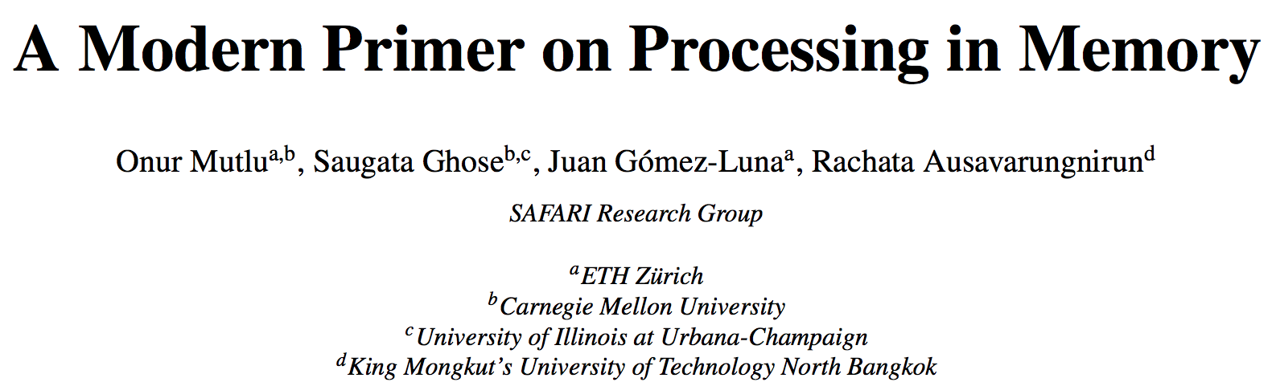
Many More Examples …
Onur Mutlu, Saugata Ghose, Juan Gomez-Luna, and Rachata Ausavarungnirun,
"A Modern Primer on Processing in Memory"
Invited Book Chapter in Emerging Computing: From Devices to Systems - Looking Beyond Moore and Von Neumann, Springer, to be published in 2021.
https://arxiv.org/pdf/2012.03112.pdf

Slide 39
Processing in Memory:
Two Types
1. Processing near Memory
2. Processing using Memory

Slide 40
Focus: Processing using DRAM
We can natively support
  Bulk bitwise COPY and INIT/ZERO
  Bulk bitwise AND, OR, NOT, MAJ, NOR, NAND
  True Random Number Generation; Physical Unclonable Functions
  More complex computation using Lookup Tables
At low cost
Using analog computation capability of DRAM
  Idea: activating (multiple) rows performs computation
    Even in commodity off-the-shelf DRAM chips!
30X-257X performance and energy improvements
Seshadri+“RowClone: Fast and Efficient In-DRAM Copy and Initialization of Bulk Data,” MICRO 2013.
Seshadri+, “Fast Bulk Bitwise AND and OR in DRAM”, IEEE CAL 2015.
Seshadri+, “Ambit: In-Memory Accelerator for Bulk Bitwise Operations Using Commodity DRAM Technology,” MICRO 2017.
Hajinazar+, “SIMDRAM: A Framework for Bit-Serial SIMD Processing using DRAM,” ASPLOS 2021.
Oliveira+, “MIMDRAM: An End-to-End Processing-Using-DRAM System for High-Throughput, Energy-Efficient and Programmer-Transparent Multiple-Instruction Multiple-Data Processing,” HPCA 2024.

Slide 41

Starting Simple: Data Copy and Initialization
  memmove & memcpy: 5% cycles in Google’s datacenter [Kanev+ ISCA’15]
000000000000000
Zero initialization
(e.g., security)
Forking
Checkpointing
Many more
VM Cloning
Deduplication
Page Migration

Slide 42
Future Systems: In-Memory Copy
3) No cache pollution
1) Low latency
Memory
L3
CPU
L2
L1
MC
2) Low bandwidth utilization
4) No unwanted data movement
1046ns, 3.6uJ
→ 90ns, 0.04uJ

Slide 43
RowClone: In-DRAM Row Copy
Idea: Two consecutive ACTivates
4 Kbytes
Negligible HW cost
Step 1: Activate row A
Step 2: Activate row B
Transfer row
DRAM subarray
Transfer
row
Row Buffer (4 Kbytes)
8 bits
Data Bus
Notes:
copy

Slide 44
RowClone: Latency and Energy Savings
11.6x
74x
Seshadri et al., “RowClone: Fast and Efficient In-DRAM Copy and Initialization of Bulk Data,” MICRO 2013.

Slide 45
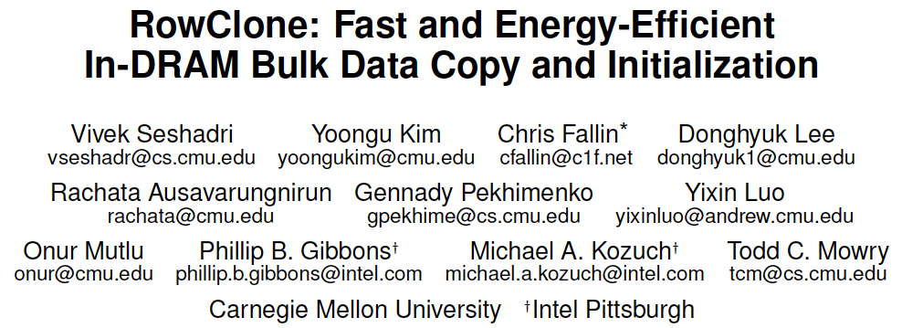
More on RowClone
Vivek Seshadri, Yoongu Kim, Chris Fallin, Donghyuk Lee, Rachata Ausavarungnirun, Gennady Pekhimenko, Yixin Luo, Onur Mutlu, Michael A. Kozuch, Phillip B. Gibbons, and Todd C. Mowry,
"RowClone: Fast and Energy-Efficient In-DRAM Bulk Data Copy and Initialization"
Proceedings of the 46th International Symposium on Microarchitecture (MICRO), Davis, CA, December 2013. [Slides (pptx) (pdf)] [Lightning Session Slides (pptx) (pdf)] [Poster (pptx) (pdf)]

Slide 46
In-DRAM AND/OR: Triple Row Activation
½V_{DD}
½V_{DD}+δ
V_{DD}
A
Final State
AB + BC + AC
B
C
C(A + B) + ~C(AB)
dis
en
0
½V_{DD}
Seshadri+, “Fast Bulk Bitwise AND and OR in DRAM”, IEEE CAL 2015.

Slide 47
In-DRAM Acceleration of Database Queries
>4-12X Performance Improvement
Seshadri+, “Ambit: In-Memory Accelerator for Bulk Bitwise Operations using Commodity DRAM Technology,” MICRO 2017.

Slide 48
Bulk Bitwise Operations in Workloads
[1] Li and Patel, BitWeaving, SIGMOD 2013
[2] Goodwin+, BitFunnel, SIGIR 2017

Slide 49
More on Ambit
Vivek Seshadri, Donghyuk Lee, Thomas Mullins, Hasan Hassan, Amirali Boroumand, Jeremie Kim, Michael A. Kozuch, Onur Mutlu, Phillip B. Gibbons, and Todd C. Mowry,
"Ambit: In-Memory Accelerator for Bulk Bitwise Operations Using Commodity DRAM Technology"
Proceedings of the 50th International Symposium on Microarchitecture (MICRO), Boston, MA, USA, October 2017.
[Slides (pptx) (pdf)] [Lightning Session Slides (pptx) (pdf)] [Poster (pptx) (pdf)]

Slide 50
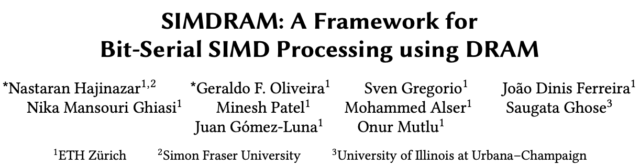
SIMDRAM Framework
Nastaran Hajinazar, Geraldo F. Oliveira, Sven Gregorio, Joao Dinis Ferreira, Nika Mansouri Ghiasi, Minesh Patel, Mohammed Alser, Saugata Ghose, Juan Gomez-Luna, and Onur Mutlu,
"SIMDRAM: An End-to-End Framework for Bit-Serial SIMD Computing in DRAM"
Proceedings of the 26th International Conference on Architectural Support for Programming Languages and Operating Systems (ASPLOS), Virtual, March-April 2021.
[2-page Extended Abstract]
[Short Talk Slides (pptx) (pdf)]
[Talk Slides (pptx) (pdf)]
[Short Talk Video (5 mins)]
[Full Talk Video (27 mins)]

Slide 51





SIMDRAM Framework: Overview
User Input
Step 1: Generate
MAJ logic
Step 2: Generate
sequence of
DRAM commands
SIMDRAM Output
Desired operation
New SIMDRAM $μ$Program
ACT/PRE
ACT/PRE
ACT/PRE
ACT/ACT/PRE
done
$$μProgram$$
$$μProgram$$
MAJ
Main memory
AND/OR/NOT logic
MAJ/NOT logic
bbop_new
New SIMDRAM
instruction
ISA
$μ$Program
User Input
Step 3: Execution according to $μ$Program
SIMDRAM Output
SIMDRAM-enabled application
Instruction result
in memory
foo () {
bbop_new
}
ACT/PRE
ACT/PRE
ACT/PRE
ACT/PRE/PRE
done
ACT/PRE
Control Unit
$μ$Program
Memory Controller

Slide 52
SIMDRAM Key Results
Large improvements over CPU & high-end GPU:
Throughput: 88× and 5.8×
(16 complex operations)
Energy: 257× and 31×
(16 complex operations)
Application Performance: 21× and 2.1×
(seven common real-world applications)

Slide 53
More on SIMDRAM
Nastaran Hajinazar, Geraldo F. Oliveira, Sven Gregorio, Joao Dinis Ferreira, Nika Mansouri Ghiasi, Minesh Patel, Mohammed Alser, Saugata Ghose, Juan Gomez-Luna, and Onur Mutlu,
"SIMDRAM: An End-to-End Framework for Bit-Serial SIMD Computing in DRAM"
Proceedings of the 26th International Conference on Architectural Support for Programming Languages and Operating Systems (ASPLOS), Virtual, March-April 2021.
[2-page Extended Abstract]
[Short Talk Slides (pptx) (pdf)]
[Talk Slides (pptx) (pdf)]
[Short Talk Video (5 mins)]
[Full Talk Video (27 mins)]

Slide 54
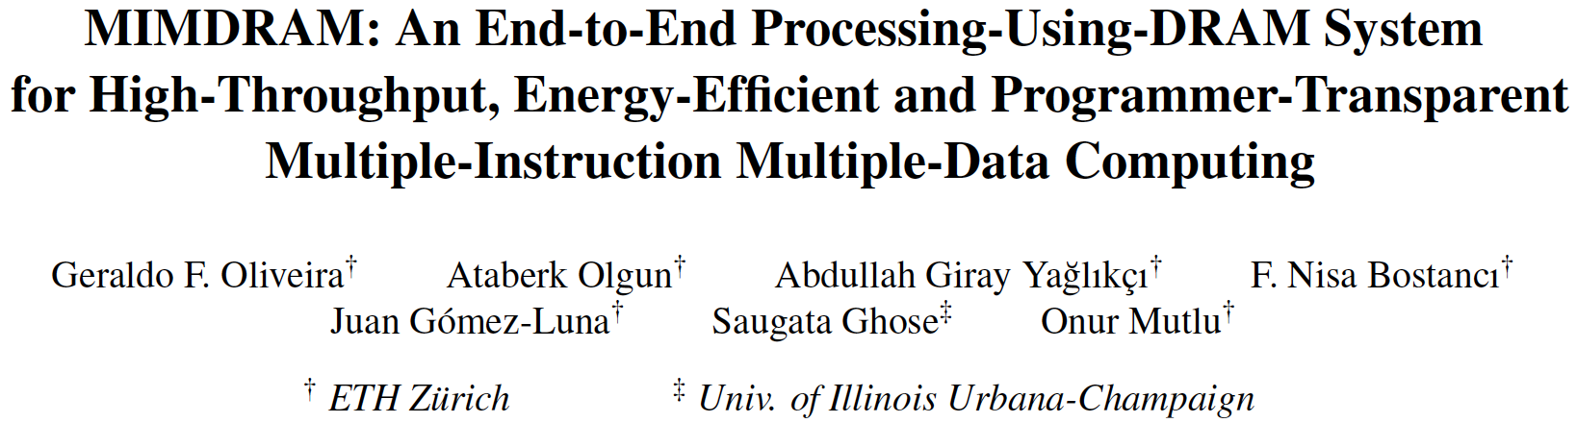
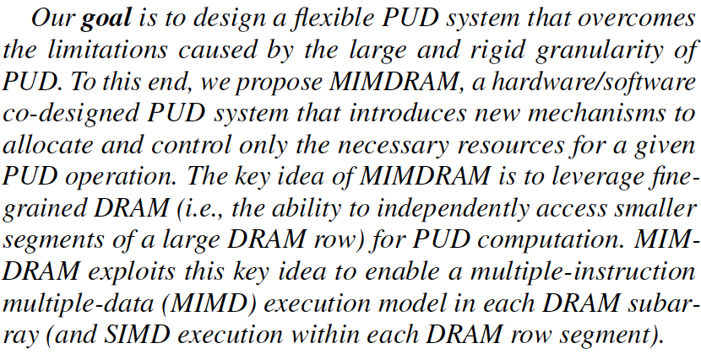
MIMDRAM: More Flexible Processing using DRAM
Appears at HPCA 2024
https://arxiv.org/pdf/2402.19080.pdf

Slide 55
MIMDRAM:
Key Idea (I)
Enable narrower-width operations than a DRAM row
DRAM mat
global wordline
row decoder
global sense amplifier
Key Issue:
on a DRAM access, the global wordline propagates across all DRAM mats
Fine-Grained DRAM:
segment the global wordline to access individual DRAM mats
Notes:
MIMDRAM’s key idea is to leverage fine-grained DRAM access for processing-using-DRAM operation
[CLICK] In traditional architectures, on every DRAM access, all rows in a DRAM mat are asserted even if only portion of that row will be accessed, since the global wordline propagates across all DRAM MATS.
[CLICK] Fine-Grained DRAM architectures segments the global wordline to access individual DRAM mats on an DRAM access.
[NEXT]

Slide 56
MIMDRAM:
Key Idea (II)
Fine-Grained DRAM:
segment the global wordline to access individual DRAM mats
segmented global wordline
row decoder
global sense amplifier
  Fine-grained DRAM for energy-efficient DRAM access:
[Cooper-Balis+, 2010]: Fine-Grained Activation for Power Reduction in DRAM
[Udipi+, 2010]: Rethinking DRAM Design and Organization for Energy-Constrained Multi-Cores
[Zhang+, 2014]: Half-DRAM
[Ha+, 2016]: Improving Energy Efficiency of DRAM by Exploiting Half Page Row Access
[O’Connor+, 2017]: Fine-Grained DRAM
[Olgun+, 2024]: Sectored DRAM
Notes:
[CLICK] Fine-grained DRAM has been previously proposed for energy-efficient DRAM access
[NEXT]

Slide 57
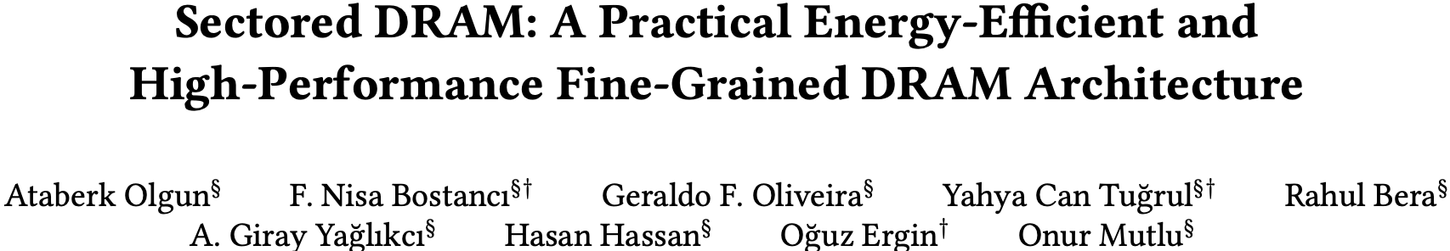
Sectored DRAM
Ataberk Olgun, F. Nisa Bostanci, Geraldo F. Oliveira, Yahya Can Tugrul, Rahul Bera, A. Giray Yaglikci, Hasan Hassan, Oguz Ergin, and Onur Mutlu,
"Sectored DRAM: A Practical Energy-Efficient and High-Performance Fine-Grained DRAM Architecture"
ACM Transactions on Architecture and Code Optimization (TACO), [online] June 2024.
[arXiv version]
[ACM Digital Library version]
https://arxiv.org/pdf/2207.13795

Slide 58
MIMDRAM:
Key Idea (III)
segmented global wordline
row decoder
global sense amplifier
  Use fine-grained DRAM for processing-using-DRAM:
1
Improves SIMD utilization
for a single PUD operation, only access the DRAM mats with target data
for multiple PUD operations, execute independent operations concurrently
Notes:
In the context of processing-using-DRAM, fine-grained DRAM provides three benefits
[CLICK] First, it improves SIMD utilization for a single PUD operations, by accessing only the DRAM mats with the target input operands
[NEXT]

Slide 59
MIMDRAM:
Key Idea (III)
segmented global wordline
row decoder
global sense amplifier
  Use fine-grained DRAM for processing-using-DRAM:
1
Improves SIMD utilization
for a single PUD operation, only access the DRAM mats with target data
for multiple PUD operations, execute independent operations concurrently
→ multiple instruction, multiple data (MIMD) execution model
Notes:
Also, we can leverage the unused DRAM mats to concurrently execute independent PUD operations, in a multiple instruction, multiple data execution model
[NEXT]

Slide 60
MIMDRAM:
Key Idea (III)
segmented global wordline
row decoder
global sense amplifier
global sense amplifier
  Use fine-grained DRAM for processing-using-DRAM:
1
Improves SIMD utilization
for a single PUD operation, only access the DRAM mats with target data
for multiple PUD operations, execute independent operations concurrently
→ multiple instruction, multiple data (MIMD) execution model
2
Enables low-cost interconnects for vector reduction
global and local data buses can be used for inter-/intra-mat communication
Notes:
Second, we can leverage the global and local data buses that connect DRAM mats to move data within a DRAM subarray, allowing for the implementation of vector reduction operations
[NEXT]

Slide 61
MIMDRAM:
Key Idea (III)
512 columns
segmented global wordline
row decoder
global sense amplifier
  Use fine-grained DRAM for processing-using-DRAM:
1
Improves SIMD utilization
for a single PUD operation, only access the DRAM mats with target data
for multiple PUD operations, execute independent operations concurrently
→ multiple instruction, multiple data (MIMD) execution model
2
Enables low-cost interconnects for vector reduction
global and local data buses can be used for inter-/intra-mat communication
3
Eases programmability
SIMD parallelism in a DRAM mat is on par with vector ISAs’ SIMD width
Notes:
Third, since the number of DRAM rows in a single DRAM mat are on par with the number of SIMD lanes in vector ISAs, we can ease PUD’s programmability by leveraging current compiler infrastructure for such ISAs
[NEXT]

Slide 62
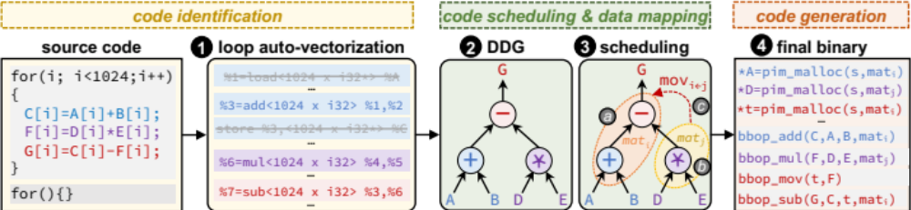
MIMDRAM:
Compiler Support (I)
Transparently to programmer:
extract SIMD parallelism from an application, and
schedule PUD instructions while maximizing utilization
Goal
Three new LLVM-based passes targeting PUD execution
Notes:
Our goal is to transparently from the user, extract SIMD parallelism from an application and schedule PUD instructions while maximizing SIMD utilization
[CLICK] To this end, we implemented three LLVM passed targeting PUD execution
[NEXT]

Slide 63
MIMDRAM:
Compiler Support (II)
Identify SIMD parallelism, generate PUD instructions,
and set the appropriate vectorization factor
Goal
Notes:
The first pass is responsible for identifying SIMD parallelism in a code, using LLVM’s auto-vectorization engine, generate PUD instructions and set the best vectorization factor for such PUD instruction
[NEXT]

Slide 64
MIMDRAM:
Compiler Support (II)
Identify SIMD parallelism, generate PUD instructions,
and set the appropriate vectorization factor
Goal
Improve SIMD utilization by allowing the distribution of independent PUD instructions across DRAM mats
Goal
Notes:
The second pass is responsible for scheduling and mapping computation. Our pass uses metadata to mark independent PUD instructions that should be executed concurrently across mats
[NEXT]

Slide 65
MIMDRAM:
Compiler Support (III)
Identify SIMD parallelism, generate PUD instructions,
and set the appropriate vectorization factor
Goal
Improve SIMD utilization by allowing the distribution of independent PUD instructions across DRAM mats
Goal
Generate the appropriate binary for
data allocation and PUD instructions
Goal
Notes:
Finally, the third pass is responsible for code generation and data allocation for PUD instructions
[NEXT]

Slide 66
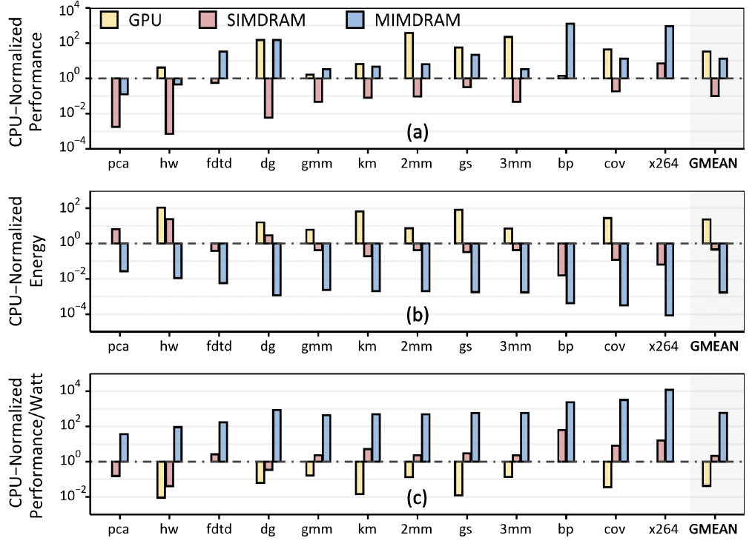
MIMDRAM Perf, Energy, Perf/Watt
582X and 13,612X the energy efficiency of CPU and GPU, respectively
Notes:
We evaluate MIMDRAM using twelve real-world applications
and 495 multi-programmed application mixes.
When using 64 DRAM subarrays per bank and 16
banks for PuD computation in a DRAM chip, MIMDRAM
provides 1) 13.2Å~/0.22Å~/173Å~ the performance,
2) 0.0017Å~/0.00007Å~/0.004Å~ the energy consumption, 3)
582.4Å~/13612Å~/272Å~ the performance per Watt of the
CPU [215]/GPU [216]/SIMDRAM [174] baseline (Fig. 5) and
4) when using a single DRAM subarray, 15.6°ø the SIMD
utilization (i.e., SIMD efficiency) of the prior state-of-the-art
PuD framework, SIMDRAM [174].

Slide 67
Capabilities of Off-The-Shelf Memory
Existing DRAM Chips
Are Already Quite Capable

Slide 68
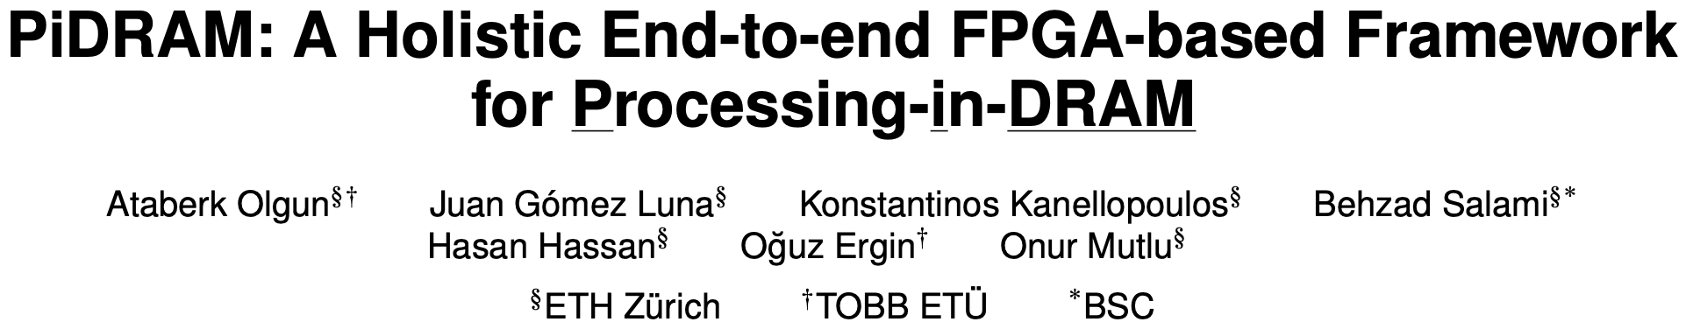
Real Processing Using Memory Prototype
End-to-end RowClone & TRNG using off-the-shelf DRAM chips
Idea: Violate DRAM timing parameters to mimic RowClone
https://arxiv.org/pdf/2111.00082.pdf
https://github.com/cmu-safari/pidram
https://www.youtube.com/watch?v=qeukNs5XI3g&t=4192s

Slide 69
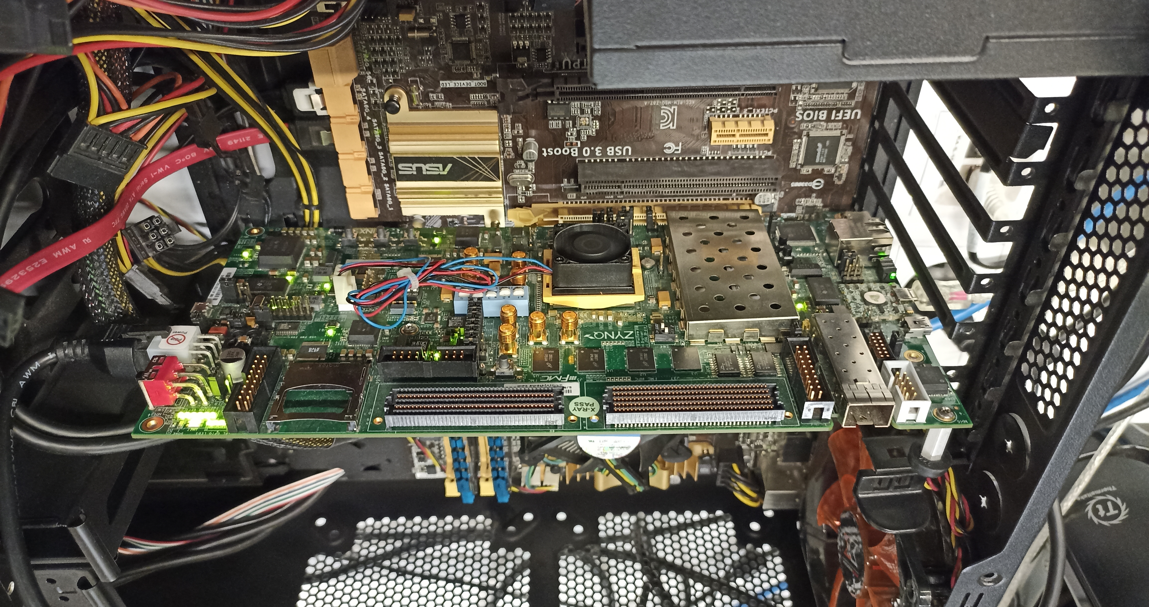
Real Processing-using-Memory Prototype
https://arxiv.org/pdf/2111.00082.pdf
https://github.com/cmu-safari/pidram
https://www.youtube.com/watch?v=qeukNs5XI3g&t=4192s
Host Machine
FPGA Board
RISC-V System
PiM-Enabled DIMM

Slide 70
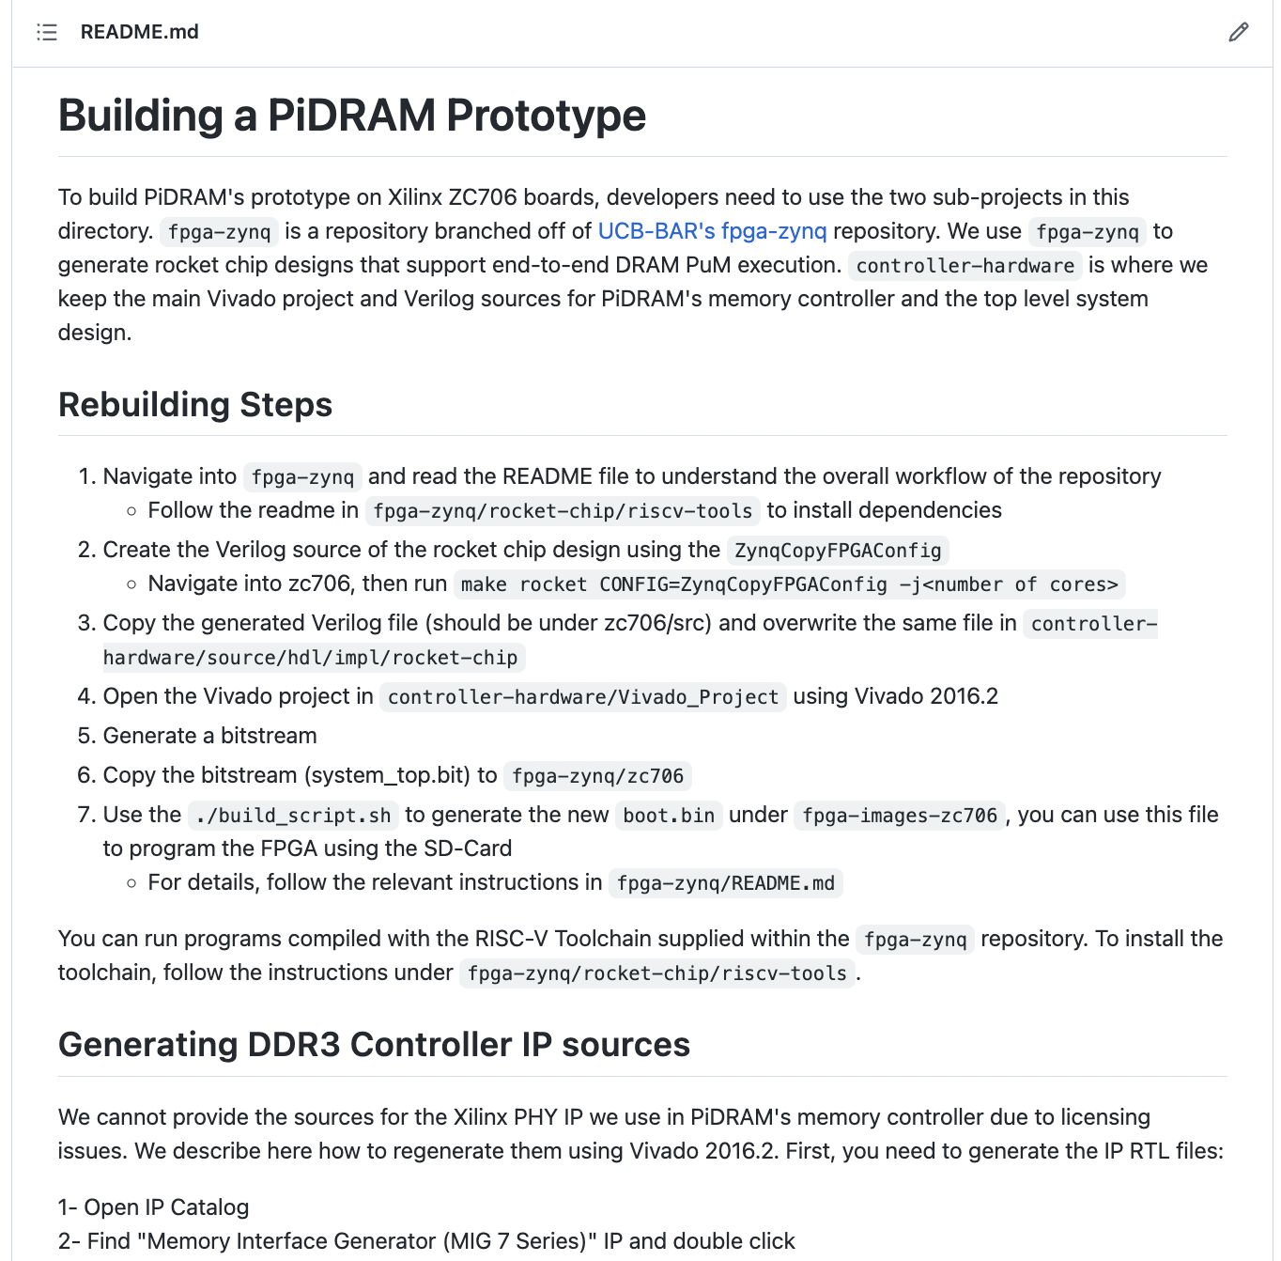
Real Processing-using-Memory Prototype
https://arxiv.org/pdf/2111.00082.pdf
https://github.com/cmu-safari/pidram
https://www.youtube.com/watch?v=qeukNs5XI3g&t=4192s

Slide 71
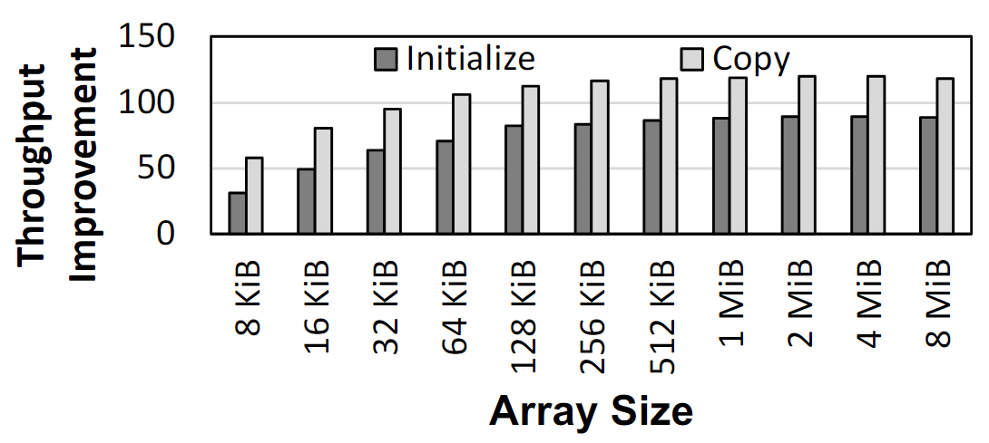
Microbenchmark Copy/Initialization Throughput
In-DRAM Copy and Initialization
improve throughput by 119x and 89x
Notes:
This plot shows the throughput improvement provided by in-DRAM copy operations for bulk data initialization and copy over CPU-based copy and initialization using LOAD and STORE instructions. We do not execute any CLFLUSH instructions and assume that the data is up to date in DRAM and there are no cached copies.
The x-axis shows the size of the arrays that we copy or initialize. The dark gray bar shows the improvement for initialization operations, and the bright gray bar shows the improvement for copy operations.
[CLICK] We observe that in-DRAM copy and initialization operations improve copy and initialization throughput by 119x and 89x including the overheads of system support required for RowClone operations

Slide 72
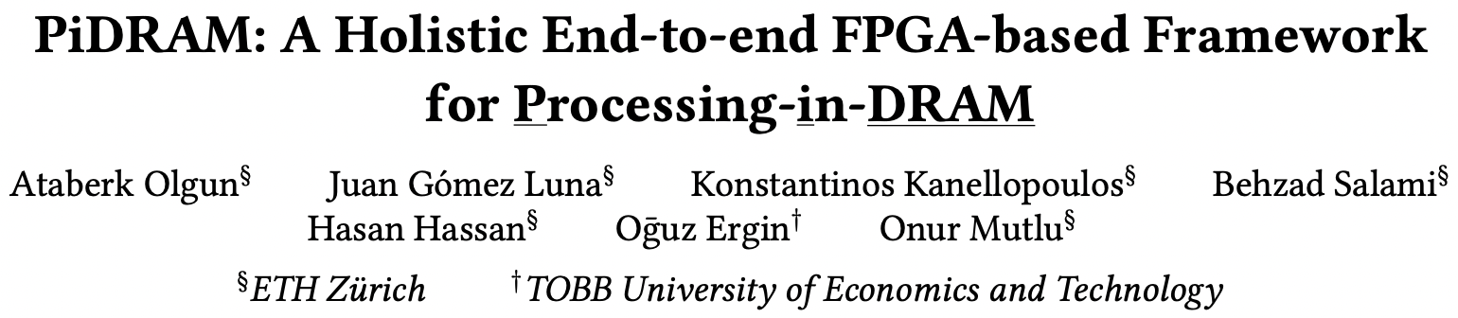
More on PiDRAM
Ataberk Olgun, Juan Gomez Luna, Konstantinos Kanellopoulos, Behzad Salami, Hasan Hassan, Oguz Ergin, and Onur Mutlu,
"PiDRAM: A Holistic End-to-end FPGA-based Framework for Processing-in-DRAM"
ACM Transactions on Architecture and Code Optimization (TACO), March 2023.
[arXiv version]
Presented at the 18th HiPEAC Conference, Toulouse, France, January 2023.
[Slides (pptx) (pdf)]
[Longer Lecture Slides (pptx) (pdf)]
[Lecture Video (40 minutes)]
[PiDRAM Source Code]

Slide 73
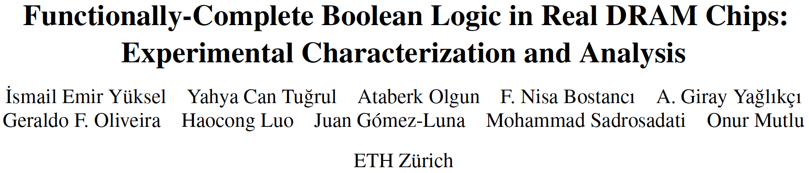
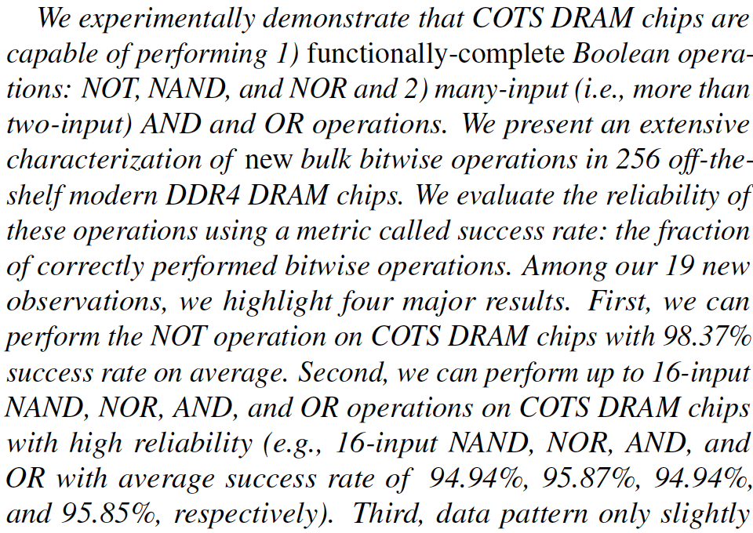
DRAM Chips Are Already (Quite) Capable!
Appears at HPCA 2024
https://arxiv.org/pdf/2402.18736.pdf

Slide 74
The Capability of COTS DRAM Chips
We demonstrate that COTS DRAM chips:
1
Can copy one row into up to 31 other rows
with >99.98% success rate
2
Can perform NOT operation
with up to 32 output operands
3
Can perform up to 16-input
AND, NAND, OR, and NOR operations
74
Notes:
[CLICK]In this study, we experimentally demonstrate that off-the-shelf DRAM chips
[CLICK] Can simultaneously activating up to 48 DRAM rows in two neighboring subarrays
[CLICK] Can performing NOT operation with up to 32 output operands
[CLICK] Can performing up to 16-input AND, NAND, OR, and NOR operations

Slide 75
In-DRAM Multiple Row Copy (Multi-RowCopy)
Simultaneously activate many rows to
copy one row’s content to multiple destination rows
RowClone
Multi-RowCopy
s
r
c
d
s
t
s
r
c
d
s
t
s
r
c
s
r
c
s
r
c
d
s
t
d
s
t
d
s
t
s
r
c
s
r
c
s
r
c
Notes:
[CLICK] Our key idea is since we can activate many rows simultaneously, we can copy one row’s content to other simultaneously activated rows
[CLICK] Let’s recall the RowClone example where we copy source to destination
[CLICK] In RowClone, we first activate the source row which will copy its content to sense amplifiers
[CLICK] And then, we activate destination row to drive the sense amplifier’s content to destination row
[CLICK] In our mechanism, which we call Multi-RowCopy, we have several destination rows
[CLICK] Here we activate many destination rows simultaneously
[CLICK] and thus sense amplifier drives its content to these destination rows.

Slide 76
Key Idea: NOT Operation
Connect rows in neighboring subarrays
through a NOT gate by consecutively activating rows
src
src
src
NOT gate
A
A
A
SA
SA
SA
ACT src
ACT dst
~A
dst
dst
dst
76
Notes:
Our key idea is to leverage the connection between neighboring subarrays,
[CLICK] the NOT gate in the sense amplifier.
[CLICK] By simultaneously activating rows in neighboring subarrays, we can connect these rows through a NOT gate
[CLICK] As an example, source and destination in neighboring subarrays and if we first activate src
[CLICK] and then activate destination, this result in sense amplifier to drive the negated src value to the dst

Slide 77
Key Idea: NAND, NOR, AND, OR
Manipulate the bitline voltage to express
a wide variety of functions using
simultaneous multi-row activation in neighboring subarrays
V_{REF}
V_{(A,B)}
A
A
B
B
SA
Multiple Row ACT
SA
sense amplifier
compares
V_{(A,B)} and V_{(X,Y)}
X
X
Y
Y
V_{REF}
V_{(X,Y)}
77
Notes:
[CLICK] Let me give the key idea by showing four cells: X,Y,A, and B, two from each neighboring subarrays.
[CLICK] Now if we activate these four cells simultaneously,
[CLICK] the bitline at the bottom subarray becomes the function of voltages in X and Y and the bitline at the top subarray becomes the function of voltages in A and B
[CLICK] Sense amplifier will compare voltage at the bottom bitline to the voltage at the top bitline and figure out which one is higher

Slide 78


Two-Input AND and NAND Operations
ACT
PRE
ACT
<3ns
<3ns
AVG(V_{DD},V_{DD}/2)
V_{DD}=1 & GND = 0
V_{DD}
Reference Subarray (REF)
AND
NAND
X
Y
COM
REF
V_{DD}/2*
0
0
0
1
0
1
0
1
Compute Subarray (COM)
X
1
0
0
1
Y
1
1
1
0
AVG(X,Y)
78
*Gao et al., "FracDRAM: Fractional Values in Off-the-Shelf DRAM," in MICRO, 2022.

Slide 79
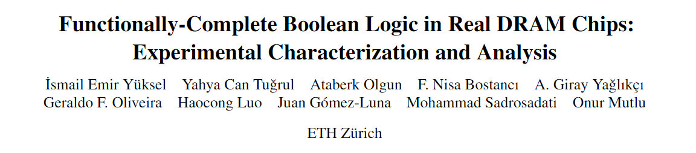
Many-Input AND, NAND, OR, and NOR Operations
ACT REF
PRE
ACT COM
<3ns
<3ns
We can express AND, NAND, OR, and NOR operations
by carefully manipulating the reference voltage
AVG(V_{DD},V_{DD}/2)
V_{DD}=1 & GND = 0
V_{DD}
Reference Subarray (REF)
X
Y
AND
NAND
V_{DD}/2
0
0
0
1
0
1
0
1
Compute Subarray (COM)
1
0
0
1
X
(More details in the paper)
Y
1
1
1
0
AVG(X,Y)
https://arxiv.org/pdf/2402.18736.pdf
79
Notes:
By carefully choosing the voltage levels of the cells in the reference subarray, we can express many-input AND, NAND, OR, and NOR operations
[CLICK] As our time is limited, please check our paper for more details.

Slide 80
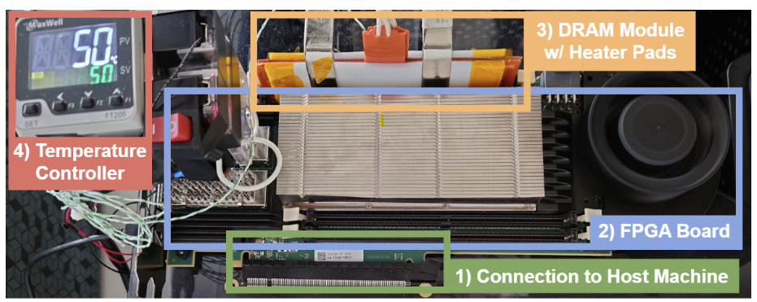
DRAM Testing Infrastructure
Developed from DRAM Bender [Olgun+, TCAD’23]*
Fine-grained control over DRAM commands, timings, and temperature
*Olgun et al., "DRAM Bender: An Extensible and Versatile FPGA-based Infrastructure
to Easily Test State-of-the-art DRAM Chips," TCAD, 2023.
80
Notes:
[CLICK] We use a FPGA based DDR4 testing infrastructure developed from DRAM bender that
[CLICK] enables fine-grained control over DRAM commands, timings, and temperature

Slide 81
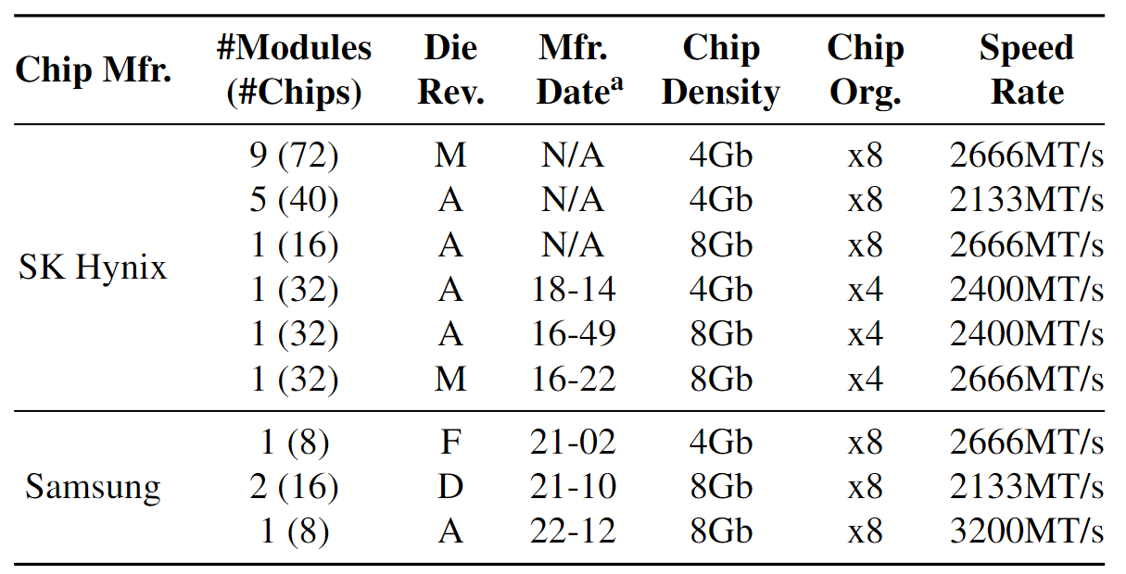
DRAM Chips Tested
256 DDR4 chips from two major DRAM manufacturers
Covers different die revisions and chip densities
81
Notes:
[CLICK]We test 256 DDR4 chips from two major DRAM manufacturers,
[CLICK] covering different die densities and revisions

Slide 82
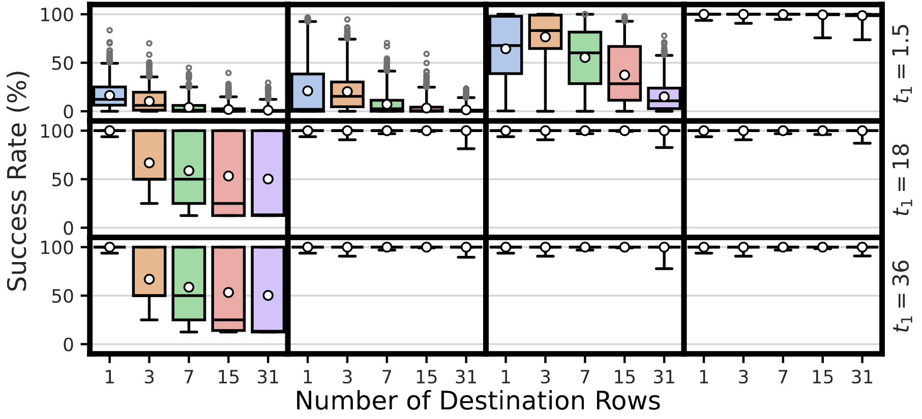
Robustness of Multi-RowCopy
Average: >99.98%
COTS DRAM chips can copy one row’s content
to up to 31 rows with a very high success rate
Notes:
Now let me show you the first result
[CLICK] In this plot, y-axis shows the success rate
[CLICK] x-axis shows the number of destination rows from 1 to 31
[CLICK] And we plot the success rate distribution as a box-and-whiskers plot
[CLICK] We observe that the average success rate is higher than 99.98% across all tested number of destination rows
[CLICK] Hence, we conclude that off-the-shelf DRAM chips can copy one row’s content to up to 31 rows with a very high success rate

Slide 83
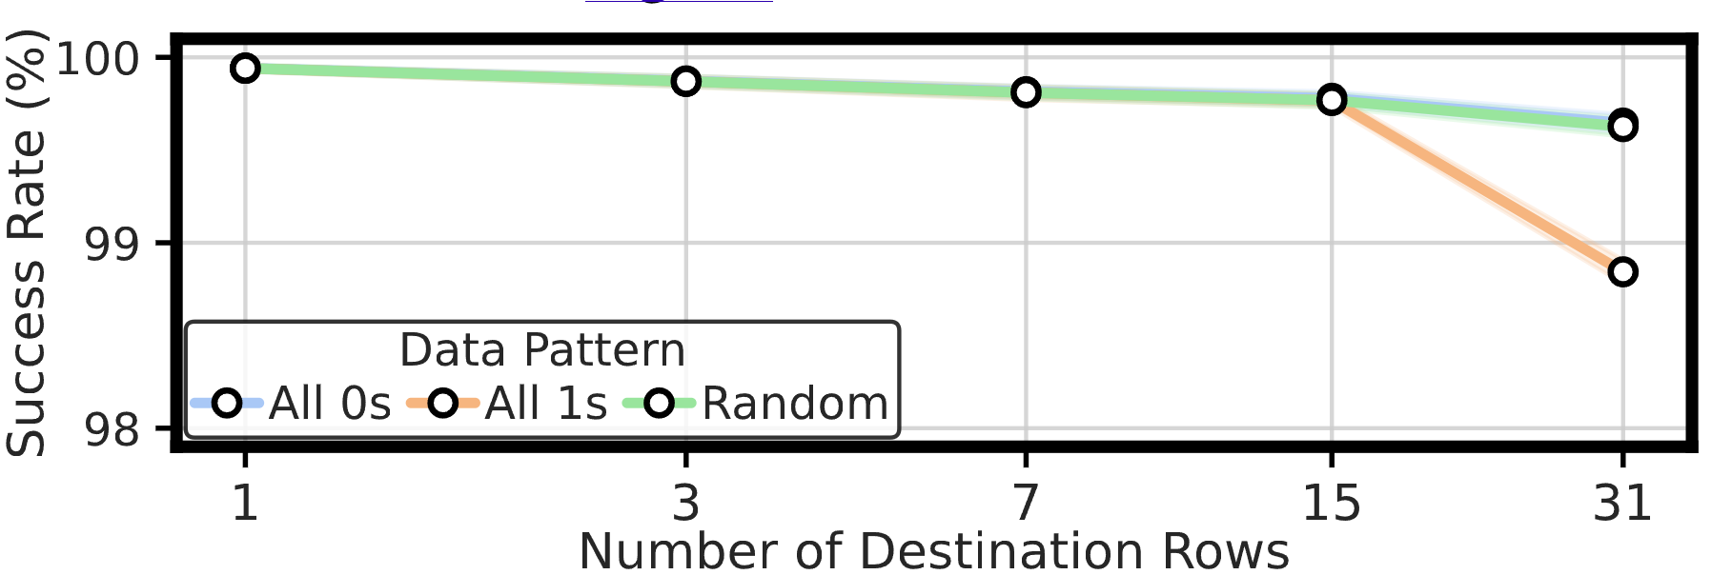
Impact of Data Pattern
At most 0.79% decrease in average success rate
Data pattern has a small effect
on the success rate of the Multi-RowCopy operation
Notes:
Now let’s analyze the impact of data pattern
[CLICK] We plot the average success rate for each number of destination rows and show the trend using a lineplot. Each colered line represent a different data pattern
[CLICK] We observe that data pattern decreases the average success rate at most by 0.79%
[CLICK] We conclude that data pattern has a small effect on the success rate

Slide 84
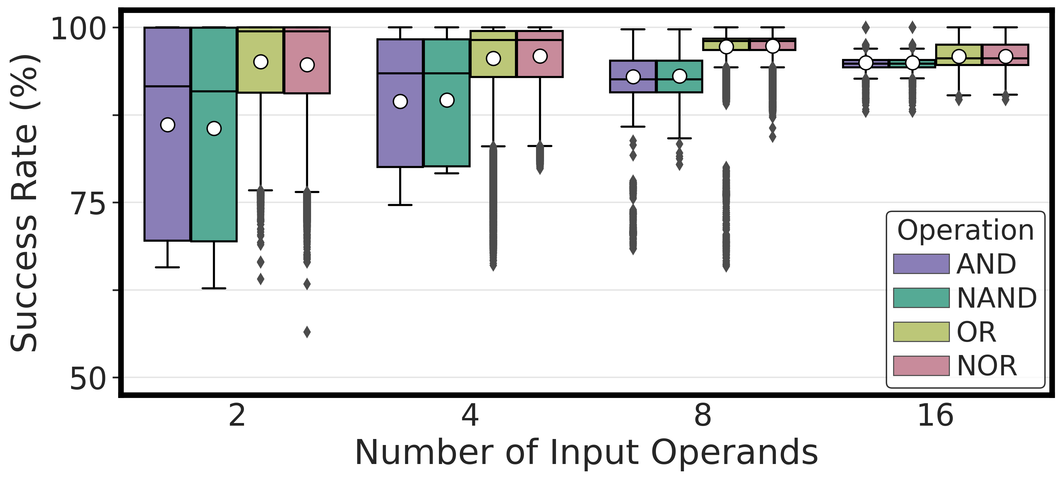
Performing AND, NAND, OR, and NOR
COTS DRAM chips can perform
{2, 4, 8, 16}-input AND, NAND, OR, and NOR operations
84
Notes:
Let’s see our first results
[CLICK] Here is the plot, in the x-axis we have the number of input operands and y-axis shows the success rate distribution across dram cells and the hue shows the type of operation
[CLICK] Our key takeaway from this experiment is off-the-shelf DRAM chips can perform 2, 4, 8, 16 input AND, NAND, OR, and NOR operations

Slide 85
Performing AND, NAND, OR, and NOR
COTS DRAM chips can perform
16-input AND, NAND, OR, and NOR operations
with very high success rate (>94%)
85
Notes:
Let’s see our first results
[CLICK] Here is the plot, in the x-axis we have the number of input operands and y-axis shows the success rate distribution across dram cells and the hue shows the type of operation
[CLICK] Our key takeaway from this experiment is off-the-shelf DRAM chips can perform 2, 4, 8, 16 input AND, NAND, OR, and NOR operations

Slide 86
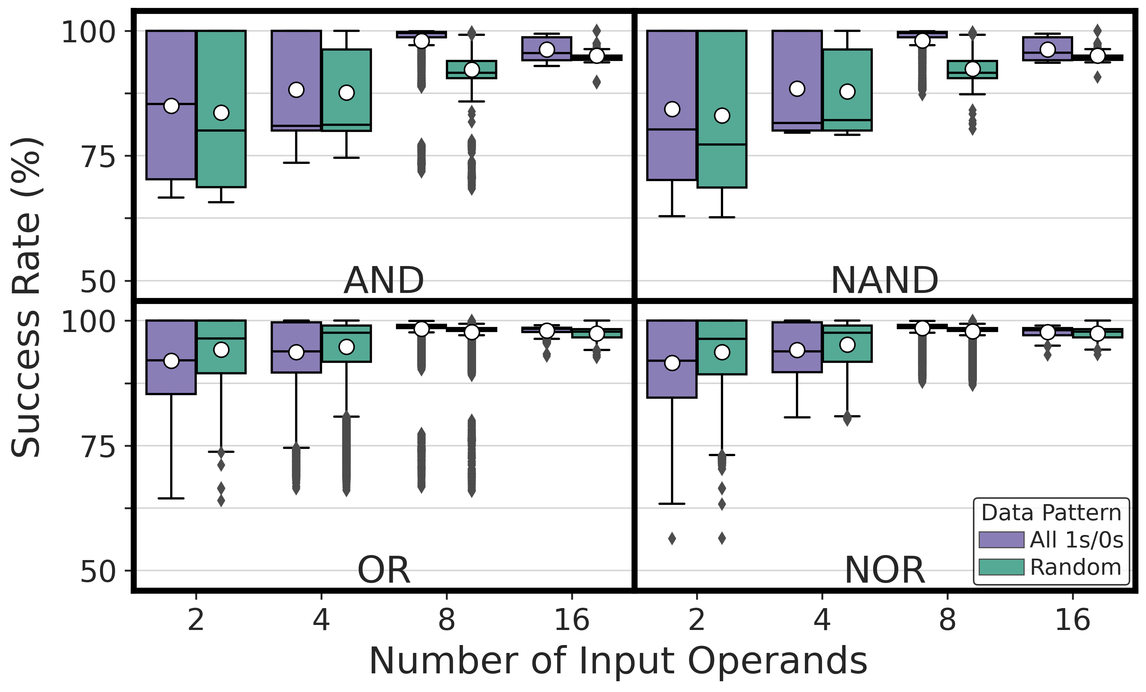
Impact of Data Pattern
Impact of data pattern is consistent
across all tested operations
86
Notes:
Here we show AND, NAND, OR, and NOR operations and
[CLICK] We observe that the impact of data pattern is consistent across all tested operations

Slide 87
Impact of Data Pattern
Data pattern slightly affects
the reliability of AND, NAND, OR, and NOR operations
87
Notes:
Our takeaway from this experiment is data pattern slightly affects the reliability of AND, NAND, OR, and NOR operations.

Slide 88
More in the Paper
Detailed hypotheses & key ideas to perform
  NOT operation
  Many-input AND, NAND, OR, and NOR operations
How the reliability of bitwise operations are affected by
  The location of activated rows
  Temperature (for AND, NAND, OR, and NOR)
  DRAM speed rate
  Chip density and die revision
Discussion on the limitations of COTS DRAM chips
88
Notes:
You can find the following in the paper
[CLICK] The key ideas and hypotheses on how a COTS DRAM chip is capable of performing these operations
[CLICK] How the reliability of tested operations are affected by: Spatial Variation, more temperature results, DRAM Speed Rate and Chip density and Die revision
[CLICK] And what are the limitations that we face in off-the-shelf DRAM chips and a broad discussion on this topic

Slide 89
More on Functionally-Complete DRAM
Ismail Emir Yuksel, Yahya Can Tugrul, Ataberk Olgun, F. Nisa Bostanci, A. Giray Yaglikci, Geraldo F. Oliveira, Haocong Luo, Juan Gomez-Luna, Mohammad Sadrosadati, and Onur Mutlu,
"Functionally-Complete Boolean Logic in Real DRAM Chips: Experimental Characterization and Analysis"
Proceedings of the 30th International Symposium on High-Performance Computer Architecture (HPCA), April 2024.
[Slides (pptx) (pdf)]
[arXiv version]
[FCDRAM Source Code]
https://arxiv.org/pdf/2402.18736

Slide 90
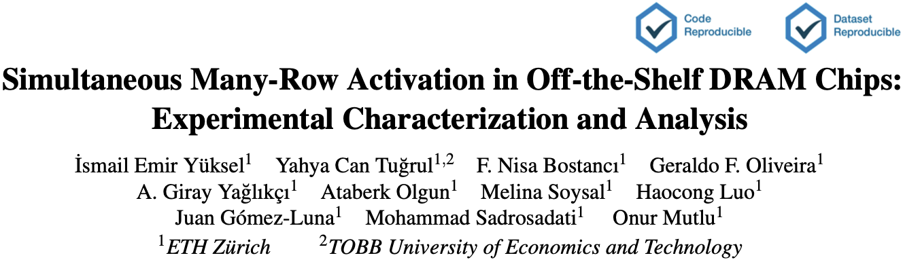
More on Multi-Row Copy
Ismail Emir Yuksel, Yahya Can Tugrul, F. Nisa Bostanci, Geraldo F. Oliveira, A. Giray Yaglikci, Ataberk Olgun, Melina Soysal, Haocong Luo, Juan Gomez-Luna, Mohammad Sadrosadati, and Onur Mutlu,
"Simultaneous Many-Row Activation in Off-the-Shelf DRAM Chips: Experimental Characterization and Analysis"
Proceedings of the 54th Annual IEEE/IFIP International Conference on Dependable Systems and Networks (DSN), Brisbane, Australia, June 2024.
[Slides (pptx) (pdf)]
[arXiv version]
[SiMRA-DRAM Source Code (Officially Artifact Evaluated with All Badges)]
Officially artifact evaluated as both code and dataset available, reviewed and reproducible.
https://arxiv.org/pdf/2405.06081

Slide 91
What Else Can We Do
Using Commodity Memories?

Slide 92

In-DRAM True Random Number Generation
Jeremie S. Kim, Minesh Patel, Hasan Hassan, Lois Orosa, and Onur Mutlu,
"D-RaNGe: Using Commodity DRAM Devices to Generate True Random Numbers with Low Latency and High Throughput"
Proceedings of the 25th International Symposium on High-Performance Computer Architecture (HPCA), Washington, DC, USA, February 2019.
[Slides (pptx) (pdf)]
[Full Talk Video (21 minutes)]
[Full Talk Lecture Video (27 minutes)]
Top Picks Honorable Mention by IEEE Micro.

Slide 93

In-DRAM True Random Number Generation
Ataberk Olgun, Minesh Patel, A. Giray Yaglikci, Haocong Luo, Jeremie S. Kim, F. Nisa Bostanci, Nandita Vijaykumar, Oguz Ergin, and Onur Mutlu,
"QUAC-TRNG: High-Throughput True Random Number Generation Using Quadruple Row Activation in Commodity DRAM Chips"
Proceedings of the 48th International Symposium on Computer Architecture (ISCA), Virtual, June 2021.
[Slides (pptx) (pdf)]
[Short Talk Slides (pptx) (pdf)]
[Talk Video (25 minutes)]
[SAFARI Live Seminar Video (1 hr 26 mins)]

Slide 94

In-DRAM TRNG: Recent Results
N-row Activation
  initialize cell values to sample random values in sense amplifiers

Slide 95

In-DRAM True Random Number Generation
F. Nisa Bostanci, Ataberk Olgun, Lois Orosa, A. Giray Yaglikci, Jeremie S. Kim, Hasan Hassan, Oguz Ergin, and Onur Mutlu,
"DR-STRaNGe: End-to-End System Design for DRAM-based True Random Number Generators"
Proceedings of the 28th International Symposium on High-Performance Computer Architecture (HPCA), Virtual, April 2022.
[Slides (pptx) (pdf)]
[Short Talk Slides (pptx) (pdf)]
https://arxiv.org/pdf/2201.01385.pdf

Slide 96

In-DRAM Physical Unclonable Functions
Jeremie S. Kim, Minesh Patel, Hasan Hassan, and Onur Mutlu,
"The DRAM Latency PUF: Quickly Evaluating Physical Unclonable Functions by Exploiting the Latency-Reliability Tradeoff in Modern DRAM Devices"
Proceedings of the 24th International Symposium on High-Performance Computer Architecture (HPCA), Vienna, Austria, February 2018.
[Lightning Talk Video]
[Slides (pptx) (pdf)] [Lightning Session Slides (pptx) (pdf)]
[Full Talk Lecture Video (28 minutes)]

Slide 97

In-DRAM Lookup-Table Based Execution
João Dinis Ferreira, Gabriel Falcao, Juan Gómez-Luna, Mohammed Alser, Lois Orosa, Mohammad Sadrosadati, Jeremie S. Kim, Geraldo F. Oliveira, Taha Shahroodi, Anant Nori, and Onur Mutlu,
"pLUTo: Enabling Massively Parallel Computation in DRAM via Lookup Tables"
Proceedings of the 55th International Symposium on Microarchitecture (MICRO), Chicago, IL, USA, October 2022.
[Slides (pptx) (pdf)]
[Longer Lecture Slides (pptx) (pdf)]
[Lecture Video (26 minutes)]
[arXiv version]
[Source Code (Officially Artifact Evaluated with All Badges)]
Officially artifact evaluated as available, reusable and reproducible.
https://arxiv.org/pdf/2104.07699.pdf

Slide 98

In-Flash Bulk Bitwise Execution
Jisung Park, Roknoddin Azizi, Geraldo F. Oliveira, Mohammad Sadrosadati, Rakesh Nadig, David Novo, Juan Gómez-Luna, Myungsuk Kim, and Onur Mutlu,
"Flash-Cosmos: In-Flash Bulk Bitwise Operations Using Inherent Computation Capability of NAND Flash Memory"
Proceedings of the 55th International Symposium on Microarchitecture (MICRO), Chicago, IL, USA, October 2022.
[Slides (pptx) (pdf)]
[Longer Lecture Slides (pptx) (pdf)]
[Lecture Video (44 minutes)]
[arXiv version]
https://arxiv.org/pdf/2209.05566.pdf

Slide 99
Processing in Memory:
Two Types
1. Processing near Memory
2. Processing using Memory

Slide 100
PIM Review and Open Problems
Onur Mutlu, Saugata Ghose, Juan Gomez-Luna, and Rachata Ausavarungnirun,
"A Modern Primer on Processing in Memory"
Invited Book Chapter in Emerging Computing: From Devices to Systems - Looking Beyond Moore and Von Neumann, Springer, to be published in 2021.
https://arxiv.org/pdf/2012.03112.pdf

Slide 101
Eliminating the Adoption Barriers
How to Enable Adoption of Processing in Memory

Slide 102
Potential Barriers to Adoption of PIM
1. Applications & software for PIM
2. Ease of programming (interfaces and compiler/HW support)
3. System and security support: coherence, synchronization, virtual memory, isolation, communication interfaces, …
4. Runtime and compilation systems for adaptive scheduling, data mapping, access/sharing control, …
5. Infrastructures to assess benefits and feasibility
All can be solved with change of mindset

Slide 103
We Need to Revisit the Entire Stack
With a memory-centric mindset
Problem
Algorithm
Program/Language
System Software
SW/HW Interface
Micro-architecture
Logic
Devices
Electrons
We can get there step by step

Slide 104
Concluding Remarks

Slide 105
Challenge and Opportunity for Future
Fundamentally
Energy-Efficient
(Data-Centric)
Computing Architectures

Slide 106
Challenge and Opportunity for Future
Fundamentally
High-Performance
(Data-Centric)
Computing Architectures

Slide 107
Challenge and Opportunity for Future
Computing Architectures
with
Minimal Data Movement

Slide 108
Concluding Remarks
Goal: Enable computation capability in memory
We highlighted major recent advances in Processing-in-DRAM
  Can lead to orders-of-magnitude energy & perf improvements
  Unmodified DRAM chips are already capable of computation
Memory should be designed as a combined computation and storage substrate
  Not as an inactive storage substrate
  Design mindset and flow should change
Future of truly memory-centric computing is bright
  We need to do research & design across the computing stack
  With a proper mindset and infrastructure shift
Notes:
Perhaps we have taken processor-centric system design a bit too far

Slide 109

PIM Tutorial November 2024 Edition
https://www.youtube.com/watch?v=KV2MXvcBgb0
https://events.safari.ethz.ch/micro24-memorycentric-tutorial/

Slide 110














Open Source Tools: SAFARI GitHub
https://github.com/CMU-SAFARI/

Slide 111
Memory-Centric Computing
Recent Advances in Processing-in-DRAM
Onur Mutlu
omutlu@gmail.com
https://people.inf.ethz.ch/omutlu
9 December 2024
IEDM Invited Talk

Slide 112

Source: http://spectrum.ieee.org/image/MjYzMzAyMg.jpeg

Slide 113
Backup Slides

Slide 114

Adoption: How to Ease Programmability? (I)
Kevin Hsieh, Eiman Ebrahimi, Gwangsun Kim, Niladrish Chatterjee, Mike O'Connor, Nandita Vijaykumar, Onur Mutlu, and Stephen W. Keckler,
"Transparent Offloading and Mapping (TOM): Enabling Programmer-Transparent Near-Data Processing in GPU Systems"
Proceedings of the 43rd International Symposium on Computer Architecture (ISCA), Seoul, South Korea, June 2016.
[Slides (pptx) (pdf)]
[Lightning Session Slides (pptx) (pdf)]

Slide 115

Adoption: How to Ease Programmability? (II)
Geraldo F. Oliveira, Alain Kohli, David Novo,
Juan Gómez-Luna, Onur Mutlu,
“DaPPA: A Data-Parallel Framework for Processing-in-Memory Architectures,”
in PACT SRC Student Competition, Vienna, Austria, October 2023.

Slide 116

Adoption: How to Ease Programmability? (III)
Jinfan Chen, Juan Gómez-Luna, Izzat El Hajj, YuXin Guo, and Onur Mutlu,
"SimplePIM: A Software Framework for Productive and Efficient Processing in Memory"
Proceedings of the 32nd International Conference on Parallel Architectures and Compilation Techniques (PACT), Vienna, Austria, October 2023.

Slide 117

Adoption: How to Ease Programmability? (IV)
Geraldo F. Oliveira, Juan Gomez-Luna, Lois Orosa, Saugata Ghose, Nandita Vijaykumar, Ivan fernandez, Mohammad Sadrosadati, and Onur Mutlu,
"DAMOV: A New Methodology and Benchmark Suite for Evaluating Data Movement Bottlenecks"
IEEE Access, 8 September 2021.
Preprint in arXiv, 8 May 2021.
[arXiv preprint]
[IEEE Access version]
[DAMOV Suite and Simulator Source Code]
[SAFARI Live Seminar Video (2 hrs 40 mins)]
[Short Talk Video (21 minutes)]

Slide 118


Adoption: How to Ease Programmability? (V)
Appears in IEEE TETC 2023
https://arxiv.org/pdf/2212.06292

Slide 119

Adoption: How to Maintain Coherence? (I)
Amirali Boroumand, Saugata Ghose, Minesh Patel, Hasan Hassan, Brandon Lucia, Kevin Hsieh, Krishna T. Malladi, Hongzhong Zheng, and Onur Mutlu,
"LazyPIM: An Efficient Cache Coherence Mechanism for Processing-in-Memory"
IEEE Computer Architecture Letters (CAL), June 2016.

Slide 120

Adoption: How to Maintain Coherence? (II)
Amirali Boroumand, Saugata Ghose, Minesh Patel, Hasan Hassan, Brandon Lucia, Kevin Hsieh, Krishna T. Malladi, Hongzhong Zheng, and Onur Mutlu,
"CoNDA: Efficient Cache Coherence Support for Near-Data Accelerators"
Proceedings of the 46th International Symposium on Computer Architecture (ISCA), Phoenix, AZ, USA, June 2019.

Slide 121
Adoption: How to Support Synchronization?
Christina Giannoula, Nandita Vijaykumar, Nikela Papadopoulou, Vasileios Karakostas, Ivan Fernandez, Juan Gómez-Luna, Lois Orosa, Nectarios Koziris, Georgios Goumas, Onur Mutlu,
"SynCron: Efficient Synchronization Support for Near-Data-Processing Architectures"
Proceedings of the 27th International Symposium on High-Performance Computer Architecture (HPCA), Virtual, February-March 2021.
[Slides (pptx) (pdf)]
[Short Talk Slides (pptx) (pdf)]
[Talk Video (21 minutes)]
[Short Talk Video (7 minutes)]

Slide 122

Adoption: How to Support Virtual Memory?
Kevin Hsieh, Samira Khan, Nandita Vijaykumar, Kevin K. Chang, Amirali Boroumand, Saugata Ghose, and Onur Mutlu,
"Accelerating Pointer Chasing in 3D-Stacked Memory: Challenges, Mechanisms, Evaluation"
Proceedings of the 34th IEEE International Conference on Computer Design (ICCD), Phoenix, AZ, USA, October 2016.

Slide 123
Adoption: Evaluation Infrastructures (I)
Geraldo F. Oliveira, Juan Gomez-Luna, Lois Orosa, Saugata Ghose, Nandita Vijaykumar, Ivan fernandez, Mohammad Sadrosadati, and Onur Mutlu,
"DAMOV: A New Methodology and Benchmark Suite for Evaluating Data Movement Bottlenecks"
IEEE Access, 8 September 2021.
Preprint in arXiv, 8 May 2021.
[arXiv preprint]
[IEEE Access version]
[DAMOV Suite and Simulator Source Code]
[SAFARI Live Seminar Video (2 hrs 40 mins)]
[Short Talk Video (21 minutes)]

Slide 124
Adoption: Evaluation Infrastructures (II)
Ataberk Olgun, Juan Gomez Luna, Konstantinos Kanellopoulos, Behzad Salami, Hasan Hassan, Oguz Ergin, and Onur Mutlu,
"PiDRAM: A Holistic End-to-end FPGA-based Framework for Processing-in-DRAM"
ACM Transactions on Architecture and Code Optimization (TACO), March 2023.
[arXiv version]
Presented at the 18th HiPEAC Conference, Toulouse, France, January 2023.
[Slides (pptx) (pdf)]
[Longer Lecture Slides (pptx) (pdf)]
[Lecture Video (40 minutes)]
[PiDRAM Source Code]

Slide 125

Adoption: Evaluation Infrastructures (III)
Haocong Luo, Yahya Can Tugrul, F. Nisa Bostanci, Ataberk Olgun, A. Giray Yaglikci, and Onur Mutlu,
"Ramulator 2.0: A Modern, Modular, and Extensible DRAM Simulator"
Preprint on arxiv, August 2023.
[arXiv version]
[Ramulator 2.0 Source Code]
https://arxiv.org/pdf/2308.11030.pdf
https://github.com/CMU-SAFARI/ramulator2

Slide 126
Referenced Papers, Talks, Artifacts
All are available at
  https://people.inf.ethz.ch/omutlu/projects.htm
  https://www.youtube.com/onurmutlulectures
  https://github.com/CMU-SAFARI/

Slide 127
Open Source Tools: SAFARI GitHub
https://github.com/CMU-SAFARI/

Slide 128
Funding Acknowledgments
Alibaba, AMD, ASML, Google, Facebook, Hi-Silicon, HP Labs, Huawei, IBM, Intel, Microsoft, Nvidia, Oracle, Qualcomm, Rambus, Samsung, Seagate, VMware, Xilinx
NSF
NIH
GSRC
SRC
CyLab
EFCL
SNSF
ACCESS
Thank you!

Slide 129

Acknowledgments
Think BIG, Aim HIGH!
https://safari.ethz.ch

Slide 130

SAFARI Newsletter June 2023 Edition
https://safari.ethz.ch/safari-newsletter-june-2023/

Slide 131

SAFARI Newsletter July 2024 Edition
https://safari.ethz.ch/safari-newsletter-july-2024/

Slide 132


Recall: DRAM Testing Infrastructure
  An Experimental Study of Data Retention Behavior in Modern DRAM Devices: Implications for Retention Time Profiling Mechanisms (Liu et al., ISCA 2013)
  The Efficacy of Error Mitigation Techniques for DRAM Retention Failures: A Comparative Experimental Study
  (Khan et al., SIGMETRICS 2014)
  Flipping Bits in Memory Without Accessing Them: An Experimental Study of DRAM Disturbance Errors (Kim et al., ISCA 2014)
  Adaptive-Latency DRAM: Optimizing DRAM Timing for the Common-Case (Lee et al., HPCA 2015)
  AVATAR: A Variable-Retention-Time (VRT) Aware Refresh for DRAM Systems (Qureshi et al., DSN 2015)

Slide 133

Recall: DRAM Testing Infrastructure
Temperature
Controller
FPGAs
Heater
FPGAs
PC
  Kim+, “Flipping Bits in Memory Without Accessing Them: An Experimental Study of DRAM Disturbance Errors,” ISCA 2014.

Slide 134


SoftMC: Open Source DRAM Infrastructure
Hasan Hassan et al., “SoftMC: A Flexible and Practical Open-Source Infrastructure for Enabling Experimental DRAM Studies,” HPCA 2017.
Flexible
Easy to Use (C++ API)
Open-source
github.com/CMU-SAFARI/SoftMC

Slide 135

SoftMC: Open Source DRAM Infrastructure
Hasan Hassan, Nandita Vijaykumar, Samira Khan, Saugata Ghose, Kevin Chang, Gennady Pekhimenko, Donghyuk Lee, Oguz Ergin, and Onur Mutlu,
"SoftMC: A Flexible and Practical Open-Source Infrastructure for Enabling Experimental DRAM Studies"
Proceedings of the 23rd International Symposium on High-Performance Computer Architecture (HPCA), Austin, TX, USA, February 2017.
[Slides (pptx) (pdf)] [Lightning Session Slides (pptx) (pdf)]
[Full Talk Lecture (39 minutes)]
[Source Code]
https://github.com/CMU-SAFARI/SoftMC

Slide 136

DRAM Bender
Ataberk Olgun, Hasan Hassan, A Giray Yağlıkçı, Yahya Can Tuğrul, Lois Orosa, Haocong Luo, Minesh Patel, Oğuz Ergin, and Onur Mutlu,
"DRAM Bender: An Extensible and Versatile FPGA-based Infrastructure to Easily Test State-of-the-art DRAM Chips"
IEEE Transactions on Computer-Aided Design of Integrated Circuits and Systems (TCAD), 2023.
[Extended arXiv version]
[DRAM Bender Source Code]
[DRAM Bender Tutorial Video (43 minutes)]
https://github.com/CMU-SAFARI/DRAM-Bender

Slide 137






DRAM Bender: Prototypes
Five out of the box FPGA-based prototypes
https://github.com/CMU-SAFARI/DRAM-Bender

Slide 138
DRAM Chips Are Already (Quite) Capable!
Appears at HPCA 2024
https://arxiv.org/pdf/2402.18736.pdf

Slide 139



DRAM Chips Are Already (Quite) Capable!
https://arxiv.org/pdf/2312.02880.pdf

Slide 140

DRAM Chips Are Already (Quite) Capable!
Appears at DSN 2024
https://arxiv.org/pdf/2405.06081

Slide 141




Simultaneous Many-Row Activation in Off-the-Shelf DRAM Chips
Experimental Characterization and Analysis
İsmail Emir Yüksel
Yahya C. Tuğrul F. Nisa Bostancı Geraldo F. Oliveira
A. Giray Yağlıkçı Ataberk Olgun Melina Soysal Haocong Luo
Juan Gómez–Luna Mohammad Sadr Onur Mutlu
Notes:
Hello, I am Ismail Emir Yuksel.
I will be presenting our work, Simultaneous Many-Row Activation in Off-the-Shelf DRAM Chips

Slide 142
In-DRAM Multiple Row Copy (Multi-RowCopy)
Simultaneously activate many rows to
copy one row’s content to multiple destination rows
RowClone
Multi-RowCopy
s
r
c
d
s
t
s
r
c
d
s
t
s
r
c
s
r
c
s
r
c
d
s
t
d
s
t
d
s
t
s
r
c
s
r
c
s
r
c
[Seshadri+ MICRO’13]
Notes:
[CLICK] Our key idea is since we can activate many rows simultaneously, we can copy one row’s content to other simultaneously activated rows
[CLICK] Let’s recall the RowClone example where we copy source to destination
[CLICK] In RowClone, we first activate the source row which will copy its content to sense amplifiers
[CLICK] And then, we activate destination row to drive the sense amplifier’s content to destination row
[CLICK] In our mechanism, which we call Multi-RowCopy, we have several destination rows
[CLICK] Here we activate many destination rows simultaneously
[CLICK] and thus sense amplifier drives its content to these destination rows.

Slide 143
Robustness of Multi-RowCopy
Average: >99.98%
COTS DRAM chips can copy one row’s content
to up to 31 rows with a very high success rate
Notes:
Now let me show you the first result
[CLICK] In this plot, y-axis shows the success rate
[CLICK] x-axis shows the number of destination rows from 1 to 31
[CLICK] And we plot the success rate distribution as a box-and-whiskers plot
[CLICK] We observe that the average success rate is higher than 99.98% across all tested number of destination rows
[CLICK] Hence, we conclude that off-the-shelf DRAM chips can copy one row’s content to up to 31 rows with a very high success rate

Slide 144
Impact of Data Pattern
At most 0.79% decrease in average success rate
Data pattern has a small effect
on the success rate of the Multi-RowCopy operation
Notes:
Now let’s analyze the impact of data pattern
[CLICK] We plot the average success rate for each number of destination rows and show the trend using a lineplot. Each colered line represent a different data pattern
[CLICK] We observe that data pattern decreases the average success rate at most by 0.79%
[CLICK] We conclude that data pattern has a small effect on the success rate

Slide 145

Available on arXiv
https://arxiv.org/pdf/2405.06081
Notes:
The extended version of our study is available on arxiv

Slide 146

Our Work is Open Source and Artifact Evaluated
https://github.com/CMU-SAFARI/SiMRA-DRAM
Notes:
And our work is artifact evaluated and got every badges
[CLICK] You can download our code from github and start testing right away!

Slide 147
What About Other
Types of Memories?

Slide 148
In-Flash Bulk Bitwise Execution
Jisung Park, Roknoddin Azizi, Geraldo F. Oliveira, Mohammad Sadrosadati, Rakesh Nadig, David Novo, Juan Gómez-Luna, Myungsuk Kim, and Onur Mutlu,
"Flash-Cosmos: In-Flash Bulk Bitwise Operations Using Inherent Computation Capability of NAND Flash Memory"
Proceedings of the 55th International Symposium on Microarchitecture (MICRO), Chicago, IL, USA, October 2022.
[Slides (pptx) (pdf)]
[Longer Lecture Slides (pptx) (pdf)]
[Lecture Video (44 minutes)]
[arXiv version]
https://arxiv.org/pdf/2209.05566.pdf

Slide 149
Flash-Cosmos: Basic Ideas
Flash-Cosmos enables
  Computation on multiple operands with a single sensing operation
  Accurate computation results by eliminating raw bit errors in stored data
NAND Flash Chip
Operand O₁
Operand O₁
Operand O₂
Operand O₂
Operand O₃
Operand O₃
…
…
Simultaneous sensing
Operand O₃₂
Operand O₃₂
Bitlines (BLs)
Page Buffer
O₁ & O₂ & O₃ & … & O₃₂
Notes:
At a very high level, Flash-Cosmos enables [Click] computation while sensing multiple operands at once and accurate computation results by zeroing raw bit errors in stored data. [Click]

Slide 150
Multi-Wordline Sensing (MWS): Bitwise AND
Intra-Block MWS:
Simultaneously activates multiple WLs in the same block
→ Bitwise AND of the stored data in the WLs
BL₁
BL₂
BL₃
BL₄
A bitline reads as ‘1’ only when all the target cells store ‘1’
→ Equivalent to the bitwise AND of all the target cells
WL₁
0
0
1
1
…
Target Cell:
Operate
as a resistance (1)
or an open switch (0)
WL₂
0
1
0
1
…
WL₃
1
0
1
1
…
WL₄
0
0
1
0
…
…
…
…
…
Result:
0
0
0
0
Notes:
The bitline current cannot flow through Bitline 4 any longer, as it has a cell that stores ‘0’ and blocks the bitline current. [Click]

Slide 151
Multi-Wordline Sensing (MWS): Bitwise AND
Intra-Block MWS:
Simultaneously activates multiple WLs in the same block
→ Bitwise AND of the stored data in the WLs
BL₁
BL₂
BL₃
BL₄
Flash-Cosmos (Intra-Block MWS) enables
bitwise AND of multiple pages in the same block
via a single sensing operation
WL₁
0
0
1
1
…
A bitline reads as ‘1’ only when all the target cells store ‘1’
→ Equivalent to the bitwise AND of all the target cells
Target Cell:
Operate
as a resistance (1)
or an open switch (0)
WL₂
0
1
0
1
…
WL₃
1
0
1
1
…
WL₄
0
0
1
1
…
…
…
…
…
Result:
0
0
0
1
Notes:
This way, intra-block MWS enables bitwise AND operation on any pages in the same block via a single sensing operation. [Click]

Slide 152


Other Types of Bitwise Operations
Flash-Cosmos also enables
other types of bitwise operations (NOT/NAND/NOR/XOR/XNOR)
leveraging existing features of NAND flash memory
https://arxiv.org/abs/2209.05566.pdf

Slide 153
Results: Real-Device Characterization
No changes to the cell array
of commodity NAND flash chips
Can have many operands
(AND: up to 48, OR: up to 4)
with small increase in sensing latency (< 10%)
ESP significantly improves
the reliability of computation results
(no observed bit error in the tested flash cells)
Notes:
Through our real-device characterization, we demnostrated that both MWS operations are possible without requiring any change ot the cell array of commodity NAND flash chips, [Click] and they can reliably activate multiple wordlines at the same time without significant increase in sensing latency. [Click]
We also observed no errors in the tested cells when we program data using ESP, which shows that Flash-Cosmos enables reliable in-flash bulk bitwise operations. [Click]

Slide 154
Results: Performance & Energy
ISP
ParaBit
Flash-Cosmos
150×
70×
Speedup over OSP
Energy benefit over OSP
14×
2×
25×
3.5×
12×
2×
13.4×
3.3×
1.6×
10×
2.5×
20×
Flash-Cosmos provides significant performance & energy benefits over all the baselines
The larger the number of operands,
the higher the performance & energy benefits
Notes:
As system-level evaluation, [Click] we evaluate the speedup and [Click] energy benefit over the conventional system. [Click]
We observe that Flash-Cosmos provides significant performance and energy benefits over all the baselines, including the state-of-the-art in-flash bulk bitwise operation technique, [Click] and the larger the number of operands for bulk bitwise operations, the higher the performance and energy benefits that Flash-Cosmos can achieve over other computing platforms. [Click]

Slide 155
Flash-Cosmos: In-Flash Bulk Bitwise Execution
Jisung Park, Roknoddin Azizi, Geraldo F. Oliveira, Mohammad Sadrosadati, Rakesh Nadig, David Novo, Juan Gómez-Luna, Myungsuk Kim, and Onur Mutlu,
"Flash-Cosmos: In-Flash Bulk Bitwise Operations Using Inherent Computation Capability of NAND Flash Memory"
Proceedings of the 55th International Symposium on Microarchitecture (MICRO), Chicago, IL, USA, October 2022.
[Slides (pptx) (pdf)]
[Longer Lecture Slides (pptx) (pdf)]
[Lecture Video (44 minutes)]
[arXiv version]
https://arxiv.org/pdf/2209.05566.pdf

