Slide 1



SAFARI Research Group
Introduction & Research
Onur Mutlu
omutlu@gmail.com
https://people.inf.ethz.ch/omutlu
19 October 2021
EFCL Huawei Day

Slide 2
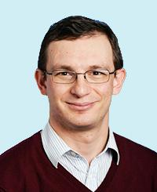
Brief Self Introduction
Onur Mutlu
  Full Professor @ ETH Zurich ITET (INFK), since September 2015
  Strecker Professor @ Carnegie Mellon University ECE/CS, 2009-2016, 2016-…
  PhD from UT-Austin, worked at Google, VMware, Microsoft Research, Intel, AMD
  https://people.inf.ethz.ch/omutlu/
  omutlu@gmail.com (Best way to reach me)
  https://people.inf.ethz.ch/omutlu/projects.htm
Research and Teaching in:
  Computer architecture, computer systems, hardware security, bioinformatics
  Memory and storage systems
  Hardware security, safety, predictability
  Fault tolerance
  Hardware/software cooperation
  Architectures for bioinformatics, health, medicine
  …

Slide 3
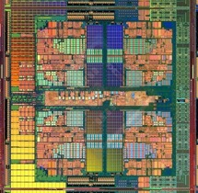

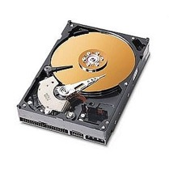
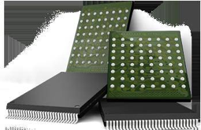
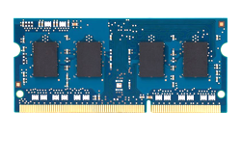
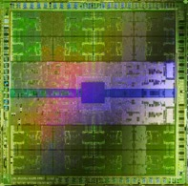
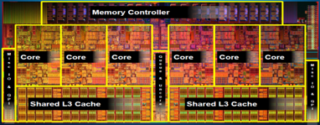
Current Research Mission
Computer architecture, HW/SW, systems, bioinformatics, security
Hybrid Main Memory
Heterogeneous
Processors and
Accelerators
Persistent Memory/Storage
Graphics and Vision Processing
Build fundamentally better architectures
Notes:
Professor Mutlu’s research focus is all aspects of computer architecture, HW/SW interaction and bioinformatics.
He is looking for students to perform research in these areas.
He and his group, SAFARI, solve fundamental problems spanning:
Memory, memory, memory, storage, interconnects
Parallel architectures, heterogeneous architectures, GP-GPUs
System/architecture interaction, new execution models
Energy efficiency, fault tolerance, hardware security
Genome sequence analysis and assembly
His group does broad research spanning systems to logic with architecture at center

Slide 4
Four Key Current Directions
Fundamentally Secure/Reliable/Safe Architectures
Fundamentally Energy-Efficient Architectures
  Memory-centric (Data-centric) Architectures
Fundamentally Low-Latency and Predictable Architectures
Architectures for AI/ML, Genomics, Medicine, Health, …

Slide 5
The Transformation Hierarchy
Problem
Algorithm
Program/Language
System Software
Computer Architecture (expanded view)
SW/HW Interface
Computer Architecture (narrow view)
Micro-architecture
Logic
Devices
Electrons

Slide 6
Axiom
To achieve the highest energy efficiency and performance:
we must take the expanded view
of computer architecture
Problem
Algorithm
Program/Language
System Software
Co-design across the hierarchy:
Algorithms to devices
SW/HW Interface
Micro-architecture
Logic
Specialize as much as possible
within the design goals
Devices
Electrons

Slide 7
Current Research Mission & Major Topics
Build fundamentally better architectures
Data-centric arch. for low energy & high perf.
  Proc. in Mem/DRAM, NVM, unified mem/storage
Low-latency & predictable architectures
  Low-latency, low-energy yet low-cost memory
  QoS-aware and predictable memory systems
Fundamentally secure/reliable/safe arch.
  Tolerating all bit flips; patchable HW; secure mem
Architectures for ML/AI/Genomics/Health/Med
  Algorithm/arch./logic co-design; full heterogeneity
Data-driven and data-aware architectures
  ML/AI-driven architectural controllers and design
  Expressive memory and expressive systems
Problem
Algorithm
Program/Language
System Software
SW/HW Interface
Micro-architecture
Logic
Devices
Electrons
Broad research
spanning apps, systems, logic
with architecture at the center

Slide 8

SAFARI Research Group
Think BIG, Aim HIGH!
https://safari.ethz.ch

Slide 9
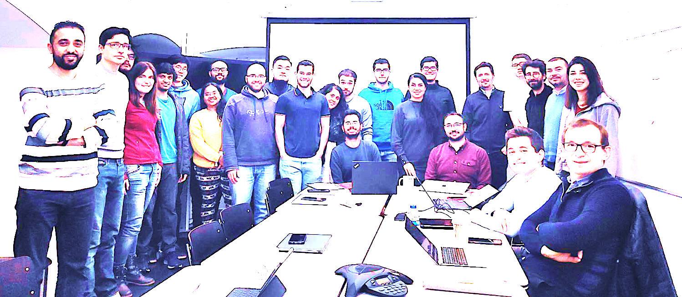

Onur Mutlu’s SAFARI Research Group
Computer architecture, HW/SW, systems, bioinformatics, security, memory
https://safari.ethz.ch/safari-newsletter-april-2020/
40+ Researchers
Think BIG, Aim HIGH!
https://safari.ethz.ch

Slide 10
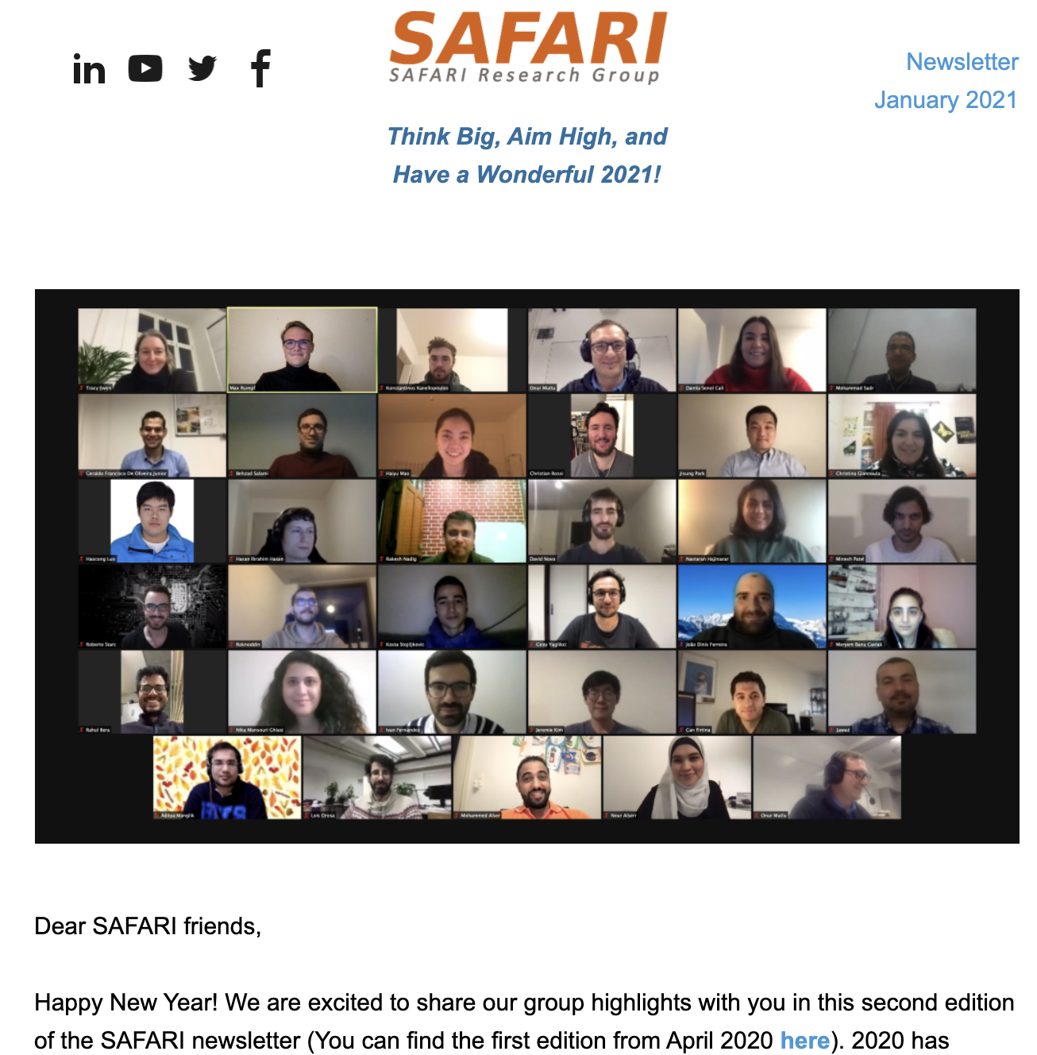
SAFARI Newsletter January 2021 Edition
https://safari.ethz.ch/safari-newsletter-january-2021/

Slide 11
SAFARI PhD and Post-Doc Alumni
https://safari.ethz.ch/safari-alumni/
Damla Senol Cali (Bionano Genomics)
Nastaran Hajinazar (ETH Zurich)
Gagandeep Singh (ETH Zurich)
Amirali Boroumand (Stanford Univ → Google)
Jeremie Kim (ETH Zurich)
Nandita Vijaykumar (Univ. of Toronto, Assistant Professor)
Kevin Hsieh (Microsoft Research, Senior Researcher)
Justin Meza (Facebook)
Mohammed Alser (ETH Zurich)
Yixin Luo (Google)
Kevin Chang (Facebook)
Rachata Ausavarungnirun (KMUNTB, Assistant Professor)
Gennady Pekhimenko (Univ. of Toronto, Assistant Professor)
Vivek Seshadri (Microsoft Research)
Donghyuk Lee (NVIDIA Research, Senior Researcher)
Yoongu Kim (Software Robotics → Google)
Lavanya Subramanian (Intel Labs → Facebook)
Samira Khan (Univ. of Virginia, Assistant Professor)
Saugata Ghose (Univ. of Illinois, Assistant Professor)
Jawad Haj-Yahya (Huawei Research Zurich, Principal Researcher)

Slide 12
Principle: Teaching and Research
…
Teaching drives Research
Research drives Teaching
…

Slide 13
Research & Teaching: Some Overview Talks
https://www.youtube.com/onurmutlulectures
Future Computing Architectures
  https://www.youtube.com/watch?v=kgiZlSOcGFM&list=PL5Q2soXY2Zi8D_5MGV6EnXEJHnV2YFBJl&index=1
Enabling In-Memory Computation
  https://www.youtube.com/watch?v=njX_14584Jw&list=PL5Q2soXY2Zi8D_5MGV6EnXEJHnV2YFBJl&index=16
Accelerating Genome Analysis
  https://www.youtube.com/watch?v=r7sn41lH-4A&list=PL5Q2soXY2Zi8D_5MGV6EnXEJHnV2YFBJl&index=41
Rethinking Memory System Design
  https://www.youtube.com/watch?v=F7xZLNMIY1E&list=PL5Q2soXY2Zi8D_5MGV6EnXEJHnV2YFBJl&index=3
Intelligent Architectures for Intelligent Machines
  https://www.youtube.com/watch?v=c6_LgzuNdkw&list=PL5Q2soXY2Zi8D_5MGV6EnXEJHnV2YFBJl&index=25
The Story of RowHammer
  https://www.youtube.com/watch?v=sgd7PHQQ1AI&list=PL5Q2soXY2Zi8D_5MGV6EnXEJHnV2YFBJl&index=39

Slide 14
Online Courses & Lectures
First Computer Architecture & Digital Design Course
  Digital Design and Computer Architecture
  Spring 2021 Livestream Edition: https://www.youtube.com/watch?v=LbC0EZY8yw4&list=PL5Q2soXY2Zi_uej3aY39YB5pfW4SJ7LlN
Advanced Computer Architecture Course
  Computer Architecture
  Falll 2020 Edition: https://www.youtube.com/watch?v=c3mPdZA-Fmc&list=PL5Q2soXY2Zi9xidyIgBxUz7xRPS-wisBN
https://www.youtube.com/onurmutlulectures

Slide 15
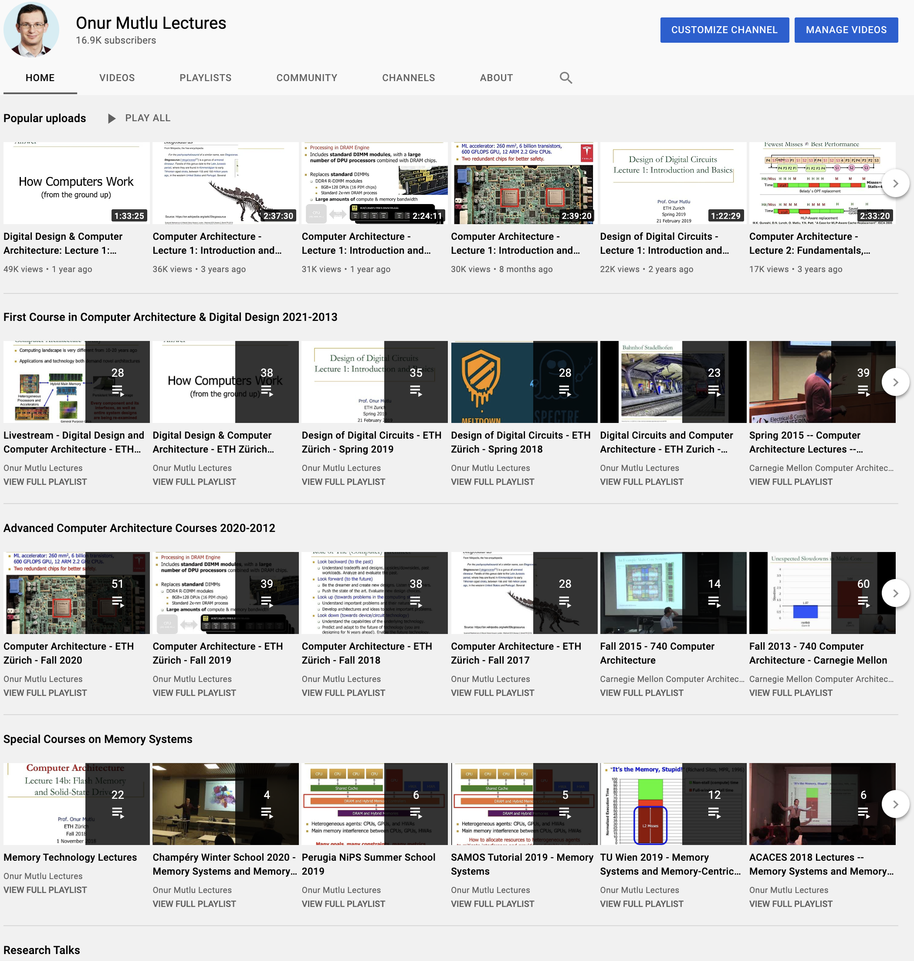
https://www.youtube.com/onurmutlulectures

Slide 16

DDCA (Spring 2021)
https://safari.ethz.ch/digitaltechnik/spring2021/doku.php?id=schedule
https://www.youtube.com/watch?v=LbC0EZY8yw4&list=PL5Q2soXY2Zi_uej3aY39YB5pfW4SJ7LlN
Bachelor’s course
  2nd semester at ETH Zurich
  Rigorous introduction into “How Computers Work”
  Digital Design/Logic
  Computer Architecture
  10 FPGA Lab Assignments

Slide 17
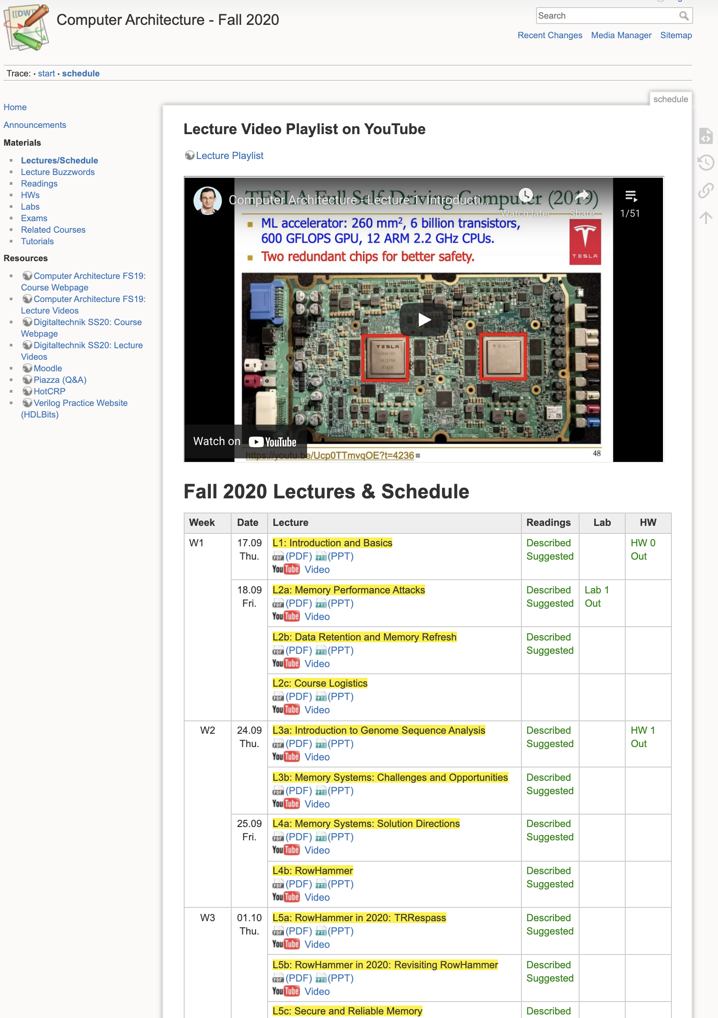
Comp Arch (Fall 2020)
https://safari.ethz.ch/architecture/fall2020/doku.php?id=schedule
https://www.youtube.com/watch?v=c3mPdZA-Fmc&list=PL5Q2soXY2Zi9xidyIgBxUz7xRPS-wisBN
Master’s level course
  Taken by Bachelor’s/Masters/PhD students
  Cutting-edge research topics + fundamentals in Computer Architecture
  5 Simulator-based Lab Assignments
  Potential research exploration
  Many research readings

Slide 18
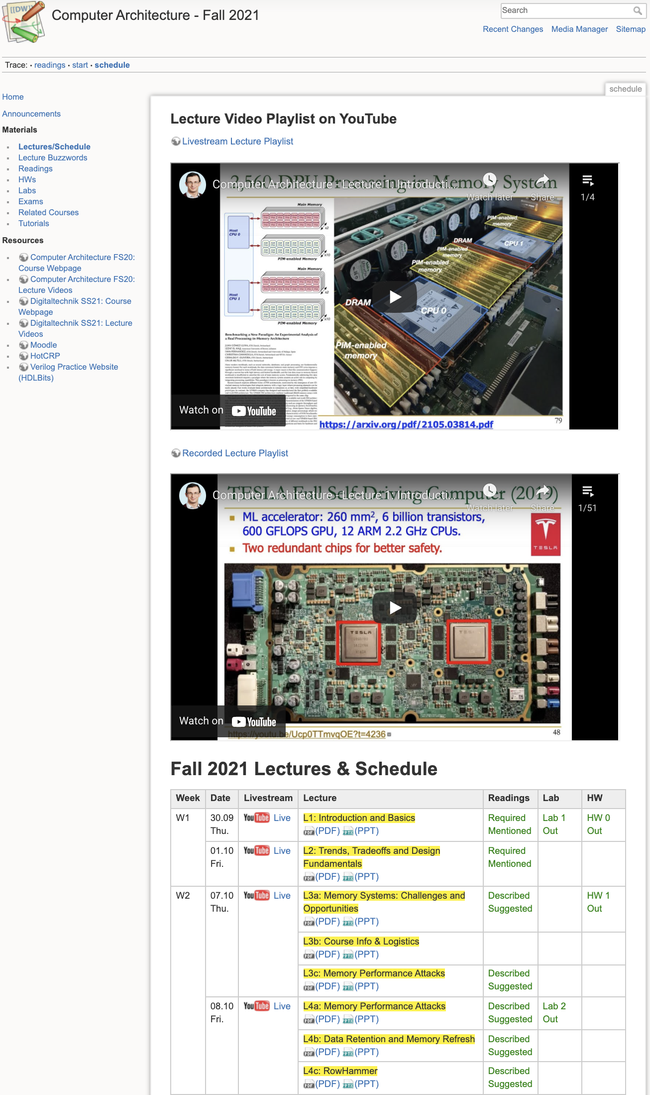
Comp Arch (Current)
https://safari.ethz.ch/architecture/fall2021/doku.php?id=schedule
Youtube Livestream:
  https://www.youtube.com/watch?v=4yfkM_5EFgo&list=PL5Q2soXY2Zi-Mnk1PxjEIG32HAGILkTOF
Master’s level course
  Taken by Bachelor’s/Masters/PhD students
  Cutting-edge research topics + fundamentals in Computer Architecture
  5 Simulator-based Lab Assignments
  Potential research exploration
  Many research readings

Slide 19
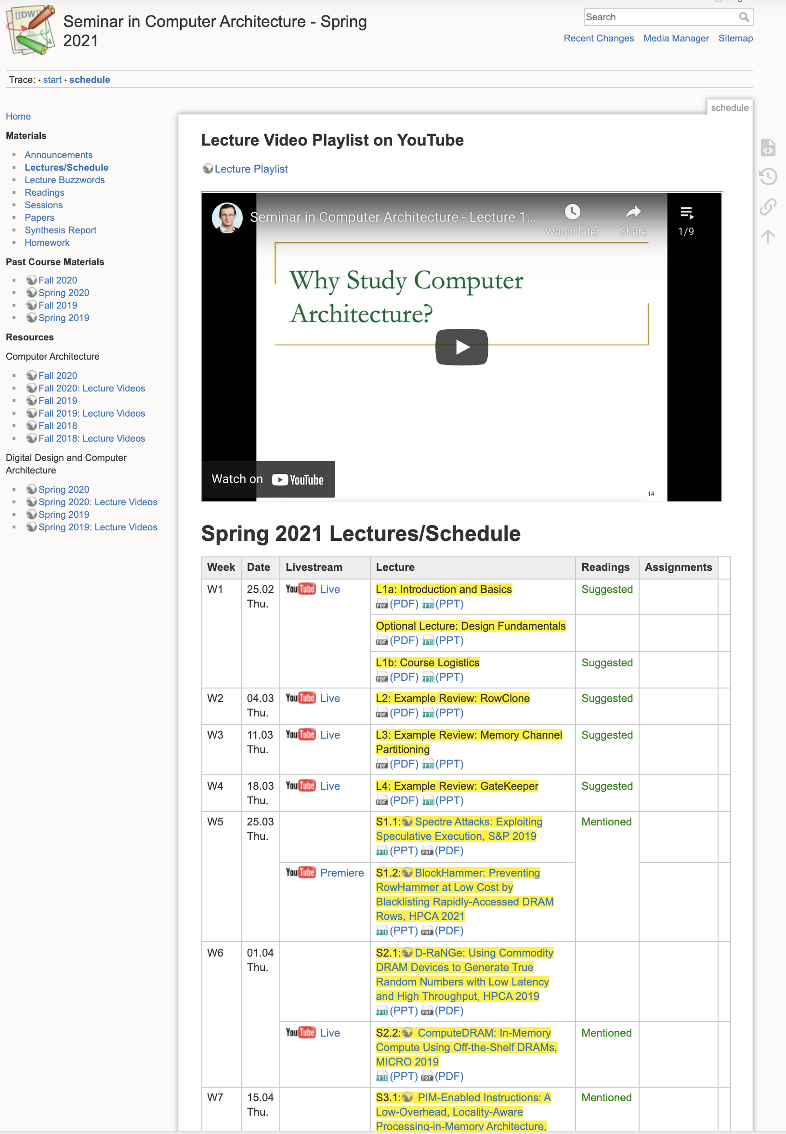
Seminar (Spring’21)
https://safari.ethz.ch/architecture_seminar/spring2021/doku.php?id=schedule
https://www.youtube.com/watch?v=t3m93ZpLOyw&list=PL5Q2soXY2Zi_awYdjmWVIUegsbY7TPGW4
Critical analysis course
  Taken by Bachelor’s/Masters/PhD students
  Cutting-edge research topics + fundamentals in Computer Architecture
  20+ research papers, presentations, analyses

Slide 20
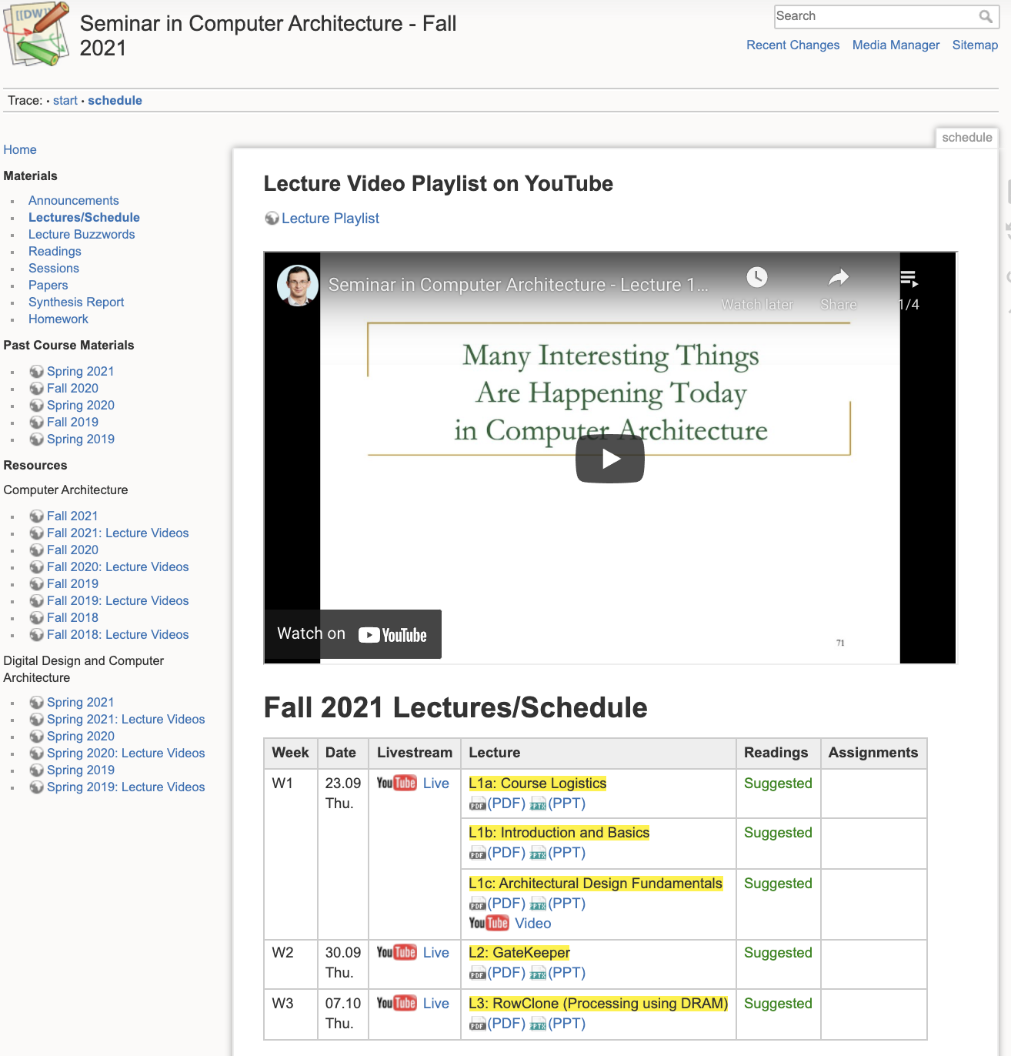
Seminar (Current)
https://safari.ethz.ch/architecture_seminar/fall2021/doku.php?id=schedule
Youtube Livestream:
  https://www.youtube.com/watch?v=4TcP297mdsI&list=PL5Q2soXY2Zi_7UBNmC9B8Yr5JSwTG9yH4
Critical analysis course
  Taken by Bachelor’s/Masters/PhD students
  Cutting-edge research topics + fundamentals in Computer Architecture
  20+ research papers, presentations, analyses

Slide 21
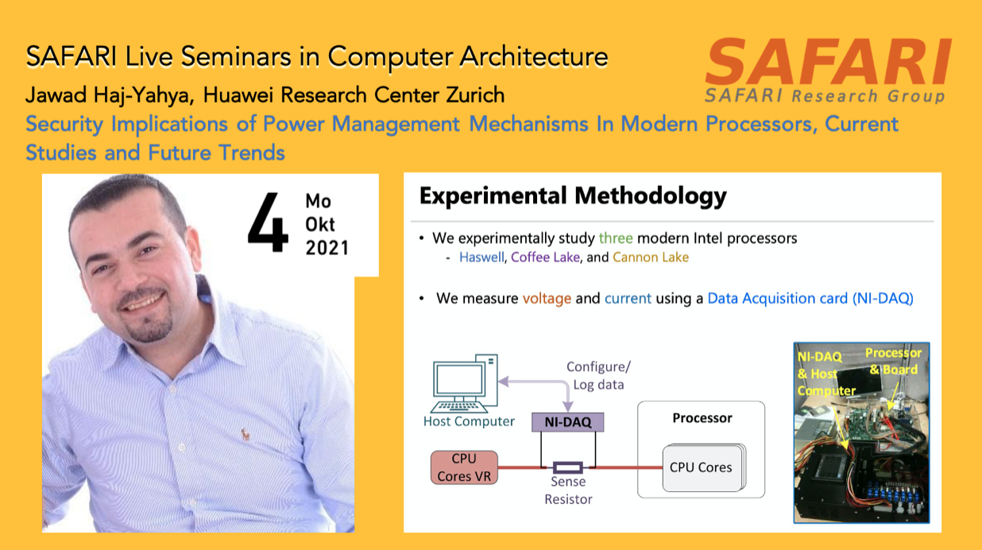
SAFARI Live Seminars
https://safari.ethz.ch/safari-seminar-series/

Slide 22
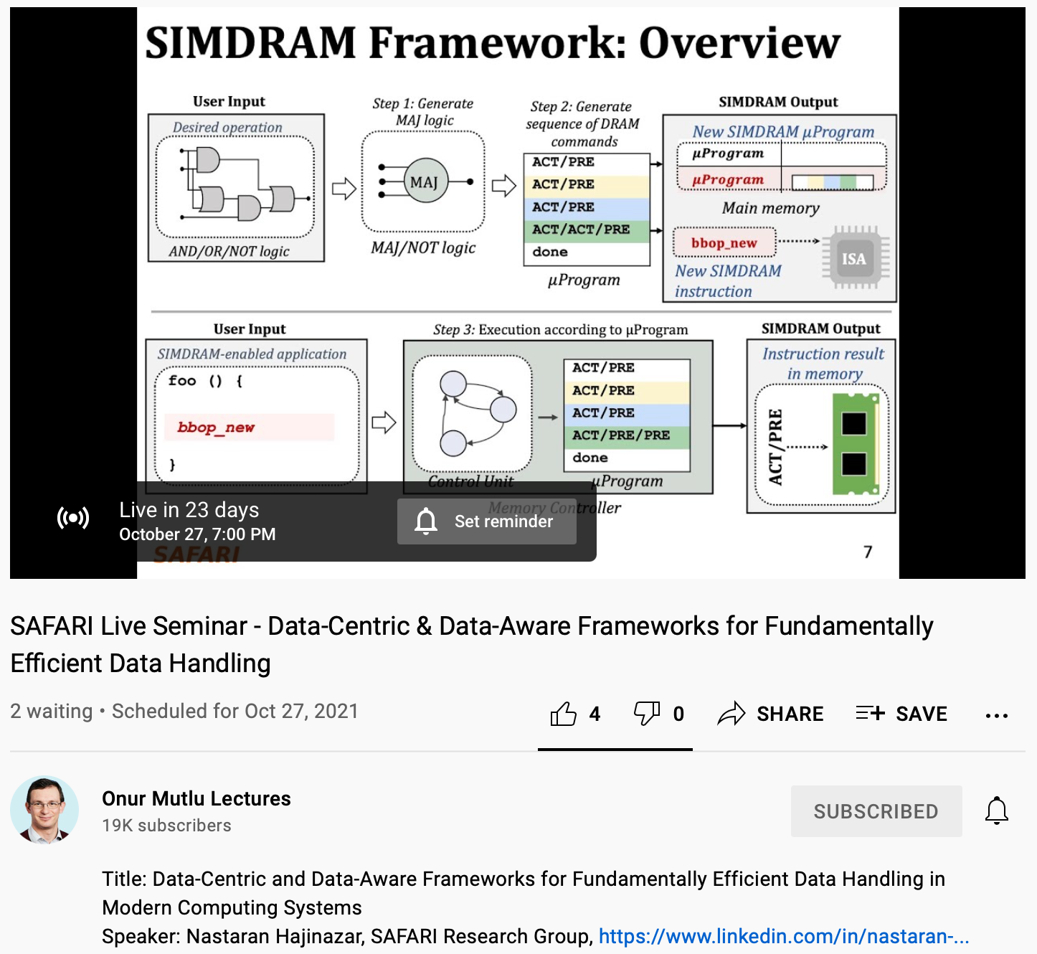
Upcoming SAFARI Live Seminar: Oct 27
https://www.youtube.com/watch?v=XIfPHtvA9rw&list=PL5Q2soXY2Zi_tOTAYm--dYByNPL7JhwR9&index=10

Slide 23

More on Our Research & Teaching
https://www.youtube.com/watch?v=83tlorht7Mc&list=PL5Q2soXY2Zi8D_5MGV6EnXEJHnV2YFBJl&index=54

Slide 24
Open-Source Artifacts
https://github.com/CMU-SAFARI

Slide 25
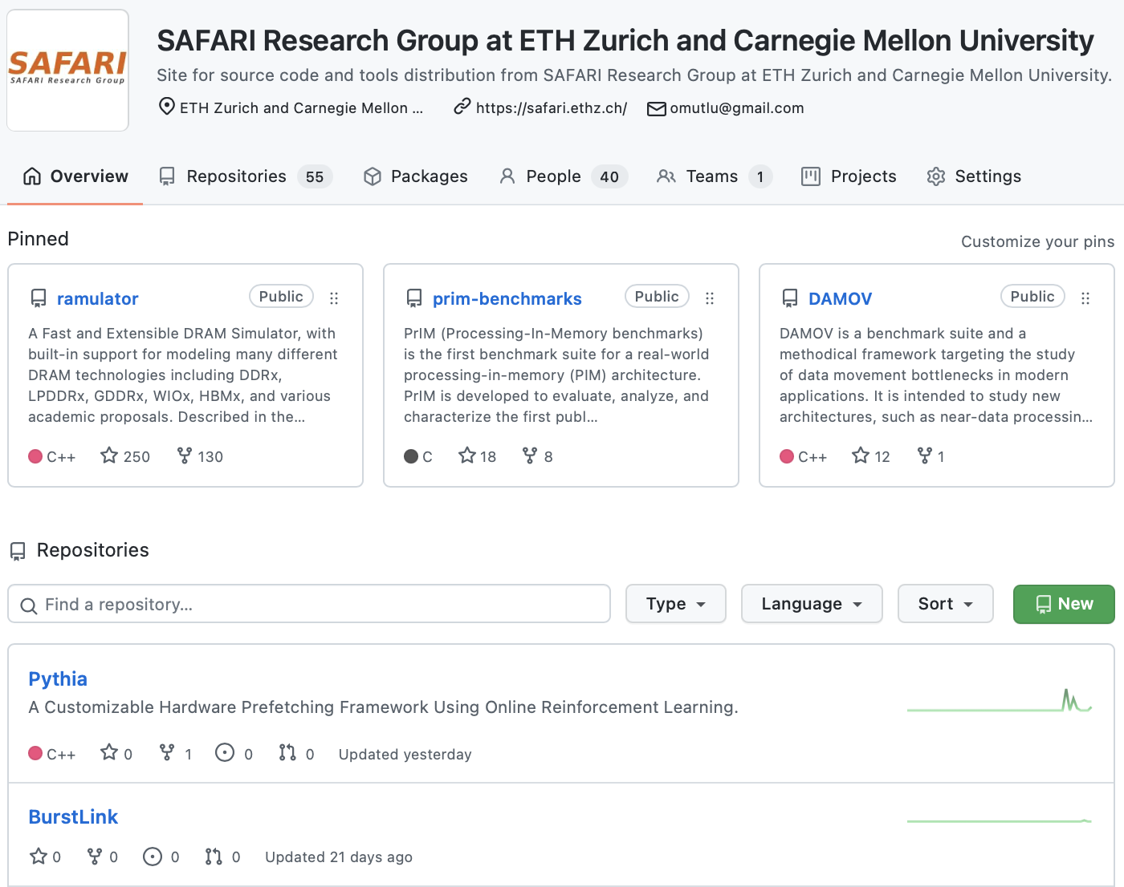
Open Source Tools: SAFARI GitHub
https://github.com/CMU-SAFARI/

Slide 26
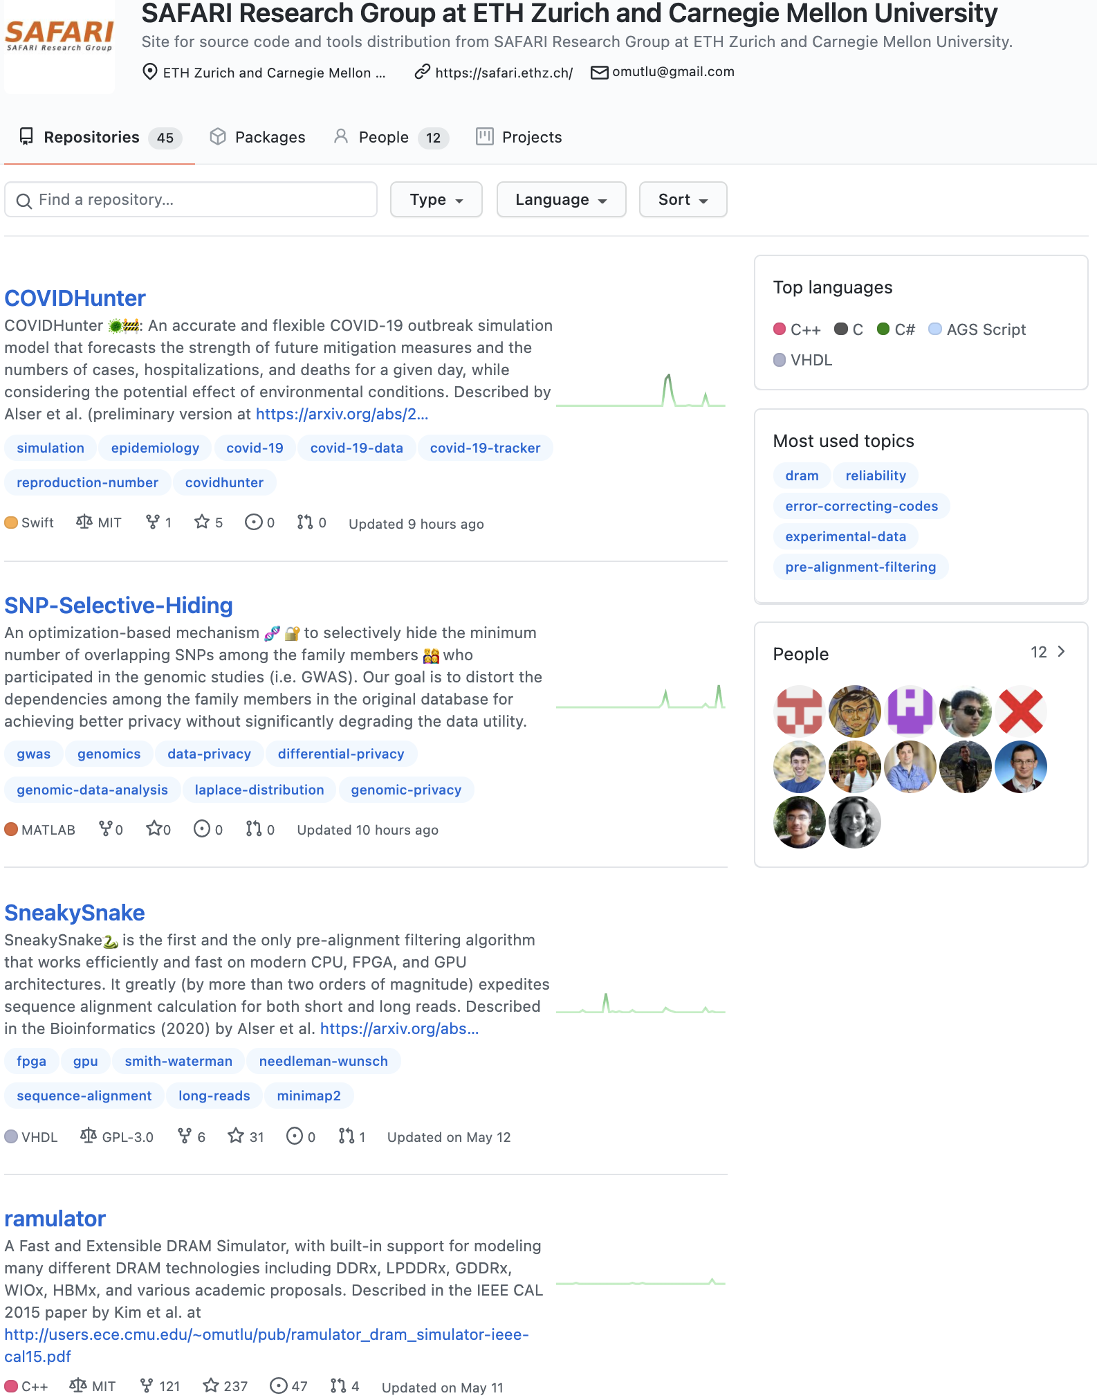
https://github.com/CMU-SAFARI

Slide 27
Papers, Talks, Videos, Artifacts
All are available at
  https://people.inf.ethz.ch/omutlu/projects.htm
  https://www.youtube.com/onurmutlulectures
  https://github.com/CMU-SAFARI/

Slide 28
Funding Acknowledgments
Alibaba, AMD, ASML, Google, Facebook, Hi-Silicon, HP Labs, Huawei, IBM, Intel, Microsoft, Nvidia, Oracle, Qualcomm, Rambus, Samsung, Seagate, VMware
NSF
NIH
GSRC
SRC
CyLab

Slide 29
Example Research Topics:
Quick Overview

Slide 30
Current Research Mission
Computer architecture, HW/SW, systems, bioinformatics, security
Hybrid Main Memory
Heterogeneous
Processors and
Accelerators
Persistent Memory/Storage
Graphics and Vision Processing
Build fundamentally better architectures
Notes:
Professor Mutlu’s research focus is all aspects of computer architecture, HW/SW interaction and bioinformatics.
He is looking for students to perform research in these areas.
He and his group, SAFARI, solve fundamental problems spanning:
Memory, memory, memory, storage, interconnects
Parallel architectures, heterogeneous architectures, GP-GPUs
System/architecture interaction, new execution models
Energy efficiency, fault tolerance, hardware security
Genome sequence analysis and assembly
His group does broad research spanning systems to logic with architecture at center

Slide 31
Four Key Issues in Future Platforms
Fundamentally Secure/Reliable/Safe Architectures
Fundamentally Energy-Efficient Architectures
  Memory-centric (Data-centric) Architectures
Fundamentally Low-Latency and Predictable Architectures
Architectures for AI/ML, Genomics, Medicine, Health

Slide 32
Architectures for Intelligent Machines
Data-centric
Data-driven
Data-aware

Slide 33
Current EFCL Projects
“A New Methodology and Open-Source Benchmark Suite for Evaluating Data Movement Bottlenecks: A Processing-in-Memory Case Study”
  Data-centric
“Machine-Learning-Assisted Intelligent Microarchitectures to Reduce Memory Access Latency”
  Data-driven
“Cross-layer Hardware/Software Techniques to Enable Powerful Computation and Memory Optimizations”
  Data-aware

Slide 34
The Problem
Computing
is Bottlenecked by Data

Slide 35
Data is Key for AI, ML, Genomics, …
Important workloads are all data intensive
They require rapid and efficient processing of large amounts of data
Data is increasing
  We can generate more than we can process

Slide 36
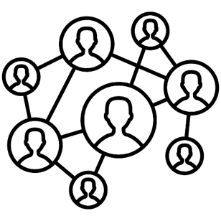

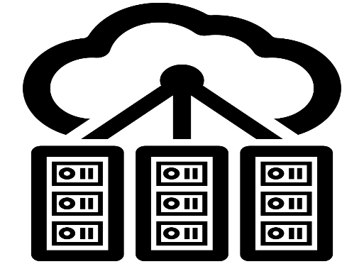

Data is Key for Future Workloads
In-memory Databases
[Mao+, EuroSys’12;
Clapp+ (Intel), IISWC’15]
Graph/Tree Processing
[Xu+, IISWC’12; Umuroglu+, FPL’15]
In-Memory Data Analytics
[Clapp+ (Intel), IISWC’15;
Awan+, BDCloud’15]
Datacenter Workloads
[Kanev+ (Google), ISCA’15]

Slide 37
Data Overwhelms Modern Machines
In-memory Databases
[Mao+, EuroSys’12;
Clapp+ (Intel), IISWC’15]
Graph/Tree Processing
[Xu+, IISWC’12; Umuroglu+, FPL’15]
Data → performance & energy bottleneck
In-Memory Data Analytics
[Clapp+ (Intel), IISWC’15;
Awan+, BDCloud’15]
Datacenter Workloads
[Kanev+ (Google), ISCA’15]

Slide 38








Data is Key for Future Workloads
  Chrome
TensorFlow Mobile
    Google’s web browser
Google’s machine learning framework
  Video Playback
  Video Capture
Google’s video codec
Google’s video codec
Notes:
In this work, we take a look at widely-used google consumer workloads, to figure out the major sources of energy consumption.
We look at Google Chrome web brower. We take a look at Tensorflow, Google’s machine learning framework, and we also take a look at two important video related workloads, video playback and video capture, both rely on Google’s vp9 codec technology.

Slide 39
Data Overwhelms Modern Machines
  Chrome
TensorFlow Mobile
    Google’s web browser
Google’s machine learning framework
Data → performance & energy bottleneck
  Video Playback
  Video Capture
Google’s video codec
Google’s video codec
Notes:
In this work, we take a look at widely-used google consumer workloads, to figure out the major sources of energy consumption.
We look at Google Chrome web brower. We take a look at Tensorflow, Google’s machine learning framework, and we also take a look at two important video related workloads, video playback and video capture, both rely on Google’s vp9 codec technology.

Slide 40
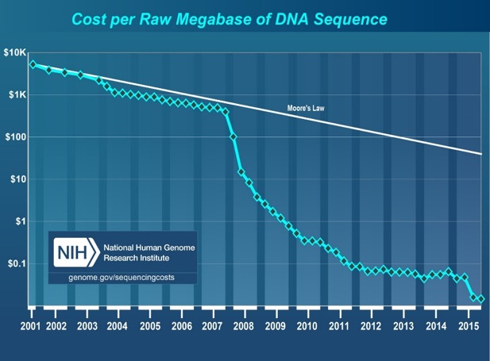
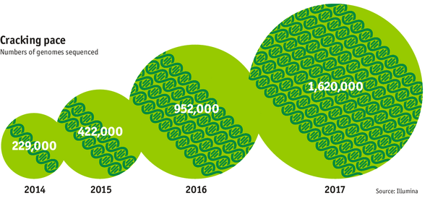

Data is Key for Future Workloads
development of high-throughput sequencing (HTS) technologies
Number of Genomes Sequenced
http://www.economist.com/news/21631808-so-much-genetic-data-so-many-uses-genes-unzipped
Notes:
However, since the development of high throughput sequencing (HTS) technologies, the cost of genome sequencing has fallen off a cliff (<< 1,000$) making it viable for almost everyone's use.

Slide 41
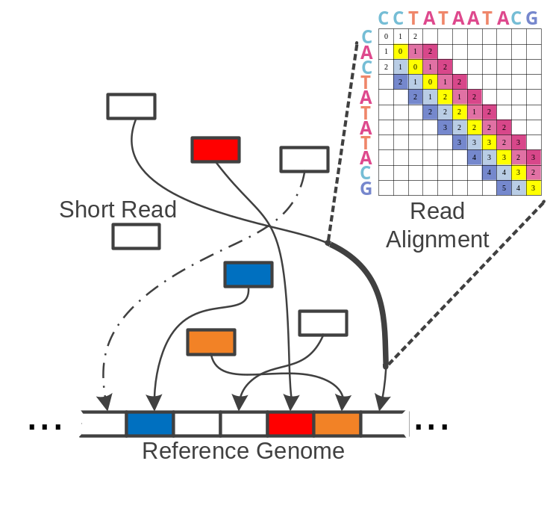
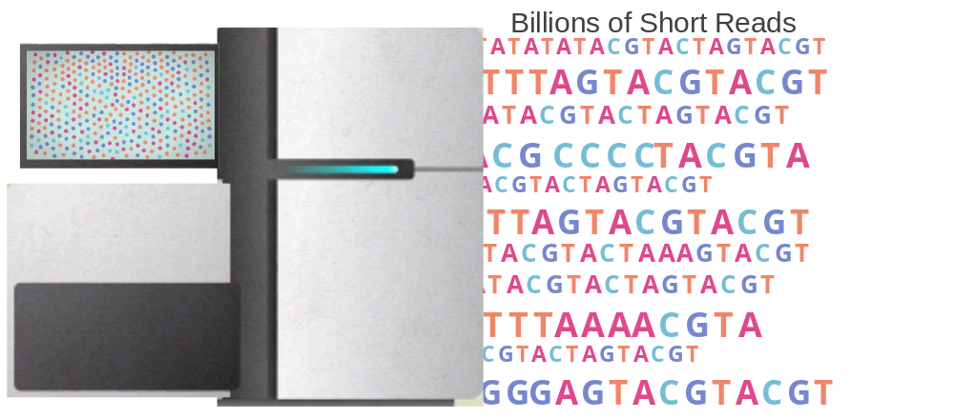

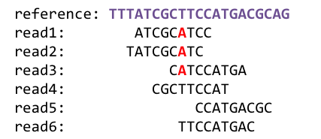
1
Sequencing
Genome Analysis
Read Mapping
2
Data → performance & energy bottleneck
Variant Calling
Scientific Discovery
3
4
Notes:
Genome analysis starts with sequencing random short DNA fragments of copies of the original molecule.
Unfortunately, these reads lack information about their order and which part of genome they are originated from.
Hence the second step is to map these reads to a long reference genome.

Slide 42
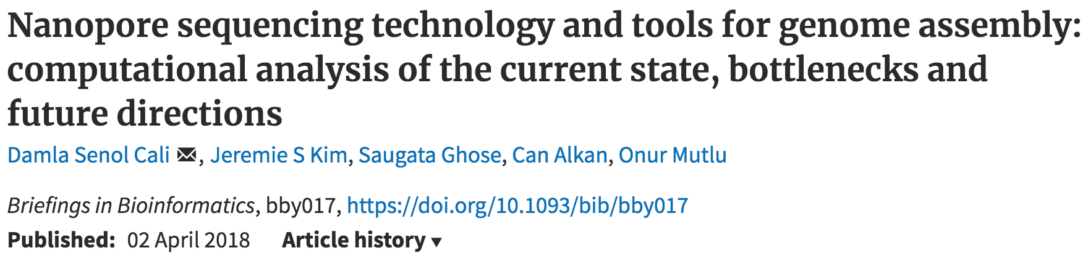
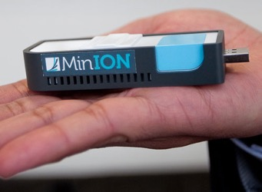
New Genome Sequencing Technologies
Oxford Nanopore MinION
Senol Cali+, “Nanopore Sequencing Technology and Tools for Genome
Assembly: Computational Analysis of the Current State, Bottlenecks
and Future Directions,” Briefings in Bioinformatics, 2018.
[Open arxiv.org version]

Slide 43
New Genome Sequencing Technologies
Oxford Nanopore MinION
Senol Cali+, “Nanopore Sequencing Technology and Tools for Genome
Assembly: Computational Analysis of the Current State, Bottlenecks
and Future Directions,” Briefings in Bioinformatics, 2018.
[Preliminary arxiv.org version]
Data → performance & energy bottleneck

Slide 44
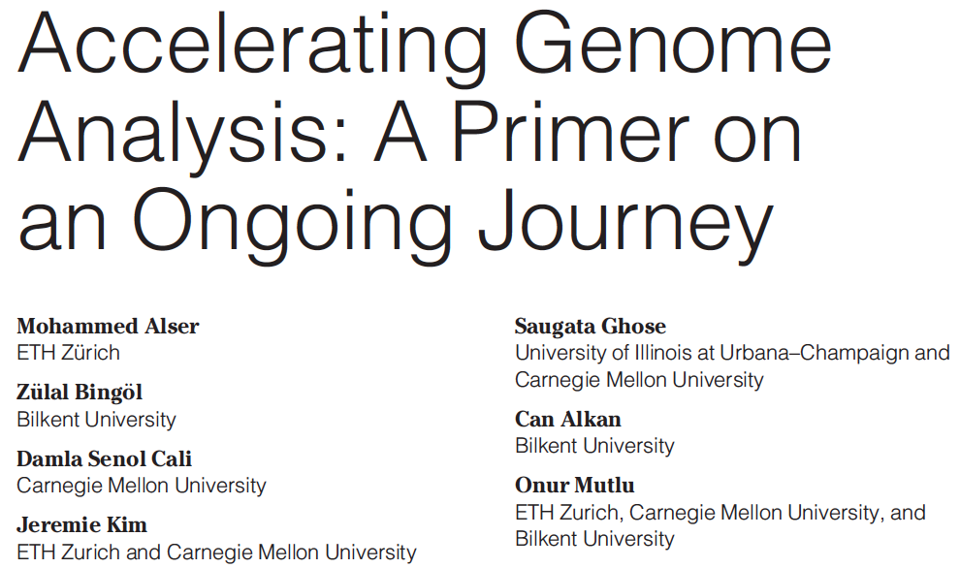
Accelerating Genome Analysis [IEEE MICRO 2020]
Mohammed Alser, Zulal Bingol, Damla Senol Cali, Jeremie Kim, Saugata Ghose, Can Alkan, and Onur Mutlu,
"Accelerating Genome Analysis: A Primer on an Ongoing Journey"
IEEE Micro (IEEE MICRO), Vol. 40, No. 5, pages 65-75, September/October 2020.
[Slides (pptx)(pdf)]
[Talk Video (1 hour 2 minutes)]

Slide 45
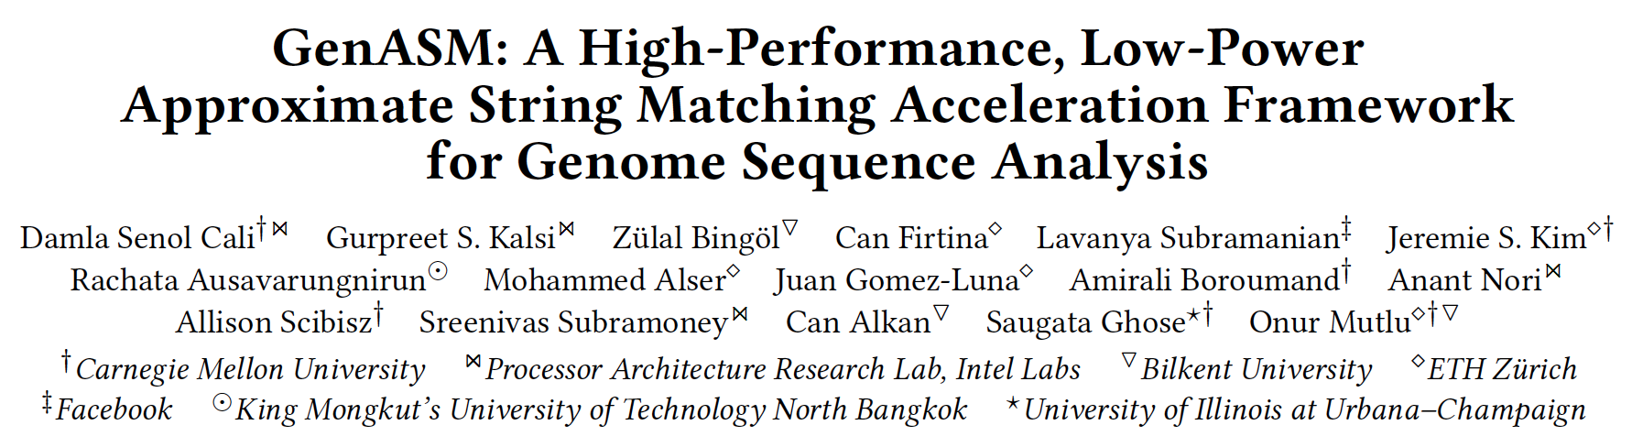
GenASM Framework [MICRO 2020]
Damla Senol Cali, Gurpreet S. Kalsi, Zulal Bingol, Can Firtina, Lavanya Subramanian, Jeremie S. Kim, Rachata Ausavarungnirun, Mohammed Alser, Juan Gomez-Luna, Amirali Boroumand, Anant Nori, Allison Scibisz, Sreenivas Subramoney, Can Alkan, Saugata Ghose, and Onur Mutlu,
"GenASM: A High-Performance, Low-Power Approximate String Matching Acceleration Framework for Genome Sequence Analysis"
Proceedings of the 53rd International Symposium on Microarchitecture (MICRO), Virtual, October 2020.
[Lighting Talk Video (1.5 minutes)]
[Lightning Talk Slides (pptx) (pdf)]
[Talk Video (18 minutes)]
[Slides (pptx) (pdf)]

Slide 46
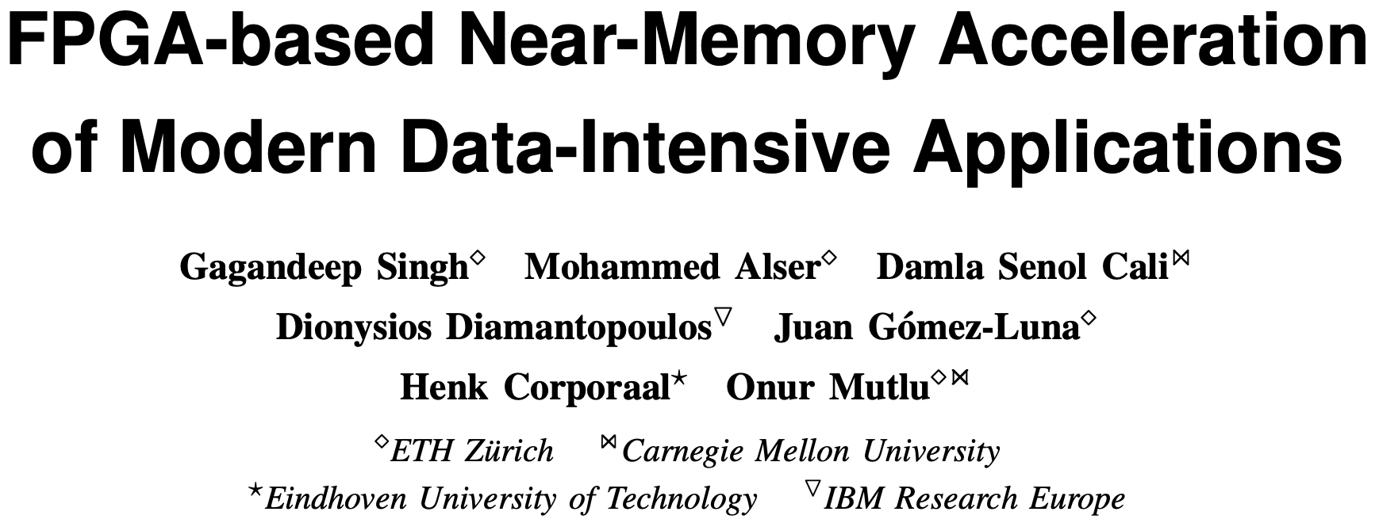
FPGA-based Processing Near Memory
Gagandeep Singh, Mohammed Alser, Damla Senol Cali, Dionysios Diamantopoulos, Juan Gómez-Luna, Henk Corporaal, and Onur Mutlu,
"FPGA-based Near-Memory Acceleration of Modern Data-Intensive Applications"
IEEE Micro (IEEE MICRO), 2021.

Slide 47
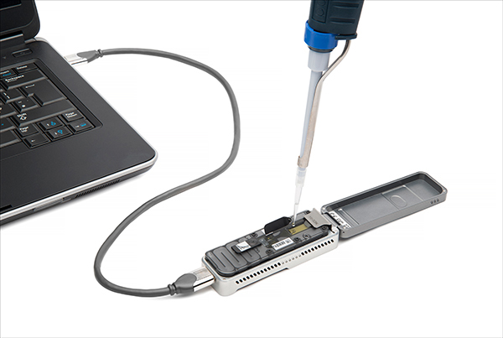
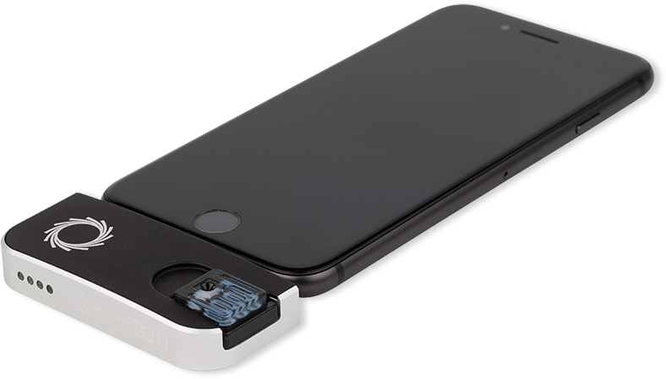
Future of Genome Sequencing & Analysis
MinION from ONT
SmidgION from ONT
Alser+, "Accelerating Genome Analysis: A Primer on an Ongoing Journey”, IEEE Micro 2020.

Slide 48
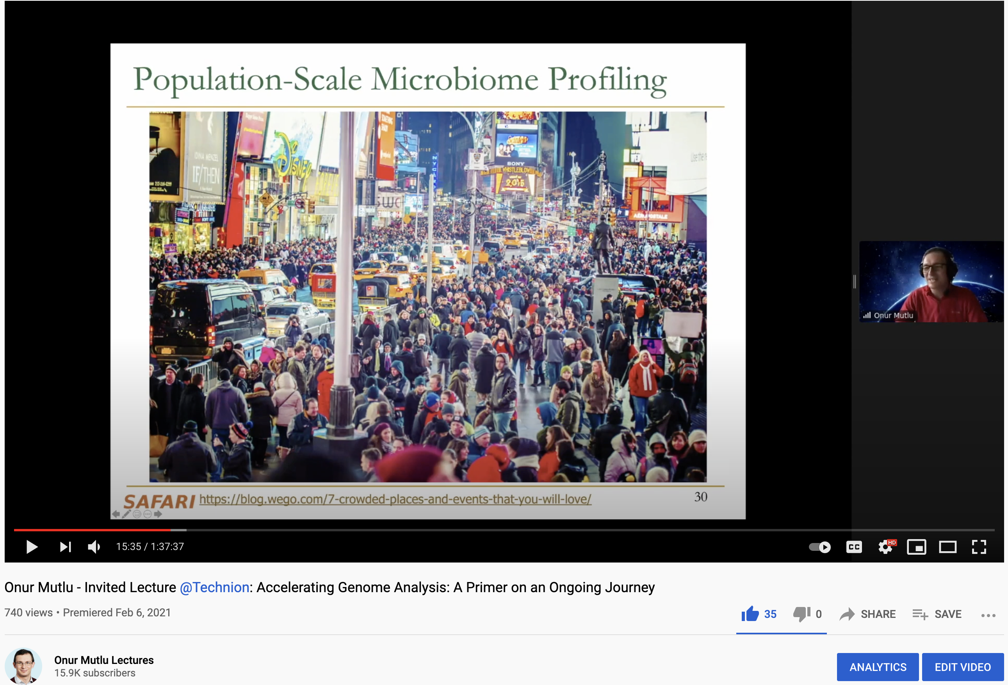
More on Fast & Efficient Genome Analysis …
Onur Mutlu,
"Accelerating Genome Analysis: A Primer on an Ongoing Journey"
Invited Lecture at Technion, Virtual, 26 January 2021.
[Slides (pptx) (pdf)]
[Talk Video (1 hour 37 minutes, including Q&A)]
[Related Invited Paper (at IEEE Micro, 2020)]

Slide 49
Detailed Lectures on Genome Analysis
Computer Architecture, Fall 2020, Lecture 3a
  Introduction to Genome Sequence Analysis (ETH Zürich, Fall 2020)
  https://www.youtube.com/watch?v=CrRb32v7SJc&list=PL5Q2soXY2Zi9xidyIgBxUz7xRPS-wisBN&index=5
Computer Architecture, Fall 2020, Lecture 8
  Intelligent Genome Analysis (ETH Zürich, Fall 2020)
  https://www.youtube.com/watch?v=ygmQpdDTL7o&list=PL5Q2soXY2Zi9xidyIgBxUz7xRPS-wisBN&index=14
Computer Architecture, Fall 2020, Lecture 9a
  GenASM: Approx. String Matching Accelerator (ETH Zürich, Fall 2020)
  https://www.youtube.com/watch?v=XoLpzmN-Pas&list=PL5Q2soXY2Zi9xidyIgBxUz7xRPS-wisBN&index=15
Accelerating Genomics Project Course, Fall 2020, Lecture 1
  Accelerating Genomics (ETH Zürich, Fall 2020)
  https://www.youtube.com/watch?v=rgjl8ZyLsAg&list=PL5Q2soXY2Zi9E2bBVAgCqLgwiDRQDTyId
https://www.youtube.com/onurmutlulectures

Slide 50
Data Overwhelms Modern Machines …
Storage/memory capability
Communication capability
Computation capability
Greatly impacts robustness, energy, performance, cost

Slide 51
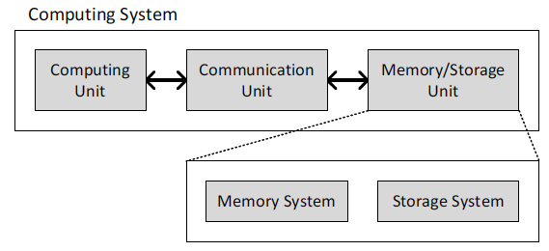
A Computing System
Three key components
Computation
Communication
Storage/memory
Burks, Goldstein, von Neumann, “Preliminary discussion of the
logical design of an electronic computing instrument,” 1946.
Image source: https://lbsitbytes2010.wordpress.com/2013/03/29/john-von-neumann-roll-no-15/

Slide 52
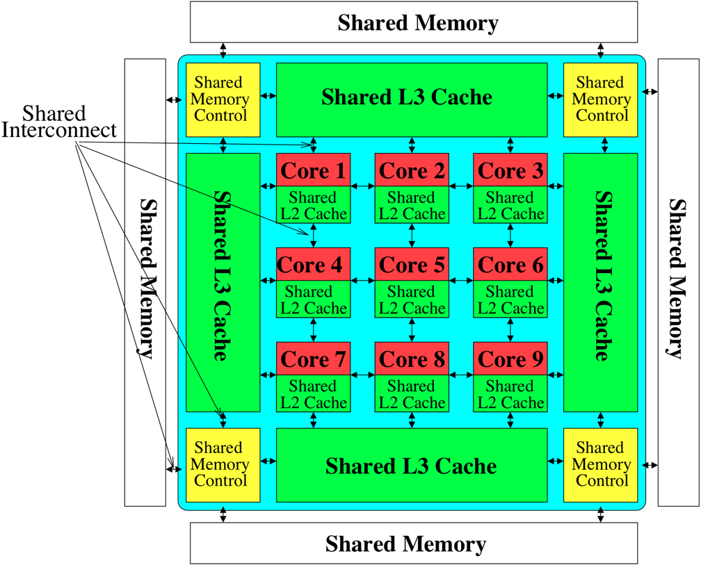

Perils of Processor-Centric Design
Most of the system is dedicated to storing and moving data
Yet, system is still bottlenecked by memory

Slide 53
Data Overwhelms Modern Machines
  Chrome
TensorFlow Mobile
    Google’s web browser
Google’s machine learning framework
Data → performance & energy bottleneck
  Video Playback
  Video Capture
Google’s video codec
Google’s video codec
Notes:
In this work, we take a look at widely-used google consumer workloads, to figure out the major sources of energy consumption.
We look at Google Chrome web brower. We take a look at Tensorflow, Google’s machine learning framework, and we also take a look at two important video related workloads, video playback and video capture, both rely on Google’s vp9 codec technology.

Slide 54
Data Movement Overwhelms Modern Machines
Amirali Boroumand, Saugata Ghose, Youngsok Kim, Rachata Ausavarungnirun, Eric Shiu, Rahul Thakur, Daehyun Kim, Aki Kuusela, Allan Knies, Parthasarathy Ranganathan, and Onur Mutlu,
"Google Workloads for Consumer Devices: Mitigating Data Movement Bottlenecks"
Proceedings of the 23rd International Conference on Architectural Support for Programming Languages and Operating Systems (ASPLOS), Williamsburg, VA, USA, March 2018.
62.7% of the total system energy
is spent on data movement

Slide 55
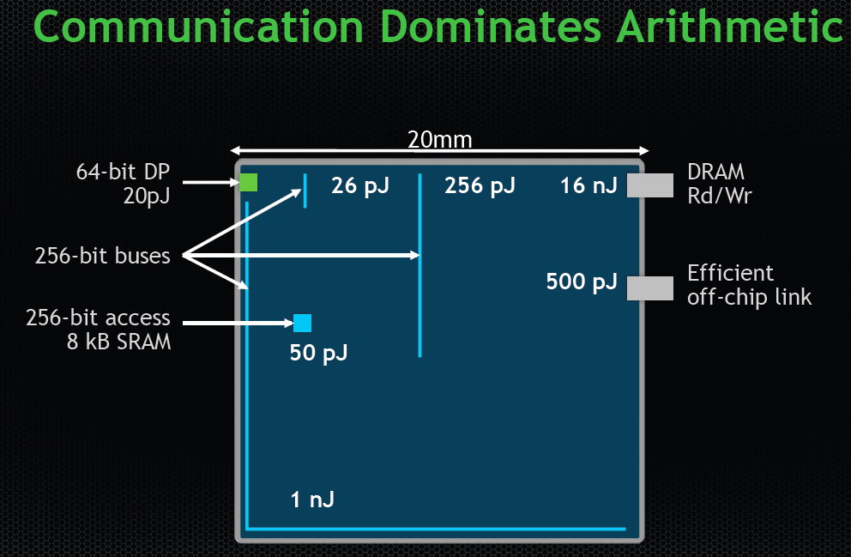
Data Movement vs. Computation Energy
Dally, HiPEAC 2015
A memory access consumes ~100-1000X
the energy of a complex addition

Slide 56
Axiom
An Intelligent Architecture
Handles Data Well

Slide 57
How to Handle Data Well
Ensure data does not overwhelm the components
  via intelligent algorithms
  via intelligent architectures
  via whole system designs: algorithm-architecture-devices
Take advantage of vast amounts of data and metadata
  to improve architectural & system-level decisions
Understand and exploit properties of (different) data
  to improve algorithms & architectures in various metrics

Slide 58
Corollaries: Architectures Today …
Architectures are terrible at dealing with data
  Designed to mainly store and move data vs. to compute
  They are processor-centric as opposed to data-centric
Architectures are terrible at taking advantage of vast amounts of data (and metadata) available to them
  Designed to make simple decisions, ignoring lots of data
  They make human-driven decisions vs. data-driven
Architectures are terrible at knowing and exploiting different properties of application data
  Designed to treat all data as the same
  They make component-aware decisions vs. data-aware

Slide 59
Data-Centric (Memory-Centric) Architectures

Slide 60
Data-Centric Architectures: Properties
Process data where it resides (where it makes sense)
  Processing in and near memory structures
Low-latency and low-energy data access
  Low latency memory
  Low energy memory
Low-cost data storage and processing
  High capacity memory at low cost: hybrid memory, compression
Intelligent data management
  Intelligent controllers handling robustness, security, cost

Slide 61
Processing Data
Where It Makes Sense

Slide 62
The Problem
Data access is the major performance and energy bottleneck
Our current
design principles
cause great energy waste
(and great performance loss)

Slide 63
The Problem
Processing of data
is performed
far away from the data

Slide 64
We Need A Paradigm Shift To …
Enable computation with minimal data movement
Compute where it makes sense (where data resides)
Make computing architectures more data-centric

Slide 65
Challenge and Opportunity for Future
Computing Architectures
with
Minimal Data Movement

Slide 66
Challenge and Opportunity for Future
Fundamentally
Energy-Efficient
(Data-Centric)
Computing Architectures

Slide 67
Challenge and Opportunity for Future
Fundamentally
High-Performance
(Data-Centric)
Computing Architectures

Slide 68
Goal: Processing Inside Memory
Many questions … How do we design the:
  compute-capable memory & controllers?
  processor chip and in-memory units?
  software and hardware interfaces?
  system software, compilers, languages?
  algorithms and theoretical foundations?
Memory
Processor
Core
Database
Graphs
Media
Cache
Query
Interconnect
Problem
Results
Algorithm
Program/Language
System Software
SW/HW Interface
Micro-architecture
Logic
Devices
Electrons

Slide 69
Mindset: Memory-Centric Computing
CPU
core
CPU
core
mini-CPU
core
GPU
(throughput)
core
GPU
(throughput)
core
video
core
GPU
(throughput)
core
GPU
(throughput)
core
CPU
core
CPU
core
Memory
imaging
core
LLC
Specialized
compute-capability
in memory
Memory Controller
Memory Bus
Memory similar to a “conventional” accelerator

Slide 70
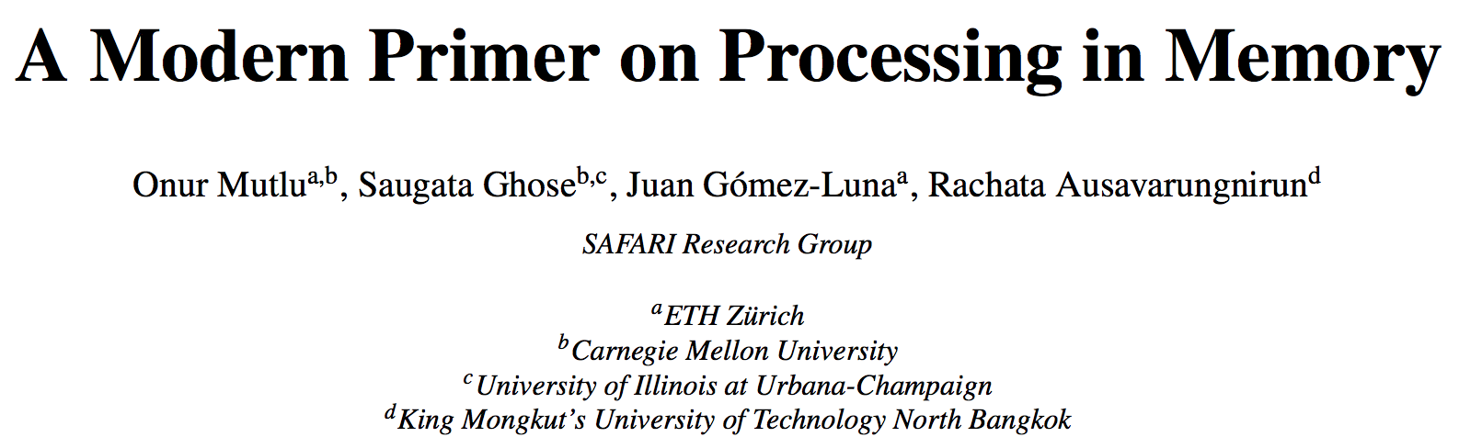
PIM Review and Open Problems
Onur Mutlu, Saugata Ghose, Juan Gomez-Luna, and Rachata Ausavarungnirun,
"A Modern Primer on Processing in Memory"
Invited Book Chapter in Emerging Computing: From Devices to Systems - Looking Beyond Moore and Von Neumann, Springer, to be published in 2021.
https://arxiv.org/pdf/1903.03988.pdf

Slide 71
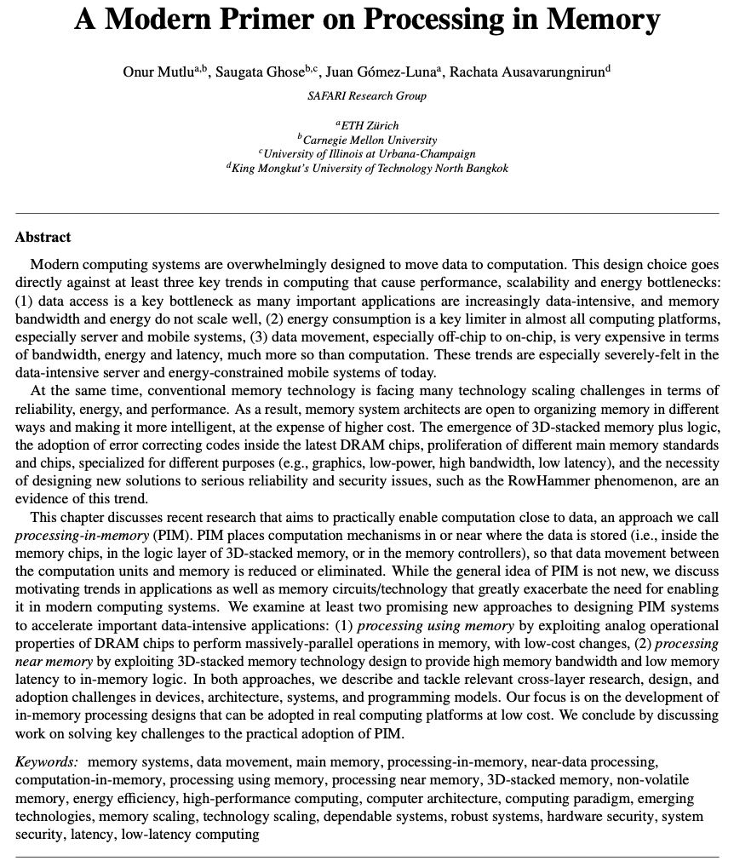

Slide 72
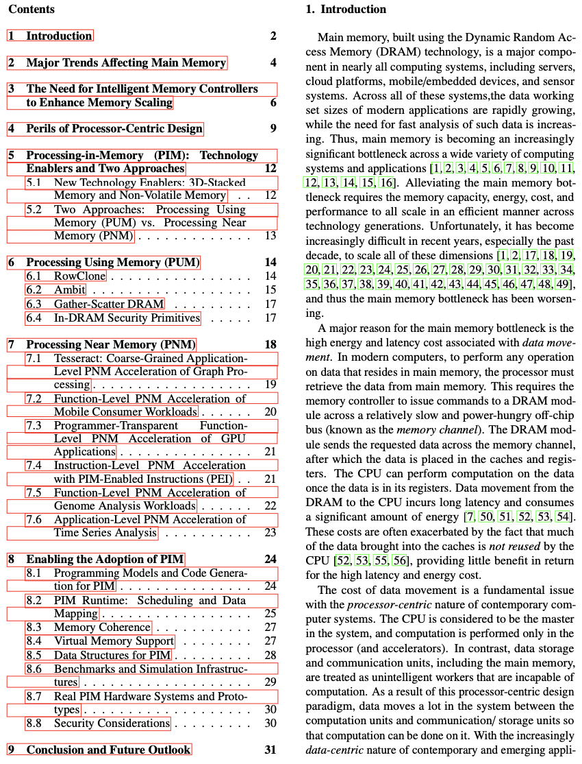

Slide 73
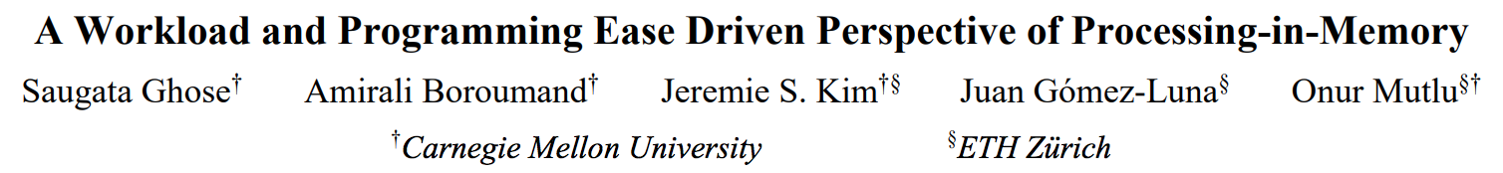
PIM Review and Open Problems (II)
Saugata Ghose, Amirali Boroumand, Jeremie S. Kim, Juan Gomez-Luna, and Onur Mutlu,
"Processing-in-Memory: A Workload-Driven Perspective"
Invited Article in IBM Journal of Research & Development, Special Issue on Hardware for Artificial Intelligence, to appear in November 2019.
[Preliminary arXiv version]
https://arxiv.org/pdf/1907.12947.pdf

Slide 74
Processing in Memory:
Two Approaches
1. Processing using Memory
2. Processing near Memory

Slide 75
Processing using Memory
We can support in-DRAM AND, OR, NOT, MAJ
At low cost
Using analog computation capability of DRAM
  Idea: activating multiple rows performs computation
30-60X performance and energy improvement
  Seshadri+, “Ambit: In-Memory Accelerator for Bulk Bitwise Operations Using Commodity DRAM Technology,” MICRO 2017.
New memory technologies enable even more opportunities
  Memristors, resistive RAM, phase change mem, STT-MRAM, …
  Can operate on data with minimal movement

Slide 76
Ambit: Bulk-Bitwise in-DRAM Computation
Vivek Seshadri, Donghyuk Lee, Thomas Mullins, Hasan Hassan, Amirali Boroumand, Jeremie Kim, Michael A. Kozuch, Onur Mutlu, Phillip B. Gibbons, and Todd C. Mowry,
"Ambit: In-Memory Accelerator for Bulk Bitwise Operations Using Commodity DRAM Technology"
Proceedings of the 50th International Symposium on Microarchitecture (MICRO), Boston, MA, USA, October 2017.
[Slides (pptx) (pdf)] [Lightning Session Slides (pptx) (pdf)] [Poster (pptx) (pdf)]

Slide 77
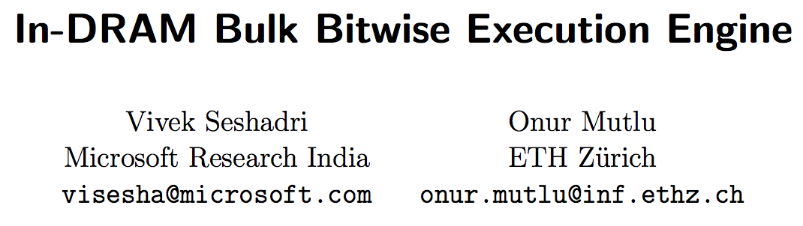
In-DRAM Bulk Bitwise Execution Paradigm
Vivek Seshadri and Onur Mutlu,
"In-DRAM Bulk Bitwise Execution Engine"
Invited Book Chapter in Advances in Computers, 2020.
[Preliminary arXiv version]

Slide 78
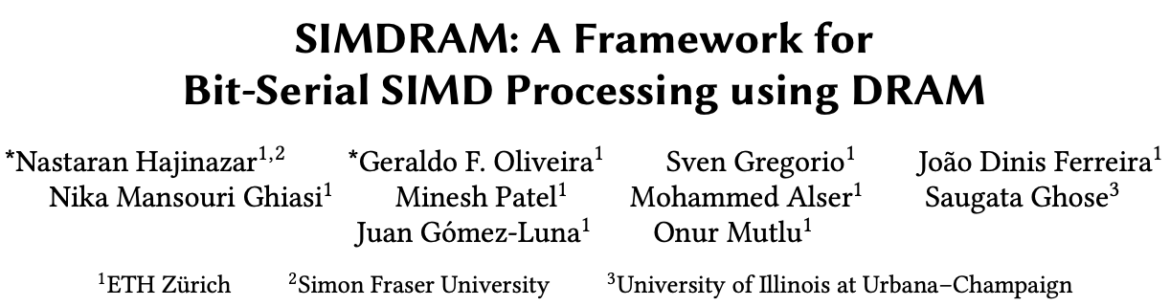
SIMDRAM Framework
Nastaran Hajinazar, Geraldo F. Oliveira, Sven Gregorio, Joao Dinis Ferreira, Nika Mansouri Ghiasi, Minesh Patel, Mohammed Alser, Saugata Ghose, Juan Gomez-Luna, and Onur Mutlu,
"SIMDRAM: An End-to-End Framework for Bit-Serial SIMD Computing in DRAM"
Proceedings of the 26th International Conference on Architectural Support for Programming Languages and Operating Systems (ASPLOS), Virtual, March-April 2021.
[2-page Extended Abstract]
[Short Talk Slides (pptx) (pdf)]
[Talk Slides (pptx) (pdf)]
[Short Talk Video (5 mins)]
[Full Talk Video (27 mins)]

Slide 79
SIMDRAM Key Idea
SIMDRAM: An end-to-end processing-using-DRAM framework that provides the programming interface, the ISA, and the hardware support for:
  Efficiently computing complex operations in DRAM
  Providing the ability to implement arbitrary operations as required
  Using an in-DRAM massively-parallel SIMD substrate that requires minimal changes to DRAM architecture
23

Slide 80





SIMDRAM Framework: Overview
User Input
Step 1: Generate
MAJ logic
Step 2: Generate
sequence of
DRAM commands
SIMDRAM Output
Desired operation
New SIMDRAM $μ$Program
ACT/PRE
ACT/PRE
ACT/PRE
ACT/ACT/PRE
done
$$μProgram$$
$$μProgram$$
MAJ
Main memory
AND/OR/NOT logic
MAJ/NOT logic
bbop_new
New SIMDRAM
instruction
ISA
$μ$Program
User Input
Step 3: Execution according to $μ$Program
SIMDRAM Output
SIMDRAM-enabled application
Instruction result
in memory
foo () {
bbop_new
}
ACT/PRE
ACT/PRE
ACT/PRE
ACT/PRE/PRE
done
ACT/PRE
Control Unit
$μ$Program
Memory Controller
27

Slide 81
SIMDRAM Key Results
Evaluated on:
  16 complex in-DRAM operations
  7 commonly-used real-world applications
SIMDRAM provides:
88× and 5.8× the throughput of a CPU and a high-end GPU, respectively, over 16 operations
257× and 31× the energy efficiency of a CPU and a high-end GPU, respectively, over 16 operations
21× and 2.1× the performance of a CPU an a high-end GPU, over seven real-world applications
81

Slide 82
SIMDRAM Conclusion
SIMDRAM:
  Enables efficient computation of a flexible set and wide range of operations in a PuM massively parallel SIMD substrate
  Provides the hardware, programming, and ISA support, to:
    Address key system integration challenges
    Allow programmers to define and employ new operations without hardware changes
More in the paper:
  Efficiently transposing data
  Programming interface
  Handling page faults, address translation, coherence, and interrupts
  Security implications
  Reliability evaluation
  Comparison to in-cache computing
  And more …
  SIMDRAM is a promising PuM framework
  Can ease the adoption of processing-using-DRAM architectures
  Improves the performance and efficiency of processing-using-memory architectures
82

Slide 83
Processing in Memory:
Two Approaches
1. Processing using Memory
2. Processing near Memory

Slide 84
UPMEM Processing-in-DRAM Engine (2019)
Processing in DRAM Engine
Includes standard DIMM modules, with a large number of DPU processors combined with DRAM chips.
Replaces standard DIMMs
  DDR4 R-DIMM modules
    8GB+128 DPUs (16 PIM chips)
    Standard 2x-nm DRAM process
  Large amounts of compute & memory bandwidth
https://www.anandtech.com/show/14750/hot-chips-31-analysis-inmemory-processing-by-upmem
https://www.upmem.com/video-upmem-presenting-its-true-processing-in-memory-solution-hot-chips-2019/

Slide 85
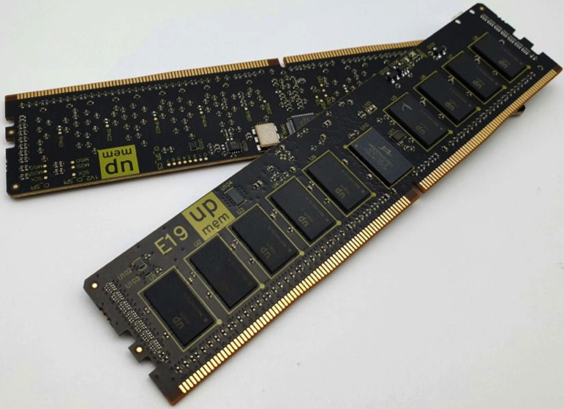
UPMEM Memory Modules
E19: 8 chips DIMM (1 rank). DPUs @ 267 MHz
P21: 16 chips DIMM (2 ranks). DPUs @ 350 MHz
www.upmem.com

Slide 86
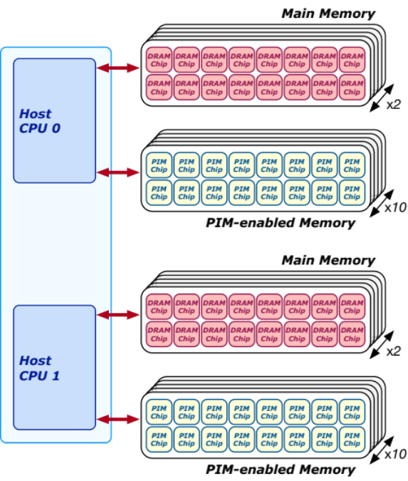
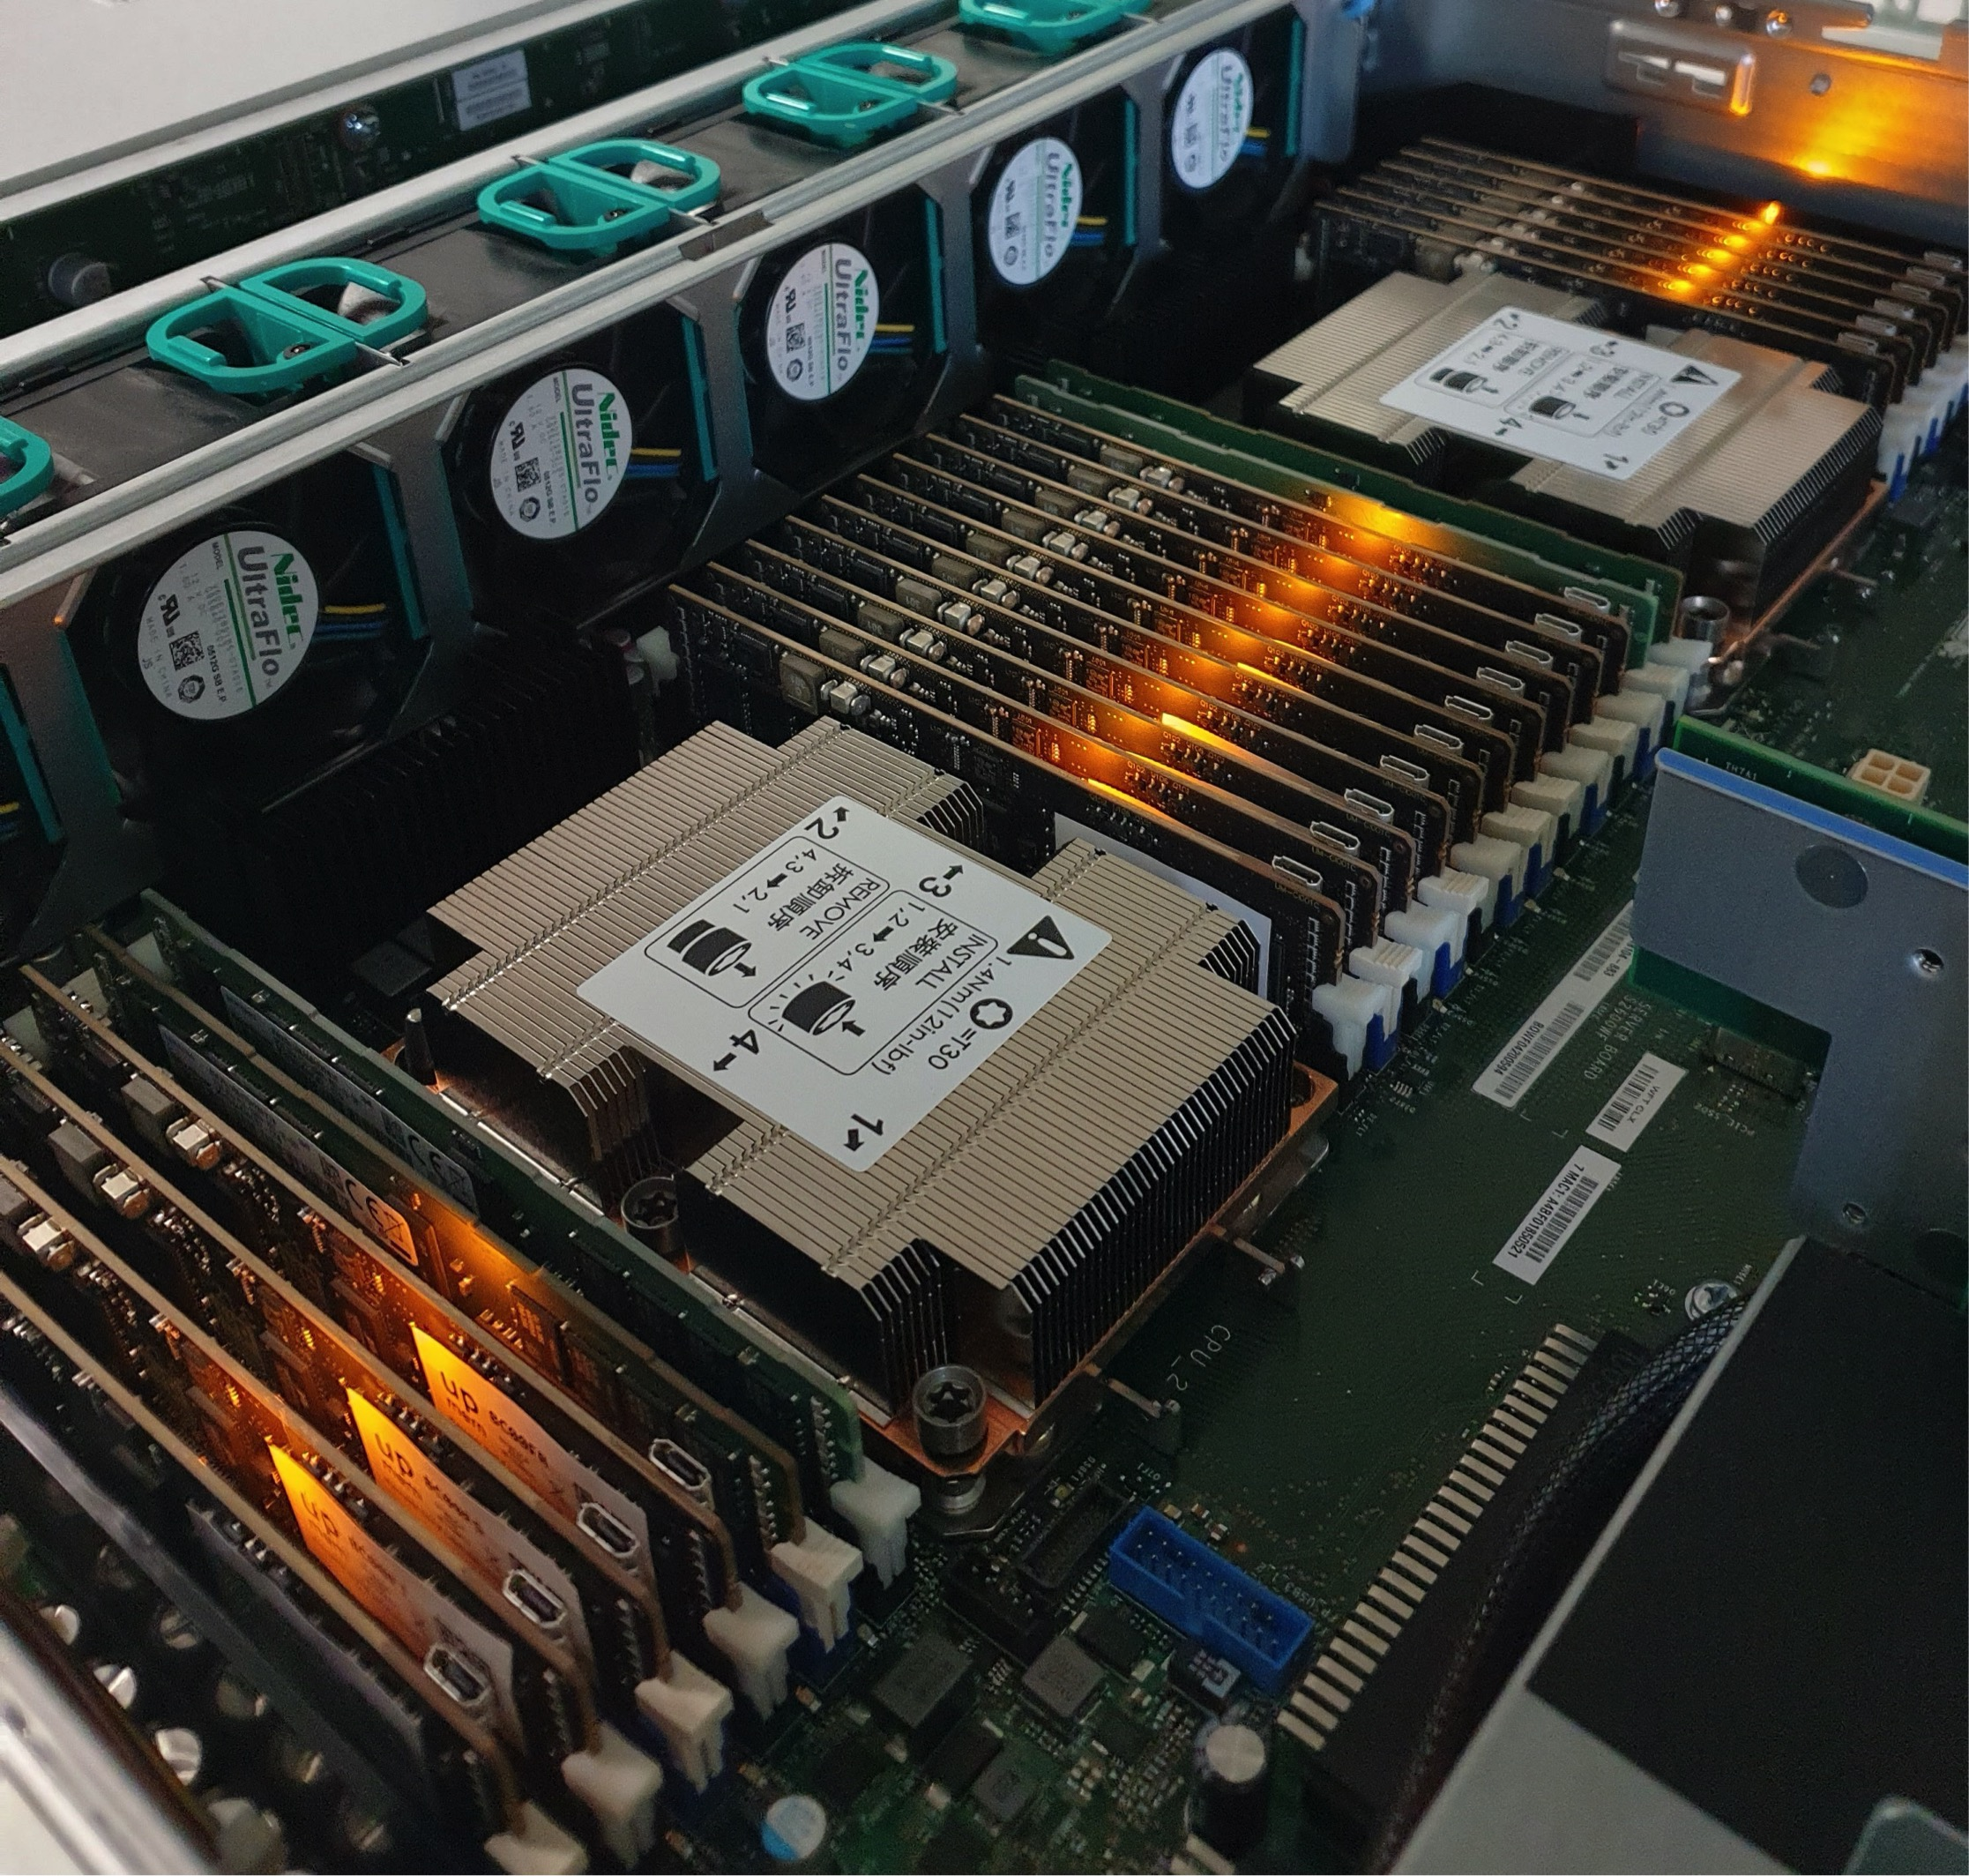
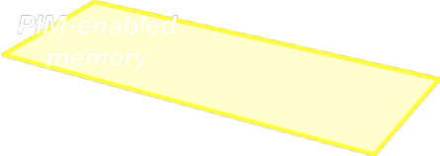
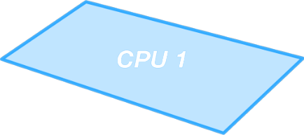
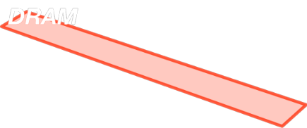
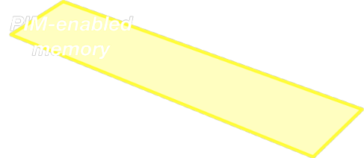
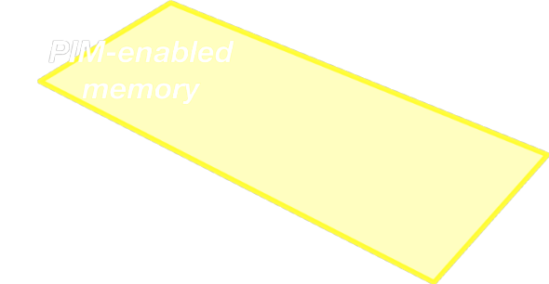




2,560-DPU Processing-in-Memory System
https://arxiv.org/pdf/2105.03814.pdf

Slide 87

More on the UPMEM PIM System
https://www.youtube.com/watch?v=Sscy1Wrr22A&list=PL5Q2soXY2Zi9xidyIgBxUz7xRPS-wisBN&index=26

Slide 88
Experimental Analysis of the UPMEM PIM Engine
https://arxiv.org/pdf/2105.03814.pdf

Slide 89
PrIM Benchmarks: Application Domains
Domain | Benchmark | Short name
Dense linear algebra | Vector Addition | VA
 | Matrix-Vector Multiply | GEMV
Sparse linear algebra | Sparse Matrix-Vector Multiply | SpMV
Databases | Select | SEL
 | Unique | UNI
Data analytics | Binary Search | BS
 | Time Series Analysis | TS
Graph processing | Breadth-First Search | BFS
Neural networks | Multilayer Perceptron | MLP
Bioinformatics | Needleman-Wunsch | NW
Image processing | Image histogram (short) | HST-S
 | Image histogram (large) | HST-L
Parallel primitives | Reduction | RED
 | Prefix sum (scan-scan-add) | SCAN-SSA
 | Prefix sum (reduce-scan-scan) | SCAN-RSS
 | Matrix transposition | TRNS

Slide 90

PrIM Benchmarks are Open Source
All microbenchmarks, benchmarks, and scripts
https://github.com/CMU-SAFARI/prim-benchmarks

Slide 91
Key Takeaway 1
The throughput saturation point is as low as ¼ OP/B,
i.e., 1 integer addition per every 32-bit element fetched
Memory-bound region
Compute-bound region
KEY TAKEAWAY 1
The UPMEM PIM architecture is fundamentally compute bound.
As a result, the most suitable workloads are memory-bound.

Slide 92
Key Takeaway 2
KEY TAKEAWAY 2
The most well-suited workloads for the UPMEM PIM architecture use no arithmetic operations or use only simple operations (e.g., bitwise operations and integer addition/subtraction).

Slide 93
Key Takeaway 3
KEY TAKEAWAY 3
The most well-suited workloads for the UPMEM PIM architecture require little or no communication across DPUs (inter-DPU communication).

Slide 94
Key Takeaway 4
KEY TAKEAWAY 4
• UPMEM-based PIM systems outperform state-of-the-art CPUs in terms of performance and energy efficiency on most of PrIM benchmarks.
• UPMEM-based PIM systems outperform state-of-the-art GPUs on a majority of PrIM benchmarks, and the outlook is even more positive for future PIM systems.
• UPMEM-based PIM systems are more energy-efficient than state-of-the-art CPUs and GPUs on workloads that they provide performance improvements over the CPUs and the GPUs.

Slide 95

More on UPMEM System & Analysis
Juan Gomez-Luna, Izzat El Hajj, Ivan Fernandez, Christina Giannoula, Geraldo F. Oliveira, and Onur Mutlu,
"Benchmarking a New Paradigm: An Experimental Analysis of a Real Processing-in-Memory Architecture"
Preprint in arXiv, 9 May 2021.
[arXiv preprint]
[PrIM Benchmarks Source Code]
[Slides (pptx) (pdf)]
[Long Talk Slides (pptx) (pdf)]
[Short Talk Slides (pptx) (pdf)]
[SAFARI Live Seminar Slides (pptx) (pdf)]
[SAFARI Live Seminar Video (2 hrs 57 mins)]
[Lightning Talk Video (3 minutes)]
[Short Talk Video (21 minutes)]
[1-hour Talk Video (58 minutes)]
https://arxiv.org/pdf/2105.03814.pdf
https://github.com/CMU-SAFARI/prim-benchmarks

Slide 96

Understanding a Modern PIM Architecture
https://www.youtube.com/watch?v=D8Hjy2iU9l4&list=PL5Q2soXY2Zi_tOTAYm--dYByNPL7JhwR9

Slide 97

More on Analysis of the UPMEM PIM Engine
https://www.youtube.com/watch?v=D8Hjy2iU9l4&list=PL5Q2soXY2Zi_tOTAYm--dYByNPL7JhwR9

Slide 98

More on Analysis of the UPMEM PIM Engine
https://www.youtube.com/watch?v=Pp9jSU2b9oM&list=PL5Q2soXY2Zi8_VVChACnON4sfh2bJ5IrD&index=159

Slide 99
FPGA-based Processing Near Memory
Gagandeep Singh, Mohammed Alser, Damla Senol Cali, Dionysios Diamantopoulos, Juan Gómez-Luna, Henk Corporaal, and Onur Mutlu,
"FPGA-based Near-Memory Acceleration of Modern Data-Intensive Applications"
IEEE Micro (IEEE MICRO), to appear, 2021.

Slide 100

DAMOV Analysis Methodology & Workloads
https://arxiv.org/pdf/2105.03725.pdf

Slide 101
When to Employ Near-Data Processing?
Mobile consumer workloads
(GoogleWL²)
Graph processing
(Tesseract¹)
Neural networks
(GoogleWL²)
Near-Data
Processing
Databases
(Polynesia⁵)
DNA
sequence mapping
(GenASM³; GRIM-Filter⁴)
Time series analysis
(NATSA⁶)
...
[1] Ahn+, “A Scalable Processing-in-Memory Accelerator for Parallel Graph Processing," ISCA, 2015
[2] Boroumand+, "Google Workloads for Consumer Devices: Mitigating Data Movement Bottlenecks,” ASPLOS, 2018
[3] Cali+, "GenASM: A High-Performance, Low-Power Approximate String Matching Acceleration Framework for Genome Sequence Analysis,” MICRO, 2020
[4] Kim+, "GRIM-Filter: Fast Seed Location Filtering in DNA Read Mapping Using Processing-in-Memory Technologies,” BMC Genomics, 2018
[5] Boroumand+, "Polynesia: Enabling Effective Hybrid Transactional/Analytical Databases with Specialized Hardware/Software Co-Design,” arXiv:2103.00798 [cs.AR], 2021
[6] Fernandez+, “NATSA: A Near-Data Processing Accelerator for Time Series Analysis,” ICCD, 2020
8
Notes:
[CLICK] Many recent works explore how NDP can benefit various application domains like
[CLICK] Graph processing,
[CLICK] mobile consumer workloads
[CLICK] neural networks
[CLICK] DNA sequence mapping
[CLICK] Databases
[CLICK] Time series analysis
[CLICK] and more
[NEXT]

Slide 102
Key Approach
New workload characterization methodology to analyze:
  data movement bottlenecks
  suitability of different data movement mitigation mechanisms
Two main profiling strategies:
Architecture-independent profiling:
  characterizes the memory behavior independently of the underlying hardware
Architecture-dependent profiling:
  evaluates the impact of the system configuration on the memory behavior
15
Notes:
[CLICK] We develop a new workload characterization methodology to analyze
[CLICK] data movement bottlenecks and
[CLICK] the suitability of different data movement mitigation mechanisms for these bottlenecks
[CLICK] We use two main profiling strategies to gather key metrics from applications
[CLICK] an architecture-independent profiling that provides metrics that characterize the application memory behavior independently of the underlying hardware.
[CLICK] And an architecture-dependent profiling that evaluates the impact of the system configuration (e.g., cache hierarchy) on the memory behavior.
[NEXT]

Slide 103

Methodology Overview
User Input
Step 1
Application Profiling
DAMOV-SIM Simulator
Target Application
roi_begin
ld 0xFF
st 0xAF
ld 0xFF
st 0xAF
ld 0xFF
Source Code
Memory Traces
# Cores
roi_end
Profiler
Scalability Analysis
DRAM Bandwidth
Methodology Output
Step 2
Locality-based Clustering
DRAM Latency
L1/L2 Cache Capacity
High
Temporal Locality
LFMR
L3 Cache Contention
High
Spatial Locality
Temp. Locality
L1 Cache Capacity
…
Step 3
Memory Bottleneck Class.
Memory Bottleneck Classes
LFMR
Compute-Bound
Low
Arithmetic Intensity
Low
LLC MPKI
Last-to-First
Miss Ratio (LFMR)
16
Notes:
Our methodology has three steps.
[CLICK] It takes as input an application’s source code and its input datasets.
[CLICK] In Step 1, we use a hardware profiling tool to identify memory-bound functions across many applications. This step allows for a quick first-level identification of many applications that suffer from memory bottlenecks and functions that cause these bottlenecks.
[CLICK] We utilize a new simulator, called DAMOV-SIM to collect key metrics and execute performance analysis of the functions identified in Step 1.
[CLICK] In Step 2, we use the architecture-independent profiling tool to collect metrics that provide insights about the memory access behavior of the memory-bottlenecked functions.
[CLICK] In Step 3, we collect architecture-dependent metrics and analyze the performance and energy of each function in an application when each of our three candidate data movement mitigation mechanisms is applied to the system.
[CLICK] By combining the data obtained from all three steps, we can systematically classify the leading causes of data movement bottlenecks in an application or function into different bottleneck classes
[NEXT]

Slide 104
Step 1: Application Profiling
We analyze 345 applications from distinct domains:
Graph Processing
Deep Neural Networks
Physics
High-Performance Computing
Genomics
Machine Learning
Databases
Data Reorganization
Image Processing
Map-Reduce
Benchmarking
Linear Algebra
…
Signal processing
Machine learning
Data mining
Data analytics
Genomics
Deep Neural Networks
Security
Linear algebra
Image processing
Data reorganization
Graph processing
Database
Physics
25
Notes:
In this work, we analyzed 345 applications from distinct domains, from
[CLICK] GRAPH Processing [CLICK] Neural Networks
[CLICK] Physics [CLICK] High-performance computing
[CLICK]Genomics [CLICK] And more
[NEXT]

Slide 105
Step 3: Memory Bottleneck Analysis
Memory Bottleneck Class
High
Low
1a: DRAM Bandwidth
High
AI
MPKI
Low
1b: DRAM Latency
AI
Low
Low
  Six classes of
  data movement bottlenecks:
  each class ↔ data movement
  mitigation mechanism
LFMR
Low
Low
1c: L1/L2
Cache Capacity
Decreasing
MPKI
AI
Temporal Locality
Increasing
Low
Low
2a: L3 Cache Contention
MPKI
AI
LFMR
Low
2b: L1 Cache Capacity
High
MPKI
AI
Low
Low
2c: Compute-Bound
High
31
Notes:
[CLICK] With such classification, we analyze how the functions in each class correlates with different data movement mitigation mechanisms in terms of performance and energy using our scalability analysis.
[NEXT]

Slide 106

DAMOV is Open Source
We open-source our benchmark suite and our toolchain
DAMOV-SIM
DAMOV
Benchmarks
44
Notes:
We open source DAMOV to facilitate further research in mitigating data movement bottlenecks, including in near data processing.
[CLICK] In our DAMOV repository, we provide
[CLICK] The complete set of 144 application functions that compose our benchmark suite
[CLICK] And our DAMOV-SIM simulator
[NEXT]

Slide 107
DAMOV is Open Source
We open-source our benchmark suite and our toolchain
Get DAMOV at:
https://github.com/CMU-SAFARI/DAMOV
DAMOV-SIM
DAMOV
Benchmarks
44
Notes:
We open source DAMOV to facilitate further research in mitigating data movement bottlenecks, including in near data processing.
[CLICK] In our DAMOV repository, we provide
[CLICK] The complete set of 144 application functions that compose our benchmark suite
[CLICK] And our DAMOV-SIM simulator
[NEXT]

Slide 108

More on DAMOV Analysis Methodology & Workloads
https://www.youtube.com/watch?v=GWideVyo0nM&list=PL5Q2soXY2Zi_tOTAYm--dYByNPL7JhwR9&index=3

Slide 109

More on DAMOV
Geraldo F. Oliveira, Juan Gomez-Luna, Lois Orosa, Saugata Ghose, Nandita Vijaykumar, Ivan fernandez, Mohammad Sadrosadati, and Onur Mutlu,
"DAMOV: A New Methodology and Benchmark Suite for Evaluating Data Movement Bottlenecks"
Preprint in arXiv, 8 May 2021.
[arXiv preprint]
[DAMOV Suite and Simulator Source Code]
[SAFARI Live Seminar Video (2 hrs 40 mins)]
[Short Talk Video (21 minutes)]

Slide 110
Eliminating the Adoption Barriers
How to Enable Adoption of Processing in Memory

Slide 111
Potential Barriers to Adoption of PIM
1. Functionality and applications & software for PIM
2. Ease of programming (interfaces and compiler/HW support)
3. System support: coherence, synchronization, virtual memory
4. Runtime and compilation systems for adaptive scheduling, data mapping, access/sharing control
5. Infrastructures to assess benefits and feasibility
All can be solved with change of mindset

Slide 112
We Need to Revisit the Entire Stack
Problem
Algorithm
Program/Language
System Software
SW/HW Interface
Micro-architecture
Logic
Devices
Electrons
We can get there step by step

Slide 113
Challenge and Opportunity for Future
Data-Driven
(Self-Optimizing)
Computing Architectures

Slide 114
Challenge and Opportunity for Future
Data-Aware
(Expressive)
Computing Architectures

Slide 115
More Info in This Tutorial…
Onur Mutlu,
"Memory-Centric Computing Systems"
Invited Tutorial at 66th International Electron Devices Meeting (IEDM), Virtual, 12 December 2020.
[Slides (pptx) (pdf)]
[Executive Summary Slides (pptx) (pdf)]
[Tutorial Video (1 hour 51 minutes)]
[Executive Summary Video (2 minutes)]
[Abstract and Bio]
[Related Keynote Paper from VLSI-DAT 2020]
[Related Review Paper on Processing in Memory]
https://www.youtube.com/watch?v=H3sEaINPBOE
https://www.youtube.com/onurmutlulectures

Slide 116

A Tutorial on PIM
Onur Mutlu,
"Memory-Centric Computing Systems"
Invited Tutorial at 66th International Electron Devices Meeting (IEDM), Virtual, 12 December 2020.
[Slides (pptx) (pdf)]
[Executive Summary Slides (pptx) (pdf)]
[Tutorial Video (1 hour 51 minutes)]
[Executive Summary Video (2 minutes)]
[Abstract and Bio]
[Related Keynote Paper from VLSI-DAT 2020]
[Related Review Paper on Processing in Memory]
https://www.youtube.com/watch?v=H3sEaINPBOE
https://www.youtube.com/onurmutlulectures

Slide 117
Architectures for Intelligent Machines
Data-centric
Data-driven
Data-aware

Slide 118

Source: http://spectrum.ieee.org/image/MjYzMzAyMg.jpeg

Slide 119
SAFARI Research Group
Introduction & Research
Onur Mutlu
omutlu@gmail.com
https://people.inf.ethz.ch/omutlu
19 October 2021
EFCL Huawei Day

Slide 120
More Detailed
Research Overview

Slide 121
Slides from ISCA 2021 Mentoring Workshop Panel
Onur Mutlu,
"Applying to Graduate School & Doing Impactful Research"
Invited Panel Talk at the 3rd Undergraduate Mentoring Workshop, held with the 48th International Symposium on Computer Architecture (ISCA), Virtual, 18 June 2021.
[Slides (pptx) (pdf)]
[Talk Video (50 minutes)]

Slide 122
A Talk on Impactful Research & Teaching
https://www.youtube.com/watch?v=83tlorht7Mc&list=PL5Q2soXY2Zi8D_5MGV6EnXEJHnV2YFBJl&index=54

Slide 123
Example Research Topics:
Quick Overview

Slide 124
Challenge and Opportunity for Future
High Performance
(to solve
the toughest & all problems)

Slide 125
Challenge and Opportunity for Future
Personalized and Private
(in every aspect of life:
health, medicine,
spaces, devices, robotics, …)

Slide 126
Accelerating Genome Analysis
Mohammed Alser, Zulal Bingol, Damla Senol Cali, Jeremie Kim, Saugata Ghose, Can Alkan, and Onur Mutlu,
"Accelerating Genome Analysis: A Primer on an Ongoing Journey"
IEEE Micro (IEEE MICRO), Vol. 40, No. 5, pages 65-75, September/October 2020.
[Slides (pptx)(pdf)]
[Talk Video (1 hour 2 minutes)]

Slide 127
GenASM Framework [MICRO 2020]
Damla Senol Cali, Gurpreet S. Kalsi, Zulal Bingol, Can Firtina, Lavanya Subramanian, Jeremie S. Kim, Rachata Ausavarungnirun, Mohammed Alser, Juan Gomez-Luna, Amirali Boroumand, Anant Nori, Allison Scibisz, Sreenivas Subramoney, Can Alkan, Saugata Ghose, and Onur Mutlu,
"GenASM: A High-Performance, Low-Power Approximate String Matching Acceleration Framework for Genome Sequence Analysis"
Proceedings of the 53rd International Symposium on Microarchitecture (MICRO), Virtual, October 2020.
[Lighting Talk Video (1.5 minutes)]
[Lightning Talk Slides (pptx) (pdf)]
[Talk Video (18 minutes)]
[Slides (pptx) (pdf)]

Slide 128

New Genome Sequencing Technologies
Oxford Nanopore MinION
Senol Cali+, “Nanopore Sequencing Technology and Tools for Genome
Assembly: Computational Analysis of the Current State, Bottlenecks
and Future Directions,” Briefings in Bioinformatics, 2018.
[Preliminary arxiv.org version]

Slide 129
Future of Genome Sequencing & Analysis
MinION from ONT
SmidgION from ONT
Alser+, "Accelerating Genome Analysis: A Primer on an Ongoing Journey”, IEEE Micro 2020.

Slide 130

More on Fast & Efficient Genome Analysis
Onur Mutlu,
"Accelerating Genome Analysis: A Primer on an Ongoing Journey"
Invited Lecture at Technion, Virtual, 26 January 2021.
[Slides (pptx) (pdf)]
[Talk Video (1 hour 37 minutes, including Q&A)]
[Related Invited Paper (at IEEE Micro, 2020)]

Slide 131
Detailed Lectures on Genome Analysis
Computer Architecture, Fall 2020, Lecture 3a
  Introduction to Genome Sequence Analysis (ETH Zürich, Fall 2020)
  https://www.youtube.com/watch?v=CrRb32v7SJc&list=PL5Q2soXY2Zi9xidyIgBxUz7xRPS-wisBN&index=5
Computer Architecture, Fall 2020, Lecture 8
  Intelligent Genome Analysis (ETH Zürich, Fall 2020)
  https://www.youtube.com/watch?v=ygmQpdDTL7o&list=PL5Q2soXY2Zi9xidyIgBxUz7xRPS-wisBN&index=14
Computer Architecture, Fall 2020, Lecture 9a
  GenASM: Approx. String Matching Accelerator (ETH Zürich, Fall 2020)
  https://www.youtube.com/watch?v=XoLpzmN-Pas&list=PL5Q2soXY2Zi9xidyIgBxUz7xRPS-wisBN&index=15
Accelerating Genomics Project Course, Fall 2020, Lecture 1
  Accelerating Genomics (ETH Zürich, Fall 2020)
  https://www.youtube.com/watch?v=rgjl8ZyLsAg&list=PL5Q2soXY2Zi9E2bBVAgCqLgwiDRQDTyId
https://www.youtube.com/onurmutlulectures

Slide 132
The Problem
Computing
is Bottlenecked by Data

Slide 133
Realization
Modern Systems are Bottlenecked by
Data Storage
and Movement

Slide 134
Realization Reworded
Modern Systems are Bottlenecked by
Memory

Slide 135

An “Early” Overview Paper…
Onur Mutlu,
"Memory Scaling: A Systems Architecture Perspective"
Proceedings of the 5th International Memory Workshop (IMW), Monterey, CA, May 2013. Slides (pptx) (pdf)
EETimes Reprint
https://people.inf.ethz.ch/omutlu/pub/memory-scaling_memcon13.pdf

Slide 136
Challenge and Opportunity for Future
Fundamentally
Secure, Reliable, Safe
Computing Architectures

Slide 137


Infrastructures to Understand Such Issues
  An Experimental Study of Data Retention Behavior in Modern DRAM Devices: Implications for Retention Time Profiling Mechanisms (Liu et al., ISCA 2013)
  The Efficacy of Error Mitigation Techniques for DRAM Retention Failures: A Comparative Experimental Study
  (Khan et al., SIGMETRICS 2014)
  Flipping Bits in Memory Without Accessing Them: An Experimental Study of DRAM Disturbance Errors (Kim et al., ISCA 2014)
  Adaptive-Latency DRAM: Optimizing DRAM Timing for the Common-Case (Lee et al., HPCA 2015)
  AVATAR: A Variable-Retention-Time (VRT) Aware Refresh for DRAM Systems (Qureshi et al., DSN 2015)

Slide 138

Infrastructures to Understand Such Issues
Temperature
Controller
FPGAs
Heater
FPGAs
PC
  Kim+, “Flipping Bits in Memory Without Accessing Them: An Experimental Study of DRAM Disturbance Errors,” ISCA 2014.

Slide 139


SoftMC: Open Source DRAM Infrastructure
Hasan Hassan et al., “SoftMC: A Flexible and Practical Open-Source Infrastructure for Enabling Experimental DRAM Studies,” HPCA 2017.
Flexible
Easy to Use (C++ API)
Open-source
github.com/CMU-SAFARI/SoftMC

Slide 140

SoftMC
https://github.com/CMU-SAFARI/SoftMC

Slide 141
A Curious Discovery [Kim et al., ISCA 2014]
One can
predictably induce errors
in most DRAM memory chips

Slide 142

DRAM RowHammer
A simple hardware failure mechanism
can create a widespread
system security vulnerability

Slide 143



One Can Take Over an Otherwise-Secure System
Flipping Bits in Memory Without Accessing Them: An Experimental Study of DRAM Disturbance Errors (Kim et al., ISCA 2014)
Exploiting the DRAM rowhammer bug to gain kernel privileges (Seaborn+, 2015)

Slide 144

Notes:
Picture from the article:
http://thehackernews.com/2015/03/dram-rowhammer-vulnerability.html

Slide 145

First RowHammer Analysis
Yoongu Kim, Ross Daly, Jeremie Kim, Chris Fallin, Ji Hye Lee, Donghyuk Lee, Chris Wilkerson, Konrad Lai, and Onur Mutlu,
"Flipping Bits in Memory Without Accessing Them: An Experimental Study of DRAM Disturbance Errors"
Proceedings of the 41st International Symposium on Computer Architecture (ISCA), Minneapolis, MN, June 2014.
[Slides (pptx) (pdf)] [Lightning Session Slides (pptx) (pdf)] [Source Code and Data]

Slide 146

Future of Memory Reliability/Security
Onur Mutlu,
"The RowHammer Problem and Other Issues We May Face as Memory Becomes Denser"
Invited Paper in Proceedings of the Design, Automation, and Test in Europe Conference (DATE), Lausanne, Switzerland, March 2017.
[Slides (pptx) (pdf)]
https://people.inf.ethz.ch/omutlu/pub/rowhammer-and-other-memory-issues_date17.pdf

Slide 147

A More Recent RowHammer Retrospective
Onur Mutlu and Jeremie Kim,
"RowHammer: A Retrospective"
IEEE Transactions on Computer-Aided Design of Integrated Circuits and Systems (TCAD) Special Issue on Top Picks in Hardware and Embedded Security, 2019.
[Preliminary arXiv version]
[Slides from COSADE 2019 (pptx)]
[Slides from VLSI-SOC 2020 (pptx) (pdf)]
[Talk Video (30 minutes)]

Slide 148
RowHammer in 2020

Slide 149

RowHammer in 2020 (I)
Jeremie S. Kim, Minesh Patel, A. Giray Yaglikci, Hasan Hassan, Roknoddin Azizi, Lois Orosa, and Onur Mutlu,
"Revisiting RowHammer: An Experimental Analysis of Modern Devices and Mitigation Techniques"
Proceedings of the 47th International Symposium on Computer Architecture (ISCA), Valencia, Spain, June 2020.
[Slides (pptx) (pdf)]
[Lightning Talk Slides (pptx) (pdf)]
[Talk Video (20 minutes)]
[Lightning Talk Video (3 minutes)]

Slide 150

RowHammer in 2020 (II)
Pietro Frigo, Emanuele Vannacci, Hasan Hassan, Victor van der Veen, Onur Mutlu, Cristiano Giuffrida, Herbert Bos, and Kaveh Razavi,
"TRRespass: Exploiting the Many Sides of Target Row Refresh"
Proceedings of the 41st IEEE Symposium on Security and Privacy (S&P), San Francisco, CA, USA, May 2020.
[Slides (pptx) (pdf)]
[Lecture Slides (pptx) (pdf)]
[Talk Video (17 minutes)]
[Lecture Video (59 minutes)]
[Source Code]
[Web Article]
Best paper award.
Pwnie Award 2020 for Most Innovative Research. Pwnie Awards 2020

Slide 151
TRRespass Key Takeaways
RowHammer is still
an open problem
Security by obscurity
is likely not a good solution

Slide 152

RowHammer in 2020 (III)
Lucian Cojocar, Jeremie Kim, Minesh Patel, Lillian Tsai, Stefan Saroiu, Alec Wolman, and Onur Mutlu,
"Are We Susceptible to Rowhammer? An End-to-End Methodology for Cloud Providers"
Proceedings of the 41st IEEE Symposium on Security and Privacy (S&P), San Francisco, CA, USA, May 2020.
[Slides (pptx) (pdf)]
[Talk Video (17 minutes)]

Slide 153
BlockHammer Solution in 2021
A. Giray Yaglikci, Minesh Patel, Jeremie S. Kim, Roknoddin Azizi, Ataberk Olgun, Lois Orosa, Hasan Hassan, Jisung Park, Konstantinos Kanellopoulos, Taha Shahroodi, Saugata Ghose, and Onur Mutlu,
"BlockHammer: Preventing RowHammer at Low Cost by Blacklisting Rapidly-Accessed DRAM Rows"
Proceedings of the 27th International Symposium on High-Performance Computer Architecture (HPCA), Virtual, February-March 2021.
[Slides (pptx) (pdf)]
[Short Talk Slides (pptx) (pdf)]
[Talk Video (22 minutes)]
[Short Talk Video (7 minutes)]

Slide 154
Detailed Lectures on RowHammer
Computer Architecture, Fall 2020, Lecture 4b
  RowHammer (ETH Zürich, Fall 2020)
  https://www.youtube.com/watch?v=KDy632z23UE&list=PL5Q2soXY2Zi9xidyIgBxUz7xRPS-wisBN&index=8
Computer Architecture, Fall 2020, Lecture 5a
  RowHammer in 2020: TRRespass (ETH Zürich, Fall 2020)
  https://www.youtube.com/watch?v=pwRw7QqK_qA&list=PL5Q2soXY2Zi9xidyIgBxUz7xRPS-wisBN&index=9
Computer Architecture, Fall 2020, Lecture 5b
  RowHammer in 2020: Revisiting RowHammer (ETH Zürich, Fall 2020)
  https://www.youtube.com/watch?v=gR7XR-Eepcg&list=PL5Q2soXY2Zi9xidyIgBxUz7xRPS-wisBN&index=10
Computer Architecture, Fall 2020, Lecture 5c
  Secure and Reliable Memory (ETH Zürich, Fall 2020)
  https://www.youtube.com/watch?v=HvswnsfG3oQ&list=PL5Q2soXY2Zi9xidyIgBxUz7xRPS-wisBN&index=11
https://www.youtube.com/onurmutlulectures

Slide 155

The Story of RowHammer Lecture …
Onur Mutlu,
"The Story of RowHammer"
Keynote Talk at Secure Hardware, Architectures, and Operating Systems Workshop (SeHAS), held with HiPEAC 2021 Conference, Virtual, 19 January 2021.
[Slides (pptx) (pdf)]
[Talk Video (1 hr 15 minutes, with Q&A)]

Slide 156

Understanding Flash Memory & SSD Reliability
Proceedings of the IEEE, Sept. 2017
https://arxiv.org/pdf/1706.08642

Slide 157

Understand and Model with Experiments (Flash)
USB Daughter Board
USB Jack
HAPS-52 Mother Board
Virtex-II Pro
(USB controller)
1x-nm
NAND Flash
Virtex-V FPGA
(NAND Controller)
[DATE 2012, ICCD 2012, DATE 2013, ITJ 2013, ICCD 2013, SIGMETRICS 2014, HPCA 2015, DSN 2015, MSST 2015, JSAC 2016, HPCA 2017, DFRWS 2017,
PIEEE 2017, HPCA 2018, SIGMETRICS 2018]
NAND Daughter Board
Cai+, “Error Characterization, Mitigation, and Recovery in Flash Memory Based Solid State Drives,” Proc. IEEE 2017.

Slide 158
One Important Takeaway
Main Memory Needs
Intelligent Controllers

Slide 159
Another Challenge and Opportunity
High Performance,
Energy Efficient,
Sustainable

Slide 160
The Problem
Processing of data
is performed
far away from the data

Slide 161
Energy Waste in Mobile Devices
Amirali Boroumand, Saugata Ghose, Youngsok Kim, Rachata Ausavarungnirun, Eric Shiu, Rahul Thakur, Daehyun Kim, Aki Kuusela, Allan Knies, Parthasarathy Ranganathan, and Onur Mutlu,
"Google Workloads for Consumer Devices: Mitigating Data Movement Bottlenecks"
Proceedings of the 23rd International Conference on Architectural Support for Programming Languages and Operating Systems (ASPLOS), Williamsburg, VA, USA, March 2018.
62.7% of the total system energy
is spent on data movement

Slide 162
The Problem
Data access is the major performance and energy bottleneck
Our current
design principles
cause great energy waste
(and great performance loss)

Slide 163
We Need A Paradigm Shift To …
Enable computation with minimal data movement
Compute where it makes sense (where data resides)
Make computing architectures more data-centric

Slide 164
Challenge and Opportunity for Future
Computing Architectures
with
Minimal Data Movement

Slide 165
Challenge and Opportunity for Future
Fundamentally
Energy-Efficient
(Data-Centric)
Computing Architectures

Slide 166
Challenge and Opportunity for Future
Fundamentally
High-Performance
(Data-Centric)
Computing Architectures

Slide 167
Goal: Processing Inside Memory
Many questions … How do we design the:
  compute-capable memory & controllers?
  processor chip and in-memory units?
  software and hardware interfaces?
  system software, compilers, languages?
  algorithms and theoretical foundations?
Memory
Processor
Core
Database
Graphs
Media
Cache
Query
Interconnect
Problem
Results
Algorithm
Program/Language
System Software
SW/HW Interface
Micro-architecture
Logic
Devices
Electrons

Slide 168
Memory as an Accelerator
CPU
core
CPU
core
mini-CPU
core
GPU
(throughput)
core
GPU
(throughput)
core
video
core
GPU
(throughput)
core
GPU
(throughput)
core
CPU
core
CPU
core
Memory
imaging
core
LLC
Specialized
compute-capability
in memory
Memory Controller
Memory Bus
Memory similar to a “conventional” accelerator

Slide 169
Processing in Memory:
Two Approaches
1. Processing using Memory
2. Processing near Memory

Slide 170
PIM Review and Open Problems
Onur Mutlu, Saugata Ghose, Juan Gomez-Luna, and Rachata Ausavarungnirun,
"A Modern Primer on Processing in Memory"
Invited Book Chapter in Emerging Computing: From Devices to Systems - Looking Beyond Moore and Von Neumann, Springer, to be published in 2021.
https://arxiv.org/pdf/1903.03988.pdf

Slide 171
PIM Review and Open Problems (II)
Saugata Ghose, Amirali Boroumand, Jeremie S. Kim, Juan Gomez-Luna, and Onur Mutlu,
"Processing-in-Memory: A Workload-Driven Perspective"
Invited Article in IBM Journal of Research & Development, Special Issue on Hardware for Artificial Intelligence, to appear in November 2019.
[Preliminary arXiv version]
https://arxiv.org/pdf/1907.12947.pdf

Slide 172
More on Processing in Memory
Vivek Seshadri et al., “Ambit: In-Memory Accelerator for Bulk Bitwise Operations Using Commodity DRAM Technology,” MICRO 2017.

Slide 173
More on Processing in Memory
Vivek Seshadri and Onur Mutlu,
"In-DRAM Bulk Bitwise Execution Engine"
Invited Book Chapter in Advances in Computers, to appear in 2020.
[Preliminary arXiv version]

Slide 174
More on Processing in Memory (II)
Nastaran Hajinazar, Geraldo F. Oliveira, Sven Gregorio, Joao Dinis Ferreira, Nika Mansouri Ghiasi, Minesh Patel, Mohammed Alser, Saugata Ghose, Juan Gomez-Luna, and Onur Mutlu,
"SIMDRAM: An End-to-End Framework for Bit-Serial SIMD Computing in DRAM"
Proceedings of the 26th International Conference on Architectural Support for Programming Languages and Operating Systems (ASPLOS), Virtual, March-April 2021.
[2-page Extended Abstract]
[Short Talk Slides (pptx) (pdf)]
[Talk Slides (pptx) (pdf)]
[Short Talk Video (5 mins)]
[Full Talk Video (27 mins)]

Slide 175

More on Processing in Memory (III)
Junwhan Ahn, Sungpack Hong, Sungjoo Yoo, Onur Mutlu, and Kiyoung Choi,
"A Scalable Processing-in-Memory Accelerator for Parallel Graph Processing"
Proceedings of the 42nd International Symposium on Computer Architecture (ISCA), Portland, OR, June 2015.
[Slides (pdf)] [Lightning Session Slides (pdf)]

Slide 176
More on Processing in Memory (IV)
Amirali Boroumand, Saugata Ghose, Youngsok Kim, Rachata Ausavarungnirun, Eric Shiu, Rahul Thakur, Daehyun Kim, Aki Kuusela, Allan Knies, Parthasarathy Ranganathan, and Onur Mutlu,
"Google Workloads for Consumer Devices: Mitigating Data Movement Bottlenecks"
Proceedings of the 23rd International Conference on Architectural Support for Programming Languages and Operating Systems (ASPLOS), Williamsburg, VA, USA, March 2018.

Slide 177

More on Processing in Memory (V)
Junwhan Ahn, Sungjoo Yoo, Onur Mutlu, and Kiyoung Choi,
"PIM-Enabled Instructions: A Low-Overhead, Locality-Aware Processing-in-Memory Architecture"
Proceedings of the 42nd International Symposium on Computer Architecture (ISCA), Portland, OR, June 2015.
[Slides (pdf)] [Lightning Session Slides (pdf)]

Slide 178

In-DRAM Physical Unclonable Functions
Jeremie S. Kim, Minesh Patel, Hasan Hassan, and Onur Mutlu,
"The DRAM Latency PUF: Quickly Evaluating Physical Unclonable Functions by Exploiting the Latency-Reliability Tradeoff in Modern DRAM Devices"
Proceedings of the 24th International Symposium on High-Performance Computer Architecture (HPCA), Vienna, Austria, February 2018.
[Lightning Talk Video]
[Slides (pptx) (pdf)] [Lightning Session Slides (pptx) (pdf)]
[Full Talk Lecture Video (28 minutes)]

Slide 179

In-DRAM True Random Number Generation
Jeremie S. Kim, Minesh Patel, Hasan Hassan, Lois Orosa, and Onur Mutlu,
"D-RaNGe: Using Commodity DRAM Devices to Generate True Random Numbers with Low Latency and High Throughput"
Proceedings of the 25th International Symposium on High-Performance Computer Architecture (HPCA), Washington, DC, USA, February 2019.
[Slides (pptx) (pdf)]
[Full Talk Video (21 minutes)]
[Full Talk Lecture Video (27 minutes)]
Top Picks Honorable Mention by IEEE Micro.

Slide 180
Eliminating the Adoption Barriers
How to Enable Adoption of Processing in Memory

Slide 181
We Need to Revisit the Entire Stack
Problem
Algorithm
Program/Language
System Software
SW/HW Interface
Micro-architecture
Logic
Devices
Electrons
We can get there step by step

Slide 182
UPMEM Processing-in-DRAM Engine (2019)
Processing in DRAM Engine
Includes standard DIMM modules, with a large number of DPU processors combined with DRAM chips.
Replaces standard DIMMs
  DDR4 R-DIMM modules
    8GB+128 DPUs (16 PIM chips)
    Standard 2x-nm DRAM process
  Large amounts of compute & memory bandwidth
CPU
(x86, ARM, RV…)
DDR
Data bus
https://www.anandtech.com/show/14750/hot-chips-31-analysis-inmemory-processing-by-upmem
https://www.upmem.com/video-upmem-presenting-its-true-processing-in-memory-solution-hot-chips-2019/

Slide 183
UPMEM Memory Modules
E19: 8 chips DIMM (1 rank). DPUs @ 267 MHz
P21: 16 chips DIMM (2 ranks). DPUs @ 350 MHz
www.upmem.com

Slide 184
PIM System Organization
UPMEM-based PIM system with 20 UPMEM memory modules of 16 chips each (40 ranks) → 2560 DPUs

Slide 185
More on the UPMEM PIM System
https://www.youtube.com/watch?v=Sscy1Wrr22A&list=PL5Q2soXY2Zi9xidyIgBxUz7xRPS-wisBN&index=26

Slide 186
Experimental Analysis of the UPMEM PIM Engine
https://arxiv.org/pdf/2105.03814.pdf

Slide 187
DAMOV Methodology & Workloads
https://arxiv.org/pdf/2105.03725.pdf

Slide 188
Detailed Lectures on PIM (I)
Computer Architecture, Fall 2020, Lecture 6
  Computation in Memory (ETH Zürich, Fall 2020)
  https://www.youtube.com/watch?v=oGcZAGwfEUE&list=PL5Q2soXY2Zi9xidyIgBxUz7xRPS-wisBN&index=12
Computer Architecture, Fall 2020, Lecture 7
  Near-Data Processing (ETH Zürich, Fall 2020)
  https://www.youtube.com/watch?v=j2GIigqn1Qw&list=PL5Q2soXY2Zi9xidyIgBxUz7xRPS-wisBN&index=13
Computer Architecture, Fall 2020, Lecture 11a
  Memory Controllers (ETH Zürich, Fall 2020)
  https://www.youtube.com/watch?v=TeG773OgiMQ&list=PL5Q2soXY2Zi9xidyIgBxUz7xRPS-wisBN&index=20
Computer Architecture, Fall 2020, Lecture 12d
  Real Processing-in-DRAM with UPMEM (ETH Zürich, Fall 2020)
  https://www.youtube.com/watch?v=Sscy1Wrr22A&list=PL5Q2soXY2Zi9xidyIgBxUz7xRPS-wisBN&index=25
https://www.youtube.com/onurmutlulectures

Slide 189
Detailed Lectures on PIM (II)
Computer Architecture, Fall 2020, Lecture 15
  Emerging Memory Technologies (ETH Zürich, Fall 2020)
  https://www.youtube.com/watch?v=AlE1rD9G_YU&list=PL5Q2soXY2Zi9xidyIgBxUz7xRPS-wisBN&index=28
Computer Architecture, Fall 2020, Lecture 16a
  Opportunities & Challenges of Emerging Memory Technologies (ETH Zürich, Fall 2020)
  https://www.youtube.com/watch?v=pmLszWGmMGQ&list=PL5Q2soXY2Zi9xidyIgBxUz7xRPS-wisBN&index=29
Computer Architecture, Fall 2020, Guest Lecture
  In-Memory Computing: Memory Devices & Applications (ETH Zürich, Fall 2020)
  https://www.youtube.com/watch?v=wNmqQHiEZNk&list=PL5Q2soXY2Zi9xidyIgBxUz7xRPS-wisBN&index=41
https://www.youtube.com/onurmutlulectures

Slide 190
A Tutorial on PIM
Onur Mutlu,
"Memory-Centric Computing Systems"
Invited Tutorial at 66th International Electron Devices Meeting (IEDM), Virtual, 12 December 2020.
[Slides (pptx) (pdf)]
[Executive Summary Slides (pptx) (pdf)]
[Tutorial Video (1 hour 51 minutes)]
[Executive Summary Video (2 minutes)]
[Abstract and Bio]
[Related Keynote Paper from VLSI-DAT 2020]
[Related Review Paper on Processing in Memory]
https://www.youtube.com/watch?v=H3sEaINPBOE
https://www.youtube.com/onurmutlulectures

Slide 191
A Tutorial on PIM
Onur Mutlu,
"Memory-Centric Computing Systems"
Invited Tutorial at 66th International Electron Devices Meeting (IEDM), Virtual, 12 December 2020.
[Slides (pptx) (pdf)]
[Executive Summary Slides (pptx) (pdf)]
[Tutorial Video (1 hour 51 minutes)]
[Executive Summary Video (2 minutes)]
[Abstract and Bio]
[Related Keynote Paper from VLSI-DAT 2020]
[Related Review Paper on Processing in Memory]
https://www.youtube.com/watch?v=H3sEaINPBOE
https://www.youtube.com/onurmutlulectures

Slide 192
PIM Can Enable New Medical Platforms
Oxford Nanopore MinION
Senol Cali+, “Nanopore Sequencing Technology and Tools for Genome
Assembly: Computational Analysis of the Current State, Bottlenecks
and Future Directions,” Briefings in Bioinformatics, 2018.
[Preliminary arxiv.org version]

Slide 193
Future of Genome Sequencing & Analysis
MinION from ONT
SmidgION from ONT

Slide 194
Accelerating Genome Analysis: Overview
Mohammed Alser, Zulal Bingol, Damla Senol Cali, Jeremie Kim, Saugata Ghose, Can Alkan, and Onur Mutlu,
"Accelerating Genome Analysis: A Primer on an Ongoing Journey"
IEEE Micro (IEEE MICRO), Vol. 40, No. 5, pages 65-75, September/October 2020.
[Slides (pptx)(pdf)]
[Talk Video (1 hour 2 minutes)]

Slide 195
More on Fast Genome Analysis …
Onur Mutlu,
"Accelerating Genome Analysis: A Primer on an Ongoing Journey"
Invited Lecture at Technion, Virtual, 26 January 2021.
[Slides (pptx) (pdf)]
[Talk Video (1 hour 37 minutes, including Q&A)]
[Related Invited Paper (at IEEE Micro, 2020)]

Slide 196
Detailed Lectures on Genome Analysis
Computer Architecture, Fall 2020, Lecture 3a
  Introduction to Genome Sequence Analysis (ETH Zürich, Fall 2020)
  https://www.youtube.com/watch?v=CrRb32v7SJc&list=PL5Q2soXY2Zi9xidyIgBxUz7xRPS-wisBN&index=5
Computer Architecture, Fall 2020, Lecture 8
  Intelligent Genome Analysis (ETH Zürich, Fall 2020)
  https://www.youtube.com/watch?v=ygmQpdDTL7o&list=PL5Q2soXY2Zi9xidyIgBxUz7xRPS-wisBN&index=14
Computer Architecture, Fall 2020, Lecture 9a
  GenASM: Approx. String Matching Accelerator (ETH Zürich, Fall 2020)
  https://www.youtube.com/watch?v=XoLpzmN-Pas&list=PL5Q2soXY2Zi9xidyIgBxUz7xRPS-wisBN&index=15
Accelerating Genomics Project Course, Fall 2020, Lecture 1
  Accelerating Genomics (ETH Zürich, Fall 2020)
  https://www.youtube.com/watch?v=rgjl8ZyLsAg&list=PL5Q2soXY2Zi9E2bBVAgCqLgwiDRQDTyId
https://www.youtube.com/onurmutlulectures

Slide 197
Challenge and Opportunity for Future
Fundamentally
Low-Latency
Computing Architectures

Slide 198
Truly Reducing Memory Latency

Slide 199

Tiered-Latency DRAM
Donghyuk Lee, Yoongu Kim, Vivek Seshadri, Jamie Liu, Lavanya Subramanian, and Onur Mutlu,
"Tiered-Latency DRAM: A Low Latency and Low Cost DRAM Architecture"
Proceedings of the 19th International Symposium on High-Performance Computer Architecture (HPCA), Shenzhen, China, February 2013. Slides (pptx)

Slide 200

Adaptive-Latency DRAM
Donghyuk Lee, Yoongu Kim, Gennady Pekhimenko, Samira Khan, Vivek Seshadri, Kevin Chang, and Onur Mutlu,
"Adaptive-Latency DRAM: Optimizing DRAM Timing for the Common-Case"
Proceedings of the 21st International Symposium on High-Performance Computer Architecture (HPCA), Bay Area, CA, February 2015.
[Slides (pptx) (pdf)] [Full data sets]

Slide 201

Analysis of Latency Variation in DRAM Chips
Kevin Chang, Abhijith Kashyap, Hasan Hassan, Samira Khan, Kevin Hsieh, Donghyuk Lee, Saugata Ghose, Gennady Pekhimenko, Tianshi Li, and Onur Mutlu,
"Understanding Latency Variation in Modern DRAM Chips: Experimental Characterization, Analysis, and Optimization"
Proceedings of the ACM International Conference on Measurement and Modeling of Computer Systems (SIGMETRICS), Antibes Juan-Les-Pins, France, June 2016.
[Slides (pptx) (pdf)]
[Source Code]

Slide 202

Design-Induced Latency Variation in DRAM
Donghyuk Lee, Samira Khan, Lavanya Subramanian, Saugata Ghose, Rachata Ausavarungnirun, Gennady Pekhimenko, Vivek Seshadri, and Onur Mutlu,
"Design-Induced Latency Variation in Modern DRAM Chips: Characterization, Analysis, and Latency Reduction Mechanisms"
Proceedings of the ACM International Conference on Measurement and Modeling of Computer Systems (SIGMETRICS), Urbana-Champaign, IL, USA, June 2017.

Slide 203

Solar-DRAM: Putting It Together
Jeremie S. Kim, Minesh Patel, Hasan Hassan, and Onur Mutlu,
"Solar-DRAM: Reducing DRAM Access Latency by Exploiting the Variation in Local Bitlines"
Proceedings of the 36th IEEE International Conference on Computer Design (ICCD), Orlando, FL, USA, October 2018.
[Slides (pptx) (pdf)]
[Talk Video (16 minutes)]

Slide 204

CLR-DRAM: Capacity-Latency Reconfigurability
Haocong Luo, Taha Shahroodi, Hasan Hassan, Minesh Patel, A. Giray Yaglikci, Lois Orosa, Jisung Park, and Onur Mutlu,
"CLR-DRAM: A Low-Cost DRAM Architecture Enabling Dynamic Capacity-Latency Trade-Off"
Proceedings of the 47th International Symposium on Computer Architecture (ISCA), Valencia, Spain, June 2020.
[Slides (pptx) (pdf)]
[Lightning Talk Slides (pptx) (pdf)]
[Talk Video (20 minutes)]
[Lightning Talk Video (3 minutes)]

Slide 205

Low-Latency Solid-State Drives (SSDs)
Jisung Park, Myungsuk Kim, Myoungjun Chun, Lois Orosa, Jihong Kim, and Onur Mutlu,
"Reducing Solid-State Drive Read Latency by Optimizing Read-Retry"
Proceedings of the 26th International Conference on Architectural Support for Programming Languages and Operating Systems (ASPLOS), Virtual, March-April 2021.
[2-page Extended Abstract]
[Short Talk Slides (pptx) (pdf)]
[Full Talk Slides (pptx) (pdf)]
[Short Talk Video (5 mins)]
[Full Talk Video (19 mins)]

Slide 206
Lectures on Low-Latency Memory
Computer Architecture, Fall 2020, Lecture 10
  Low-Latency Memory (ETH Zürich, Fall 2020)
  https://www.youtube.com/watch?v=vQd1YgOH1Mw&list=PL5Q2soXY2Zi9xidyIgBxUz7xRPS-wisBN&index=19
Computer Architecture, Fall 2020, Lecture 12b
  Capacity-Latency Reconfigurable DRAM (ETH Zürich, Fall 2020)
  https://www.youtube.com/watch?v=DUtPFW3jxq4&list=PL5Q2soXY2Zi9xidyIgBxUz7xRPS-wisBN&index=23
Computer Architecture, Fall 2019, Lecture 11a
  DRAM Latency PUF (ETH Zürich, Fall 2019)
  https://www.youtube.com/watch?v=7gqnrTZpjxE&list=PL5Q2soXY2Zi-DyoI3HbqcdtUm9YWRR_z-&index=15
Computer Architecture, Fall 2019, Lecture 11b
  DRAM True Random Number Generator (ETH Zürich, Fall 2020)
  https://www.youtube.com/watch?v=Y3hPv1I5f8Y&list=PL5Q2soXY2Zi-DyoI3HbqcdtUm9YWRR_z-&index=16
https://www.youtube.com/onurmutlulectures

Slide 207

A Tutorial on Low-Latency Memory
https://www.youtube.com/onurmutlulectures

Slide 208
We Need to Revisit the Entire Stack
Problem
Algorithm
Program/Language
System Software
SW/HW Interface
Micro-architecture
Logic
Devices
Electrons
We can get there step by step

Slide 209
Open-Source Artifacts
https://github.com/CMU-SAFARI

Slide 210
https://github.com/CMU-SAFARI

Slide 211
Some Open Source Tools (I)
Rowhammer – Program to Induce RowHammer Errors
  https://github.com/CMU-SAFARI/rowhammer
Ramulator – Fast and Extensible DRAM Simulator
  https://github.com/CMU-SAFARI/ramulator
MemSim – Simple Memory Simulator
  https://github.com/CMU-SAFARI/memsim
NOCulator – Flexible Network-on-Chip Simulator
  https://github.com/CMU-SAFARI/NOCulator
SoftMC – FPGA-Based DRAM Testing Infrastructure
  https://github.com/CMU-SAFARI/SoftMC
Other open-source software from my group
  https://github.com/CMU-SAFARI/
  http://www.ece.cmu.edu/~safari/tools.html

Slide 212
Some Open Source Tools (II)
MQSim – A Fast Modern SSD Simulator
  https://github.com/CMU-SAFARI/MQSim
Mosaic – GPU Simulator Supporting Concurrent Applications
  https://github.com/CMU-SAFARI/Mosaic
IMPICA – Processing in 3D-Stacked Memory Simulator
  https://github.com/CMU-SAFARI/IMPICA
SMLA – Detailed 3D-Stacked Memory Simulator
  https://github.com/CMU-SAFARI/SMLA
HWASim – Simulator for Heterogeneous CPU-HWA Systems
  https://github.com/CMU-SAFARI/HWASim
Other open-source software from my group
  https://github.com/CMU-SAFARI/
  http://www.ece.cmu.edu/~safari/tools.html

Slide 213

More Open Source Tools (III)
A lot more open-source software from my group
  https://github.com/CMU-SAFARI/

Slide 214



Slide 215
End of Slides on More Detailed
Research Overview

