Slide 1

Memory System Design for AI/ML Accelerators & ML/AI Techniques for Memory System Design
Onur Mutlu
omutlu@gmail.com
https://people.inf.ethz.ch/omutlu
30 August 2022
SRC AIHW Annual Review

Slide 2
Confidentiality
By reviewing this presentation or participating in a SRC event, you are agreeing not to use the presented information for purposes unrelated to the event until approved by SRC;
Material may be presented that represents current research, some of which has not been published or protected. This material is not for public disclosure and until potential IP rights have been protected, please treat all of the information presented as confidential information which is the property of the researcher and their university.

Slide 3
Agenda
Problem and Background
Task Overview
Technical Challenges, Goals and Ideas
Ideas, Results and Papers from the Past Year

Slide 4
The Problem
Computing
is Bottlenecked by Data

Slide 5
Data is Key for AI, ML, Genomics, …
Important workloads are all data intensive
They require rapid and efficient processing of large amounts of data
Data is increasing
  We can generate more than we can process

Slide 6
Data is Key for Future Workloads
In-memory Databases
[Mao+, EuroSys’12;
Clapp+ (Intel), IISWC’15]
Graph/Tree Processing
[Xu+, IISWC’12; Umuroglu+, FPL’15]
In-Memory Data Analytics
[Clapp+ (Intel), IISWC’15;
Awan+, BDCloud’15]
Datacenter Workloads
[Kanev+ (Google), ISCA’15]

Slide 7
Data Overwhelms Modern Machines
In-memory Databases
[Mao+, EuroSys’12;
Clapp+ (Intel), IISWC’15]
Graph/Tree Processing
[Xu+, IISWC’12; Umuroglu+, FPL’15]
Data → performance & energy bottleneck
In-Memory Data Analytics
[Clapp+ (Intel), IISWC’15;
Awan+, BDCloud’15]
Datacenter Workloads
[Kanev+ (Google), ISCA’15]

Slide 8
Data is Key for Future Workloads
  Chrome
TensorFlow Mobile
    Google’s web browser
Google’s machine learning framework
  Video Playback
  Video Capture
Google’s video codec
Google’s video codec
Notes:
In this work, we take a look at widely-used google consumer workloads, to figure out the major sources of energy consumption.
We look at Google Chrome web brower. We take a look at Tensorflow, Google’s machine learning framework, and we also take a look at two important video related workloads, video playback and video capture, both rely on Google’s vp9 codec technology.

Slide 9
Data Overwhelms Modern Machines
  Chrome
TensorFlow Mobile
    Google’s web browser
Google’s machine learning framework
Data → performance & energy bottleneck
  Video Playback
  Video Capture
Google’s video codec
Google’s video codec
Notes:
In this work, we take a look at widely-used google consumer workloads, to figure out the major sources of energy consumption.
We look at Google Chrome web brower. We take a look at Tensorflow, Google’s machine learning framework, and we also take a look at two important video related workloads, video playback and video capture, both rely on Google’s vp9 codec technology.

Slide 10
Data is Key for Future Workloads
development of high-throughput sequencing (HTS) technologies
Number of Genomes Sequenced
http://www.economist.com/news/21631808-so-much-genetic-data-so-many-uses-genes-unzipped
Notes:
However, since the development of high throughput sequencing (HTS) technologies, the cost of genome sequencing has fallen off a cliff (<< 1,000$) making it viable for almost everyone's use.

Slide 11
1
Sequencing
Genome Analysis
Read Mapping
2
Data → performance & energy bottleneck
Variant Calling
Scientific Discovery
3
4
Notes:
Genome analysis starts with sequencing random short DNA fragments of copies of the original molecule.
Unfortunately, these reads lack information about their order and which part of genome they are originated from.
Hence the second step is to map these reads to a long reference genome.

Slide 12
Example Data Generator: Genome Sequencing
Oxford Nanopore MinION
Senol Cali+, “Nanopore Sequencing Technology and Tools for Genome
Assembly: Computational Analysis of the Current State, Bottlenecks
and Future Directions,” Briefings in Bioinformatics, 2018.
[Preliminary arxiv.org version]
Data → performance & energy bottleneck

Slide 13
Data Overwhelms Modern Machines …
Storage/memory capability
Communication capability
Computation capability
Greatly impacts robustness, energy, performance, cost

Slide 14
Data Overwhelms Modern Machines
  Chrome
TensorFlow Mobile
    Google’s web browser
Google’s machine learning framework
Data → performance & energy bottleneck
  Video Playback
  Video Capture
Google’s video codec
Google’s video codec
Notes:
In this work, we take a look at widely-used google consumer workloads, to figure out the major sources of energy consumption.
We look at Google Chrome web brower. We take a look at Tensorflow, Google’s machine learning framework, and we also take a look at two important video related workloads, video playback and video capture, both rely on Google’s vp9 codec technology.

Slide 15
Data Movement Overwhelms Modern Machines
Amirali Boroumand, Saugata Ghose, Youngsok Kim, Rachata Ausavarungnirun, Eric Shiu, Rahul Thakur, Daehyun Kim, Aki Kuusela, Allan Knies, Parthasarathy Ranganathan, and Onur Mutlu,
"Google Workloads for Consumer Devices: Mitigating Data Movement Bottlenecks"
Proceedings of the 23rd International Conference on Architectural Support for Programming Languages and Operating Systems (ASPLOS), Williamsburg, VA, USA, March 2018.
62.7% of the total system energy
is spent on data movement

Slide 16
Axiom
An Intelligent Architecture
Handles Data Well

Slide 17
How to Handle Data Well
Ensure data does not overwhelm the components
  via intelligent algorithms
  via intelligent architectures
  via whole system designs: algorithm-architecture-devices
Take advantage of vast amounts of data and metadata
  to improve architectural & system-level decisions
Understand and exploit properties of (different) data
  to improve algorithms & architectures in various metrics

Slide 18
Corollaries: Computing Systems Today …
Are processor-centric vs. data-centric
Make designer-dictated decisions vs. data-driven
Make component-based myopic decisions vs. data-aware

Slide 19
Architectures for Intelligent Machines
Data-centric
Data-driven
Data-aware

Slide 20
A Blueprint for Fundamentally Better Architectures
Onur Mutlu,
"Intelligent Architectures for Intelligent Computing Systems"
Invited Paper in Proceedings of the Design, Automation, and Test in Europe Conference (DATE), Virtual, February 2021.
[Slides (pptx) (pdf)]
[IEDM Tutorial Slides (pptx) (pdf)]
[Short DATE Talk Video (11 minutes)]
[Longer IEDM Tutorial Video (1 hr 51 minutes)]

Slide 21
Agenda
Problem and Background
Task Overview
Technical Challenges, Goals and Ideas
Ideas, Results and Papers from the Past Year

Slide 22
In This Task… (Task #2946.001)
We focus on designing memory systems to handle data well
We aim to solve two different yet related and synergistic problems, both focusing on ML/AI and memory system design
We explore (and exploit the synergy between)
  Memory system design for AI/ML workloads/accelerators
  AI/ML techniques for improving memory system designs
Task Name: Memory System Design for AI/ML Accelerators & ML/AI Techniques for Memory System Design

Slide 23
Our Goals in This Task
Two Major Goals:
  1. Memory system design for AI/ML workloads/accelerators
  → in-depth exploration of memory system designs for cutting-edge and emerging machine learning accelerators
  → more efficient on-chip and off-chip memory systems
  2. AI/ML techniques for improving memory system designs
  → take a comprehensive look at memory system design and make it data driven, i.e., based on machine learning
  → more effective cache/memory/prefetch/thread controllers and data/resource management/mapping/scheduling policies

Slide 24
Anticipated Primary Results
Realistic, practical and effective novel memory system designs for ML/AI accelerators
New ML-based techniques to improve memory system efficiency and performance
Open-source workloads, metrics, methodologies & infrastructures to analyze such designs and techniques.

Slide 25
Task Description

Slide 26
Task Deliverables (2020)

Slide 27
Task Deliverables (2021)

Slide 28
Task Deliverables (2022)

Slide 29
Task Information #2946.001 (1)
Thrust: AI Hardware
Task Leader: Onur Mutlu
  https://people.inf.ethz.ch/omutlu/
  onur.mutlu@inf.ethz.ch
Students
  Rahul Bera (ETH)
  Joao Ferreira (ETH)
  Geraldo Francisco de Oliveira Junior (ETH)
  Konstantinos Kanellopoulos (ETH)
  Joel Lindegger (ETH)
  Aditya Manglik (ETH)
  Rakesh Nadig (ETH)

Slide 30
Task Information #2946.001 (2)
Senior Researchers
  Juan Gomez Luna (ETH)
  Haiyu Mao (ETH)
  Lois Orosa (ETH)
  Jisung Park (ETH)
  Gagandeep Singh (ETH)
More students/postdocs to be added as the task evolves

Slide 31
Recent PhD Graduate
Minesh Patel
  October 2021
  Enabling Effective Error Mitigation in Memory Chips That Use On-Die Error-Correcting Codes
  2022 William C. Carter PhD Dissertation Award in Dependability
  Best Paper Awards at DSN 2019 & MICRO 2020
  https://www.youtube.com/watch?v=0c9bDr18jZE
  https://arxiv.org/abs/2204.10387
  https://www.mineshp.com/

Slide 32
Recent PostDoc Alumni
Dr. Lois Orosa
  March 2022
  Director at the Galician Supercomputing Center
Dr. Gagandeep Singh
  September 2022
  Joining AMD Research
Dr. Jisung Park
  September 2022
  Joining POSTECH (South Korea) as Assistant Professor

Slide 33
Soon to Finish PhD
Hasan Hassan
  PhD Defense date: September 29, 2022
  Improving DRAM Performance, Reliability, and Security by Rigorously Understanding Intrinsic DRAM Operation
  https://drive.google.com/file/d/1E5mFYl_SMjCP-7TQ8qt6kRALROGhZs9K/view

Slide 34
Recent Internships
Dr. Gagandeep Singh
  February-June 2022
  Visit to AMD Research

Slide 35
Upcoming TECHCON Presentation
Dr. Juan Gomez-Luna
  Benchmarking Memory-Centric Computing Systems: Analysis of Real Processing-in-Memory Hardware
  Based on two major works
    https://arxiv.org/pdf/2105.03814.pdf
    https://arxiv.org/pdf/2207.07886.pdf
https://www.youtube.com/watch?v=nphV36SrysA

Slide 36
Industry Liaisons
Charles Augustine, Intel
Pradip Bose, IBM
Alper Buyuktosunoglu, IBM
Rosario Cammarota, Intel
Ramesh Chauhan, Qualcomm
Prokash Ghosh, NXP
Jose Joao, ARM
Arun Joseph, IBM
Preetham Lobo, IBM
Nithyakalyani Sampath, TI
Willem Sanberg, NXP
Pushkar Sareen, NXP
Sreenivas Subramoney, Intel
Xin Zhang, IBM
We are having and will have regular and irregular meetings with all liaison companies
Very open to other collaborators, feedback, internships, visits

Slide 37
Industry Interactions (This Year I)
Intel: Collaborative papers with as part of this task
  Sreenivas Subramoney, Gurpreet Kalsi, Anant Nori, Kamlesh Pillai, Shankar Balachandran, Bharathwaj Suresh
  SeGraM: A Universal Hardware Accelerator for Genomic Sequence-to-Graph and Sequence-to-Sequence Mapping [ISCA 2022]
  pLUTo: Enabling Massively Parallel Computation In DRAM via Lookup Tables [MICRO 2022]
  Hermes: Accelerating Long-Latency Load Requests via Perceptron-Based Off-Chip Load Prediction [MICRO 2022]
  ApHMM: Accelerating Profile Hidden Markov Models for Fast and Energy-Efficient Genome Analysis [arXiv 2022]
IBM: Collaborative papers
  Dionysios Diamantopoulos, Christoph Hagleitner
  Accelerating Weather Prediction Using Near-Memory Reconfigurable Fabric [TRETS 2022]

Slide 38
Industry Interactions (This Year II)
IBM: Collaborative EU Horizon Project BioPIM
  Abu Sebastian, Irem Boybat (IBM Research Zurich)
  http://www.biopim.eu/
  BioPIM project aims to leverage the emerging processing-in-memory (PIM) technologies to enable powerful edge computing.
  Synergistic with this task
  We will focus on co-designing algorithms and data structures commonly used in bioinformatics together with several types of PIM architectures to obtain the highest benefit in cost, energy, and time savings.
  BioPIM will also impact other fields that employ similar algorithms.
  Our designs and algorithms will not be limited to cheap hardware, and they will impact computation efficiency on all forms of computing environments including cloud platforms.
  The targeted breakthrough of BioPIM is to invent and leverage in-memory computing architectures to fundamentally improve the performance and energy efficiency of various important bioinformatics algorithms to make mobile genomics a reality

Slide 39
Industry Interactions (This Year III)
Qualcomm: In-person Visit & Talk
  Ramesh Chauhan
  May 2022
IBM Research: In-person Visit & Talk
  Pradip Bose, Karthik Swaminathan, Alper Buyuktosunoglu, Krishnan Kailas
  May 2022
Intel: Keynote Talk at the Intel Interconnect & Connectivity Summit
  Debendra Das Sharma
  "Memory-Centric Computing"
  Keynote Talk at the Intel Interconnect & Connectivity Summit (IICS), Virtual, 9 February 2022.
  [Slides (pptx) (pdf)]

Slide 40
Posters for Annual Review 2022
Sibyl: Adaptive and Extensible Data Placement in Hybrid Storage Systems Using Online Reinforcement Learning [ISCA 2022]
  Gagandeep Singh
SeGraM: A Universal Hardware Accelerator for Genomic Sequence-to-Graph and Sequence-to-Sequence Mapping [ISCA 2022]
  Damla Senol Cali, Joel Lindegger
Hermes: Accelerating Long-Latency Load Requests via Perceptron-Based Off-Chip Load Prediction [MICRO 2022]
  Rahul Bera
Polynesia: Enabling High-Performance and Energy-Efficient Hybrid Transactional/Analytical Databases with Hardware/Software Co-Design [ICDE 2022]
  Geraldo Francisco de Oliveira Junior
Benchmarking Memory-Centric Computing Systems: Analysis of Real Processing-in-Memory Hardware [IEEE Access 2022]
  Juan Gómez-Luna
Google Neural Network Models for Edge Devices: Analyzing and Mitigating Machine Learning Inference Bottlenecks [PACT 2021]
  Geraldo Francisco de Oliveira Junior

Slide 41
Special Research Sessions & Courses
Special Session at ISVLSI 2022: 9 cutting-edge talks
https://www.youtube.com/watch?v=qeukNs5XI3g

Slide 42
Comp Arch (Fall’21)
Fall 2021 Edition:
  https://safari.ethz.ch/architecture/fall2021/doku.php?id=schedule
Fall 2020 Edition:
  https://safari.ethz.ch/architecture/fall2020/doku.php?id=schedule
Youtube Livestream (2021):
  https://www.youtube.com/watch?v=4yfkM_5EFgo&list=PL5Q2soXY2Zi-Mnk1PxjEIG32HAGILkTOF
Youtube Livestream (2020):
  https://www.youtube.com/watch?v=c3mPdZA-Fmc&list=PL5Q2soXY2Zi9xidyIgBxUz7xRPS-wisBN
Master’s level course
  Taken by Bachelor’s/Masters/PhD students
  Cutting-edge research topics + fundamentals in Computer Architecture
  5 Simulator-based Lab Assignments
  Potential research exploration
  Many research readings
https://www.youtube.com/onurmutlulectures

Slide 43
DDCA (Spring 2022)
Spring 2022 Edition:
  https://safari.ethz.ch/digitaltechnik/spring2022/doku.php?id=schedule
Spring 2021 Edition:
  https://safari.ethz.ch/digitaltechnik/spring2021/doku.php?id=schedule
Youtube Livestream (Spring 2022):
  https://www.youtube.com/watch?v=cpXdE3HwvK0&list=PL5Q2soXY2Zi97Ya5DEUpMpO2bbAoaG7c6
Youtube Livestream (Spring 2021):
  https://www.youtube.com/watch?v=LbC0EZY8yw4&list=PL5Q2soXY2Zi_uej3aY39YB5pfW4SJ7LlN
Bachelor’s course
  2nd semester at ETH Zurich
  Rigorous introduction into “How Computers Work”
  Digital Design/Logic
  Computer Architecture
  10 FPGA Lab Assignments
https://www.youtube.com/onurmutlulectures

Slide 44
PIM Course (Spring 2022)
Spring 2022 Edition:
  https://safari.ethz.ch/projects_and_seminars/spring2022/doku.php?id=processing_in_memory
Youtube Livestream:
  https://www.youtube.com/watch?v=9e4Chnwdovo&list=PL5Q2soXY2Zi-841fUYYUK9EsXKhQKRPyX
Project course
  Taken by Bachelor’s/Master’s students
  Processing-in-Memory lectures
  Hands-on research exploration
  Many research readings

Slide 45
Genomics (Spring 2022)
Spring 2022 Edition:
  https://safari.ethz.ch/projects_and_seminars/spring2022/doku.php?id=bioinformatics
Youtube Livestream:
  https://www.youtube.com/watch?v=DEL_5A_Y3TI&list=PL5Q2soXY2Zi8NrPDgOR1yRU_Cxxjw-u18
Project course
  Taken by Bachelor’s/Master’s students
  Genomics lectures
  Hands-on research exploration
  Many research readings

Slide 46
Hetero. Systems (Spring’22)
Spring 2022 Edition:
  https://safari.ethz.ch/projects_and_seminars/spring2022/doku.php?id=heterogeneous_systems
Youtube Livestream:
  https://www.youtube.com/watch?v=oFO5fTrgFIY&list=PL5Q2soXY2Zi9XrgXR38IM_FTjmY6h7Gzm
Project course
  Taken by Bachelor’s/Master’s students
  GPU and Parallelism lectures
  Hands-on research exploration
  Many research readings

Slide 47
HW/SW Co-Design (Spring 2022)
Spring 2022 Edition:
  https://safari.ethz.ch/projects_and_seminars/spring2022/doku.php?id=hw_sw_codesign
Youtube Livestream:
  https://youtube.com/playlist?list=PL5Q2soXY2Zi8nH7un3ghD2nutKWWDk-NK
Project course
  Taken by Bachelor’s/Master’s students
  HW/SW co-design lectures
  Hands-on research exploration
  Many research readings

Slide 48
SSD Course (Spring 2022)
Spring 2022 Edition:
  https://safari.ethz.ch/projects_and_seminars/spring2022/doku.php?id=modern_ssds
Youtube Livestream:
  https://www.youtube.com/watch?v=_q4rm71DsY4&list=PL5Q2soXY2Zi8vabcse1kL22DEcgMl2RAq
Project course
  Taken by Bachelor’s/Master’s students
  SSD Basics and Advanced Topics
  Hands-on research exploration
  Many research readings

Slide 49
Agenda
Problem and Background
Task Overview
Technical Challenges, Goals and Ideas
Ideas, Results and Papers from the Past Year

Slide 50
Two Major Thrusts
  1. Memory system design for AI/ML workloads/accelerators
  2. AI/ML techniques for improving memory system designs

Slide 51
Thrust 1 Exploration Ideas
1.1. Comprehensive Energy and Performance Analysis of ML/AI Accelerator Execution on Key ML/AI Workloads
1.2. Cache/Buffer, On-Chip Memory, Interconnect, Memory Controller Designs for ML Accelerators and Their Interfaces
1.3. Complete on-chip ML/AI accelerator designs with careful data orchestration and on-chip memory management.
1.4. On-chip & off-chip near-data processing (NDP) designs, interfaces, evaluation, programming for AI/ML workloads
1.5. Evaluation and understanding of both short-term and long-term options for NDP for AI/ML Workloads
1.6. Use of NVM devices, simple customized DRAM and 3D-stacked Memory+Logic for AI/ML Acceleration
1.7. High-Fidelity and Highly-Flexible Open Source Simulation & Modeling Infrastructures for ML/AI Memory Systems
This talk

Slide 52
Two Major Thrusts
  1. Memory system design for AI/ML workloads/accelerators
  2. AI/ML techniques for improving memory system designs

Slide 53
Thrust 2 Exploration Ideas
2.1. Comprehensive performance and energy analysis of rigid policies in the memory hierarchy – how far are they from the ideal policies? What is the maximum potential ML techniques can achieve?
2.2. New caching, prefetching, mem. controller, runahead, compression policies that are directed with appropriate ML techniques
2.3. Rigorous specification and coordination of ML-based on-chip cache, prefetch, DRAM, NVM, hybrid mem. Controllers
2.4. Design and evaluation of new ML-based techniques to manage hybrid memories consisting of multiple different technologies
2.5. Design and evaluation of new ML-based data mapping policies across on-chip caches and memory controllers
2.6. Design and evaluation of new ML-based thread scheduling policies in both SMT and memory controllers
2.7. High-Fidelity and Highly-Flexible Open Source Simulation & Modeling Infrastructures for ML-Based Controllers
This talk

Slide 54
System Architecture Design Today
Human-driven
  Humans design the policies (how to do things)
Many (too) simple, short-sighted policies all over the system
No automatic data-driven policy learning
(Almost) no learning: cannot take lessons from past actions
Can we design
fundamentally intelligent architectures?

Slide 55
An Intelligent Architecture
Data-driven
  Machine learns the “best” policies (how to do things)
Sophisticated, workload-driven, changing, far-sighted policies
Automatic data-driven policy learning
All controllers are intelligent data-driven agents
How do we start?

Slide 56
Two Major Thrusts & Their Synergies
  1. Memory system design for AI/ML workloads/accelerators
  2. AI/ML techniques for improving memory system designs

Slide 57
Agenda
Problem and Background
Task Overview
Technical Challenges, Goals and Ideas
Ideas, Results and Papers from the Past Year

Slide 58
Initial Results in Year I (2020 Review)
GenASM: A High-Performance, Low-Power Approximate String Matching Acceleration Framework for Genome Sequence Analysis [MICRO 2020]
NERO: A Near High-Bandwidth Memory Stencil Accelerator for Weather Prediction Modeling [FPL 2020]
An Experimental Study of Reduced-Voltage Operation in Modern FPGAs for Neural Network Acceleration [DSN 2020]
NATSA: A Near-Data Processing Accelerator for Time Series Analysis [ICCD 2020]
Robust Machine Learning Systems: Challenges, Current Trends, Perspectives, and the Road Ahead [IEEE D&T 2020]
Accelerating Genome Analysis: A Primer on an Ongoing Journey [IEEE Micro 2020]
SMASH Open Source Software Code Release [GitHub]

Slide 59
Initial Results in Year I (2020 Ongoing)
Efficiently Accelerating Edge ML Inference by Exploiting Layer Heterogeneity: An Empirical Study with Google Edge Models [Ongoing]
A New Methodology and Open-Source Benchmark Suite for Evaluating Data Movement Bottlenecks: A Near-Data Processing Case Study [Ongoing]
Accelerating Profile Hidden Markov Models in Computational Biology Applications [Ongoing]
StenCache: A Near-Cache Accelerator for Stencil Computations [Ongoing]
SIMDRAM: A Framework for Bit-Serial SIMD Processing using DRAM [Ongoing]
Polynesia: Enabling Effective Hybrid Transactional/Analytical Databases with Specialized Hardware/Software Co-Design [Ongoing]
Reinforcement Learning based Prefetch Generation [Ongoing]
Benchmarking a New Paradigm: Understanding a Modern Processing-in-Memory Architecture [Ongoing]

Slide 60
Year II Results (2021 Annual Review I)
Google Neural Network Models for Edge Devices: Analyzing and Mitigating Machine Learning Inference Bottlenecks [PACT 2021]
Pythia: A Customizable Hardware Prefetching Framework Using Online Reinforcement Learning [MICRO 2021]
Refresh Triggered Computation: Improving the Energy Efficiency of Convolutional Neural Network Accelerators [TACO 2020]
SynCron: Efficient Synchronization Support for Near-Data-Processing Architectures [HPCA 2021]
SIMDRAM: An End-to-End Framework for Bit-Serial SIMD Computing in DRAM [ASPLOS 2021]

Slide 61
Year II Results (2021 Annual Review II)
DAMOV: A New Methodology and Benchmark Suite for Evaluating Data Movement Bottlenecks [IEEE Access 2021]
Benchmarking a New Paradigm: An Experimental Analysis of a Real Processing-in-Memory Architecture [Arxiv, 2021]
FPGA-based Near-Memory Acceleration of Modern Data-Intensive Applications [IEEE Micro 2021]
A Modern Primer on Processing in Memory [Arxiv, 2020]
Sibyl: A Reinforcement Learning Approach to Data Placement in Hybrid Storage Systems [Ongoing]

Slide 62
Year III Results (2022 Annual Review 1)
Benchmarking a New Paradigm: Experimental Analysis and Characterization of a Real Processing-in-Memory System [IEEE Access’22]
Benchmarking Memory-Centric Computing Systems: Analysis of Real Processing-in-Memory Hardware [CUT 2021]
An Experimental Evaluation of Machine Learning Training on a Real Processing-in-Memory System [arXiv 2022]
SparseP: Towards Efficient Sparse Matrix Vector Multiplication on Real Processing-In-Memory Architectures [SIGMETRICS 2022]
High-throughput Pairwise Alignment with the Wavefront Algorithm using Processing-in-Memory [HICOMB 2022]
PiDRAM: A Holistic End-to-end FPGA-based Framework for Processing-in-DRAM [arXiv 2021]
Part of Thrust 1:
Real PIM Systems

Slide 63
Year III Results (2022 Annual Review 2)
SeGraM: A Universal Hardware Accelerator for Genomic Sequence-to-Graph and Sequence-to-Sequence Mapping [ISCA 2022]
GenStore: A High-Performance and Energy-Efficient In-Storage Computing System for Genome Sequence Analysis [ASPLOS 2022]
Algorithmic Improvement and GPU Acceleration of the GenASM Algorithm [HICOMB 2022]
Polynesia: Enabling High-Performance and Energy-Efficient Hybrid Transactional/Analytical Databases with Hardware/Software Co-Design [ICDE 2022]
Flash-Cosmos: In-Flash Bitwise Operations Using Inherent Computation Capability of NAND Flash Memory [MICRO 2022]
Part of Thrust 1

Slide 64
Year III Results (2022 Annual Review 3)
Sibyl: Adaptive and Extensible Data Placement in Hybrid Storage Systems Using Online Reinforcement Learning [ISCA 2022]
Hermes: Accelerating Long-Latency Load Requests via Perceptron-Based Off-Chip Load Prediction [MICRO 2022]
GenPIP: In-Memory Acceleration of Genome Analysis via Tight Integration of Basecalling and Read Mapping [MICRO 2022]
pLUTo: Enabling Massively Parallel Computation via In DRAM via Lookup Tables [MICRO 2022]
DeepSketch: A New Machine Learning-Based Reference Search Technique for Post-Deduplication Delta Compression [FAST 2022]
A Modern Primer on Processing in Memory [Arxiv, Updated 2022]
Part of Thrust 2
Part of Thrust 1

Slide 65
Year III Results (2022 Annual Review 4)
EcoFlow: Efficient Convolutional Dataflows for Low-Power Neural Network Accelerators [arXiv 2022] https://arxiv.org/abs/2202.02310
ApHMM: Accelerating Profile Hidden Markov Models for Fast and Energy-Efficient Genome Analysis [arXiv 2022] https://arxiv.org/abs/2207.09765
Accelerating Weather Prediction Using Near-Memory Reconfigurable Fabric [TRETS 2022] https://arxiv.org/abs/2107.08716

Slide 66
Third Year Results: More Detail

Slide 67
Year III Results (2022 Annual Review 1)
Benchmarking a New Paradigm: Experimental Analysis and Characterization of a Real Processing-in-Memory System [IEEE Access’22]
Benchmarking Memory-Centric Computing Systems: Analysis of Real Processing-in-Memory Hardware [CUT 2021]
An Experimental Evaluation of Machine Learning Training on a Real Processing-in-Memory System [arXiv 2022]
SparseP: Towards Efficient Sparse Matrix Vector Multiplication on Real Processing-In-Memory Architectures [SIGMETRICS 2022]
High-throughput Pairwise Alignment with the Wavefront Algorithm using Processing-in-Memory [HICOMB 2022]
PiDRAM: A Holistic End-to-end FPGA-based Framework for Processing-in-DRAM [arXiv 2021]

Slide 68
Eliminating the Adoption Barriers
Processing-in-Memory
in the Real World

Slide 69

Processing-in-Memory Landscape Today
[Samsung 2021]
[Alibaba 2022]
[SK Hynix 2022]
[Samsung 2021]
[UPMEM 2019]
This does not include many experimental chips and startups

Slide 70
UPMEM Processing-in-DRAM Engine (2019)
Processing in DRAM Engine
Includes standard DIMM modules, with a large number of DPU processors combined with DRAM chips.
Replaces standard DIMMs
  DDR4 R-DIMM modules
    8GB+128 DPUs (16 PIM chips)
    Standard 2x-nm DRAM process
  Large amounts of compute & memory bandwidth
https://www.anandtech.com/show/14750/hot-chips-31-analysis-inmemory-processing-by-upmem
https://www.upmem.com/video-upmem-presenting-its-true-processing-in-memory-solution-hot-chips-2019/

Slide 71
UPMEM Memory Modules
E19: 8 chips DIMM (1 rank). DPUs @ 267 MHz
P21: 16 chips DIMM (2 ranks). DPUs @ 350 MHz
www.upmem.com

Slide 72
2,560-DPU Processing-in-Memory System
https://arxiv.org/pdf/2105.03814.pdf

Slide 73
More on the UPMEM PIM System
https://www.youtube.com/watch?v=Sscy1Wrr22A&list=PL5Q2soXY2Zi9xidyIgBxUz7xRPS-wisBN&index=26

Slide 74
Experimental Analysis of the UPMEM PIM Engine
https://arxiv.org/pdf/2105.03814.pdf

Slide 75
Understanding a Modern Processing-in-Memory Architecture:
Benchmarking and Experimental Characterization
Juan Gómez Luna, Izzat El Hajj,
Ivan Fernandez, Christina Giannoula,
Geraldo F. Oliveira, Onur Mutlu
https://arxiv.org/pdf/2105.03814.pdf
https://github.com/CMU-SAFARI/prim-benchmarks

Slide 76
Executive Summary
Data movement between memory/storage units and compute units is a major contributor to execution time and energy consumption
Processing-in-Memory (PIM) is a paradigm that can tackle the data movement bottleneck
  Though explored for +50 years, technology challenges prevented the successful materialization
UPMEM has designed and fabricated the first publicly-available real-world PIM architecture
  DDR4 chips embedding in-order multithreaded DRAM Processing Units (DPUs)
Our work:
  Introduction to UPMEM programming model and PIM architecture
  Microbenchmark-based characterization of the DPU
  Benchmarking and workload suitability study
Main contributions:
  Comprehensive characterization and analysis of the first commercially-available PIM architecture
  PrIM (Processing-In-Memory) benchmarks:
    16 workloads that are memory-bound in conventional processor-centric systems
    Strong and weak scaling characteristics
  Comparison to state-of-the-art CPU and GPU
Takeaways:
  Workload characteristics for PIM suitability
  Programming recommendations
  Suggestions and hints for hardware and architecture designers of future PIM systems
  PrIM: (a) programming samples, (b) evaluation and comparison of current and future PIM systems

Slide 77
Upcoming TECHCON Presentation
Dr. Juan Gomez-Luna
  Benchmarking Memory-Centric Computing Systems: Analysis of Real Processing-in-Memory Hardware
  Based on two major works
    https://arxiv.org/pdf/2105.03814.pdf
    https://arxiv.org/pdf/2207.07886.pdf
https://www.youtube.com/watch?v=nphV36SrysA

Slide 78
Observations, Recommendations, Takeaways
GENERAL PROGRAMMING RECOMMENDATIONS
Execute on the DRAM Processing Units (DPUs) portions of parallel code that are as long as possible.
Split the workload into independent data blocks, which the DPUs operate on independently.
Use as many working DPUs in the system as possible.
Launch at least 11 tasklets (i.e., software threads) per DPU.
PROGRAMMING RECOMMENDATION 1
For data movement between the DPU’s MRAM bank and the WRAM, use large DMA transfer sizes when all the accessed data is going to be used.
KEY OBSERVATION 7
Larger CPU-DPU and DPU-CPU transfers between the host main memory and the DRAM Processing Unit’s Main memory (MRAM) banks result in higher sustained bandwidth.
KEY TAKEAWAY 1
The UPMEM PIM architecture is fundamentally compute bound. As a result, the most suitable work- loads are memory-bound.

Slide 79
Outline
Introduction
  Accelerator Model
  UPMEM-based PIM System Overview
UPMEM PIM Programming
  Vector Addition
  CPU-DPU Data Transfers
  Inter-DPU Communication
  CPU-DPU/DPU-CPU Transfer Bandwidth
DRAM Processing Unit
  Arithmetic Throughput
  WRAM and MRAM Bandwidth
PrIM Benchmarks
  Roofline Model
  Benchmark Diversity
Evaluation
  Strong and Weak Scaling
  Comparison to CPU and GPU
Key Takeaways

Slide 80
Key Takeaway 1
The throughput saturation point is as low as ¼ OP/B,
i.e., 1 integer addition per every 32-bit element fetched
Memory-bound region
Compute-bound region
KEY TAKEAWAY 1
The UPMEM PIM architecture is fundamentally compute bound.
As a result, the most suitable workloads are memory-bound.

Slide 81
Key Takeaway 2
KEY TAKEAWAY 2
The most well-suited workloads for the UPMEM PIM architecture use no arithmetic operations or use only simple operations (e.g., bitwise operations and integer addition/subtraction).

Slide 82
Key Takeaway 3
KEY TAKEAWAY 3
The most well-suited workloads for the UPMEM PIM architecture require little or no communication across DPUs (inter-DPU communication).

Slide 83
Key Takeaway 4
KEY TAKEAWAY 4
• UPMEM-based PIM systems outperform state-of-the-art CPUs in terms of performance and energy efficiency on most of PrIM benchmarks.
• UPMEM-based PIM systems outperform state-of-the-art GPUs on a majority of PrIM benchmarks, and the outlook is even more positive for future PIM systems.
• UPMEM-based PIM systems are more energy-efficient than state-of-the-art CPUs and GPUs on workloads that they provide performance improvements over the CPUs and the GPUs.

Slide 84
Understanding a Modern Processing-in-Memory Architecture:
Benchmarking and Experimental Characterization
Juan Gómez Luna, Izzat El Hajj,
Ivan Fernandez, Christina Giannoula,
Geraldo F. Oliveira, Onur Mutlu
el1goluj@gmail.com
https://arxiv.org/pdf/2105.03814.pdf
https://github.com/CMU-SAFARI/prim-benchmarks

Slide 85
UPMEM PIM System Summary & Analysis
Juan Gomez-Luna, Izzat El Hajj, Ivan Fernandez, Christina Giannoula, Geraldo F. Oliveira, and Onur Mutlu,
"Benchmarking Memory-Centric Computing Systems: Analysis of Real Processing-in-Memory Hardware"
Invited Paper at Workshop on Computing with Unconventional Technologies (CUT), Virtual, October 2021.
[arXiv version]
[PrIM Benchmarks Source Code]
[Slides (pptx) (pdf)]
[Talk Video (37 minutes)]
[Lightning Talk Video (3 minutes)]

Slide 86
PrIM Benchmarks: Application Domains
Domain | Benchmark | Short name
Dense linear algebra | Vector Addition | VA
 | Matrix-Vector Multiply | GEMV
Sparse linear algebra | Sparse Matrix-Vector Multiply | SpMV
Databases | Select | SEL
 | Unique | UNI
Data analytics | Binary Search | BS
 | Time Series Analysis | TS
Graph processing | Breadth-First Search | BFS
Neural networks | Multilayer Perceptron | MLP
Bioinformatics | Needleman-Wunsch | NW
Image processing | Image histogram (short) | HST-S
 | Image histogram (large) | HST-L
Parallel primitives | Reduction | RED
 | Prefix sum (scan-scan-add) | SCAN-SSA
 | Prefix sum (reduce-scan-scan) | SCAN-RSS
 | Matrix transposition | TRNS

Slide 87
PrIM Benchmarks are Open Source
All microbenchmarks, benchmarks, and scripts
https://github.com/CMU-SAFARI/prim-benchmarks

Slide 88
Understanding a Modern PIM Architecture
https://arxiv.org/pdf/2105.03814.pdf
https://github.com/CMU-SAFARI/prim-benchmarks

Slide 89
Understanding a Modern PIM Architecture
https://www.youtube.com/watch?v=D8Hjy2iU9l4&list=PL5Q2soXY2Zi_tOTAYm--dYByNPL7JhwR9

Slide 90
More on Analysis of the UPMEM PIM Engine
https://www.youtube.com/watch?v=D8Hjy2iU9l4&list=PL5Q2soXY2Zi_tOTAYm--dYByNPL7JhwR9

Slide 91
More on Analysis of the UPMEM PIM Engine
https://www.youtube.com/watch?v=Pp9jSU2b9oM&list=PL5Q2soXY2Zi8_VVChACnON4sfh2bJ5IrD&index=159

Slide 92
More on PRIM Benchmarks
Juan Gomez-Luna, Izzat El Hajj, Ivan Fernandez, Christina Giannoula, Geraldo F. Oliveira, and Onur Mutlu,
"Benchmarking a New Paradigm: An Experimental Analysis of a Real Processing-in-Memory Architecture"
Preprint in arXiv, 9 May 2021.
[arXiv preprint]
[PrIM Benchmarks Source Code]
[Slides (pptx) (pdf)]
[Long Talk Slides (pptx) (pdf)]
[Short Talk Slides (pptx) (pdf)]
[SAFARI Live Seminar Slides (pptx) (pdf)]
[SAFARI Live Seminar Video (2 hrs 57 mins)]
[Lightning Talk Video (3 minutes)]

Slide 93
UPMEM PIM System Summary & Analysis
Juan Gomez-Luna, Izzat El Hajj, Ivan Fernandez, Christina Giannoula, Geraldo F. Oliveira, and Onur Mutlu,
"Benchmarking Memory-Centric Computing Systems: Analysis of Real Processing-in-Memory Hardware"
Invited Paper at Workshop on Computing with Unconventional Technologies (CUT), Virtual, October 2021.
[arXiv version]
[PrIM Benchmarks Source Code]
[Slides (pptx) (pdf)]
[Talk Video (37 minutes)]
[Lightning Talk Video (3 minutes)]

Slide 94
Year III Results (2022 Annual Review 1)
Benchmarking a New Paradigm: Experimental Analysis and Characterization of a Real Processing-in-Memory System [IEEE Access’22]
Benchmarking Memory-Centric Computing Systems: Analysis of Real Processing-in-Memory Hardware [CUT 2021]
An Experimental Evaluation of Machine Learning Training on a Real Processing-in-Memory System [arXiv 2022]
SparseP: Towards Efficient Sparse Matrix Vector Multiplication on Real Processing-In-Memory Architectures [SIGMETRICS 2022]
High-throughput Pairwise Alignment with the Wavefront Algorithm using Processing-in-Memory [HICOMB 2022]
PiDRAM: A Holistic End-to-end FPGA-based Framework for Processing-in-DRAM [arXiv 2021]

Slide 95
ML Training on a Real PIM System
Short version: https://arxiv.org/pdf/2206.06022.pdf
Long version: https://arxiv.org/pdf/2207.07886.pdf
https://www.youtube.com/watch?v=qeukNs5XI3g&t=11226s

Slide 96
Machine Learning Training
on a Real Processing-in-Memory System
Juan Gómez Luna, Yuxin Guo, Sylvan Brocard,
Julien Legriel, Remy Cimadomo, Geraldo F. Oliveira,
Gagandeep Singh, Onur Mutlu
Short version: https://arxiv.org/pdf/2206.06022.pdf
Long version: https://arxiv.org/pdf/2207.07886.pdf
https://www.youtube.com/watch?v=qeukNs5XI3g&t=11226s

Slide 97
Executive Summary
Training machine learning (ML) algorithms is a computationally expensive process, frequently memory-bound due to repeatedly accessing large training datasets
Memory-centric computing systems, i.e., with Processing-in-Memory (PIM) capabilities, can alleviate this data movement bottleneck
Real-world PIM systems have only recently been manufactured and commercialized
  UPMEM has designed and fabricated the first publicly-available real-world PIM architecture
Our goal is to understand the potential of modern general-purpose PIM architectures to accelerate machine learning training
Our main contributions:
  PIM implementation of several classical machine learning algorithms: linear regression, logistic regression, decision tree, K-means clustering
  Workload characterization in terms of accuracy, performance, and scaling
  Comparison to their counterpart implementations on processor-centric systems (CPU and GPU)
Experimental evaluation on a real-world PIM system with 2,524 PIM cores @ 425 MHz and 158 GB of DRAM memory
New observations and insights:
  ML training in PIM systems benefits from (1) fixed-point representation, (2) quantization, and (3) hybrid precision implementations
  Complex activation functions (e.g., sigmoid) can take advantage of LUTs in PIM systems without native support for those activation functions
  Data can be placed and laid out for PIM cores to access nearby memory banks in streaming, thus maximizing PIM memory bandwidth
  ML training benefits from scaling the size of PIM-enabled memory with PIM cores attached to memory banks

Slide 98
ML Training on Real PIM Talk Video
https://www.youtube.com/watch?v=qeukNs5XI3g&t=11226s

Slide 99
Outline
Machine learning workloads
Processing-in-memory
PIM implementation of ML workloads
Evaluation
Key observations and insights

Slide 100
Machine Learning Workloads
Machine learning training with large amounts of data is a computationally expensive process, which requires many iterations to update an ML model’s parameters
Frequent data movement between memory and processing elements to access training data
The amount of computation is not enough to amortize the cost of moving training data to the processing elements
  Low arithmetic intensity
  Low temporal locality
  Irregular memory accesses

Slide 101
Machine Learning Workloads: Our Goal
Our goal is to study and analyze how real-world general-purpose PIM can accelerate ML training
Four representative ML algorithms: linear regression, logistic regression, decision tree, K-means
Roofline model to quantify the memory boundedness of CPU versions of the four workloads
All workloads fall in the memory-bound area of the Roofline

Slide 102
Processing-in-Memory (PIM)
PIM is a computing paradigm that advocates for memory-centric computing systems, where processing elements are placed near or inside the memory arrays
Real-world PIM architectures are becoming a reality
  UPMEM PIM, Samsung HBM-PIM, Samsung AxDIMM, SK Hynix AiM, Alibaba HB-PNM
These PIM systems have some common characteristics:
  There is a host processor (CPU or GPU) with access to (1) standard main memory, and (2) PIM-enabled memory
  PIM-enabled memory contains multiple PIM processing elements (PEs) with high bandwidth and low latency memory access
  PIM PEs run only at a few hundred MHz and have a small number of registers and small (or no) cache/scratchpad
  PEs may need to communicate via the host processor

Slide 103
A State-of-the-Art PIM System
In our work, we use the UPMEM PIM architecture
  General-purpose processing cores called DRAM Processing Units (DPUs)
    Up to 24 PIM threads, called tasklets
    32-bit integer arithmetic, but multiplication/division are emulated, as well as floating-point operations
  64-MB DRAM bank (MRAM), 64-KB scratchpad (WRAM)

Slide 104
ML Training Workloads
Four widely-used machine learning workloads:
  Linear regression (LIN)
  Logistic regression (LOG)
  Decision tree (DTR)
  K-means clustering (KME)
Diversity of our ML training workloads:
  Memory access patterns
  Operations and datatypes
  Communication/synchronization

Slide 105
Evaluation Methodology
Synthetic and real datasets
Evaluated systems
  UPMEM PIM system with 2,524 PIM cores @ 425 MHz and 158 GB of DRAM
  Intel Xeon Silver 4215 CPU (16 hardware threads)
  NVIDIA A100 GPU
We evaluate:
  Metrics
  Performance of PIM kernels
  Performance scaling
  Comparison to CPU and GPU

Slide 106
2,560-DPU System (I)
UPMEM-based PIM system with 20 UPMEM DIMMs of 16 chips each (40 ranks)
  P21 DIMMs
  Dual x86 socket
    UPMEM DIMMs coexist with regular DDR4 DIMMs
    2 memory controllers/socket (3 channels each)
    2 conventional DDR4 DIMMs on one channel of one controller
2560 DPUs*
160 GB
* There are some faulty DPUs in the system that we use in our experiments. Thus, the maximum number of DPUs we can use is 2,524

Slide 107
2,560-DPU System (II)

Slide 108
Evaluation: Metrics
Linear regression
  Training error rate of LIN-FP32 is the same as the CPU version
  For integer versions, it remains low and close to that of LIN-FP32
Logistic regression
  LUT-based versions obtain lower training error rates that LOG-INT32, since they use exact values, not approximations
Decision tree
  Training accuracy only slightly lower than that of the CPU version
K-means
  Same Calinski-Harabasz score and adjusted Rand index of PIM and CPU versions

Slide 109
Evaluation: Analysis of PIM Kernels (I)
Linear regression
All versions saturate at 11 or more PIM threads
Fixed point accelerates the kernel by an order of magnitude
LIN-HYB is 41% faster than LIN-INT32
LIN-BUI provides an additional 25% speedup

Slide 110
Evaluation: Analysis of PIM Kernels (II)
Logistic regression
Very high kernel time of LOG-FP32 and LOG-INT32 due to sigmoid approximation
LOG-INT32-LUT(MRAM) is 53x faster than LOG-INT32
LOG-HYB-LUT is 28% faster than LOG-INT32-LUT
LOG-BUI-LUT provides an additional 43% speedup

Slide 111
Evaluation: Analysis of PIM Kernels (III)
Decision tree & K-means
Both workloads saturate at 11 or more PIM threads
Maximum number of PIM threads in DTR is 16 due to the usage of local scratchpad memory

Slide 112
Evaluation: Performance Scaling
Strong scaling: 256 to 2,048 PIM cores
PIM kernel time scales linearly with the number of PIM cores
Little overhead from inter PIM core communicati0n and communication between host and PIM cores

Slide 113
Comparison to CPU and GPU (I)
Linear regression and logistic regression
PIM versions are heavily burdened when they use operations that are not natively supported by the hardware
Several optimizations reduce the execution time considerably and close the gap with GPU performance

Slide 114
Comparison to CPU and GPU (II)
Decision tree and K-means
PIM version of DTR is 27x faster than the CPU version and 1.34x faster than the GPU version
PIM version of KME is 2.8x faster than the CPU version and 3.2x faster than the GPU version

Slide 115
Key Observations and Insights
ML training workloads can greatly benefit from (1) fixed-point data representation, (2) quantization, and (3) hybrid precision implementation in PIM systems
ML training workloads that require complex activation functions (e.g., sigmoid) can take advantage of lookup tables (LUTs) in PIM systems instead of function approximation
Data can be placed and laid out such that memory accesses of PIM cores are streaming
ML training workloads with large training datasets benefit from scaling the size of PIM-enabled memory with PIM cores attached to memory arrays

Slide 116
Machine Learning Training
on a Real Processing-in-Memory System
Juan Gómez Luna, Yuxin Guo, Sylvan Brocard,
Julien Legriel, Remy Cimadomo, Geraldo F. Oliveira,
Gagandeep Singh, Onur Mutlu
Short version: https://arxiv.org/pdf/2206.06022.pdf
Long version: https://arxiv.org/pdf/2207.07886.pdf
https://www.youtube.com/watch?v=qeukNs5XI3g&t=11226s

Slide 117
Year III Results (2022 Annual Review 1)
Benchmarking a New Paradigm: Experimental Analysis and Characterization of a Real Processing-in-Memory System [IEEE Access’22]
Benchmarking Memory-Centric Computing Systems: Analysis of Real Processing-in-Memory Hardware [CUT 2021]
An Experimental Evaluation of Machine Learning Training on a Real Processing-in-Memory System [arXiv 2022]
SparseP: Towards Efficient Sparse Matrix Vector Multiplication on Real Processing-In-Memory Architectures [SIGMETRICS 2022]
High-throughput Pairwise Alignment with the Wavefront Algorithm using Processing-in-Memory [HICOMB 2022]
PiDRAM: A Holistic End-to-end FPGA-based Framework for Processing-in-DRAM [arXiv 2021]

Slide 118
SpMV Multiplication on Real PIM Systems
Appears in SIGMETRICS 2022
https://arxiv.org/pdf/2201.05072.pdf
https://github.com/CMU-SAFARI/SparseP
https://www.youtube.com/watch?v=5kaOsJKlGrE

Slide 119
SparseP
Towards Efficient Sparse Matrix Vector Multiplication
on Real Processing-In-Memory Architectures
Christina Giannoula
Ivan Fernandez, Juan Gomez-Luna,
Nectarios Koziris, Georgios Goumas, Onur Mutlu

Slide 120
SparseP Summary
Efficient Algorithmic Designs
The first open-source Sparse Matrix Vector Multiplication (SpMV) software package, SparseP, for real Processing-In-Memory (PIM) systems
Extensive Characterization
The first comprehensive analysis of SpMV on the first real commercial PIM architecture
SparseP is Open-Source
SparseP: https://github.com/CMU-SAFARI/SparseP
Recommendations for Architects and Programmers
Full Paper: https://arxiv.org/pdf/2201.05072.pdf

Slide 121
SparseP: SpMV Library for Real PIMs
Our Contributions:
Design efficient SpMV kernels for current and future PIM systems
  25 SpMV kernels
    4 compressed matrix formats (CSR, COO, BCSR, BCOO)
    6 data types
    4 data partitioning techniques
    Various load balancing schemes among PIM cores/threads
    3 synchronization approaches
Provide a comprehensive analysis of SpMV on the first commercially-available real PIM system
  26 sparse matrices
  Comparisons to state-of-the-art CPU and GPU systems
  Recommendations for software, system and hardware designers

Slide 122
SparseP Talk Video
https://www.youtube.com/watch?v=5kaOsJKlGrE

Slide 123
Sparse Matrix Vector Multiplication
Sparse Matrix Vector Multiplication (SpMV):
Widely-used kernel in graph processing, machine learning, scientific computing …
A highly memory-bound kernel
Roofline Model
Peak Compute Performance
Performance
Peak Memory Bandwidth
SpMV
Operational Intensity

Slide 124
Real Processing-In-Memory Systems
Real Near-Bank Processing-In-Memory (PIM) Systems:
High levels of parallelism
Low memory access latency
Large aggregate memory bandwidth
Host CPU
Main Memory
PIM-Enabled Memory
PIM-Enabled Memory
PIM-Enabled Memory
Bus
DRAM Bank
DRAM Bank
DRAM Bank
DRAM Bank
PIM-Enabled Memory
PIM-Enabled Memory
PIM-Enabled Memory
PIM Core
PIM Core
PIM Core
PIM Core
PIM-Enabled Memory
Bus
DRAM Bank
DRAM Bank
DRAM Bank
DRAM Bank

Slide 125
Real Processing-In-Memory Systems
Real Near-Bank Processing-In-Memory (PIM) Systems:
High levels of parallelism
Low memory access latency
Large aggregate memory bandwidth
Host CPU
Main Memory
PIM-Enabled Memory
Lee+, [ISSCC 2022]
Kwon+, [ISSCC 2021]
PIM-Enabled Memory
PIM-Enabled Memory
Bus
DRAM Bank
DRAM Bank
DRAM Bank
DRAM Bank
https://www.upmem.com
PIM-Enabled Memory
PIM-Enabled Memory
PIM-Enabled Memory
PIM Core
PIM Core
PIM Core
PIM Core
PIM-Enabled Memory
Bus
DRAM Bank
DRAM Bank
DRAM Bank
DRAM Bank

Slide 126
SpMV Execution on a PIM System
1
2
3
4
Load the
input vector
Execute the kernel
Retrieve the
partial results
Merge the
partial results
PIM-Enabled Memory
Host CPU
Main Memory
PIM Core
PIM Core
PIM Core
DRAM Bank
DRAM Bank
bus
DRAM Bank
DRAM Bank
DRAM Bank
bus
+

Slide 127
SparseP Software Package
25 SpMV kernels for PIM Systems →
https://github.com/CMU-SAFARI/SparseP
Partitioning | Matrix Format | Load-Balancing
9x 1D Kernels | CSR | rows, nnzs *
 | COO▵ | rows, nnzs *, nnzs
 | BCSR | blocks ^, nnzs ^
 | BCOO▵ | blocks, nnzs
4x 2D Equally-Sized Tiles | CSR | --
 | COO▵ | --
 | BCSR | --
 | BCOO▵ | --
6x 2D Equally-Wide Tiles | CSR | nnzs *
 | COO▵ | nnzs
 | BCSR | blocks ^, nnzs ^
 | BCOO▵ | blocks, nnzs
6x 2D Variable-Sized Tiles | CSR | nnzs *
 | COO▵ | nnzs
 | BCSR | blocks ^, nnzs ^
 | BCOO▵ | blocks, nnz
Load-balance
across PIM cores/threads:
* row-granularity (CSR)
^ block-row-granularity (BCSR)
Synchronization
among threads of a PIM core:
▵ lb-cg, lb-fb, lf (COO, BCOO)
Data Types:
8-bit integer
16-bit integer
32-bit integer
64-bit integer
32-bit float
64-bit float

Slide 128
Comparison of Compressed Formats
2048 PIM Cores, 32-bit integer
The compressed matrix format used to store the input matrix determines the data partitioning across DRAM banks of PIM-enabled memory. As a result, it affects the load-balance across PIM cores (and threads of a PIM core) with corresponding performance implications.
Key Takeaway 1
Design compressed data structures that can be effectively partitioned across DRAM banks, with the goal of providing high computation balance across PIM cores (and threads of a PIM core).
Recommendation 1

Slide 129
Scalability
COO format, 32-bit integer
2D
Equally-Sized
2D
Equally-Wide
2D
Variable-Sized
The 1D-partitioned kernels are severely bottlenecked by the high data transfer costs to broadcast the whole input vector into DRAM banks of all PIM cores, through the narrow off-chip memory bus.
Key Takeaway 2
1D
Optimize the broadcast collective collective in data transfers to PIM-enabled memory to efficiently copy the input data into DRAM banks in the PIM system.
Recommendation 2
#PIM Cores
#PIM Cores
#PIM Cores
#PIM Cores

Slide 130
Scalability
COO format, 32-bit integer
2D
Equally-Sized
2D
Equally-Wide
2D
Variable-Sized
The 2D equally-wide and variable-sized kernels need fine-grained parallel data transfers at DRAM bank granularity (zero padding) to be supported by the PIM system to achieve high performance.
Key Takeaway 3
1D
88.6%
88.0%
Optimize the gather collective operation at DRAM bank granularity in data transfers from PIM-enabled memory to efficiently retrieve the output results to the host CPU.
Recommendation 3
#PIM Cores
#PIM Cores
#PIM Cores
#PIM Cores

Slide 131
1D vs 2D
2528 PIM Cores, 32-bit float
Expensive data transfers to/from PIM-enabled memory performed via the narrow memory bus impose significant performance overhead to end-to-end SpMV execution. Thus, it is hard to fully exploit all available PIM cores of the system.
Key Takeaway 4
1329 Cores
253 Cores
1.31x
1.45x
Design high-speed communication channels and optimized libraries in data transfers to/from PIM-enabled memory, provide hardware support to effectively overlap computation with data transfers in the PIM system, and/or integrate PIM-enabled memory as the main memory of the system.
Recommendation 4
regular
scale-free

Slide 132
CPU/GPU Comparisons
Kernel-Only (COO, 32-bit float):
  CPU = 0.51% of Peak Perf.
  GPU = 0.21% of Peak Perf.
  PIM (1D) = 50.7% of Peak Perf.
End-to-End (COO, 32-bit float):
  CPU = 4.08 GFlop/s
  GPU = 1.92 GFlop/s
  PIM (1D) = 0.11 GFlop/s
System | Cores | Peak Performance | Bandwidth | TDP
CPU | Intel Xeon Silver 4110 | 660 GFlops | 23.1 GB/s | 2x85 W
GPU | NVIDIA Tesla V100 | 14.13 TFlops | 897 GB/s | 300 W
PIM | UPMEM 1st Gen. | 4.66 GFlops | 1.77 TB/s | 379 W
Processor-
Centric
Memory-Centric

Slide 133
CPU/GPU Comparisons
Kernel-Only (COO, 32-bit float):
  CPU = 0.51% of Peak Perf.
  GPU = 0.21% of Peak Perf.
  PIM (1D) = 50.7% of Peak Perf.
End-to-End (COO, 32-bit float):
  CPU = 4.08 GFlop/s
  GPU = 1.92 GFlop/s
  PIM (1D) = 0.11 GFlop/s
Many more results in the full paper: https://arxiv.org/pdf/2201.05072.pdf

Slide 134
SparseP
Towards Efficient Sparse Matrix Vector Multiplication
on Real Processing-In-Memory Architectures
Christina Giannoula
Ivan Fernandez, Juan Gomez-Luna,
Nectarios Koziris, Georgios Goumas, Onur Mutlu

Slide 135
Year III Results (2022 Annual Review 1)
Benchmarking a New Paradigm: Experimental Analysis and Characterization of a Real Processing-in-Memory System [IEEE Access’22]
Benchmarking Memory-Centric Computing Systems: Analysis of Real Processing-in-Memory Hardware [CUT 2021]
An Experimental Evaluation of Machine Learning Training on a Real Processing-in-Memory System [arXiv 2022]
SparseP: Towards Efficient Sparse Matrix Vector Multiplication on Real Processing-In-Memory Architectures [SIGMETRICS 2022]
High-throughput Pairwise Alignment with the Wavefront Algorithm using Processing-in-Memory [HICOMB 2022]
PiDRAM: A Holistic End-to-end FPGA-based Framework for Processing-in-DRAM [arXiv 2021]

Slide 136
Real Processing Using Memory Prototype
https://arxiv.org/pdf/2111.00082.pdf
https://github.com/cmu-safari/pidram
https://www.youtube.com/watch?v=qeukNs5XI3g&t=4192s

Slide 137
Real Processing Using Memory Prototype
https://arxiv.org/pdf/2111.00082.pdf
https://github.com/cmu-safari/pidram
https://www.youtube.com/watch?v=qeukNs5XI3g&t=4192s
Host Machine
FPGA Board
RISC-V System
PiM-Enabled DIMM

Slide 138
Real Processing Using Memory Prototype
https://arxiv.org/pdf/2111.00082.pdf
https://github.com/cmu-safari/pidram
https://www.youtube.com/watch?v=qeukNs5XI3g&t=4192s

Slide 139
PiDRAM
An FPGA-based Framework for End-to-end Evaluation of Processing-in-DRAM Techniques
Ataberk Olgun
Juan Gomez Luna
Konstantinos Kanellopoulos
Behzad Salami
Hasan Hassan
Oğuz Ergin
Onur Mutlu
Notes:
Hi, I am Ataberk and I will present PiDRAM: An FPGA-based Framework for End-to-end Evaluation of Processing-in-DRAM Techniques. This work was done in a collaboration of SAFARI and Kasirga Research groups in ETH Zurich and TOBB University of Economics and technology.

Slide 140
Executive Summary
Motivation: Commodity DRAM based PiM techniques improve the performance
and energy efficiency of computing systems at no additional DRAM hardware cost
Problem: Challenges of integrating these PiM techniques into real systems are not solved
General-purpose computing systems, special-purpose testing platforms, and
system simulators cannot be used to efficiently study system integration challenges
Goal: Design and implement a flexible framework that can be used to:
Solve system integration challenges
Analyze trade-offs of end-to-end implementations
of commodity DRAM based PiM techniques
Key idea: PiDRAM, an FPGA-based framework that enables:
System integration studies
End-to-end evaluations
of commodity DRAM based PiM techniques using real unmodified DRAM chips
Evaluation: End-to-end integration of two PiM techniques on PiDRAM’s FPGA prototype
Case Study #1 – RowClone: In-DRAM bulk data copy operations
119x speedup for copy operations compared to CPU-copy with system support
198 lines of Verilog and 565 lines of C++ code over PiDRAM’s flexible codebase
Case Study #2 – D-RaNGe: DRAM-based random number generation technique
8.30 Mb/s true random number generator (TRNG) throughput, 220 ns TRNG latency
190 lines of Verilog and 78 lines of C++ code over PiDRAM’s flexible codebase
Notes:
I will start with an executive summary
[CLICK] Commodity DRAM-based PIM techniques improve the performance and energy efficiency of computing systems without incurring any DRAM hardware cost
[CLICK] However, challenges of integrating these techniques into real systems are not yet solved.
[CLICK] Moreover, these challenges cannot be efficiently studied using existing computing systems, special-purpose DRAM testing platforms or system simulators
[CLICK] Our goal is to design and implement a flexible framework that can be used to [CLICK] solve the important system integration challenges and [CLICK] analyze the trade-offs of end-to-end implementations of commodity DRAM based PiM techniques
[CLICK] Our key idea is to develop PiDRAM, an FPGA-based framework that enables such studies using real unmodified DRAM chips
[CLICK] Using our framework, we conduct two case studies on two recent commodity DRAM based PiM techniques on a real FPGA prototype of a full system
[CLICK] In our first case study about in-DRAM bulk data copy operations, we show that in-DRAM data copy operations provide 119 times speedup over CPU-copy operations including system support. To conduct this case study over PiDRAM’s extensible code base, we add only 198 lines of Verilog and only 565 lines of C++ code.
[CLICK] In our second case study about an in-DRAM true random number generation technique, we show that an end-to-end implementation of a DRAM-based true random number generator can provide high throughput true random numbers at low latency. Implementing the true random number generator takes us only 190 additional lines of Verilog and 78 additional lines of C++ code over PiDRAM’s code base.

Slide 141
PiDRAM Talk Video
https://www.youtube.com/watch?v=qeukNs5XI3g&t=4243s

Slide 142
PiDRAM: Overview (I)
A flexible framework that can be used to:
Solve system integration challenges
Analyze trade-offs of end-to-end implementations
of commodity DRAM based PiM techniques
Identify key components shared across PiM techniques
Implement customizable key components:
Provide modularity, enhance extensibility of the framework
Common basis to enable system support for PiM techniques
Notes:
PiDRAM’s goal is to provide a flexible framework that is useful for studies on commodity DRAM based PiM techniques
[CLICK] To achieve this goal, we first identify several key components that are shared across end-to-end implementations of different PiM techniques
[CLICK] Then, we develop these key components as customizable modules to provide modularity and enhance the extensibility of PiDRAM
[CLICK] Overall, these components provide a common basis for developers of the framework to implement and enable system support for PiM techniques

Slide 143

PiDRAM: Overview (II)
Identify and develop four key hardware and software components
Hardware
Software
Flexible
PiM Ops. Controller
Extensible
Software Library
1
3
Easy-to-extend
Memory Controller
Custom
Supervisor Software
2
4
Notes:
We implement four hardware and software components
[CLICK] On the hardware side, we implement a flexible Processing in memory operations controller
[CLICK] and an easy to extend memory controller
[CLICK] On the software side, we implement an extensible software library
[CLICK] and a custom supervisor software
I will describe how these components behave in the upcoming slides

Slide 144
PiDRAM: System Design
Key components are attached to a real computing system
PiM Ops. Controller and PiDRAM Memory Controller
is implemented within the hardware system
Custom supervisor software runs on the hardware system
Extensible software library
is used by the supervisor software
Notes:
We attach the key components to a real RISC-V based computing system to develop PiDRAM’s system design.
[CLICK] In the system, we implement PiM Operations Controller and PiDRAM memory controller as hardware modules in the hardware system
[CLICK] the custom supervisor software runs on the hardware system
[CLICK] and the extensible software library is used by the supervisor software and runs on the hardware system
[CLICK] I will describe each component using this diagram

Slide 145
PiM Operations Controller (POC)
Decode & execute PiDRAM instructions (e.g., in-DRAM copy)
Receive instructions over memory-mapped interface
(portable to other systems with different CPU ISAs)
Simple interface to the PiDRAM memory controller
(i) send request, (ii) wait until completion, (iii) read results
Notes:
The PiM Operations Controller
[CLICK] decodes and executes PiDRAM instructions to perform PiM operations
[CLICK] It is connected to the hardware system as a memory mapped module, meaning that it receives the PiDRAM instructions over the memory bus from the RISC-V CPU core. The three registers, depicted as instruction, flag, and data registers in the figure are accessible over the memory bus. This makes it easy to port PiM operations controller to another system that uses a different CPU ISA.
[CLICK] PiM operations controller communicates with the PiDRAM memory controller over a simple interface where it sends a request for a PiM operation to the memory controller, waits until the operation is complete, and reads the results from the memory controller to perform a PiM operation.

Slide 146
PiDRAM Memory Controller
Perform PiM operations by violating DRAM timing parameters
Support conventional memory operations (e.g., LOAD/STORE)
One state machine per operation (e.g., LOAD/STORE, in-DRAM copy)
Easily replicate a state machine to implement a new operation
Controls the physical DDR3 interface
Receives commands from command scheduler & operates DDR3 pins
Notes:
The PiDRAM memory controller performs PiM operations by using timing parameters smaller than manufacturer-recommended values.
[CLICK] The command scheduler supports conventional memory operations like stores and loads. We implement one state machine in its command scheduler to control the execution per each memory operation. [CLICK] This makes PiDRAM memory controller easy to extend to support new PiM operations or new DRAM commands by replicating the state machines.
[CLICK] The physical interface controls the physical signals on the DDR3 interface. It receives DRAM commands from the command scheduler and drives the DDR3 interface signals.

Slide 147
PiM Operations Library (pimolib)
Contains customizable functions that interface with the POC
Software interface for performing PiM operations
Executes LOAD & STORE requests to communicate with the POC
Notes:
The PiM operations library or pimolib encapsulates customizable functions that interface with the pim operations controller to perform pim operations. We expose the PIM functionality to software using pimolib.
[CLICK] To perform a PiM operation, a typical function in pimolib executes LOAD&STORE requests to access the memory mapped registers of the Pim operations controller
I will later describe the communication protocol that pimolib obeys while communicating with the pim operations controller

Slide 148
Custom Supervisor Software
Exposes PiM operations to the user application via system calls
Contains the necessary OS primitives to develop end-to-end PiM techniques
(e.g., memory management and allocation for RowClone)
Notes:
The last component, custom supervisor software, exposes PiM oeprations to user applications via system calls
[CLICK] We implement the necessary OS primitivies to develop end-to-end PiM techniques in the custom supervisor software such as memory management and allocation for in-DRAM copy or RowClone operations)

Slide 149
PiM Operation Execution Flow
copy() function called by the user to perform a RowClone-Copy operation in DRAM
1
Application makes a system call: copy(A, B, N bytes)
2
Custom Supervisor Software calls the copy() pimolib function
Copy (S, D)
S: source DRAM row
D: destination DRAM row
Notes:
I will describe the execution flow for a PiM operation in our PiDRAM framework
As an example, we will look at what happens when the user calls the copy() function to perform an in-DRAM copy operation
[CLICK] The user first makes a system call to the copy function to copy N bytes from array A to array B
[CLICK] The custom supervisor software find the physical addresses corresponding to arrays A and B, and then calls the copy() function in the pimolib with the semantics that I show here
[CLICK] It takes two arguments, S is the address of the source DRAM row, and D is the address of the destination DRAM row

Slide 150
PiM Operation Execution Flow
3
Copy(S, D) executes two store instructions in the CPU
4
The first store updates the instruction register with Copy(S, D)
5
The second store sets the “Start” flag in the flag register
Start (S)
Start the execution of PiM operation
1
Notes:
The Copy function executes two store instrutions in the CPU
[CLICK] The first store instruction updates the instruction register with a PiDRAM instruction that instructs the Pim operations controller to perform in-DRAM copy from row S to row D
[CLICK] The second store instruction sets the start flag in the flag register [CLICK] to initiate the PiM operation

Slide 151
PiM Operation Execution Flow
6
POC instructs the memory controller to perform RowClone
7
POC resets the “Start” flag, and sets the “Ack” flag
8
PiDRAM memory controller issues commands
with violated timing parameters to the DDR3 module
Notes:
When the start flag is set, the Pim operations controller instructs the memory controller to perform an in-DRAM copy operation from row S to row D
[CLICK] When the memory controller acknowledges the Pim operations controller’s request, the Pim operations controller resets the start flag and sets the ack. flag. This indicates that the PiDRAM memory controller has started executing the last valid PiM operation.
[CLICK] To execute the PiM operation, the PiDRAM memory controller issues DRAM commands with violated timing parameters to the DDR3 module

Slide 152
PiM Operation Execution Flow
9
The memory controller sets the “Fin.” flag
10
Copy(S, D) periodically checks either “Ack” or “Fin.” flags
using LOAD instructions
Copy(S, D)returns when the periodically checked flag is set
Notes:
When the memory controller issues the last DRAM command to perform the operation, it sets the Fin. Flag. This indicates that the memory controller has finished executing the last valid PiM operation
[CLICK] The pimolib copy function periodically checks either the ACK or the FIN flags, based on a user-specified argument, to block until either the start or the end of the PiM operation. [CLICK] In other words, the pimolib function returns when either the ACK or the FIN flag is set.

Slide 153
PiM Operation Execution Flow
Data Register is not used in RowClone operations
because the result is stored in memory
It is used to read true random numbers generated by D-RaNGe
Notes:
In this example, we did not make use of the data register in the pim operations controller. This register was not useful because the in-DRAM copy operation’s result is already stored in memory.
[CLICK] However, we use this register in our in-DRAM true random number generator implementation in which case the random number generation function in the pimolib accesses the data register using LOAD instructions

Slide 154
PiDRAM Components Summary
Four key components orchestrate PiM operation execution
Four key components provide an extensible basis
for end-to-end integration of PiM techniques
Notes:
[CLICK] In short, we implement four key components that together orchestrate the execution of PiM operations
[CLICK] and these components provide an extensible basis for end-to-end integration of PiM techniques in real systems.

Slide 155
PiDRAM’s FPGA Prototype
Full system prototype on Xilinx ZC706 FPGA board
RISC-V System: In-order, pipelined RISC-V Rocket CPU core, L1D/I$, TLB
PiM-Enabled DIMM: Micron MT8JTF12864, 1 GiB, 8 banks
Notes:
We develop a prototype of PiDRAM’s full system on a Xilinx ZC706 FPGA board
[CLICK] The RISC-V system comprises an in-order pipelined RISC-V core and level 1 data and instruction caches as well as a translation lookaside buffer
[CLICK] and we enable PIM operations in the DRAM module under the metal cage in the photograph

Slide 156
PiDRAM is Open Source
https://github.com/CMU-SAFARI/PiDRAM
Notes:
PiDRAM is openly and freely available on Github. If you are interested in PiDRAM, please use it and feel free to contribute to it.

Slide 157
Extended Version on ArXiv
https://arxiv.org/abs/2111.00082
Notes:
An extended version of our conference paper is available on arXiv on this link where we discuss our framework in more detail.

Slide 158
Longer Talk + Tutorial on Youtube
https://youtu.be/s_z_S6FYpC8
Notes:
I also describe PiDRAM in more detail and give a tutorial on how to use our framework in this SAFARI live seminar talk.

Slide 159
Year III Results (2022 Annual Review 2)
SeGraM: A Universal Hardware Accelerator for Genomic Sequence-to-Graph and Sequence-to-Sequence Mapping [ISCA 2022]
GenStore: A High-Performance and Energy-Efficient In-Storage Computing System for Genome Sequence Analysis [ASPLOS 2022]
Algorithmic Improvement and GPU Acceleration of the GenASM Algorithm [HICOMB 2022]
Polynesia: Enabling High-Performance and Energy-Efficient Hybrid Transactional/Analytical Databases with Hardware/Software Co-Design [ICDE 2022]
Flash-Cosmos: In-Flash Bitwise Operations Using Inherent Computation Capability of NAND Flash Memory [MICRO 2022]

Slide 160
Accelerating Sequence-to-Graph Mapping
Damla Senol Cali, Konstantinos Kanellopoulos, Joel Lindegger, Zulal Bingol, Gurpreet S. Kalsi, Ziyi Zuo, Can Firtina, Meryem Banu Cavlak, Jeremie Kim, Nika MansouriGhiasi, Gagandeep Singh, Juan Gomez-Luna, Nour Almadhoun Alserr, Mohammed Alser, Sreenivas Subramoney, Can Alkan, Saugata Ghose, and Onur Mutlu,
"SeGraM: A Universal Hardware Accelerator for Genomic Sequence-to-Graph and Sequence-to-Sequence Mapping"
Proceedings of the 49th International Symposium on Computer Architecture (ISCA), New York, June 2022.
[arXiv version]
https://arxiv.org/pdf/2205.05883.pdf

Slide 161

SeGraM: A Universal Hardware Accelerator for Genomic Sequence-to-Graph and
Sequence-to-Sequence Mapping
Damla Senol Cali, Ph.D.
damlasenolcali@gmail.com
https://damlasenolcali.github.io/
Konstantinos Kanellopoulos, Joel Lindegger, Zulal Bingol, Gurpreet S. Kalsi, Ziyi Zuo, Can Firtina, Meryem Banu Cavlak, Jeremie S. Kim, Nika Mansouri Ghiasi,
Gagandeep Singh, Juan Gomez-Luna, Nour Almadhoun Alserr, Mohammed Alser, Sreenivas Subramoney, Can Alkan, Saugata Ghose, Onur Mutlu
Notes:
Hello, I am Damla Senol Cali. Today, I'll be presenting our work “SeGraM: A Universal Hardware Accelerator for Genomic Sequence-to-Graph and Sequence-to-Sequence Mapping ".

Slide 162
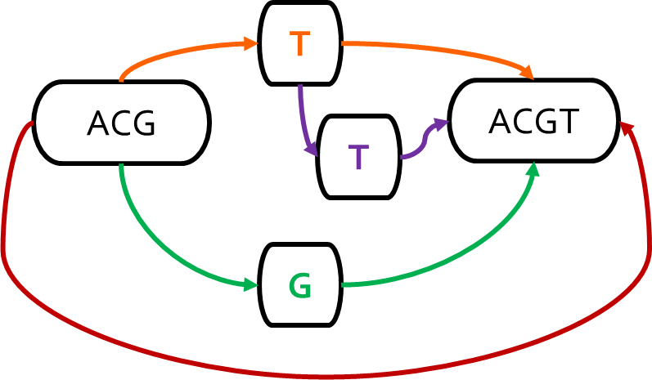
Genome Sequence Analysis
Mapping the reads to a reference genome (i.e., read mapping) is a
critical step in genome sequence analysis
Sequence-to-Sequence (S2S) Mapping
Sequence-to-Graph (S2G) Mapping
Linear Reference: ACGTACGT
Read: ACGG
Alternative Sequence: ACGGACGT
Alternative Sequence: ACGTTACGT
Alternative Sequence: ACG‒ACGT
Graph-based Reference:
Read: ACGG
Sequence-to-graph mapping results in notable quality improvements.
However, it is a more difficult computational problem,
with no prior hardware design.
Notes:
Read mapping, which is the process of mapping the reads to a reference genome is a critical step in genome sequence analysis
Traditionally, we perform seq2seq mapping, where we
Map reads collected from an individual to a known linear reference genome sequence
Emphasizes the genetic variations that are present in the single reference genome
Ignores other variations that are not represented in the single linear reference sequence
Introduces reference bias
However, s2s mapping is a well studied problem with many available tools and accelerators
Recent works replace the linear reference sequence with a graph-based representation of the reference genome (genome graph). Thus, we can perform seq2graph mapping.
Captures the genetic variations and diversity across many individuals in a population
[CLICK] Results in notable quality improvements in GSA

Slide 163
SeGraM: First Graph Mapping Accelerator
Our Goal:
Specialized, high-performance, scalable, and low-cost algorithm/hardware co-design that alleviates bottlenecks in multiple steps of sequence-to-graph mapping
SeGraM: First universal algorithm/hardware co-designed genomic mapping accelerator that can effectively and efficiently support:
Sequence-to-graph mapping
Sequence-to-sequence mapping
Both short and long reads
Notes:
[CLICK] Thus, our goal is to come up with a specialized, high-performance, scalable, and low-cost algorithm/hardware co-design that alleviates bottlenecks in both the seeding and alignment steps of sequence-to-graph mapping.
[CLICK] To this end, we propose SeGraM, a universal algorithm/hardware co-designed genomic mapping accelerator that can effectively and efficiently support both sequence-to-graph mapping and sequence-to-sequence mapping, for both short and long reads. To our knowledge, SeGraM is the first algorithm/hardware co-design for accelerating
sequence-to-graph mapping.

Slide 164
Use Cases & Key Results
Sequence-to-Graph (S2G) Mapping
5.9×/106× speedup, 4.1×/3.0× less power than GraphAligner
for long and short reads, respectively (state-of-the-art SW)
3.9×/742× speedup, 4.4×/3.2× less power than vg
for long and short reads, respectively (state-of-the-art SW)
Sequence-to-Graph (S2G) Alignment
41×–539× speedup over PaSGAL with AVX-512 support (state-of-the-art SW)
Sequence-to-Sequence (S2S) Alignment
1.2×/4.8× higher throughput than GenASM and GACT of Darwin
for long reads (state-of-the-art HW)
1.3×/2.4× higher throughput than GenASM and SillaX of GenAX
for short reads (state-of-the-art HW)
Notes:
[CLICK] [CLICK] [CLICK] We demonstrate that SeGraM provides significant improvements for multiple steps of the sequence-to-graph (i.e., S2G) and sequence-to-sequence (i.e., S2S) mapping pipelines.
==================================================================================================================
[CLICK] We show that (1) SeGraM provides greatly higher throughput and lower power consumption on both short and long reads compared to state-of-the-art software tools for sequence-to-graph mapping, and
[CLICK] (2) BitAlign significantly outperforms a state-of-the-art sequence-to-graph alignment tool and [CLICK] three state-of-the-art hardware solutions that are specifically designed for sequence-to-sequence alignment.
===========================================================================================================
We also show that MinSeed can be employed for the seeding step of both sequence-to-graph and sequence-to-sequence mapping pipelines.

Slide 165
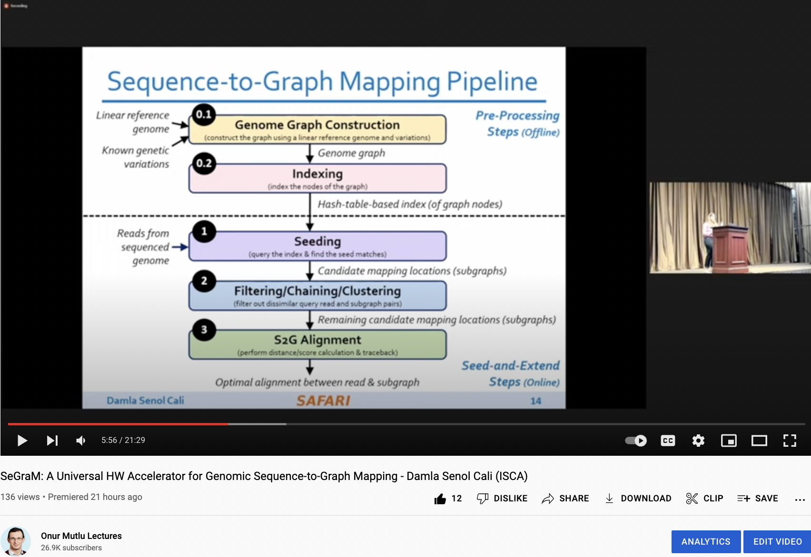
SeGraM Talk Video
https://www.youtube.com/watch?v=gyjqYoyDP9s

Slide 166
Genome Graphs
Genome graphs:
Combine the linear reference genome with the known genetic variations in the entire population as a graph-based data structure
Enable us to move away from aligning with a single linear reference genome (reference bias) and more accurately express the genetic diversity in a population
T
Sequence #1: ACGTACGT
Sequence #2: ACGGACGT
Sequence #3: ACGTTACGT
Sequence #4: ACGACGT
ACG
ACGT
T
G
Notes:
With increasing importance and usage of genome graphs, having accurate and efficient tools for mapping genomic sequences to these genome graphs has become crucial. [CLICK]

Slide 167
Sequence-to-Graph Mapping Pipeline
0.1
Pre-Processing
Steps (Offline)
Seed-and-Extend
Steps (Online)
Linear reference genome
Known genetic variations
Genome Graph Construction
(construct the graph using a linear reference genome and variations)
Genome graph
0.2
Indexing
(index the nodes of the graph)
Hash-table-based index (of graph nodes)
Reads from sequenced
genome
1
Seeding
(query the index & find the seed matches)
Candidate mapping locations (subgraphs)
2
Filtering/Chaining/Clustering
(filter out dissimilar query read and subgraph pairs)
Remaining candidate mapping locations (subgraphs)
3
S2G Alignment
(perform distance/score calculation & traceback)
Optimal alignment between read & subgraph
Notes:
Which brings us to seq2graph mapping.
Sequence-to-graph mapping pipeline has [CLICK] two pre-processing and [CLICK] three main steps.
[CLICK] The first pre-processing step constructs the genome graph using a linear reference genome and the associated variations for that genome.
[CLICK] The second pre-processing step indexes the nodes of the graph. The resulting index is used in the first main step of the pipeline, [CLICK] seeding, which aims to find seed matches between the query read and a region of the graph.
[CLICK] After optionally filtering these seed matches with a filtering, chaining, or clustering step, [CLICK] alignment is performed between all of the non-filtered seed locations within the graph and the query read to find the optimal alignment. Alignment is the most expensive step of the pipeline, so let’s look at it in detail.

Slide 168
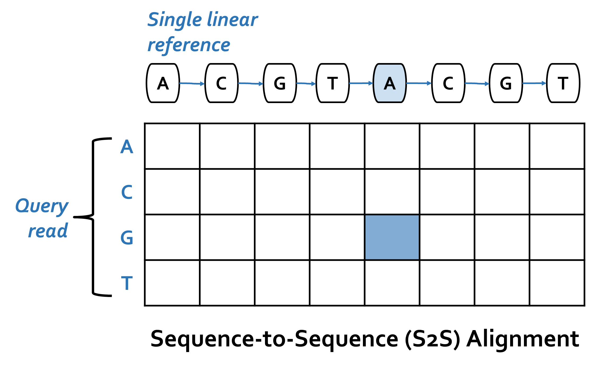
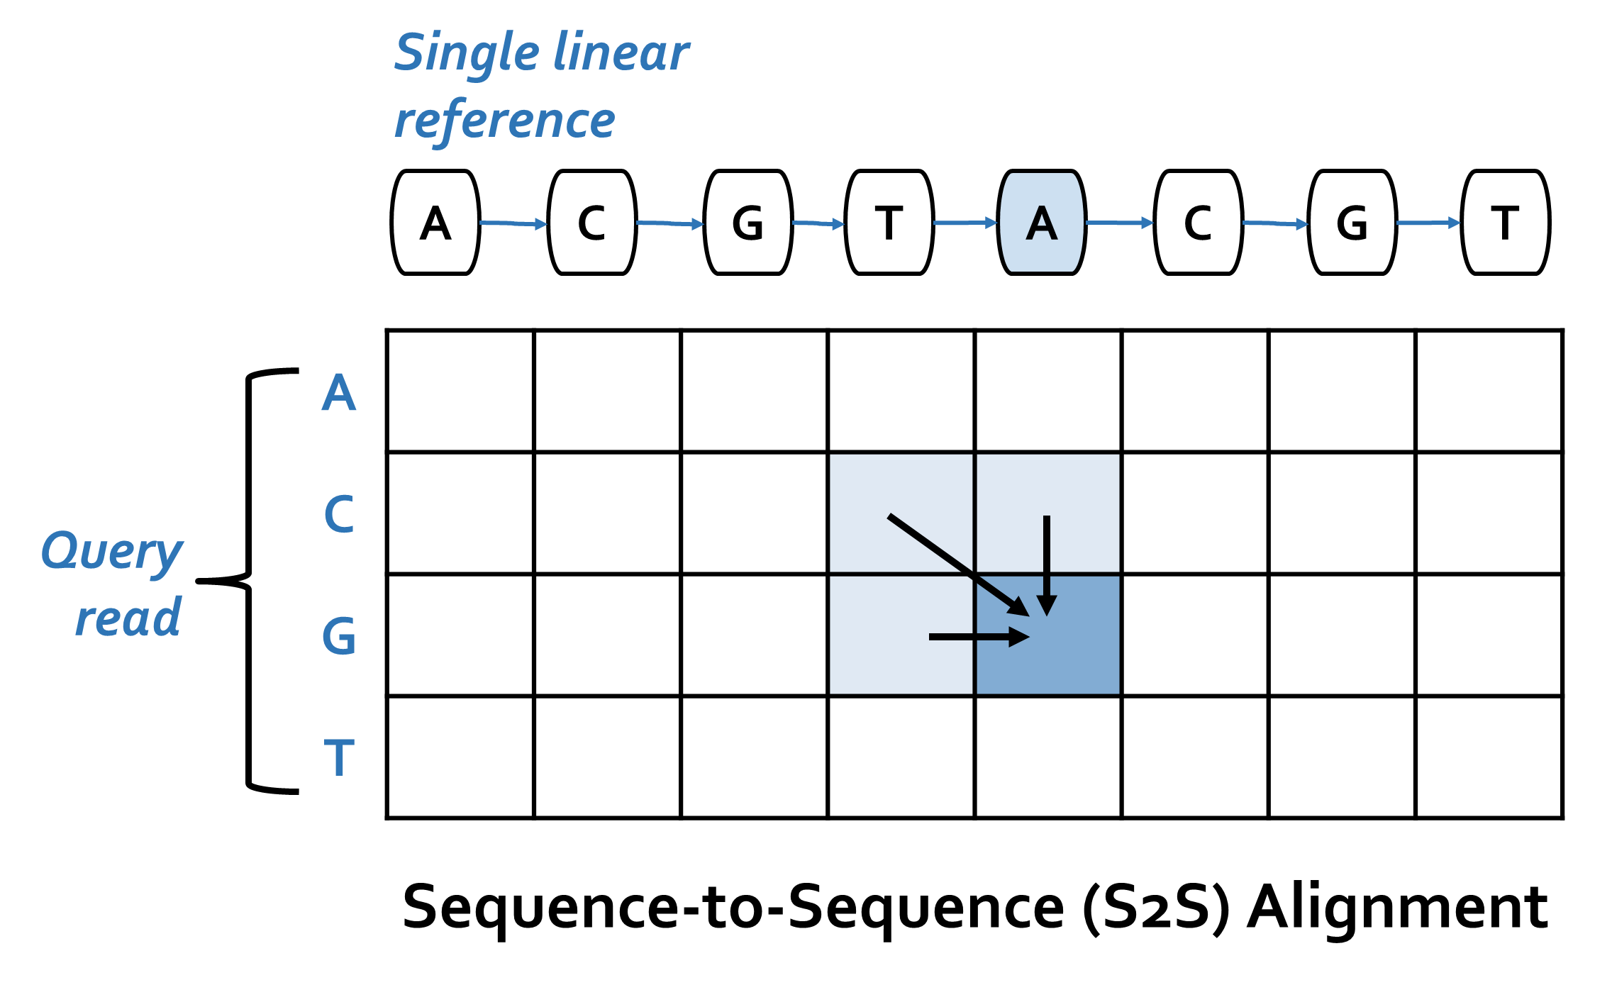
S2S vs. S2G Alignment
Notes:
[CLICK] Traditional sequence-to-sequence (S2S) alignment typically employs DP-based algorithms with quadratic time and space complexity.
A DP-based algorithm operates on a table, where each column of the table corresponds to a reference character, and each row of the table corresponds to a query read character.
[HIGHLIGHT] In S2S alignment, a new cell in the table is determined with simple rules from 3 of its neighbor cells.

Slide 169
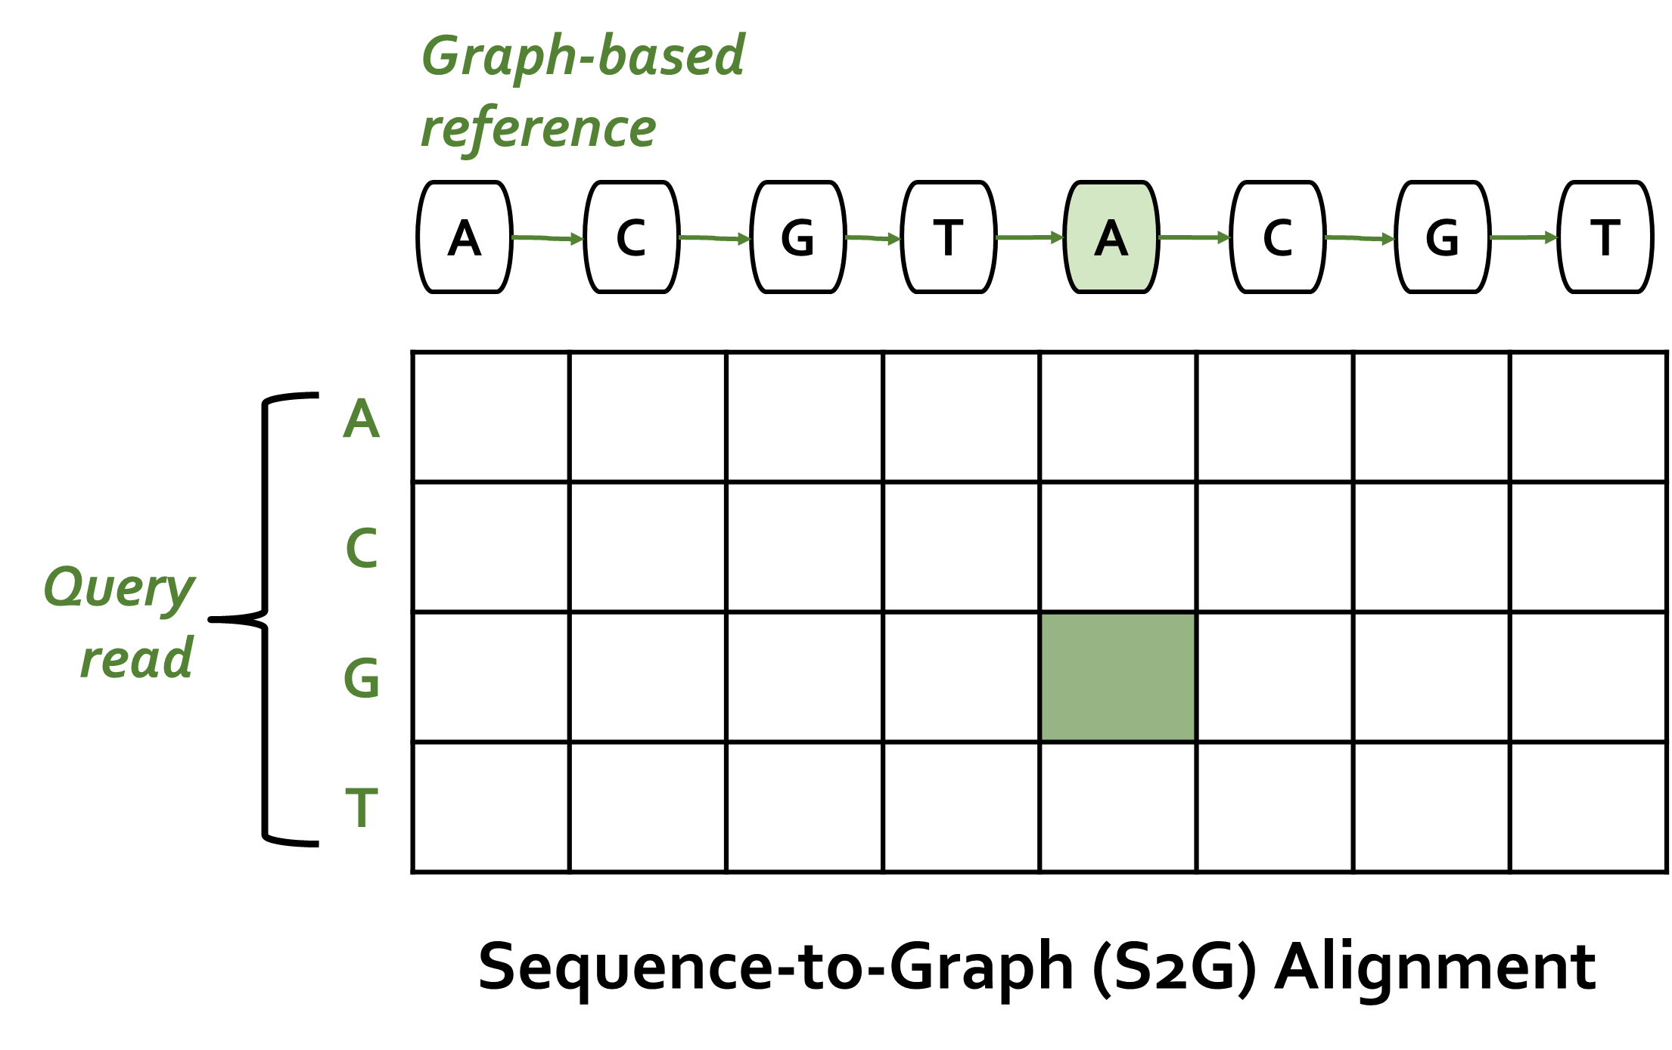
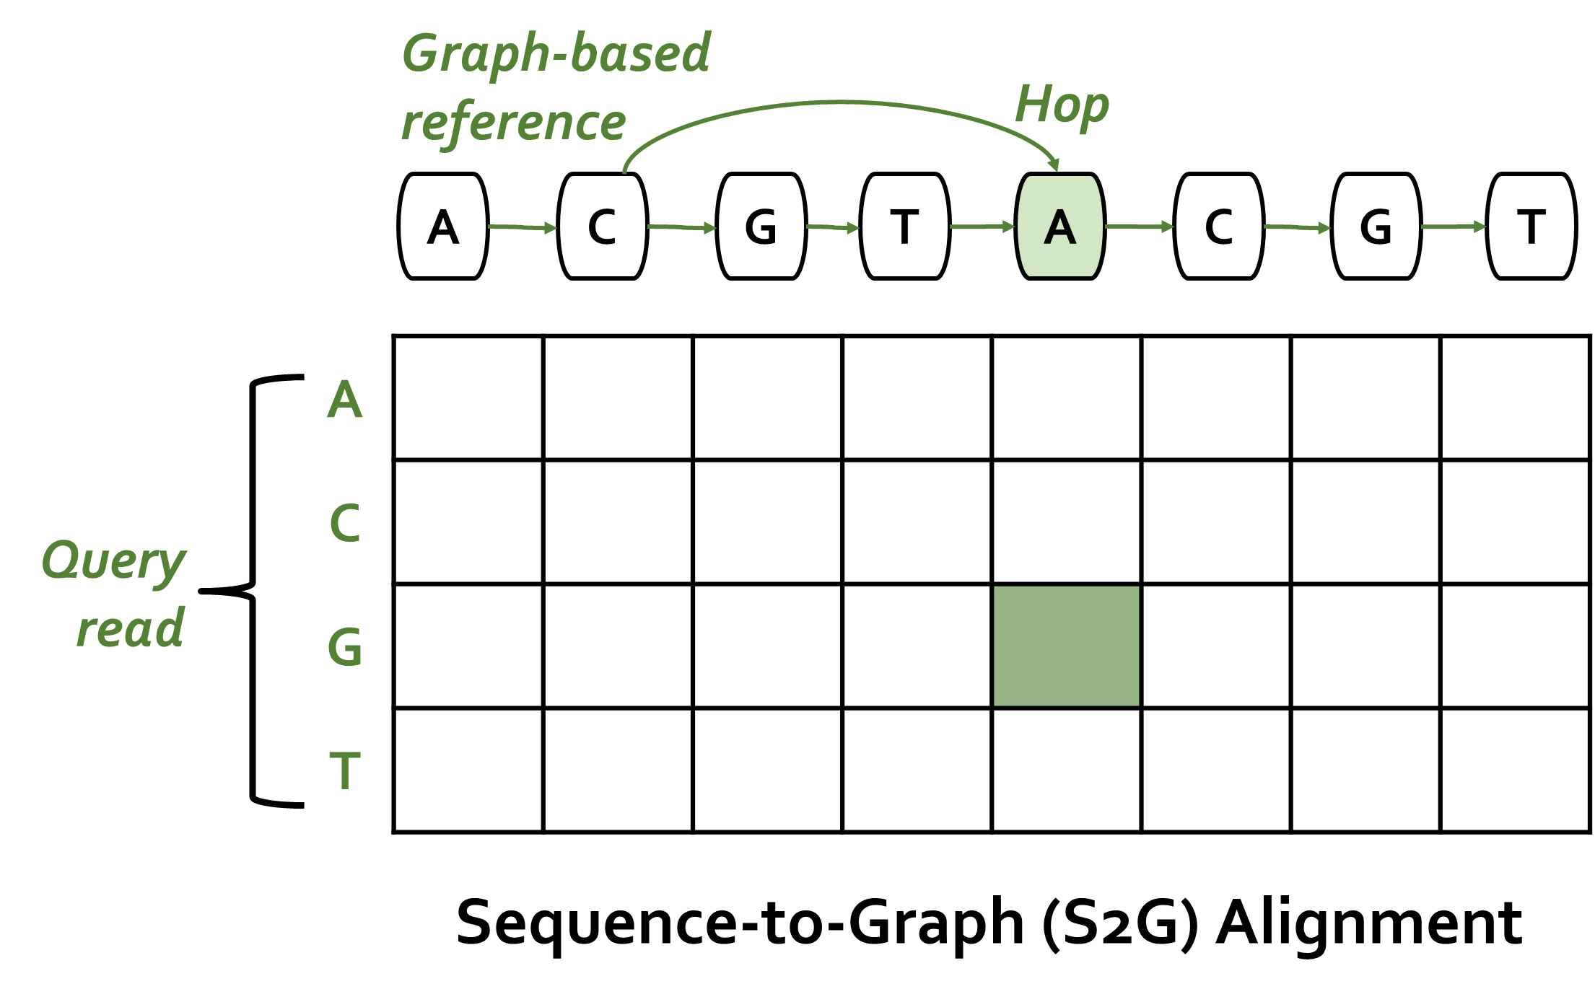
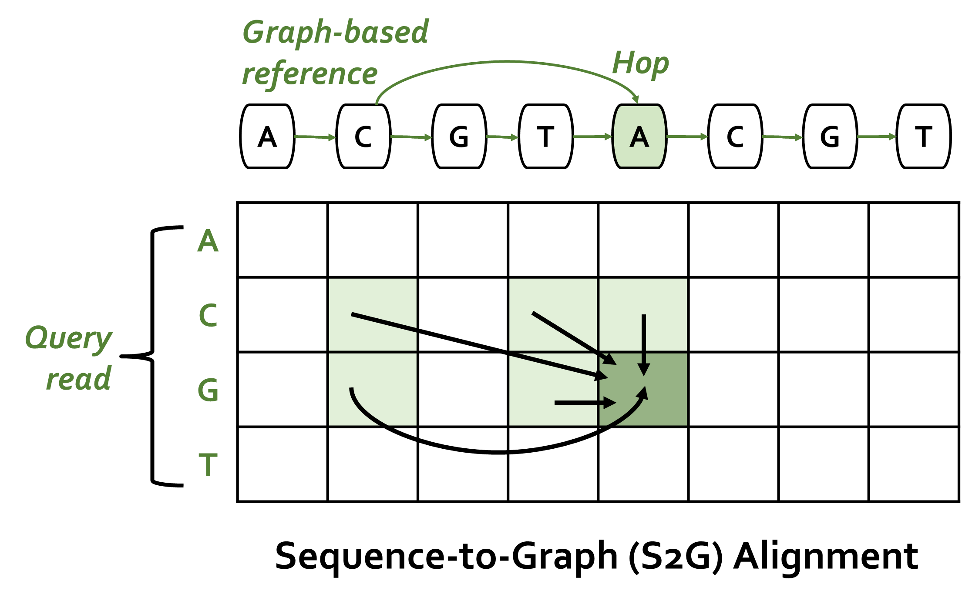
S2S vs. S2G Alignment
In contrast to S2S alignment,
S2G alignment must incorporate non-neighboring characters
as well whenever there is an edge (i.e., hop)
from the non-neighboring character to the current character
Notes:
[CLICK] In contrast to S2S alignment, S2G alignment must incorporate non-neighboring characters as well whenever there is an edge (i.e., hop) from the non-neighboring character to the current character. [HIGHLIGHT] For example, when computing the green-shaded cell, we need information from all of the light green-shaded cells.
=======================================================================================================
Even though sequence-to-sequence mapping is a well-studied problem, given the additional complexities and overheads of processing a genome graph instead of a linear reference genome, sequence-to-graph mapping is a more difficult computational problem with a smaller number of practical software tools currently available.

Slide 170
Analysis of State-of-the-Art Tools
SW
Based on our analysis with GraphAligner and vg:
Observation 1: Alignment step is the bottleneck
Observation 2: Alignment suffers from high cache miss rates
Observation 3: Seeding suffers from the DRAM latency bottleneck
Observation 4: Baseline tools scale sublinearly
Observation 5: Existing S2S mapping accelerators are unsuitable
for the S2G mapping problem
Observation 6: Existing graph accelerators are unable to handle
S2G alignment
HW
Notes:
In order to further understand the performance bottlenecks of the state-of-the-art sequence-to-graph mapping tools, we rigorously analyze two such tools, GraphAligner [61] and vg [36], and we make four key observations.
[CLICK] (1) Among the three online steps of the read mapping pipeline alignment i) constitutes majority of the end-to-end execution of sequence-to-graph mapping, and ii) is even more expensive than its counterpart in the traditional read mapping pipeline.
[CLICK] (2) Alignment suffers from high cache miss rates, due to the high amount of internal data that is generated and reused during this step.
[CLICK} (3) Seeding suffers from the main memory (DRAM) latency bottleneck, due to the high number of irregular memory accesses.
[CLICK] (4) Both state-of-the-art tools scale sublinearly as thread count increases, wasting available thread-level parallelism in hardware.
[CLICK] We also investigate the existing HW accelerators. It is important to note that there is no existing hardware accelerator for sequence-to-graph mapping or alignment problems.
[CLICK] Even though there are several hardware accelerators designed to alleviate bottlenecks in several steps of traditional sequence-to-sequence (S2S) mapping, none of these
designs can be directly employed for the sequence-to-graph (S2G) mapping problem. This is because S2S mapping is a special case of S2G mapping, where all nodes have only one incoming edge. Existing accelerators are limited to only this special case, and are unsuitable for the more general S2G mapping problem, where we also need to consider multiple edges (i.e., hops) that a node can have.
[CLICK] We also look at the possibility of exploiting existing several graph accelerators. While existing graph accelerators could potentially be customized to help the seeding step of the sequence-to-graph mapping pipeline, they are unable to handle the major bottleneck of sequence-to-graph mapping, which is alignment. Alignment is not a graph traversal workload, and instead is an expensive bitvector-based or DP-based computational problem.
Thus, we need to have a specialized, balanced, and scalable design for compute units, on-chip memory, and main memory accesses for both the seeding and alignment steps of sequence-to-graph mapping.

Slide 171
SeGraM: Universal Genomic Mapping Accelerator
First universal genomic mapping accelerator that can support both sequence-to-graph mapping and sequence-to-sequence mapping, for both short and long reads
First algorithm/hardware co-design for accelerating
sequence-to-graph mapping
We base SeGraM upon a minimizer-based seeding algorithm
We propose a novel bitvector-based alignment algorithm to perform approximate string matching between a read and a graph-based reference genome
We co-design both algorithms with high-performance, scalable, and efficient hardware accelerators
SW
HW
Notes:
[CLICK] the first universal genomic mapping accelerator that can support both sequence-to-graph mapping and sequence-to-sequence mapping, for both short and
long reads.
[CLICK] To our knowledge, SeGraM is the first algorithm/hardware co-design for accelerating sequence-to-graph mapping.
[CLICK] We base SeGraM upon a minimizer-based seeding algorithm and we propose a novel bitvector-based alignment algorithm for sequence-to-graph alignment.
[CLICK] these cover the algorithmic contributions of SeGraM
[CLICK] We co-design both algorithms with high-performance, scalable, and efficient hardware accelerators.
[CLICK] and this covers the hardware-level contributions of SeGraM

Slide 172
SeGraM Hardware Design
Main Memory (graph-based reference & index)
SeGraM Accelerator
MinSeed (MS)
BitAlign (BA)
MinSeed (MS)
BitAlign (BA)
Minimizer Scratchpad
Seed Scratchpad
Input Scratchpad
Minimizer Scratchpad
Seed Scratchpad
Input Scratchpad
Generate Bitvectors
Hop Queues
Generate Bitvectors
Hop Queues
Find Minimizers
Filter
Minimizers by Frequency
Find Candidate
Seed Regions
Find Minimizers
Filter
Frequencies by Frequency
Find Candidate
Seed Regions
Bitvector Scratchpad
Bitvector Scratchpad
Host CPU
Read
Scratchpad
Perform
Traceback
Read
Scratchpad
Perform
Traceback
MinSeed: first hardware
accelerator for
Minimizer-based Seeding
BitAlign: first hardware accelerator for (Bitvector-based) sequence-to-graph Alignment
Notes:
A SeGraM accelerator consists of two main components:
[CLICK] MinSeed (MS), which is responsible for the seeding step and it is the first hardware accelerator for minimizer-based seeding, and second component is
[CLICK] (2) BitAlign (BA), which is responsible for the alignment step and it is the first hardware accelerator for sequence-to-graph alignment.

Slide 173
SeGraM Hardware Design
Main Memory (graph-based reference & index)
Main Memory (graph-based reference & index)
frequencies
seed locations
graph nodes
3
5
7
SeGraM Accelerator
MinSeed (MS)
BitAlign (BA)
Minimizer Scratchpad
Seed Scratchpad
Input Scratchpad
8
Generate Bitvectors
Hop Queues
9
minimizers
2
4
6
Find Minimizers
Filter
Minimizers by Frequency
Find Candidate
Seed Regions
10
Bitvector Scratchpad
query k-mers
Host CPU
Host CPU
11
1
Read
Scratchpad
Perform
Traceback
query
read
optimal alignment information
12
MinSeed: first hardware
accelerator for
Minimizer-based Seeding
BitAlign: first hardware accelerator for (Bitvector-based) sequence-to-graph Alignment
Notes:
Let’s look at the overview of our hardware design.
[CLICK] Before SeGraM execution starts, as pre-processing steps, we (1) generate each chromosome’s graph structure, (2) index each graph’s nodes, and (3) pre-load both the resulting graph and hash table index into the main memory. Both the graph and its index are static data structures that can be generated only once and reused for multiple mapping executions.
[CLICK] SeGraM execution starts when the query read is streamed from the host and MinSeed writes it to the read scratchpad ( 1 ).
[CLICK] Using all of the k-length subsequences (i.e., k-mers) of the query read, [CLICK] MinSeed finds the minimum representative set of these k-mers (i.e., minimizers) according to a scoring mechanism and [CLICK] writes them to the minimizer scratchpad ( 2 ).
[CLICK] For each minimizer, MinSeed fetches its occurrence frequency from the hash table in main memory ( 3 ) and [CLICK] filters out each minimizer whose occurrence frequency is above a user-defined threshold ( 4 ). We aim to select the least frequent minimizers and filter out the most frequent minimizers such that we minimize the number of seed locations to be considered for the expensive alignment step.
[CLICK] Next, MinSeed fetches the seed locations of the remaining minimizers from main memory, and writes them to the seed scratchpad ( 5 ).
[CLICK] Finally, MinSeed calculates the candidate reference region (i.e., subgraph surrounding the seed) for each seed ( 6 ), [CLICK] fetches the graph nodes from memory for each candidate region in the reference and writes the nodes to the input scratchpad of BitAlign. ( 7 ).
[CLICK] BitAlign starts by reading the subgraph and the query read from the input scratchpad, and generates the bitvectors ( 8 ) required for performing approximate string matching and edit distance calculation.
While generating these bitvectors, [CLICK] BitAlign writes them to the hop queues ( 9 ) in order to handle the hops required for graph-based alignment, and also, [CLICK] to the bitvector scratchpad ( 10 ) to be later used as part of the traceback operation.
Once BitAlign finishes generating and writing all the bitvectors, [CLICK] it starts reading them back from the bitvector scratchpad, performs the traceback operation ( 11 ), finds the optimal alignment between the subgraph and the query read, and [CLICK] streams the optimal alignment information back to the host ( 12 ).

Slide 174

Overall System Design of SeGraM
High Bandwidth Memory (HBM2E) Stack
High Bandwidth Memory (HBM2E) Stack
. . .
CH1
. . .
CH0
CH2
CH6
CH7
SeGraM Module (1 x per HBM2E stack)
Host
SeGraM Module (1 x per HBM2E stack)
Host
MS
MS
MS
MS
MS
X
4
. . .
BA
BA
BA
BA
BA
SeGraM
Acc.
SeGraM
Acc.
SeGraM
Acc.
SeGraM
Acc.
SeGraM
Acc.
Notes:
[CLICK] SeGraM is connected to a host system that is responsible for the pre-processing steps and for transferring the query read to the accelerator.
[CLICK] Next to each HBM2E channel, we place one SeGraM accelerator, such that it will have exclusive access without any interference from other SeGraM accelerators.
[CLICK] Each SeGraM accelerator is a combination of one MinSeed accelerator and one BitAlign accelerator.
[CLICK] Each HBM2E stack has eight memory channels, thus connected to 8 SeGraM accelerators, which define one SeGraM module.
[CLICK] Our hardware platform includes four off-chip HBM2E stacks, thus 4 SeGraM modules, thus 32 SeGraM accelerators in total. ====================================================================================================================
Each SeGraM accelerator has exclusive access to one HBM2E channel to ensure low-latency memory access, without any interference from other SeGraM accelerators in each module.
There is no communication required between different SeGraM accelerators in a single SeGraM module, and each SeGraM accelerator communicates with the host independently of other SeGraM accelerators.
[CLICK] We replicate the graph-based reference and hash-table-based index across all 4 independent HBM2E stacks, which enables us to have 32 independent SeGraM accelerators running in parallel.
[CLICK] Within each stack, to balance the memory footprint across all channels, we distribute the graph and index structures of all chromosomes (1–22, X, Y) based on their sizes across the eight independent channels
[CLICK] We design each SeGraM accelerator (MinSeed + BitAlign) to operate in a pipelined fashion and we employ double buffering technique for all MS scratchpads, such that we can hide the latency of the MinSeed accelerator.

Slide 175
Use Cases of SeGraM
(1) Sequence-to-Graph
Mapping
(2) Sequence-to-Graph
Alignment
(3) Sequence-to-Sequence
Alignment
(4) Seeding
MS
BA
MS or
Other
BA
MS or
Other
BA
MS
BA or
Other
Notes:
As a result of the flexibility and modularity of the SeGraM framework, we can run each accelerator together or separately. Thus, we describe four use cases of SeGraM: [CLICK] (1) end-to-end mapping w/ SeGraM, [CLICK] (2) standalone s2g alignment w/ BitAlign and can be coupled with any seeding tool or accelerator, [CLICK] (3) similarly, standalone s2s alignment w/ BitAlign, and [CLICK] (4) standalone seeding for both s2g and s2s w/ MinSeed and can be coupled with any alignment tool or accelerator.
=========================================================================================================
[CLICK] For sequence-to-graph mapping, the whole SeGraM design (MinSeed + BitAlign) should be employed, since both seeding and alignment steps are required. With the help of the divide-and-conquer approach inherited from the GenASM algorithm, we can use SeGraM to perform sequence-to-graph mapping for both short reads and long reads.
[CLICK] Since BitAlign takes in a graph-based reference and a query read as its inputs, it can be used as a standalone sequence-to-graph aligner, without MinSeed. BitAlign is orthogonal to and can be coupled with any seeding (or filtering) tool/accelerator.
[CLICK] BitAlign can also be used for sequence-to-sequence alignment, as sequence-to-sequence alignment is a special and simpler variant of sequence-to-graph alignment. [CLICK] Similarly, MinSeed can be used without BitAlign as a standalone seeding accelerator for both graph-based mapping and traditional linear mapping. MinSeed is orthogonal to and can be coupled with any alignment tool or accelerator.

Slide 176
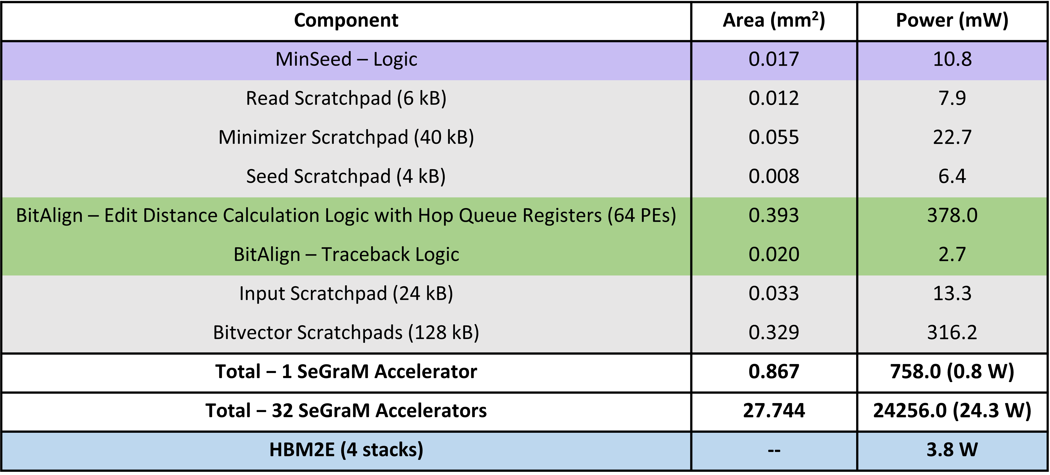
Key Results – Area & Power
Based on our synthesis of MinSeed and BitAlign accelerator datapaths using the Synopsys Design Compiler with a 28nm process (@ 1GHz):
Notes:
Based on our synthesis of MinSeed and BitAlign accelerator datapaths, [CLICK] total area overhead of SeGraM attached to all 32 channels is around 28mm2 and the total power consumption is around 28 W, including the HBM power.
[CLICK] We find that the main contributors for the area overhead and power consumption are (1) hopQueueRegisters since they constitute more than 60% of the area and power of BitAlign logic, and (2) the bitvector scratchpads.

Slide 177
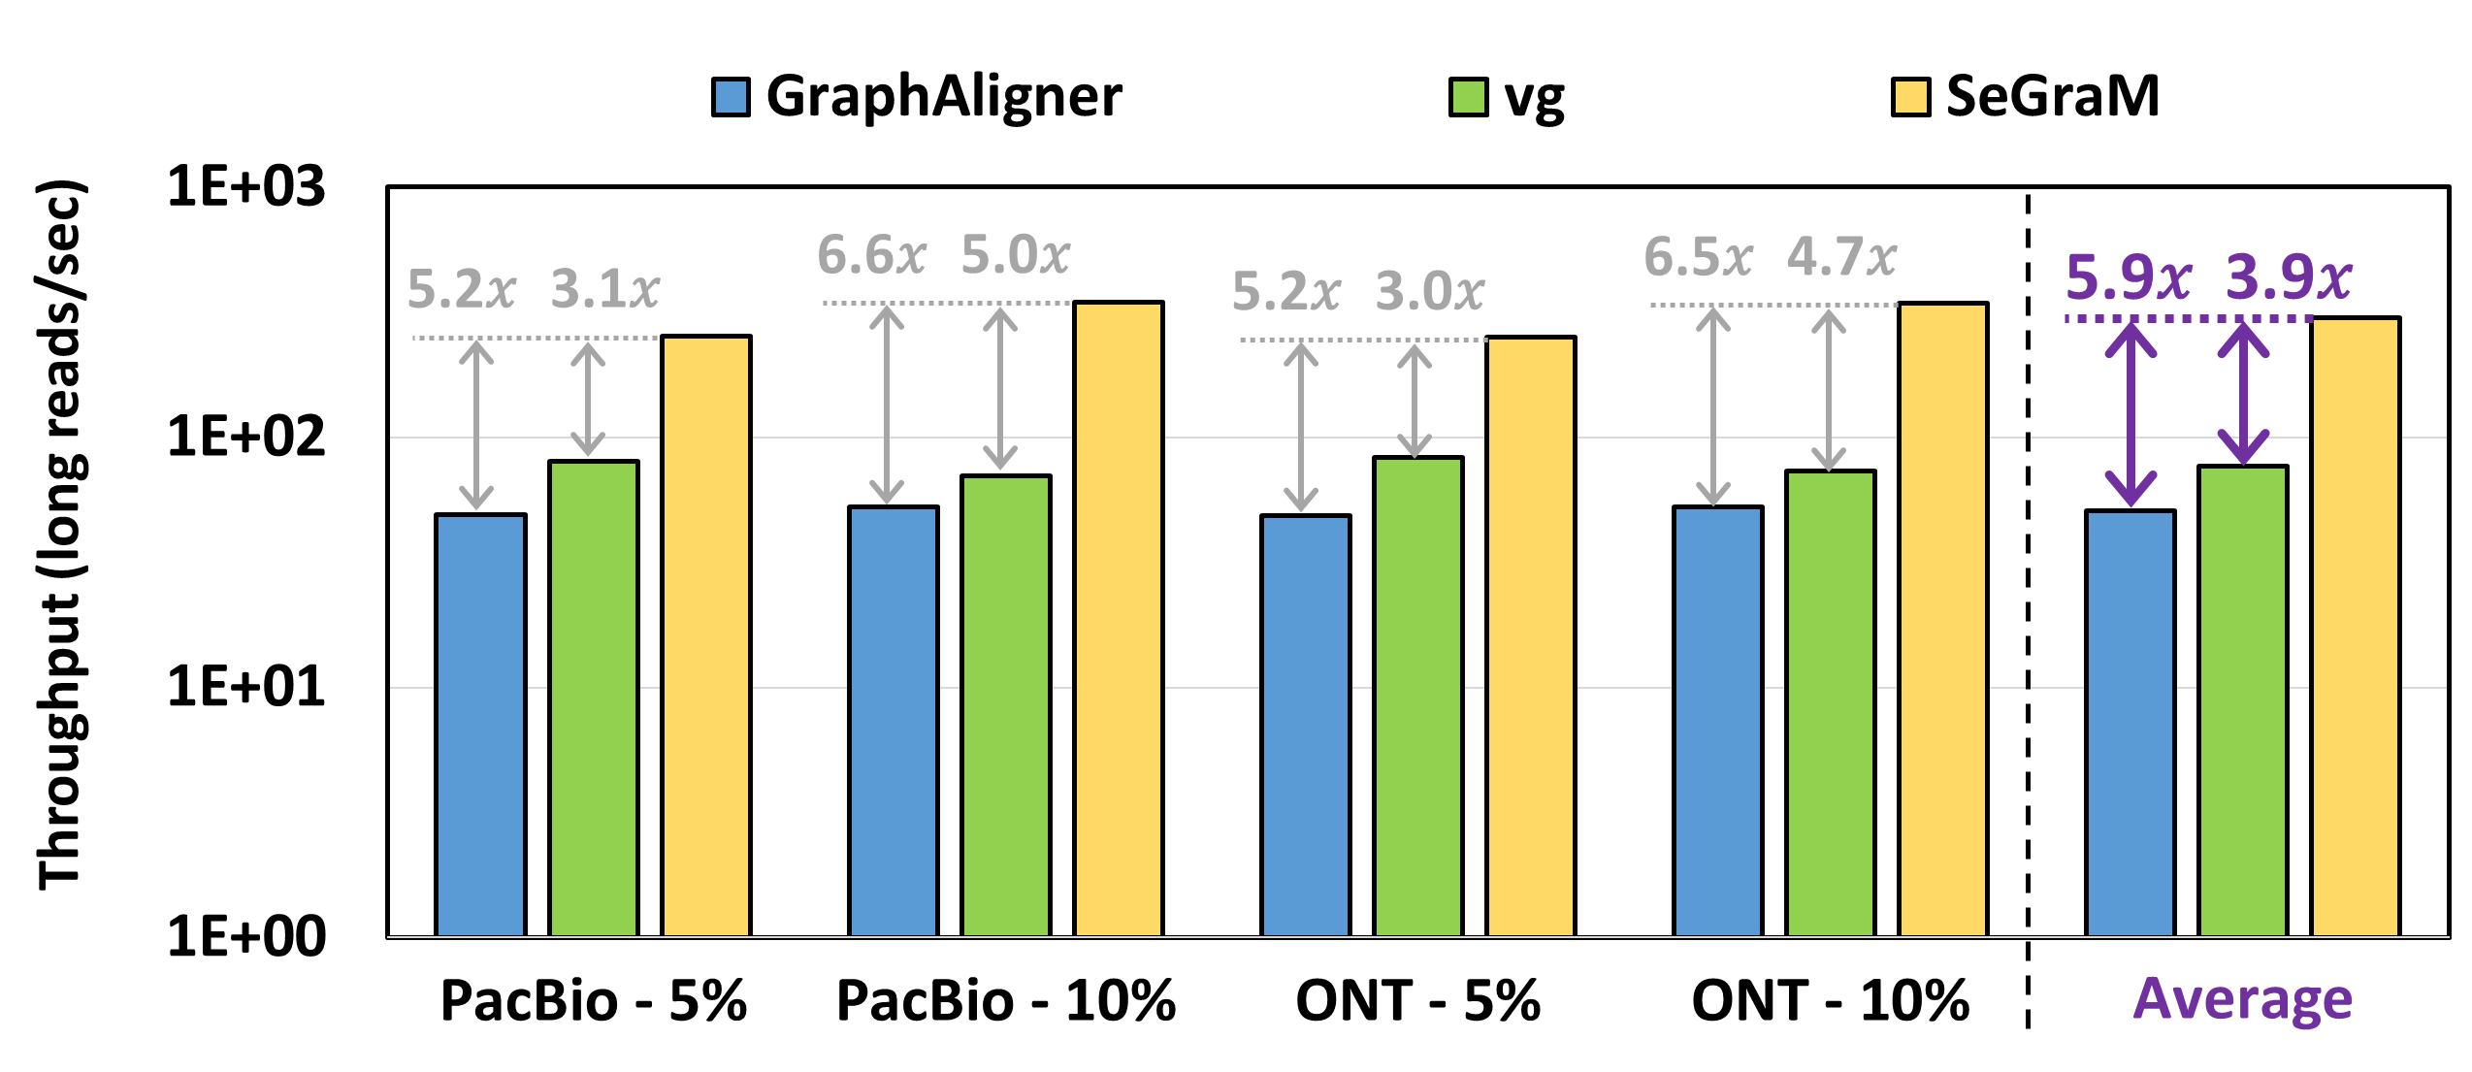
Key Results – SeGraM with Long Reads
  SeGraM provides 5.9× and 3.9× throughput improvement over GraphAligner and vg,
  while reducing the power consumption by 4.1× and 4.4×
Notes:
Let’s look at our long read analysis for s2g mapping with SeGraM. Here we only show our throughput numbers in the plot, not the power numbers.
Compared to two state-of-the-art s2g mapping software tools, GraphAligner and vg, we find that [CLICK]

Slide 178
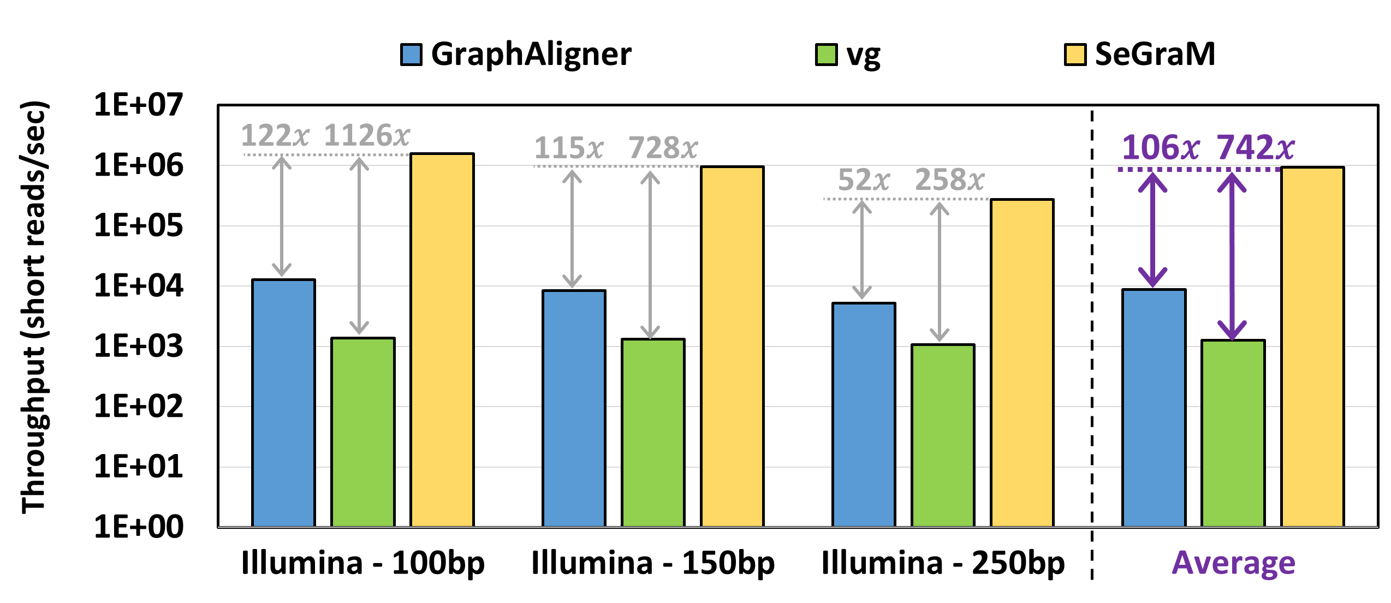
Key Results – SeGraM with Short Reads
  SeGraM provides 106× and 742× throughput improvement over GraphAligner and vg,
  while reducing the power consumption by 3.0× and 3.2×
Notes:
and when we look at our short read analysis, we find that [CLICK][CLICK]

Slide 179
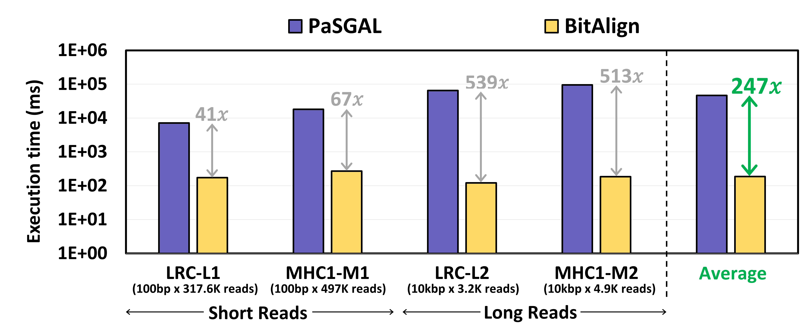
Key Results – BitAlign (S2G Alignment)
  BitAlign provides 41×-539× speedup over PaSGAL
Notes:
Let’s look at the key results for the sequence-to-graph alignment module of SeGraM, which is BitAlign.

Slide 180
Key Results – BitAlign (S2S Alignment)
BitAlign can also be used for sequence-to-sequence alignment
  The cost of more functionality: extra hop queue registers
  We do not sacrifice any performance
For long reads (over GACT of Darwin and GenASM):
  4.8× and 1.2× throughput improvement,
  2.7× and 7.5× higher power consumption, and
  1.5× and 2.6× higher area overhead
For short reads (over SillaX of GenAx and GenASM):
  2.4× and 1.3× throughput improvement
Notes:
GACT of Darwin is optimized for long reads, SillaX of GenAx is optimized for short reads, and GenASM is optimized for both short and long reads.
We use the optimum configuration of each accelerator reported in their corresponding papers.

Slide 181
Conclusion
SeGraM: First universal algorithm/hardware co-designed genomic mapping accelerator that supports:
    Sequence-to-graph (S2G) & sequence-to-sequence (S2S) mapping
    Short & long reads
  MinSeed: First minimizer-based seeding accelerator
  BitAlign: First (bitvector-based) S2G alignment accelerator
SeGraM supports multiple use cases:
  End-to-end S2G mapping
  S2G alignment
  S2S alignment
  Seeding
SeGraM outperforms state-of-the-art software & hardware solutions
Notes:
[CLICK] To conclude, in this work, we propose SeGraM, the first universal… To our knowledge, SeGraM is also the first alg/hw co-design for accelerating S2G mapping.
[CLICK] SeGraM consists of 2 components: MinSeed … and BitAlign …
[CLICK] SeGraM supports multiple steps of S2G and S2S mapping pipelines, and
[CLICK] Based on our extensive analysis, we show that SeGraM outperforms state-of-the-art SW and HW solutions

Slide 182
SeGraM Talk Video
https://www.youtube.com/watch?v=gyjqYoyDP9s

Slide 183
Year III Results (2022 Annual Review 2)
SeGraM: A Universal Hardware Accelerator for Genomic Sequence-to-Graph and Sequence-to-Sequence Mapping [ISCA 2022]
GenStore: A High-Performance and Energy-Efficient In-Storage Computing System for Genome Sequence Analysis [ASPLOS 2022]
Algorithmic Improvement and GPU Acceleration of the GenASM Algorithm [HICOMB 2022]
Polynesia: Enabling High-Performance and Energy-Efficient Hybrid Transactional/Analytical Databases with Hardware/Software Co-Design [ICDE 2022]
Flash-Cosmos: In-Flash Bitwise Operations Using Inherent Computation Capability of NAND Flash Memory [MICRO 2022]

Slide 184
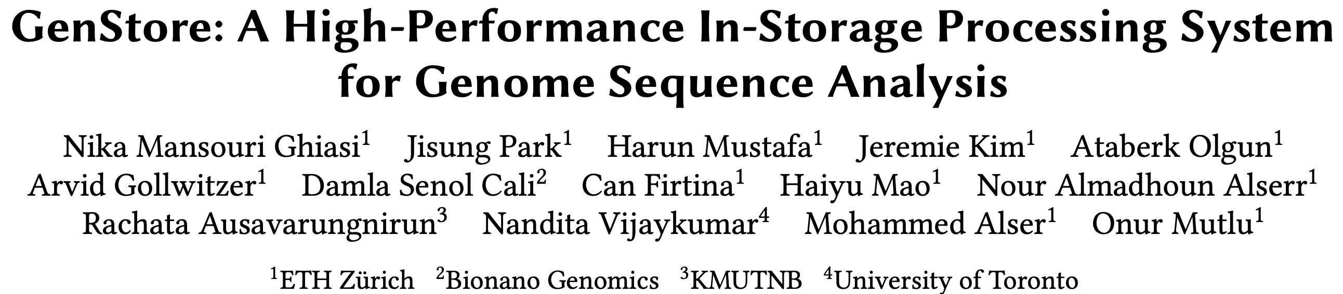
In-Storage Genomic Data Filtering [ASPLOS 2022]
Nika Mansouri Ghiasi, Jisung Park, Harun Mustafa, Jeremie Kim, Ataberk Olgun, Arvid Gollwitzer, Damla Senol Cali, Can Firtina, Haiyu Mao, Nour Almadhoun Alserr, Rachata Ausavarungnirun, Nandita Vijaykumar, Mohammed Alser, and Onur Mutlu,
"GenStore: A High-Performance and Energy-Efficient In-Storage Computing System for Genome Sequence Analysis"
Proceedings of the 27th International Conference on Architectural Support for Programming Languages and Operating Systems (ASPLOS), Virtual, February-March 2022.
[Lightning Talk Slides (pptx) (pdf)]
[Lightning Talk Video (90 seconds)]

Slide 185

Genome Sequence Analysis
Data Movement from Storage
Alignment
Storage
System
Main
Memory
Cache
Computation
Unit
(CPU or Accelerator)
AAGCTTCCATGG
CGTTCCTTGGCA
GGGCCAGAATG
CCTTTGGGTCCA
AAAATTCCATGG
GAATGGGGCCA
TTTTTTCCAAAA
TCCCCGGGGCCA
GCTTCCAGAATG
Computation overhead
Data movement overhead
Notes:
Read mapping performs alignment on large genomic datasets, containing millions of reads. [CLICK]
Therefore, read mapping is both computationally expensive [CLICK]
And incurs high data movement overhead [CLICK]

Slide 186



Accelerating Genome Sequence Analysis
Heuristics
Accelerators
Filters
Storage
System
Main
Memory
Cache
Computation
Unit
(CPU or Accelerator)
AAGCTTCCATGG
CGTTCCTTGGCA
GGGCCAGAATG
CCTTTGGGTCCA
AAAATTCCATGG
GAATGGGGCCA
TTTTTTCCAAAA
TCCCCGGGGCCA
GCTTCCAGAATG
✓
Computation overhead
Data movement overhead
Notes:
There has been significant effort into improving read mapping performance [CLICK]
Through efficient heuristics [CLICK]
hardware accelerators [CLICK]
and various filters that prune reads that do not require expensive computation [CLICK].
While these approaches address the computation overhead in read mapping [CLICK]
[While Reads Move] None of them alleviate the data movement overhead from storage, whose impact becomes even larger when the computation overhead gets alleviated [CLICK]

Slide 187

Key Idea
Filter reads that do not require alignment
inside the storage system
Storage
System
Main
Memory
Cache
Computation
Unit
(CPU or Accelerator)
AAGCTTCCATGG
CGTTCCTTGGCA
GGGCCAGAATG
CCTTTGGGTCCA
AAAATTCCATGG
GAATGGGGCCA
TTTTTTCCAAAA
TCCCCGGGGCCA
GCTTCCAGAATG
Filtered Reads
Exactly-matching reads
Do not need expensive approximate string matching during alignment
Non-matching reads
Do not have potential matching locations and can skip alignment
Notes:
Our key idea is to filter reads that do not require the expensive alignment computation in the storage system [CLICK] …
[While Reads Move] To fundamentally reduce the data movement overhead of read mapping
Examples of the reads that not require the costlt alignment step
Exactly-matching reads to the reference genome that do not need approximate string matching performed during alignment
Non-matching reads that have no potential matching locations in the reference genome hence skip the alignemt step

Slide 188
Challenges
Filter reads that do not require alignment
inside the storage system
Storage
System
Main
Memory
Cache
Computation
Unit
(CPU or Accelerator)
AAGCTTCCATGG
CGTTCCTTGGCA
GGGCCAGAATG
CCTTTGGGTCCA
AAAATTCCATGG
GAATGGGGCCA
TTTTTTCCAAAA
TCCCCGGGGCCA
GCTTCCAGAATG
Filtered Reads
Read mapping workloads can exhibit different behavior
There are limited hardware resources
in the storage system
Notes:
However, filtering reads in a modern SSD can be challenging [CLICK]
Due to different behavior across read mapping workloads. [CLICK]
And the limited hardware resources in the SSD. By addressing these challenges [CLICK]

Slide 189
GenStore
Filter reads that do not require alignment
inside the storage system
GenStore-Enabled
Storage
System
Main
Memory
Cache
Computation
Unit
(CPU or Accelerator)
✓
Computation overhead
✓
Data movement overhead
  GenStore provides significant speedup (1.4x - 33.6x) and
  energy reduction (3.9x – 29.2x) at low cost
Notes:
We propose GenStore, the first in-storage processing system designed for genome sequence analysis. [CLICK]
To reduce both the computation [CLICK]
And the data movement overhead [CLICK]
GenStore provides high-performance and energy benefits compared to state-of-the-art HW and SW baselines [CLICK]

Slide 190
In-Storage Genomic Data Filtering [ASPLOS 2022]
Nika Mansouri Ghiasi, Jisung Park, Harun Mustafa, Jeremie Kim, Ataberk Olgun, Arvid Gollwitzer, Damla Senol Cali, Can Firtina, Haiyu Mao, Nour Almadhoun Alserr, Rachata Ausavarungnirun, Nandita Vijaykumar, Mohammed Alser, and Onur Mutlu,
"GenStore: A High-Performance and Energy-Efficient In-Storage Computing System for Genome Sequence Analysis"
Proceedings of the 27th International Conference on Architectural Support for Programming Languages and Operating Systems (ASPLOS), Virtual, February-March 2022.
[Lightning Talk Slides (pptx) (pdf)]
[Lightning Talk Video (90 seconds)]

Slide 191
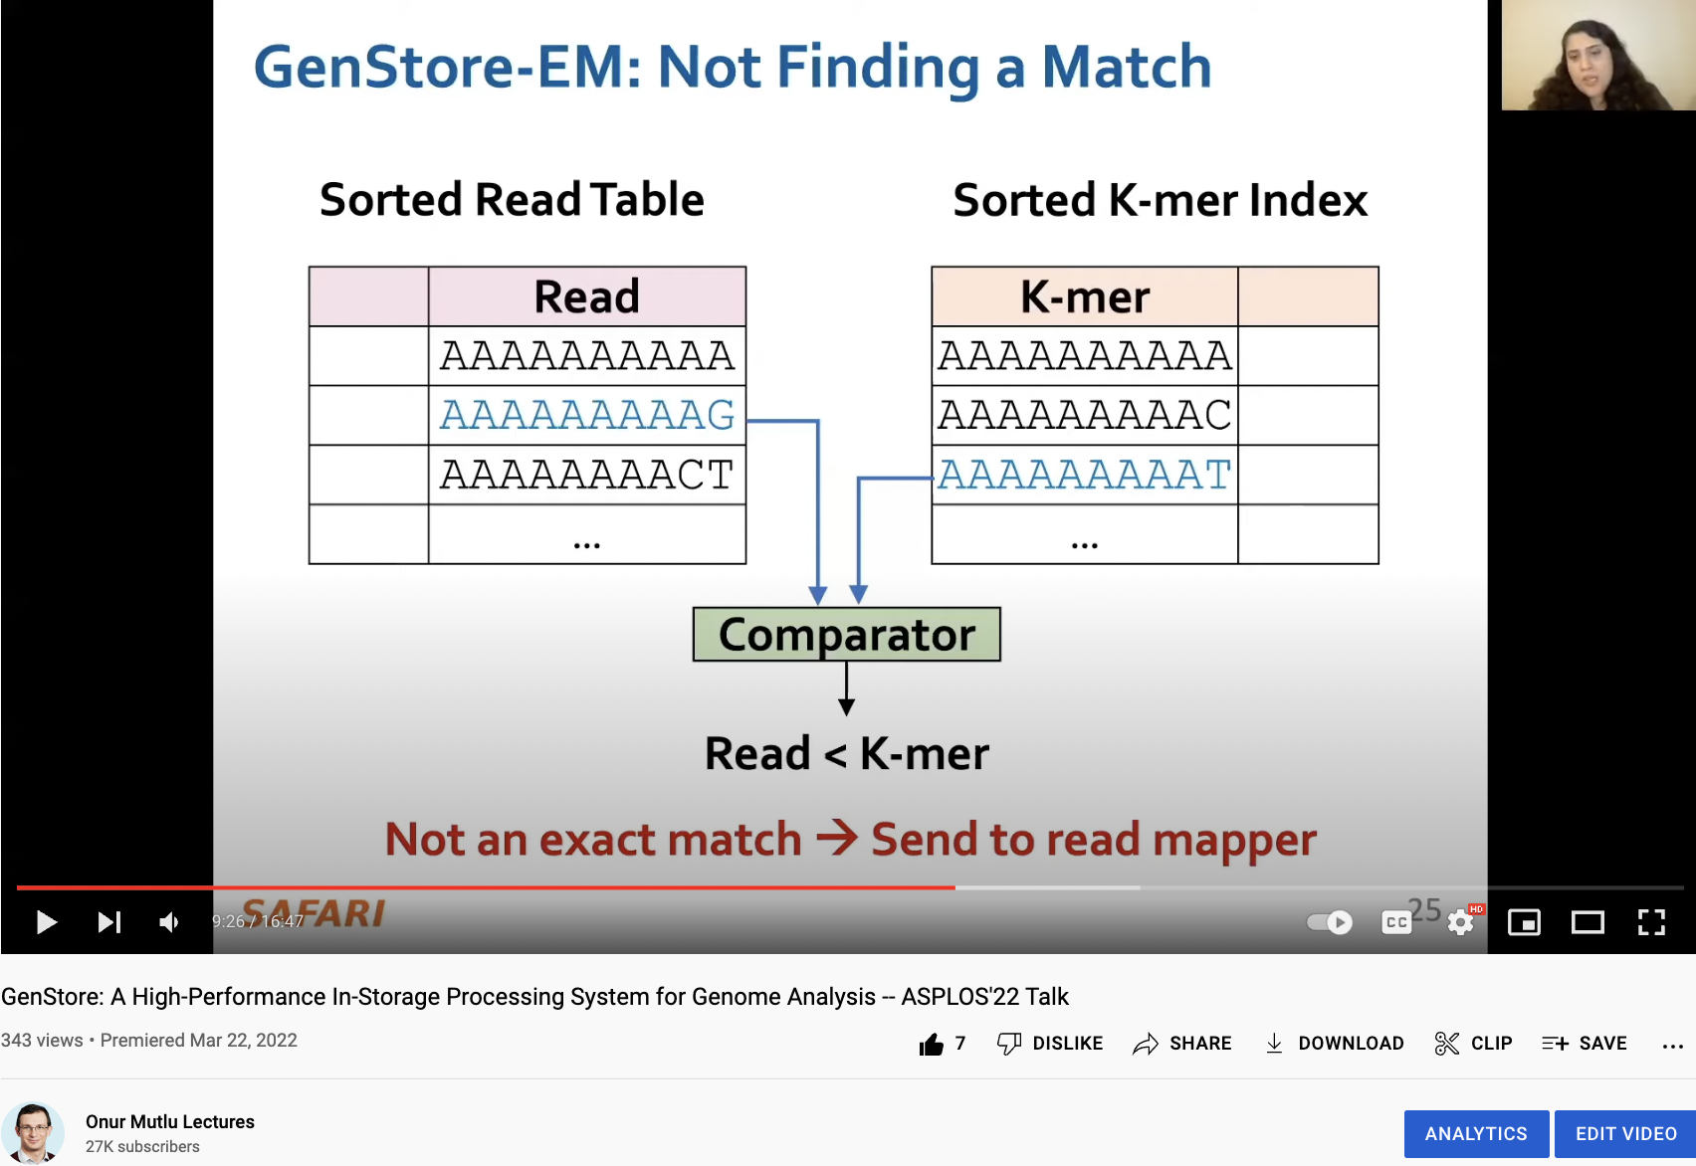
GenStore Talk Video
https://www.youtube.com/watch?v=bv7hgXOOMjk

Slide 192
Year III Results (2022 Annual Review 2)
SeGraM: A Universal Hardware Accelerator for Genomic Sequence-to-Graph and Sequence-to-Sequence Mapping [ISCA 2022]
GenStore: A High-Performance and Energy-Efficient In-Storage Computing System for Genome Sequence Analysis [ASPLOS 2022]
Algorithmic Improvement and GPU Acceleration of the GenASM Algorithm [HICOMB 2022]
Polynesia: Enabling High-Performance and Energy-Efficient Hybrid Transactional/Analytical Databases with Hardware/Software Co-Design [ICDE 2022]
Flash-Cosmos: In-Flash Bitwise Operations Using Inherent Computation Capability of NAND Flash Memory [MICRO 2022]

Slide 193
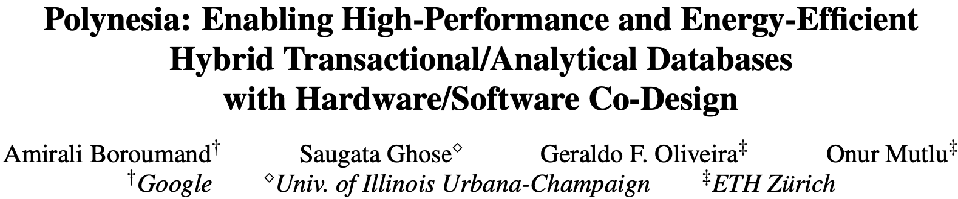
Accelerating HTAP Database Systems
Amirali Boroumand, Saugata Ghose, Geraldo F. Oliveira, and Onur Mutlu,
"Polynesia: Enabling High-Performance and Energy-Efficient Hybrid Transactional/Analytical Databases with Hardware/Software Co-Design"
Proceedings of the 38th International Conference on Data Engineering (ICDE), Virtual, May 2022.
[arXiv version]
[Slides (pptx) (pdf)]
[Short Talk Slides (pptx) (pdf)]
https://arxiv.org/pdf/2204.11275.pdf

Slide 194


Polynesia:
Enabling High-Performance and Energy-Efficient
Hybrid Transactional/Analytical Databases
with Hardware/Software Co-Design
Amirali Boroumand
Saugata Ghose
Geraldo F. Oliveira
Onur Mutlu
ICDE
2022
Notes:
Hi, I’m Geraldo, a PhD student at the SAFARI research group and today I will talk about our work called ”Polynesia: Enabling High-Performance and Energy-Efficient Hybrid Transactional/Analytical Databases with Hardware/Software Co-Design.”
This work was led by Amirali Boroumand, whom is now at Google.
[NEXT]

Slide 195
Executive Summary
Context: Many applications need to perform real-time data analysis using
an Hybrid Transactional/Analytical Processing (HTAP) system
  An ideal HTAP system should have three properties:
  (1) data freshness and consistency, (2) workload-specific optimization,
  (3) performance isolation
Problem: Prior works cannot achieve all properties of an ideal HTAP system
Key Idea: Divide the system into transactional and analytical processing islands
  Enables workload-specific optimizations and performance isolation
Key Mechanism: Polynesia, a novel hardware/software cooperative design
for in-memory HTAP databases
  Implements custom algorithms and hardware to reduce the costs of
  data freshness and consistency
  Exploits PIM for analytical processing to alleviate data movement
Key Results: Polynesia outperforms three state-of-the-art HTAP systems
  Average transactional/analytical throughput improvements of 1.7x/3.7x
  48% reduction on energy consumption
Notes:
Before we start, I will give a brief summary of this talk
[CLICK] Many applications today need to perform real-time data analysis, meaning that they need to execute data analysis with the most-recent version of the data.
Such applications often use an Hybrid Transactional/Analytical Processing system, or HTAP.
An ideal HTAP system should provide three properties:
first, high data freshness and data consistency,
second, it should allow for workload-specific optimizations,
and third, it should provide performance isolation to transactional and analytical workloads.
[CLICK] We extensively analyze state-of-the-art HTAP systems, and we observe that they fail to achieve all three HTAP properties
[CLICK] Our Key Idea to solve such an issue is to divide the HTAP system into processing islands, one for transactional and another for analytical workloads. Each island has a set of optimized hardware resources and algorithms.
[CLICK] By enabling processing island, we can perform workload-specific optimizations to transactional and analytical workloads while providing performance isolation
[CLICK] We leverage our key idea to implement Polynesia, a novel hardware/software co-designed HTAP system that implements custom algorithms and hardware to reduce the cost of maintaining data freshness and consistency in HTAP systems, and exploit processing-in-memory (or PIM) to alleviate the data movement caused by analytical workloads.
[CLICK] We extensively evaluate Polynesia against three state-of-the-art HTAP systems, and we observe that
[CLICK] It increases transactional and analytical throughput by 1.7x and 3.7x on average and
[CLICK] Reduces energy consumption by 48%
[NEXT]

Slide 196

Polynesia Talk Video (I)
https://arxiv.org/pdf/2205.14664.pdf
https://www.youtube.com/watch?v=qeukNs5XI3g&t=5897s

Slide 197
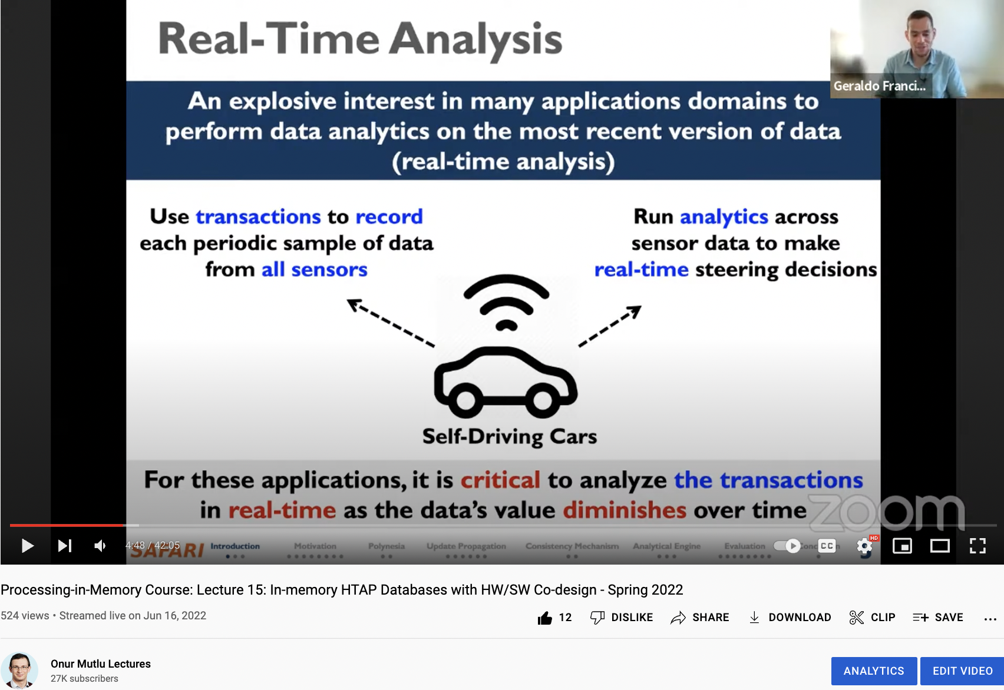
Polynesia Talk Video (II)
https://arxiv.org/pdf/2204.11275.pdf
https://www.youtube.com/watch?v=1HkXy3g6FF4

Slide 198

Real-Time Analysis
Increasing interest in many applications domains to
perform data analytics on the most recent version of data
(real-time analysis)
Use transactions to record each periodic sample of data from all sensors
Run analytics across
sensor data to make
real-time steering decisions
Self-Driving Cars
For these applications, it is critical to analyze the transactions in real-time as the data’s value diminishes over time
Introduction | Motivation | Polynesia | Update Propagation | Consistency Mechanism | Analytical Engine | Evaluation | Conclusion
● ● ● | ● ● ● ● ● ● ● ● | ● ● | ● ● ● ● ● ● | ● ● | ● ● ● | ● ● ● ● ● ● ● ● | ●
Notes:
[CLICK] Recently, in many different application domains, there has been an explosive interest in performing data analytic on the most recent version of data or real-time analysis
[CLICK] Self driving cars are a major example of these application.
[CLICK] Self driving cars ingest a large volume of data from various sensors, and
[CLICK] typically have some form of learning model that is applied to the ingested data to make in-the-field decisions.
Other applications that require real-time data analysis include fraud detection, personalized recommendation, and healthcare monitoring.
[CLICK] Therefore, for these applications, it is critical to performance data analytics with the most recent version of the data, since the value of data diminishes over time
[NEXT]

Slide 199



HTAP: Supporting Real-Time Analysis
Traditionally, new transactions (updates) are propagated to the analytical database using a periodic and costly process
hours/days
Transactions
Analytics
Transactions
Analytics
Data
Migration
Transactional DBMS
Analytical
DBMS
Hybrid DBMS
(HTAP System)
To support real-time analysis: a single hybrid DBMS is used to execute both transactional and analytical workloads
Notes:
[CLICK] Traditionally, database management systems use two separate systems to performance transactions and analytics over some data. This creates an issue since data migration between transactional and analytical DBMS can take hours to days, depending on the data volume
[CLICK] To solve this issue and support real time analysis, prior works have proposed an hybrid transactional and analytical processing system. As the name indicate, such a system has the ability to perform both transactions and analytics concurrently
[NEXT]

Slide 200
Ideal HTAP System Properties
  An ideal HTAP system should have three properties:
1
Workload-Specific Optimizations
Transactional and analytical workloads must benefit from their own specific optimizations
2
Data Freshness and Consistency Guarantees
Guarantee access to the most recent version of data for analytics while ensuring that transactional and analytical workloads have a consistent view of data
3
Performance Isolation
Latency and throughput of transactional and analytical workloads are the same as if they were run in isolation
  Achieving all three properties at the same time
  is very challenging
Notes:
[CLICK] In order to allow for real-time data analysis, an HTAP system should provide three properties.
[CLICK] First, an HTAP system needs to provide workload-specific optimizations, meaning that both transactional and analytical workloads must benefit from their own specific optimizations
[CLICK] Second, the HTAP system needs to guarantee that analytical workloads access the up-to-date version of the data, while ensuring a consistency view of data in the entire system
[CLICK] Third, the latency and throughput of transactional and analytical workloads should be as if they are run in a isolation.
[CLICK] However, it is challenging to achieve all three desired HTAP properties
[NEXT]

Slide 201
Problem and Goal
Problems:
State-of-the-art HTAP systems do not achieve
all of the desired HTAP properties
1
1
1
Data freshness and consistency mechanisms are
data-intensive and cause a drastic reduction in throughput
2
These systems fail to provide performance isolation
because of high resource contention
3
Goal:
Take advantage of custom algorithm and
processing-in-memory (PIM) to address these challenges
4
Notes:
[CLICK] We extensively analyzed state-of-the-art HTAP systems and we identify three major limitations of state-of-the-art HTAP systems
[CLICK] First, they do do meet all of the desired HTAP properties, failing to provide high data freshens and consistency, performance isolation, and workload specific optimizations.
[CLICK] Second, data freshness and consistency mechanisms suffer from data movement overheads and are data-intensive, leading to a reduction in transactional and analytical throughput.
[CLICK] Third, the system fails to provide performance isolation due to high resource contention at shared hardware resources in the system, particularly main memory.
[CLICK] Based on that, our goal in this work is to
[CLICK] take advantage of custom algorithms and hardware to address such limitations of HTAP systems
[NEXT]

Slide 202
Polynesia
Key idea: partition computing resources into
two types of isolated and specialized processing islands
Isolating transactional islands from analytical islands allows us to:
1
Apply workload-specific optimizations to each island
2
Avoid high resource contention
3
Design efficient data freshness and consistency mechanisms without incurring high data movement costs
Leverage processing-in-memory (PIM) to reduce data movement
PIM mitigates data movement overheads by
placing computation units nearby or inside memory
Notes:
[CLICK] The key idea behind our mechanism is to partition the computing resources in two types of isolated and tailored processing island, where each island is dedicated to either transactional or analytical workloads
[CLICK] By isolating transactional workloads using transactional islands from analytical workloads using analytical island, we can
[CLICK] Apply workload-specific optimizations to each island
[CLICK] avoid high resource contention
[CLICK] and design efficient data freshness and consistency mechanisms while mitigating data movement overheads
[CLICK] Polynesia leverage processing-in-memory (or PIM) techniques to reduce data movement caused by data freshness and consistency mechanisms
[CLICK] PIM can mitigate data movement overheads by adding computation units near or inside memory devices
[NEXT]

Slide 203
Polynesia: High-Level Overview
Each island includes (1) a replica of data, (2) an optimized execution engine, and (3) a set of hardware resources
Designed to provide high read throughput
Designed to sustain
bursts of updates
Analytical Island
Transactional Island
DRAM
Banks
Analytical Engine
Memory
Controller
Transactional Engine
PIM Core
PIM Core
PIM Core
PIM Core
CPU
CPU
CPU
CPU
Update Propagation Mechanism
Consistency Mechanism
Shared Last-Level Cache (LLC)
Off-Chip
Link
TSV
Update Gathering and Shipping Unit
Update
Application Unit
Copy
Unit
Vault
Processor
3D-Stacked Memory
Take advantage of PIM to mitigate data movement bottleneck
Conventional multicore CPUs with multi-level caches
Notes:
[CLICK] Based on the concept of processing island, we propose Polynesia, a hardware-software co-designed HTAP system. Polynesia includes tailored transactional and analytical islands that include a replica of the data, optimized execution engines, and specialized hardware resources. Next, I briefly describe the main components of Polynesia.
[CLICK] First, the transactional island includes an execution engine tailored for transactions, and a replica of the data.
[CLICK] The transactional island is designed to sustain high transactional update rates
[CLICK] thus, it uses conventional multicore CPUs with deep cache hierarchy, since transactional workloads benefit from such CPU organization
[CLICK] Second, the analytical island is implemented inside the logic layer of a 3D-stacked memory device. The 3D-stacked memory connects layers of DRAM banks with a layer of logic using high throughput through silicon vias or TSVs.
Vertical partitions of the 3D-stacked memory is called a vault. We place hardware resources inside each vault of the 3D-stacked memory, including an execution engine tailored for analytics, and a replica of the data
[CLICK] The analytical island is design to provide high read throughput
[CLICK] Thus, the analytical island leverages simpler PIM cores that can mitigate data movement caused during analytics processing
[CLICK] We co-design algorithms and hardware units that can efficiently maintain data consistency and data freshness in our analytical island.
[NEXT]

Slide 204
Key Results
Polynesia achieves 91.6% the transactional throughput of
an ideal system by employing
custom PIM logic for data freshness/consistency,
which significantly reduces
resource contention and data movement
Polynesia improves analytical throughput by 63.8% over
an optimized multiple-instance system, by eliminating
data movement, and using custom logic for update propagation and consistency
Overall, Polynesia achieves all three properties of HTAP system
and has a higher transactional/analytical throughput (1.7x/3.74x)
over prior HTAP systems

Slide 205
Conclusion
Context: Many applications need to perform real-time data analysis using
an Hybrid Transactional/Analytical Processing (HTAP) system
  An ideal HTAP system should have three properties:
  (1) data freshness and consistency, (2) workload-specific optimization,
  (3) performance isolation
Problem: Prior works cannot achieve all properties of an ideal HTAP system
Key Idea: Divide the system into transactional and analytical processing islands
  Enables workload-specific optimizations and performance isolation
Key Mechanism: Polynesia, a novel hardware/software cooperative design
for in-memory HTAP databases
  Implements custom algorithms and hardware to reduce the costs of
  data freshness and consistency
  Exploits PIM for analytical processing to alleviate data movement
Key Results: Polynesia outperforms three state-of-the-art HTAP systems
  Average transactional/analytical throughput improvements of 1.7x/3.7x
  48% reduction on energy consumption
Notes:
[CLICK] Many applications today need to perform real-time data analysis, meaning that they need to execute data analysis with the most-recent version of the data. Such applications often use an Hybrid Transactional/Analytical Processing system. Or HTAP. An ideal HTAP system should provide three properties: first, high data freshness and data consistency, second, it should allow for workload-specific optimizations, and third, it should provide performance isolation to transactional and analytical workloads.
[CLICK] We extensively analyze state-of-the-art HTAP systems, and we observe that they fail to meet all three HTAP properties
[CLICK] Our Key Idea to solve such an issue is to divide the HTAP system into processing islands, one for transactional and another for analytical workloads. Each island has a set of optimized hardware resources and algorithms.
[CLICK] By enabling processing island, we can perform workload-specific optimizations to transactional and analytical workloads while providing performance isolation
[CLICK] We leverage our key idea to implement Polynesia, a novel hardware/software co-designed HTAP system that implements custom algorithms and hardware to reduce the cost of maintaining data freshness and consistency in HTAP systems, and exploit processing-in-memory (or PIM) to alleviate the data movement caused by analytical workloads.
[CLICK] We extensively evaluate Polynesia against three state-of-the-art HTAP systems, and we observe that
[CLICK] It increases transactional and analytical throughput by 1.7x and 3.7x on average and
[CLICK] Reduces energy consumption by 48%
[NEXT]

Slide 206
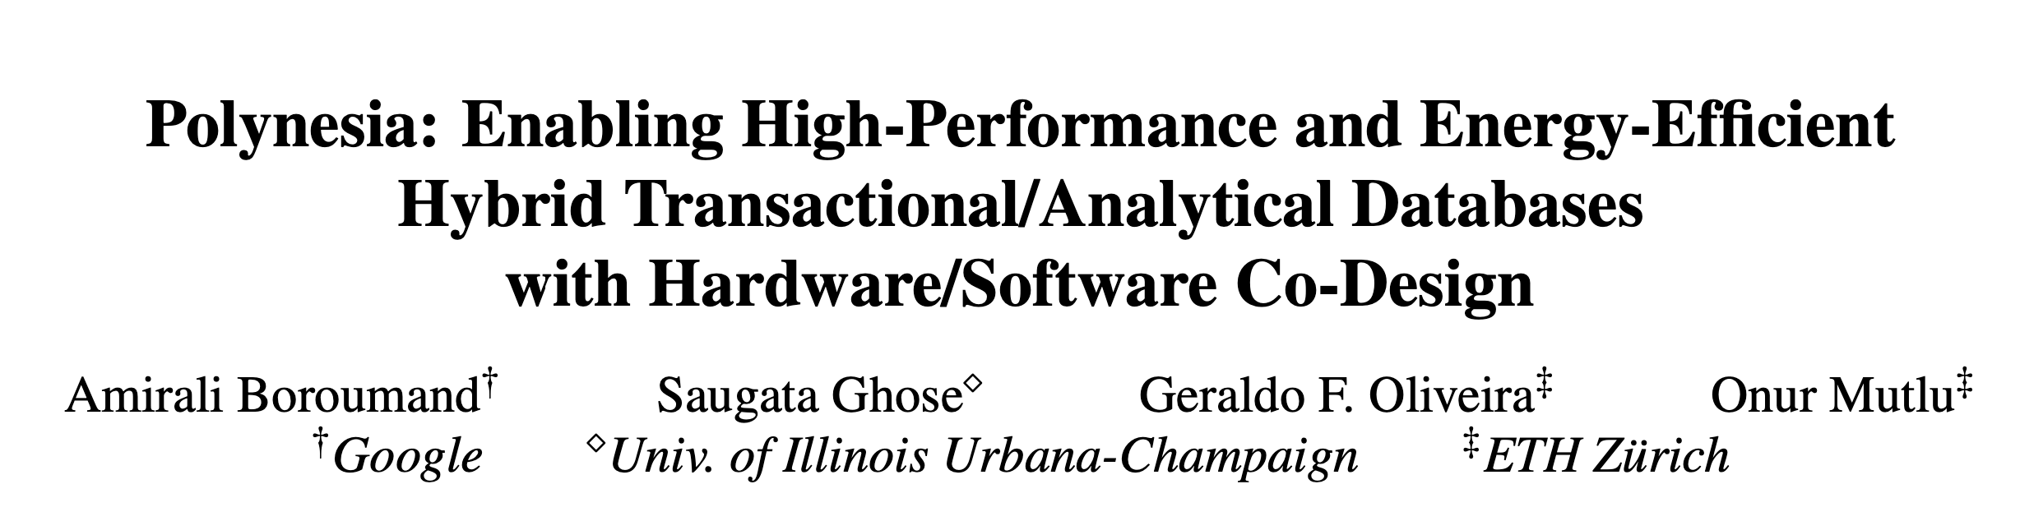

More in the Paper
Real workload analysis
Effect of the update propagation technique
Effect of the consistency mechanism
Effect of the analytical engine
Effect of the dataset size
Area Analysis
Introduction | Motivation | Polynesia | Update Propagation | Consistency Mechanism | Analytical Engine | Evaluation | Conclusion
● ● ● | ● ● ● ● ● ● ● ● | ● ● | ● ● ● ● ● ● | ● ● | ● ● ● | ● ● ● ● ● ● ● ● | ●
Notes:
We invite you to check our paper for more evaluations, including
[CLICK] real workload analysis
[CLICK] the effect of our update propagation
[CLICK] and consistency mechanisms
[CLICK] The effect of our analytical engine and
[CLICK] How Polynesia performs with large dataset sizes
[NEXT]

Slide 207
Polynesia:
Enabling High-Performance and Energy-Efficient
Hybrid Transactional/Analytical Databases
with Hardware/Software Co-Design
Amirali Boroumand
Saugata Ghose
Geraldo F. Oliveira
Onur Mutlu
ICDE
2022
Notes:
Thanks for listening.

Slide 208
Year III Results (2022 Annual Review 3)
Sibyl: Adaptive and Extensible Data Placement in Hybrid Storage Systems Using Online Reinforcement Learning [ISCA 2022]
Hermes: Accelerating Long-Latency Load Requests via Perceptron-Based Off-Chip Load Prediction [MICRO 2022]
GenPIP: In-Memory Acceleration of Genome Analysis via Tight Integration of Basecalling and Read Mapping [MICRO 2022]
pLUTo: Enabling Massively Parallel Computation via In DRAM via Lookup Tables [MICRO 2022]
DeepSketch: A New Machine Learning-Based Reference Search Technique for Post-Deduplication Delta Compression [FAST 2022]
A Modern Primer on Processing in Memory [Arxiv, Updated 2022]

Slide 209
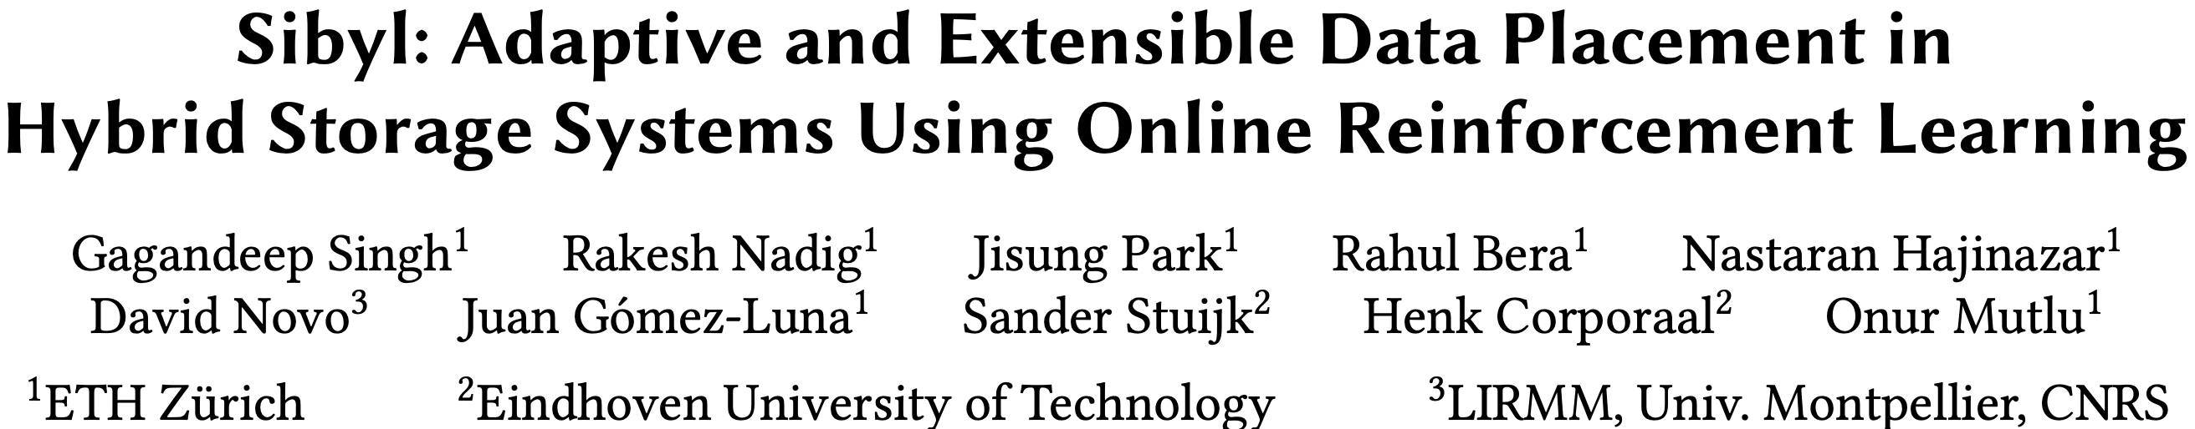
Sibyl: Self-Optimizing Hybrid Storage Systems
Gagandeep Singh, Rakesh Nadig, Jisung Park, Rahul Bera, Nastaran Hajinazar, David Novo, Juan Gomez-Luna, Sander Stuijk, Henk Corporaal, and Onur Mutlu,
"Sibyl: Adaptive and Extensible Data Placement in Hybrid Storage Systems Using Online Reinforcement Learning"
Proceedings of the 49th International Symposium on Computer Architecture (ISCA), New York, June 2022.
[Slides (pptx) (pdf)]
[arXiv version]
[Sibyl Source Code]
[Talk Video (16 minutes)]
https://arxiv.org/pdf/2205.07394.pdf

Slide 210



Sibyl:
Adaptive and Extensible Data Placement in Hybrid Storage Systems
Using Online Reinforcement Learning
Gagandeep Singh, Rakesh Nadig, Jisung Park,
Rahul Bera, Nastaran Hajinazar, David Novo,
Juan Gómez Luna, Sander Stuijk, Henk Corporaal,
Onur Mutlu
Notes:
Thank you Onur for the introduction
I’m going to present our work “…”

Slide 211
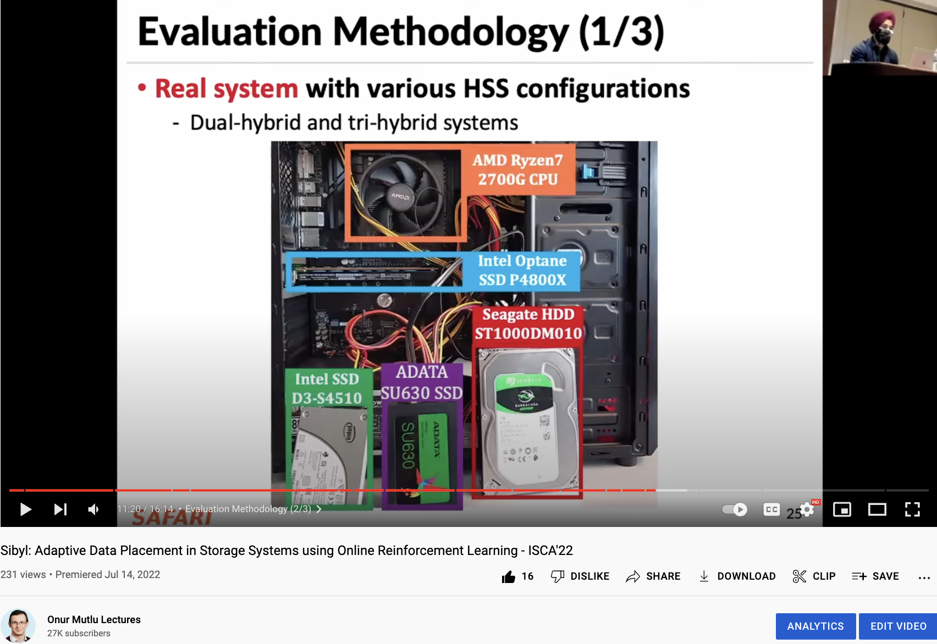

Sibyl Talk Video [ISCA’22]
Gagandeep Singh, Rakesh Nadig, Jisung Park, Rahul Bera, Nastaran Hajinazar, David Novo, Juan Gomez-Luna, Sander Stuijk, Henk Corporaal, and Onur Mutlu,
"Sibyl: Adaptive and Extensible Data Placement in Hybrid Storage Systems Using Online Reinforcement Learning"
ISCA, New York, June 2022.
[Sibyl Source Code]
https://www.youtube.com/watch?v=5-WedkiB000
Notes:
This paper was recently published in ISCA’22

Slide 212
Executive Summary
Background: A hybrid storage system (HSS) uses multiple different storage devices to provide high and scalable storage capacity at high performance
Problem: Two key shortcomings of prior data placement policies:
  Lack of adaptivity to:
    Workload changes
    Changes in device types and configurations
  Lack of extensibility to more devices
Goal: Design a data placement technique that provides:
  Adaptivity, by continuously learning and adapting to the application and underlying device characteristics
  Easy extensibility to incorporate a wide range of hybrid storage configurations
Contribution: Sibyl, the first reinforcement learning-based data placement technique in hybrid storage systems that:
  Provides adaptivity to changing workload demands and underlying device characteristics
  Can easily extend to any number of storage devices
  Provides ease of design and implementation that requires only a small computation overhead
Key Results: Evaluate on real systems using a wide range of workloads
  Sibyl improves performance by 21.6% compared to the best previous data placement technique in dual-HSS configuration
  In a tri-HSS configuration, Sibyl outperforms the state-of-the-art-policy policy by 48.2%
  Sibyl achieves 80% of the performance of an oracle policy with storage overhead of only 124.4 KiB
https://github.com/CMU-SAFARI/Sibyl
Notes:
First, I am going to start with an executive summary.
[CLICK] Hybrid storage systems use multiple different storage devices to provide high and scalable storage capacity at high performance
[CLICK] We observe two key shortcomings in prior data placement techniques:
First, lack of adaptivity to workload changes and changes in device types and configurations
Second, they also lack extensibility to to more devices.
[CLICK] Our goal in this work is to design a data placement technique that provides
Adaptivity, by continuously learning and adapting to the application and underlying device characteristics
Easy extensibility to incorporate a wide range of hybrid storage configurations
[CLICK] to this end we propose Sibyl, an online reinforcement learning-based data placement in Hybrid storage systems that:
Provides both adaptivity
and easy extensiblity
and also Provides ease of design and implementation that requires only a small computation overhead
[CLICK] We extensively evaluate Sibyl on real systems using a wide range of workloads
We show that Sibyl outperforms prior state-of-the-art data placement policeis by 21.6% in dual-hybrid storage system and upto 48.2% on trihybrid system
Sibyl achieves 80% of the performance of an oracle policy that has a complete knowledge of future access patterns while incurring a very modest storage overhead of only 124.4 KiB
The code is opensourced on our GitHub repository.
https://github.com/CMU-SAFARI/Sibyl

Slide 213
Talk Outline
Key Shortcomings of Prior Data Placement Techniques
Formulating Data Placement as Reinforcement Learning
Sybil: Overview
Evaluation of Sybil and Key Results
Conclusion
Notes:
This is the outline of my talk.
First, I am going to start by discussing key shortcomings of prior data placement techniques.

Slide 214
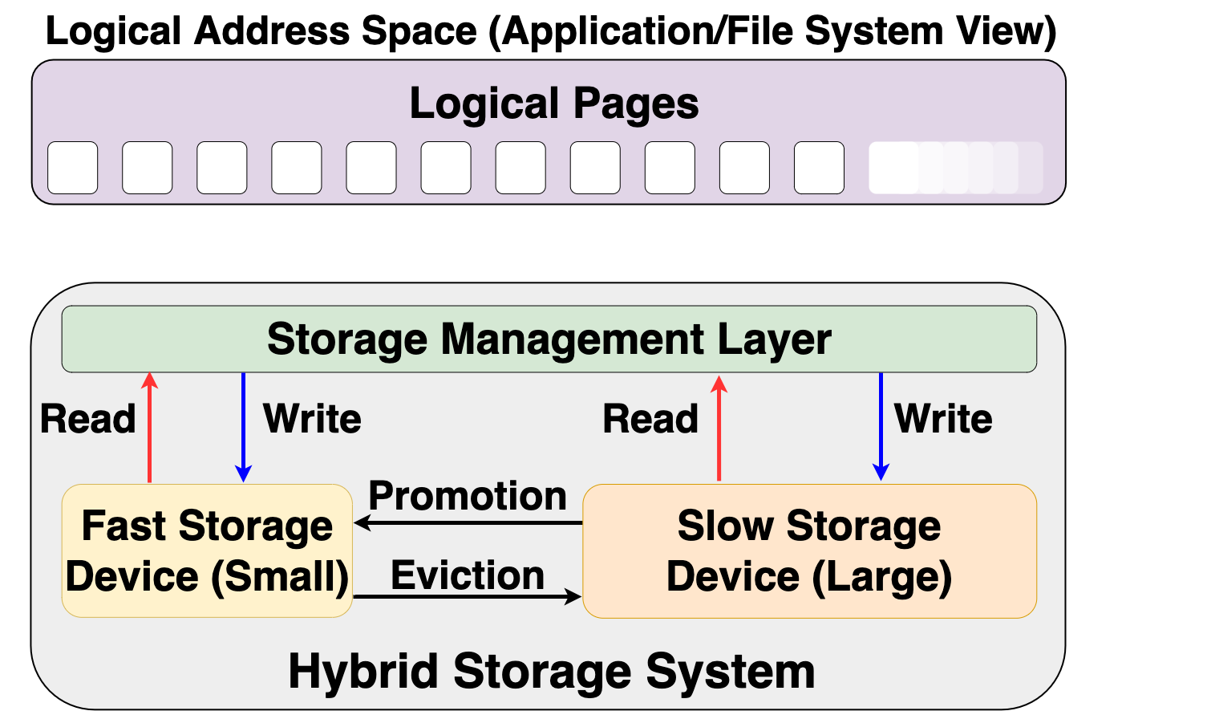
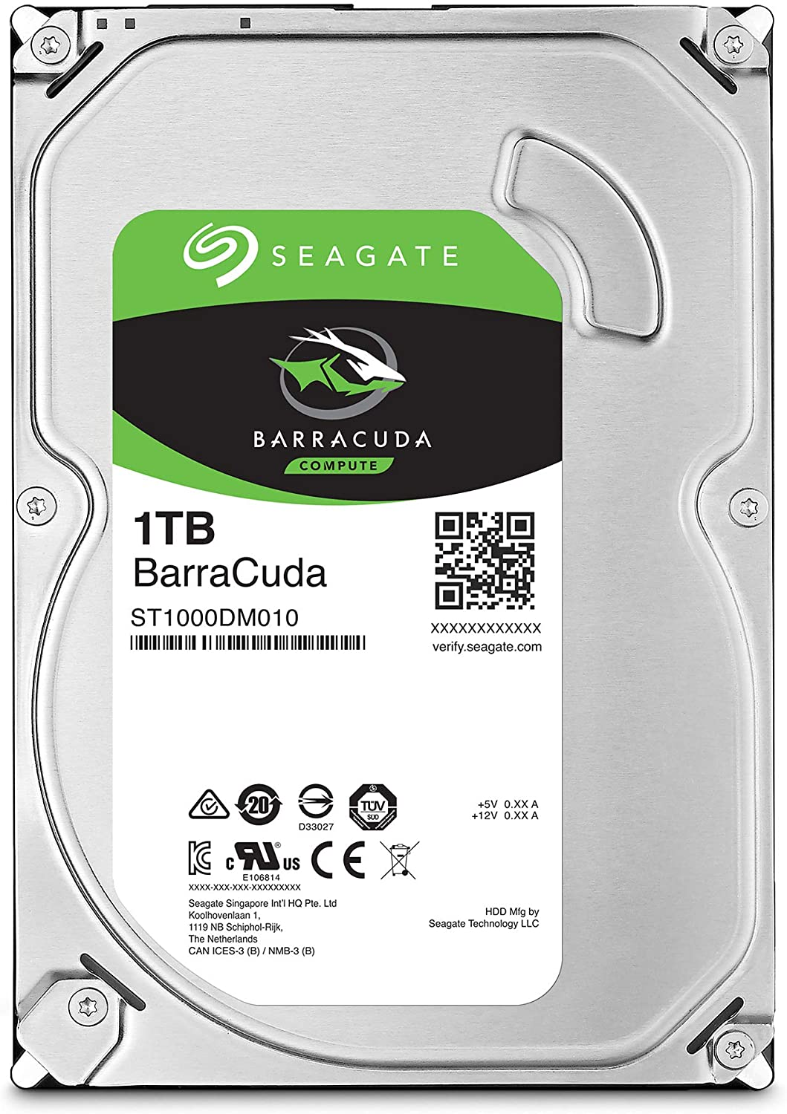
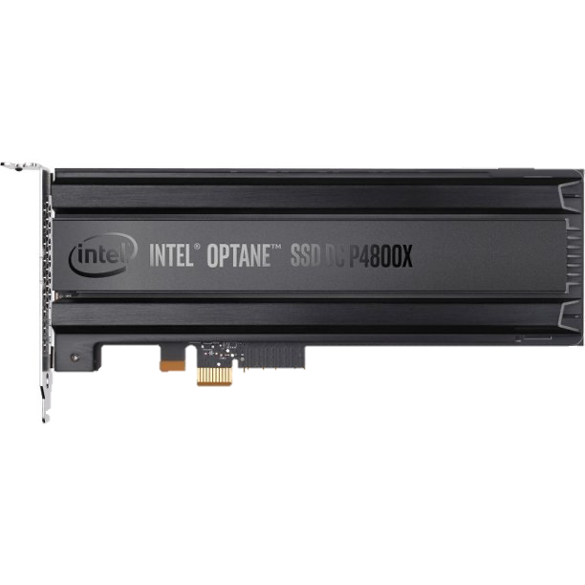
Hybrid Storage System Basics
Address Space (Application/File System View)
Read
Write
Storage Management Layer
Read
Write
Read
Write
Promotion
Eviction
Fast Device
Slow Device
Hybrid Storage System
Notes:
Let's look at some basics on hybrid storage systems. [CLICK] OVER here we show a typical HSS consisting of a fast-yet-small storage device and a slow-yet-large storage device
[CLICK]The address space is divided into a number of logical pages (e.g. 4kib), which are assigned to an application.
[CLICK] The storage management layer in the OS orchestrates host I/O requests across heterogeneous devices,
[CLICK] the storage management layer also manages data migration between the storage devices in an Hybrid storage systems . Eviction usually moves infrequently access data fom the fast storage to the slow storage or when the fast storage device is full.
When data currently stored in the slow storage device is moved to the fast storage device, it is called promotion. Promotion is usually performed when a page in the slow storage device is accessed frequently.
[CLICK] A desirable policy has to effectively utilize the low latency characteristics of the fast device while making optimal use of its small capacity and should provide easy extensibility to a wide range of workloads and Hybrid storage systems configurations

Slide 215
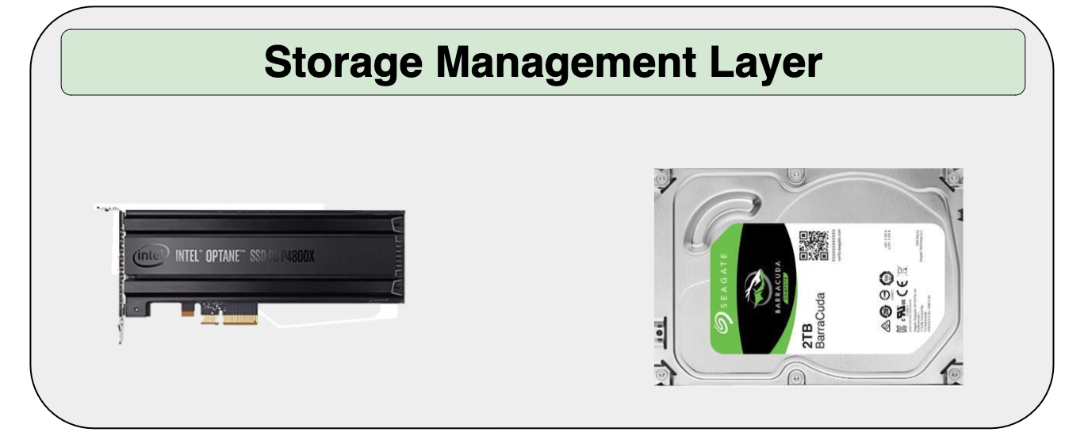
Hybrid Storage System Basics
Read
Write
Performance of a hybrid storage system
highly depends on the ability of the
storage management layer
Read
Write
Read
Write
Promotion
Eviction
Hybrid Storage System
Notes:
[CLICK] Therefore the performance of a hybrid storage system highly depends on the ability of the storage management layer to effectively manage diverse deviaces and workloads

Slide 216
Key Shortcomings in Prior Techniques
We observe two key shortcomings that significantly limit the performance benefits of prior techniques
Lack of adaptivity to:
  Workload changes
  Changes in device types and configuration
Lack of extensibility to more devices
Notes:
We observe two key shortcomings in prior data placement techniques that significantly limits their performance improvement
[CLICK] First, lack of adaptivity to both workload changes and
CLICK] changes in device types and configurations
[CLICK] Second, Lack of extensibility: to more devices

Slide 217
Our Goal
A data-placement mechanism
that can provide:
Adaptivity, by continuously learning and adapting to the application and underlying device characteristics
Easy extensibility to incorporate a wide range of hybrid storage configurations
Notes:
So our goal in this work is to design a data-placement mechanism that can provide
[CLICK]
Adaptivity, by continuously learning and adapting to the application and underlying device characteristics
[CLICK]
Easy extensibility to incorporate a wide range of hybrid storage configurations.

Slide 218

Our Proposal
Sibyl
Formulates data placement in hybrid storage systems as a reinforcement learning problem
Sybil is an oracle that makes accurate prophecies
https://en.wikipedia.org/wiki/Sibyl
Notes:
To this end, we propose Sibyl
Which formulates data placement in hybrid…

Slide 219
Talk Outline
Key Shortcomings of Prior Data Placement Techniques
Formulating Data Placement as Reinforcement Learning
Sybil: Overview
Evaluation of Sybil and Key Results
Conclusion
Notes:
Lets go into the formulation of dataplacement as a reinforcement learning problem

Slide 220
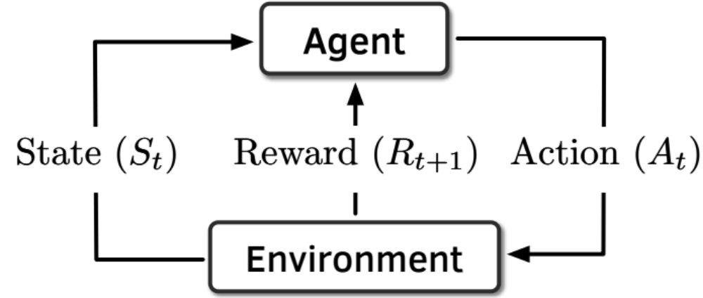
Basics of Reinforcement Learning (RL)
Agent learns to take an action in a given state
to maximize a numerical reward
Notes:
First, let me briefly describe the basics of reinforcement learning.
A RL system contains two components: [CLICK] the agent and the environment.
The agent observes the state of the environment in every timestep [CLICK], takes an action based on the state [CLICK], and receives a reward for that action [CLICK].
[CLICK] Agent’s goal is to find a policy where agent’s action in a given state leads to maximum reward

Slide 221
Formulating Data Placement as RL
Agent
State (S_{t})
Reward (R_{t+1})
Action (A_{t})
Environment
Sibyl
Features of the current request and system
Request latency
(of last served request)
Select storage device to place the current page
Hybrid Storage System
Notes:
In Sibyl, we formulate data-placement as a reinforcement learning problem.
[CLICK] Sibyl acts as the agent, while [CLICK] the hybrid storage subsystem acts as the environment.
[CLICK] Sibyl observes workload and system features from every storage request and use it as a state information to take a data placement action [CLICK]
[CLICK] For every data placement action, Sibyl receives a numerical reward that evaluates the effectiveness of the data placement decision
Now we will concretely define the state, action, and the reward for Sibyl.

Slide 222

What is State?
Sibyl
Features of the current request and system
Request latency
(of last served request)
Select storage device to place
the current page
Limited number of state features:
  Reduce the implementation overhead
  RL agent is more sensitive to reward
6-dimensional vector of state features
We quantize the state representation into bins to reduce storage overhead
Hybrid Storage System
Notes:
[CLICK] For the state, we use limited number of state features after performing feature selection to:
reduce implementation overhead
[CLICK] and we observe RL agent's perfromance is more sensitive to the reward than state features. So adding many feature does not help
[CLICK] We define the state as a 6-dimensional vector of program features.
[CLICK] Some examples are the size of the incoming request the type of request etc
[click] we also quantize the state representation into bins to reduce the storage overhead

Slide 223
What is Reward?
Sibyl
Features of the current request and system
Request latency
(of last served request)
Select storage device to place
the current page
Defines the objective of Sibyl
We formulate the reward as a function of the request latency
Encapsulates three key aspects:
  Internal state of the device (e.g., read/write latencies, the latency of garbage collection, queuing delays, …)
  Throughput
  Evictions
More details in the paper
Hybrid Storage System
Notes:
The reward defines the objective of Sibyl
[CLICK] Though Sibyl can learn from any …, in this paper we formulate the reward as a function of the request latency
[CLICK] A reward encapsulates three metrics: …

Slide 224
What is Action?
Sibyl
Features of the current request and system
Request latency
(of last served request)
Select storage device to place
the current page
At every new page request, the action is to select a storage device
Action can be easily extended to any number of storage devices
Sibyl learns to proactively evict or promote a page
Hybrid Storage System
Notes:
We define the action as the selection of a storage device to place the current page.
[CLICK] Such an action allows easy extensiblity to any number of storage devices
[CLICK] it makes SIbyl learn to proactively evit or promote a page from the storage device

Slide 225
Talk Outline
Key Shortcomings of Prior Data Placement Techniques
Formulating Data Placement as Reinforcement Learning
Sybil: Overview
Evaluation of Sybil and Key Results
Conclusion
Notes:
We now provide a brief overview and design of Sibyl.

Slide 226
Sibyl Execution
RL Training Thread
Asynchronous
Execution
State, Reward, and Action Information
Periodic Policy
Weight Update
Storage
Request
(from OS)
RL Decision Thread
Data Placement Decision
Sibyl
Notes:
We implement sibyl in the the host OS. [CLICK] Where for every storage request Sibyl uses an RL decision thread to make [CLICK] data placemnet decisions.
Sibyl uses another thread, [CLICK] called the RL training thread that works in the background. It keeps collecting information about Sibyl's state, action and reward, which uses this information to train a data placement policy. [CLICK] periodically we replace the RL decision thread policy with RL training thread policy.
[CLICK] Our two-threaded implementation runs ASYNCHROUNOUS AND avoids that the training in RL training thread interrupts or delays data placement decisions for incoming requests.

Slide 227
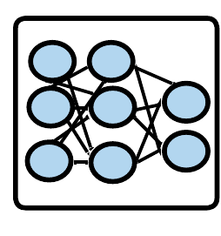
Sibyl Design: Overview
RL Training Thread
Training
Network
Training Dataset
Batch
Periodic Policy
Weight Update
Periodic Weights update
10
RL Decision Thread
Experience Buffer (in host DRAM)
State
Max
Action
Storage
Request
(from OS)
Inference
Network
Sibyl Policy
Observation
Vector
HSS
Reward
Collect
Experiences
State
Notes:
We provide implementation details in the paper including

Slide 228
Sibyl Design: Overview
RL Training Thread
Training
Network
Training Dataset
Batch
Periodic Policy
Weight Update
Periodic Weights update
10
RL Decision Thread
Experience Buffer (in host DRAM)
State
Max
Action
Storage
Request
(from OS)
Inference
Network
Sibyl Policy
Observation
Vector
HSS
Reward
Collect
Experiences
State
Notes:
how we enable the parallel execution rl training and decision making

Slide 229
Talk Outline
Key Shortcomings of Prior Data Placement Techniques
Formulating Data Placement as Reinforcement Learning
Sybil: Overview
Evaluation of Sybil and Key Results
Conclusion
Notes:
We now present our key results

Slide 230
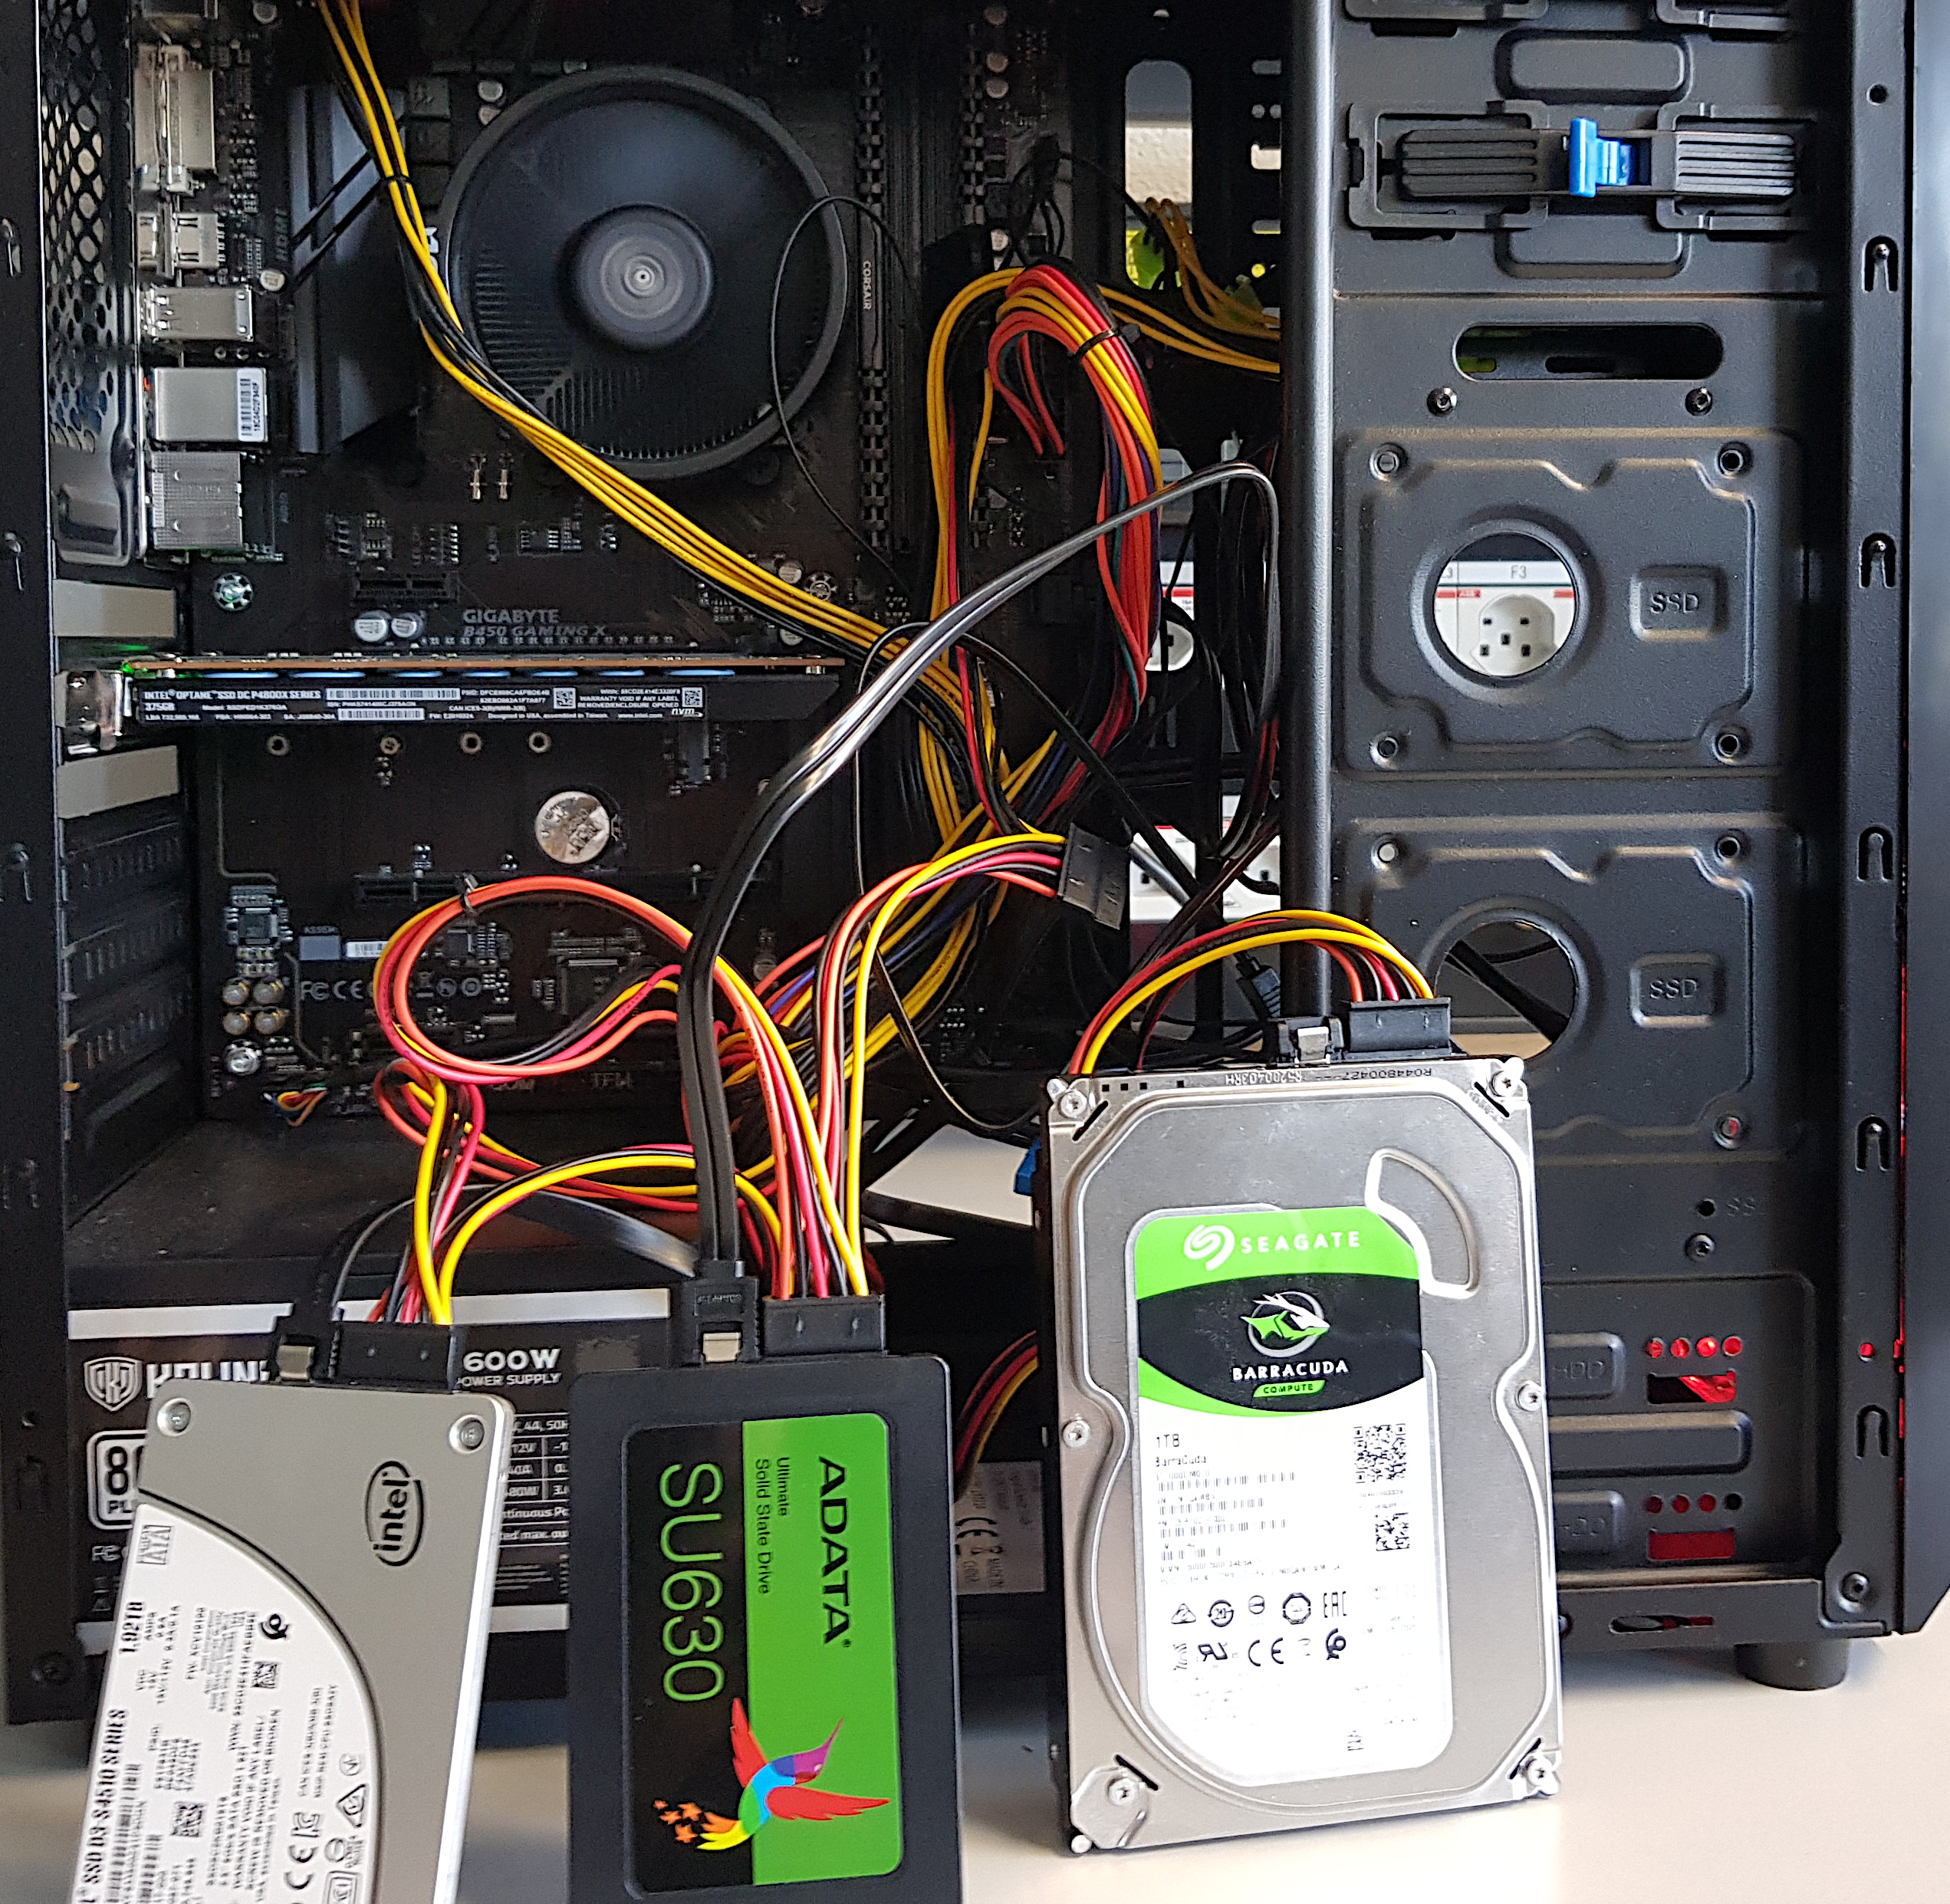
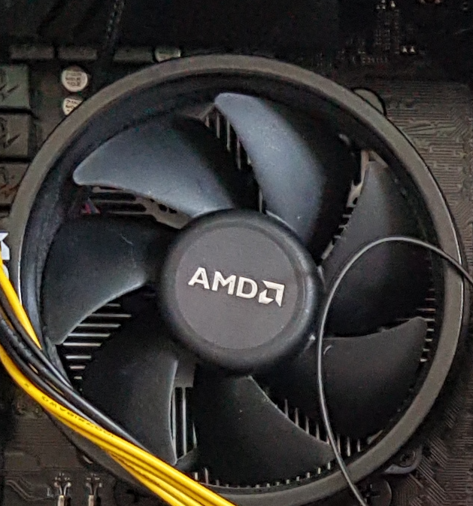
Evaluation Methodology (1/3)
Real system with various HSS configurations
  Dual-hybrid and tri-hybrid systems
AMD Ryzen7 2700G CPU
Intel Optane SSD P4800X
Seagate HDD
ST1000DM010
Intel SSD D3-S4510
ADATA
SU630 SSD
Notes:
[CLICK] We perfrom real system evaluation for both dual-hybrid and tri-hybrid systems
[CLICK] over here we show our evaluation setup that consists of multi different devices
[CLICK] We implement sibyl in the storage management layer of AMD Ryzen 7 2700G CPU

Slide 231
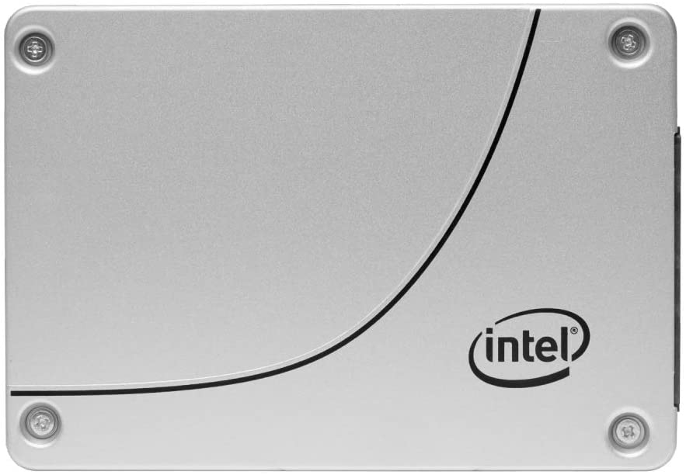
Evaluation Methodology (2/3)
Cost-Oriented HSS Configuration
High-end SSD
Low-end HDD
Performance-Oriented HSS Configuration
High-end SSD
Middle-end SSD
Notes:
First we evalutate a cost-oriented hybrid storage configuration in which we use
[CLICK]a high end ssd with a low-end hard disk drive where the latency difference between the two devices is quite large
[CLICK] Performance oriented hybrid storage configuration we
[CLICK]use a high end ssd with a middle end ssd
where two devices have less difference in their latencies [CLICK]

Slide 232
Evaluation Methodology (3/3)
18 different workloads from:
  MSR Cambridge and Filebench Suites
Four state-of-the-art data placement baselines:
  CDE [Matsui+, Proc. IEEE’17]
  HPS [Meswani+, HPCA’15]
  Archivist [Ren+, ICCD’19]
  RNN-HSS [Doudali+, HPDC’19]
Heuristic-based
Learning-based
Notes:
[CLICK] We use 18 different workloads from MSR CAMBRIDGE and Filebench Suite
[CLICK] and compare Sibyl against four state of heuristic and supervised—learning based data placmenet policies

Slide 233
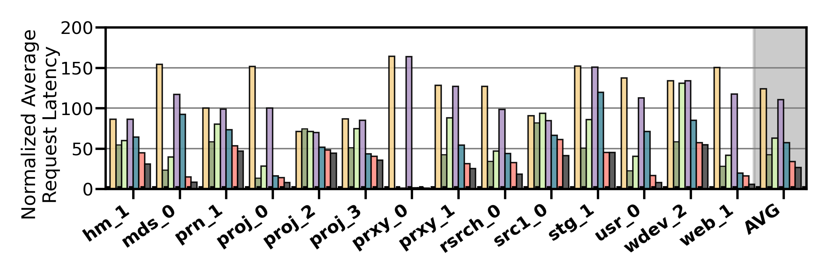
Performance Analysis
High-end SSD
Low-end HDD
Cost-Oriented HSS Configuration
Slow-Only
CDE
HPS
Archivist
RNN-HSS
Sibyl
Oracle
Notes:
[CLICK]Over here we show the performance results in terms of average request latency for MSR CAMBRIDGE workloads for all the workloads and policies

Slide 234
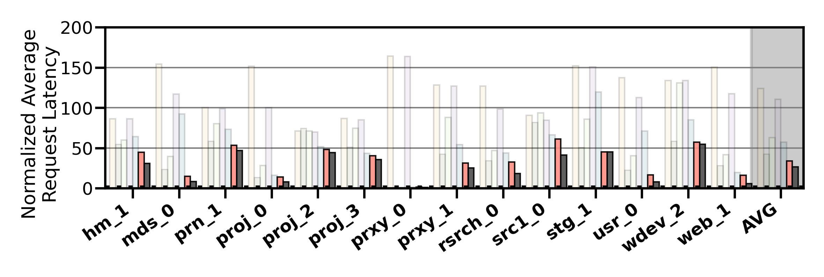
Performance Analysis
High-end SSD
Low-end HDD
Cost-Oriented HSS Configuration
Slow-Only
CDE
HPS
Archivist
RNN-HSS
Sibyl
Oracle
Sibyl consistently outperforms all the baselines
for all the workloads
Notes:
We observe that Sibyl consistently outperforms all the baselines for all the workloads

Slide 235
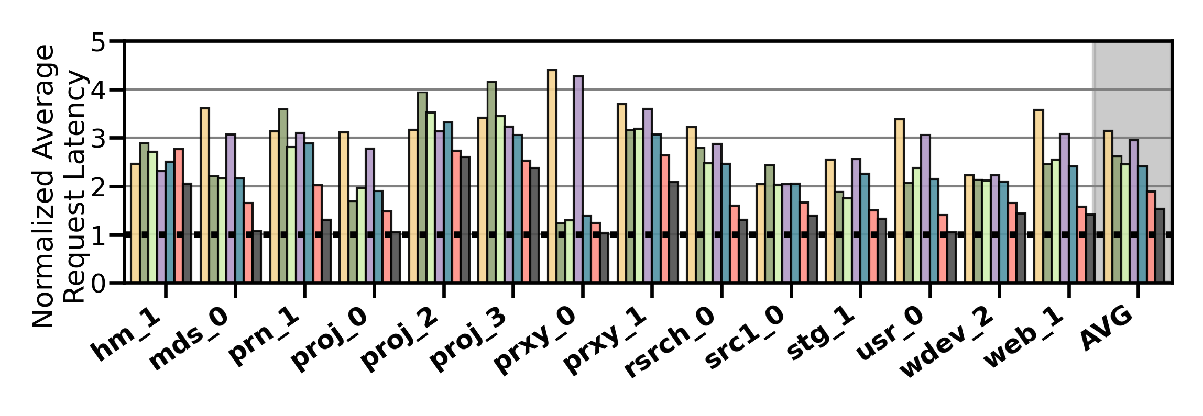
Performance Analysis
High-end SSD
Mid-end SSD
Performance-Oriented HSS Configuration
Slow-Only
CDE
HPS
Archivist
RNN-HSS
Sibyl
Oracle
Notes:
In a performance oriented Hybrid storage systems configuration, where two devices have less difference in their latencies [CLICK]
[CLICK]

Slide 236
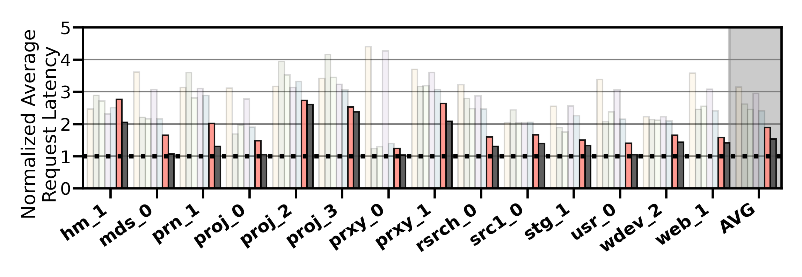
Performance Analysis
High-end SSD
Mid-end SSD
Performance-Oriented HSS Configuration
Slow-Only
CDE
HPS
Archivist
RNN-HSS
Sibyl
Oracle
Sibyl provides 21.6% performance improvement by dynamically adapting its data placement policy
Notes:
Sibyl provides 21.6% performance improvement by dynamically adapting its data placement policy

Slide 237
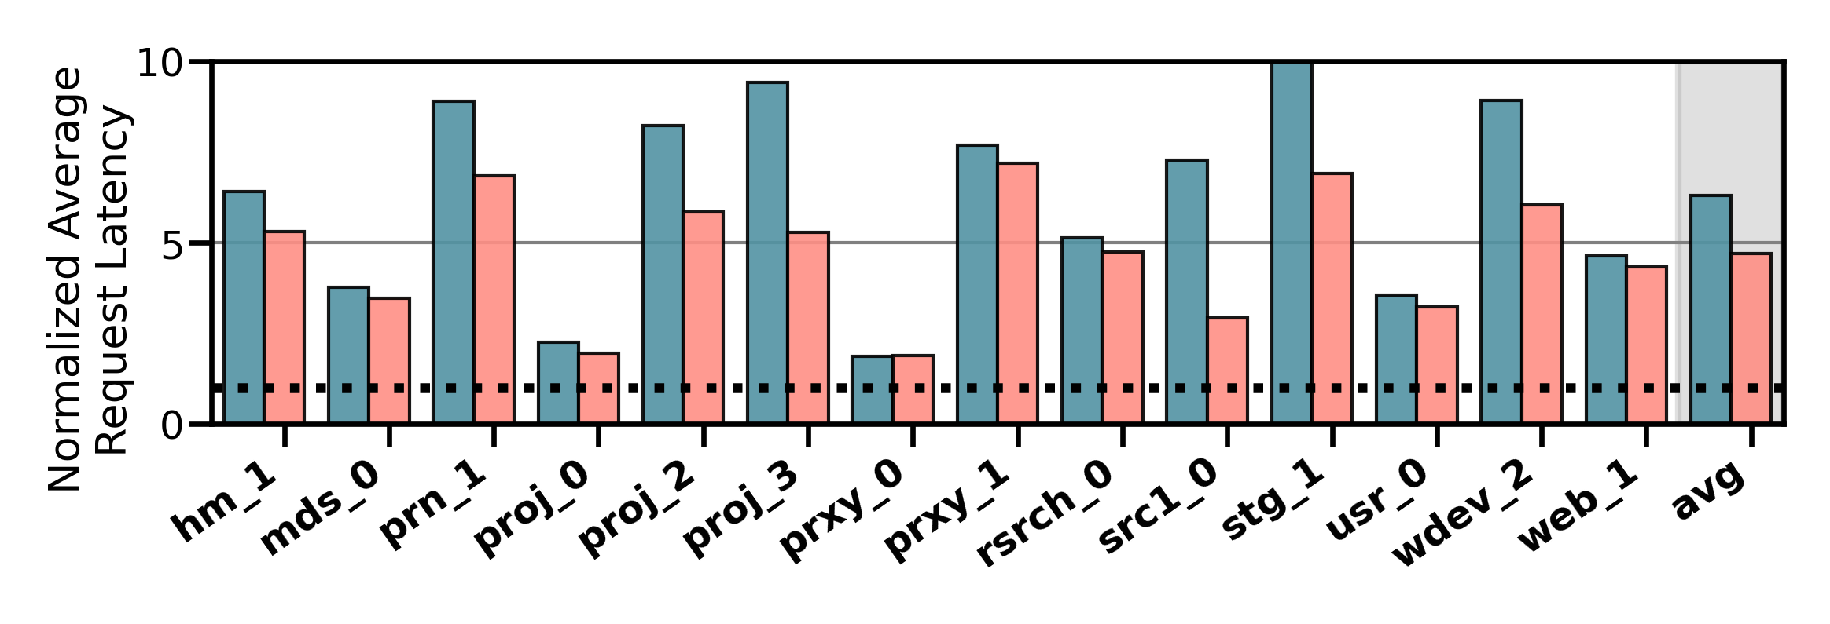
Performance on Tri-HSS
High-end SSD
Mid-end SSD
Low-end HDD
Extending Sibyl for more devices:
  Add a new action
  Add the remaining capacity of the new device as a state feature
Heuristic_{Tri-hybrid}
Sibyl_{Tri-hybrid}
Notes:
We also evaluate the EXTENSIBILITY of sibyl to more devices
To extend sibyl for more storage devices we have to only:
1. Add a new action in sibyl’s action space
2. Add the remaining capacity of the new device as a state feature
and sibyl automatically figures out the best policy
Here we show the performanc results for a state of the art heuristic based policy. This heuristic policy is an extended version of CDE policy which requires significant implementation effort for handling all the dataplacement cases because of the new device like eviction and promotion from the new device and where to send that data, set threshold values etc.

Slide 238
Performance on Tri-HSS
High-end SSD
Mid-end SSD
Low-end HDD
Extending Sibyl for more devices:
  Add a new action
  Add the remaining capacity of the new device as a state feature
Sibyl outperforms the state-of-the-art
data placement policy by
48.2% in a real tri-hybrid system
Heuristic_{Tri-hybrid}
Sibyl_{Tri-hybrid}
Sibyl reduces the system architect's burden
by providing ease of extensibility
Notes:
Sibyl outperforms the state-of-the-art-policy policy by upto 48.2%
[click]
We conclude that Sibyl provides ease of extensibility to new storage system configurations, which reduces the system architect’s burden in designing sophisticated data placement mechanisms.

Slide 239

Sibyl’s Overhead
124.4 KiB of total storage cost
  Experience buffer, inference and training network
40-bit metadata overhead per page for state features
Inference latency of ~10ns
Training latency of ~2us
Small area overhead
Small inference overhead
Satisfies prediction latency
Notes:
All of Sybil performance benefits comes at a modest cost of 124.4KB storage cost to implement experience buffer, inference and training network
[CLICK] and 40-bit metadata overhead per page
[CLICK] We have inference latency of 10nanos, which are orders of magnitude smaller than the I/O read latency of a even a high end SSD (around 3micro seconds for Samsung ZNAND SSD)
[CLICK] with training latency of 2mico sec
So sibyl provides:
[CLICK]small area and
[CLICK]inference overhead [CLICK] which satisfied the prediction latency for making a data placement decision

Slide 240
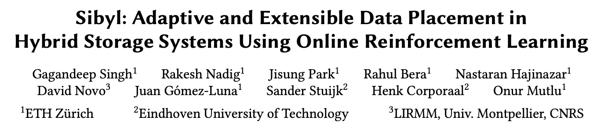
More in the Paper
https://arxiv.org/pdf/2205.07394.pdf
https://github.com/CMU-SAFARI/Sibyl
https://www.youtube.com/watch?v=5-WedkiB000

Slide 241
Talk Outline
Key Shortcomings of Prior Data Placement Techniques
Formulating Data Placement as Reinforcement Learning
Sybil: Overview
Evaluation of Sybil and Key Results
Conclusion
Notes:
Now I will conclude my talk

Slide 242
Conclusion
We introduced Sibyl, the first reinforcement learning-based data placement technique in hybrid storage systems that provides
  Adaptivity
  Easily extensibility
  Ease of design and implementation
We evaluated Sibyl on real systems using many different workloads
  Sibyl improves performance by 21.6% compared to the best prior data placement policy in a dual-HSS configuration
  In a tri-HSS configuration, Sibyl outperforms the state-of-the-art-data placement policy by 48.2%
  Sibyl achieves 80% of the performance of an oracle policy with a storage overhead of only 124.4 KiB
Notes:
We introduced Sibyl, the first reinforcement learning-based data placement in HSS that provides
Adaptivity
Easily extensibility
Ease of design and implementation
We extensively evaluated Sibyl on real systems using many different workloads and show Sibyl provides high performance benefits

Slide 243
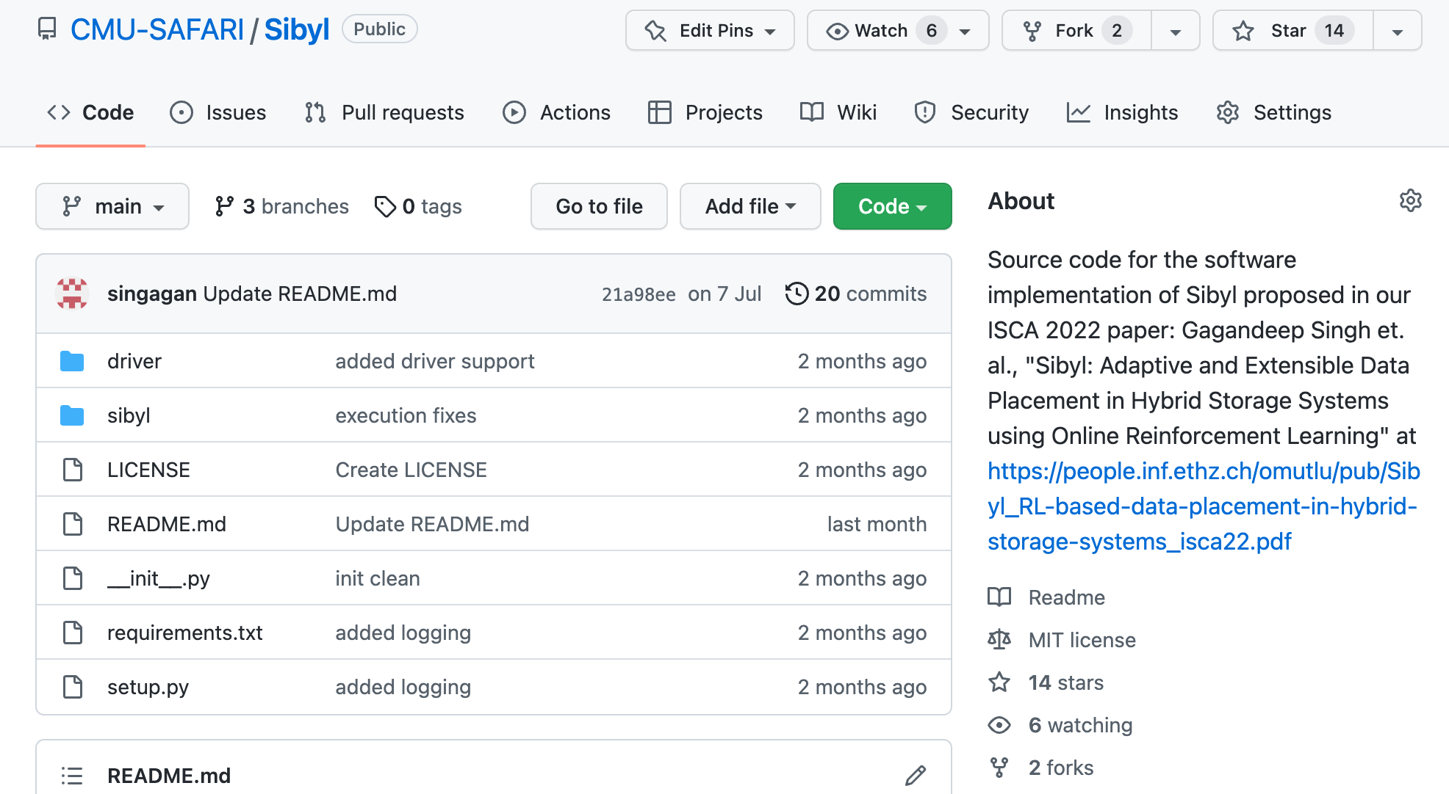

Sibyl is Open-Source
https://github.com/CMU-SAFARI/Sibyl
Notes:
Our repository is publicly available in our github.
[CLICK]

Slide 244
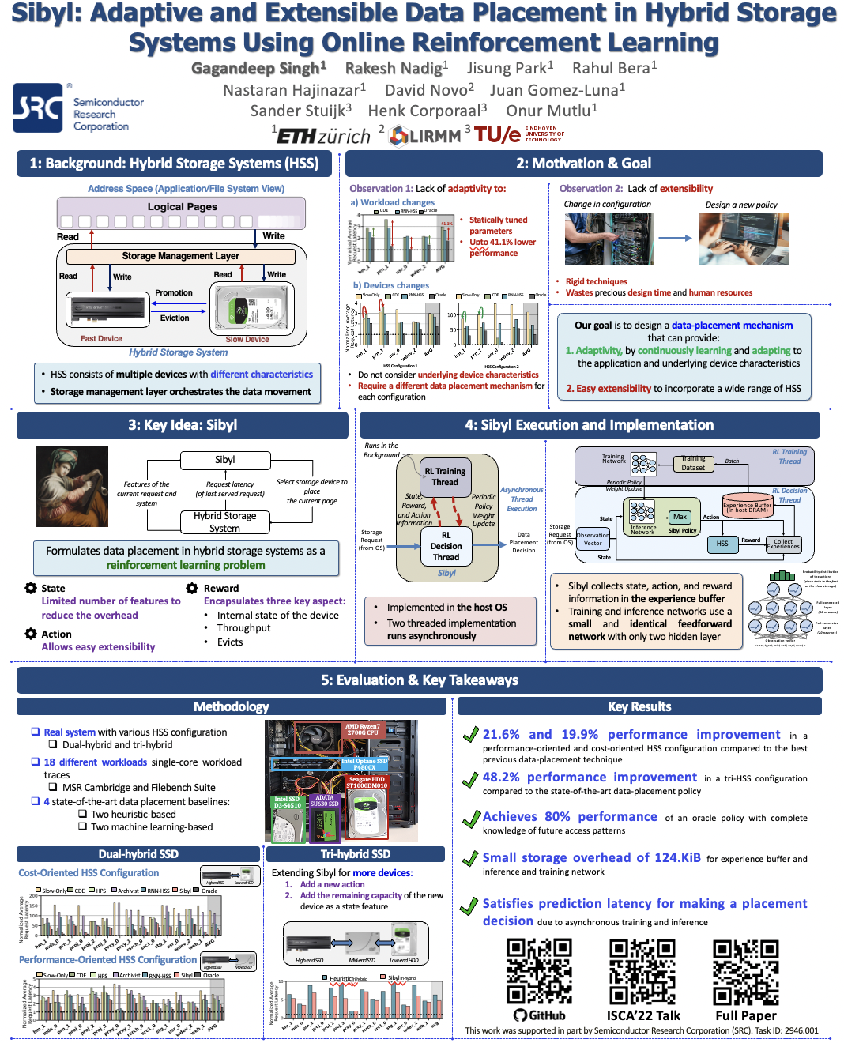

Please Check Out Our Poster!

Slide 245
Sibyl:
Adaptive and Extensible Data Placement in Hybrid Storage Systems
Using Online Reinforcement Learning
Gagandeep Singh, Rakesh Nadig, Jisung Park,
Rahul Bera, Nastaran Hajinazar, David Novo,
Juan Gómez Luna, Sander Stuijk, Henk Corporaal,
Onur Mutlu
Notes:
Thank you Onur for the introduction
I’m going to present our work “…”

Slide 246
Year III Results (2022 Annual Review 3)
Sibyl: Adaptive and Extensible Data Placement in Hybrid Storage Systems Using Online Reinforcement Learning [ISCA 2022]
Hermes: Accelerating Long-Latency Load Requests via Perceptron-Based Off-Chip Load Prediction [MICRO 2022]
GenPIP: In-Memory Acceleration of Genome Analysis via Tight Integration of Basecalling and Read Mapping [MICRO 2022]
pLUTo: Enabling Massively Parallel Computation via In DRAM via Lookup Tables [MICRO 2022]
DeepSketch: A New Machine Learning-Based Reference Search Technique for Post-Deduplication Delta Compression [FAST 2022]
A Modern Primer on Processing in Memory [Arxiv, Updated 2022]

Slide 247
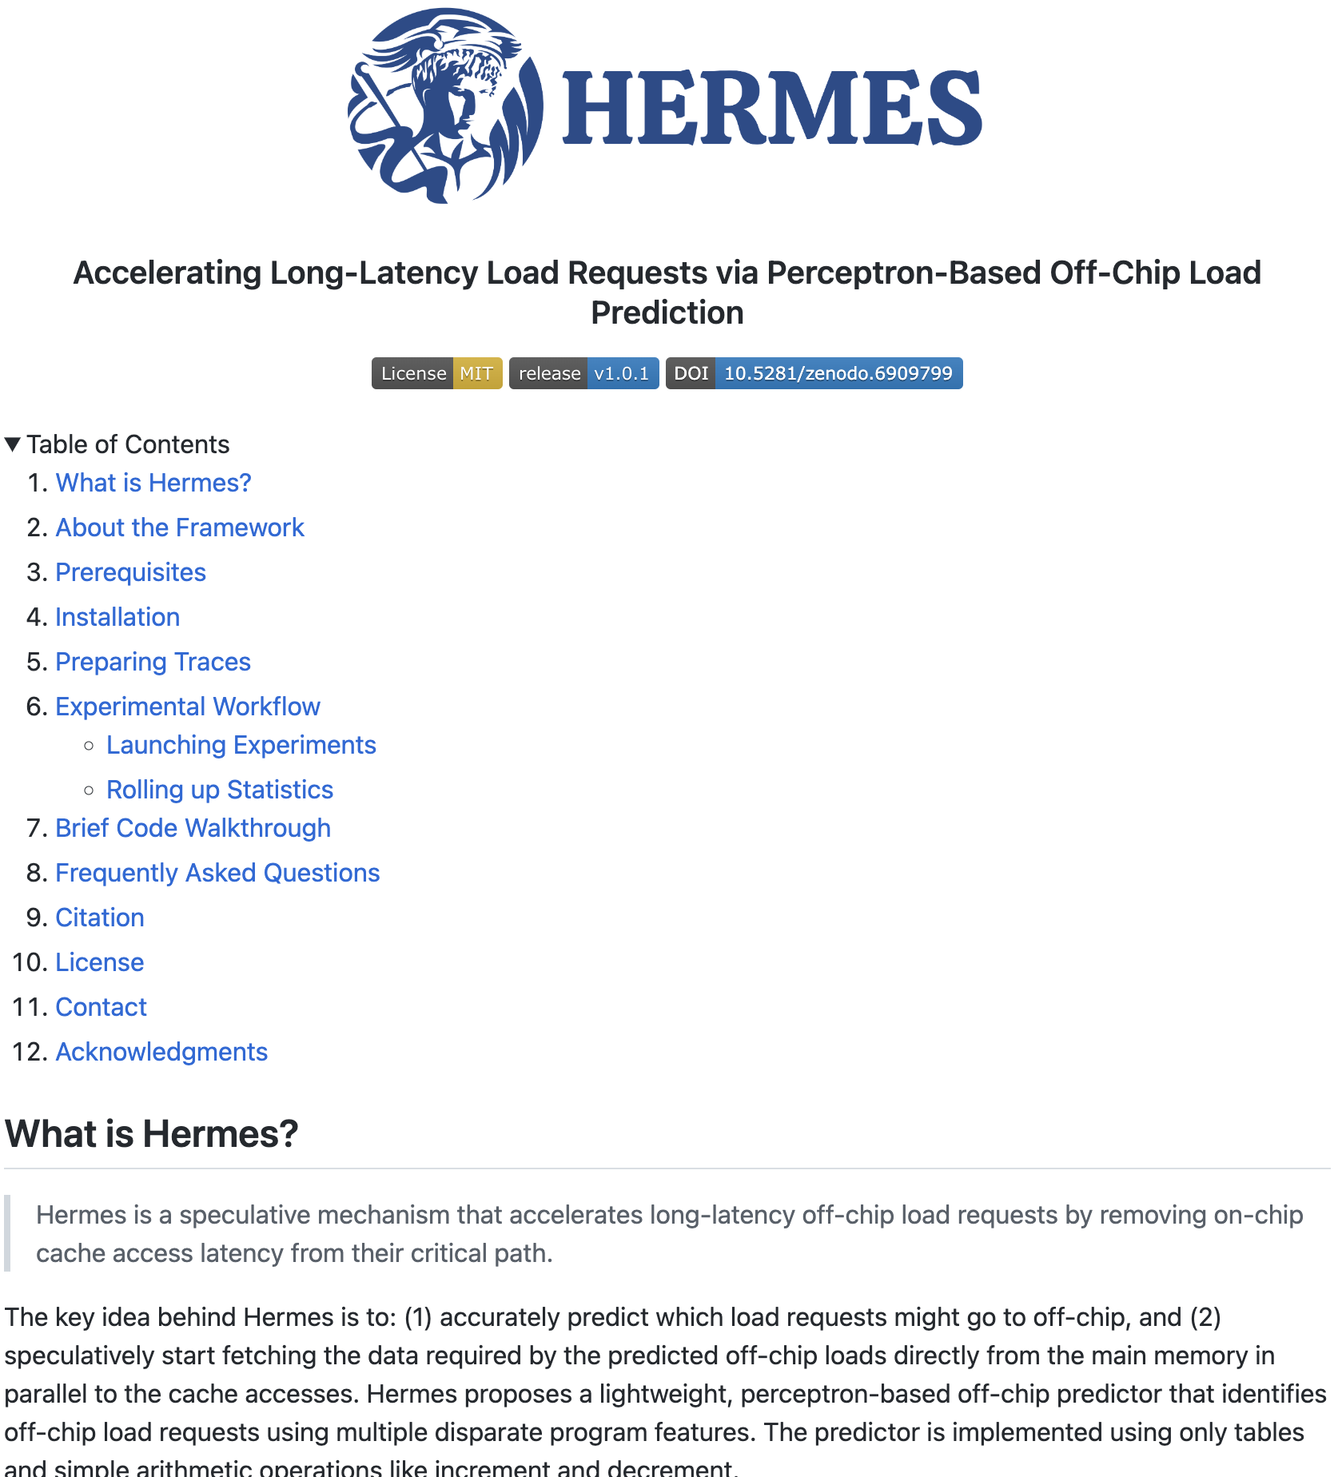
Hermes
To Appear in MICRO 2022
https://github.com/CMU-SAFARI/Hermes

Slide 248

Accelerating Long-Latency Load Requests
via Perceptron-based Off-chip Load Prediction
Rahul Bera, Konstantinos Kanellopoulos, Shankar Balachandran,
David Novo, Ataberk Olgun, Mohammad Sadrosadati, Onur Mutlu
Notes:
Hi I’m Rahul. Today, I will introduce Pythia.

Slide 249


Long-latency off-chip requests
significantly limit performance of a processor

Slide 250

1
Deploy sophisticated prefetchers
2
Increase size of on-chip caches

Slide 251


Nearly 50% of the off-chip requests
in a no-prefetching system
still go to the main memory
even in presence of state-of-the-art prefetcher

Slide 252
37.5% of the stall cycles caused by an off-chip load can be reduced by removing on-chip cache access latency from its critical path

Slide 253
Predicts which load requests might go off-chip using multiple program features
Starts fetching data directly from main memory while concurrently accessing the cache hierarchy

Slide 254
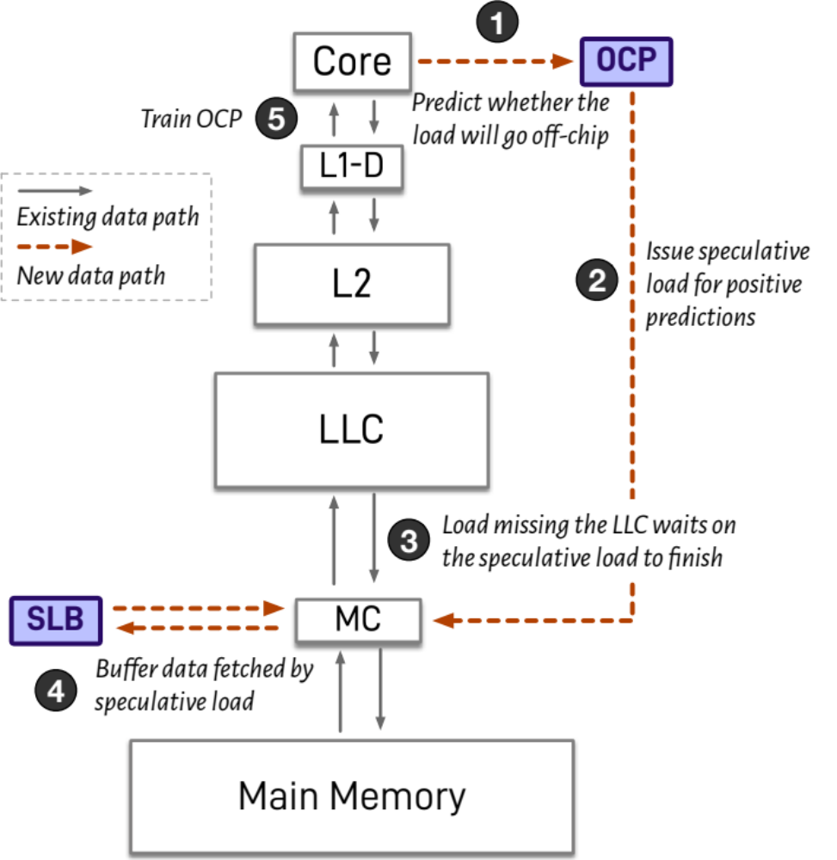
Hermes: Overview
Notes:
This is a brief overview of Hermes.
For every load, Hermes’s off-chip predictor predicts whether the load would go to off-chip.

Slide 255
Hermes: Overview
Notes:
If the load is predicted to go off-chip, Hermes issues a speculative load request directly to the memory controller to start fetching the data from the main memory, while concurrently accessing the on-chip cache hierarchy for the load.

Slide 256
Hermes: Overview
Notes:
In case of a correct prediction, the load eventually misses the LLC, and waits on the ongoing speculative load to finish, thus completely hiding the on-chip cache access latency from the critical path.

Slide 257
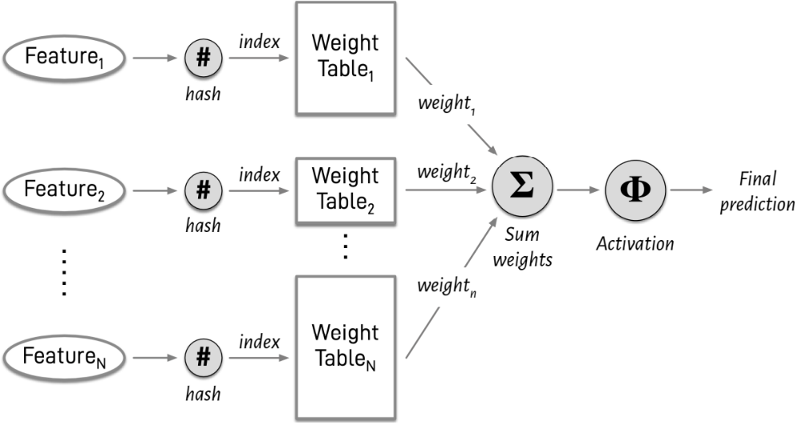
Perceptron-based Off-chip Predictor
Notes:
Hermes employs a perceptron-based off-chip predictor which uses multiple disparate program features to make accurate off-chip predictions.

Slide 258
1
We evaluate Hermes using a wide-range of workloads
Hermes improves performance by
5.4% in single-core
5.1% in eight-core
6.2% in memory bandwidth-constrained core
over the baseline with the state-of-the-art prefetcher
2
Consistent performance improvement in a wide range of configurations with varying prefetchers and cache access latency
5.1%, 6.2%, 7.7% performance improvement
in single-core with SPP, Bingo, SMS prefetchers
3
Realistic, practical implementation
Only 5.1 KB storage and 1.5% power overhead
of a desktop-class processor
Notes:
[CLICK] We extensively evaluate Pythia over a wide range of workloads and show that Pythia outperforms many state-of-the-art prefetcher over a wide range of system configuration.
[CLICK] We also show that by simple customization via configuration registers, Pythia can provide higher performance benefits for target workloads, without any changes to the underlying hardware.
[CLICK] Finally, Pythia proposes a realistic implementation of its RL algorithm that incurs a modest area and power overhead on top of a traditional processor.

Slide 259
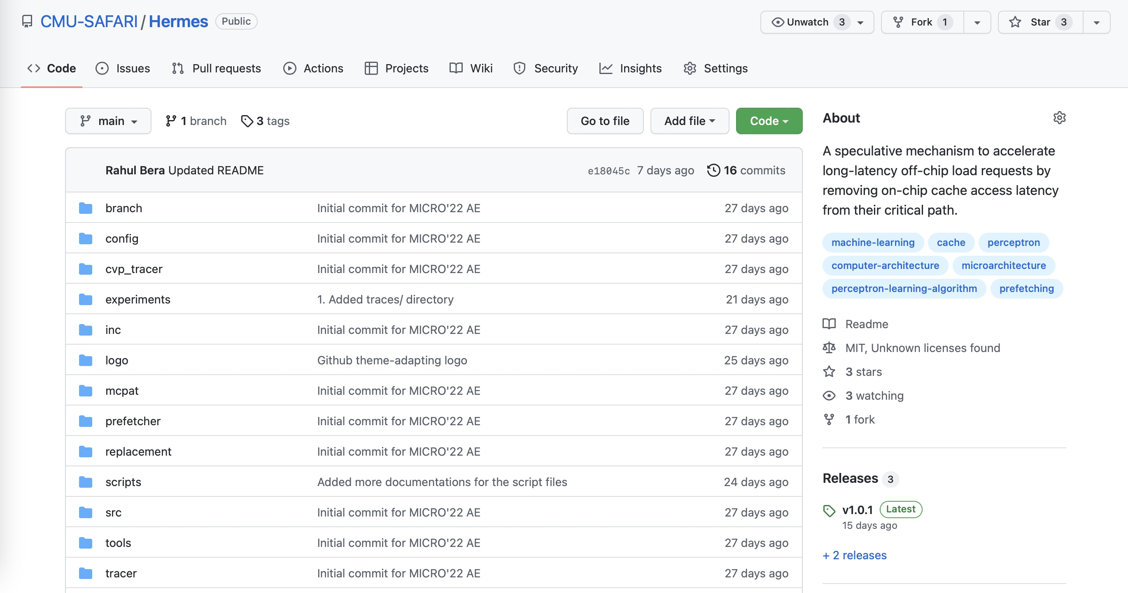
Hermes is Open Source
https://github.com/CMU-SAFARI/Hermes
All 3 badges from MICRO’22 artifact evaluation
Champsim and McPAT source code
All traces & scripts used for evaluation
Notes:
Pythia is open-sourced and artifact evaluated.
All necessary source code and traces used for evaluation can be found online in our GitHub repository.

Slide 260
Accelerating Long-Latency Load Requests
via Perceptron-based Off-chip Load Prediction
Rahul Bera, Konstantinos Kanellopoulos, Shankar Balachandran,
David Novo, Ataberk Olgun, Mohammad Sadrosadati, Onur Mutlu
Notes:
Hi I’m Rahul. Today, I will introduce Pythia.

Slide 261
Year III Results (2022 Annual Review 3)
Sibyl: Adaptive and Extensible Data Placement in Hybrid Storage Systems Using Online Reinforcement Learning [ISCA 2022]
Hermes: Accelerating Long-Latency Load Requests via Perceptron-Based Off-Chip Load Prediction [MICRO 2022]
GenPIP: In-Memory Acceleration of Genome Analysis via Tight Integration of Basecalling and Read Mapping [MICRO 2022]
pLUTo: Enabling Massively Parallel Computation via In DRAM via Lookup Tables [MICRO 2022]
DeepSketch: A New Machine Learning-Based Reference Search Technique for Post-Deduplication Delta Compression [FAST 2022]
A Modern Primer on Processing in Memory [Arxiv, Updated 2022]

Slide 262
Year III Results (2022 Annual Review 3)
Sibyl: Adaptive and Extensible Data Placement in Hybrid Storage Systems Using Online Reinforcement Learning [ISCA 2022]
Hermes: Accelerating Long-Latency Load Requests via Perceptron-Based Off-Chip Load Prediction [MICRO 2022]
GenPIP: In-Memory Acceleration of Genome Analysis via Tight Integration of Basecalling and Read Mapping [MICRO 2022]
pLUTo: Enabling Massively Parallel Computation via In DRAM via Lookup Tables [MICRO 2022]
DeepSketch: A New Machine Learning-Based Reference Search Technique for Post-Deduplication Delta Compression [FAST 2022]
A Modern Primer on Processing in Memory [Arxiv, Updated 2022]

Slide 263
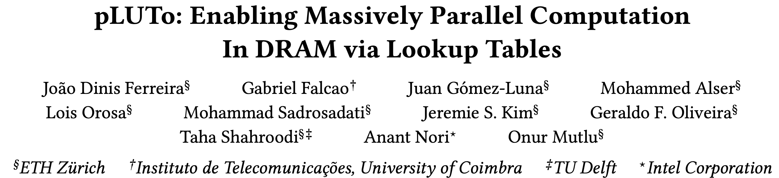
pLUTo
To Appear in MICRO 2022
https://arxiv.org/pdf/2104.07699.pdf

Slide 264

pLUTo: In-DRAM Lookup Tables to Enable
General-Purpose Massively Parallel Computations
João Dinis Ferreira, Gabriel Falcao, Juan Gómez-Luna,
Mohammed Alser, Geraldo F. Oliveira, Jeremie S. Kim, Mohammad Sadrosadati,
Lois Orosa, Taha Shahroodi, Anant Nori, Onur Mutlu
August 2022

Slide 265
Executive Summary
Problem. Many workloads require significant data movement. Existing Processing-using-Memory solutions mitigate this data movement but lack support for complex operations.
Key Idea. LUTs enable general-purpose computation: perform LUT-based computation inside memory subarrays to perform complex operations.
Mechanism Overview. With the LUT query operation, the elements in a source memory row are queried simultaneously in a LUT. In this way, it is possible to perform bulk LUT queries in-DRAM.
Key Contributions.
  Introduce support for bulk in-memory LUT querying for general-purpose in-memory computing.
  Three implementations of pLUTo with varying area/performance/efficiency trade-offs.
Key Results.
  Compared to CPU: up to 33x faster and 110x more energy-efficient.
  Compared to GPU: up to 8x faster and 80x more energy-efficient.

Slide 266
Year III Results (2022 Annual Review 3)
Sibyl: Adaptive and Extensible Data Placement in Hybrid Storage Systems Using Online Reinforcement Learning [ISCA 2022]
Hermes: Accelerating Long-Latency Load Requests via Perceptron-Based Off-Chip Load Prediction [MICRO 2022]
GenPIP: In-Memory Acceleration of Genome Analysis via Tight Integration of Basecalling and Read Mapping [MICRO 2022]
pLUTo: Enabling Massively Parallel Computation via In DRAM via Lookup Tables [MICRO 2022]
DeepSketch: A New Machine Learning-Based Reference Search Technique for Post-Deduplication Delta Compression [FAST 2022]
A Modern Primer on Processing in Memory [Arxiv, Updated 2022]

Slide 267
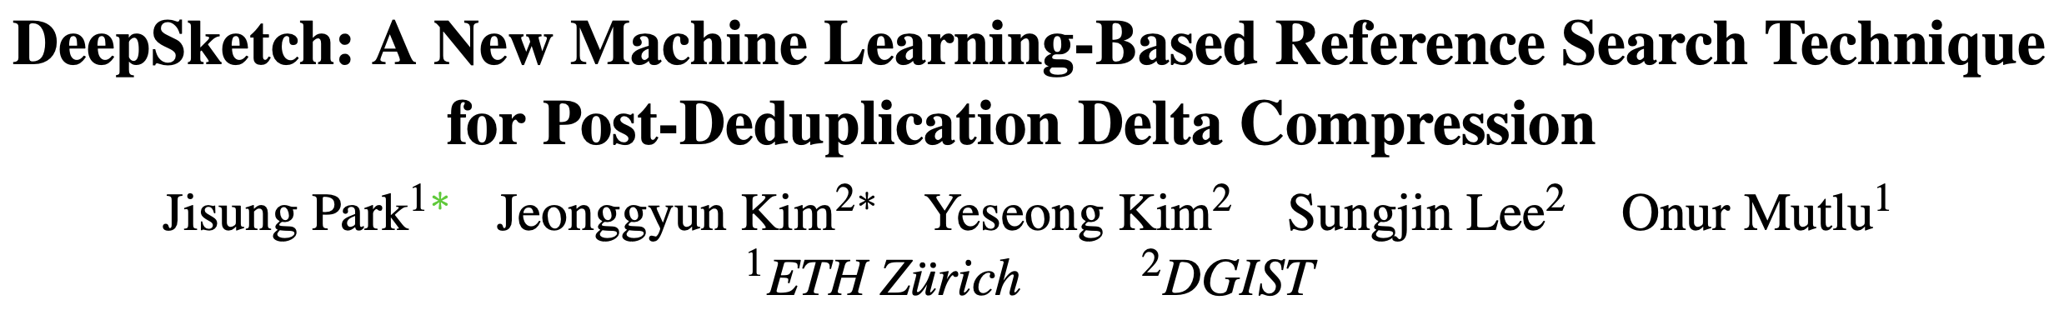
DeepSketch
Jisung Park, Jeonggyun Kim, Yeseong Kim, Sungjin Lee, and Onur Mutlu,
"DeepSketch: A New Machine Learning-Based Reference Search Technique for Post-Deduplication Delta Compression"
Proceedings of the 20th USENIX Conference on File and Storage Technologies (FAST), Santa Clara, CA, USA, February 2022.
[Slides (pptx) (pdf)]
[Talk Video (15 minutes)]
https://arxiv.org/pdf/2202.10584.pdf

Slide 268
Executive Summary
Motivation
  Data reduction: Effective at reducing the management cost of a data center by reducing the amount of data physically written to storage devices
  Post-deduplication delta compression: Maximizes the data-reduction ratio by applying delta compression along with deduplication and lossless compression
Problem: Existing post-deduplication delta-compression techniques provide significantly low data-reduction ratios compared to the optimal.
  Due to the limited accuracy of reference search for delta compression
  Cannot identify a good reference block for many incoming data blocks
Key Idea: DeepSketch, a new machine learning-based reference search technique that uses the learning-to-hash method
  Generates a given data block’s signature (sketch) using a deep neural network
  The higher the delta-compression benefit of two data blocks,
  the more similar the signatures of the two blocks to each other
Evaluation Results: DeepSketch reduces the amount of physically-written data
  Up to 33% (21% on average) compared to a state-of-the-art baseline

Slide 269
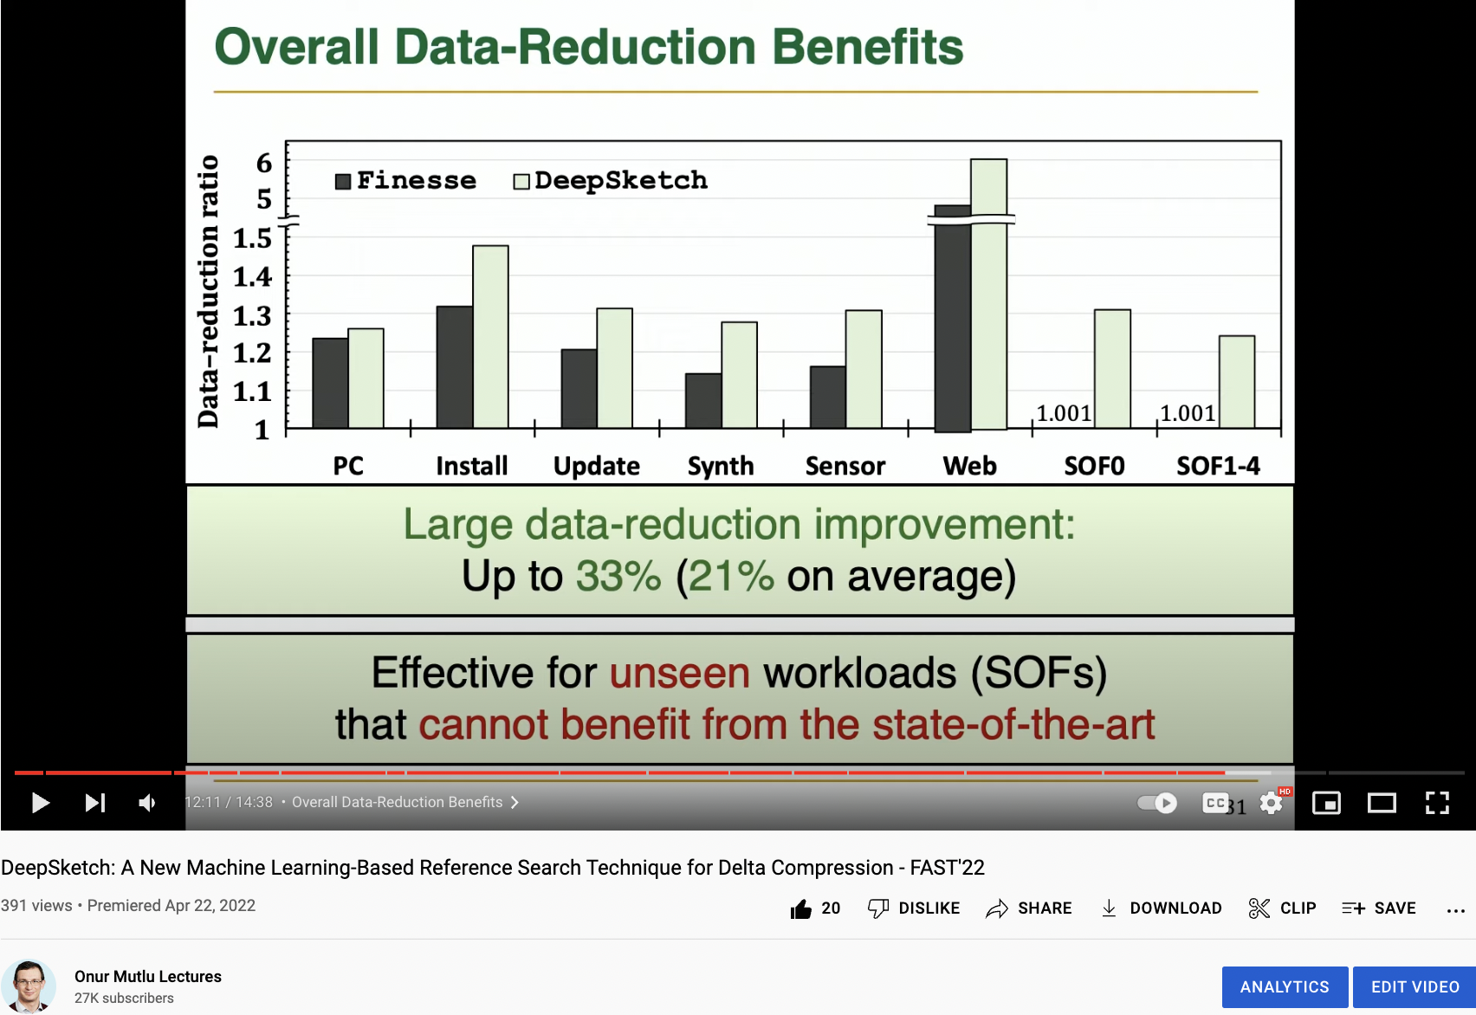
DeepSketch Talk Video
https://www.youtube.com/watch?v=RFdGyAJCk9M

Slide 270
Year III Results (2022 Annual Review 3)
Sibyl: Adaptive and Extensible Data Placement in Hybrid Storage Systems Using Online Reinforcement Learning [ISCA 2022]
Hermes: Accelerating Long-Latency Load Requests via Perceptron-Based Off-Chip Load Prediction [MICRO 2022]
GenPIP: In-Memory Acceleration of Genome Analysis via Tight Integration of Basecalling and Read Mapping [MICRO 2022]
pLUTo: Enabling Massively Parallel Computation via In DRAM via Lookup Tables [MICRO 2022]
DeepSketch: A New Machine Learning-Based Reference Search Technique for Post-Deduplication Delta Compression [FAST 2022]
A Modern Primer on Processing in Memory [Arxiv, Updated 2022]

Slide 271
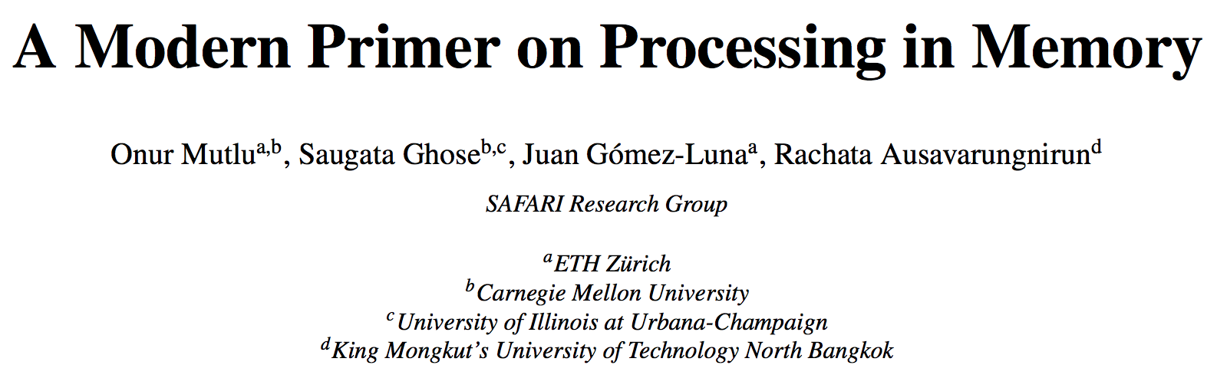
PIM Review and Open Problems
Onur Mutlu, Saugata Ghose, Juan Gomez-Luna, and Rachata Ausavarungnirun,
"A Modern Primer on Processing in Memory"
Invited Book Chapter in Emerging Computing: From Devices to Systems - Looking Beyond Moore and Von Neumann, Springer, to be published in 2021.
https://arxiv.org/pdf/1903.03988.pdf

Slide 272
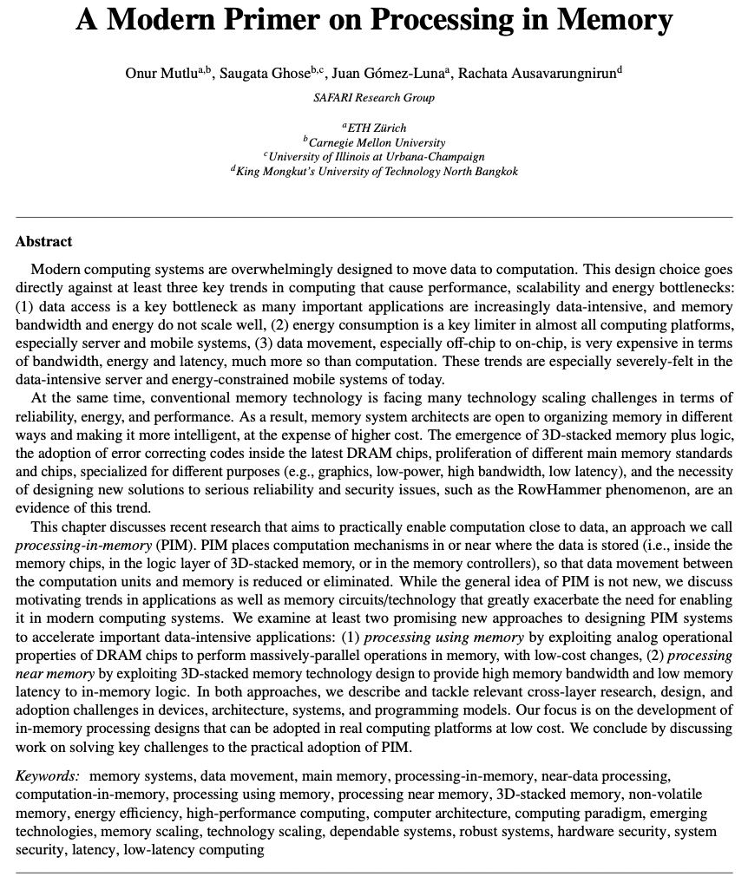

Slide 273
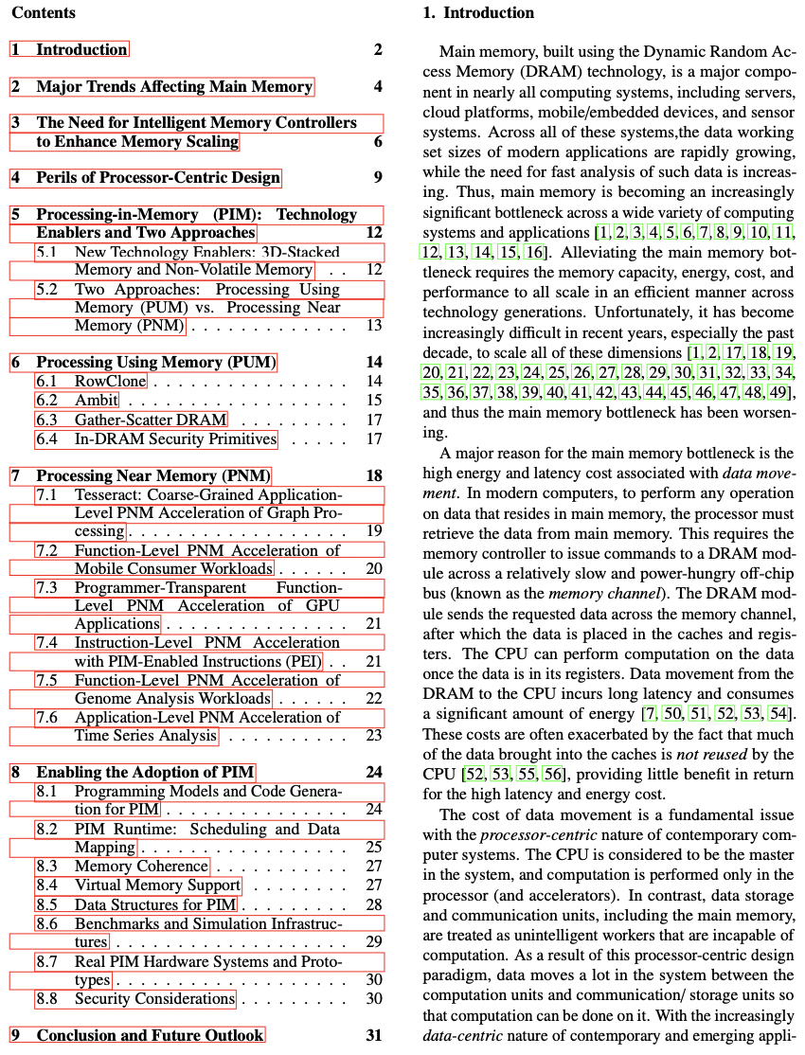

Slide 274
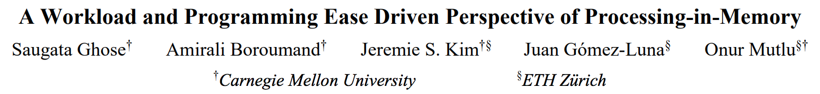
PIM Review and Open Problems (II)
Saugata Ghose, Amirali Boroumand, Jeremie S. Kim, Juan Gomez-Luna, and Onur Mutlu,
"Processing-in-Memory: A Workload-Driven Perspective"
Invited Article in IBM Journal of Research & Development, Special Issue on Hardware for Artificial Intelligence, to appear in November 2019.
[Preliminary arXiv version]
https://arxiv.org/pdf/1907.12947.pdf

Slide 275
Year III Results (2022 Annual Review 4)
EcoFlow: Efficient Convolutional Dataflows for Low-Power Neural Network Accelerators [arXiv 2022] https://arxiv.org/abs/2202.02310
ApHMM: Accelerating Profile Hidden Markov Models for Fast and Energy-Efficient Genome Analysis [arXiv 2022] https://arxiv.org/abs/2207.09765
Accelerating Weather Prediction Using Near-Memory Reconfigurable Fabric [TRETS 2022] https://arxiv.org/abs/2107.08716

Slide 276
Memory System Design for AI/ML Accelerators & ML/AI Techniques for Memory System Design
Onur Mutlu
omutlu@gmail.com
https://people.inf.ethz.ch/omutlu
30 August 2022
SRC AIHW Annual Review

