Slide 1



ColumnDisturb
Understanding Column-based Read Disturbance in Real DRAM Chips and Implications for Future Systems
İsmail Emir Yüksel
Ataberk Olgun F. Nisa Bostancı Haocong Luo
A. Giray Yağlıkçı Onur Mutlu
Notes:
Hello, I am Ismail Emir Yuksel.
I will be presenting our work, ColumnDisturb [..]

Slide 2
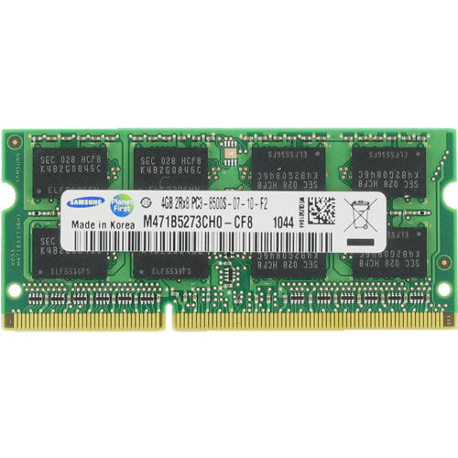
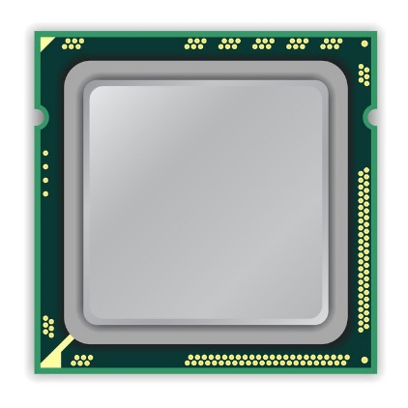
A Typical DRAM-Based Computing System
DRAM Chip
CPU
DRAM Module
Notes:
This is a typical DRAM-based computing system with a CPU [CLICK] and a DRAM module with multiple DRAM chips.

Slide 3

DRAM Organization
DRAM Module
DRAM
Chip
Subarray
DRAM Cell
Bank
…
Wordline
Chip I/O
Row Decoder
DRAM Row
Bitline
…
Sense Amps.
DRAM Chip
DRAM Bank
DRAM Subarray
Notes:
[CLICKx2] Each chip contains multiple banks
[CLICK] Each bank is composed of multiple subarrays and sense amplifiers
[CLICK] And within each subarray, there is a two dimensional array of DRAM cells.
[CLICK] These cells are organized into rows that are selected using wordlines
[CLICK] And the cells are connected to a row of sense amplifiers via bitlines
To access data in a row, you need to activate the row and too many repeated activations can lead to

Slide 4
Read Disturbance in DRAM (I)
Read disturbance in DRAM breaks memory isolation
Prominent example: RowHammer
Subarray
Sense A.
Sense A.
DRAM Cell
DRAM Column
Subarray
DRAM Row
Sense
Amplifier
Sense A.
Sense A.
Subarray
Notes:
[CLICK] Read disturbance bitflips have significant system-level implications because they break memory isolation
[CLICK] A prominent example is RowHammer
[CLICK] Let me illustrate RowHammer
[CLICK] Here we have three subarrays one on the top, one in the middle between sense amplifiers, and one in the bottom
[CLICK] Each circle is a DRAM cell and purple boxes are sense amplifiers

Slide 5

Read Disturbance in DRAM (I)
Read disturbance in DRAM breaks memory isolation
Prominent example: RowHammer
Sense A.
Sense A.
Victim Cell
Victim Row
Aggressor Row
Victim Row
Sense A.
Sense A.
Repeatedly opening and closing a DRAM row many times
causes bitflips in adjacent rows in the same subarray
Notes:
[CLICK] To induce RowHammer bitflips, we repeatedly open and close a DRAM row called aggressor row
[CLICK] Too many activations causes bitflips in adjacent rows in the same subarray, and rows that experience bitflips are called victim rows

Slide 6
Read Disturbance in DRAM (II)
Read disturbance in DRAM breaks memory isolation
A new read disturbance phenomenon: RowPress
Sense A.
Sense A.
Victim Cell
Victim Row
keep open
Aggressor Row
Victim Row
Sense A.
Sense A.
Keeping a DRAM row open for a long time
causes bitflips in adjacent rows in the same subarray
Notes:
[CLICK] There is also another read disturbance phenomenon called RowPress
[CLICK] In RowPress, instead of hammering we keep the aggressor row open for a long time to induce bitflips in again adjacent rows in the same subarray

Slide 7
Read Disturbance in DRAM (III)
RowHammer and RowPress are
row-based read disturbance phenomena
that affect only a few neighboring victim rows
Most of the mitigations work by
    1) detecting high row activation count or high row open time
    2) refreshing a few neighboring rows (e.g., +/-4)
Detecting and refreshing even only a few neighboring rows
is shown to be a difficult problem
Notes:
To summarize,
[CLICK] RowHammer and RowPress are row-based read disturbance phenomena and they affect only a few neighboring victim rows
[CLICK] As a result, most of the mitigations (including state-of-the-art industry and academia solutions) work by
[CLICK] First, detecting high row activation count and/or high row open time
[CLICK] Second, they refresh a few neighboring rows
[CLICK] Detecting and refreshing even only a few neighboring rows is shown to be a difficult problem. People are still publishing papers developing new solutions to solve this problem

Slide 8
Research Question
What if there is a much worse
read disturbance phenomenon
that affects
thousands of DRAM rows
through the bitlines?
Notes:
In this work, we ask the question:
What if there is a much worse read disturbance phenomenon that affects thousands of rows, through the bitlines

Slide 9
ColumnDisturb
By repeatedly opening or keeping a DRAM row open,
it is possible to disturb many DRAM cells
on the same DRAM column
Subarray
Victim Cell
Subarray
Subarray
With ColumnDisturb, the activation of a single row concurrently affects DRAM cells across as many as three DRAM subarrays
(e.g., up to 3072 DRAM rows)
Notes:
Turns out, there is one: which we call ColumnDisturb
[CLICK] We observe that by repeatedly opening or keeping a DRAM row open, it is possible to disturb many DRAM cells on the same DRAM column
[CLICK] With ColumnDisturb, the activation of a single row concurrently affects DRAM cells across as many as three DRAM subarrays: which translates to up to 3072 DRAM rows

Slide 10
Outline
What is ColumnDisturb?
Testing Infrastructure
Real DRAM Chip Results
Implications
Conclusion
Notes:
Here is the outline of my talk

Slide 11
Outline
What is ColumnDisturb?
Testing Infrastructure
Real DRAM Chip Results
Implications
Conclusion
Notes:
Let me start with explaining what ColumnDisturb is

Slide 12
What is ColumnDisturb?
ColumnDisturb is a column-based read disturbance phenomenon
that affects thousands of rows
An activation of a row perturbs all the columns connected to that row
Sense A.
Sense A.
Sense A.
Sense A.
Cells in all perturbed columns are disturbed
Notes:
ColumnDisturb is fundamentally different phenomenon than RowHammer and RowPress: it is a column-based read disturbance phenomenon that affects thousands of rows
[CLICK] By hammering or pressing a single DRAM row.
Why this happens? Because
[CLICK] Activating of a row perturbs all the columns that are connected to that row
[CLICK] as a result cells in all perturbed columns are affected.

Slide 13
What is ColumnDisturb?
ColumnDisturb is a column-based read disturbance phenomenon
that affects thousands of rows
Sense A.
Sense A.
As a result,
all columns
in the aggressor subarray
Open-bitline architecture:
columns of a single row
span multiple subarrays
Aggressor
Subarray
Also half of the columns
in the neighboring subarrays are affected
Sense A.
Sense A.
Notes:
As a result, all columns in the aggressor subarray .
[CLICK] also half of the columns in the neighboring subarrays of the aggressor subarray are affected. Why ColumnDisturb affects multiple subarrays?
[CLICK] This is because of the open bitline architecture: columns of a single row span multiple subarrays as these columns are connected to the same set of sense amplifier

Slide 14
What is ColumnDisturb?
ColumnDisturb is a column-based read disturbance phenomenon
that affects thousands of rows
Victim
Column
Victim
Column
Sense A.
Sense A.
Victim
Victim
Column
Victim
Column
Column
Victim
Column
Sense A.
Sense A.
Victim
Column
Victim
Column
ColumnDisturb affects cells vertically connected to the same bitline.
DRAM columns are the victims
Notes:
Consequently, ColumnDisturb affect cells that are vertically connected to the same bitline, DRAM columns are the victims

Slide 15
What is ColumnDisturb?
ColumnDisturb is a column-based read disturbance phenomenon
that affects thousands of rows
Neighboring
Subarray
Victim
→ 1024 rows
Column
Victim
Column
Sense A.
Sense A.
Aggressor
Subarray
→ 1024 rows
Victim
Victim
Column
Victim
Column
Column
Victim
Column
Sense A.
Sense A.
Neighboring
Subarray
Victim
→ 1024 rows
Column
Victim
Column
ColumnDisturb affects cells
across both the same subarray and multiple neighboring subarrays
Notes:
As columns of an activated row span three subarrays,
[CLICK] ColumnDisturb affect cells across both the same subarray and multiple neighboring subarrays, in total three consecutive subarrays

Slide 16
Outline
What is ColumnDisturb?
Testing Infrastructure
Real DRAM Chip Results
Implications for Future Systems & Mechanisms
Conclusion
Notes:
We experimentally characterize ColumnDisturb in real DRAM chips using our testing infrastructure

Slide 17
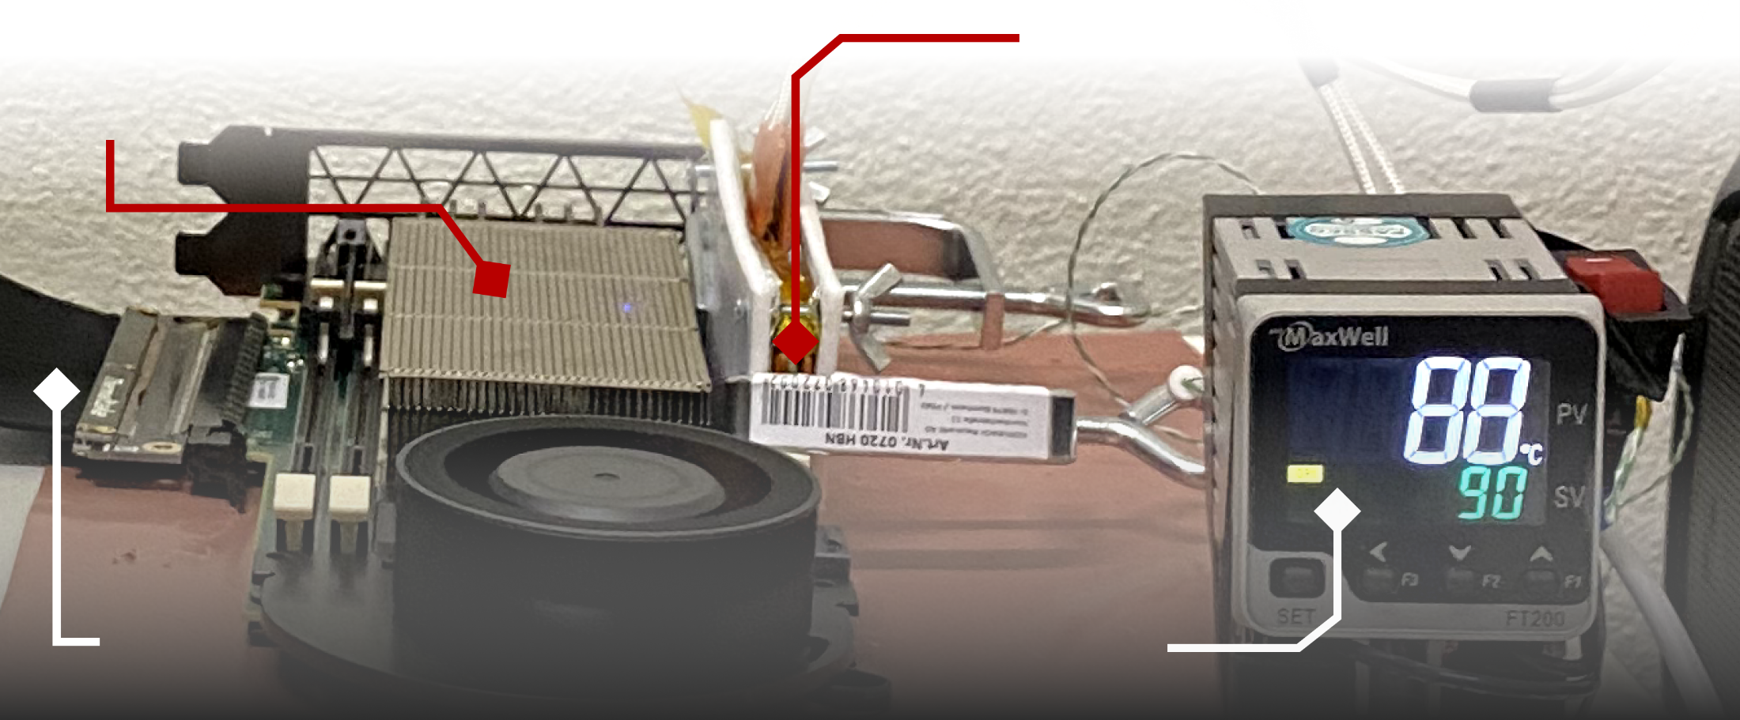
DDR4 DRAM Testing Infrastructure
  DRAM Bender on a Xilinx Virtex UltraScale+ XCU200
Xilinx Alveo U200 FPGA Board
(programmed with DRAM Bender*)
DRAM Module with Heaters
PCIe
Host Interface
MaxWell FT200 Temperature Controller
Fine-grained control over DRAM commands,
timing parameters (±1.5ns), and temperature (±0.5°C )
*Olgun et al., "DRAM Bender: An Extensible and Versatile FPGA-Based Infrastructure to Easily Test
State-of-the-Art DRAM Chips,” TCAD, 2023. [GitHub: https://github.com/CMU-SAFARI/DRAM-Bender]
Notes:
Which is DRAM Bender. It enables us to test DDR4 DRAM modules
[CLICK]
with fine-grained control over DRAM commands, timing parameters, and temperature

Slide 18
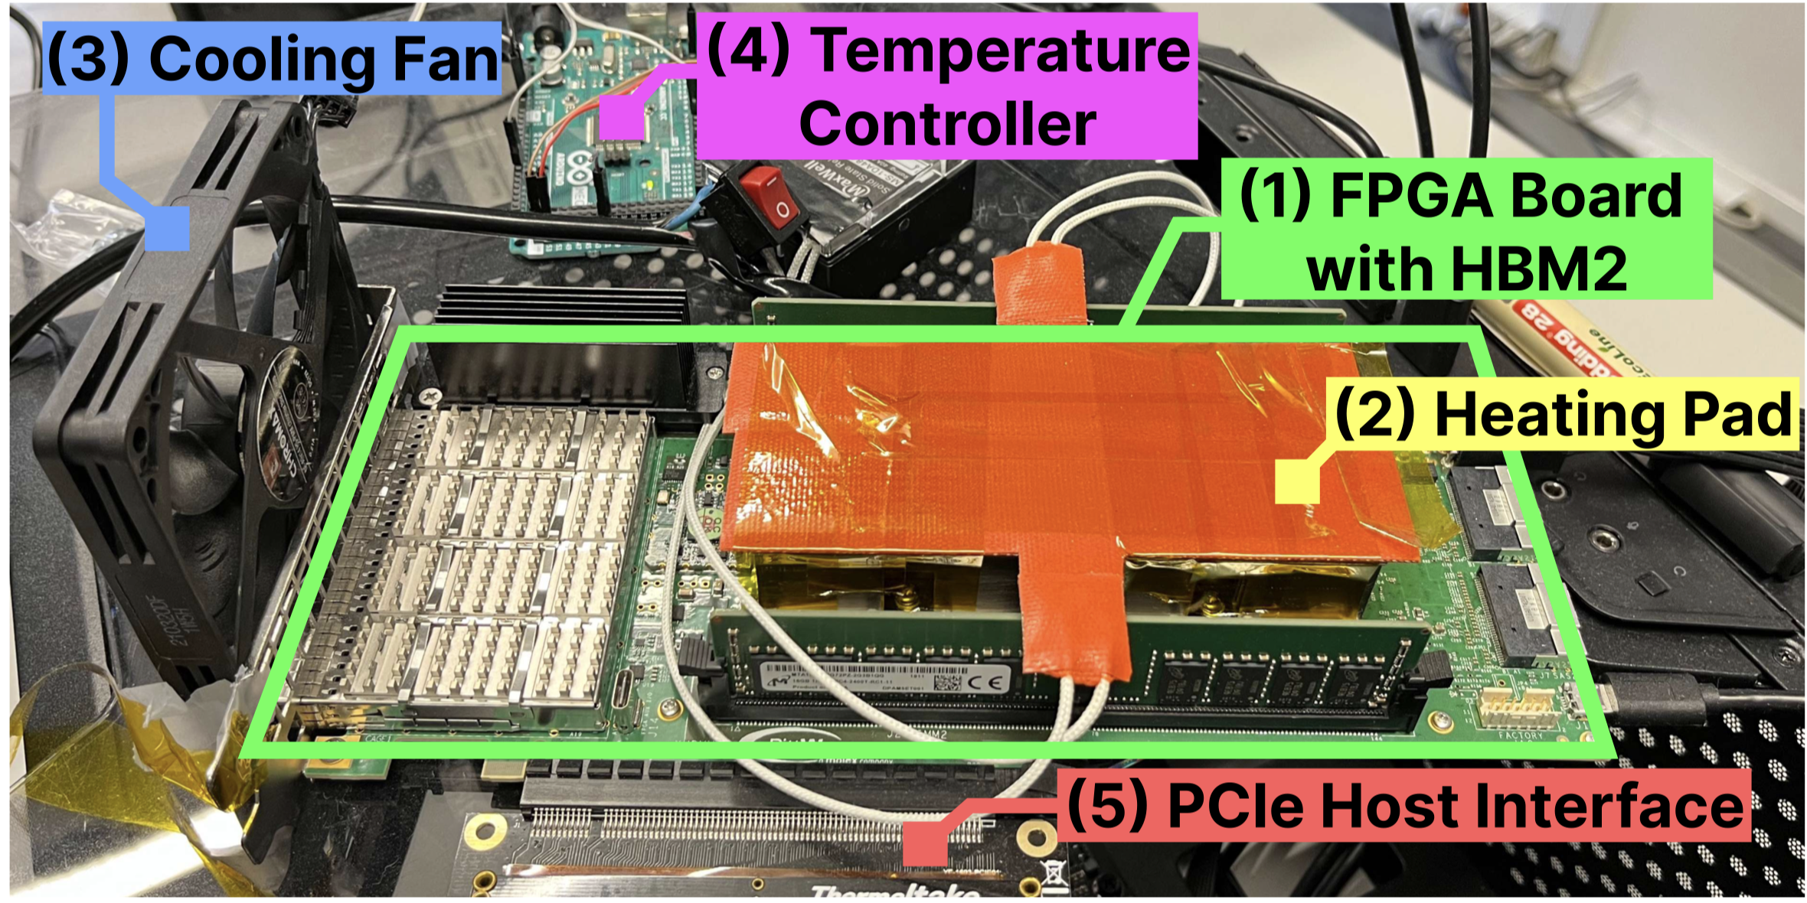
HBM2 DRAM Testing Infrastructure
  DRAM Bender on a Bittware XUPVVH
Fine-grained control over DRAM commands,
timing parameters (±1.67ns), and temperature (±0.5°C )
*Olgun et al., "DRAM Bender: An Extensible and Versatile FPGA-Based Infrastructure to Easily Test
State-of-the-Art DRAM Chips,” TCAD, 2023. [GitHub: https://github.com/CMU-SAFARI/DRAM-Bender]
Notes:
This is another version of the same infrastructure we use to test HBM2 DRAM chips.

Slide 19
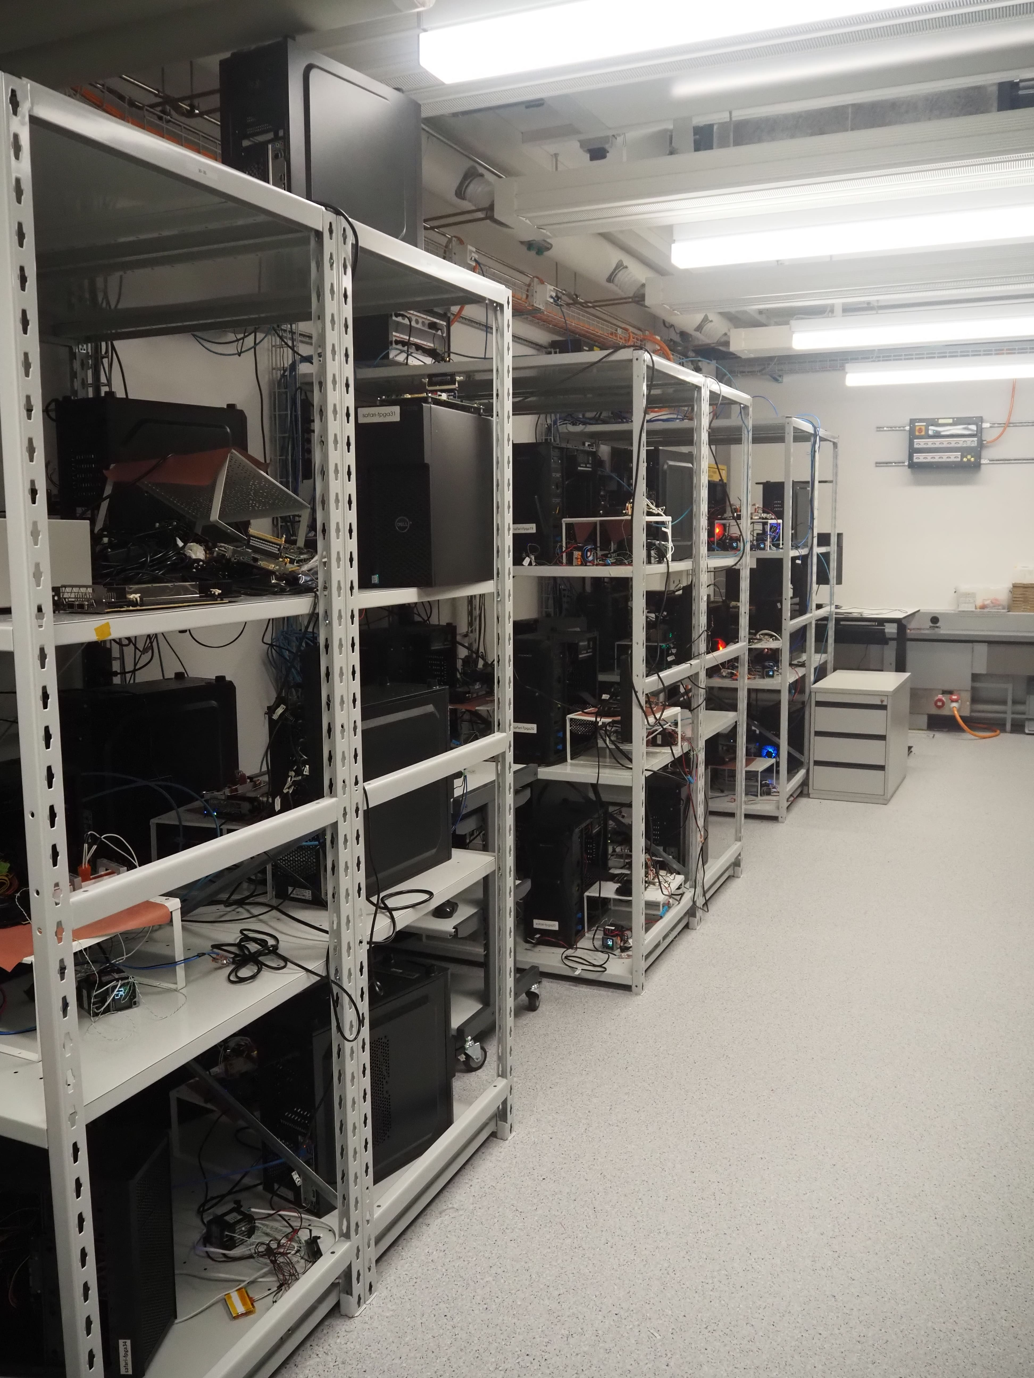
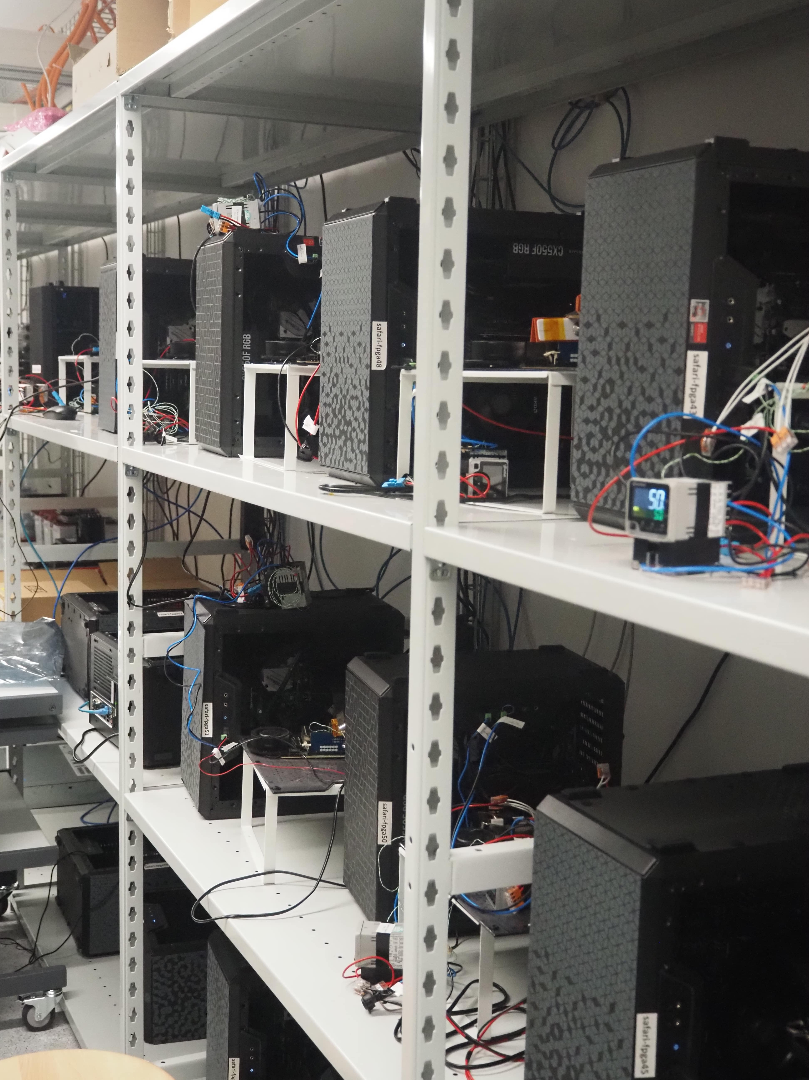
Laboratory for Understanding Memory
Notes:
And in our lab, we have many machines to test many DRAM modules and chips

Slide 20
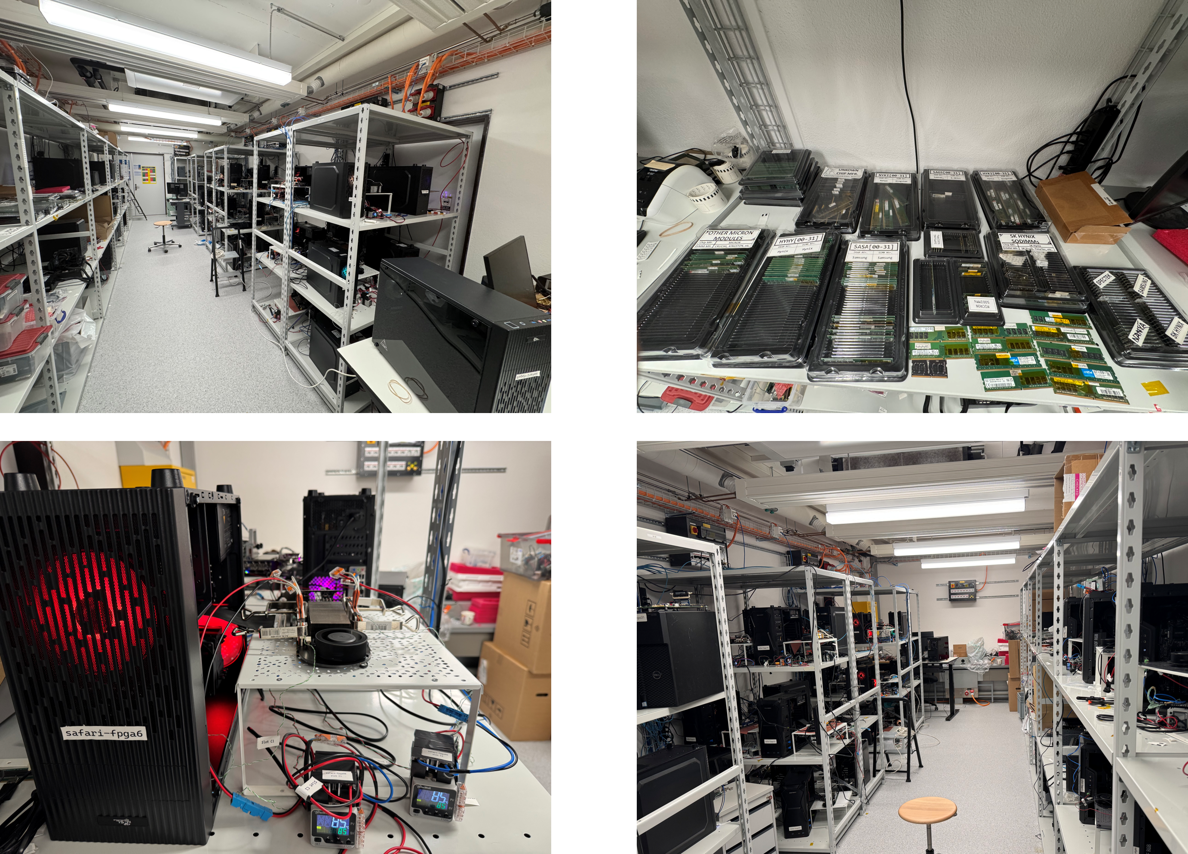
Laboratory for Understanding Memory
Notes:
And in our lab, we have many machines to test many DRAM modules and chips

Slide 21
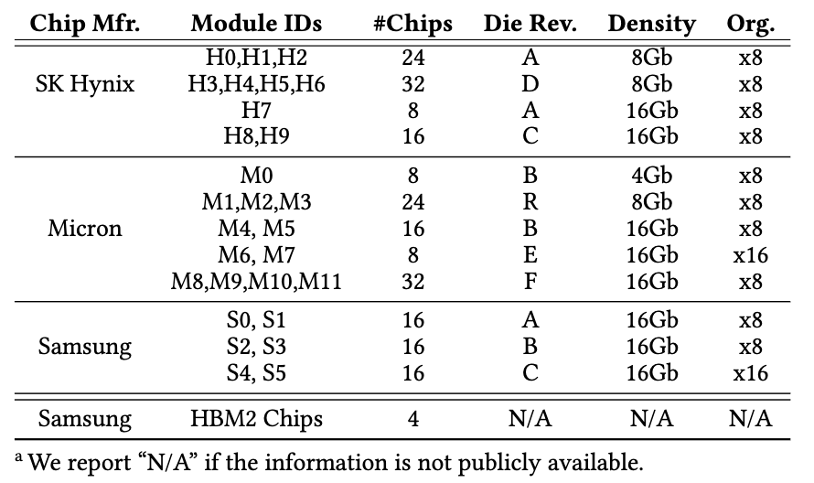
Tested DRAM Chips
216 DDR4 and 4 HBM2 Chips from SK Hynix, Micron, Samsung
Notes:
We test many DRAM chips from three major DRAM manufacturers spanning
[CLICK] various die density and die revisions.

Slide 22
Testing Methodology: Sources of Interference
Prevent sources of interference during core test loop
No DRAM refresh
    to avoid refreshing victim rows
No read disturbance mitigation mechanisms
    to observe circuit-level effects
No error correcting codes (ECC)
    to observe all bitflips
Filter out Retention & RowHammer/RowPress bitflips
    to demonstrate that ColumnDisturb bitflips are new and unique
Notes:
[CLICK as you say below]
We carefully re-use the rigorous read disturbance characterization methodology as done by prior work where we prevent sources of interference
and
[CLICK] we also filter out retention failures and rowhammer and rowpress bitflips
to demonstrate that ColumnDisturb bitflips are new and unique

Slide 23
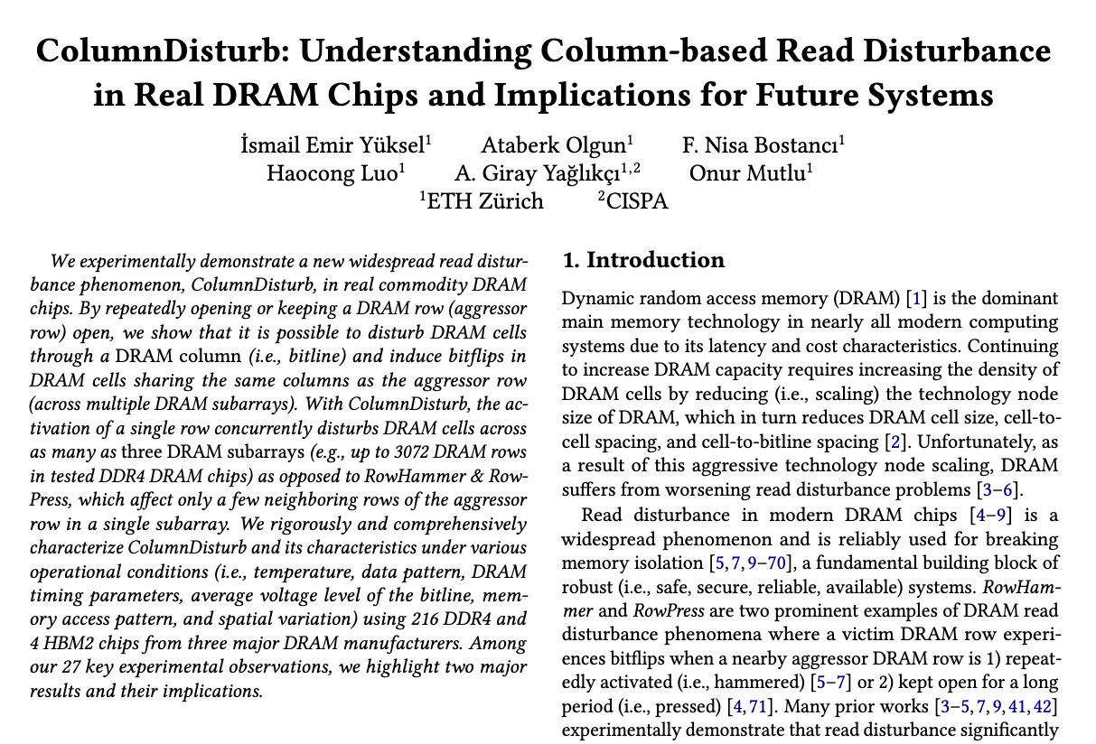
Testing Methodology: Sources of Interference
https://arxiv.org/pdf/2510.14750
Notes:
I’d like to refer you to our paper for more details on how we deal these sources of interferences

Slide 24
Testing Methodology: Metric & Access Pattern
Minimum time required to induce
the first ColumnDisturb bitflip
Lower is worse
Number of ColumnDisturb bitflips
in a subarray
Higher is worse
Number of rows with
ColumnDisturb bitflips in a subarray
Higher is worse
Victim Row
…
Record bitflips
in victim rows
across three subarrays
Victim Row
Three consecutive subarrays
Victim Row
Aggressor Row (AGG)
Victim Row
Victim Row
…
Victim Row
…
ACT AGG
PRE
ACT AGG
Notes:
In our study we use three key metrics to understand ColumnDisturb in real DRAM chips
[CLICK] First, [..]
[CLICK] second, [..]
[CLICK] And third, [..]
[CLICK] In our experiments, we use a single aggressor row and
Since ColumnDisturb affects cells in three consecutive subarrays, all rows in three consecutive subarrays (except the aggressor row) are victim rows
[CLICK] We use a very similar access pattern as prior works which we hammer or press the aggressor row during the experiments
[CLICK] and record bitflips in victim rows

Slide 25
Testing Methodology: Test Parameters
We carefully sweep
Data Pattern
    0x00, 0xAA, 0x33, and 0x77 (and their inverse pattern)
Temperature (◦C)
    45, 65, 85, and 95
Aggressor Row On Time (tAggOn)*
    36ns, 7.8us, 70.2us, and 1ms
DRAM Refresh Interval
    64ms, 128ms, 256ms, 512ms, 1s, 2s, 4s, 8s, and 16s
Aggressor Row Location
    Aggressor subarray’s first, middle, and last rows
Tested Subarrays (Rows)
    Up to +49K (+4.5M): all subarrays in all banks across all DRAM chips
* The time an aggressor row stays open after each activation during a ColumnDisturb test

Slide 26
Outline
What is ColumnDisturb?
Testing Infrastructure
Real DRAM Chip Results
Implications
Conclusion

Slide 27
Key Takeaways from Major Characterization Experiments
Takeaway 1
ColumnDisturb is a widespread read disturbance phenomenon and becomes worse as DRAM technology scales down to smaller node sizes
Takeaway 2
ColumnDisturb induces bitflips in thousands of DRAM rows and
is different from RowHammer, RowPress, and Retention failures
Takeaway 3
The bitflip directionalities of ColumnDisturb and RowHammer & RowPress
are significantly different
Takeaway 4
Significantly more rows are vulnerable to ColumnDisturb
than retention failures
Takeaway 5
As temperature increases,
DRAM chips become more vulnerable to ColumnDisturb
Notes:
We have five key takeaways from major characterization experiments

Slide 28
Key Takeaways from Major Characterization Experiments
Takeaway 1
ColumnDisturb is a widespread read disturbance phenomenon and becomes worse as DRAM technology scales down to smaller node sizes
Takeaway 2
ColumnDisturb induces bitflips in thousands of DRAM rows and
is different from RowHammer, RowPress, and Retention failures
Takeaway 3
The bitflip directionalities of ColumnDisturb and RowHammer & RowPress
are significantly different
Takeaway 4
Significantly more rows are vulnerable to ColumnDisturb
than retention failures
Takeaway 5
As temperature increases,
DRAM chips become more vulnerable to ColumnDisturb
Notes:
First, ColumnDisturb is a widespread read disturbance phenomenon and becomes worse as DRAM technology scales down to smaller node sizes

Slide 29
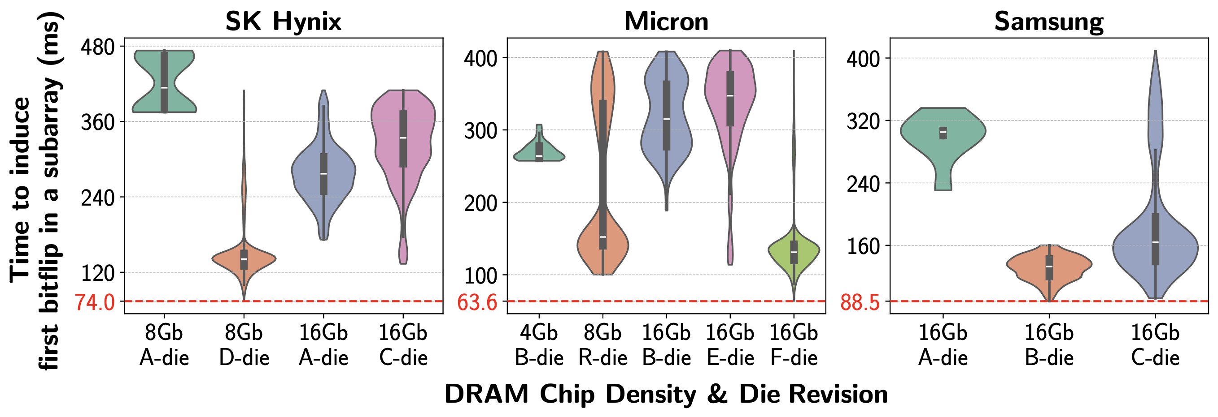
Minimum Time to Induce First Bitflip
All tested 216 DDR4 chips are vulnerable to ColumnDisturb
Notes:
Here we show the first result that lead us to first takeaway: y-axis shows the time to induce first bitflip in a subarray
[CLICK] X-axis shows the DRAM die revision and density and each subplot is dedicated to different manufacturer
[CLICK] Here is the result and as you can see all tested DRAM chips experience ColumnDisturb bitflips
[CLICK] We conclude that all tested 216 DDR4 chips are vulnerable to ColumnDisturb

Slide 30
Minimum Time to Induce First Bitflip
5.1x
3x
2.5x
1.3x
Newer chips tend to be
more vulnerable to ColumnDisturb bitflips
This trend is consistent across all tested manufacturers
Notes:
For the second observation,
[CLICK] Let’s first focus on one manufacturer: Sk hynix
[CLICK] We observe that from A-die to D-die, the minimum time to observe first bitflips reduces by up to 5.1x, note that 8Gb D-die chips are newer than 8Gb A-die chips
And a similar reduction in 16Gb A-die to C-die
[CLICK] We conclude that newer chips tend to be more vulnerable to ColumnDisturb bitflips
[CLICK] And this observation is consistent across all tested manufacturers

Slide 31
Minimum Time to Induce First Bitflip
Some real DRAM chips experience ColumnDisturb bitflips
within the nominal refresh window (64ms)
under nominal operating conditions
Notes:
[CLICK] Another observation we made is based on the lowest time to induce the first bitflip in a subarray for each manufacturer, highlighted as red.
[CLICK] In some Micron chips, specifically 16Gb F-die chips experience ColumnDisturb bitflips within the nominal refresh window under nominal operating conditions, note that these 16Gb F-die chips are the newest one across all tested chips according to datasheet release date and manufacturing time.

Slide 32
Key Takeaways from Major Characterization Experiments
Takeaway 1
ColumnDisturb is a widespread read disturbance phenomenon and becomes worse as DRAM technology scales down to smaller node sizes
Takeaway 2
ColumnDisturb induces bitflips in thousands of DRAM rows and
is different from RowHammer, RowPress, and Retention failures
Takeaway 3
The bitflip directionalities of ColumnDisturb and RowHammer & RowPress
are significantly different
Takeaway 4
Significantly more rows are vulnerable to ColumnDisturb
than retention failures
Takeaway 5
As temperature increases, DRAM chips become
more vulnerable to ColumnDisturb
Notes:
Moving onto second takeaway: ColumnDisturb induces bitflips in thousands of DRAM rows and is different from RowHammer, RowPress, and Retention failures

Slide 33
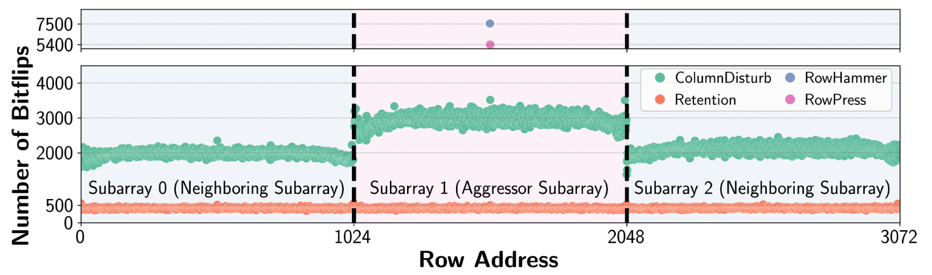
ColumnDisturb vs. RH/RP & Retention
Aggressor Row
RowHammer
RowPress
ColumnDisturb
Retention
RowHammer & RowPress induce bitflips only
in the immediate neighboring rows of the aggressor row
Retention failures are almost constant (around 500) for every row
ColumnDisturb induces many more bitflips than retention failures
and affects many more rows than RowHammer & RowPress
Notes:
In this experiment, we compare ColumnDisturb with RH, RP, and retention.
On the y-axis now we have number of bitflips and in the x-axis we have row addresses covering the first three consecutive subarray
[CLICK] First 1024 rows belongs to first subarray, second 1024 rows belongs to second subarray and so on.
[CLICK] In this experiment, we use a single aggressor row for ColumnDisturb, RowHammer, and RowPress and it is located in the middle row of the second subarray
[CLICK] Let’s first look at RH & RP bitflips
[CLICK] They induce a lot bitflips but in only immediate neighboring rows of the aggressor row,
plus 1 and minus 1 rows of the aggressor row
[CLICK] Second, let’s take a look at retention. It introduces bitflips across all rows but
[CLICK] in the constant number of bitflips, around 500
[CLICK] Lastly, ColumnDisturb.
[CLICK] It introduces a lot more bitflips than retention and has much wider effect than RowHammer and RowPress.ColumnDisturb induces bitflips in all 3072 rows (all rows in three consecutive subarray)

Slide 34
Key Takeaways from Major Characterization Experiments
Takeaway 1
ColumnDisturb is a widespread read disturbance phenomenon and becomes worse as DRAM technology scales down to smaller node sizes
Takeaway 2
ColumnDisturb induces bitflips in thousands of DRAM rows and
is different from RowHammer, RowPress, and Retention failures
Takeaway 3
The bitflip directionalities of ColumnDisturb and RowHammer & RowPress
are significantly different
Takeaway 4
Significantly more rows are vulnerable to ColumnDisturb
than retention failures
Takeaway 5
As temperature increases,
DRAM chips become more vulnerable to ColumnDisturb
Notes:
We have five key takeaways from major characterization experiments

Slide 35
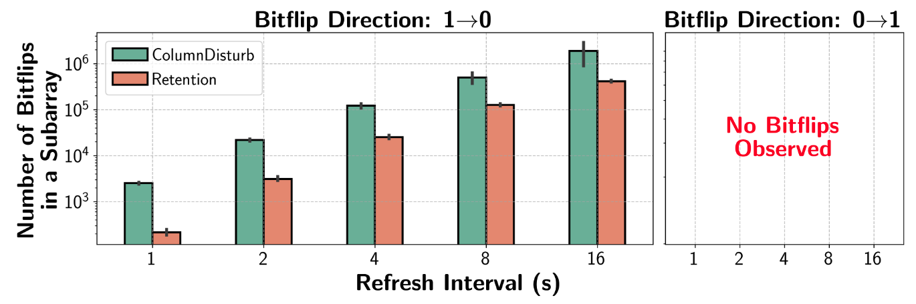
Bitflip Direction
Cell initialized
with 0
and experience bitflip
Cell initialized with 1 and experience bitflip
DRAM refreshes all rows within the refresh interval
e.g., 1s means DRAM refreshes
all rows within 1 second
Notes:
Here in the y-axis we report number of bitflips in a subarray
[CLICKx2] In the x-axis we have refresh invertal which means DRAM refreshes all rows within this interval
For example, 1 second means DRAM refreshes all rows within 1 second
[CLICK] Bitflip direction 1 to 0 means cell is initialized with 1 and experience bitflip and thus becomes 0
Bitflip direction 0 to 1 means cell is initialized with 0 and experience bitflip and thus becomes 1

Slide 36
Bitflip Direction
ColumnDisturb induces only 1 to 0 bitflips,
which are the same direction as retention failures
This is in stark contrast to RowHammer and RowPress,
which induce bitflips in both 1 to 0 and 0 to 1 directions
Notes:
[CLICK] We observe that both ColumnDisturb do not cause 0 to 1 bitflips, only 1 to 0
[CLICK] We conclude that ColumnDisturb induces only 1 to 0 bitflips, which are the same direction as retention failures
[CLICK] This observation in stark contrast to RowHammer and RowPess. RowHammer and RowPress induce bitflips in both directions: 1 to 0 and 0 to 1.

Slide 37
Key Takeaways from Major Characterization Experiments
Takeaway 1
ColumnDisturb is a widespread read disturbance phenomenon and becomes worse as DRAM technology scales down to smaller node sizes
Takeaway 2
ColumnDisturb induces bitflips in thousands of DRAM rows and
is different from RowHammer, RowPress, and Retention failures
Takeaway 3
The bitflip directionalities of ColumnDisturb and RowHammer & RowPress
are significantly different
Takeaway 4
Significantly more rows are vulnerable to ColumnDisturb
than retention failures
Takeaway 5
As temperature increases,
DRAM chips become more vulnerable to ColumnDisturb
Notes:
We have five key takeaways from major characterization experiments

Slide 38
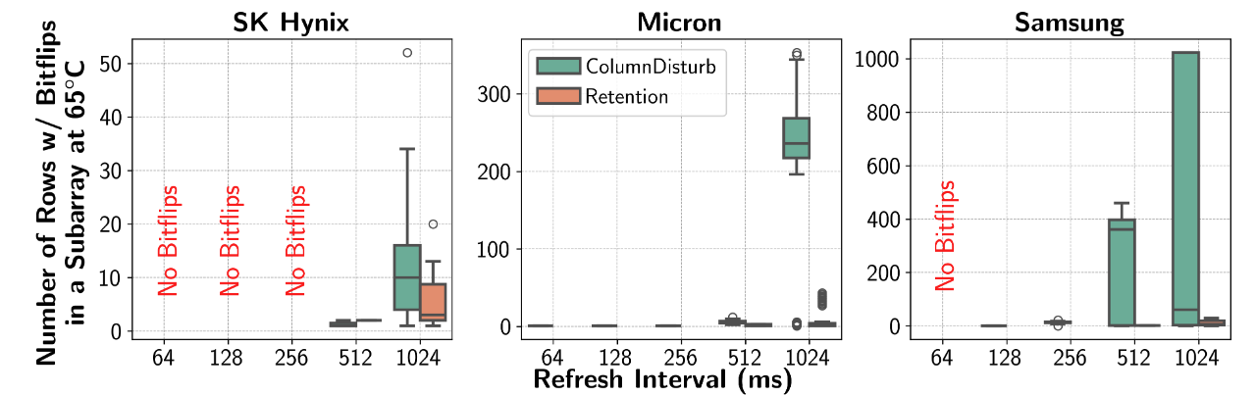
Number of Rows w/ Bitflips
30.4x
35.2x
2.6x
ColumnDisturb induces bitflips
in significantly more DRAM rows than retention failures
This trend is consistent across all tested manufacturers

Slide 39
Key Takeaways from Major Characterization Experiments
Takeaway 1
ColumnDisturb is a widespread read disturbance phenomenon and becomes worse as DRAM technology scales down to smaller node sizes
Takeaway 2
ColumnDisturb induces bitflips in thousands of DRAM rows and
is different from RowHammer, RowPress, and Retention failures
Takeaway 3
The bitflip directionalities of ColumnDisturb and RowHammer & RowPress
are significantly different
Takeaway 4
Significantly more rows are vulnerable to ColumnDisturb
than retention failures
Takeaway 5
As temperature increases,
DRAM chips become more vulnerable to ColumnDisturb
Notes:
We have five key takeaways from major characterization experiments

Slide 40
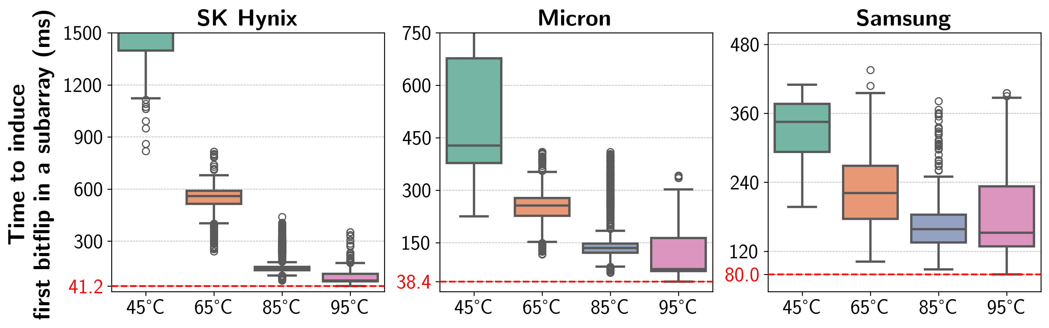
Effect of Temperature
9.1x
5.2x
2.0x
Time to induce the first ColumnDisturb bitflip
significantly reduces as temperature increases
This trend is consistent across all tested manufacturers

Slide 41
Outline
What is ColumnDisturb?
Testing Infrastructure
Real DRAM Chip Results
Implications
Conclusion
Notes:
The observations I presented have implications for future systems and retention-aware refresh mechanisms

Slide 42
Implications Summary
1. Implications on Future Computing Systems
ColumnDisturb could jeopardize the robustness of computing systems
    ColumnDisturb bitflips occur in very far away rows from the aggressor row,
    even in nominal operating conditions
    ColumnDisturb is getting worse: newer chips are more vulnerable
2. Implications on Retention-Aware Refresh Mechanisms
ColumnDisturb dramatically decreases the benefits of these mechanisms
    At long refresh intervals (e.g., >512ms),
    a large majority of rows experience ColumnDisturb bitflips
    ColumnDisturb induces significantly more bitflips than retention failures
Notes:
[CLICK] First, implications on future computing systems
[CLICK] ColumnDisturb could jeopardize the robustness of computing systems because
[CLICK] ColumnDisturb bitflips occur in very far away rows from the aggressor row, even in nominal operating conditions
[CLICK] And ColumnDisturb is getting worse: newer chips are more vulnerable to ColumnDisturb
[CLICK] Second, implications on retention-aware refresh mechanisms
[CLICK] We observe that ColumnDisturb dramatically decreases the benefits of these mechanisms
[CLICK] Because, a large majority of rows experience ColumnDisturb bitflips, many more than retention failures
[CLICK] And ColumnDisturb induces significantly more bitflips than retention failures

Slide 43
Implications for System Robustness
ColumnDisturb bitflips occur in very far away rows from the aggressor row
    E.g., one of the bitflips we observe in nominal refresh window is
    374 rows away from the aggressor row
Most of the read disturbance mitigations refresh only
a few neighboring rows
as RowHammer and RowPress induces bitflips in close proximity
Even refreshing only a few rows is shown to be a difficult problem
We describe and analytically evaluate two solutions
    Increasing DRAM Refresh Rate
      Reduces DRAM throughput by 42.1%
    Proactively Refreshing Victim Rows
      Reduces DRAM throughput by 12.4%
Notes:
Let’s start with the first line of implications: implications for system robustness
[CLICK] As I mentioned, the first bitflip we observe in nominal refresh window is 374 rows away from the aggressor row
Why is this important?
[CLICK] Because, most of the read disturbance mitgations including the state-of-the-art solutions from industry and academia only refresh a few neighboring rows since RowHammer and RowPress induces bitflips in close proximity
[CLICK] To tackle this problem, we describe and analytically evaluate two solutions
[CLICK] First, increasing DRAM refresh rate
[CLICK] (add the script)
[CLICK] And second, proactively refreshing ColumnDisturb victim rows
[CLICK] (add the script)
[CLICK] (add the script about the more in the paper)

Slide 44
Implications for System Robustness
https://arxiv.org/pdf/2510.14750
Notes:
I’d like to refer you to our paper for more details on how we deal these sources of interferences

Slide 45
Retention-Aware Refresh Mechanisms
Leverage the heterogeneity in DRAM cell data retention time
    Most of the rows do not need to be frequently refreshed
DRAM Bank
Row 1
Retention-Weak Row
Less
Frequently
Refreshed
Row 2
Frequently
Refreshed
Row 3
Row 4
Retention-Weak Row
Less
Frequently
Refreshed
Row 5
Row 6
Notes:
Retention-aware refresh mechanisms
[CLICK] leverage the heterogeneity in DRAM cell data retention time
[CLICK] Most of the DRAM rows do not need to be frequently refreshed, which means for these rows refresh interval is increased to improve performance and energy efficiency

Slide 46
Implications on Retention-Aware Refresh Mechanisms
However, in the presence of ColumnDisturb,
less frequently refreshed rows become vulnerable to ColumnDisturb
DRAM Bank
Row 1
Retention-Weak Row
Less
Frequently
Refreshed
Row 2
Frequently
Refreshed
Row 3
Row 4
Retention-Weak Row
Less
Frequently
Refreshed
Row 5
Row 6
ColumnDisturb
bitflip
Benefits of retention-aware refresh mechanisms significantly reduces in the presence of ColumnDisturb
Notes:
[CLICK] However, now, in the presence of ColumnDisturb, by increasing the refresh interval a lot of rows become vulnerable to ColumnDisturb
[CLICK] And these mechanisms as a result, do not work
[CLICK] To make these mechanisms work, ColumnDisturb bitflips must be mitigated
[CLICK] If these mechanisms configured to mitigate ColumnDisturb, now, they lose their performance and energy benefits

Slide 47
Implications on Retention-Aware Refresh Mechanisms
https://arxiv.org/pdf/2510.14750
Notes:
I’d like to refer you to our paper for more details on how we deal these sources of interferences

Slide 48
More in the Paper
Many more characterization results
    Average voltage level on the perturbed columns
    Temperature
    Spatial variation
    Access pattern
    Data pattern
    Aggressor row on time
Details and analyses on Implications
    Effectiveness of System-Level and on-Die ECC
    More details on ColumnDisturb mitigation mechanisms
    Implications on a retention-aware refresh mechanism: RAIDR
      How ColumnDisturb affects energy-efficiency and the speedup of
      such mechanisms
    ..
Notes:
We have more content in the paper, including
…

Slide 49
Available on arXiv
https://arxiv.org/pdf/2510.14750
Notes:
The extended version of our study is available on arxiv

Slide 50
Outline
What is ColumnDisturb?
Testing Infrastructure
Real DRAM Chip Results
Implications for Future Systems & Mechanisms
Conclusion
Notes:
And let me conclude my talk

Slide 51
Conclusion
We demonstrate and extensively study a new widespread
read disturbance phenomenon in real DRAM chips: ColumnDisturb
We characterize 216 DDR4 and 4 HBM2 chips from three major manufacturers
ColumnDisturb affects all tested chips
ColumnDisturb is getting worse as DRAM technology node size reduces
ColumnDisturb is different from RowHammer, RowPress, and Retention failures
We describe and evaluate two major implications of ColumnDisturb
ColumnDisturb affects robustness of future systems
ColumnDisturb makes retention-aware refresh mechanisms much less effective
We hope ColumnDisturb inspires
system-level, architectural-level, and device-level solutions and understanding to enable ColumnDisturb-resilient future systems

Slide 52
ColumnDisturb
Understanding Column-based Read Disturbance in Real DRAM Chips and Implications for Future Systems
İsmail Emir Yüksel
Ataberk Olgun F. Nisa Bostancı Haocong Luo
A. Giray Yağlıkçı Onur Mutlu
Notes:
Hello, I am Ismail Emir Yuksel.
I will be presenting our work, ColumnDisturb [..]

Slide 53
ColumnDisturb
Understanding Column-based Read Disturbance in Real DRAM Chips and Implications for Future Systems
Backup Slides
İsmail Emir Yüksel
Ataberk Olgun F. Nisa Bostancı Haocong Luo
A. Giray Yağlıkçı Onur Mutlu
Notes:
Hello, I am Ismail Emir Yuksel.
I will be presenting our work, ColumnDisturb [..]

Slide 54
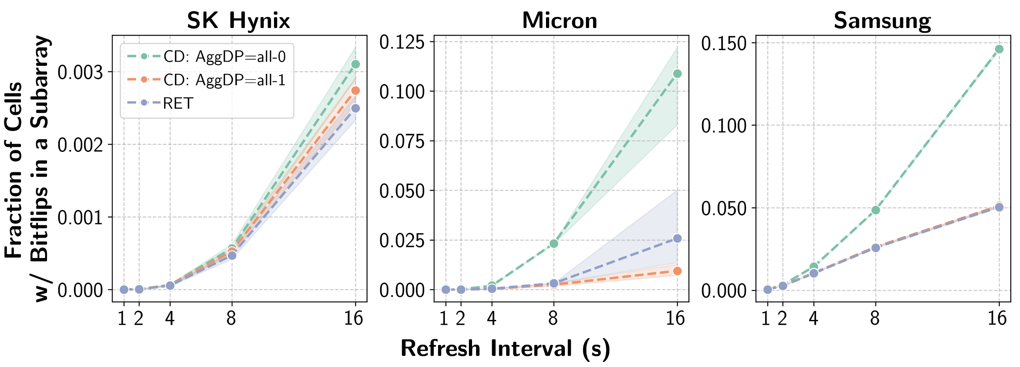
Foundational Results: Data Pattern
ColumnDisturb induces many more bitflips
when the aggressor row data pattern is all-0 versus all-1

Slide 55
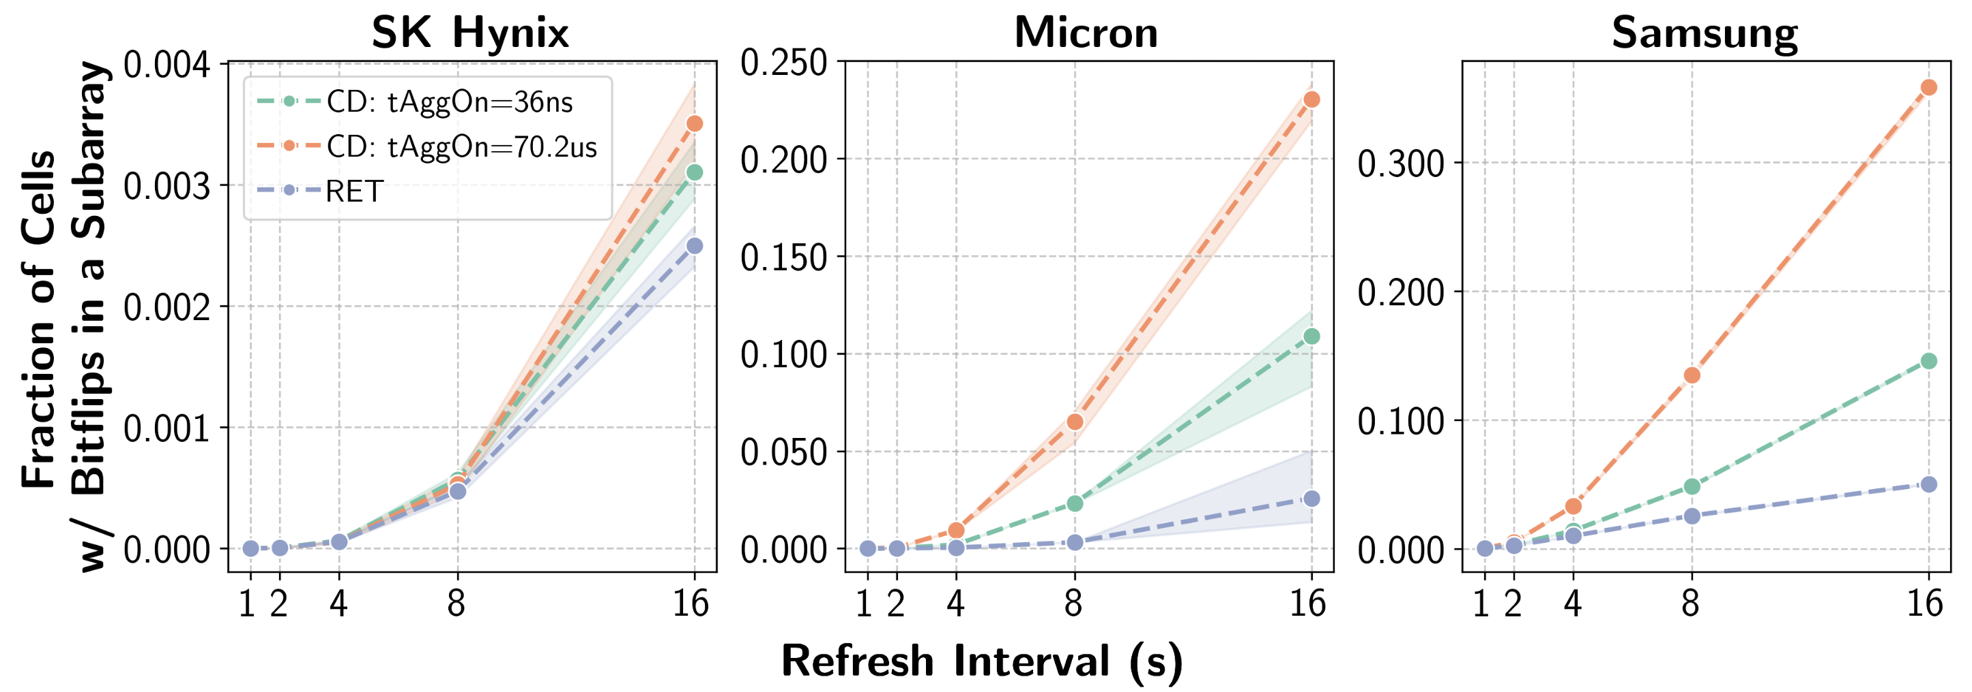
Foundational Results: tAggOn
Fraction of cells with ColumnDisturb bitflips in a subarray significantly increases as tAggOn increases

Slide 56
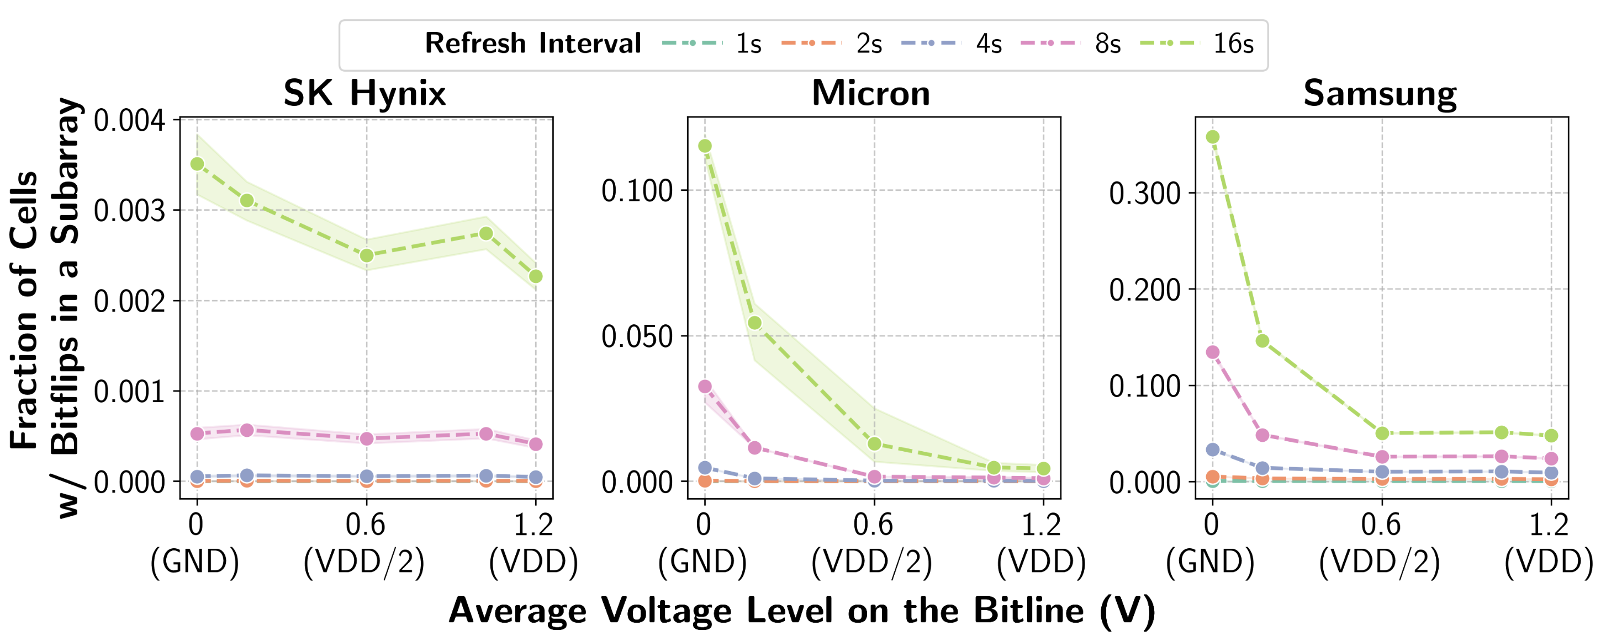
Foundational Results: AVG(V_{BL})
A DRAM chip becomes
significantly morev ulnerable to ColumnDisturb
as the average voltage level on the perturbed columns decreases

Slide 57
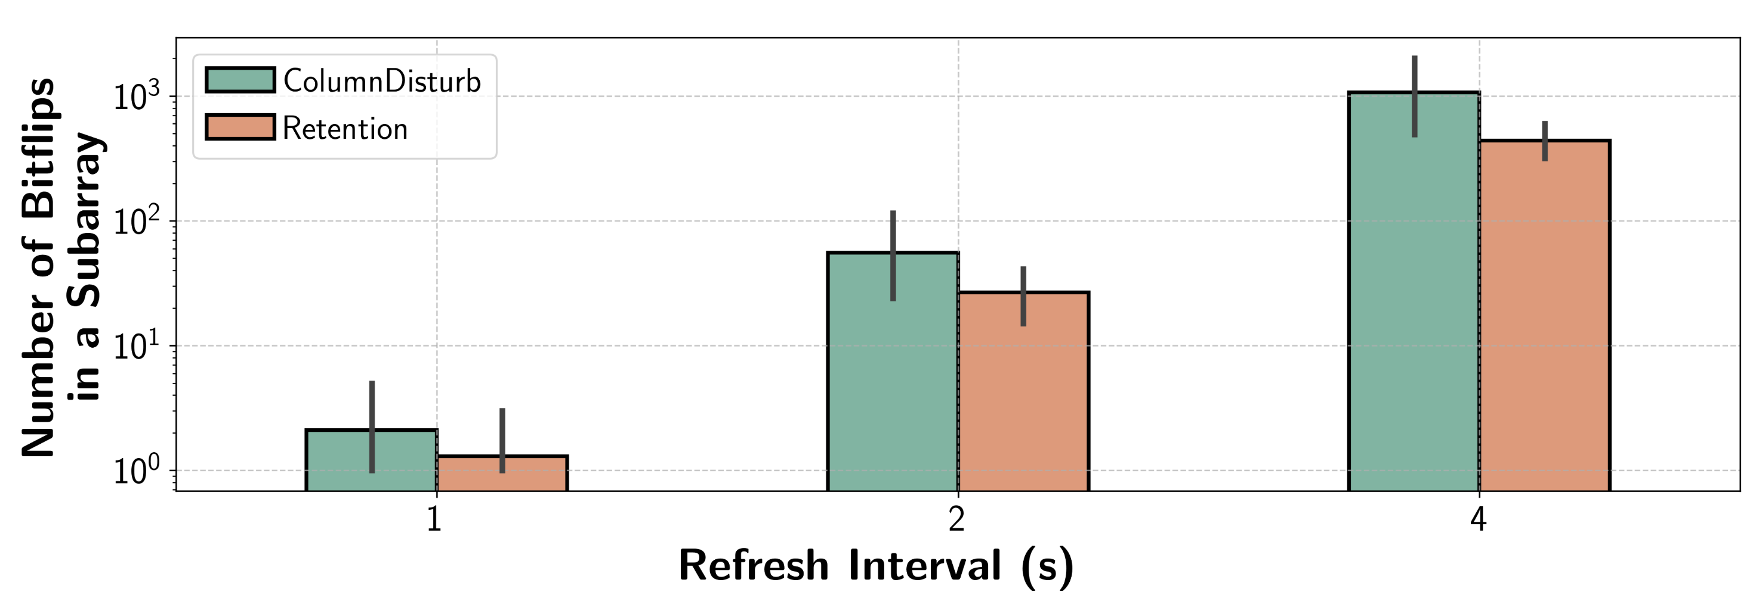
Foundational Results: CD on HBM
HBM2 chips are vulnerable to ColumnDisturb.
ColumnDisturb induces many more bitflips than retention failures

Slide 58
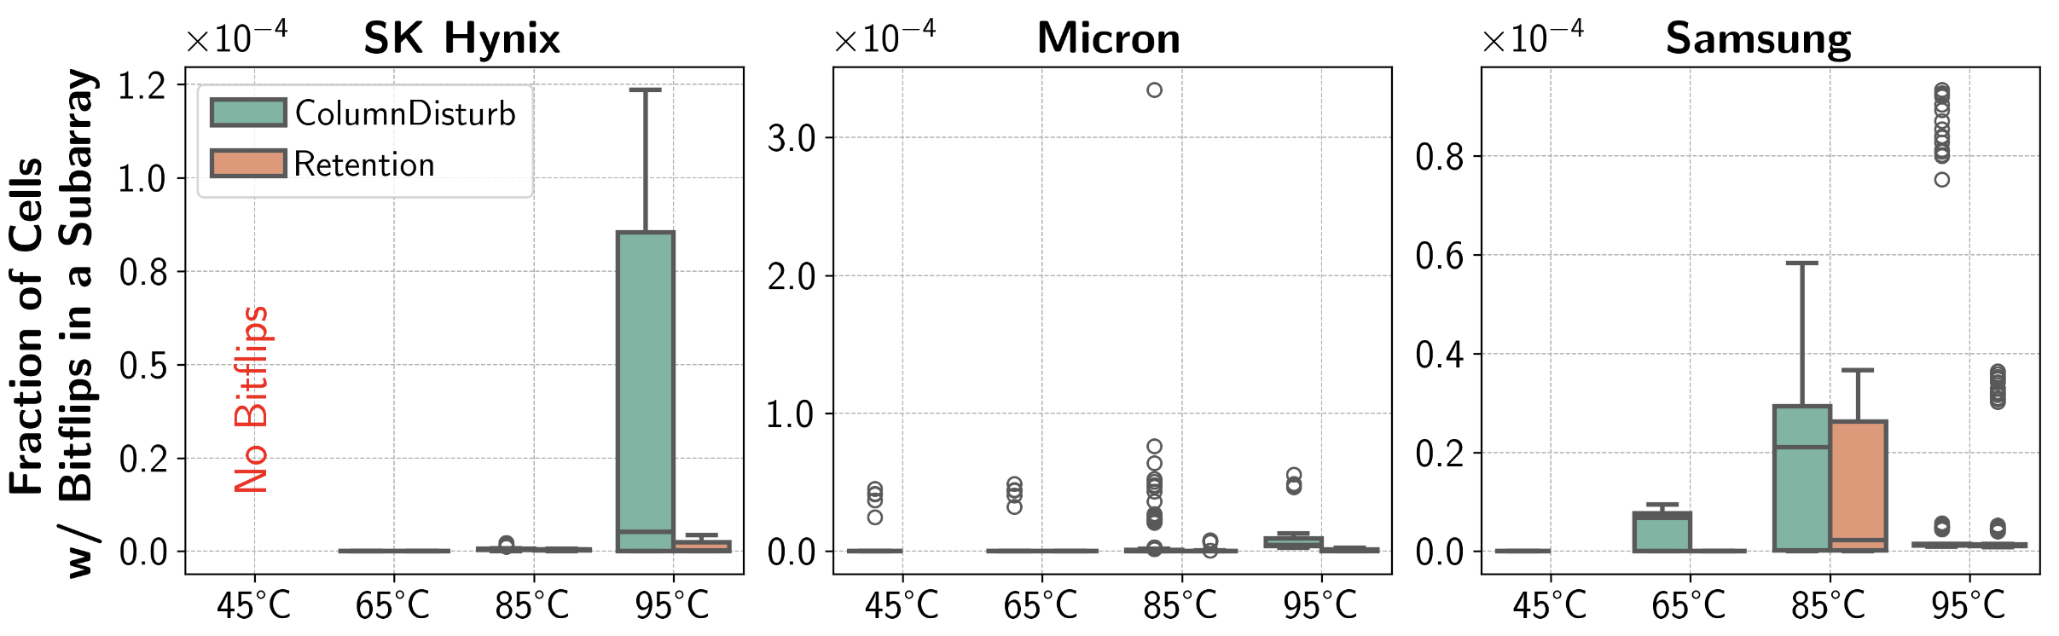
Temperature: Fraction of Cells w/ Bitflips
ColumnDisturb is more sensitive to temperature
than retention failures

Slide 59
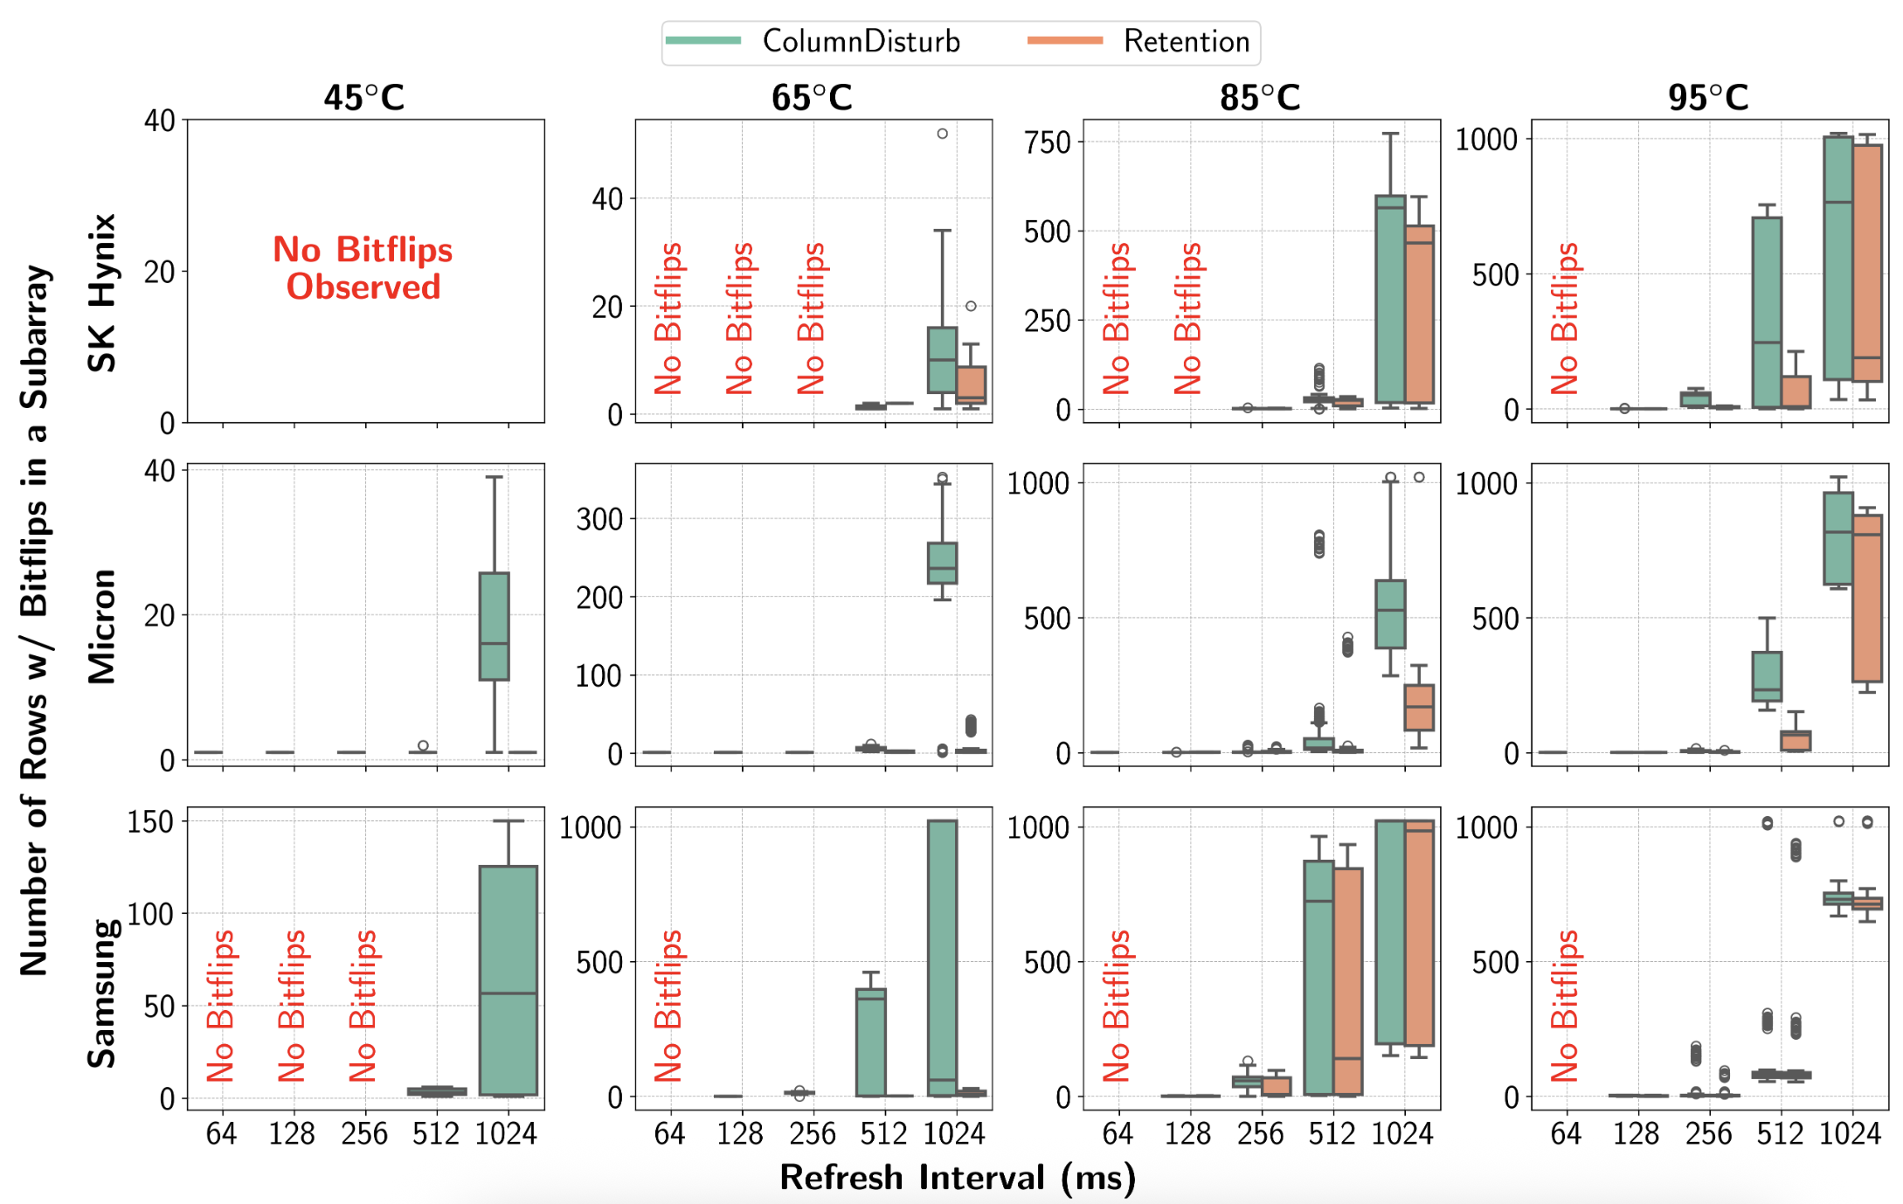
Temperature: Number of Rows w/ Bitflips

Slide 60
Temperature: Number of Rows w/ Bitflips
The blast radius of both ColumnDisturb and
retention failures increase with higher temperature

Slide 61
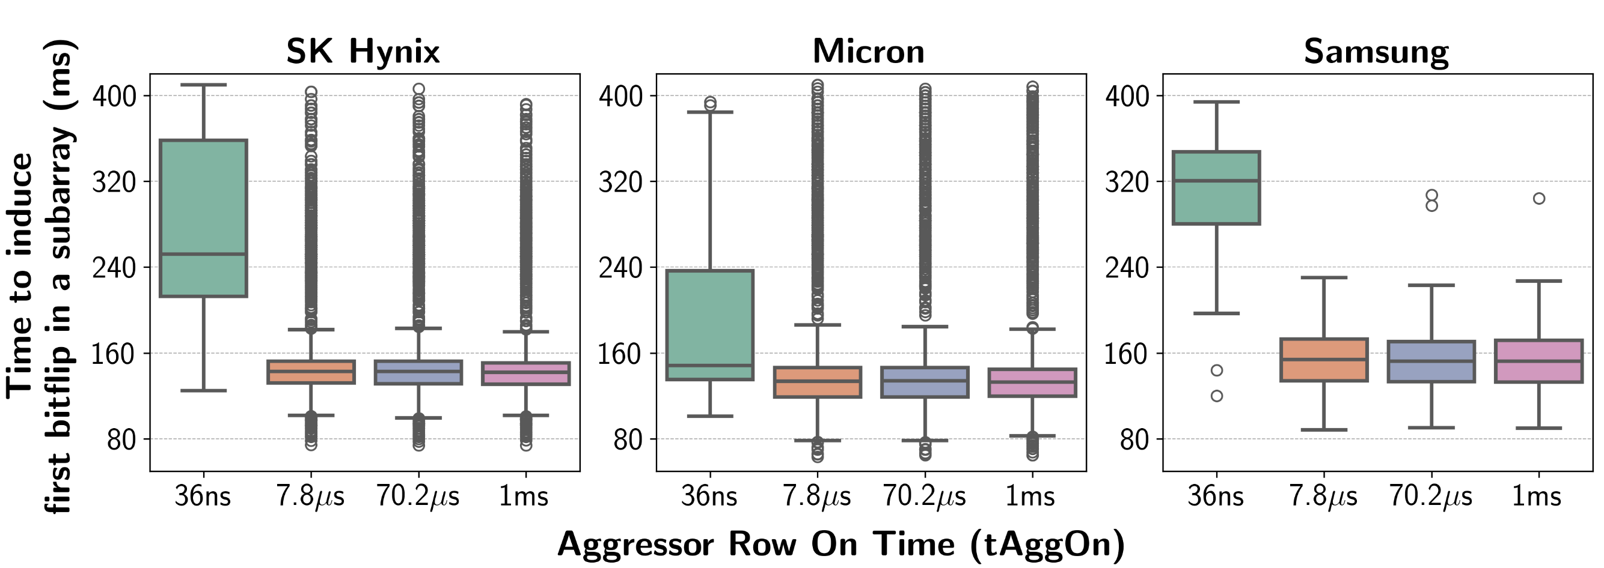
In-Depth: Aggressor Row On Time
Keeping a row open (tAggOn >> tRAS) is
significantly more effective than
immediately closing it (tAggOn = tRAS)
in inducing the first ColumnDisturb bitflip in a subarray

Slide 62
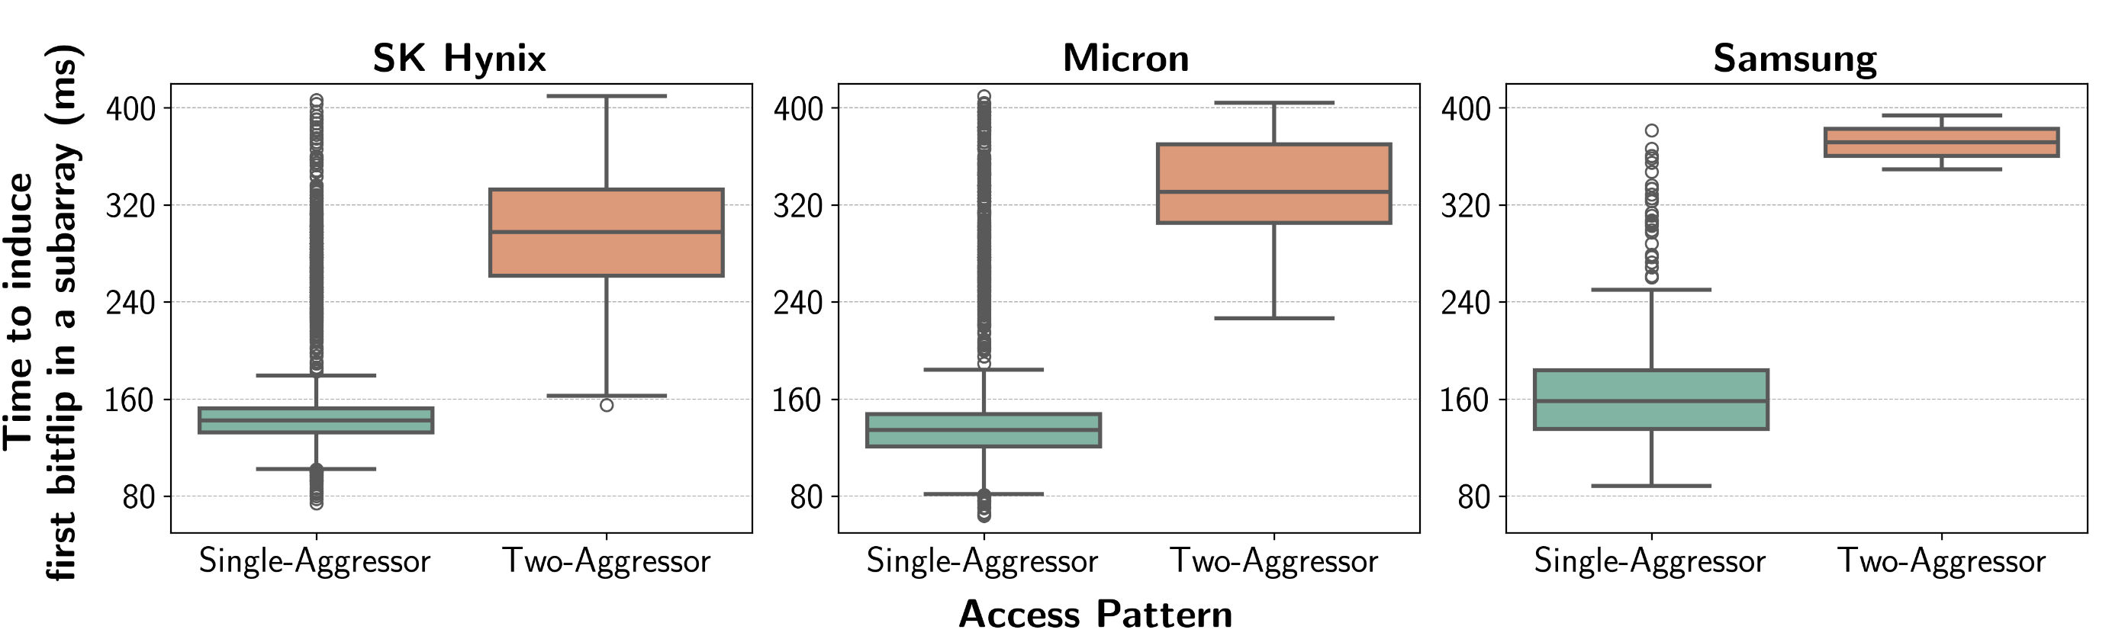
In-Depth: Access Pattern
Single-aggressor access pattern
induces the first ColumnDisturb bitflip in a subarray
significantly faster than the two-aggressor access pattern

Slide 63
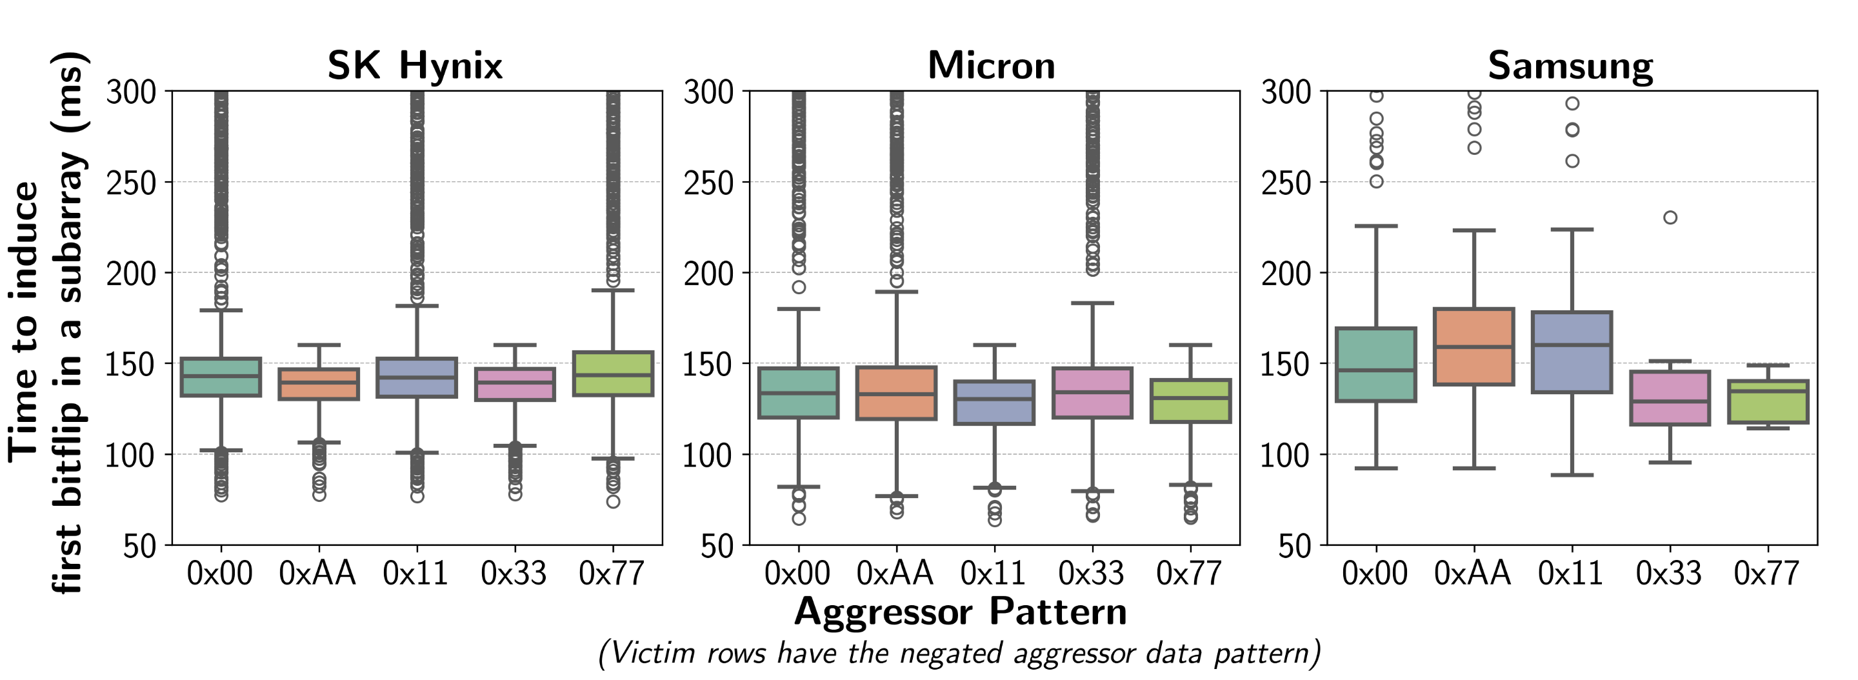
In-Depth: Data Pattern: TTIFB
Data pattern has a small effect on
the time to induce the first ColumnDisturb bitflip in a subarray

Slide 64
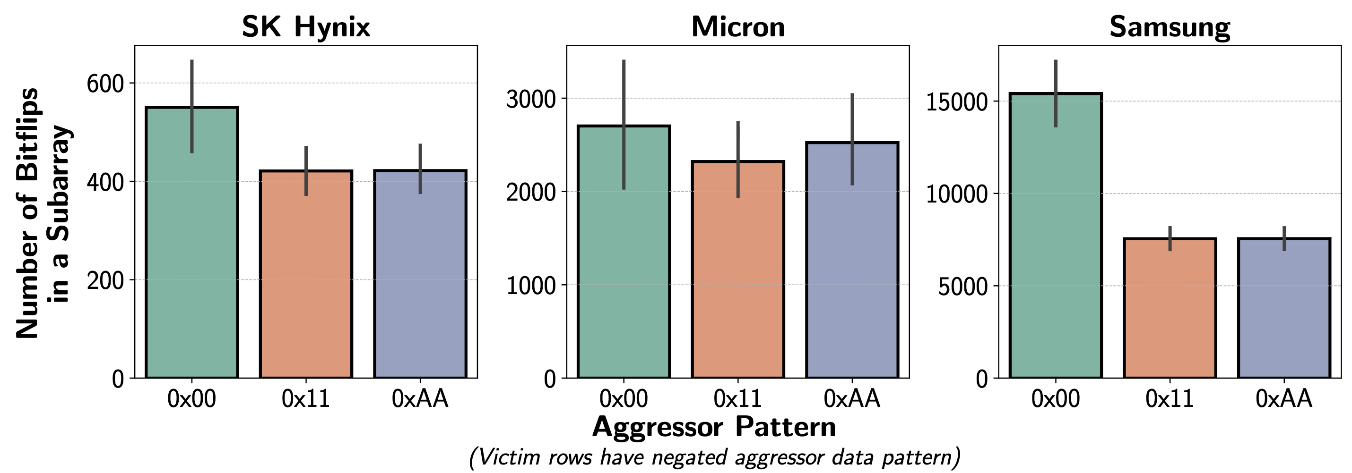
In-Depth: Data Pattern: # of Bitflips
Data pattern greatly affects total ColumnDisturb:
having more logic-0 values
In the perturbed columns generates more bitflips

Slide 65
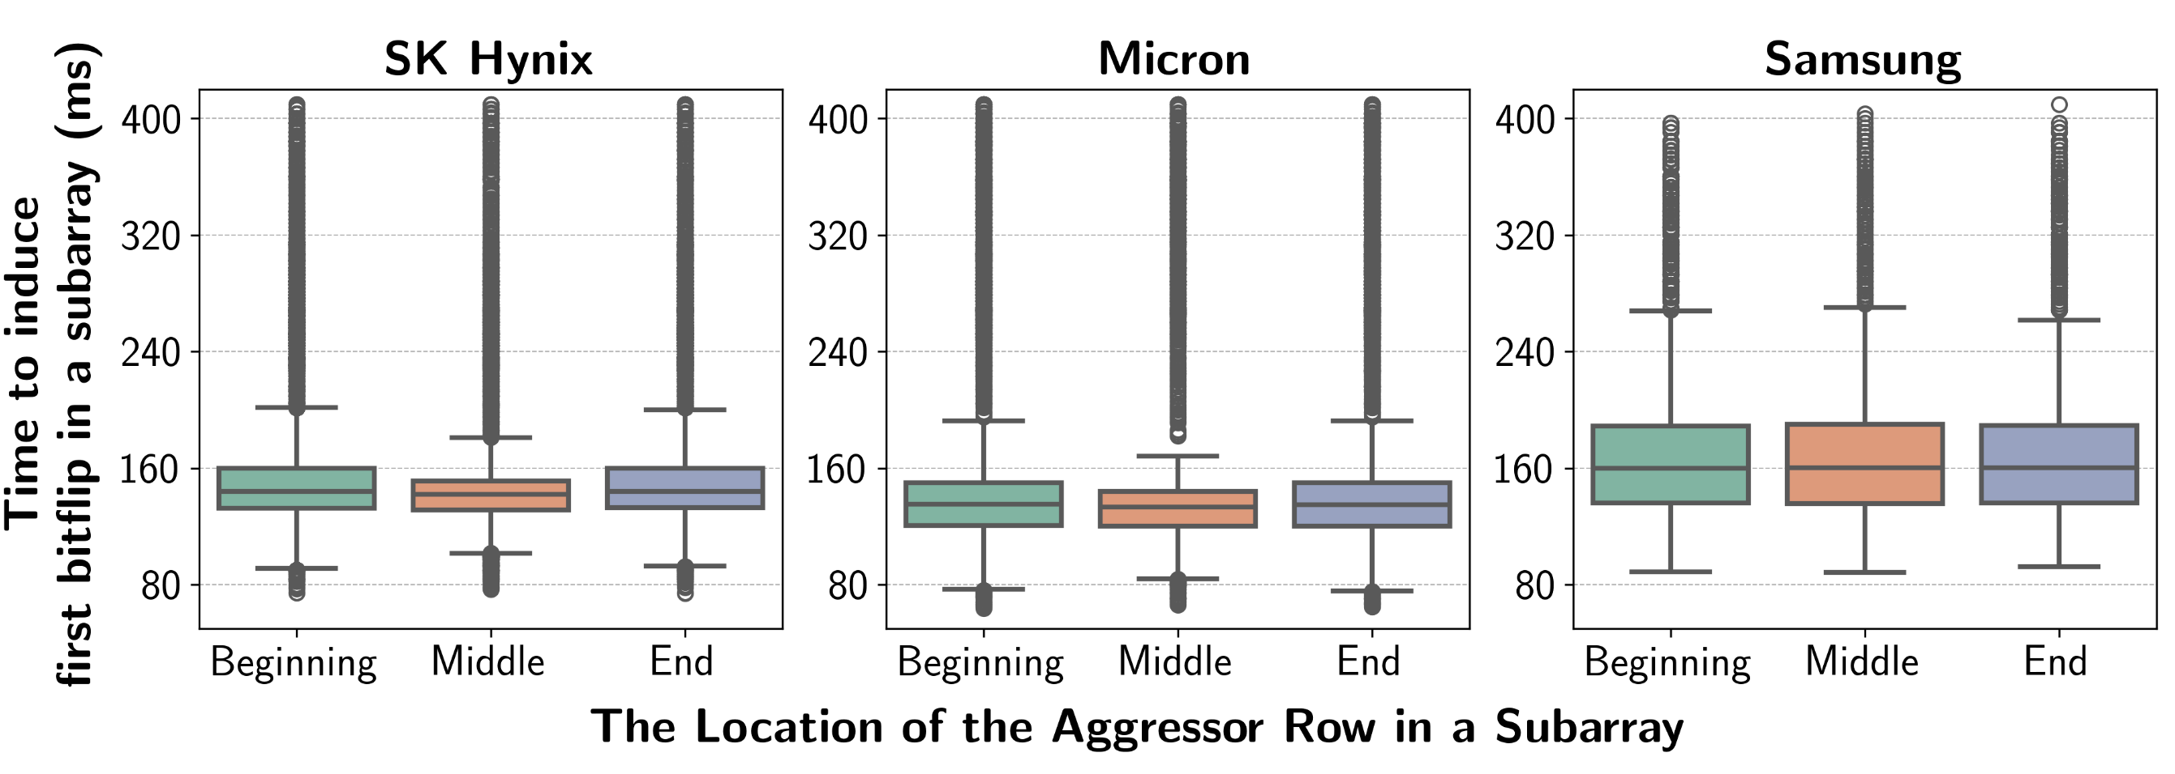
Aggressor Row Location in a Subarray
The location of the aggressor row
only slightly affects
the time to induce the first ColumnDisturb bitflip

Slide 66
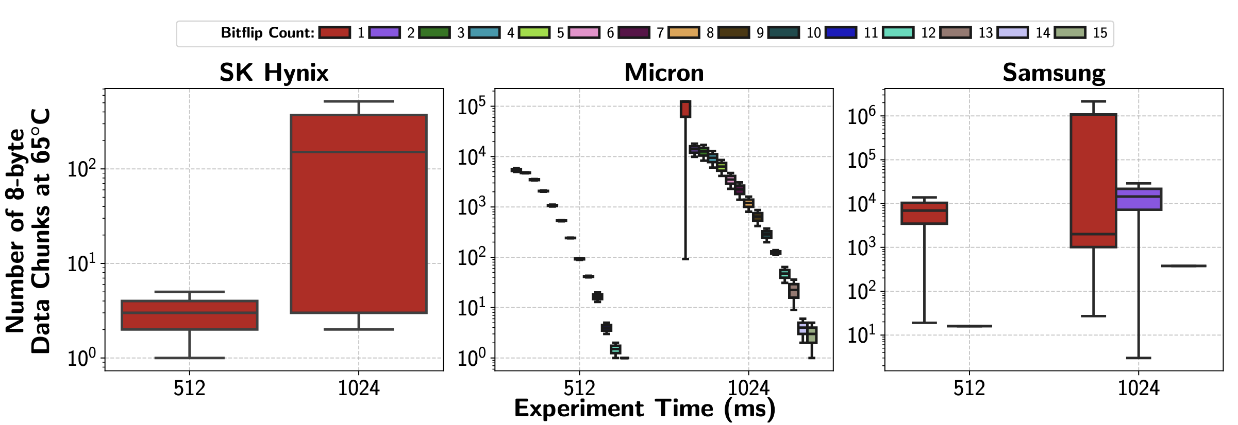
Effectiveness of ECC
Many 8-byte data chunks experience
3 (up to 15) ColumnDisturb bitflips,
which the SECDED ECC cannot correct or detect

Slide 67
Effectiveness of ECC
Since ColumnDisturb can induce 15 bitflips
in multiple 8-byte data chunks, a (7,4) Hamming code
could correct such bitflips with very large DRAM storage overheads
(75%, i.e., three parity bits for every four data bits)

Slide 68
Implications for System Robustness
Increasing DRAM Refresh Rate
Increasing DRAM refresh rate in future DRAM chips
to prevent ColumnDisturb-induced bitflips
DRAM chips perform periodic refreshes to avoid retention failures
    E.g., Each row in DDR5 chips is refreshed in every 32ms
The benefit
    It can be applied immediately in today’s systems
Downside
    It degrades system performance and energy efficiency drastically
For a 32Gb DDR5 chip, 4x higher refresh rate
    Reduces system throughput by 42.1%
    Increases energy consumption by 67.5%
Notes:
[CLICK] The key idea is very simple: increase DRAM refresh rate in future DRAM chips to prevent ColumnDisturb bitflips
[CLICK] Normally, DRAM chips perform periodic refreshes to avoid retention failures
For example, each row in DDR5 chips is refreshed in every 32ms
[CLICK] What is the benefit of this approach?
[CLICK] It can be applied immediately in today’s systems, for example changing the timing parameter in the BIOS in our computers
[CLICK] However, it degrades the system performance and energy efficiency drastically
[CLICK] We analytically analyze an hypothetical scenario in a 32Gb DDR5 chip: if we increase the refresh rate by 4 times
[CLICK] It reduces the system throughput by more than 40 percent
[CLICK] and increases energy consumption by almost 70 percent

Slide 69
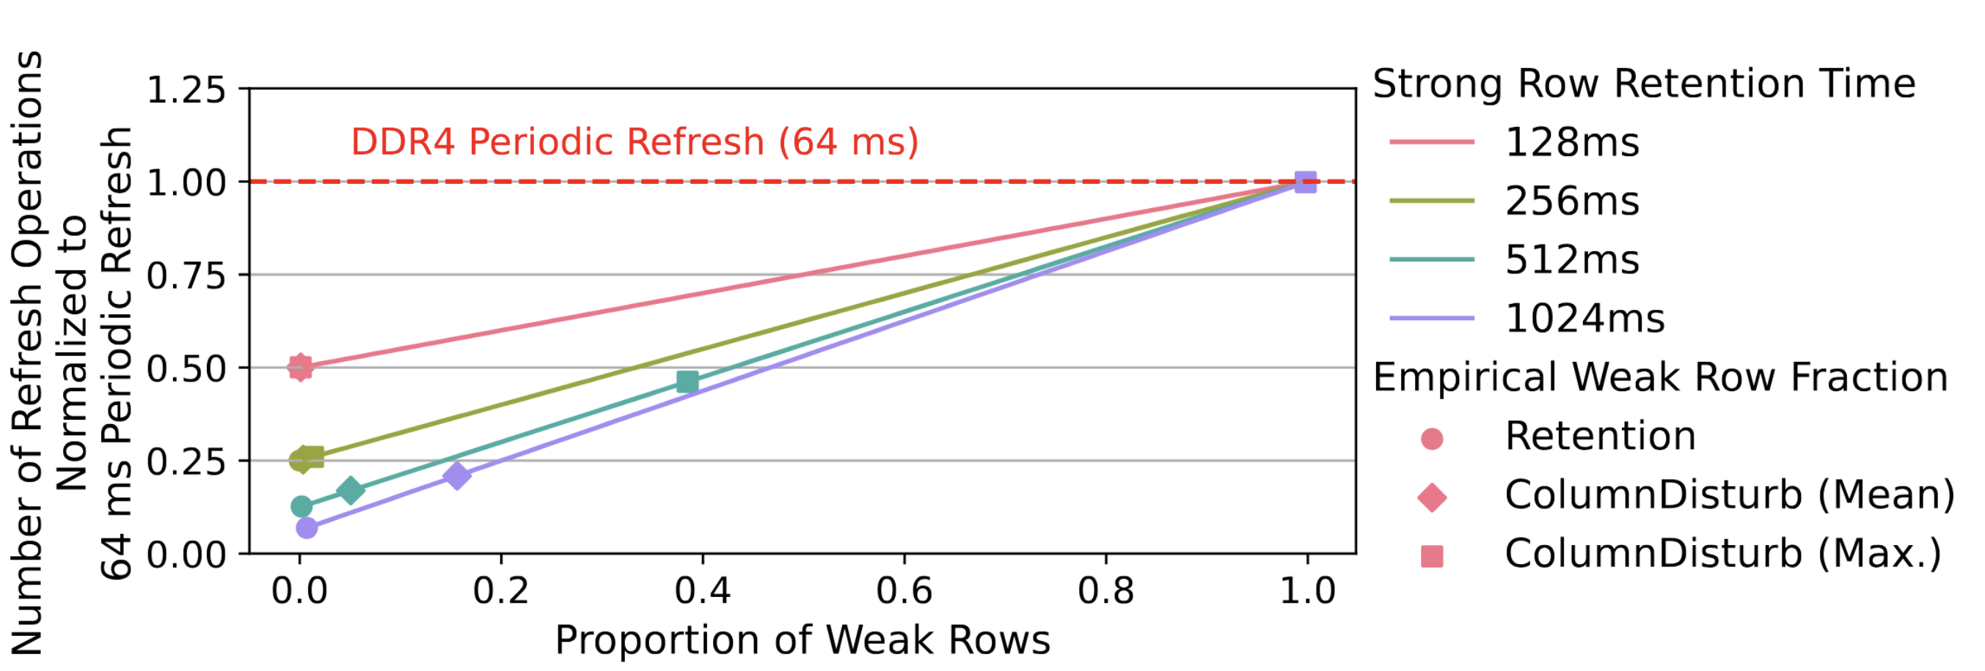
Number of Refresh Operations Needed
In the presence of ColumnDisturb,
for a strong row retention time of 1024 ms,
the number of refresh operations increases by 3.02x on average

Slide 70
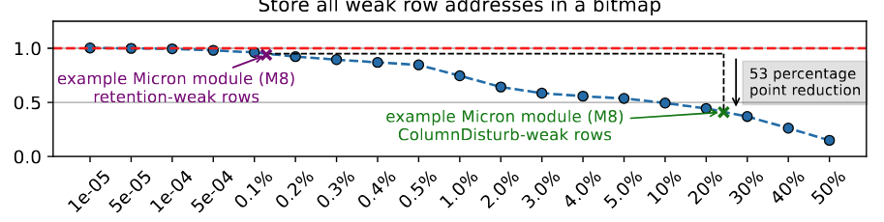
Implications on Retention-Aware Refresh
RAIDR Speedup Normalized to
No Refresh
Proportion of Weak Rows
(% of rows experience bitflips)
The speedup benefits of RAIDR reduce significantly
in the presence of ColumnDisturb
compared to a baseline where there is no ColumnDisturb bitflips
Notes:
Now let’s take a look how ColumnDisturb affects retention-aware refresh mechanisms
[CLICKx2] We take RAIDR as an example retention-aware refresh mechanism
Y-axis shows the RAIDR speedup normalized to no refresh
[CLICK] X-axis shows the proportion of weak rows, in other words percentage of rows that experience bitflips for a given refresh interval
[CLICK] According to our empirical results from a representative Micron module, retention-weak rows are only around 0.1 to 0.2 percent of the rows, which does not affect the system performance significantly
[CLICK] However, for the same module, around 25 percent of the rows experience ColumnDisturb bitflips
[CLICK] which translates to 53 percent reduction the system’s performance
[CLICK] We conclude that the speedup benefits of RAIDR reduce significantly in the presence of ColumnDisturb

Slide 71
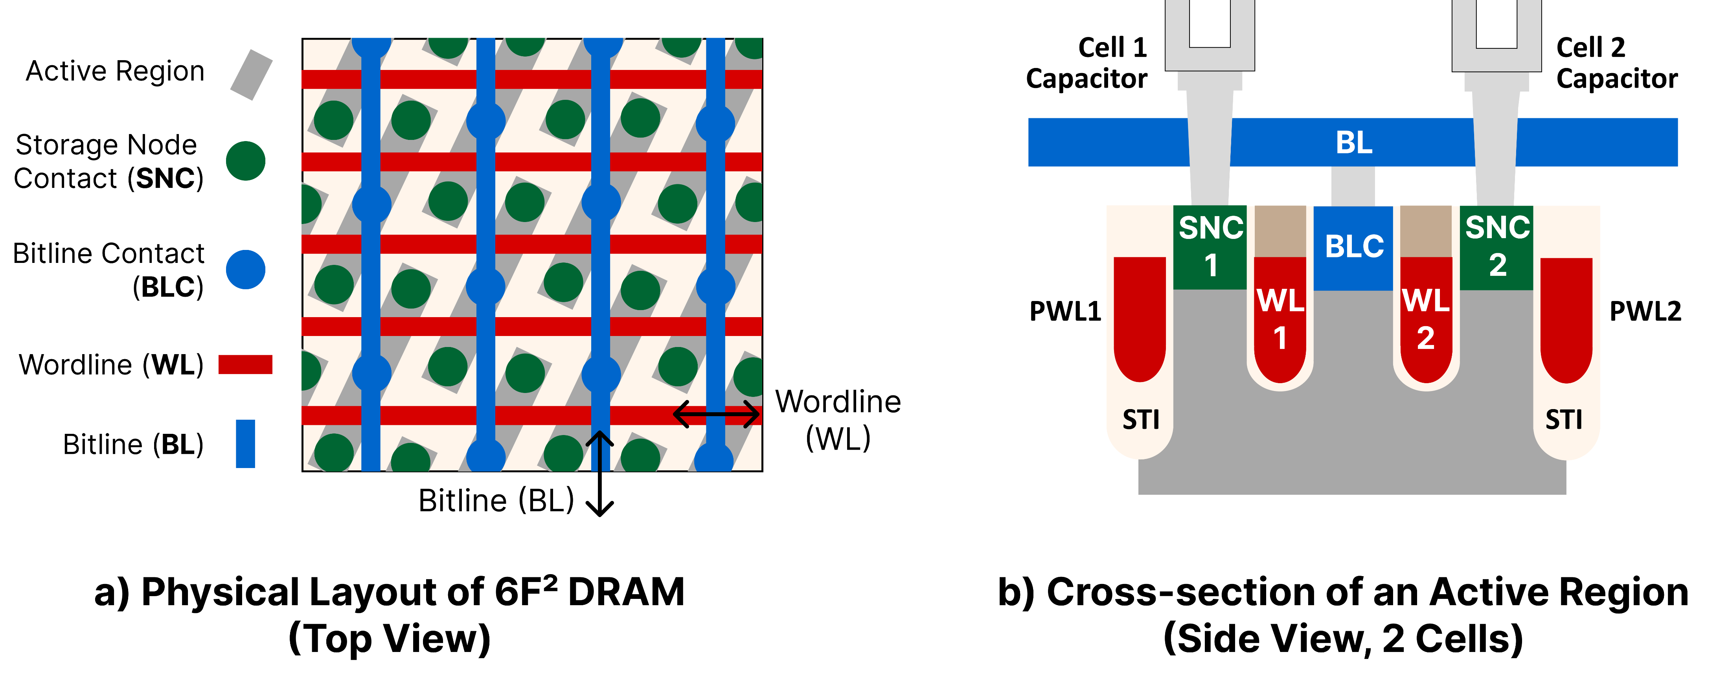
Device-Level Mechanisms – Physical Layout
Modern 6F² DRAM cell array layout
Passing
WL1
2
WL1
WL2
1
Passing
WL2
Notes:
Here is the actual physical layout of DRAM cells in modern DRAM array. Now, let us focus on two DRAM cells sharing the same active region. We focus on 1) the two respective wordlines of the two cells, and 2) the two passing wodlines that does not form an access transistor with the cell

Slide 72
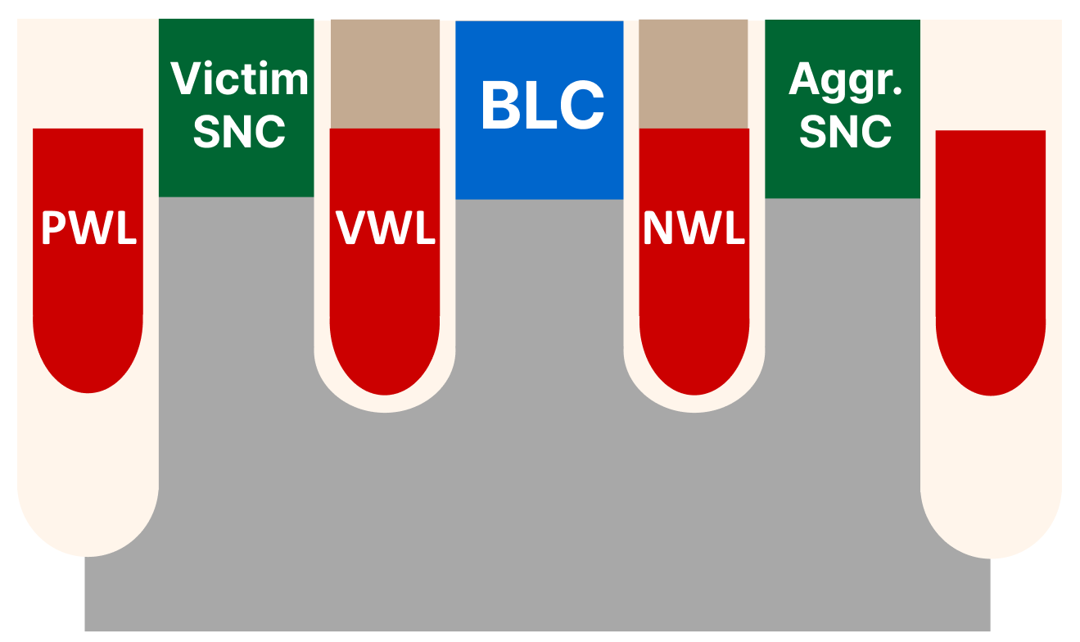
Device-Level Mechanism – RowHammer
Key Error Mechanisms of RowHammer
  Trap-assisted Electron Migration [Yang+, EDL’19] [Walker+, TED’21] [Zhou+, IRPS’23]
    When NWL (aggressor) is open, acceptor-like traps are charged with electrons
Open
Trap Charged w/ Electron
e-
PWL: Passing Wordline VWL: Victim Wordline
NWL: Neighboring Wordline (Aggressor)

Slide 73
Device-Level Mechanism – RowHammer
Key Error Mechanisms of RowHammer
  Trap-assisted Electron Migration [Yang+, EDL’19] [Walker+, TED’21] [Zhou+, IRPS’23]
    When NWL (aggressor) is open, acceptor-like traps are charged with electrons
    When NWL (aggressor) is closed, electrons are emitted from traps and
    migrate towards the victim cell
Closed
e-
Electron
Migration
PWL: Passing Wordline VWL: Victim Wordline
NWL: Neighboring Wordline (Aggressor)

Slide 74
Device-Level Mechanism – RowPress
Key Error Mechanisms of RowPress
  NWL RowPress: When NWL is kept open for a long period, its strong electric field increases the leakage from the victim to the BLC,
  causing 0→1 bitflips [Zhou+, TED’24] [Zhou+, IRPS’24]
  PWL RowPress: When PWL is kept open for a long period, its strong electric field draws electrons towards the victim,
  causing 1→0 bitflips [Zhou+, TED’24] [Zhou+, IRPS’24]
Open
Open
+
+
+
+
e-
e-
Increased
Leakage
NWL RowPress
PWL RowPress
Notes:
Optimize, use colors

Slide 75
Device-Level ColumnDisturb Mechanism
ColumnDisturb happens due to columns are perturbed and then driven. There is a direct contact between the cell and the column
This contact spans and affects thousands of rows
We have preliminary hypotheses on what might be happening
    “ColumnDisturb exacerbates subthreshold leakage of the access transistor [112] and/or the dielectric leakage between the capacitor and the bitline [2].”
We need device-level studies
to fundamentally understand ColumnDisturb, and
our study can inspire such future works and be a good starting point

Slide 76
Access Pattern Difference
For RowHammer and RowPress,
    one must need to hammer/press
    the same aggressor row(s) to observe bitflips.
However, for ColumnDisturb,
    one can distribute the number of activations across many rows
    As long as the activated rows perturbs the same set of columns,
    it does not matter whether
    one aggressor row or thousands of aggressor rows are used
For example (assume one cell requires 3K activations for a bitflip)
    Activating a single row 3K times = activating 1K rows 3 times
    It is not easy to detect and refresh cells

