Slide 1





ScaleDisturb: Exploiting Temporal Asymmetry to Amplify Read Disturbance in Modern DRAM Chips
Jikun Wang
Haocong Luo Ataberk Olgun Ismail Emir Yüksel A. Giray Yağlıkçı
Yu Liang F. Nisa Bostanci Mohammad Sadrosadati Onur Mutlu
Notes:
Hello, I’m Jikun Wang.
I will be presenting our work, ScaleDisturb, […]

Slide 2
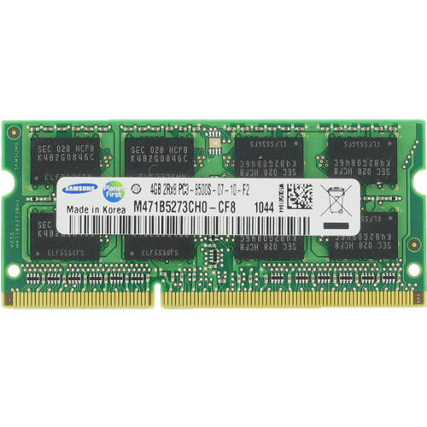
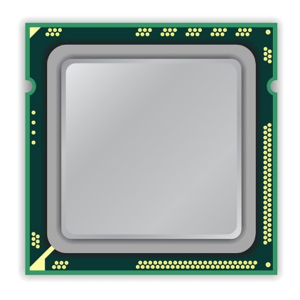
A Typical DRAM-Based Computing System
DRAM Chip
DRAM
Channel
CPU
DRAM Module
Notes:
This is a typical DRAM-based computing system with a CPU and a DRAM module connected over the DRAM channel.
[CLICK] This DRAM module has multiple DRAM chips.

Slide 3
DRAM Organization
DRAM Module
Bank
Bank
Bank
Bank
Row Decoder
Wordline
Transistor
Activation
Subarray
DRAM Row
Chip I/O
...
capacitor
…
…
…
Bank
Bank
Bank
Bank
Bitline
Sense Amps.
DRAM Cell
DRAM Chip
DRAM Bank
DRAM Subarray
Notes:
[CLICK] Each chip contains multiple banks
[CLICK] Each bank is composed of multiple subarrays
[CLICK] And within each subarray, there is a two-dimensional array of DRAM cells.
[CLICK] Each DRAM cell stores 1-bit data.
[CLICK] These cells are organized into rows that are selected using wordlines
[CLICK] And the cells are connected to a row of sense amplifiers via bitlines
To access data in a row, you need to activate the row first, and too many repeated row activations can lead to…

Slide 4

DRAM Read Disturbance (I): RowHammer
Read disturbance in DRAM breaks memory isolation
Prominent example: RowHammer [Kim+, ISCA 2014]
Victim Row
Aggressor Row
Victim Row
Repeatedly opening and closing a DRAM row many times causes bitflips in physically adjacent victim rows
Notes:
… read disturbance bitflips.
[CLICK] Read disturbance bitflips have significant system-level implications because they break memory isolation.
[CLICK] A prime example of read disturbance is RowHammer.
[CLICK] If we keep opening and closing a DRAM row, called aggressor row, many times,
[CLICK] We can observe bitflips in physically nearby DRAM rows called victim rows.

Slide 5

DRAM Read Disturbance (II): RowPress
A new read disturbance phenomenon: RowPress [Luo+, ISCA 2023]
Victim Row
Keep Open
Aggressor Row
Victim Row
Keeping a DRAM row open for a long time
causes bitflips in physically adjacent victim rows
Notes:
[CLICK] A new read disturbance phenomenon is RowPress
[CLICK] Different from RowHammer, RowPress induces bitflips in the victim rows by keeping the aggressor row open for a long time

Slide 6
Read Disturbance Solutions
There are many solutions to mitigate read disturbance bitflips
More robust DRAM chips and/or error-correcting codes
Increased refresh rate
Physical isolation
Row remapping
Preventive refresh
Proactive throttling
Each solution offers a different system design point
in reliability, performance, energy, and area tradeoff space
Notes:
[CLICKx6 as you talk] To mitigate read disturbance bitflips, prior works proposed many techniques to maintain system robustness.
[CLICK] Many different techniques are valuable as each technique comes with a different reliability, performance, energy, and area tradeoff.

Slide 7
Accurate Identification of Read Disturbance Threshold
Many secure read disturbance solutions take a preventive action before a bitflip manifests
  E.g., preventively refresh a victim row
Must accurately quantify the amount of disturbance
that a row can withstand before experiencing a bitflip
Read Disturbance Threshold (ACmin)
  The minimum aggressor row activation count required to induce the first bitflip
To securely prevent read disturbance bitflips,
the ACmin of DRAM rows must be accurately identified
Notes:
[CLICK] A *common* operation pattern across these solutions is that they take *an action* before a bitflip happens.
[CLICK] For example, refreshing a victim row.
[CLICK] To do so, they *must accurately quantify* the amount of disturbance a row can withstand before it experiences a bitflip.
[CLICK] The read disturbance threshold, ACmin, or the minimum row activation count required to induce the first bitflip, is a widely-used metric to quantify the amount of disturbance.
[CLICK] To securely prevent read disturbance bitflips, ACmin must be accurately identified.

Slide 8
DRAM Access Pattern Affects ACmin (I)
A DRAM row’s ACmin is strongly affected by the DRAM access pattern used in real DRAM chip characterization
Victim Row
Aggressor Row
Aggressor Row
Victim Row
Victim Row
Aggressor Row
Single-sided RowHammer
Double-sided RowHammer
Higher ACmin
Lower ACmin
DRAM is more vulnerable to read disturbance under
double-sided RowHammer than single-sided RowHammer
[Kim+, ISCA 2020]
Notes:
[CLICK] However, the DRAM access pattern we use during real DRAM chip profiling can strongly affect the ACmin value.
[CLICK] For example, in single-sided RowHammer, we activate only one aggressor row
[CLICK] While In double-sided RowHammer, we alternately activate both two aggressor rows.
[CLICK] double-sided RowHammer is more effective than single-sided RowHammer, inducing bitflips with lower ACmin value

Slide 9
DRAM Access Pattern Affects ACmin (II)
Aggressor Row
Aggressor Row
Victim Row
Victim Row
Aggressor Row
Aggressor Row
Double-sided RowPress
Double-sided RowHammer
Lower ACmin
Higher ACmin
DRAM is more vulnerable to read disturbance
under double-sided RowPress than double-sided RowHammer
[Luo+, ISCA 2023]
Notes:
[CLICK] Compare to RowHammer access pattern, which opens a row only for the minimum activation time
[CLICK] the RowPress access pattern keeps the aggressor rows open for longer times.
[CLICK] RowPress is more effective than RowHammer, requiring lower ACmin to induce bitflips

Slide 10
Problem & Goal
Problem:
Existing read disturbance characterization works explore DRAM’s vulnerability under only a limited set of DRAM access patterns
A more effective access pattern (i.e., one causes bitflips with lower ACmin), if undetected, would lead to insufficient protection
Goal:
To explore a new DRAM access pattern that can induce bitflips with fewer row activations compared to existing access patterns
To evaluate its implications on modern DRAM-based systems
Notes:
[CLICK] The key problem is that prior works only study a limited set of DRAM access patterns.
[CLICK] So, if there exists a more effective pattern that they miss, current defenses may provide insufficient protection.
[CLICK] Our goal is to find a new DRAM access pattern that trigger bitflips with fewer row activations than existing patterns.
[CLICK] And evaluate its implications on modern DRAM-based systems.

Slide 11
Talk Outline
ScaleDisturb Access Pattern
Testing Infrastructure
Real DRAM Chip Results
Real System Demonstration of ScaleDisturb
Implications and Mitigations
Conclusion
Notes:
Here is the outline of my talk

Slide 12
Talk Outline
ScaleDisturb Access Pattern
Testing Infrastructure
Real DRAM Chip Results
Real System Demonstration of ScaleDisturb
Implications and Mitigations
Conclusion
Notes:
Let’s start from the access pattern study

Slide 13
Existing Symmetric Access Pattern
tRAS
Aggr. Row
tAggON
Aggr. Row
Victim Row
Victim Row
tRAS
Aggr. Row
tAggON
Aggr. Row
Double-sided
RowHammer
Double-sided
RowPress
Symmetric open times
tRAS
Symmetric open times
tAggON
Existing double-sided DRAM access patterns
keep the aggressor rows open for equal durations
Notes:
[CLICK] First, we show conventional double-sided RowHammer, which is widely used to characterize the ACmin of a DRAM row. In each access loop,
[CLICK] we activate the first aggressor row, and keep it open for the minimum activation time, tRAS.
[CLICK] We then close it and activate the second aggressor row and keep it open for tRAS as well.
[forward&Forth*3] and then repeat this access many time
[CLICK] In double-sided RowHammer access pattern, both aggressor rows open with the same duration.
Second, in conventional double-sided RowPress,
[CLICK] we activate the first aggressor row and keep it open for a longer duration, which we call tAggON.
[CLICK] We then close this row, activate the other aggressor row and keep it open for the same duration as the first one.
[forward&Forth*3] and then repeat this access many time
[CLICK] In double-sided RowPress access pattern, both two aggressor rows are kept open with the same duration, tAggON
[CLICK] We find that existing double-sided access patterns keep the aggressor rows open for equal durations.

Slide 14
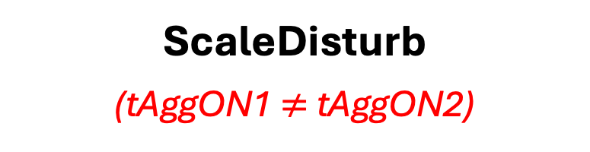
ScaleDisturb Access Pattern
What if the two aggressor rows have different open durations?
ScaleDisturb
(tAggON1 $≠$ tAggON2)
tAggON1
Aggr. Row
Victim Row
tAggON2
Aggr. Row
ScaleDisturb is a new DRAM access pattern
that asymmetrically extends the open time of two aggressor rows
Notes:
[CLICK] This leads to a natural question: what happens if we keep the two aggressor rows open for different durations? To answer this question,
[CLICK] In this work, we propose a new access pattern, ScaleDisturb, which keeps two aggressor row open for different time
[CLICK] In each access loop, we activate the first aggressor row and keep it open for tAggON1,
[CLICK] then we close it and activate the other aggressor row, keeping it open for a different duration, tAggON2
[forward&forth*3] We repeat this access loop, and observe the bitflips in the victim row.
[CLICK] We define ScaleDisturb as a new DRAM access pattern that asymmetrically extends the open times of the two aggressor rows.

Slide 15
Talk Outline
ScaleDisturb Access Pattern
Testing Infrastructure
Real DRAM Chip Results
Real System Demonstration of ScaleDisturb
Implications and Mitigations
Conclusion
Notes:
We characterize real DRAM chips vulnerability under the proposed ScaleDisturb using our testing infrastructure

Slide 16
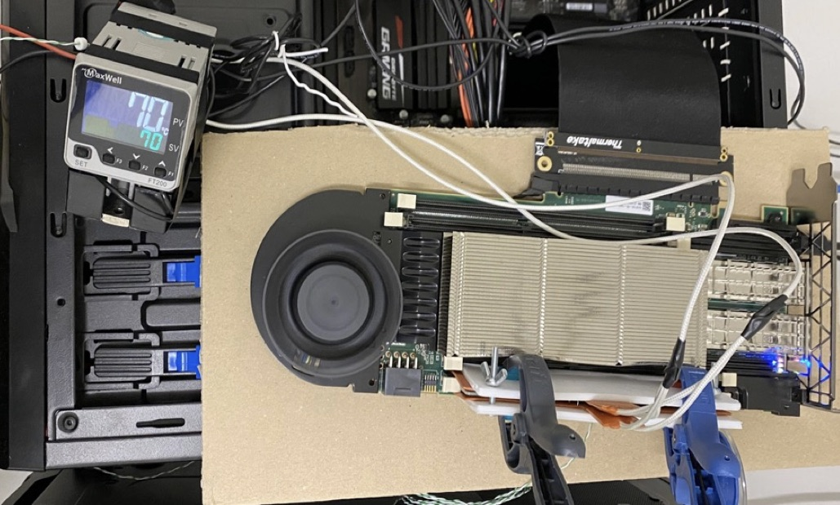
DDR4 DRAM Testing Infrastructure
  DRAM Bender on a Xilinx Virtex UltraScale+ XCU200
PCI-e Connection
to Host
Xilinx Alveo U200
FPGA Board
(programmed with DRAM Bender*)
MaxWell FT200
Temperature Controller
DRAM Module
w/ Heater Pads
Fine-grained control over DRAM commands,
timing parameters (±1.5ns), and temperature (±0.5°C)
*Olgun et al., "DRAM Bender: An Extensible and Versatile FPGA-Based Infrastructure to Easily Test
State-of-the-Art DRAM Chips,” TCAD, 2023. [GitHub: https://github.com/CMU-SAFARI/DRAM-Bender]
Notes:
Which is DRAM Bender. It enables us to test DDR4 DRAM modules with fine-grained control over DRAM commands, timing parameters, and temperature

Slide 17
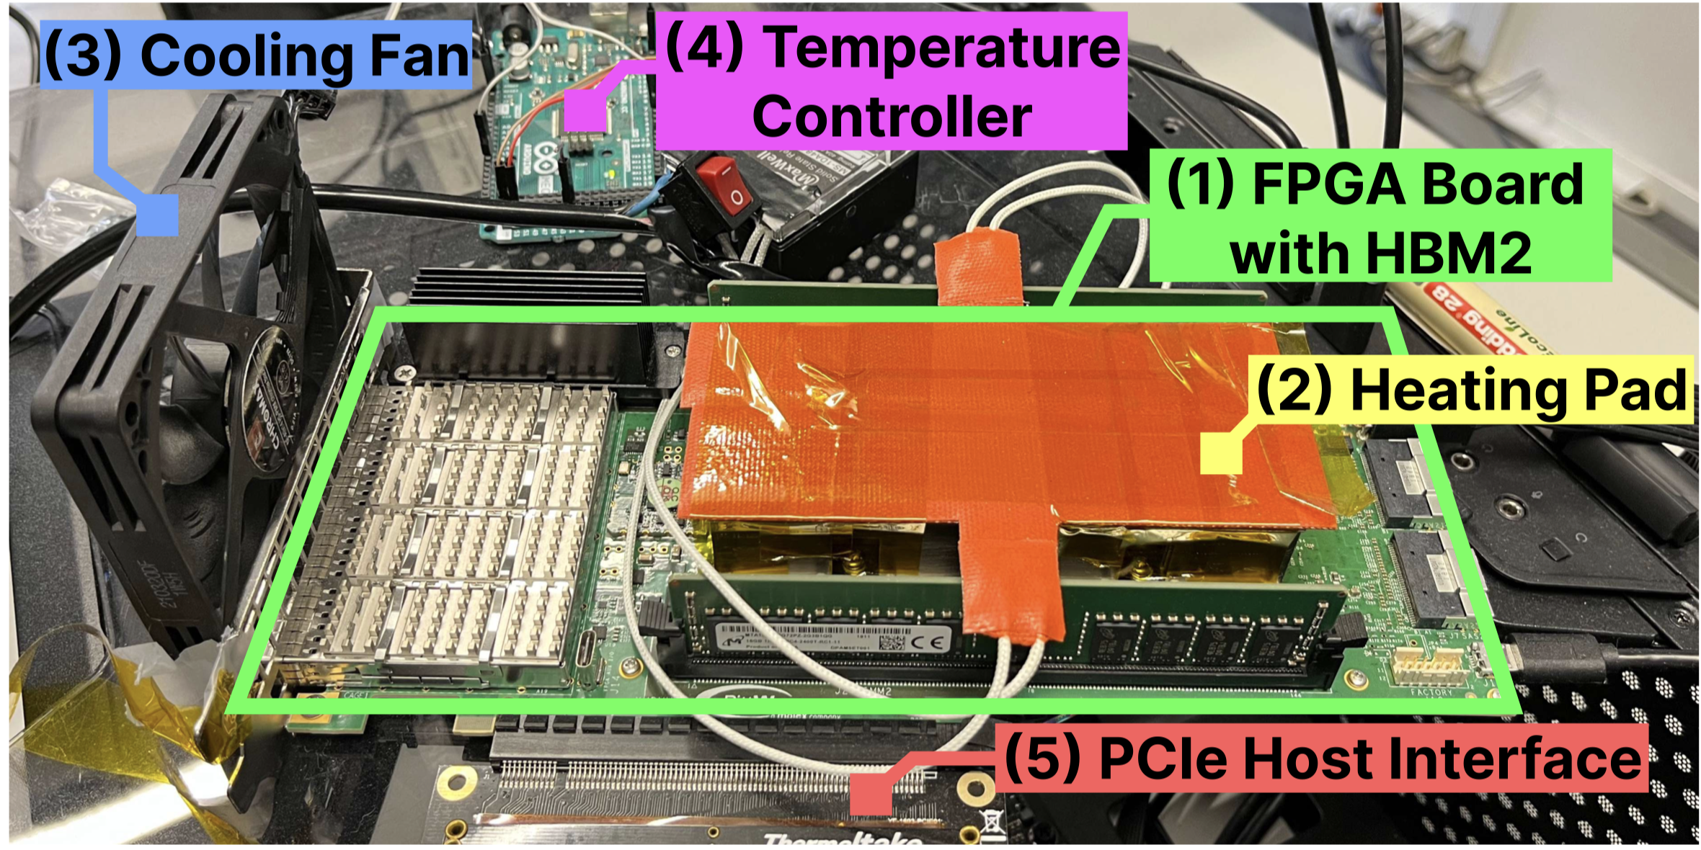
HBM2 DRAM Testing Infrastructure
  DRAM Bender on a Bittware XUPVVH
Fine-grained control over DRAM commands,
timing parameters (±1.67ns), and temperature (±0.5°C)
*Olgun et al., "DRAM Bender: An Extensible and Versatile FPGA-Based Infrastructure to Easily Test
State-of-the-Art DRAM Chips,” TCAD, 2023. [GitHub: https://github.com/CMU-SAFARI/DRAM-Bender]
Notes:
This is another version we use to test HBM2 DRAM chips.

Slide 18
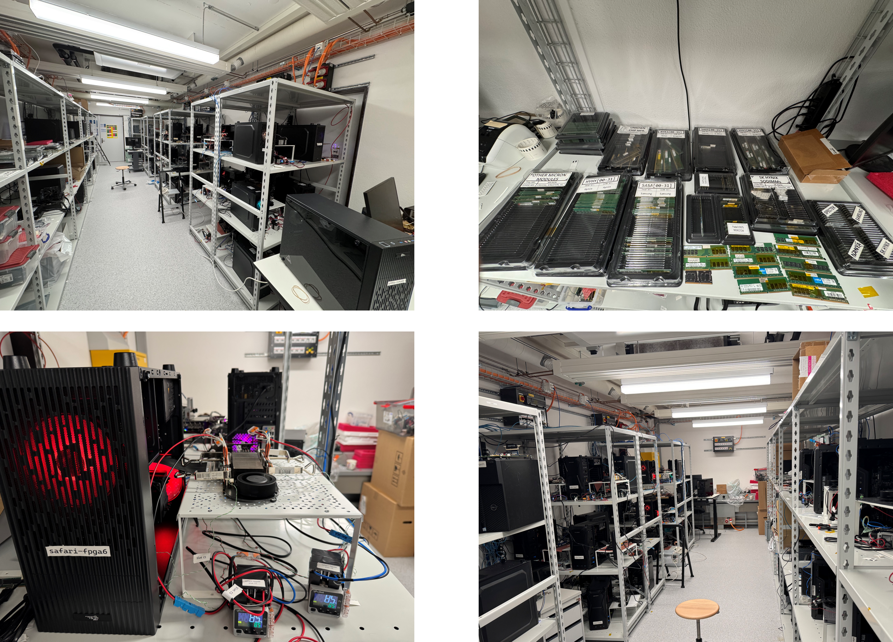
Laboratory for Understanding Memory
*Olgun et al., “A Modern Large-Scale Memory Characterization Laboratory”, arXiv, 2026 https://arxiv.org/abs/2606.13725
Notes:
And in our lab, we have many machines to test many DRAM modules and chips

Slide 19
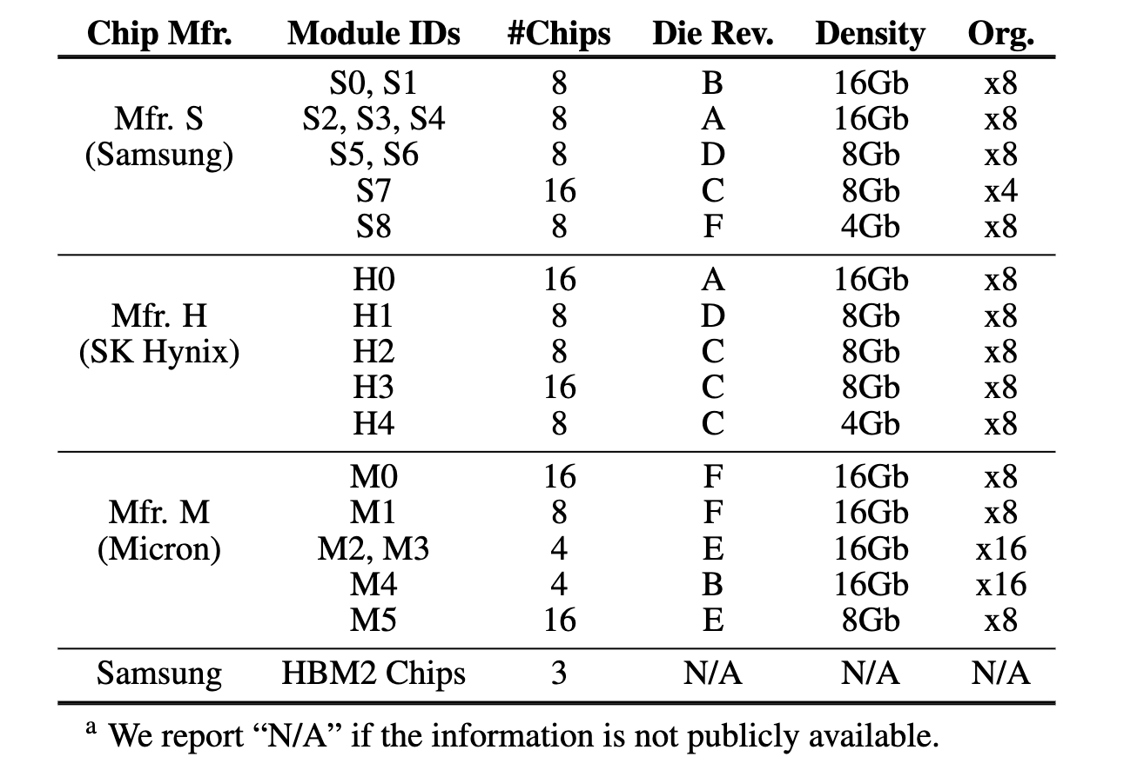
Tested DRAM Chips
196 DDR4 and 3 HBM2 Chips from Samsung, SK Hynix, and Micron
Notes:
In this work, we test many DRAM chips from three major DRAM manufacturers spanning
[CLICK] various die density and die revisions.

Slide 20
Testing Methodology: Sources of Interference
Prevent sources of interference during core test loop
No DRAM refresh
    to avoid refreshing victim rows
Within a single refresh window
    to avoid retention failures
No read disturbance mitigation mechanisms
    to observe circuit-level effects
No error correcting codes (ECC)
    to observe all bitflips
Notes:
[CLICK] as you say below
We carefully re-use the read disturbance characterization methodology as done by prior work where we prevent sources of interference

Slide 21
Testing Methodology: Metrics & Parameters
Metric: Minimum aggressor row activation count
required to induce the first bitflip (ACmin)
Lower
is worse
Access patterns: ScaleDisturb, double-/single-sided RowPress, double-/single-sided RowHammer
Row Open Time Budget (OTB) = tAggON1 + tAggON2 – 2*tRAS
OTB: 0ns, 48ns, 120ns, 300ns, 1200ns, 7800ns
Data Pattern: Rowstripe0 (0x00 in victim and 0xFF in aggressor) and Rowstripe1 (0xFF in victim and 0x00 in aggressor)
Temperature: 50°C and 80°C
Algorithm: Bisection-based ACmin search
Notes:
[CLICK] The key metric we use is the minimum aggressor row activation count to cause at least one bitflip, or ACmin.
[CLICK] A lower ACmin means a row is more vulnerable to read disturbance
[CLICK] We test DRAM row vulnerability under ScaleDisturb and other 4 access patterns,
[CLICK] We define a new parameter, row open time budget or OTB, which present the total row open time of two aggressor row in each loop, OTB equals tAggON1 plus tAggON2 minus 2 times tRAS,
[CLICK] We test with 6 OTB sizes,
[CLICK] using 2 data patterns
[CLICK] under 2 different temperatures.
[CLICK] We apply a bisection-based algorithm to search ACmin of each DRAM row

Slide 22
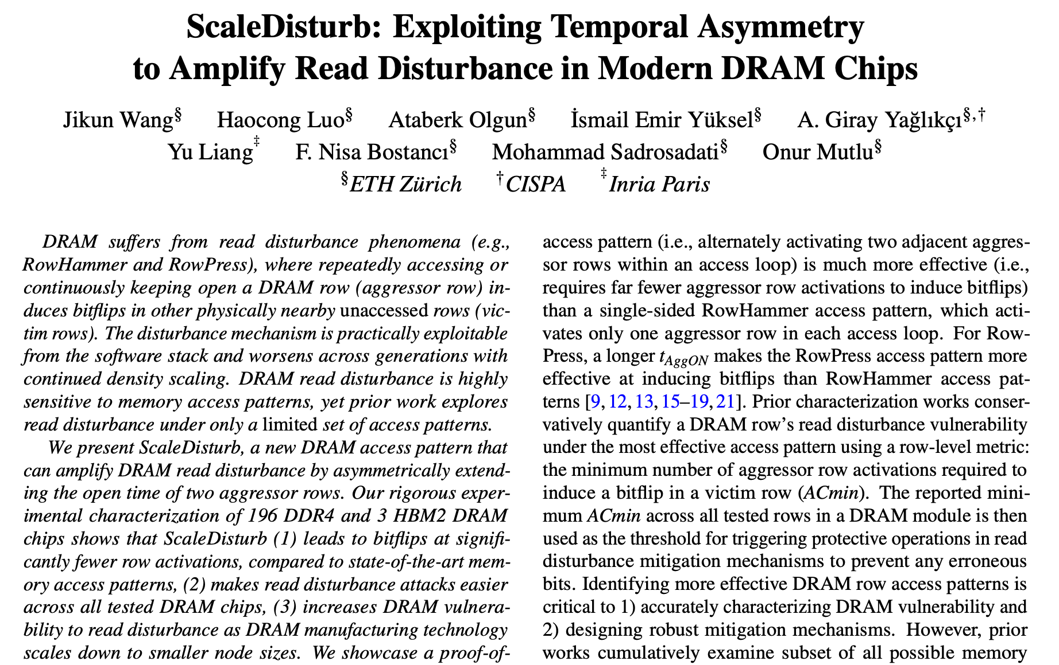

More in the Paper
https://arxiv.org/pdf/2606.07761
Notes:
More details on testing methodology can be found in the paper

Slide 23
Talk Outline
ScaleDisturb Access Pattern
Testing Infrastructure
Real DRAM Chip Results
Real System Demonstration of ScaleDisturb
Implications and Mitigations
Conclusion
Notes:
Now, let’s look at the results from real DRAM chips.

Slide 24
Key Takeaways from Major Characterization Experiments
Takeaway 1
ScaleDisturb significantly amplifies DRAM’s vulnerability
to read disturbance
Takeaway 2
ScaleDisturb widely affects DRAM chips, and worsens as DRAM technology scales down to smaller node sizes
Notes:
We have two key takeaways from major characterization experiments

Slide 25
Key Takeaways from Major Characterization Experiments
Takeaway 1
ScaleDisturb significantly amplifies DRAM’s vulnerability
to read disturbance
Takeaway 2
ScaleDisturb widely affects DRAM chips, and worsens as DRAM technology scales down to smaller node sizes
Notes:
First, ScaleDisturb amplifies DRAM’s vulnerability to read disturbance

Slide 26
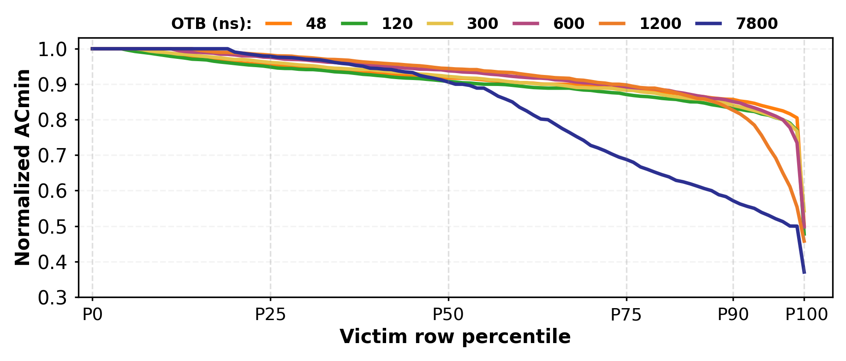
ScaleDisturb vs. Double-sided RowPress
Avg. ACmin Reduction
Max. ACmin Reduction
Ordered by ACmin Reduction
ScaleDisturb reduces ACmin by 9.6% on average (up to 63%)
across all tested DRAM rows compared to double-sided RowPress
Notes:
We compare all tested DRAM rows vulnerability under ScaleDisturb and double-sided RowPress
[CLICK] y-axis shows the ACmin value under ScaleDisturb access pattern normalized to double-sided RowPress;
[CLICK] x-axis shows the percentile of victim rows, rows toward the right side of the plot experience larger ACmin reductions
[CLICK] The lines with different color show the ACmin distribution at different OTBs
[CLICK] We can see that, compare to double-sided RowPress, ScaleDisturb reduce ACmin by around 10 percent on average and up to over 60% across all tested DRAM rows

Slide 27
Key Takeaways from Major Characterization Experiments
Takeaway 1
ScaleDisturb significantly amplifies DRAM’s vulnerability
to read disturbance
Takeaway 2
ScaleDisturb widely affects DRAM chips, and worsens as DRAM technology scales down to smaller node sizes
Notes:
[Click] Second, ScaleDisturb widely affects DRAM chips and becomes worse as DRAM technology scales down to smaller node sizes

Slide 28
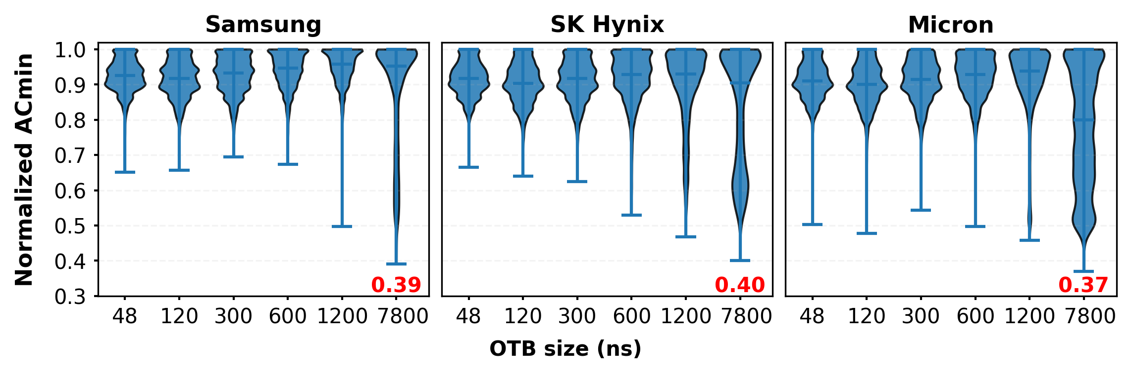
Prevalence of ScaleDisturb
OTB
ScaleDisturb widely affects DRAM chips vulnerability
to read disturbance from all three major DRAM manufacturers
Notes:
[CLICK] y-axis shows the ACmin value under ScaleDisturb normalized to double-sided RowPress
[CLICK] x-axis shows different OTB
[CLICK] and each subplot is dedicated to modules from a different manufacturer
[CLICK] each violin plots the normalized ACmin distribution with dedicated OTB and we highlight the minimum ACmin with red text
[CLICK] we can see ScaleDisturb reduces ACmin across all DRAM chips from three manufacturers

Slide 29
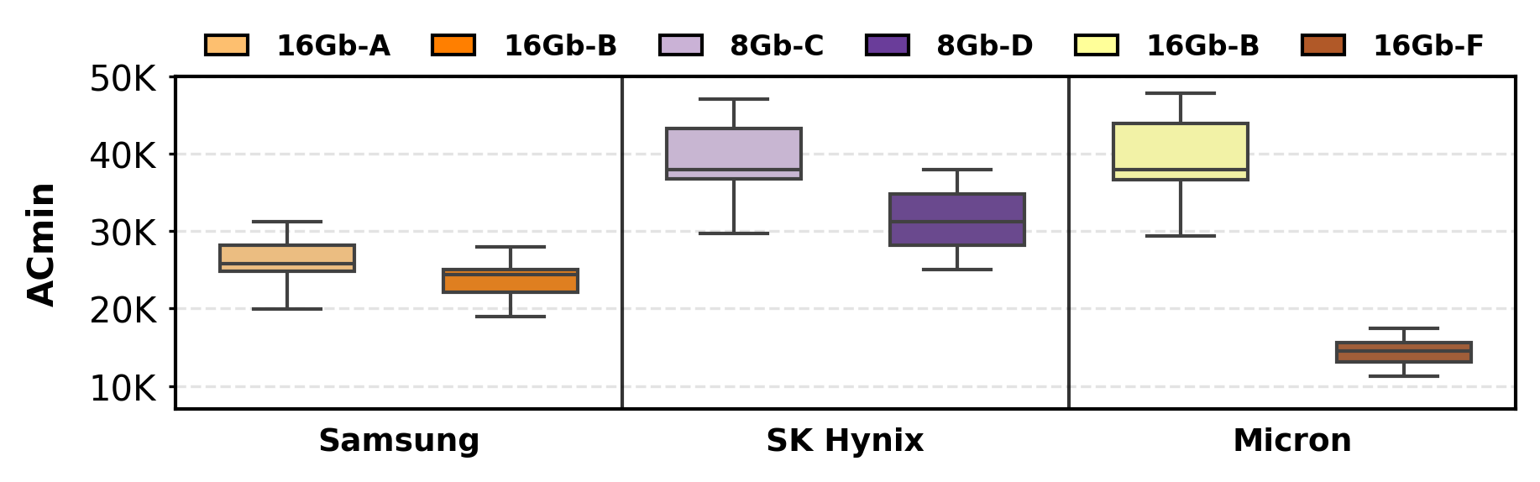
Newer Chips Are More Vulnerable
1.23x
2.68x
1.11x
Newer chips tend to be more vulnerable to read disturbance
under ScaleDisturb access pattern
Notes:
[CLICK] We then analyze the
[CLICK] ACmin values across DRAM modules with different die density and die revision, from three manufactures.
[CLICK] When DRAM nodes scale down, for example, Micron module, 16Gb, from B-die to F-die, the ACmin significantly decrease by more than 2x, and the same trend is observed in Samsung and SK Hynix modules.
[CLICK] We observe that under ScaleDisturb access pattern, newer chips tend to be more vulnerable.

Slide 30
Talk Outline
ScaleDisturb Access Pattern
Testing Infrastructure
Real DRAM Chip Results
Real System Demonstration of ScaleDisturb
Implications and Mitigations
Conclusion
Notes:
We demonstrate ScaleDisturb on a real system

Slide 31
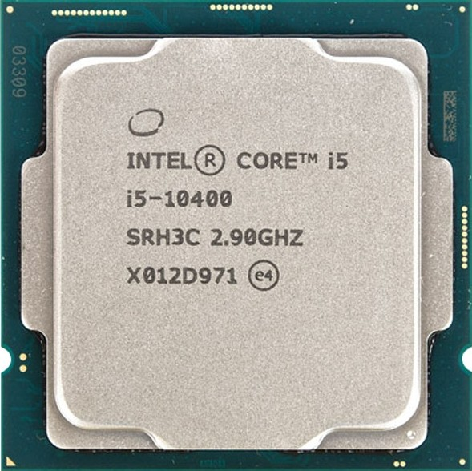
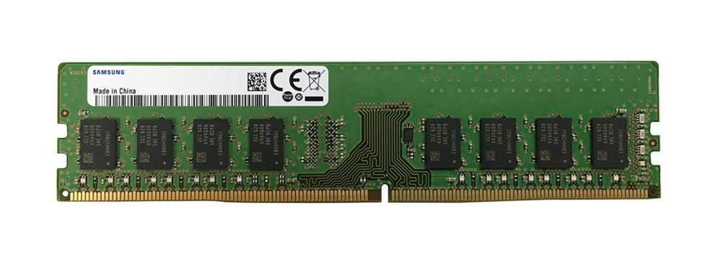
Methodology of Real System Demonstration
Samsung DDR4 Module M378A2K43CB1-CTD
w/ TRR RowHammer Mitigation
Intel Core i5-10400 (Comet Lake)
Our ScaleDisturb program
keeps a DRAM row open for a longer time by accessing more cache blocks in the row [Luo+, ISCA 2023]
keeps the two DRAM rows open for different times by accessing different numbers of cache blocks in the two aggressor rows
Notes:
[CLICK] with an Intel processor and a Samsung DDR4 module with TRR RowHammer mitigation.
[CLICK] First, our ScaleDisturb program follows the prior work to keep a DRAM row open for a longer duration by keeping accessing more cache blocks in the row.
[CLICK] Second, we keep two aggressor rows open for different time by accessing different number of cache blocks

Slide 32
Real System Demonstration Program
// Sync with Refresh and Loop Below
for(NUM_READ1 = 0;NUM_READ1 < TOTAL_READ; NUM_READ1++)
// Sweep two rows’ activation time
NUM_READ2 = TOTAL_READ - NUM_READ1;
for (k = 0; k < NUM_AGGR_ACTS; k++)
for (j = 0; j < NUM_READ1; j++)
∗AGGRESSOR1[j];
clflushopt(AGGRESSOR1[j]);
for (j = 0; j < NUM_READ2; j++)
∗AGGRESSOR2[j];
clflushopt(AGGRESSOR2[j]);
mfence();
activate_dummy_rows();
# Cache Blocks Accessed Per Row Activation
NUM_READ1 != NUM_READ2 (ScaleDisturb)
NUM_READ1 = NUM_READ2 > 1 (RowPress)
NUM_READ1 = NUM_READ2 = 1 (RowHammer)
NUM_AGGR_ACTS: Dummy row activation frequency
Notes:
[CLICK] Here is the key part of our code, where two rows share the total number of read and we can change the number of cache blocks read per row activation.
[CLICK] When NUM_READ1 and 2 are different, the program runs ScaleDisturb,
[CLICK] When these two are the same and greater than 1, it runs RowPress.
[CLICK] If both of them are set to 1, then the program runs RowHammer.
[CLICK] We use the num_aggr_act parameter to control the dummy row activation frequency. as We need this to bypass the TRR mitigation

Slide 33
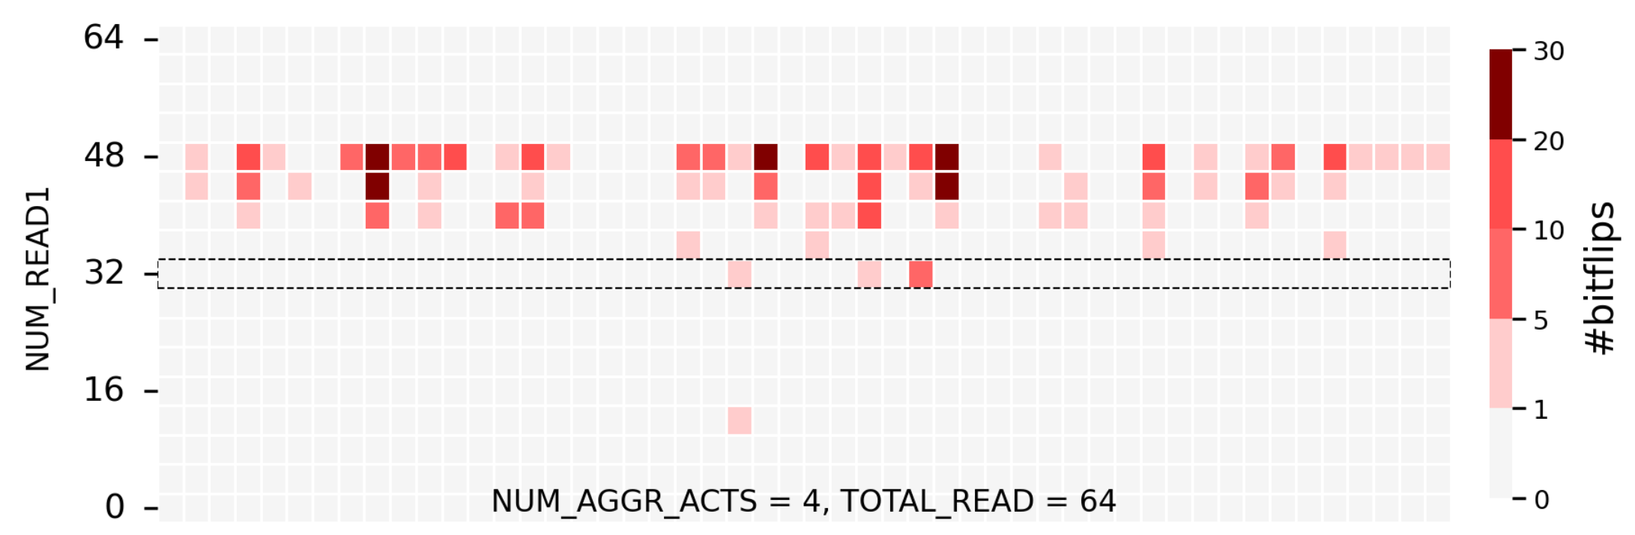
Real System Demonstration Results (I)
Top 50 rows with highest #bitflips
ScaleDisturb – 33 rows
Double-sided RowPress – only 3 rows
Victim Row ID
A user-level program leveraging ScaleDisturb induces bitflips
in cells where double-sided RowPress cannot
Notes:
[CLICK] We show the top 50 rows with highest bitflips count.
[CLICK] Y-axis shows the number of cache block read in aggressor row 1
[CLICK] and x-axis shows the row ID,
[CLICK] the color indicates the bitflips count. We highlight the RowPress in each subplot with dash-box;
[CLICK] We found that, leveraging ScaleDisturb, our program induces bitflips when double-sided RowPress cannot

Slide 34
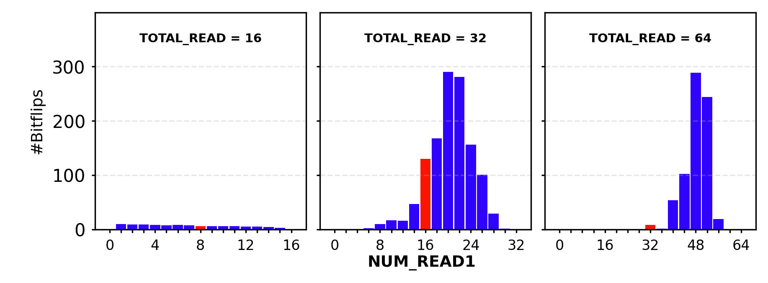
Real System Demonstration Results (II)
NUM_AGGR_ACT = 4
NUM_READ1
ScaleDisturb induces more bitflips than double-sided RowPress, under low dummy row activation frequency
Notes:
[CLICK] We plot the bitflip distribution at a low dummy row activation frequency, or ACT is 4
[CLICK] under different total number of cache blocks
[CLICK] y-axis shows the bitflip count
[CLICK] x-axis shows the number of read1
[CLICK] We highlight double-sided RowPress with red bars and ScaleDisturb in blue bars
[CLICK] We observe ScaleDisturb induces more bitflips than double-sided RowPress, when dummy row activation frequency is low

Slide 35
Talk Outline
ScaleDisturb Access Pattern
Testing Infrastructure
Real DRAM Chip Results
Real System Demonstration of ScaleDisturb
Implications and Mitigations
Conclusion
Notes:
ScaleDisturb has critical implications on the robustness of DRAM-based system and existing read disturbance mitigations…

Slide 36
Implications and Mitigations Summary
Security guarantees provided by mitigation techniques rely on accurately profiling the read disturbance threshold (ACmin) using existing DRAM access patterns
ScaleDisturb leads to much lower ACmin than existing access patterns, defenses should take ScaleDisturb into account
We analyze ScaleDisturb’s implication on three classes of potential solutions
We propose a new solution with low additional overhead
Notes:
[CLICK] I’ll give a high-level implication summary
[CLICK] First, read disturbance mitigation mechanisms rely on identifying ACmin using existing DRAM access patterns
[CLICK] ScaleDisturb leads to much lower ACmin than existing access patterns, defenses should take ScaleDisturb into account
[CLICK] We analyze three potential solutions to mitigate ScaleDisturb bitflips and propose a new solution

Slide 37
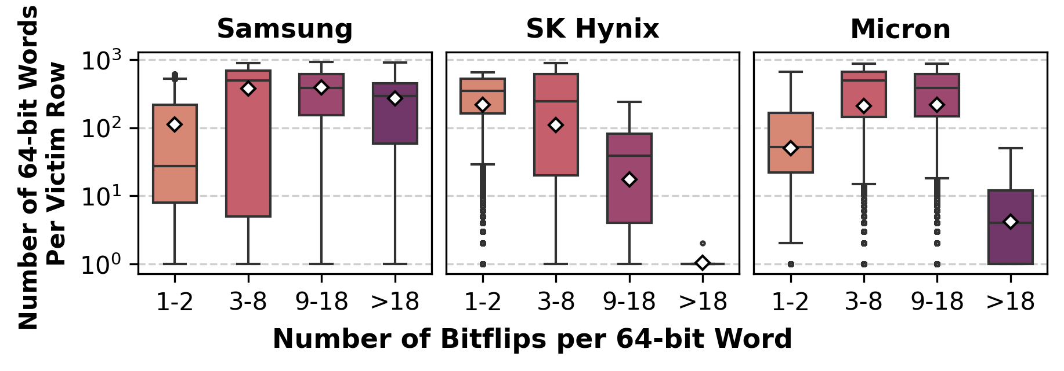
ECC Is Ineffective
Error Correcting Code (ECC)
Up to 40 bitflips in a 64-bit word
ScaleDisturb induces more bitflips (up to 40 bitflips) per 64-bit word than widely used ECC techniques can correct
Notes:
[CLICK] First, we examine ECC’s capability to mitigate ScaleDisturb bitflips,
[CLICK] Y-axis shows the number of 64-bit words per victim row,
[CLICK] x-axis show the bitflips count per word
[CLICK] ScaleDisturb induces bitflips within a 64-bit word that far exceed the correction capability of ECC techniques.

Slide 38
Methodology for Safety Margin Evaluation
Applying Safety Margin to existing SOTA mitigation mechanisms
Performance evaluation:
  cycle-level simulations using Ramulator 2.0 [Luo+, CAL 2023]
Threshold baselines: 1024 and 128
Safety margins: 10%, 25%, and 60%
Five state-of-the-art mitigation mechanisms
  Graphene, Hydra, PRAC, PRFM, PARA
System Configuration:
  Processor 4 cores, 4.2GHz clock frequency, 4-wide issue, 128-entry instruction window
  DRAM DDR5, 1 channel, 2 rank/channel, 8 bank groups, 4 banks/bank group, 64K rows/bank
  Memory Ctrl. 64-entry read and write requests queues,
  Scheduling policy: FR-FCFS with a column cap of 4 Last-Level Cache 8 MiB (4-core)
Workloads: 60 4-core workload mixes from 5 benchmark suites
Notes:
[CLICK] To mitigate ScaleDisturb bitflips, system designers can reduce the configured threshold by a safety margin,
[CLICK] We evaluate the overhead of applying safety margins, using a cycle-level simulation, ramulator 2
[CLICK] We configure it with two baseline thresholds,
[CLICK] each with three safety margins from our characterization,
[CLICK] We conduct our experiments on five SOTA solutions with system configurations and workloads below.

Slide 39
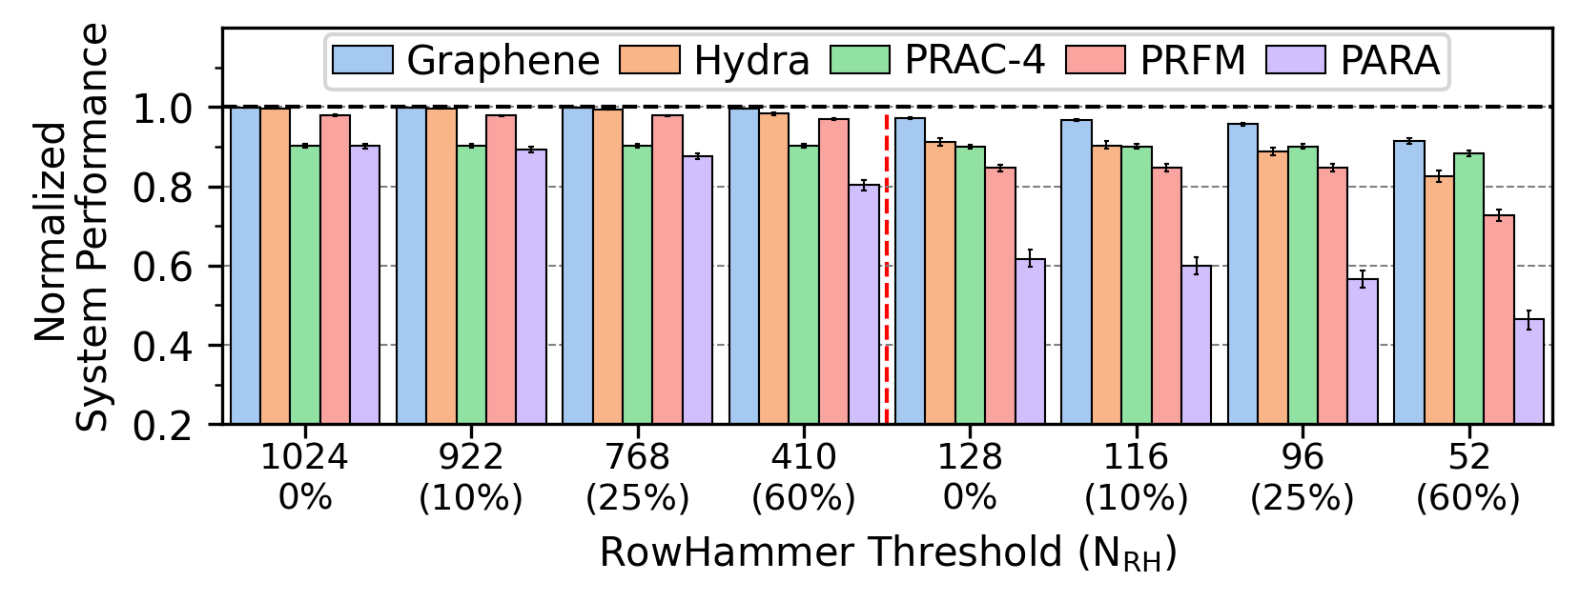
Performance Overhead
28.6%
Configured Read Disturbance Threshold
Adding a large safety margin to mitigation mechanisms incurs up to 28.6% (8.8% on average) performance overhead
Notes:
[CLICK] To show the performance overhead caused by reduced thresholds,
[CLICK] y-axis shows the system performance of different read disturbance mitigation, normalized to a base system without any mitigation,
[CLICK] x-axis shows the configured read disturbance threshold
[CLICK] Our evaluation results show that using large safety margins introduces significant performance overhead

Slide 40
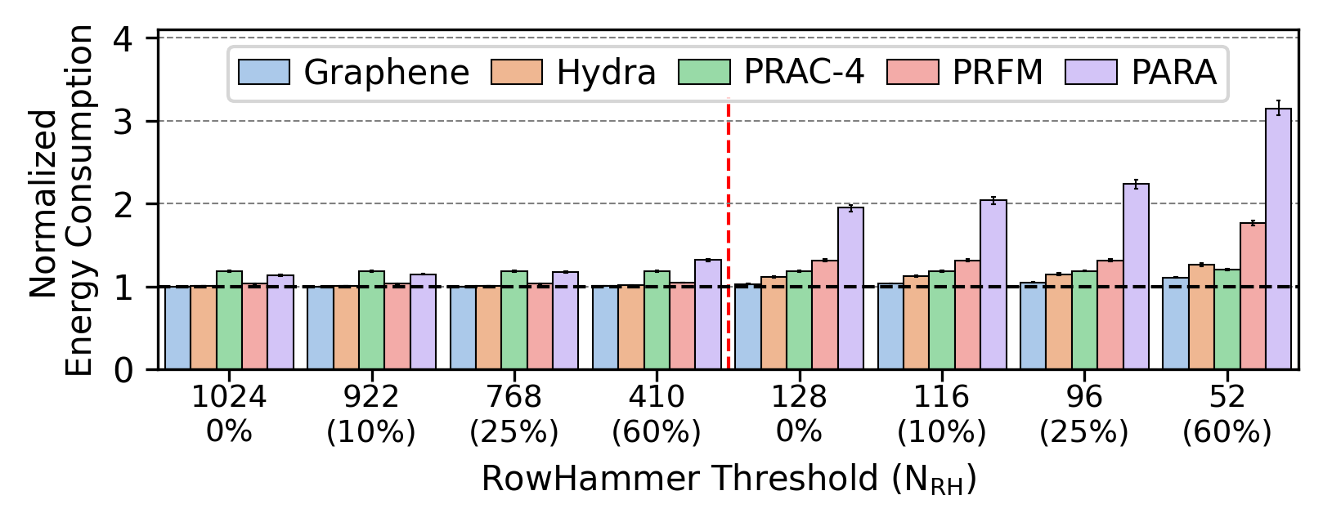
Energy Overhead
58.8%
Configured Read Disturbance Threshold
Using safety margin to existing mitigation mechanisms incurs
up to 58.8% (12.3% on average) energy overhead
Notes:
[CLICK] And at the same time, using large safety margins significantly increases the energy consumption

Slide 41
Our Solution: TeACUp
We develop a new mitigation, Temporal Asymmetry-aware Counter Update (TeACUp), by adapting a state-of-the-art RowPress mitigation, ImPress
The key idea of TeACUp is to scale the row counter increment adaptively based on the asymmetric activation times
Notes:
We develop a new mitigation, Temporal Asymmetry-aware Counter Update (TeACUp), by adapting a state-of-the-art RowPress mitigation, ImPress, which naively maps a RowPress activation to multiple RowHammer activation but caused unnecessary preventive refreshes under ScaleDisturb.
The key idea of TeACUp is to scale the row counter increment adaptively based on the asymmetric activation times

Slide 42
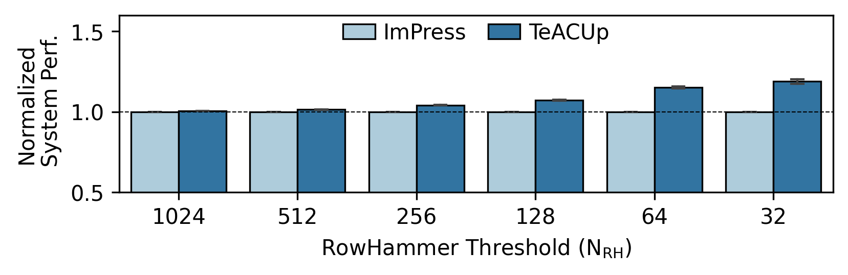
TeACUp Evaluation Results
Configured Read Disturbance Threshold
TeACUp improves system performance by 3.2% on average
(up to 9.2%) over state-of-the-art RowPress mitigation
Notes:
[CLICK] Our evaluation results show that, compared to ImPress, TeACUp improves the system performance by 3% on average.

Slide 43
More in the Paper
Many more characterization results
  Bitflip index analysis
  Access pattern comparison
  Data pattern analysis
  Temperature analysis
  HBM2 analysis
Hypothetical explanation for ScaleDisturb
Mitigation implications
  ECC capability
  Adapting existing RowHammer/RowPress mitigation mechanisms
  TeACUp: security analysis, evaluation methodology, overhead analysis
Notes:
We have more content in the paper that I cannot talk about now
[CLICK]
[CLICK]
In the interest of time, I’ll refer you to…

Slide 44
Available on arXiv
https://arxiv.org/pdf/2606.07761
Notes:
our paper is available on arXiv

Slide 45
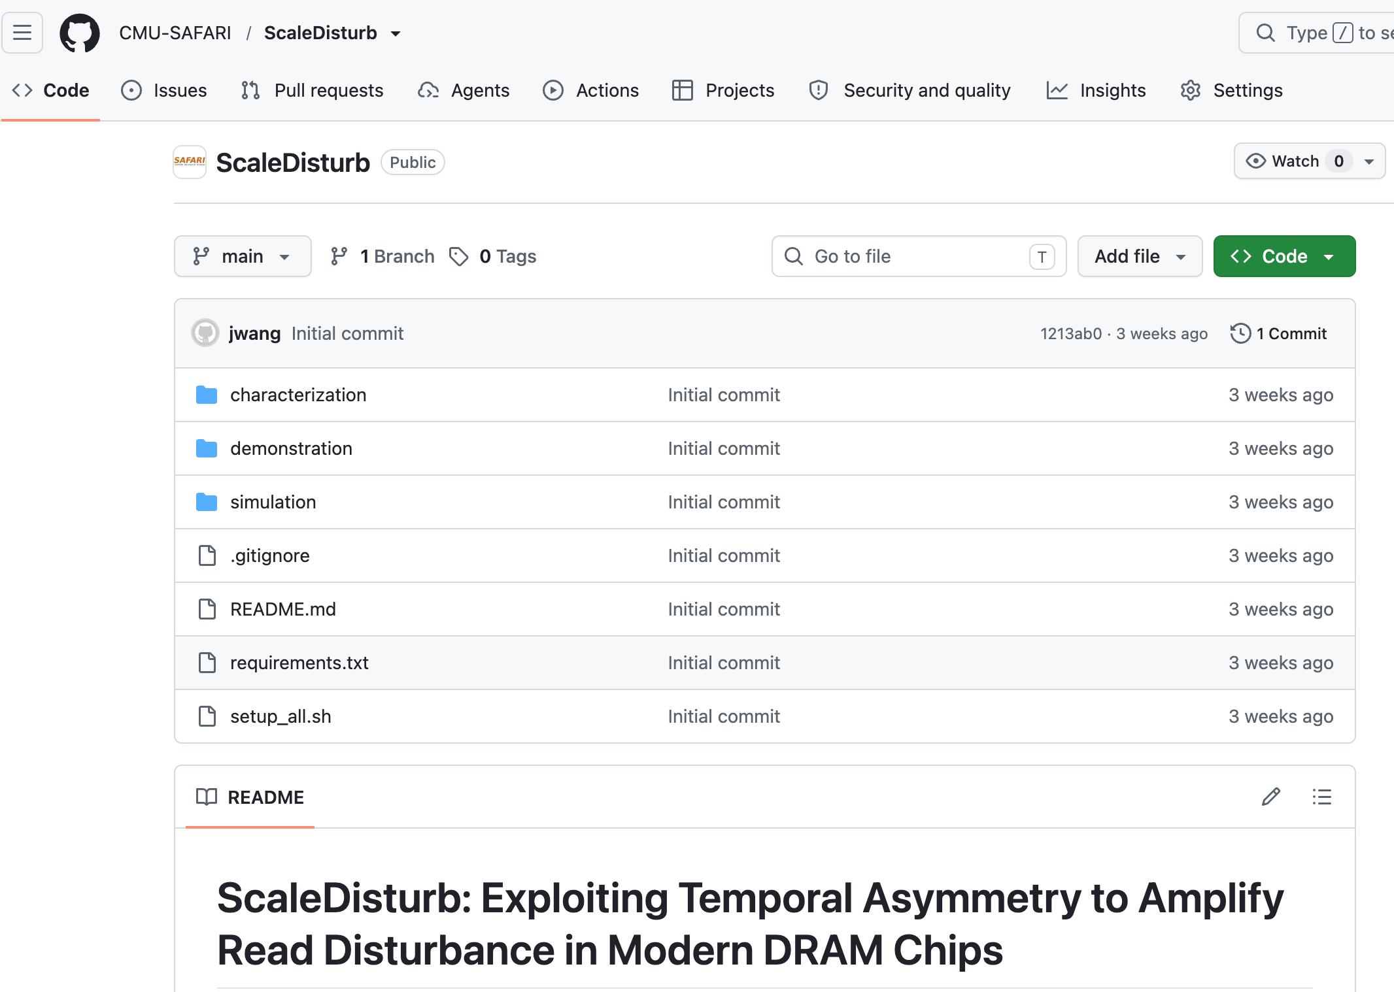
Open-Sourced & Artifact-Evaluated
Notes:
Our artifact is open-sourced and officially evaluated

Slide 46
Talk Outline
ScaleDisturb Access Pattern
Testing Infrastructure
Real DRAM Chip Results
Real System Demonstration of ScaleDisturb
Implications and Mitigations
Conclusion
Notes:
To conclude my talk,

Slide 47
Conclusion
We propose ScaleDisturb, a new DRAM access pattern that amplifies DRAM vulnerability to read disturbance by asymmetrically extending
the open time of two aggressor rows
We characterize ScaleDisturb on 196 DDR4 and 3 HBM2 DRAM chips
ScaleDisturb worsens DRAM’s vulnerability to read disturbance
ScaleDisturb becomes worse as DRAM technology node size reduces
We demonstrate ScaleDisturb bitflips on a real system with TRR mitigation
ScaleDisturb induces bitflips in cells where double-sided RowPress cannot
ScaleDisturb induce more bitflips than double-sided RowPress
We evaluate the implications of ScaleDisturb on existing DRAM-based systems and propose a new solution with low overhead
Notes:
[CLICK] We introduce a new DRAM access pattern called ScaleDisturb that exploits temporal asymmetry to amplify DRAM read disturbance
[CLICK] We characterize ScaleDisturb on real DRAM chips and show that ScaleDisturb worsens DRAM’s vulnerability to read disturbance and become worse
[CLICK] We demonstrate ScaleDisturb bitflips on a real system with TRR RowHammer mitigation
[CLICK] We evaluate the implications of ScaleDisturb on existing read disturbance mitigations and propose a new solution

Slide 48


ScaleDisturb: Exploiting Temporal Asymmetry to Amplify Read Disturbance in Modern DRAM Chips
Jikun Wang
Haocong Luo Ataberk Olgun Ismail Emir Yüksel A. Giray Yağlıkçı
Yu Liang F. Nisa Bostanci Mohammad Sadrosadati Onur Mutlu

Slide 49
ScaleDisturb: Exploiting Temporal Asymmetry to Amplify Read Disturbance in Modern DRAM Chips
Backup Slides
Jikun Wang
Haocong Luo Ataberk Olgun Ismail Emir Yüksel A. Giray Yağlıkçı
Yu Liang F. Nisa Bostanci Mohammad Sadrosadati Onur Mutlu

Slide 50
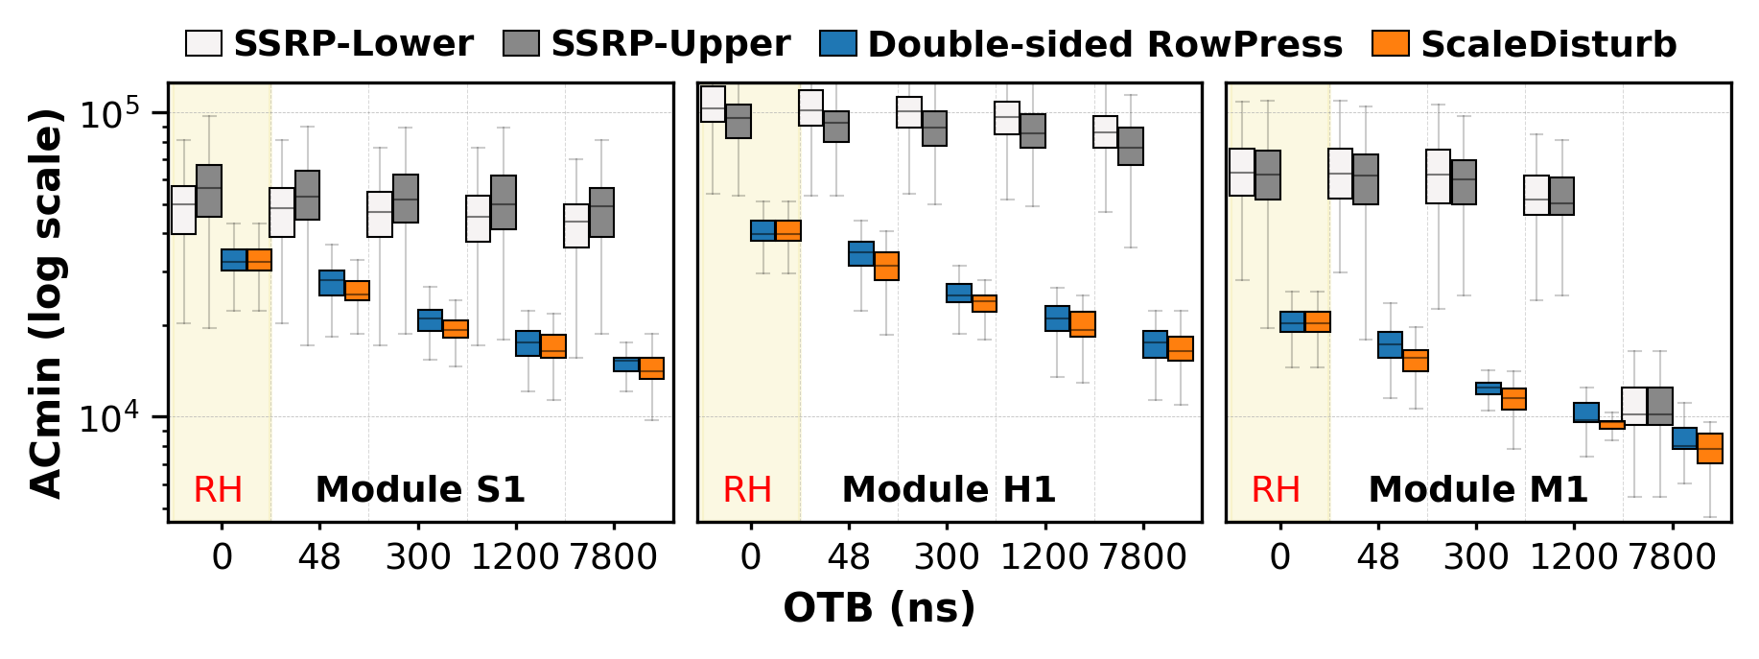
DRAM Access Pattern Comparison
Single-sided access patterns causes asymmetric
vulnerability based on victim row’s position
ScaleDisturb consistently leads to the lowest ACmin
across all access patterns under tested OTB values.

Slide 51
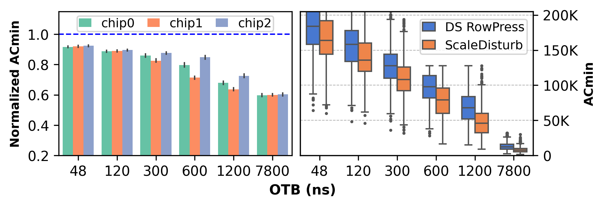
HBM2 DRAM Chips – ACmin Reduction
HBM2 chips are more vulnerable to read disturbance
under ScaleDisturb access pattern than double-sided RowPress

Slide 52
Hypothetical explanation
Enhanced electric fields drive electron migration more effectively than trap-assisted leakage or crosstalk-induced mechanisms
In double-sided patterns, the electric fields from the two aggressor wordlines can interact and partially cancel each other
ScaleDisturb introduces temporal asymmetry that breaks this interference, thereby increasing net electron migration

Slide 53
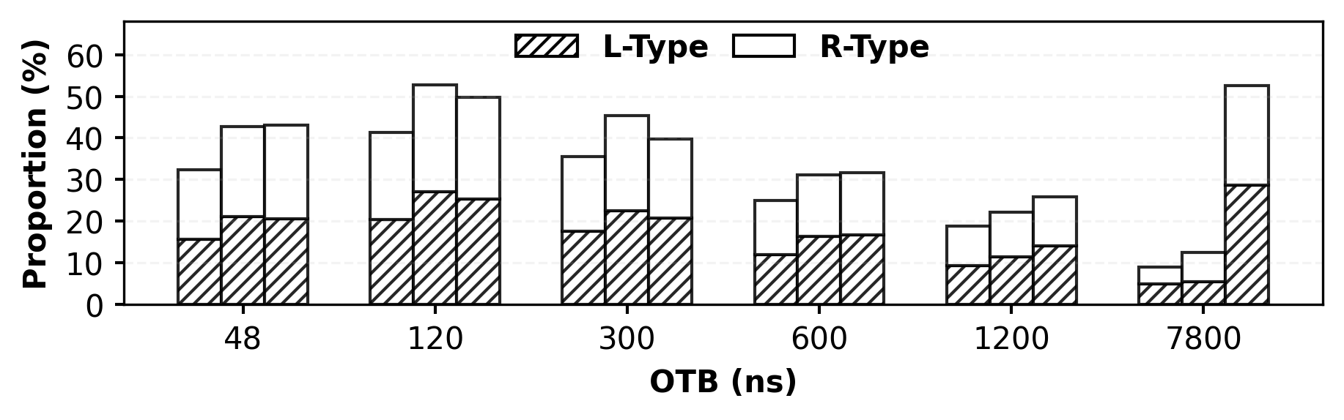
Proportions of three ACmin Changing Pattern
L-type and R-type patterns constitute a large
fraction of rows, and their proportions vary with OTB
L-type and R-type patterns occur at nearly
equal rates across all evaluated OTB values

Slide 54
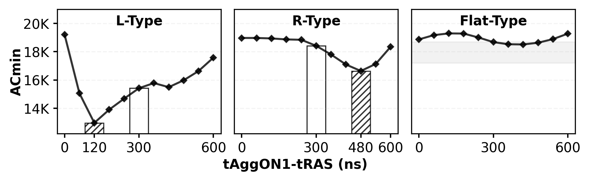
Three Observed ACmin Changing Pattern
DRAM rows under ScaleDisturb exhibit
three major ACmin reduction patterns: L-, R- and Flat-type

Slide 55
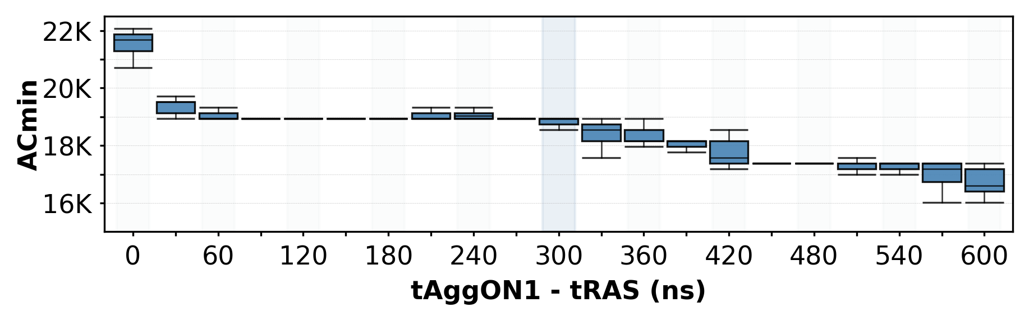
Distinguish ScaleDisturb and Variable Read Disturbance (VRD)
ScaleDisturb is fundamentally different from Variable Read Disturbance
in both stability and ACmin reduction

Slide 56
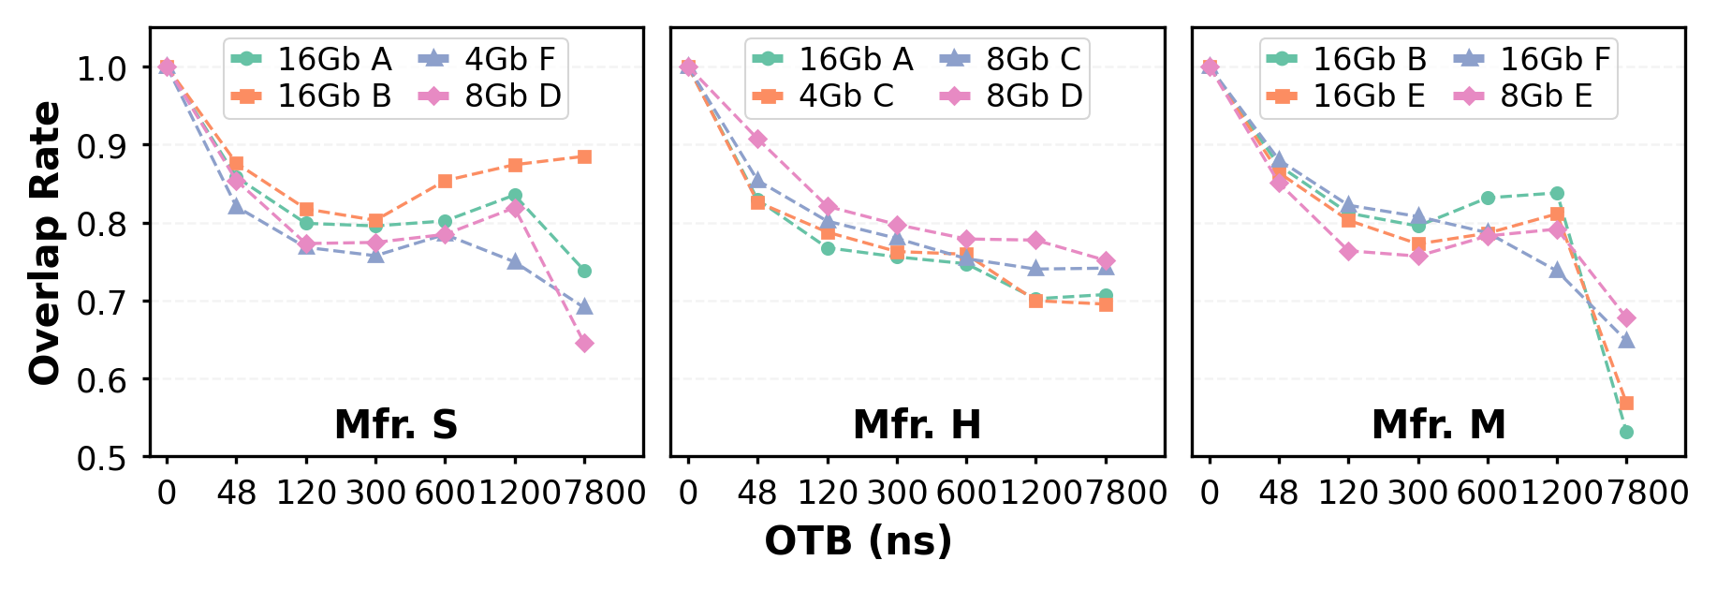
Bitflip Index Analysis
ScaleDisturb flips a distinct set of cells
than double-sided RowPress

Slide 57
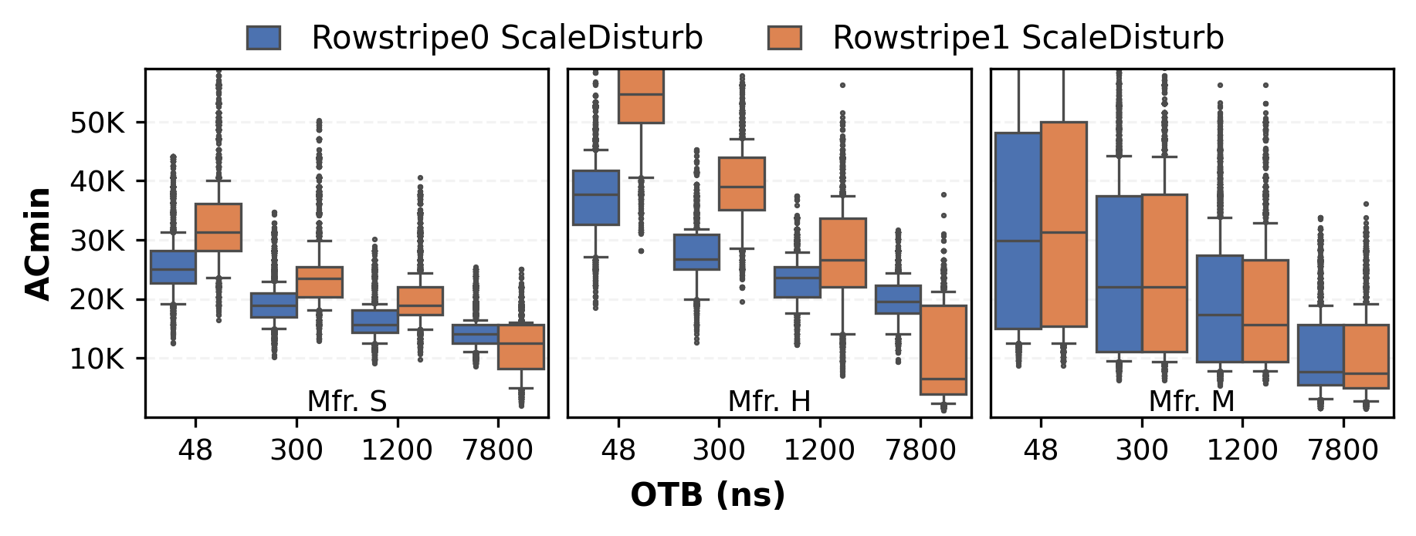
Data Pattern’ Effects on ScaleDisturb
Rowstripe0 yields lower ACmin at small OTBs
Rowstripe1 yields lower ACmin at large OTBs

Slide 58
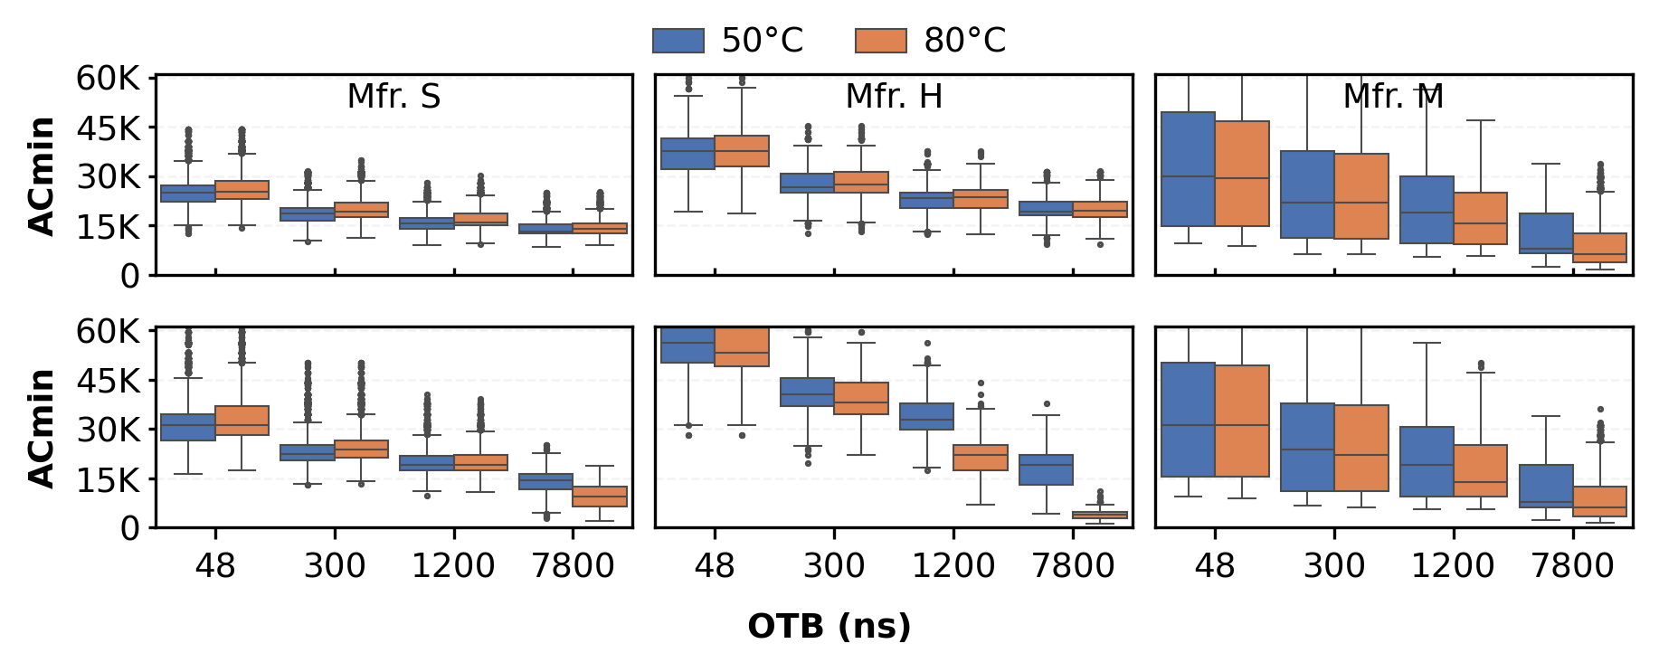
Temperature’ Effects on ScaleDisturb
Under ScaleDisturb access pattern,
ACmin is less sensitive to a higher temperature for Rowstripe0
than for Rowstripe1 as OTB increases

Slide 59
ScaleDisturb Access Pattern (I)
a
tRAS
tRP
tRAS
…
CMD
ACT
PRE
ACT
PRE
tAggON2
tAggON
b
ADDR
N-1
N+1
Double-sided RowHammer
tRAS
a
tAggON
tAggON
…
b
tRAS
tRP
tRAS
45°
At low dummy row activation frequency (or ACT=4),
tRAS
tAggON
CMD
ACT
PRE
ACT
PRE
ADDR
N-1
N+1
tAggON1
Double-sided RowPress
Existing double-sided DRAM access patterns
always keep the two aggressor rows open for equal durations

Slide 60
ScaleDisturb Access Pattern (II)
What if the two aggressor rows have different open durations?
New Parameter: Additional Row Open Time Budget (OTB) = tAggON1 + tAggON2 – 2*tRAS
a
tRAS
tRP
tRAS
…
CMD
ACT
PRE
ACT
PRE
ADDR
N-1
N+1
tRAS+OTB
Double-sided RowHammer (OTB = 0)
tAggON
tAggON
tAggON2
c
b
tRAS
OTB/2
tRP
tRAS
OTB/2
…
tRAS+OTB/2
b
CMD
ACT
PRE
ACT
PRE
ADDR
N-1
N+1
Double-sided RowPress (tAggON = tRAS +OTB/2)
tRAS
a
tAggON1
tAggON2
…
c
tRAS
tRP
tRAS
45°
CMD
ACT
PRE
ACT
PRE
tRAS
tRAS+
OTB/2
tRAS+OTB
ADDR
N-1
N+1
tAggON1
ScaleDisturb (tAggON1 != tAggON2)
ScaleDisturb is a new DRAM access pattern
that asymmetrically extends the open time of two aggressor rows

Slide 61
ScaleDisturb Access Pattern (III)
What if the two aggressor rows have different open durations?
New Parameter: Extra Row Open Time Budget (OTB) = tAggON1 + tAggON2 – 2*tRAS
a
Double-sided RowHammer (OTB = 0)
b
Double-sided RowPress (tAggON = tRAS +OTB/2)
tRAS+OTB
tAggON1
Aggr. Row
c
tAggON2
Victim Row
tRAS+OTB/2
b
tAggON2
Aggr. Row
tRAS
a
c
ScaleDisturb
(tAggON1 != tAggON2)
45°
tRAS
tRAS+
OTB/2
tRAS+OTB
tAggON1
ScaleDisturb is a new DRAM access pattern
that asymmetrically extends the open time of two aggressor rows

Slide 62
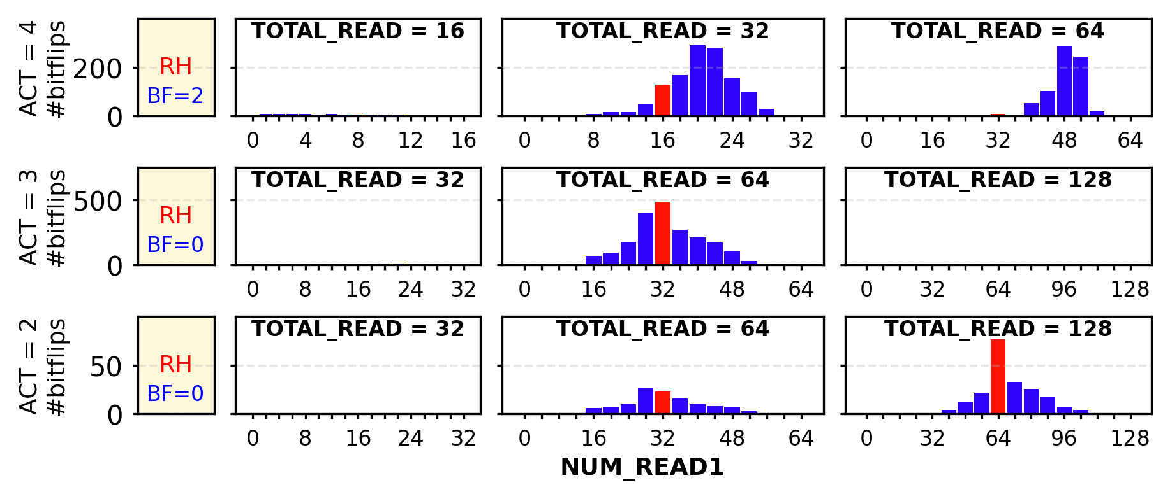
Real System Demonstration Results (II)
ScaleDisturb induces bitflips in more cells than double-sided RowPress, under low dummy row activation frequency

Slide 63
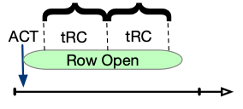
Implications and Mitigations (III)
Activation-time-based counter update
ImPress, [Saxena+, MICRO 2024]
Aggressor
Row Counter
Threshold
slower
Symmetric Rows
faster
Premature
Refresh
Asymmetric Faster Row
Asymmetric Slower Row
TeACUp
Delayed
Refresh
Total Row Activations & Time
Naively mapping activation time to counter increment causes unnecessary protective refreshes
Temporal Asymmetry-aware Counter Update (TeACUp) safely slow the increment of faster row to delay the refresh

