Slide 1



Revelator
Rapid Data Fetching
via System-Software-Guided Hash-based
Speculative Address Translation
Konstantinos Kanellopoulos Konstantinos Sgouras
Harsh Songara Andreas Kosmas Kakolyris Vlad-Petru Nitu
Spiros Galanopoulos Rahul Bera Konstantina Koliogeorgi
Rakesh Kumar Onur Mutlu

Slide 2
Background

Slide 3


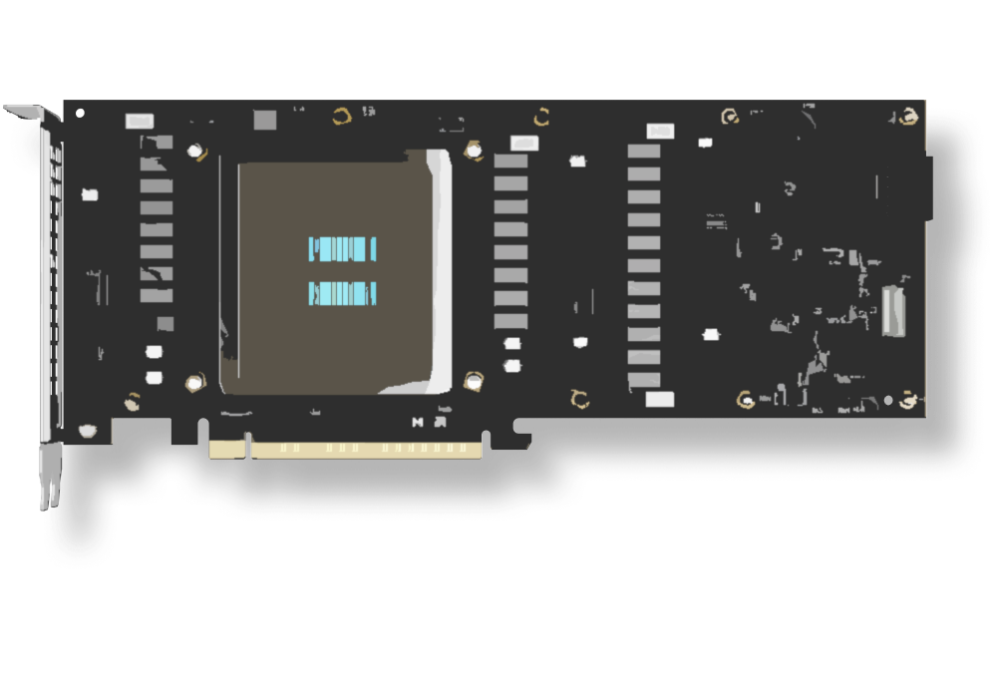



Virtual Memory is a Cornerstone
of Modern Computing Systems
CPUs
GPUs
AI Accelerators
Mobile/ Embedded SoCs
NICs
Notes:
Virtual memory is the cornerstone abstraction underpinning every modern computing system.
From CPUs to GPUs and NICs— they all rely on it.

Slide 4




Emerging Workloads
Sparse
Machine
Learning
Graph
Analytics
Genomics
Databases
Performance bottleneck: 10-30%
of cycles spent on address translation
Zao et al. “Contiguitas: The Pursuit of Physical Memory Contiguity in Datacenters” ISCA 2023
Notes:
What happens when modern workloads meet this old contract?
[CLICK] Databases, genomics, graph analytics [CLICK] introduce address translation overheads

Slide 5

Address Translation Overheads
Irregular Memory
Accesses
Large Data
Footprints
Notes:
These workloads exhibit:
[CLICK] — irregular memory accesses
[CLICK] — large data footprints

Slide 6
Low Spatial and Temporal Locality
TLB
PMLE4
PMLE4
PMLE4
PMLE4
PMLE4
PMLE4
PMLE4
PMLE4
0xA4266459
PMLE4
PMLE4
PMLE4
PMLE4
PMLE4
PMLE4
Level 4
PMLE4
0x54277457
PDP
0x54277457
PDP
PDP
PDP
PDP
PDP
0x51428887
PDP
PDP
PDP
PDP
PDP
PDP
PDP
PDP
Level 3
PDP
0x54277457
PD
0x54277457
0x56477457
PD
PD
PD
PD
PD
PD
PD
PD
PD
PD
PD
PD
PD
Level 2
PD
0x940F5498
0xA4266459
PT
PT
PT
PT
PT
PT
PT
PT
PT
PT
PT
PT
PT
PT
Level 1
PT
Frequent
TLB Misses
Frequent High-Latency Page Table Walks
Notes:
Thus, experience low spatial/temporal locality causing:
[CLICK] frequent TLB misses
[CLICK]→ frequent high-latency page table walks

Slide 7

The
address
tRANSLATION
Wall
Notes:
Transition slide — 'Virtual Memory'. Pause.

Slide 8
The
address
tRANSLATION
Speculation
Wall
Notes:
Transition slide — 'Virtual Memory'. Pause.

Slide 9
The
address
tRANSLATION
Speculation
Wall
Notes:
Transition slide — 'Virtual Memory'. Pause.

Slide 10
Notes:
Transition slide — 'Virtual Memory'. Pause.

Slide 11
Speculative Address Translation
  Conventional Address Translation
TLB Miss
Page Table Walk
Data Fetch
Likely DRAM access
Physical address
is known
Notes:
[CLICK] Compared to regular translation
[CLICK] The idea of speculative translation is this:
[CLICK] instead of waiting for the page-table walk to complete,
[CLICK] predict the physical address and start the data fetch immediately. [CLICK] If the prediction is right, we overlap translation latency with data fetch and
[CLICK] gain performance

Slide 12
Speculative Address Translation
  Conventional Address Translation
TLB Miss
Page Table Walk
Data Fetch
  Speculative Address Translation
TLB Miss
Page Table Walk
Data Fetch
Likely
cache hit
Predict Physical
Address
Speculative Data Fetch
Notes:
[CLICK] Compared to regular translation
[CLICK] The idea of speculative translation is this:
[CLICK] instead of waiting for the page-table walk to complete,
[CLICK] predict the physical address and start the data fetch immediately. [CLICK] If the prediction is right, we overlap translation latency with data fetch and
[CLICK] gain performance

Slide 13
Speculative Address Translation
  Conventional Address Translation
TLB Miss
Page Table Walk
Data Fetch
  Speculative Address Translation
TLB Miss
Page Table Walk
Data Fetch
Saved
Cycles
Likely
cache hit
Predict Physical
Address
Speculative Data Fetch
Notes:
[CLICK] Compared to regular translation
[CLICK] The idea of speculative translation is this:
[CLICK] instead of waiting for the page-table walk to complete,
[CLICK] predict the physical address and start the data fetch immediately. [CLICK] If the prediction is right, we overlap translation latency with data fetch and
[CLICK] gain performance

Slide 14
Predicting the PA is Challenging
Virtual-to-physical mapping depends
on unpredictable runtime conditions
and system-level factors
1
Scheduling Decisions
2
Co-running Applications
3
Memory Utilization
4
Memory Fragmentation
Notes:
But predicting the physical address is hard. The OS allocates pages based on many system-level factors, so the VA-to-PA mapping looks essentially random.

Slide 15
Example:
Same Process, Different Instances
Virtual Address Space
Physical Address Space
Notes:
But predicting the physical address is hard. The OS allocates pages based on many system-level factors, so the VA-to-PA mapping looks essentially random.

Slide 16
Example:
Same Process, Different Instances
Virtual Address Space
Physical Address Space
Process A – Instance 1
Notes:
But predicting the physical address is hard. The OS allocates pages based on many system-level factors, so the VA-to-PA mapping looks essentially random.

Slide 17
Example:
Same Process, Different Instances
Virtual Address Space
Physical Address Space
Process A – Instance 2
Notes:
But predicting the physical address is hard. The OS allocates pages based on many system-level factors, so the VA-to-PA mapping looks essentially random.

Slide 18
Example:
Same Process, Different Instances
Virtual Address Space
Physical Address Space
Takeaway: VA-to-PA mapping is established by modern OSes in an unpredictable manner
Process A – Instance 3
Notes:
But predicting the physical address is hard. The OS allocates pages based on many system-level factors, so the VA-to-PA mapping looks essentially random.

Slide 19
Motivation: Shortcomings of Prior Works
To improve VA-to-PA predictability,
prior speculative translation schemes require:
1
Free large pages and/or VA-to-PA contiguity
2
Costly hardware changes for speculation metadata
Notes:
Prior speculative translation schemes work around this by making strong assumptions —
[CLICK] they require free large pages or contiguity,
[CLICK] and they use costly hardware for metadata.

Slide 20
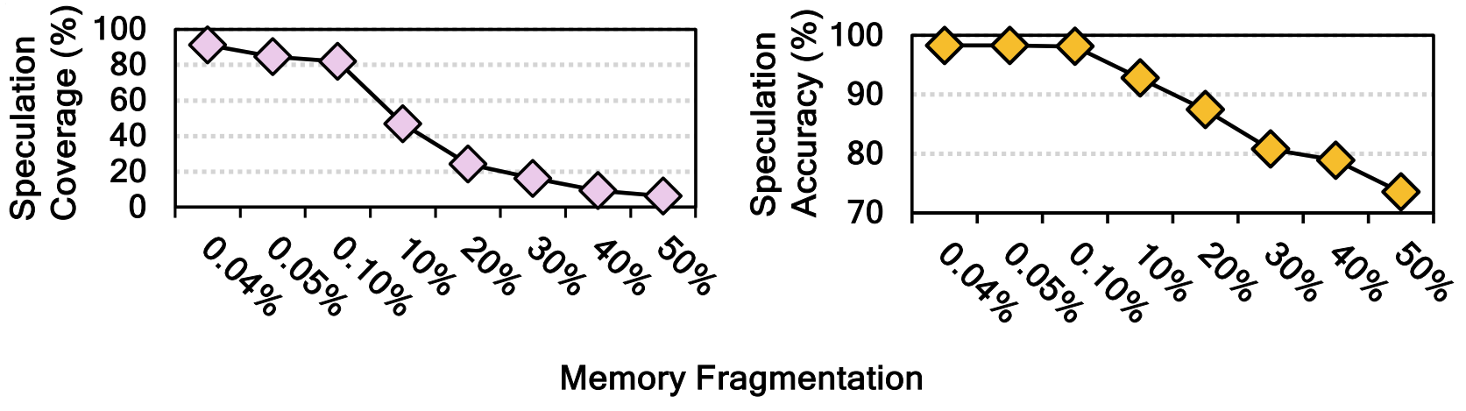
Prior Work: Contiguity-based Speculation¹
Reduction of
Translation
Latency (%)
Memory Fragmentation
As memory fragmentation increases, reduction
of translation latency drops significantly
¹Alverti et al. “Enhancing and Exploiting Contiguity for Fast Memory Virtualization”, ISCA 2020
Notes:
Prior speculative translation schemes work around this by making strong assumptions —
[CLICK] they require free large pages or contiguity,
[CLICK] and they use costly hardware for metadata.

Slide 21

Our Goal
Enable highly-accurate speculative address translation without requiring:
Large page availability
VA-to-PA contiguity
Costly hardware for metadata
Notes:
Our goal for Revelator is to
[CLICK] enable highly accurate speculative translation
[CLICK] without relying on large pages,
[CLICK] without relying on contiguity, and
[CLICK] without costly metadata hardware.

Slide 22
Revelator

Slide 23
Revelator: Key Approach
Co-design hardware and OS to perform
highly accurate speculative translation
Notes:
The Revelator key idea:
[CLICK] co-design the hardware and the OS.
[CLICK] The OS uses a tiered hash-based allocation policy so that
[CLICK] the physical location of a page
[CLICK] is predictable from its virtual address at the hardware level using a speculation engine

Slide 24
Revelator: Key Idea
Employ hashing to enable highly accurate speculative
address translation with small system modifications
Operating System
Hardware
Tiered Hash-based Allocation
Speculation
Engine
Predictable
Physical Location
Establish
Leverage
Data + Page Table
Notes:
The Revelator key idea:
[CLICK] co-design the hardware and the OS.
[CLICK] The OS uses a tiered hash-based allocation policy so that
[CLICK] the physical location of a page
[CLICK] is predictable from its virtual address at the hardware level using a speculation engine

Slide 25
Revelator:
Overview

Slide 26
Revelator: Overview
TLB Miss
Page Table Walk
Data Fetch
Parallel Operations
Data is found in the cache
Hash Function
Speculative Data Fetch
Virtual Address
Notes:
The Revelator key idea:
[CLICK] co-design the hardware and the OS.
[CLICK] The OS uses a tiered hash-based allocation policy so that
[CLICK] the physical location of a page
[CLICK] is predictable from its virtual address at the hardware level using a speculation engine

Slide 27
Revelator: Overview
Page Table Walk
TLB Miss
L4
L3
L2
PTE
PTE is
found in
the cache
Parallel Operations
2
Speculatively Fetch PTE
Hash Function
Parallel Operations
1
Virtual Address
Speculative Data Fetch
Data is found in the cache
Notes:
The Revelator key idea:
[CLICK] co-design the hardware and the OS.
[CLICK] The OS uses a tiered hash-based allocation policy so that
[CLICK] the physical location of a page
[CLICK] is predictable from its virtual address at the hardware level using a speculation engine

Slide 28
Revelator: Key Benefit
Co-design hardware and OS to perform
highly accurate speculative translation
Operating System
Hardware
Hides & reduces address translation latency
without depending on memory fragmentation
(i.e., large pages, contiguity)
Tiered Hash-based Allocation
Speculation
Engine
Predictable
Physical Location
Establish
Leverage
Data + Page Table
Notes:
The Revelator key idea:
[CLICK] co-design the hardware and the OS.
[CLICK] The OS uses a tiered hash-based allocation policy so that
[CLICK] the physical location of a page
[CLICK] is predictable from its virtual address at the hardware level using a speculation engine

Slide 29
Revelator: Key Components
Operating System
Tiered Hash-based Allocation
Predictable
Physical Location
Establish
Data + Page Table
Notes:
The Revelator key idea:
[CLICK] co-design the hardware and the OS.
[CLICK] The OS uses a tiered hash-based allocation policy so that
[CLICK] the physical location of a page
[CLICK] is predictable from its virtual address at the hardware level using a speculation engine

Slide 30
Revelator: OS Side
Operating System
Tiered Hash-based Allocation
Virtual Page
Establish
Hash()
Predictable
Physical Location
PPN₀
PPN_{i}
PPN_{M}
Data + Page Table
M Different allocation tiers
(i.e., allocation attempts)
Notes:
The Revelator key idea:
[CLICK] co-design the hardware and the OS.
[CLICK] The OS uses a tiered hash-based allocation policy so that
[CLICK] the physical location of a page
[CLICK] is predictable from its virtual address at the hardware level using a speculation engine

Slide 31
Revelator: OS Side
Hardware
Virtual Page
Small OS modifications with
low impact on allocation latency
Predictable
Physical Location
Hash Circuit
PPN₀
..
PPN_{i}
..
PPN_{M}
M Candidate
Physical Locations
Notes:
The Revelator key idea:
[CLICK] co-design the hardware and the OS.
[CLICK] The OS uses a tiered hash-based allocation policy so that
[CLICK] the physical location of a page
[CLICK] is predictable from its virtual address at the hardware level using a speculation engine

Slide 32
Revelator: Key Components
Hardware
Speculation
Engine
Predictable
Physical Location
Leverage
Data + Page Table
Notes:
The Revelator key idea:
[CLICK] co-design the hardware and the OS.
[CLICK] The OS uses a tiered hash-based allocation policy so that
[CLICK] the physical location of a page
[CLICK] is predictable from its virtual address at the hardware level using a speculation engine

Slide 33
Revelator: Hardware Side
Hardware
Virtual Page
Leverage
Predictable
Physical Location
Hash Circuit
Data + Page Table
PPN₀
PPN_{i}
PPN_{M}
..
..
M Candidate
Physical Locations
Notes:
The Revelator key idea:
[CLICK] co-design the hardware and the OS.
[CLICK] The OS uses a tiered hash-based allocation policy so that
[CLICK] the physical location of a page
[CLICK] is predictable from its virtual address at the hardware level using a speculation engine

Slide 34
Revelator: Hardware Side
Operating System
Tiered Hash-based Allocation
Virtual Page
Establish
Low-cost hardware
to generate candidate PAs
without the need for extra metadata
Hash()
Predictable
Physical Location
PPN₀
PPN_{i}
PPN_{M}
M Different Tiers
(i.e., Hash Attempts)
Notes:
The Revelator key idea:
[CLICK] co-design the hardware and the OS.
[CLICK] The OS uses a tiered hash-based allocation policy so that
[CLICK] the physical location of a page
[CLICK] is predictable from its virtual address at the hardware level using a speculation engine

Slide 35
Revelator:
Detailed Design

Slide 36
Revelator: Key Components
Operating System
Hardware
Tiered Hash-based Allocation
Speculation
Engine
Predictable
Physical Location
Establish
Leverage
Data + Page Table
Notes:
The Revelator key idea:
[CLICK] co-design the hardware and the OS.
[CLICK] The OS uses a tiered hash-based allocation policy so that
[CLICK] the physical location of a page
[CLICK] is predictable from its virtual address at the hardware level using a speculation engine

Slide 37
Revelator: Key Components
Operating System
Tiered Hash-based Allocation
Predictable
Physical Location
Establish
Data + Page Table
Notes:
The Revelator key idea:
[CLICK] co-design the hardware and the OS.
[CLICK] The OS uses a tiered hash-based allocation policy so that
[CLICK] the physical location of a page
[CLICK] is predictable from its virtual address at the hardware level using a speculation engine

Slide 38
OS: Tiered Hash-based Allocation
Seed₀
PPN₀
PPN₁
Hash Function
..
PPN_{i}
..
Virtual Page
PPN_{M}
Notes:
If that slot is taken, we try the next candidate using a new seed

Slide 39

OS: Tiered Hash-based Allocation
Seed₁
Seed₀
PPN₁
Hash Function
..
PPN_{i}
..
Virtual Page
PPN_{M}
Notes:
If that slot is taken, we try the next candidate using a new seed

Slide 40

OS: Tiered Hash-based Allocation
Seed₀
Seed₁
PPN₁
Hash Function
..
PPN_{i}
..
Virtual Page
PPN_{M}
Notes:
If that slot is taken, we try the next candidate using a new seed

Slide 41
OS: Tiered Hash-based Allocation
Seed_{n}
Seed₀
Seed₁
Hash Function
..
PPN_{i}
..
Virtual Page
PPN_{M}
Notes:
If that slot is taken, we try the next candidate using a new seed

Slide 42
OS: Tiered Hash-based Allocation
Seed₁
Seed₀
Seed_{M}
Hash Function
..
..
Virtual Page
PPN_{M}
Notes:
If that slot is taken, we try the next candidate using a new seed

Slide 43
OS: Tiered Hash-based Allocation
Seed₁
Seed₀
Seed_{M}
Hash Function
..
..
Virtual Page
Notes:
If that slot is taken, we try the next candidate using a new seed

Slide 44
OS: Tiered Hash-based Allocation
If all M hash attempts fail
Revelator falls back
to the conventional allocator
Tiered
Hash-based Allocation
Buddy Allocator
Fallback
Notes:
If that slot is taken, we try the next candidate using a new seed

Slide 45
OS: Tiered Hash-based Allocation
If all N hash attempts fail
Revelator falls back
to the conventional allocator
Does tiered hash-based allocation work well?
Tiered
Hash-based Allocation
Buddy Allocator
Fallback
Notes:
If that slot is taken, we try the next candidate using a new seed

Slide 46
OS: Tiered Hash-based Allocation
L = Number of occupied pages
N = Total number of pages
Each allocation attempt is a Bernoulli trial: a slot is free with probability P = L / N
Each request makes k independent hash attempts
Allocation fails only if all k attempts land on taken slots
Probability data is allocated with a hash function
P(success) = 1 − (L / N)ᵏ
Notes:
And we conclude that Revelator’s effectiveness..

Slide 47
Revelator: Allocation Properties
1
L = Number of occupied pages
N = Total number of pages
Number of hash-based allocation attempts
Each allocation attempt is a Bernoulli trial: a slot is free with probability P = L / N
Each request makes k independent hash attempts
Allocation fails only if all k attempts land on taken slots
Probability data is allocated with a hash function
Notes:
And we conclude that Revelator’s effectiveness..

Slide 48

Number of Hash-based Alloc. Attempts
P (Success. alloc.)
Memory Utilization: 50%
High Fragmentation
  Increasing the number of hash-based allocation attempts exponentially increases the probability of successul allocation
Notes:
And we conclude that Revelator’s effectiveness..

Slide 49
Revelator: Allocation Properties
1
L = Number of occupied pages
N = Total number of pages
Number of hash-based allocation attempts
Each allocation attempt is a Bernoulli trial: a slot is free with probability P = L / N
Each request makes k independent hash attempts
Allocation fails only if all k attempts land on taken slots
2
Allocation success is independent
from memory fragmentation
Probability data is allocated with a hash function
Notes:
And we conclude that Revelator’s effectiveness..

Slide 50
Allocation Success is Independent from Memory Fragmentation
P (Success. alloc.)
Memory Utilization: 50%
High Fragmentation
  Even at high fragmentation, using 4 hash
  attempts leads to >90% successful allocation
Notes:
And we conclude that Revelator’s effectiveness..

Slide 51
Revelator: Key Components
Hardware
Speculation
Engine
Predictable
Physical Location
Leverage
Data + Page Table
Notes:
The Revelator key idea:
[CLICK] co-design the hardware and the OS.
[CLICK] The OS uses a tiered hash-based allocation policy so that
[CLICK] the physical location of a page
[CLICK] is predictable from its virtual address at the hardware level using a speculation engine

Slide 52
Hardware: Speculation Engine
Memory Management Unit
PPN₀
Memory Hierarchy
PPN₁
Hash
Circuit
..
PPN_{i}
Generate Candidate PAs
..
PPN_{M}
Notes:
If confidence is high, the MMU dispatches the data fetch to the memory hierarchy in parallel with the real page-table walk.

Slide 53
Revelator: Speculation Engine
Memory Management Unit
PPN₀
Filter
Memory Hierarchy
PPN₁
Hash
Circuit
..
PPN_{i}
..
PPN_{M}
Notes:
If confidence is high, the MMU dispatches the data fetch to the memory hierarchy in parallel with the real page-table walk.

Slide 54
Speculation Degree Filter
Two-level Degree Filtering
Filter
1
0
Hash₀
0.6
Speculation
degree up to
1 is allowed
1
Hash₁
0.2
1
2
3
.
.
.
4
Hash_{M}
0.1
0
Hash-Based Allocation Statistics
Bandwidth Consumption Monitor

Slide 55
Revelator: Speculation Engine
Memory Management Unit
PPN₀
Filter
Memory Hierarchy
PPN₁
Hash
Circuit
..
Data stored in PPN₀ is fetched into the cache before PTW completes
PPN_{i}
..
PPN_{M}
Notes:
If confidence is high, the MMU dispatches the data fetch to the memory hierarchy in parallel with the real page-table walk.

Slide 56
Extensions of Revelator

Slide 57
Revelator: Extensions
Synergy with large pages
1
Virtualized environments
2
NUMA/CXL-like systems
3

Slide 58
Revelator: Extensions
Synergy with large pages
1
Virtualized environments
2
NUMA/CXL-like systems
3

Slide 59
Synergy with Large Pages
Try tiered hash-based allocation for 2MB pages
1
2MB
Virtual Page
PPN₀
..
PFN₅₁₁
Hash Function
PPN₅₁₂
..
PPN₁₀₂₃

Slide 60
Synergy with Large Pages
Try tiered hash-based allocation for 2MB pages
1
2MB
Virtual Page
PPN₀
..
Hide address translation
latency of 2MB pages
PFN₅₁₁
Hash Function
PPN₅₁₂
..
PPN₁₀₂₃

Slide 61
Synergy with Large Pages
Try tiered hash-based allocation for 2MB pages
1
Try to allocate with conventional THP
2
Use large pages when
fragmentation levels allow it

Slide 62
Synergy with Large Pages
Try tiered hash-based allocation for 2MB pages
1
Try to allocate with conventional THP
2
Try 4KB hash-based data allocation
3
Maintain fast address translation
when large pages are not available

Slide 63
Synergy with Large Pages
Try tiered hash-based allocation for 2MB pages
1
Try to allocate with conventional THP
2
Try 4KB hash-based data allocation
3
Fallback to conventional allocation
4

Slide 64
Synergy with Large Pages
Try tiered hash-based allocation for 2MB pages
1
Try to allocate with conventional THP
Revelator uses large pages
when possible while being effective
even when they are not available
2
Try 4KB hash-based data allocation
3
Fallback to conventional allocation
4

Slide 65
Revelator: Extensions
Synergy with large pages
1
Virtualized environments
2
NUMA/CXL-like systems
3

Slide 66
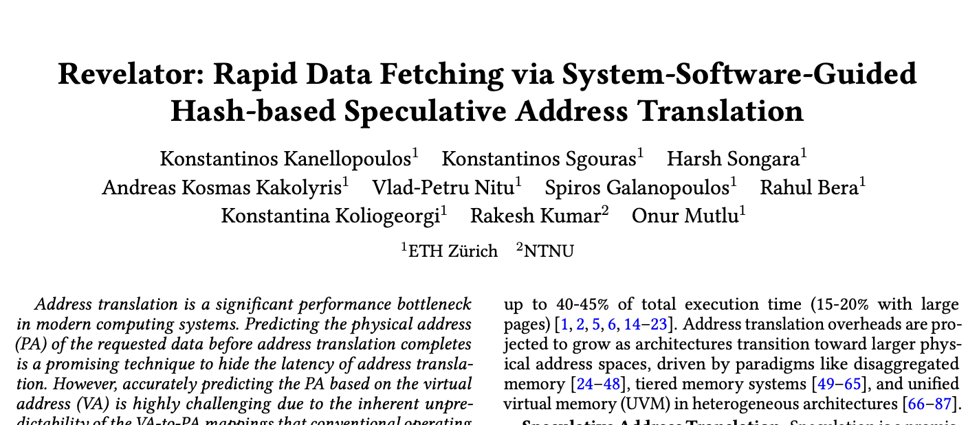
Revelator: Extensions
Synergy with large pages
1
Revelator in virtualized environments
2
Revelator in NUMA/CXL-like systems
3
https://arxiv.org/abs/2508.02007

Slide 67
Evaluation
Results

Slide 68
Evaluation Methodology
Prototyped the SW component of Revelator in Linux 6.10.8
  Modifications in the buddy allocator
  Extensions on top of THP
Evaluation using Virtuoso [Kanellopoulos+ ASPLOS’25] ported on top of Sniper [Carlson+ SC’11]
Open source: https://github.com/CMU-SAFARI/Virtuoso
Workloads: Executed for 300M instructions
  GraphBIG: PR, BFS, BC, GC, CC
  HPCC: Randacc
  XSBench: Particle Simulation
  DLRM: Sparse-Length Sum
  GenomicsBench: k-mer count
  Google DPC-4 mixes in multicore systems
Single-core systems
Notes:
[CLICK] We rototyped Revelator in Linux and
[CLICK] evaluated with Virtuoso
[CLICK] Same workloads as Utopia/Victima

Slide 69
Evaluated Systems
THP: Baseline with THP enabled
ReserveTHP: System with reservation-based THP
SpecTLB [Barr+ ISCA’11]: Speculative translation scheme for reserved large pages
POM-TLB [Ryoo+ ISCA’17]: Large software-managed 64K-entry L3 TLB
64K-entry L2 TLB: L2 TLB with optimistic 12-cycle access latency
ASAP [Margaritov+ MICRO’19]: Intra-page table walk prefetching
DMT [Zhang+ ASPLOS’24]: Direct memory translation via VA-to-PTE mappings
ECHT [Skarlatos+ ASPLOS’20]: State of the art page table design
Mosaic Pages [Gosakan+ ASPLOS’24]: Large TLB reach via hash-based allocation
SpOT [Alverti+ ISCA’20]: Speculative translation via contiguous allocation
Revelator: Tiered hash-based allocation + speculation engine
Revelator+THP
Notes:
Evaluated Revelator against 10 diverse techniques

Slide 70
Single-Core: Performance Speedup
Speedup over THP
Revelator outperforms the best-performing scheme
by 17% on average when memory is highly fragmented
Notes:
In this plots, [CLICK] we show thatRevelator outperforms the state-of-the-art speculative scheme by 17% on average when memory is highly fragmented.

Slide 71
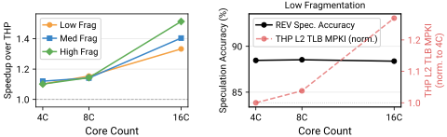
Multi-Core: Performance Speedup
Revelator achieves increasing performance speedups (up to 1.5x) against THP with increasing core counts
Notes:
In this plots, [CLICK] we show thatRevelator outperforms the state-of-the-art speculative scheme by 17% on average when memory is highly fragmented.

Slide 72
Area and Power Overhead
We implement the speculation engine in Chisel
and synthesize it with Yosys using
the NanGate 45nm open-source cell library
0.02%
Additional Area
0.0149 mm²
0.03%
Additional Power
14.723 mW static power
Compared with a high-performance
Intel Cascade Lake core
Notes:
In this plots, [CLICK] we show thatRevelator outperforms the state-of-the-art speculative scheme by 17% on average when memory is highly fragmented.

Slide 73
More in the Paper
Analysis on the shortcomings of prior works
Deep dive into Revelator’s performance
Evaluation in NUMA and virtualized systems
Revelator combined with other schemes
Energy reduction achieved by Revelator
Sensitivity to the number of allocation attempts
Cache pollution caused by Revelator
Security implications

Slide 74
More in the Paper
Synergy with large pages
1
Revelator in virtualized environments
2
Revelator in NUMA/CXL-like systems
3
https://arxiv.org/abs/2508.02007

Slide 75
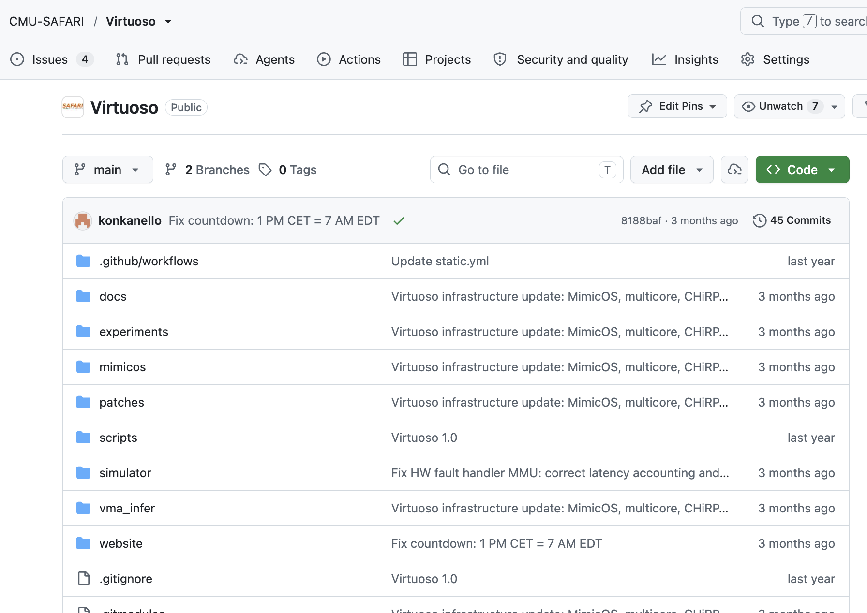
Revelator is Open-Source
https://github.com/CMU-SAFARI/Virtuoso
Notes:
In this plots, [CLICK] we show thatRevelator outperforms the state-of-the-art speculative scheme by 17% on average when memory is highly fragmented.

Slide 76
Conclusion

Slide 77
Revelator: HW/OS Cooperation
Employ hashing to enable highly accurate speculative
address translation with small system modifications
Operating System
Hardware
Tiered Hash-based Allocation
Predictable
Physical Location
Speculation
Engine
Hides & reduces address translation latency without depending on memory fragmentation (i.e., large pages, contiguity)
Outperforms all state-of-the-art schemes
in both single-core and multi-core systems

Slide 78


Revelator
Rapid Data Fetching
via System-Software-Guided Hash-based
Speculative Address Translation
Konstantinos Kanellopoulos Konstantinos Sgouras
Harsh Songara Andreas Kosmas Kakolyris Vlad-Petru Nitu
Spiros Galanopoulos Rahul Bera Konstantina Koliogeorgi
Rakesh Kumar Onur Mutlu

Slide 79
Revelator: Allocation Properties
1
L = Number of occupied pages
N = Total number of pages
Number of hash-based allocation attempts
Each allocation attempt is a Bernoulli trial: a slot is free with probability P = L / N
Each request makes k independent hash attempts
Allocation fails only if all k attempts land on taken slots
2
Dependence on memory fragmentation
Probability data is allocated with a hash function
3
Allocation bias
P(success) = 1 − (L / N)ᵏ
Notes:
And we conclude that Revelator’s effectiveness..

Slide 80
Allocation Bias
+6.25%
P (Success. alloc.)
+12.5%
+25%
50%
Memory Utilization: 50%
High Fragmentation
3
  Sequential hashing biases allocations to succeed toward earlier hash functions
Notes:
And we conclude that Revelator’s effectiveness..

Slide 81
Example Scenarios of Allocation
1
3
Low Fragmentation
High Fragmentation
VPN
VPN
2
Allocated Early
4
Allocated Late
VPN
VPN

Slide 82
SpOT [Alverti et al. ISCA 2020]
VMA₁
VMA₂
VMA₃
Offset
Offset
Offset
Contiguous
Segment
Contiguous
Segment
Contiguous
Segment
Physical Memory
Hardware Table
VMA₁
Offset₁
VMA₂
Offset₂
Speculate PA assuming
VMA-Offset mapping is stable
VMA₃
Offset₃

Slide 83
Limitations of SpOT (1)
SpOT is sensitive to the amount of fragmentation in the system

Slide 84
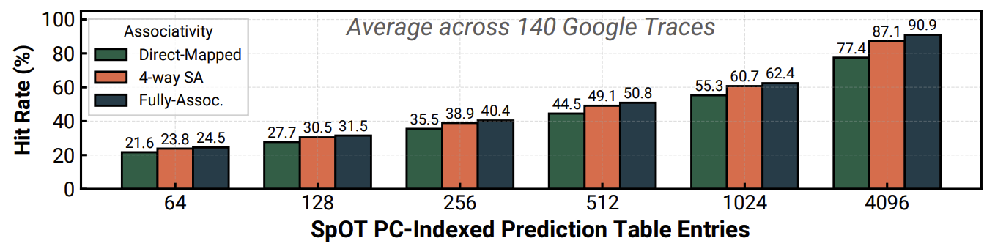
Limitations of SpOT (2)
SpOT is sensitive to the number
of allocation contexts

Slide 85
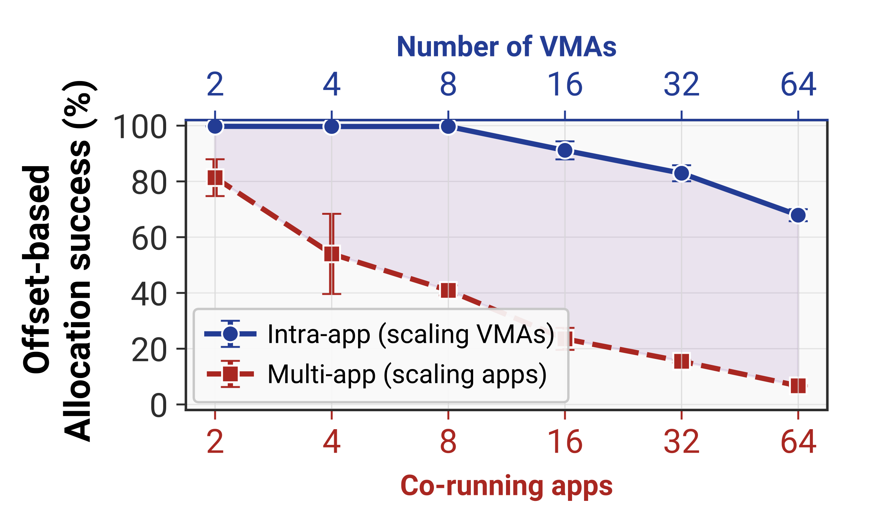
Limitations of Prior Work (3)
SpOT is sensitive to allocation interference

Slide 86
Our Goal
Hide address translation latency in modern systems
Without relying on large pages
Without relying on VA-to-PA contiguity
Without costly hardware for metadata

Slide 87
Revelator: Key Idea
Co-design hardware and OS to perform
highly accurate speculative translation
Hash-based allocation limits the potential
PA locations
VPN
Hash Function #1
Hash Function #2
OS
Hash Function-aware
HW
Translation
Saved cycles
Translation
is resolved
Calculate hash-function result, form PA and fetch data

Slide 88
OS: Page Allocation Algorithm
Page is free
PPN
Direct Mapped
Hash #1
VPN

Slide 89
OS: Page Allocation Algorithm
Page is not free
PPN
Direct Mapped
Hash #1
VPN

Slide 90
OS: Page Allocation Algorithm
PPN
Hash #2
VPN
PPN
Change the seed and try again

Slide 91
OS: Page Allocation Algorithm
Hash #N
VPN
Change the seed up to N times

Slide 92
OS: Page Allocation Algorithm
Hash #N
VPN
Change the seed up to N times

Slide 93
OS: Page Allocation Algorithm
Hash #N
VPN
Change the seed up to N times

Slide 94
OS: Page Allocation Algorithm
PPN
Place
Anywhere
VPN
Fallback to conventional allocation

Slide 95
OS: Page Allocation Algorithm
Page is not free
PPN
PPN
Can we allocate the page table in the same way to enable faster pointer-chasing?
PPN
VPN
Place at any
free location
PPN
Fallback to conventional fault mechanism before N+1

Slide 96
OS: Allocating the Page Table
Physical Memory
3rd Level
Page Table
Frame
Hash Function
Null
4th Level

Slide 97
OS: Allocating the Page Table
Try the following PPN
Allocate PT
Frame
Hash(VPN >> 9) = Z
Offset_{PD}
PD
Offset_{PT}
PT
VPN
… … .
Z
W
Y
Z
Enables overlapping the access to 3rd and 4th level of the walk

Slide 98
Probability of Successful Allocation
Setup: each VPN allocation attempt = a Bernoulli trial
Trial outcome: success (slot is free) with probability p, failure (collision) with probability 1 − p
Per-slot occupancy: p = L / N, where L = active VPNs, N = total available slots
Trials are independent across the k hash probes (speculation degree)
Probability of successful allocation
All k probes fail (allocation rejected): P(fail) = pᵏ
At least one probe succeeds: P(success) = 1 − pᵏ = 1 − (L / N)ᵏ
Implication: increasing k drives P(success) → 1 exponentially, at the cost of bandwidth contention

Slide 99
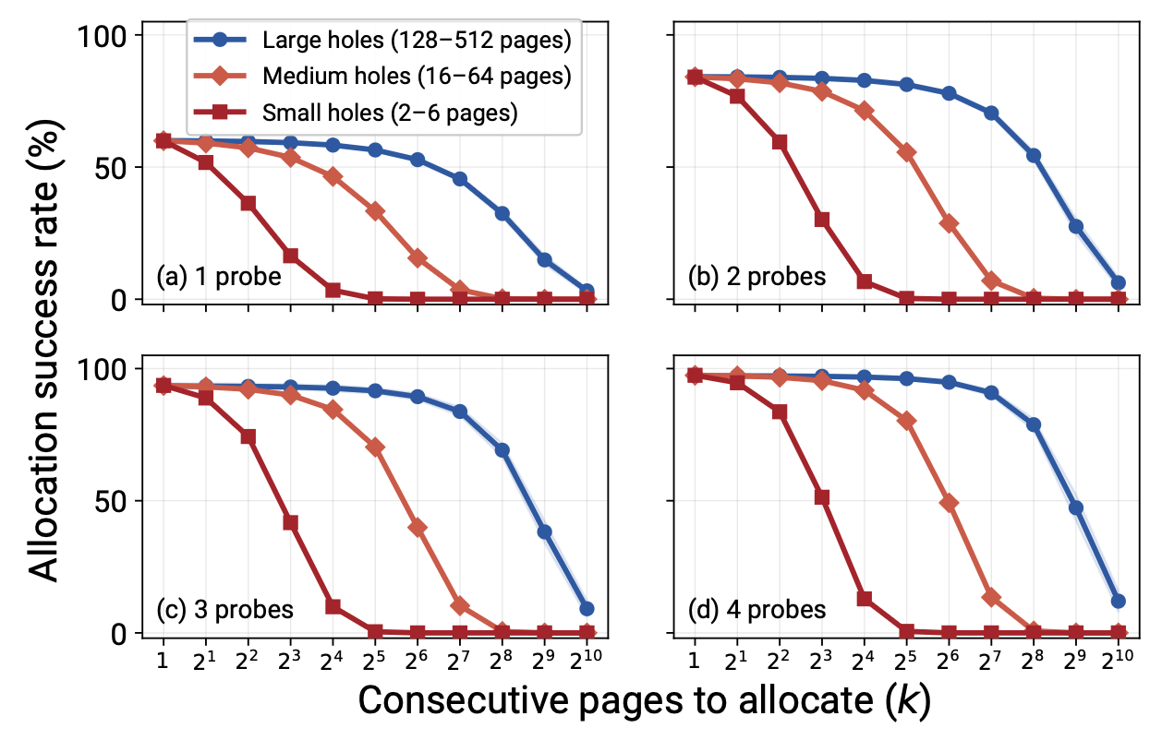
Probability of Successful Allocation

Slide 100
Revelator: Hardware Side
Speculation Engine
Seed Generator
Memory Hierarchy
Hash₁(VPN)
Hash Function Circuit
Hash₂(VPN)
.
.
.
Hash_{N}(VPN)
PID
Bandwidth consumption is going to explode if N is large

Slide 101
Speculation Degree Filter
Speculate?
Contention Zones
Hash₁
0.6
1
0
Hash₂
0.2
1
1
2
Speculation
degree up to
4 is allowed
.
.
.
3
Hash_{N}
0.1
0
4
Hash-Based Allocation Statistics
Bandwidth Contention

Slide 102
Revelator with Large Pages
Try tiered hash-based allocation for 2MB pages
1
Try 2MB allocation via THP
2
Try tiered hash-based allocation for 4KB page
3
Fallback to conventional allocation
4

Slide 103
Revelator with Large Pages
Try tiered hash-based allocation for 2MB pages
1
Try 2MB allocation via THP
2
Leverages available contiguity when possible while maintaining the benefits of hash-based allocation
in the absence of contiguity
Try tiered hash-based allocation for 4KB page
3
Fallback to conventional allocation
4

Slide 104

Security Analysis
We do not introduce more vulnerabilities than existing data-dependent prefetchers used in modern processors
Hash₁
Mis-speculation
Hash₂
Correct
.
.
.
Hash_{N}
Mis-speculation
Mis-speculated data can not be used by the CPU as an index
to another data structure -> no new Meltdown/Spectre variants
However, mis-speculated data remain in the caches
-> an attacker can try to leak data

Slide 105
Security Analysis
# Victim code
# The programmer believes the bounds check prevents illegal access.
array1 = public_array
array2 = probe_array
secret = sensitive_data
function victim(index):
if index < length(array1):
value = array1[index]
# Use value to touch a location in another array
touch(array2[value])
# This creates a microarchitectural trace, such as a cache effect.

Slide 106
Security Analysis
touch(array2[value])
L2 Cache
Iterate over
all values
Hash₁
Hash₁
Hash₂
Side-
Channel
Hash₂
.
.
.
Hash_{N}
Hash_{N}
Threat Model:
Attacker knows the key of the victim and somehow the defender keeps all cache lines of array2 hot but not the TLB ones

Slide 107
Security Analysis
1
Cleanup mis-speculated fetches
If the PTW completes before all data fetches complete, we can cancel them from the MSHRs so that they are not installed in the L2 cache
PTW confirms correct PA
MMU
log
MSHRs
Cancel mis-speculated fetches

Slide 108
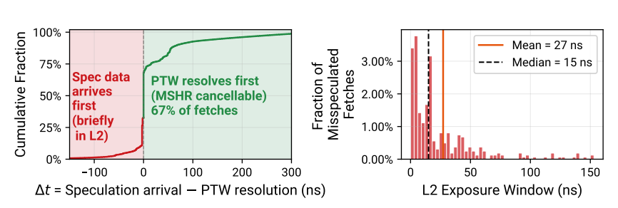
Security Analysis
1
Cleanup mis-speculated fetches
We can cancel 67% of mis-speculated fetches

Slide 109
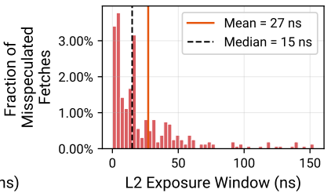
Security Analysis
What happens with the rest that remain in the caches until they are invalidated?
2

Slide 110
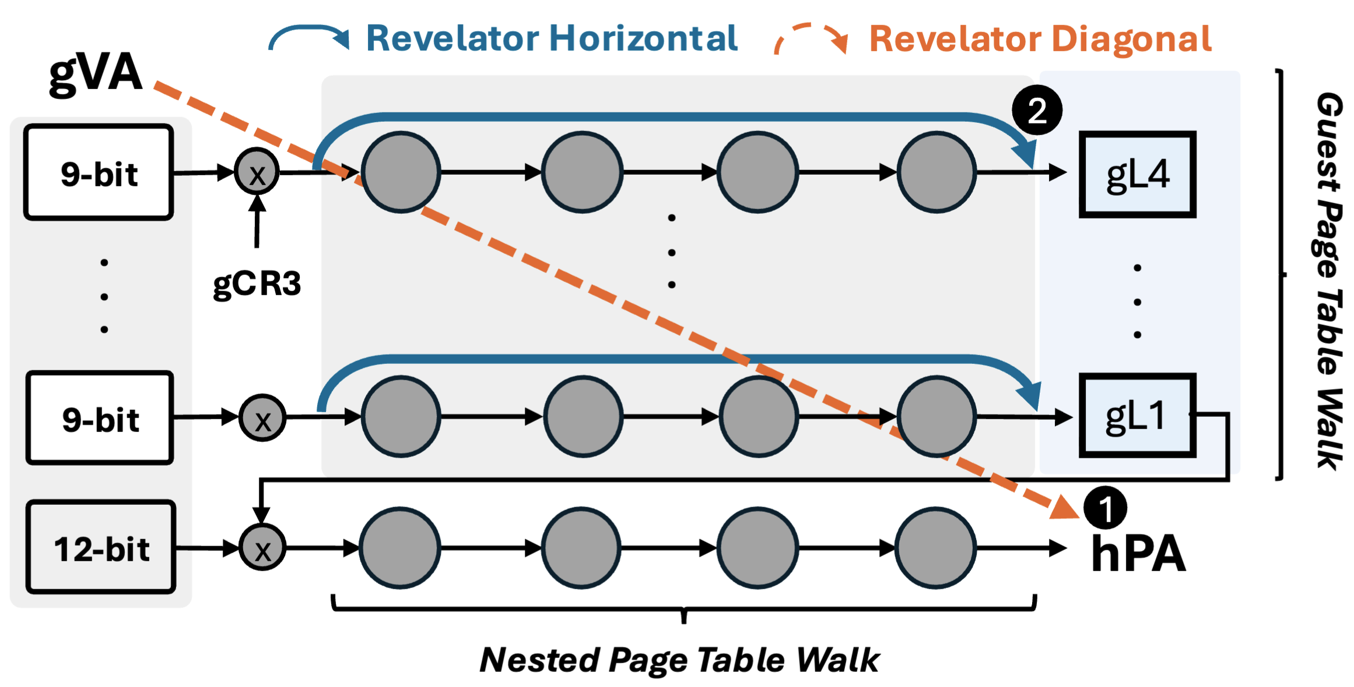
Revelator in Virtualized Systems

Slide 111
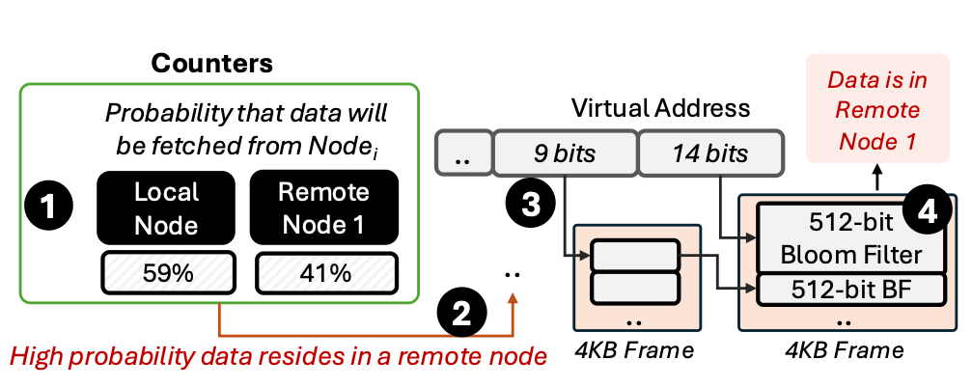
Revelator in NUMA

Slide 112
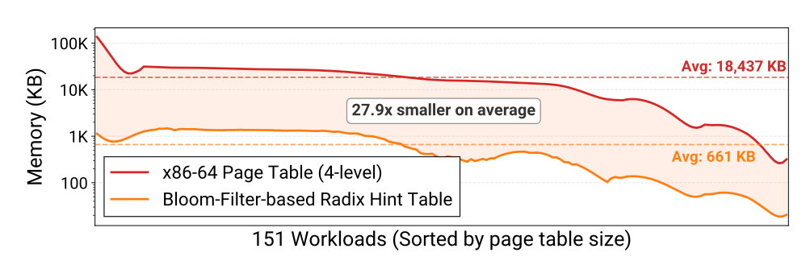
Bloom-Filter-based Radix Table

Slide 113
Succesful Allocations
10%
20%
40%
80%
Memory Pressure

Slide 114
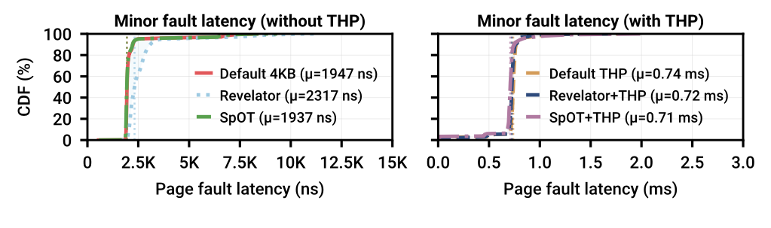
Effect on Allocation Latency

Slide 115
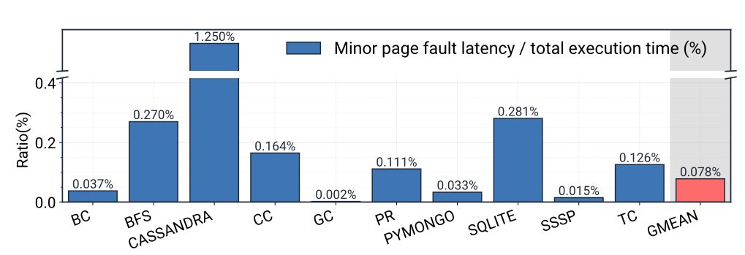
Effect on Allocation Latency

Slide 116
Performance Speedup over THP
High Memory Fragmentation (Scarce contiguity)
Medium Memory Fragmentation (Medium availability of contiguity)
Very Low Fragmentation (Maximum contiguity)

Slide 117
Deep dive into Revelator’s benefits
Medium Fragmentation
Translation Speedup over THP
Medium Fragmentation
Data Fetching Speedup over THP

Slide 118
Sweeping Memory Utilization
Number of Hash Functions:
Speedup over THP
Memory Utilization

Slide 119
Ablation Study
Speedup over THP

Slide 120
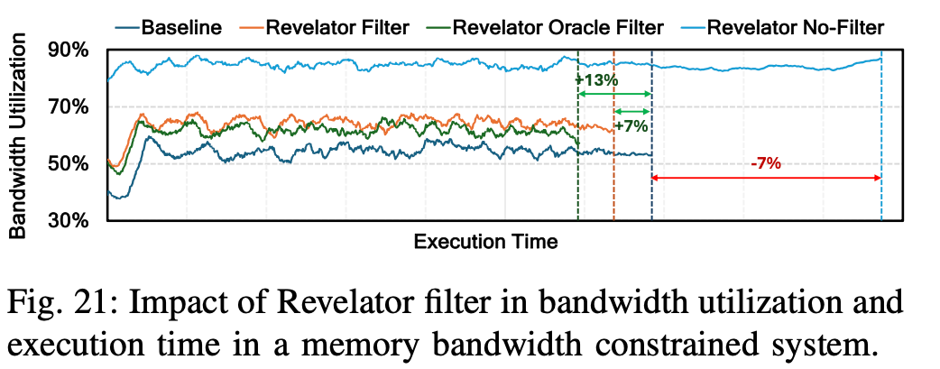
Bandwidth Filter

Slide 121
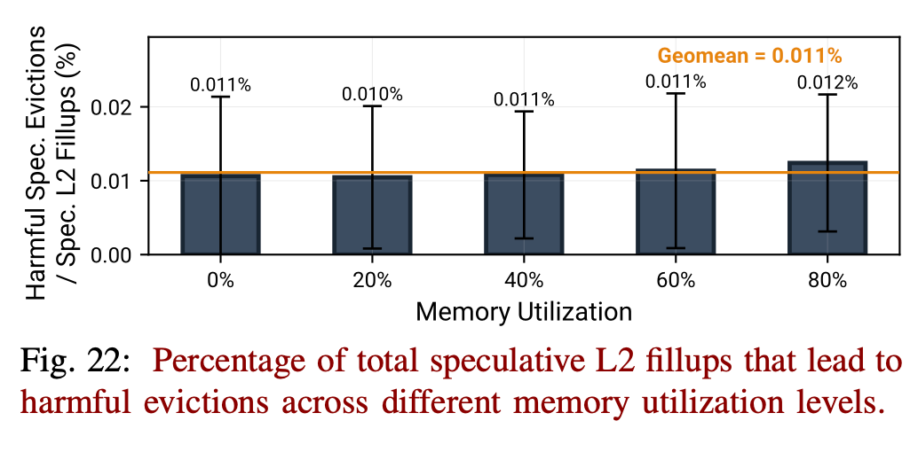
L2 Cache Pollution

Slide 122
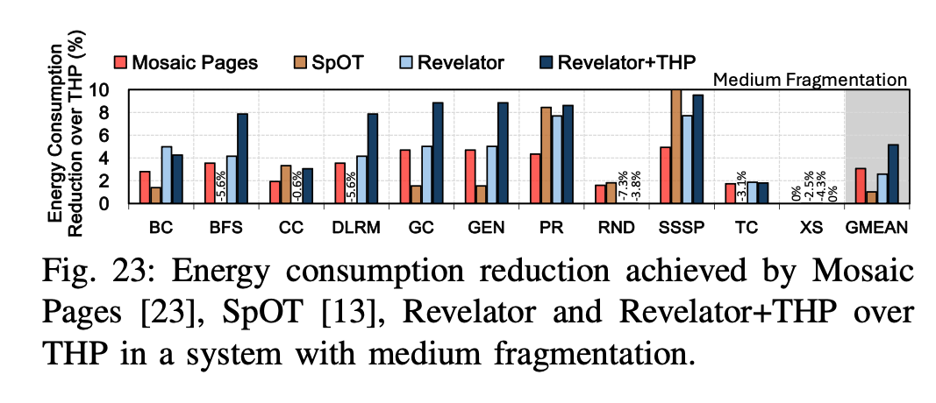
Energy Reduction

Slide 123
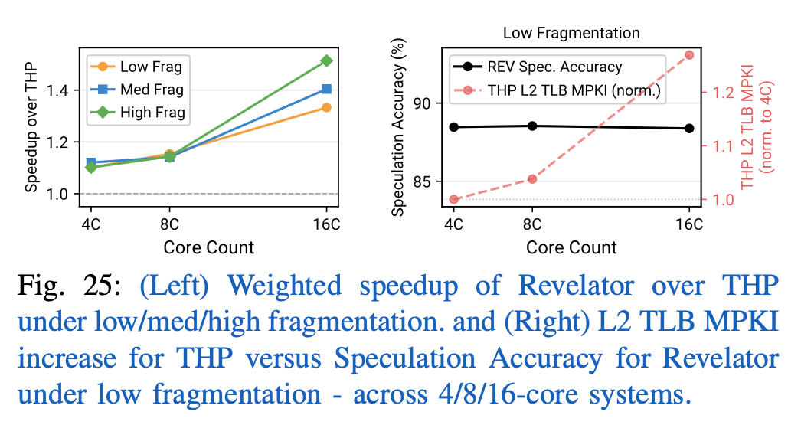
Multicore Environments

Slide 124
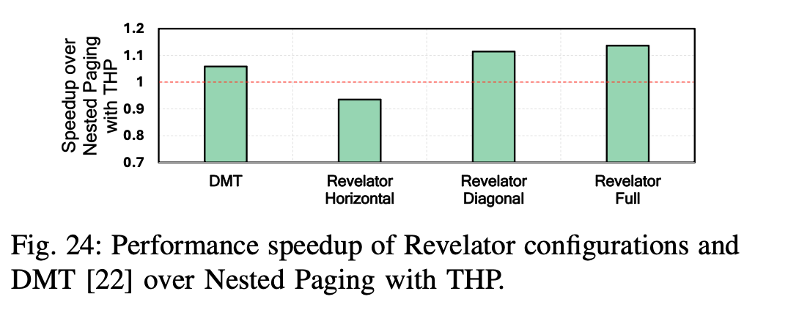
Virtualized Environments

Slide 125
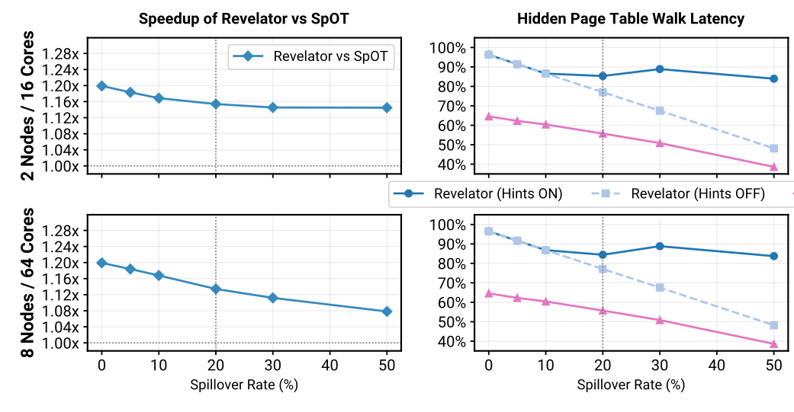
NUMA

Slide 126
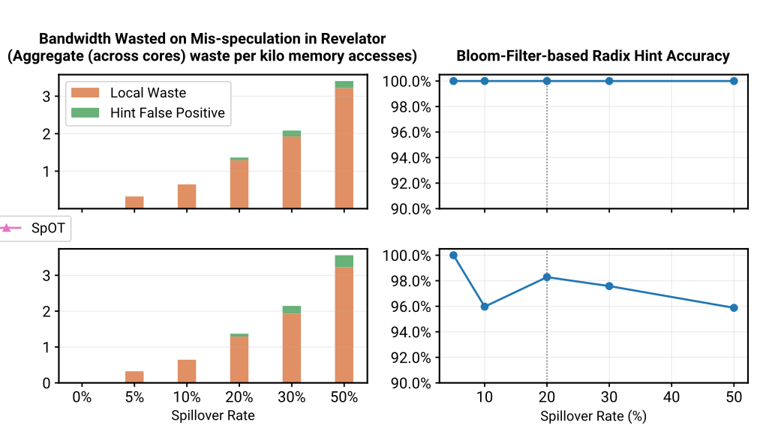
NUMA Details

Slide 127
Revelator + ECHT
Speedup over THP

Slide 128
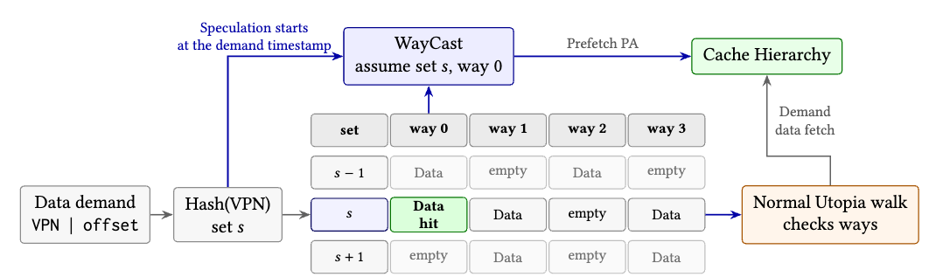
WayCast: Utopia vs Revelator

Slide 129
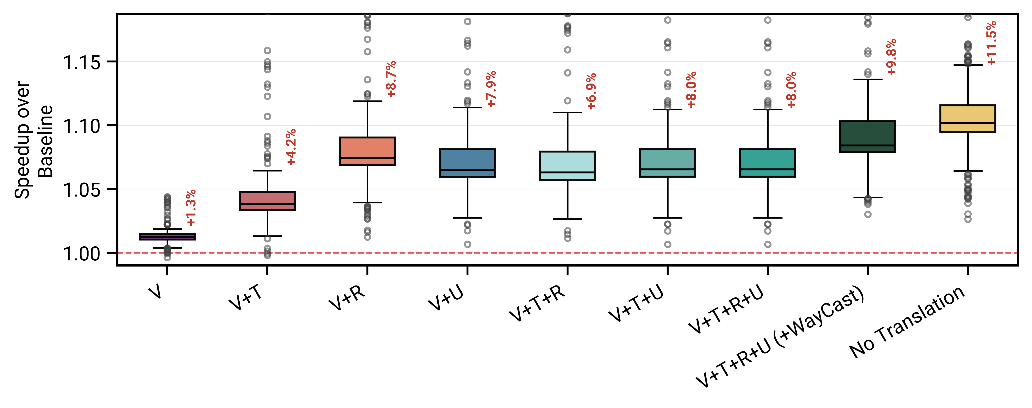
Modularity and Composability
V = Victima T = Trail R = Revelator U = Utopia
Notes:
We evaluated different combinations of all schemes

