Slide 1

Ramulator 2.1 Deeper Dive
Haocong Luo
ETH Zurich
3rd R&DB Workshop and Tutorial @ ICS’26
06.07.2026
Notes:
Hello everyone, I am Haocong, and I will be presenting our work revisiting…

Slide 2
Introduction
Ramulator 2.1 is a major overhaul of Ramulator 2.0
  Fixes bugs identified by Github issues and internal testing
  More comprehensive support for new DRAM & controller features
  More comprehensive set of tests and validations
  Significantly improved ease of use, configuration, and extension
  Overall code quality and documentation improvements
Github main branch updated to v2.1.0
  https://github.com/CMU-SAFARI/ramulator2/
  codespace and devcontainer ready!
  V2.0a is archived as legacy/v2.0a
Welcomes your use, contribution, and feedback!
  Issues & Discussions on Github
  Open PRs for bug fixes, improvements, and new features

Slide 3
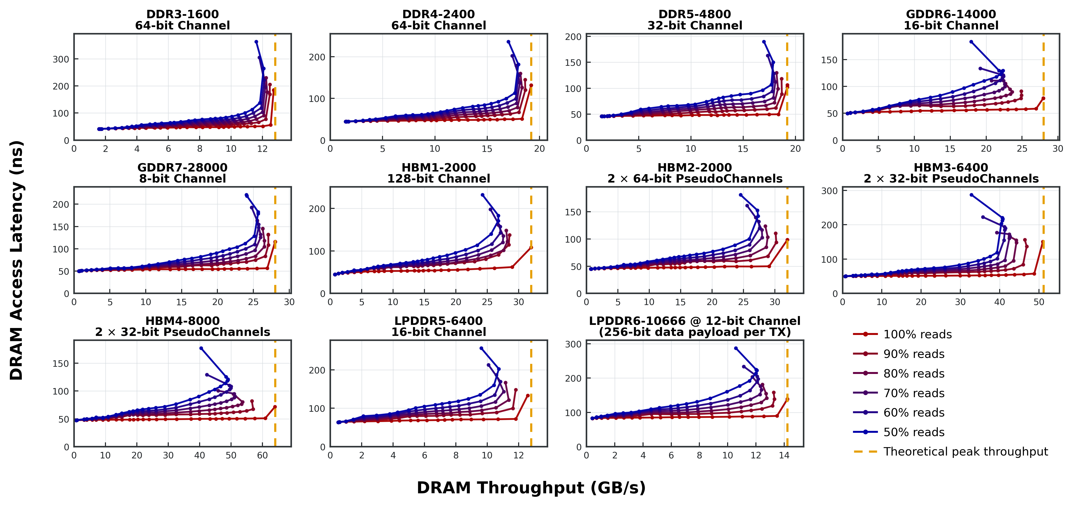
Currently Supported DRAM Standards

Slide 4
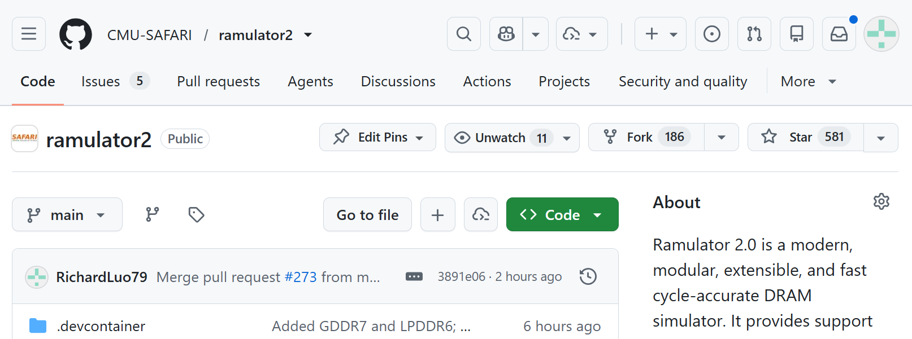
Getting Started (I)
Github codespace
  https://github.com/CMU-SAFARI/ramulator2

Slide 5
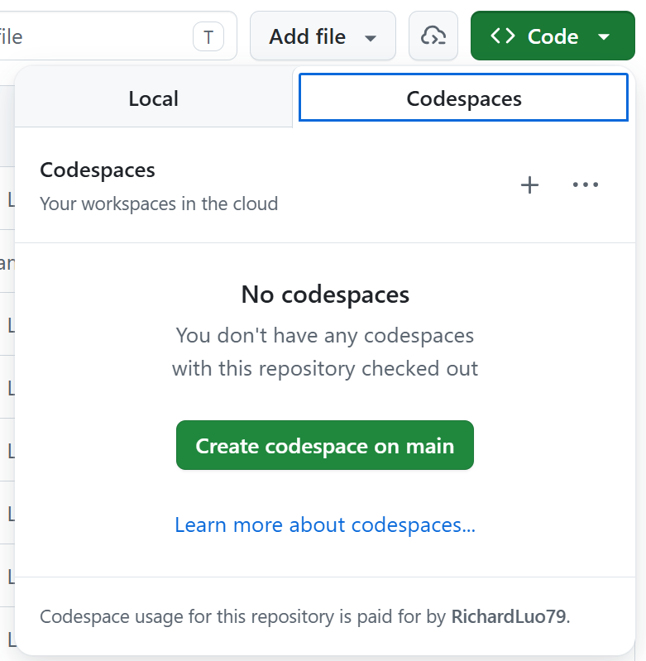
Getting Started (I)
Github codespace
  https://github.com/CMU-SAFARI/ramulator2

Slide 6
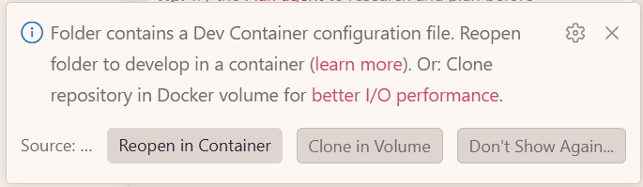
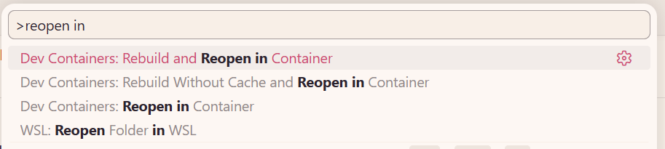
Getting Started (II)
Local (devcontainer)
  Clone the repository
  Open with VSCode

Slide 7
Getting Started (III)
Local
  .devcontainer/Dockerfile
  .devcontainer/post-create.sh

Slide 8
Navigating the Source Tree
examples/ # example configs, traces
python/ramulator/
  <auto-generated python wrappers>
  dram/ # source code for DRAM standards
resources/
  gem5_wrappers/
src/ramulator/
  base/ # sw framework of Ramulator 2.1
  controller/ # source code of the mem. ctrl. Interface
    i_controller.h # interface source
    impl/ # implementation source
      hbm34_controller.cpp
      …
  dram/ # auto-generated C++ source of DRAM device
  …
tests/

Slide 9
Simulator Architecture (I)
Two top-level components
send
memory requests
Memory
System
Frontend
callback
upon completion
Builtin core model
Memory trace parser
Wrappers for other simulators
1 or more memory controllers

Slide 10
Simulator Architecture (II)
Inside the Memory System
Memory System
Request from frontend
Channel Mapper
Strip channel bits
Dispatch to the controller
…
Controller 0
Controller K
Controller 1

Slide 11
Simulator Architecture (III)
Inside the Memory Controller
DRAM Controller
Request from memory system
Address Mapper
Addr -> Addr Vector
e.g., <Ch, Ra, Bg, Ba, Ro, Co>
Completion
Callback
Req. Forwarding
Read Queue
Write Queue

Slide 12
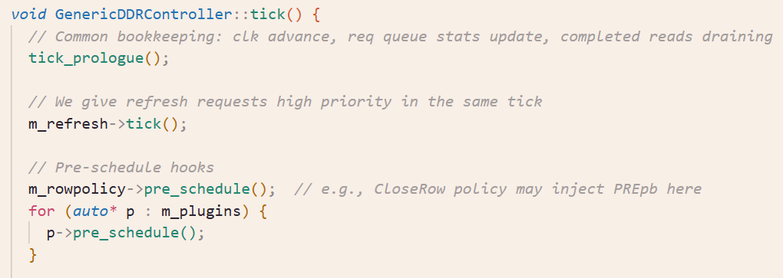
Simulator Architecture (IV)
Inside the Scheduler

Slide 13
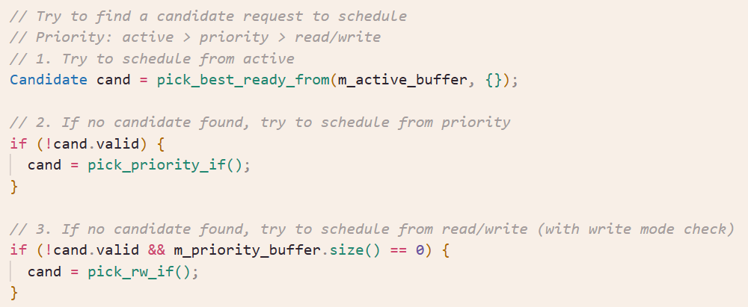
Simulator Architecture (IV)
Inside the Scheduler

Slide 14
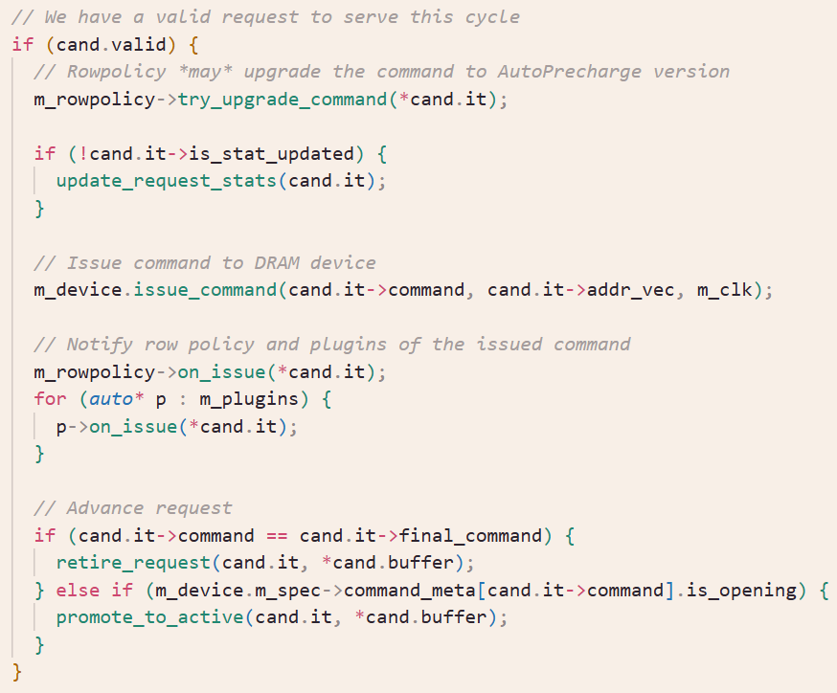
Simulator Architecture (IV)
Inside the Scheduler

Slide 15
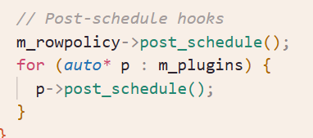
Simulator Architecture (IV)
Inside the Scheduler

Slide 16
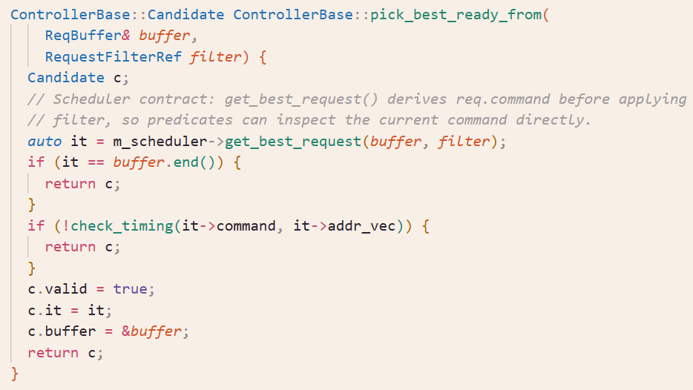
Simulator Architecture (IV)
Inside the Scheduler

Slide 17
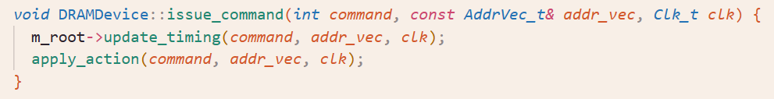
Simulator Architecture (IV)
Inside issue_command()
  Recursively walks the tree hierarchy of DRAM nodes
  Update timings along the way
    Update the earliest ready cycle of following commands based on timing constraints
  Apply the action that the issued command has on involved nodes
    Node state changes

Slide 18
Simulator Architecture (V)
Hierarchical state-machine based modeling of DRAM
State of a DRAM node:
Current state: open, close, activating, etc.
Timing constraints: Earliest time in the future that each DRAM command is allowed to be issued
Can be extended to include more:
  Energy & power: Time spent in each state and the number of DRAM commands served (DRAMPower model)
Level: “Channel”
Id: 0
State: …
Parent
Level: “Rank”
Id: 0
State: …
Sibling
Level: “Rank”
Id: 1
State: …
Children
Level: “BankGroup”
Id: 0
State: …
Level: “BankGroup”
Id: 1
State: …

Slide 19
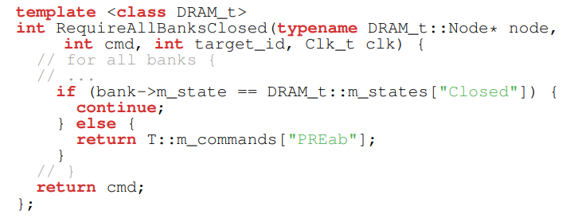
Simulator Architecture (VI)
DRAM commands implemented as lambda functions that hierarchically traverses and updates the states of the nodes
  Checks the current states of the nodes to
  decode which DRAM command to issue
  Programmatically apply state changes
  Updates the timing constraints, power metrics, etc.
Templated library of generalized DRAM command lambda functions allow reuse of command implementations across different DRAM standards
Example Function

Slide 20
Contribute to Ramulator 2.1 (II)
Example directions of contributions
  Better timing presets of DRAM standards
    Some of the DRAM timings are our best effort “guesstimates”
    We welcome your more accurate set of timings w/o breaking NDA
  More DRAM request scheduling techniques
  More DRAM read disturbance mitigation techniques
    Make use of controller plugins and scheduler filters
  More intelligent scheduling of refresh
    Refresh postponing & pull-in
    Dynamic choice of REFab/sb/pb
  PUD/PNM modeling
  More integration with other simulators
Please open an Issue/Discussion first to coordinate with potential internal development!

Slide 21
Acknowledgements
Contributors (growing)
  Haocong Luo
  Nisa Bostancı
  Ataberk Olgun
  Maria Makeenkova
  Ziad Malik
  Ipek Akdeniz
  Kislay Arya
  Roman Hoffmann
  Wonhyuk Yang
  @jiegec
  Julien Eudine
  Sangjae Park
  …
Join the list!

