Slide 1

Introduction to Ramulator 2.1 and
Memory Systems Research
Haocong Luo
ETH Zurich
3rd R&DB Workshop and Tutorial @ ICS’26
06.07.2026

Slide 2
Ramulator
A Fast and Extensible DRAM Simulator
[IEEE Computer Architecture Letters’15]

Slide 3
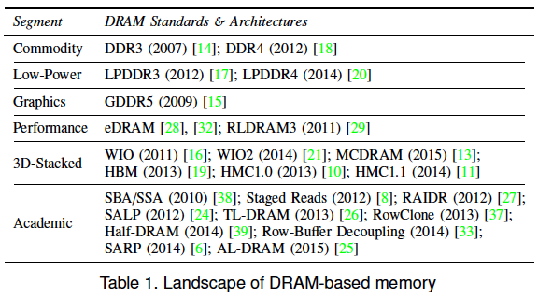
Motivation
DRAM and Memory Controller landscape is changing
Many new and upcoming standards
Many new controller designs
A fast and easy-to-extend simulator is very much needed

Slide 4
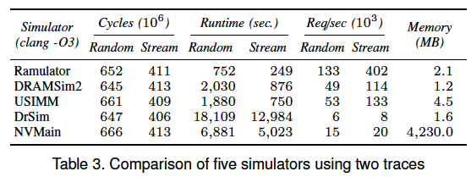
Ramulator: A Fast and Extensible
DRAM Simulator
Modular and extensible to different standards
Provides out-of-the box support for many DRAM standards:
  DDR3/4, LPDDR3/4, GDDR5, WIO1/2, HBM, PCM, STT-RAM
  new proposals (SALP, AL-DRAM, TLDRAM, RowClone, and SARP)
~2.5X faster than fastest open-source simulator
Notes:
To address this need,
Ramulator was developed. Ramulator is a A Fast and Extensible Memory simulator.
which provides out-of-the-box support for many DRAM standards

Slide 5
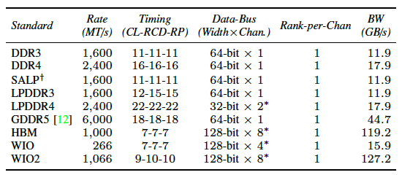
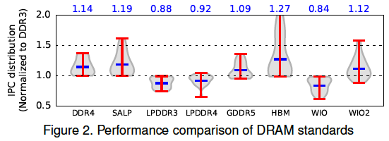
Case Study: Comparison of DRAM Standards
Across 22 workloads, simple CPU model

Slide 6
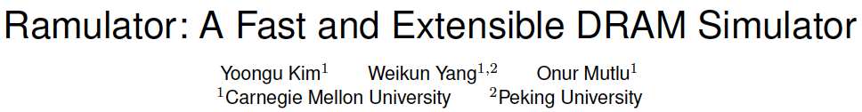
Ramulator Paper and Source Code
Yoongu Kim, Weikun Yang, and Onur Mutlu,
"Ramulator: A Fast and Extensible DRAM Simulator"
IEEE Computer Architecture Letters (CAL), March 2015.
[Source Code]
Source code is released under the liberal MIT License
  https://github.com/CMU-SAFARI/ramulator

Slide 7
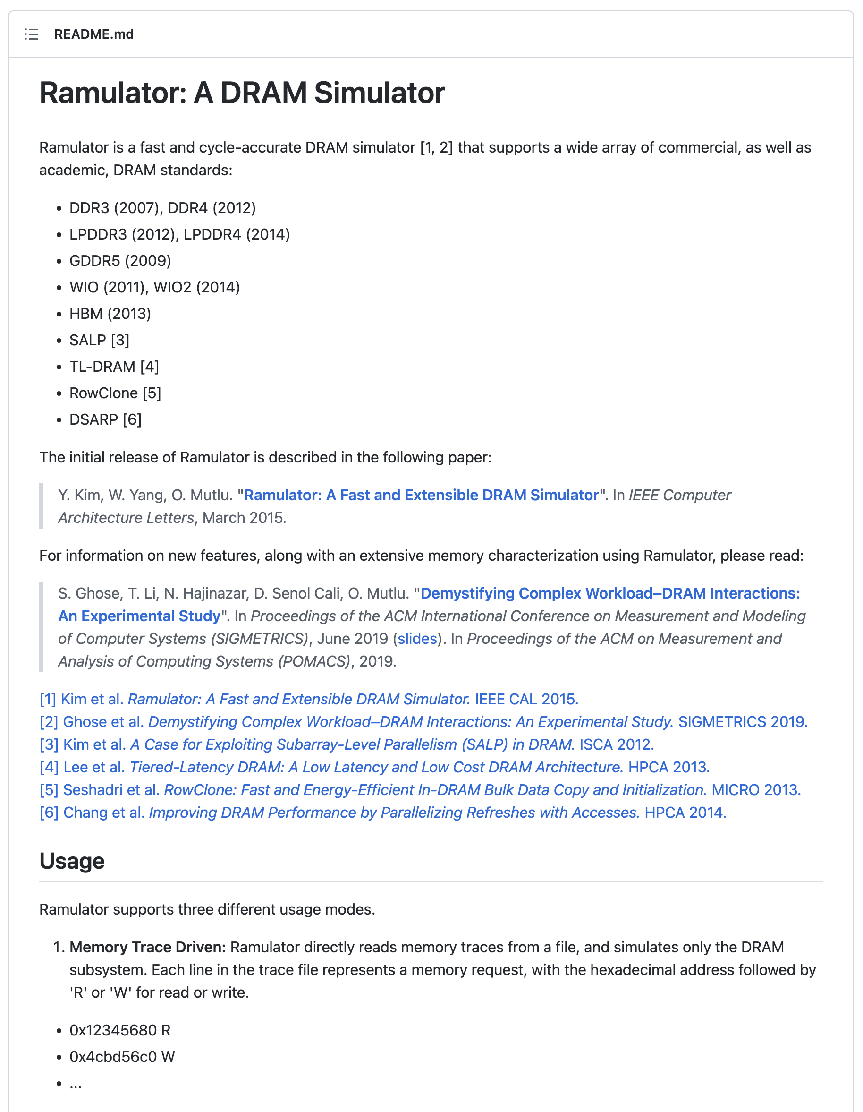
Ramulator: Free & Open Source
https://github.com/CMU-SAFARI/ramulator

Slide 8
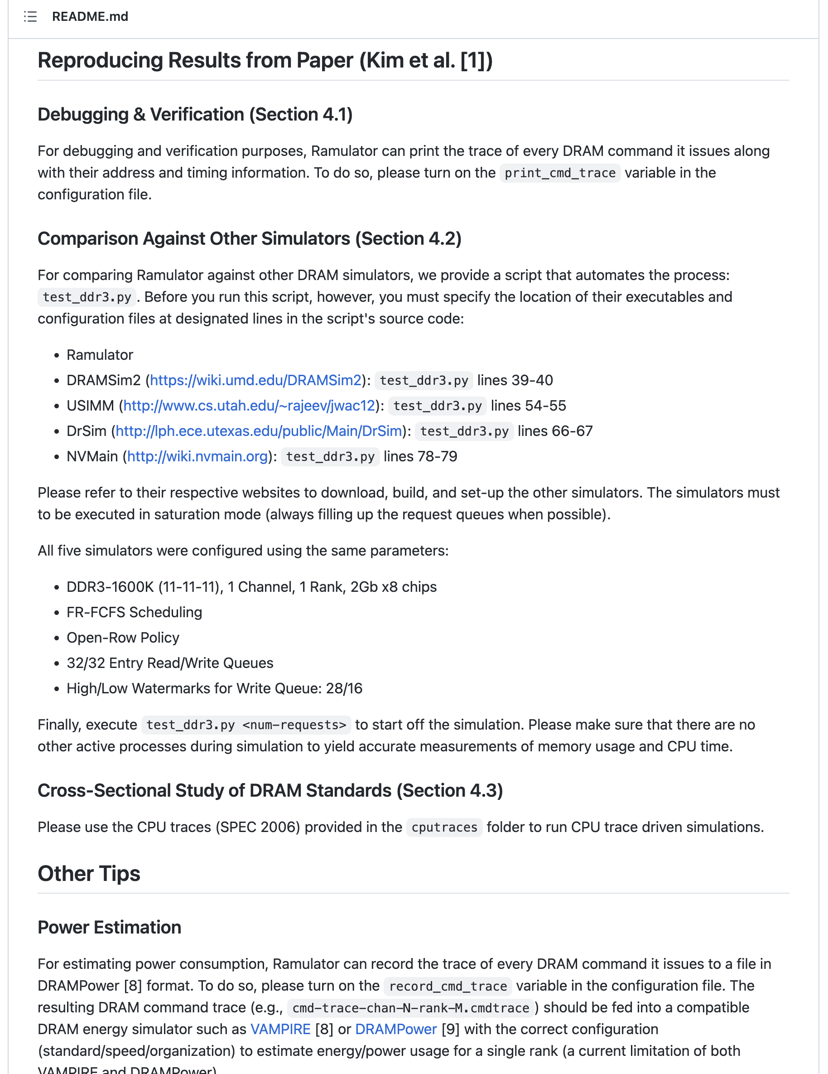
Ramulator: Reproducibility
https://github.com/CMU-SAFARI/ramulator

Slide 9
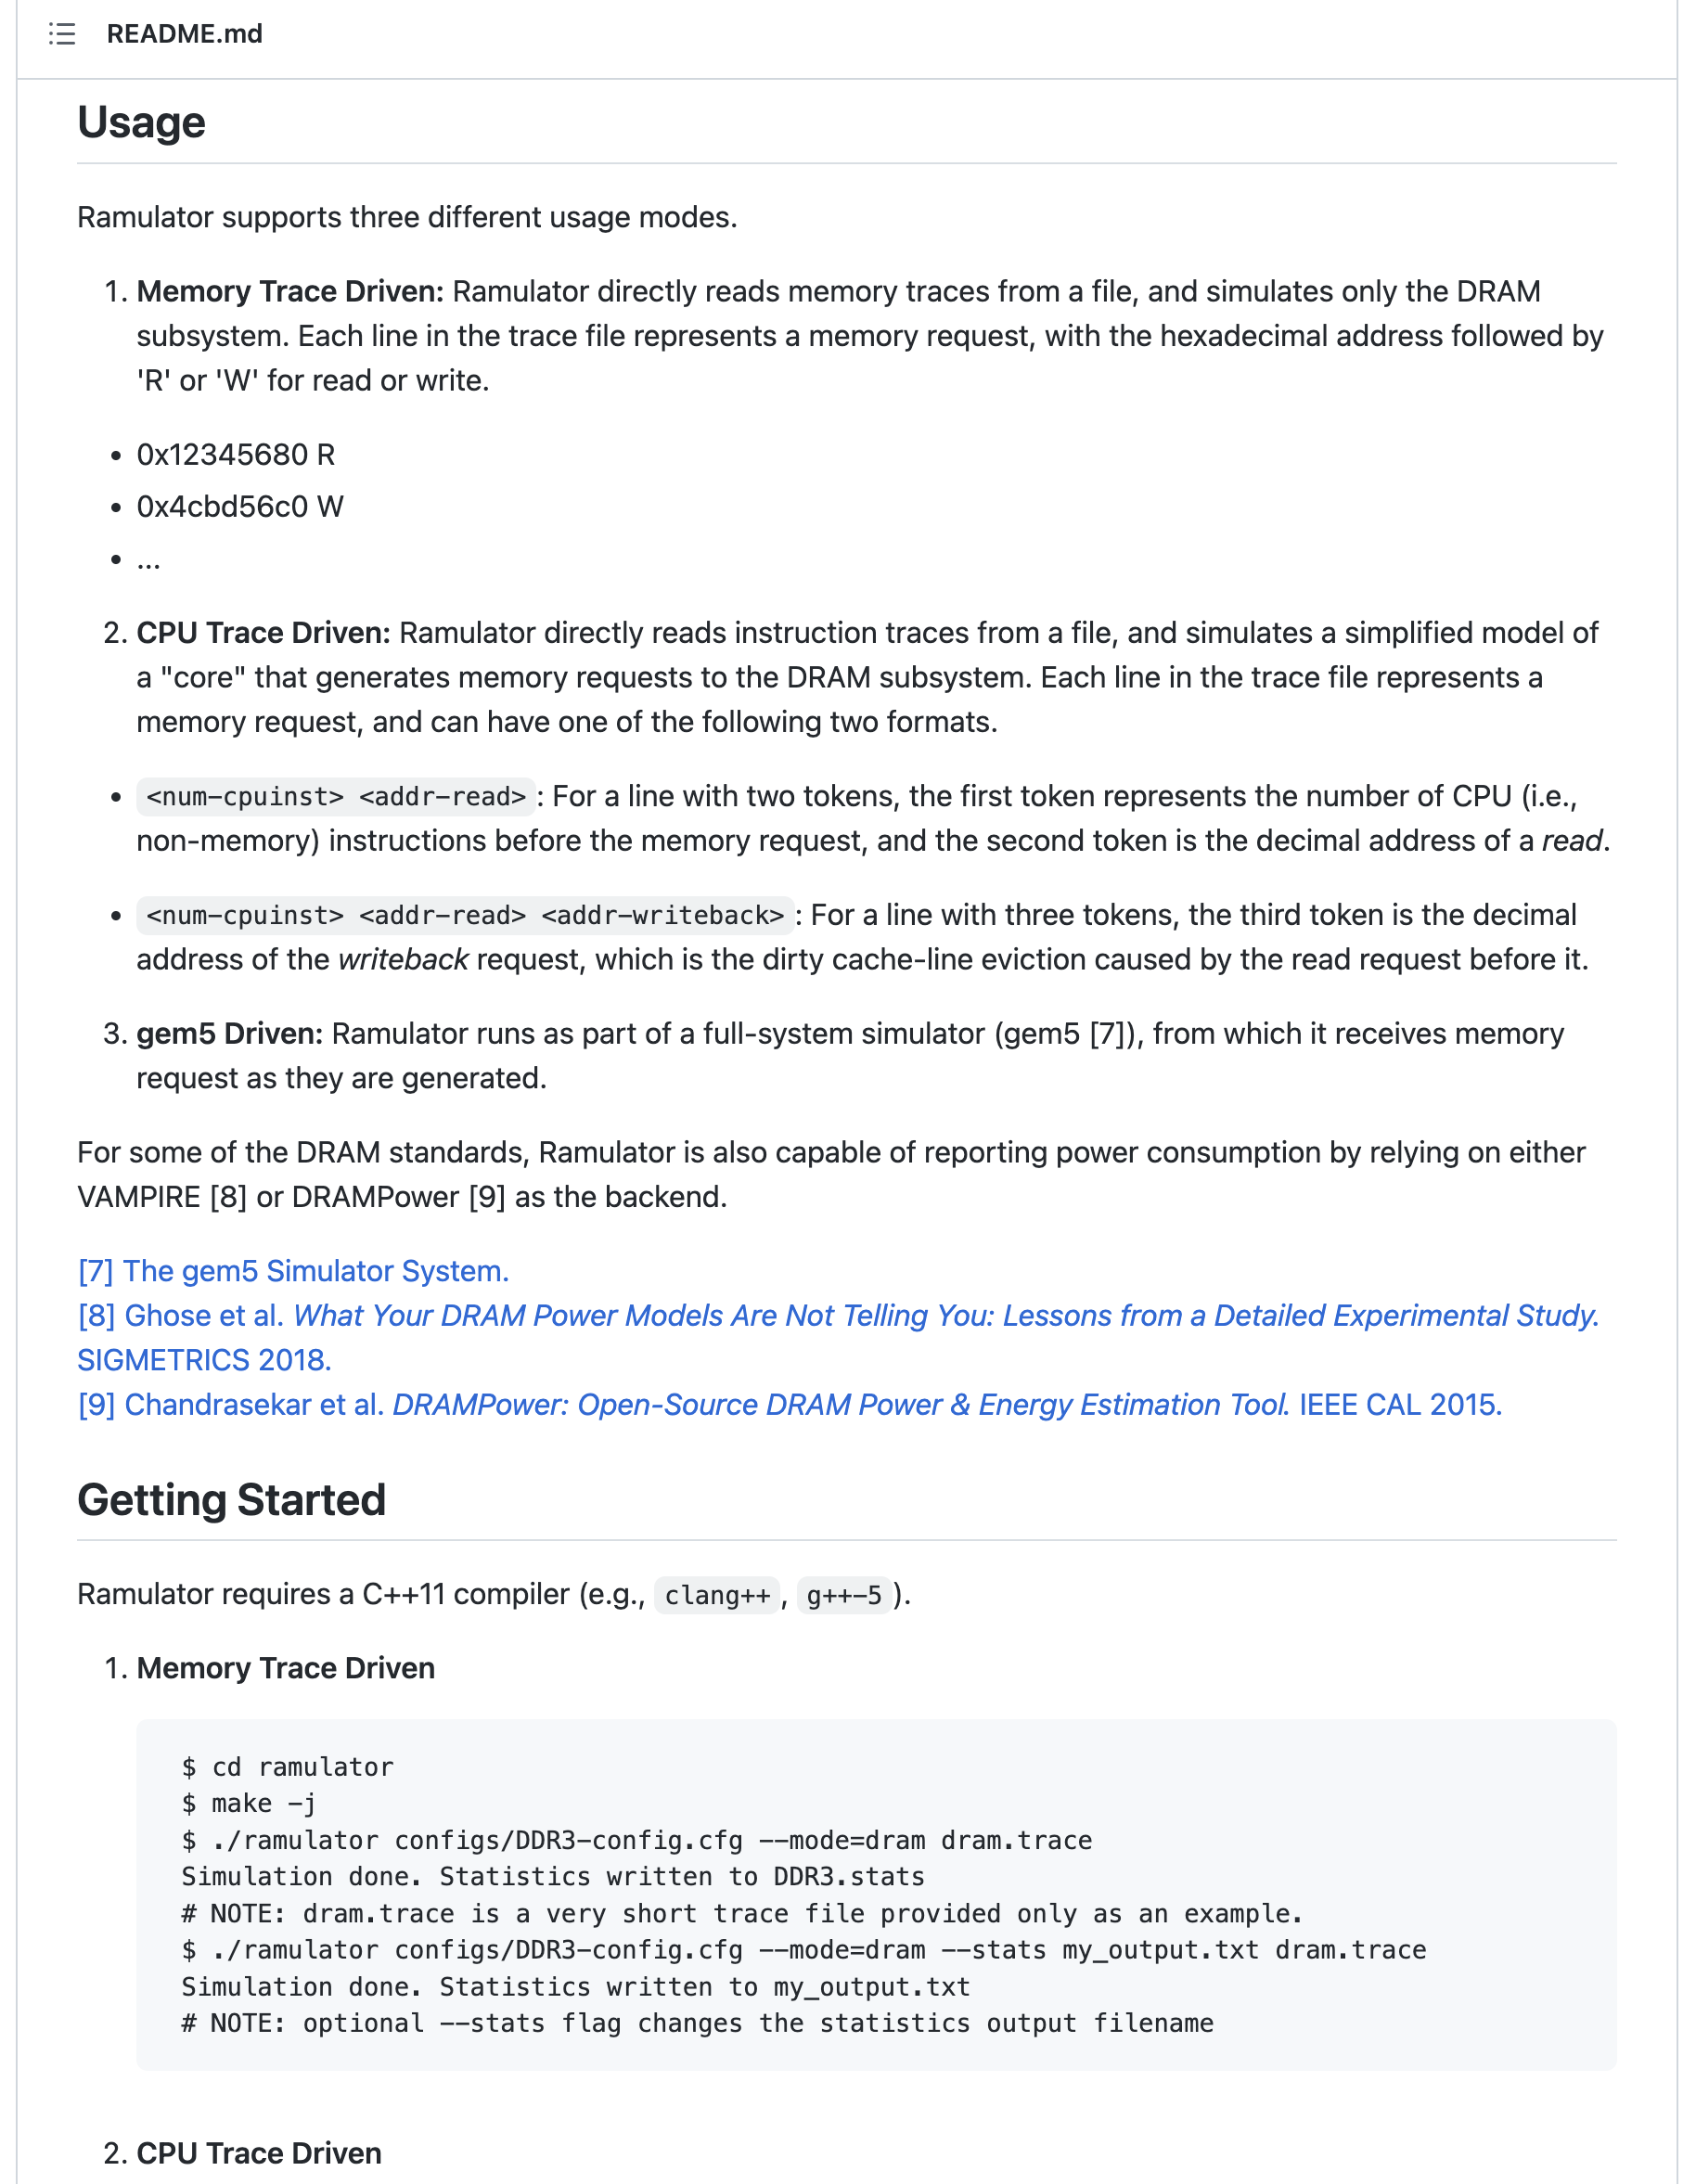
Ramulator: Integration with Other Simulators
https://github.com/CMU-SAFARI/ramulator

Slide 10
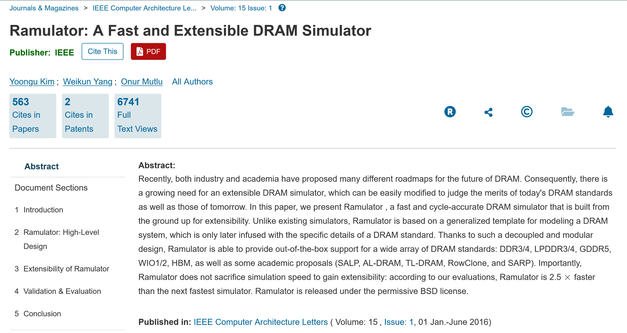
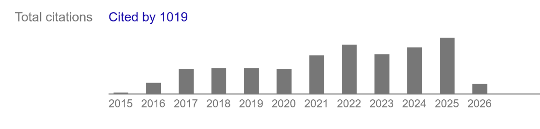
Ramulator Enabled Many Works

Slide 11
Ramulator 2.0
A Modern, Modular, and Extensible DRAM Simulator
[IEEE Computer Architecture Letters’24]

Slide 12
Motivation
DRAM and Memory Controller landscape is changing
Robustness issues in DRAM
  Data retention
  Read disturbance (RowHammer, RowPress, ColumnDisturb etc.)
  …
Performance issues in main memory system
  Processing-in-Memory architectures
  Emerging memory technologies
  Performance overhead analysis of read disturbance mitigation techniques
  …
DRAM simulation infrastructures are needed
to understand, characterize, and evaluate
the robustness and performance of DRAM

Slide 13
Executive Summary
Ramulator 2.0: Modern, modular, and extensible
DRAM & memory system simulator
Models a wide range of DRAM standards and memory controller functionalities
Modular and extensible software architecture
Fine-grained modeling of DRAM operation (cycle-level)
Used in a wide range of research works

Slide 14

Implementing Many RowHammer Mitigations in Ramulator 2.0
Haocong Luo, Yahya Can Tugrul, F. Nisa Bostanci, Ataberk Olgun, A. Giray Yaglikci, and Onur Mutlu,
"Ramulator 2.0: A Modern, Modular, and Extensible DRAM Simulator"
Preprint on arxiv, August 2023.
[arXiv version]
[Ramulator 2.0 Source Code]
https://arxiv.org/pdf/2308.11030.pdf
https://github.com/CMU-SAFARI/ramulator2

Slide 15
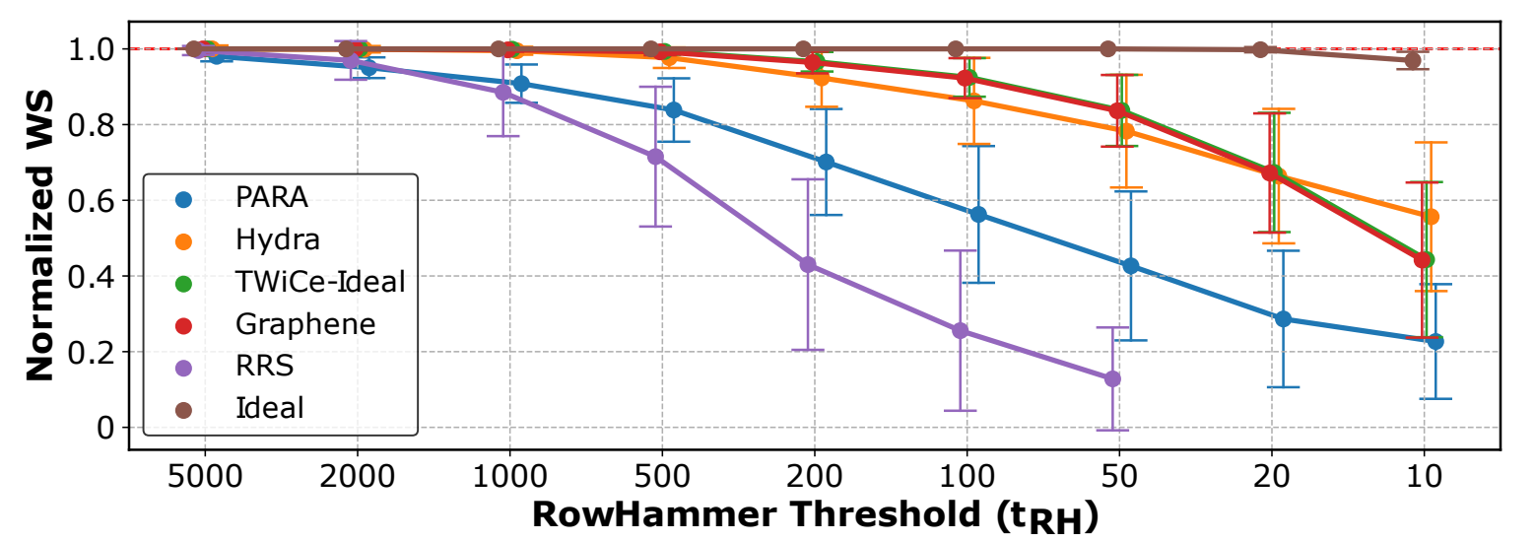
Implementing Many RowHammer Mitigations in Ramulator 2.0
Cross-section performance overhead evaluation of different RowHammer mitigation techniques
Six different RowHammer mitigation techniques all implemented
as plugins to the same memory controller implementation
As DRAM becomes more vulnerable to RowHammer, evalauted RowHammer mitigations incur higher performance overheads

Slide 16
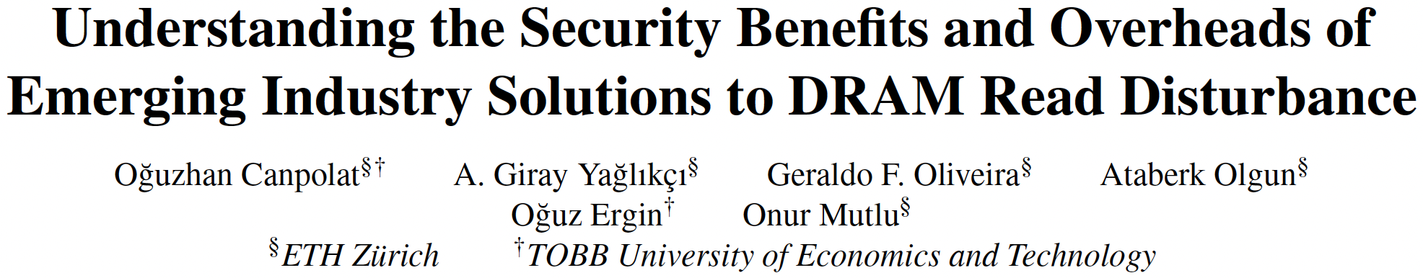
Evaluating Per-Row Activation Counting
(as introduced in DDR5 standard)
Oğuzhan Canpolat, A. Giray Yağlıkçı, Geraldo F. Oliveira, Ataberk Olgun, Oğuz Ergin, and Onur Mutlu,
"Understanding the Security Benefits and Overheads of Emerging Industry Solutions to DRAM Read Disturbance"
4th Workshop on DRAM Security (DRAMsec), held with ISCA,
Buenos Aires, Argentina, July 2024.
https://arxiv.org/pdf/2406.19094
https://github.com/CMU-SAFARI/ramulator2

Slide 17
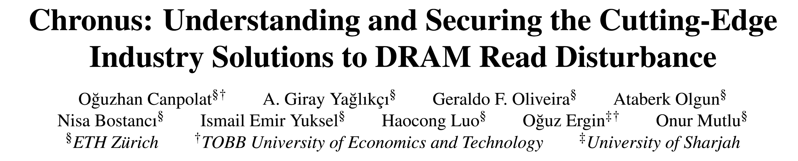
Addressing Drawbacks of PRAC
Oguzhan Canpolat, Abdullah Giray Yaglikci, Geraldo Francisco de Oliveira, Ataberk Olgun, Nisa Bostanci, Ismail Emir Yuksel, Haocong Luo, Oguz Ergin, and Onur Mutlu,
"Chronus: Understanding and Securing the Cutting-Edge Industry Solutions to DRAM Read Disturbance"
HPCA, Las Vegas, NV, USA, March 2025.
Officially artifact evaluated as available, functional, and reproduced.
https://arxiv.org/pdf/2502.12650

Slide 18
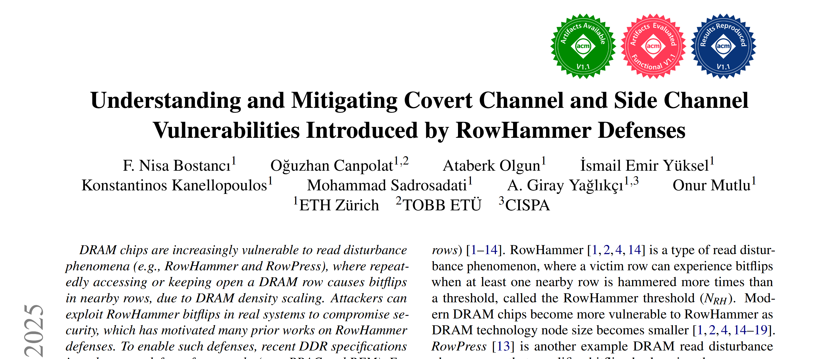
A Recent Paper using gem5+Ramulator 2.0
MICRO 2025
https://arxiv.org/pdf/2503.17891
https://github.com/CMU-SAFARI/LeakyHammer

Slide 19



Cleaning up the Mess
Re-Evaluating the Real-System
Modeling Accuracy of Ramulator 2.0
F. Nisa Bostancı* Haocong Luo* Ataberk Olgun*
Maria Makeenkova Geraldo F. de Oliveira
A. Giray Yağlıkçı Onur Mutlu
* Equal Contribution
Notes:
Hi everyone, I am Nisa and
Today Haocong and I are going to present our work called
Cleaning up the Mess
Re-Evaluating the Real-System Modeling Accuracy of Ramulator 2.0

Slide 20
Mess: A MICRO'24 Best Paper Runner-Up
"A Mess of Memory System Benchmarking, Simulation
and Application Profiling", MICRO'24
  A best paper runner-up with all 3 artifact badges
  (including "Reproducible")
Proposes a new benchmark to evaluate the real and simulated memory system performance
Makes strong negative claims about two of our simulation infrastructures, Ramulator 2.0 and DAMOV,
and shows unexpected results
  Contending that they "poorly resemble the actual system performance"
Notes:
A MICRO 2024 best paper runner-up publication with all 3 artifact badges, titled "A Mess of Memory System Benchmarking, Simulation and Application Profiling", which we call the Mess paper,
[CLICK] proposes a new benchmark to evaluate the real and simulated memory system performance
[CLICK] while doing so, it also makes some strong negative claims about two of our simulation infrastructures: Ramulator 2.0 and DAMOV and shows unexpected results
[CLICK] concluding that they poorly resemble the actual system performance

Slide 21
Cleaning up the Mess
We demonstrate that these claims and results are incorrect
and are due to configuration and simulator usage errors
made in the Mess paper
We describe four best practices
to aid users and developers of simulation tools
To facilitate transparency and reproducibility,
we open source all our code and results:
https://github.com/CMU-SAFARI/Cleaning-up-the-Mess
Notes:
[CLICK] In this work, we demonstrate that these claims and results are incorrect and are due to configuration and simulator usage errors
Made in the Mess paper.
We describe four best practices
to aid users and developers of simulation tools
To facilitate transparency and reproducibility,
we open source all our code and results:
https://github.com/CMU-SAFARI/Cleaning-up-the-Mess

Slide 22
Cleaning up the Mess
Analysis of the Evaluation of Ramulator 2.0
in the Mess Paper
Analysis of the Evaluation of DAMOV
in the Mess Paper
Ramulator 2.0 and DAMOV Best Practices
Notes:
To demonstrate that these results and claims are incorrect, [CLICK] we first analyze the evaluation of Ramulator 2.0 and DAMOV in the Mess paper
[CLICK] and then describe best practices for these tools for users to avoid such issues in the future
[CLICK] Now lets talk about our analysis of the evaluation of Ramulator 2.0 in the mess paper

Slide 23
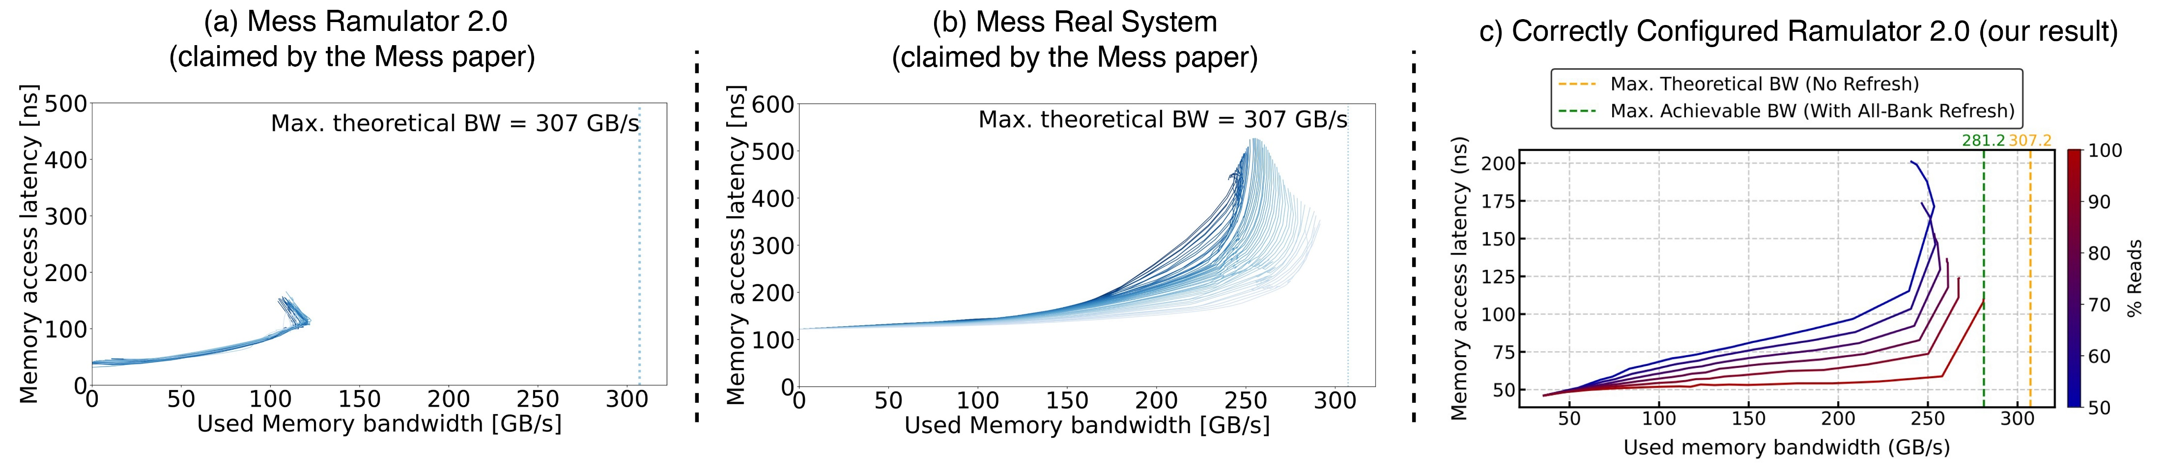
High-Level Memory System
Performance Evaluation & Reasoning
The Mess benchmark aims to characterize a memory system
based on a set of latency-throughput ("used bandwidth") curves
Consists of two concurrently running workloads:
Streaming and Pointer-Chasing patterns
  Varies the memory intensity using NOPs between requests
  Evaluates a sweep of read/write intensities
  (from 50% to 100% reads)
increasing memory intensity
50%
Memory Access Latency (ns)
100%
1 experiment
Used Memory Bandwidth (GB/s)
Notes:
The Mess paper evaluates memory system performance by proposing the mess benchmark:
The Mess benchmark aims to characterize a memory system, using a set of latency-throughput, or "used bandwidth" curves
[CLICK] These curves are plotted as a line figure,
[CLICK] where each data point is an experiment that performs two types of accesses concurrently : streaming and pointer-chasing patterns
[CLICK] plots the measured average memory access latency and [CLICK] the used memory bandwidth
[CLICK] The Mess benchmark then varies the memory intensity by adding NOPs between subsequent memory requests which creates "a single curve"
[CLICK] And evaluating a sweep of read write operation intensities from 50% to 100% reads
[CLICK] creates different curves

Slide 24
The Mess Paper's Evaluation of Ramulator 2.0
2
smaller
latency
1
smaller bandwidth
Contending that Ramulator 2.0 "poorly resembles
the actual system performance"
Ramulator 2.0 simulation results in the Mess paper are incorrect
and, at the time of the publication of the Mess paper, irreproducible
Notes:
The Mess paper comments on the accuracy of Ramulator 2.0 by first evaluating a real DDR5 system with the Mess benchmark,
[CLICK] which results in these curves in the first figure
[CLICK] and then compares them against the Ramulator 2.0 curves that it obtains
[CLICK] The Mess paper observes that Ramulator 2.0's curves show 1) smaller used memory bandwidth and [CLICK] 2) smaller memory access latency compared to the real system curves
[CLICK] And contends that Ramulator 2.0 poorly resembles the actual system performance
[CLICK] However, Ramulator 2.0 results in the Mess paper are incorrect and at the time of the publication of the paper, *were* irreproducible

Slide 25
Analysis of the Evaluation of Ramulator 2.0 in the Mess Paper
1
Reproducibility Issues:
It was not possible to reproduce any Ramulator 2.0 result from the Mess paper artifacts available at the time of publication and artifact evaluation of the paper
The missing source codes were uploaded to the Mess GitHub repository
10 months after the artifact evaluation badges
2
Fundamental Configuration Errors:
The Mess paper effectively compares an 8-channel DDR5 memory
system in Ramulator 2.0 against a 16-channel real DDR5 memory system
The Mess paper uses unrealistically low cache latency configurations
that lead to low memory access latency
3
Scholarship Issues:
The Mess paper does not disclose
1) modifications to the cache latency configurations, and
2) differences in evaluation methodology between simulation and
real system results (identified via email exchange with Mess paper's authors)
Notes:
We analyze the Mess paper and its open-sourced artifact and identify various issues in three categories:
[CLICK] First, it was not possible to reproduce any of the Ramulator 2.0 results from the Mess paper artifacts available due to missing source codes
[CLICK] The missing source codes were uploaded only after our contact, 10 months after the artifact evaluation badges were awarded
Second,
[CLICK] We identify that Ramulator 2.0's evaluation suffers from fundamental configuration errors as
[CLICK] the Mess paper compares an 8-channel memory system in Ramulator 2.0 against a 16-channel real memory system.
[CLICK] and configures the system to have unrealistically low cache latency configurations that lead to low memory access latency
Lastly,
[CLICK] We also identified scholarship issues as the paper does not disclose
[CLICK] these modifications to the source code of Ramulator 2.0
[CLICK] and differences in evaluation methodologies of real and simulated memory systems that we will not cover in this presentation but explained in detail in our paper
In the interest of time, we will focus on the fundamental configuration errors

Slide 26
Fundamental Configuration Errors
The Mess paper's configuration errors result in
the claimed Ramulator 2.0 inaccuracies
2
1
smaller
latency
smaller bandwidth
Notes:
The Mess paper's configuration errors result in the claimed inaccuracies, and lead to incorrect claims.
"
The mess paper's configuration errors result in incorrect claims about Ramulator 2. now we will describe how they lead to smaller bandwidth and smaller latency
"

Slide 27
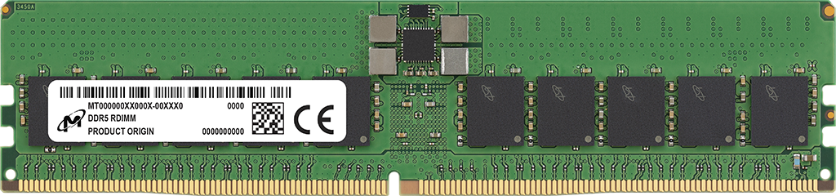
Fundamental Configuration Errors:
Smaller Used Bandwidth
Mess Paper’s
Ramulator 2.0 Configuration
Mess Paper’s
Real System Configuration
channel: 8
“8 x DDR5”
Channel A
Channel B
8 DDR5 channels
16 DDR5 channels
Notes:
First, the smaller used bandwidth results are caused by the difference in numbers of channels available [CLICK] in simulation and in real system evaluations
[CLICK] Mess Paper's Ramulator 2.0 configuration specifies 8 channels with this configuration line.
And the paper specifies the real system configuration as "8 X DDR5"
This leads to Ramulator 2.0 instantiating 8 independent DDR5 channels
Whereas the real system configuration has 8 DDR5 DIMMS each of which containing 2 channels. Meaning that there are actually 16 independent DDR5 channels in the Mess paper’s real system configuration
[CLICK] And because of this mismatch,

Slide 28
Fundamental Configuration Errors:
Smaller Used Bandwidth
Mess Paper’s
Ramulator 2.0 Configuration
Mess Paper’s
Real System Configuration
8 DDR5 channels
16 DDR5 channels
The Mess paper incorrectly assumes a DDR5 channel in
Ramulator 2.0 is 64-bit, instead of the actual width of 32-bit
that is consistent with JEDEC DDR5 standards (JESD79-5)
Notes:
Ramulator 2.0 results show around half the used bandwidth of real system measurements, as it has half the number of channels.
We identify that this is because, the mess paper incorrectly assumes a DDR5 channel in Ramulator 2 is 64 bits wide
Whereas the implementation clearly states a channel as 32 bits wide, which is the consistent value with the JEDEC DDR5 standards

Slide 29
Fundamental Configuration Errors:
Smaller Used Bandwidth
Mess Paper’s
Ramulator 2.0 Configuration
Mess Paper’s
Real System Configuration
8 DDR5 channels
16 DDR5 channels
The Mess paper incorrectly assumes a DDR5 channel in
Ramulator 2.0 is 64-bit, instead of the actual width of 32-bit
that is consistent with JEDEC DDR5 standards (JESD79-5)
The Mess paper configures Ramulator 2.0 with half the channels of
a real system, and thus, results in smaller used bandwidth
Notes:
Because of this configuration error, the mess paper configures Ramulator 2 with half the channels of a real system and thus results in smaller used bandwidth

Slide 30
Fundamental Configuration Errors:
Smaller Memory Access Latency
The Mess paper's artifact hardcodes
  the cache latency as 0 cycles
  the number of miss-status holding registers (MSHRs)
  per CPU as 1024
This leads to significantly smaller DRAM round-trip latency
and queueing delays, thus smaller memory access latency
The Mess paper uses unrealistically low cache latency configurations
resulting in the low memory access latency
that it attributes to Ramulator 2.0
Notes:
The second issue, smaller memory access latency is due to the unrealistic cache latency configurations
The mess paper's artifact hardcodes the cache latency as 0 cycles and instantiates a high number of miss-status holding registers
This configuration leads to significantly smaller DRAM round-trip latency and queueing delays, thus a low memory access latency compared to a real system
so, The Mess paper uses unrealistically low cache latency configurations
resulting in the the low memory access latency
that it attributes to Ramulator 2.0
Transition:
Now lets hear from Haocong about how *we* evaluate Ramulator 2.0

Slide 31
Our Evaluation Methodology
We independently evaluate the Mess benchmark
by executing the same access pattern
  Streaming and Pointer-Chasing access patterns
  Sweeping memory intensity
We correctly configure Ramulator 2.0
  Provide the same number of channels as the real system
  Evaluate the memory access latency from the memory controller
  to isolate the DDR5 model's simulation accuracy
Notes:
To this end,
[CLICK]
we independently evaluate the Mess benchmark by executing the same access pattern
[CLICK]
And configure Ramulator 2.0 correctly:
We instantiate a 16-channel DDR5 memory system
And measure the memory access latency from the memory controller

Slide 32
Our Key Results
Ramulator 2.0's memory model achieves high used memory bandwidth, close to the achievable bandwidth value,
as opposed to the claims of the Mess paper
https://github.com/CMU-SAFARI/ramulator2/tree/mess
Notes:
Now lets see our results
[CLICK]
On the X axis, we see the used memory bandwidth and on the y-axis, the memory access latency.
[CLICK]
We show the maximum theoretical bandwidth as the yellow line
[CLICK]
Since this does not account for periodic refresh, we draw a second line to show the maximum achievable bandwidth that accounts for refreshes.
[CLICK]
These are our results,
We make two key observations
[CLICK]
First, Ramulator 2.0's memory model
[CLICK]
achieves a high used memory bandwidth, close to the achievable bandwidth value, as opposed to the claims of the Mess paper.

Slide 33
Our Key Results
The memory access latency of Ramulator 2.0’s model increases
as the used memory bandwidth and the write ratio increases
https://github.com/CMU-SAFARI/ramulator2/tree/mess
Notes:
Second, the memory access latency [CLICK] of Ramulator 2.0’s DRAM model increases as as the used memory bandwidth and the write ratio increases

Slide 34
Our Key Results
When correctly configured, Ramulator 2.0’s simulated memory system performance resembles real system characteristics
https://github.com/CMU-SAFARI/ramulator2/tree/mess
Notes:
We conclude that
When correcty configured,
Ramulator 2.0's simulated memory system performance
Resembles real system characteristics

Slide 35
Cleaning up the Mess
Analysis of the Evaluation of Ramulator 2.0
in the Mess Paper
Analysis of the Evaluation of DAMOV
in the Mess Paper
Ramulator 2.0 and DAMOV Best Practices
Notes:
Now lets look at the analysis of the evaluation of DAMOV in the Mess paper

Slide 36
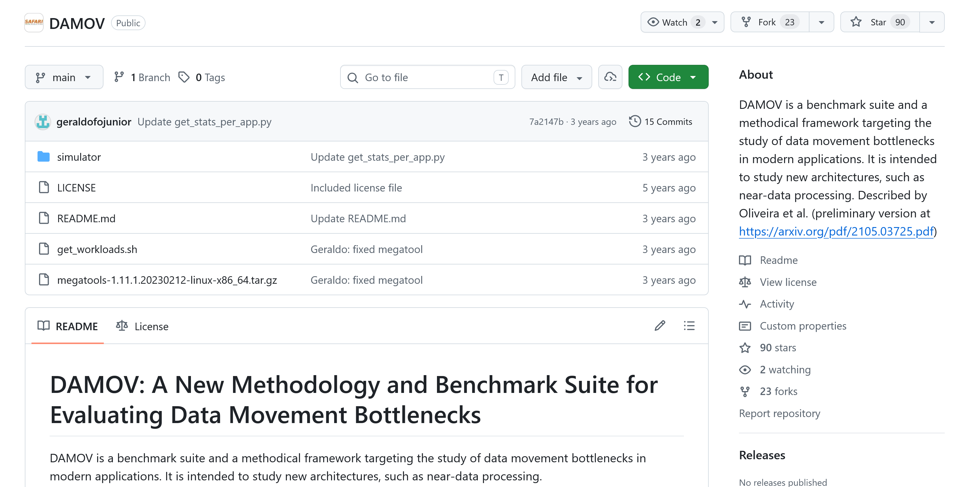
DAMOV: A Simulation Framework for PiM
DAMOV integrates ZSim [Sanchez+, ISCA'13] with Ramulator [Kim+, CAL'15]
  Enables evaluating emerging processing-in-memory architectures
https://github.com/CMU-SAFARI/DAMOV
Notes:
DAMOV is another simulation framework that integrates a core model, Zsim with an earlier version of Ramulator for evaluating emerging processing-in-memory architectures
=========================
second point could come later?

Slide 37
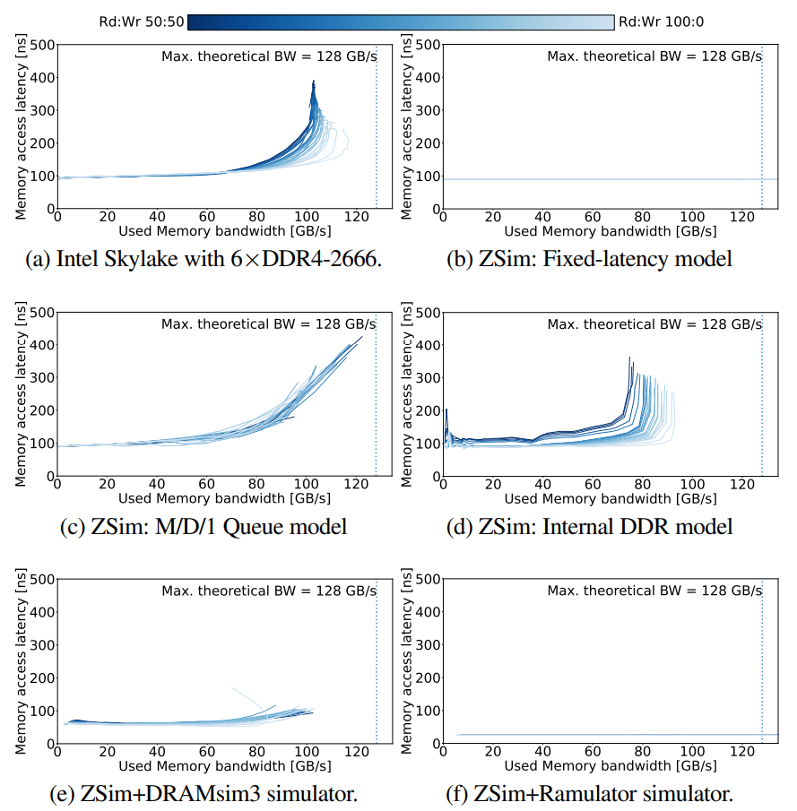
The Mess Paper's Evaluation of DAMOV
Mess Real System
(claimed by the Mess paper)
Mess DAMOV
(claimed by the Mess paper)
constant latency
DAMOV results in the Mess paper use incorrect simulation statistics
that are unrelated to the simulated DRAM performance
Notes:
The Mess paper evaluates a real DDR4 system as shown on the left
For DAMOV, the Mess paper’s results are on the right, which shows a constant memory access latency
We identify that DAMOV results in the Mess paper use wrong simulation statistics that are unrelated to the simulated DRAM performance

Slide 38
Analysis of the Evaluation of DAMOV in the Mess Paper
Reproducibility Issues:
We could not reproduce any DAMOV results in the Mess paper, using the Mess paper's artifact due to:
​Missing source code and configurations of Ramulator
Rigid assertion failure according to the ZSim configurations
1
Technical Simulator Usage Errors:
Uses two ZSim statistics for DRAM latency: latGETnl and mGETs
from the L1-D cache
These statistics are not Ramulator statistics and
does not reflect simulated DRAM latency from Ramulator
2
We independently evaluate DAMOV by executing the Mess benchmark
and adding missing pieces to the artifact in a best-guess manner
and measure the used bandwidth statistics reported by Ramulator
Notes:
We analyzed the Mess paper and its artifact and identified 2 key issues
[CLICK]
First, we could not reproduce any DAMOV results in the Mess paper due to missing source code and configurations in their artifact
[CLICK]
Second, we identify that the Mess paper's scripts use statistics from Zsim to calculate the memory latency, but these stats are not related to DRAM latency modeled by Ramulator.
[CLICK]
Due to these issues, we independently evaluate DAMOV by executing the Mess benchmark by adding missing resources in a best-guess manner

Slide 39
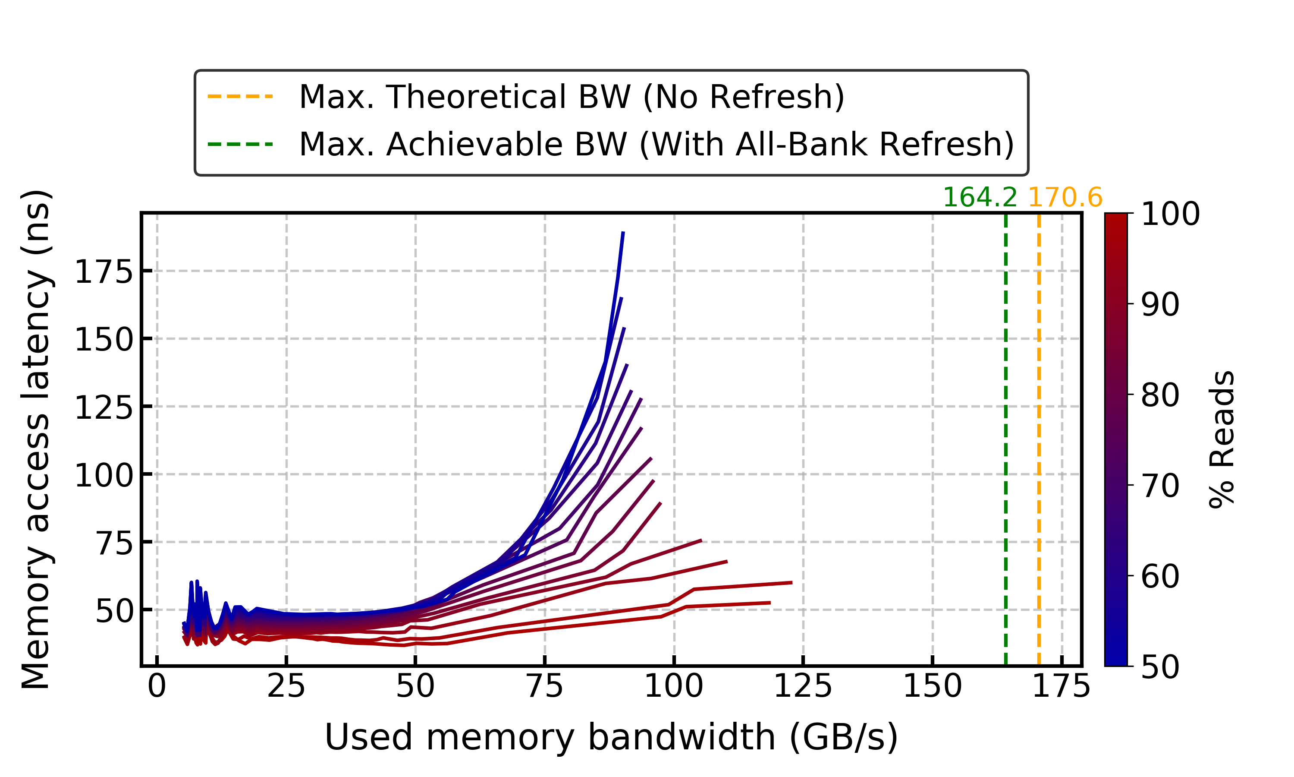
Our Key DAMOV Results
When correct statistics are used, DAMOV's memory access latency
is not constant, in contrast to the claims of the Mess paper
Notes:
Here is our results
[CLICK]
We observe that when correct statistics are used DAMOV's memory access latency is not constant,
In contrast to the claims of the Mess paper

Slide 40
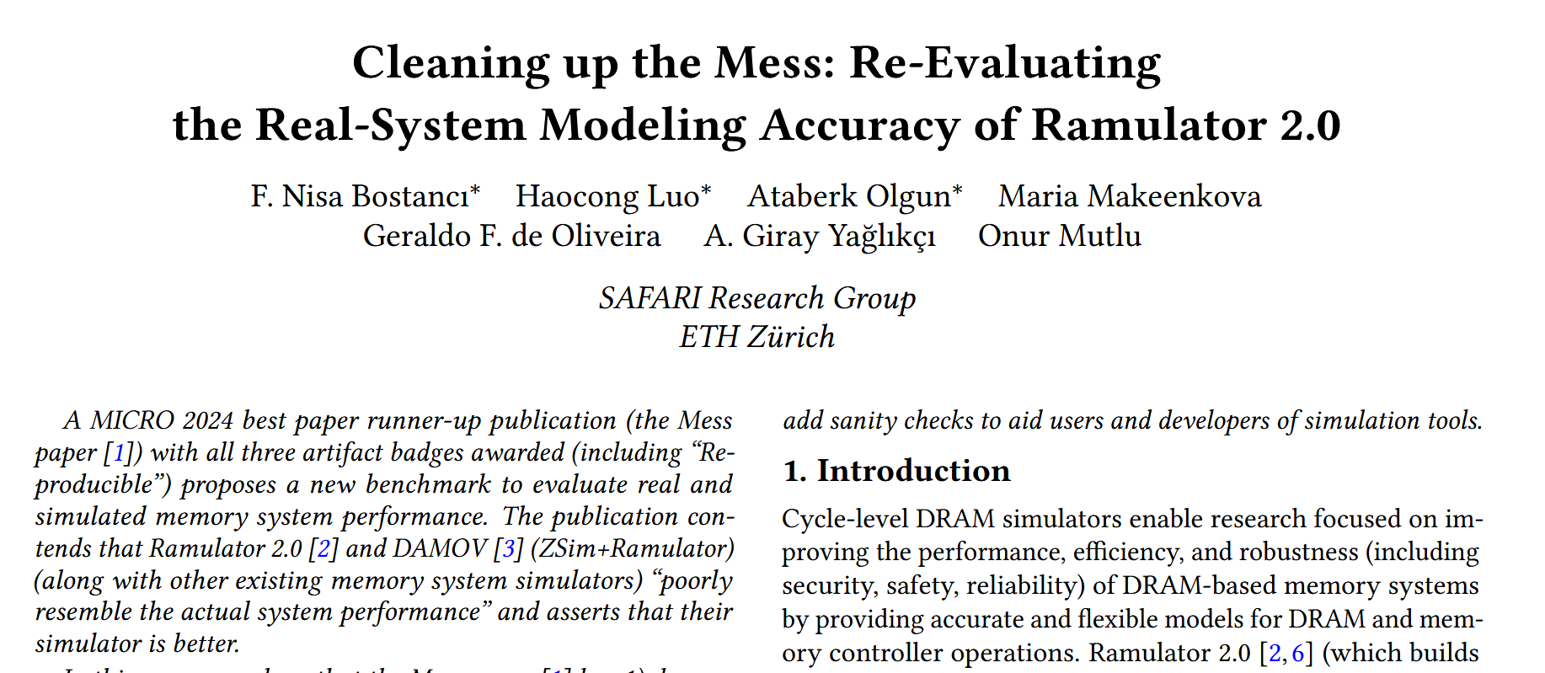
More in the Paper
* Equal contribution
https://arxiv.org/pdf/2510.15744
Notes:
There are even more details and analyses in the extended version of our paper on arxiv which you can access it with this link

Slide 41
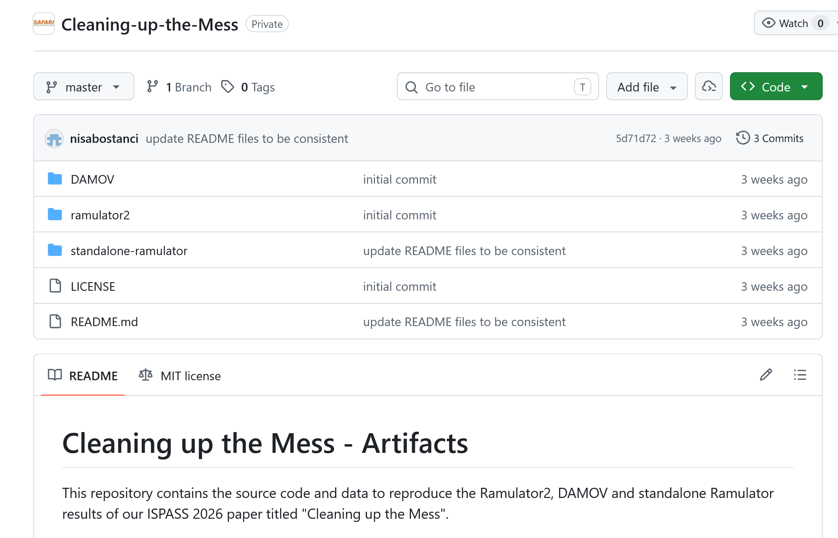
Cleaning up the Mess is Open Source
https://github.com/CMU-SAFARI/Cleaning-up-the-Mess
Notes:
All our source code and scripts are open sourced and artifact evaluated which you can check from the Github repo

Slide 42
Cleaning up the Mess
Analysis of the Evaluation of Ramulator 2.0
in the Mess Paper
Analysis of the Evaluation of DAMOV
in the Mess Paper
Ramulator 2.0 and DAMOV Best Practices
Notes:
Lastly, based on these analyses, we identify best practices for Ramulator 2 and DAMOV

Slide 43
Ramulator 2.0 and DAMOV Best Practices
Be familiarized with JEDEC standard documents
instead of relying on information other than the official standard
or the simulator documentation
1
2
Understand Ramulator 2.0’s
memory organization and configurations,
which are documented in the code and in the repository
3
Understand simulation methodology and simulator implementations
sufficiently to use the correct statistics
Communicate with the simulator developers
or user community when unexpected results are observed
to ensure correct simulator usage
4
Notes:
To avoid such configuration and usage errors,
[CLICK] First, the users should be familiarized with JEDEC standard documents
[CLICK] Second, they should understand the simulators memory organization and configurations
These two best practices would help avoiding the Ramulator 2.0 configuration error in the Mess paper
[CLICK] Third, they should understand simulation methodology and simulator implementations sufficiently to use the correct statistics
This would help avoiding the statistics usage errors in the Mess paper
[CLICK] Lastly, the users should communicate with the simulator developers or user community when unexpected results are observed to ensure correct simulator usage
This best practice would help avoid all errors in the Mess paper.

Slide 44
Conclusion
A recent paper, "A Mess of Memory System Benchmarking, Simulation and Application Profiling", MICRO'24 makes strong negative claims
about Ramulator 2.0 and DAMOV and shows unexpected results
We demonstrate that these claims and results are incorrect
and are due to configuration and simulator usage errors made
in the Mess paper
We strongly encourage the computer architecture community to consider
our corrections to the Ramulator 2.0 and DAMOV results of the Mess paper
to prevent the propagation of inaccurate and misleading results
To facilitate transparency and reproducibility, we open source all our
code and results: https://github.com/CMU-SAFARI/Cleaning-up-the-Mess
Notes:
Now, let us conclude our talk.

Slide 45


Cleaning up the Mess
Re-Evaluating the Real-System
Modeling Accuracy of Ramulator 2.0
Paper
GitHub
F. Nisa Bostancı* Haocong Luo* Ataberk Olgun*
Maria Makeenkova Geraldo F. de Oliveira
A. Giray Yağlıkçı Onur Mutlu
* Equal Contribution

Slide 46
Ramulator 2.1 - Introduction
Ramulator 2.1 is a major overhaul of Ramulator 2.0
  Fixes bugs identified by Github issues and internal testing
  More comprehensive support for new DRAM & controller features
  More comprehensive set of tests and validations
  Significantly improved ease of use, configuration, and extension
  Overall code quality and documentation improvements
Github main branch updated to v2.1.0
  https://github.com/CMU-SAFARI/ramulator2/
  codespace and devcontainer ready!
  V2.0a is archived as legacy/v2.0a
Welcomes your use, contribution, and feedback!
  Issues & Discussions on Github
  Open PRs for bug fixes, improvements, and new features

Slide 47
Key Bug Fixes & New Features (I)
Currently modeled DRAM Standards
  DDR
    DDR3
    DDR4
    DDR5
Modeling scope & priority
  Timing and functional simulation of DRAM commands
  Load/Store transactions, refresh, read disturbance mitigation
  High frequency operation and organization
  LPDDR
    LPDDR5
    LPDDR6
  GDDR
    GDDR6
    GDDR7
  HBM
    HBM1 (Legacy mode)
    HBM2 (Pseudochannel mode)
    HBM3
    HBM4

Slide 48
Key Bug Fixes & New Features (II)
Major bugs from Github Issues all fixed
  HBM/HBM2/HBM3 organization, timing, throughput, etc.
  LPDDR5 timing, WCK2CK sync commands, etc.
Better support for new DRAM & controller features
  HBMController for HBM/HBM2/HBM3/HBM4
    Pseudo Channels (HBM2+)
    Row and Column commands dual-issue in the same cycle
  LPDDR5/6 Controller
    WCK2CK sync (CAS_RD/WR) commands with sync state expiry tracking
    ACT1-ACT2 separation with tAAD deadline-aware scheduling
  GDDR7 Controller
Improved scheduler implementation
  Add custom filtering logic to FR-FCFS via lambdas

Slide 49
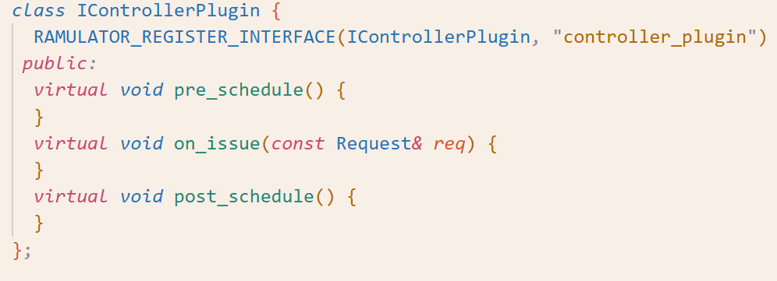
Key Bug Fixes & New Features (III)
Enhanced memory controller plugins
  Standardized and modular interface to flexibly extend the functionality of existing memory controllers
  Enables plug&play implementation of
    Utilities like DRAM command trace recorder
    RH mitigations

Slide 50
Tests & Validations (I)
Three automated test & validation workflows
  Smoke tests: Quick checks to see if simulation crashes
  DRAM command and request traces: Low-level verification of DRAM timings and controller scheduling
  Latency-Throughput Plots: High-level validation of memory system performance

Slide 51
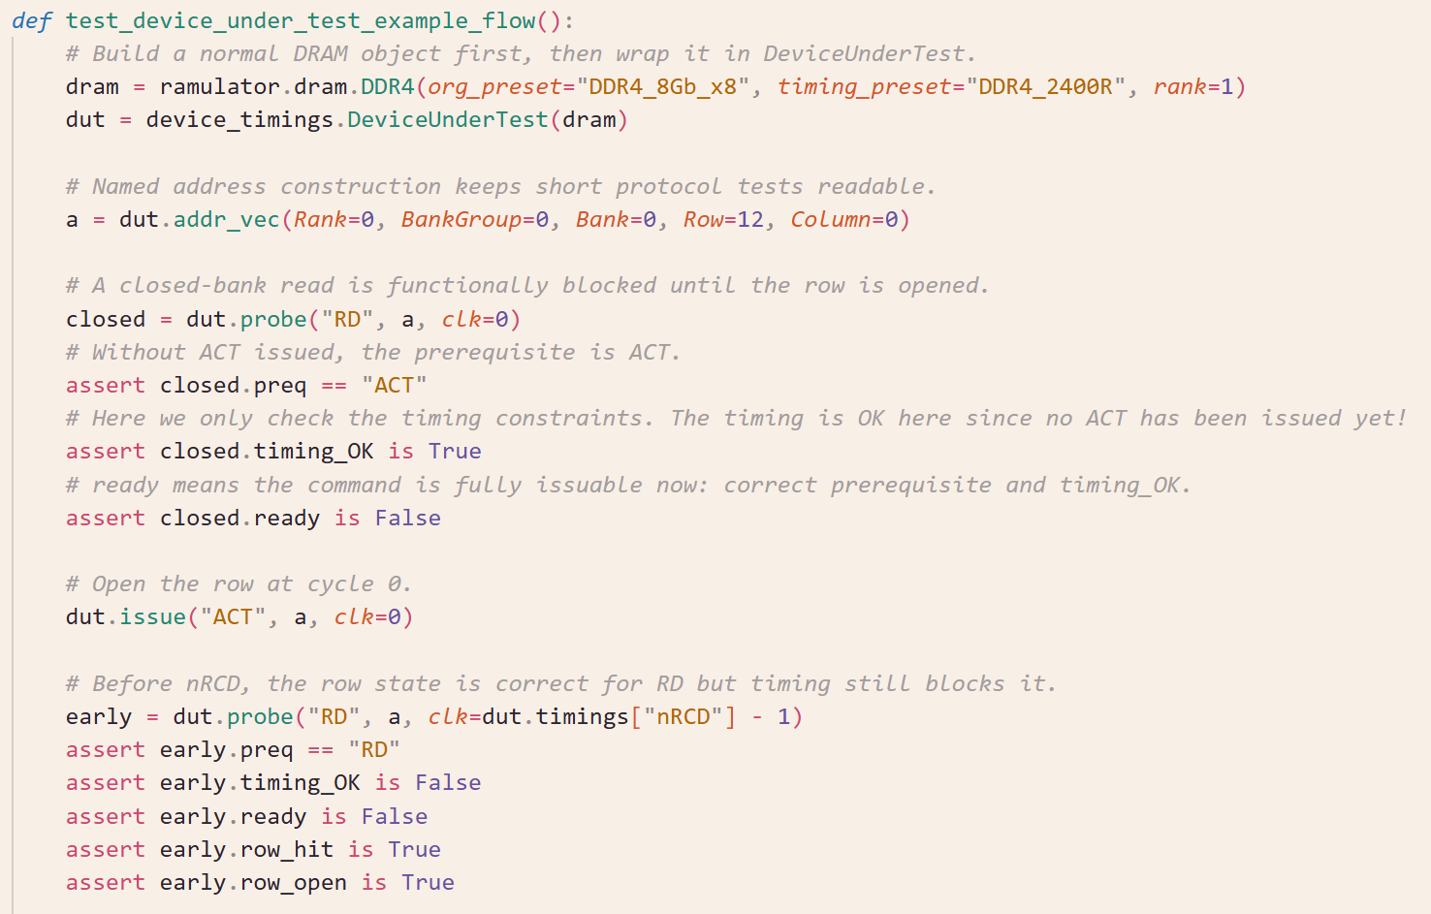
Tests & Validations (II)
DRAM Commands and Timings Test

Slide 52
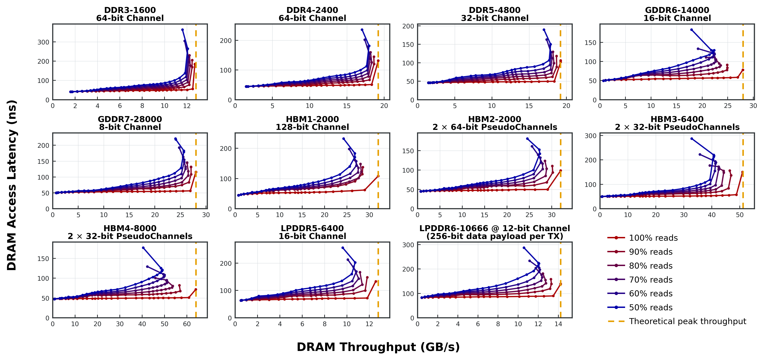
Tests & Validations (III)
Latency-Throughput Plots

Slide 53
QoL Improvements (I)
Ramulator is now a python package
  C++ code with python bindings
Python driven configuration
  Configuration, simulation, results parsing all in one script
  Easy parameter sweeps with python flexibility
  gem5 friendly
    Both SE and FS works out-of-box (tested with gem5 v25.1)
No extra burden for end-user
  Single-source of truth implementation
  Python wrappers are automatically generated from C++
    No need of manual maintenance of boilerplate code
  Equivalent YAML config can be automatically generated for other pure C++ simulators

Slide 54
QoL Improvements (II)
Write code in C++
Use macros to register your interface, implementation, parameters
Ramulator 2.1’s software framework and build system automatically picks up these information to:
  Understand, register, and build the object hierarchy of your interfaces and implementations
  Create Python wrappers (proxy objects) with the specified parameters

Slide 55
QoL Improvements (III)
DRAM Standard Authoring in python
  Replaced verbose and hacky C++ DRAM specs in Ramulator 2.0 with much cleaner python scripts
  Flexible authoring of DRAM organization, commands, and timings, etc. thanks to the scriptibility of Python
  Code generation utility automatically generates C++
  DRAM specs that Ramulator 2’s internal modeling and simulation engine recognizes

Slide 56
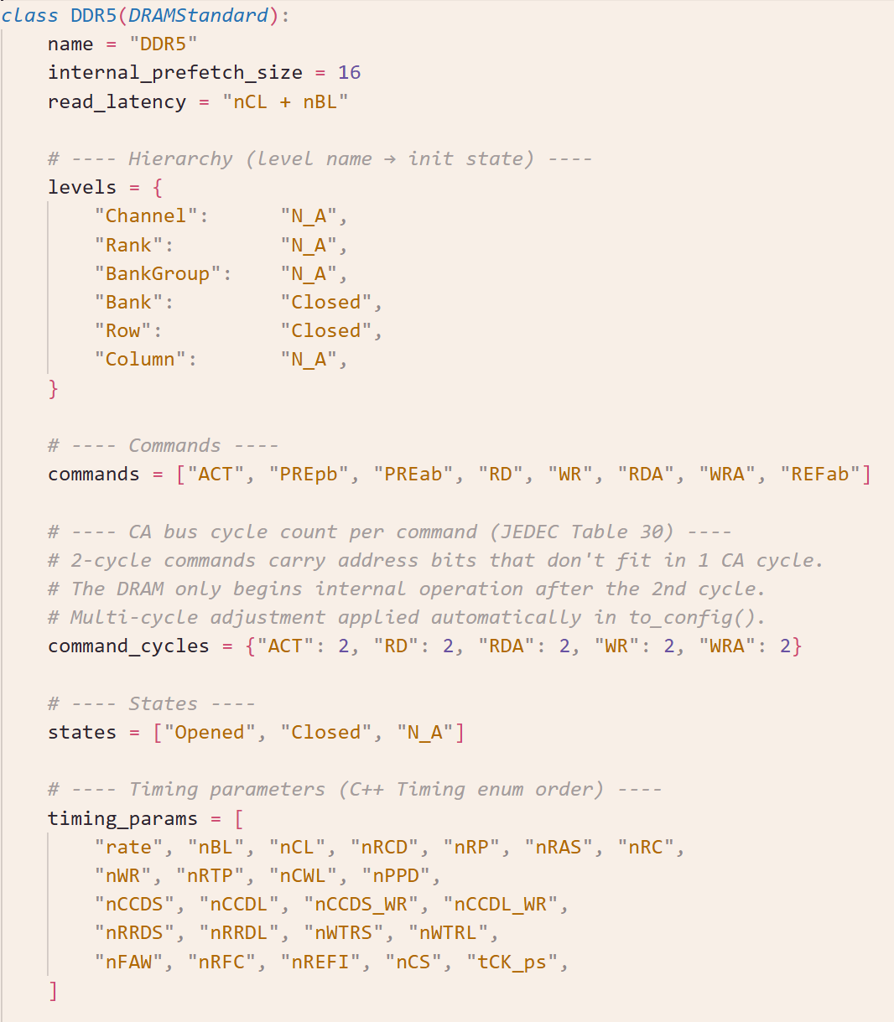
QoL Improvements (III)
DRAM Standard Authoring in python
  Replaced verbose and hacky C++ DRAM specs in Ramulator 2.0 with much cleaner python scripts
  Flexible authoring of DRAM organization, commands, and timings, etc. thanks to the scriptibility of Python
  Code generation utility automatically generates C++
  DRAM specs that Ramulator 2’s internal modeling and simulation engine recognizes

Slide 57
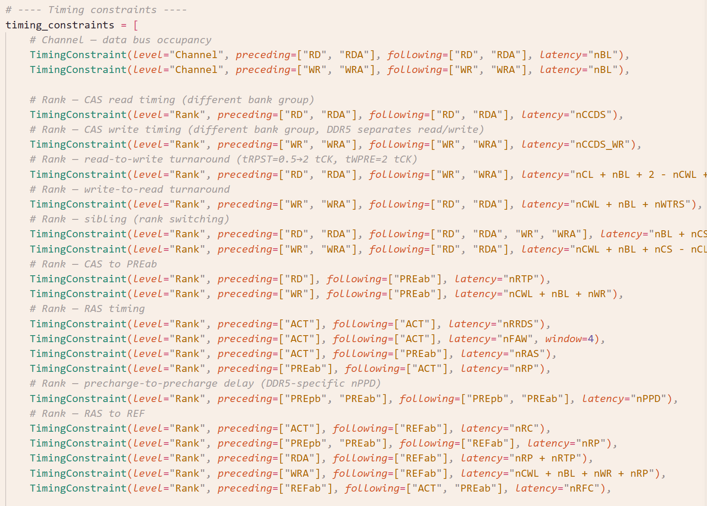
QoL Improvements (III)
DRAM Standard Authoring in python
  Replaced verbose and hacky C++ DRAM specs in Ramulator 2.0 with much cleaner python scripts
  Flexible authoring of DRAM organization, commands, and timings, etc. thanks to the scriptibility of Python
  Code generation utility automatically generates C++
  DRAM specs that Ramulator 2’s internal modeling and simulation engine recognizes

Slide 58
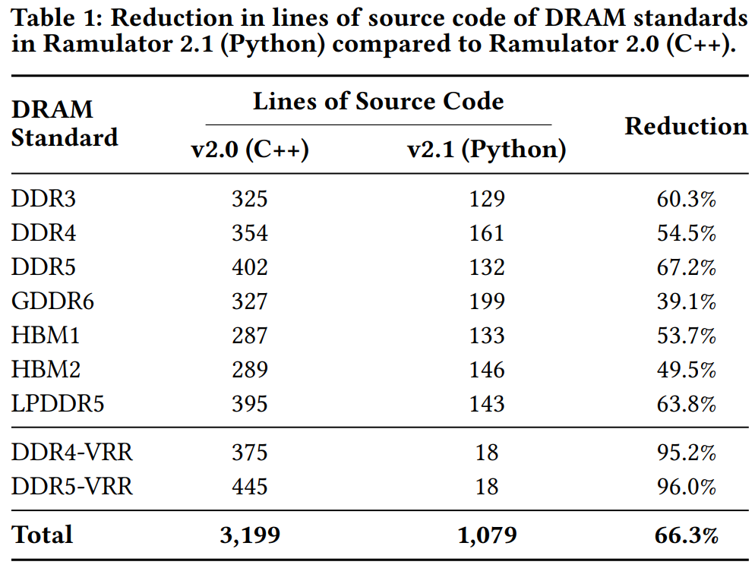
QoL Improvements (IV)
DRAM Standard Authoring in python
  Significant reduction in lines of source code

Slide 59
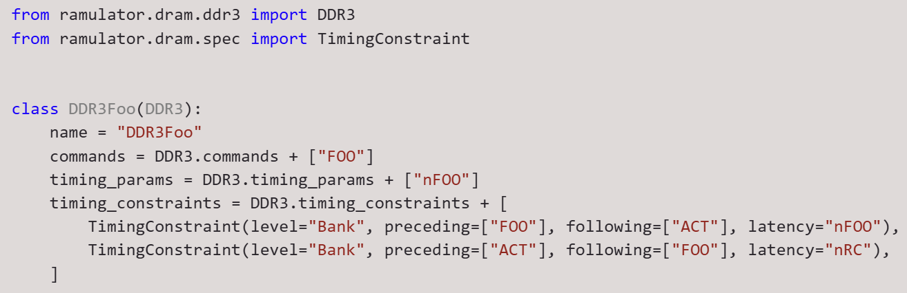
QoL Improvements (V)
DRAM Standard Authoring in python
  Python scripting enables easy extension of DRAM standards by just adding what is new (i.e., no duplication of base DRAM code)
    Inherit the base DRAM standard
    Append just the new commands, timings, etc. to those of the base DRAM standard

Slide 60
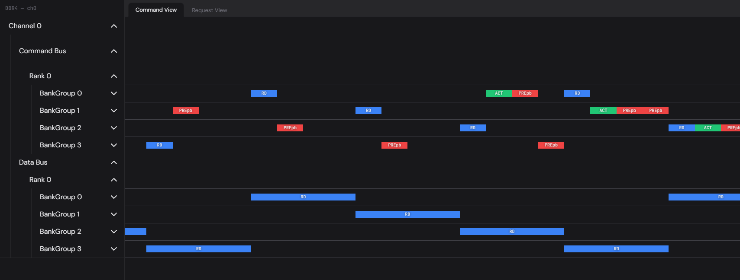
QoL Improvements (III)
Web-Based Interactive DRAM Trace Visualizer
  Supports both offline (read dumped trace file) and online (from a running simulation) visualization
  Inspect memory requests and DRAM commands for performance analysis & debugging (e.g., timing violation)
    Many convenient and QoL features WIP
  Real-time interactive rendering (tested w/ a 300MB+ trace)

Slide 61
Contribute to Ramulator 2.1 (I)
Released on Github (current tag v2.1.0)
  https://github.com/CMU-SAFARI/ramulator2/
  Please checkout v2.1 and let us know if you encounter any issues!
    We will regularly address issues and check PRs
  Earlier v2.0a version is archived at legacy/v2.0a
How to contribute to Ramulator 2.1
  Use it, report any issue/feedback you have on Github
  Add new features and components
  Add more testcases
  …
Check our detailed README and rich in-source documentation on using, extending, and integrating Ramulator 2.1

Slide 62
Contribute to Ramulator 2.1 (II)
Example directions of contributions
  Better timing presets of DRAM standards
    Some of the DRAM timings are our best effort “guesstimates”
    We welcome your more accurate set of timings w/o breaking NDA
  More DRAM request scheduling techniques
  More DRAM read disturbance mitigation techniques
    Make use of controller plugins and scheduler filters
  More intelligent scheduling of refresh
    Refresh postponing & pull-in
    Dynamic choice of REFab/sb/pb
  PUD/PNM modeling
  More integration with other simulators
Please open an Issue/Discussion first to coordinate with potential internal development!

Slide 63
Acknowledgements
Contributors (growing)
  Haocong Luo
  Nisa Bostancı
  Ataberk Olgun
  Maria Makeenkova
  Ziad Malik
  Ipek Akdeniz
  Kislay Arya
  Roman Hoffmann
  Wonhyuk Yang
  @jiegec
  Julien Eudine
  Sangjae Park
  …
Join the list!

