Slide 1






PuDGhost
Experimental Analysis of Computation Result Corruption in Processing-using-DRAM Operations on Real DRAM Chips and Implications for Future Systems
Daichi Tokuda
I. E. Yuksel T. Kubo A. Olgun H. Luo
F. N. Bostanci J. Wang A. G. Yağlıkçı
S. Takamaeda-Yamazaki O. Mutlu
Notes:
I will present PuDGhost: Experimental Analysis of Computation Result Corruption in Processing-using-DRAM Operations on Real DRAM Chips and Implications for Future Systems.

Slide 2
Executive Summary
Motivation: Processing-using-DRAM (PuD) alleviates data movement bottlenecks by performing computation within DRAM
PuD activates multiple DRAM rows simultaneously (SiMRA) to compute in parallel across columns
Ideally, each column’s result is determined solely by the activated cells used as operands
Problem: No prior work studies how data not intended to participate in PuD operations (non-operand data) affects PuD reliability
Experimental Study: 96 off-the-shelf DDR4 chips to study PuDGhost, interference from non-operand data that can corrupt PuD operations
Non-activated rows affect SiMRA outputs by up to 10%
Concurrently computing columns affects SiMRA outputs by up to 48%
Mitigation: We propose robust column screenings that account for PuDGhost Our solutions provide 413× lower GEMV NMSE vs. PuDGhost-unaware systems
Notes:
Let me give you a quick overview of our work.
[CLICK]
Processing-using-DRAM, or PuD, is a promising paradigm that alleviates data movement bottlenecks by performing computation within DRAM.
PuD activates multiple DRAM rows simultaneously, called SiMRA, to compute in parallel across columns.
Ideally, each column's result is determined solely by the activated cells used as operands.
[CLICK]
However, no prior work studies how data not intended to participate in PuD operations—thta is non-operand data — affects PuD reliability.
[CLICK]
We characterize 96 off-the-shelf DDR4 chips to study
PuDGhost, an interference phenomenon where non-operand data corrupts PuD operations.
We find two major results. First, non-activated rows affect SiMRA outputs by up to 10%. Second, concurrently computing columns affect SiMRA outputs by up to 48%.
[CLICK]
To address PuDGhost, we propose robust column screening techniques.
Our solutions provide around 400 times lower matrix-vector multiplication error compared to PuDGhost-unaware systems.

Slide 3
Outline
Background
Problem & Goal
Testing Infrastructure & Methodology
Interference from Non-Activated Rows
Interference from Concurrently Computing Columns
Mitigating PuDGhost
Conclusion
Notes:
Here is the outline of our talk.

Slide 4
Outline
Background
Problem & Goal
Testing Infrastructure & Methodology
Interference from Non-Activated Rows
Interference from Concurrently Computing Columns
Mitigating PuDGhost
Conclusion
Notes:
I will start with the background of DRAM and Processing-using-DRAM.

Slide 5

DRAM Organization
DRAM Module
DRAM
Chip
Subarray
DRAM Cell
Bank
…
Wordline
Chip I/O
Row Decoder
DRAM Row
Bitline
…
Sense Amps.
DRAM Chip
DRAM Bank
DRAM Subarray
Notes:
DRAM is used as the main memory in many computing systems.
[CLICK] A DRAM module consists of multiple DRAM chips.
[CLICK] Each chip contains multiple banks.
[CLICK] Each bank is composed of multiple subarrays and sense amplifiers.
[CLICK] And within each subarray, there is a two-dimensional array of DRAM cells.
Each cell stores one bit of data as charge in a capacitor.
[CLICK] These cells are organized into rows that are selected using wordlines.
[CLICK] And cells in the same column are connected to a sense amplifier through a shared bitline.

Slide 6
DRAM Operation
DRAM Subarray
1
ACTIVATE (ACT):
Fetch the row’s content
into the sense amplifiers
2
Column Access (RD/WR):
Read/Write the target
column and drive to I/O
Sense
Amplifiers
3
PRECHARGE (PRE):
Prepare the bank
for a new ACTIVATE
I/O Circuitry
Notes:
Data is internally accessed in a row granularity.
To access data,
[CLICK] the memory controller first needs to activate the row
and fetch the row’s content into the sense amplifiers
[CLICK] Then, column accesses are serviced from the sense amplifiers
[CLICK] Finally, the subarray needs to be precharged to get ready for the next row activation

Slide 7

Data Movement Bottleneck
Today’s computing systems are processor centric
All data is processed in the processor
Computing Unit
(CPU, GPU, FPGA, Accelerator)
High
Data Movement
Main Memory (DRAM)
More than 60% of the total system energy is spent on
data movement¹
Notes:
Until now, DRAM is just used as a storage device.
Today's computing systems are processor-centric, meaning all data must be moved from DRAM to the computing units for computation.
(This data movement between DRAM and the processor has become a major bottleneck.)
[CLICK]
Prior work shows that more than 60% of the total system energy is spent on this data movement,
(highlighting the need for a new computing paradigm) (that can reduce this overhead.)

Slide 8
Processing-using-DRAM (PuD)
Processing-using-DRAM (PuD) uses the analog operational principles of DRAM cells to perform computation
PuD alleviates the frequent data movement between main memory and computing units
Computing Unit
(CPU, GPU, FPGA, Accelerator)
Low
Data Movement
Main Memory (DRAM)
Notes:
To address this challenge, Processing-using-DRAM repurposes DRAM from a storage device to a computation device.
PuD leverages the analog operational principles of DRAM cells to perform computation, directly within DRAM,
(alleviating the frequent data movement between main memory and computing units.)

Slide 9
Simultaneous Multiple-Row Activation (SiMRA)
Simultaneously activating X rows in a subarray enables
a majority-of-X operation (MAJX)
Notes:
The core computational capability of PuD relies on Simultaneous Multiple-Row Activation, or SiMRA.
Simultaneously activating X rows within a subarray
enables a majority-of-X operation,

Slide 10
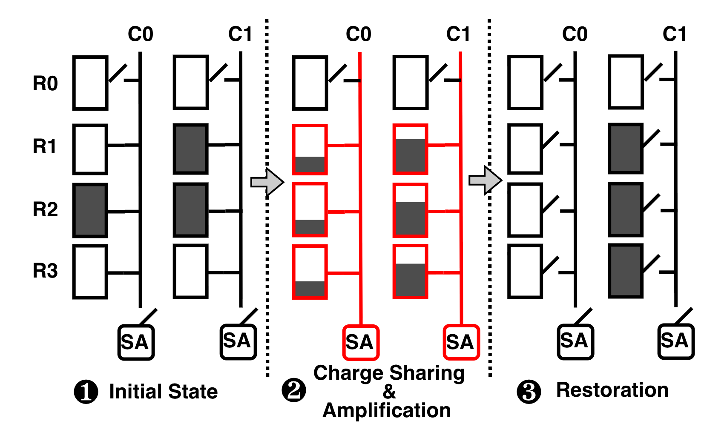
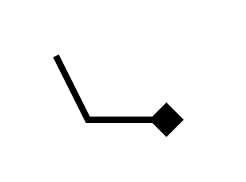
Simultaneous Multiple-Row Activation (SiMRA)
Simultaneously activating X rows in a subarray enables
a majority-of-X operation (MAJX)
DRAM Column
DRAM Cell
DRAM Row
Sense
Amplifier
Notes:
In this figure,
[CLICK] each rectangle represents a DRAM cell
[CLICK] Here we have four rows (Row 0, R1, R2, and R3).
[CLICK] and two columns
[CLICK] And, cells in each column share a sense amplifier

Slide 11
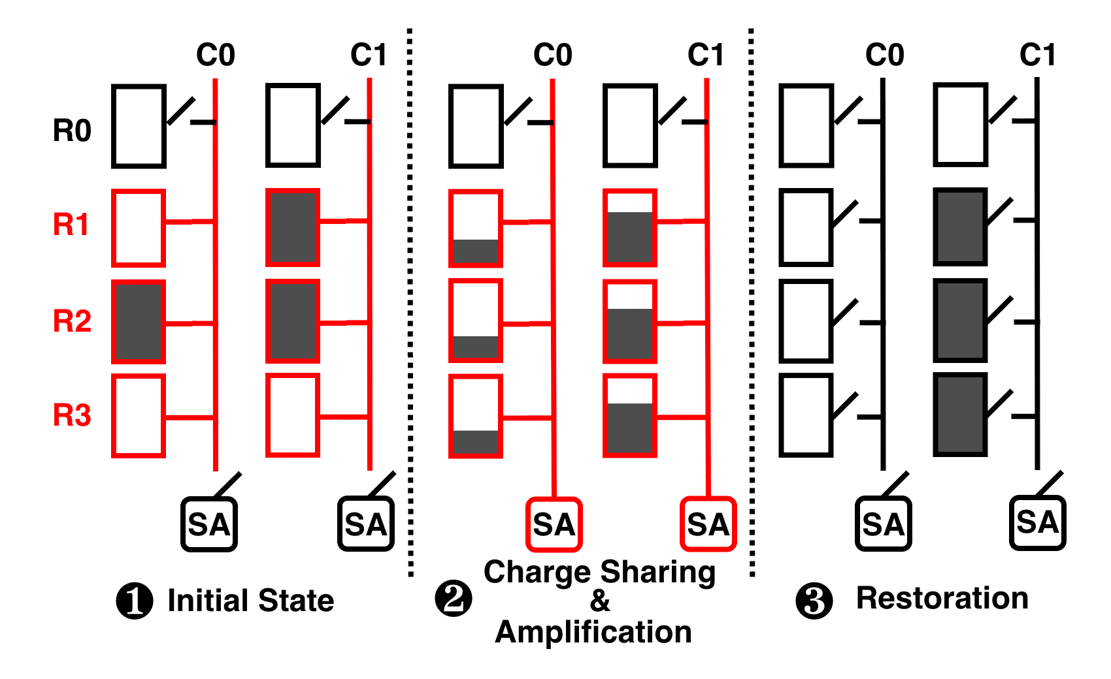
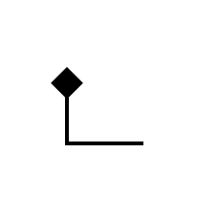
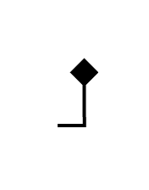
Simultaneous Multiple-Row Activation (SiMRA)
Simultaneously activating X rows in a subarray enables
a majority-of-X operation (MAJX)
Operands
for C1
Operands
for C0
Notes:
In this figure, PuD activates three rows simultaneously (Row 1,2 ,and 3)
so that Each column performs a MAJ3 operation
[CLICK]
For example, these three highlighted cells in red store the operand data for Column 0's computation.
[CLICK]
and these three cells in blue store the operand data for Column 1's computation.

Slide 12
Simultaneous Multiple-Row Activation (SiMRA)
Simultaneously activating X rows in a subarray enables
a majority-of-X operation (MAJX)
Operands
for C0
Notes:
[CLICK]

Slide 13
Simultaneous Multiple-Row Activation (SiMRA)
Simultaneously activating X rows in a subarray enables
a majority-of-X operation (MAJX)
Enabling charge sharing
across the activated cells
in each column
through the shared bitline
Operands
for C0
Notes:
When SiMRA starts,
[CLICK]
[CLICK]
it enables charge sharing across the activated cells in each column through the shared bitline.

Slide 14
Simultaneous Multiple-Row Activation (SiMRA)
Simultaneously activating X rows in a subarray enables
a majority-of-X operation (MAJX)
Operands
for C0
Notes:
[CLICK]

Slide 15
Simultaneous Multiple-Row Activation (SiMRA)
Simultaneously activating X rows in a subarray enables
a majority-of-X operation (MAJX)
Each column
performs
MAJ3
Operands
for C0
Notes:
Then,
[CLICK][CLICK]
the sense amplifier kicks in and samples the result.
As a result, each column performs MAJ3 over its own operand data.
(For example, if a column's operand data is 0, 1, and 0, the MAJ3 result is 0.)

Slide 16

SiMRA in COTS DRAM Chips
Activating two rows in quick succession
in COTS DRAM chips simultaneously activates multiple rows in a subarray
36ns
14ns
ACT Row A
PRE
ACT Row B
<3ns
<3ns
Subarray X
ACT
Row A
…
ACT
Row B
DRAM Bank
Notes:
Interestingly, recent work demonstrates that commodity off-the-shelf DRAM chips can simultaneously activate multiple rows up to 32 rows.
[CLICK] The key observation is activating two rows in quick succession can simultaneously activate many rows in a subarray
[CLICK] In this example Row A and Row B is in Subarray X.
[CLICK] When we respect to the timing parameters between ACT and PRE and PRE and ACT
[CLICK] we activate a single row at a time.
[CLICK] However, when we greatly violate these timing parameters,
we can activate many rows at once in the same subarray

Slide 17
Outline
Background
Problem & Goal
Testing Infrastructure & Methodology
Interference from Non-Activated Rows
Interference from Concurrently Computing Columns
Mitigating PuDGhost
Conclusion
Notes:
Now, let me move on to the problem and goal of our work.

Slide 18
Problem
A Key Expectation of PuD:
Each column’s SiMRA result
depends solely on its own operand data
Our Hypothesis:
This key expectation of PuD might be challenged
by ongoing DRAM density scaling
Does this key expectation
hold on real DRAM chips?
Unfortunately, no.
Notes:
[CLICK]
For PuD to function reliably, there is a key expectation:
each column's computation result, namely each column's SiMRA result depends solely on its own operand data, (isolated from any other data.)
[CLICK]
However, we hypothesize that this key expectation might be challenged by ongoing DRAM density scaling,
It is because with rapid DRAM scaling and denser cell arrays, even regular DRAM operations become susceptible to interference from neighboring cells
[CLICK]
Therefore,our key reseach question is:
Does this key expectation of PuD hold on real DRAM chips?
[CLICK]
The answer is unfortunately, no.

Slide 19
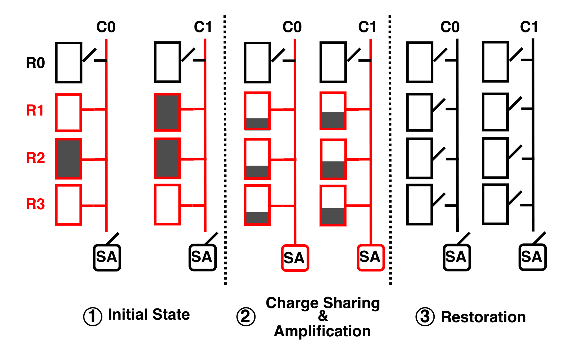
What is PuDGhost?
Notes:
In this work, we are the first to reveal an interference phenomenon that corrupts PuD computations on real DRAM chips, which we call PuDGhost.

Slide 20
What is PuDGhost?
Interference from
Non-Activated Rows
1
1
Notes:
[CLICK][CLICK]
The first source of interference is
[CLICK]
[CLIKC][CLICK]
data stored in non-activated rows.

Slide 21
What is PuDGhost?
Interference from
Non-Activated Rows
Other Columns
1
2
1
2
Notes:
[CLICK]
The second source is
[CLICK] [CLICK]
data stored in other columns that concurrently perform computations under the same SiMRA operation.

Slide 22

What is PuDGhost?
Violate Isolation of
Each Computation
Interference from
Non-Activated Rows
Other Columns
Erroneous
Outputs
1
2
1
Computation
Error
induced by
PuDGhost
2
Notes:
[CLICK]
Due to this interference from non-operand data,
[CLICK][CLICK]
PuD computations can produce erroneous outputs.
[CLICK]
(Therefore, PuDGhost violates the ideal picture of PuD computation and threatens the robustness of PuD systems.)

Slide 23
Outline
Background
Problem & Goal
Testing Infrastructure & Methodology
Interference from Non-Activated Rows
Interference from Concurrently Computing Columns
Mitigating PuDGhost
Conclusion
Notes:
Now, let me describe our testing infrastructure for characterizing PuDGhost on real DRAM chips.

Slide 24
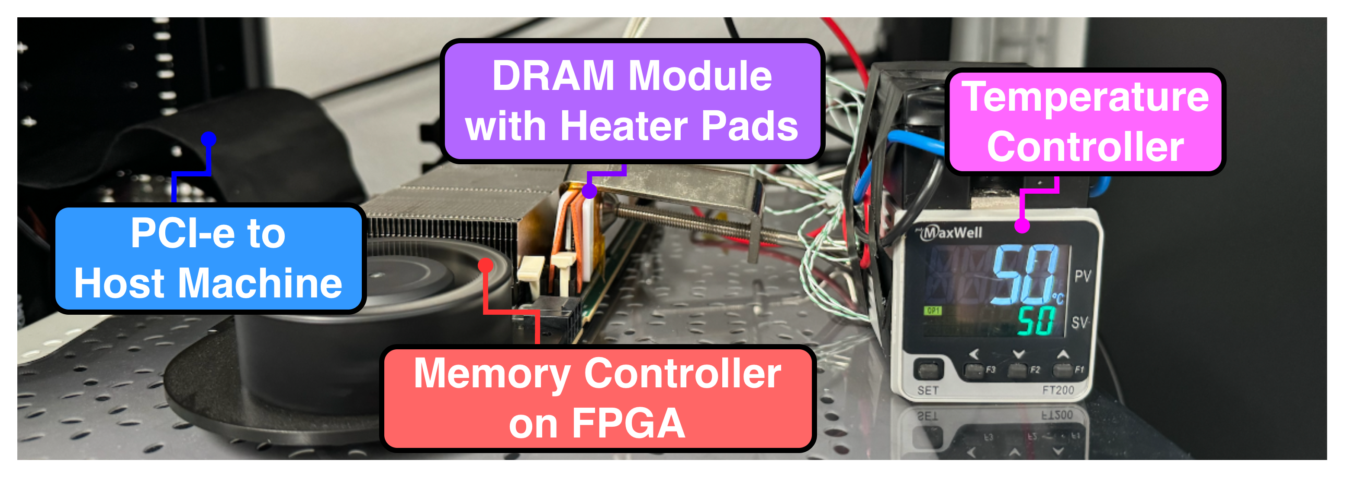
DRAM Bender: DRAM Testing Infrastructure
Fine-grained control over DRAM commands, timings,
and temperature
Notes:
We use DRAM Bender (as our testing infrastructure), which provides fine-grained control over DRAM commands, timings, and temperature.
(This allows us to precisely configure SiMRA operations and observe their behavior under controlled conditions.)

Slide 25
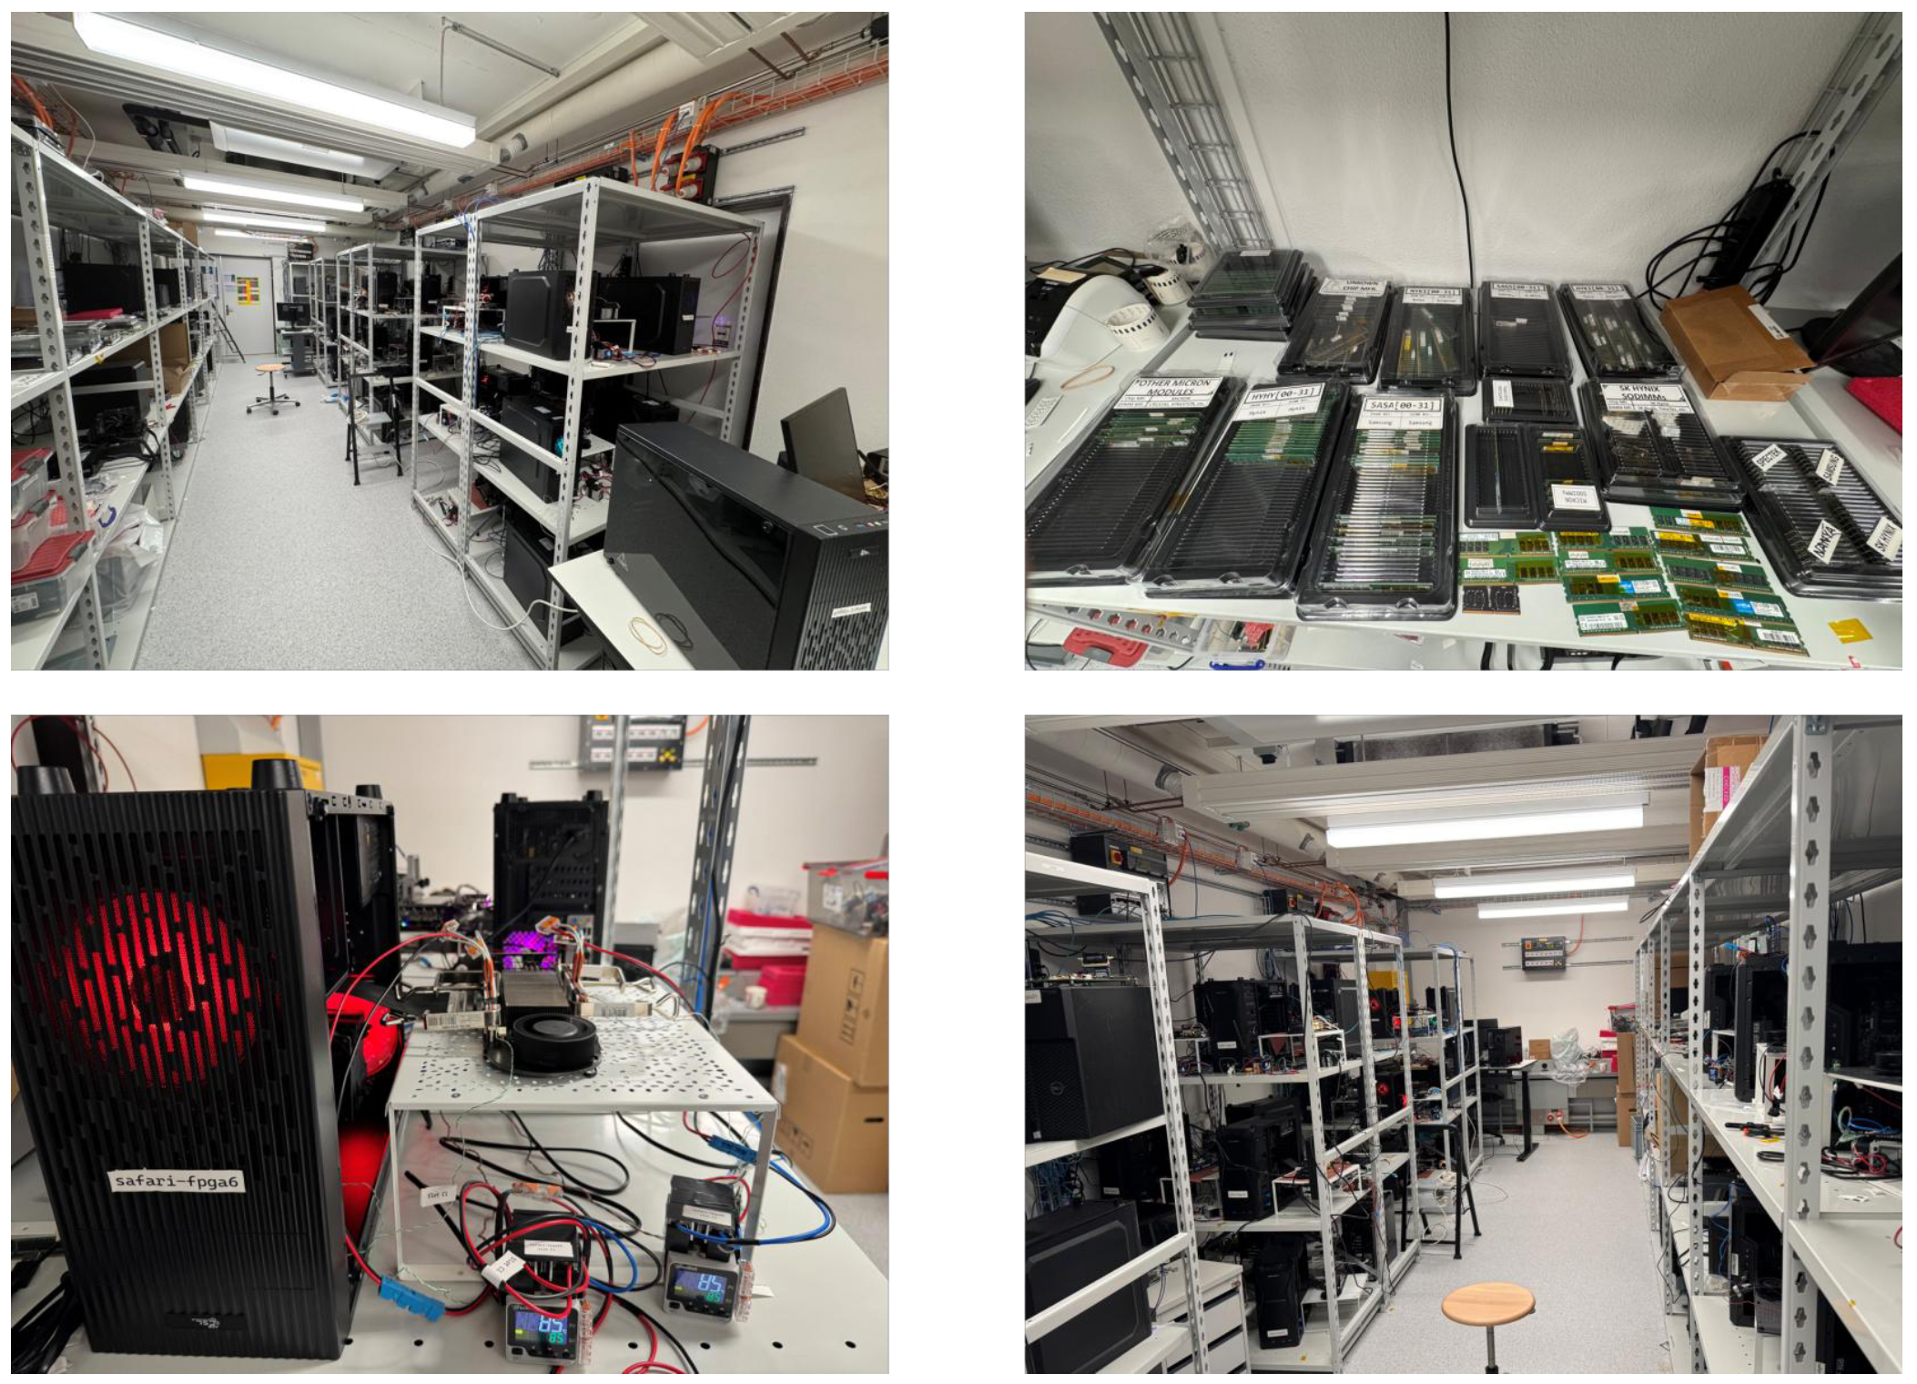
Laboratory for Understanding Memory
Notes:
(Our experiments in this work are conducted in our laboratory
This laboratory is equipped with dozens of testing machines and FPGA boards, covering a wide variety of DRAM modules. )
Now we test a wide variety of DRAM modules in our laboratory

Slide 26
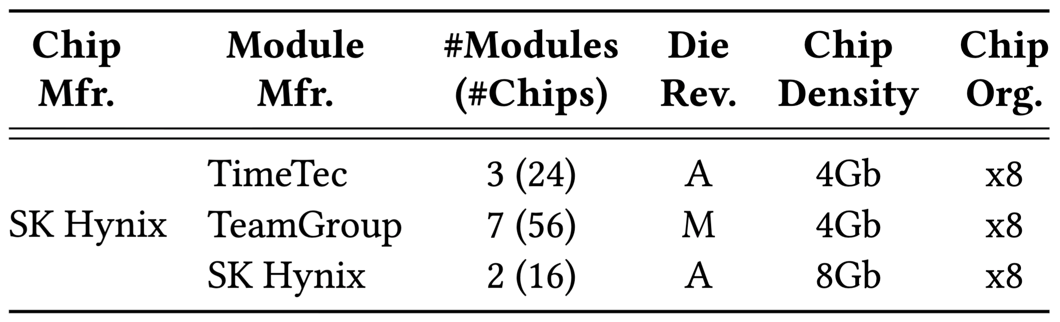
DRAM Chips Tested
96 DDR4 chips from SK Hynix
Covering three different die-revision and chip-density pairs
Notes:
We test 96 DDR4 chips from SK Hynix, covering three different die revision and chip density pairs.
(As prior work reports, only SK Hynix chips among commodity DRAM can perform SiMRA.)

Slide 27
Characterization Methodology - I
Number of Simultaneously Activated Rows:
  2 / 4 / 8 / 16 / 32 Rows
Tested Instances:
  We select three subarrays for each bank and each module
How to Quantify Interference from Non-Operand Data:
We vary data not intended to participate in SiMRA
We then measure the resulting change in SiMRA outputs
Notes:
(In our characterization,) we test SiMRA with 2, 4, 8, 16, and 32 SiMRA rows.
For each bank and each module, we select three subarrays as target subarrays for our experiments.
[CLICK][CLICK]
Now, the question is how to quantify this interference.
[CLICK]
Our key approach is to vary data not intended to participate in SiMRA
[CLICK]
and measure the resulting change in SiMRA outputs.

Slide 28
Outline
Background
Problem & Goal
Testing Infrastructure & Methodology
Interference from Non-Activated Rows
Interference from Concurrently Computing Columns
Mitigating PuDGhost
Conclusion
Notes:
Let us now look at the detailed methodology for interference from non-activated rows.

Slide 29
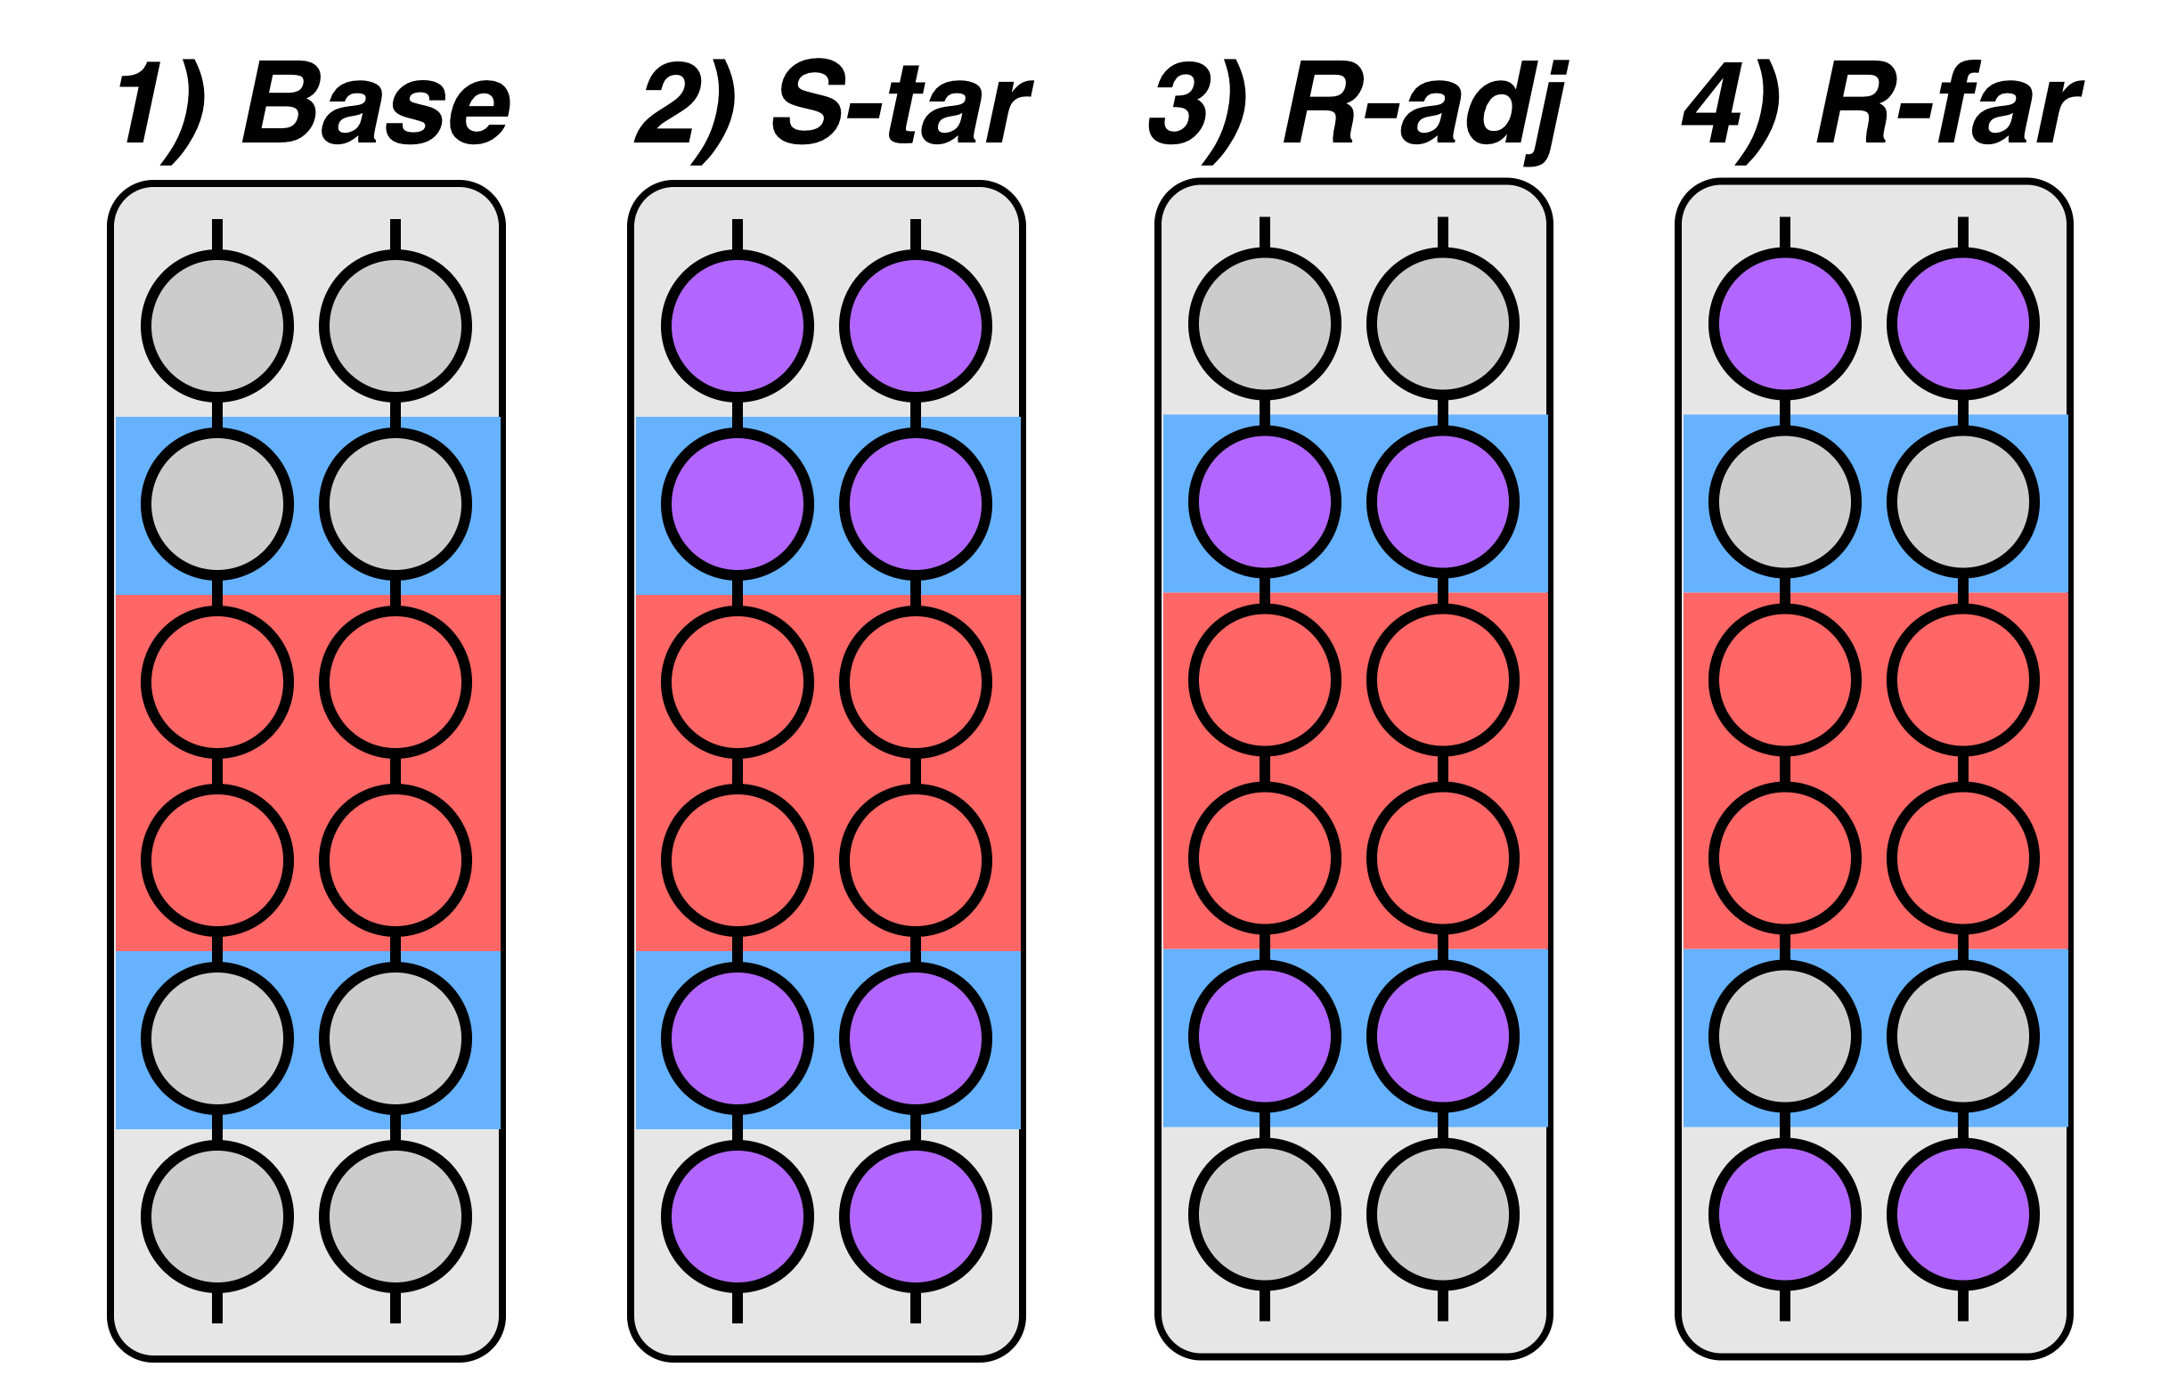
Interference from Non-Activated Rows
Main metric (p_{o1}): fraction of output bits across all columns that equal logic-1 when SiMRA is executed with random inputs
Controlled cells: cells whose data pattern is intentionally varied to observe how SiMRA outputs change
We compare four configurations
Notes:
[CLICK]
Our main metric is p_o1, the fraction of output bits across all columns
that equal logic-1
when SiMRA is executed with random inputs.
[CLICK]
We define controlled cells as cells whose data pattern is intentionally varied to observe how SiMRA outputs change.
By varying the data in these cells, we quantify how these controlled cells affect SiMRA outputs
[CLICK]
[CLICK]
In order to identify which non-activated rows affect SiMRA outputs,
we compare four configurations
(that differ in which rows are designated as controlled cells.)

Slide 30
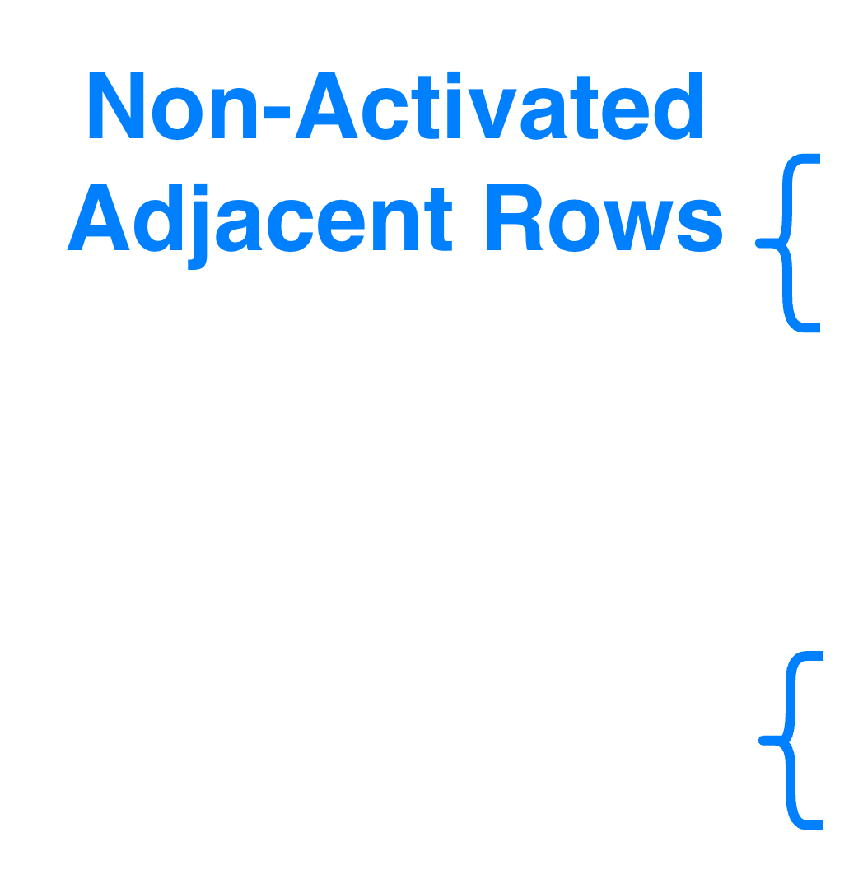
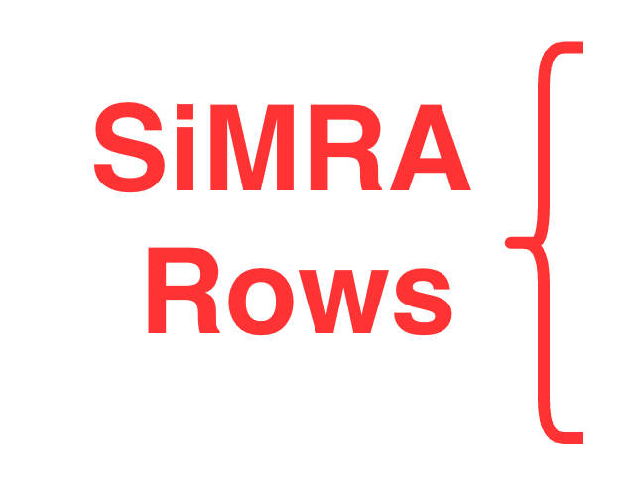
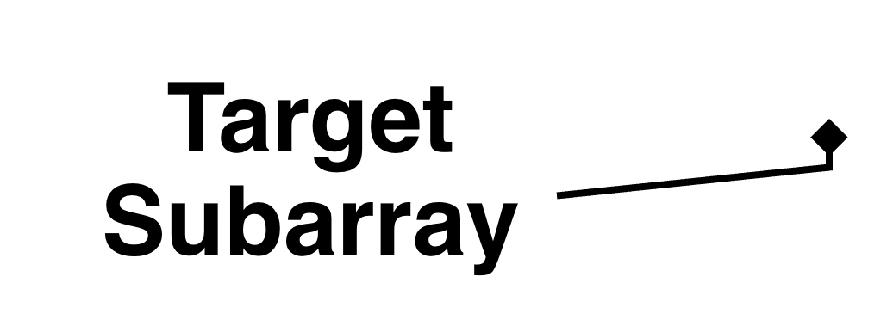
Interference from Non-Activated Rows
Main metric (p_{o1}): fraction of output bits across all columns that equal logic-1 when SiMRA is executed with random inputs
Controlled cells: cells whose data pattern is intentionally varied to observe how SiMRA outputs change
We compare four configurations
Notes:
In this figure,
[CLICK]
the cell array represents the target subarray,
[CLICK]
the red bands represent the SiMRA rows,
[CLICK]
and the blue bands represent non-activated rows that are physically adjacent to the SiMRA rows.

Slide 31
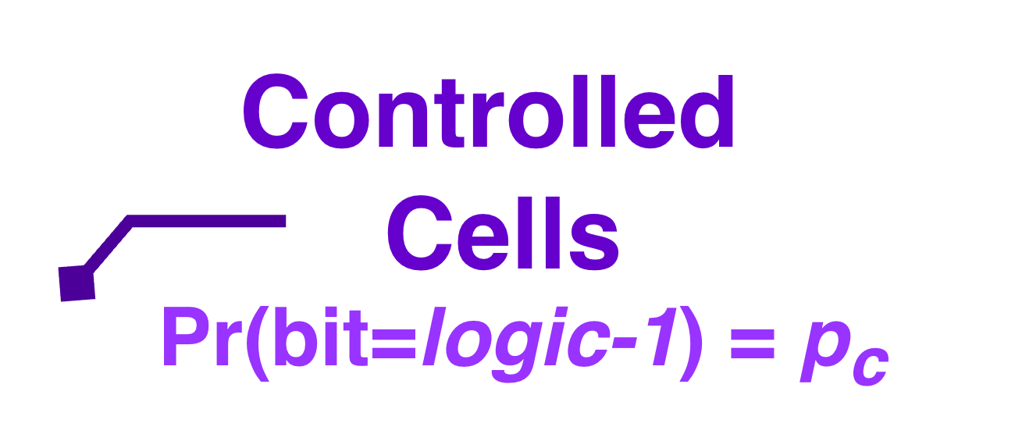
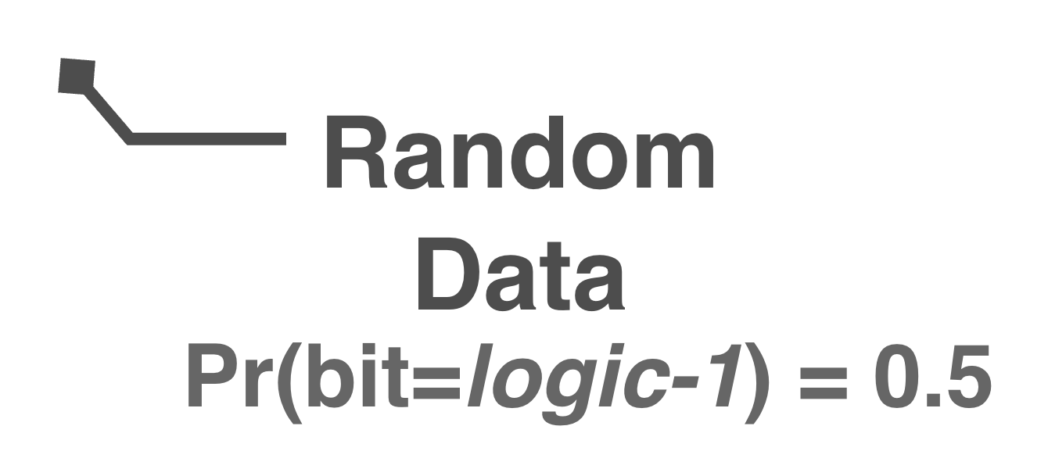
Interference from Non-Activated Rows
Main metric (p_{o1}): fraction of output bits across all columns that equal logic-1 when SiMRA is executed with random inputs
Controlled cells: cells whose data pattern is intentionally varied to observe how SiMRA outputs change
We compare four configurations
Notes:
Among the cells,
[CLICK]
gray ones indicate that they are initialized with fully random data,
[CLICK]
while purple ones represent controlled cells, whose data pattern we intentionally vary

Slide 32
Interference from Non-Activated Rows
Main metric (p_{o1}): fraction of output bits across all columns that equal logic-1 when SiMRA is executed with random inputs
Controlled cells: cells whose data pattern is intentionally varied to observe how SiMRA outputs change
We compare four configurations
1) Base fills all rows
with random data,
(with no controlled cells)
Notes:
[CLICK]
For example,
our baseline, Configuration 1 Base, fills all rows with fully random data with no controlled cells.

Slide 33
Interference from Non-Activated Rows
Main metric (p_{o1}): fraction of output bits across all columns that equal logic-1 when SiMRA is executed with random inputs
Controlled cells: cells whose data pattern is intentionally varied to observe how SiMRA outputs change
We compare four configurations
2) S-tar designates all rows except the SiMRA rows
as controlled rows
Notes:
[CLICK]
On the other hand, configuration 2 designates all rows except the SiMRA rows
as controlled rows.

Slide 34
Interference from Non-Activated Rows
Main metric (p_{o1}): fraction of output bits across all columns that equal logic-1 when SiMRA is executed with random inputs
Controlled cells: cells whose data pattern is intentionally varied to observe how SiMRA outputs change
We compare four configurations
3) R-adj designates all
non-activated adjacent rows
as controlled rows
Notes:
[CLICK]
Configuration 3 designates all non-activated adjacent rows
(as controlled rows.)

Slide 35
Interference from Non-Activated Rows
Main metric (p_{o1}): fraction of output bits across all columns that equal logic-1 when SiMRA is executed with random inputs
Controlled cells: cells whose data pattern is intentionally varied to observe how SiMRA outputs change
We compare four configurations
4) R-far designates all rows
except the SiMRA rows and the adjacent rows
as controlled rows
Notes:
[CLICK]
Configuration 4 designates all rows
except the SiMRA rows
and the adjacent rows
(as controlled rows.)

Slide 36
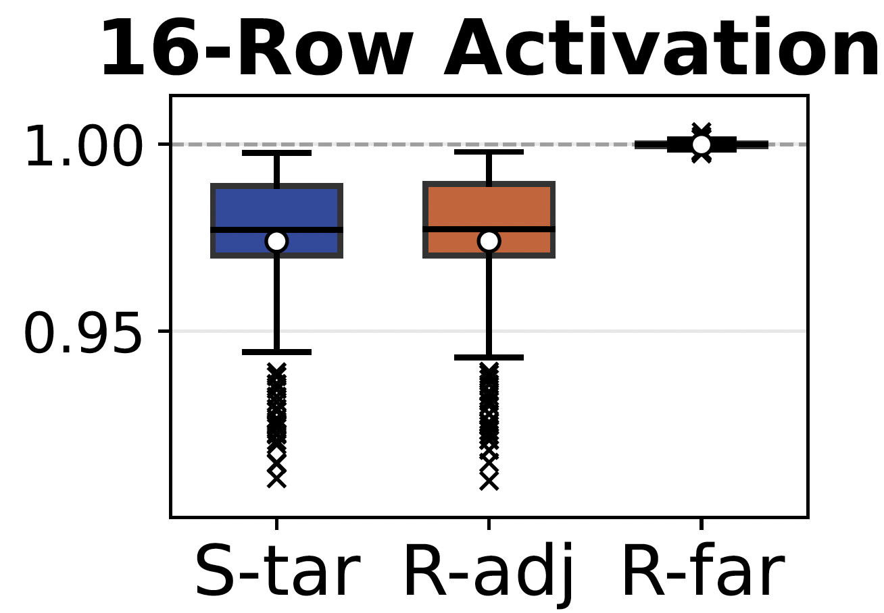

Results: Non-Activated Rows - I
Results: Controlled cells store all zeros
Recall: p_{o1} is the fraction of SiMRA output bits
that equal logic-1
p_{o1} under each configuration normalized to Base
Three different non-baseline configurations
Notes:
Here are the results on real DRAM chips.
First, let us look at the results when all controlled cells store all zeros.
For clarity, we show the results of the 16-row SiMRA case.
[CLICK]
The y-axis shows p_o1 under each configuration, normalized to the Base p_o1.
[CLICK]
Recall that p_o1 is the fraction of output bits that equal logic-1
A normalized p_o1 of 1.0 means no change from the baseline and
Higher normalized p_o1 means SiMRA outputs contain more logic-1
[CLICK]
The x-axis shows the three different non-baseline configurations.

Slide 37
Results: Non-Activated Rows - I
Results: Controlled cells store all zeros
-2%
from Base
Non-activated rows bias SiMRA outputs toward logic-0
when the rows store logic-0
by 2% on average and up to 10%
Notes:
[CLICK]
[CLICK]
Among them, we observe significant deviation from the baseline in two configurations: Configurations 2 and 3.
[CLICK]
In these two configurations,
[CLICK]
p_o1 decreases by 2% on average from the baseline.
[CLICK]
Our key observation is that non-activated rows bias SiMRA outputs toward logic-0 when the rows store logic-0, by 2% on average and up to 10%.

Slide 38
Results: Non-Activated Rows - I
Results: Controlled cells store all zeros
Non-Activated
Adjacent Rows
±~0 %
from Base
Interference from non-activated rows is
highly localized to physically adjacent rows
Notes:
On the other hand,
[CLICK][CLICK]
[CLIOCK]
the remaining one configuration, Configuration 4, shows no significant deviation from the baseline.
[CLICK]
Notably, only in this configuration, controlled cells do not include the non-activated adjacent rows.
This indicates another key observation that interference from non-activated rows is highly localized to physically adjacent rows.

Slide 39
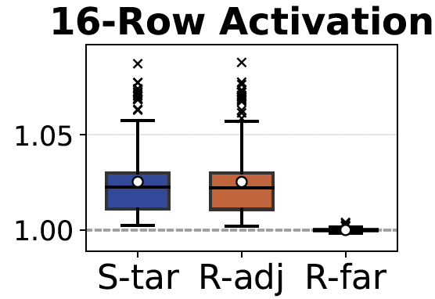
Results: Non-Activated Rows - II
Results: Controlled cells store all ones
+2%
from Base
Non-activated rows bias SiMRA outputs toward logic-1
when the rows store logic-1
by 2% on average and up to 10%
Notes:
Now let us look at the results when all controlled cells store ones.
We observe exactly the opposite effect.
[CLICK] [CLICK]
[CLICK]
Again, only Configurations 2 and 3 show significant deviation from the baseline,
[CLICK]
with p_o1 increasing by 2% on average.
[CLICK]
Our key observation is that non-activated rows bias SiMRA outputs toward logic-1 when the rows store logic-1,
(by 2% on average and up to 10%.)

Slide 40
Results: Non-Activated Rows - II
Results: Controlled cells store all ones
+2%
from Base
Key Takeaway
Non-activated adjacent rows bias SiMRA outputs
toward logic-0 (logic-1) when the rows store logic-0 (logic-1)
Notes:
So, in summary,
[CLICK]
our key takeaway is: non-activated adjacent rows bias SiMRA outputs toward logic-0 when the rows store logic-0, and toward logic-1 when the rows store logic-1.

Slide 41
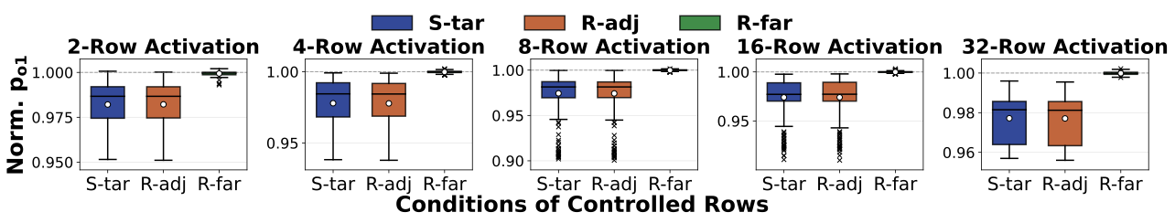
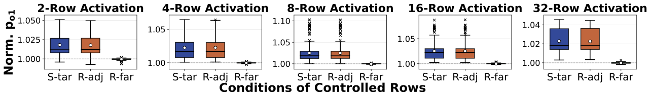
Results: Non-Activated Rows - I & II
We consistently observe the similar trend across all tested SiMRA row counts
Notes:
And
[CLICK][CLICK]
we consistently observe the similar trend across all tested SiMRA row count

Slide 42
Outline
Background
Problem & Goal
Testing Infrastructure & Methodology
Interference from Non-Activated Rows
Interference from Concurrently Computing Columns
Mitigating PuDGhost
Conclusion
Notes:
Next, let us look at the second source of PuDGhost: interference from columns that concurrently perform computations

Slide 43
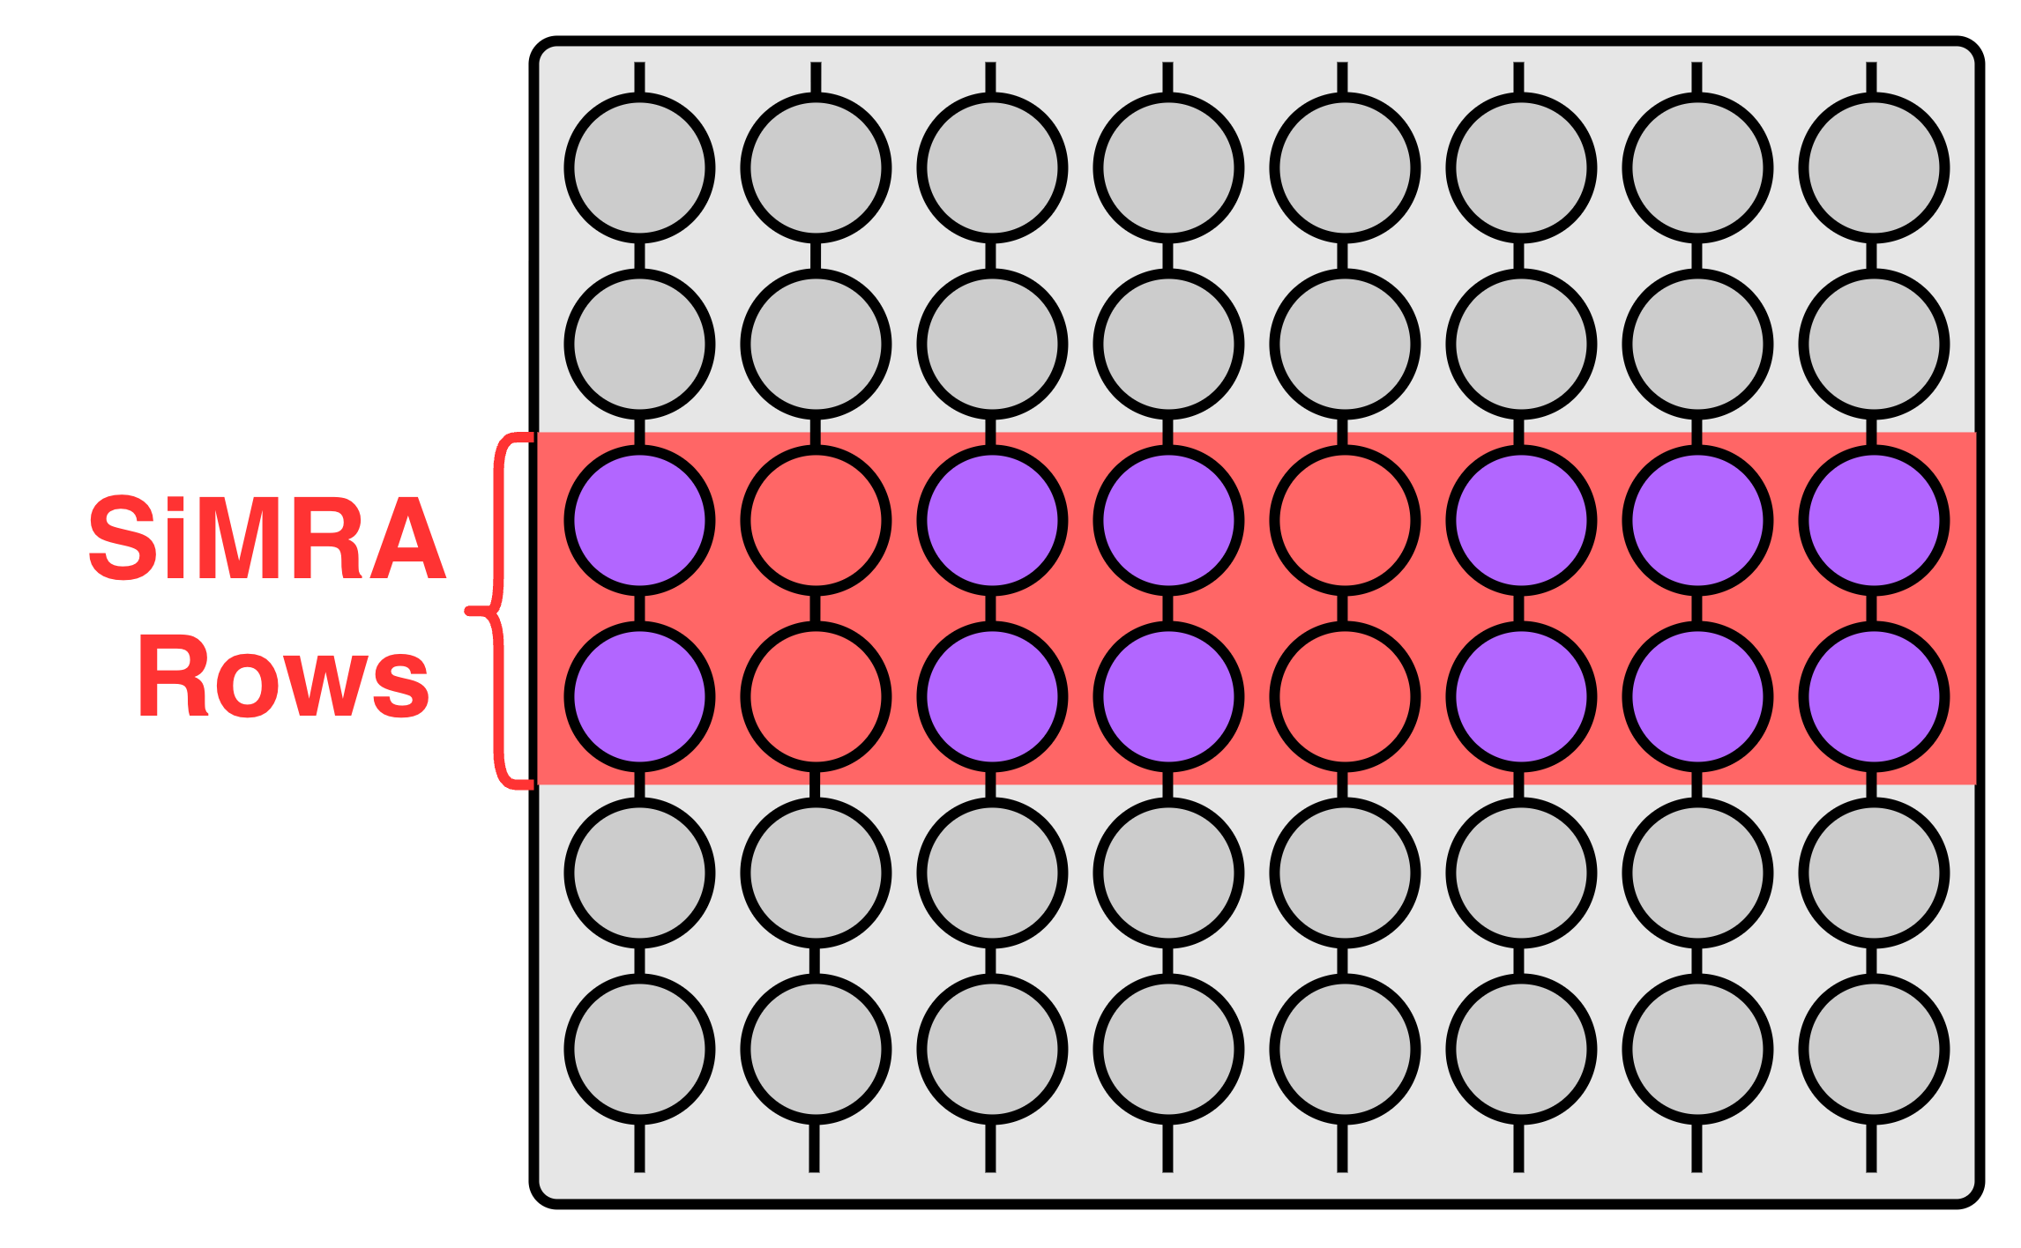
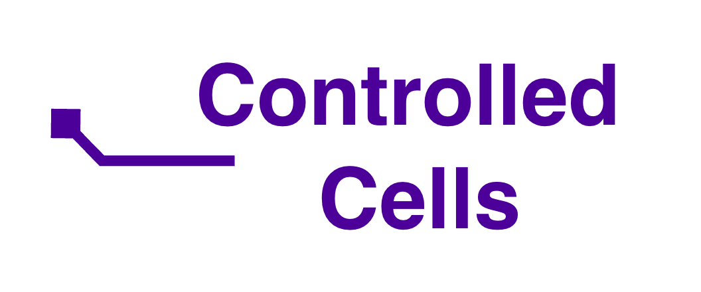
Interference from Concurrently Computing Columns
Target Columns: Randomly Select 1/8th of All Columns
Main metric (p_{o1}): fraction of output bits across target columns that equal logic-1 when SiMRA is executed with random inputs
We sweep the fraction of logic-1 in controlled cells
across {0.0, 0.25, 0.50, 0.75, 1.0}
Baseline
Target Columns
Notes:
(To investigate this), we change the experimental setup as follows
[CLICK]
We randomly select one-eighth of all columns as target columns,
[CLICK]
and the activated cells in the remaining columns serve as controlled cells.
We quantify how the data in these controlled cells affects the SiMRA outputs of the target columns.
[CLICK]
Our main metric, p_o1, is the fraction of SiMRA output bits across target columns that equal logic-1.
[CLICK]
We sweep the fraction of logic-1 in controlled cells across five values: from 0.0 to 1.0.
[CLICK]
We use the fraction of 0.5 as the baseline, where controlled cells store fully random data.

Slide 44
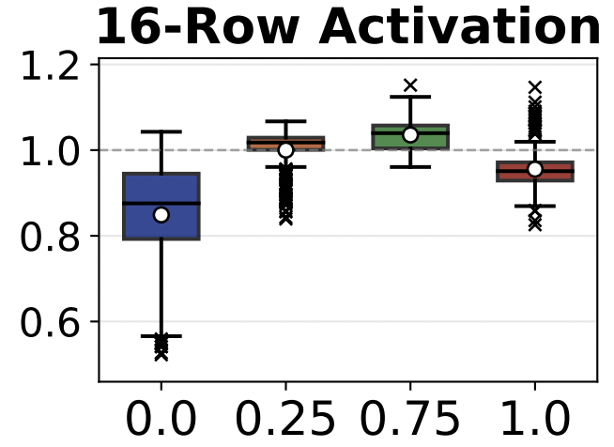
Results: Concurrently Computing Columns
p_{o1} normalized to
the p_{c} = 0.5 baseline
Recall: p_{o1} is the fraction of SiMRA output bits
across target columns
that equal logic-1
Fraction of logic-1
in controlled cells:
{0.0, 0.25, 0.75, 1.0}
Notes:
Here are the results on real DRAM chips
[CLICK]
The y-axis shows p_o1 normalized to the baseline.
[CLICK]
Recall that p_o1 is the fraction of SiMRA output bits across target columns
that equal logic-1.
Higher values mean SiMRA outputs contain more logic-1.
[CLICK]
The x-axis shows the fraction of logic-1 in controlled cells: 0.0, 0.25, 0.75, and 1.0.

Slide 45

Results: Concurrently Computing Columns
p_{o1} normalized to
the p_{c} = 0.5 baseline
Fraction of logic-1
in controlled cells:
{0.0, 0.25, 0.75, 1.0}
Notes:
Looking at the results,
[CLICK]
The normalized p_o1 exhibits an inverted-U pattern, showing non-monotonic behavior as the fraction of logic-1 in controlled cells increases.

Slide 46
Results: Concurrently Computing Columns
p_{o1} normalized to
the p_{c} = 0.5 baseline
Fraction of logic-1
in controlled cells:
{0.0, 0.25, 0.75, 1.0}
Columns that concurrently perform computations affect SiMRA output by 6% on average and up to 48%
Notes:
[CLICK]
Our key observation is that columns that concurrently perform computations affect SiMRA output by 6% on average and up to 48%.

Slide 47
Results: Concurrently Computing Columns
p_{o1} normalized to
the p_{c} = 0.5 baseline
Fraction of logic-1
in controlled cells:
{0.0, 0.25, 0.75, 1.0}
Key Takeaway
Concurrently computing columns more strongly affect SiMRA outputs than adjacent rows
Notes:
considering that adjacent-row interference is around 2% on average,
[CLICK]
Our key takeaway is: concurrently computing columns more strongly affect SiMRA outputs than adjacent rows

Slide 48
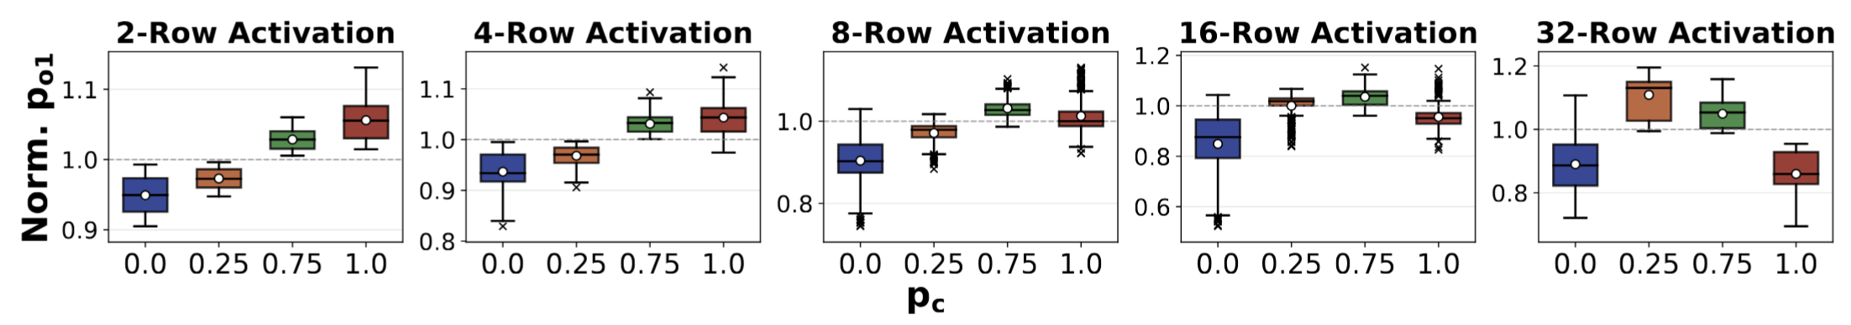
Results: Concurrently Computing Columns
We consistently observe the substantial interference
across all tested SiMRA row counts
Notes:
And
[CLICK]
We consistently observe the substantial interference across all tested SiMRA row counts

Slide 49
Outline
Background
Problem & Goal
Testing Infrastructure & Methodology
Interference from Non-Activated Rows
Interference from Concurrently Computing Columns
Mitigating PuDGhost
Conclusion
Notes:
Now let me move on to mitigating PuDGhost.

Slide 50
Reliability Challenges Induced by Non-Operand Data
PuDGhost violates a key expectation of PuD: each column’s computation should depend solely on its own operand data
Key Challenge: PuDGhost-induced Interference is Dynamic
Columns that appear reliable under one non-operand data configuration may produce errors under another
Notes:
[CLICK]
Our results show that PuDGhost violates a key expectation of PuD: (that each column's computation should depend solely on its own operand data.)
[CLICK]
[CLICK]
A key challenge here is that PuDGhost-induced interference is dynamic.
Namely, Non-operand data, can change during execution.
[CLICK]
This means that columns that appear reliable under one non-operand data configuration
may later produce errors under another.

Slide 51
Challenges of Naive Column Screening
Column Screening:
  Post-manufacturing screening identifies reliable columns by testing with large sets of random inputs
  Only identified reliable columns are used during execution
Screening that does not account for PuDGhost can fail:
Columns labeled as reliable during column screening
can later become unreliable during PuD execution
due to dynamic non-operand data
Notes:
To understand and quantify the impact of this challenge, let us consider
column screening, a fundamental approach to handling PuD computation errors.
[CLICK]
Column screening identifies reliable columns through post-manufacturing testing
with large sets of random inputs,
[CLICK]
and only identified reliable columns are used during execution,
(or only modules where all columns qualify as reliable are selected.)
[CLICK]
[CLICK]
However, screening that does not account for PuDGhost can fail.
(Interference from other columns can be addressed
by screening with sufficiently large random input sets. )
This is because, in PuDGhost-unaware systems, columns labeled as reliable during screening can later produce errors due to unpredictable interference from dynamic non-operand data
-------------------------
[CLICK]
However, adjacent-row data during screening may not reflect the actual adjacent-row data during execution.
[CLICK]
(As a result, columns labeled as reliable during screening can later produce errors.)

Slide 52
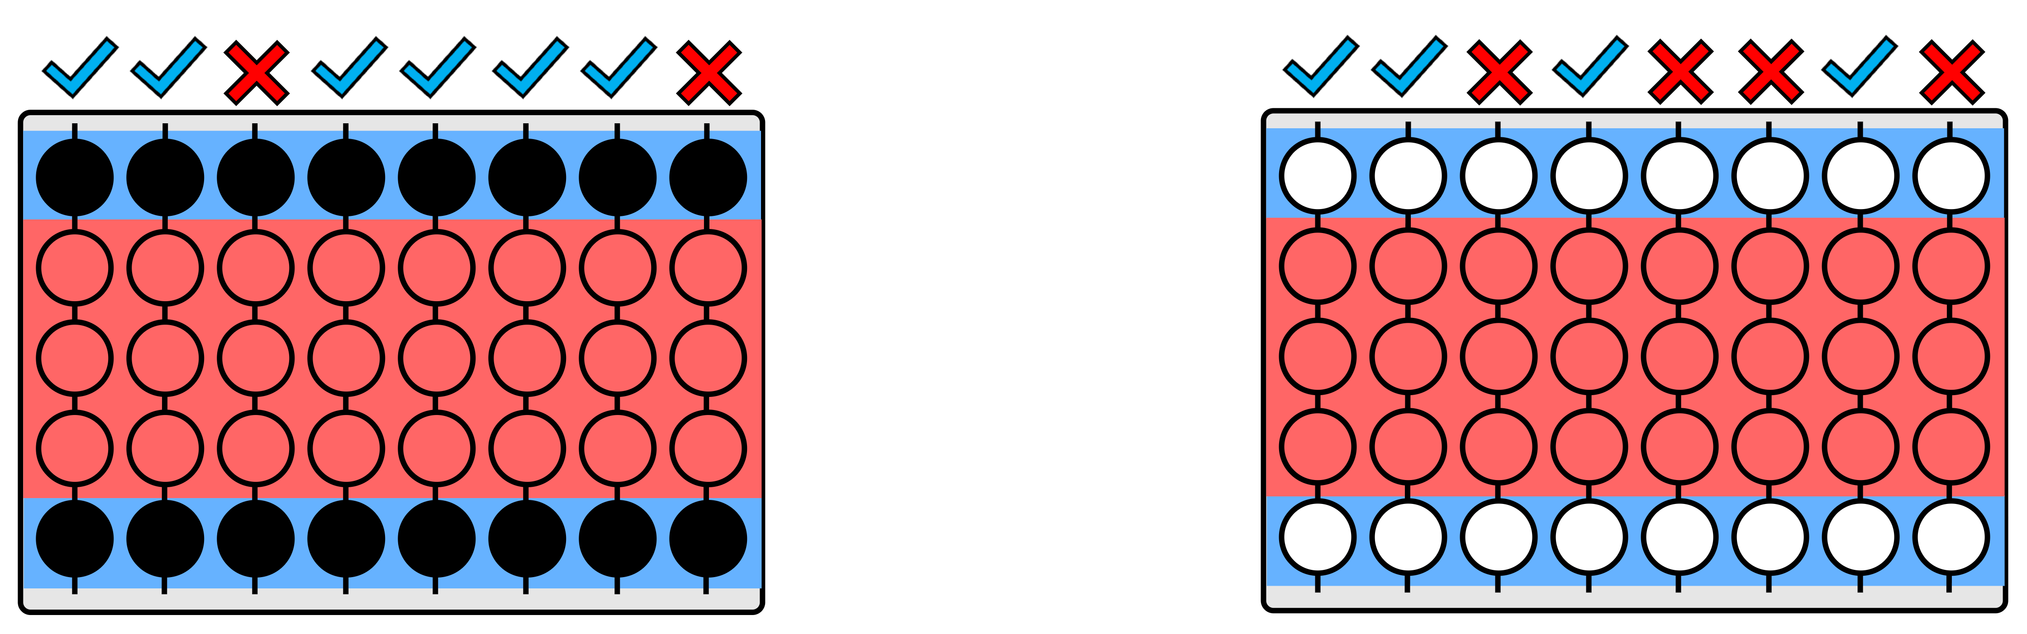


Challenges of Naive Column Screening
Non-Activated
Adjacent Rows
SiMRA
Rows
Stage 1:
Column Screening
Notes:
Let me illustrate the risk of a naive column screening under PuDGhost.
[CLICK]
In this figure, the read band represents SiMRA Rows,
[CLICK]
and the blue band represents non-activated adjacent rows

Slide 53
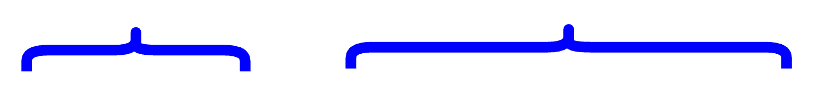

Challenges of Naive Column Screening
Columns labeled
as reliable
Stage 1:
Column Screening
Notes:
In Stage 1, we perform column screening with large random inputs
[CLICK]
to identify reliable columns.

Slide 54
Challenges of Naive Column Screening
Columns labeled
as reliable
Adjacent-row
data changes
Stage 1:
Column Screening
Stage 2:
PuD Execution
Notes:
In Stage 2,
[CLICK]
we execute the application using only these reliable columns.
[CLICK]
However, in a PuDGhost-unaware system, the adjacent-row data can differ between screening and execution.

Slide 55
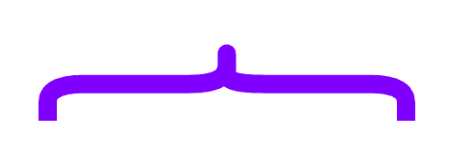
Challenges of Naive Column Screening
Columns labeled
as reliable
Columns labeled as reliable
later become unreliable
Adjacent-row
data changes
Stage 1:
Column Screening
Stage 2:
PuD Execution
Notes:
[CLICK]
[CLICK]
As a result, columns labeled as reliable in Stage 1 can later become unreliable in Stage 2 due to PuDGhost.
[CLICK]

Slide 56
Robust Column Screening Technique
We propose a new robust column screening
Our approach: Fix adjacent-row data across column screening and PuD execution
  Use the same data pattern in adjacent rows during
  both column screening and PuD execution
Notes:
To address this challenge, we propose a robust column screening technique that accounts for PuDGhost.
[CLICK]
The ides is simple.
Our approach fixes adjacent-row data across screening and execution.
[CLICK]
It uses the same fixed adjacent-row data pattern during both screening and execution
(, ensuring consistency between the two stages.)

Slide 57
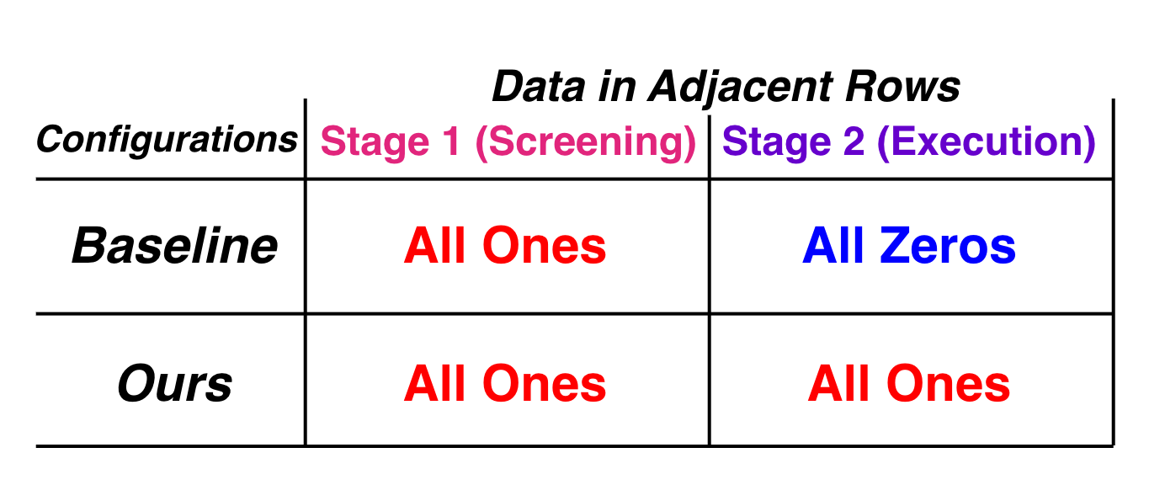
Evaluation of Robust Column Screening
Setup: Execute Matrix-Vector Multiplication (GEMV) with
8-bit precision on COTS DRAM chips using MAJ3
  Stage 1 (Screening): Screen columns using 8,192 random inputs; columns with no errors across all inputs are labeled as reliable
  Stage 2 (Execution): Execute GEMV using the 32K columns labeled as reliable in Stage 1
Configurations:
Mismatch
Match
Notes:
[CLICK]
We evaluate our robust column screening technique on real DRAM chips.
We execute matrix-vector multiplication, or GEMV, using MAJ3
(with randomly generated 8-bit precision matrices.)
[CLICK]
In Stage 1, we screen columns using random inputs
and label columns with no errors as reliable.
[CLICK]
In Stage 2, we execute GEMV using the columns labeled as reliable in Stage 1.
[CLICK] [CLICK]
We compare two configurations.
[CLICK]
The PuDGhost-unaware baseline maximizes the mismatch between the two stages,
using all ones during screening but all zeros during execution, representing the worst case.
[CLICK]
Our solution fixes adjacent-row data to all ones during both screening and execution.

Slide 58
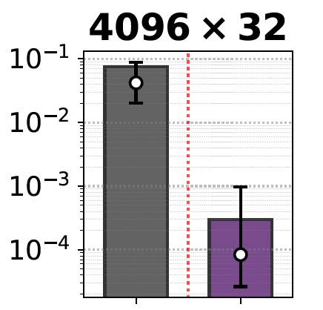

Results: Column Screening
Normalized Mean
Squared Error
of GEMV output
Matrix dimension
PuDGhost-Unaware Column Screening
Our PuDGhost-Aware Column Screening
Notes:
Here are the results of column screenings
[CLICK]
For clarity, we show the results for a matrix dimension of N equals 32 as an example.
[CLICK]
[CLICK]
The y-axis represents the normalized mean squared error of GEMV output executed on real DRAM chips.
(Higher values indicate larger errors.)
[CLICK]
We compare one PuDGhost-unaware column screening
[CLICK]
against our proposed column screening

Slide 59
Results: Column Screening
Normalized Mean
Squared Error
of GEMV output
413×
Our robust column screening
reduces NMSE of GEMV outputs by 413× compared to
PuDGhost-unaware baseline
Notes:
[CLICK]
[CLICK]
The result shows that our solutions reduce NMSE of GEMV by around 400 times compared to PuDGhost-unaware baseline on average.

Slide 60
Results: Column Screening
Normalized Mean
Squared Error
of GEMV output
413×
Key Takeaway
Our solution significantly
reduces application-level errors
Notes:
Therefore, we conclude our robust column screening techniques significantly reduce application-level errors

Slide 61
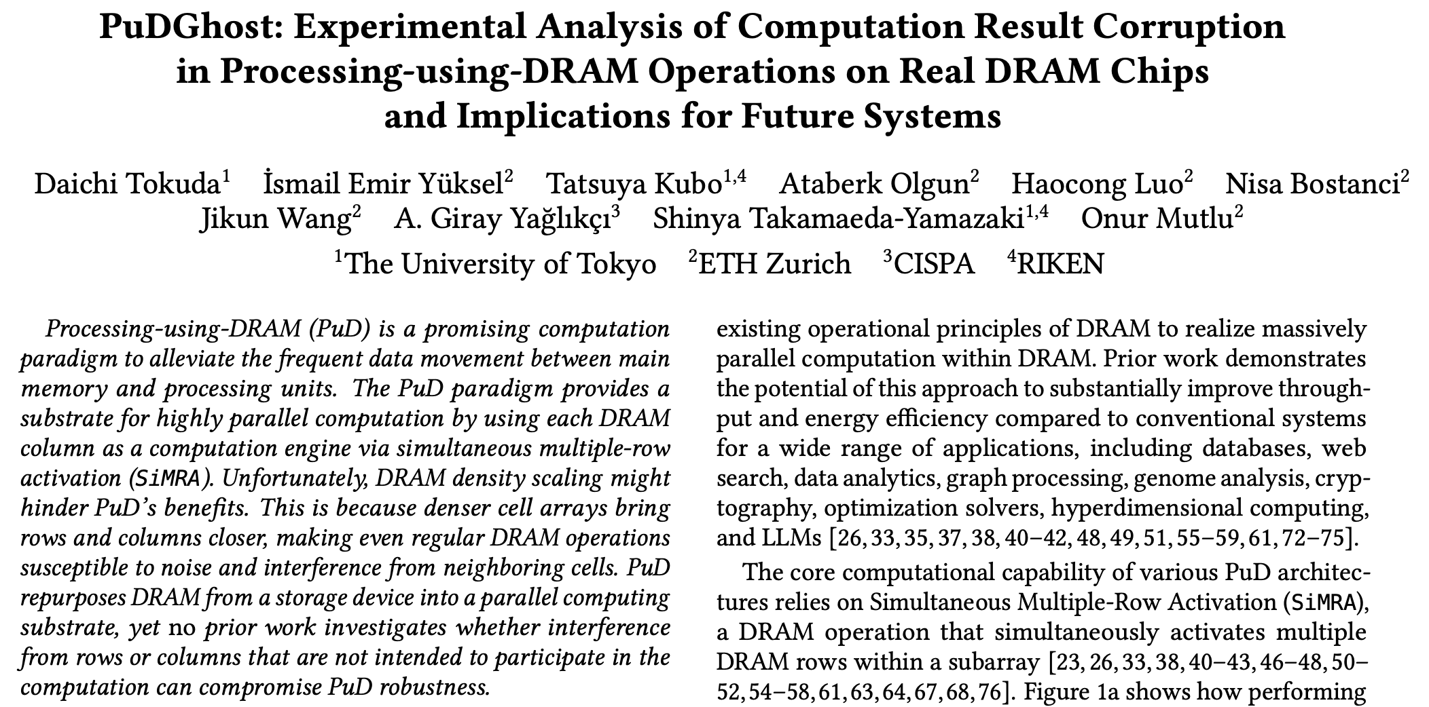
Available on arXiv
https://arxiv.org/pdf/2606.19119
Notes:
Our paper is also available on arXiv, so please feel free to check it out for the full details.

Slide 62
More in the Paper
More Characterization Results
  Temperature, spatial variation, data patterns
Details and Analyses on Mitigating PuDGhost
  Discussion on how modifying DRAM chips could help mitigate PuDGhost
  Interference-aware compute row layout
  Column screening tradeoffs across reliability, throughput, and capacity overhead
More Application-level Evaluation
  PuDGhost’s impact on SiMRA-based true random number generation (TRNG)
Notes:
In the paper, we present more results that we could not cover in this talk, including additional results, more detailed mitigation analyses
(including how modifying DRAM chips could help mitigate PuDGhost),
and further application-level evaluation on true random number generation.
------------
In the paper, we present more results that we could not cover in this talk.
For characterization, we provide additional results on the effects of temperature, spatial variation, and different data patterns.
For mitigations, we discuss in more detail how modifying DRAM chips at the circuit level could help mitigate PuDGhost, propose an interference-aware compute row layout, and analyze column screening tradeoffs across reliability, throughput, and capacity overhead.
We also present further application-level evaluation, studying PuDGhost's impact on SiMRA-based true random number generation.

Slide 63
Outline
Background
Problem & Goal
Testing Infrastructure & Methodology
Interference from Non-Activated Rows
Interference from Concurrently Computing Columns
Mitigating PuDGhost
Conclusion
Notes:
Finally, let me conclude our talk.

Slide 64
Conclusion
We extensively study the impact of interference from
non-operand data in Processing-using-DRAM operations
We characterize 96 DDR4 chips:
Non-activated rows affect SiMRA outputs by up to 10% for random inputs
Concurrently computing columns affect SiMRA outputs by up to 48% for random inputs
We propose PuDGhost-aware column screening techniques:
Our solutions reduce GEMV NMSE by 413× compared to PuDGhost-unaware systems
We hope our work motivates and guides solutions to enable
future PuD systems that are robust
Notes:
[CLICK]
In this work, we extensively study the impact of interference from non-operand data in Processing-using-DRAM operations, which we call PuDGhost.
[CLICK]
We characterize 96 DDR4 chips and reveal two major sources of interference: data in non-activated rows and data in concurrently computing columns, both of which affect SiMRA outputs.
[CLICK]
To address PuDGhost, we propose robust column screening techniques that significantly reduce application-level errors compared to PuDGhost-unaware systems.
[CLICK]
We hope our work motivates and guides future solutions to enable PuD systems that are robust.
[CLICK]
Thank you for your attention.

Slide 65
PuDGhost:
Experimental Analysis of Computation Result Corruption in Processing-using-DRAM Operations on Real DRAM Chips and Implications for Future Systems
Daichi Tokuda
E. Yuksel T. Kubo A. Olgun H. Luo
N. Bostanci J. Wang A. G. Yağlıkçı
S. Takamaeda-Yamazaki O. Mutlu

Slide 66
Backup Slides

Slide 67

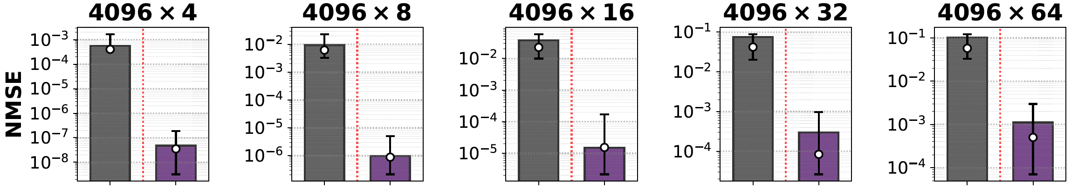
Results: Column Screening

Slide 68
PuDGhost’s Impact on SiMRA-based TRNG
We evaluate PuDGhost’s impact on SiMRA-based true random number generation (TRNG) on COTS DRAM chips
Setup:
  Step 1: Find input pattern that maximizes entropy; identify source columns with randomness
  Step 2: Fix the input pattern of source columns from Step 1 and measure entropy while varying other data
Conditions:
  Fixed (baseline): All data remains identical to Step 1
  Adjacent-row interference: Vary adjacent-row data
  Inter-column interference: Vary non-source columns' inputs
Notes:
We also evaluate PuDGhost's impact on SiMRA-based true random number generation, or TRNG, on real DRAM chips. SiMRA-based TRNG exploits columns that produce non-deterministic outputs under fixed SiMRA inputs. These columns, called source columns, serve as entropy sources for random number generation. We investigate how data in adjacent rows and non-source columns affects the entropy of these source columns.
[CLICK]
We conduct a two-step experiment. In Step 1, we search for the input pattern that maximizes entropy and identify source columns that exhibit randomness. In Step 2, we fix the input pattern of source columns from Step 1 and measure entropy while varying other data.
[CLICK]
We have three groups of conditions for Step 2. Fixed is our baseline, where all non-operand data remains identical to Step 1. For adjacent-row interference, we have three conditions that vary only the adjacent-row data to random, all-zeros, or all-ones. For inter-column interference, we have three conditions that vary only the non-source columns' inputs to random, all-zeros, or all-ones.

Slide 69
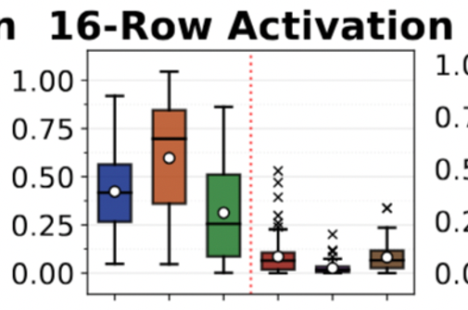

PuDGhost’s Impact on SiMRA-based TRNG
We evaluate PuDGhost’s impact on SiMRA-based true random number generation (TRNG) on COTS DRAM chips
Entropy normalized to Fixed (baseline)
Adjacent-Row Interference
Inter-Column Interference
Notes:
The y-axis shows entropy under each condition, normalized to the Fixed baseline.
Values below 1.0 indicate entropy loss due to PuDGhost.
The x-axis shows the six non-baseline conditions — three for adjacent-row interference and three for inter-column interference — and each subplot corresponds to a different number of SiMRA rows.

Slide 70
PuDGhost’s Impact on SiMRA-based TRNG
We evaluate PuDGhost’s impact on SiMRA-based true random number generation (TRNG) on COTS DRAM chips
Entropy normalized to Fixed (baseline)
SiMRA-based TRNG designs
that do not account for PuDGhost could unknowingly lose up to 93% of the entropy
Notes:
The y-axis shows entropy under each condition, normalized to the Fixed baseline.
Values below 1.0 indicate entropy loss due to PuDGhost.
The x-axis shows the six non-baseline conditions — three for adjacent-row interference and three for inter-column interference — and each subplot corresponds to a different number of SiMRA rows.

Slide 71
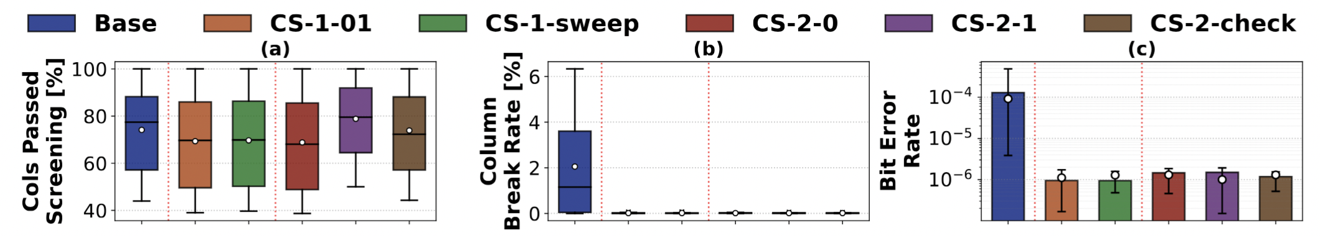
Column Screening Techniques
Our column screening techniques reduce
MAJ3 bit error rate by 91×
compared to PuDGhost-unaware systems

Slide 72
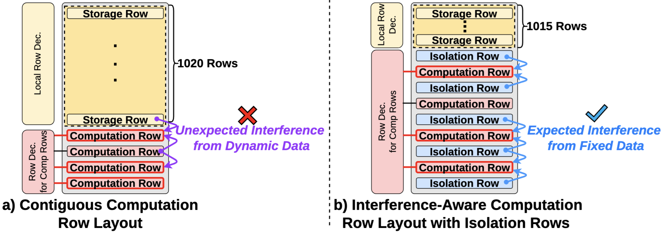
PuDGhost-Aware Compute Row Layout

Slide 73
Device-Level PuDGhost Mechanism
Hypothesis: PuDGhost arises from electrical coupling during SiMRA charge sharing and sensing
Interference from non-activated rows
  Electrical coupling from adjacent rows
Interference from concurrently computing columns
  Coupling through bitlines
  Interactions through sense amplifier circuitry
  The combination of these two effects leads to the complex interference behavior
We need device-level studies to fundamentally understand PuDGhost, and our study can inspire such future work
and be a good starting point
Notes:
We believe that PuDGhost arises from electrical coupling during SiMRA charge sharing and sensing.
There are two main sources of interference.
First, non-activated rows can affect the computation through electrical coupling from adjacent rows. Even though these rows are not intentionally activated, their stored data can still influence the charge-sharing process.
Second, concurrently computing columns can interfere with each other.
This may happen through coupling between bitlines, as well as interactions inside or around the sense amplifier circuitry.
As a result, PuDGhost is not caused by a single simple effect. Instead, it likely comes from the combination of row-level and column-level coupling, which together produce the complex interference behavior we observe experimentally.

Slide 74
PuDGhost vs. Read Disturbance Phenomena
Interference source:
  Read disturbance: activated aggressor row
  PuDGhost: non-activated adjacent rows and concurrently computing columns
Triggering mechanism:
  Read disturbance: repeated activation (RowHammer) or prolonged activation (RowPress)
  PuDGhost: a single SiMRA operation
Manifestation:
  Read disturbance: persistent bitflips through gradual charge leakage
  PuDGhost: transient errors during charge sharing and sensing
Notes:
PuDGhost is qualitatively different from read disturbance phenomena in three key aspects.
First, the interference source. Read disturbance is caused by an activated aggressor row.
In contrast, PuDGhost is caused by data in non-activated adjacent rows and concurrently computing columns.
Second, the triggering mechanism. Read disturbance requires repeated activation, as in RowHammer, or prolonged activation, as in RowPress. PuDGhost requires neither — it occurs within a single SiMRA operation.
Third, the manifestation. Read disturbance causes persistent bitflips through gradual charge leakage. PuDGhost causes transient errors during charge sharing and sensing.

Slide 75
Toward Relibale PuD Systems
Full DRAM Redesign:
  Design DRAM from the ground up for reliable PuD; a promising but long-term direction
Cell Array-Level Modifications:
  Potential modifications to DRAM cell array design to reduce interference (e.g., isolation transistors)
PuD ECC Schemes
  Prior work proposes ECC schemes tailored for PuD to detect and correct computation errors
  (e.g., Reed-Solomon-like approach)
Error-Tolerant Applications
  Some applications can tolerate a certain level of computation errors without significant quality degradation (e.g. machine learning, genomic sequence search)

Slide 76
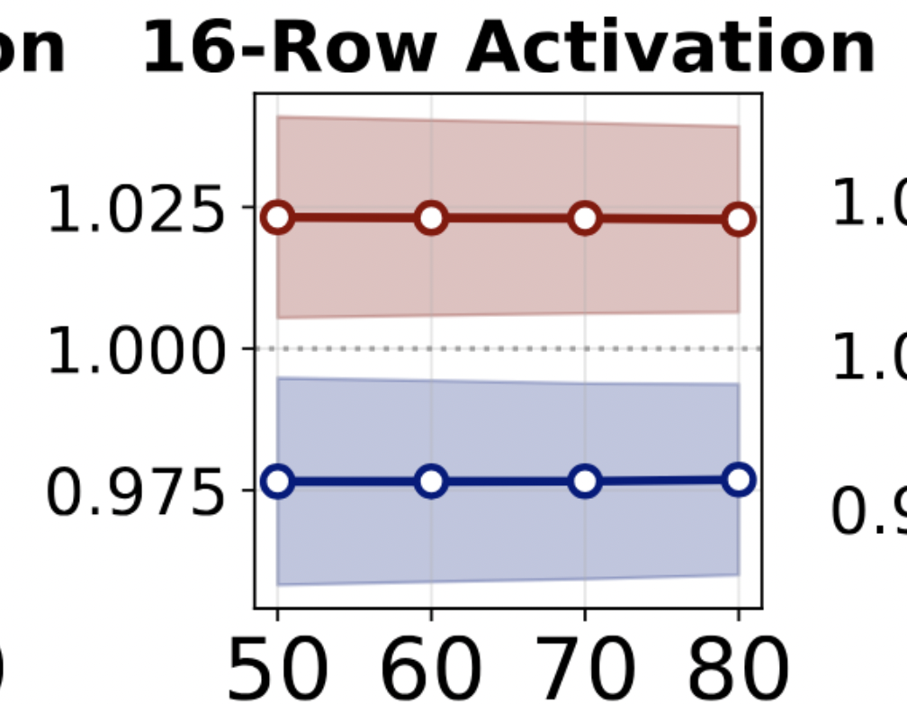
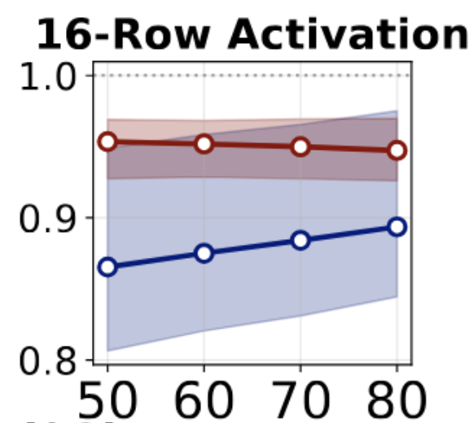

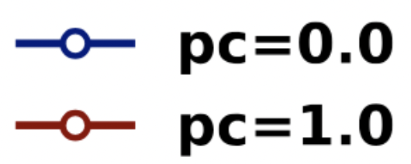
Temperature Sensitivities
Conucurrently Computing
Columns
Adjacent Rows

Slide 77
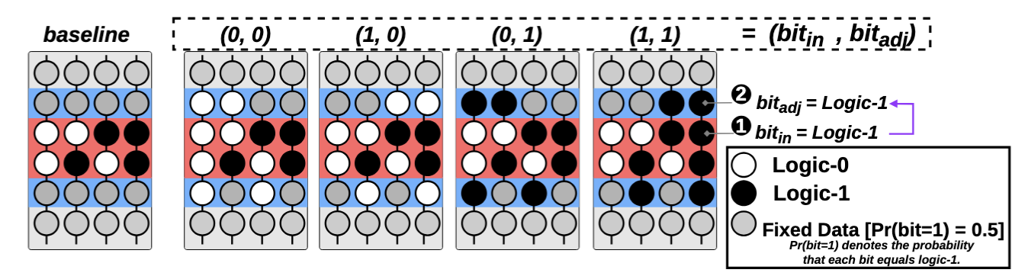
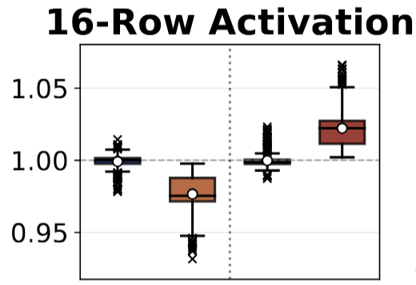
Input-Dependent Adjacent Row Patterns
Cells in SiMRA rows
storing logic-1 are substantially more susceptible to
interference from non-activated adjacent rows

