Slide 1

7th Workshop on
Memory-Centric Computing
Processing-Using-Memory in Real DRAM Chips
İsmail Emir Yüksel
ICS 2026
6 July 2026

Slide 2
Brief Self Introduction
Ismail Emir Yuksel
    Researcher @ SAFARI Research Group since September 2022
      PhD @ ETH Zurich (Feb 2024 – ongoing)
    ismail.yuksel@safari.ethz.ch
Research interests:
    Computer architecture
    Processing-in-Memory (specifically Processing-using-DRAM)
    DRAM Safety, Security and Reliability
    Hardware security, safety, reliability, performance, availability, fairness, energy efficiency
    ...

Slide 3
Problem
Computing
is Bottlenecked by Data

Slide 4
Data is Key for AI, ML, Genomics, …
Important workloads are all data intensive
They require rapid and efficient processing of large amounts of data
Data is increasing
    We can generate more than we can process
    We need to perform more sophisticated analyses on more data

Slide 5
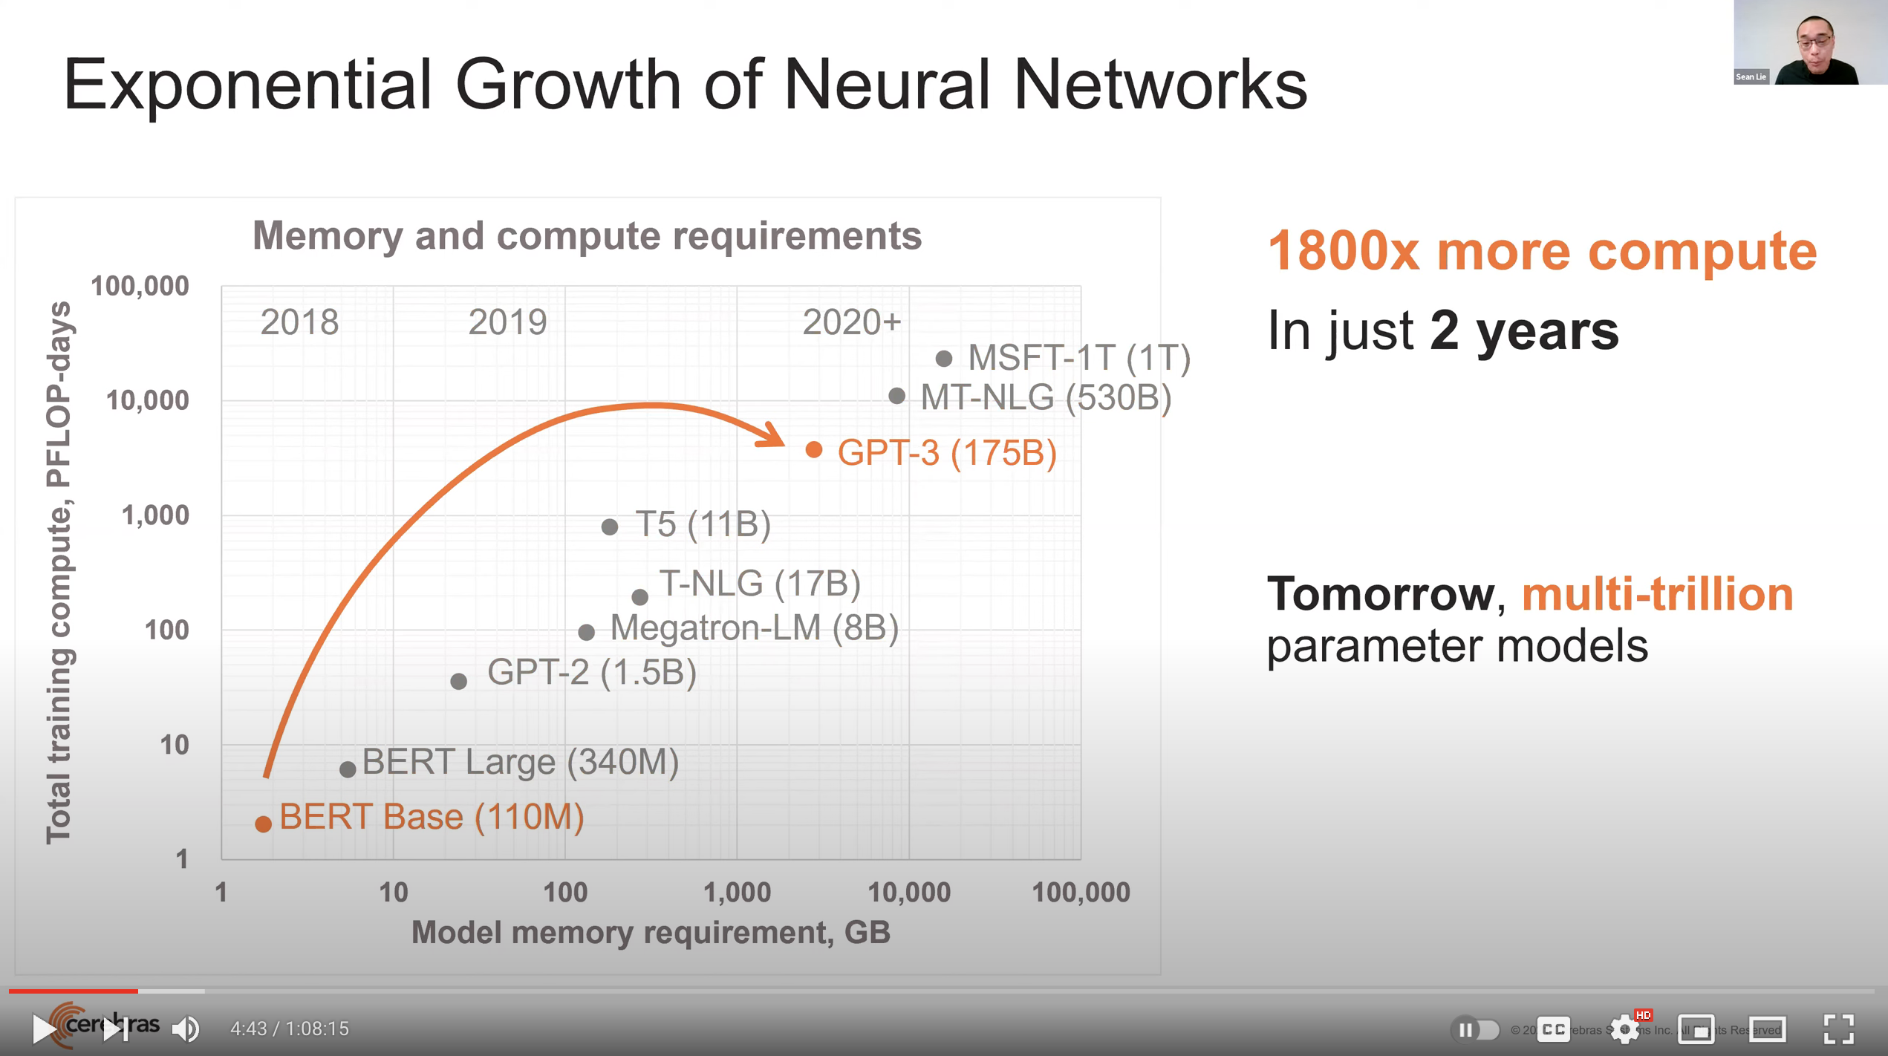
Huge Demand for Performance & Efficiency
~4 orders of magnitude increase in memory requirement
in just a few years!
Source: https://youtu.be/Bh13Idwcb0Q?t=283

Slide 6
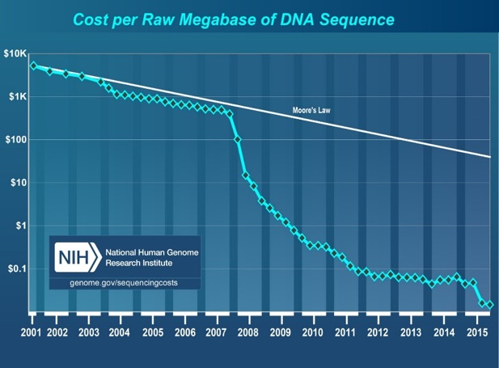

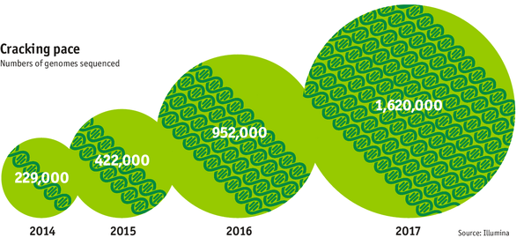

Huge Demand for Performance & Efficiency
development of new
sequencing technologies
Oxford Nanopore MinION
Number of Genomes Sequenced
http://www.economist.com/news/21631808-so-much-genetic-data-so-many-uses-genes-unzipped
Notes:
However, since the development of high throughput sequencing (HTS) technologies, the cost of genome sequencing has fallen off a cliff (<< 1,000$) making it viable for almost everyone's use.

Slide 7
The Problem
Data access is the major performance and energy bottleneck
Our current
design principles
cause great energy waste
(and great performance loss)

Slide 8
Data Movement Bottleneck
Today’s computing systems are processor centric
All data is processed in the processor → at great system cost
Computing Unit
(CPU, GPU, FPGA, Accelerators)
Main Memory
(DRAM)
Memory
Channel
More than 60% of the total system energy is spent on data movement¹
¹ A. Boroumand et al., “Google Workloads for Consumer Devices: Mitigating Data Movement Bottlenecks,” ASPLOS, 2018

Slide 9
Processor-Centric System Performance
All of Google’s Data Center Workloads (2015):
Kanev+, “Profiling a Warehouse-Scale Computer,” ISCA 2015.

Slide 10
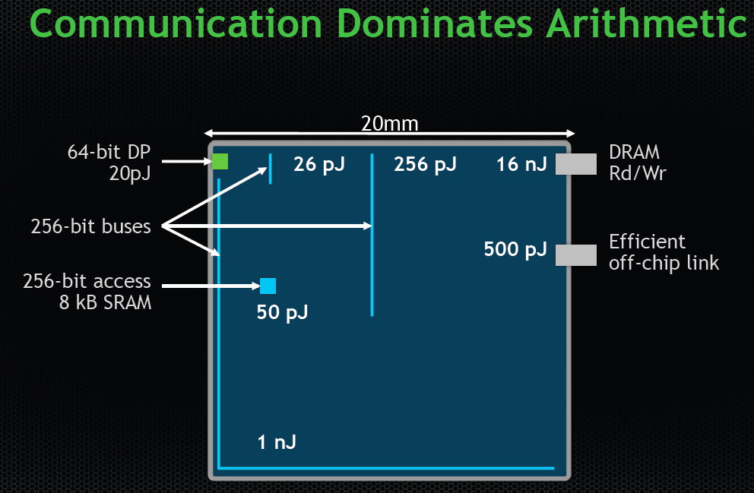
Data Movement vs. Computation Energy
Dally, HiPEAC 2015
A memory access consumes ~100-1000X
the energy of a complex addition

Slide 11
Data Movement vs. Computation Energy
Han+, “EIE: Efficient Inference Engine on Compressed Deep Neural Network,” ISCA 2016.

Slide 12
Data Movement vs. Computation Energy
6400X
A memory access consumes 6400X
the energy of a simple integer addition
Han+, “EIE: Efficient Inference Engine on Compressed Deep Neural Network,” ISCA 2016.

Slide 13
Energy Waste in Accelerators
Amirali Boroumand, Saugata Ghose, Youngsok Kim, Rachata Ausavarungnirun, Eric Shiu, Rahul Thakur, Daehyun Kim, Aki Kuusela, Allan Knies, Parthasarathy Ranganathan, and Onur Mutlu,
"Google Workloads for Consumer Devices: Mitigating Data Movement Bottlenecks"
Proceedings of the 23rd International Conference on Architectural Support for Programming Languages and Operating Systems (ASPLOS), Williamsburg, VA, USA, March 2018.
62.7% of the total system energy
is spent on data movement

Slide 14
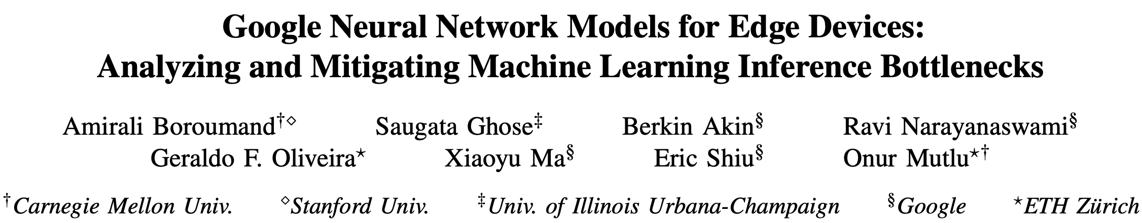
Energy Waste in Accelerators
Amirali Boroumand, Saugata Ghose, Berkin Akin, Ravi Narayanaswami, Geraldo F. Oliveira, Xiaoyu Ma, Eric Shiu, and Onur Mutlu,
"Google Neural Network Models for Edge Devices: Analyzing and Mitigating Machine Learning Inference Bottlenecks"
Proceedings of the 30th International Conference on Parallel Architectures and Compilation Techniques (PACT), Virtual, September 2021.
[Slides (pptx) (pdf)]
[Talk Video (14 minutes)]
> 90% of the total system energy
is spent on memory in large ML models

Slide 15
Fundamental Problem
Processing of data
is performed
far away from the data

Slide 16
We Need A Paradigm Shift To …
Enable computation with minimal data movement
Compute where it makes sense (where data resides)
Make computing architectures more data-centric

Slide 17
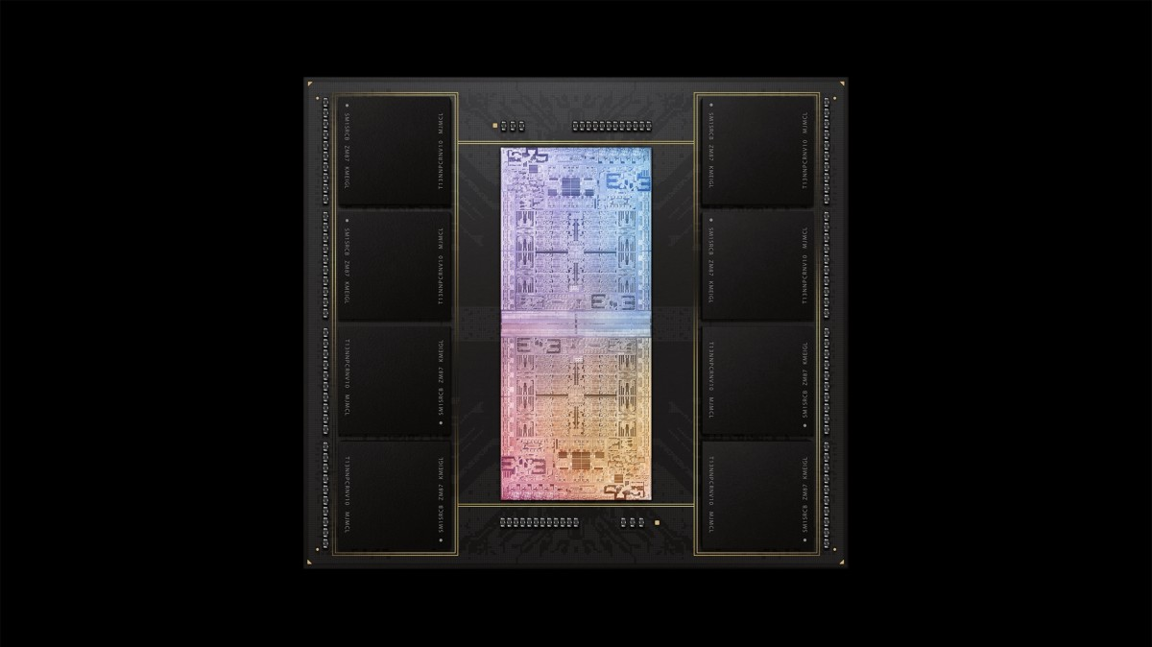
Process Data Where It Makes Sense
Sensors
A lot of
SRAM
Storage
DRAM
DRAM
Storage
Apple M1 Ultra System (2022)
https://www.gsmarena.com/apple_announces_m1_ultra_with_20core_cpu_and_64core_gpu-news-53481.php

Slide 18
Memory as an Accelerator
CPU
core
CPU
core
mini-CPU
core
GPU
(throughput)
core
GPU
(throughput)
core
video
core
GPU
(throughput)
core
GPU
(throughput)
core
CPU
core
CPU
core
Memory
imaging
core
LLC
Specialized
compute-capability
in memory
Memory Controller
Memory Bus
Memory similar to a “conventional” accelerator

Slide 19
Goal: Processing Inside Memory/Storage
Many questions … How do we design the:
    compute-capable memory & controllers?
    processors & communication units?
    software & hardware interfaces?
    system software, compilers, languages?
    algorithms & theoretical foundations?
Database
Graphs
Media
ML Model
Memory/Storage
Processor
Core
Cache
Query
Interconnect
Problem
Results
Algorithm
Program/Language
System Software
SW/HW Interface
Micro-architecture
Logic
Devices
Electrons

Slide 20
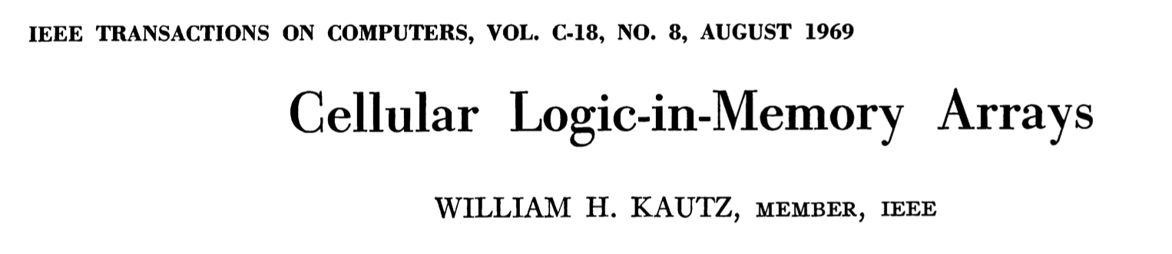
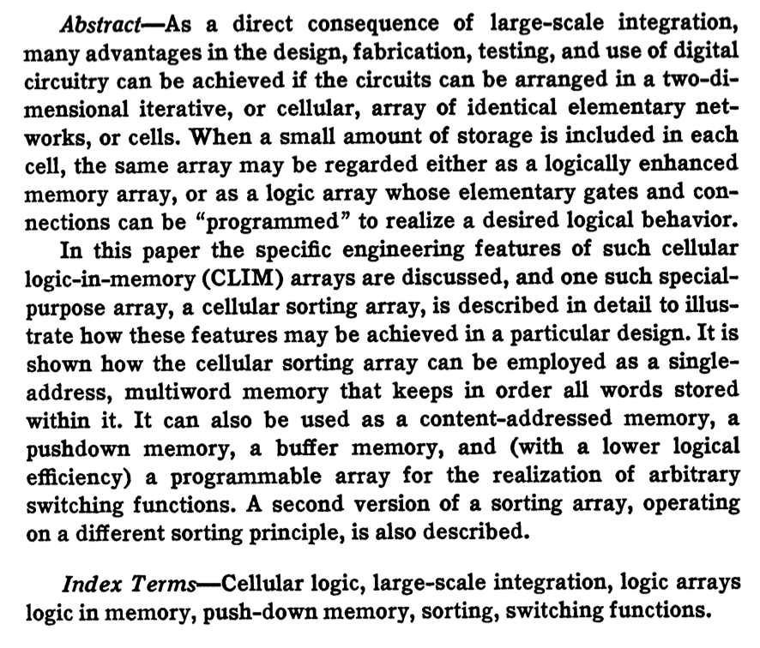
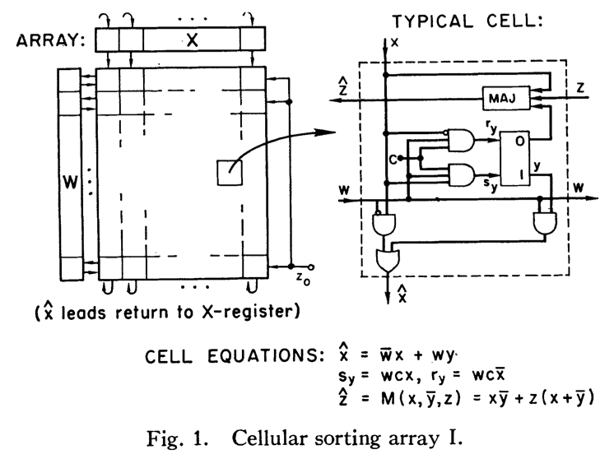
Processing in/near Memory: An Old Idea
Kautz, “Cellular Logic-in-Memory Arrays”, IEEE TC 1969.
https://doi.org/10.1109/T-C.1969.222754

Slide 21
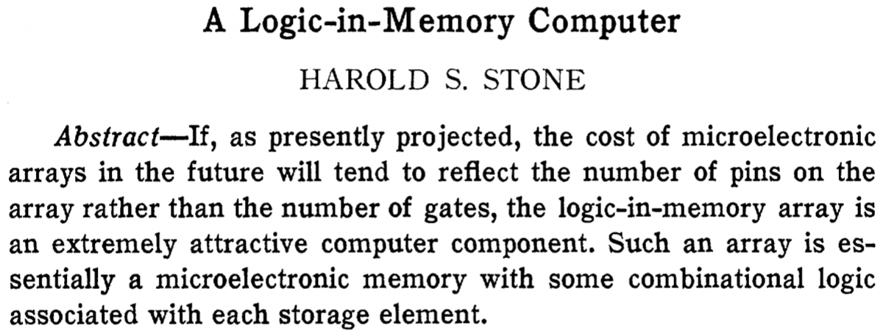
Processing in/near Memory: An Old Idea
Stone, “A Logic-in-Memory Computer,” IEEE TC 1970.
https://safari.ethz.ch/architecture/fall2020/lib/exe/fetch.php?media=stone_logic_in_memory_1970.pdf

Slide 22
Processing-in-Memory: Two Types
1
Processing-Near-Memory: Computation logic is added to the
same die as memory or to the logic layer of 3D-stacked memory
2
Processing-Using-Memory: uses the operational principles of
memory cells & circuitry to perform computation
DRAM
(e.g., 3D-Stacked Memory)
DRAM Bank
Vault
Controller
Processing-
Using-DRAM
DRAM Vault
…
PHY
Processing-Near-Vault
…
Processing-Near-Bank
Notes:
Processing-in-Memory architectures alleviate data movement bottlenecks by moving computation to where the data resides. Such architectures can be implemented
[CLICK] by adding logic near the memory arrays, in what is called processing-near-memory or
[CLICK] by using the analog operating principles of the memory cells to perform computation, in what is called processing-using-memory
[NEXT]

Slide 23
Focus: Processing-using-DRAM
We can natively support
    Bulk bitwise COPY and INIT/ZERO
    Bulk bitwise AND, OR, NOT, MAJ, NOR, NAND
    True Random Number Generation; Physical Unclonable Functions
    More complex computation using Lookup Tables
At low cost
Using analog computation capability of DRAM
    Idea: activating (multiple) rows performs computation
      Even in commodity off-the-shelf DRAM chips!
30X-257X performance and energy improvements
    Seshadri+“RowClone: Fast and Efficient In-DRAM Copy and Initialization of Bulk Data,” MICRO 2013.
    Seshadri+, “Fast Bulk Bitwise AND and OR in DRAM”, IEEE CAL 2015.
    Seshadri+, “Ambit: In-Memory Accelerator for Bulk Bitwise Operations Using Commodity DRAM Technology,” MICRO 2017.
    Hajinazar+, “SIMDRAM: A Framework for Bit-Serial SIMD Processing using DRAM,” ASPLOS 2021.
    Oliveira+, “MIMDRAM: An End-to-End Processing-Using-DRAM System for High-Throughput, Energy-Efficient and Programmer-Transparent Multiple-Instruction Multiple-Data Processing,” HPCA 2024.

Slide 24

DRAM Organization
DRAM Module
DRAM
Chip
Sense Amplifiers
DRAM Cell
…
Subarray
Bank
DRAM Row
Chip I/O
Sense Amps.
…
Wordline
Bitline
DRAM Chip
DRAM Bank
Notes:
DRAM is used as the main memory in many computing systems. [CLICK]
a DRAM module consists of multiple DRAM chips [CLICK]
Each chip contains multiple banks [CLICK]
Each bank is composed of multiple subarrays and sense amplifiers [CLICK]
And within each subarray, there is a two dimensional array of DRAM cells. [CLICK]
These cells are organized into rows that are selected using wordlines [CLICK]
And the cells are connected to a row of sense amplifiers via bitlines [CLICK]

Slide 25
Major DRAM Operations
DRAM Subarray
1
ACTIVATE (ACT):
Fetch the row’s content
into the sense amplifiers
2
Column Access (RD/WR):
Read/Write the target
column and drive to I/O
Sense
Amplifiers
3
PRECHARGE (PRE):
Prepare the bank
for a new ACTIVATE
I/O Circuitry
Notes:
Data is internally accessed in a row granularity. To access data,
[CLICK] the memory controller first needs to activate the row that contains the data and fetch the row’s content into the sense amplifiers
[CLICK] Then, column accesses are serviced from the sense amplifiers
[CLICK] Finally, the subarray needs to be precharged to get ready for the next row activation

Slide 26
Closer Look to a DRAM Cell
wordline
capacitor
bitline
access transistor
Sense Amp
enable

Slide 27
DRAM Cell Operation upon ACT
deviation in bitline voltage
raise wordline
wordline
1
0
½ V_{DD} + δ
V_{DD}
½ V_{DD}
capacitor
bitline
access transistor
connects cell to bitline
cell regains charge
cell loses charge to bitline
Sense Amp
1
0
enable sense amp
enable
½ V_{DD}
0

Slide 28

Starting Simple: Data Copy and Initialization
  memmove & memcpy: 5% cycles in Google’s datacenter [Kanev+ ISCA’15]
000000000000000
Zero initialization
(e.g., security)
Forking
Checkpointing
Many more
VM Cloning
Deduplication
Page Migration

Slide 29
Current Systems: Data Copy
Memory
L3
CPU
L2
L1
MC

Slide 30
Future Systems: In-Memory Copy
3) No cache pollution
1) Low latency
Memory
L3
CPU
L2
L1
MC
2) Low bandwidth utilization
4) No unwanted data movement
1046ns, 3.6uJ
→ 90ns, 0.04uJ

Slide 31
In-DRAM Row-Copy (RowClone)
Copying the source (src) row’s content to
the destination (dst) row
s
r
c
d
s
t
s
r
c
d
s
t
s
r
c
[Seshadri+ MICRO’13]
Notes:
In this study, we focus on two prior in-DRAM operations. First one is in-DRAM Row-Copy, which is also called RowClone
[CLICK] The RowClone operation copies the source row’s content to the destination row. Now let’s see how we perform RowClone

Slide 32
RowClone: In-DRAM Bulk Data Copy
activate
source
1
½ V_{DD} + δ
V_{DD}
0
½ V_{DD}
Source Cell
activate
destination
1
0
Destination Cell
Sense
Amp
1
0
enable sense amp
data gets copied source to destination

Slide 33
RowClone: Latency and Energy Savings
11.6x
74x
Seshadri et al., “RowClone: Fast and Efficient
In-DRAM Copy and Initialization of Bulk Data,” MICRO 2013

Slide 34
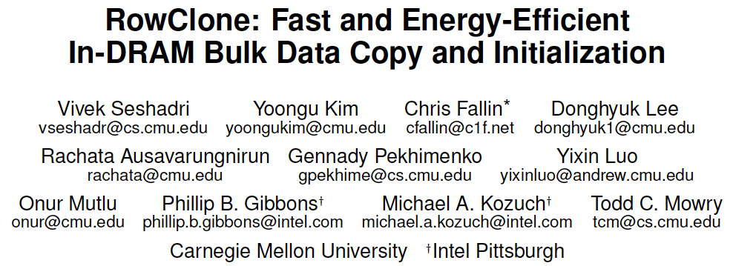
More on RowClone
Vivek Seshadri, Yoongu Kim, Chris Fallin, Donghyuk Lee, Rachata Ausavarungnirun,
Gennady Pekhimenko, Yixin Luo, Onur Mutlu, Michael A. Kozuch,
Phillip B. Gibbons, and Todd C. Mowry,
"RowClone: Fast and Energy-Efficient In-DRAM Bulk Data Copy and Initialization"
Proceedings of the 46th International Symposium on Microarchitecture (MICRO),
Davis, CA, December 2013.
[Slides (pptx) (pdf)] [Lightning Session Slides (pptx) (pdf)] [Poster (pptx) (pdf)]

Slide 35
Triple-Row Activation: Majority Function
1
½ V_{DD} + δ
V_{DD}
0
½ V_{DD}
1
activate
all three rows
simultaneously
0
1
0
Sense Amp
1
0
enable sense amp

Slide 36
Bitwise AND/OR Using Triple-Row Activation
1
V_{DD}
A
1
B
1
C
Sense Amp
1

Slide 37
Bitwise AND/OR Using Triple-Row Activation
1
V_{DD}
A
Output = MAJ(A, B, C)
= C (A OR B) +
~C (A AND B)
1
B
1
Control the value of C
to perform
bitwise OR or AND
C
Sense Amp
1

Slide 38
In-DRAM Acceleration of Database Queries
>4-12X Performance Improvement

Slide 39
More on Ambit
Vivek Seshadri, Donghyuk Lee, Thomas Mullins, Hasan Hassan, Amirali Boroumand, Jeremie Kim, Michael A. Kozuch, Onur Mutlu, Phillip B. Gibbons, and Todd C. Mowry,
"Ambit: In-Memory Accelerator for Bulk Bitwise Operations Using Commodity DRAM Technology"
Proceedings of the 50th International Symposium on Microarchitecture (MICRO), Boston, MA, USA, October 2017.
[Slides (pptx) (pdf)] [Lightning Session Slides (pptx) (pdf)] [Poster (pptx) (pdf)]

Slide 40
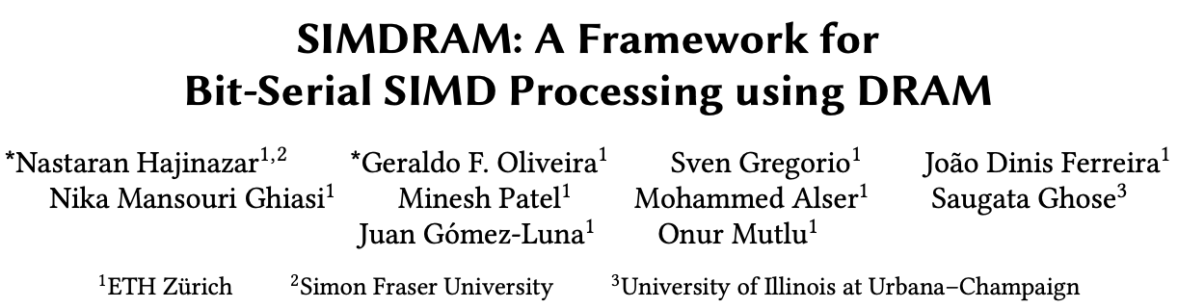
SIMDRAM Framework
Nastaran Hajinazar, Geraldo F. Oliveira, Sven Gregorio, Joao Dinis Ferreira,
Nika Mansouri Ghiasi, Minesh Patel, Mohammed Alser,
Saugata Ghose, Juan Gomez-Luna, and Onur Mutlu,
"SIMDRAM: An End-to-End Framework for Bit-Serial SIMD Computing in DRAM"
Proceedings of the 26th International Conference on Architectural Support for Programming Languages and Operating Systems (ASPLOS), Virtual, March-April 2021.
[2-page Extended Abstract]
[Short Talk Slides (pptx) (pdf)]
[Talk Slides (pptx) (pdf)]
[Short Talk Video (5 mins)]
[Full Talk Video (27 mins)]

Slide 41





SIMDRAM Framework: Overview
User Input
Step 1: Generate
MAJ logic
Step 2: Generate
sequence of
DRAM commands
SIMDRAM Output
Desired operation
New SIMDRAM $μ$Program
ACT/PRE
ACT/PRE
ACT/PRE
ACT/ACT/PRE
done
$$μProgram$$
$$μProgram$$
MAJ
Main memory
AND/OR/NOT logic
MAJ/NOT logic
bbop_new
New SIMDRAM
instruction
ISA
$μ$Program
User Input
Step 3: Execution according to $μ$Program
SIMDRAM Output
SIMDRAM-enabled application
Instruction result
in memory
foo () {
bbop_new
}
ACT/PRE
ACT/PRE
ACT/PRE
ACT/PRE/PRE
done
ACT/PRE
Control Unit
$μ$Program
Memory Controller

Slide 42
SIMDRAM Key Results
Large improvements over CPU & high-end GPU:
Throughput: 88× and 5.8×
(16 complex operations)
Energy: 257× and 31×
(16 complex operations)
Application Performance: 21× and 2.1×
(seven common real-world applications)

Slide 43
More on SIMDRAM
Nastaran Hajinazar, Geraldo F. Oliveira, Sven Gregorio, Joao Dinis Ferreira,
Nika Mansouri Ghiasi, Minesh Patel, Mohammed Alser,
Saugata Ghose, Juan Gomez-Luna, and Onur Mutlu,
"SIMDRAM: An End-to-End Framework for Bit-Serial SIMD Computing in DRAM"
Proceedings of the 26th International Conference on Architectural Support for Programming Languages and Operating Systems (ASPLOS), Virtual, March-April 2021.
[2-page Extended Abstract]
[Short Talk Slides (pptx) (pdf)]
[Talk Slides (pptx) (pdf)]
[Short Talk Video (5 mins)]
[Full Talk Video (27 mins)]

Slide 44
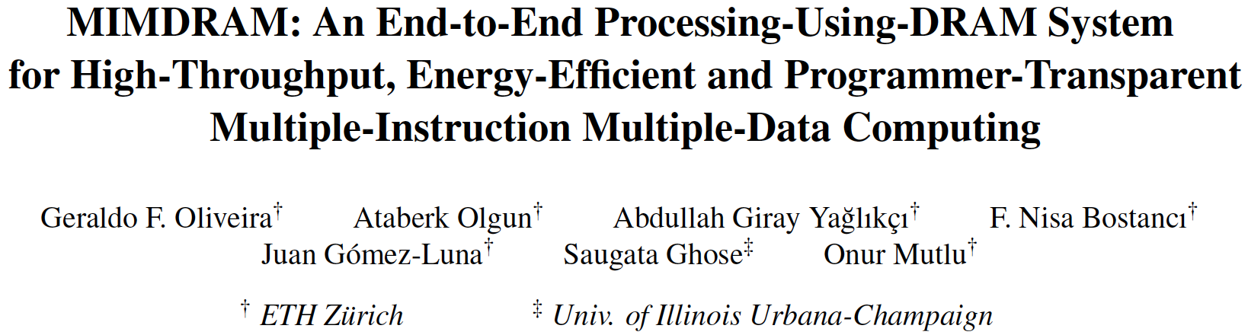
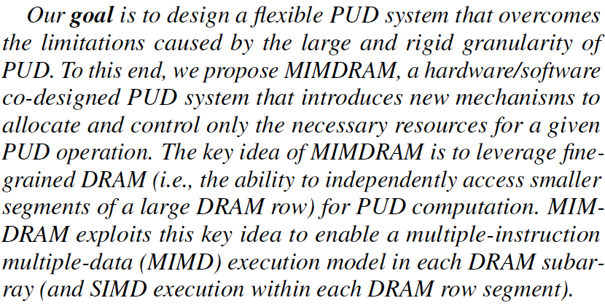
MIMDRAM: More Flexible Processing using DRAM
Appears at HPCA 2024
https://arxiv.org/pdf/2402.19080.pdf

Slide 45
MIMDRAM: Key Idea (I)
Enable narrower-width operations than a DRAM row
DRAM mat
global wordline
row decoder
global sense amplifier
Key Issue:
on a DRAM access, the global wordline propagates across all DRAM mats
Fine-Grained DRAM:
segment the global wordline to access individual DRAM mats
Notes:
MIMDRAM’s key idea is to leverage fine-grained DRAM access for processing-using-DRAM operation
[CLICK] In traditional architectures, on every DRAM access, all rows in a DRAM mat are asserted even if only portion of that row will be accessed, since the global wordline propagates across all DRAM MATS.
[CLICK] Fine-Grained DRAM architectures segments the global wordline to access individual DRAM mats on an DRAM access.
[NEXT]

Slide 46
MIMDRAM: Key Idea (II)
Fine-Grained DRAM:
segment the global wordline to access individual DRAM mats
segmented global wordline
row decoder
global sense amplifier
  Fine-grained DRAM for energy-efficient DRAM access:
[Cooper-Balis+, 2010]: Fine-Grained Activation for Power Reduction in DRAM
[Udipi+, 2010]: Rethinking DRAM Design and Organization for Energy-Constrained Multi-Cores
[Zhang+, 2014]: Half-DRAM
[Ha+, 2016]: Improving Energy Efficiency of DRAM by Exploiting Half Page Row Access
[O’Connor+, 2017]: Fine-Grained DRAM
[Olgun+, 2024]: Sectored DRAM
Notes:
[CLICK] Fine-grained DRAM has been previously proposed for energy-efficient DRAM access
[NEXT]

Slide 47
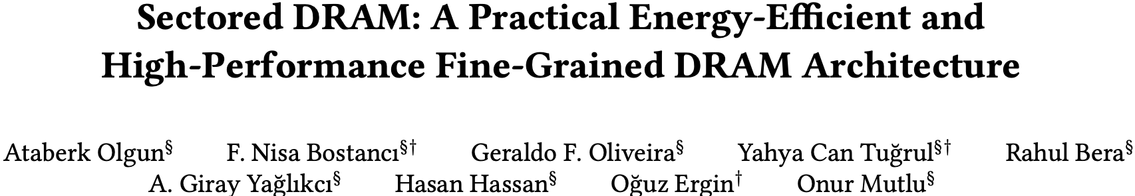
Sectored DRAM
Ataberk Olgun, F. Nisa Bostanci, Geraldo F. Oliveira, Yahya Can Tugrul, Rahul Bera, A. Giray Yaglikci, Hasan Hassan, Oguz Ergin, and Onur Mutlu,
"Sectored DRAM: A Practical Energy-Efficient and High-Performance Fine-Grained DRAM Architecture"
ACM Transactions on Architecture and Code Optimization (TACO), [online] June 2024.
[arXiv version]
[ACM Digital Library version]
https://arxiv.org/pdf/2207.13795

Slide 48
MIMDRAM: Key Idea (III)
segmented global wordline
row decoder
global sense amplifier
  Use fine-grained DRAM for processing-using-DRAM:
1
Improves SIMD utilization
for a single PUD operation, only access the DRAM mats with target data
for multiple PUD operations, execute independent operations concurrently
Notes:
In the context of processing-using-DRAM, fine-grained DRAM provides three benefits
[CLICK] First, it improves SIMD utilization for a single PUD operations, by accessing only the DRAM mats with the target input operands
[NEXT]

Slide 49
MIMDRAM: Key Idea (III)
segmented global wordline
row decoder
global sense amplifier
  Use fine-grained DRAM for processing-using-DRAM:
1
Improves SIMD utilization
for a single PUD operation, only access the DRAM mats with target data
for multiple PUD operations, execute independent operations concurrently
→ multiple instruction, multiple data (MIMD) execution model
Notes:
Also, we can leverage the unused DRAM mats to concurrently execute independent PUD operations, in a multiple instruction, multiple data execution model
[NEXT]

Slide 50
MIMDRAM: Key Idea (III)
segmented global wordline
row decoder
global sense amplifier
global sense amplifier
  Use fine-grained DRAM for processing-using-DRAM:
1
Improves SIMD utilization
for a single PUD operation, only access the DRAM mats with target data
for multiple PUD operations, execute independent operations concurrently
→ multiple instruction, multiple data (MIMD) execution model
2
Enables low-cost interconnects for vector reduction
global and local data buses can be used for inter-/intra-mat communication
Notes:
Second, we can leverage the global and local data buses that connect DRAM mats to move data within a DRAM subarray, allowing for the implementation of vector reduction operations
[NEXT]

Slide 51
MIMDRAM: Key Idea (III)
512 columns
segmented global wordline
row decoder
global sense amplifier
  Use fine-grained DRAM for processing-using-DRAM:
1
Improves SIMD utilization
for a single PUD operation, only access the DRAM mats with target data
for multiple PUD operations, execute independent operations concurrently
→ multiple instruction, multiple data (MIMD) execution model
2
Enables low-cost interconnects for vector reduction
global and local data buses can be used for inter-/intra-mat communication
3
Eases programmability
SIMD parallelism in a DRAM mat is on par with vector ISAs’ SIMD width
Notes:
Third, since the number of DRAM rows in a single DRAM mat are on par with the number of SIMD lanes in vector ISAs, we can ease PUD’s programmability by leveraging current compiler infrastructure for such ISAs
[NEXT]

Slide 52
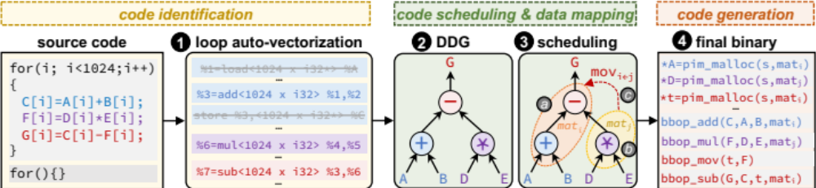
MIMDRAM: Compiler Support
Transparently to programmer:
extract SIMD parallelism from an application, and
schedule PUD instructions while maximizing utilization
Goal
Three new LLVM-based passes targeting PUD execution
Notes:
Our goal is to transparently from the user, extract SIMD parallelism from an application and schedule PUD instructions while maximizing SIMD utilization
[CLICK] To this end, we implemented three LLVM passed targeting PUD execution
[NEXT]

Slide 53
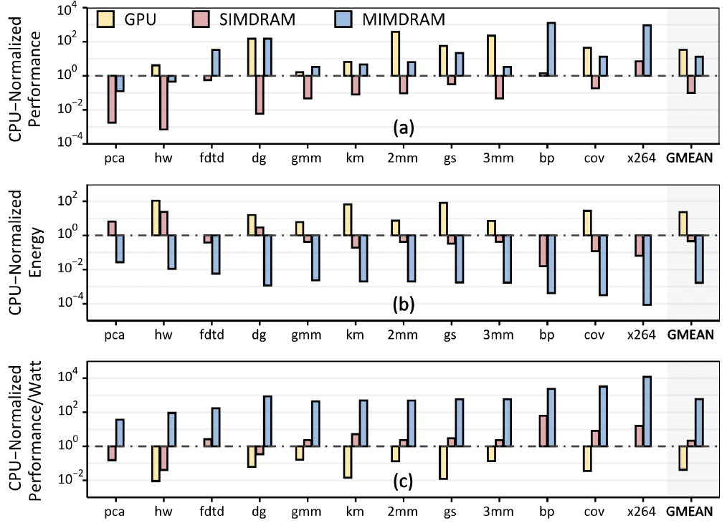
MIMDRAM Perf, Energy, Perf/Watt
582X and 13,612X the energy efficiency of CPU and GPU, respectively
Notes:
We evaluate MIMDRAM using twelve real-world applications
and 495 multi-programmed application mixes.
When using 64 DRAM subarrays per bank and 16
banks for PuD computation in a DRAM chip, MIMDRAM
provides 1) 13.2Å~/0.22Å~/173Å~ the performance,
2) 0.0017Å~/0.00007Å~/0.004Å~ the energy consumption, 3)
582.4Å~/13612Å~/272Å~ the performance per Watt of the
CPU [215]/GPU [216]/SIMDRAM [174] baseline (Fig. 5) and
4) when using a single DRAM subarray, 15.6°ø the SIMD
utilization (i.e., SIMD efficiency) of the prior state-of-the-art
PuD framework, SIMDRAM [174].

Slide 54
Capabilities of Off-The-Shelf Memory
Existing DRAM Chips
Are Already Quite Capable

Slide 55
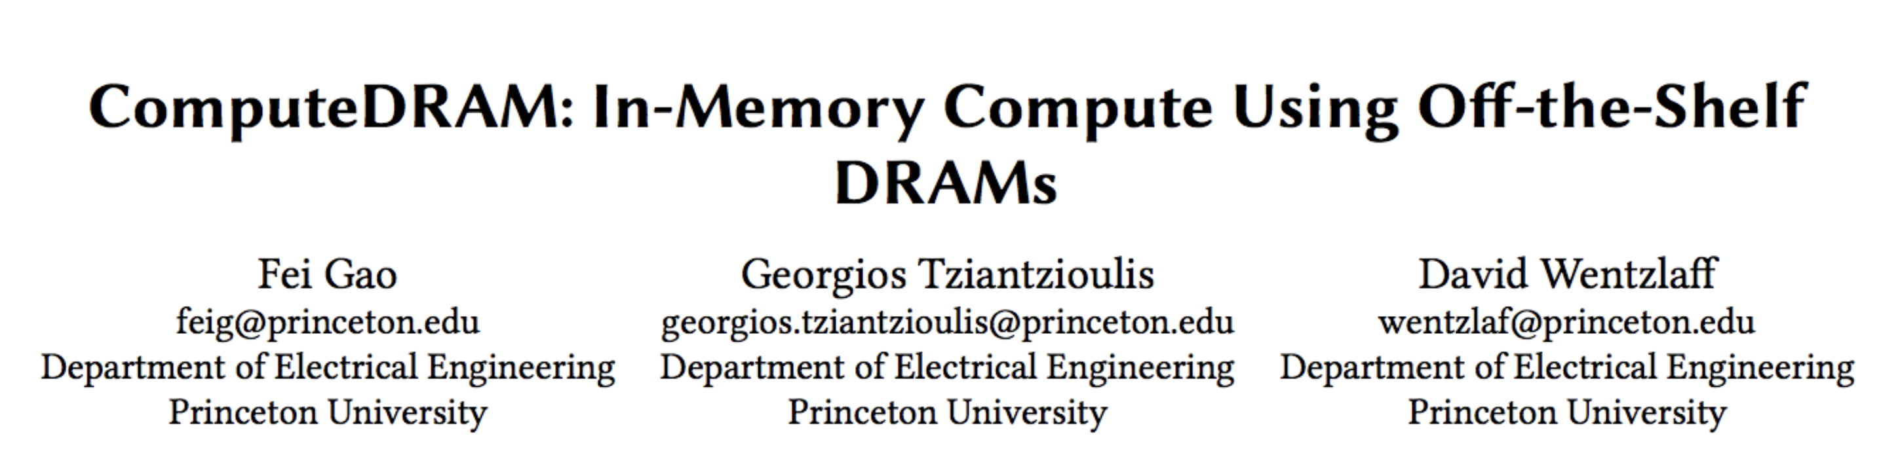
RowClone and MAJ3 in Real DRAM Chips
Key Idea: Violate DRAM timing parameters
to mimic RowClone and Ambit’s MAJ3 operation

Slide 56
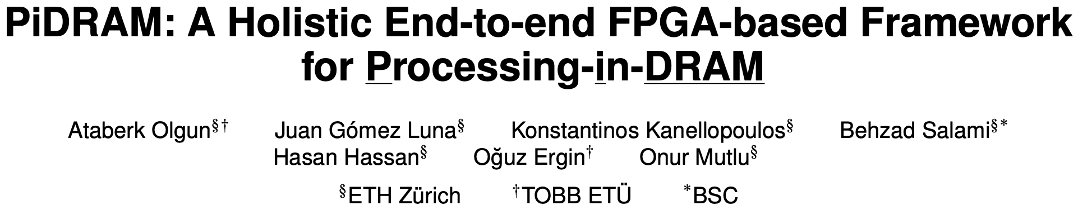
Real Processing Using Memory Prototype
End-to-end RowClone & TRNG using off-the-shelf DRAM chips
Idea: Violate DRAM timing parameters to mimic RowClone
https://arxiv.org/pdf/2111.00082.pdf
https://github.com/cmu-safari/pidram
https://www.youtube.com/watch?v=qeukNs5XI3g&t=4192s

Slide 57
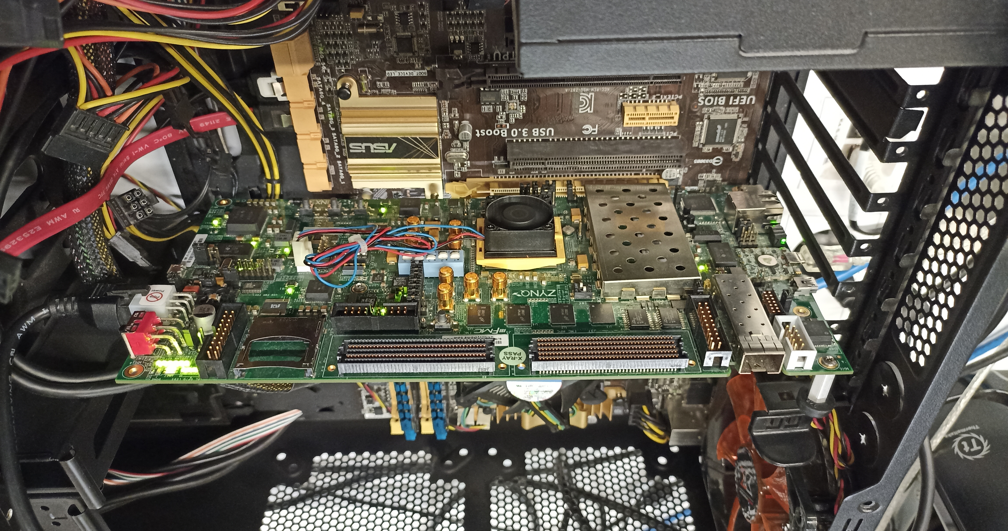
Real Processing Using Memory Prototype
https://arxiv.org/pdf/2111.00082.pdf
https://github.com/cmu-safari/pidram
https://www.youtube.com/watch?v=qeukNs5XI3g&t=4192s
Host Machine
FPGA Board
RISC-V System
PiM-Enabled DIMM

Slide 58
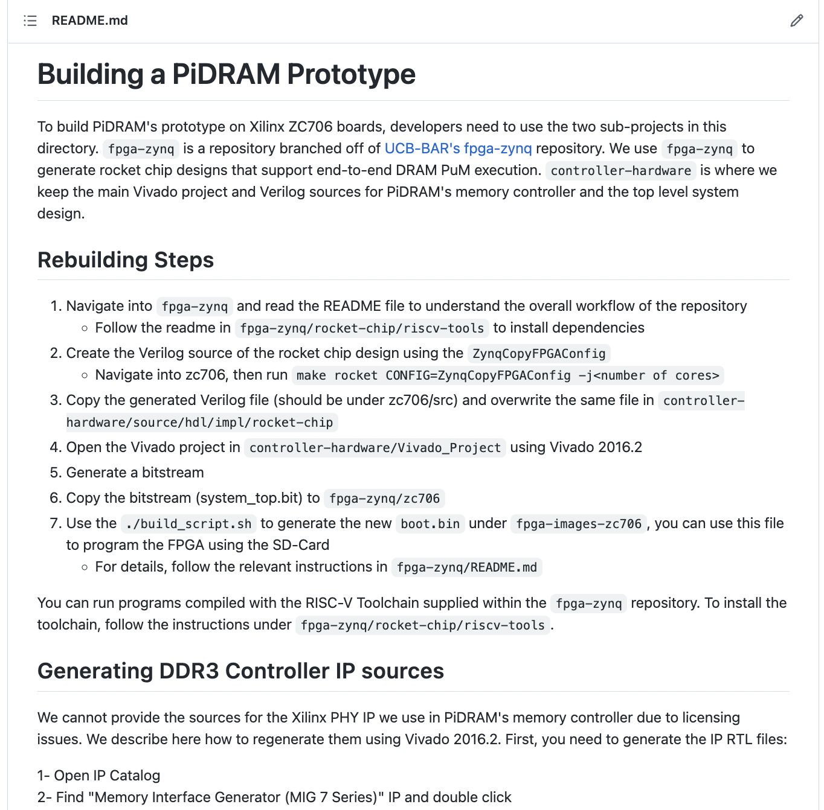
Real Processing Using Memory Prototype
https://arxiv.org/pdf/2111.00082.pdf
https://github.com/cmu-safari/pidram
https://www.youtube.com/watch?v=qeukNs5XI3g&t=4192s

Slide 59
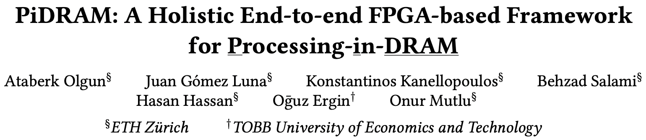
More on PiDRAM
Ataberk Olgun, Juan Gomez Luna, Konstantinos Kanellopoulos,
Behzad Salami, Hasan Hassan, Oguz Ergin, and Onur Mutlu,
"PiDRAM: A Holistic End-to-end FPGA-based Framework for Processing-in-DRAM"
ACM Transactions on Architecture and Code Optimization (TACO), March 2023.
[arXiv version]
Presented at the 18th HiPEAC Conference, Toulouse, France, January 2023.
[Slides (pptx) (pdf)]
[Longer Lecture Slides (pptx) (pdf)]
[Lecture Video (40 minutes)]
[PiDRAM Source Code]

Slide 60
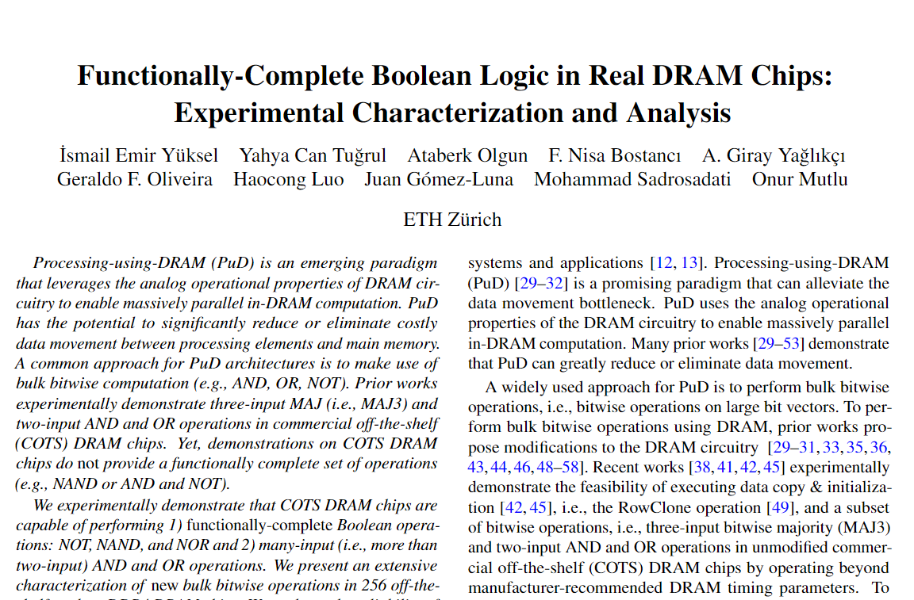
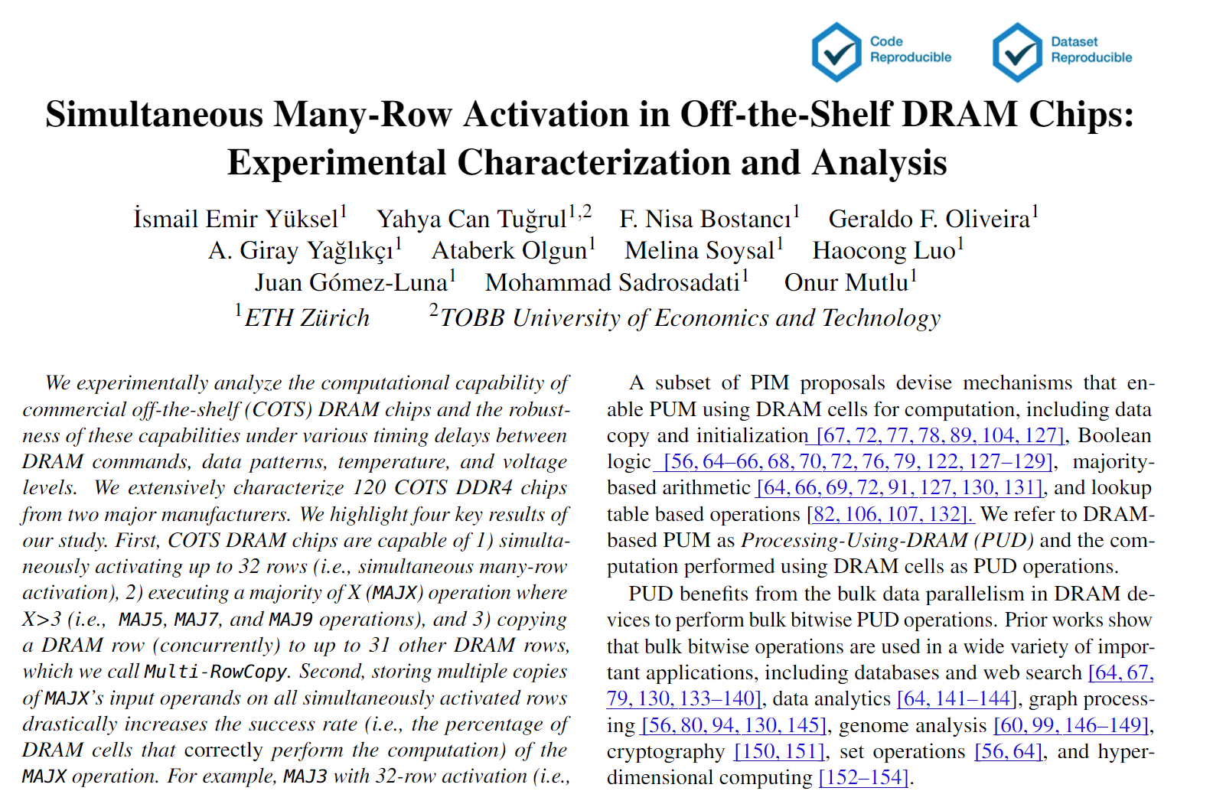
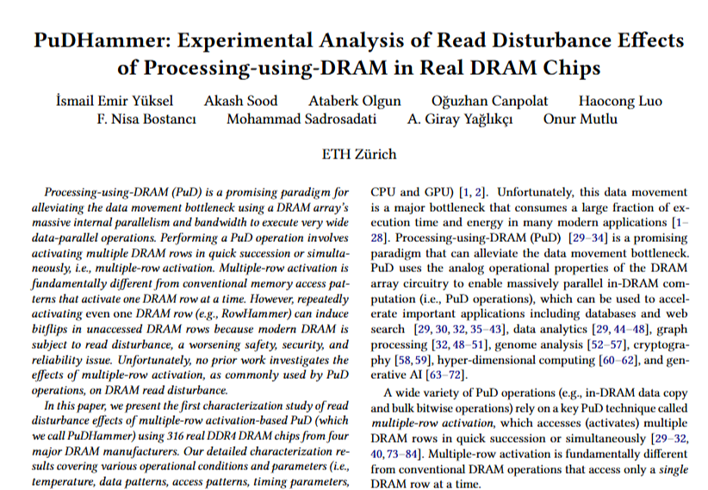
Focus on Recent Real DRAM Chip-based PuD Works
HPCA 2024
DSN 2024
ISCA 2025

Slide 61
Functionally-Complete Boolean Logic in Real DRAM Chips
Experimental Characterization and Analysis
Ismail Emir Yüksel
Yahya C. Tugrul Ataberk Olgun F. Nisa Bostancı
A. Giray Yaglıkçı Geraldo F. Oliveira Haocong Luo
Juan Gómez–Luna Mohammad Sadr Onur Mutlu
Notes:
Hello, I am Ismail Emir Yuksel.
I will be presenting our work, Functionally-Complete Boolean Logic in Real DRAM Chips

Slide 62
Executive Summary
Motivation: Processing-using-DRAM can alleviate
the performance and energy bottlenecks caused by data movement
  Prior works show that existing DRAM chips can perform
  three-input majority and two-input AND and OR operations
Problem: Proof-of-concept demonstrations on
commercial off-the-shelf (COTS) DRAM chips do not provide
  functionally-complete operations (e.g., NAND or NOR)
  NOT operation
  AND and OR operations with more than two inputs
Experimental Study: 256 DDR4 chips from two major manufacturers
Key Results:
  COTS DRAM chips can perform NOT and
  {2, 4, 8, 16}-input AND, NAND, OR, and NOR operations
  with very high reliability (>94% success rate)
  Data pattern and temperature only slightly affect
  the reliability of these operations (<1.98% decrease in success rate)
Notes:
Let’s start with an executive summary.
[CLICK] Processing-Using-DRAM is a promising paradigm that can alleviate the performance and energy bottlenecks caused by frequent data movement between main memory and processing units.
[CLICK] Proof-of-concept demonstrations on commercial-off-the-shelf DRAM chips do not provide
[CLICK]Functionally-complete operations, such as NAND or NOR
[CLICK] NOT operation
[CLICK] More than two-input AND and OR operations
[CLICK]In this study, we test 256 off-the-shelf DDR4 DRAM chips from two major manufacturers
[CLICK] Based on our analyses, we highlight that
[CLICK] We can perform NOT and up to 16-input AND, NAND, OR, and NOR operations with very high reliability
[CLICK] The impact of data patterns and the temperature on the reliability of these operations are small.
our work demonstrates the capability of performing functionally-complete Boolean logic in COTS DRAM chips. We believe these empirical results demonstrate
the promising potential of using DRAM as a computation substrate. Now let’s delve in ..

Slide 63
DRAM Organization
DRAM Module
DRAM
Chip
Sense Amplifiers
DRAM Cell
…
Subarray
Bank
DRAM Row
Chip I/O
Sense Amps.
…
Wordline
Bitline
DRAM Chip
DRAM Bank
Notes:
DRAM is used as the main memory in many computing systems. [CLICK]
a DRAM module consists of multiple DRAM chips [CLICK]
Each chip contains multiple banks [CLICK]
Each bank is composed of multiple subarrays and sense amplifiers [CLICK]
And within each subarray, there is a two dimensional array of DRAM cells. [CLICK]
These cells are organized into rows that are selected using wordlines [CLICK]
And the cells are connected to a row of sense amplifiers via bitlines [CLICK]

Slide 64
DRAM Open Bitline Architecture
SA
SA
bitline
SA
Sense
Amplifier
SA
SA
Subarray
bitline
SA
SA
DRAM Bank
Notes:
To achieve high-density DRAM chips, open-bitline architecture is widely adopted in modern DRAM modules.
[CLICK]
In this architecture each subarray’s bitlines are connected to two rows of sense amplifiers one above and one below the subarray,
This results in neighboring subarrays share common sense amplifiers.

Slide 65
DRAM Open Bitline Architecture
Activated
SA
SA
bitline
Sense
Amplifier
NOT
Gate
SA
SA
Subarray
bitline
SA
SA
DRAM Bank
Not
Activated
Serves as the reference for the SA
Notes:
[Click] During an activation, another bitline in a neighboring subarray is also involved to serve as the reference of the sense amplifier, which is bitline-bar in this example.
After a successful activation, the bitline and bitline-bar have a complementary voltage
[CLICK] as the sense amplifier consists of two back-to-back inverters.

Slide 66
DRAM Operation
DRAM Subarray
1
ACTIVATE (ACT):
Fetch the row’s content
into the sense amplifiers
2
Column Access (RD/WR):
Read/Write the target
column and drive to I/O
Sense
Amplifiers
3
PRECHARGE (PRE):
Prepare the bank
for a new ACTIVATE
I/O Circuitry
Notes:
Data is internally accessed in a row granularity. To access data,
[CLICK] the memory controller first needs to activate the row that contains the data and fetch the row’s content into the sense amplifiers
[CLICK] Then, column accesses are serviced from the sense amplifiers
[CLICK] Finally, the subarray needs to be precharged to get ready for the next row activation

Slide 67
The Capability of COTS DRAM Chips
We demonstrate that COTS DRAM chips:
1
Can simultaneously activate up to
48 rows in two neighboring subarrays
2
Can perform NOT operation
with up to 32 output operands
3
Can perform up to 16-input
AND, NAND, OR, and NOR operations
Notes:
[CLICK]In this study, we experimentally demonstrate that off-the-shelf DRAM chips
[CLICK] Can simultaneously activating up to 48 DRAM rows in two neighboring subarrays
[CLICK] Can performing NOT operation with up to 32 output operands
[CLICK] Can performing up to 16-input AND, NAND, OR, and NOR operations

Slide 68
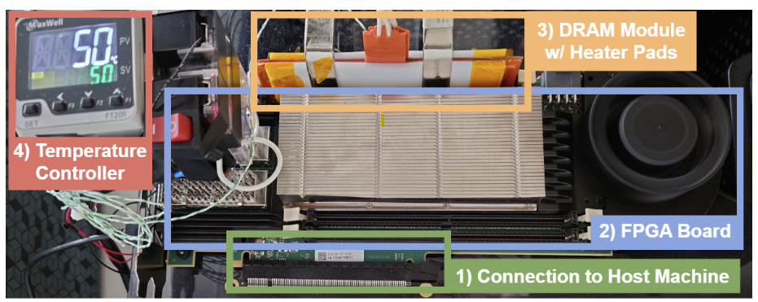
DRAM Testing Infrastructure
Developed from DRAM Bender [Olgun+, TCAD’23]*
Fine-grained control over
DRAM commands, timings, and temperature
*Olgun et al., "DRAM Bender: An Extensible and Versatile FPGA-based Infrastructure
to Easily Test State-of-the-art DRAM Chips," TCAD, 2023.
Notes:
[CLICK] We use a FPGA based DDR4 testing infrastructure developed from DRAM bender that
[CLICK] enables fine-grained control over DRAM commands, timings, and temperature

Slide 69
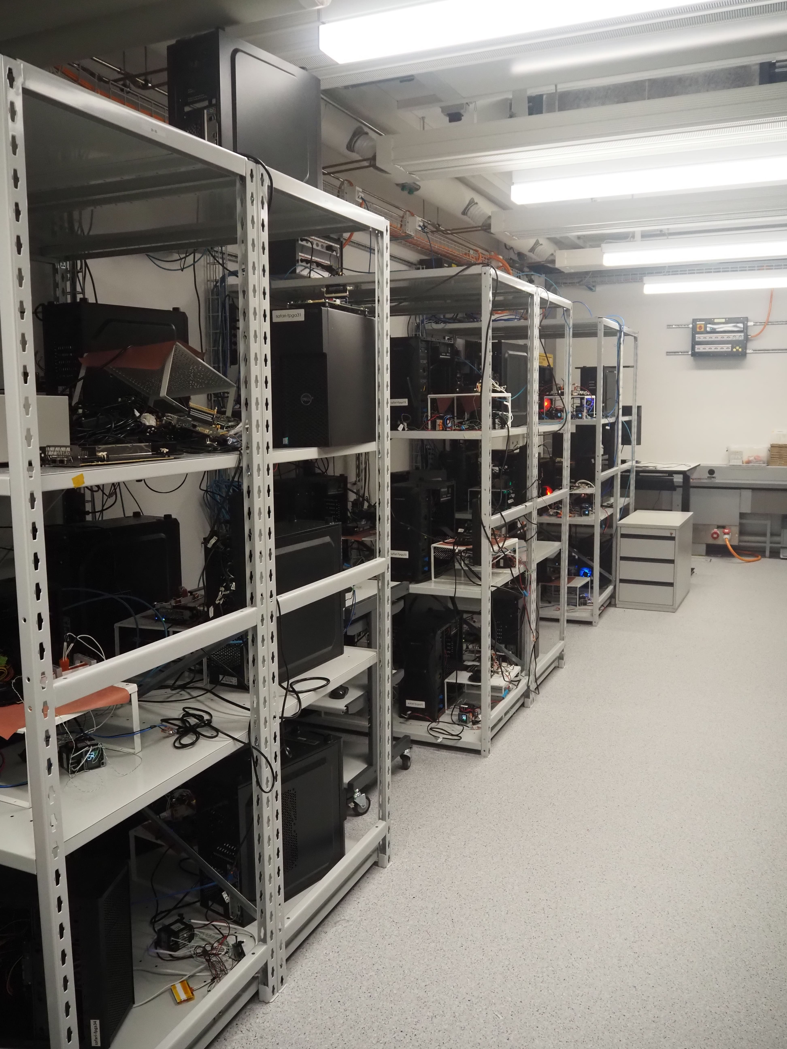
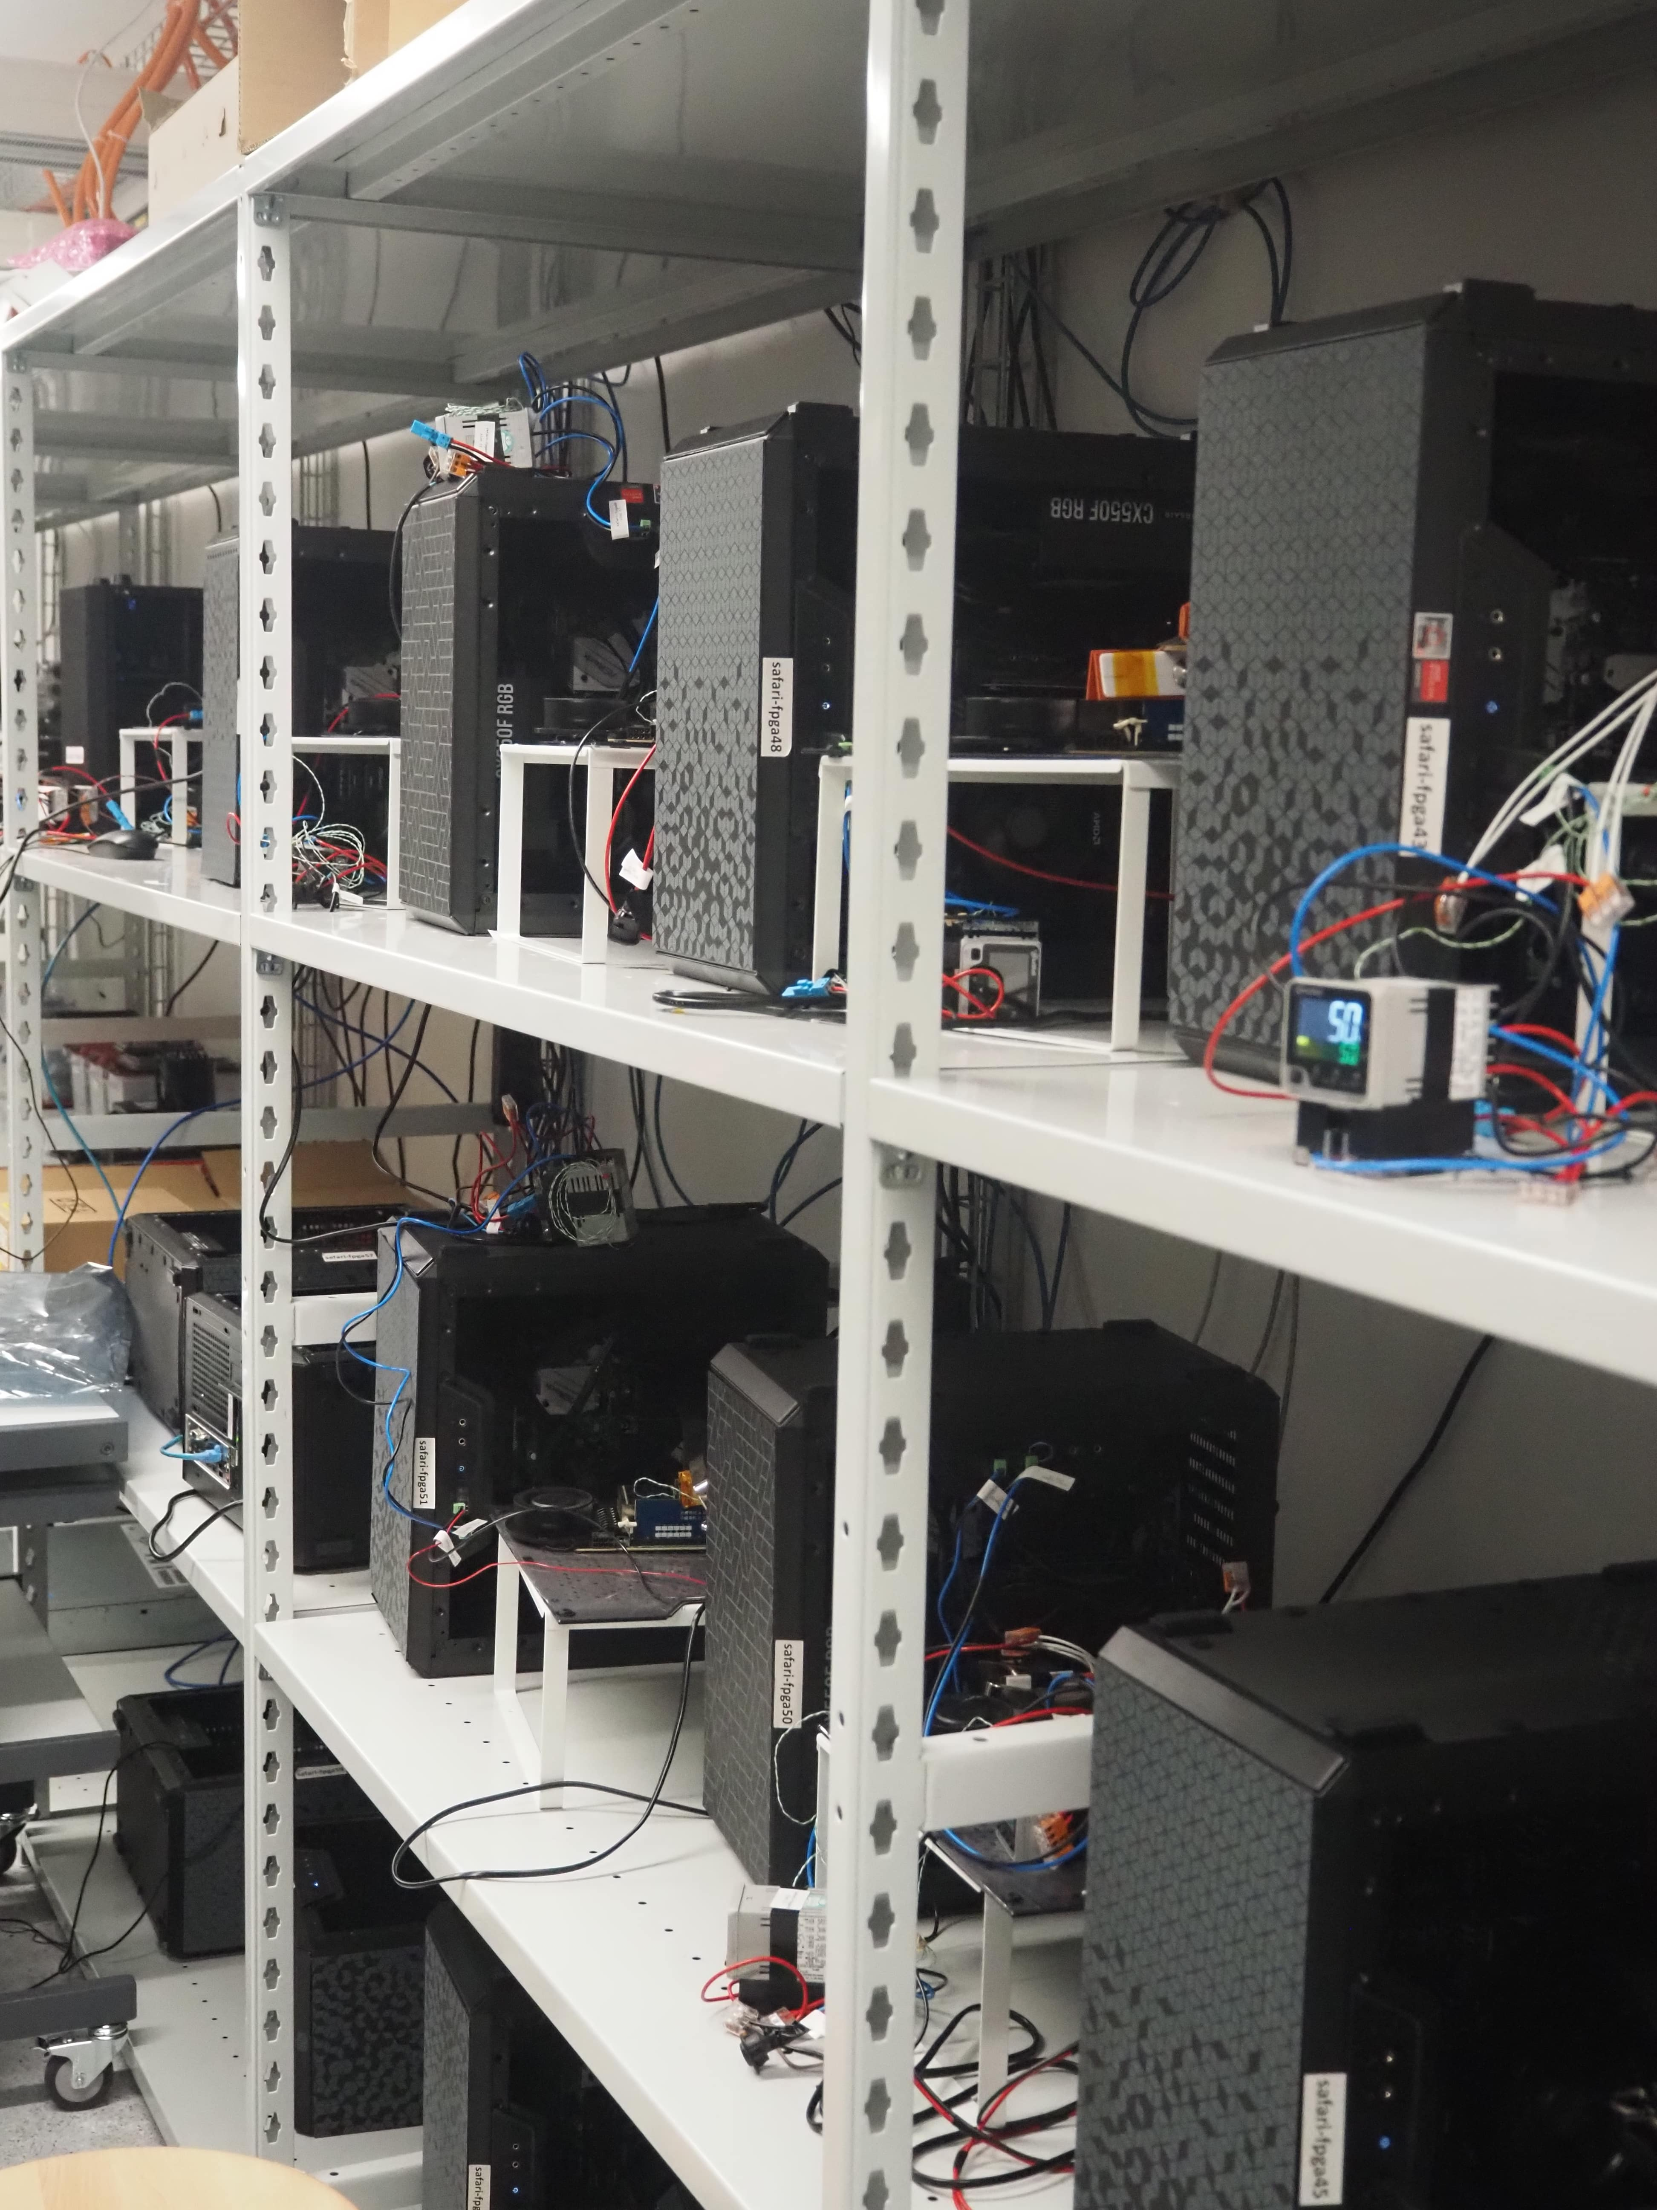
Laboratory for Understanding Memory
Notes:
And in our lab, we have many machines to test many DRAM modules and chips

Slide 70
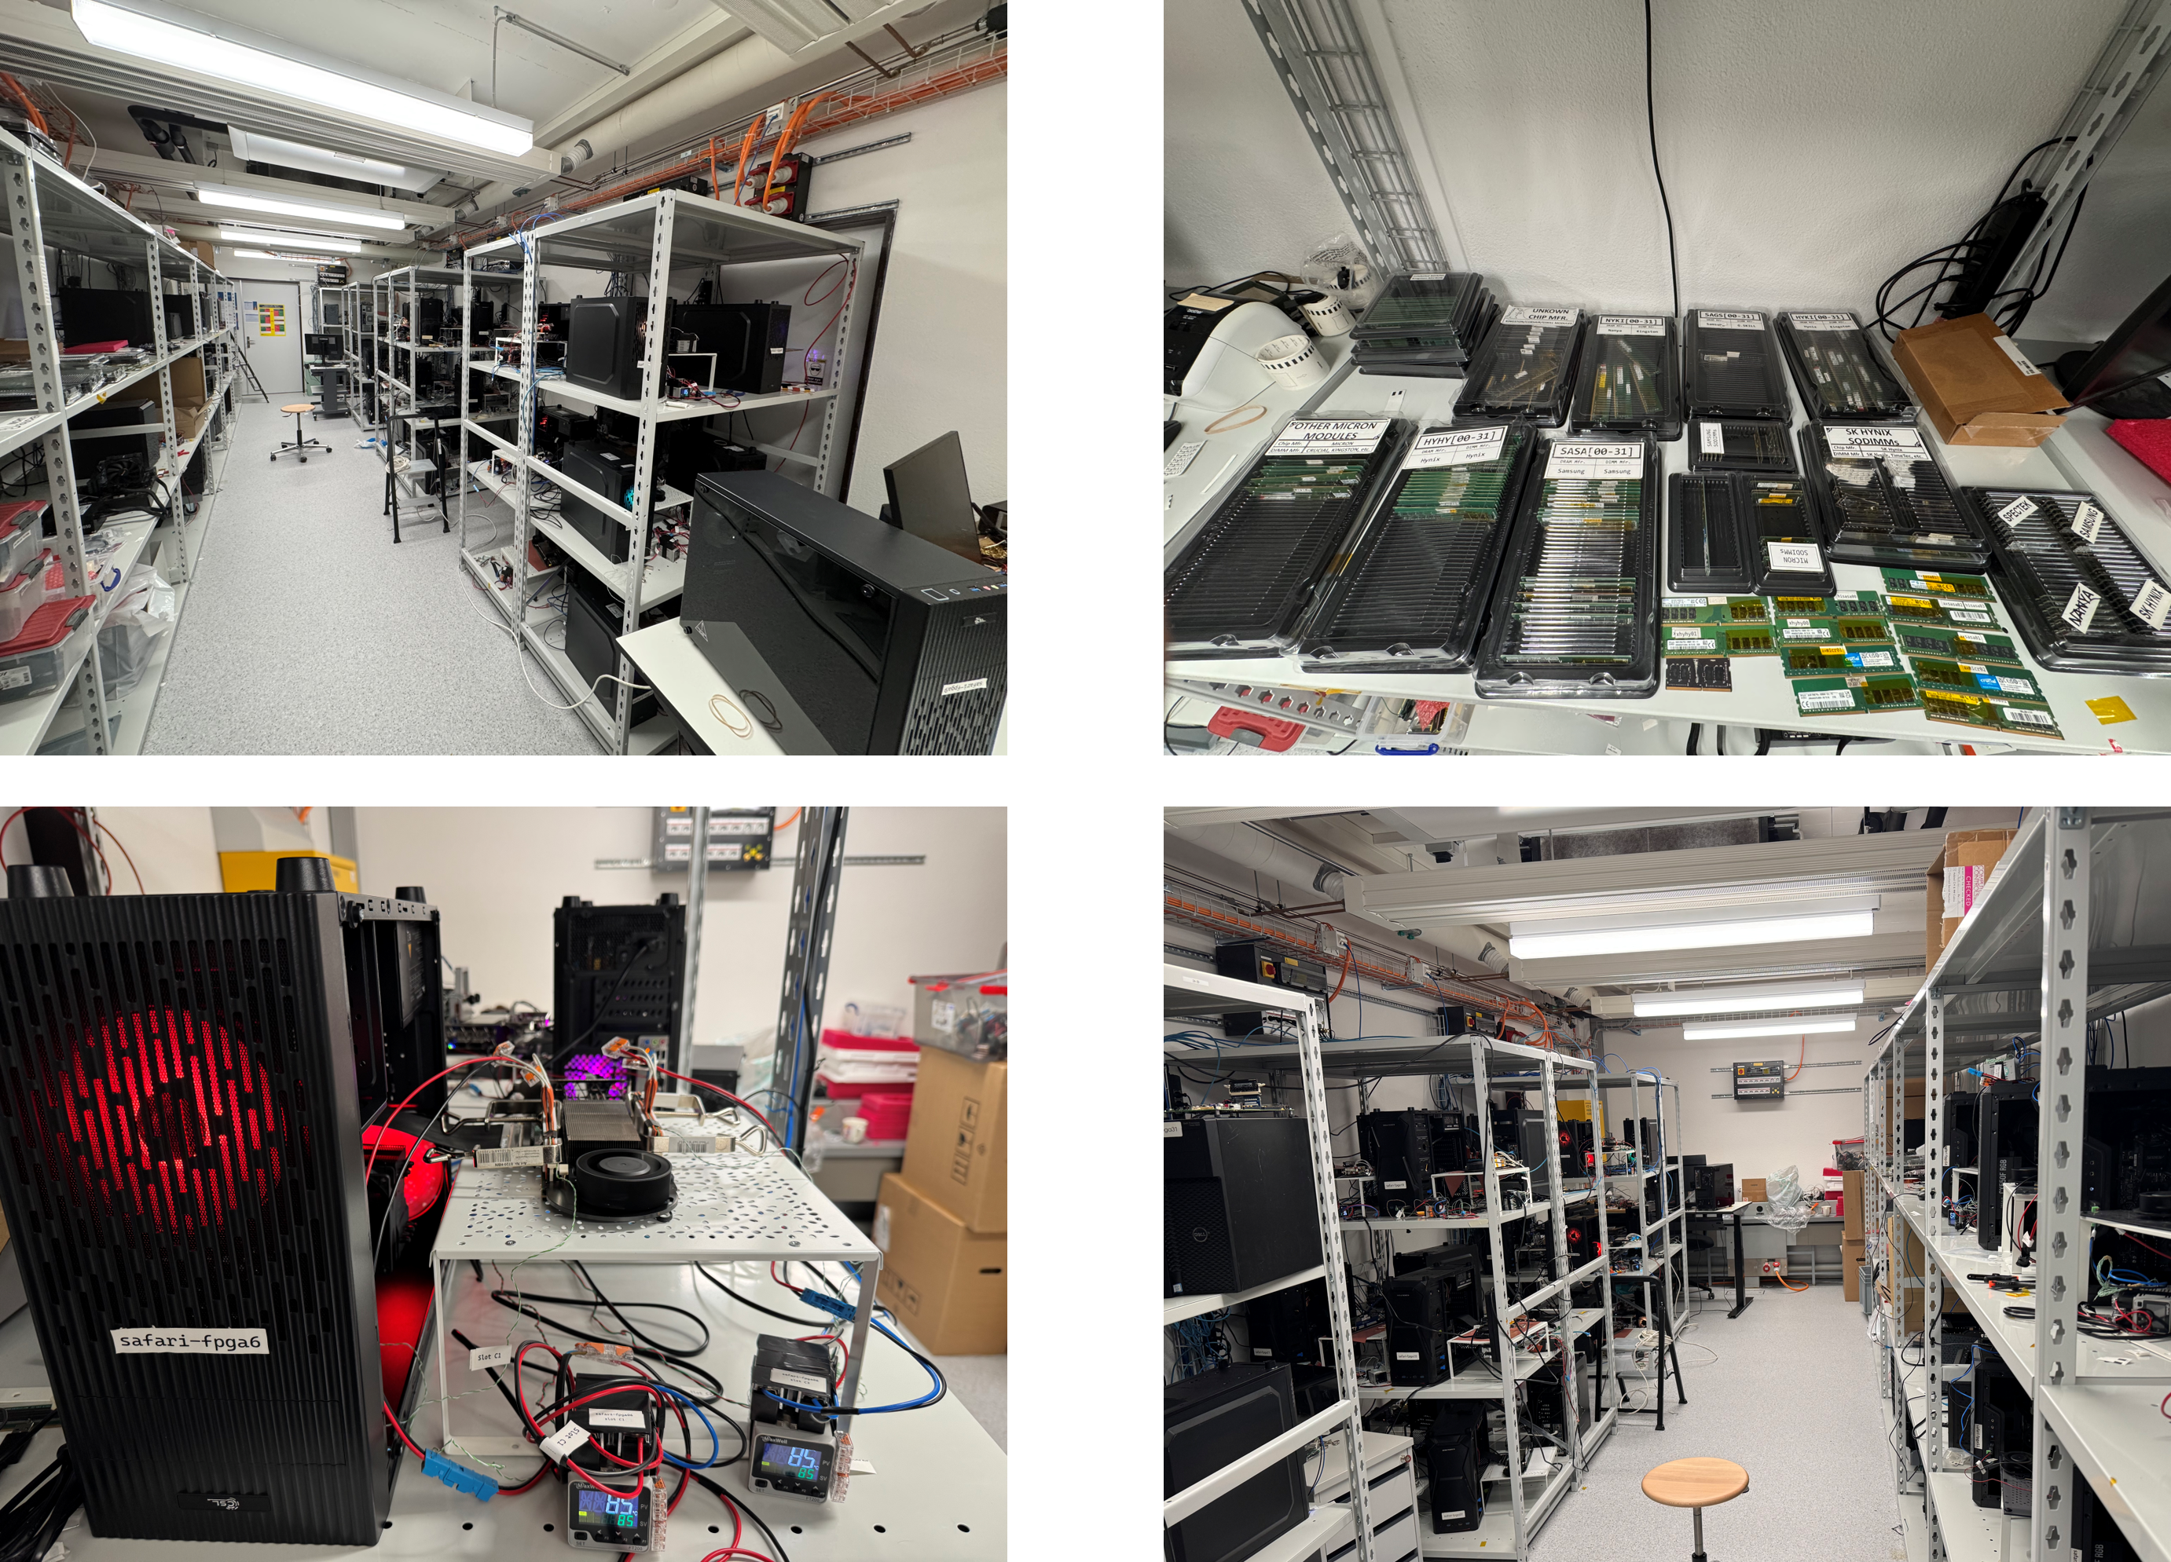
Laboratory for Understanding Memory
Notes:
And in our lab, we have many machines to test many DRAM modules and chips

Slide 71
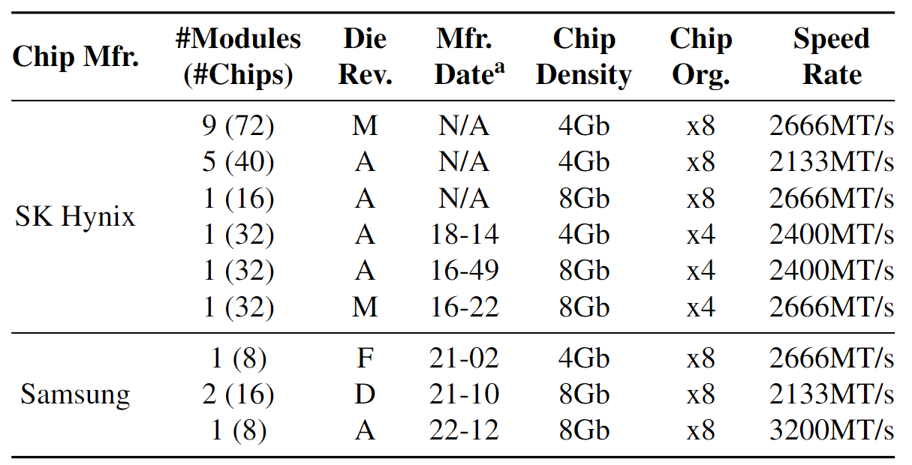
DRAM Chips Tested
256 DDR4 chips from two major DRAM manufacturers
Covers different die revisions and chip densities
Notes:
[CLICK]We test 256 DDR4 chips from two major DRAM manufacturers,
[CLICK] covering different die densities and revisions

Slide 72
The Capability of COTS DRAM Chips
We demonstrate that COTS DRAM chips:
1
Can simultaneously activate up to
48 rows in two neighboring subarrays
2
Can perform NOT operation
with up to 32 output operands
3
Can perform up to 16-input
AND, NAND, OR, and NOR operations
Notes:
[CLICK]In this study, we experimentally demonstrate that off-the-shelf DRAM chips
[CLICK] Can simultaneously activating up to 48 DRAM rows in two neighboring subarrays
[CLICK] Can performing NOT operation with up to 32 output operands
[CLICK] Can performing up to 16-input AND, NAND, OR, and NOR operations

Slide 73
Key Observation
Activating two rows in quick succession
can simultaneously activate
multiple rows in neighboring subarrays
36ns
14ns
ACT Row A
PRE
ACT Row B
<3ns
<3ns
Subarray X
ACT
Row A
Neighboring Subarrays
Shared Sense Amplifiers
Subarray Y
ACT
Row B
DRAM Bank
Notes:
Our key observation is activating two rows in quick succession can simultaneously activate multiple rows in neighboring subarrays
[CLICK] You may remember this pictorial example where Subarray X and Subarray Y are neighbor subarrays and Row A is in Subarray X and Row B is in Subarray Y.
[CLICK] When we respect to the timing parameters between ACT and PRE and PRE and ACT, we activate a single row at a time.
[CLICK] However, when we greatly violate these timing parameters, we observe that we can activate multiple rows at once in neighboring subarrays

Slide 74
Hypothesis: Row Decoder Circuitry
Simultaneous many-row activation is possible
due to the hierarchical DRAM row decoder design
DRAM Subarray
Row Address
Wordline
Row Decoder
Row Address (RA)
2x4
Stage 1
Decoder
Stage 2
Decoder
Stage 3
Decoder
Stage 4
Decoder
Stage 5
Decoder
Notes:
We hypothesize that simultaneous many-row activation is possible due to the hierarchical DRAM row decoder design
[CLICK] Let’s recall a DRAM subarray where we have rows, sense amplifiers and row decoder circuitry
[CLICK] Row decoder circuitry decodes the row address that is sent with activate command and assert the corresponding wordline
[CLICK] As we mentioned, row decoder circuitry is hierarchical and has multiple stages of decoders
[CLICK] Each decoder stage takes some parts of the row address and asserts intermediate signals that are essentially drives the wordline using such intermediate signals

Slide 75
Row Decoder: A Tree Example
We can visualize the hierarchical row decoder circuitry as a tree
Decoder Output
...
...
...
...
...
Wordline A
...
...
...
...
...
...
...
...
Wordline B
...
...
...
2x4
Stage 1
Decoder
Stage 5
Decoder
Notes:
To explain it in a higher abstraction level,
[CLICK] We can visualize the row decoder as a tree which
[CLICK] Each level of the tree represents a decoder stage
[CLICK] each node represents a decoder output

Slide 76
Activating a Single Row
36ns
ACT Row A
PRE
1. Decode
Row A address
...
...
...
...
Wordline A
...
Wordline A
2. Assert
corresponding signals
...
...
...
...
3. Follow
asserted nodes path from root to leaf
...
...
...
...
4. Assert wordline
...
Wordline B
...
...
Notes:
Let’s see an example when we activate a single row
[CLICK] Assume that we issue ACT Row A command, which will essentially assert the Wordline A signal
[CLICK] After issuing the activation command, the row decoder circuitry decodes Row A address
[CLICK] And assert corresponding signals in the tree
[CLICK] After the decoding completed, row decoder follows the asserted nodes path from root to leaf
[CLICK] As a result, it asserts wordline, in this it is Wordline A
[CLICK] After a successful activation we can issue PRE command which deasserts every asserted signals in the row decoder circuitry including the wordline

Slide 77
Activating Many Rows: A Walkthrough
Back-to-back ACT commands with violated timings
asserts many more signals in the row decoder
36ns
14ns
ACT Row A
PRE
ACT Row B
<3ns
<3ns
...
...
...
1. Keep the previously asserted signals active
...
Wordline A
...
Wordline A
...
2. Decode Row B &
assert corresponding signals
...
...
...
...
3. Follow
newly asserted nodes’ path
...
...
...
4. Simultaneously
activate many rows
Wordline B
...
Wordline B
...
...
Notes:
So that was an activation of a single row, now let’s see a simultaneous activation of many rows.
[CLICK] Our hypothesis is back-to-back ACT commands with violated timings asserts many more signals in the circuitry

Slide 78
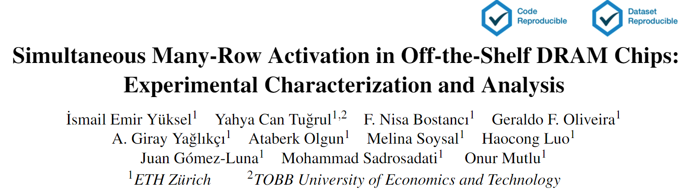
Hypothesis: Row Decoder Circuitry
(More discussions & hypotheses in the paper)
https://arxiv.org/pdf/2405.06081
Notes:
As our time limited, I would like to refer you to our paper for more detailed circuitry and discussions about row decoder circuitry

Slide 79
Key Results
COTS DRAM chips have two distinct sets of
activation patterns in neighboring subarrays
when two rows are activated with violated timings
Exactly the same number of rows
in each subarray
are activated
Twice as many rows in one subarray
compared to its neighbor subarray are activated
Subarray X
Subarray X
Up to 16 rows
Up to 16 rows
Shared Sense Amplifiers
Shared Sense Amplifiers
Subarray Y
Subarray Y
Up to 16 rows
Up to 32 rows
A total of 32 rows
A total of 48 rows
Notes:
We observe when Row A and B in neighboring subarrays are activated with violated timing parameters
[CLICK] Off-the-shelf DRAM chips have two distinct sets of simultaneous activation patterns in two neighboring subarrays
[CLICK] First pattern is exactly the same number rows in each subarray are activated.
[CLICK] We observe that we can activate up to 16 rows in neighboring subarrays, in other words a total of 32 rows
[CLICK] Second pattern is twice as many rows in one subarray compared to its neighbor subarray are activated
[CLICK] We observe that we can activate up to 16 rows in one subarray while activating up to 32 rows in its neighbor subarray, a total of 48 rows

Slide 80
The Capability of COTS DRAM Chips
We demonstrate that COTS DRAM chips:
1
Can simultaneously activate up to
48 rows in two neighboring subarrays
2
Can perform NOT operation
with up to 32 output operands
3
Can perform up to 16-input
AND, NAND, OR, and NOR operations
Notes:
[CLICK]In this study, we experimentally demonstrate that off-the-shelf DRAM chips
[CLICK] Can simultaneously activating up to 48 DRAM rows in two neighboring subarrays
[CLICK] Can performing NOT operation with up to 32 output operands
[CLICK] Can performing up to 16-input AND, NAND, OR, and NOR operations

Slide 81
Key Idea
Connect rows in neighboring subarrays
through a NOT gate by simultaneously activating rows
src
src
src
NOT gate
A
A
A
SA
SA
SA
ACT src
ACT dst
~A
dst
dst
dst
Notes:
Our key idea is to leverage the connection between neighboring subarrays,
[CLICK] the NOT gate in the sense amplifier.
[CLICK] By simultaneously activating rows in neighboring subarrays, we can connect these rows through a NOT gate
[CLICK] As an example, source and destination in neighboring subarrays and if we first activate src
[CLICK] and then activate destination, this result in sense amplifier to drive the negated src value to the dst

Slide 82
NOT Operation: A Walkthrough
ACT src
GND
½ V_{DD}
src
connects src to bitline
dst
½ V_{DD}
GND
Notes:
Let’s see how we can perform NOT operation in real DRAM chips at a lower abstraction-level
[CLICK] As an example, we have source and destination cells, both store GROUND (low voltage) and bitlines are precharged to vdd over two
[CLICK] We first issue an activation to the source, which asserts the source wordline and starts charge sharing process between source and its bitline

Slide 83
NOT Operation: A Walkthrough
ACT src
Nominal
GND
GND
drives bitline to GND
src
drives bitline to VDD
dst
VDD
GND
Notes:
We wait for nominal timing parameters, which assures sense amplifier amplifies the difference and
[CLICK] drives ground to the source’s bitline and VDD to the destination’s bitline

Slide 84
NOT Operation: A Walkthrough
ACT src
PRE
ACT dst
Nominal
<3ns
GND
src
sense amplifier is still enabled
connects dst to bitline
dst
VDD
dst’s bitline is still VDD
Notes:
We then issue back-to-back precharge and activation commands with violated timing parameters. This operation leads to
[CLICK] connecting destination cell to its bitline
[CLICK] keeping the sense amplifier enabled
[CLICK] keeping the destination’s bitline to VDD

Slide 85
NOT Operation: A Walkthrough
ACT src
PRE
ACT dst
Nominal
<3ns
GND
negated value of src (VDD) is written to dst
src
dst
VDD
Notes:
Eventually, as sense amplifier is enabled and bitline is still VDD, the negated value of the source, which is VDD, is written to dst

Slide 86
Reliability Metric
Success Rate (for a DRAM cell)
Percentage of trials where the correct output of
a tested operation is stored in the cell
GND
Total of 10000 trials
src
…
dst
GND
Success rate for this cell: 50%
Notes:
To evaluate the reliability of NOT Operation,
[CLICK]we define a metric called success rate
[CLICK] Success rate for a DRAM cell refers to percentage of correct trials
[CLICK] We test total of 10000 trials and record the success rate for each tested cell

Slide 87
Key Takeaways from In-DRAM NOT Operation
Key Takeaway 1
COTS DRAM chips can perform NOT operations
with up to 32 destination rows
Key Takeaway 2
Temperature has a small effect on
the reliability of NOT operations
Notes:
This analysis provides two key takeaway lessons: [CLICK]
[CLICK] First, off-the-shelf DRAM chips can perform NOT operations with up to 32 destination rows
[CLICK] Second, temperature has a small effect on the reliability of NOT operations

Slide 88
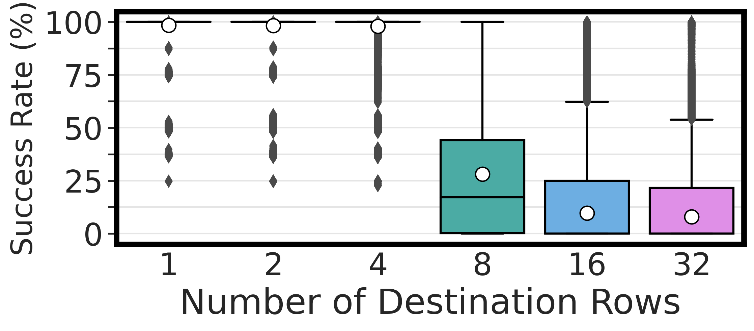
Performing NOT in COTS DRAM Chips
There is at least one DRAM cell that can
perform the NOT operation
with a 100% success rate
COTS DRAM chips can perform NOT operations
with up to 32 destination rows
Notes:
Let’s take a look at our first results
[CLICK] In the x-axis you see the number of destination rows and y-axis shows the success rate distributions across tested DRAM cells
[CLICK] We observe that there is at least one DRAM cell that can perform the NOT operation with a 100% success rate in every tested number of destination rows
[CLICK] Our takeaway from this experiment is off-the-shelf DRAM chips are capable of performing NOT operations with up to 32 destination rows

Slide 89
The Capability of COTS DRAM Chips
We demonstrate that COTS DRAM chips:
1
Can simultaneously activate up to
48 rows in two neighboring subarrays
2
Can perform NOT operation
with up to 32 output operands
3
Can perform up to 16-input
AND, NAND, OR, and NOR operations
Notes:
[CLICK]In this study, we experimentally demonstrate that off-the-shelf DRAM chips
[CLICK] Can simultaneously activating up to 48 DRAM rows in two neighboring subarrays
[CLICK] Can performing NOT operation with up to 32 output operands
[CLICK] Can performing up to 16-input AND, NAND, OR, and NOR operations

Slide 90
Key Idea
Manipulate the bitline voltage to express
a wide variety of functions using
multiple-row activation in neighboring subarrays
V_{REF}
V_{(A,B)}
A
A
B
B
SA
Multiple Row ACT
SA
sense amp.
compares
V_{(A,B)} and V_{(X,Y)}
X
X
Y
Y
V_{REF}
V_{(X,Y)}
Notes:
[CLICK] Let me give the key idea by showing four cells: X,Y,A, and B, two from each neighboring subarrays.
[CLICK] Now if we activate these four cells simultaneously,
[CLICK] the bitline at the bottom subarray becomes the function of voltages in X and Y and the bitline at the top subarray becomes the function of voltages in A and B
[CLICK] Sense amplifier will compare voltage at the bottom bitline to the voltage at the top bitline and figure out which one is higher

Slide 91
Two-Input AND and NAND Operations
ACT
PRE
ACT
<3ns
<3ns
AVG(V_{DD},V_{DD}/2)
V_{DD}
Reference Subarray (REF)
V_{DD}/2*
Compute Subarray (COM)
X
Y
AVG(X,Y)
*Gao et al., "FracDRAM: Fractional Values in Off-the-Shelf DRAM," in MICRO, 2022.
Notes:
Now let me show you the basic intuition to perform two-input AND and NAND operations.
[CLICK] For this example, we have two subarrays: reference and compute subarrays, each of which consists of two cells.
[CLICK] Reference subarray’s cells store VDD and VDD/2 as a side note we store VDD/2,using FracDRAM’s technique.
[CLICK] and in the compute subarray we have X and Y.
With this setup, if we activate all these four cells
[CLICK] using ACT-PRE-ACT sequence, we will get AND of X and Y in the compute subarray and NAND of X and Y in the reference subarray.
[CLICK] To simplify things assume bitlines will have the average value of their corresponding cell’s voltage values. Such as, Reference bitline will be the average of VDD and VDD half.
Now let me prove that that is the case. I am going to cover all combinations of X and Y values.

Slide 92
Two-Input AND and NAND Operations
ACT
PRE
ACT
<3ns
<3ns
3V_{DD}/4
V_{DD}=1 & GND = 0
X
Y
COM
REF
VDD
0
1
sense amp.
compares
the voltages on the bitlines
0
0
0
1
0
1
0
1
1
0
0
1
GND
1
1
1
0
GND
Notes:
In the first row of truth table, X and Y are GND.
[CLICK] This results in bitline in the compute subarray to be GND and the reference bitline is 3 vdd over 4.
[CLICK] Sense amplifier will amplify the voltage difference and since 3 vdd over 4 is greater than GND, reference cells store VDD and compute cells store GND

Slide 93
Two-Input AND and NAND Operations
ACT
PRE
ACT
<3ns
<3ns
3V_{DD}/4
V_{DD}=1 & GND = 0
X
Y
COM
REF
VDD
0
1
sense amp.
compares
the voltages on the bitlines
0
0
0
1
0
1
0
1
0
1
0
1
1
0
0
1
GND
1
1
1
0
V_{DD}/2
Notes:
In the second row of truth table, X is GND and Y is VDD
[CLICK] As the bitline voltage in compute subarray is lower than reference subarray’s bitline voltage
[CLICK] reference cells store VDD and compute cells store GND

Slide 94
Two-Input AND and NAND Operations
ACT
PRE
ACT
<3ns
<3ns
3V_{DD}/4
V_{DD}=1 & GND = 0
X
Y
COM
REF
VDD
0
1
sense amp.
compares
the voltages on the bitlines
0
0
0
1
0
1
0
1
0
1
0
1
1
0
0
1
GND
1
0
0
1
1
1
1
0
V_{DD}/2
Notes:
In the third row of truth table, X is VDD and Y is GND
[CLICK] This results in bitline in the compute subarray to be VDD half and the reference bitline is 3 vdd over 4.
[CLICK] Again, the sense amplifier will amplify the voltage difference and since 3 vdd over 4 is greater than vdd half, reference cells store VDD and compute cells store GND

Slide 95
Two-Input AND and NAND Operations
ACT
PRE
ACT
<3ns
<3ns
3V_{DD}/4
V_{DD}=1 & GND = 0
X
Y
COM
REF
GND
0
1
sense amp.
compares
the voltages on the bitlines
0
0
0
1
0
1
0
1
0
1
0
1
1
0
0
1
VDD
1
0
0
1
1
1
1
0
1
1
1
0
VDD
Notes:
In the last row of truth table, X and Y are both VDD
[CLICK] This results in bitline in the compute subarray to be VDD and the reference bitline is 3 vdd over 4.
[CLICK] Again, the sense amplifier will amplify the voltage difference. However, this time compute subarray’s bitline is greater than. As a results reference cells store GND and compute cells store VDD
Consequently, this example shows compute subarray stores the result of the and operation of X and Y. and reference subarray cells store the result of the nand of operation of X and Y.

Slide 96
Two-Input AND and NAND Operations
ACT
PRE
ACT
<3ns
<3ns
AVG(V_{DD},V_{DD}/2)
V_{DD}=1 & GND = 0
V_{DD}
Reference Subarray (REF)
AND
NAND
X
Y
COM
REF
V_{DD}/2*
0
0
0
1
0
1
0
1
Compute Subarray (COM)
X
1
0
0
1
Y
1
1
1
0
AVG(X,Y)
*Gao et al., "FracDRAM: Fractional Values in Off-the-Shelf DRAM," in MICRO, 2022.

Slide 97
Key Takeaways from In-DRAM Operations
Key Takeaway 1
COTS DRAM chips can perform
{2, 4, 8, 16}-input AND, NAND, OR, and NOR operations
Key Takeaway 2
COTS DRAM chips can perform
AND, NAND, OR, and NOR operations
with very high reliability
Key Takeaway 3
Data pattern slightly affects
the reliability of AND, NAND, OR, and NOR operations

Slide 98
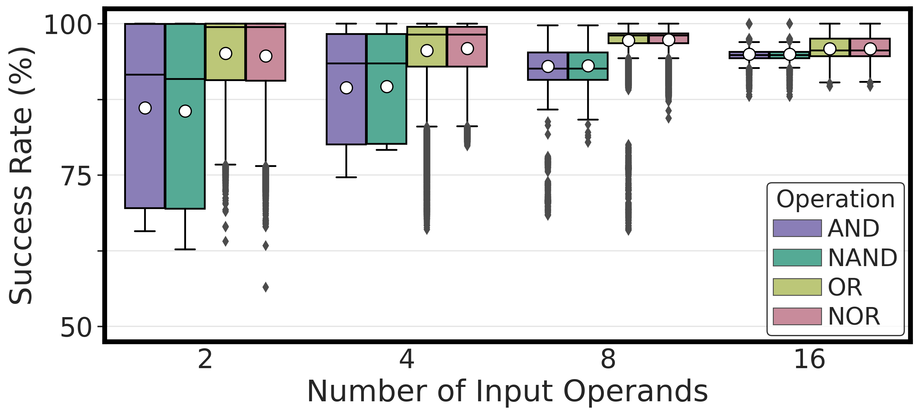
Performing AND, NAND, OR, and NOR
COTS DRAM chips can perform
{2, 4, 8, 16}-input AND, NAND, OR, and NOR operations
Notes:
Let’s see our first results
[CLICK] Here is the plot, in the x-axis we have the number of input operands and y-axis shows the success rate distribution across dram cells and the hue shows the type of operation
[CLICK] Our key takeaway from this experiment is off-the-shelf DRAM chips can perform 2, 4, 8, 16 input AND, NAND, OR, and NOR operations

Slide 99
Performing AND, NAND, OR, and NOR
COTS DRAM chips can perform
16-input AND, NAND, OR, and NOR operations
with very high success rate (>94%)
Notes:
Let’s see our first results
[CLICK] Here is the plot, in the x-axis we have the number of input operands and y-axis shows the success rate distribution across dram cells and the hue shows the type of operation
[CLICK] Our key takeaway from this experiment is off-the-shelf DRAM chips can perform 2, 4, 8, 16 input AND, NAND, OR, and NOR operations

Slide 100
Available on arXiv
https://arxiv.org/pdf/2402.18736.pdf
Notes:
The extended version of our study is available on arxiv

Slide 101
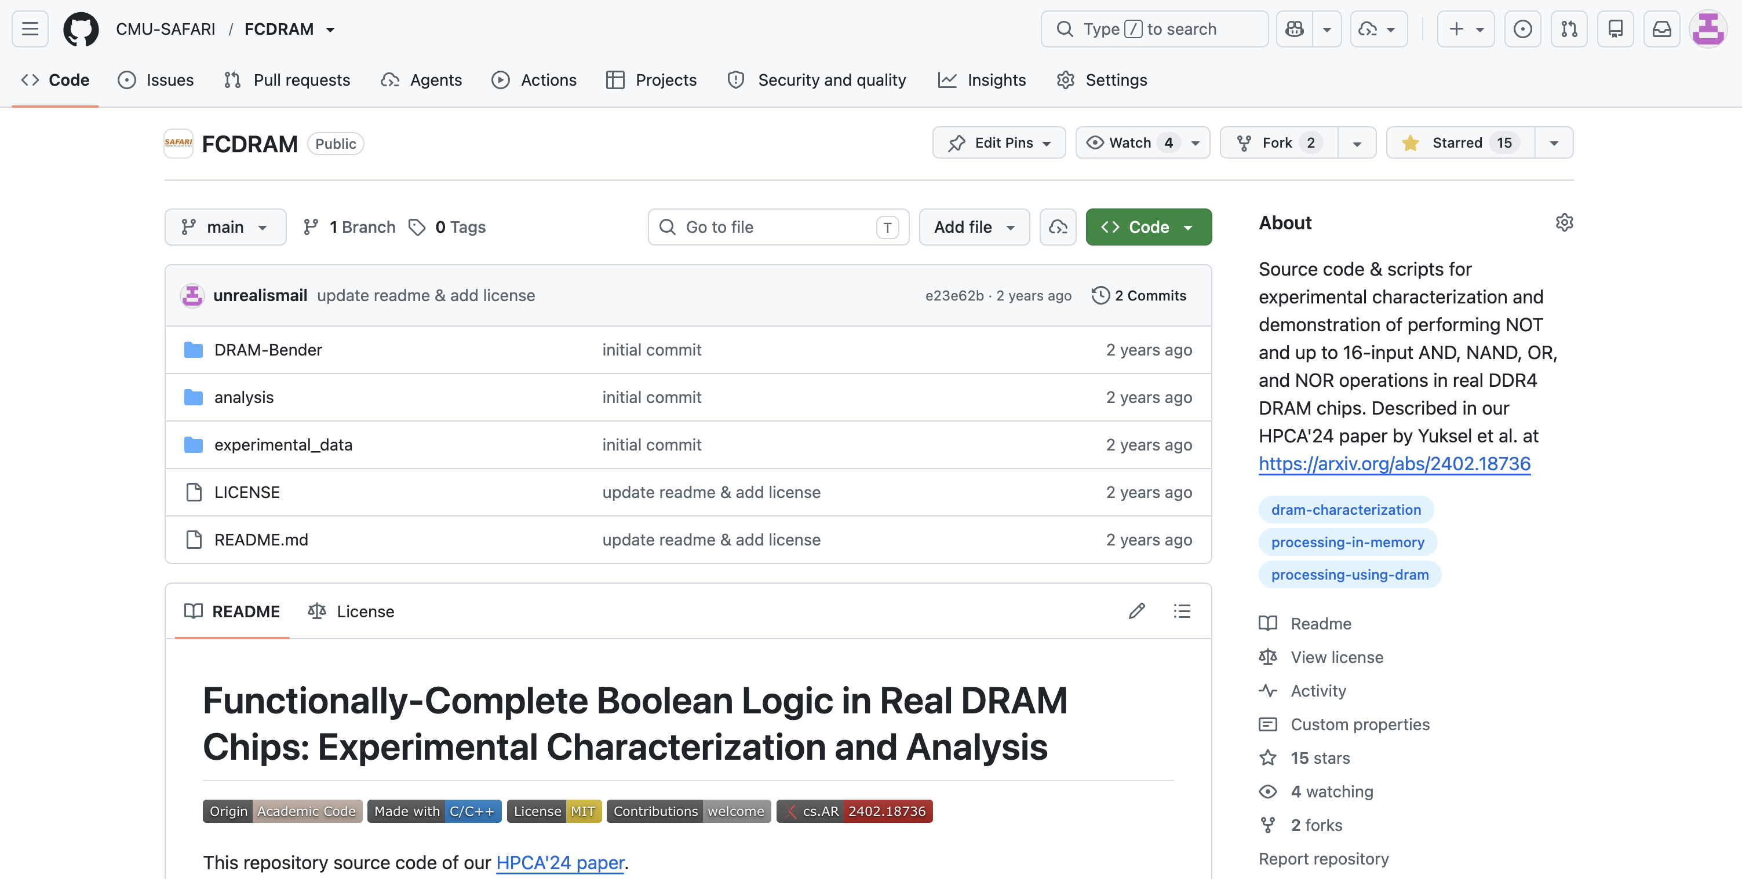
FCDRAM is Open Source

Slide 102
Functionally-Complete Boolean Logic in Real DRAM Chips
Experimental Characterization and Analysis
Ismail Emir Yüksel
Yahya C. Tugrul Ataberk Olgun F. Nisa Bostancı
A. Giray Yaglıkçı Geraldo F. Oliveira Haocong Luo
Juan Gómez–Luna Mohammad Sadr Onur Mutlu
Notes:
Hello, I am Ismail Emir Yuksel.
I will be presenting our work, Functionally-Complete Boolean Logic in Real DRAM Chips

Slide 103


Simultaneous Many-Row Activation in Off-the-Shelf DRAM Chips
Experimental Characterization and Analysis
İsmail Emir Yüksel
Yahya C. Tuğrul F. Nisa Bostancı Geraldo F. Oliveira
A. Giray Yağlıkçı Ataberk Olgun Melina Soysal Haocong Luo
Juan Gómez–Luna Mohammad Sadr Onur Mutlu
Notes:
Hello, I am Ismail Emir Yuksel.
I will be presenting our work, Simultaneous Many-Row Activation in Off-the-Shelf DRAM Chips

Slide 104
Leveraging Simultaneous Many-Row Activation
1
Perform MAJX (where X>3) operations
2
Increase the robustness of MAJX operations
3
Copy one row’s content to multiple rows
Notes:
By leveraging simultaneous many-row activation, we can
[CLICK] Perform majority operations with more than three inputs
[CLICK] We can increase the robustness of majority operations
[CLICK] And we can copy one row’s content to multiple rows

Slide 105
In-DRAM Majority-of-X (MAJX)
Simultaneously activate many rows to perform MAJX (where X>3) operations
MAJ5(a, b, b, b, a) = b
MAJ7(a, b, b, a, a, b, b) = b
a
a
a
a
a
a
b
b
b
b
b
b
b
b
b
b
b
b
b
b
b
a
a
a
a
a
a
a
a
a
d
s
t
b
b
b
d
s
t
b
b
b
b
b
b
b
b
b
Notes:
Our key idea is to simultaneously activate many rows to perform MAJX operations where X is greater than 3
[CLICK] For example, if we can activate 5 rows at once
[CLICK] we can perform MAJ5 operations
[CLICK] Or if we simultaneously activate seven rows,
[CLICK] we can perform MAJ7

Slide 106
MAJX in Real DRAM Chips
For MAJX, we need to activate X rows simultaneously
We can only simultaneously activate 2, 4, 8, 16, and 32 rows
Question
  How do we perform MAJX while
  simultaneously activating more than X rows?
Answer
  Making some rows neutral during the MAJX operation
  using the Frac operation*
a
a
=
b
b
b
MAJ5
w/ 8-row activation
MAJ5
w/ 5-row activation
b
b
a
b
3x Neutral
Rows
N
a
N
b
N
b
*[Gao+MICRO’22]
Notes:
So, let’s see how we can perform majority operations in real chips
[CLICK] For MAJX, we need to activate X rows simultaneously
[CLICK] However, we can simultaneously activate 2, 4, 8, 16, and 32 rows
[CLICK] The question is straightforward: How do we perform MAJX by simultaneously activating more than X rows? For example MAJ5 with 8-row activation
[CLICK] The answer is we prevent some rows from contributing to charge using the Frac operation, which is demonstrated in the prior work. Basically, these rows will be neutral rows, as if they are not activated
[CLICK] For example, MAJ5 with 5-row activation will be the same as MAJ5 with 8-row activation where three of these rows are neutral rows

Slide 107
Leveraging Simultaneous Many-Row Activation
1
Perform MAJX (where X>3) operations
2
Increase the robustness of MAJX operations
3
Copy one row’s content to multiple rows
Notes:
Now we are done with performing MAJX operations, let’s see how we can increase the robustness of these operations

Slide 108
Improving the Robustness (Input Replication)
Storing multiple copies of MAJX input operands can increase the robustness of MAJX operations
MAJ3(a, b, b) = b
MAJ6(a, b, b, a, b, b) = b
a
a
a
a
a
a
a
a
a
a
a
a
b
b
b
b
b
b
b
b
b
b
b
b
b
b
b
b
b
b
b
b
b
b
b
b
d
s
t
a
a
a
d
s
t
b
b
b
d
s
t
Incorrect
result
b
b
b
Correct
result
d
s
t
d
s
t
b
b
a
b
b
b
Notes:
Our key idea is to store multiple copies of majority operations’ input operands, which we call Input Replication
[CLICK] For example, we can increase the success rate of MAJ3 operation by activating 6 rows and replicating input operands two times

Slide 109


Characterization Methodology
Carefully sweep
    Row addresses: Row A and Row B
    Timing parameters: Between ACT → PRE and PRE → ACT
    Temperature (◦C): 50, 60, 70, 80, and 90
    Wordline Voltage (V): 2.5, 2.4, 2.3, 2.2, and 2.1
All rows in Subarray X
Temperature
Wordline Voltage
ACT Row A
PRE
ACT Row B
Subarray X
ACT
Row A
…
ACT
Row B
50 ◦C
90 ◦C
2.5V
2.1V
DRAM Bank
Notes:
As we mentioned previously; we carefully sweep
[CLICK] Row Addresses and timing parameters
[CLICK] Temperature and wordline voltage

Slide 110
Key Takeaways from MAJX Operation
Key Takeaway 1
COTS DRAM chips are capable of performing
MAJ5, MAJ7, and MAJ9 operations
Key Takeaway 2
Storing multiple copies of MAJX’s input operands
significantly increases the MAJX’s success rate
Key Takeaway 3
Voltage and temperature slightly affect the success rate,
whereas data pattern affects significantly
Notes:
Our analysis provides three key takeaway lessons:
[CLICK] First, off-the-shelf DRAM chips are capable of performing MAJ5, MAJ7, MAJ9 operations
[CLICK] Second, storing multiple copies of MAJX’s input operands significantly increases the MAJX’s success rate
[CLICK] Voltage and temperature slightly affects the success rate whereas data pattern affects significantly

Slide 111
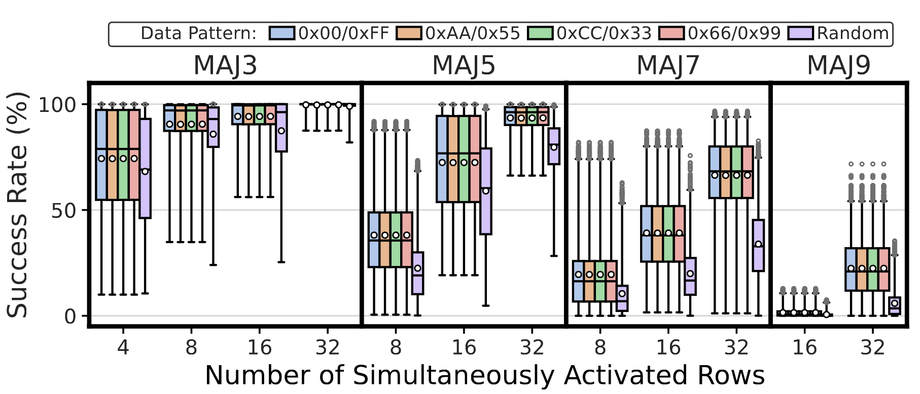
Robustness of MAJX Operations
COTS DRAM chips are capable of performing
MAJ5, MAJ7, and MAJ9 operations
Notes:
Now let me show you the first result the robustness of tested majority operations. In this figure, each subplot shows a different majority operation, from left to right the number of input operand in majority operation increases.
[CLICK] x-axis shows the number simultaneously activated rows
[CLICK] For this analysis, we will first focus on one data pattern: all ones or zeros
[CLICK] Let’s take look at the MAJ3 results where we use boxplot to show the success rate distributions
[CLICK] To simplify things, we focus on one distribution point that achieves highest success rate
[CLICK] From this figure we conclude that off-the-shelf DRAM chips are capable of performing up to nine-input majority operations

Slide 112
Impact of Input Replication
13.11% increase
30.81% increase
56.27% increase
35.15% increase
Similar trend in success rate increase in all tested MAJX operations
Final average success rate MAJ3 (MAJ5): 99.68% (93.49%)
Storing multiple copies of MAJ’s input operands increases
the success rate of MAJ3, MAJ5, MAJ7, and MAJ9 operations
Notes:
Now let’s see how input replication affects the success rate
[CLICK] Again, here, let’s first focus on MAJ3 operation
[CLICK] We observe that when we increase the number of input operand copies in majority-of-three operation, we observe a drastic 30.81% increase in average success rate
[CLICK] And this increasing trend in success rate is consistent across all tested majority operations
[CLICK] Hence, we conclude that storing multiple copies of input operands increases the success rate of MAJ3, 5, 7, and 9 operations

Slide 113
Leveraging Simultaneous Many-Row Activation
1
Perform MAJX (where X>3) operations
2
Increase the robustness of MAJX operations
3
Copy one row’s content to multiple rows
Notes:
Next, I will show how we can copy one row’s content to multiple rows

Slide 114
In-DRAM Multiple Row Copy (Multi-RowCopy)
Simultaneously activate many rows to
copy one row’s content to multiple destination rows
RowClone
Multi-RowCopy
s
r
c
d
s
t
s
r
c
d
s
t
s
r
c
s
r
c
s
r
c
d
s
t
d
s
t
d
s
t
s
r
c
s
r
c
s
r
c
[Seshadri+ MICRO’13]
Notes:
[CLICK] Our key idea is since we can activate many rows simultaneously, we can copy one row’s content to other simultaneously activated rows
[CLICK] Let’s recall the RowClone example where we copy source to destination
[CLICK] In RowClone, we first activate the source row which will copy its content to sense amplifiers
[CLICK] And then, we activate destination row to drive the sense amplifier’s content to destination row
[CLICK] In our mechanism, which we call Multi-RowCopy, we have several destination rows
[CLICK] Here we activate many destination rows simultaneously
[CLICK] and thus sense amplifier drives its content to these destination rows.

Slide 115
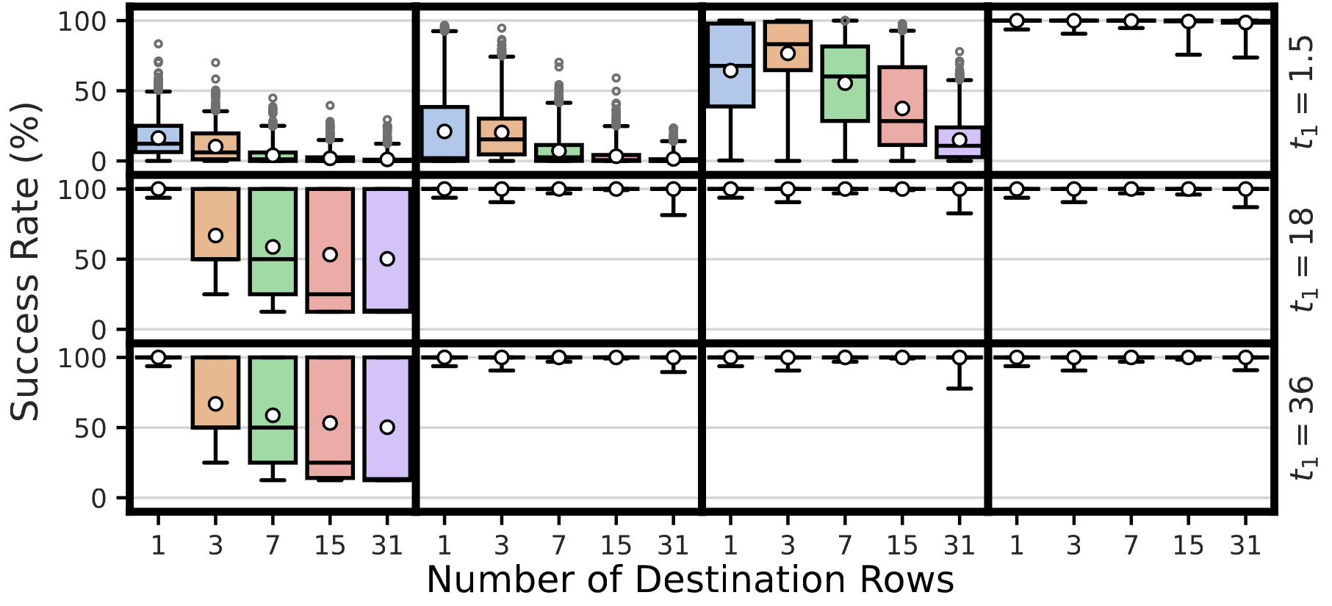
Robustness of Multi-RowCopy
Average: >99.98%
COTS DRAM chips can copy one row’s content
to up to 31 rows with a very high success rate
Notes:
Now let me show you the first result
[CLICK] In this plot, y-axis shows the success rate
[CLICK] x-axis shows the number of destination rows from 1 to 31
[CLICK] And we plot the success rate distribution as a box-and-whiskers plot
[CLICK] We observe that the average success rate is higher than 99.98% across all tested number of destination rows
[CLICK] Hence, we conclude that off-the-shelf DRAM chips can copy one row’s content to up to 31 rows with a very high success rate

Slide 116
Available on arXiv
https://arxiv.org/pdf/2405.06081
Notes:
The extended version of our study is available on arxiv

Slide 117
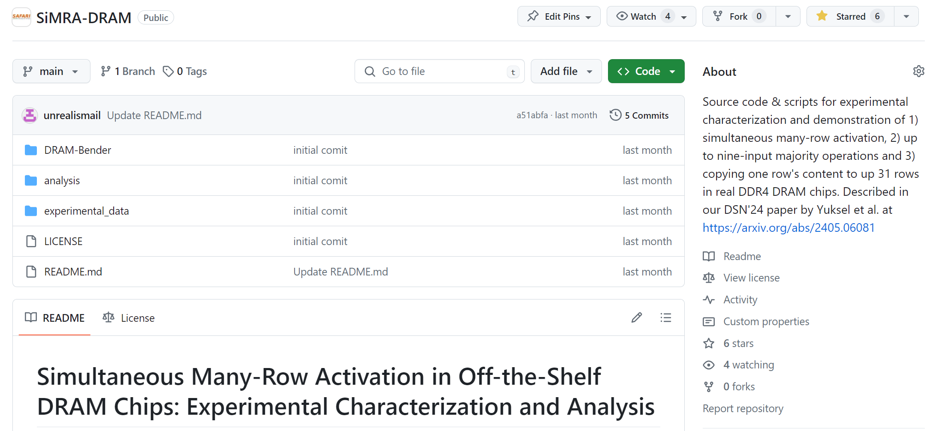
Our Work is Open Source and Artifact Evaluated
https://github.com/CMU-SAFARI/SiMRA-DRAM
Notes:
And our work is artifact evaluated and got every badges
[CLICK] You can download our code from github and start testing right away!

Slide 118


Simultaneous Many-Row Activation in Off-the-Shelf DRAM Chips
Experimental Characterization and Analysis
Paper
GitHub
İsmail Emir Yüksel
Yahya C. Tuğrul F. Nisa Bostancı Geraldo F. Oliveira
A. Giray Yağlıkçı Ataberk Olgun Melina Soysal Haocong Luo
Juan Gómez–Luna Mohammad Sadr Onur Mutlu
Notes:
Hello, I am Ismail Emir Yuksel.
I will be presenting our work, Simultaneous Many-Row Activation in Off-the-Shelf DRAM Chips

Slide 119
PuDHammer
Experimental Analysis of Read Disturbance Effects of Processing-using-DRAM in Real DRAM Chips
İsmail Emir Yüksel
Akash Sood Ataberk Olgun Oğuzhan Canpolat Haocong Luo
Nisa Bostancı Mohammad Sadrosadati Giray Yağlıkçı Onur Mutlu
Notes:
Hello, I am Ismail Emir Yuksel.
I will be presenting our work, PuDHammer [..]

Slide 120
Executive Summary
Motivation: Processing-using-DRAM (PuD) alleviates data movement bottlenecks
DRAM can perform many PuD operations by activating multiple DRAM rows
in quick succession or simultaneously (i.e., multiple-row activation)
Modern DRAM is subject to read disturbance (e.g., RowHammer)
    Repeatedly activating even a single row induces bitflips in unaccessed rows
Problem: No prior work studies the read disturbance effects of multiple-row activation
Goal: Understand and analyze read disturbance effects of multiple-row activation
Experimental Study: 316 COTS DDR4 chips from four major manufacturers to study
read disturbance effects of multiple-row activation, which we call PuDHammer
PuDHammer significantly exacerbates DRAM read disturbance,
causing up to 158.58x reduction in min. hammer count to induce first bitflip
PuDHammer bypasses in-DRAM RowHammer mitigation in DDR4 and
induces 11340x more bitflips than RowHammer
Mitigation: We adapt Per Row Activation Counting (PRAC) for PuDHammer
Adapted PRAC solution incurs an average system performance overhead of 48.26%

Slide 121
Processing-using-DRAM (PuD)
Multiple-row activation is a key technique to realize many PuD operations
1. Consecutive Multiple-Row Activation (CoMRA)
Multiple-row activation is a key technique to realize many PuD operations
2. Simultaneous Multiple-Row Activation (SiMRA)
DRAM
(e.g., 3D-Stacked Memory)
DRAM Bank
Vault
Controller
Processing-
Using-DRAM
Processing-
Using-DRAM
DRAM Vault
PHY
…
…
…
…
Notes:
We categorize multiple-row activation into two categories
First, consecutive multiple-row activation, CoMRA
Second, simultaneous multiple-row activatio,, SiMRA
Now, let me dive deeper into these two and give their key ideas

Slide 122
Consecutive Multiple-Row Activation
Violating timing of PRE command greatly
in COTS DRAM chips
activates two rows consecutively
36ns
14ns
ACT src
PRE
ACT dst
<9ns
d
s
t
s
r
c
src’s content
is copied to dst
s
r
c
d
s
t
s
r
c
Notes:
However, if we violate the timing between PRE and ACT dst
[CLICK] We can activate destination row without deactivating sense amplifier and keeping the bitlines at source voltage level
[CLICK] As a result of this, we can perform in-dram row copy operation: source row can be copied to destination row

Slide 123
Simultaneous Multiple-Row Activation
Activating two rows in quick succession
in COTS DRAM chips simultaneously activates multiple rows in a subarray
36ns
14ns
ACT Row A
PRE
ACT Row B
<3ns
<3ns
Subarray X
ACT
Row A
…
ACT
Row B
DRAM Bank
Notes:
Now let’s see how SiMRA works
[CLICK] The key observation is activating two rows in quick succession can simultaneously activate many rows in a subarray
[CLICK] In this pictorial example Row A and Row B is in Subarray X.
[CLICK] When we respect to the timing parameters between ACT and PRE and PRE and ACT
[CLICK] we activate a single row at a time.
[CLICK] However, when we greatly violate these timing parameters,
we can activate many rows at once in the same subarray

Slide 124
Read Disturbance in DRAM
Unfortunately, even activating a single DRAM row
disturbs the data integrity of other unaccessed DRAM rows
Prominent example: RowHammer
DRAM Subarray
Row 1
Row 1
Row 1
Victim Row
Row 2
Row 2
Row 2
Row 2
Row 2
open
open
Aggressor Row
closed
open
Row 3
Row 3
Row 3
Victim Row
Repeatedly opening (activating) and closing a DRAM row
many times causes RowHammer bitflips in adjacent rows
[Kim+, ISCA’14]
Notes:
Read disturbance bitflips have significant system-level implications because they break memory isolation.
[CLICK] Even activating a single DRAM row disturbs the data integrity of ther unaccessed DRAM rows.
[CLICK] A prominent example of read disturbance is RowHammer.
[CLICKx9] Repeatedly activating and closing a DRAM row many times causes RowHammer bitflips in adjacent rows
We call the repeatedly activated row the aggressor row and the rows that have bitflips victim rows.

Slide 125
Problem & Goal
Problem
No prior work investigates the read disturbance effects of multiple-row activation
Goal
Understand how multiple-row activation
affects read disturbance vulnerability in DRAM

Slide 126
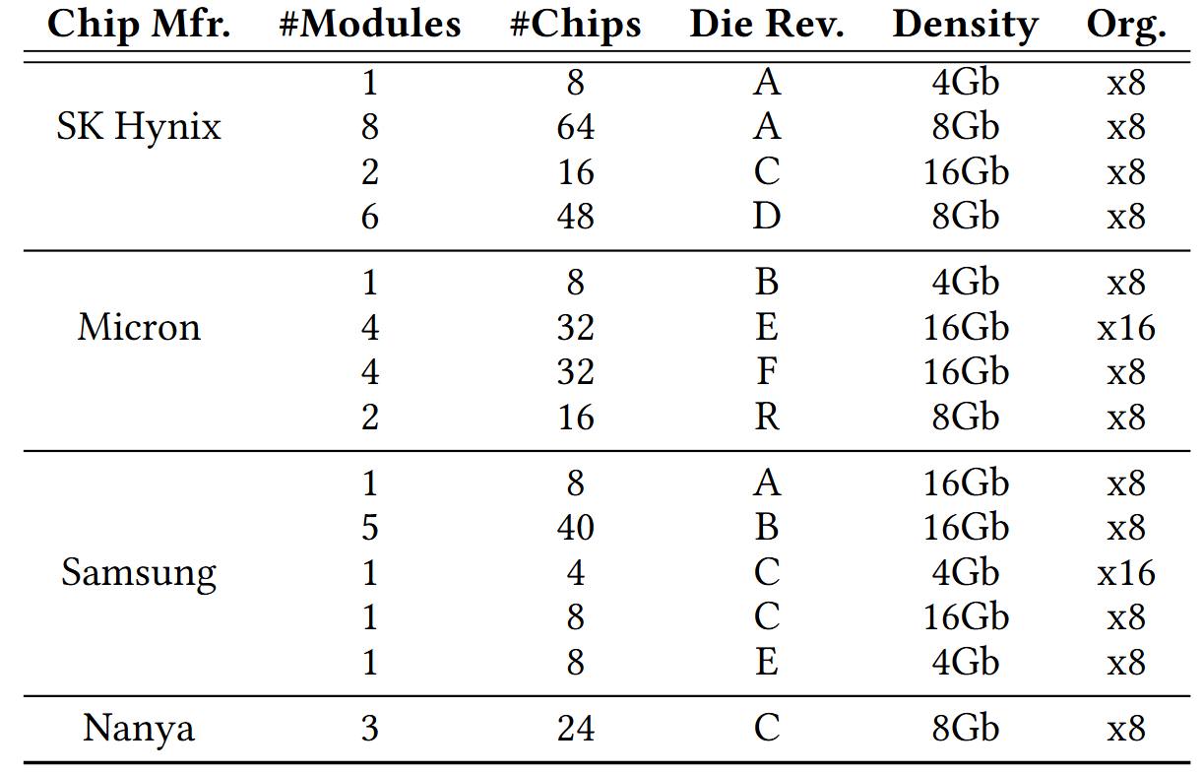
DRAM Chips Tested
316 DDR4 chips from four major DRAM manufacturers
Covers different die revisions and chip densities
Notes:
[CLICK] We test 316 DDR4 chips from four major DRAM manufacturers,
[CLICK] covering different die densities and revisions

Slide 127
Hammering with CoMRA
ACT src
PRE
ACT dst
36ns
7.5ns
Double-Sided
Single-Sided
victim
.
.
.
src
aggressor
src
aggressor
victim
victim
.
.
.
dst
aggressor
victim
.
.
.
dst
aggressor
victim
DRAM Subarray
DRAM Subarray
Notes:
To hammer using CoMRA access pattern, we use two versions of hammering:
[CLICK] First, double-sided where we sandwich a victim row
[CLICK] We adapt CoMRA to perform copy operation to sandwich a victim row for double-sided
[CLICK] Second, single-sided where a single aggressor row disturbs its neighboring victim rows
[CLICK] To perform single-sided CoMRA, we perform the copy operation between two rows that are far away from each other

Slide 128

Read Disturbance Vulnerability Metric: HC_{first}
The minimum hammer count
required to induce the first bitflip
Lower is worse
1 Hammer
Aggressor Row (src)
ACT src
Record bitflips
in victim
PRE
Victim Row
PRE
Aggressor Row (dst)
ACT dst
Notes:
To evaluate the read disturbance vulnerability of DRAM chips, we use widely-adopted metric called Hcfirst
[CLICK] which is the minimum hammer count required to induce the first bitflip and lower the Hcfirst worse the read disturbance is
[CLICK] Here we have a double sided scenario where we sandwich a victim row
[CLICK] We count one CoMRa operation, ACT-PRE-ACT as 1 Hammer and we record bitflips in victim

Slide 129
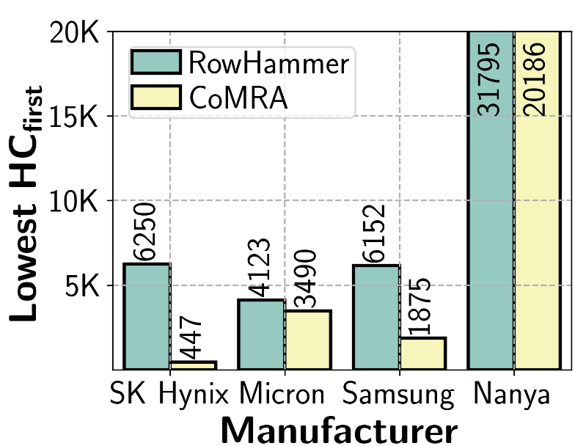
Double-Sided CoMRA vs. RowHammer (I)
1.58x
13.98x
3.28x
1.18x
Double-sided CoMRA decreases lowest HC_{first} by 13.98x
compared to double-sided RowHammer
Lowest HC_{first} reduction trend consistent across all four manufacturer

Slide 130
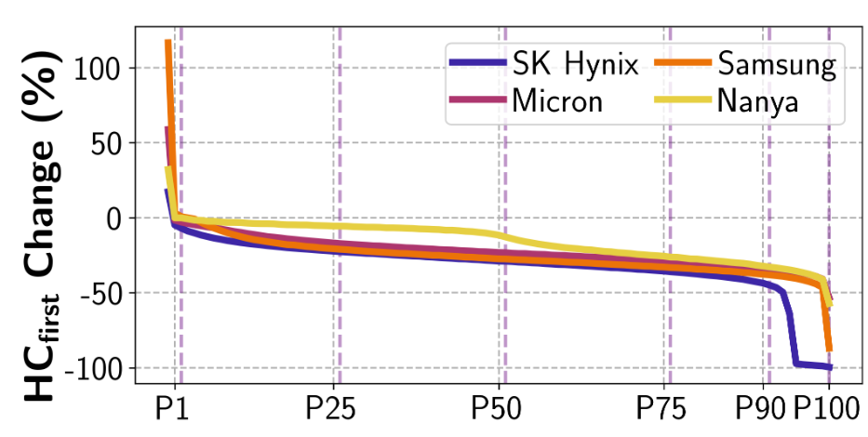
Double-Sided CoMRA vs. RowHammer (II)
Represents 99% of tested victim rows
Represents 50% of tested victim rows
CoMRA reduces HC_{first}
HC_{first} reduction of 50%
DRAM Rows (sorted by reducing HC_{first} changes)
RowHammer HC_{first} = 100
CoMRA HC_{first} = 50
Notes:
In this experiment,
[CLICK]
we investigate how much Hcfirst changes when we perform CoMRA compared to RowHammer
[CLICK] across all the tested DRAM rows sorted by reducing Hcfirst changes value on the x-axis.
[CLICK] Each curve in this plot represents a different DRAM vendor
Now let me walk through what this plot represents
[CLICK] X-axis from P1 to P100 shows 99% of the tested rows
[CLICK] Similarly, from P50 to P100 represents 50% of the tested rows
[CLICK] Hcfirst change of -50 means Hcfirst reduction of 50%
For example, a victim row has Hcfirst of 100 for RowHammer while having 50 for CoMRA

Slide 131
Double-Sided CoMRA vs. RowHammer (II)
>99% of tested victim rows
experience lower HC_{first}
Double-sided CoMRA decreases HC_{first} for a large fraction of rows
compared to double-sided RowHammer

Slide 132
Recall: SiMRA
Activating two rows in quick succession
in COTS DRAM chips simultaneously activates multiple rows in a subarray
36ns
14ns
ACT Row A
PRE
ACT Row B
<3ns
<3ns
Subarray X
ACT
Row A
…
ACT
Row B
DRAM Bank
Notes:
Our key observation is activating two rows in quick succession can simultaneously activate many rows in a subarray
[CLICK] You may remember this pictorial example where Row A and Row B is in Subarray X.
[CLICK] When we respect to the timing parameters between ACT and PRE and PRE and ACT
[CLICK] we activate a single row at a time.
[CLICK] However, when we greatly violate these timing parameters, we observe that we can activate many rows at once in the same subarray

Slide 133
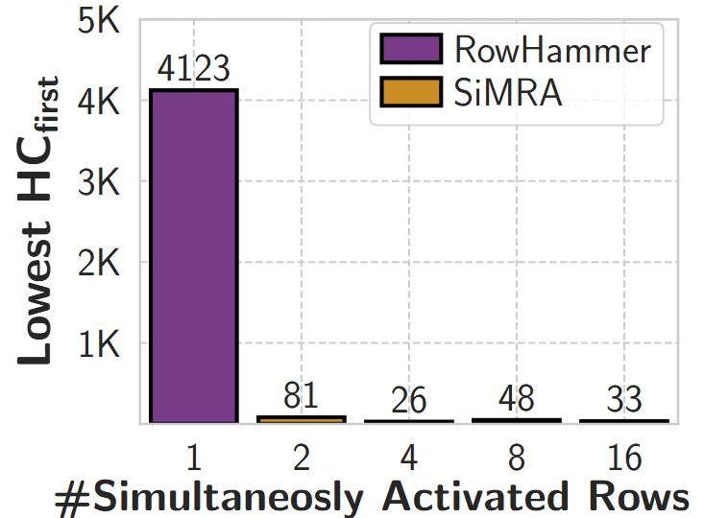
Double-Sided SiMRA vs. RowHammer (I)
51x
159x
86x
125x
Min. hammer count to induce first bitflip
#Simultaneously Activated Rows
Double-sided SiMRA decreases lowest HC_{first} by 159x
compared to double-sided RowHammer
Lowest HC_{first} reduction trend consistent
across all tested number of simultaneously activated rows

Slide 134
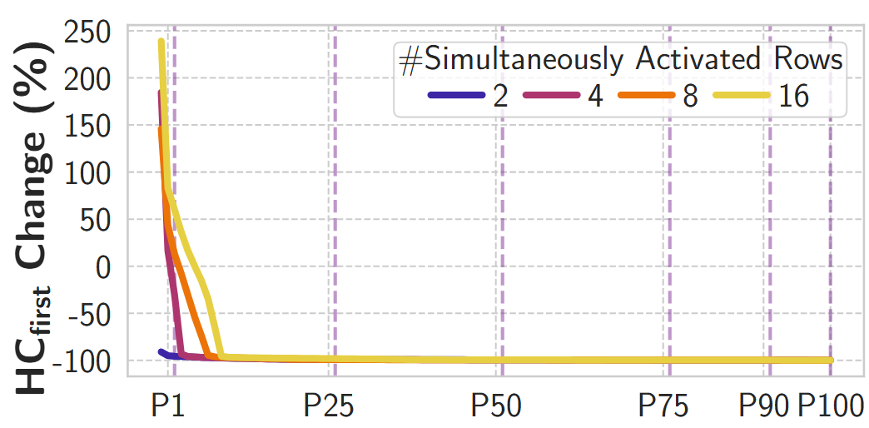
Double-Sided SiMRA vs. RowHammer (II)
>99% of tested victim rows
experience lower HCfirst
at least 25.19%
of tested victim rows
experience >99% HCfirst reduction

Slide 135
Double-Sided SiMRA vs. RowHammer (II)
Double-sided SiMRA
significantly decreases HC_{first} for a majority of rows
compared to double-sided RowHammer

Slide 136
Mitigating PuDHammer
1
Analyze the effectiveness of existing in-DRAM RowHammer mitigation against PuDHammer
2
Adapt RowHammer mitigations
to account for PuDHammer

Slide 137
Mitigating PuDHammer
1
Analyze the effectiveness of existing in-DRAM RowHammer mitigation against PuDHammer
2
Adapt RowHammer mitigations
to account for PuDHammer

Slide 138
Target Row Refresh (TRR)
DRAM vendors equip their DRAM chips with a proprietary
mitigation mechanisms known as Target Row Refresh (TRR)
Key Idea: TRR refreshes nearby rows upon detecting an aggressor row
TRR-equipped DRAM Chip
Memory
Controller
REF
Row 0
TRR
Row 1
aggressor
Row 2
Row 3
Aggressor detected: Row 2
Row 4
Refresh neighbor rows
TRR-induced refreshes
Notes:
To protect their DRAM chips against RowHammer, DRAM vendors currently implement proprietary RowHammer mitigation mechanisms typically called Target Row Refresh or (TRR)
[CLICK] The key idea of TRR is to refresh nearby rows upon detecting an aggressor row
[CLICK] We demonstrate how TRR operates at a high-level.
[CLICK] The TRR mechanism detects [CLICK] an aggressor row as a result of [CLICK] repeatedly activating and precharging the same row. [CLICK]
[CLICK] To protect the neighbor victim rows from experiencing RowHammer bit flips, [CLICK] TRR refreshes the victim rows by performing TRR-induced refresh operations. TRR refreshes victim rows by piggybacking TRR-induced refreshes to the REFRESH commands that the memory controller periodically issues.

Slide 139
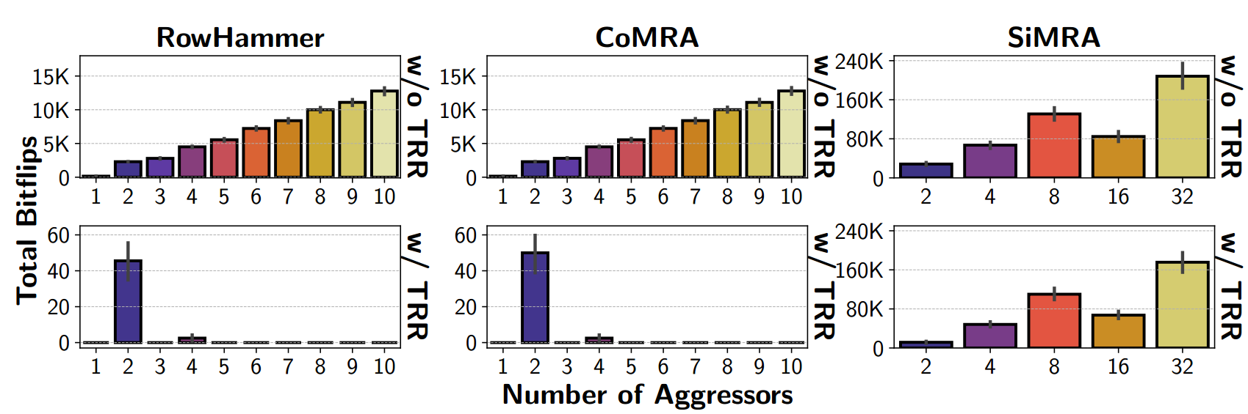
Real DRAM Chip Results
>10K bitflips
<60
bitflips
>10K bitflips
~60
bitflips
CoMRA induces 1.10x more bitflips than RowHammer
on average in the presence of TRR

Slide 140
Real DRAM Chip Results
>10K bitflips
<60
bitflips
~240K
bitflips
~180K
bitflips
SiMRA induces 11340x more bitflips than RowHammer
on average in the presence of TRR

Slide 141
Mitigating PuDHammer
1
Analyze the effectiveness of existing in-DRAM RowHammer mitigation against PuDHammer
2
Adapt RowHammer mitigations
to account for PuDHammer

Slide 142
Adapting PRAC for PuDHammer
A Naïve Approach (PRAC-Naïve)
Reducing RowHammer threshold
to SiMRA’s lowest observed HCfirst
Weighted Counting (PRAC-WC)
Increase counters based on the vulnerability
caused by the operation (RH, CoMRA, and SiMRA)

Slide 143
Methodology
Environment: Cycle-level DRAM simulator Ramulator2 [Kim+ CAL'15, Luo+ CAL'23]
System Configuration:
  Processor 4-core, out-of-order, 4.2GHz clock frequency
  DRAM DDR5, 1 channel, 2 rank/channel, 8 bank groups,
  4 banks/bank group, 128K rows/bank
  Memory Ctrl. 64-entry read and write requests queues,
  Scheduling policy: FR-FCFS with a column cap of 4
  PRAC 4 RFMs per Back-off
  PIM Unit 1-core, issues CoMRA & SiMRA operations with a fixed invertal
Workloads:
    60 five-core multiprogrammed workload mixes.
    Each mix is composed of
      four workloads from five major benchmark suites and
      one synthetic workload that periodically performs back-to-back one SiMRA with 32-row activation and one CoMRA operation

Slide 144
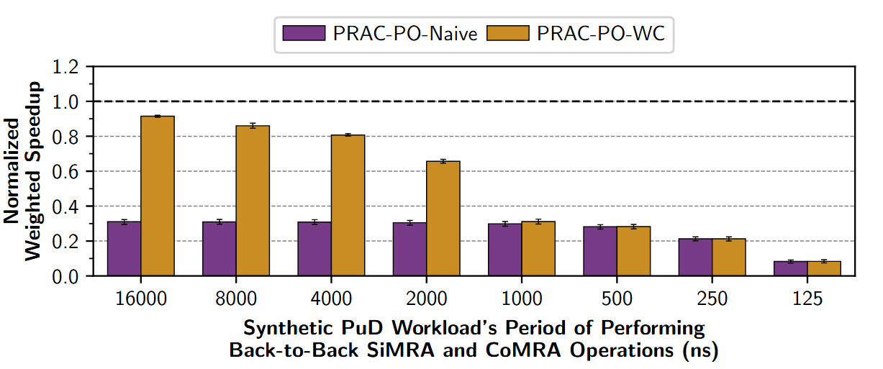
Weighted Speedup Results
PRAC-Naïve
PRAC-WC
PRAC-Naïve
PRAC-WC
Normalized
to no RH mitigation
DRAM performs PuD operations in every 125ns

Slide 145
Weighted Speedup Results
PRAC-Naïve
PRAC-WC
PRAC-WC greatly outperforms PRAC-Naïve until 2us
PRAC-WC incurs an average (maximum)
performance overhead of 48.26% (98.83%)

Slide 146
More in the Paper
More characterization results
    Temperature, spatial variation, timing parameters, access pattern,
    data pattern, aggressor row on time analyses for CoMRA and SiMRA
    Combined Read Disturbance Effect of RowHammer with PuD
      Combined pattern is more effective than RowHammer alone
      (e.g., 1.66x reduction in HCfirst on average)
Details and analyses on mitigating PuDHammer
    Discussion on how modifying DRAM chips could help mitigating PuDHammer
    More details on PRAC adaptation
      Challenges on adapting for PuDHammer
      An area-efficient PRAC solution
      ..
Notes:
We have more content in the paper, including
…

Slide 147
Available on arXiv
https://arxiv.org/pdf/2506.12947
Notes:
The extended version of our study is available on arxiv

Slide 148
PuDHammer
Experimental Analysis of Read Disturbance Effects of Processing-using-DRAM in Real DRAM Chips
İsmail Emir Yüksel
Akash Sood Ataberk Olgun Oğuzhan Canpolat Haocong Luo
Nisa Bostancı Mohammad Sadrosadati Giray Yağlıkçı Onur Mutlu
Notes:
Hello, I am Ismail Emir Yuksel.
I will be presenting our work, Simultaneous Many-Row Activation in Off-the-Shelf DRAM Chips

Slide 149
7th Workshop on
Memory-Centric Computing
Processing-Using-Memory in Real DRAM Chips
İsmail Emir Yüksel
ICS 2026
6 July 2026

