Slide 1


The 3rd
Ramulator & DRAM Bender Tutorial
DRAM Bender Overview
Ataberk Olgun
ICS 2026
6 July 2026

Slide 2
DRAM Bender
An Extensible and Versatile
FPGA-based Infrastructure to
Easily Test State-of-the-art DRAM Chips
Ataberk Olgun
Yahya Can Tugrul
Minesh Patel
Hasan Hassan
Lois Orosa
Oguz Ergin
A. Giray Yaglikci
Haocong Luo
Onur Mutlu

Slide 3
Factors Affecting DRAM Reliability and Latency
DRAM timing violation
Inter-cell interference
Manufacturing process
Temperature
Voltage
Factors affecting DRAM reliability and latency
cannot be properly modeled in simulation or analytically
We need to perform experimental studies
of real DRAM chips

Slide 4
DRAM Testing Infrastructure
Allow experimental studies of real DRAM chips
Open-source FPGA-based testing infrastructure
Publicly-available: Start using today
Relatively low cost: An FPGA board + DRAM modules
SoftMC
Litex Tester

Slide 5
Limitations of Existing Infrastructure
Impose restrictions on the DDR4 interface.
Restrictions limit various characterization experiments.
Difficult to set up (based on discontinued HW/SW)
and use (require developing HW)
Monolithic hardware design
makes extensions (new standards, prototypes) relatively difficult

Slide 6
DRAM Bender: Design Goals
Flexibility
  Ability to test any DRAM operation
  Ability to test any combination of DRAM operations
  and custom timing parameters
Ease of use
  Simple programming interface (C++ and Python)
  Minimal programming effort and time
  Accessible to a wide range of users
    who may lack experience in hardware design
Extensibility
  Modular design
  Well-defined interfaces between hardware modules

Slide 7
DRAM Bender: Overview
Publicly-available FPGA-based
DDR4/3 and HBM2 characterization infrastructure
Easily programmable using the C++ and Python APIs
[Yaglikci+, DSN’22]

Slide 8
DRAM Bender: Prototypes
Six
Six out of the box FPGA-based prototypes
Bittware XUPVVH
(DDR4 & HBM2)
Bittware XUSP3S (DDR4)
AMD ZC706 (DDR3)
Bittware XUPP3R (DDR4)
AMD Alveo U200 (DDR4)
AMD Alveo U50 (HBM2)

Slide 9
DRAM Bender: Coming Soon (I)
Support for AMD Alveo U55C HBM2 board
16 GB 2x8-HI HBM2
Enable HBM2 power measurement

Slide 10
DRAM Bender: Coming Soon (II)
Enable DDR4 power measurement
Enable DDR4 over/undervolting studies

Slide 11
Laboratory for Understanding Memory
Notes:
And in our lab, we have many machines to test many DRAM modules and chips

Slide 12
Laboratory for Understanding Memory
Notes:
And in our lab, we have many machines to test many DRAM modules and chips

Slide 13
Laboratory for Understanding Memory
https://arxiv.org/pdf/2606.13725

Slide 14
People for Understanding Memory
Konstantinos Sgouras
Ismail E. Yuksel
Umut Baser

Slide 15
Other People that Understand Memory
Haocong Luo
Jikun Wang
Spyridon Galanopoulos
Orhun Ecemis

Slide 16
DRAM Bender: Ease of Use
Easily programmable using the DRAM Bender C++ API
RowHammer: Repeatedly activating two DRAM rows
one iteration of the RowHammer test
Easy to devise new experiments to uncover new insights
Notes:
… the ease of use also comes with flexibility

Slide 17
DRAM Bender: Three Case Studies
RowHammer: Interleaving Pattern of Activations
  Interleaving pattern significantly affects
  the number of RowHammer bitflips
RowHammer: Random Data Patterns
  Use 512-bit random data patterns
  Uncover more bitflips than 8-bit SoftMC random patterns
In-DRAM Bitwise Operations
  Demonstrate in-DRAM bitwise AND/OR capability
  in real DDR4 chips
DRAM Bender is flexible:
supports many different types of experiments

Slide 18
More in the Paper
DRAM Bender design details
  DRAM Bender instruction set architecture
  Hardware & software modules
  Prototype design
  Temperature controller setup
DRAM Bender application programming interface
Detailed results for three case studies
Future work & improvements

Slide 19
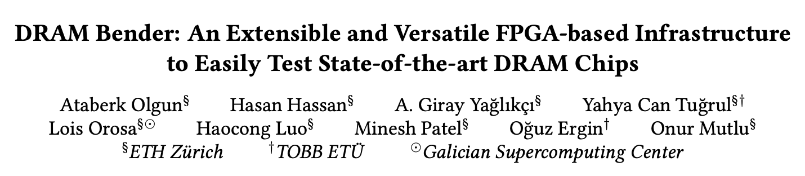
More in the Paper
https://arxiv.org/abs/2211.05838

Slide 20
Research DRAM Bender Enabled (I)
[ICS’26] Tokuda+, “Clutch: High Performance Vector-Scalar Comparison using DRAM via Chunked Temporal Coding”
[ISCA’26] Luo+, “DejaVu: Why You Should Write to Your DRAM Rows Twice”
[ISCA’26] Tokuda+, “Altering Processing-using-DRAM Operation Results Without Changing Operands:
A Study of Real DRAM Chips and Implications for Future Systems”
[DSN’26] Wang+, “ScaleDisturb: Exploiting Temporal Asymmetry to Amplify Read Disturbance in Modern DRAM Chips”
[DSN Disrupt’26] Baser+, “In-DRAM Signature Generation Using Simultaneous Multiple-Row Activation: An Experimental Study of Off-The-Shelf DRAM Chips”
[ICCD’25] Yuksel+, “In-DRAM True Random Number Generation Using Simultaneous Multiple-Row Activation: An Experimental Study of Real DRAM Chips”
[MICRO’25] Yuksel+, “ColumnDisturb: Understanding Column-based Read Disturbance in Real DRAM Chips and Implications for Future Systems”
[ISCA’25] Yuksel+, “PuDHammer: Experimental Analysis of Read Disturbance Effects of Processing-using-DRAM in Real DRAM Chips”
[DSN’25] Canpolat+, “EasyDRAM: An FPGA-based Infrastructure for Fast and Accurate End-to-End Evaluation of Emerging DRAM Techniques”
[VTS’25] Luo+, “Revisiting DRAM Read Disturbance: Identifying Inconsistencies Between Experimental Characterization and Device-Level Studies”
[HPCA’25] Olgun+, “Variable Read Disturbance: An Experimental Analysis of Temporal Variation in DRAM Read Disturbance”
[HPCA’25] Tugrul+, “Understanding RowHammer Under Reduced Refresh Latency: Experimental Analysis of Real DRAM Chips and Implications on Future Solutions”
[DSN’24] Olgun+, “Read Disturbance in High Bandwidth Memory: A Detailed Experimental Study on HBM2 DRAM Chips”
[DSN’24] Yuksel+, “Simultaneous Many-Row Activation in Off-the-Shelf DRAM Chips:
Experimental Characterization and Analysis”

Slide 21
Research DRAM Bender Enabled (I)
[DSN’24 Disrupt] Luo+, “An Experimental Characterization of Combined RowHammer
and RowPress Read Disturbance in Modern DRAM Chips”
[HPCA’24] Yaglikci+, ”Spatial Variation-Aware Read Disturbance Defenses: Experimental Analysis of
Real DRAM Chips and Implications on Future Solutions”
[HPCA’24] Yuksel+, “Functionally-Complete Boolean Logic in Real DRAM Chips: Experimental Characterization and Analysis"
[ISCA’23] Luo+, “RowPress: Amplifying Read Disturbance in Modern DRAM Chips”
[DSN’23 Disrupt] Olgun+, ”An Experimental Analysis of RowHammer on HBM2 DRAM Chips”
[arXiv Preprint, 2023] Orosa+, ”SpyHammer: Using RowHammer to Remotely Spy on Temperature”
[MICRO’22] Yaglikci+, “HIRA: Hidden Row Activation for Reducing Refresh Latency of Off-the-Shelf DRAM Chips”
[DSN’22] Yaglikci+, “Understanding RowHammer Under Reduced Wordline Voltage:
An Experimental Study Using Real DRAM Devices”
[MICRO’21] Orosa+, “A Deeper Look into RowHammer’s Sensitivities: Experimental Analysis of
Real DRAM Chips and Implications on Future Attacks and Defenses”
[MICRO’21] Hassan+, “Uncovering In-DRAM RowHammer Protection Mechanisms:
A New Methodology, Custom RowHammer Patterns, and Implications”
[ISCA’21] Olgun+, “QUAC-TRNG: High-Throughput True Random Number Generation
Using Quadruple Row Activation in Commodity DRAM Chips”
[ISCA’21] Orosa+, “CODIC: A Low-Cost Substrate for Enabling Custom In-DRAM Functionalities and Optimizations”
[ISCA’20] Kim+, “Revisiting RowHammer: An Experimental Analysis of Modern Devices and Mitigation Techniques”
[S&P’20] Frigo+, “TRRespass: Exploiting the Many Sides of Target Row Refresh”
[HPCA’19] Kim+, “D-RaNGe: Using Commodity DRAM Devices to Generate True Random Numbers with Low Latency and High Throughput”

Slide 22
Research DRAM Bender Enabled (I)
[MICRO’19] Koppula+, “EDEN: Enabling Energy-Efficient, High-Performance Deep Neural Network Inference Using Approximate DRAM”
[SIGMETRICS’18] Ghose+, “What Your DRAM Power Models Are Not Telling You: Lessons from a Detailed Experimental Study”
[SIGMETRICS’17] Chang+, “Understanding Reduced-Voltage Operation in Modern DRAM Devices:
Experimental Characterization, Analysis, and Mechanisms”
[MICRO’17] Khan+, “Detecting and Mitigating Data-Dependent DRAM Failures by Exploiting Current Memory Content”
[SIGMETRICS’16] Chang+, “Understanding Latency Variation in Modern DRAM Chips:
Experimental Characterization, Analysis, and Optimization”
[ISCA’14] Kim+, "Flipping Bits in Memory Without Accessing Them: An Experimental Study of DRAM Disturbance Errors"
[SIGMETRICS’14] Khan+, "The Efficacy of Error Mitigation Techniques for DRAM Retention Failures: A Comparative Experimental Study”
[ISCA’13] Liu+, "An Experimental Study of Data Retention Behavior in Modern DRAM Devices: Implications for Retention Time Profiling Mechanisms"

Slide 23
Even More Research DRAM Bender Enabled
[IMW’26] Jiang+, “DRAM Operations under Cryogenic Temperatures: From Device Physics to DIMM Behavior”
[JSA’26] Garzon+, “CADM: Content addressable commodity off-the-shelf DRAM-based genome classifier”
[IEEE CAL’25] Kubo+, “PUDTune: Multi-Level Charging for High-Precision Calibration in Processing-Using-DRAM”
[arXiv’25] Zhou+, “EIM-TRNG: Obfuscating Deep Neural Network Weights with Encoding-in-Memory True Random Number Generator via RowHammer”
[ASPLOS’25] Baek+, “Marionette: A RowHammer Attack via Row Coupling”
[DATE’25] Zhou+, “Compromising the Intelligence of Modern DNNs: On the Effectiveness of Targeted RowPress”
[ISCA’24] Nam+, ”DRAMScope: Uncovering DRAM Microarchitecture and Characteristics by Issuing Memory Commands”
[DATE’24] Zhou+, “DRAM-Locker: A General-Purpose DRAM Protection Mechanism Against Adversarial DNN Weight Attacks”
[DRAMSec’23] Lang+, “BLASTER: Characterizing the Blast Radius of Rowhammer”
[IEEE CAL’23] Nam+ ”X-ray: Discovering DRAM Internal Structure and Error Characteristics by Issuing Memory Commands”
[MICRO’22] Gao+, “FracDRAM: Fractional Values in Off-the-Shelf DRAM”
[Applied Sciences’22] Bepary+, “DRAM Retention Behavior with Accelerated Aging in Commercial Chips”
[ETS’21] Farmani+, “RHAT: Efficient RowHammer-Aware Test for Modern DRAM Modules”
[HOST’20] Talukder+, “Towards the Avoidance of Counterfeit Memory: Identifying the DRAM Origin”
[MICRO’19] Gao+, “ComputeDRAM: In-Memory Compute Using Off-the-Shelf DRAMs”
[IEEE Access’19] Talukder+, “PreLatPUF: Exploiting DRAM Latency Variations for Generating Robust Device Signatures”
[ICCE’18] Talukder+, “Exploiting DRAM Latency Variations for Generating True Random Numbers”
Notes:
SoftMC has also contributed to research from other research groups.

Slide 24
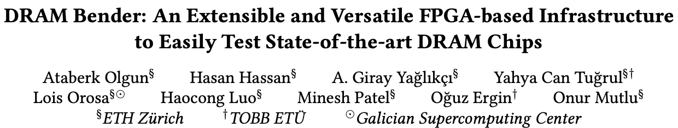
DRAM Bender Paper, Slides, Videos, Code
Ataberk Olgun, Hasan Hassan, A Giray Yağlıkçı, Yahya Can Tuğrul, Lois Orosa, Haocong Luo, Minesh Patel, Oğuz Ergin, and Onur Mutlu,
"DRAM Bender: An Extensible and Versatile FPGA-based Infrastructure to Easily Test State-of-the-art DRAM Chips"
IEEE Transactions on Computer-Aided Design of Integrated Circuits and Systems (TCAD), 2023.
[Extended arXiv version]
[DRAM Bender Source Code]
[DRAM Bender Tutorial Video (43 minutes)]
https://github.com/CMU-SAFARI/DRAM-Bender

Slide 25

Summary
DRAM Bender
The first publicly-available DDR4/3 & HBM2
characterization infrastructure
Flexible and Easy to Use
Source code available:
[Yaglikci+, DSN’22]
github.com/CMU-SAFARI/DRAMBender
DRAM Bender enables many studies, ideas,
and methodologies in the design of future memory systems
Notes:
[CLICK] In summary, SoftMC is the first publicly-available DRAM characterization infrastructure
[CLICK] It is flexible and easy to use
[CLICK] The source code of SoftMC is available on GitHub
[CLICK] SoftMC enables many new studies, ideas, and methodologies in the design of future memory systems

Slide 26
DRAM Bender
An Extensible and Versatile
FPGA-based Infrastructure to
Easily Test State-of-the-art DRAM Chips
Ataberk Olgun
Yahya Can Tugrul
Minesh Patel
Hasan Hassan
Lois Orosa
Oguz Ergin
A. Giray Yaglikci
Haocong Luo
Onur Mutlu

Slide 27
The 3rd
Ramulator & DRAM Bender Tutorial
DRAM Bender Overview
Ataberk Olgun
ICS 2026
6 July 2026

Slide 28
The 3rd
Ramulator & DRAM Bender Tutorial
DRAM Bender Research Highlights
Ataberk Olgun
ICS 2026
6 July 2026

Slide 29
DRAM Bender is a Versatile Platform (I)
DRAM Bender is widely used for:
1
Understanding DRAM robustness problems
2
Uncovering new DRAM functionality
3
Learning DRAM internals
Notes:
Point to Profs. Shaahin Angizi in NJIT and Jung Ho Ahn in SNU works and also Prof. Shinya Takamaeda-Yamazaki in the University of Tokyo
We have one speaker each from Shaahin Angizi and Jung Ho Ahn’s groups Ranyang Zhou and Hwayong Nam and we are excited to listen to them talk about their experience with DRAM Bender today

Slide 30
Understanding DRAM Robustness Problems
[ISCA’26] Luo+, “DejaVu: Why You Should Write to Your DRAM Rows Twice”
[ISCA’26] Tokuda+, “Altering Processing-using-DRAM Operation Results Without Changing Operands: A Study of Real DRAM Chips and Implications for Future Systems”
[DSN’26] Wang+, “ScaleDisturb: Exploiting Temporal Asymmetry to Amplify Read Disturbance in Modern DRAM Chips”
[IMW’26] Jiang+, “DRAM Operations under Cryogenic Temperatures: From Device Physics to DIMM Behavior”
[MICRO’25] Yuksel+, “ColumnDisturb: Understanding Column-based Read Disturbance in Real DRAM Chips and Implications for Future Systems”
[ISCA’25] Yuksel+, “PuDHammer: Experimental Analysis of Read Disturbance Effects of Processing-using-DRAM in Real DRAM Chips”
[VTS’25] Luo+, “Revisiting DRAM Read Disturbance: Identifying Inconsistencies Between Experimental Characterization and Device-Level Studies”
[HPCA’25] Olgun+, “Variable Read Disturbance: An Experimental Analysis of Temporal Variation in DRAM Read Disturbance”
[HPCA’25] Tugrul+, “Understanding RowHammer Under Reduced Refresh Latency: Experimental Analysis of Real DRAM Chips and Implications on Future Solutions”
[DSN’24] Olgun+, “Read Disturbance in High Bandwidth Memory: A Detailed Experimental Study on HBM2 DRAM Chips”
DSN’24 Disrupt] Luo+, “An Experimental Characterization of Combined RowHammer
and RowPress Read Disturbance in Modern DRAM Chips”
[HPCA’24] Yaglikci+, ”Spatial Variation-Aware Read Disturbance Defenses: Experimental Analysis of
Real DRAM Chips and Implications on Future Solutions”
[ISCA’23] Luo+, “RowPress: Amplifying Read Disturbance in Modern DRAM Chips”
[DSN’22] Yaglikci+, “Understanding RowHammer Under Reduced Wordline Voltage:
An Experimental Study Using Real DRAM Devices”
[MICRO’21] Orosa+, “A Deeper Look into RowHammer’s Sensitivities: Experimental Analysis of
Real DRAM Chips and Implications on Future Attacks and Defenses”
[ISCA’20] Kim+, “Revisiting RowHammer: An Experimental Analysis of Modern Devices and Mitigation Techniques”
[MICRO’19] Koppula+, “EDEN: Enabling Energy-Efficient, High-Performance Deep Neural Network Inference Using Approximate DRAM”
[MICRO’17] Khan+, “Detecting and Mitigating Data-Dependent DRAM Failures by Exploiting Current Memory Content”
[ISCA’14] Kim+, "Flipping Bits in Memory Without Accessing Them: An Experimental Study of DRAM Disturbance Errors"
[SIGMETRICS’14] Khan+, "The Efficacy of Error Mitigation Techniques for DRAM Retention Failures: A Comparative Experimental Study”
[ISCA’13] Liu+, "An Experimental Study of Data Retention Behavior in Modern DRAM Devices: Implications for Retention Time Profiling Mechanisms"
[ASPLOS’25] Baek+, “Marionette: A RowHammer Attack via Row Coupling”
[DATE’25] Zhou+, “Compromising the Intelligence of Modern DNNs: On the Effectiveness of Targeted RowPress”
[DRAMSec’23] Lang+, “BLASTER: Characterizing the Blast Radius of Rowhammer”
[Applied Sciences’22] Bepary+, “DRAM Retention Behavior with Accelerated Aging in Commercial Chips”
[ETS’21] Farmani+, “RHAT: Efficient RowHammer-Aware Test for Modern DRAM Modules”

Slide 31
Uncovering New DRAM Functionality
[ICS’26] Tokuda+, “Clutch: High Performance Vector-Scalar Comparison using DRAM via Chunked Temporal Coding”
[DSN Disrupt’26] Baser+, “In-DRAM Signature Generation Using Simultaneous Multiple-Row Activation: An Experimental Study of Off-The-Shelf DRAM Chips”
[ICCD’25] Yuksel+, “In-DRAM True Random Number Generation Using Simultaneous Multiple-Row Activation: An Experimental Study of Real DRAM Chips”
[DSN’24] Yuksel+, “Simultaneous Many-Row Activation in Off-the-Shelf DRAM Chips:
Experimental Characterization and Analysis”
[HPCA’24] Yuksel+, “Functionally-Complete Boolean Logic in Real DRAM Chips: Experimental Characterization and Analysis"
[MICRO’22] Yaglikci+, “HIRA: Hidden Row Activation for Reducing Refresh Latency of Off-the-Shelf DRAM Chips”
[ISCA’21] Orosa+, “CODIC: A Low-Cost Substrate for Enabling Custom In-DRAM Functionalities and Optimizations”
[ISCA’21] Olgun+, “QUAC-TRNG: High-Throughput True Random Number Generation
Using Quadruple Row Activation in Commodity DRAM Chips”
[HPCA’19] Kim+, “D-RaNGe: Using Commodity DRAM Devices to Generate True Random Numbers with Low Latency and High Throughput”
[JSA’26] Garzon+, “CADM: Content addressable commodity off-the-shelf DRAM-based genome classifier”
[IEEE CAL’25] Kubo+, “PUDTune: Multi-Level Charging for High-Precision Calibration in Processing-Using-DRAM”
[arXiv’25] Zhou+, “EIM-TRNG: Obfuscating Deep Neural Network Weights with Encoding-in-Memory True Random Number Generator via RowHammer”
[DATE’24] Zhou+, “DRAM-Locker: A General-Purpose DRAM Protection Mechanism Against Adversarial DNN Weight Attacks”
[MICRO’22] Gao+, “FracDRAM: Fractional Values in Off-the-Shelf DRAM”
[HOST’20] Talukder+, “Towards the Avoidance of Counterfeit Memory: Identifying the DRAM Origin”
[MICRO’19] Gao+, “ComputeDRAM: In-Memory Compute Using Off-the-Shelf DRAMs”
[IEEE Access’19] Talukder+, “PreLatPUF: Exploiting DRAM Latency Variations for Generating Robust Device Signatures”
[ICCE’18] Talukder+, “Exploiting DRAM Latency Variations for Generating True Random Numbers”

Slide 32
Learning proprietary DRAM details
[ISCA’24] Nam+, ”DRAMScope: Uncovering DRAM Microarchitecture and Characteristics by Issuing Memory Commands”
[IEEE CAL’23] Nam+ ”X-ray: Discovering DRAM Internal Structure and Error Characteristics by Issuing Memory Commands”
[MICRO’21] Hassan+, “Uncovering In-DRAM RowHammer Protection Mechanisms:
A New Methodology, Custom RowHammer Patterns, and Implications”
[S&P’20] Frigo+, “TRRespass: Exploiting the Many Sides of Target Row Refresh”

Slide 33
DRAM Bender is a Versatile Platform (II)
Other noteworthy use cases:
  Understanding DRAM voltage
  and latency sensitivity
    [SIGMETRICS’17] Chang+, “Understanding Reduced-Voltage Operation
    in Modern DRAM Devices:
    Experimental Characterization, Analysis, and Mechanisms”
    [SIGMETRICS’16] Chang+, “Understanding Latency Variation in Modern DRAM Chips:
    Experimental Characterization, Analysis, and Optimization”
  DRAM power characterization
    [SIGMETRICS’18] Ghose+, “What Your DRAM Power Models Are Not Telling You: Lessons from a Detailed Experimental Study”
  Reused in new FPGA-based
  evaluation infrastructures
    [DSN’25] Canpolat+, “EasyDRAM: An FPGA-based Infrastructure for Fast and Accurate End-to-End Evaluation of Emerging DRAM Techniques”

Slide 34
DRAM Bender
Enables Understanding
DRAM Robustness Problems

Slide 35
Variable Read Disturbance
Ataberk Olgun, Nisa Bostanci, Ismail Emir Yuksel, Abdullah Giray Yaglikci, Geraldo Francisco de Oliveira, Haocong Luo, Oguzhan Canpolat, Minesh Patel, and Onur Mutlu,
"Variable Read Disturbance: An Experimental Analysis of Temporal Variation in DRAM Read Disturbance"
Proceedings of the 31st International Symposium on High-Performance Computer Architecture (HPCA), Las Vegas, NV, USA, March 2025.
[Slides (pptx) (pdf)]

Slide 36
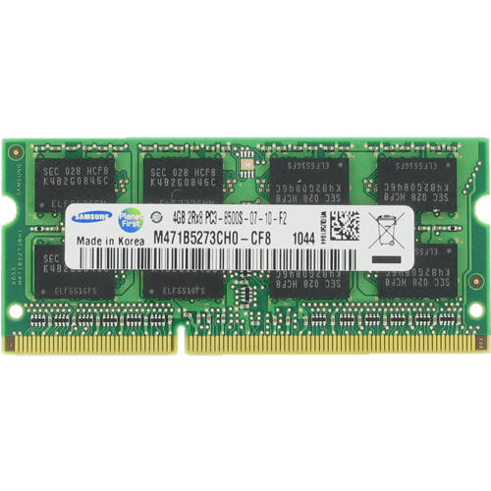
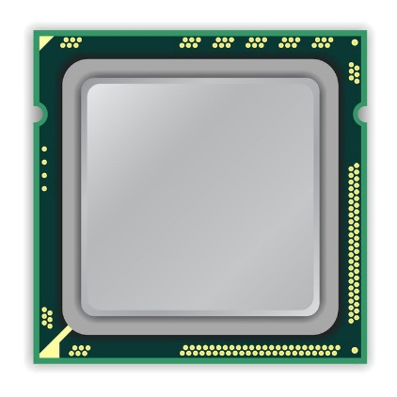
A Typical DRAM-Based Computing System
DRAM Chip
CPU
DRAM Module
Notes:
This is a typical DRAM-based computing system with a CPU [CLICK] and a DRAM module with multiple DRAM chips.

Slide 37
DRAM Organization
Subarray
Bitline
DRAM Cell
Bank
Wordline
…
Chip I/O
. . .
DRAM Row
…
…
…
…
…
Row Buffer
DRAM Chip
DRAM Bank
DRAM Subarray
Notes:
Each DRAM chip contains multiple banks
Each bank is composed of many subarrays [CLICK]
And within each subarray, there is a two dimensional array of DRAM cells. [CLICK]
These cells are organized into rows that are selected using wordlines [CLICK]
And the cells are connected to a row buffer via bitlines [CLICK]
To access data in a row, you need to activate the row and too many repeated activations can lead to

Slide 38
Read Disturbance in DRAM (I)
Read disturbance in DRAM breaks memory isolation
Prominent example: RowHammer
DRAM Subarray
Row 1
Row 1
Row 1
Victim Row
Row 2
Row 2
Row 2
Row 2
Row 2
Row 2
open
open
Aggressor Row
closed
open
closed
Row 3
Row 3
Row 3
Victim Row
Repeatedly opening (activating) and closing a DRAM row
many times causes RowHammer bitflips in adjacent rows
[Kim+, ISCA’14]
Notes:
… read disturbance bitflips.
Read disturbance bitflips have significant system-level implications because they break memory isolation.
[CLICK] A prominent example of read disturbance is RowHammer.
[CLICKx9] Repeatedly activating and closing a DRAM row many times causes RowHammer bitflips in adjacent rows
We call the repeatedly activated row the aggressor row and the rows that have bitflips victim rows.
That’s RowHammer…

Slide 39
Read Disturbance in DRAM (II)
Read disturbance in DRAM breaks memory isolation
A new read disturbance phenomenon: RowPress
DRAM Subarray
Row 1
Row 1
Row 1
Victim Row
Row 2
Row 2
Row 2
Row 2
Row 2
Row 2
open
open
Aggressor Row
closed
open
keep open
Row 3
Row 3
Row 3
Victim Row
Keeping a DRAM row open for a long time
causes bitflips in adjacent rows
[Luo+, ISCA’23]
Notes:
…, but there is also RowPress.
[Click]
RowPress induces bitflips by keeping the aggressor row open for a very long time.
Why do these bitflips occur?

Slide 40
DRAM Cell Leakage
Each cell encodes information in leaky capacitors
wordline
access
transistor
charge
leakage
paths
capacitor
bitline
Stored data is corrupted if too much charge leaks
(i.e., the capacitor voltage degrades too much)
[Patel+, ISCA’17]
Notes:
Each cell encodes data in fundamentally leaky capacitors [CLICK] Here is a simplified diagram of a DRAM cell, where the capacitor in red stores the data and the access transistor gates access to the data
[CLICK]
There are a number of leakage paths by which charge can enter or exit the capacitor.
[CLICK]
The important thing to note is that stored data can be corrupted if too much charge leaks
Which is the same as saying if the capacitor voltage degrades too much
[END]

Slide 41
DRAM Refresh
Refresh Operations
Refresh Window
100%
Vmin
Capacitor voltage (Vdd)
0%
REF
REF
REF
time
Periodic refresh operations preserve stored data
[Kim+, ISCA’20]
Notes:
Here, we have a simplified diagram of the capacitor voltage over time
We see that the voltage decreases over time in an exponential decay.
There’s a threshold Vmin under which we can no longer guarantee that we will correctly read the data that was originally stored in the cell.
[CLICK]
As long as a cell’s voltage remains above this line, we consider this a retention success.
[CLICK]
However, as soon as the voltage drops below Vmin, we consider this a retention failure
In order to prevent charge leakage failures, also known as retention failures, [CLICK] we issue periodic refresh operations to restore the charge in the cell. [CLICK] The interval between refresh commands are referred to as the refresh window.

Slide 42
Read Disturbance Bitflips
Read Disturbance
Bitflip
100%
Vmin
Capacitor voltage (Vdd)
0%
REF
REF
REF
time
Accesses to nearby row
[Kim+, ISCA’20]
Notes:
Now lets take a look at this diagram in the context of a read disturbance access pattern.
[CLICK] If enough activations are issued to a nearby row within a refresh window, the charge leakage rate can be accelerated such that we end up with a bitflip.

Slide 43
Read Disturbance Solutions
There are many solutions to mitigate read disturbance bitflips
More robust DRAM chips and/or error-correcting codes
Increased refresh rate
Physical isolation
Row remapping
Preventive refresh
Proactive throttling
Each solution offers a different system design point
in reliability, performance, energy, and area tradeoff space
Notes:
[CLICKx6 as you talk] Prior works proposed many techniques to mitigate read disturbance bitflips and maintain system robustness and security.
[CLICK] Many different techniques are valuable as each technique comes with a different reliability, performance, energy, and area tradeoff.

Slide 44
The Read Disturbance Threshold (RDT)
Many secure read disturbance solutions
take a preventive action before a bitflip manifests
  E.g., preventively refresh a victim row
Must accurately quantify the amount of disturbance
that a row can withstand before experiencing a bitflip
  Typically identified by testing for read disturbance failures
Read Disturbance Threshold (RDT):
The number of aggressor row activations
needed to induce the first bitflip
Notes:
Regardless, a *common* operation pattern across many different solutions is that they take *an action* before a bitflip manifests. For example, refreshing a victim row.
[CLICK] To do so, they *must accurately quantify* the amount of disturbance a row can withstand before it experiences a bitflip. [CLICK] This is typically quantified by time-intensive testing for read disturbance failures.
[CLICK] The read disturbance threshold, or RDT for short, quantifies the amount of disturbance a row can withstand before it experiences a bitflip. This metric is typically expressed in terms of an activation count.

Slide 45
Accurate Identification of Read Disturbance Threshold is Critical for System Security and Performance
RDT underestimated
High overhead
Secure
(e.g., 20)
RDT overestimated
Insecure
Low overhead
(e.g., 10,000)
Ground truth RDT
(e.g., 1,000)
Performance and
Energy Overhead
Configured RDT
for the Mitigation Technique
To securely prevent bitflips at low overhead
RDT must be accurately identified and carefully configured
Notes:
Now I will try to illustrate [CLICK] why it is important to *accurately identify RDT*.
[CLICK] The x-axis shows increasing RDT values in arbitrary units
[CLICK] and the y-axis shows performance and energy overheads in arbitrary units.
[CLICK] This is a curve you’d expect to see: as the RDT becomes smaller, read disturbance solutions induce more performance and energy overheads, for example by more frequently performing time- and energy-intensive preventive refresh operations.
[CLICK] If you have this ground truth RDT value for the row, you want to configure your solution with that exact RDT value, why?
[CLICK] because if you configure it with a higher value you cannot mitigate bitflips and your system is no longer secure
[CLICK] and if you are overly conservative you incur unnecessary performance and energy overheads
[CLICK] In summary, we must accurately identify RDT to securely prevent bitflips at low overhead

Slide 46
Motivation
RDT underestimated
High overhead
Secure
(e.g., 20)
RDT overestimated
Insecure
Low overhead
(e.g., 10,000)
Ground truth RDT
(e.g., 1,000)
Performance and
Energy Overhead
Configured RDT
for the Mitigation Technique
Prior works assume that the ground truth
Read Disturbance Threshold (RDT) can be identified
Notes:
Moreover [CLICKx2], prior works assume that the ground truth read disturbance threshold can be identified
In our work, we challenge this assumption…

Slide 47
Our Goal
Answer two research questions:
Analyze implications for
read disturbance solutions
1
Does RDT change over time?
2
How reliably and efficiently
can RDT be measured?
Notes:
Our goal is twofold:
First we’d like to answer two research questions: [CLICK] Does the read disturbance threshold change over time? [CLICK] If so, how reliably and efficiently can we measure it?
[CLICK] Second, we’d like to analyze implications of temporal variation of read disturbance threshold for read disturbance solutions.

Slide 48
DDR4 DRAM Testing Infrastructure
  DRAM Bender on a Xilinx Virtex UltraScale+ XCU200
Xilinx Alveo U200 FPGA Board
(programmed with DRAM Bender*)
DRAM Module with Heaters
PCIe
Host Interface
MaxWell FT200 Temperature Controller
Fine-grained control over DRAM commands,
timing parameters (±1.5ns), and temperature (±0.5°C )
*Olgun et al., "DRAM Bender: An Extensible and Versatile FPGA-Based Infrastructure to Easily Test
State-of-the-Art DRAM Chips,” TCAD, 2023. [GitHub: https://github.com/CMU-SAFARI/DRAM-Bender]
Notes:
We use DRAM Bender to test DDR4 DRAM modules [CLICK]
This infrastructure provides us with fine-grained control over DRAM commands, timing parameters, and temperature

Slide 49
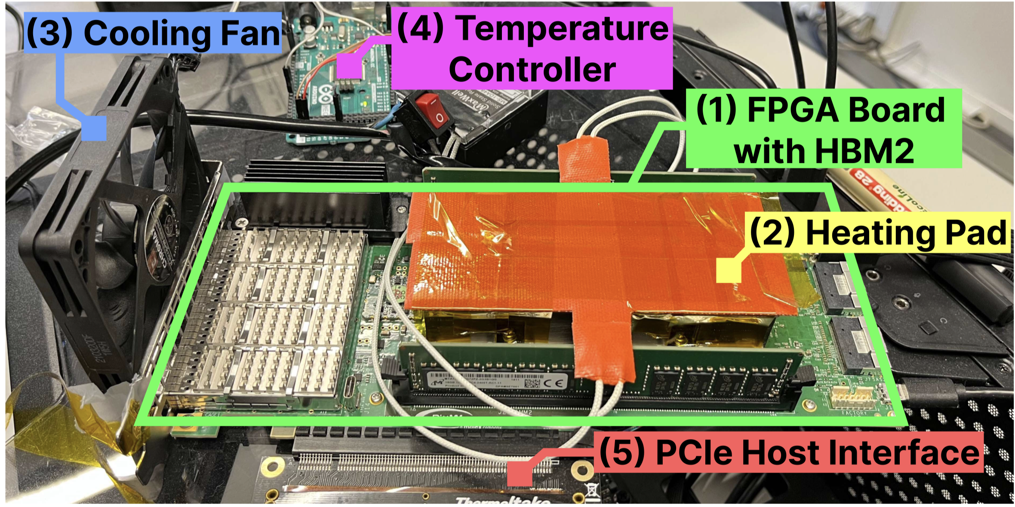
HBM2 DRAM Testing Infrastructure
  DRAM Bender on a Bittware XUPVVH
Fine-grained control over DRAM commands,
timing parameters (±1.67ns), and temperature (±0.5°C )
*Olgun et al., "DRAM Bender: An Extensible and Versatile FPGA-Based Infrastructure to Easily Test
State-of-the-Art DRAM Chips,” TCAD, 2023. [GitHub: https://github.com/CMU-SAFARI/DRAM-Bender]
Notes:
This is another version of the same infrastructure we use to test HBM2 DRAM chips.

Slide 50
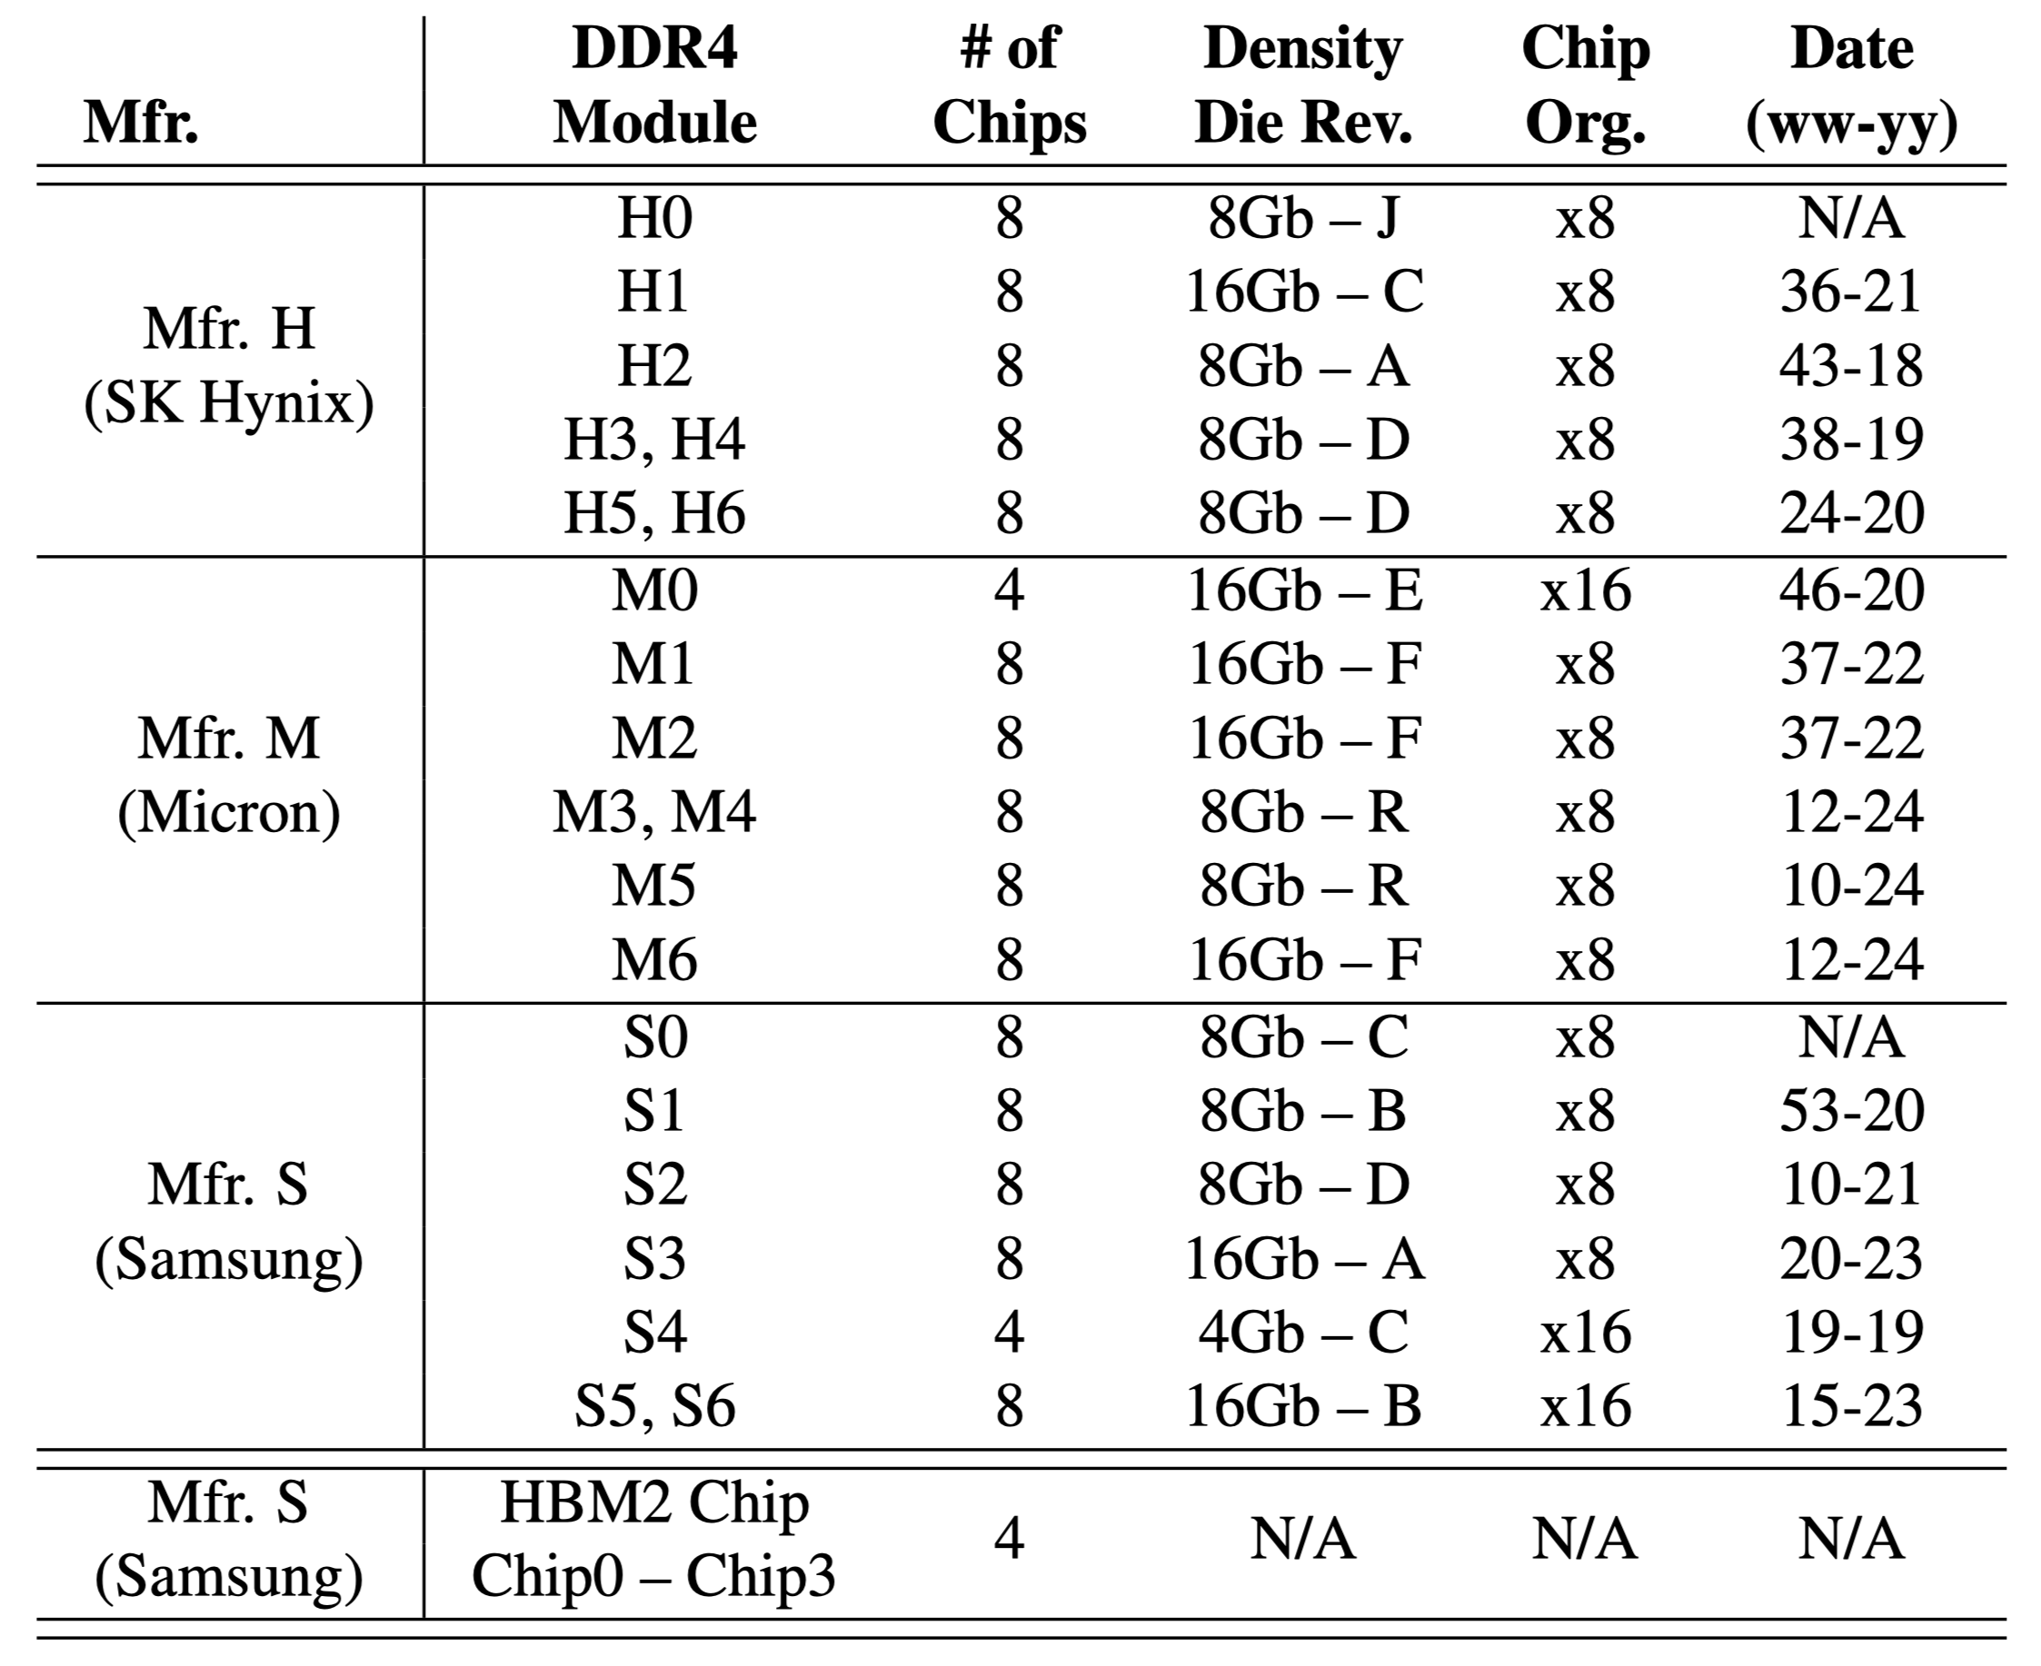
Tested DRAM Chips
160 DDR4 and 4 HBM2 Chips from SK Hynix, Micron, Samsung
Notes:
We test many DRAM chips from three major DRAM manufacturers spanning
[CLICK] various die density and die revisions and chip organizations.

Slide 51
Foundational Results: Key Takeaway
Key Takeaway
The Read Disturbance Threshold (RDT) of a row
changes randomly and unpredictably over time
Accurately identifying RDT is challenging
Notes:
… starting with this takeaway message.
We find that the read disturbance threshold of a row changes randomly and unpredictably over time.
This makes accurately identifying RDT very challenging.

Slide 52
Read Disturbance Threshold Changes Over Time
Read Disturbance Threshold
37360 hammers
Measurement Number
Notes:
[CLICKx2] We plot the read disturbance threshold values observed
[CLICK] across many read disturbance threshold measurements (or samples, or observations) for one DRAM row
[CLICK] Here is an example point in the plot describing a measurement [CLICK] that yields a read disturbance threshold value of 37K hammers

Slide 53
Read Disturbance Threshold Changes Over Time
Read Disturbance Threshold
Measurement Number
Notes:
Here are the RDT values across 5 measurements

Slide 54
Read Disturbance Threshold Changes Over Time
Read Disturbance Threshold
Measurement Number
Notes:
Here is across 1000. To expand the x-axis further and still make sense out of the plot…

Slide 55
Read Disturbance Threshold Changes Over Time
Maximum
Read Disturbance Threshold
Average
Minimum
Measurement Number
Notes:
We “compress” a series of 1000 measurements into this form: circle shows the average across 1000 measurements and error bars show the range of values

Slide 56
Read Disturbance Threshold Changes Over Time
Read Disturbance Threshold
Measurement Number
Notes:
Now, here is RDT across one hundred thousand measurements for one DRAM row.

Slide 57
Read Disturbance Threshold Changes Over Time
Read Disturbance Threshold
Minimum RDT at 16926th measurement
Measurement Number
Notes:
We observe that for this series of RDT measurements, the minimum RDT appears at around 17 thousand measurements.

Slide 58
Read Disturbance Threshold Changes Over Time
Read Disturbance Threshold
Read Disturbance Threshold of a DRAM row
varies over time: Variable Read Disturbance (VRD)
Notes:
This is a key result that demonstrates the variable read disturbance phenomenon

Slide 59
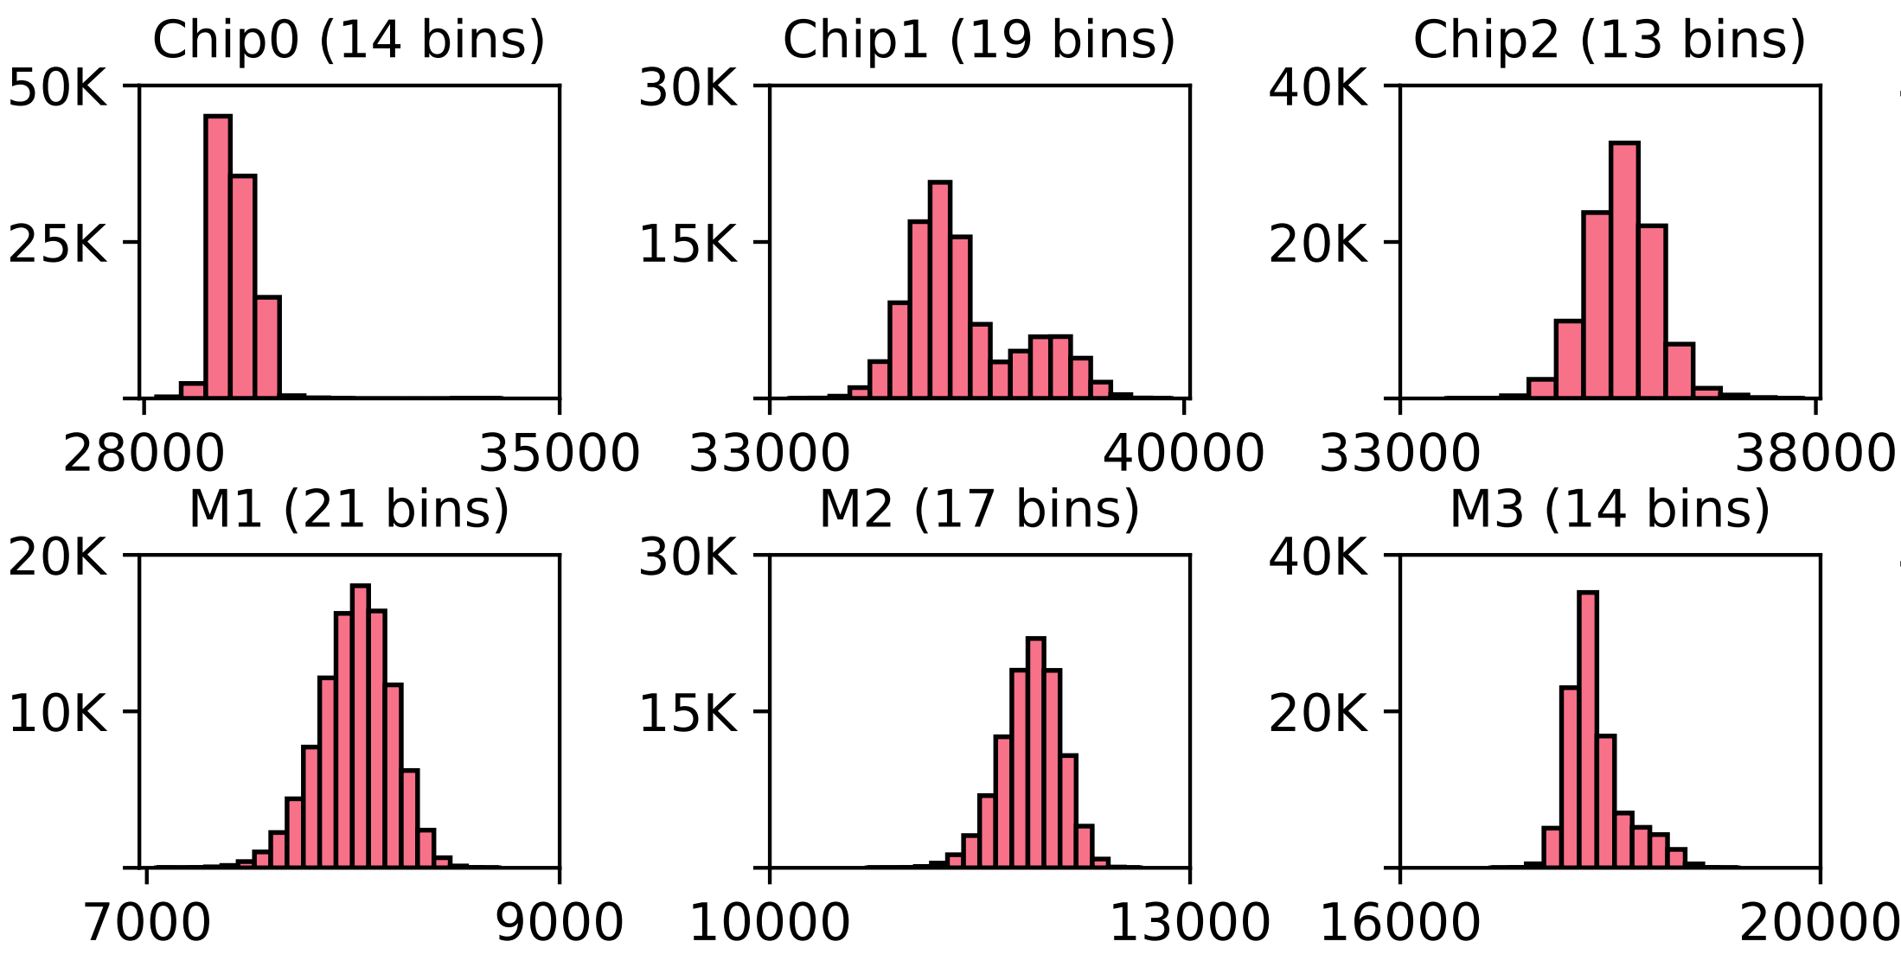
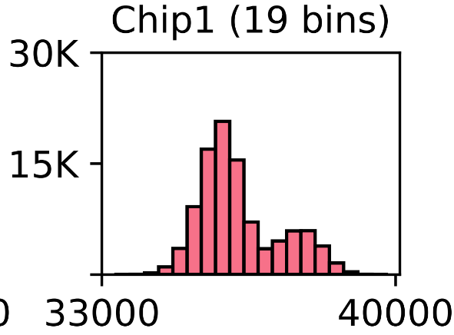
Variable Read Disturbance Across DRAM Chips
# of Measurements
Read Disturbance Threshold
RDT consistently varies over time
across all tested DRAM chips
Notes:
Here we show data for one tested row each from 6 tested chips [CLICK].
This observation is consistent across all tested chips…

Slide 60
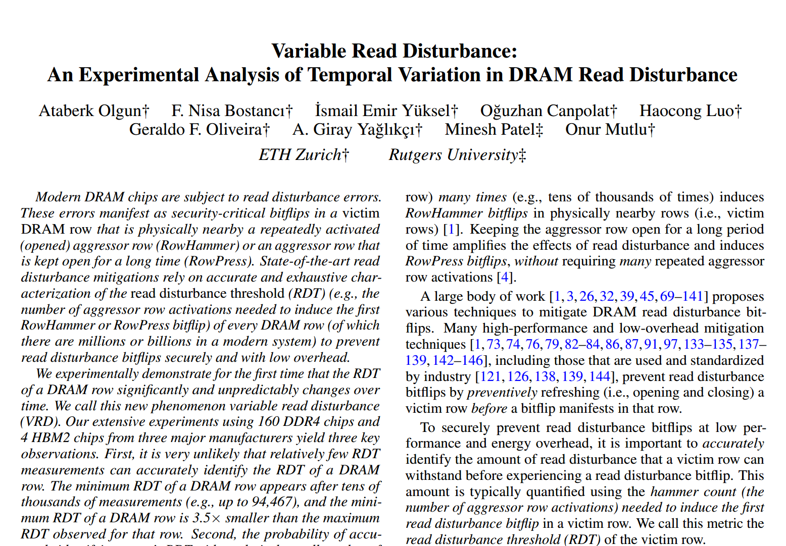
Variable Read Disturbance Across DRAM Chips
https://arxiv.org/pdf/2502.13075
# of Measurements
RDT
RDT consistently varies over time
across all tested DRAM chips
Notes:
=

Slide 61
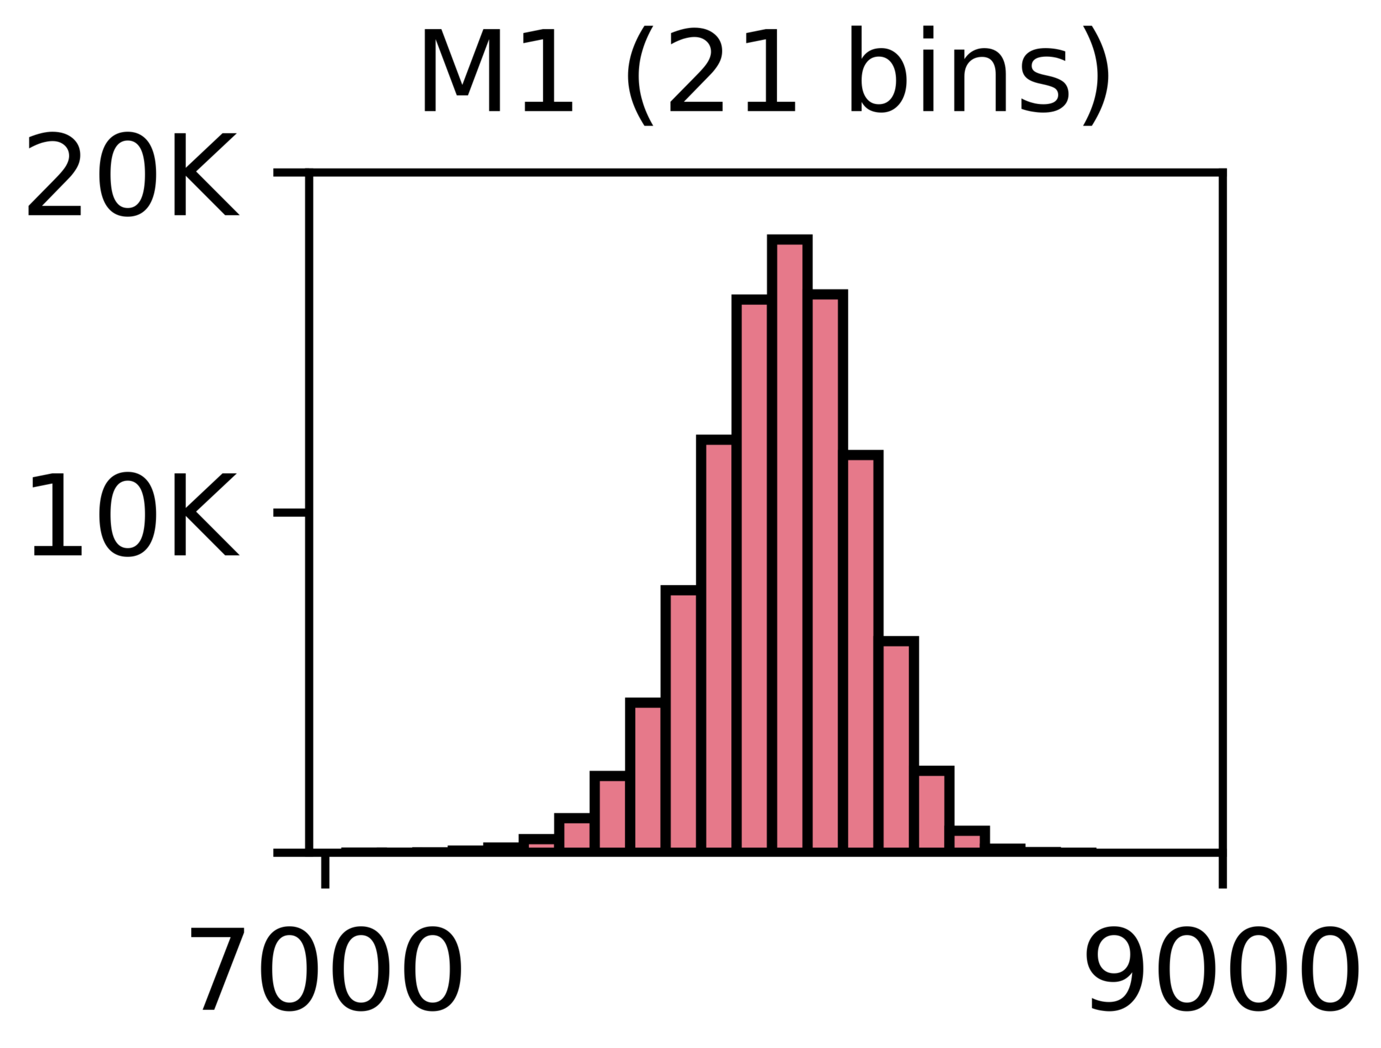
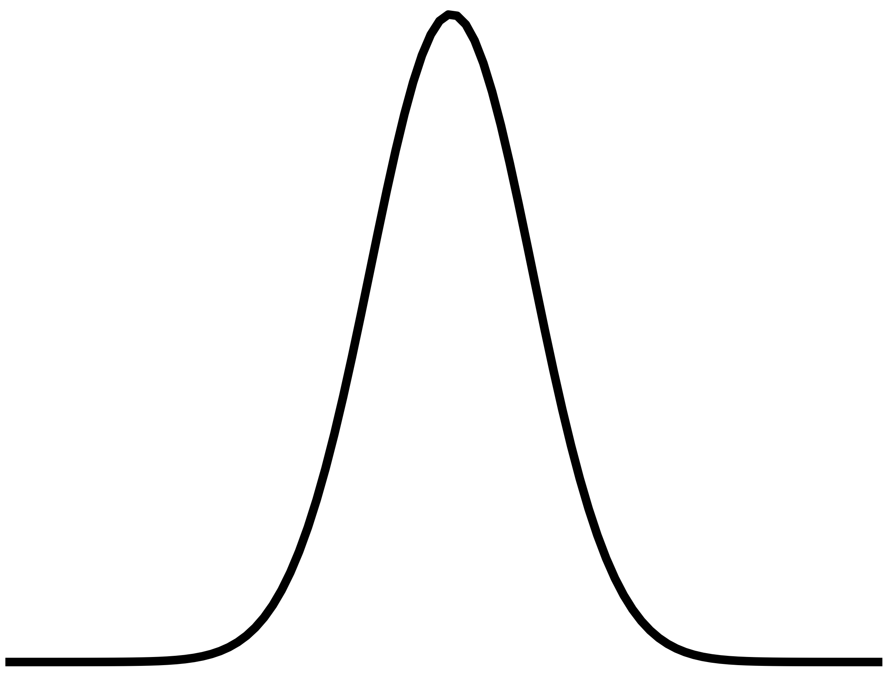
VRD is (Likely) Unpredictable
The outcome of the next
read disturbance threshold (RDT) measurement
cannot be predicted given past measurements
1
RDT histograms well resemble*
random probability distributions
e.g., normal distribution
2
Analyze and find no repeating patterns
in the series of consecutively measured RDT values
using the autocorrelation function
* Resemblance quantified using statistical tests in the paper
Notes:
We analyze the predictability of the next RDT value given past RDT measurements and we find that it is likely unpredictable.

Slide 62
VRD is (Likely) Unpredictable
https://arxiv.org/pdf/2502.13075
The outcome of the next RDT measurement
cannot be predicted given past measurements
1
RDT histograms well resemble*
random probability distributions
e.g., normal distribution
2
Analyze and find no repeating patterns
using the autocorrelation function
Notes:
For more details on our methodology, please check the paper

Slide 63
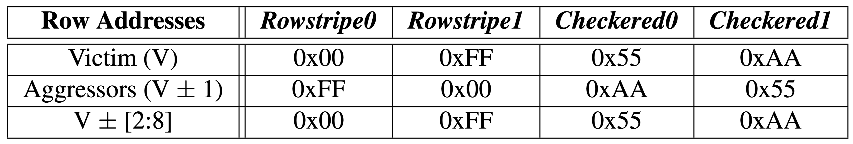
In-Depth Analysis: Parameter Space
Four data patterns
Three temperature levels: 50°C, 65°C, 80°C
Three aggressor row on time values (RowPress):
  Minimum t_{RAS} = ~35ns
  Interval between two periodic refresh commands t_{REFI} = 7.8µs (DDR4)
  Maximum interval between two refresh 9 ⨉ t_{REFI} = 70.2µs (DDR4)
Test 3750 rows and measure RDT 1000 times per row
  Aside: what would happen if we measure >1M times?
Notes:
We perform a more in-depth analysis of VRD by varying many test parameters

Slide 64
In-Depth Analysis: Key Takeaways
Takeaway 1
All tested DRAM rows exhibit VRD
Takeaway 2
Relatively few (<500) RDT measurements are
unlikely to yield the minimum RDT of a row
Takeaway 3
Data patterns, temperature, and
aggressor row on time affect VRD
Notes:
And this leads to 3 key takeaways

Slide 65
Implications Summary
Security guarantees provided by mitigation techniques
rely on accurately identified
minimum read disturbance threshold (RDT)
Accurate identification of minimum RDT (for each row)
is extremely challenging (even with 1000s measurements) because RDT unpredictably changes over time
We analyze the use of a guardband and ECC
  May prevent VRD-induced bitflips
  Large guardbands induce performance overhead
Call for future work on online RDT profiling and
runtime configurable read disturbance mitigations
Notes:
Security guarantees provided by read disturbance mitigation techniques or solutions rely on an accurately identified RDT
[CLICK] Our results show that accurate identification of RDT is extremely challenging
[CLICK] We evaluate a short-term solution: combining a guardband for RDT and error-correcting codes. [CLICK] Given our limited empirical bitflip dataset, we show that this combined solution could prevent VRD-induced bitflips at performance cost.
[CLICK] Our results call for future work on online read disturbance profiling and runtime configurable read disturbance mitigations

Slide 66
Combining ECC and Guardbands (II)
RDT guardbands ≥20% yield 1 unique bitflip in a row
Given our limited measurement dataset (10K measurements)
RDT guardbands ≥20% combined with ECC
may prevent VRD-induced read disturbance bitflips
More detailed analysis (following a large-scale study)
needed to make a definitive conclusion
Notes:
We evaluate combining guardbands with ECC as a solution for VRD. We find that guardbands greater than or equal to 20% yield only 1 unique bitflip in a row
[CLICK] The bitflip patterns *we* observe could be prevented with larger than or equal to 20% guardband combined with widely-used ECC schemes.
[CLICK] But more detailed analysis likely following a large-scale study is needed to make a definitive conclusion about the effectiveness of guardbands and ECC.

Slide 67
Extended Version on arXiv
https://arxiv.org/pdf/2502.13075
Notes:
An extended version of our conference paper is on arXiv.

Slide 68
Variable Read Disturbance
Ataberk Olgun, Nisa Bostanci, Ismail Emir Yuksel, Abdullah Giray Yaglikci, Geraldo Francisco de Oliveira, Haocong Luo, Oguzhan Canpolat, Minesh Patel, and Onur Mutlu,
"Variable Read Disturbance: An Experimental Analysis of Temporal Variation in DRAM Read Disturbance"
Proceedings of the 31st International Symposium on High-Performance Computer Architecture (HPCA), Las Vegas, NV, USA, March 2025.
[Slides (pptx) (pdf)]

Slide 69
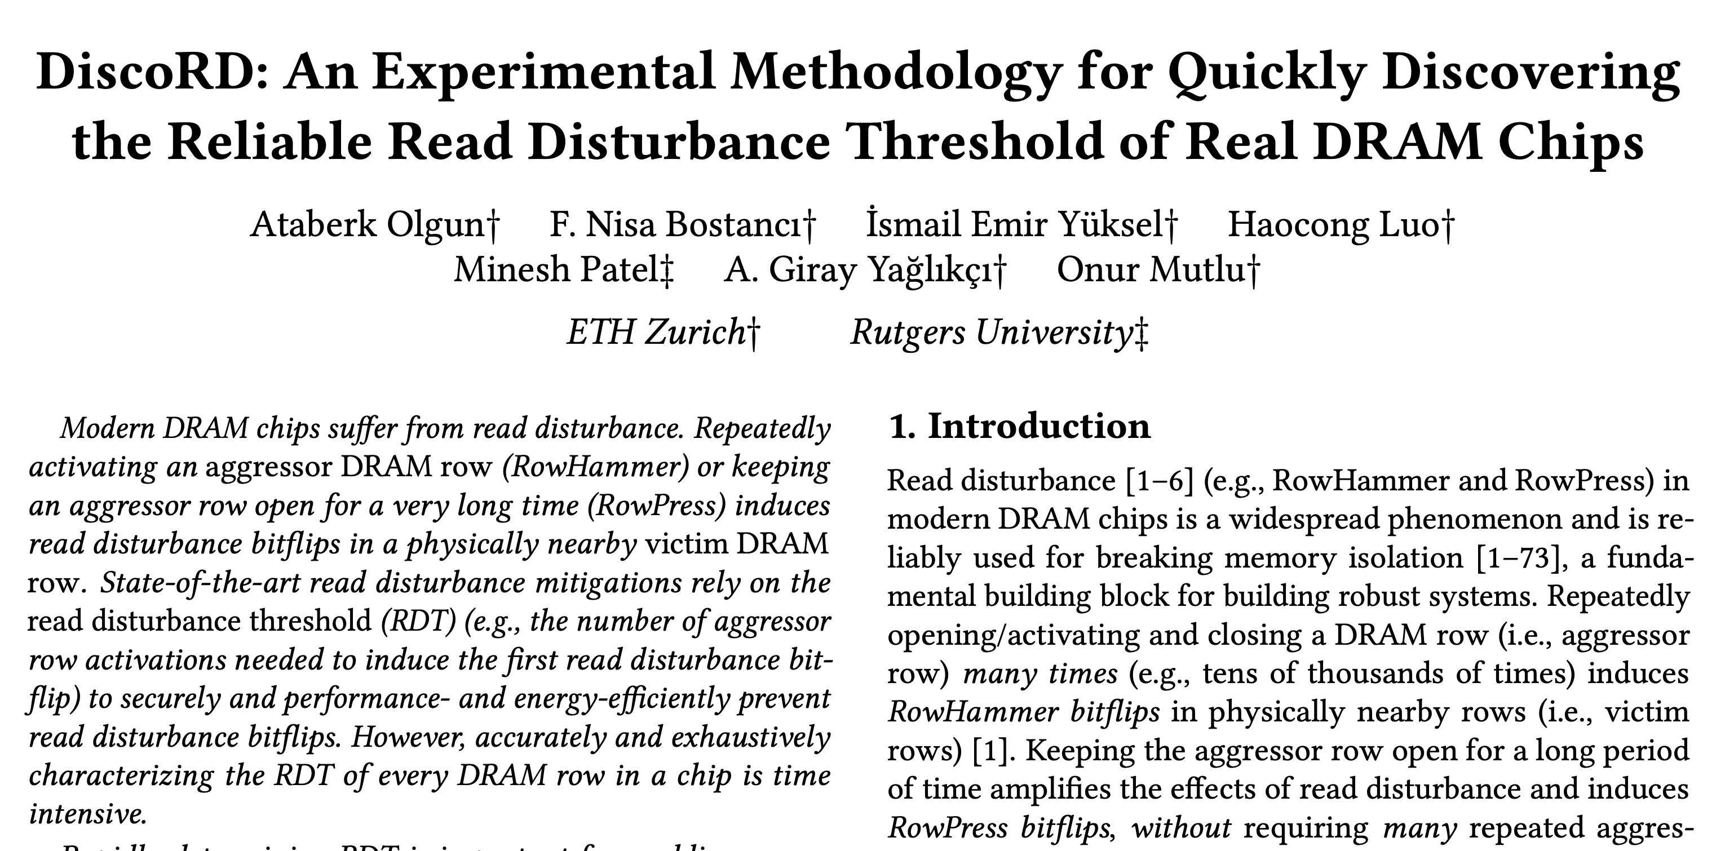
DiscoRD (Preprint)
How can we reliably identify RDT given VRD?
https://arxiv.org/pdf/2603.12435v1

Slide 70

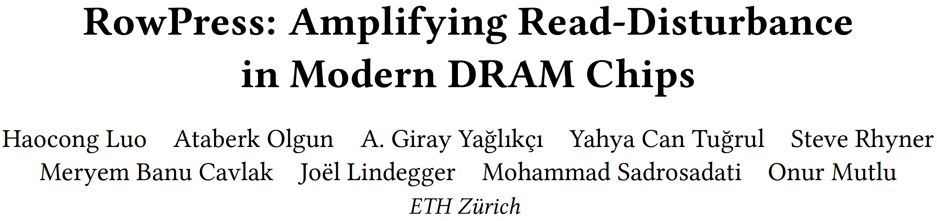
RowPress [ISCA 2023]
Haocong Luo, Ataberk Olgun, Giray Yaglikci, Yahya Can Tugrul, Steve Rhyner, M. Banu Cavlak, Joel Lindegger, Mohammad Sadrosadati, and Onur Mutlu,
"RowPress: Amplifying Read Disturbance in Modern DRAM Chips"
Proceedings of the 50th International Symposium on Computer Architecture (ISCA), Orlando, FL, USA, June 2023.
[Slides (pptx) (pdf)]
[Lightning Talk Slides (pptx) (pdf)]
[Lightning Talk Video (3 minutes)]
[RowPress Source Code and Datasets (Officially Artifact Evaluated with All Badges)]
Officially artifact evaluated as available, reusable and reproducible.
Best artifact award at ISCA 2023.
One of the 12 computer architecture papers of 2023
selected as Top Picks by IEEE Micro.

Slide 71
RowPress: Key Observation
Keeping a DRAM row open for a long time
causes bitflips in adjacent rows
These bitflips do NOT require many row activations
Only one activation is enough in some cases!
RowHammer
Aggressor Row
Open
Close
36ns, 47K activations to induce bitflips
RowPress
Aggressor Row
Open
Close
7.8µs, only 5K activations to induce bitflips

Slide 72
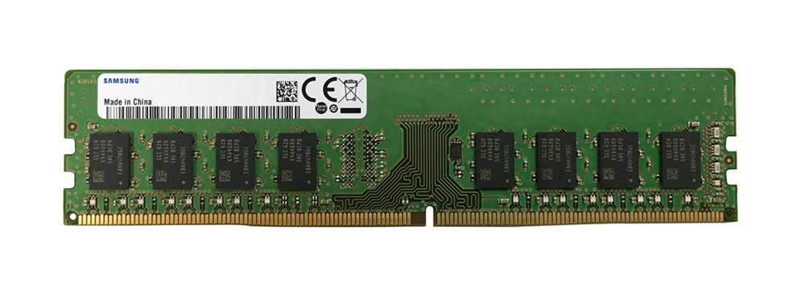
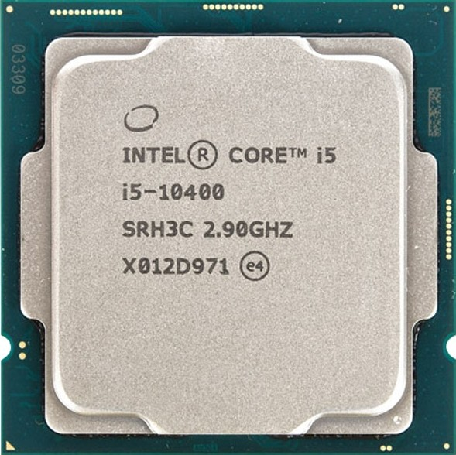
Real-System Demonstration (I)
Samsung DDR4 Module M378A2K43CB1-CTD
(Date Code: 20-10)
w/ TRR RowHammer Mitigation
Intel Core i5-10400 (Comet Lake)
Key Idea: A proof-of-concept RowPress program keeps a DRAM row open for a longer period by keeping on accessing different cache blocks in the row
// Sync with Refresh and Loop Below
for (k = 0; k < NUM_AGGR_ACTS; k++)
for (j = 0; j < NUM_READS; j++) ∗AGGRESSOR1[j];
for (j = 0; j < NUM_READS; j++) ∗AGGRESSOR2[j];
for (j = 0; j < NUM_READS; j++)
clflushopt(AGGRESSOR1[j]);
clflushopt(AGGRESSOR2[j]);
mfence();
activate_dummy_rows();
Number of Cache Blocks Accessed
Per Aggressor Row ACT
(NUM_READS=1 is Rowhammer)
Notes:
We demonstrate RowPress on a real system with a recent Intel processor and a Samsung DDR4 module with TRR rowhammer mitigation. The key idea of our RowPress program is to keep a DRAM row open for a longer period by keeping accessing different cache blocks in the row.
Here is the key part of our program, where we can change the number of cache blocks read per aggressor row activation. If we only read 1 cache block, then the program does the same as RowHammer

Slide 73
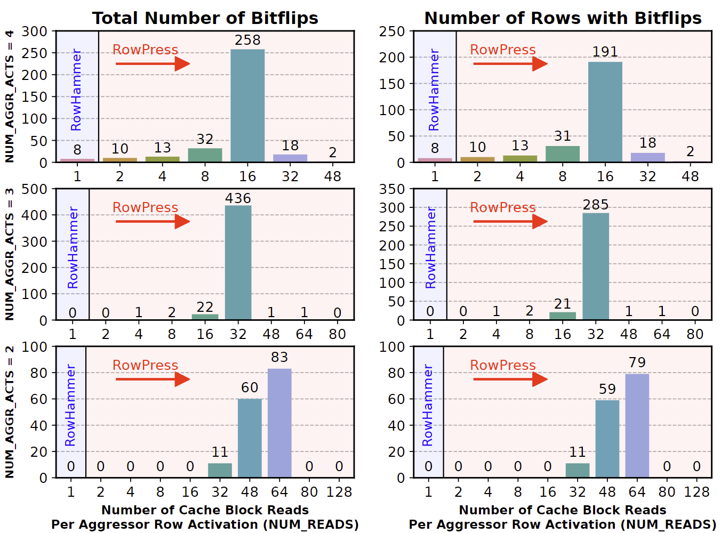
Real-System Demonstration (II)
On 1500 victim rows
Leveraging RowPress, our user-level program
induces bitflips when RowHammer cannot
Notes:
We run the program on 1500 arbitrarily selected victim rows, and we show the total number of bitflips we observe on the left, and the number of rows with bitflips on the right.
Leveraging RowPress, our program induces bitflips when RowHammer cannot

Slide 74
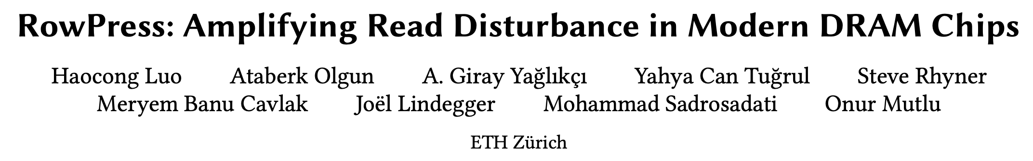




RowPress Results & Source Code
Fully open source and artifact evaluated
https://github.com/CMU-SAFARI/RowPress
Notes:
We have more results in the paper, and our work is fully open-source and artifact evaluated.

Slide 75
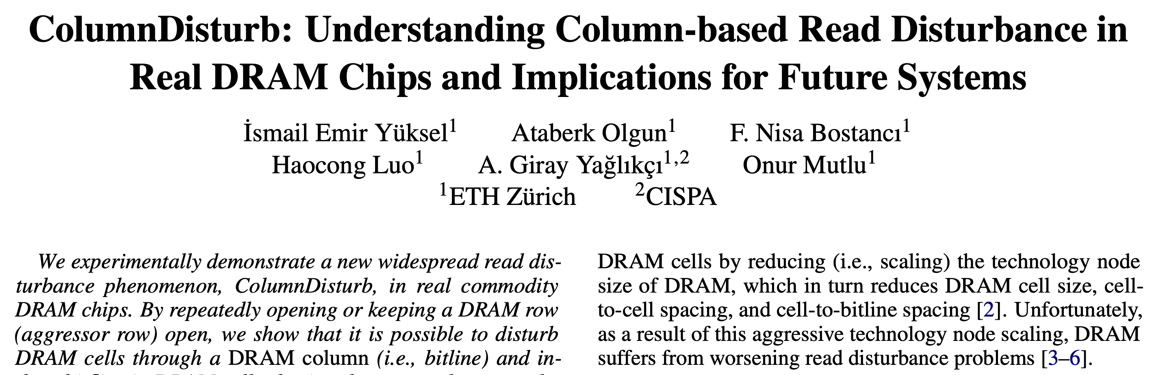
ColumnDisturb
Ismail Emir Yuksel, Ataberk Olgun, Nisa Bostanci,
Haocong Luo, A. Giray Yaglikci, and Onur Mutlu,
"ColumnDisturb: Understanding Column-based Read Disturbance in Real DRAM Chips and Implications for Future Systems"
Proceedings of the 58th International Symposium on Microarchitecture (MICRO), Seoul, South Korea, October 2025.
[Slides (pptx) (pdf)]

Slide 76
Research Question
What if there is a much worse
read disturbance phenomenon
that affects
thousands of DRAM rows
through the bitlines?
Notes:
In ColumnDisturb, we ask:
What if there is a much worse read disturbance phenomenon that affects thousands of rows, through the bitlines

Slide 77

ColumnDisturb
By repeatedly opening or keeping a DRAM row open,
it is possible to disturb many DRAM cells
on the same DRAM column
Subarray
Victim Cell
Subarray
Subarray
With ColumnDisturb, the activation of a single row concurrently affects DRAM cells across as many as three DRAM subarrays
(e.g., up to 3072 DRAM rows)
Notes:
Turns out, there is one: which we call ColumnDisturb
[CLICK] We observe that by repeatedly opening or keeping a DRAM row open, it is possible to disturb many DRAM cells on the same DRAM column
[CLICK] With ColumnDisturb, the activation of a single row concurrently affects DRAM cells across as many as three DRAM subarrays: which translates to up to 3072 DRAM rows

Slide 78
Key Takeaways from Major Characterization Experiments
Takeaway 1
ColumnDisturb is a widespread read disturbance phenomenon and becomes worse as DRAM technology scales down to smaller node sizes
Takeaway 2
ColumnDisturb induces bitflips in thousands of DRAM rows and
is different from RowHammer, RowPress, and Retention failures
Takeaway 3
The bitflip directionalities of ColumnDisturb and RowHammer & RowPress
are significantly different
Takeaway 4
Significantly more rows are vulnerable to ColumnDisturb
than retention failures
Takeaway 5
As temperature increases,
DRAM chips become more vulnerable to ColumnDisturb
Notes:
We have five key takeaways from major characterization experiments

Slide 79
Key Takeaways from Major Characterization Experiments
Takeaway 1
ColumnDisturb is a widespread read disturbance phenomenon and becomes worse as DRAM technology scales down to smaller node sizes
Takeaway 2
ColumnDisturb induces bitflips in thousands of DRAM rows and
is different from RowHammer, RowPress, and Retention failures
Takeaway 3
The bitflip directionalities of ColumnDisturb and RowHammer & RowPress
are significantly different
Takeaway 4
Significantly more rows are vulnerable to ColumnDisturb
than retention failures
Takeaway 5
As temperature increases,
DRAM chips become more vulnerable to ColumnDisturb
Notes:
First, ColumnDisturb is a widespread read disturbance phenomenon and becomes worse as DRAM technology scales down to smaller node sizes

Slide 80
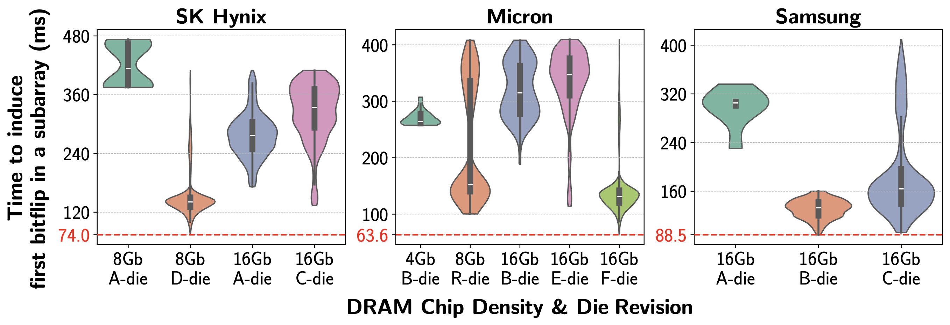
Minimum Time to Induce First Bitflip
All tested 216 DDR4 chips are vulnerable to ColumnDisturb
Notes:
Here we show the first result that lead us to first takeaway: y-axis shows the time to induce first bitflip in a subarray
[CLICK] X-axis shows the DRAM die revision and density and each subplot is dedicated to different manufacturer
[CLICK] Here is the result and as you can see all tested DRAM chips experience ColumnDisturb bitflips
[CLICK] We conclude that all tested 216 DDR4 chips are vulnerable to ColumnDisturb

Slide 81
Minimum Time to Induce First Bitflip
5.1x
3x
2.5x
1.3x
Newer chips tend to be
more vulnerable to ColumnDisturb bitflips
This trend is consistent across all tested manufacturers
Notes:
For the second observation,
[CLICK] Let’s first focus on one manufacturer: Sk hynix
[CLICK] We observe that from A-die to D-die, the minimum time to observe first bitflips reduces by up to 5.1x, note that 8Gb D-die chips are newer than 8Gb A-die chips
And a similar reduction in 16Gb A-die to C-die
[CLICK] We conclude that newer chips tend to be more vulnerable to ColumnDisturb bitflips
[CLICK] And this observation is consistent across all tested manufacturers

Slide 82
Minimum Time to Induce First Bitflip
Some real DRAM chips experience ColumnDisturb bitflips
within the nominal refresh window (64ms)
under nominal operating conditions
Notes:
[CLICK] Another observation we made is based on the lowest time to induce the first bitflip in a subarray for each manufacturer, highlighted as red.
[CLICK] In some Micron chips, specifically 16Gb F-die chips experience ColumnDisturb bitflips within the nominal refresh window under nominal operating conditions, note that these 16Gb F-die chips are the newest one across all tested chips according to datasheet release date and manufacturing time.

Slide 83
ColumnDisturb
Ismail Emir Yuksel, Ataberk Olgun, Nisa Bostanci,
Haocong Luo, A. Giray Yaglikci, and Onur Mutlu,
"ColumnDisturb: Understanding Column-based Read Disturbance in Real DRAM Chips and Implications for Future Systems"
Proceedings of the 58th International Symposium on Microarchitecture (MICRO), Seoul, South Korea, October 2025.
[Slides (pptx) (pdf)]

Slide 84
DRAM Bender
Enables Uncovering
New DRAM Functionality

Slide 85
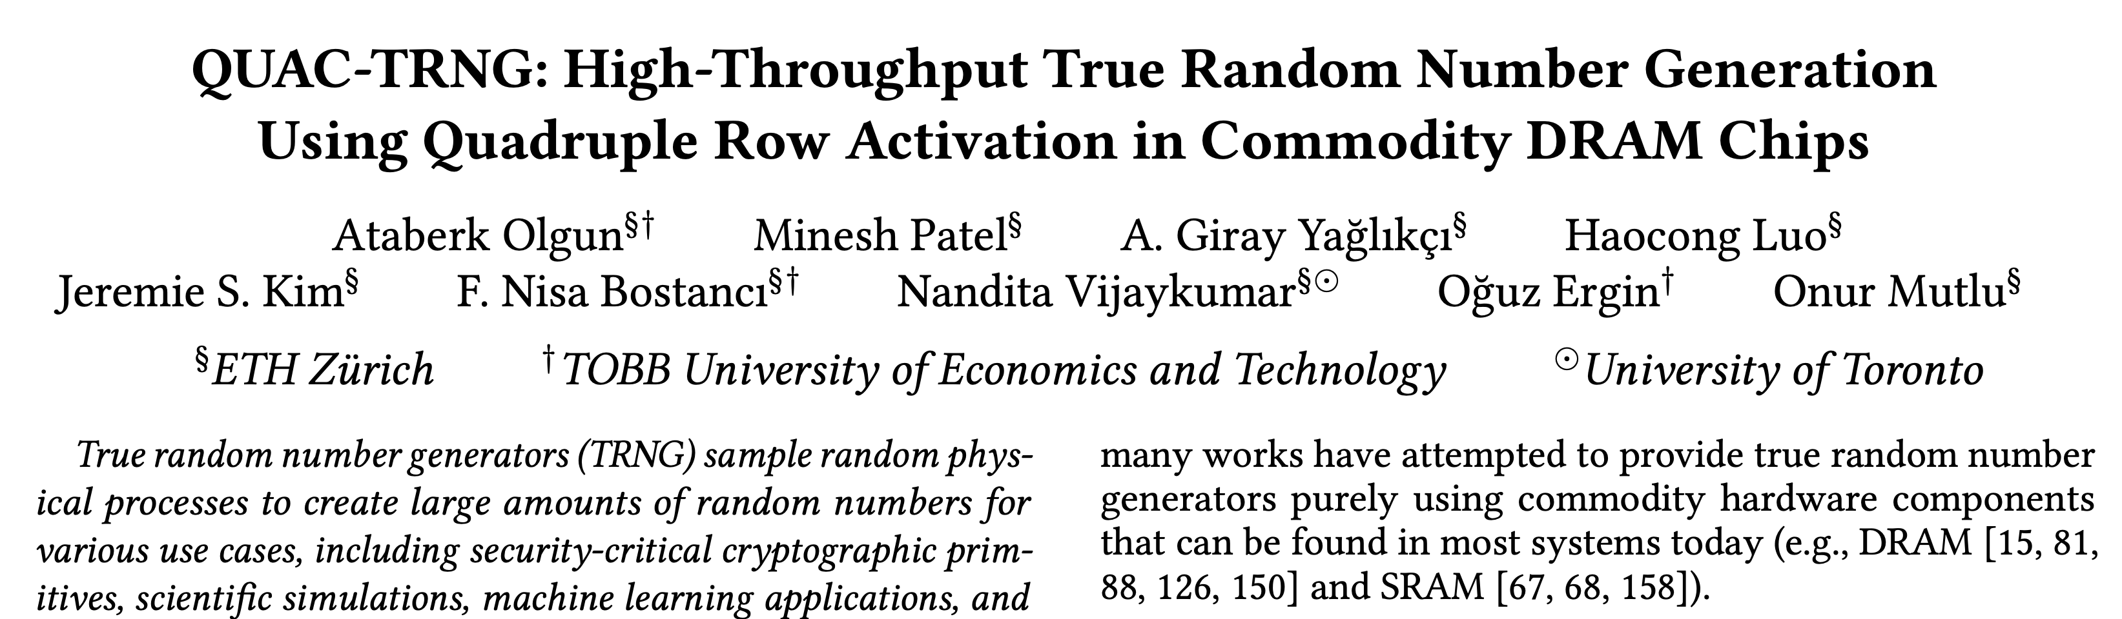
QUAC-TRNG
Ataberk Olgun, Minesh Patel, A. Giray Yaglikci, Haocong Luo, Jeremie S. Kim, F. Nisa Bostanci, Nandita Vijaykumar, Oguz Ergin, and Onur Mutlu,
"QUAC-TRNG: High-Throughput True Random Number Generation Using Quadruple Row Activation in Commodity DRAM Chips"
Proceedings of the 48th International Symposium on Computer Architecture (ISCA), Virtual, June 2021.
[Slides (pptx) (pdf)]
[Short Talk Slides (pptx) (pdf)]
[Talk Video (25 minutes)]
[SAFARI Live Seminar Video (1 hr 26 mins)]

Slide 86
Accessing a DRAM Cell
wordline
capacitor
bitline
access transistor
Sense Amp
enable
bitline
[Seshadri+ MICRO’17]

Slide 87
Accessing a DRAM Cell
4
deviation in bitline voltage
enable wordline
wordline
1
½ V_{DD} + δ
V_{DD}
½ V_{DD}
capacitor
bitline
access transistor
2
connects cell to bitline
3
cell charge restored
cell loses charge to bitline
6
Sense Amp
enable sense amp
enable
5
bitline
½ V_{DD}
0
[Seshadri+ MICRO’17]

Slide 88
DRAM Operation
Cache line
…
Wordline Drivers
…
…
…
…
…
Sense Amplifiers
Sense Amplifiers
Sense Amplifiers
READ
READ
READ
READ
READ
READ
tRAS
(Activation Latency)
tRP
(Precharge Latency)
DRAM Command Sequence
ACT R0
RD
RD
RD
PRE R0
ACT R1
RD
RD
RD
time
[Kim+ HPCA’19]

Slide 89
Quadruple Activation (QUAC)
New Observation
Carefully-engineered DRAM commands
can activate four rows in real DRAM chips
Activate four rows with two ACT commands
Violated
ACT
<3ns
PRE
<3ns
ACT
35ns
14ns
Default

Slide 90
Why Does QUAC Work?
Hypothetical circuit to explain QUAC
Hierarchical Wordlines
High density and performance requirements
Hierarchical organization of DRAM wordlines enable high-density and low-latency DRAM operation

Slide 91
Hierarchical Wordlines
A master wordline drives multiple local wordlines
Select signals for rows 0-3

Slide 92
Hypothetical Row Decoder
Predecode the
least significant two bits
Drive
control signals
Latch
A0
S0
A1
Address [0]
L
A0
A0
S1
L
A0
A1
Address [1]
L
A1
A0
S2
A1
L
A1
A0
S3
A1
Notes:
Made up of two stages

Slide 93
Hypothetical Row Decoder
Command
ACT R0
A0
S0
A1
0
L
A0
A0
S1
L
A0
A1
0
L
A1
A0
S2
A1
L
A1
A0
S3
A1
First ACT command drives a single wordline

Slide 94
Hypothetical Row Decoder
Command
ACT R0
Violate Timing
PRE
A0
S0
A1
0
L
A0
A0
S1
L
A0
A1
0
L
A1
A0
S2
A1
L
A1
A0
S3
A1
PRE command cannot disable latches

Slide 95
Hypothetical Row Decoder
Command
ACT R0
Violate Timing
PRE
Violate Timing
ACT R3
A0
S0
A1
1
L
0
A0
A0
S1
L
A0
A1
1
L
A0
0
A1
S2
A1
L
A1
A0
S3
A1
Second ACT drives the remaining three wordlines

Slide 96
Hypothetical Row Decoder
Command
ACT R0
Violate Timing
PRE
Violate Timing
ACT R3
A0
S0
A1
1
L
A0
A0
S1
L
A0
A1
1
L
A1
A0
S2
A1
L
A1
A0
S3
A1
All four wordlines are enabled
Quadruple Activation
Second ACT drives the remaining three wordlines
Notes:
… and you can use Quadruple Activation for true random number generation

Slide 97

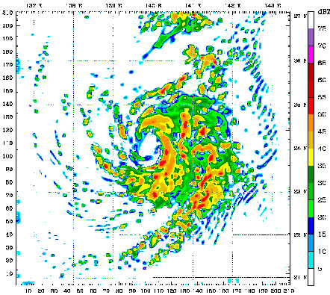
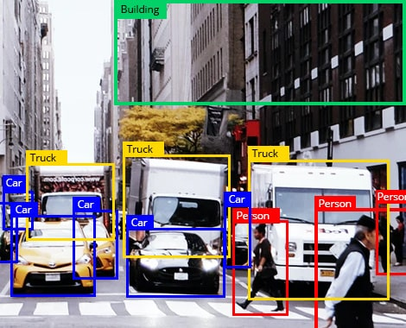
Use Cases of True Random Numbers
High-quality true random numbers
are critical to many applications
True random numbers can only be obtained
by sampling random physical processes
Unfortunately, not all computing systems are equipped with TRNG hardware (e.g., dedicated circuitry)
Notes:
These true random numbers are critical to many cryptographic applications, scientific simulations, and even machine learning applications

Slide 98
Generating Random Values via QUAC
V_{DD}/2
R3
V_{dd}
R2
V_{TH}
R1
0
Voltage Difference
Logic-1
R0
-V_{TH}
Ready to Sense
Voltage Level
Sense Amplifier
-V_{dd}
Enable
Time
V_{DD}/2

Slide 99
Generating Random Values via QUAC
V_{DD}/2
+ $ε$
R3
V_{dd}
R2
V_{TH}
R1
0
Voltage Difference
R0
-V_{TH}
Sense Amplifier
-V_{dd}
Enable
ACT
R0
PRE
ACT R3
Time
V_{DD}/2

Slide 100
Generating Random Values via QUAC
V_{DD}/2
+ $ε$
R3
V_{dd}
Random perturbation
R2
V_{TH}
R1
0
Voltage Difference
R0
-V_{TH}
Sense Amplifier
-V_{dd}
Enable
ACT
R0
PRE
ACT R3
Time
Enable Sense Amplifiers
V_{DD}/2

Slide 101
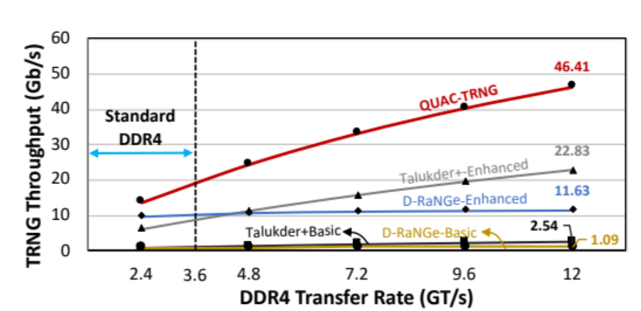
QUAC-TRNG vs State-Of-The-Art
Outperforms best prior DRAM-based TRNG
(i) “base” by 15.08x at 2.4 GT/s
(ii) “enhanced” by 2.03x at 12 GT/s

Slide 102
QUAC-TRNG
Ataberk Olgun, Minesh Patel, A. Giray Yaglikci, Haocong Luo, Jeremie S. Kim, F. Nisa Bostanci, Nandita Vijaykumar, Oguz Ergin, and Onur Mutlu,
"QUAC-TRNG: High-Throughput True Random Number Generation Using Quadruple Row Activation in Commodity DRAM Chips"
Proceedings of the 48th International Symposium on Computer Architecture (ISCA), Virtual, June 2021.
[Slides (pptx) (pdf)]
[Short Talk Slides (pptx) (pdf)]
[Talk Video (25 minutes)]
[SAFARI Live Seminar Video (1 hr 26 mins)]

Slide 103
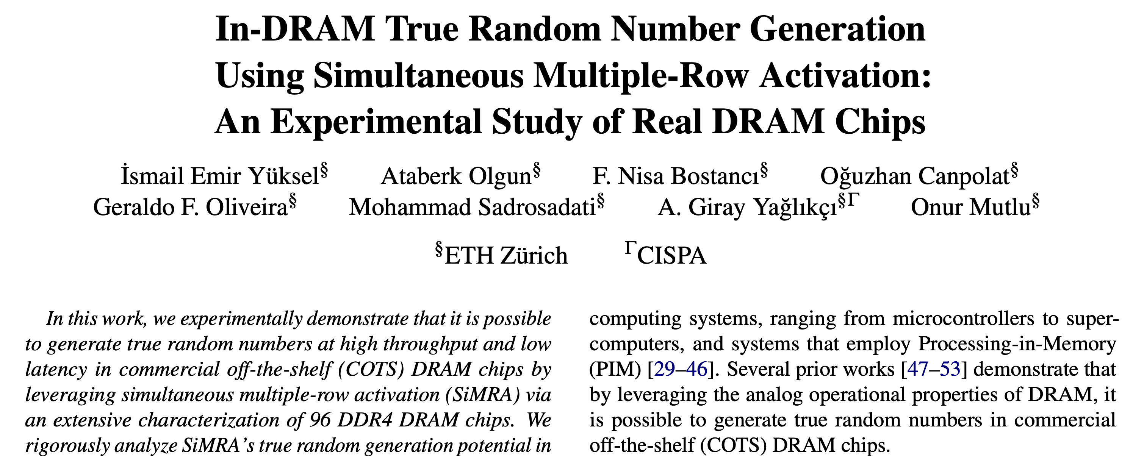
SiMRA-TRNG
Ismail Emir Yuksel, Ataberk Olgun, Nisa Bostancı, Oğuzhan Canpolat, Geraldo Francisco de Oliveira Junior, Mohammad Sadrosadati, Abdullah Giray Yağlıkçı, and Onur Mutlu,
"In-DRAM True Random Number Generation Using Simultaneous Multiple-Row Activation: An Experimental Study of Real DRAM Chips"
Proceedings of the 43rd IEEE International Conference on Computer Design (ICCD), Dallas, TX, USA, November 2025.
[Slides (pptx) (pdf)]

Slide 104
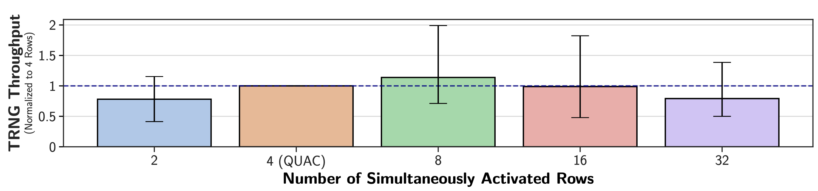
SiMRA-TRNG: Throughput
1.99x
1.82x
1.15x
1.39x
State-of-the-art DRAM-based TRNG
SiMRA-based TRNG designs outperform
the state-of-the-art DRAM-based TRNG
Notes:
Moving onto the throughput results
Here on the y-axis we have the TRNG throughput normalized to the state-of-the-art DRAM-based TRNG
[CLICK] which is four row activation
[CLICK] Here is the result
[CLICK] And we observe that SiMRA-TRNG achieves up to 2 times higher throughput than the state-of-the-art
[CLICK] We conclude that SiMRA-based TRNG designs outperforms the state-of-the-art DRAM-based TRNG

Slide 105
SiMRA-TRNG
Ismail Emir Yuksel, Ataberk Olgun, Nisa Bostancı, Oğuzhan Canpolat, Geraldo Francisco de Oliveira Junior, Mohammad Sadrosadati, Abdullah Giray Yağlıkçı, and Onur Mutlu,
"In-DRAM True Random Number Generation Using Simultaneous Multiple-Row Activation: An Experimental Study of Real DRAM Chips"
Proceedings of the 43rd IEEE International Conference on Computer Design (ICCD), Dallas, TX, USA, November 2025.
[Slides (pptx) (pdf)]

Slide 106
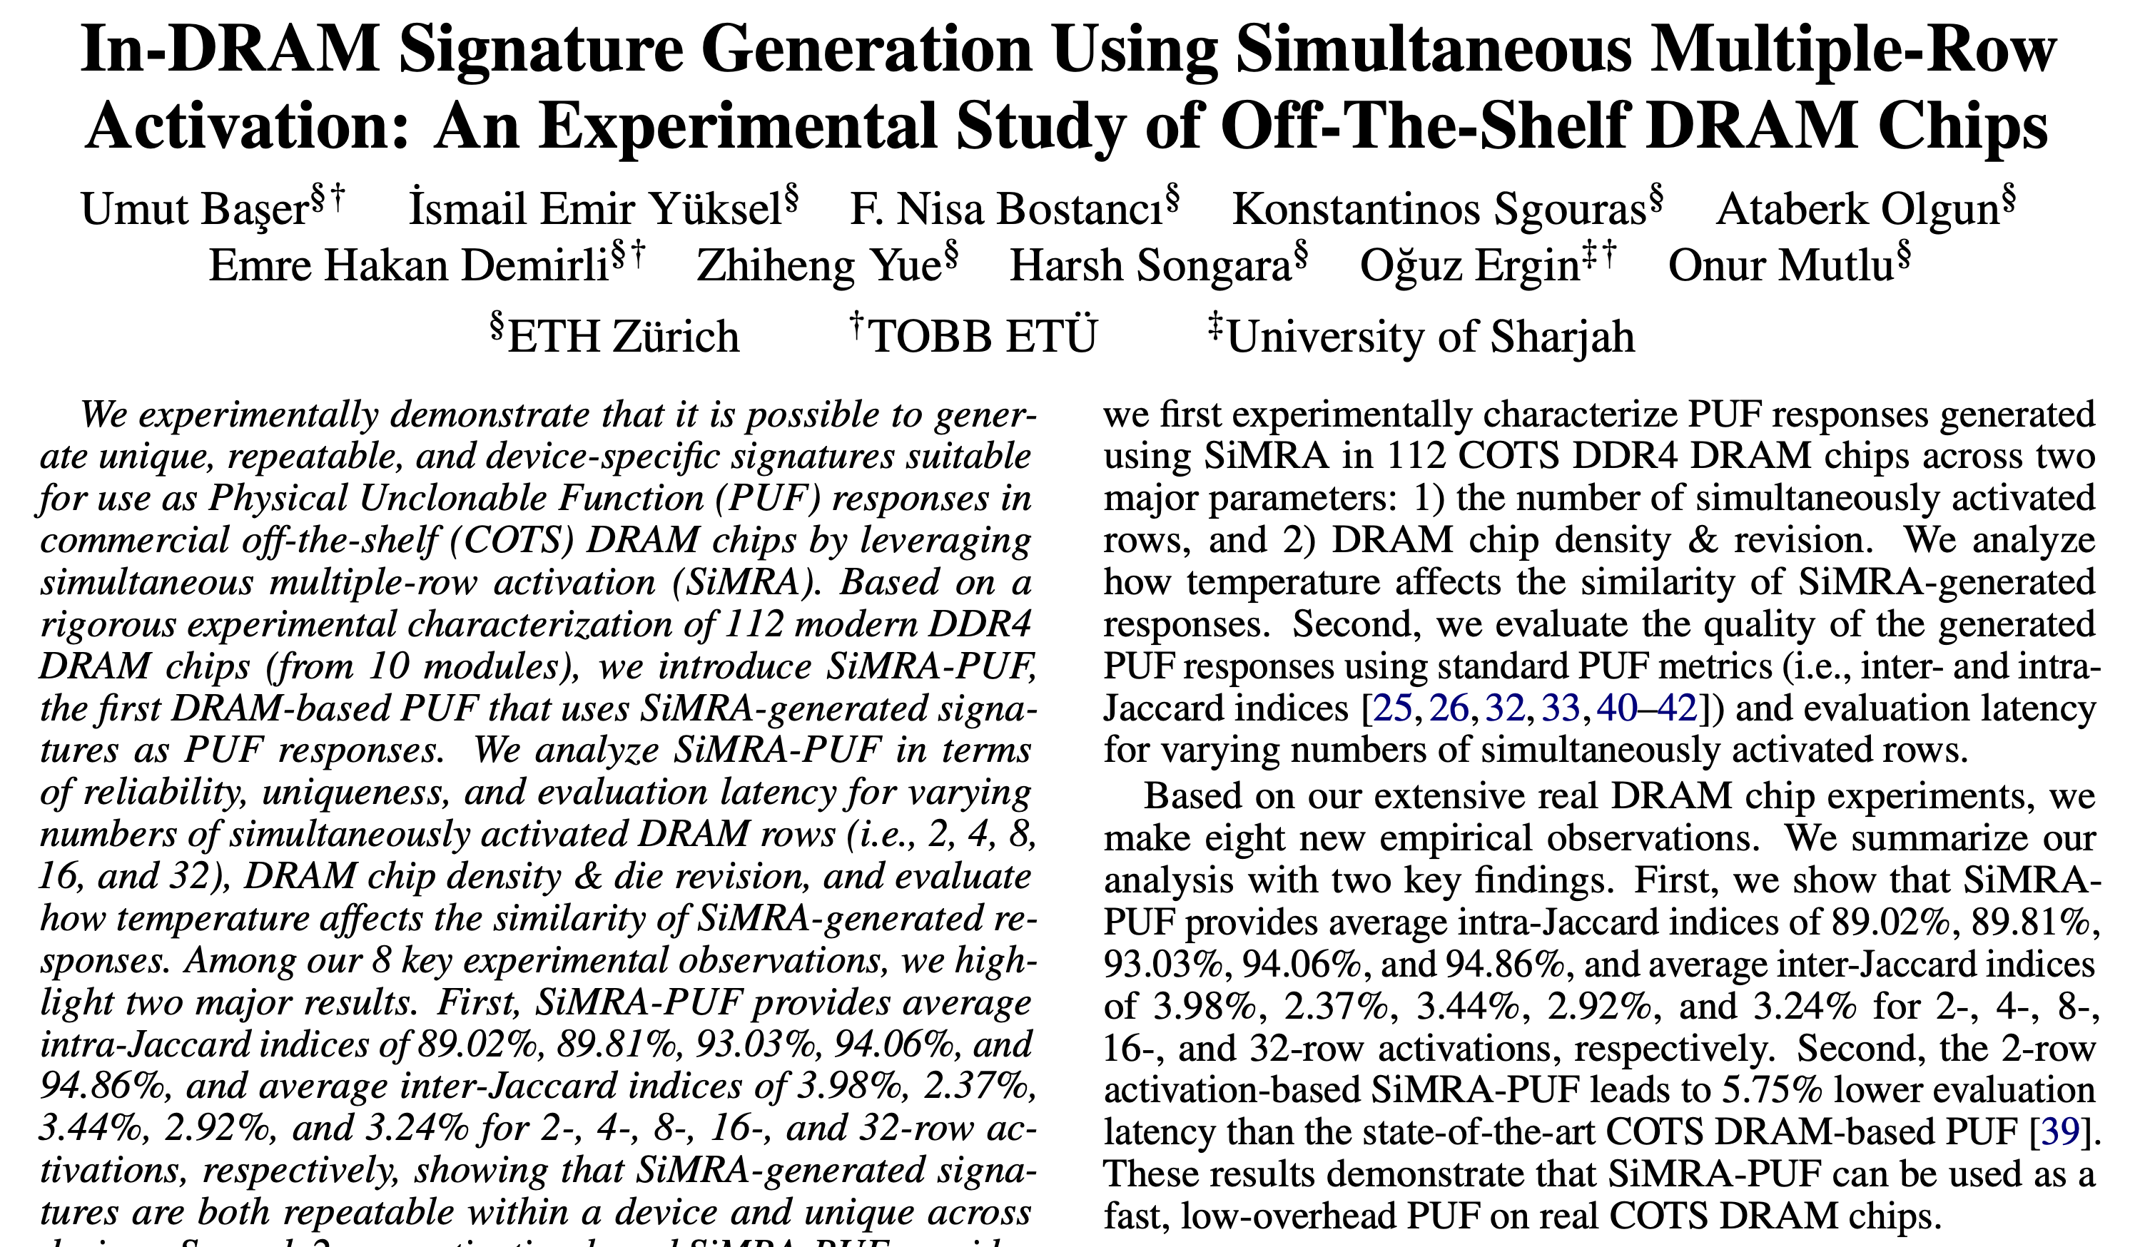
SiMRA-PUF

Slide 107
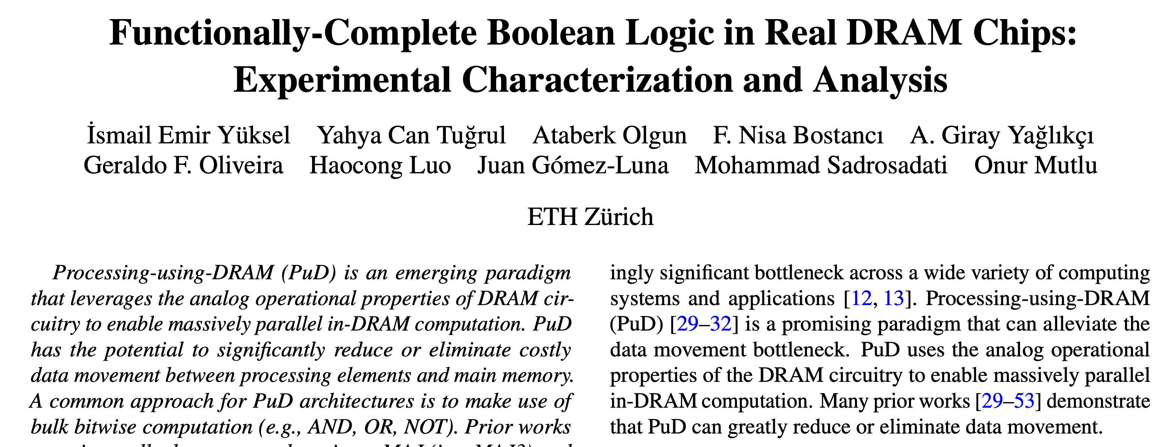
FC-DRAM
Ismail Emir Yuksel, Yahya Can Tugrul, Ataberk Olgun, F. Nisa Bostanci, A. Giray Yaglikci, Geraldo F. Oliveira, Haocong Luo, Juan Gomez-Luna, Mohammad Sadrosadati, and Onur Mutlu,
"Functionally-Complete Boolean Logic in Real DRAM Chips: Experimental Characterization and Analysis"
Proceedings of the 30th International Symposium on High-Performance Computer Architecture (HPCA), Edinburgh, UK, March 2024.
[Slides (pptx) (pdf)]
[arXiv version]
[FCDRAM Source Code]

Slide 108
The Capability of COTS DRAM Chips
We demonstrate that COTS DRAM chips:
1
Can simultaneously activate up to
48 rows in two neighboring subarrays
2
Can perform NOT operation
with up to 32 output operands
3
Can perform up to 16-input
AND, NAND, OR, and NOR operations
108
Notes:
[CLICK]In this study, we experimentally demonstrate that off-the-shelf DRAM chips
[CLICK] Can simultaneously activating up to 48 DRAM rows in two neighboring subarrays
[CLICK] Can performing NOT operation with up to 32 output operands
[CLICK] Can performing up to 16-input AND, NAND, OR, and NOR operations

Slide 109
48 Simultaneously Activated Rows
COTS DRAM chips have two distinct sets of
activation patterns in neighboring subarrays
when two rows are activated with violated timings
Exactly the same number of rows
in each subarray
are activated
Twice as many rows in one subarray
compared to its neighbor subarray are activated
Subarray X
Subarray X
Up to 16 rows
Up to 16 rows
Shared Sense Amplifiers
Shared Sense Amplifiers
Subarray Y
Subarray Y
Up to 16 rows
Up to 32 rows
A total of 32 rows
A total of 48 rows
109
Notes:
We observe when Row A and B in neighboring subarrays are activated with violated timing parameters
[CLICK] Off-the-shelf DRAM chips have two distinct sets of simultaneous activation patterns in two neighboring subarrays
[CLICK] First pattern is exactly the same number rows in each subarray are activated.
[CLICK] We observe that we can activate up to 16 rows in neighboring subarrays, in other words a total of 32 rows
[CLICK] Second pattern is twice as many rows in one subarray compared to its neighbor subarray are activated
[CLICK] We observe that we can activate up to 16 rows in one subarray while activating up to 32 rows in its neighbor subarray, a total of 48 rows

Slide 110
Bitwise NOT: Key Idea
Connect rows in neighboring subarrays
through a NOT gate by simultaneously activating rows
src
src
src
NOT gate
A
A
A
SA
SA
SA
ACT src
ACT dst
~A
dst
dst
dst
110
Notes:
Our key idea is to leverage the connection between neighboring subarrays,
[CLICK] the NOT gate in the sense amplifier.
[CLICK] By simultaneously activating rows in neighboring subarrays, we can connect these rows through a NOT gate
[CLICK] As an example, source and destination in neighboring subarrays and if we first activate src
[CLICK] and then activate destination, this result in sense amplifier to drive the negated src value to the dst

Slide 111
NOT Operation: A Walkthrough
ACT src
GND
½ V_{DD}
src
connects src to bitline
dst
½ V_{DD}
GND
111
Notes:
Let’s see how we can perform NOT operation in real DRAM chips at a lower abstraction-level
[CLICK] As an example, we have source and destination cells, both store GROUND (low voltage) and bitlines are precharged to vdd over two
[CLICK] We first issue an activation to the source, which asserts the source wordline and starts charge sharing process between source and its bitline

Slide 112
NOT Operation: A Walkthrough
ACT src
Nominal
GND
GND
drives bitline to GND
src
drives bitline to VDD
dst
VDD
GND
112
Notes:
We wait for nominal timing parameters, which assures sense amplifier amplifies the difference and
[CLICK] drives ground to the source’s bitline and VDD to the destination’s bitline

Slide 113
NOT Operation: A Walkthrough
ACT src
PRE
ACT dst
Nominal
<3ns
GND
src
sense amplifier is still enabled
connects dst to bitline
dst
VDD
dst’s bitline is still VDD
113
Notes:
We then issue back-to-back precharge and activation commands with violated timing parameters. This operation leads to
[CLICK] connecting destination cell to its bitline
[CLICK] keeping the sense amplifier enabled
[CLICK] keeping the destination’s bitline to VDD

Slide 114
NOT Operation: A Walkthrough
ACT src
PRE
ACT dst
Nominal
<3ns
GND
negated value of src (VDD) is written to dst
src
dst
VDD
114
Notes:
Eventually, as sense amplifier is enabled and bitline is still VDD, the negated value of the source, which is VDD, is written to dst

Slide 115
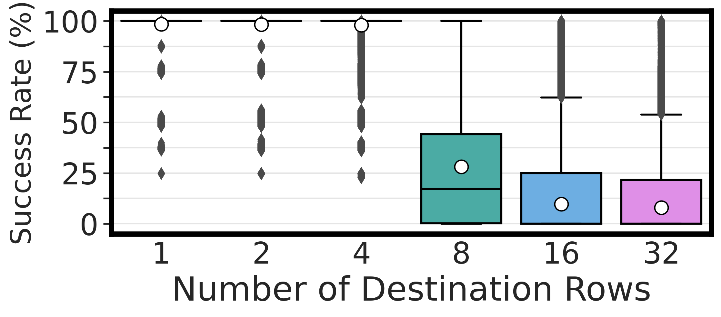
Performing NOT in COTS DRAM Chips
There is at least one DRAM cell that can
perform the NOT operation
with a 100% success rate
COTS DRAM chips can perform NOT operations
with up to 32 destination rows
115
Notes:
This is a quite crowded picture but the key takeaway is that NOT in COTS DRAM chips can be done with very high success rates: most bitlines can reliably perform NOT operations

Slide 116
16-Input NAND/NOR/AND/OR
Manipulate the bitline voltage to express
a wide variety of functions using
multiple-row activation in neighboring subarrays
V_{REF}
V_{(A,B)}
A
A
B
B
SA
Multiple Row ACT
SA
sense amp.
compares
V_{(A,B)} and V_{(X,Y)}
X
X
Y
Y
V_{REF}
V_{(X,Y)}
116
Notes:
… and you can build on the phenomena that enables NOT across the sense amplifier to perform bitwise NAND, NOR, AND, and OR operations.

Slide 117
Two-Input AND and NAND Operations
ACT
PRE
ACT
<3ns
<3ns
AVG(V_{DD},V_{DD}/2)
V_{DD}=1 & GND = 0
V_{DD}
Reference Subarray (REF)
AND
NAND
X
Y
COM
REF
V_{DD}/2*
0
0
0
1
0
1
0
1
Compute Subarray (COM)
X
1
0
0
1
Y
1
1
1
0
AVG(X,Y)
117
*Gao et al., "FracDRAM: Fractional Values in Off-the-Shelf DRAM," in MICRO, 2022.

Slide 118
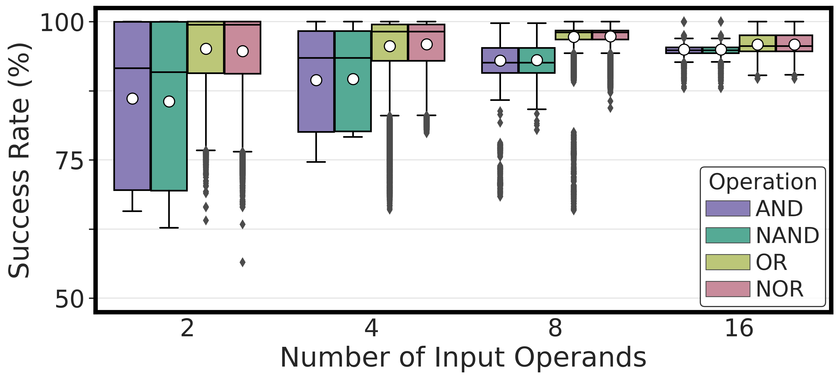
Performing AND, NAND, OR, and NOR
COTS DRAM chips can perform
{2, 4, 8, 16}-input AND, NAND, OR, and NOR operations
118

Slide 119
Performing AND, NAND, OR, and NOR
COTS DRAM chips can perform
16-input AND, NAND, OR, and NOR operations
with very high success rate (>94%)
119

Slide 120
FC-DRAM
Ismail Emir Yuksel, Yahya Can Tugrul, Ataberk Olgun, F. Nisa Bostanci, A. Giray Yaglikci, Geraldo F. Oliveira, Haocong Luo, Juan Gomez-Luna, Mohammad Sadrosadati, and Onur Mutlu,
"Functionally-Complete Boolean Logic in Real DRAM Chips: Experimental Characterization and Analysis"
Proceedings of the 30th International Symposium on High-Performance Computer Architecture (HPCA), Edinburgh, UK, March 2024.
[Slides (pptx) (pdf)]
[arXiv version]
[FCDRAM Source Code]

Slide 121
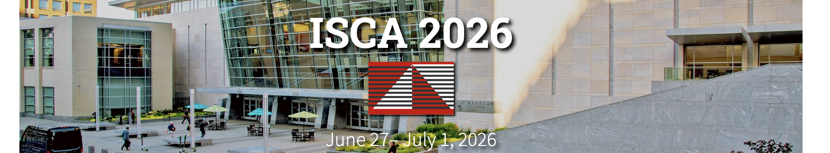
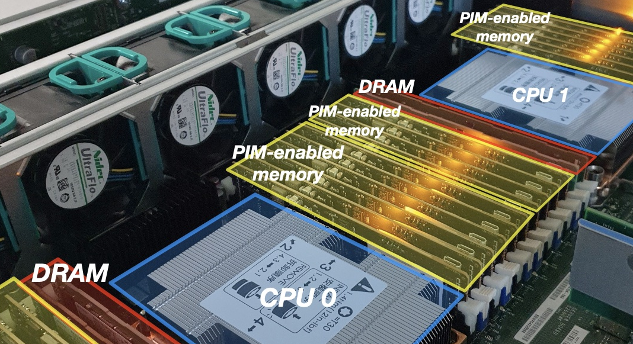

6th Workshop on Memory-Centric Computing Systems
MCCSys
A full-day workshop @ ISCA 2026
28th June 2026 (Sunday)
Organizers: Ismail Emir Yuksel, F. Nisa Bostanci,
Ataberk Olgun, Prof. Onur Mutlu
More information &
call for papers:
Overview of PIM &
PIM Taxonomy
PIM in Memory & Storage
Infrastructures for
PIM Research
Real-World PnM Systems
PuM for
Bulk Bitwise Operations
Programming Techniques & Tools
Research Challenges & Opportunities
https://events.safari.ethz.ch/isca26-mccsys/

Slide 122
DRAM Bender
Enables Learning
DRAM Internals

Slide 123
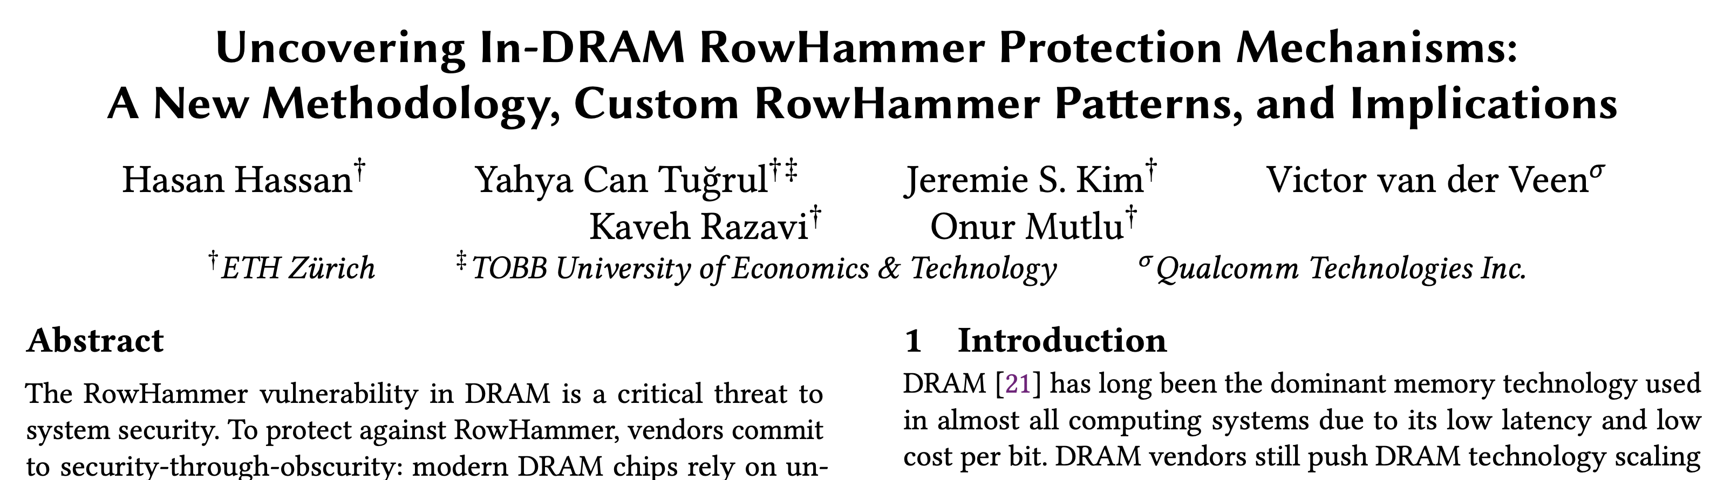
U-TRR
Hasan Hassan, Yahya Can Tugrul, Jeremie S. Kim, Victor van der Veen, Kaveh Razavi, and Onur Mutlu,
"Uncovering In-DRAM RowHammer Protection Mechanisms: A New Methodology, Custom RowHammer Patterns, and Implications"
Proceedings of the 54th International Symposium on Microarchitecture (MICRO), Virtual, October 2021.
[Slides (pptx) (pdf)]
[Short Talk Slides (pptx) (pdf)]
[Lightning Talk Slides (pptx) (pdf)] [Talk Video (25 minutes)]
[Lightning Talk Video (100 seconds)] [arXiv version]

Slide 124
The RowHammer Vulnerability
DRAM Chip
Row 0
Row 0
Victim Row
Row 1
Row 1
Row 1
Victim Row
Row 2
Row 2
Row 2
Row 2
Row 2
Row 2
closed
open
open
Aggressor Row
closed
open
Row 3
Row 3
Row 3
Victim Row
Row 4
Row 4
Victim Row
Repeatedly opening (activating) and closing (precharging)
a DRAM row causes RowHammer bit flips in nearby cells

Slide 125
Target Row Refresh (TRR)
DRAM vendors equip their DRAM chips with a proprietary
mitigation mechanisms known as Target Row Refresh (TRR)
Key Idea: TRR refreshes nearby rows upon detecting an aggressor row
TRR-equipped DRAM Chip
Memory
Controller
REF
Row 0
TRR
Row 1
open
closed
Row 2
Row 3
Aggressor detected: Row 2
Row 4
Refresh neighbor rows
TRR-induced refreshes
Notes:
To protect their DRAM chips against RowHammer, DRAM vendors currently implement proprietary RowHammer mitigation mechanisms typically called Target Row Refresh or (TRR)
[CLICK] The key idea of TRR is to refresh nearby rows upon detecting an aggressor row
[CLICK] We demonstrate how TRR operates at a high-level.
[CLICK] The TRR mechanism detects [CLICK] an aggressor row as a result of [CLICK] repeatedly activating and precharging the same row. [CLICK]
[CLICK] To protect the neighbor victim rows from experiencing RowHammer bit flips, [CLICK] TRR refreshes the victim rows by performing TRR-induced refresh operations. TRR refreshes victim rows by piggybacking TRR-induced refreshes to the REFRESH commands that the memory controller periodically issues.

Slide 126
Goal
Study in-DRAM TRR mechanisms to
understand how they operate
1
assess their security
2
secure DRAM completely against RowHammer
3
Notes:
Our goal is to study in-DRAM TRR mechanisms to [CLICK] understand how they operate, [CLICK] asses their security, [CLICK] and secure DRAM completely against RowHammer

Slide 127
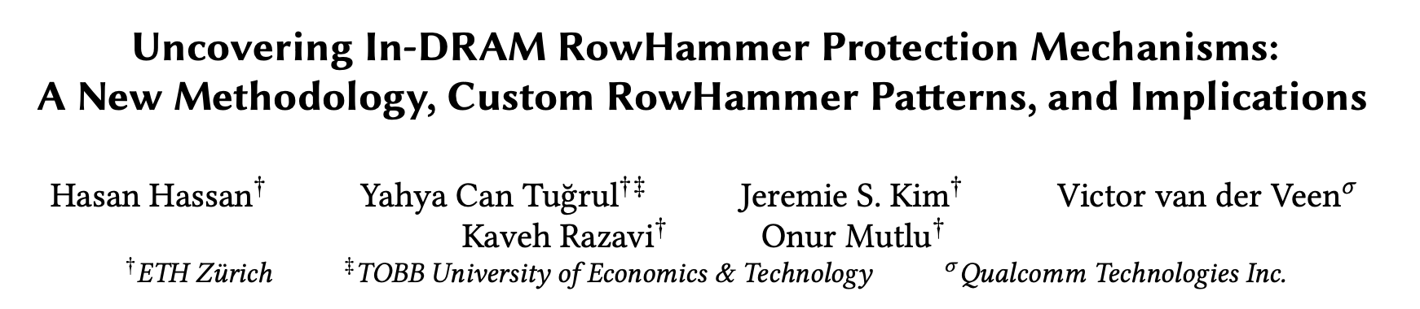
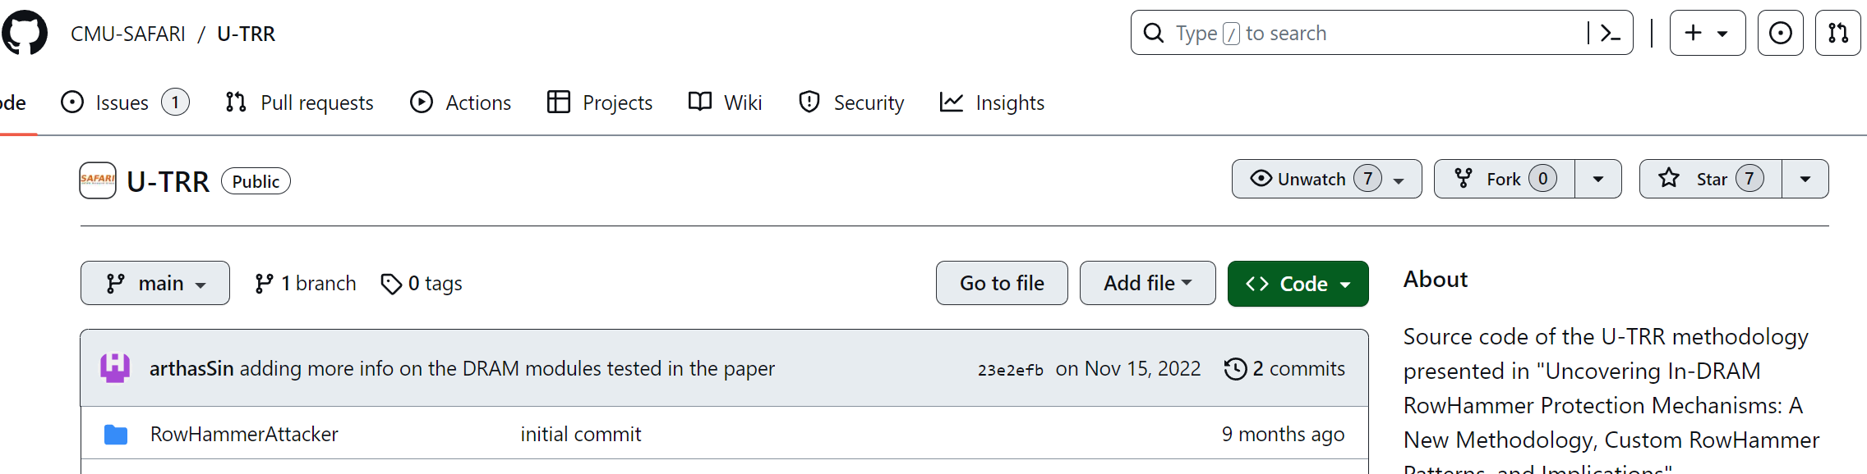
U-TRR: Key Idea
Hassan et al., "Uncovering In-DRAM RowHammer Protection Mechanisms:
A New Methodology, Custom RowHammer Patterns, and Implications,” in MICRO, 2021.
Key idea: Use data retention failures as a side channel
to detect when a row is refreshed by on-die mitigation
[Hassan+, MICRO’21, source code available at https://github.com/CMU-SAFARI/U-TRR]

Slide 128
Experimental Methodology
1. Identify a row (R) with T retention time
2. Wait for T/2
3. Hammer R+1 once
Sample as aggressor row
4. Issue a periodic REF command (trigger mitigation)
5. Wait for T/2, read out row R and check for bitflips
On-DRAM-die
Mitigation
Aggressor Row R + 1
Victim Row R
Refresh victim row
Refresh R
Mitigation refreshes R
Read R
time = 0
time = T/2
time = T
Timeline
[Hassan+, MICRO’21]
Notes:
Our experiment first
[CLICK] finds a DRAM row R with a retention time of T. This means that the row will harbor retention failures if we do not refresh its content for T units of time.
[CLICK] On the bottom we show a timeline of actions taken by us and the currently-hypothetical on-die mitigation mechanism. Initially, the row R is refreshed, so it can retain data correctly until time is T.
[CLICK] We wait for half T.
[CLICK] We activate and precharge R+1 (which is adjacent to R) once.
[CLICK] Let’s now look at what a hypothetical on-die mitigation would do
[CLICK] It will sample the hammering of R+1 as an aggressor row activation
[CLICK] after which we issue a periodic refresh command (to trigger the mitigation)
[CLICK] If the mitigation sampled R+1 as an aggressor row, it will refresh R as the victim row
[CLICK] We then wait for half T, read out row R and check for bitflips in row R.

Slide 129
Experimental Methodology
1. Identify a row (R) with T retention time
Row R experiences no bitflips
only if on-DRAM-die mitigation exists
2. Wait for T/2
3. Hammer R+1 once
Sample as aggressor row
4. Issue a periodic REF command (trigger mitigation)
5. Wait for T/2, read out row R and check for bitflips
On-DRAM-die
Mitigation
Aggressor Row R + 1
Victim Row R
Refresh victim row
Refresh R
Mitigation refreshes R
Read R
time = 0
time = T/2
time = T
Timeline
[Hassan+, MICRO’21]
Notes:
Row R will not experience any bitflips
Only if on-DRAM-die mitigation exists and has refreshed R at half T

Slide 130
Experimental Methodology
1. Identify a row (R) with T retention time
Row R experiences no bitflips
only if on-DRAM-die mitigation exists
2. Wait for T/2
3. Hammer R+1 once
Sample as aggressor row
4. Issue a periodic REF command (trigger mitigation)
5. Wait for T/2, read out row R and check for bitflips
On-DRAM-die
Mitigation
Row R experiences retention bitflips
if not refreshed at T/2
Aggressor Row R + 1
Victim Row R
Refresh victim row
retention bitflips
Refresh R
Row R not refreshed
Read R
time = 0
time = T/2
time = T
Timeline
[Hassan+, MICRO’21]
Notes:
Otherwise, row R will experience retention bitflips because it was not refreshred for T units of time.

Slide 131
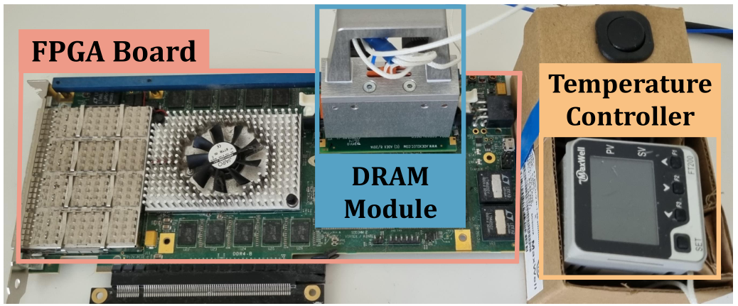
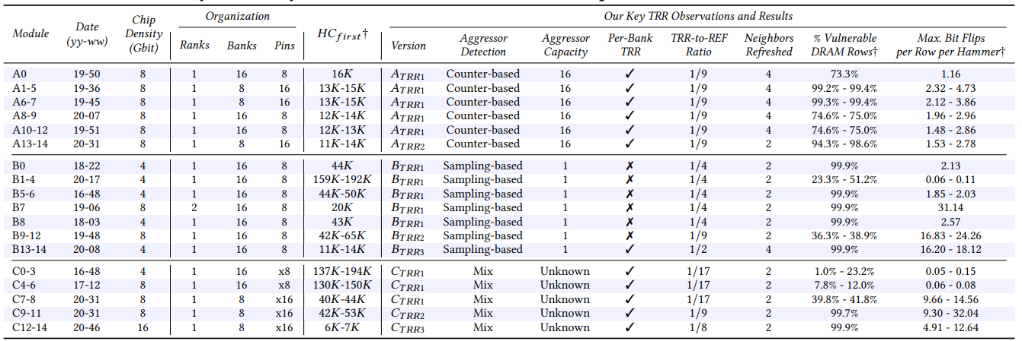
DRAM Testing Infrastructure
We implement U-TRR using
FPGA-based SoftMC [Hassan+, HPCA’17]
modified to support DDR4 DRAM
SoftMC provides fine-grained control over DRAM commands,
timing parameters and temperature
15x Vendor A
DDR4 modules
We analyze 45 DDR4 DRAM modules
from three vendors
15x Vendor B
DDR4 modules
Table 1 in our paper provides more information about the analyzed modules
15x Vendor C
DDR4 modules
Notes:
To implement U-TRR and conduct the DRAM experiments, we use SoftMC, an FPGA-based DRAM testing infrastructure.
We modified SoftMC to support DDR4 modules.
[CLICK] We used SoftMC because it provides fine-grained control over DRAM commands, timing parameters, and temperature.
[CLICK] In our study, we analyzed 15 DDR4 DRAM modules from each of the three major DRAM vendors.
[CLICK] In the paper, we have a table that provides detailed information about the tested modules and here is a glimpse of the table

Slide 132
Bypassing TRR with New RowHammer Access Patterns
We craft new RowHammer access patterns
that circumvent TRR of three major DRAM vendors
On the 45 DDR4 modules we test, the new access patterns cause a large number of RowHammer bit flips
Notes:
Leveraging the understanding we develop using U-TRR, we craft new RowHammer access patterns that circumvent the TRR mechanisms of three major DRAM vendors.
[CLICK] We evaluate the effectiveness of these patterns on 45 DDR4 DRAM modules, and we find that the new RowHammer access patterns cause a large number of RowHammer bit flips.

Slide 133
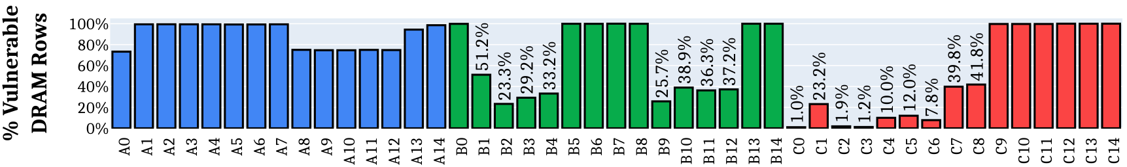
Effect on Individual Rows
All 45 modules we tested are vulnerable
to our new RowHammer access patterns
Our RowHammer access patterns
cause bit flips in more than 99.9% of the rows
Why are some modules less vulnerable?
Fundamentally less vulnerable to RowHammer
Different TRR mechanisms
Unique row organization
Notes:
Let’s look at the effectiveness of our new RowHammer access patterns at DRAM row granularity.
[CLICK] The plot shows, for each of the 45 modules we test, the fraction of rows that experience at least one RowHammer bit flip compared to all rows in a DRAM bank.
[CLICK] We find that all 45 modules we tested are vulnerable to our new RowHammer access patterns
[CLICK] Further, in 20 of the modules, our RowHammer access patterns cause bit flips in almost all of the rows
[CLICK] But why are some modules less vulnerable? We find that it is because of three main reasons.
[CLICK] First, some modules are fundamentally less vulnerable to RowHammer, in the sense that rows in those modules can tolerate a higher number of hammers before experiencing RowHammer bit flips.
[CLICK] Second, some modules implement a different TRR mechanism that our custom access patterns are not as effective. We believe understanding more those different TRR mechanisms can help crafting more effective rowhammer access patterns.
[CLICK] Third, some modules of Vendor C implement a unique row organization that appears to mitigate RowHammer at DRAM circuit level.

Slide 134
U-TRR
Hasan Hassan, Yahya Can Tugrul, Jeremie S. Kim, Victor van der Veen, Kaveh Razavi, and Onur Mutlu,
"Uncovering In-DRAM RowHammer Protection Mechanisms: A New Methodology, Custom RowHammer Patterns, and Implications"
Proceedings of the 54th International Symposium on Microarchitecture (MICRO), Virtual, October 2021.
[Slides (pptx) (pdf)]
[Short Talk Slides (pptx) (pdf)]
[Lightning Talk Slides (pptx) (pdf)] [Talk Video (25 minutes)]
[Lightning Talk Video (100 seconds)] [arXiv version]

Slide 135
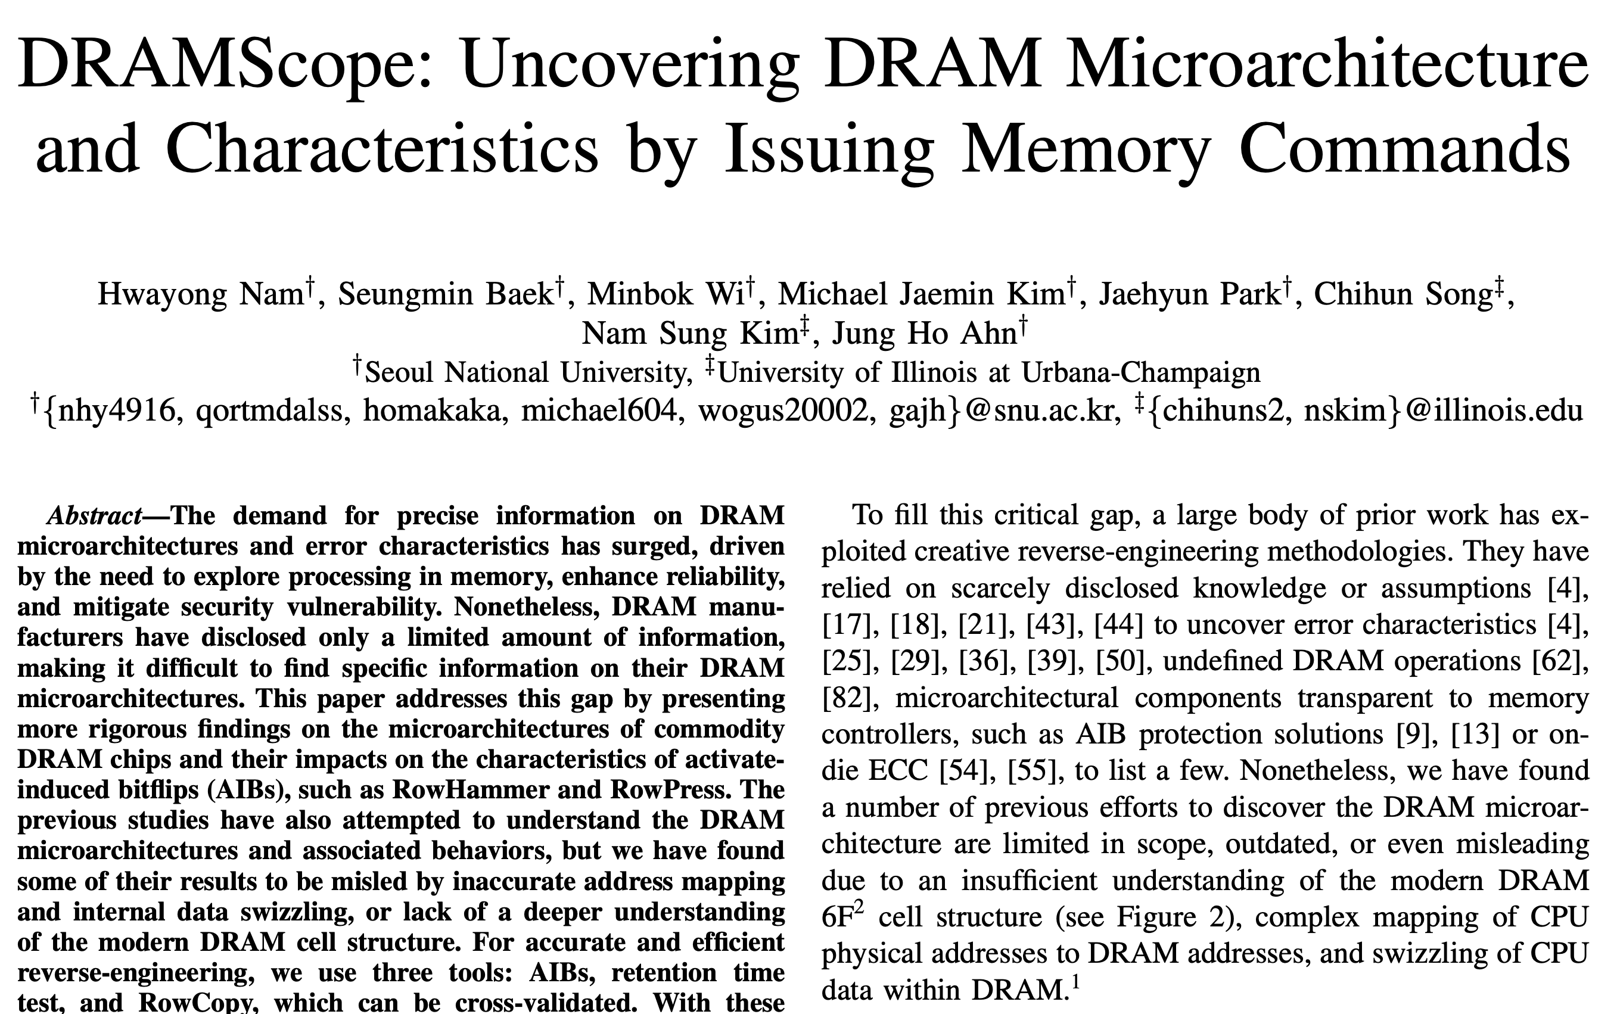
DRAMScope
Notes:
I will not spoil it for you

Slide 136
Research Highlights Conclusion
DRAM Bender enables many studies, ideas,
and methodologies in the design of future memory systems
  Understanding DRAM robustness problems
  Uncovering new DRAM functionality
  Learning DRAM internals
  …
We attribute DRAM Bender’s widespread success
in enabling research to its flexibility and ease of use
Research drives new DRAM Bender features & improvements
  DDR3 → DDR4 → HBM2
  Support for 6 FPGA boards out of the box

Slide 137
The 3rd
Ramulator & DRAM Bender Tutorial
DRAM Bender Research Highlights
Ataberk Olgun
ICS 2026
6 July 2026

Slide 138
The 3rd
Ramulator & DRAM Bender Tutorial
DRAM Bender Live Demo
& Hardware/Software Overview
Ataberk Olgun
ICS 2026
6 July 2026

Slide 139
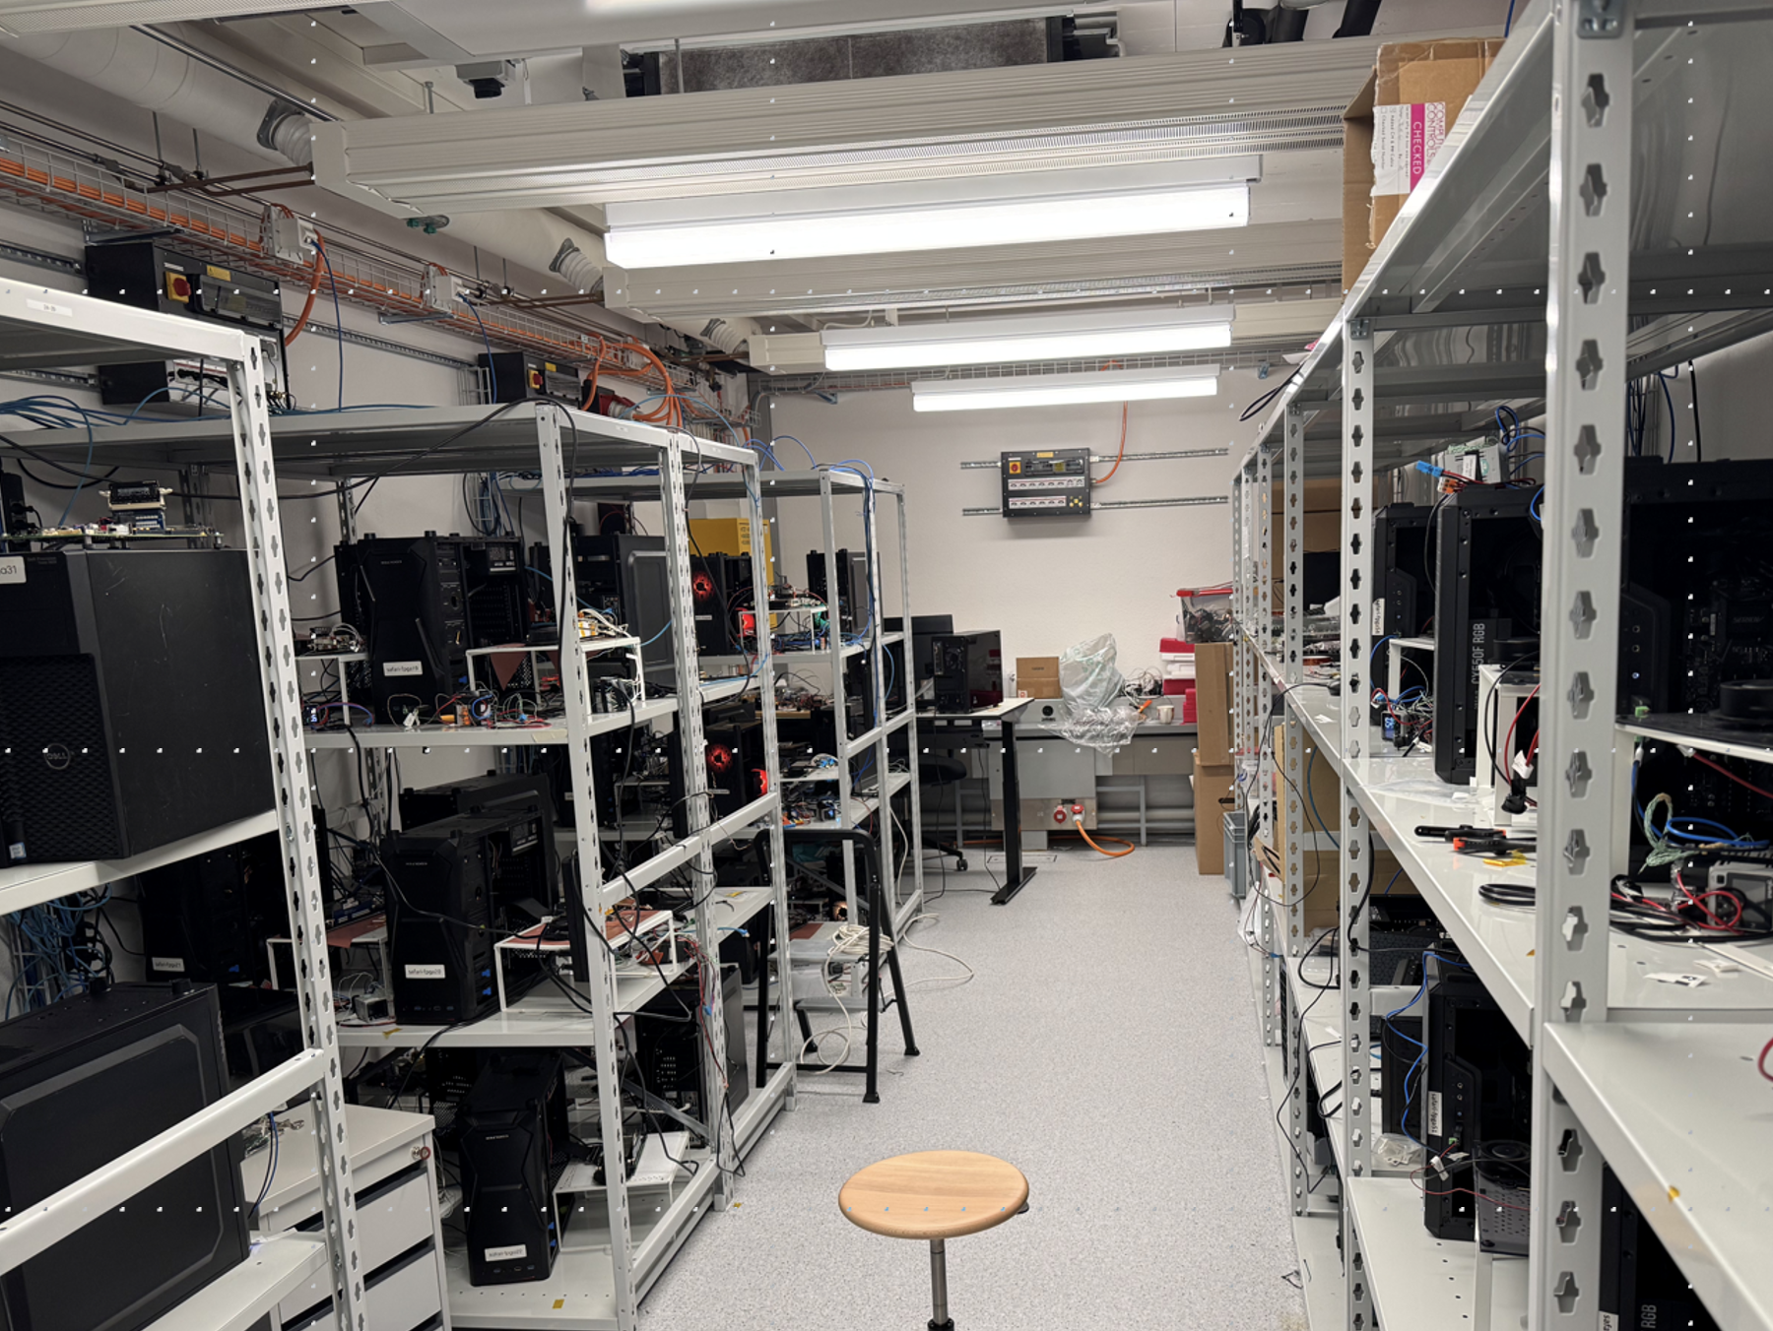
RowHammer Using DRAM Bender
Connect to a DRAM Bender host machine via SSH
Execute a program to hammer a DRAM row
  Vary program parameters
Understand how the program gets executed

Slide 140
Typical DRAM Bender Test Workflow
In a C++ or a Python executable:
1
Initialize DRAM Bender platform
2
Create DRAM Bender test program
3
Execute DRAM Bender test program
4
Read & analyze experimental data

Slide 141
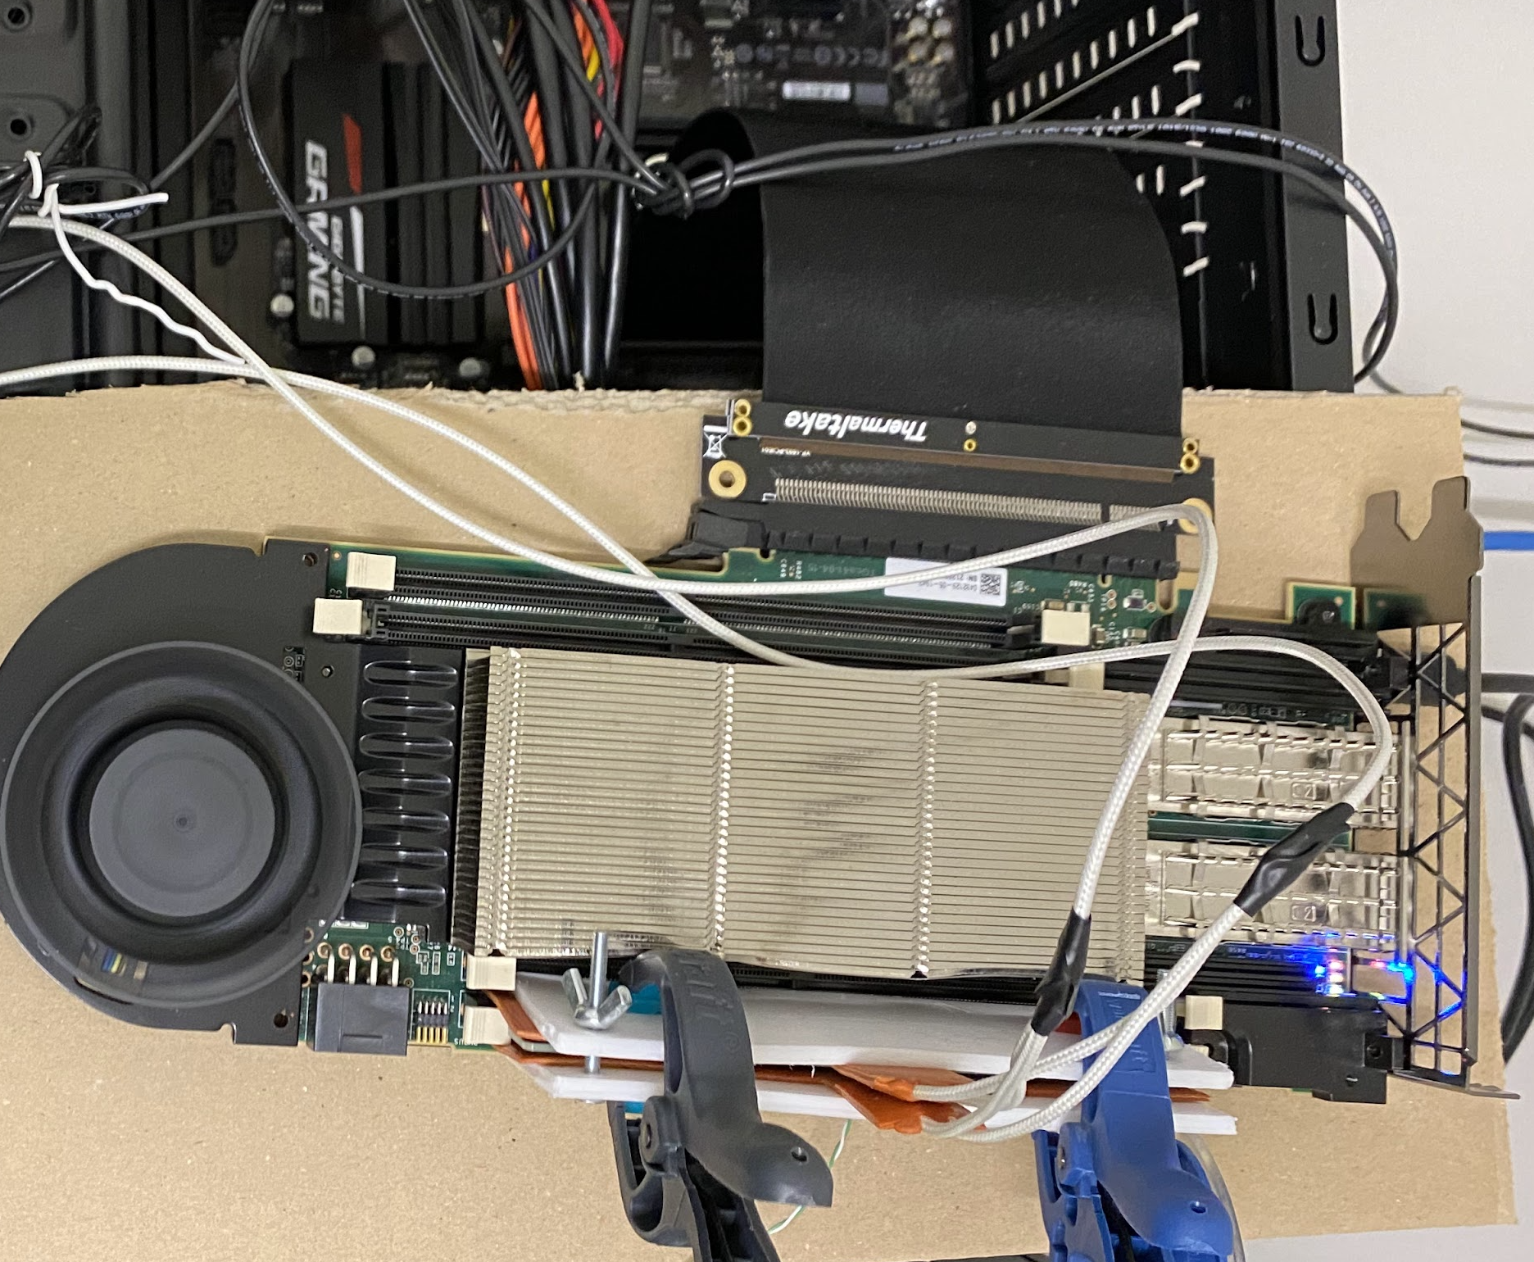
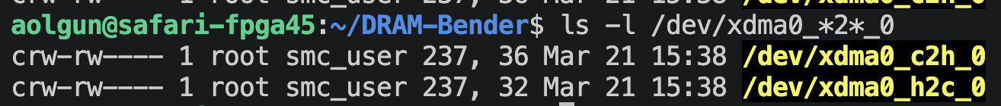
Aside: Transferring Programs & Data
Host
PCIe
Program
Data
DRAM Bender
in FPGA
Card
Host to card (H2C) transfer: Write to a file
Card to host (C2H) transfer: Read from a file

Slide 142
Typical DRAM Bender Test Workflow
In a C++ or a Python executable:
1
Initialize DRAM Bender platform
2
Create DRAM Bender test program
3
Execute DRAM Bender test program
4
Read & analyze experimental data
Notes:
Lines 581-588

Slide 143
Typical DRAM Bender Test Workflow
In a C++ or a Python executable:
1
Initialize DRAM Bender platform
2
Create DRAM Bender test program
3
Execute DRAM Bender test program
4
Read & analyze experimental data

Slide 144
DRAM Bender Programming Model
Assembly-like programming using C++/Python API
Two “types” of instructions
  DRAM command batch (ACT, READ, WRITE…)
  Regular (arithmetic, control-flow, load/store)
13 general purpose 32-bit registers
3 special-purpose DRAM address stride registers

Slide 145
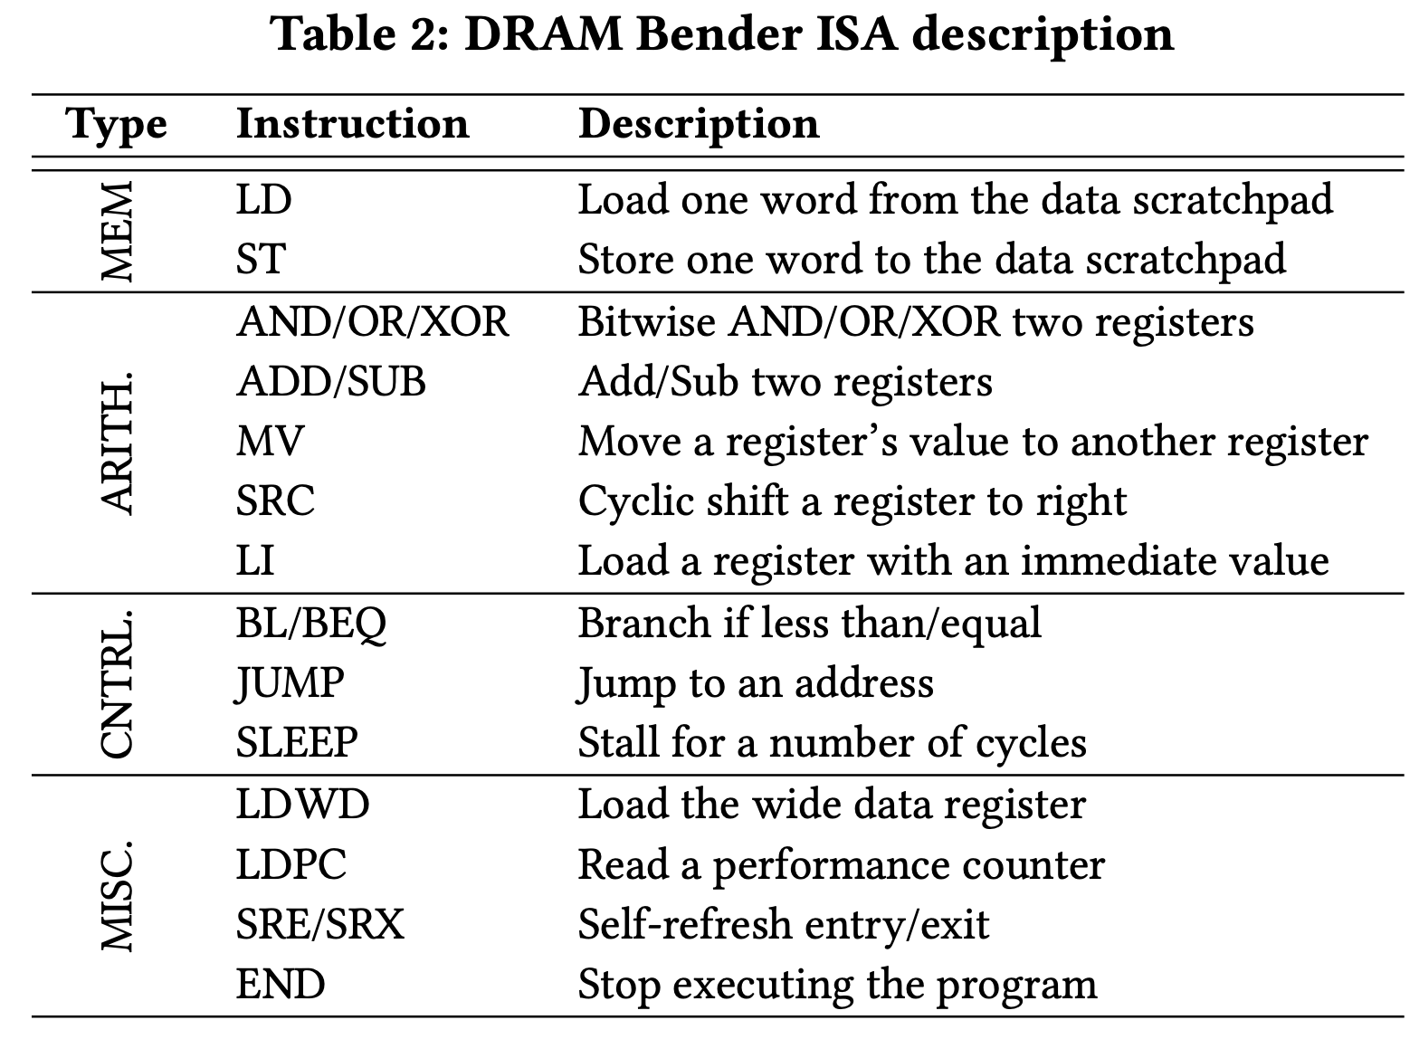
Regular DRAM Bender Instructions
Notes:
We create our programs with these instructions

Slide 146
Typical DRAM Bender Test Workflow
In a C++ or a Python executable:
1
Initialize DRAM Bender platform
2
Create DRAM Bender test program
3
Execute DRAM Bender test program
4
Read & analyze experimental data
Notes:
Go over the program now

Slide 147
RowHammer Test Program
Create programs by appending instructions to a list
Initialize 8 rows surrounding the victim row
  Including the two aggressor rows
Initialize the victim row
Hammer the two aggressor rows
Read the victim row
Notes:
- Lines 98-400

Slide 148
Typical DRAM Bender Test Workflow
In a C++ or a Python executable:
1
Initialize DRAM Bender platform
2
Create DRAM Bender test program
3
Execute DRAM Bender test program
4
Read & analyze experimental data

Slide 149
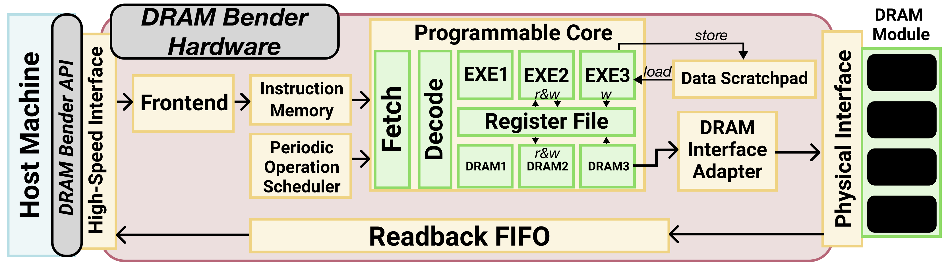
DRAM Bender Hardware Overview
Notes:
Do not describe in detail. I will show you what executing a program means.

Slide 150
Life of a DRAM Bender Program
1
Host machine calls platform.execute(prog)
Frontend stores instructions
in instruction memory
2

Slide 151
Life of a DRAM Bender Program
3
Regular instructions take the exe pipeline path

Slide 152
Life of a DRAM Bender Program
3
Regular instructions take the exe pipeline path
DRAM command batches
take the dram pipeline path
4

Slide 153
Life of a DRAM Bender Program
READ commands in the program
fill up the Readback FIFO
5

Slide 154
Life of a DRAM Bender Program
READ commands in the program
fill up the Readback FIFO
5
6
The END instruction flushes the Readback FIFO

Slide 155
Typical DRAM Bender Test Workflow
In a C++ or a Python executable:
1
Initialize DRAM Bender platform
2
Create DRAM Bender test program
3
Execute DRAM Bender test program
4
Read & analyze experimental data

Slide 156
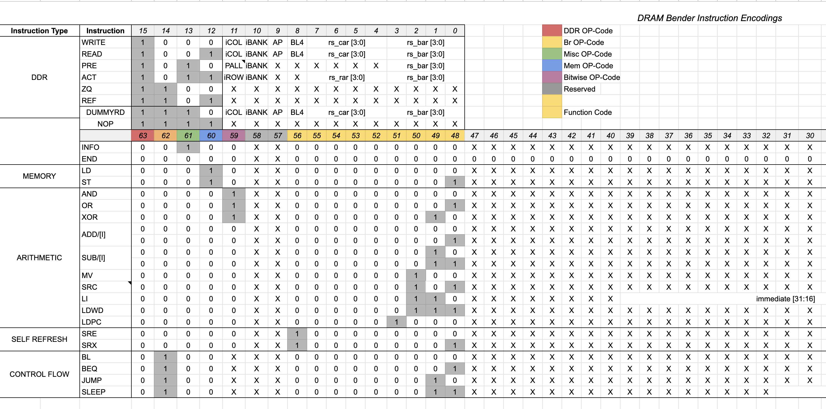
Aside: DRAM Bender Instruction Encoding
https://docs.google.com/spreadsheets/d/18mPiKa1HBoO0OmzAbWRvo5OnIguL6A9tLEIwNeVfOe8

Slide 157
Typical DRAM Bender Test Workflow
In a C++ or a Python executable:
1
Initialize DRAM Bender platform
2
Create DRAM Bender test program
3
Execute DRAM Bender test program
4
Read & analyze experimental data

Slide 158
The 3rd
Ramulator & DRAM Bender Tutorial
DRAM Bender Live Demo
& Hardware/Software Overview
Ataberk Olgun
ICS 2026
6 July 2026

Slide 159
Summary
DRAM Bender
The first publicly-available DDR4/3 & HBM2
characterization infrastructure
Flexible and Easy to Use
Source code available:
[Yaglikci+, DSN’22]
github.com/CMU-SAFARI/DRAMBender
DRAM Bender enables many studies, ideas,
and methodologies in the design of future memory systems
Notes:
[CLICK] In summary, SoftMC is the first publicly-available DRAM characterization infrastructure
[CLICK] It is flexible and easy to use
[CLICK] The source code of SoftMC is available on GitHub
[CLICK] SoftMC enables many new studies, ideas, and methodologies in the design of future memory systems

Slide 160
The 3rd
Ramulator & DRAM Bender Tutorial
Realistic DRAM Timing for HLS: Closing the Memory Fidelity Gap with Ramulator-Backed Co-Simulation
Dr. Antonino Tumeo
ICS 2026
6 July 2026

Slide 161
A Highlight: RowPress
Keeping a DRAM row open for a long time
causes bitflips in adjacent rows
These bitflips do NOT require many row activations
Only one activation is enough in some cases!
RowHammer
Aggressor Row
Open
Close
36ns, 47K activations to induce bitflips
RowPress
Aggressor Row
Open
Close
7.8µs, only 5K activations to induce bitflips

Slide 162
RowPress Results & Source Code
Fully open source and artifact evaluated
https://github.com/CMU-SAFARI/RowPress
Notes:
We have more results in the paper, and our work is fully open-source and artifact evaluated.

Slide 163
RowPress [ISCA 2023]
Haocong Luo, Ataberk Olgun, Giray Yaglikci, Yahya Can Tugrul, Steve Rhyner, M. Banu Cavlak, Joel Lindegger, Mohammad Sadrosadati, and Onur Mutlu,
"RowPress: Amplifying Read Disturbance in Modern DRAM Chips"
Proceedings of the 50th International Symposium on Computer Architecture (ISCA), Orlando, FL, USA, June 2023.
[Slides (pptx) (pdf)]
[Lightning Talk Slides (pptx) (pdf)]
[Lightning Talk Video (3 minutes)]
[RowPress Source Code and Datasets (Officially Artifact Evaluated with All Badges)]
Officially artifact evaluated as available, reusable and reproducible.
Best artifact award at ISCA 2023.

Slide 164
Variable Read Disturbance (VRD) Summary
Research Question
How accurately and efficiently can we measure
the read disturbance threshold (RDT) of each DRAM row?
Experimental Characterization
Record >100M RDT measurements across 3750 rows and
many test parameters (e.g., temperature, data pattern) in
160 DDR4 and 4 HBM2 chips
Key Observations
RDT changes significantly and unpredictably over time: VRD
Maximum observed RDT is 3.5X higher than minimum (for a row)
Smallest RDT (for a row) may appear after 94,467 measurements
Implications for System Security and Robustness
RDT cannot be accurately identified quickly
Given our limited dataset, guardbands (>10%) and ECC (SECDED or Chipkill)
may prevent VRD-induced bitflips at significant performance cost
  More data and analyses needed to make definitive conclusion
Call for future work on understanding and efficiently mitigating VRD
Notes:
[CLICK] Our work tries to answer a key question about the read disturbance threshold: “How accurately and efficiently can we measure the read disturbance threshold of each DRAM row?”
[CLICK] We record more than a hundred million read disturbance threshold measurements across many rows in many DRAM chips
[CLICK] We find that the read disturbance threshold of a DRAM row varies significantly and unpredictably over time.
[CLICK] The largest RDT observed for a DRAM row can be 3.5 times the smallest observed for the same row, and
[CLICK] a row’s smallest RDT may appear after 94 thousand measurements
We call this new phenomenon Variable Read Disturbance.
[CLICK] Variable read disturbance has implications for system security and robustness because the RDT of a row cannot be quickly and accurately identified.
[CLICK] We evaluate using guardbands for RDT and error-correcting codes as a solution for VRD-induced bitflips: **Given our limited dataset of bitflip locations** we find that relatively large guardbands and ECC could prevent VRD-induced bitflips at significant performance cost.
[CLICK] But more data and analyses are needed to make a definitive conclusion
[CLICK] Our results call for future work on understanding and efficiently mitigating VRD.

Slide 165
Talk Outline
Motivation
Experimental Characterization Methodology
Foundational Results
In-Depth Analysis of VRD
Implications for System Security and Robustness
Conclusion
Notes:
Here is the outline for the rest of the talk

Slide 166
Talk Outline
Motivation
Experimental Characterization Methodology
Foundational Results
In-Depth Analysis of VRD
Implications for System Security and Robustness
Conclusion
Notes:
I will continue by motivating our study

Slide 167
Motivation
Technology Scaling
DRAM chips are increasingly more vulnerable
to read disturbance with technology scaling
[Yaglikci+, HPCA’24]
Notes:
Read disturbance bitflips happen in more DRAM cells with fewer activations as DRAM technology scales to smaller sizes to satisfy our memory requirements.
[CLICK] We see more than 10X reduction in the read disturbance threshold between chips manufactured approximately 7 years apart.
[CLICK] Thus, DRAM chips become more vulnerable to read disturbance with technology scaling.

Slide 168
Motivation
DRAM read disturbance worsens
as DRAM chip density increases
Existing solutions become more aggressive
Aggressive preventive actions make
existing solutions prohibitively expensive
Notes:
Reducing read disturbance thresholds, or, worsening read disturbance [CLICK] causes existing mitigations to become more aggressive, [CLICK] and in turn, induce higher overheads

Slide 169
In-Depth Analysis: Key Takeaways
Takeaway 1
All tested DRAM rows exhibit VRD
Takeaway 2
Relatively few (<500) RDT measurements are
unlikely to yield the minimum RDT of a row
Takeaway 3
Data patterns, temperature, and
aggressor row on time affect VRD
Notes:
First, all tested DRAM rows exhibit variable read disturbance, to *varying* degrees

Slide 170
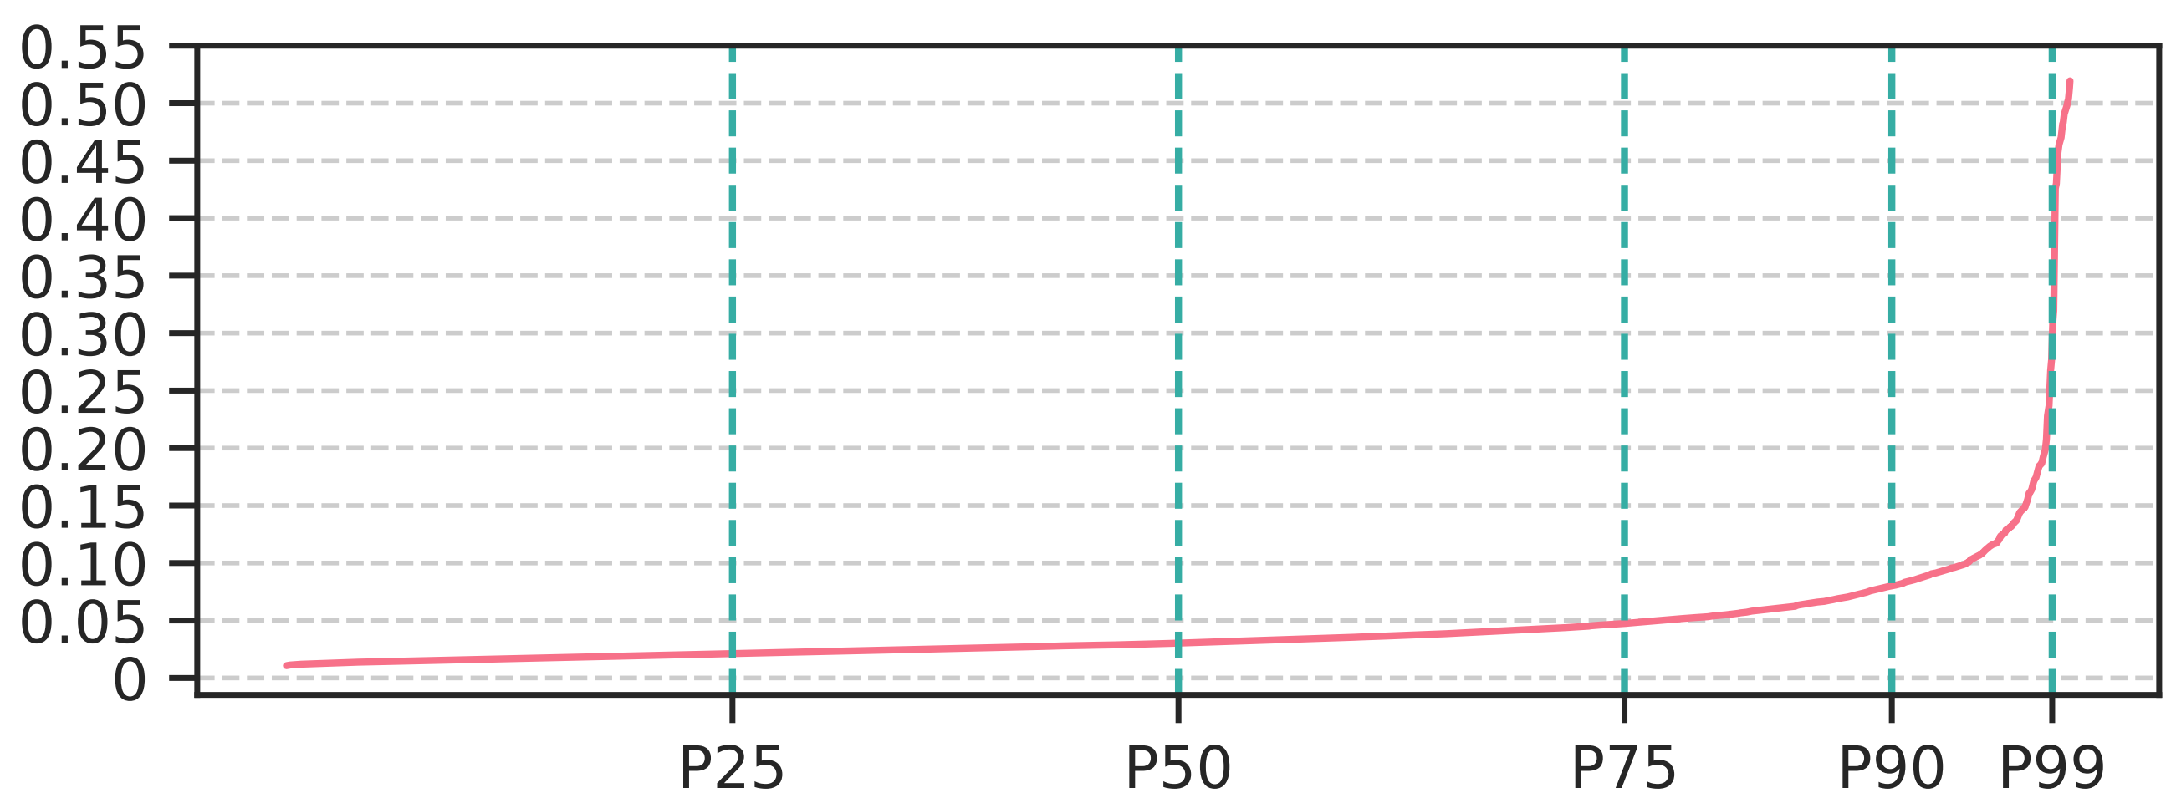
VRD Across DRAM Rows
A row with small variance in RDT distribution
across 1000 measurements
Coefficient of Variation
DRAM Rows Sorted by Increasing Coefficient of Variation of RDT
Across 1000 RDT Measurements
Notes:
Here we show the coefficient of variation in the distribution of 1000 read disturbance threshold measurements for each tested row.
[CLICK] The circled tiny pink dot stands for the DRAM row with the smallest coefficient of variation in its RDT distribution. Another way to look at this is that this row’s RDT values are very close to each other.
[CLICK] We show the rows sorted in increasing coefficient of variation on the x-axis

Slide 171
VRD Across DRAM Rows
Row with the greatest
variance in RDT distribution
Median
row
Coefficient of Variation
DRAM Rows Sorted by Increasing Coefficient of Variation of RDT
Across 1000 RDT Measurements
All tested rows exhibit VRD
Notes:
We observe that all tested rows exhibit VRD: no row has 0 variation in its RDT measurements
[CLICKx2] We highlight two points in this plot: the median row, and the row with the greatest variance in its read disturbance threshold distribution

Slide 172
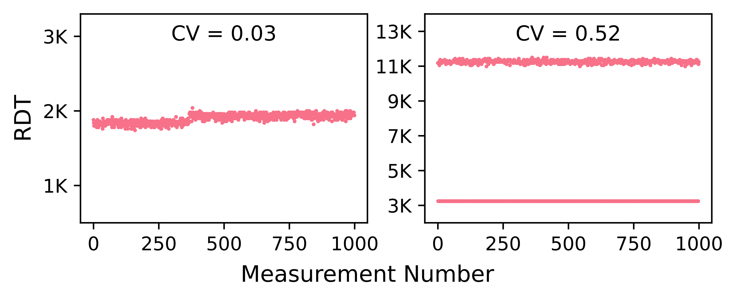
VRD in Two Example Rows
3.5⨉
1.2⨉
Variation in read disturbance threshold
can reach 3.5⨉
Notes:
Here is a look at those two rows. We see their RDT values across 1000 successive measurements on the x-axis
[CLICK] For the median row, we see that the maximum observed RDT is 1.2 times higher than the minimum
[CLICK] and we observe that the variation in RDT can reach a high factor: it is 3.5 times for the row with the greatest RDT variation

Slide 173
In-Depth Analysis: Key Takeaways
Takeaway 1
All tested DRAM rows exhibit VRD
Takeaway 2
Relatively few (<500) RDT measurements are
unlikely to yield the minimum RDT of a row
Takeaway 3
Data patterns, temperature, and
aggressor row on time affect VRD
Notes:
Now moving onto the second takeaway: Relatively few measurements are unlikely to yield the minimum read disturbance threshold of a row

Slide 174
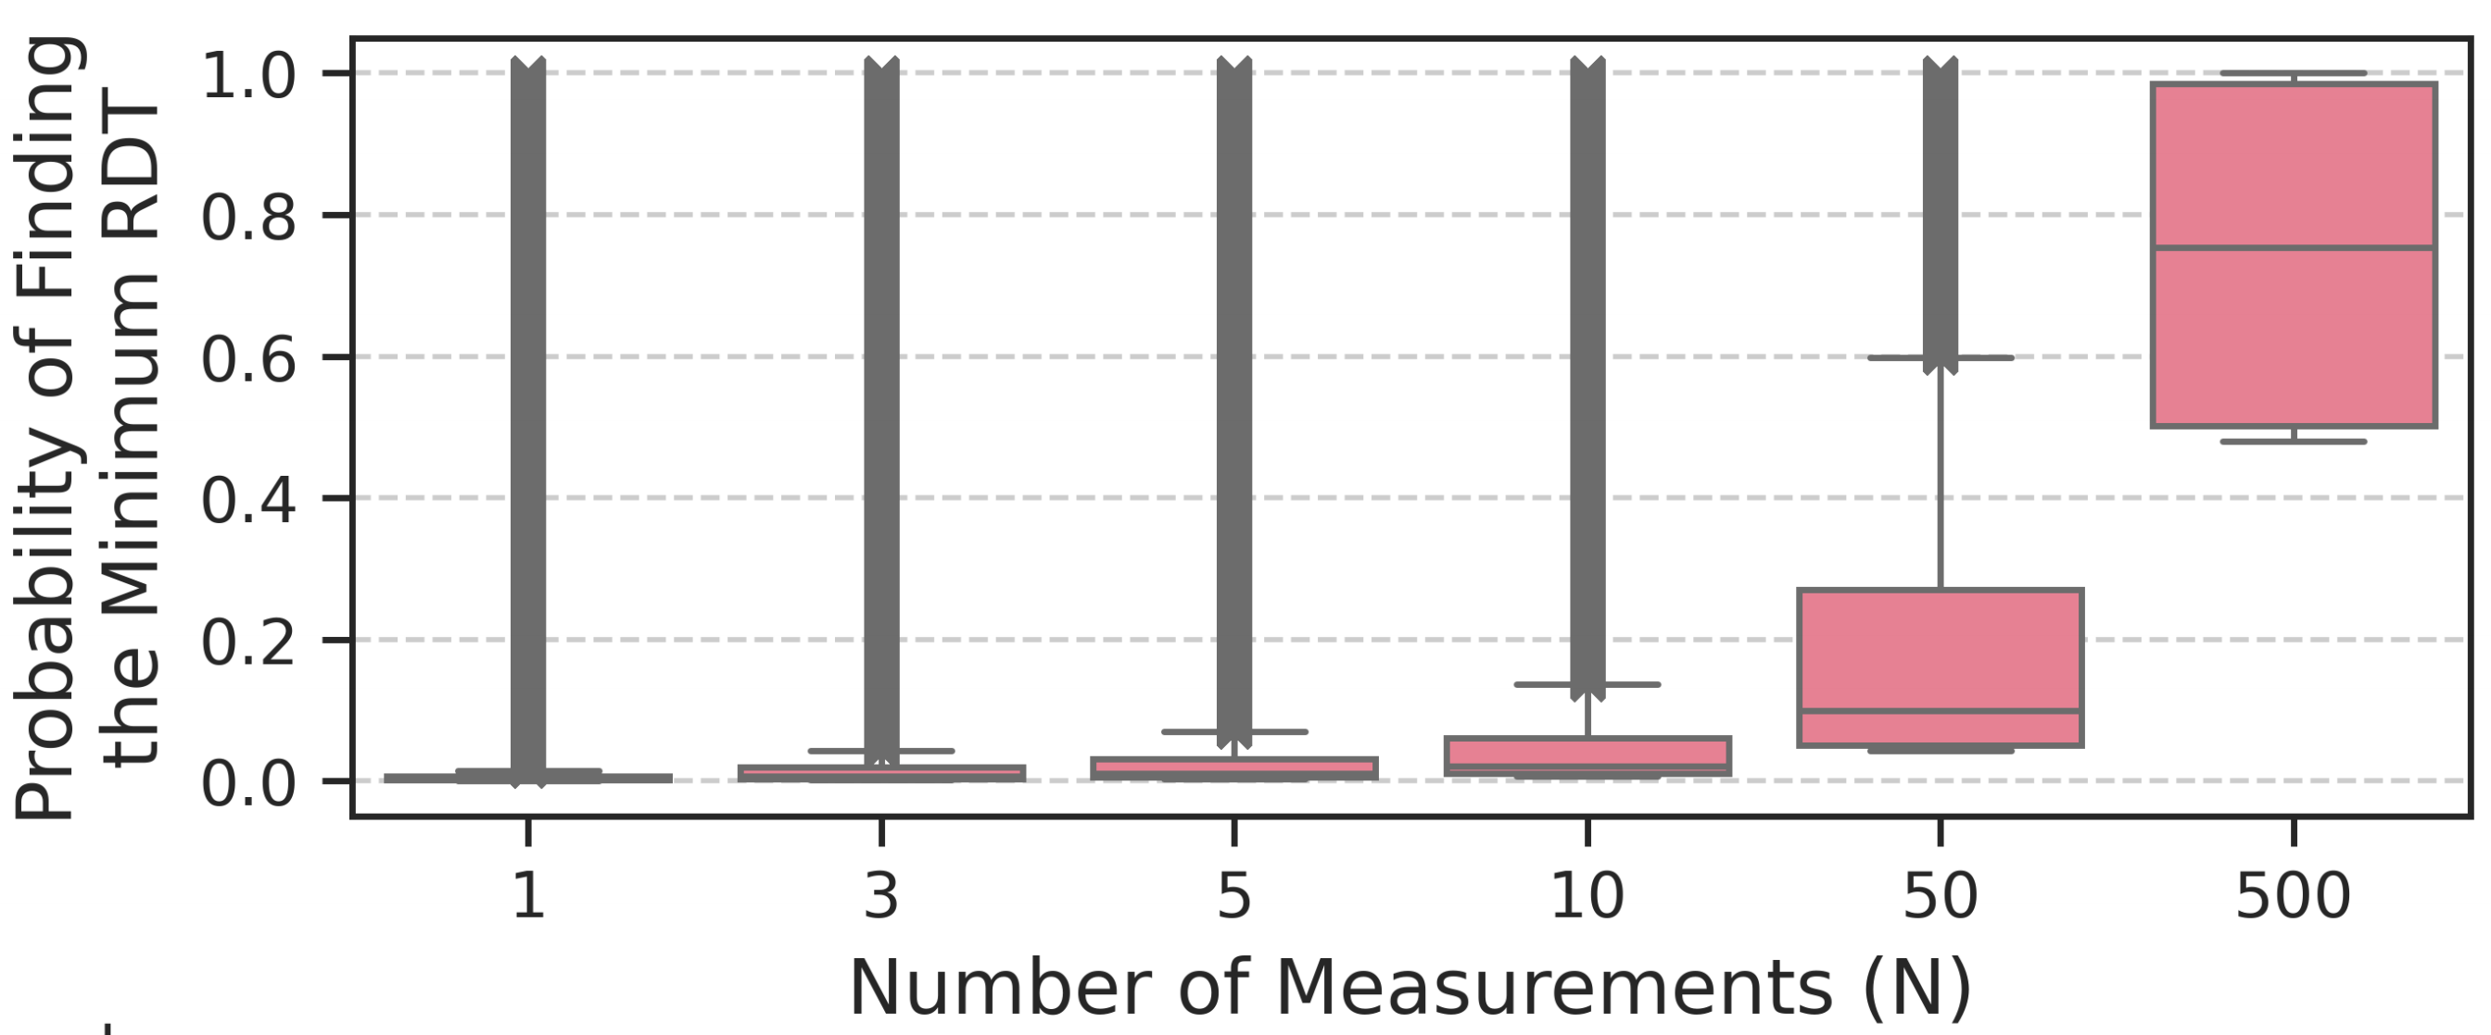
Probability of Identifying the Minimum RDT
How likely is it that N < 1000 measurements
yield the minimum RDT value across 1000 measurements?
N = 1, 3, 5, 10, 50, and 500
Monte Carlo simulations for 10K iterations
Notes:
We try to answer this question: how likely is it for us to find the minimum observed RDT across 1000 measurements, using
[CLICK] only N measurements where N is smaller than 1000? [CLICK]
We use monte carlo simulations and [CLICK] plot the probability of identifying the minimum RDT value over varying N [CLICK] for all tested rows

Slide 175
Probability of Identifying the Minimum RDT
only 0.2% for the median row
Very unlikely to find the minimum RDT
of a DRAM row with N = 1 measurement
Notes:
[CLICK] N = 1 measurement has a very low probability of yielding the minimum RDT across 1000 measurements, only 0.2%... and

Slide 176
Probability of Identifying the Minimum RDT
0.2%
0.7%
1.1%
2.1%
10.0%
75.3%
Probability values for the median row
Probability of finding the minimum
read disturbance threshold increases with N
(i.e., with more and more testing)
Notes:
(SLOWLY) we observe that the probability increases with N
goes up to 75% for the median row - but does not reach 100% -, for N = 500 measurements
====
TODO: spend more time here

Slide 177
Expected Value of the Minimum RDT
With only N < 1000 RDT measurements
how far are we from the minimum RDT across 1000 measurements
Read Disturbance Threshold
Minimum
across 1000
measurements
Measurement Number
Notes:
To gain more insight into VRD, we devise another metric called the expected value of the minimum RDT to quantify how higher of an RDT value we expect to find with N smaller than 1000 measurements.
[CLICK] I’ll describe this pictorially. [CLICK] This line depicts the minimum RDT value across 1000 measurements

Slide 178
Expected Value of the Minimum RDT
With only N < 1000 RDT measurements
how far are we from the minimum RDT across 1000 measurements
5 random samples
Minimum
across 5
samples
Read Disturbance Threshold
Expected value of the minimum RDT
Minimum
across 1000
measurements
Measurement Number
Notes:
Here are 5 random samples from the set of 1000 measurements
[CLICK] and the minimum across those 5 samples
[CLICK] this metric quantifies the distance between the two minimums

Slide 179
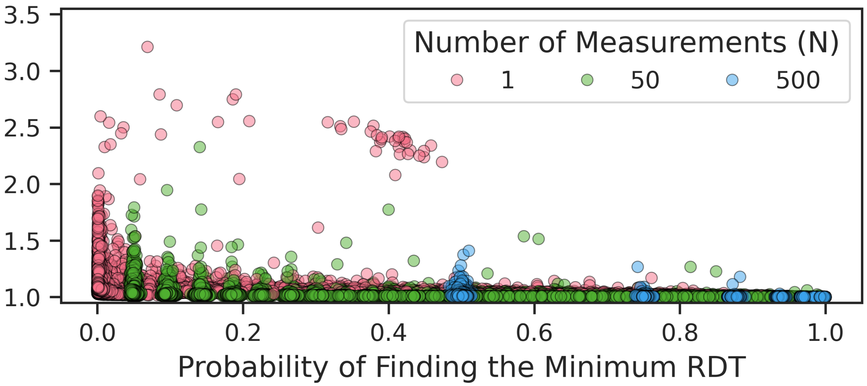
Expected Value of the Minimum RDT
Expected Normalized Value
of the Minimum RDT
Notes:
We plot the new metric on the [CLICK] y-axis and the probability of finding the minimum RDT on x-axis.

Slide 180
Expected Value of the Minimum RDT
Expected Normalized Value
of the Minimum RDT
RDT found by 1 measurement
3.21⨉ greater than
minimum RDT across 1000 measurements
Notes:
Each point on this plot stands for one row [CLICK]. [CLICK] This point shows you that there is a row where we expect to find an RDT value using one measurement 3.21 times greater than the one we would find if we were to test for 1000 times

Slide 181
Expected Value of the Minimum RDT
Expected Normalized Value
of the Minimum RDT
“Better” for testing
tight RDT distribution
Plot interpretation
“Better” for testing == as tight an RDT distribution as possible
Notes:
A good way to interpret this plot is that we want to have small y-axis values. Small y-axis values indicate *tighter* RDT distributions and you want RDT distributions as tight as possible.

Slide 182
Expected Value of the Minimum RDT
Expected Normalized Value
of the Minimum RDT
RDT expected to be found by 1 measurement is
1.9⨉ greater than minimum RDT across 1000 measurements
The minimum RDT is significantly smaller
than the one expected to be found with N = 1 measurement
Notes:
This is the full plot.
[CLICK] Now we highlight the rows with smaller than 0.1% probability of finding the minimum RDT: for these rows the minimum RDT appears only once in the series of 1000 measurements
[CLICK] They can have up to 1.9 times expected normalized value of the minimum RDT
[CLICK] We conclude that the minimum RDT across 1000 measurements is significantly smaller than the one expected to be found by N = 1 measurement

Slide 183
Expected Value of the Minimum RDT
Expected Normalized Value
of the Minimum RDT
With increasing N (number of measurements)
we expect to identify an RDT value
closer to the minimum across 1000 measurements
Notes:
With increasing N, we expect to identify an RDT value closer to the minimum value across 1000 measurements

Slide 184
In-Depth Analysis: Key Takeaways
Takeaway 1
All tested DRAM rows exhibit VRD
Takeaway 2
Relatively few (<500) RDT measurements are
unlikely to yield the minimum RDT of a row
Takeaway 3
Data patterns, temperature, and
aggressor row on time affect VRD
Notes:
Finally, data patterns, temperature, and aggressor row on time all affect VRD and you can find the detailed analyses in the paper, but I am not going to cover these details in the presentation.

Slide 185
Talk Outline
Motivation
Experimental Characterization Methodology
Foundational Results
In-Depth Analysis of VRD
Implications for System Security and Robustness
Conclusion
Notes:
The observations I presented have implications for system security and robustness

Slide 186
Important Caveat
VRD solution analysis based on 1K or 10K
read disturbance threshold measurements per row
More measurements could yield worse results
  Read disturbance threshold distribution tail could expand
What results would millions or billions
of RDT measurements yield?
Notes:
I’d like to stress an important caveat. The results I presented in the last slide and that I am going to present next are based on only a limited number of read disturbance threshold measurements.
[CLICK] More RDT measurements could yield worse results
[CLICK] and it is good to think about what millions of or billions of or more RDT measurements would yield.

Slide 187
Challenges of Accurately Identifying RDT
Variation in read disturbance threshold across 1000 measurements
can reach 3.5⨉ and may not be bounded
VRD is affected by data pattern, temperature,
aggressor row on time
Comprehensive RDT profiling is time-intensive
RDT
3.5⨉
Measurement Number
Measuring RDT of each row only once with 8000 hammers
using four data patterns, at three temperature levels
takes 39 minutes in a bank of 256K rows
Notes:
That, was a summary. I will do a deep dive by explaining why it’s challenging to accurately identify the minimum RDT
[CLICK] The variation in RDT can reach 3.5X and it may not be bounded.
[CLICK] RDT distribution is affected by many parameters and comprehensive RDT testing is time intensive
[CLICK] Measuring the RDT of each row in a bank of 256K rows *only once* can take 39 minutes

Slide 188
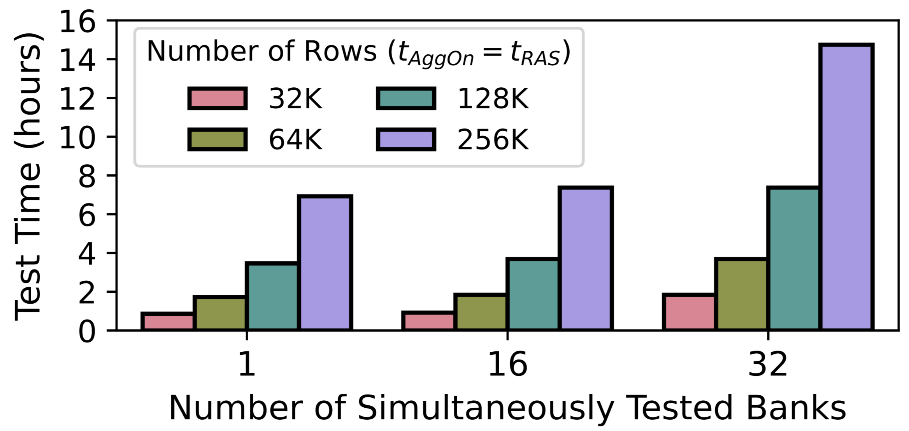
RDT Profiling is Time-Intensive
Comprehensive RDT testing can take tens of hours
(only 1000 measurements, one data pattern,
one temperature level, one aggressor row on time)
Notes:
In fact, we show that comprehensive read disturbance threshold testing for a DRAM chip can take tens of hours to complete if you want to measure RDT multiple times

Slide 189
RDT Profiling is Time-Intensive
https://arxiv.org/pdf/2502.13075
Comprehensive RDT testing can take hours
(1000 measurements, one data pattern,
one temperature level, one aggressor row on time)
Notes:
I refer you to our paper for more details on that

Slide 190

Making Do With Few RDT Measurements
A system designer might measure RDT a few times
and apply a safety margin (guardband) to the minimum observed value
Notes:
Because it is so time consuming to comprehensively test for read disturbance bitflips, a system designer might measure RDT a few times,
take the minimum across those few measurements, and apply a guardband to it with the hope of covering a not yet observed minimum RDT value
[CLICK] This plot shows you the probability that N measurements displayed on the x-axis + the guardband shown above will cover the minimum RDT value across 1,000 measurements.

Slide 191
Making Do With Few RDT Measurements
A system designer might measure RDT a few times
and apply a safety margin (guardband) to the minimum observed value
Average across all tested rows
Minimum across all tested rows
Notes:
We show both the average value across all tested rows using circles and the minimum across all tested rows using bars.
What that pink bar means is there is a row where you *don’t* expect to find the minimum read disturbance threshold across 1K measurements with 100% probability, even with 500 measurements.
[CLICK] Here is the full plot.

Slide 192
Making Do With Few RDT Measurements
A large guardband does not guarantee that
the minimum RDT is always identified
Using guardbands alone is likely not effective
Notes:
We observe that a large guardband does not guarantee that the minimum RDT is always identified and conclude that guardbands alone are likely not effective.

Slide 193

RDT Guardband Increases Performance Overheads
45%
35%
50% RDT safety margin can induce
45% additional overhead (over no margin)
Relying solely on guardbands not recommended
Notes:
Moreover, large guardbands can [CLICK] introduce significant performance overhead.
[CLICK] Thereby we do not recommend relying solely on guardbands.

Slide 194

Combining ECC and Guardbands (I)
Single-error correcting double-error detecting (SECDED)
or Chipkill ECC combined with guardbands
could mitigate VRD-induced bitflips
Unique bitflips when 10% RDT guardband applied
10% guardband combined w/ ECC is likely unsafe
Notes:
We evaluate error-correcting codes as a complementary technique to using a guardband for RDT
[CLICK] The plot shows you a histogram of the number of unique bitflips in a row when we use a 10% RDT guardband.
[CLICK] The bitflip rate we observe suggests that widely-used ECC schemes combined with 10% guardband for RDT is likely unsafe, depending on how the bitflips are located.

Slide 195
More in the Paper
Hypothetical explanation for VRD
Effect of True- and Anti-Cell Layout
  Presence of true- and anti-cells in the victim row
  does not significantly affect the RDT distribution
Read disturbance mitigation evaluation methodology
Probability of errors at the worst observed bitflip rate
for 10% RDT guardband
  SEC, SECDED, and Chipkill-like (SSC)
Read disturbance testing time and energy consumption
Detailed information on tested modules and chips
Notes:
There are many more things in the paper that I cannot talk about now
In the interest of time, I’ll refer you to…

Slide 196
More in the Paper
https://arxiv.org/pdf/2502.13075
Hypothetical explanation for VRD
Effect of True- and Anti-Cell Layout
  Presence of true- and anti-cells in the victim row
  does not significantly affect the RDT distribution
Read disturbance mitigation evaluation methodology
Probability of errors at the worst observed bitflip rate
for 10% safety margin
  SEC, SECDED, and Chipkill-like (SSC)
Read disturbance testing time and energy consumption
Detailed information on tested modules and chips
Notes:
… our paper for those details

Slide 197
Talk Outline
Motivation
Experimental Characterization Methodology
Foundational Results
In-Depth Analysis of VRD
Implications for System Security and Robustness
Conclusion
Notes:
I’ll quickly conclude my talk

Slide 198
Variable Read Disturbance
Backup Slides

Slide 199
Is this Experiment Noise?
Short answer: no
Hypothetical explanation for VRD:
Randomly changing charge trap state in the active region
Long answer:
We cannot identify any independent variables
within our control that allow reliably predicting
the minimum RDT despite extensive testing
Device-level studies should confirm our hypotheses

Slide 200
Hypothetical Explanation for VRD
No device-level study shows temporal variations
in read disturbance vulnerability
Electron migration and injection into victim cell
is a major read disturbance failure mechanism
This mechanism is assisted by charge traps
in the shared active region of the victim and aggr. cell
Temporal variation attributed to randomly changing
occupied/unoccupied states of charge traps

Slide 201

RDT Distribution Across Chips

Slide 202

# of Consecutive Measurements That
Yield the Same RDT Value

Slide 203

Autocorrelation Function Tests

Slide 204

Expected Value of the Minimum RDT
Expected Normalized Value
of the Minimum RDT

Slide 205
Expected Value of the Minimum RDT
Min. RDT found by 1 measurement
3.21⨉ greater than
min. RDT found by 1000 measurements
Expected Normalized Value
of the Minimum RDT

Slide 206
Expected Value of the Minimum RDT
Expected Normalized Value
of the Minimum RDT

Slide 207




Effect of Die Density and Die Revision (I)
Expected Normalized Value
of the Minimum RDT
Number of Measurements (N)
RDT distribution worsens with increasing die density
and with advanced DRAM technology
Notes:
We plot the expected normalized value of the minimum RDT [CLICK] for three die revision and die density combinations
[CLICK] We observe that the RDT distribution worsens: that is, we expect to find a larger RDT with N < 1000 measurements, with increasing die density

Slide 208

Effect of Die Density and Die Revision (II)
The effect of die density and die revision
is consistent across all tested modules
Notes:
[CLICK] We consistently make this observation across all tested modules

Slide 209

Effect of Data Pattern (I)
Expected Normalized Value
of the Minimum RDT
Number of Measurements (N)
Notes:
Here we show the expected normalized value of the minimum RDT for four tested data patterns

Slide 210
Effect of Data Pattern (I)
Expected Normalized Value
of the Minimum RDT
Number of Measurements (N)
1.04⨉
1.06⨉
expected normalized value for the median row
RDT distribution changes with data pattern
Notes:
We observe that the RDT distribution [CLICK] changes with the data pattern. Here we show the y-axis values for the median rows to quantify the change.

Slide 211


Effect of Data Pattern (II)
Expected Normalized Value
of the Minimum RDT
Number of Measurements (N)
No single data pattern causes
the worst RDT distribution across all tested DRAM chips
Notes:
We look at the effect of data pattern across all tested modules. We observe that [CLICK] no single data pattern causes the worst RDT distribution across all tested DRAM chips

Slide 212




Effect of Aggressor Row On Time
Expected Normalized Value
of the Minimum RDT
RDT distribution changes with aggressor row on time
RDT distribution can become better or worse
with increasing row on time
Notes:
This shows the effect of aggressor row on time.
[CLICK] We see that the RDT distribution changes with aggressor row on time
[CLICK] It can become better or worse with increasing row on time

Slide 213

Effect of Temperature
Expected Normalized Value
of the Minimum RDT
Number of Measurements (N) = 1
RDT distribution tends to change with temperature
Notes:
We look at the effect of temperature
[CLICK] and we see that the RDT distribution tends to change with temperature

Slide 214

Effect of True- and Anti-Cell Layout
The presence of true- and anti-cells in the victim row
does not significantly affect the RDT distribution

Slide 215

Error Probability Analysis

Slide 216
DRAM Operation: Activate and Precharge
Access data in Row 1
DRAM Subarray
Row 1
Row 1
Row 2
Row 3
Row Buffer
Row 1 is closed
Notes:
To access a cell we use activate and precharge operations.
[CLICK] If we want to access data in Row 1, [CLICK] we must first activate Row 1, or open it

Slide 217
DRAM Operation: Activate and Precharge
Access data in Row 1
Activate
command
DRAM Subarray
Row 1
Row 1
Row 2
Row 3
Row Buffer
Row 1 is open
Row 1 is closed
Notes:
We do that [CLICK] using an ACTIVATE [CLICK] command.

Slide 218
DRAM Operation: Activate and Precharge
Access data in Row 3
DRAM Subarray
Row 1
Row 2
Row 3
Precharge
command
Row Buffer
Row 1
Row 3 is closed
Notes:
If, in this opened state, we [CLICK] want to access data in Row 3, [CLICK] we close the open row [CLICK] using the PREcharge command.

Slide 219
DRAM Operation: Activate and Precharge
Access data in Row 3
DRAM Subarray
Row 1
Activate
command
Row 2
Row 3
Row 3
Row Buffer
Row 3 is open
Row 3 is closed
Notes:
[CLICK] Now we can activate Row 3 and access data in Row 3.
Repeatedly performing activate and precharge operations can lead to…

