Slide 1






Understanding and Mitigating
Covert Channel and Side Channel Vulnerabilities
Introduced by RowHammer Defenses
F. Nisa Bostancı
O. Canpolat A. Olgun I. E. Yüksel K. Kanellopoulos
M. Sadrosadati A. G. Yağlıkçı O. Mutlu

Slide 2
Talk Outline
Motivation and Problem
Key Observation
LeakyHammer and Case Studies
Mitigating LeakyHammer
Conclusion

Slide 3
Talk Outline
Motivation and Problem
Key Observation
LeakyHammer and Case Studies
Mitigating LeakyHammer
Conclusion

Slide 4



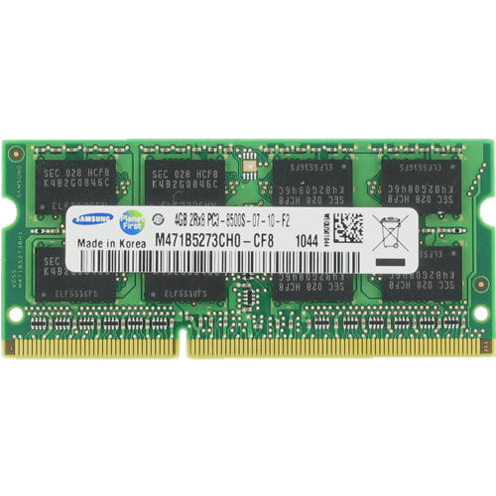
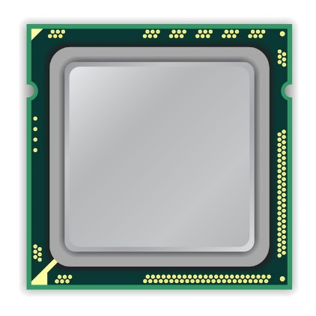

A Typical DRAM-Based Computing System
Modern systems are vulnerable to security attacks such as covert channel and side channel attacks
A set of attacks exploit hardware structures that result in different execution time for a type of operation
based on the input or the current state of the structure
timing differences leak information
Computing System
Notes:
Modern computing systems are vulnerable to security attacks such as covert channel and side channel attacks where an attacker uses the shared computing system to communicate with other attacker processes or to leak security critical data of concurrently running applications
A set of attacks exploit shared hardware structures that result in different execution time for executing a type of operation based on the inpu or the current state of the structure
Lets take a look at these computing systems

Slide 5
A Typical DRAM-Based Computing System
DRAM Chip
DRAM
Channel
CPU
DRAM Module
Notes:
This is a typical DRAM-based computing system with a CPU and a DRAM module connected over an off-chip link called the DRAM channel. [CLICK] This DRAM module has multiple DRAM chips.

Slide 6
DRAM Organization
DRAM Cell
…
Bank
Wordline
Chip I/O
Row Decoder
DRAM Row
…
Bitline
Row Buffer
DRAM Chip
DRAM Bank
Notes:
Inside each DRAM chip we have multiple banks And within each bank, DRAM cells are laid out as a two-dimensional array. [CLICK]
These cells are organized into rows that are selected using wordlines [CLICK]
And the cells are connected to a row buffer via bitlines [CLICK]
To access data in a row, we first need to activate the row and bring its data to the row buffer, where the next accesses to the same row are served from
and too many repeated activations can lead to

Slide 7
DRAM Read Disturbance
Read disturbance in DRAM breaks memory isolation
Prominent example: RowHammer
DRAM Bank
Row 1
Row 1
Row 1
Victim Row
Row 2
Row 2
Row 2
Row 2
Row 2
Row 2
open
open
open
closed
closed
Aggressor Row
Row 3
Row 3
Row 3
Victim Row
Repeatedly opening (activating) and closing (precharging)
a DRAM row causes RowHammer bitflips in nearby cells
Notes:
… read disturbance bitflips.
Read disturbance bitflips have significant system-level implications because they break memory isolation.
A prime example of DRAM read disturbance is RowHammer, which I will show in this slide.
For example, to access a data stored in Row 2, [CLICK]
We first need to open Row 2, and then perform accesses. Once we need to access another row, we need to close Row 2 and open the other row [CLICK]
[BACK& FORTH] If we keep opening and closing this row many times, called hammering a row, [CLICK]
We observe bitflips in physically nearby DRAM rows [CLICK]
This phenomenon is called RowHammer. We refer to the hammered row as the aggressor row and the rows that are affected as victim rows. [CLICK]

Slide 8

Mitigating Read Disturbance (I):
Preventive Refresh
DRAM Bank
Row 1
Row 1
Row 1
Row 1
Victim Row
Row 2
Row 2
Row 2
Row 2
Row 2
Row 2
open
open
open
closed
Aggressor Row
Aggressor Row
Row 3
Row 3
Row 3
Row 3
Victim Row
Refreshing potential victim rows
mitigates read disturbance bitflips
Notes:
One way to mitigate read disturbance is to preventively refresh potential victim rows before they experience bitflips

Slide 9

Mitigating Read Disturbance (II):
Preventive Refresh
DRAM Bank
Row 1
Row 1
Row 1
Row 1
Victim Row
Row 2
Row 2
Row 2
Row 2
Row 2
Row 2
open
open
open
closed
Aggressor Row
Aggressor Row
Row 3
Row 3
Row 3
Row 3
Victim Row
Defense techniques track row activation counts
(of aggressor rows) to preventively refresh potential victim rows
Notes:
However, doing so requires tracking row actvation counts of aggressor rows to determine which rows to preventively refresh

Slide 10
Read Disturbance is Getting Worse
Technology node scaling
[Kim+, ISCA’14]
[Kim+, ISCA’20]
[Luo+, ISCA’23]
DRAM cells become increasingly more vulnerable to read disturbance, requiring low-cost defenses
Notes:
To make things worse:
With technology node scaling, DRAM cells get smaller in size and closer to each other[CLICK]
Such that we observe significant reductions in the minimum hammer count to induce the first bitflip in the last decade [CLICK]
Thus DRAM cells become increasingly more vulnerable to read disturbance [CLICK]

Slide 11

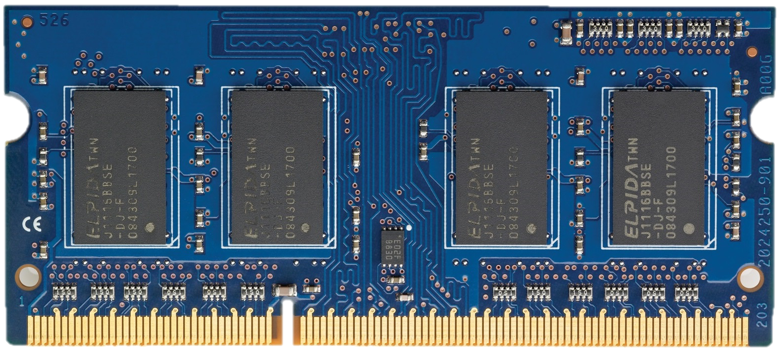
Latest Industry Defenses for RowHammer
Recent DDR5 specifications introduce two new defense frameworks to mitigate RowHammer bitflips:
Per-row activation counters
to accurately track aggressor rows' activation counts
Per Row Activation Counting (PRAC)
as of April 2024
A command to
provide DRAM with the time
for performing preventive actions
Refresh Management (RFM)
before 2024

Slide 12
Problem
Unfortunately, yes.
Do industrial and academic
RowHammer defenses introduce
new covert and side channel vulnerabilities?
Notes:
The industry already standardized multiple RowHammer defenses to mitigate read disturbance bitflips, yet their full security implications are not known

Slide 13
Talk Outline
Motivation and Problem
Key Observation
LeakyHammer and Case Studies
Mitigating LeakyHammer
Conclusion

Slide 14

Key Observation (I)
Preventive actions have two fundamental features that enable covert channels and side channels:
1
    Preventive actions often result in high memory access latencies for regular memory requests
Request
Request
Request
Request
higher memory access latencies
Preventive actions have high latency
(e.g., 1400 ns for PRAC)
Notes:
We make the key observation that preventive actions have two fundamental features that enable covert and side channels:
[CLICK]
Preventive actions often result in significantly high memory access latencies for regular memory requests
This is because preventive actions have high latency

Slide 15


Key Observation (II)
Preventive actions have two fundamental features that enable covert channels and side channels:
2
    A user can leverage memory access patterns
    to intentionally trigger a preventive action
Request
Request
Request
Request
higher memory access latencies
Notes:
We make the key observation that preventive actions have two fundamental features that enable covert and side channels:
[CLICK]
Preventive actions often result in significantly high memory access latencies for regular memory requests
This is because preventive actions have high latency

Slide 16
Talk Outline
Motivation and Problem
Key Observation
LeakyHammer and Case Studies
Mitigating LeakyHammer
Conclusion

Slide 17




LeakyHammer
A new class of attacks that exploit
RowHammer defense-induced memory latency differences
Deterministically and intentionally impose observable latency overheads
on requests via preventive actions
Accurately infer victims'
memory access patterns
that result in preventive actions

Slide 18
LeakyHammer Case Studies
CS1: PRAC-Based Covert Channel Attack
CS2: RFM-Based Covert Channel Attack
CS3: PRAC-Based Website Fingerprinting
Notes:
We demonstrate three different attacks as case studies of LeakyHammer
We first establish PRAC and RFM based covert communication channels
And then, we demonstrate a website fingerprinting attack that leaks which website is loaded by a victim user by just observing the preventive actions caused by the victim

Slide 19
Evaluation Methodology
Environment: System simulation using gem5 [Lowe-Power+ '20] integrated with cycle-level DRAM simulator Ramulator 2.0
[Kim+ CAL'15, Luo+ CAL'24]
System Configuration:
  Processor 1-, 2-, and 4-core, out-of-order, 3GHz clock frequency
  DRAM DDR5, 1 channel, 2 rank/channel, 8 bank groups,
  4 banks/bank group, 128K rows/bank
  Memory Ctrl. 64-entry read and write requests queues,
  Scheduling policy: FR-FCFS with a column cap of 16 Last-level cache 4 MiB (per-core), 16-way
  PRAC N_{BO}=128 activations, 4 RFMs per back-off
  PRFM T_{RFM}=40 activations
https://github.com/CMU-SAFARI/LeakyHammer

Slide 20
LeakyHammer Case Studies
CS1: PRAC-Based Covert Channel Attack
CS2: RFM-Based Covert Channel Attack
CS3: PRAC-Based Website Fingerprinting

Slide 21
Per Row Activation Counting in DDR5
Unavailable
RFM
ACT A
ACT A
ACT A
Back-off
becomes available again
DRAM Rows
0xA
PRAC Counters
back-off threshold
continues to
send commands
N_{BO}
1
2
requires
preventive
action
accurately tracks
activation counts
of each row
allocates a fixed time for preventive refresh
Back-off
...
ACT A
ACT A
ACT A
RFM
ACT
DRAM Command Timeline
Notes:
[CLICK] Here we have a CPU with a DRAM module
[CLICK] Inside the DRAM module we have many rows
[CLICK] and each row has a dedicated activation counter
A PRAC based mitigation works as follows
[CLICK] When a row is activated, PRAC increments the counter corresponding to that row
[CLICK] and keeps incrementing the same row with each activation
after some point the counter reaches a threshold called the back off threshold
[CLICK] which means that the row requires a preventive action to prevent RowHammer bitflips and PRAC identifies the row as an aggressor row
[CLICK] and sends the memory controller a back-off signal
[CLICK] Upon receiving the back-off signal, the memory controller issues an RFM command
[CLICK] which allocates a fixed time for the DRAM module to perform preventive refreshes
[CLICK] During this time the DRAM module becomes unavailable for regular memory requests
[CLICK] and performs preventive refreshes
[CLICK] after preventive refreshes are completed, DRAM becomes available again and the memory controller can continue to send commands

Slide 22
Observing PRAC-Induced Latencies (I)
We test if an application can:
intentionally trigger a PRAC back-off
observe PRAC-induced higher memory access latencies
DRAM Bank
1
Allocate pages (0xA and 0xB) in different rows of a DRAM bank
DRAM Rows
PRAC Ctrs
0xA
…
0xB
Repeat
clflush 0xA
Read 0xA and measure access latency
2
clflush 0xB
Read 0xB and measure access latency
Row Buffer
3
Notes:
To exploit PRAC for an attack, we first need to verify if we can observe PRAC induced latencies
[CLICK] We test if an application can
[CLICK] intentionally trigger a PRAC back-off
[CLICK] and observe higher memory access latencies caused by it
To do so, we first
[CLICK] allocate pages in different rows of a DRAM bank to cause many row activations and increment their activation counts, lets say addresses A and B.
[CLICK] we then first flush address A from the cache hierarchy to ensure the next accesses to it would go to the main memory
And read address A and measure the access latency
[CLICK] We repeat this step for address B
[CLICK] since A and B are in the same bank, repeating these steps many times potentially activates both rows in an interleaved manner and increments their activation counts

Slide 23
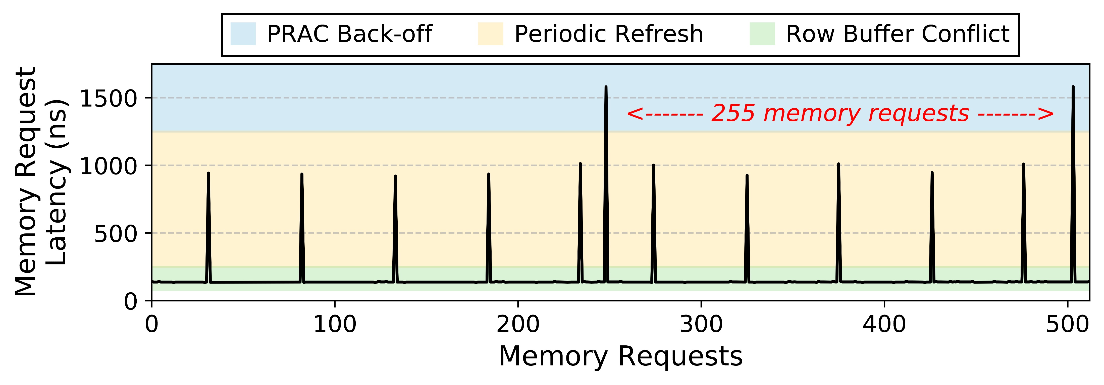
Observing PRAC-Induced Latencies (II)
N_{BO} = 128
Notes:
And now let me show you the measured request latencies.
On the X axis we see a window of 512 memory requests, basically a random window from the whole execution. And on the y axis we have the measured memory request latencies
[CLICK] and these are the results
[CLICK] We split the measured access latencies empirically into three categories, from the highest to the lowest latency, we have prac back-off, periodic refresh and row buffer conflict latencies.
We observe that…

Slide 24
Observing PRAC-Induced Latencies (II)
N_{BO} = 128
Back-off latency
The observed back-off latency is consistent with the specification
and can be distinguished from regular memory operations
Notes:
… we can identify back-offs as the highest peaks in the figure
[CLICK] which is consistent with the specification and can be distinguished from regular memory requests
This experiment shows that PRAC creates a promising timing channel to build attacks.

Slide 25


PRAC-Based Covert Channel:
Attack Overview
Encoding
logic-1: back-off
logic-0: no-back-off
10101001
DRAM Bank
DRAM Rows
Ctrs
R_{Sender}
…
R_{Receiver}
Sender
Row Buffer
Receiver
Only 1 bit will be transmitted
Transmission Windows
Notes:
Now lets see an overview of the covert channel attack

Slide 26

PRAC-Based Covert Channel:
Attack Overview
Encoding
logic-1: back-off
logic-0: no-back-off
Loop:
access R_{Receiver}
time( )
DRAM Bank
DRAM Rows
Ctrs
R_{Sender}
…
R_{Receiver}
Sender
Row Buffer
Receiver
Only 1 bit will be transmitted
used to determine the bit value
Recv.
Latency
Transmission Windows

Slide 27

PRAC-Based Covert Channel:
Attack Overview
Encoding
logic-1: back-off
logic-0: no-back-off
1 (Back-off)
1
DRAM Bank
DRAM Rows
Ctrs
R_{Sender}
…
R_{Receiver}
Sender
Row Buffer
Back-off
Receiver
back-off
Recv.
Latency
Transmission Windows

Slide 28
PRAC-Based Covert Channel:
Attack Overview
Encoding
logic-1: back-off
logic-0: no-back-off
0 (No Back-off)
0
Zzz
DRAM Bank
DRAM Rows
Ctrs
R_{Sender}
…
R_{Receiver}
Sender
HIT!
Row Buffer
Receiver
back-off
no back-off
Recv.
Latency
…
Transmission Windows

Slide 29
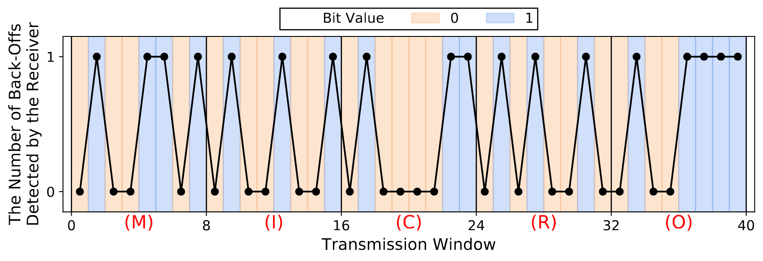
PRAC-Based Covert Channel:
Proof-of-Concept and Channel Capacity
Validation with transmitting a 40-bit message
The receiver successfully decodes the sender's message
The attack achieves 39.0 Kbps raw bit rate

Slide 30
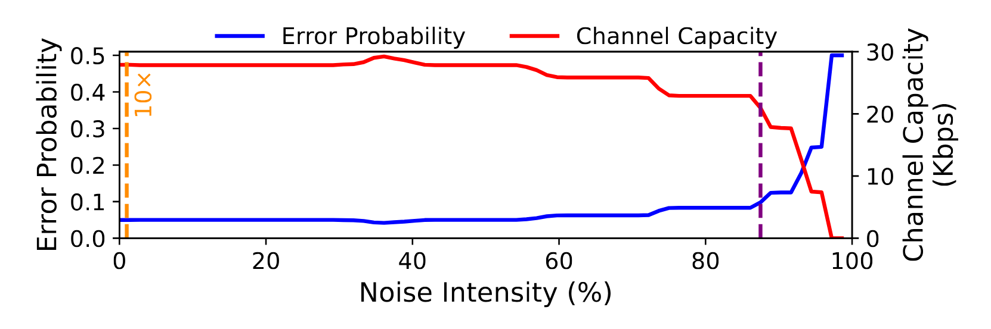
PRAC-Based Covert Channel: Noise Analysis
We use a microbenchmark that causes back-offs
with varying frequencies to simulate system noise
1
1% = 10 x 4-core memory-intensive workload
Similar back-off intensity
to memory performance attacks [Moscibroda+, USENIX Security'07]

Slide 31
PRAC-Based Covert Channel: Noise Analysis
We use a microbenchmark that causes back-offs
with varying frequencies to simulate system noise
27.8 Kbps
20.9 Kbps
0.05
0.1
1
1% = 10 x 4-core memory-intensive workload
Similar back-off intensity
to memory performance attacks
[Moscibroda+, USENIX Security'07]
The PRAC-based covert channel attack maintains its capacity
until very high noise intensity values

Slide 32
LeakyHammer Case Studies
CS1: PRAC-Based Covert Channel Attack
CS2: RFM-Based Covert Channel Attack
CS3: PRAC-Based Website Fingerprinting

Slide 33
RFM-Based Covert Channel Summary
We exploit an RFM-based RowHammer defense that tracks
the number of row activations per DRAM bank
as described in the DDR5 standard
We observe that applications can intentionally trigger an RFM command
and can detect it by observing the high memory latency
The attack successfully transmits the message
Due to per DRAM bank activation counting, applications can trigger RFM more easily, making the channel more susceptible to noise

Slide 34
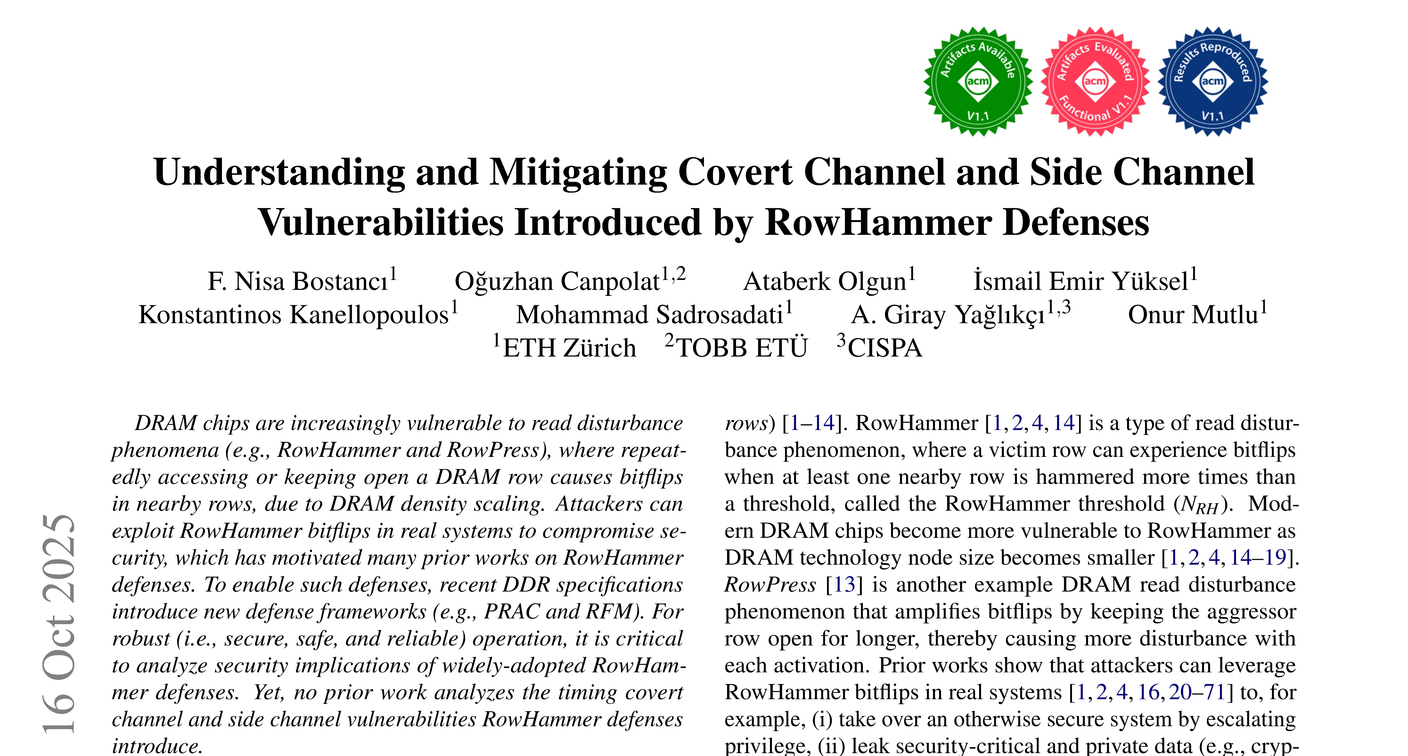
RFM-Based Covert Channel Summary
Send 1 w/ many RFMs
Count # of RFMs
Sender
Receiver
https://arxiv.org/abs/2503.17891

Slide 35
LeakyHammer Case Studies
CS1: PRAC-Based Covert Channel Attack
CS2: RFM-Based Covert Channel Attack
CS3: PRAC-Based Website Fingerprinting

Slide 36

PRAC-Based Website Fingerprinting Attack
No need to colocate in the same bank as back-off affects the whole channel
Attacker
Victim
Determines which website the victim loads
by only observing own memory request latencies
Loads websites using a web browser

Slide 37
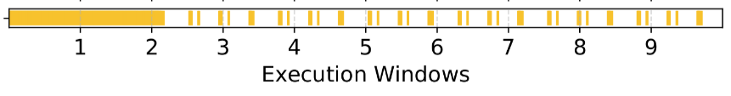
How to Fingerprint
1
allocate multiple test rows to avoid triggering back-off
while observing
Attacker
each line is a back-off
access test rows continuously and measure access latencies to detect back-offs
2
create fingerprint by only using
the timestamps of back-offs
3

Slide 38

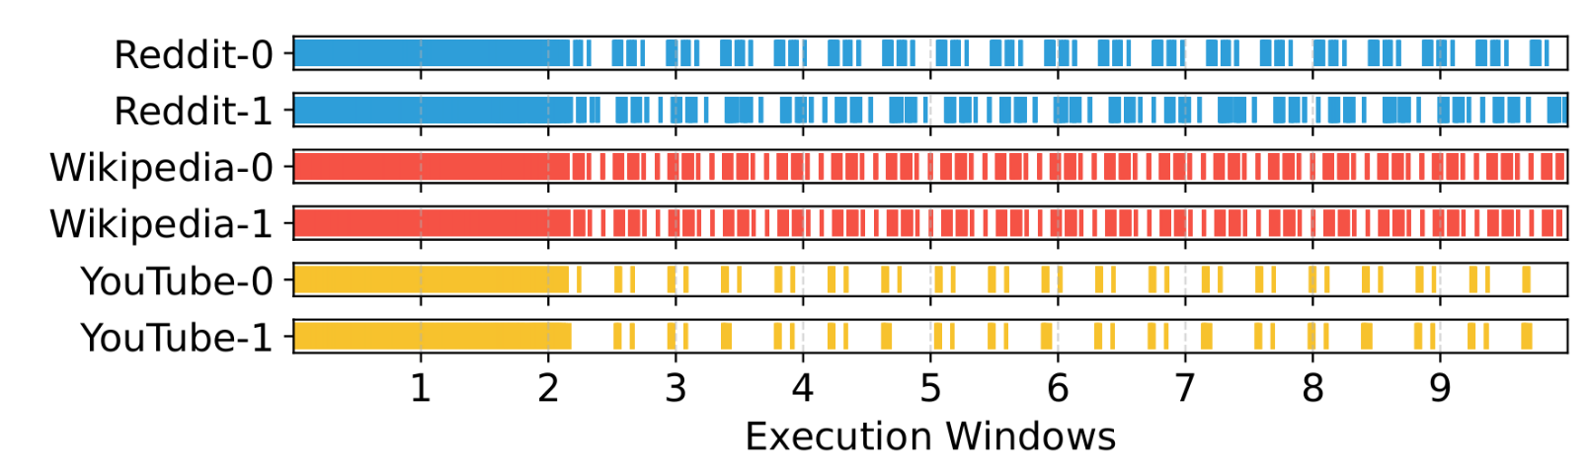
Preparing for the Attack: Creating a Database
Attacker
fingerprint many websites
and create a fingerprint database
Multiple instances

Slide 39
Launching the Attack
Attacker
Get a fingerprint when
the victim loads a website
1
Victim
compare with the database
and determine the website
2
Website: YouTube

Slide 40
PRAC-Based Website Fingerprinting: Evaluation
We collect back-off fingerprints of a website by loading it with a browser and getting a back-off trace
with the attacker routine
  40 most-visited websites
  from Semrush and Similarweb top sites
A machine learning approach to classify websites:
  Simple and lightweight machine learning models
  (e.g., decision tree, random forest, gradient boosting,
  k-nearest neighbors)
https://github.com/CMU-SAFARI/LeakyHammer

Slide 41
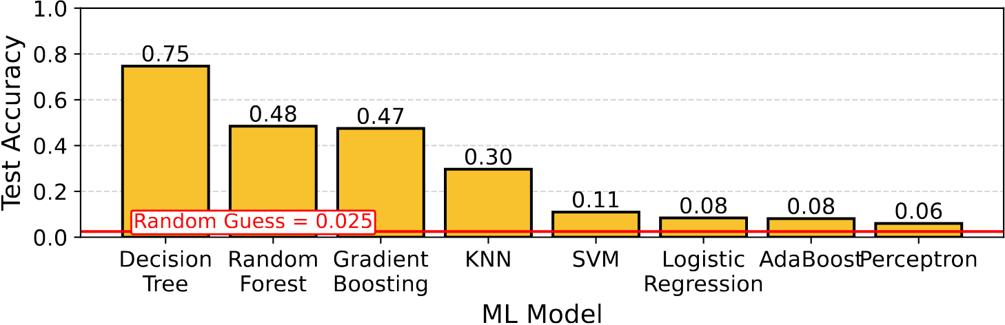
PRAC-Based Website Fingerprinting:
Test Accuracy
Using back-off-based fingerprints, classical machine learning models
can classify websites with up to 75% accuracy

Slide 42
Talk Outline
Motivation and Problem
Key Observation
LeakyHammer and Case Studies
Mitigating LeakyHammer
Conclusion
Notes:
We showed that LeakyHammer can have significant implications on system security and now lets discuss how to mitigate it

Slide 43
Mitigating LeakyHammer
We propose three countermeasures against LeakyHammer:
Fixed-Rate RFM (FR-RFM)
eliminates LeakyHammer by decoupling preventive actions
from memory access patterns of running applications
Randomly Initialized Activation Counters (RIAC)
reduces channel capacity with a randomization method
Bank-Level PRAC (PRAC-Bank)
performs bank-level preventive actions to limit the attack scope to that of existing DRAM-based attacks

Slide 44
Fixed-Rate RFM (FR-RFM)
Periodically performs a preventive action,
  independently from the memory access patterns
DRAM Command Timeline
RFM
RFM
RFM
shortest time window needed to perform T_{RFM} activations*
A sender cannot cause preventive actions intentionally to send messages
An attacker cannot observe
a victim's memory access patterns
that lead to a preventive action

Slide 45
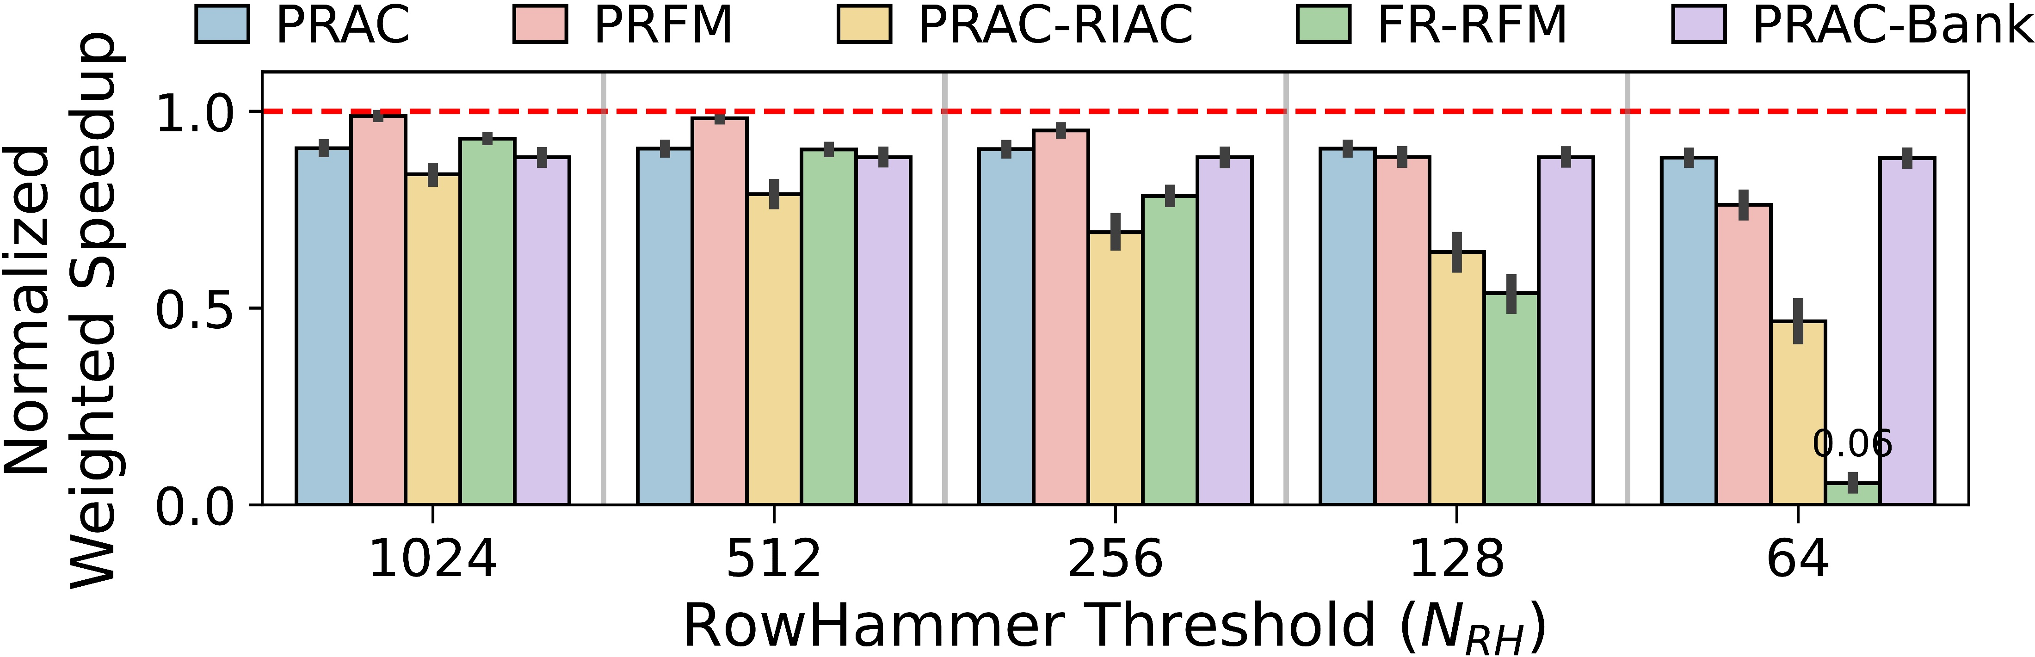
Evaluating LeakyHammer Countermeasures
60 four-core workloads: SPEC2017 and SPEC2006
not secure
against LeakyHammer
reduces
the capacity by 86%
secure against LeakyHammer
limits
the attack scope

Slide 46
Evaluating LeakyHammer Countermeasures
60 four-core workloads: SPEC2017 and SPEC2006
not secure
against LeakyHammer
reduces
the capacity by 86%
secure against LeakyHammer
limits
the attack scope
FR-RFM mitigates LeakyHammer and performs similar to PRAC and PRFM for near-future N_{RH} values (e.g., 1024)
As N_{RH} decreases, other countermeasures
have lower performance overheads

Slide 47
More in the Paper
More details of LeakyHammer
  Operational details on case studies
  (e.g., RFM-based covert channel)
  Multibit LeakyHammer covert channels
  LeakyHammer countermeasures
More results and analyses
  LeakyHammer with other RowHammer mitigations
  Impact of real workloads on LeakyHammer
  Sensitivity of PRAC-based covert channel
    Impact of RFM commands per back-off, RowHammer defense latency, larger cache hierarchy and data prefetchers
  Comparison against existing cache and memory-based timing channels

Slide 48
More in the Paper
More details of LeakyHammer
  Operational details on case studies
  (e.g., RFM-based covert channel)
  Multibit LeakyHammer covert channels
  LeakyHammer countermeasures
More results and analyses
  Analysis of LeakyHammer with other RowHammer mitigations
  The impact of real workloads on LeakyHammer
  Sensitivity of PRAC-based covert channel
    The impact of RFM commands per back-off, RowHammer defense latency, larger cache hierarchy and data prefetchers
  Comparison against existing cache and memory-based timing channels
https://arxiv.org/abs/2503.17891

Slide 49
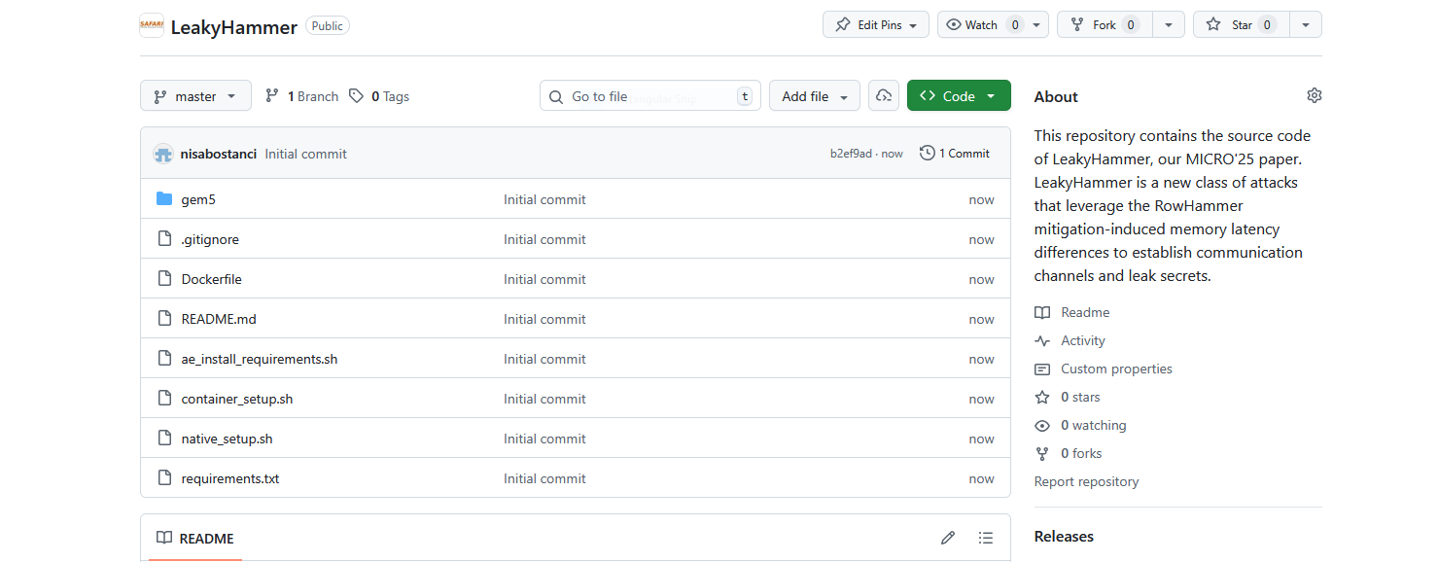
LeakyHammer is Open Source and Artifact Evaluated
https://github.com/CMU-SAFARI/LeakyHammer

Slide 50
Talk Outline
Motivation and Problem
Key Observation
LeakyHammer and Case Studies
Mitigating LeakyHammer
Conclusion

Slide 51
Conclusion
We introduce LeakyHammer, a new class of timing attacks
that exploit RowHammer defense-induced memory latency differences
We systematically analyze two latest industry defenses to RowHammer
Build two covert communication channels
Demonstrate a website fingerprinting attack that identifies visited websites with high accuracy
We propose and evaluate three countermeasures
Completely mitigating LeakyHammer with low performance overhead in near-future DRAM-based systems
In systems that are highly RowHammer-vulnerable, countermeasures
that reduce channel capacity have lower performance overhead
https://github.com/CMU-SAFARI/LeakyHammer

Slide 52


Understanding and Mitigating
Covert Channel and Side Channel Vulnerabilities
Introduced by RowHammer Defenses
arXiv
GitHub
F. Nisa Bostancı
O. Canpolat A. Olgun I. E. Yüksel K. Kanellopoulos
M. Sadrosadati A. G. Yağlıkçı O. Mutlu

