Slide 1





LTRF: Enabling High-Capacity Register Files for GPUs via Hardware/Software Cooperative Register Prefetching
Mohammad Sadrosadati | Amirhossein Mirhosseini
Seyed Borna Ehsani | Hamid Sarbazi-Azad
Mario Drumond | Babak Falsafi
Rachata Ausavarungnirun | Onur Mutlu

Slide 2
Register file size limits GPU scalability
Register file (RF) already accounts for 60% of on-chip storage
But, there is still demand for more registers to achieve maximum performance and concurrency
Future slow memory accesses call for more threads
  Multi-socket, multi-GPU, RDMA, NVM, etc.
Compiler optimizations call for more registers per thread
  Loop unrolling, thread coarsening, etc.
5.9x
2.3x
(KB)
Need mechanisms to expand RF capacity (without large area/power overheads)

Slide 3
How to make register files larger?
  Emerging technologies [Jing’13][Mao’14][Wang’15][Abdel-Majid’17]
  Register file compression [Lee’15]
  Register file virtualization [Jion’15][Vijaykumar’16][Kloosterman’17]
  Common challenge: Latency overhead
    Example: 8x larger register file with NTV TFET
No latency overhead
5.3x slower
Goal: Tolerate register file latencies

Slide 4
Contributions
Latency Tolerant Register File (LTRF)
  “2-level” main register file + register cache
  Performs prefetch ops while executing other warps
  Paves the way for several power/area optimizations
Compiler-driven Register Prefetching
  Break control flow graph into “prefetch subgraphs”
  Prefetch registers at the beginning of each subgraph
  Interval analysis to identify prefetch subgraphs
LTRF tolerates up to 6x slower register files
Example LTRF use case:
8× larger RF → 34.8% higher performance

Slide 5
Outline
Background and challenges
The case for compiler-driven register prefetching in GPUs
LTRF architecture and compiler support
Evaluation methodology
Results

Slide 6
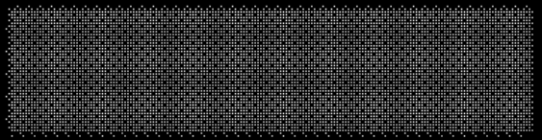
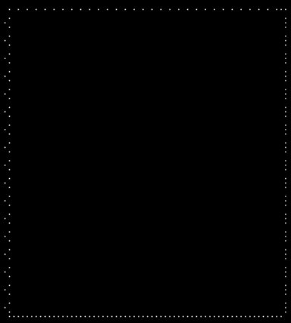
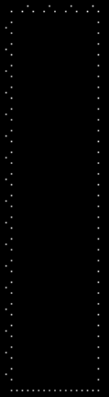
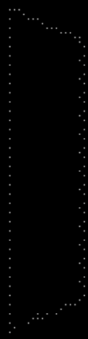
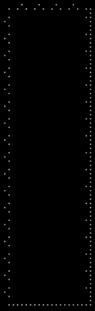
Register file caching [Gebhart’ ISCA11]
Promising approach for latency tolerant register files
Warp Scheduler
Main
Register
Register
File
Crossbar
Crossbar
SIMD Units
Operand Collector
File
Cache
(
multiple banks
)
(
multiple banks)
Unfortunately, classic demand fetch and replace yields low hit rate in register caches

Slide 7
Demand fetch/replace register caching
8-30% hit rate
Why?
  No spatial locality for registers
  Values might be renamed to different registers
    Scrambles temporal locality
  Lots of threads ➔ cache thrashing
Our solution: Precise register prefetching

Slide 8
Compiler-driven register prefetching
Possible to have near-perfect register prefetchers
  Register working sets known at compile time
    No indirection or address translation
  Prefetch latency may overlap with other warps

Slide 9
Compiler-driven register prefetching
Possible to have near-perfect register prefetchers
  Register working sets known at compile time
    No indirection or address translation
  Prefetch latency may overlap with other warps
Key idea: “prefetch subgraphs”
  Prefetch register working sets into the cache at the beginning of each subgraph
  All register accesses in the prefetch subgraph hit in the register cache

Slide 10
Compiler-driven register prefetching
Possible to have near-perfect register prefetchers
  Register working sets known at compile time
    No indirection or address translation
  Prefetch latency may overlap with other warps
R1
Key idea: “prefetch subgraphs”
  Prefetch register working sets into the cache at the beginning of each subgraph
  All register accesses in the prefetch subgraph hit in the register cache
R2
R3
R4

Slide 11
Compiler-driven register prefetching
Possible to have near-perfect register prefetchers
  Register working sets known at compile time
    No indirection or address translation
  Prefetch latency may overlap with other warps
P(R1,R2)
R1
Key idea: “prefetch subgraphs”
  Prefetch register working sets into the cache at the beginning of each subgraph
  All register accesses in the prefetch subgraph hit in the register cache
R2
P(R3)
R3
P(R4)
R4
What are best prefetch subgraphs?

Slide 12
Optimal prefetch subgraphs
Objectives
Implications
Prefetch operations dominate register uses
Minimum number of prefetch operations
Fit entire loops
  Maximize dynamic insts
Single-entry subgraphs
Largest possible subgraphs
Capture backward branches

Slide 13
Register intervals
Intervals: disjoint single-entry subgraphs of CFG
Register intervals access at most k registers
  Reserve k register slots for each warp to prevent eviction
Entry block is the header of the first interval
Greedily add child basic blocks iff:
  Incoming edges only from within interval, AND
  | registers accessed in interval | ≤ k
Remaining children become new headers
Repeat until graph is irreducible
Prefetch register working sets
at the beginning of register intervals

Slide 14
Register intervals in action
A
R1
B
R1, R9
E
R7, R8
C
R1
F
R3, R8
G
R2, R3
D
R5, R6

Slide 15
Register intervals in action
A is the first interval header
A
R1
B
R1, R9
E
R7, R8
C
R1
F
R3, R8
G
R2, R3
R1
D
R5, R6

Slide 16
Register intervals in action
E is the only candidate to merge
A
R1
B
R1, R9
E
R7, R8
C
R1
F
R3, R8
G
R2, R3
R1
D
R5, R6

Slide 17
Register intervals in action
E merges
A
R1
B
R1, R9
E
R7, R8
C
R1
F
R3, R8
G
R2, R3
R1 | R7 | R8
D
R5, R6

Slide 18
Register intervals in action
F and G are potential candidates to merge
A
R1
B
R1, R9
E
R7, R8
C
R1
F
R3, R8
G
R2, R3
R1 | R7 | R8
D
R5, R6

Slide 19
Register intervals in action
F merges but G can’t (register cache is full)
A
R1
B
R1, R9
E
R7, R8
C
R1
F
R3, R8
G
R2, R3
R1 | R7 | R8 | R3
D
R5, R6

Slide 20
Register intervals in action
Done with first interval --- B and G become headers
A
R1
B
R1, R9
E
R7, R8
C
R1
F
R3, R8
G
R2, R3
R1 | R7 | R8 | R3
R2 | R3
R1 | R9
D
R5, R6

Slide 21
Register intervals in action
No candidate to merge into B --- C becomes header
A
R1
B
R1, R9
E
R7, R8
C
R1
F
R3, R8
G
R2, R3
R1 | R7 | R8 | R3
R2 | R3
R1 | R9
R1
D
R5, R6

Slide 22
Register intervals in action
D becomes candidate to merge into C
A
R1
B
R1, R9
E
R7, R8
C
R1
F
R3, R8
G
R2, R3
R1 | R7 | R8 | R3
R2 | R3
R1 | R9
R1
D
R5, R6

Slide 23
Register intervals in action
D merges into C --- done with the first pass
A
R1
B
R1, R9
E
R7, R8
C
R1
F
R3, R8
G
R2, R3
R1 | R7 | R8 | R3
R2 | R3
R1 | R9
R1 | R5 | R6
D
R5, R6

Slide 24
Register intervals in action
Second pass: Yellow is able to merge into Red
A
R1
B
R1, R9
E
R7, R8
C
R1
F
R3, R8
G
R2, R3
R1 | R7 | R8 | R3
R2 | R3
R1 | R9
R1 | R5 | R6
D
R5, R6

Slide 25
Register intervals in action
Done with second pass --- graph no further reducible
PREFETCH
R1, R7, R8 , R3
Terminate
A
R1
PREFETCH
R1, R9, R5 , R6
B
R1, R9
E
R7, R8
PREFETCH
R2, R3
Entire
nested
loop
C
R1
F
R3, R8
G
R2, R3
R1 | R7 | R8 | R3
R2 | R3
R1 | R9 | R5 | R6
D
R5, R6

Slide 26
Register interval highlights
Single-entry prefetch subgraphs
  Prefetch operations dominate register uses
Maximal-length subgraphs
  Minimize prefetch overheads
Minimal termination constraints
  Encapsulate entire loops
  Maximize dynamic instructions per interval
Multi-pass construction algorithm based on classic interval analysis
Need hardware mechanisms to provide fixed-size cache partitions for register intervals

Slide 27
Outline
Background and challenges
The case for compiler-driven register prefetching in GPUs
LTRF architecture and compiler support
Evaluation methodology
Results

Slide 28
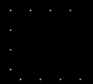

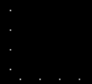
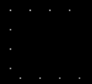

Latency Tolerant Register File (LTRF)
“2-level” register file
Warp Scheduler
Main
Register File Cache
Register
Crossbar
Crossbar
SIMD Units
Operand Collector
File

Slide 29
Latency Tolerant Register File (LTRF)
“2-level” register file + warp scheduler
Two-Level
Warp Scheduler
Main
Register File Cache
Register
Crossbar
Crossbar
SIMD Units
Operand Collector
File

Slide 30
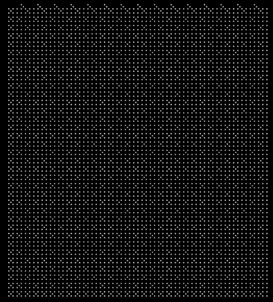

Latency Tolerant Register File (LTRF)
“2-level” register file + warp scheduler
Cache registers only for the active warps
Two-Level
Warp Scheduler
Main
Active Warps
Cache
Register
Crossbar
Crossbar
SIMD Units
Operand Collector
File

Slide 31






Latency Tolerant Register File (LTRF)
“2-level” register file + warp scheduler
Cache registers only for the active warps
Dedicated register cache space for each warp
Two-Level
Warp Scheduler
16
Registers
Main
Register
Crossbar
Crossbar
SIMD Units
Operand Collector
File
Active Warps
Cache

Slide 32
Latency Tolerant Register File (LTRF)
“2-level” register file + warp scheduler
Cache registers only for the active warps
Dedicated register cache space for each warp
Swap warps on PREFETCH
Two-Level
Warp Scheduler
16
Registers
Main
Register
Crossbar
Crossbar
SIMD Units
Operand Collector
File
Active Warps
Cache

Slide 33
Outline
Background and challenges
The case for compiler-driven register prefetching in GPUs
LTRF architecture and compiler support
Evaluation methodology
Results

Slide 34
Evaluation methodology
Simulator: GPGPU-Sim modeling NVIDIA Maxwell
Workloads: CUDA-SDK, Rodinia, and Parboil suites
Comparison points:
  Baseline: No register caching
  RFC: Demand fetch register file caching (Gebhart’ ISCA 2011)
  LTRF
  Ideal: Increased capacity with no latency overhead

Slide 35
Latency tolerance
Max tolerable RF latency with IPC slowdown <= 5%
LTRF tolerates the latencies of up to 6x slower register files

Slide 36
Performance improvement
Example use case: Increase register file capacity from 256KB to 2MB using NTV TFET
  Same power/area as the baseline register file (256 KB)
  2nd-level RF accesses 5.3X slower than baseline
LTRF+TFET improves performance by 34.8%
within 2.3% of an ideal large register file

Slide 37
Also in the paper…
LTRF+: minimize register movement between the register file and register cache using liveness analysis
Register interval compared to other subraphs
  Strands, superblocks, etc.
Detailed analysis of hardware overheads
  16% more area
  21% less power
Various LTRF use cases with different register file technologies and optimizations

Slide 38
Conclusion
Register files are the main GPU scalability bottlenecks
  They already consume 60% of total on-chip memory
  Need more registers for highest performance
Standalone register caching solutions yield low hit rates
Latency Tolerant Register File (LTRF)
  “2-level” main register file + register cache
  Prefetch register working sets ahead of time
  Performs prefetch ops while executing other warps
  Interval analysis for near-optimal prefetching
  Tolerates up to 6x slower main register files
  Paves the way for several power/area optimizations

Slide 39
LTRF: Enabling High-Capacity Register Files for GPUs via Hardware/Software Cooperative Register Prefetching
Mohammad Sadrosadati | Amirhossein Mirhosseini
Seyed Borna Ehsani | Hamid Sarbazi-Azad
Mario Drumond | Babak Falsafi
Rachata Ausavarungnirun | Onur Mutlu

