Slide 1




Enhancing Data Placement and Migration
in Hybrid Storage Systems
via Multi-Agent Reinforcement Learning
Harmonia
Rakesh Nadig, Vamanan Arulchelvan, Rahul Bera, Taha Shahroodi, Gagandeep Singh, Andreas Kosmas Kakolyris, İsmail Emir Yüksel,
Mohammad Sadrosadati, Jisung Park and Onur Mutlu
ICS 2026

Slide 2
Talk Outline
Background and Motivation
HSS Data Management using Reinforcement Learning
Harmonia: Overview
Evaluation and Key Results
Conclusion

Slide 3
Talk Outline
Background and Motivation
HSS Data Management using Reinforcement Learning
Harmonia
Evaluation and Key Results
Conclusion

Slide 4
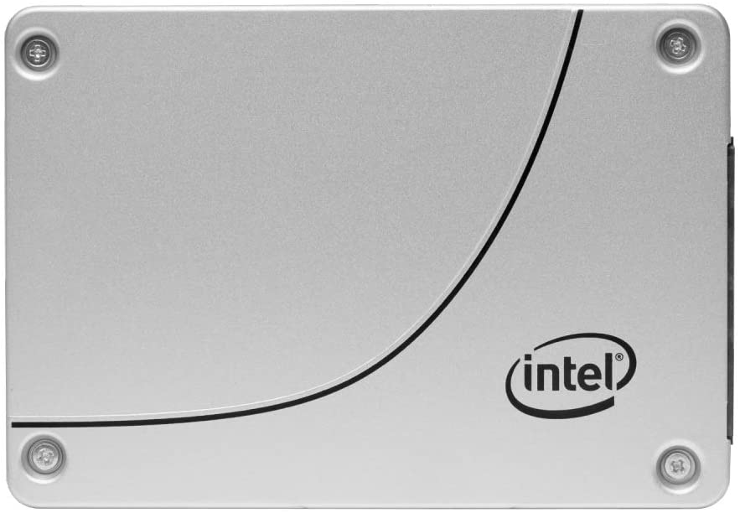


Hybrid Storage System (HSS)
Unified Virtual Address Space
High-End Devices
Mid-Range Devices
Low-End Devices
Higher performance, higher cost/GB
Lower cost/GB,
lower performance
Hybrid Storage System (HSS)
An HSS combines multiple storage devices
with different performance and cost characteristics
under a single unified address space

Slide 5




Hybrid Storage System (HSS)
…
AI/ML Infrastructure
High-Performance Computing (HPC) Clusters
HSS
Edge & Embedded Systems
Enterprise Storage Systems

Slide 6
Factors Affecting HSS Performance
HSS performance depends on two key factors:
Where is the
data placed?
When and where to migrate data?
Data Placement
Data Migration
Select the best-fit device for each new write
Reorganize data across devices over time

Slide 7
Factors Affecting HSS Performance
HSS performance depends on two key factors:
Where is the
data placed?
When and where to migrate data?
Data Placement
Data Migration
Select the best-fit device for each new write
Reorganize data across devices over time

Slide 8
Data Placement
Choose the best-suited HSS storage device for each incoming write or allocation request
Application/File System
Hot Data
Low Latency
High-End
Device
Low-End Device
Hybrid Storage System (HSS)

Slide 9
Data Placement
Choosing the best-suitable HSS storage device for each incoming write or allocation request
Application/File System
Hot Data
High-End
Device
Low-End Device
High Latency
Hybrid Storage System (HSS)

Slide 10
Data Placement: Key Requirements
Choosing the best-suitable HSS storage device for each incoming write or allocation request
Data Placement
Need to operate with low latency
on the critical path of I/O handling
Application/File System
Hot Data
Make accurate, yet low-overhead decisions
Adapt to changes in workload
and system conditions
High-End
Device
Low-End Device
High Latency
Hybrid Storage System (HSS)

Slide 11
Factors Affecting HSS Performance
HSS performance depends on two key factors:
Where is the
data placed?
When and where to migrate data?
Data Placement
Data Migration
Select the best-fit device for each new write
Reorganize data across devices over time

Slide 12

Data Migration
Reorganize data across HSS devices (e.g., prefetch hot data to the high-end devices and evict cold data to the low-end devices) to sustain high HSS performance
Application/File System
Hot Data
Data Placement
Cold Data
Data Migration
High-End
Device
Low-End Device
Hybrid Storage System (HSS)

Slide 13
Data Migration
Reorganize data across HSS devices (e.g., prefetch hot data to the faster devices and evict cold data to the slower devices) to sustain high HSS performance
Application/File System
Read
Cold Data
High-End
Device
Low-End Device
Hybrid Storage System (HSS)

Slide 14
Data Migration
Reorganize data across HSS devices (e.g., prefetch hot data to the faster devices and evict cold data to the slower devices) to sustain high HSS performance
Application/File System
Data Migration
High-End
Device
Low-End Device
Hybrid Storage System (HSS)

Slide 15
Data Migration: Key Requirements
Data Migration
Prefetch hot data to the faster device and evict cold data
to the slower devices to sustain high HSS performance
Need to operate in the background,
off the critical path of I/O handling
Application/File System
Minimize interference
with foreground I/O operations
Read
Data Migration
Cold Data
Hot Data
Perform timely migrations to adapt
to workload and system changes
High-End
Device
Low-End Device
Hybrid Storage System (HSS)

Slide 16
Key Limitations of Prior Techniques
Prior HSS techniques do not optimize
both data placement and migration
Naive combination of prior placement
and migration techniques provides sub-optimal performance due to lack of coordination
Lack extensibility to more devices
and configurations

Slide 17
Key Limitations of Prior Techniques
Prior HSS techniques do not optimize
both data placement and migration
Naive combination of prior placement
and migration techniques provides sub-optimal performance due to lack of coordination
Lack extensibility to more devices
and configurations

Slide 18
Lack of Holistic Data Management in HSS
Performance-Optimized HSS
Avg. Request Latency

Slide 19
Lack of Holistic Data Management in HSS
State-of-the-art
data migration technique
Performance-Optimized HSS
Avg. Request Latency

Slide 20
Lack of Holistic Data Management in HSS
State-of-the-art
data placement technique
Performance-Optimized HSS
Avg. Request Latency

Slide 21
Lack of Holistic Data Management in HSS
Ideal approach with full knowledge of future access patterns
Performance-Optimized HSS
Avg. Request Latency

Slide 22
Lack of Holistic Data Management in HSS
Performance-Optimized HSS
100.4%
Avg. Request Latency

Slide 23
Lack of Holistic Data Management in HSS
The large latency gap between Sibyl and Oracle
is due to Sibyl’s heuristic migration policy which does not adapt to workload and system changes
Performance-Optimized HSS
100.4%
Avg. Request Latency
The latency gap becomes wider in a cost-optimized HSS where Sibyl’s heuristic migration policy performs
costly data evictions

Slide 24
Key Limitations of Prior Techniques
Prior HSS techniques do not optimize
both data placement and migration
Naive combination of prior placement
and migration techniques provides sub-optimal performance due to lack of coordination
Lack extensibility to more devices
and configurations

Slide 25
Lack of Coordination in Extended Techniques
What happens if we combine the state-of-the art placement and migration techniques?
Performance-Optimized HSS
19.6%
Avg. Request Latency

Slide 26
Lack of Coordination in Extended Techniques
What happens if we combine the state-of-the art placement and migration techniques?
Naive combinations provide sub-optimal performance because the constituent policies are oblivious
to each other’s decisions
Performance-Optimized HSS
19.6%
Avg. Request Latency
The extended techniques make conflicting placement
and migration decisions due to lack of coordination

Slide 27
Key Limitations of Prior Techniques
Prior HSS techniques do not optimize
both data placement and migration
Naive combination of prior placement
and migration techniques provide sub-optimal performance due to lack of coordination
Lack extensibility to more devices
and configurations

Slide 28

Lack of Extensibility (1/2)
Prior HSS data-management techniques are rigid, and require significant designer effort to extend the policies to more devices
Changes in HSS configuration
Dual-HSS

Slide 29

Lack of Extensibility (2/2)
Prior HSS-data management techniques are rigid, and require significant designer effort to extend the policies to more devices
Changes in HSS configuration
Design a new policy
Tri-HSS

Slide 30
Our Goal
A holistic data-management mechanism that
Performs combined optimization of both
data placement and data migration policies
Achieves coordination between data placement
and data migration policies
Provides easy extensibility to incorporate a wide range of HSS configurations

Slide 31

Harmonia
An online multi-agent reinforcement learning technique
for HSS data management
Harmonia consists of two autonomous, coordinating
RL agents that co-optimize
data placement and data migration
Harmonia is the Greek goddess of harmony and balance
https://en.wikipedia.org/wiki/Harmonia

Slide 32
Talk Outline
Background and Motivation
HSS Data Management using Reinforcement Learning
Harmonia
Evaluation and Key Results
Conclusion

Slide 33
Basics of Reinforcement Learning (RL)
An algorithmic approach where an RL agent learns to select the best action for the current state to maximize long-term reward
Agent stores Q-values for every state-action pair
  Expected return for taking an action in a state
State (s_{t})
Agent
Environment
Action (a_{t})
Reward (r_{t+1})
Notes:
First, let me briefly describe the basics of reinforcement learning.
Reinforcement learning, in its simplest form, is the ...
A RL system contains two components: [CLICK] the agent and the environment.
The agent observes the state of the environment in every timestep [CLICK], takes an action based on the state [CLICK], and receives a reward for that action [CLICK].
[CLICK] The agent stores …
Given a state, the agent …

Slide 34
Formulating HSS Data Management using RL
State (s_{t})
Agent
Action (a_{t})
Environment
Reward (r_{t+1})
State
State
Data Placement Agent
Hybrid
Storage
System
Action
Data Migration Agent
Action
Reward
Reward

Slide 35

Harmonia’s State
Action
Harmonia
Reward
HSS
7-dimensional vector of state features
State features common for both agents
  Captures workload changes and system conditions
Limited number of state features
  Reduce the implementation overhead
  RL agent is more sensitive to reward
We quantize the state features into bins to reduce storage overhead
State
Request Size
Request Type
Access Interval of a Page
Access Frequency of a Page
Free Space in the Fast Device
Current Location of a Page
Migration Interval of a Page

Slide 36
Harmonia’s Reward (1/2)
Action
Harmonia
Reward
HSS
Defines Harmonia’s objective
Data Placement Agent
  Performs data placement on the critical path of I/O handling
  Objective: Reduce average I/O request latency of current request
Harmonia learns to balance device utilization
  Overutilization of high-end device leads to higher latency
  due to contention, queuing delays and garbage collection
  Selectively placing less-critical data on low-end devices
  preserves high-end device capacity
State
Placement
Action (aₜ)
Immediate Reward = 1 / Lₜ
(time)
t
t+1

Slide 37
Harmonia’s Reward (2/2)
Action
Harmonia
Reward
HSS
Data Migration Agent
  Runs in the background
  Objective: Maximizes long-term HSS performance by reorganizing data across HSS devices
State
Delayed Reward=
(n / Σ Lᵢ) − P_migr
Migrate x pages
(e.g., x = 10)
observe next n I/O request latencies
(latencies L_t … L_t+n) (e.g., n = 50)
(time)

Slide 38
Harmonia’s Reward (2/2)
Action
Harmonia
Reward
HSS
Data Migration Agent
  Runs in the background
  Objective: Maximizes long-term HSS performance by reorganizing data across HSS devices
State
Application may not immediately access prefetched data
Delayed Reward=
(n / Σ Lᵢ) − P_migr
Migrate x pages
(e.g., x = 10)
observe next n I/O request latencies
(latencies L_t … L_t+n) (e.g., n = 50)
(time)

Slide 39
Harmonia’s Reward (2/2)
Action
Harmonia
Reward
HSS
Data Migration Agent
  Runs in the background
  Objective: Maximizes long-term HSS performance by reorganizing data across HSS devices
State
Performance gains from freed high-end device capacity is seen on future placements
Delayed Reward=
(n / Σ Lᵢ) − P_migr
Migrate x pages
(e.g., x = 10)
observe next n I/O request latencies
(latencies L_t … L_t+n) (e.g., n = 50)
(time)

Slide 40
Harmonia’s Reward (2/2)
Action
Harmonia
Reward
HSS
Data Migration Agent
  Runs in the background
  Objective: Maximizes long-term HSS performance by reorganizing data across HSS devices
Latency encapsulates the device’s internal state
  (e.g., read/write latencies, garbage collection latency, queuing delays, …)
State
Delayed Reward=
(n / Σ Lᵢ) − P_migr
Migrate x pages
(e.g., x = 10)
observe next n I/O request latencies
(latencies L_t … L_t+n) (e.g., n = 50)
(time)

Slide 41
What is Action?
Action
Harmonia
Reward
HSS
Data Placement
  For every new I/O request, the action is to select
  a storage device to place the I/O request data
Data Migration
  For every page already placed in HSS, select the storage device to migrate the data
Action can be easily extended to any number of storage devices
State

Slide 42
Talk Outline
Background and Motivation
HSS Data Management using Reinforcement Learning
Harmonia
Evaluation and Key Results
Conclusion

Slide 43
Harmonia: Overview
I/O Request from Application
Data Placement Agent
Hybrid Storage System
Training Thread
High-End Device
Low-End Device
Placement
Inference Thread
Perform background migration during idle time
Coordination
(via reward for each agent)
Data previously stored in HSS
Migration Thread
Data Migration Agent
Migration Queue
Training Thread
Inference Thread
Candidate pages to migrate

Slide 44

Harmonia: RL Agent Design
Inference Network
Periodic
Weight Update
Training Network
Max
Action
Policy
Experience Replay
HSS
Action
State
Experience Buffer
(stored in DRAM)
Training Dataset
Experience
Reward
Inference Thread
Training Thread

Slide 45
More in the Paper
Coordination between Harmonia’s agents
  Harmonia (with coordination) outperforms its uncoordinated variant by 26.7% (59.8%) on a performance- (cost-) optimized HSS
Harmonia’s adaptability to changes in workload access patterns
Detailed RL agent design
  RL algorithm
  Hyper-parameter tuning
  Training and inference network design
Detailed workload characterization
Detailed analysis of why RL is a good fit for HSS data management
Detailed background on the prior data placement and migration techniques

Slide 46
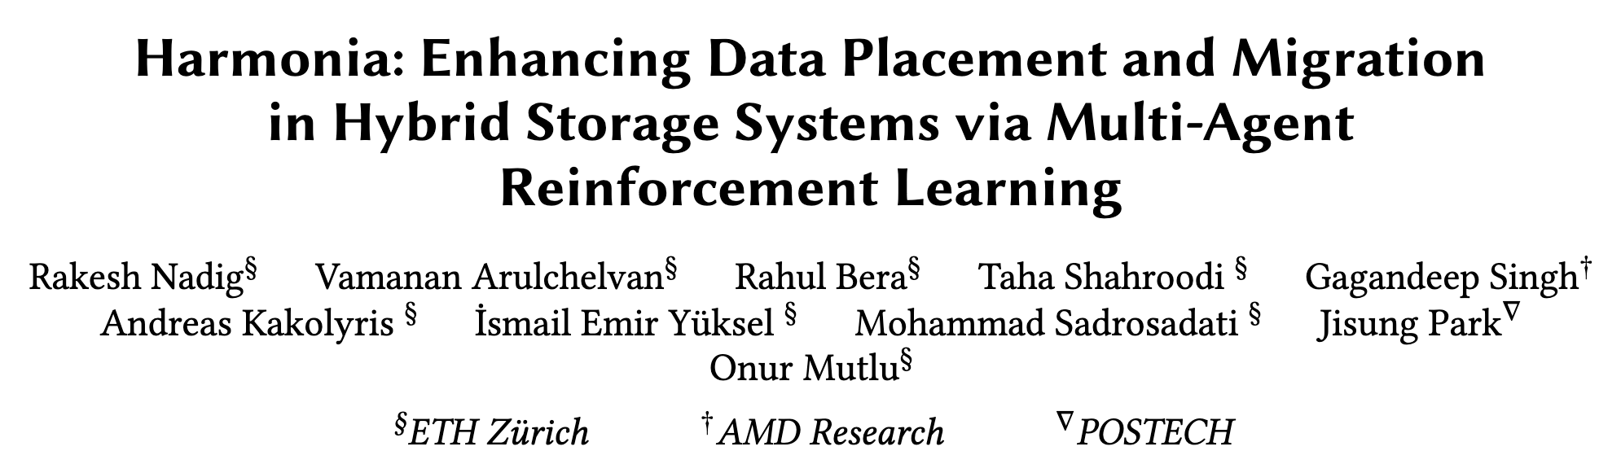

More in the Paper
https://arxiv.org/pdf/2503.20507

Slide 47
Talk Outline
Background and Motivation
HSS Data Management using Reinforcement Learning
Harmonia
Evaluation and Key Results
Conclusion

Slide 48





Evaluation Methodology (1/2)
Real system with various HSS configurations
  Dual-hybrid, tri-hybrid and quad-hybrid storage systems
AMD Ryzen7 2700G CPU
Cost-Optimized Dual HSS
Intel Optane SSD P4800X
Seagate HDD
ST1000DM010
High-end SSD
Low-end HDD
ADATA
SU630 SSD
Performance-Optimized Dual HSS
Intel SSD D3-S4510
High-end SSD
Mid-Range SSD

Slide 49
Evaluation Methodology (2/2)
Eight Baselines
25 Data-Intensive Workloads
Data Placement
Yahoo Cloud-Serving Benchmark
CDE [Matsui+, Proc. IEEE 2017]
Sibyl [Singh+, ISCA 2022]
Cloud Database workloads
(e.g., insert, update, read, scan)
SYSTOR’17
Data Migration
Traffic on enterprise virtual desktop infrastructure (VDI)
RNN-HSS [Doudali+, HPDC 2019]
K-SVM [Shetti+, NAS 2022]
RocksDB
Key-Value Store
Extended Techniques
MLPerf Storage
Sibyl + K-SVM
Sibyl + RNN-HSS
CDE + RL-Migr
SAPM (Single Agent for Placement and Migration)
Image Classification and Cosmology Parameter Prediction
Large Language Models
Checkpoint writes, loading of weights and model parameters, and KV Cache accesses

Slide 50


Performance Analysis (1/2)
High-end SSD
Mid-end SSD
Performance-Optimized HSS
29.3%
Avg. Request Latency
Harmonia significantly reduces average I/O latency
over Sibyl by co-optimizing and coordinating
the placement and migration policies

Slide 51
Performance Analysis (1/2)
High-end SSD
Mid-end SSD
Performance-Optimized HSS
41.0%
Avg. Request Latency
Harmonia’s average I/O latency is closer to Oracle than prior approaches without the knowledge of
workload’s future access patterns

Slide 52

Performance Analysis (2/2)
High-end SSD
Low-end HDD
Cost-Optimized HSS
44.8%
33.1%
Avg. Request Latency
Harmonia’s proactive background migration
and coordinated decisions reduces the average I/O latency compared to prior approaches

Slide 53




Extensibility Analysis
Extending Harmonia for more devices:
  Add a new action in each agent
  Add the remaining capacity of the new device as a state feature for each agent
High-end SSD
Mid-end SSD
Low-end HDD
High-end SSD
Mid-end SSD
Low-end SSD
Low-end HDD
39%
40%
Avg. Request Latency

Slide 54
Extensibility Analysis
Extending Harmonia for more devices:
  Add a new action in each agent
  Add the remaining capacity of the new device as a state feature for each agent
Harmonia provides greater latency reduction
than prior approaches as the number of devices increases in the HSS
High-end SSD
Mid-end SSD
Low-end HDD
High-end SSD
Mid-end SSD
Low-end SSD
Low-end HDD
39%
40%
Avg. Request Latency

Slide 55
Overhead Analysis
206 KiB of total storage cost
  Experience buffers, inference and training networks
32-bit metadata overhead per page for state features
Inference Latency - 240ns
Training Latency - 53µs (background)
Small storage overhead
Small inference overhead

Slide 56
More in the Paper (1/3)
Throughput (IOPS) evaluation
  Harmonia provides high end-to-end throughput compared to baseline policies because it’s state and reward structures indirectly captures throughput
Evaluation on unseen workloads
  Harmonia provides high performance benefits when evaluated on unseen workloads that are not used for hyperparameter tuning
Performance sensitivity to
  Migration queue size
  Number of incoming requests considered in migration agent’s reward
Convergence of Harmonia’s policies
  Both data-placement and data-migration policies converge in less than 8K I/O requests

Slide 57
More in the Paper (2/3)
Harmonia’s impact on device lifetimes
Evaluation using multi-programmed workloads
Evaluation on persistent-memory based HSS
  Harmonia provides higher performance benefits when evaluated on a PMEM-based HSS
Detailed overhead analysis
More observations and insights from our evaluation

Slide 58
More in the Paper (3/3)
https://arxiv.org/pdf/2503.20507

Slide 59
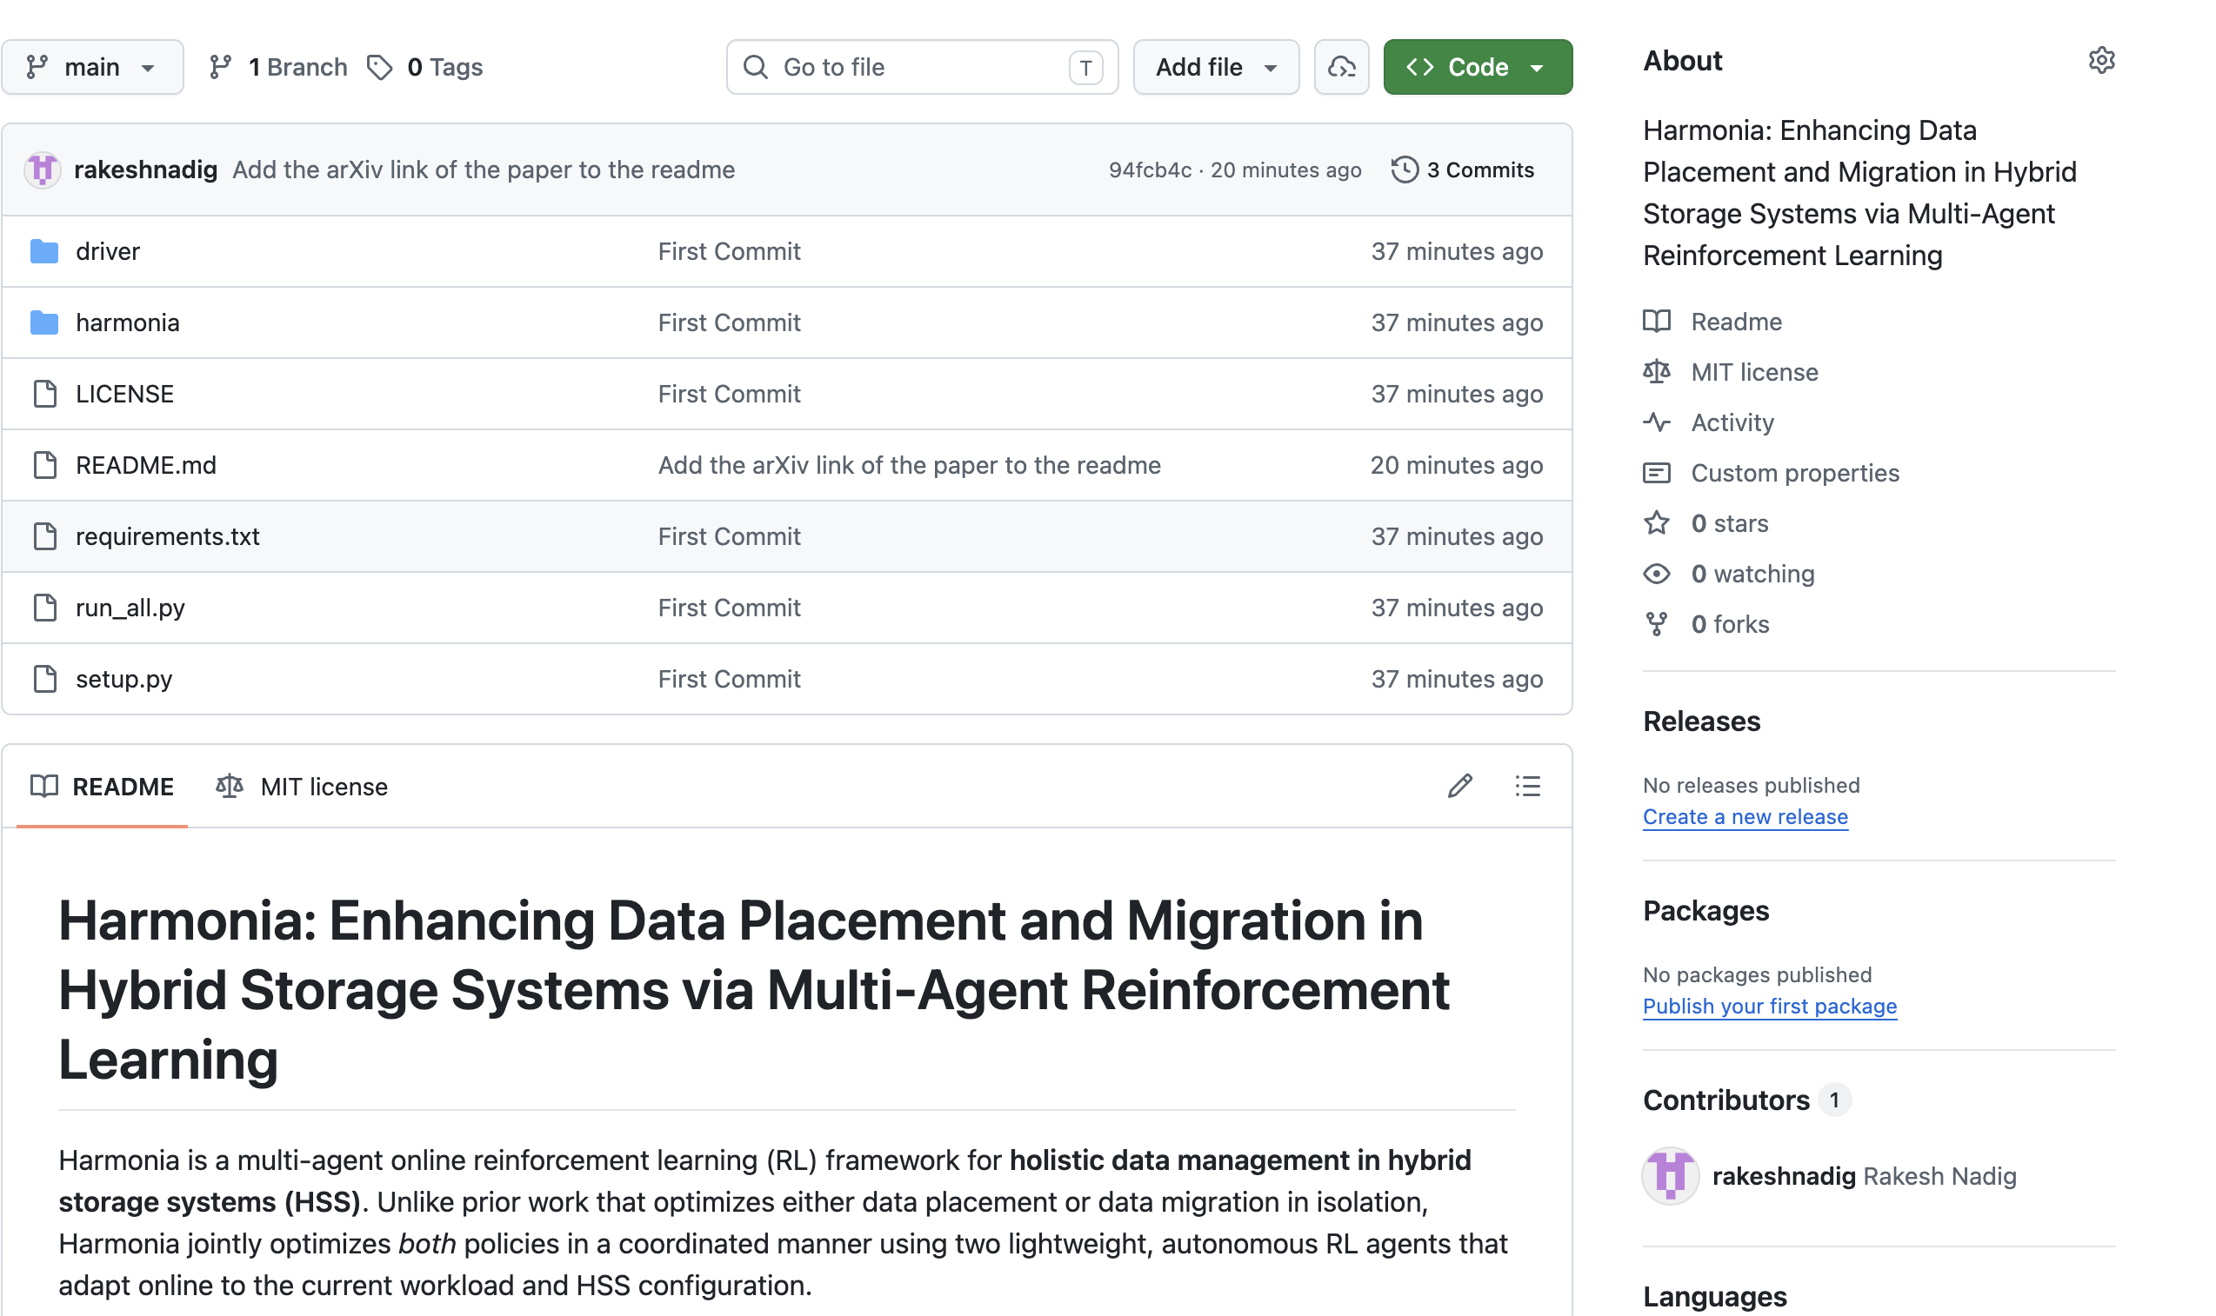
Harmonia is Open-Source
https://github.com/cmu-safari/Harmonia

Slide 60
Talk Outline
Background and Motivation
HSS Data Management using Reinforcement Learning
Harmonia
Evaluation and Key Results
Conclusion

Slide 61
Conclusion
First work to use multi-agent reinforcement learning
to optimize data management
in hybrid storage systems
Reduces average I/O latency
by 29.3%/44.8% over the best-performing prior work
on performance-optimized/cost-optimized dual HSS
Provides greater latency reduction than the
prior approaches when extended to more storage devices
Low inference latency and storage overheads

Slide 62


Enhancing Data Placement and Migration
in Hybrid Storage Systems
via Multi-Agent Reinforcement Learning
Harmonia
Rakesh Nadig, Vamanan Arulchelvan, Rahul Bera, Taha Shahroodi, Gagandeep Singh, Andreas Kosmas Kakolyris, İsmail Emir Yüksel,
Mohammad Sadrosadati, Jisung Park and Onur Mutlu
ICS 2026

Slide 63
FAQ (1/2)
Executive Summary
Lack of Holistic Data Management in HSS
Lack of Coordination in Extended Techniques
Limitations of a Single-Agent RL Technique
Workload Access Patterns
State Features in Harmonia
Training and Inference Network
Hyperparameter Tuning
Evaluation Methodology
Workload Characteristics

Slide 64
FAQ (2/2)
Multi-Programmed Workloads
Results
  Throughput Analysis
  Device Lifetimes
  Multi-Programmed Workloads
  Tail Latency
  Harmonia’s Adaptivity
  Sensitivity Analysis
  Write Traffic Distribution
  Unseen Workloads
  Impact of Coordination

Slide 65
Executive Summary (1/2)
Background:
  A hybrid storage system (HSS) uses multiple heterogeneous storage devices to provide scalable storage capacity at high performance
  The performance of an HSS highly depends on the effectiveness of its (1) data-placement, and (2) data-migration policies
Problem: Two key shortcomings of prior HSS data-management techniques:
  Prior techniques focus on improving only data-placement or only data-migration policies, but do not optimize both
  Naively combining prior data-placement and data-migration techniques provide sub-optimal performance due to lack of coordination between the two policies
Goal: Design a holistic data management technique that
  optimizes both data-placement and data-migration policies, and
  achieves coordination between the two policies

Slide 66
Executive Summary (2/2)
Contribution: Harmonia, the first multi-agent online reinforcement learning-based HSS data-management technique that:
  Performs combined optimization of both data placement and data migration policies
  Achieves coordination between data placement and data migration to avoid conflicting decisions
  Can easily extend to any number of storage devices
Key Results: Evaluate on a real system with multiple HSS configurations using 25 data-intensive workloads
  Harmonia improves latency by 29.3%/44.8% compared to the state-of-the-art data placement technique in performance-optimized/cost-optimized dual-HSS configuration
  In a tri-/quad-HSS configuration, Harmonia outperforms the state-of-the-art policy by 39%/40%
  Harmonia’s performance benefits come with low latency (240ns for inference) and storage overheads (206 KiB in DRAM for both RL agents together)

Slide 67
Lack of Holistic Data Management in HSS
Prior techniques
  do not optimize both data placement and migration policies together
  use heuristic approaches, which do not adapt to changes in workload access patterns and HSS conditions
Performance-Optimized HSS
Cost-Optimized HSS
176.2%
100.4%
Avg. Request Latency

Slide 68
Lack of Holistic Data Management in HSS
Prior techniques
  do not optimize both data placement and migration policies together
  use heuristic approaches, which do not adapt to changes in workload access patterns and HSS conditions
Performance-Optimized HSS
Cost-Optimized HSS
176.2%
100.4%
The latency gap between Sibyl and Oracle is exacerbated
due to the heuristic policy’s inability to adapt to changes
in system conditions
Avg. Request Latency

Slide 69
Lack of Coordination in Extended Techniques
What happens if we combine the best placement and migration techniques?
Performance-Optimized HSS
7.1%
Cost-Optimized HSS
12.4%
Avg. Request Latency

Slide 70
Lack of Coordination in Extended Techniques
What happens if we combine the best placement and migration techniques?
7.1%
Naive combinations of prior techniques show
sub-optimal performance compared to their constituent policies due to lack of coordination
12.4%
Avg. Request Latency

Slide 71
Limitations of a Single-Agent RL Technique
An RL-based technique can adapt to changes in workload and HSS configurations
  Sibyl is the best-performing prior HSS data-management technique
Data placement and data migration are two different tasks in HSS with different objectives
A single RL agent based technique cannot optimize different tasks concurrently because it relies on task similarity to learn multiple tasks
Performance-Optimized HSS
21.9%
30.5%
Cost-Optimized HSS
Avg. Request Latency
SAPM has higher latency than Sibyl because
it cannot learn optimal policies for two different tasks concurrently

Slide 72
Workload Access Patterns
1 x 10⁹
7.5 x 10⁸
Virtual
Addresses
5 x 10⁸
2.5 x 10⁸
0
64K
48K
Request Sizes
(in Bytes)
32K
16K
0
Time (in seconds)

Slide 73
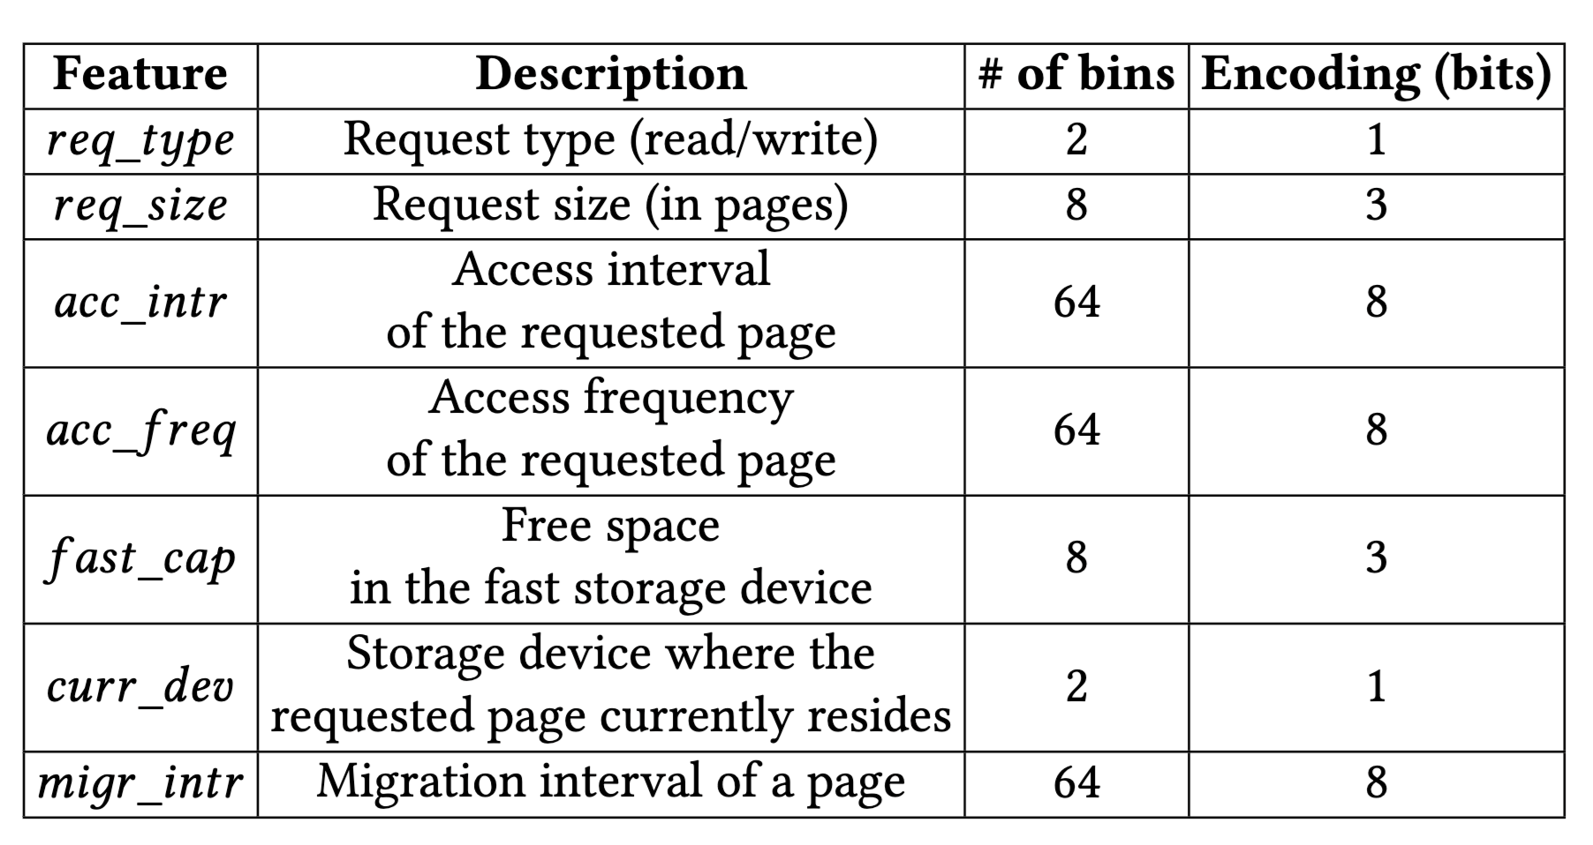
State Features in Harmonia

Slide 74
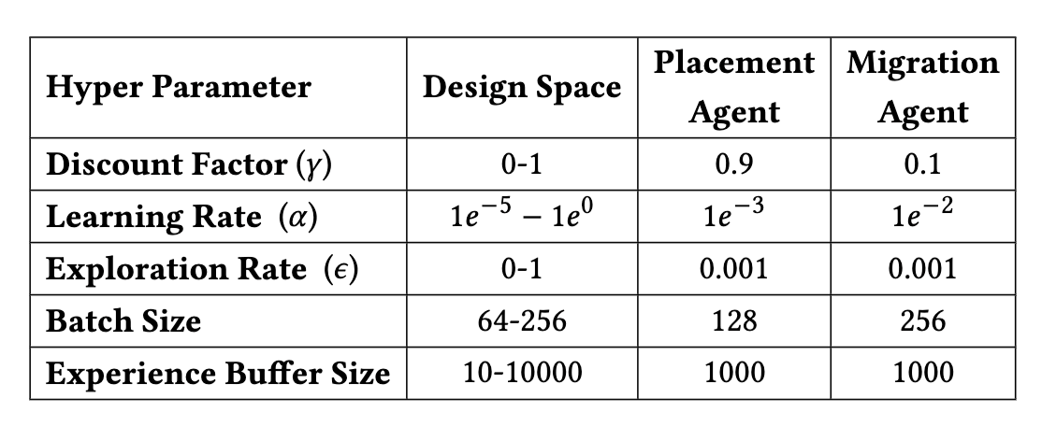
Hyper-Parameter Tuning
Different hyper-parameter configurations were chosen using the design of experiments (DoE) technique

Slide 75
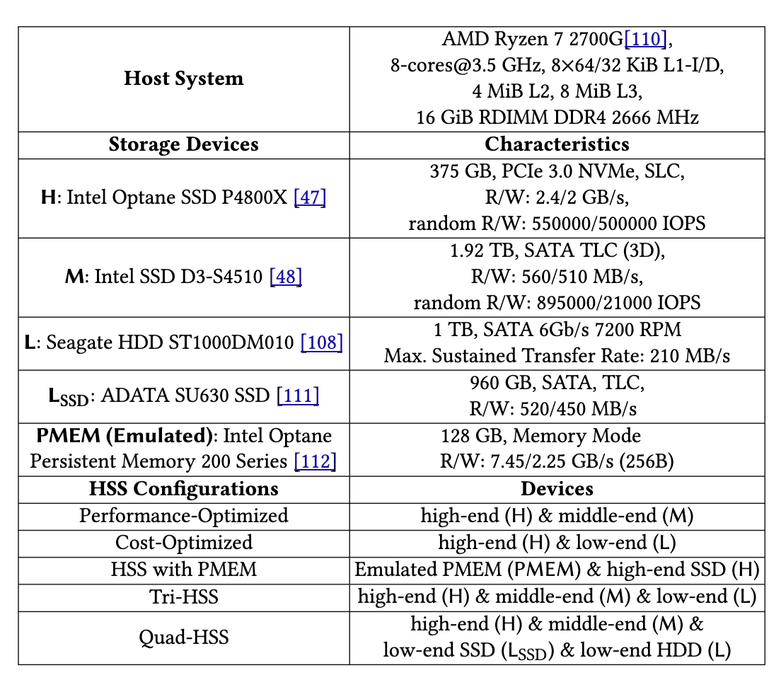
Evaluation Methodology

Slide 76
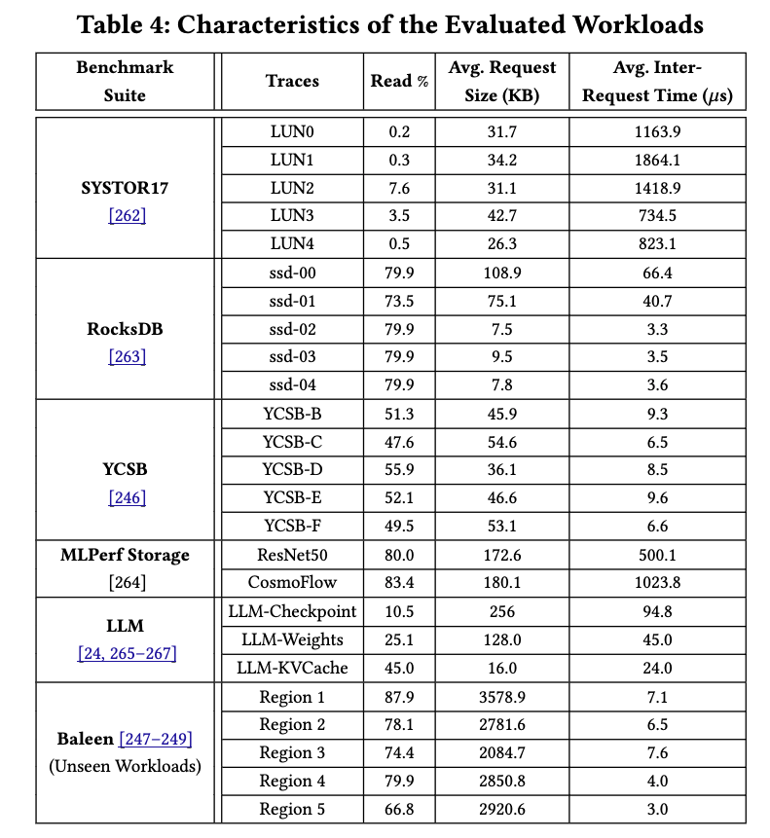
Workload Characteristics

Slide 77
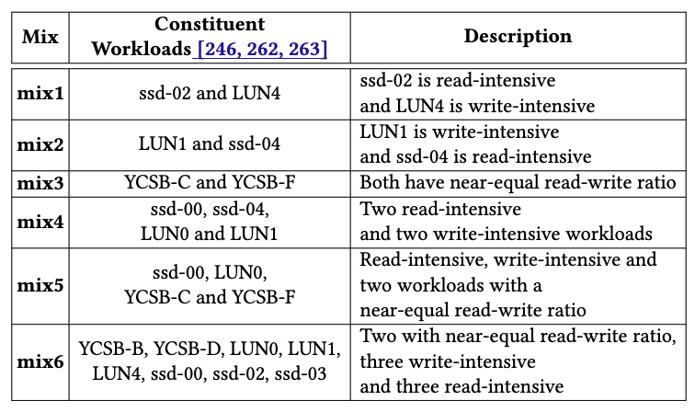
Multi-Programmed Workloads

Slide 78
Throughput Analysis (1/2)
(a) Performance-Optimized HSS
Normalized
End-to-End Throughput
0.20
0.14
(b) Cost-Optimized
HSS
0.48
0.08

Slide 79
Throughput Analysis (2/2)
(a) Performance-Optimized HSS
Harmonia improves end-to-end throughput by 49.4% (136.7%) over Sibyl
in performance- (cost-) optimized HSS
Normalized
End-to-End Throughput
0.20
0.14
(b) Cost-Optimized
HSS
0.48
0.08

Slide 80
Impact on Device Lifetimes (1/2)
(a) Performance-Optimized HSS
Write Amplification
(b) Cost-Optimized HSS

Slide 81
Impact on Device Lifetimes (2/2)
Harmonia learns to migrate more data in
read-intensive workloads, since there are infrequent updates from the application
(a) Performance-Optimized HSS
Write Amplification
(b) Cost-Optimized HSS
Harmonia migrates less data in
write-intensive workloads as data is moved during updates from application , which causes
lower write amplification

Slide 82
Multi-Programmed Workloads (1/2)
Performance-Optimized HSS
High-end SSD
Mid-end SSD
Avg. Request Latency
Harmonia improves latency by 33% on average
over best-performing prior work, Sibyl

Slide 83
Multi-Programmed Workloads (2/2)
Cost-Optimized HSS
High-end SSD
Low-end HDD
Avg. Request Latency
Harmonia improves latency by 25% over Sibyl due to faster learning of access pattern variations compared to prior approaches

Slide 84
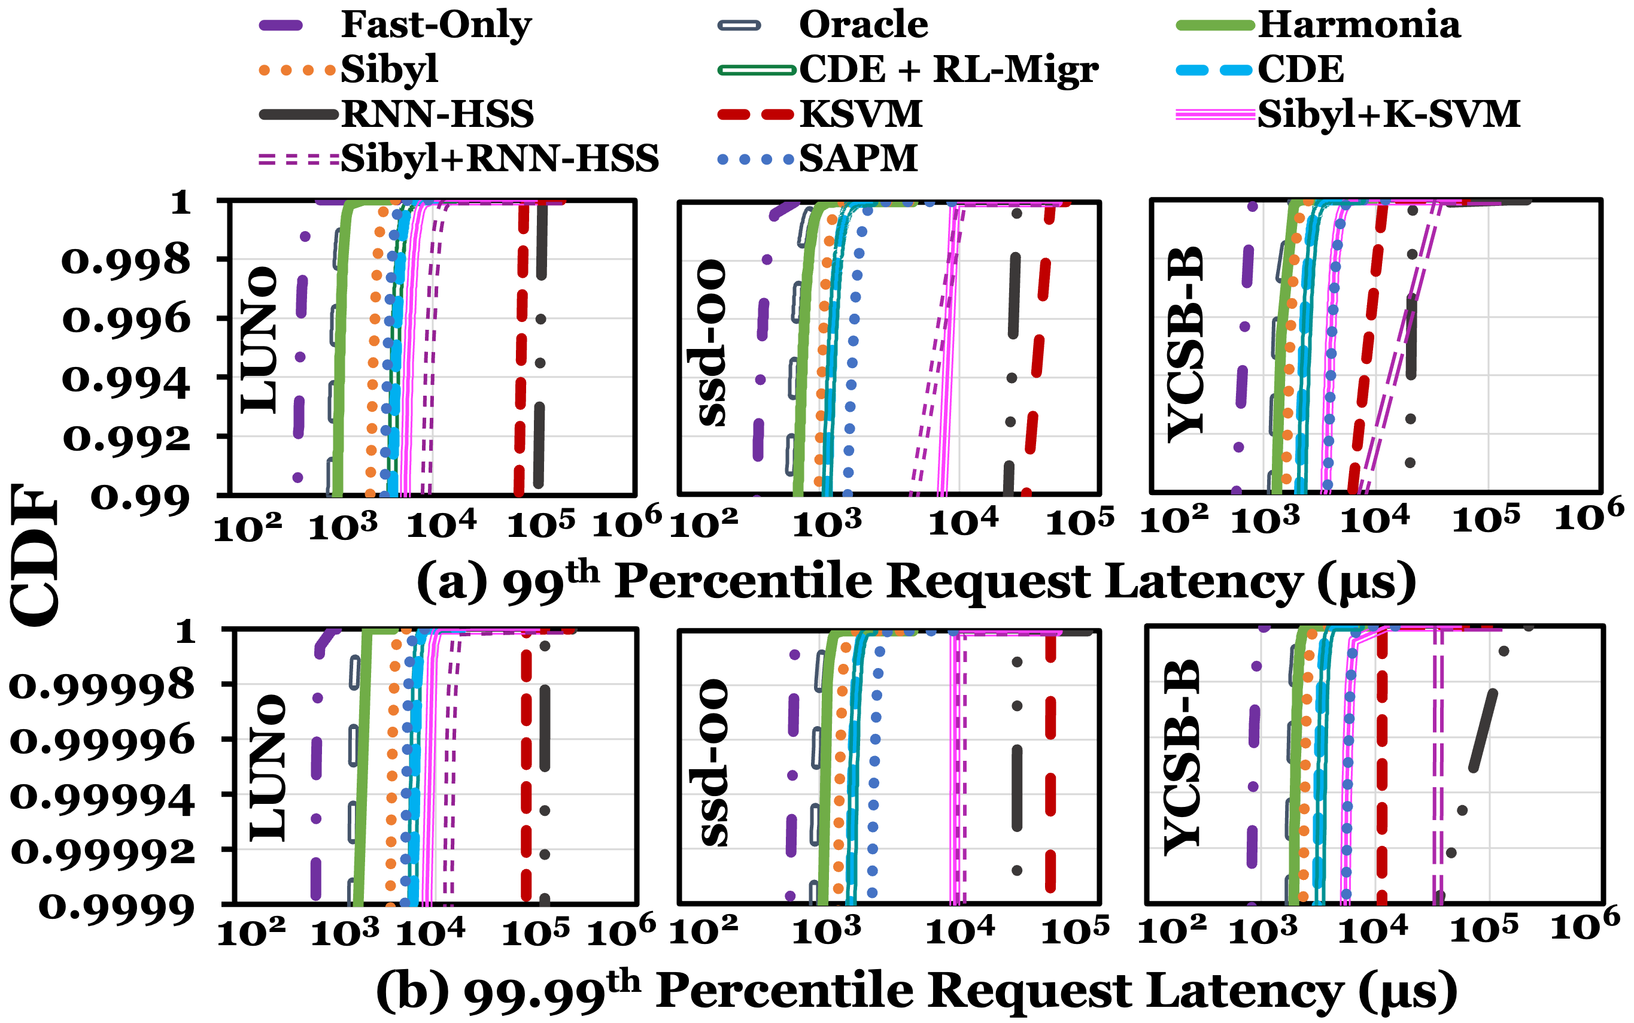
Tail Latency
High-end SSD
Mid-end SSD

Slide 85
Tail Latency
High-end SSD
Mid-end SSD
Prior approaches have high tail latency because they migrate data in the
critical path of I/O request handling
Harmonia improves tail latency by
migrating data during system idle times

Slide 86
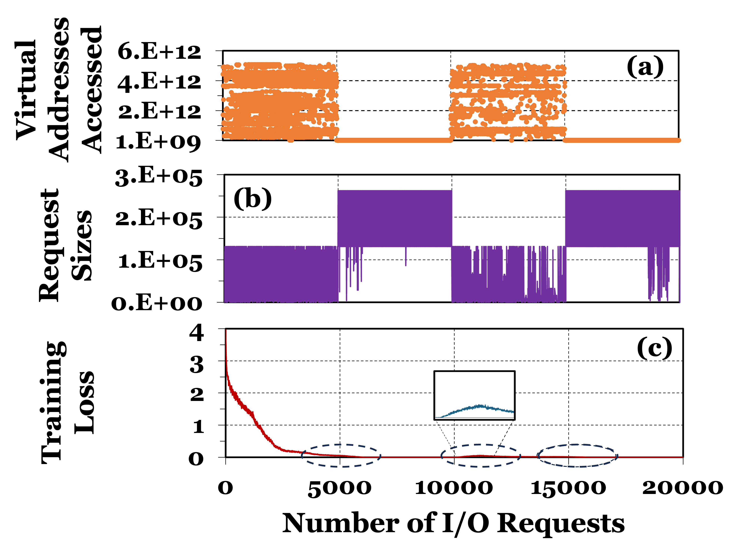
Harmonia’s Adaptivity

Slide 87
Sensitivity Analysis
Normalized
Avg. I/O Latency
Migration Queue Size
Number of I/O requests used for migration agent’s reward

Slide 88
Write Traffic Distribution
(a) Performance-Optimized HSS
(b) Cost-Optimized HSS

Slide 89
Unseen Workloads
We use Meta’s Baleen workloads to test Harmonia’s latency on unseen workloads
(a) Performance-Optimized HSS
31.2%
Normalized
Avg. I/O Latency
(b) Cost-Optimized HSS
31.5%
Harmonia improves performance by 31.2% (31.5%)
over Sibyl due to adaptive data placement and data migration

Slide 90
Impact of Coordination
(a) Performance-Optimized HSS
Normalized
Avg. I/O Latency
(b) Cost-Optimized HSS
Harmonia outperforms its uncoordinated variant by 26.7% (59.8%)
by avoiding conflicting decisions

