Slide 1
Exploring High-Bandwidth Flash for Modern LLM Inference: Opportunities and Challenges
SAFARI Live Seminar
Jisung Park
2026.07.24

Slide 2

Brief Self-Introduction
Dr. Jisung Park
  Assistant Professor @ POSTECH CSE, 2022.09 – Present
  Postdoctoral Research Associate and Lecturer, ETH Zurich, 2019 – 2022
  Ph.D. from SNU EECS, 2019
  Homepages
    Research Group – CAOS (Computer Architecture and Operating Systems) Laboratory:
    http://caos.postech.ac.kr
    Personal: https://jisung-park.github.io/
  Email: jisung.park@postech.ac.kr
Research Interests
  Computer Architecture and System Software
  Memory and Storage Systems
  System Security
  HW/SW Cooperation
  Application-Specific System Design (e.g., Bioinformatics and AI)

Slide 3
Research on NAND Flash Memory (Selected)
Performance Optimizations
  RPS: Relaxed Program Sequence – DAC 2016
  P&AR²: Pipelined & Adaptive Read Retry – ASPLOS 2021
  Flash-Cosmos: In-Flash Bulk Bitwise Operation – MICRO 2022
  Experimental Study on Performance Impact of Read Disturbance – SIGMETRICS 2026
Cost-effectiveness Optimizations
  DAC: Dedup-Assisted Compression – DATE 2017
  DeepSketch: ML-Assisted Delta Compression – USENIX FAST 2022
  AERO: Adaptive Erase Operation – ASPLOS 2024
  Norns: Learning-Based Post-Fabrication Optimization – ICCAD 2024
Security & Privacy
  RansomBlocker: Ransomware-Proof SSD – DAC 2019
  Evanesco: Low-Cost Data Sanitization – ASPLOS 2020
+14 publications in ISCA, ASPLOS, MICRO, HPCA, DAC, and DATE

Slide 4


NAND Flash in AI Era
NAND flash has received far less attention in (AI) systems research
This is rapidly changing as AI systems face explosive data growth

Slide 5

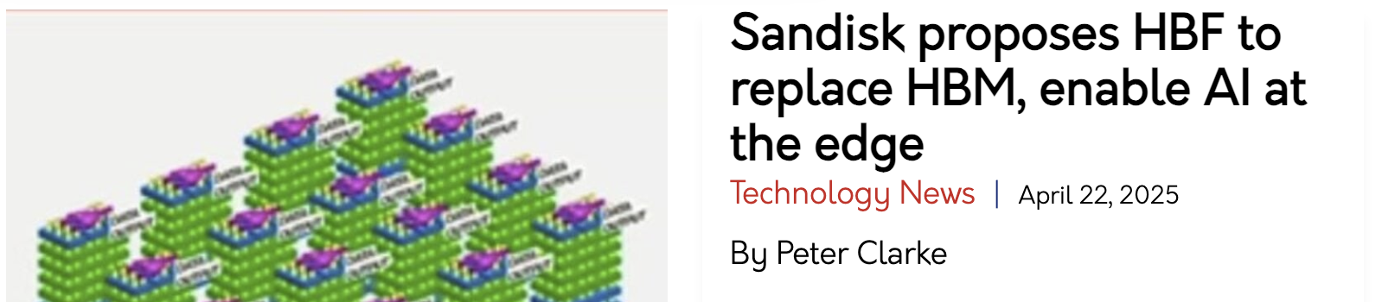


Growing Interest in NAND Flash
Industry is paying increasing attention to importance and new possibilities
  Now is the time for academia to explore potential and address challenges

Slide 6
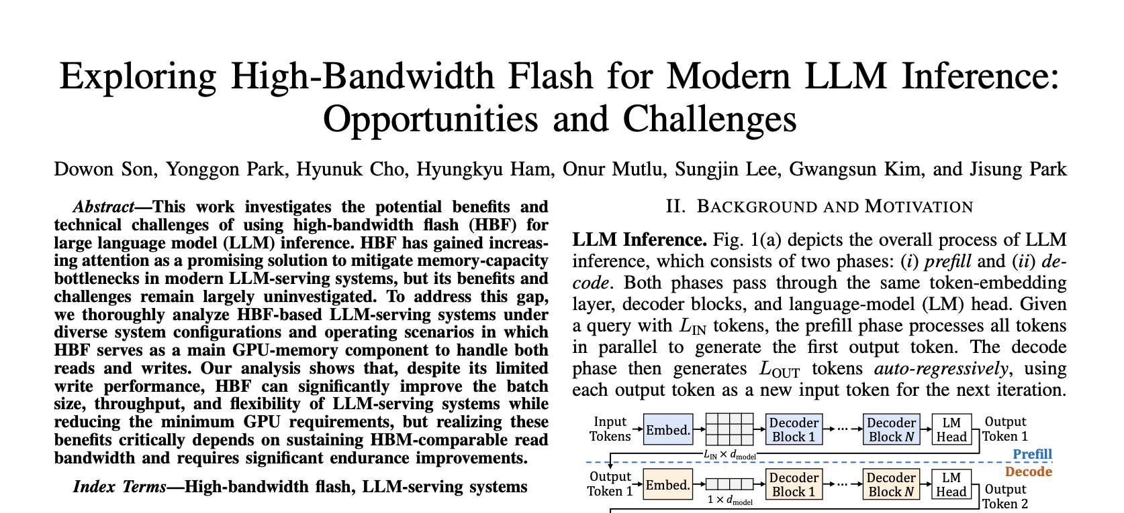
Exploring HBF for LLM-Serving Systems
D. Son et al., “Exploring High-Bandwidth Flash for Modern LLM Inference: Opportunities and Challenges,” IEEE Computer Architecture Letters (IEEE CAL), 2026 (early access).

Slide 7
Executive Summary
Motivation: High-bandwidth flash (HBF) is gaining significant attention as a promising alternative or complement to high-bandwidth memory (HBM)
Goal: Understand HBF's potential benefits and technical challenges
  In modern LLM-serving systems
  When used as the main GPU-memory component
Methodology: Simulation of HBF-enabled LLM-serving systems
  Using recent large-scale LLMs
  While varying GPU count, SLO constraint, and context length
Ten key observations and five takeaways, including
  HBF can significantly improve the batch size, throughput, and system flexibility
  Providing larger capacity alone is insufficient; requires (1) HBM-comparable read bandwidth and (2) significant endurance enhancement (+ write performance)

Slide 8
Outline
Background & Motivation
Methodology
Evaluation Results
Conclusion

Slide 9
Large Language Models (LLMs)
Predicts the next token from the given context
  Statistically based on patterns learned from training datasets
  Autoregressively by using a new output token as an input for the next token
Requires access to and computation on massive amounts of data
  For every token
  Increasing amount of model weights
  KV cache also increasing w/ context length
  → e.g., Generating the 100,000th token in Llama-3 405B model requires
  reading ~800-GB data (756-GB weights + 50-GB KV cache)
  LLM inference: Significant memory requirements in both capacity and bandwidth

Slide 10
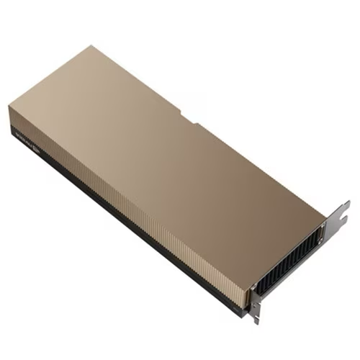
Memory Requirements of LLMs
Llama-3 405B case
  Model weights ≈ 750 GB
  Max. KV cache per query ≈ 50 GB (128K context length)
Capacity Requirement: > 800 GB
  Including memory space for activations and compute buffers
Bandwidth Requirement: > 8 TB/s
  Service-Level Objective (SLO) = 10 Tokens Per Second (TPS)
  = 0.1-second Time Per Output Token (TPOT)
  Max. amount of data to read per token ≈ 800 GB
NVIDIA H200
141-GB capacity
4.8-TB/s bandwidth
(HBM3e)

Slide 11
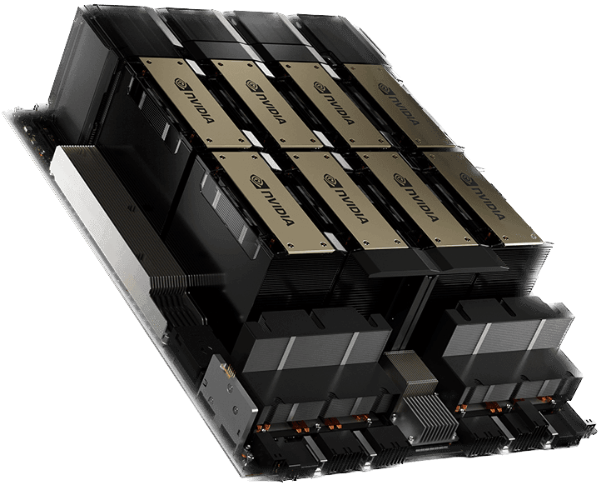
Today’s Solution: Scale Up GPUs
Aggregate HBM capacity and bandwidth
  HGX H200 (8 GPUs)
  Capacity: 141×8 = 1,128 GB > 800 GB
  Bandwidth: 4.8×8 = 38.4 TB/s > 8 TB/s
Partition a single large model across GPUs
  Relying on high-bandwidth interconnects (e.g., NVLink)
Batch Size: 7
GPU 1
Weight
$#1
$#2
…
$#6
$#7
GPU 2
Weight
$#1
$#2
…
$#6
$#7
…
GPU 8
Weight
$#1
$#2
…
$#6
$#7

Slide 12
Today’s Solution: Scale Up GPUs
Aggregate HBM capacity and bandwidth
  HGX H200 (8 GPUs)
  Capacity: 141×8 = 1,128 GB > 800 GB 1,100 GB
  Bandwidth: 4.8×8 = 38.4 TB/s > 8 TB/s 11 TB/s
Partition a single large model across GPUs
  Relying on high-bandwidth interconnects (e.g., NVLink)
HBM bandwidth is
largely underutilized
Batch Size: 7
GPU 1
Weight
$#1
$#2
…
$#6
$#7
GPU 2
Weight
$#1
$#2
…
$#6
$#7
…
GPU 8
Weight
$#1
$#2
…
$#6
$#7

Slide 13
Today’s Solution: Scale Up GPUs
Aggregate HBM capacity and bandwidth
  HGX H200 (8 GPUs)
  Capacity: 141×8 = 1,128 GB > 800 GB 1,100 GB
  Bandwidth: 4.8×8 = 38.4 TB/s > 8 TB/s 11 TB/s
Partition a single large model across GPUs
  Relying on high-bandwidth interconnects (e.g., NVLink)
  LLM inference: Significant memory requirements on both capacity and bandwidth
HBM bandwidth is largely underutilized
  Current solution: Scaling memory capacity w/ multiple GPUs - costly and wasteful
Batch Size: 7
GPU 1
Weight
$#1
$#2
…
$#6
$#7
GPU 2
Weight
$#1
$#2
…
$#6
$#7
…
GPU 8
Weight
$#1
$#2
…
$#6
$#7

Slide 14
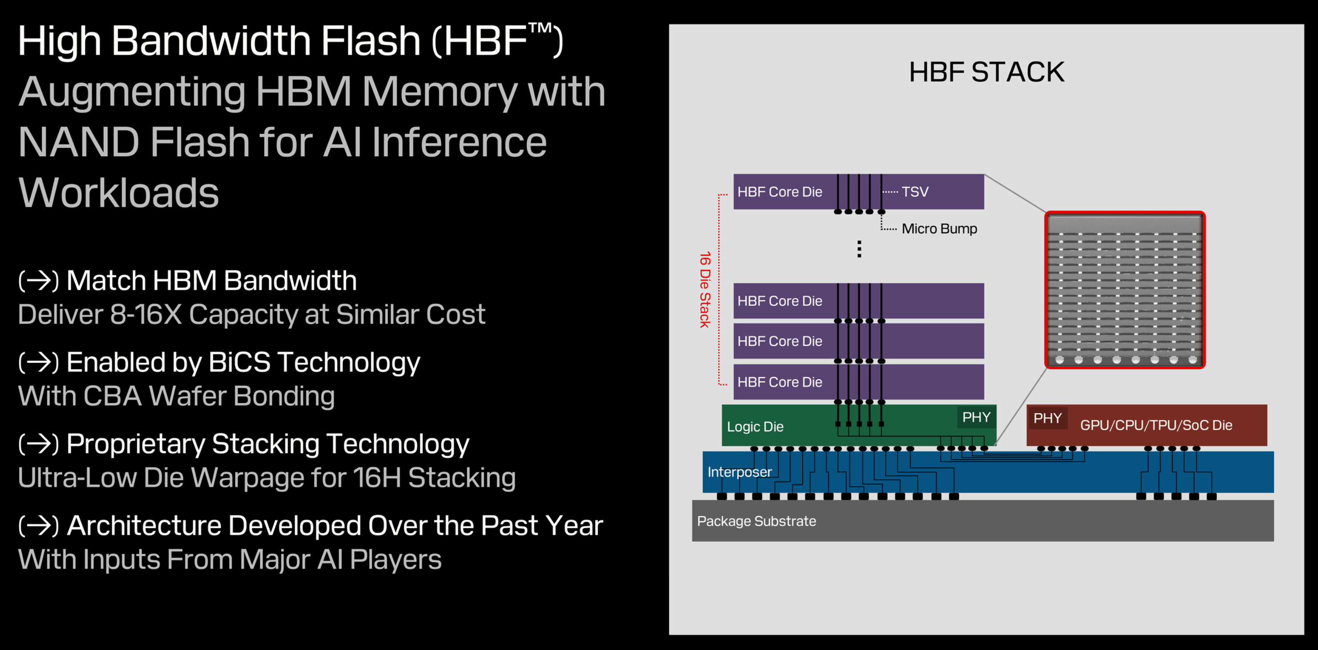
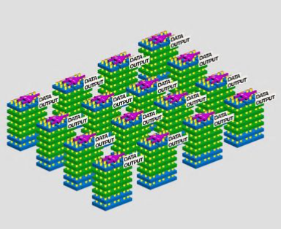
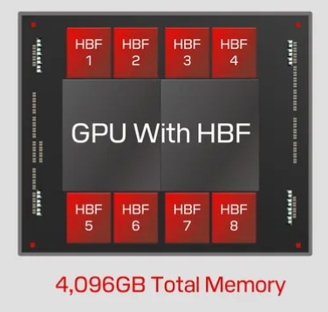
NAND Flash-Based High-Bandwidth Memory
SanDisk’s High-Bandwidth Flash (HBF)

Slide 15
NAND Flash-Based High-Bandwidth Memory
SanDisk’s High-Bandwidth Flash (HBF)

Slide 16
NAND Flash-Based High-Bandwidth Memory
SanDisk’s High-Bandwidth Flash (HBF)
Sandisk’s promise:
>10x capacity than & comparable bandwidth to HBM4
10% of GPUs or 10x throughput?:
We need a systematic analysis of the potential of HBF

Slide 17
Our Goal
Provide new insights on HBF’s potential benefits and challenges
through a systematic analysis of HBF-based LLM-serving systems
under realistic, challenging workloads

Slide 18
Outline
Background & Motivation
Methodology
Evaluation Results
Conclusion

Slide 19
Methodology: Key Assumption
All HW components (GPU cores, memory stacks, and interconnects)
operate at their specified peak performance
+ Rapid exploration of HBF’s potential benefits
- How to achieve such performance? (future work)

Slide 20
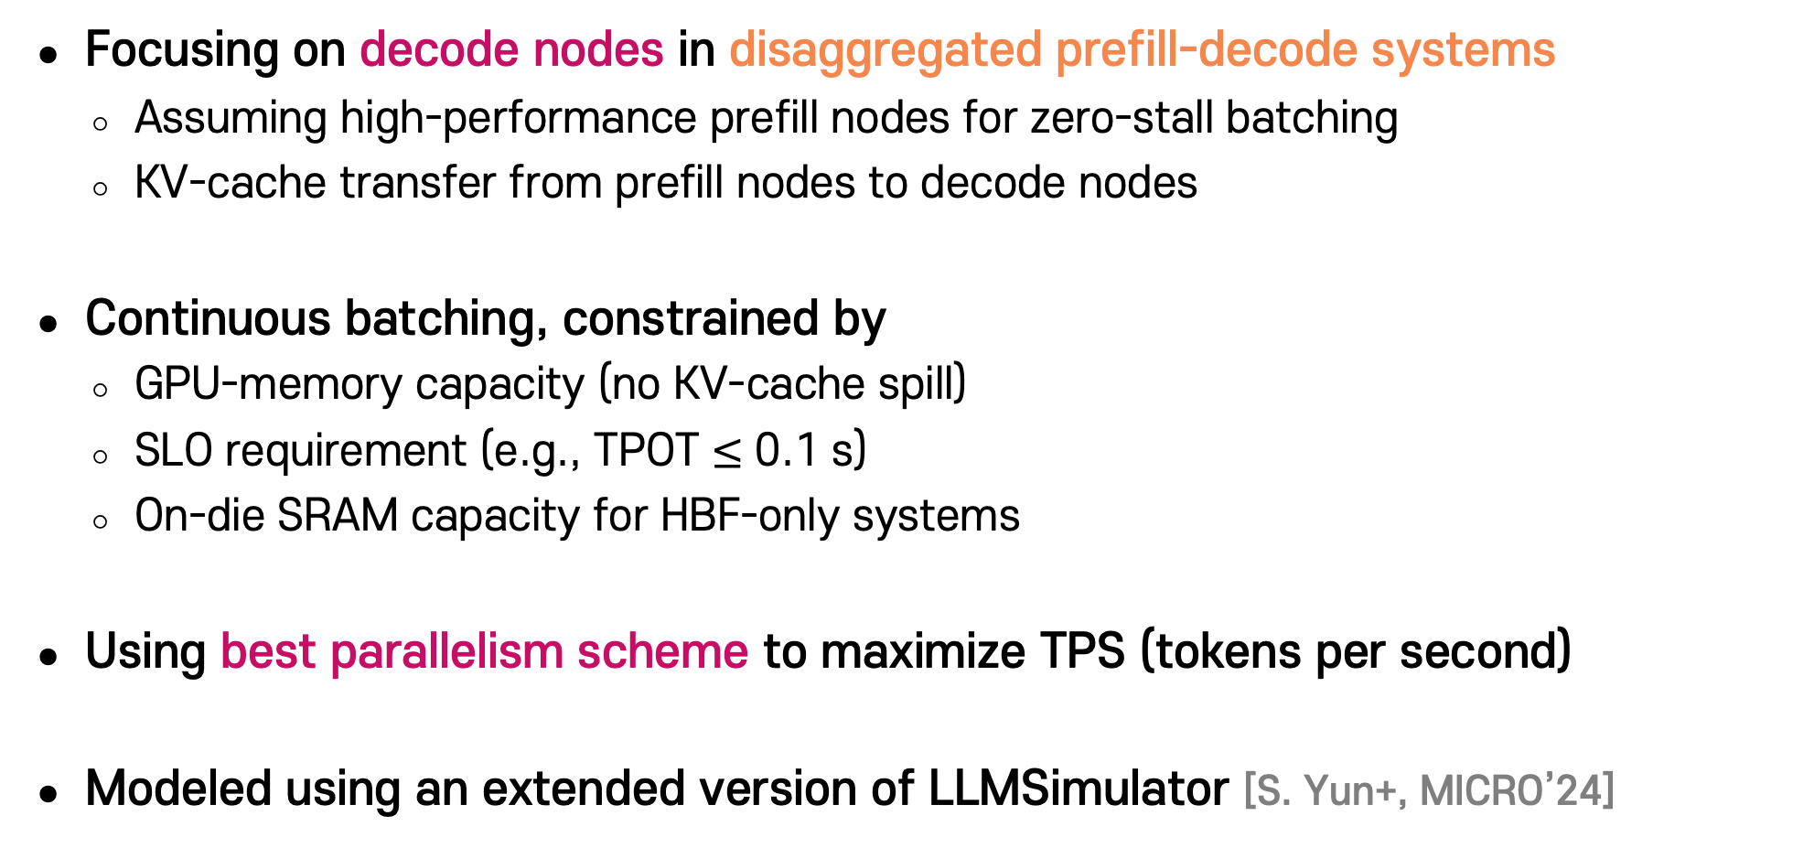
Methodology: LLM-Serving Systems
Focusing on decode nodes in disaggregated prefill-decode systems
  Assuming high-performance prefill nodes for zero-stall batching
  KV-cache transfer from prefill nodes to decode nodes
Continuous batching, constrained by
  GPU-memory capacity (no KV-cache spill)
  SLO requirement (e.g., TPOT $≤$ 0.1 s)
  On-die SRAM capacity for HBF-only systems
Using best parallelism scheme to maximize TPS (tokens per second)
Modeled using an extended version of LLMSimulator [S. Yun+, MICRO’24]

Slide 21
GPU Configurations
Three GPU-memory architectures
  HBM-only: eight HBM stacks per GPU
  HBM-HBF: one HBM stack and seven HBF stacks per GPU
    HBM stack dedicated to intermediate data (not KV)
  HBF-only: eight HBF stacks per GPU
    Equipped with 40-MB SRAM on logic die to store intermediate data
HBM
stack
HBM
stack
HBM
stack
HBM
stack
HBM
stack
HBF
stack
HBF
stack
HBF
stack
HBF
stack
HBF
stack
HBF
stack
HBF
stack
GPU
GPU
GPU
HBM
stack
HBM
stack
HBM
stack
HBM
stack
HBF
stack
HBF
stack
HBF
stack
HBF
stack
HBF
stack
HBF
stack
HBF
stack
HBF
stack
HBM-only
HBM-HBF
HBF-only

Slide 22

Methodology: GPU Configurations (Cont’d)
Red
(Trans)
Postech Red
Orange (Trans)
Orange
R100 GPU core (4 PFLOPS for BF16)
Interconnects
  Intra-node (~8 GPUs): 1,800 GB/s NVLink
  Inter-node: 100 GB/s InfiniBand
HBM stacks (HBM4)
  Per-stack read bandwidth: 1.6 TB/s
  Per-stack capacity: 36 GB
HBF stacks (based on Sandisk’s projection)
  Per-stack read bandwidth: 1.6 TB/s
  Per-stack capacity: 512 GB
Green (Trans)
Postech Orange
Blue (Trans)
Sky Blue
Dark Blue
Postech Grey

Slide 23
Methodology: GPU Configurations (Cont’d)
Red
(Trans)
Postech Red
Orange (Trans)
Orange
HBF model based on conventional low-latency NAND flash
  It may not be easy to achieve the 1.6-TB/s per-stack bandwidth with NAND flash
  e.g., Samsung Z-NAND and Kioxia XL Flash
    Page size: 2 KiB and 4 KiB
    Planes per die: 8 and 16
    Page-read latency: 3 μs and 4 μs
    Die bandwidth: ~5 GB/s and ~16 GB/s
    Stack bandwidth: ~80 GB/s and ~256 GB/s (16 dies per stack)
  Achieving target bandwidth requires 27 planes per die even with 1-μs latency
  Optimistic modeling of conventional NAND-based HBF
    4-KiB page, 16 planes per die, 3-μs latency
    → ~350-GB/s per-stack bandwidth
Green (Trans)
Postech Orange
Blue (Trans)
Sky Blue
Dark Blue
Postech Grey

Slide 24
Methodology: GPU Configurations (Cont’d)
Red
(Trans)
Postech Red
Orange (Trans)
Orange
Five LLM-serving systems w/ different GPU-memory configurations
HBM4 (HBM-only), HBF and CONV (HBM-HBF), HBF⁺ and CONV⁺ (HBF-only)
  Assume 100-μs program latency (from Z-NAND) for all HBF configurations
Green (Trans)
Postech Orange
Blue (Trans)
Sky Blue
GPU | # Stacks (HBM/HBF) | Capacity [GB] | RD BW [TB/s] (HBM/HBF) | WR BW [TB/s] (HBM/HBF)
HBM4 | 8/0 | 288 | 12.8/- | 12.8/-
HBF | 1/7 | 3,620 | 1.6/11.2 | 1.6/0.112
HBF⁺ | 0/8 | 4,096 | -/12.8 | -/0.128
CONV | 1/7 | 3,620 | 1.6/2.45 | 1.6/0.073
CONV⁺ | 0/8 | 4,096 | -/2.80 | -/0.084
Dark Blue
Postech Grey

Slide 25
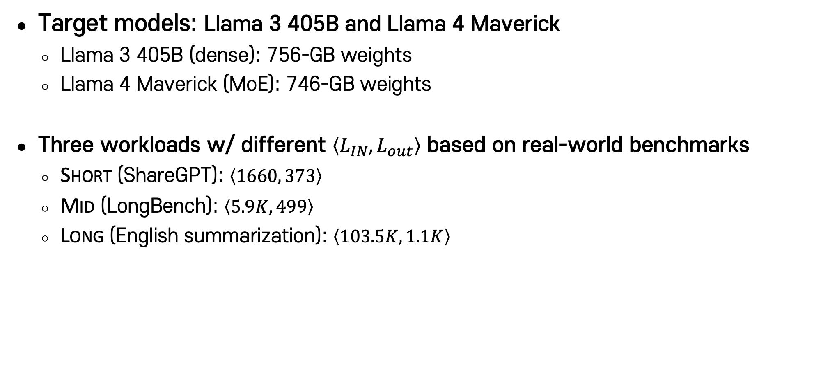
Methodology: Workloads
Red
(Trans)
Postech Red
Orange (Trans)
Orange
Target models: Llama 3 405B and Llama 4 Maverick
  Llama 3 405B (dense): 756-GB weights
  Llama 4 Maverick (MoE): 746-GB weights
Three workloads w/ different $\left\langle L_{IN}, L_{out}\right\rangle$ based on real-world benchmarks
  Short (ShareGPT): $\left\langle 1660, 373\right\rangle$
  Mid (LongBench): $\left\langle 5.9K, 499\right\rangle$
  Long (English summarization): $\left\langle 103.5K, 1.1K\right\rangle$
Green (Trans)
Postech Orange
Blue (Trans)
Sky Blue
Dark Blue
Postech Grey

Slide 26
Outline
Background & Motivation
Methodology
Evaluation Results
Conclusion

Slide 27
Evaluation Results: System Throughput
Normalized to HBM4 w/ 8 GPUs: Significantly higher TPS in MoE models
HBM4
HBF
HBF⁺
CONV
CONV⁺
1.5
w/ 8 GPUs: 3.3K
19K
1.0
Per-GPU TPS
0.5
1.8K
147
6.3K
1.3K
0
# GPUs
1
2
4
8
16
1
2
4
8
16
1
2
4
8
16
1
2
4
8
16
1
2
4
8
16
1
2
4
8
16
Short
Mid
Long
Short
Mid
Long
Llama3
Llama4
Per-GPU TPS under 0.1-second TPOT SLO

Slide 28
Evaluation Results: System Throughput
HBM4
HBF
HBF⁺
CONV
CONV⁺
1.5
1.0
Per-GPU TPS
0.5
0
# GPUs
1
2
4
8
16
1
2
4
8
16
1
2
4
8
16
1
2
4
8
16
1
2
4
8
16
1
2
4
8
16
Short
Mid
Long
Short
Mid
Long
Llama3
Llama4
Per-GPU TPS under 0.1-second TPOT SLO
  Benefit: HBF reduces the minimum GPU count to support the given models

Slide 29
Evaluation Results: System Throughput
HBM4
HBF
HBF⁺
CONV
CONV⁺
1.5
1.0
Per-GPU TPS
0.5
0
# GPUs
1
2
4
8
16
1
2
4
8
16
1
2
4
8
16
1
2
4
8
16
1
2
4
8
16
1
2
4
8
16
Short
Mid
Long
Short
Mid
Long
Llama3
Llama4
Per-GPU TPS under 0.1-second TPOT SLO
  Benefit: HBF can improve system throughput at the same GPU count:
  larger improvements for longer-context workloads

Slide 30
Evaluation Results: System Throughput
HBM4
HBF
HBF⁺
CONV
CONV⁺
1.5
1.0
Per-GPU TPS
0.5
0
# GPUs
1
2
4
8
16
1
2
4
8
16
1
2
4
8
16
1
2
4
8
16
1
2
4
8
16
1
2
4
8
16
Short
Mid
Long
Short
Mid
Long
Llama3
Llama4
Per-GPU TPS under 0.1-second TPOT SLO
  Diminishing improvements as GPU count increases
  → Is HBF effective only for small-scale systems?

Slide 31
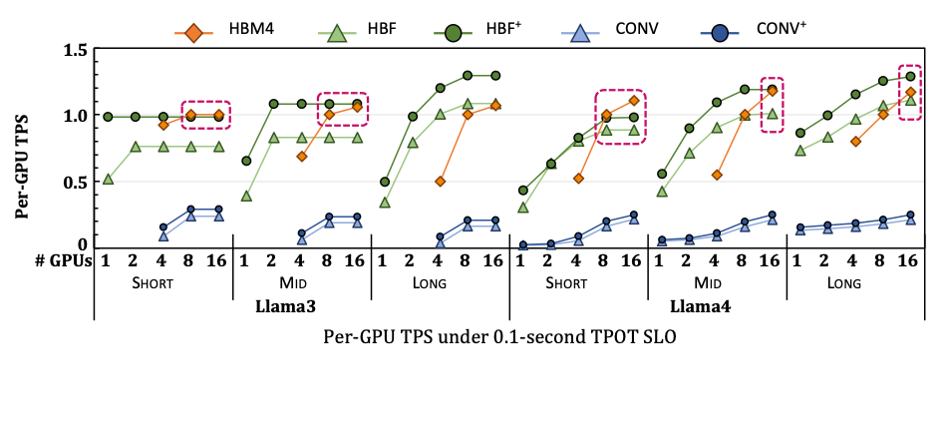
Evaluation Results: Diminishing Gains w/ more GPUs
GPU scaling
  → Larger aggregate capacity & bandwidth
  → Overcome the memory wall (at high cost)
The benefits of GPU scaling diminish under all evaluated systems
  Regardless of the memory technology (i.e., also in HBM-based systems)
  Larger batch → Amortizing more weight accesses (diminishing after a certain point)
HBF enables achieving such batch sizes w/ fewer GPUs, which can potentially
  Provide larger throughput gains for larger models (e.g., w/ trillion-parameter LLMs)
  Allow developing even larger LLMs or leveraging multiple LLMs

Slide 32
Evaluation Results: System Throughput
HBM4
HBF
HBF⁺
CONV
CONV⁺
1.5
1.0
Per-GPU TPS
0.5
0
# GPUs
1
2
4
8
16
1
2
4
8
16
1
2
4
8
16
1
2
4
8
16
1
2
4
8
16
1
2
4
8
16
Short
Mid
Long
Short
Mid
Long
Llama3
Llama4
Per-GPU TPS under 0.1-second TPOT SLO
  Diminishing improvements as GPU count increases?
  → Benefit: HBF enables achieving sufficient batch sizes w/ fewer GPUs

Slide 33
Evaluation Results: System Throughput
HBM4
HBF
HBF⁺
CONV
CONV⁺
1.5
1.0
Per-GPU TPS
0.5
0
# GPUs
1
2
4
8
16
1
2
4
8
16
1
2
4
8
16
1
2
4
8
16
1
2
4
8
16
1
2
4
8
16
Short
Mid
Long
Short
Mid
Long
Llama3
Llama4
Per-GPU TPS under 0.1-second TPOT SLO
  HBF can enable high per-GPU TPS even w/ fewer GPUs
  → Benefit: HBF can simultaneously improve performance and flexibility

Slide 34
Evaluation Results: System Throughput
HBM4
HBF
HBF⁺
CONV
CONV⁺
1.5
1.0
Per-GPU TPS
0.5
0
# GPUs
1
2
4
8
16
1
2
4
8
16
1
2
4
8
16
1
2
4
8
16
1
2
4
8
16
1
2
4
8
16
Short
Mid
Long
Short
Mid
Long
Llama3
Llama4
Per-GPU TPS under 0.1-second TPOT SLO
  HBF+ significantly outperforms other HBF-based systems
  → Requirement: Achieving high read bandwidth is the key to benefits over HBM

Slide 35
Evaluation: Performance Breakdown
Red
(Trans)
Postech Red
Orange (Trans)
Orange
Attention
FFN
KV Write
Communication
Others
100
Green (Trans)
Postech Orange
75
Blue (Trans)
Sky Blue
50
TPOT breakdown [%]
25
Dark Blue
0
# GPUs
4
8
16
4
8
16
4
8
16
4
8
16
4
8
16
4
8
16
4
8
16
4
8
16
Mid
Long
Mid
Long
Mid
Long
Mid
Long
Postech Grey
HBM4
HBF⁺
HBM4
HBF⁺
Llama3
Llama4
Decoding time breakdown under 0.1-second TPOT SLO
  KV-cache writes (from prefill nodes) introduce non-trivial performance overhead
  → Requirement: Reducing tPROG would further improve performance

Slide 36
Evaluation: Effect of TPOT SLO Constraint
Red
(Trans)
Postech Red
Orange (Trans)
Orange
TPS:
HBM4
HBF
HBF⁺
Batch:
HBM4
HBF
HBF⁺
1.5
30
Green (Trans)
Postech Orange
1.0
20
Per-GPU TPS
Blue (Trans)
Sky Blue
Per-GPU batch size
0.5
10
Dark Blue
0
0
SLO
0.05
0.1
0.2
0.05
0.1
0.2
0.05
0.1
0.2
0.05
0.1
0.2
0.05
0.1
0.2
0.05
0.1
0.2
Postech Grey
offline
offline
offline
offline
offline
offline
# GPUs
4
8
16
4
8
16
Llama3
Llama4
Performance and batch size impact of TPOT SLO
  Benefit: HBF provides larger benefits under relaxed SLO constraints

Slide 37
Evaluation: Write-Traffic Analysis
Red
(Trans)
Postech Red
Orange (Trans)
Orange
HBF (online)
HBF⁺ (online)
HBF (offline)
HBF⁺ (offline)
500
Green (Trans)
Postech Orange
400
SLC P/E-cycle limit
300
Blue (Trans)
Sky Blue
3-year P/E cycles (10³)
200
Dark Blue
100
0
Postech Grey
# GPUs
1
8
16
1
8
16
1
8
16
1
8
16
1
8
16
1
8
16
Short
Mid
Long
Short
Mid
Long
Llama3
Llama4
Required PEC under different operating scenarios
  Requirement: HBF requires significant endurance enhancement (2~5x)

Slide 38
Summary: Exploring HBF for LLM-Serving Systems
Various potential benefits
  Reducing the minimum GPU count
  Improving system throughput at the same GPU count, especially
    Before GPUs are sufficiently scaled for a given model
    For long-context workloads
    Under relaxed SLO requirements
  Improving the performance and flexibility of LLM-serving systems
Requirements
  Maximizing read bandwidth
  Significantly enhancing endurance
  Improving program speed
  w/ extensive architecture- and system-level optimizations

Slide 39
Exploring High-Bandwidth Flash for Modern LLM Inference: Opportunities and Challenges
SAFARI Live Seminar
Jisung Park
2026.07.24

