Slide 1






DejaVu
Why You Should Write
to Your DRAM Rows Twice, Carefully
Haocong Luo
İsmail Emir Yüksel Ataberk Olgun Nisa Bostanci Orhun Ecemiş
Abdullah Giray Yaglikci Onur Mutlu

Slide 2
High-Level Summary
We demonstrate and analyze DejaVu, a new phenomenon in DRAM where data previously written to a DRAM row affects
Tested 112 DDR4 chips from all 3 major manufacturers
Analyze two hypotheses on root causes
Implications on DRAM testing
Vulnerability to read disturbance
Vulnerability to retention failure
Reliability of Processing-Using-DRAM Operations

Slide 3
Outline
DRAM Background
DejaVu
Vulnerability to Read Disturbance
Vulnerability to Retention Failure
Reliability of Processing-Using-DRAM Operations
Hypotheses on Root Causes
Implications
Conclusion

Slide 4
Outline
DRAM Background
DejaVu
Vulnerability to Read Disturbance
Vulnerability to Retention Failure
Reliability of Processing-Using-DRAM Operations
Hypotheses on Root Causes
Implications
Conclusion

Slide 5
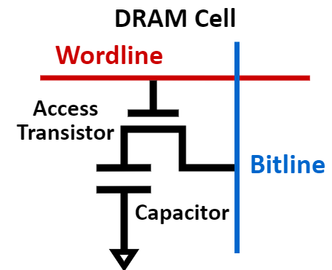
DRAM Organization
A DRAM cell stores 1 bit of information in a capacitor
DRAM cells are organized into DRAM rows
High-Level Illustration of DRAM Cell and DRAM Row
DRAM Row
…
Wordline
…

Slide 6
Key DRAM Operation
DRAM cells are accessed at row granularity
To read/write data in DRAM, the memory controller
  Sends an ACT (activate) command to open the DRAM row
  Sends RD/WR commands to read/write data
  Sends a PRE (precharge) command that closes the row
Commands need to respect timing constraints
Timeline of DRAM Commands
tRCD
ACT
RD/WR
PRE
Time
tRAS

Slide 7
DRAM Robustness Issues (I) – Read Disturbance
Modern DRAM is vulnerable to read disturbance
RowHammer
Repeatedly opening (activating) and closing a DRAM row
many times causes RowHammer bitflips in adjacent rows
RowPress
Keeping a DRAM row open for a long period of time causes RowPress bitflips in adjacent rows
DRAM
Victim Row
Row 1
Aggressor Row
Row 2
Row 2
Row 2
Row 2
Opened
Closed
Victim Row
Row 3

Slide 8
DRAM Robustness Issues (I) – Read Disturbance
Modern DRAM is vulnerable to read disturbance
RowHammer
Repeatedly opening (activating) and closing a DRAM row
many times causes RowHammer bitflips in adjacent rows
RowPress
Keeping a DRAM row open for a long period of time causes RowPress bitflips in adjacent rows
DRAM
Victim Row
Row 1
Aggressor Row
Row 2
Row 2
Row 2
Opened
Victim Row
Row 3

Slide 9
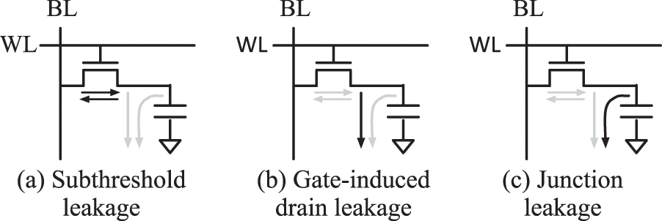
DRAM Robustness Issues (II) – Retention Failure
The DRAM cell capacitor that stores data is leaky
DRAM needs frequent and periodic refresh to prevent data retention failure bitflips
  One of the main DRAM scaling challenges [Liu+, ISCA’13]
Illustration of DRAM Cell Leakage Paths [Wang+, TC’19]

Slide 10
Processing-Using-DRAM
The analog operational principles of DRAM
can be used to perform computation
Simultaneously activating X rows that share bitlines enables a majority-of-X operation (MAJ-X)
a
a
a
Three rows of DRAM cells perturb bitlines simultaneously
b
b
b
Assert three rows’ wordlines
b
b
b
d
s
t
b
b
b
Sense amplifiers sample the output of majority

Slide 11
Outline
DRAM Background
DejaVu
Vulnerability to Read Disturbance
Vulnerability to Retention Failure
Reliability of Processing-Using-DRAM Operations
Hypotheses on Root Causes
Implications
Conclusion

Slide 12
DejaVu - Summary
We demonstrate and analyze DejaVu, a new phenomenon in DRAM where data previously written to a DRAM row affects
Vulnerability to read disturbance
Vulnerability to retention failure
Reliability of Processing-Using-DRAM Operations

Slide 13
DejaVu – Row Initialization Patterns
Different ways of initializing (writing to) a DRAM row
Baseline
DRAM row is written only once
ACT
WR X
×128 (Full row write)
PRE
OverWrite
DejaVu Patterns
DRAM row is first written with opposite data ~X, then overwritten with data X
ACT
WR ~X
×128 (Full row write)
PRE
then
ACT
WR X
×128 (Full row write)
PRE
SameWrite
DRAM row is written with data X twice
ACT
WR X
×128 (Full row write)
PRE
then
ACT
WR X
×128 (Full row write)
PRE

Slide 14
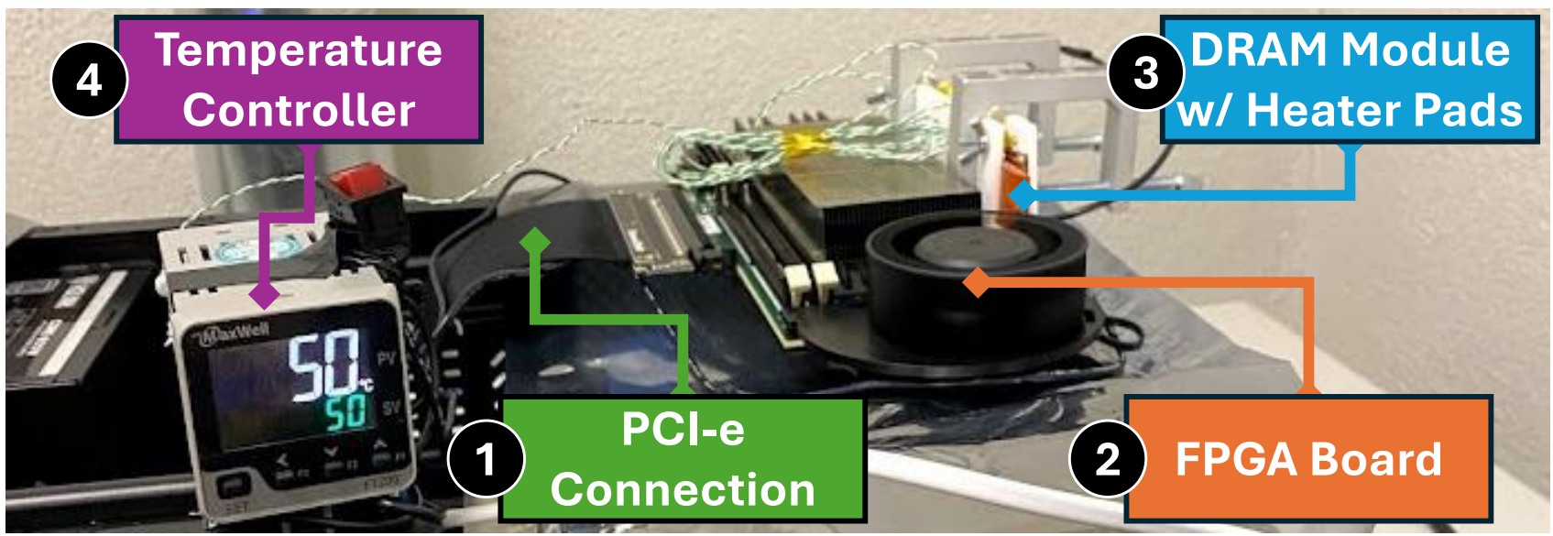
DRAM Characterization Methodology (I)
FPGA-based real DDR4 DRAM testing infrastructure
  Developed from DRAM Bender
  Tests Commercial Off-The-Shelf (COTS) DDR4 modules
  Fine-grained control of DRAM commands, timings, and temperature
Photo of an instance of our testing infrastructure

Slide 15
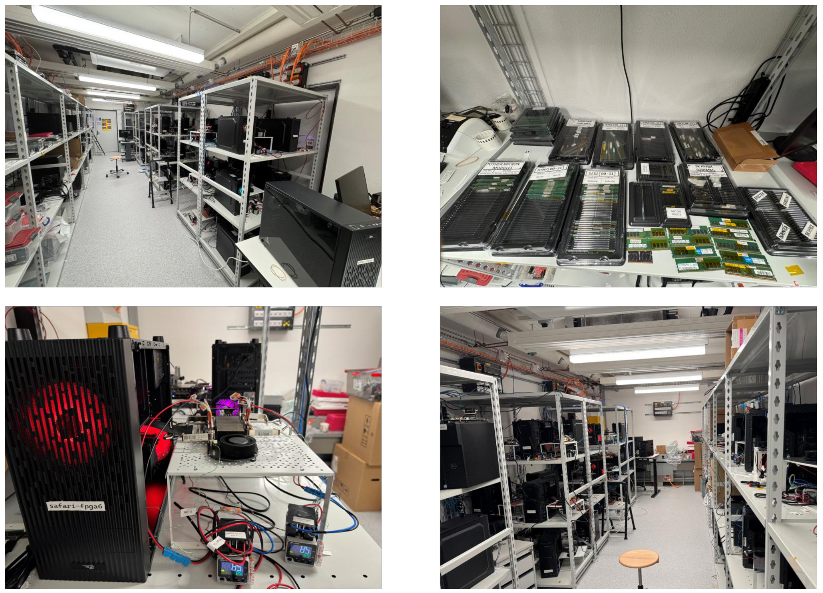
DRAM Characterization Methodology (I)
Photos of our laboratory for understanding DRAM

Slide 16
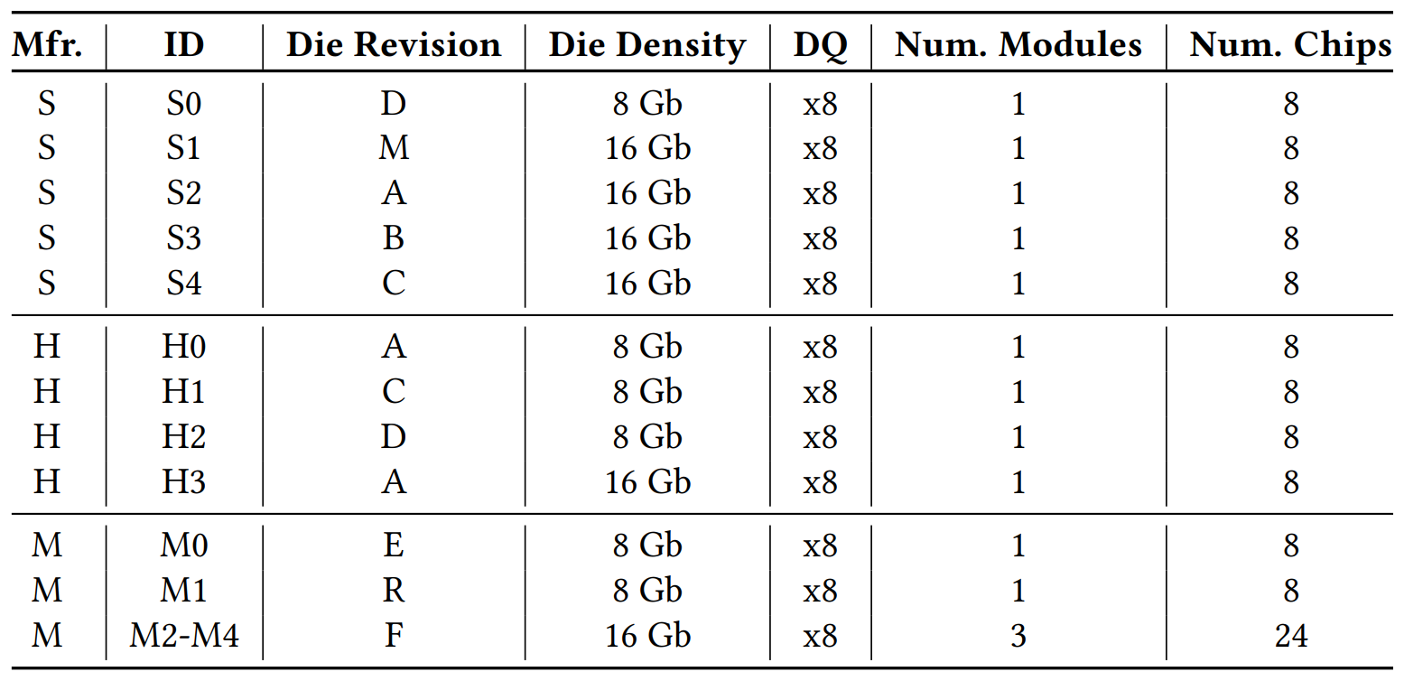
DRAM Characterization Methodology (II)
112 DDR4 DRAM chips tested (14 modules)
  All three major DRAM manufacturers
  Variety of die density and revisions
Details of the tested DDR4 DRAM chips

Slide 17
Outline
DRAM Background
DejaVu
Vulnerability to Read Disturbance
Vulnerability to Retention Failure
Reliability of Processing-Using-DRAM Operations
Hypotheses on Root Causes
Implications
Conclusion

Slide 18
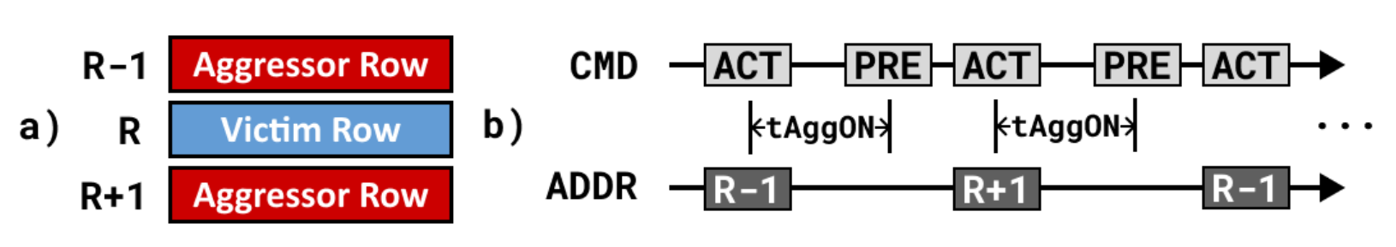
DejaVu on RowHammer (I) - Methodology
Double-sided RowHammer
Key vulnerability metric: AC_{min}
  The minimum aggressor row activation count to induce
  at least one bitflip in the victim row
  128 randomly sampled victim rows
  50 experiment repetitions
Illustrations of the double-sided RowHammer access pattern

Slide 19
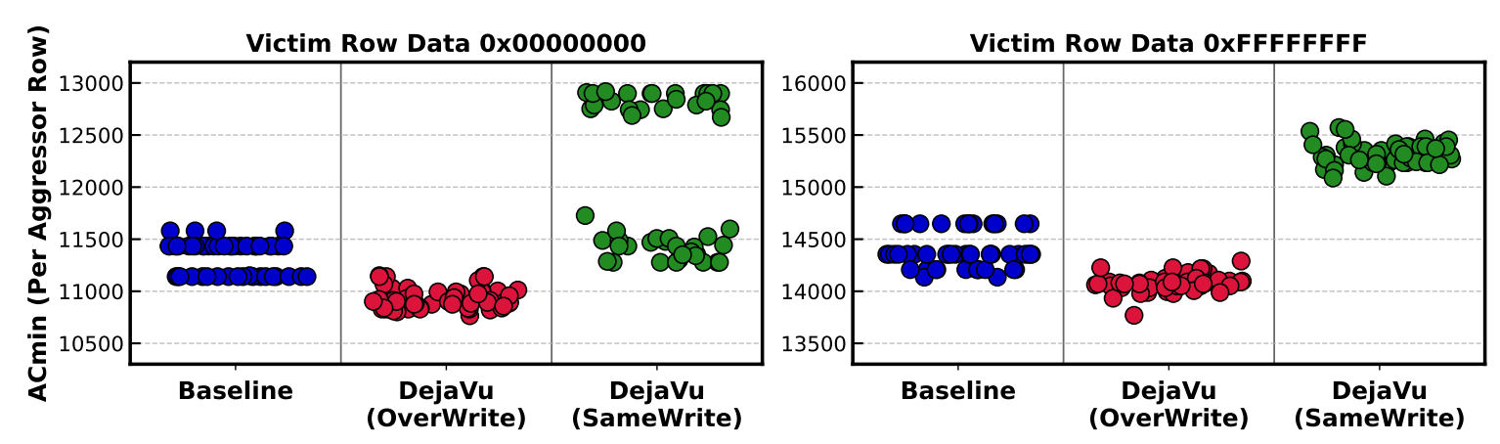
DejaVu on RowHammer (II) – Example
Double-sided RowHammer AC_{min} distribution from one example victim row across 50 test repetitions
(0->1 bitflips)

Slide 20
DejaVu on RowHammer (II) – Example
Double-sided RowHammer AC_{min} distribution from one example victim row across 50 test repetitions
(1->0 bitflips)

Slide 21
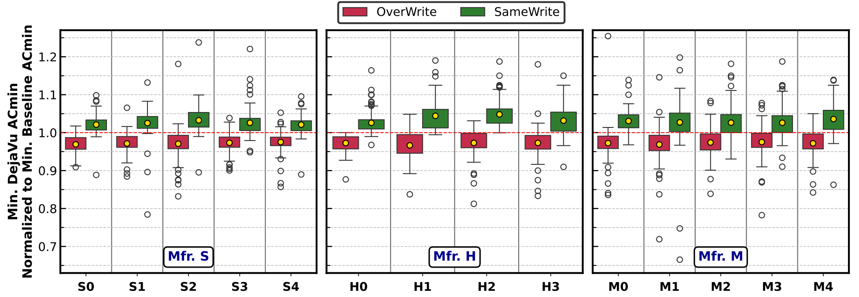
DejaVu on RowHammer (III) – Key Results
Distribution of minimum AC_{min} (y-axis) across all tested rows and repetitions for each module (x-axis)
DejaVu patterns (OverWrite and SameWrite) normalized to baseline (0->1 bitflips)
Less vulnerable to RowHammer
More vulnerable to RowHammer

Slide 22
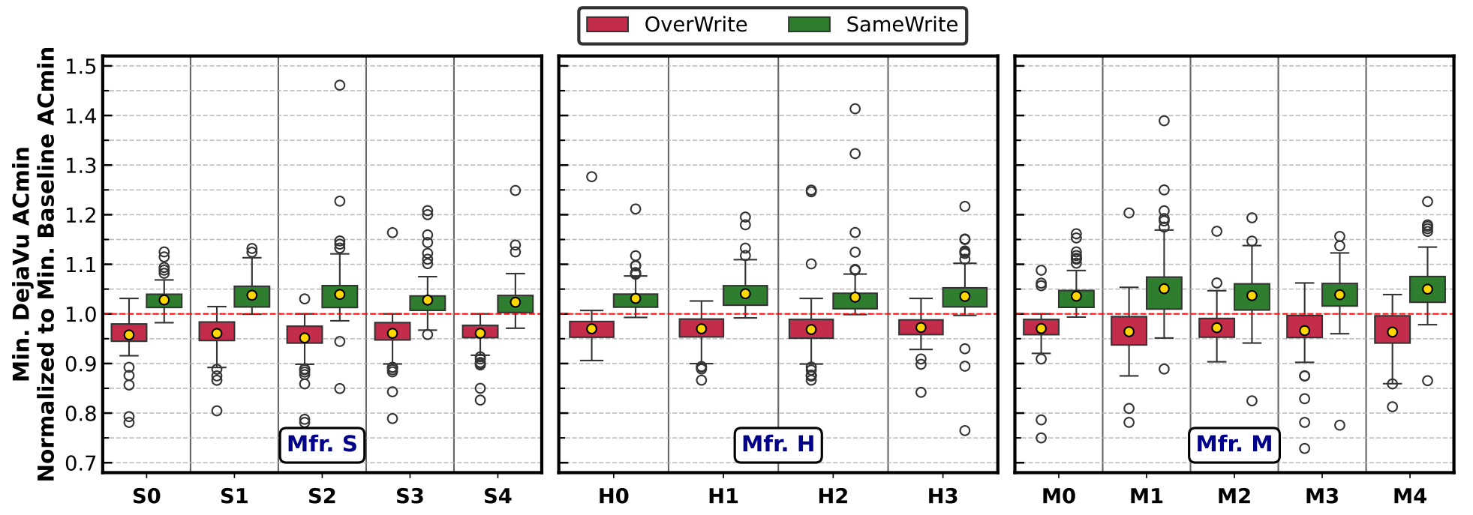
DejaVu on RowHammer (III) – Key Results
Distribution of minimum AC_{min} (y-axis) across all tested rows and repetitions for each module (x-axis)
DejaVu patterns (OverWrite and SameWrite) normalized to baseline (1->0 bitflips)
Less vulnerable to RowHammer
More vulnerable to RowHammer

Slide 23
DejaVu on RowHammer (IV) - Summary
Takeaway 1
DejaVu causes consistent changes in RowHammer vulnerability on DRAM chips from all three manufacturers
Takeaway 2
Overwriting the victim row with opposite data makes DRAM more vulnerable to RowHammer
Writing the same data to the victim row twice makes DRAM less vulnerable to RowHammer

Slide 24
DejaVu on RowPress (I) - Methodology
Double-sided RowPress
Key metric: AC_{min} at different tAggON values
  The minimum aggressor row activation count to induce
  at least one bitflip in the victim row
  128 randomly sampled victim rows
  50 experiment repetitions
Illustrations of the double-sided RowPress access pattern

Slide 25
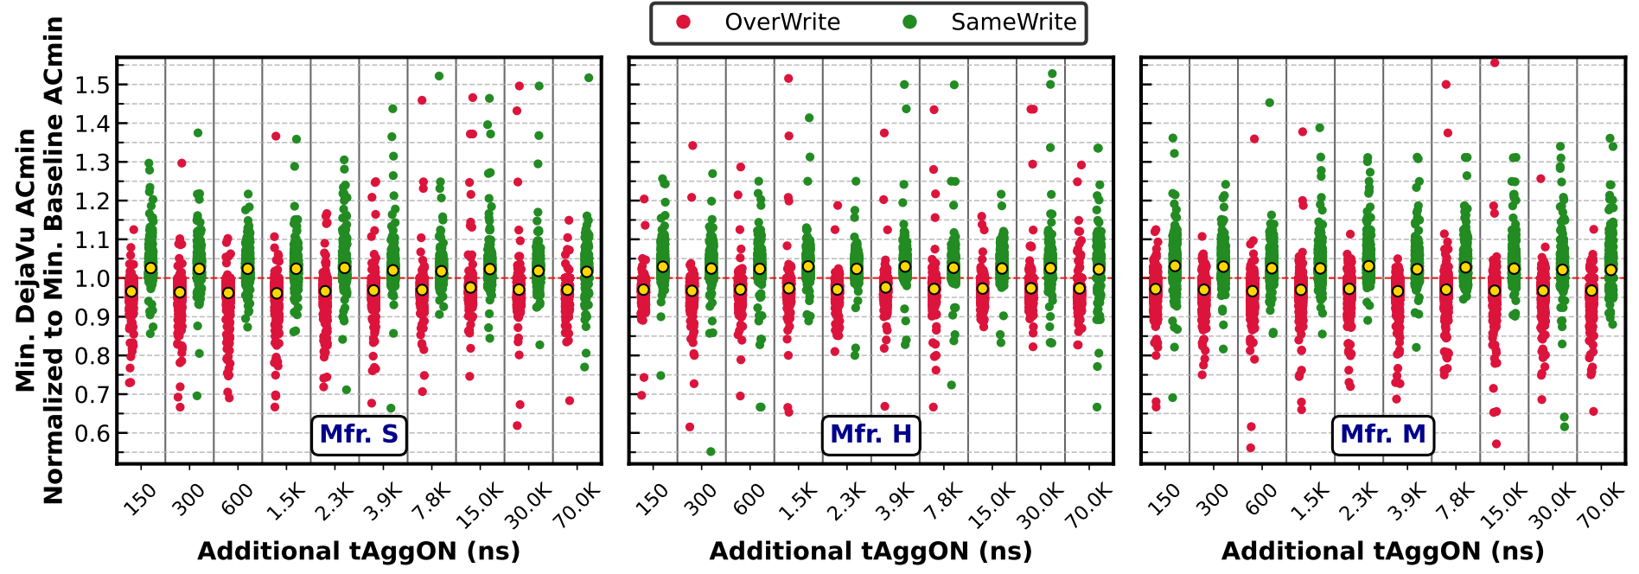
DejaVu on RowPress (II)
Distribution of minimum AC_{min} (y-axis) across all tested rows and repetitions from all modules for different
tAggON values (x-axis)
DejaVu patterns (OverWrite and SameWrite)
normalized to baseline (1->0 bitflips)
Less vulnerable to RowPress
More vulnerable to RowPress
tAggON (ns)

Slide 26
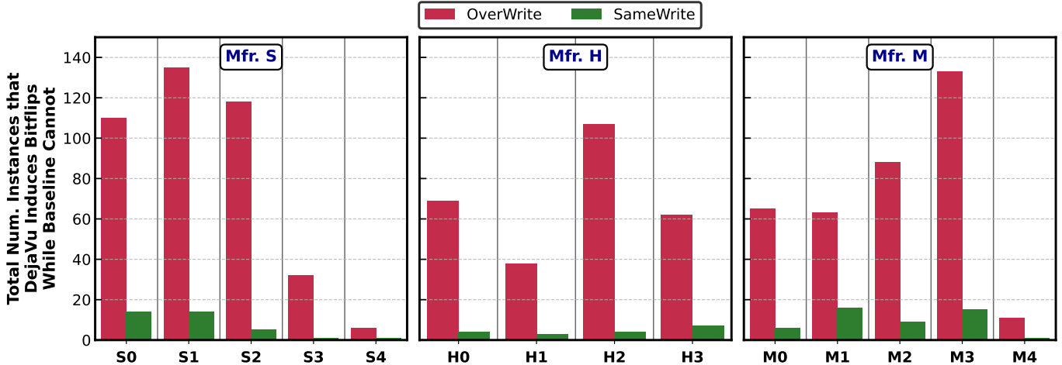
DejaVu on RowPress (III)
Number of instances (y-axis) DejaVu patterns (OverWrite and SameWrite) can induce RowPress bitflips when the baseline cannot across all tested modules (x-axis)

Slide 27
DejaVu on RowPress (IV) - Summary
Takeaway 3
DejaVu consistently makes DRAM less (SameWrite) or more (OverWrite) vulnerable to RowPress; similar to RowHammer
Takeaway 4
OverWrite significantly worsens DRAM’s vulnerability to RowPress by inducing bitflips the baseline pattern cannot

Slide 28
Outline
DRAM Background
DejaVu
Vulnerability to Read Disturbance
Vulnerability to Retention Failure
Reliability of Processing-Using-DRAM Operations
Hypotheses on Root Causes
Implications
Conclusion

Slide 29
DejaVu on Retention Failure (I) - Methodology
Retention failure characterization workflow
  Set DRAM temperature to 95°C
  Write “1” to the DRAM row under test using either SameWrite or OverWrite
  Pause DRAM auto-refresh for 4096 ms
  Read back data and check for bitflips
Key metric: Number of retention failure bitflips
  The same 128 tested rows as in read disturbance tests
  50 experiment repetitions

Slide 30
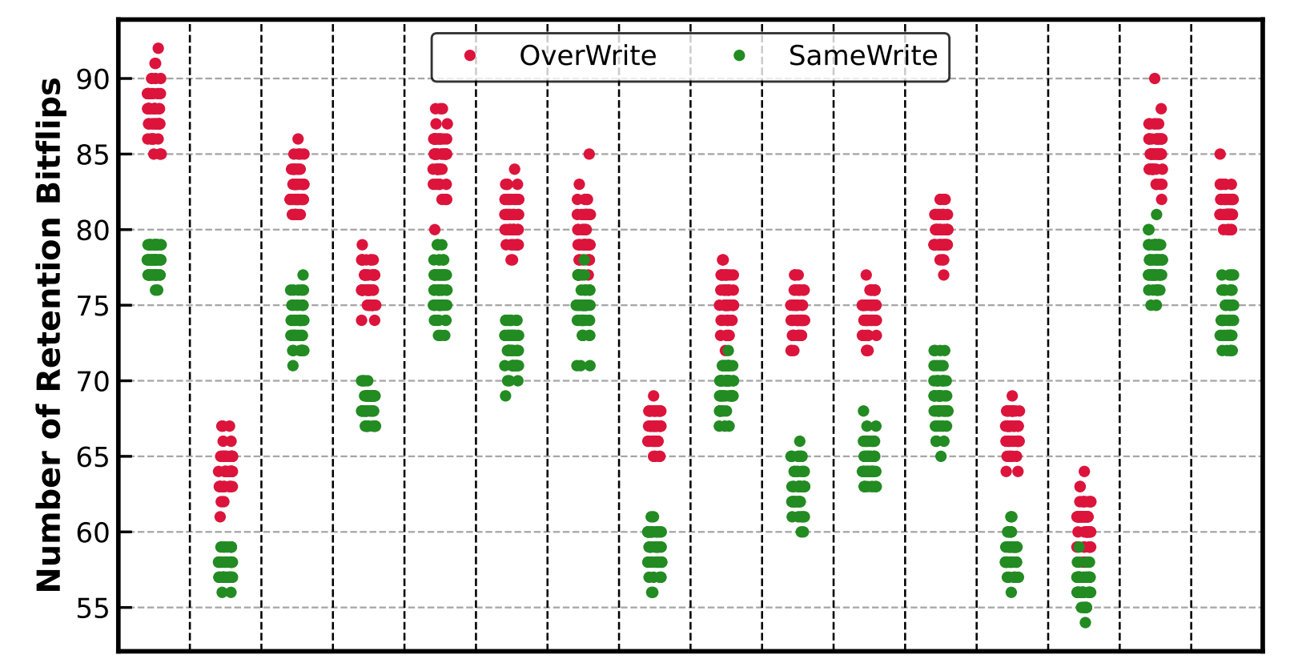
DejaVu on Retention Failure (II)
Distribution of retention failure bitflip counts
per row (y-axis) from 16 example rows (x-axis)
DejaVu patterns (OverWrite and SameWrite)

Slide 31
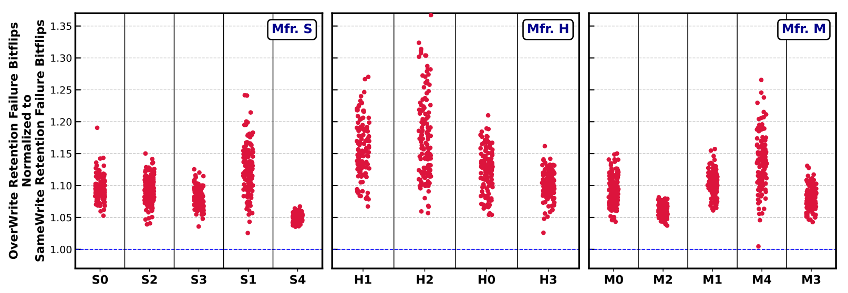
DejaVu on Retention Failure (III)
Distribution of the average retention failure bitflip counts (y-axis) from all tested modules (x-axis)
OverWrite normalized to SameWrite
Avg: +10.4%, Max: +36.7%
More vulnerable to retention failure

Slide 32
DejaVu on Retention Failure (IV) - Takeaway
Takeaway 5
OverWrite significantly worsens DRAM’s vulnerability
to retention failures

Slide 33
Outline
DRAM Background
DejaVu
Vulnerability to Read Disturbance
Vulnerability to Retention Failure
Reliability of Processing-Using-DRAM Operations
Hypotheses on Root Causes
Implications
Conclusion

Slide 34
DejaVu on PuD Reliability (I) - Methodology
PuD Operations: 16- and 32-row MAJ-3 operations
Input Data: Random pattern
  Maximize inter-bitline interference during
  simultaneous multi-row activation
Reliability Metric: Bitline Failure Rate
  Fraction of DRAM cells (bitlines) that produce an incorrect output in at least 1 of 1000 repetitions
Tested Input Rows
  3 different subarrays
  100 row groups from each subarray that can
  perform simultaneous multi-row activation

Slide 35
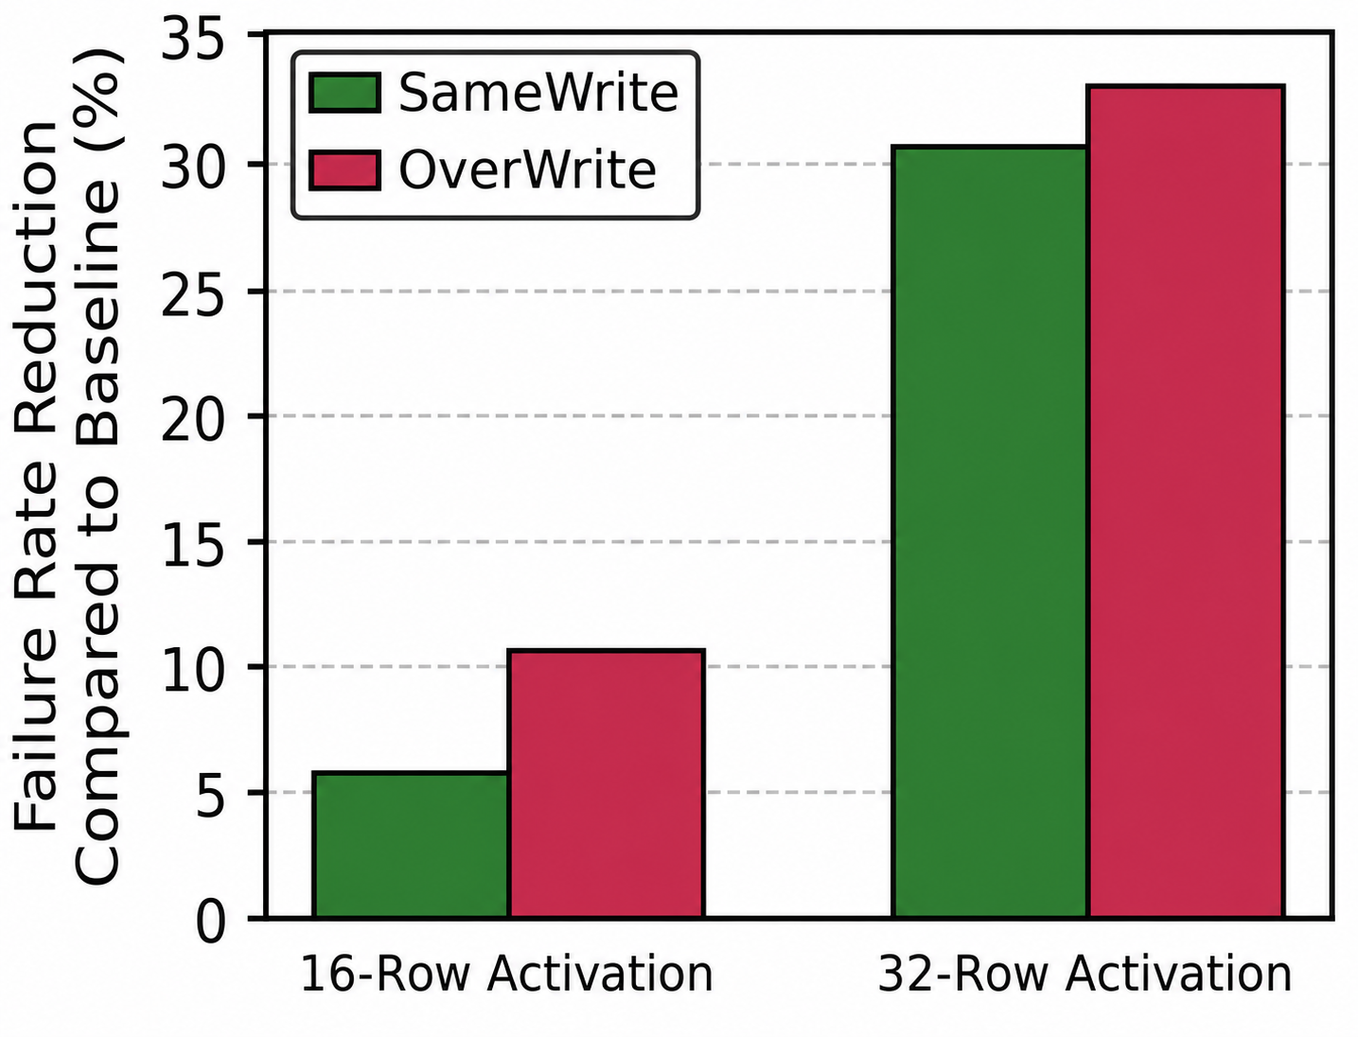
DejaVu on PuD Reliability (II) - Results
Failure rate reduction (y-axis) of DejaVu patterns (OverWrite and SameWrite) for 16- and 32-row
MAJ-3 operations
32.7%
30.6%
10.7%
5.8%

Slide 36
DejaVu on PuD Reliability (III) - Takeaway
Takeaway 6
Both OverWrite and SameWrite significantly improves the reliability of Processing-Using-DRAM operations

Slide 37
Outline
DRAM Background
DejaVu
Vulnerability to Read Disturbance
Vulnerability to Retention Failure
Reliability of Processing-Using-DRAM Operations
Hypotheses on Root Causes
Implications
Conclusion

Slide 38
Hypotheses (I)
Hypothesis 1
DejaVu is caused by the under-restoration of charge
in the capacitors of DRAM cells
Hypothesis 2
DejaVu is caused by the change in charge-trap occupancy in the DRAM cell access transistor

Slide 39
Hypotheses (II)
More investigations on the hypotheses in the paper
  Experiments to (partially) test the charge-under restoration hypothesis
  Analyses of the relationship between the trap occupancy hypothesis and PuD reliability results
Call for Contribution
We call for future works to fundamentally understand DRAM read disturbance and other robustness issues across the stack: from device to circuit and to chip to enable high-performance, safe, secure, and robust DRAM

Slide 40
Outline
DRAM Background
DejaVu
Vulnerability to Read Disturbance
Vulnerability to Retention Failure
Reliability of Processing-Using-DRAM Operations
Hypotheses on Root Causes
Implications
Conclusion

Slide 41
Implications (I)
Characterizing read disturbance threshold
Critical for configuring mitigation techniques
Overwriting data is legal and not uncommon
(e.g., page zeroing)
Our results show OverWrite consistently reduces AC_{min} of RowHammer and RowPress
Implication 1
When characterizing DRAM to find the minimum AC_{min}
to configure read disturbance mitigation techniques, the victim row should always be initialized with OverWrite

Slide 42
Implications (II)
Avoiding accidental interference from DejaVu
Without being aware of DejaVu, one may mistakenly attribute the DejaVu induced changes in AC_{min} to
something else
Example case study: Does the data in rows beyond the
two immediate neighboring rows of the victim row affects
AC_{min} of RowHammer?
R-k
Far Row
R-1
Aggr. Row
Any effect?
R
Victim Row
R+1
Aggr. Row
R+k
Far Row

Slide 43
Implications (II) – Cont’d
Avoiding accidental interference from DejaVu
It is natural to use a range-based loop to bulk-initialize many contiguous DRAM rows (i.e., from R-k to R+k), and then initialize row R to test different data patterns
Test Pattern A – Same Data
for i in range(R-k, R+k):
write_row(i, data)
write_row(R, data)
Accidental SameWrite
AC_{min} difference!
Test Pattern B – Opposite Data
for i in range(R-k, R+k):
write_row(i, data)
write_row(R, ~data)
Accidental OverWrite

Slide 44
Implications (III) – Cont’d
Implication 2
Test Pseudocode A
Avoid accidentally comparing SameWrite to OverWrite by always writing the same data to the tested DRAM row twice (i.e., always do SameWrite)
Test Pseudocode B

Slide 45
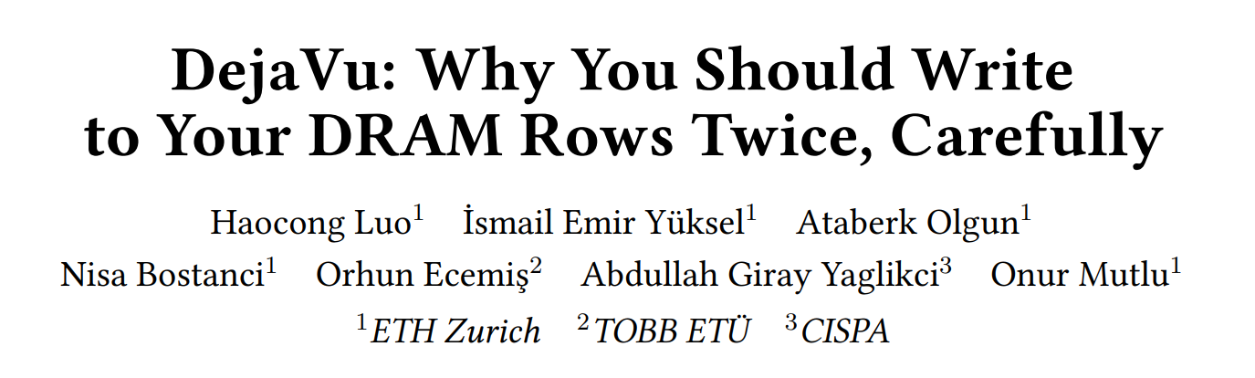

More in Our Paper
Paper (arXiv)

Slide 46
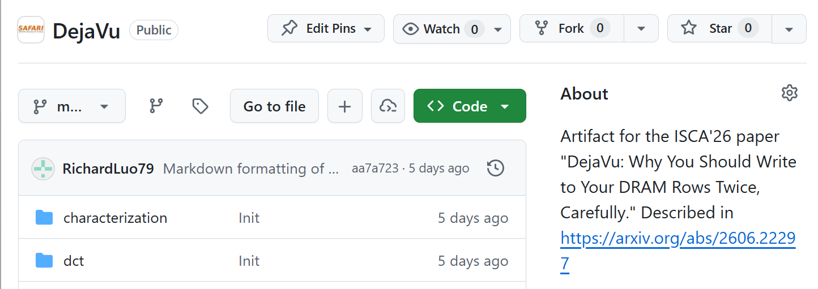

Open-source Artifact
Artifact (Github)

Slide 47
Outline
DRAM Background
DejaVu
Vulnerability to Read Disturbance
Vulnerability to Retention Failure
Reliability of Processing-Using-DRAM Operations
Hypotheses on Root Causes
Implications
Conclusion

Slide 48
Conclusion
We demonstrate and analyze DejaVu, a new phenomenon in DRAM where data previously written to a DRAM row affects
Vulnerability to read disturbance
Vulnerability to retention failure
Reliability of Processing-Using-DRAM Operations
Call for Contribution
We call for future works to fundamentally understand DRAM read disturbance and other robustness issues across the stack: from device to circuit and to chip to enable high-performance, safe, secure, and robust DRAM

Slide 49
DejaVu
Why You Should Write
to Your DRAM Rows Twice, Carefully
Haocong Luo
İsmail Emir Yüksel Ataberk Olgun Nisa Bostanci Orhun Ecemiş
Abdullah Giray Yaglikci Onur Mutlu

