Slide 1



Conduit
Programmer-Transparent Near-Data Processing Using Multiple Compute-Capable Resources in Solid State Drives
Rakesh Nadig, Vamanan Arulchelvan, Mayank Kabra,
Harshita Gupta, Rahul Bera, Nika Mansouri Ghiasi,
Nanditha Rao, Qingcai Jiang, Andreas Kosmas Kakolyris,
Yu Liang, Mohammad Sadrosadati, and Onur Mutlu
HPCA 2026

Slide 2
Talk Outline
Background and Motivation
Conduit
Evaluation
Summary
2

Slide 3
Talk Outline
Background and Motivation
Conduit
Evaluation
Summary
3

Slide 4
Overview of a Modern SSD
Channel
Embedded Cores
Flash Controller
Embedded Cores
Embedded Cores
Embedded Cores
Flash Chip
Flash Chip
…
…
PCIe
Channel
Host
Flash Controller
SSD Controller
Flash Chip
Flash Chip
…
Chip
Chip
…
Chip
DRAM
SSD
4

Slide 5

Near Data Processing in an SSD (ISP)
Channel
Embedded Cores
Flash Controller
Embedded Cores
Embedded Cores
Embedded Cores
Flash Chip
Flash Chip
…
…
PCIe
Channel
Host
Flash Controller
SSD Controller
Flash Chip
Flash Chip
…
Chip
Chip
…
Chip
DRAM
SSD
In-Storage Processing (ISP)
Processing using embedded cores in the SSD controller
5

Slide 6
Near Data Processing in an SSD (ISP)
Channel
Embedded Cores
Flash Controller
Embedded Cores
Embedded Cores
Embedded Cores
Flash Chip
Flash Chip
…
…
PCIe
Channel
Host
Flash Controller
SSD Controller
Flash Chip
Flash Chip
…
Chip
Chip
…
Chip
DRAM
SSD
Many prior ISP works (e.g., Biscuit [Gu+, ISCA 2016],
GenStore [Mansouri Ghiasi+, ASPLOS 2022], REIS [Chen+, ISCA 2025]) accelerate complex tasks including
filtering, aggregation, encryption, and search
6

Slide 7
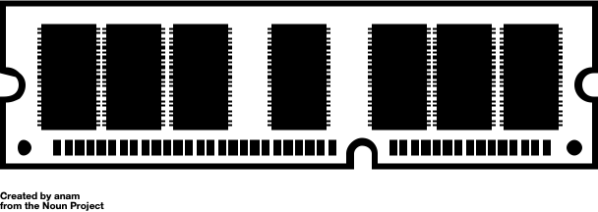
Near Data Processing in an SSD (PuD-SSD)
Channel
Embedded Cores
Flash Controller
Embedded Cores
Embedded Cores
Embedded Cores
Flash Chip
Flash Chip
…
…
PCIe
Channel
Host
Flash Controller
SSD Controller
Flash Chip
Flash Chip
…
Chip
Chip
…
Chip
DRAM
SSD
Processing-using-DRAM in SSD (PuD-SSD)
Computation using SSD DRAM’s intrinsic operational principles
7

Slide 8
Near Data Processing in an SSD (PuD-SSD)
Channel
Embedded Cores
Flash Controller
Embedded Cores
Embedded Cores
Embedded Cores
Flash Chip
Flash Chip
…
…
PCIe
Channel
Host
Flash Controller
SSD Controller
Flash Chip
Flash Chip
…
Chip
Chip
…
Chip
DRAM
SSD
PuD works (e.g., Ambit [Seshadri+, MICRO 2017],
SIMDRAM [Hajinazar+, ASPLOS 2021], MIMDRAM [Oliveira+, HPCA 2024]) enable bulk-bitwise and complex arithmetic operations entirely within the DRAM chips
8

Slide 9
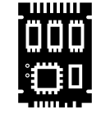
Near Data Processing in an SSD (IFP)
Channel
Embedded Cores
Flash Controller
Embedded Cores
Embedded Cores
Embedded Cores
Flash Chip
Flash Chip
…
…
PCIe
Channel
Host
Flash Controller
SSD Controller
Flash Chip
Flash Chip
…
Chip
Chip
…
Chip
DRAM
SSD
In-Flash Processing (IFP)
Computation by exploiting the flash chip’s structure
9

Slide 10
Near Data Processing in an SSD (IFP)
Channel
Embedded Cores
Flash Controller
Embedded Cores
Embedded Cores
Embedded Cores
Flash Chip
Flash Chip
…
…
PCIe
Channel
Host
Flash Controller
SSD Controller
Flash Chip
Flash Chip
…
Chip
Chip
…
Chip
DRAM
SSD
Several IFP techniques (e.g., Ares-Flash [Chen+, MICRO 2024]) enable
arithmetic operations inside NAND flash chips
by controlling the latching circuit of the page buffer
10

Slide 11
Near Data Processing in an SSD (IFP)
Channel
Embedded Cores
Flash Controller
Embedded Cores
Embedded Cores
Embedded Cores
Flash Chip
Flash Chip
…
…
PCIe
Channel
Host
Flash Controller
SSD Controller
Flash Chip
Flash Chip
…
Chip
Chip
…
Chip
DRAM
SSD
Flash-Cosmos [Park+, MICRO 2022] enables bulk-bitwise operations within NAND flash chips by simultaneously reading multiple pages
11

Slide 12


Near Data Processing in an SSD: Tradeoffs
Channel
NDP Paradigm
Embedded Cores
Flash Controller
Embedded Cores
Embedded Cores
Embedded Cores
Flash Chip
Flash Chip
Wimpy embedded cores provide
limited performance
ISP
Supports general-purpose computations
…
…
PCIe
Channel
Host
Flash Controller
PuD-SSD
Flash Chip
Flash Chip
Computations in a highly parallel manner within the
DRAM chips
Requires transferring operands from flash chips via bandwidth-limited
flash channels
SSD Controller
…
Chip
Chip
…
Chip
DRAM
SSD
IFP
Eliminates data movement overhead and provides high computation parallelism
Limited operation set
12

Slide 13

NDP in an SSD: Research Questions
Channel
Embedded Cores
Flash Controller
Embedded Cores
Embedded Cores
Embedded Cores
Is a single NDP paradigm good for all workloads?
Flash Chip
Flash Chip
…
…
PCIe
Channel
Host
Flash Controller
Do we need to combine these NDP paradigms?
SSD Controller
Flash Chip
Flash Chip
…
Chip
Chip
…
Chip
DRAM
SSD
Which is the most suitable NDP paradigm
for each computation?
13

Slide 14
Case Study on Combining NDP Paradigms (1/5)
We examine the performance bottlenecks by hand-mapping parts of the workload to multiple SSD computation resources
Evaluated Policies
  Host CPU
  In-storage processing (ISP)
  In-flash processing (IFP)
  Offloading to both ISP and IFP (ISP + IFP)
Evaluated Workloads
  Hybrid workloads: Workloads that involve both computation and data movement (e.g., aggregation, sorting)
  I/O-Intensive workloads: Workloads dominated by data movement (e.g., databases, bitmap indices)
  More in the paper
14

Slide 15
Case Study on Combining NDP Paradigms (2/5)
Computation
Host-SSD
Data Movement
SSD-Internal
Data Movement
Flash Read
Host CPU
Hybrid Workloads
ISP
IFP
IFP+ISP
Overall Execution Time (Normalized to Host CPU)
15

Slide 16
Case Study on Combining NDP Paradigms (3/5)
Computation
Host-SSD
Data Movement
SSD-Internal
Data Movement
Flash Read
Host CPU
Hybrid Workloads
ISP
IFP
40% performance improvement
IFP+ISP
Overall Execution Time (Normalized to Host CPU)
Offloading to ISP and IFP improves performance by 40% over IFP
by reducing data movement and mapping computations
to the most suitable computation resource
16

Slide 17
Case Study on Combining NDP Paradigms (4/5)
Computation
Host-SSD
Data Movement
SSD-Internal
Data Movement
Flash Read
Host CPU
Hybrid Workloads
ISP
IFP
IFP+ISP
Host CPU
I/O-Intensive
Workloads
ISP
IFP
IFP+ISP
Overall Execution Time (Normalized to Host CPU)
17

Slide 18
Case Study on Combining NDP Paradigms (5/5)
Computation
Host-SSD
Data Movement
SSD-Internal
Data Movement
Flash Read
Host CPU
Naively combining multiple computation resources in
I/O-intensive workloads negates offloading benefits due to
data movement between computation resources
Hybrid Workloads
ISP
IFP
IFP+ISP
Host CPU
I/O-Intensive
Workloads
ISP
IFP
15% performance reduction
IFP+ISP
Overall Execution Time (Normalized to Host CPU)
18

Slide 19



Case Study: Key Takeaways
Computation
Host-SSD
Data Movement
SSD-Internal
Data Movement
Flash Read
No single computation resource consistently performs well across different workloads
Host CPU
Hybrid Workloads
ISP
IFP
Performance bottlenecks are workload-dependent and
vary across different execution phases of the same workload
IFP+ISP
Host CPU
I/O-Intensive
Workloads
ISP
IFP
15% performance reduction
IFP+ISP
Offloading to multiple SSD computation resources
provides benefits, but only when done judiciously
Overall Execution Time (Normalized to Host CPU)
19

Slide 20



Limitations of Prior SSD-Based NDP Techniques
Prior SSD-based NDP techniques
Map computations only to one or two NDP paradigms and fail to exploit the SSD’s full computational potential
Lack generality across a wide range of applications
Are not programmer-transparent
20

Slide 21
NDP Offloading Techniques For Main Memory
No prior work proposes application-transparent offloading of computations across multiple SSD computation resources
Several NDP offloading techniques explore partitioning and mapping application code segments between host and NDP units near main memory
We adapt these offloading models for SSD-based NDP
BW-Offloading: Makes offloading decisions based on
bandwidth utilization of the host and NDP units
(e.g., TOM [Hsieh+, ISCA 2016], ƛ-IO [Yang+, FAST 2023])
DM-Offloading: Makes offloading decisions to minimize
data movement between the host and NDP units
(e.g., ALP [Mansouri Ghiasi+, TETC 2023], PIMProf [Wei+, DATE 2022])
21

Slide 22
Effectiveness of Prior Offloading Techniques
8.0
Speedup over CPU
2.5x
DM-Offloading falls short of the Ideal’s performance by 2.5x
due to its narrow offloading model
DM-Offloading prefers a single computation resource to reduce
data movement, causing queueing delays and resource contention
22

Slide 23
Our Goal
To enable programmer-transparent NDP in an SSD that
effectively utilizes multiple SSD computation resources to perform computations
makes workload- and system-aware offloading decisions
improves performance and energy efficiency of a
wide range of applications
23

Slide 24
Talk Outline
Background and Motivation
Conduit
Evaluation
Summary
24

Slide 25

Our Proposal
Conduit
A general-purpose programmer-transparent NDP framework
that dynamically offloads computations at instruction granularity
to multiple heterogeneous SSD computation resources
25

Slide 26


Conduit: Key Steps
Compile-time pre-processing step to identify offloadable code regions
in the application and transform them to wide vector operations
Runtime offloading of vectorized instructions to the most suitable SSD computation resource based on application and system characteristics
26

Slide 27
Conduit: Key Steps
Compile-time pre-processing step to identify offloadable code regions
in the application and transform them to wide vector operations
Runtime offloading of vectorized instructions to the most suitable SSD computation resource based on application and system characteristics
27

Slide 28
Conduit: Compile-Time Preprocessing (1/3)
Application Code
Intermediate Representation (IR)
for (j = 0; j < nb; ++j)
{
….
if ((ret[1 + j * 4] >> 8) == 1)
{
ret[1 + j * 4] ^= 283;
}
….
}
…
%38 = load <4096 x i32>, ptr %37, align 4
%39 = xor <4096 x i32> %38, %34
%40 = xor <4096 x i32> %39, %21
%41 = xor <4096 x i32> %40, %22
%42 = and <4096 x i32> %20, <i32 283 … i32>
…
Loop
Auto-Vectorization
Host
Conduit runs a custom compiler (e.g., LLVM) pass to identify offloadable code regions
Embedded Core
Loop auto-vectorization transforms scalar instructions into wide vector operations
that match the SSD-internal parallelism
Conduit leverages partial vectorization so that partially vectorizable code regions benefit from parallel execution in an SSD
28

Slide 29
Conduit: Compile-Time Preprocessing (2/3)
Application Code
Intermediate Representation (IR)
Metadata
for (j = 0; j < nb; ++j)
{
….
if ((ret[1 + j * 4] >> 8) == 1)
{
ret[1 + j * 4] ^= 283;
}
….
}
…
%38 = load <4096 x i32>, ptr %37, align 4
%39 = xor <4096 x i32> %38, %34
%40 = xor <4096 x i32> %39, %21
%41 = xor <4096 x i32> %40, %22
%42 = and <4096 x i32> %20, <i32 283 … i32>
…
"element_size": "i32",
"index": "%42",
"length": 4096,
"line": 387,
"load_addr": ["const"],
"operands": [ "%20", const"],
"operation": "and"
Extract Metadata
Loop
Auto-Vectorization
Host
Conduit extracts lightweight metadata (e.g., operation type, operand pointers, element sizes, vector length) for each vector operation
Embedded Core
Conduit embeds the metadata with IR to reduce
runtime scheduling latency and preserve programmer transparency
29

Slide 30
Conduit: Compile-Time Preprocessing (3/3)
Application Code
Intermediate Representation (IR)
Metadata
for (j = 0; j < nb; ++j)
{
….
if ((ret[1 + j * 4] >> 8) == 1)
{
ret[1 + j * 4] ^= 283;
}
….
}
…
%38 = load <4096 x i32>, ptr %37, align 4
%39 = xor <4096 x i32> %38, %34
%40 = xor <4096 x i32> %39, %21
%41 = xor <4096 x i32> %40, %22
%42 = and <4096 x i32> %20, <i32 283 … i32>
…
"element_size": "i32",
"index": "%42",
"length": 4096,
"line": 387,
"load_addr": ["const"],
"operands": [ "%20", const"],
"operation": "and"
Generate an ARM Executable
Host
Transfer Executable to SSD
SSD
Embedded Core
Conduit converts the IR with metadata to an executable
capable of running on ARM cores
Conduit transfers the ARM executable to the SSD by repurposing
existing NVMe admin commands for firmware update
30

Slide 31
Conduit: Key Steps
Compile-time pre-processing step to identify offloadable code regions
in the application and transform them to wide vector operations
Runtime offloading of vectorized instructions to the most suitable SSD computation resource based on application and system characteristics
31

Slide 32
Conduit: Runtime Offloading (1/3)
Host
Transfer Binary
to SSD
Processing
using DRAM
Emb.
Core
Emb.
Core
Emb.
Core
In-Flash Processing
Runtime Offloading
…
SSD Controller
SSD
Conduit performs runtime offloading in the SSD controller
to preserve programmer transparency and avoid changes to the storage stack
The SSD controller has real-time knowledge of the current state
(e.g., resource utilization, contention in shared channels)
of all SSD computation resources
32

Slide 33
Conduit: Runtime Offloading (2/3)
17
SSD Offloader
Cost Function
Embedded
Core
Processing
using DRAM
In-Flash Processing
Emb.
Core
Emb.
Core
…
Emb.
Core
SSD
SSD Controller
Conduit’s SSD offloader maps each vectorized instruction in the ARM executable
to the most-suitable SSD computation resource based on a cost function
33

Slide 34
Conduit: Runtime Offloading (3/3)
SSD Offloader
Cost Function
Embedded
Core
Processing
using DRAM
In-Flash Processing
Emb.
Core
Emb.
Core
…
Emb.
Core
SSD
SSD Controller
Conduit’s SSD offloader maps each vectorized instruction in the ARM executable
to the most-suitable SSD computation resource based on a cost function
34

Slide 35
Conduit: Cost Function
SSD Offloader
SSD Offloader
Cost Function
Cost Function
35

Slide 36
Conduit: Cost Function
Data Movement Latency
Data movement latencies if the operands are not in the target computation resource
SSD Offloader
Cost Function
Conduit tracks both application characteristics and current system conditions to evaluate the cost of offloading an instruction to each SSD computation resource
36

Slide 37
Conduit: Cost Function
Data Movement Latency
+
SSD Offloader
Cost Function
Expected Computation Latency
Estimated instruction execution latency on a computation resource based on the operation type
Conduit tracks both application characteristics and current system conditions to evaluate the cost of offloading an instruction to each SSD computation resource
37

Slide 38
Conduit: Cost Function
Data Movement Latency
+
SSD Offloader
Cost Function
Expected Computation Latency
+
Data Dependence Delay
Delay for operand availability
Conduit tracks both application characteristics and current system conditions to evaluate the cost of offloading an instruction to each SSD computation resource
38

Slide 39
Conduit: Cost Function
Data Movement Latency
+
SSD Offloader
Cost Function
Expected Computation Latency
+
Data Dependence Delay
Resource Queueing Delay
Delay caused by pending instructions in a computation resource’s execution queue
Conduit tracks both application characteristics and current system conditions to evaluate the cost of offloading an instruction to each SSD computation resource
39

Slide 40
Conduit: Cost Function
Data Movement Latency
+
SSD Offloader
Cost Function
Expected Computation Latency
Total Execution Latency Per Resource
+
Data Dependence Delay
max
Resource Queueing Delay
Conduit tracks both application characteristics and current system conditions to evaluate the cost of offloading an instruction to each SSD computation resource
40

Slide 41
Conduit: Cost Function
Total Latency_{ISP}
SSD Offloader
Cost Function
Total Latency_{PuD-SSD}
Offloading Target
min
Total Latency_{IFP}
Conduit calculates the latency of executing each instruction on each computation resource, and selects the computation resource with the lowest execution latency
41

Slide 42
Conduit: Instruction Transformation (1/4)
SSD Offloader
Cost Function
Embedded
Core
Instruction
Transformation
Processing
using DRAM
In-Flash Processing
Emb.
Core
Emb.
Core
…
Emb.
Core
SSD
SSD Controller
Conduit’s instruction transformation unit transforms each vectorized instruction
to the native ISA of the chosen SSD computation resource
42

Slide 43
Conduit: Instruction Transformation (2/4)
SSD Offloader
Cost Function
Offload to ISP
Embedded
Core
Instruction
Transformation
ARM Cortex ISA
Processing
using DRAM
In-Flash Processing
Emb.
Core
Emb.
Core
…
Emb.
Core
SSD
SSD Controller
For ISP, Conduit transforms each vector operation to ARM Cortex ISA,
and schedules the instruction for execution
43

Slide 44
Conduit: Instruction Transformation (3/4)
Offload to PuD-SSD
SSD Offloader
Cost Function
Embedded
Core
Instruction
Transformation
PuD ISA
Processing
using DRAM
In-Flash Processing
Emb.
Core
Emb.
Core
…
Emb.
Core
SSD
SSD Controller
Conduit transforms each vector operation to ISA extensions (e.g., bbop_op for
2-input arithmetic) from prior PuD works
(e.g., SIMDRAM [Hajinazar and Oliveira+, ASPLOS 2021])
44

Slide 45
Conduit: Instruction Transformation (4/4)
Offload to IFP
SSD Offloader
Cost Function
Embedded
Core
Instruction
Transformation
IFP ISA
Processing
using DRAM
In-Flash Processing
Emb.
Core
Emb.
Core
…
Emb.
Core
SSD
SSD Controller
For IFP, Conduit leverages the MWS primitives from
Flash-Cosmos [Park+, MICRO 2022] and arithmetic operations
from Ares-Flash [Chen+, MICRO 2024] for instruction transformation
45

Slide 46
More in the paper
Data coherence across SSD computation resources
  Conduit employs a lazy coherence mechanism
Data mapping and SSD-internal data movement
Host-SSD communication
  Regular I/O mode
  Computation mode
Failure handling
Conduit’s extensibility
Limitations of auto-vectorization
Conduit’s applicability to irregular workloads
Detailed background on the three NDP paradigms
Detailed description of binary transfer from the host to the SSD
46

Slide 47
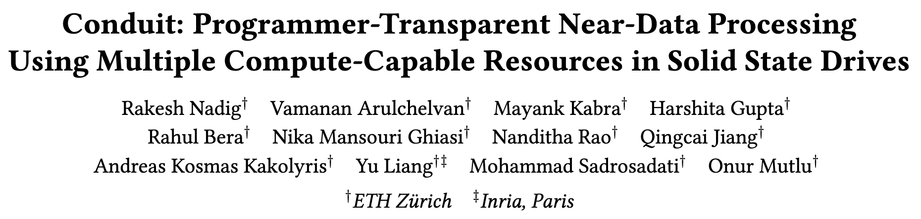

More in the Paper
https://arxiv.org/pdf/2601.17633
47

Slide 48
Talk Outline
Background and Motivation
Conduit
Evaluation
Summary
48

Slide 49
Evaluation Methodology
Using an in-house event-driven SSD simulator that faithfully models:
  Core SSD functionalities (e.g., address translation, transaction scheduling) based on MQSim [Tavakkol+, FAST 2018]
  DRAM modeling based on Ramulator [Kim+, CAL 2015]
  Shared resource contention
  Performance models of three NDP paradigms
SSD configuration based on Samsung 980 Pro SSD
Six data-intensive workloads from
  AES, XOR Filter, heat-3d, jacobi-1d, LlaMA2 training and inference
Evaluated Policies
  Host CPU
  BW-Offloading: Offloading based on bandwidth utilization
  (based on TOM [Hsieh+, ISCA 2016], ƛ-IO [Yang+, FAST 2023])
  DM-Offloading: Offloading based on data movement cost
  (based on ALP [Mansouri Ghiasi+, TETC 2023], PIMProf [Wei+, DATE 2022])
  Conduit
  Ideal Offloading: No resource contention, resource selection based on lowest computation latency and zero data movement
49

Slide 50
Results: Performance Analysis
8.0
38%
2.0x
1.8x
Speedup over CPU
Conduit outperforms the best-performing prior approach
by 1.8x on average by making holistic offloading decisions
Conduit provides 62% of the Ideal offloading policy’s performance without the ideal approach’s unrealistic assumptions
50

Slide 51
Results: Energy Consumption
Energy Consumption
46.8%
32%
Conduit reduces energy consumption by 46.8% on average
compared to DM-Offloading by exploiting all SSD computation resources and reducing resource queueing delays
Conduit provides 68% of the energy efficiency of the Ideal approach
51

Slide 52
Offloading Decisions
LLM
Training
LlaMA 2
Inference
jacobi-1d
heat-3d
XOR Filter
AES

Slide 53
Offloading Decisions
LLM
Training
LlaMA 2
Inference
Conduit makes similar offloading decisions as the
Ideal offloading approach without the Ideal’s unrealistic assumptions
jacobi-1d
heat-3d
XOR Filter
AES
53

Slide 54
Overhead Analysis
Storage Overhead
Runtime Latency Overhead
Area Overhead
  17 bytes for storing cost function features in the SSD DRAM
  1.5 KiB for storing the instruction transformation mapping
  of vectorized instructions to the native ISA
  of all computation resources
  3.8 µs on average for cost function feature collection
  and instruction transformation for each instruction
  Conduit does not add any area overhead
  beyond that of the prior techniques it leverages
54

Slide 55
More in the Paper
Tail latency evaluation
  In LlaMA2 inference, compared to DM-Offloading, Conduit reduces 99th percentile latency by 5.6x, and 99.99th percentile latency by 22.3x
Interaction between the workload and
SSD computation resources
Detailed description of overhead analysis
Detailed workload description and characteristics
Detailed description of SSD modeling and NDP extensions
55

Slide 56
More in the Paper
https://arxiv.org/pdf/2601.17633
56

Slide 57
Talk Outline
Background and Motivation
Conduit
Evaluation
Summary
57

Slide 58




Conduit: Summary
First general-purpose programmer-transparent
NDP framework that enables fine-grained computation offloading across multiple SSD computation resources
Improves performance by 1.8x on average over the
best-performing prior offloading approach
Reduces energy consumption
by 46.8% on average over the most efficient prior work
Low latency and storage overheads
58

Slide 59
Conduit
Programmer-Transparent Near-Data Processing Using Multiple Compute-Capable Resources in Solid State Drives
Rakesh Nadig, Vamanan Arulchelvan, Mayank Kabra,
Harshita Gupta, Rahul Bera, Nika Mansouri Ghiasi,
Nanditha Rao, Qingcai Jiang, Andreas Kosmas Kakolyris,
Yu Liang, Mohammad Sadrosadati, and Onur Mutlu
HPCA 2026
Notes:
Hello and Good afternoon. I am Rakesh Nadig, a Phd student from SAFARI Research group at ETH Zurich. I am going to present our work “Conduit: Programmer-Transparent Near-Data Processing Using Multiple Compute-Capable Resources in Solid-State Drives”.

Slide 60
Backup Slides

Slide 61
FAQ (1/2)
Executive Summary
PuD-SSD
IFP
Extended Case Study (With More Compute-Intensive Workloads)
Compile-Time Preprocessing
Runtime Offloading
System Integration

Slide 62
FAQ (2/2)
Evaluated Configurations
Workload Characteristics
Results
  Extended Performance Results
  Extended Energy Consumption
  Tail Latency
  Workload-Computation Resource Interaction

Slide 63

Executive Summary
Background: A solid-state drive enables three near-data processing paradigms:
processing using embedded cores, processing using DRAM, and in-flash processing
Problem:
  Prior SSD-based NDP techniques (1) do not exploit the SSD’s full computational potential, (2) are application-specific, and (3) are not programmer-transparent
  Prior main-memory-based NDP offloading techniques provide limited benefits for an SSD because they optimize for limited factors (e.g., bandwidth utilization)
Goal: To enable a programmer-transparent NDP framework in SSDs that
(1) offloads computations across multiple SSD computation resources, and
(2) makes offloading decisions that are both workload- and system-aware
Conduit: A general-purpose programmer-transparent NDP framework that consists of:
  compile-time preprocessing to identify offloadable code regions and transform them to wide vector operations,
  runtime offloading that maps computations to the most suitable SSD computation resource based on workload and system factors
Key Results: We evaluate Conduit and two prior NDP offloading techniques using an
in-house event-driven SSD simulator on six data-intensive workloads
  Compared to the best prior offloading policy, Conduit improves performance by 1.8x on average and reduces energy consumption by 46% on average

Slide 64
In-Storage Processing (ISP)
The embedded cores in the SSD controller typically execute
FTL firmware and handle host communication
The embedded cores can be repurposed to perform
general-purpose computations
Many prior works show that ISP accelerates various tasks including filtering, aggregation, encryption, and search
Limited SIMD parallelism (e.g., 32-bit registers in ARM Cortex R5)
64

Slide 65
Processing-Using-DRAM in SSD (PuD-SSD)
DRAM Chip
DRAM Bank
Bank
Bank
…
Bank
…
I/O Logic
…
Bank
Bank
…
Bank
SSD-Internal DRAM
PuD techniques leverage DRAM’s operational principles
to perform computations within the memory array
Prior works (e.g., SIMDRAM^{[1]}, MIMDRAM^{[2]}) enable bulk-bitwise
and complex arithmetic operations entirely within the DRAM chips
[1] Hajinazar+, “SIMDRAM: A Framework for Bit-Serial SIMD Processing using DRAM," In ASPLOS, 2021
[2] Oliveira+, “MIMDRAM: An End-to-End Processing-Using-DRAM System for High-Throughput, Energy-Efficient and Programmer-Transparent Multiple-Instruction Multiple-Data Computing,” In HPCA, 2024
65

Slide 66
Processing-Using-DRAM in SSD (PuD-SSD)
DRAM Chip
DRAM Bank
Bank
Bank
…
Bank
…
I/O Logic
…
Bank
Bank
…
Bank
SSD-Internal DRAM
PuD-SSD requires transferring operands
from flash chips to the DRAM via bandwidth-limited flash channels
These data transfers incur latency and energy overheads,
and cause contention in flash channels
[1] Hajinazar+, “SIMDRAM: A Framework for Bit-Serial SIMD Processing using DRAM," In ASPLOS, 2021
[2] Oliveira+, “MIMDRAM: An End-to-End Processing-Using-DRAM System for High-Throughput, Energy-Efficient and Programmer-Transparent Multiple-Instruction Multiple-Data Computing,” In HPCA, 2024
66

Slide 67
In-Flash Processing (IFP) (1/2)
SSD Controller
Channel
NAND Flash Chip
Flash Chip
Flash Chip
Operand O₁
Operand O₁
Operand O₂
Operand O₃
…
Operand O₃₂
Bitlines (BLs)
Page Buffer
67

Slide 68
In-Flash Processing (IFP) (1/2)
SSD Controller
Channel
NAND Flash Chip
Flash Chip
Flash Chip
Operand O₁
Operand O₁
Operand O₂
Operand O₃
…
Sensing
Operand O₃₂
Bitlines (BLs)
Page Buffer
Operand O₁
Several IFP techniques (e.g., Ares-Flash^{[3]}) enable
arithmetic operations inside NAND flash chips by controlling
the latching circuit of the page buffer
[3] Chen+, “Ares-Flash: Efficient Parallel Integer Arithmetic Operations Using NAND Flash Memory," In MICRO, 2024
68

Slide 69
In-Flash Processing (IFP) (1/2)
SSD Controller
Channel
NAND Flash Chip
Flash Chip
Flash Chip
Operand O₁
Operand O₂
Operand O₂
Operand O₃
…
Sensing
Operand O₃₂
Bitlines (BLs)
Page Buffer
Operand O₁
O₁ Add O₂
Several IFP techniques (e.g., Ares-Flash^{[3]}) enable
arithmetic operations inside NAND flash chips by controlling
the latching circuit of the page buffer
[3] Chen+, “Ares-Flash: Efficient Parallel Integer Arithmetic Operations Using NAND Flash Memory," In MICRO, 2024
69

Slide 70
In-Flash Processing (IFP) (2/2)
SSD Controller
Channel
NAND Flash Chip
Flash Chip
Flash Chip
Operand O₁
Operand O₁
Operand O₂
Operand O₂
Operand O₃
Operand O₃
…
Single Sensing
…
Operand O₃₂
Operand O₃₂
Bitlines (BLs)
Page Buffer
Operand O₁
Page Buffer
O₁ & O₂ & O₃ & …& O₃₂
Flash-Cosmos^{[4]} enables bulk-bitwise operations inside
NAND flash chips by simultaneously reading multiple pages
within the flash chips
IFP techniques support limited set of operations and are
less suitable for complex workloads
[4] Park+, "Flash-Cosmos: In-Flash Bulk Bitwise Operations Using Inherent Computation Capability
of NAND Flash Memory." In MICRO, 2022
70

Slide 71
Extended Case Study (1/5)
We examine the performance bottlenecks when offloading computations to multiple SSD computation resources
Evaluated Policies
  Host CPU
  In-storage processing (ISP)
  In-flash processing (IFP)
  Offloading to both ISP and IFP (ISP + IFP)
Evaluated Workloads
  I/O-Intensive workloads: Workloads dominated by data transfer
  (e.g., databases, bitmap indices)
  More compute-intensive workloads: Workloads dominated by computations
  (e.g., encryption, matrix multiplication)
  Hybrid workloads: Workloads that involve both computation and data movement (e.g., aggregation, sorting)
71

Slide 72
Extended Case Study (2/5)
Computation
Host-SSD
Data Movement
SSD-Internal
Data Movement
Flash Read
Host CPU
I/O-Intensive
Workloads
ISP
IFP
IFP+ISP
Host CPU
More
Compute-Intensive Workloads
ISP
IFP
IFP+ISP
Host CPU
Hybrid Workloads
ISP
IFP
IFP+ISP
Overall Execution Time (Normalized to Host CPU)
72

Slide 73
Extended Case Study (3/5)
Computation
Host-SSD
Data Movement
SSD-Internal
Data Movement
Flash Read
Host CPU
I/O-Intensive
Workloads
ISP
IFP
IFP+ISP
Offloading to ISP and IFP in I/O-intensive workloads
reduces performance by 15% compared to IFP
Host CPU
More
Compute-Intensive Workloads
ISP
IFP
IFP+ISP
Offloading to multiple computation resources incurs
additional data movement between flash chips and SSD controller
Host CPU
Hybrid Workloads
ISP
IFP
IFP+ISP
Overall Execution Time (Normalized to Host CPU)
73

Slide 74
Extended Case Study (4/5)
Computation
Host-SSD
Data Movement
SSD-Internal
Data Movement
Flash Read
Host CPU
I/O-Intensive
Workloads
ISP
IFP
IFP+ISP
Host CPU
More
Compute-Intensive Workloads
ISP
IFP
IFP+ISP
Host CPU
Offloading to ISP and IFP improves performance by 28% over IFP
by mitigating the limitations of individual computation paradigms
Hybrid Workloads
ISP
IFP
IFP+ISP
Overall Execution Time (Normalized to Host CPU)
74

Slide 75
Extended Case Study (5/5)
Computation
Host-SSD
Data Movement
SSD-Internal
Data Movement
Flash Read
Host CPU
ISP
Offloading to ISP and IFP improves performance by 40% over IFP
by reducing data movement and mapping computations
to the most suitable computation resource
I/O-Intensive
Workloads
IFP
IFP+ISP
Host CPU
More
Compute-Intensive Workloads
ISP
IFP
IFP+ISP
Host CPU
Hybrid Workloads
ISP
IFP
IFP+ISP
Overall Execution Time (Normalized to Host CPU)
75

Slide 76
Compile-Time Preprocessing
Compiler Flags
  -O3 -g –mllvm -force-vector-width=4096 -force-vector-interleave=1 -Rpass-analysis=loop-vectorize -Rpass=loop-vectorize
-force-vector-width=4096 - Aligns each vector to a typical NAND flash page (vector width of 4096 for 32-bit operands)
  Simplifies data movement across computation resources
  Avoids misaligned accesses
  Matches L2P mapping granularity
-force-vector-interleave=1 flag controls loop unrolling to enable instruction-granularity offloading
76

Slide 77
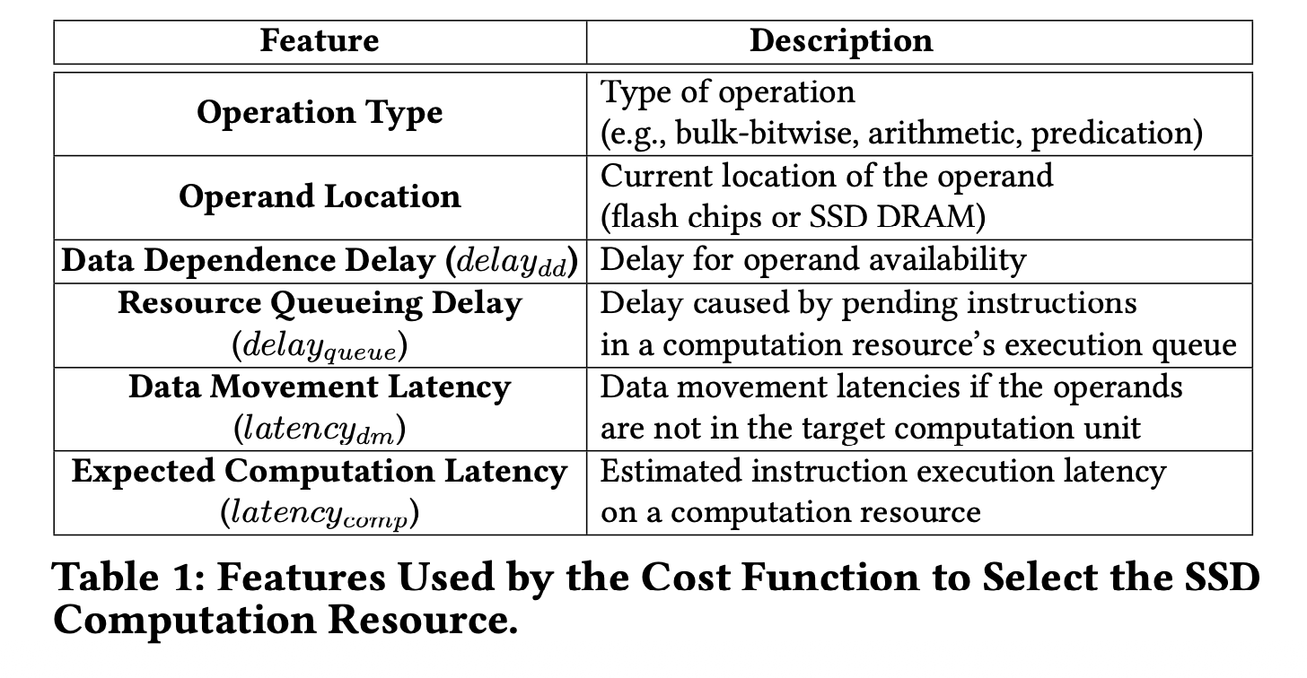
Runtime Offloading: Cost Function
77

Slide 78
Runtime Offloading: Why do it in SSD?
SSD controller has real-time knowledge of all computation resources and shared resource contention
We explored offloading in the host CPU
Limitations of offloading in the host CPU
  No real-time status of the SSD internals in the host
  Significant traffic if the SSD needs to transfer information to the host frequently
  We need to think of a better way to do this in the future
78

Slide 79
System Integration (1/4)
Transferring the binary
  Repurpose fw-download and fw-commit commands
  Extend these commands with a new flag
  to identify Conduit’s executable
Data mapping and SSD-internal data movement
  Conduit adheres to the data layout requirements
  of prior techniques
Host-SSD communication
  Regular I/O mode: Host I/O and FTL operations are executed
  Computation mode: Host I/O is suspended while performing maintenance tasks such as garbage collection
  and wear-leveling
79

Slide 80
System Integration (2/4)
Data Coherence between SSD computation resources
  Conduit employs a lazy coherence mechanism
  Conduit synchronizes data across SSD computation resources only when
    Another computation resource requests data
    Computation result must be transferred to the host
    Data must be evicted from SSD DRAM, page buffers
    or SSD controller registers
    FTL initiates garbage collection
    SSD undergoes power cycle
80

Slide 81
System Integration (3/4)
Data Coherence between SSD computation resources
  Conduit maintains coherence at page-granularity
  by extending the logical-to-physical mapping table to store:
    Owner - SSD computation resource that holds the latest version of the page
    State – page’s modification status (i.e., clean or dirty)
    Version – 1-byte monotonically-increasing counter to order updates and detect stale copies
81

Slide 82
System Integration (4/4)
Failure Handling
  For transient failures (e.g., instruction abort, ECC correction failures), the SSD controller maintains completion
  and status flags, and replays the instruction
  in a different computation resource
  For permanent faults (e.g., bad blocks), Conduit relies
  on existing FTL recovery mechanisms
  such as bad-block remapping, garbage collection
  and wear-leveling
82

Slide 83
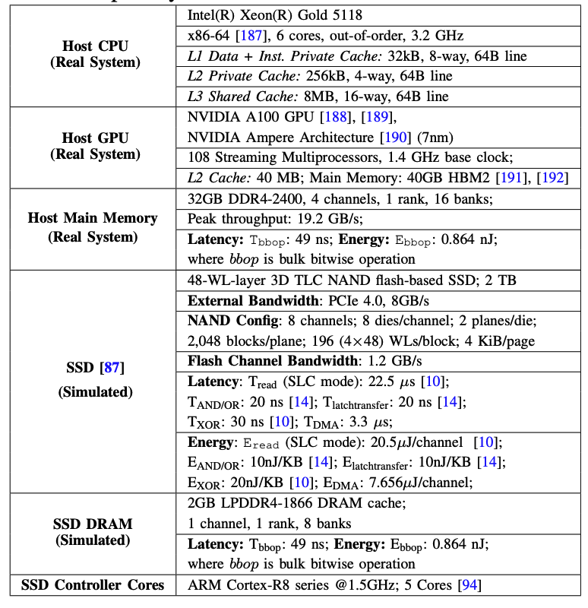
Evaluated Configurations
83

Slide 84
Workloads (1/3)
AES
  256-bit encryption and decryption algorithm
  with high data reuse and low-latency bitwise operations
XOR Filter
  A probabilistic data structure for fast membership tests
  Dominated by arithmetic and predication operations
heat-3d
  3D stencil computation that repeatedly updates each grid point using its neighbors
  Moderate-to-high arithmetic intensity with high data reuse
jacobi-1d
  1D stencil computation solver that updates each element using values from its immediate neighbors
  Moderate-to-high latency operations
84

Slide 85
Workloads (2/3)
LlaMA2 Inference
  INT8 inference of a 7B-parameter LlaMA2 model
  High and medium latency operations
LLM Training
  Bandwidth-intensive INT8 training of 7B-parameter model characterized by frequent weight updates, data movement, and a combination of arithmetic and control-intensive operations
Quantization enables complete execution of all workloads within the SSD
Memory footprint of each workload exceeds the SSD capacity by 2x
  Induces resource contention and data movement scenarios
85

Slide 86
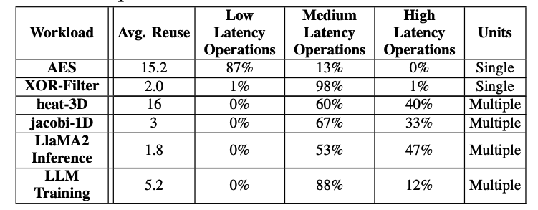
Workloads (3/3)
86

Slide 87
LLM Inference and Training Characteristics
LLM Inference
  Linear layers (Q, K, V, FFN)
    Matrix multiplications, high arithmetic intensity
  Attention-Score computation
    Dot products
  Element-wise operations: scaling, residual add…
  Layer normalization
    Accumulation, scale and shift
  Partially vectorizable – reduction, exponentiation, normalization
  Not vectorizable
    Token selection and sampling
      Branch-heavy, data-dependent
87

Slide 88
LLM Inference and Training Characteristics
LLM Training
  Forward Pass
    Vectorizable
  Backpropagation
    Gradient computation: Dense matrix computations, high reuse, arithmetic-heavy
  Weight updates
    Element-wise arithmetic (SIMD friendly)
  Optimizer logic
    Conditionals, state updates and control flow
88

Slide 89
Extended Results: Performance Analysis
38%
1.79x
2.2x
2.0x
Speedup over CPU
3.3x
2.3x
1.8x
Conduit outperforms the best-performing prior approach
by 1.8x on average by making holistic offloading decisions
Conduit provides 62% of the Ideal offloading policy’s performance without the ideal approach’s unrealistic assumptions
89

Slide 90
Extended Results: Energy Consumption
67.3%
60.6%
57.4%
58.2%
47.8%
Energy Consumption
46.8%
32%
Conduit reduces energy consumption by 46.8% on average compared to DM-Offloading by reducing resource queueing delays
and exploiting all SSD computation resources
Conduit provides 68% of the energy efficiency of the Ideal approach
90

Slide 91
Tail Latency Evaluation (1/2)
LlaMA 2 Inference
10²
10⁴
10⁶
10²
10⁴
10⁶
CDF
  In LlaMA2 inference, compared to DM-Offloading, Conduit reduces 99th percentile latency by 5.6x,
  and 99.99th percentile latency by 22.3x
jacobi-1d
10²
10³
10⁴
10⁵
10²
10³
10⁴
10⁵
(a) 99th Percentile Access Latency
(b) 99.99th Percentile
Access Latency
91

Slide 92
Tail Latency Evaluation (2/2)
  In jacobi-1d, compared to DM-Offloading, Conduit reduces 99th percentile latency by 1.1x,
  and 99.99th percentile latency by 1.3x
LlaMA 2 Inference
10²
10⁴
10⁶
10²
10⁴
10⁶
CDF
jacobi-1d
10²
10³
10⁴
10⁵
10²
10³
10⁴
10⁵
(a) 99th Percentile Access Latency
(b) 99.99th Percentile
Access Latency
92

Slide 93
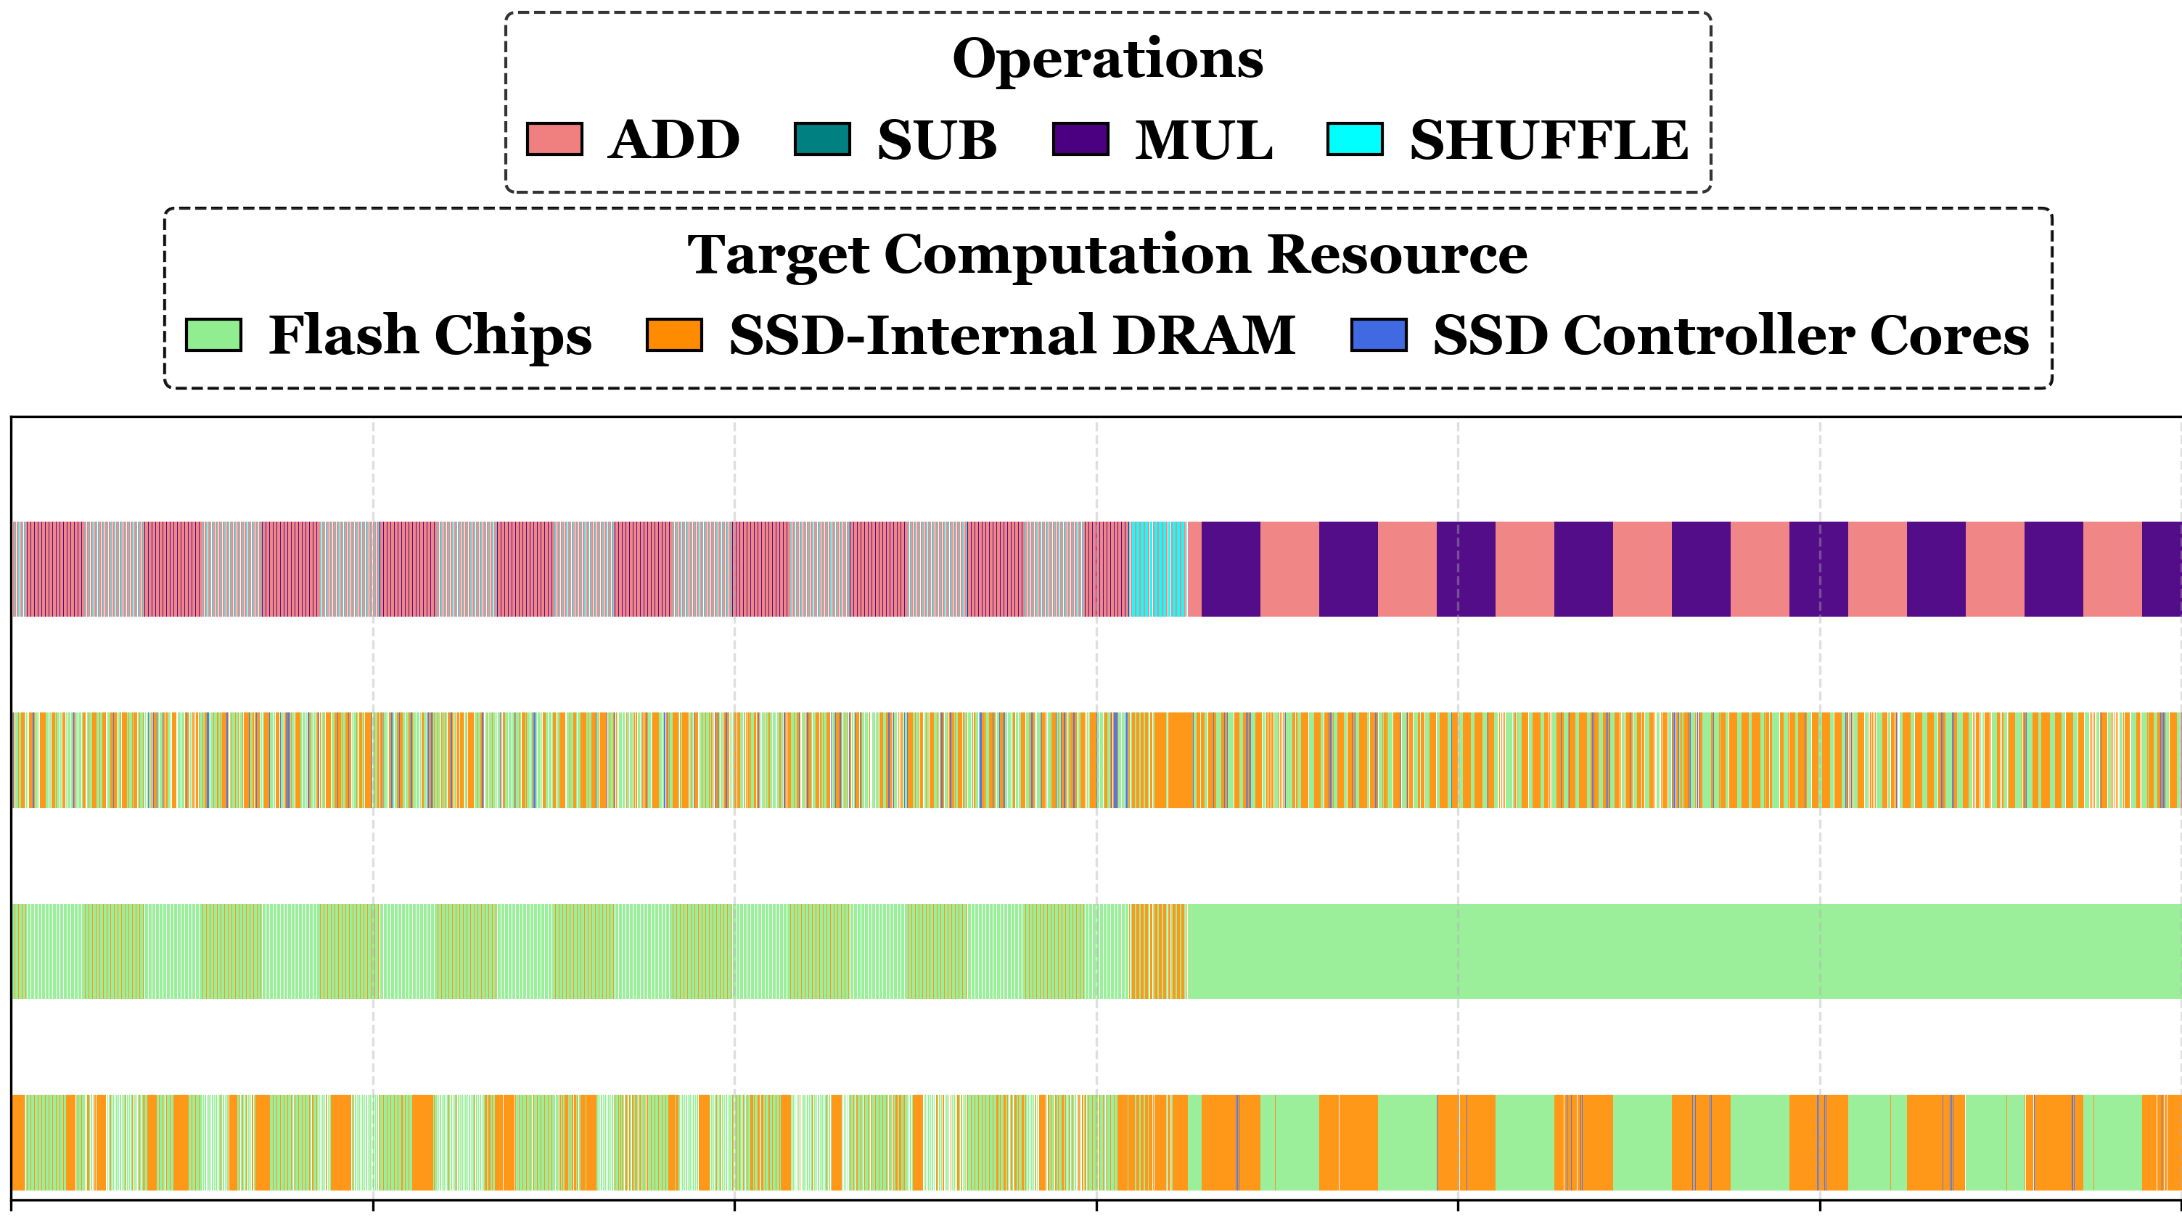
Workload-Computation Resource Interaction
(a) Operations
(b) BW-Offloading
(c) DM-Offloading
(d) Conduit
0
2000
4000
6000
8000
10000
12000
Number of Instructions
93

