Slide 1





ColumnKeeper: Efficient Solutions
to the ColumnDisturb Vulnerability
in DRAM-based Systems
Andreas Kosmas Kakolyris
F. Nisa Bostancı
Harsh Songara
Konstantinos Kanellopoulos
Ataberk Olgun
Konstantinos Marios Sgouras
A. Giray Yağlıkçı
İsmail Emir Yüksel
Umut Başer
Onur Mutlu

Slide 2
Executive Summary
Problem: DRAM chips are vulnerable to ColumnDisturb, a new, column-based read disturbance phenomenon.
Naively mitigating ColumnDisturb incurs significant overheads.
Goal: Design mechanisms that mitigate ColumnDisturb bitflips with
low performance, energy and area overheads
Key Idea: Track row activations at subarray granularity.
Iteratively refresh all rows.
ColumnKeeper-D (Deterministic): Uses separate activation counters for odd and even bitlines of each subarray and issues a preventive refresh when either counter reaches a predetermined threshold
ColumnKeeper-P (Probabilistic): Probabilistically issues refreshes to one row in
three consecutive subarrays upon a row activation in the middle subarray
Evaluation
ColumnKeeper mitigates ColumnDisturb bitflips with low overheads
at current (1M) and “near-future” (128K) thresholds
ColumnKeeper can mitigate ColumnDisturb bitflips with low overheads
even at low thresholds (16K) with changes to DRAM microarchitecture
https://github.com/CMU-SAFARI/ColumnKeeper

Slide 3
Outline
Background
Motivation
ColumnKeeper-D (Deterministic)
ColumnKeeper-P (Probabilistic)
Evaluation
Conclusion

Slide 4
Outline
Background
Motivation
ColumnKeeper-D (Deterministic)
ColumnKeeper-P (Probabilistic)
Evaluation
Conclusion

Slide 5
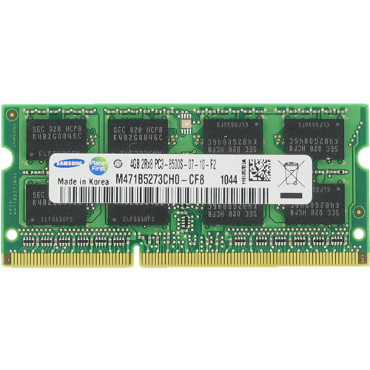
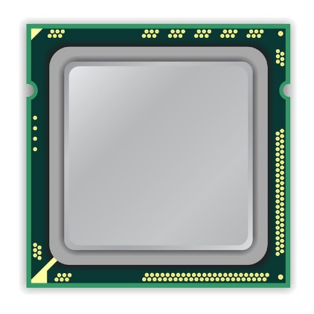
DRAM Organization
DRAM Chip
DRAM
Channel
CPU
DRAM Module

Slide 6
DRAM Organization
DRAM
Chip
Sense Amplifiers
DRAM Row
Bank
DRAM Subarray 0
wordline
Bank
…
Bank
Sense Amplifiers
DRAM Subarray 1
SA
SA
…
SA
bitline
Chip I/O
Sense Amplifiers
capacitor
DRAM Subarray 2
DRAM Cell
…
SA
SA
…
SA
…
Bank
Bank
Bank
DRAM Subarray N
Sense Amplifiers
DRAM Chip
DRAM Bank
DRAM Subarrays
DRAM Column

Slide 7
DRAM Organization
1
ACTIVATE: Fetch the row
into the sense amplifiers
SA
SA
1
0
2
READ/WRITE: Retrieve or
update data
1
1
0
1
1
1
SA
SA
3
PRECHARGE: Prepare the bank for a new ACTIVATE
to/from I/O

Slide 8

DRAM Read Disturbance: RowHammer
Read disturbance in DRAM breaks memory isolation
Prominent example: RowHammer
SA
SA
Victim Row
Aggressor Row
Victim Row
SA
SA

Slide 9
DRAM Read Disturbance: RowHammer
Read disturbance in DRAM breaks memory isolation
Prominent example: RowHammer
SA
SA
Victim Row
Aggressor Row
Victim Row
SA
SA
RowHammer causes bitflips in adjacent rows
in the same subarray

Slide 10
DRAM Read Disturbance: RowPress
Read disturbance in DRAM breaks memory isolation
Another prominent example: RowPress
SA
SA
keep
open
Victim Row
Aggressor Row
Victim Row
SA
SA

Slide 11
DRAM Read Disturbance: RowPress
Read disturbance in DRAM breaks memory isolation
Another prominent example: RowPress
SA
SA
keep
open
Victim Row
Aggressor Row
Victim Row
SA
SA
RowPress causes more bitflips in adjacent rows
in the same subarray

Slide 12
DRAM Read Disturbance: ColumnDisturb
ColumnDisturb: Repeatedly hammering or pressing a DRAM row
disturbs many DRAM cells on the same DRAM column
Subarray
SA
SA
Open-bitline architecture:
columns of a single row
span multiple subarrays
Subarray
SA
SA
Subarray

Slide 13
DRAM Read Disturbance: ColumnDisturb
ColumnDisturb: Repeatedly hammering or pressing a DRAM row
disturbs many DRAM cells on the same DRAM column
Cells on odd columns
Subarray
All cells
Subarray
Cells on even columns
Subarray

Slide 14
DRAM Read Disturbance: ColumnDisturb
ColumnDisturb: Repeatedly hammering or pressing a DRAM row
disturbs many DRAM cells on the same DRAM column
ColumnDisturb affects DRAM cells across
three consecutive DRAM subarrays (up to 3072 DRAM rows)
Cells on odd columns
Subarray
ColumnDisturb induces bitflips within the DDR4 refresh window
All cells
Subarray
The number of activations required to
induce ColumnDisturb bitflips (N_{CD}) is currently $≈$ 1M
Cells on even columns
Subarray
Scaling studies show ColumnDisturb is getting worse in newer chips

Slide 15
Outline
Background
Motivation
ColumnKeeper-D (Deterministic)
ColumnKeeper-P (Probabilistic)
Evaluation
Conclusion

Slide 16
Mitigating ColumnDisturb (I)
The easiest way of mitigating ColumnDisturb is to reduce the
DRAM refresh window so that all rows are refreshed before bitflips can occur
Significant performance overheads at near-future ColumnDisturb thresholds:
More than 50% for workloads with high memory intensity
Significant DRAM energy overheads at near-future ColumnDisturb thresholds:
More than 6x increase in energy consumption
Mitigating ColumnDisturb by increasing the DRAM refresh rate
incurs prohibitive overheads

Slide 17
Mitigating ColumnDisturb (II)
Alternative method: Modifying RowHammer mitigation mechanisms
to protect against ColumnDisturb
RowHammer mitigations such as Per-Row Activation Counting (PRAC):
Track activations at the row granularity
Only refresh a few neighboring victim rows
Using PRAC to mitigate ColumnDisturb requires:
Aggressively configuring PRAC to fire at a low threshold
Refreshing all 3072 rows across three subarrays
Modified PRAC incurs prohibitive overheads

Slide 18
Our Goal
Design mechanisms
that prevent ColumnDisturb bitflips
at low performance, energy, and area overheads

Slide 19
Our Overarching Key Idea
Track activations at subarray granularity
Iteratively refresh all rows within each subarray

Slide 20
Outline
Background
Motivation
ColumnKeeper-D (Deterministic)
ColumnKeeper-P (Probabilistic)
Evaluation
Conclusion

Slide 21
Key Observation
Activations in one subarray affect all columns in that subarray but
either odd or even columns in neighboring subarrays

Slide 22
Key Observation
Activations in one subarray affect all columns in that subarray but
either odd or even columns in neighboring subarrays
N_{odd} = Χ
Total ACTs = Χ
Subarray A
N_{even} = Χ
Actual ACTs = Χ
Χ
SA
SA
SA
SA
N_{odd} = Υ
Total ACTs = Χ+Υ
Subarray B
Actual ACTs = max{Χ,Υ}
N_{even} = Χ
SA
SA
SA
SA
Υ
N_{odd} = Υ
Subarray C
Total ACTs = Υ
N_{even} = Υ
Actual ACTs = Υ

Slide 23

Key Observation
Activations in one subarray affect all columns in that subarray but
either odd or even columns in neighboring subarrays
N_{odd} = Χ
Total ACTs = Χ
Subarray A
N_{even} = Χ
Actual ACTs = Χ
Χ
Naively counting the activations affecting a subarray
overestimates the activation count of cells and increases overheads
SA
SA
SA
SA
N_{odd} = Υ
Total ACTs = Χ+Υ
Subarray B
Actual ACTs = max{Χ,Υ}
N_{even} = Χ
In the worst case when Χ = Υ
Total ACTs = 2 $×$ Actual ACTs
SA
SA
SA
SA
Υ
N_{odd} = Υ
Subarray C
Total ACTs = Υ
N_{even} = Υ
Actual ACTs = Υ

Slide 24
ColumnKeeper-D Key Idea
Separately count activations in odd and even columns of each subarray to mitigate ColumnDisturb
at low performance and energy overheads

Slide 25
ColumnKeeper-D Overview
ColumnKeeper-D consists of:
Counter Table – Even (CT-Even): Counts activations in even columns
Counter Table – Odd (CT-Odd): Counts activations in odd columns
Row Pointer Table (RPT): Points to the next row to be preventively refreshed
in each subarray
CT-Even
CT-Odd
RPT
5
3
8
2
4
9
N_{SUBARRAYS}
…
…
…
Memory Request Scheduler

Slide 26
ColumnKeeper-D Overview
Upon a row activation in subarray k, ColumnKeeper-D:
Increments both the CT-Even and CT-Odd entries for subarray k
Increments the CT-Even entry for the previous subarray
Increments the CT-Odd entry for the next subarray
CT-Even
CT-Odd
RPT
+1
5
3
5
6
+1
+1
8
2
9
3
8
2
+1
9
4
10
9
N_{SUBARRAYS}
…
…
…
Memory Request Scheduler

Slide 27



ColumnKeeper-D Overview
Upon a row activation in subarray k, ColumnKeeper-D:
Calculates the maximum value of the two counters for the three subarrays
Compares the calculated value to a predetermined threshold (N_{PR})
CT-Even
CT-Odd
RPT
6
3
6
MAX
$$≥$$
9
3
MAX
9
$$≥$$
4
10
MAX
10
N_{SUBARRAYS}
$$≥$$
N_{PR} = 10
…
…
…
Memory Request Scheduler

Slide 28
ColumnKeeper-D Overview
Row activation in subarray k:
Calculates the maximum value of the two counters for the three subarrays
Compares the calculated value to a predetermined threshold (N_{PR})
CT-Even
CT-Odd
RPT
6
3
6
MAX
$$≥$$
9
3
MAX
9
$$≥$$
10
We set N_{PR} to N_{CD} divided by the subarray size
This ensures all rows are iteratively refreshed before reaching N_{CD}
4
10
MAX
$$≥$$
N_{SUBARRAYS}
N_{PR} = 10
…
…
…
Memory Request Scheduler

Slide 29
ColumnKeeper-D Overview
Row activation in subarray k:
Calculates the maximum value of the two counters for the three subarrays
Compares the calculated value to a predetermined threshold (N_{PR})
If the maximum counter value for a subarray exceeds N_{PR}
ColumnKeeper-D decides to issue a preventive refresh for that subarray
CT-Even
CT-Odd
RPT
6
N
6
3
MAX
$$≥$$
9
N
9
3
MAX
$$≥$$
10
Y
4
10
MAX
$$≥$$
N_{SUBARRAYS}
N_{PR} = 10
…
…
…
Memory Request Scheduler

Slide 30
ColumnKeeper-D Overview
ColumnKeeper-D:
Issues an ACT command followed by a PRE command to the Row Address pointed by the corresponding RPT entry
Increments the RPT entry to point to the next row in that subarray
Zeroes the CT-Even and CT-Odd entries for that subarray
CT-Even
CT-Odd
RPT
6
N
6
3
MAX
$$≥$$
9
N
9
3
MAX
$$≥$$
10
Y
4
10
+1
0
0
7
MAX
$$≥$$
6
N_{SUBARRAYS}
N_{PR} = 10
…
…
…
Row Address
Preventive Refresh
ACT+PRE
Memory Request Scheduler

Slide 31
Outline
Background
Motivation
ColumnKeeper-D (Deterministic)
ColumnKeeper-P (Probabilistic)
Evaluation
Conclusion

Slide 32
ColumnKeeper-P Key Idea
Probabilistically issue preventive refreshes to
avoid activation counting and
mitigate ColumnDisturb at lower area overhead

Slide 33
ColumnKeeper-P Overview
ColumnKeeper-P substitutes ColumnKeeper-D’s deterministic activation counting mechanism with a probabilistic one
CT-Even
CT-Odd
RPT
6
N
6
3
MAX
$$≥$$
9
N
9
3
MAX
$$≥$$
10
Y
4
10
+1
0
0
6
MAX
$$≥$$
7
N_{SUBARRAYS}
N_{PR} = 10
…
…
…
Row Address
Preventive Refresh
ACT+PRE
Memory Request Scheduler

Slide 34

ColumnKeeper-P Overview
Upon a row activation in one subarray:
ColumnKeeper-P flips a coin that lands heads up with a
predetermined probability (P_{PR})
Coin Flip w/
Probability P_{PR}
RPT
…
Memory Request Scheduler

Slide 35
ColumnKeeper-P Overview
Upon a row activation in one subarray:
ColumnKeeper-P flips a coin that lands heads up with a
predetermined probability (P_{PR})
Coin Flip w/
Probability P_{PR}
RPT
$
P_{PR} is calculated to upper bound the probability of a ColumnDisturb bitflip occurring during a year of continuous ColumnDisturb attack
…
Preventive Refreshes
ACT+PRE
Memory Request Scheduler

Slide 36
ColumnKeeper-P Overview
Upon a row activation in one subarray:
ColumnKeeper-P flips a coin that lands heads up with a
predetermined probability (P_{PR})
If the coin lands heads up, ColumnKeeper-P issues preventive refreshes for that subarray and its neighbors and increments all three RPT entries
Coin Flip w/
Probability P_{PR}
RPT
+1
7
7
Heads up?
Y
+1
2
2
+1
9
9
…
Row Addresses
Preventive Refreshes
ACT+PRE
Memory Request Scheduler

Slide 37
More Details in the Paper
Detailed calculation of N_{PR} for ColumnKeeper-D
Security analysis of ColumnKeeper-D
Detailed calculation of P_{PR} for ColumnKeeper-P
Monte-Carlo security analysis of ColumnKeeper-P

Slide 38
Outline
Background
Motivation
ColumnKeeper-D (Deterministic)
ColumnKeeper-P (Probabilistic)
Evaluation
Conclusion

Slide 39
Methodology
Performance and energy consumption evaluation: cycle-level simulations
using Ramulator2 [Luo+, CAL 2023] and DRAMPower [Chandrasekar+, DATE 2013]
System Configuration:
  Processor 1 or 4 cores, Last-Level Cache: 2 MiB/core
  DRAM 16GB DDR4, 1 channel, 2 rank/channel, 4 bank groups,
  4 banks/bank group, 64K rows/bank, 1K rows/subarray
  Mem. Ctrl. 64-entry read/write request queue,
  Scheduling policy: FR-FCFS, Open-Row Policy
  Address mapping: RoBaRaCoCh
  ColumnKeeper-D (Det) or
  ColumnKeeper-P w/ yearly failure probability of 10⁻³ (Pr-Perf) or 10⁻¹² (Pr-Cons)
Workloads:
62 single-core workloads from SPEC CPU2006, SPEC CPU2017, TPC, MediaBench, and YCSB categorized by Row Buffer Misses per-kilo-instructions (RBMPKI)
60 quad-core workload mixes synthesized from the resulting RBMPKI categories

Slide 40
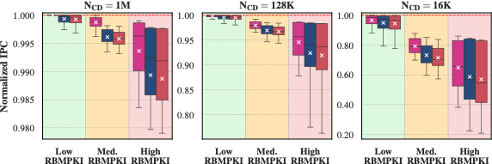
Evaluation: Single-Core Performance

Slide 41
Evaluation: Single-Core Performance
Higher is better
More memory-intensive

Slide 42
Evaluation: Single-Core Performance
ColumnKeeper-D and –P incur low (<1%) average performance overheads
for current ColumnDisturb thresholds (1M)

Slide 43
Evaluation: Single-Core Performance

Slide 44
Evaluation: Single-Core Performance
Performance overheads increase for more memory-intensive workloads

Slide 45
Evaluation: Single-Core Performance
Performance overheads increase for more memory-intensive workloads
All ColumnKeeper mechanisms incur significant performance overheads
at low ColumnDisturb thresholds of N_{CD}=16K

Slide 46
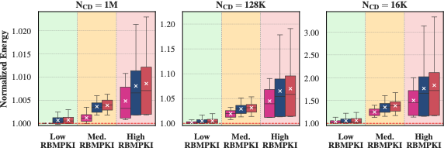
Evaluation: DRAM Energy (Single-Core)

Slide 47
Evaluation: DRAM Energy (Single-Core)
Lower is better
More memory-intensive

Slide 48
Evaluation: DRAM Energy (Single-Core)
Energy overheads increase for more memory-intensive workloads
Low energy overheads for current thresholds
Significant energy overheads for future low thresholds

Slide 49
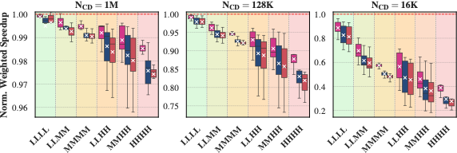
Evaluation: Multi-Core Performance

Slide 50
Evaluation: Multi-Core Performance
Higher is better
More memory-intensive

Slide 51
Evaluation: Multi-Core Performance

Slide 52
Evaluation: Multi-Core Performance
Performance overheads increase for memory-intensive workload mixes
Low performance overheads for current thresholds
Significant performance overheads for future low thresholds

Slide 53
Evaluation: Multi-Core Performance
1.5%
More pronounced difference between the deterministic and
the probabilistic mechanisms than single-core

Slide 54
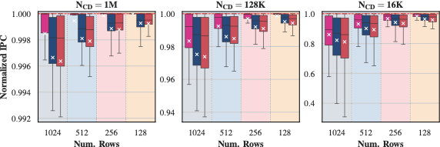
Evaluation: Sensitivity to Subarray Size

Slide 55
Evaluation: Sensitivity to Subarray Size
Higher is better
Smaller Subarrays

Slide 56
Evaluation: Sensitivity to Subarray Size
Smaller subarrays (128 rows) eliminate the overheads of ColumnKeeper
for current ColumnDisturb thresholds (1M)

Slide 57
Evaluation: Sensitivity to Subarray Size
Smaller subarrays reduce the overheads of ColumnKeeper
for all ColumnDisturb thresholds

Slide 58
Evaluation: Sensitivity to Subarray Size

Slide 59
Evaluation: Sensitivity to Subarray Size
Smaller subarrays reduce the overheads of ColumnKeeper
even at very low thresholds

Slide 60
Evaluation: Area and Power Overheads
ColumnKeeper requires:
7.5 KB of SRAM for ColumnKeeper-D
2.5 KB of SRAM for ColumnKeeper-P
Hardware Implementation & Synthesis:
ColumnKeeper implemented in Verilog
OpenRoad + NanGate 45nm Open-Source Cell Library
Area Overheads:
0.1 mm² for ColumnKeeper-D
0.03 mm² for ColumnKeeper-P
Power Overheads:
50 mW for ColumnKeeper-D
15 mW for ColumnKeeper-P

Slide 61
More in the Paper
Evaluation of ColumnKeeper with
Subarray-level Parallelism [Kim+, ISCA 2012]
Impact of physical page allocation policy on
the performance overheads of ColumnKeeper
Performance evaluation of ColumnKeeper integrated with RowHammer mitigation mechanisms
Performance evaluation under adversarial workloads
An in-DRAM implementation of our design

Slide 62
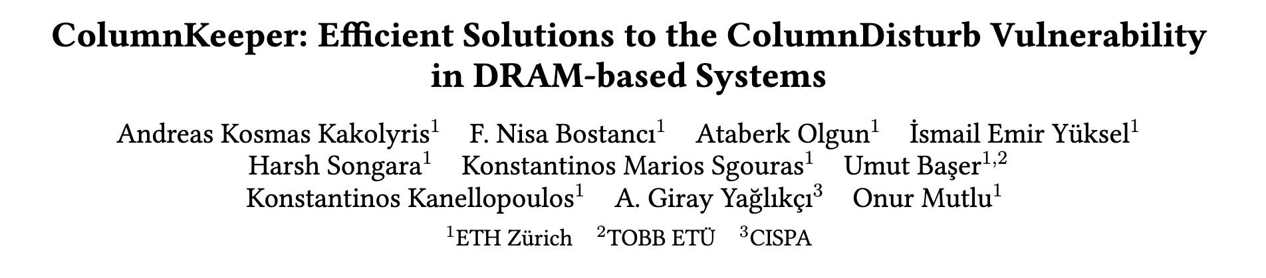
Available on arXiv
https://arxiv.org/pdf/2606.22632

Slide 63
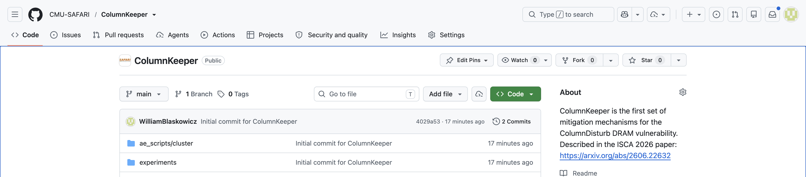
Artifact Evaluated & Open-Source
https://github.com/CMU-SAFARI/ColumnKeeper

Slide 64
Outline
Background
Motivation
ColumnKeeper-D (Deterministic)
ColumnKeeper-P (Probabilistic)
Evaluation
Conclusion

Slide 65
Conclusion
Goal: Mitigate ColumnDisturb bitflips at low overhead
Key Idea: Track row activations at subarray granularity and iteratively refresh
all affected rows in a subarray
ColumnKeeper-D: Uses separate activation counters for odd and even columns of each subarray
ColumnKeeper-P: Probabilistically issues refreshes to one row in
three consecutive subarrays upon a row activation in the middle subarray
Key Results:
ColumnKeeper prevents ColumnDisturb bitflips with low overheads for current and near-future thresholds
ColumnKeeper can prevent ColumnDisturb bitflips at low overheads for low thresholds with changes to DRAM microarchitecture

Slide 66
ColumnKeeper: Efficient Solutions
to the ColumnDisturb Vulnerability
in DRAM-based Systems
Paper
Code

Slide 67
ColumnKeeper: Efficient Solutions
to the ColumnDisturb Vulnerability
in DRAM-based Systems
Backup Slides
Andreas Kosmas Kakolyris
F. Nisa Bostancı
Harsh Songara
Konstantinos Kanellopoulos
Ataberk Olgun
Konstantinos Marios Sgouras
A. Giray Yağlıkçı
İsmail Emir Yüksel
Umut Başer
Onur Mutlu

Slide 68
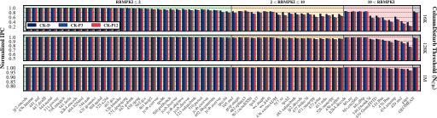
Evaluation: Detailed Single-Core Results

Slide 69
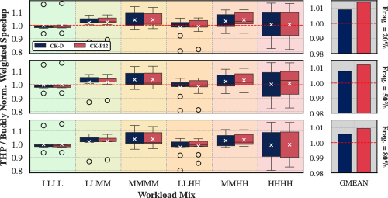
Evaluation: Sensitivity to Page Allocation
No significant difference in performance between the two allocators

Slide 70
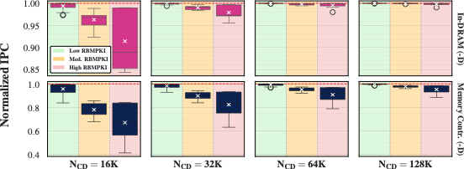
Evaluation: In-DRAM Implementation
The in-DRAM implementation of ColumnKeeper-D
reduces its overheads at low ColumnDisturb thresholds

Slide 71
ColumnKeeper-P: P_{PR} Calculation
Methodology
Similar to the one proposed in HiRA [Yaglikci+, MICRO 2022]
Considers the maximum number of attacks that can happen
in a refresh window
At least one of these attacks has to succeed
To induce bitflips: The number of preventive issues issued to a subarray must be lower than the subarray size (S) when the ColumnDisturb threshold is reached
Total number of preventive refreshes issued after N activations (M_{N}):
Sum of Bernoulli random variables
M_{N} follows a binomial distribution
$$P\left(M_{N}≤k\right)=I_{q}\left(N−k,1+k\right), q=1−P_{PR}$$

Slide 72
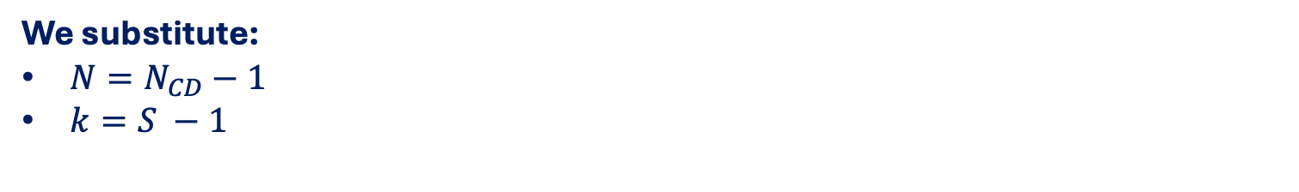


ColumnKeeper-P: P_{PR} Calculation
We substitute:
$N=N_{CD}−1$
$k=S −1$
A single ColumnDisturb attack succeeds with probability P₁:
$$P_{1}=P\left(M_{N_{CD}}< S \right)=P\left(M_{N_{CD}}≤S−1 \right)=I_{q}(N_{CD}−S,S)$$
Probability of a successful attack within a refresh window based on maximum number of attacks:
$$P_{REFW}=1 −{\left(1−P_{1}\right)}^{A}, A=\frac{t_{REFW}}{t_{F}}+1,t_{F}=\left(1+3S\right)⋅t_{RC}$$
Probability of a successful attack within a year (P_{Y}):
$$P_{Y}=1 −{\left(1−P_{REFW}\right)}^{492.7⋅{10}^{6}}$$

Slide 73
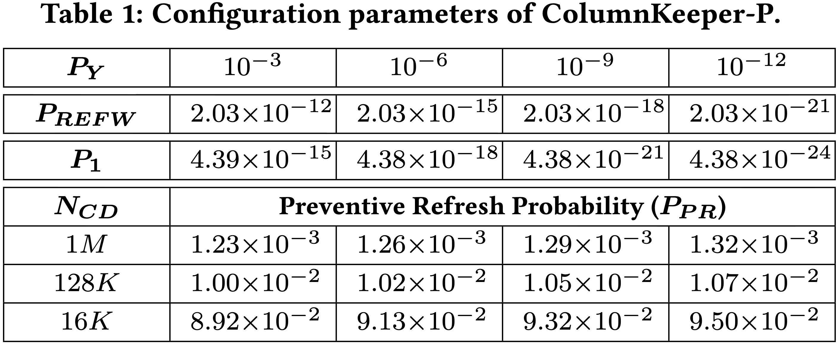
ColumnKeeper-P Configuration
Small increases in P_{PR} significantly increase security for the same N_{CD}

Slide 74
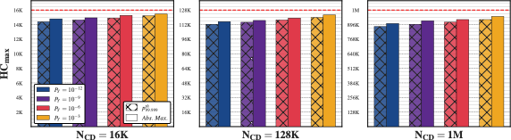
ColumnKeeper-P: Monte-Carlo Simulation
Lower P_{Y} leads to more preventive refreshes and a lower HC_{max}

Slide 75
Evaluation: Integration w/ RH Mitigations
ColumnKeeper issues ACT+PRE commands:
ACTs and PREs are transparent to RowHammer mitigation mechanisms
RowHammer mitigation mechanisms issue:
ACT + PRE commands
RFM commands
RFM commands accounted by
incrementing all activation counters in affected banks
ColumnKeeper operates transparently to
RowHammer mitigation mechanisms
RowHammer mitigation mechanisms operate
transparently to ColumnKeeper

Slide 76
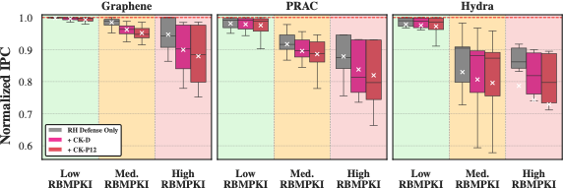
Evaluation: Integration w/ RH Mitigations
N_{CD} = 128K, N_{RH} = 128
No destructive interference between
RowHammer mitigation mechanisms and ColumnKeeper

Slide 77
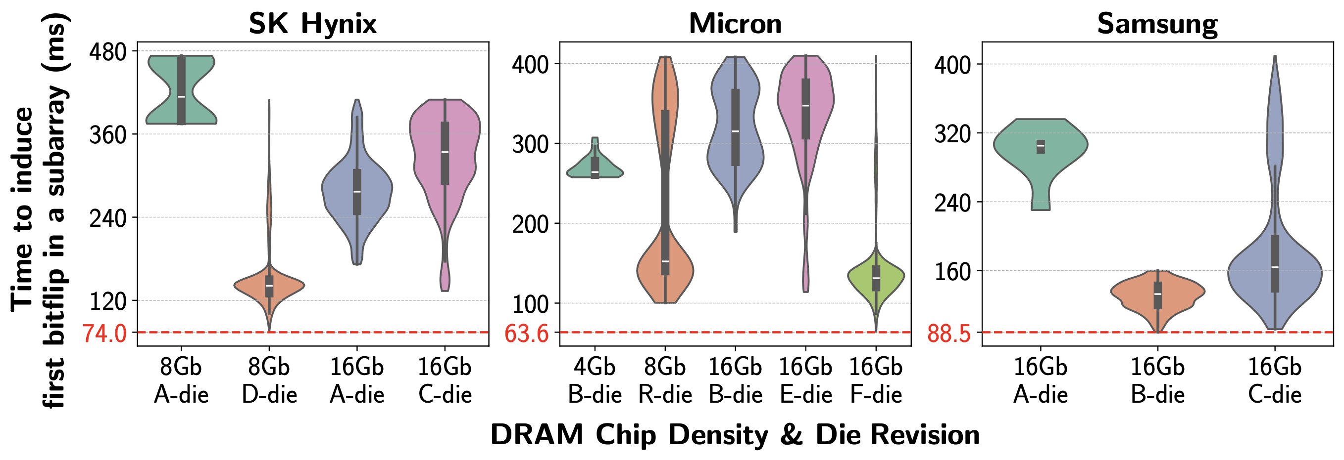
ColumnDisturb:
Newer Chips are More Vulnerable
5.1x
3x
2.5x
1.3x
Newer chips tend to be
more vulnerable to ColumnDisturb bitflips
This trend is consistent across all tested manufacturers

Slide 78
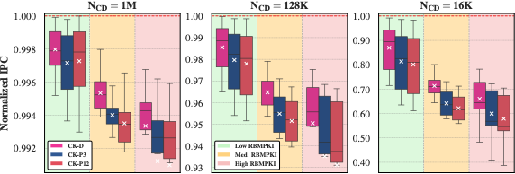
Evaluation: Adversarial Workloads
Low performance overheads for current and near-future thresholds
Significant performance overheads for future low thresholds

