Slide 1






Clutch
High Performance Vector-Scalar Comparison using DRAM via Chunked Temporal Coding
Daichi Tokuda
T. Kubo I. E. Yuksel A. Olgun H. Luo
T. Nagatani G. F. Oliveira A. G. Yağlıkçı M. Sadrosadati
O. Mutlu S. Takamaeda-Yamazaki
Notes:
Today I will present Clutch
High Performance Vector-Scalar Comparison using DRAM via Chunked Temporal Coding

Slide 2
Executive Summary
Motivation: Vector–scalar comparison is a fundamental primitive in data-intensive workloads
Processing-using-DRAM (PuD) is a promising approach to alleviate
the memory-bound bottleneck, as it performs computations directly within the DRAM array
Problem: Existing PuD approaches require many PuD operations for comparison due to the bit-serial execution model, limiting end-to-end application-level speedup
Key Mechanism: Clutch introduces a new data representation and algorithm
Temporal coding encodes values so that a comparison reduces to
a single lookup, dramatically reducing PuD operation count
Divide-and-conquer approach decomposes operands into smaller chunks, enabling a flexible throughput–footprint tradeoff
Key Results: Clutch achieves 12x higher throughput and 69x higher energy efficiency over CPU, and 2.9x/3.0x over the bit-serial PuD
Notes:
I will give you a quick overview of our work
[CLICK]
Vector-scalar comparison is a fundamental computation primitive that compares each element in a vector against a single scalar value.
This operation is widely used in data-intensive workloads
Processing-using-DRAM is a promising approach to alleviate the memory-bound bottleneck of this operation,
as it performs computations directly within the DRAM array
[CLICK]
However, existing PuD approaches require many DRAM commands, due to the bit-serial execution model, limiting end-to-end application-level speedup
[CLICK]
To address this, we propose Clutch, which introduces a new data representation and algorithm.
First, temporal coding encodes values so that a comparison reduces to a single lookup
Second, a divide-and-conquer approach, enabling a flexible throughput-footprint tradeoff.
[CLICK]
Our evaluation shows that Clutch significantly improves both throughput and energy efficiency over CPU and bit-serial PuD
(Clutch provides12 times higher throughput and 70 times better energy efficiency over CPU, and around 3.0 times over the bit-serial PuD approach)

Slide 3
Outline
Background
Motivation: PuD for Vector-Scalar Comparison
Limitation of Prior PuD Approaches
Clutch: Lookup Table-Based Comparison
Clutch: Divide-and-Conquer Approach
Evaluation
Conclusion
Notes:
Here is the outline of our talk.

Slide 4
Outline
Background
Motivation: PuD for Vector-Scalar Comparison
Limitation of Prior PuD Approaches
Clutch: Lookup Table-Based Comparison
Clutch: Divide-and-Conquer Approach
Evaluation
Conclusion
Notes:
I will start with the background of vector-scalar comparison and Processing-using-DRAM

Slide 5
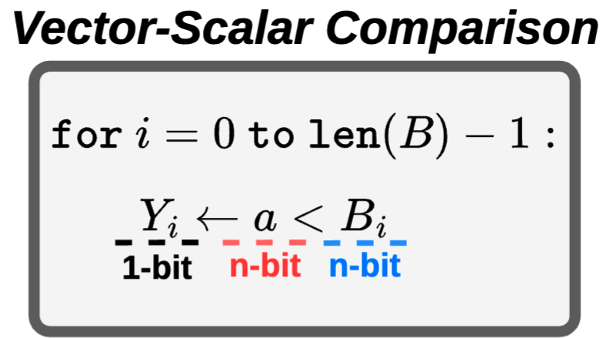
Vector-Scalar Comparison
Vector-Scalar Comparison: compares each element in a vector against a single scalar value
  A fundamental primitive in data-intensive workloads, including predicate evaluation and decision tree inference
  Due to its low computational intensity, its execution tends to be memory-bound
Notes:
[CLICK]
Vector-scalar comparison is a fundamental primitive that compares each element in a vector against a single scalar value.
As shown in this figure, we have n-bit scalar value A and vector B, where each element B_i is also n bits
For each index i, we compare a scalar value A against the i-th element of vector B, producing a 1-bit result Y_i.
[CLICK]
This operation is a fundamental primitive in data-intensive workloads, including predicate evaluation in databases and decision tree inference in machine learning.
[CLICK]
Due to its low computational intensity, its execution tends to be main memory bandwidth-bound

Slide 6

DRAM Organization
DRAM Module
DRAM
Chip
Subarray
DRAM Cell
Bank
…
Wordline
Chip I/O
Row Decoder
DRAM Row
Bitline
…
Sense Amps.
DRAM Chip
DRAM Bank
DRAM Subarray
Notes:
Then I will walk you through the background of DRAM
DRAM is used as the main memory in many computing systems.
[CLICK] A DRAM module consists of multiple DRAM chips.
[CLICK] Each chip contains multiple banks.
[CLICK] Each bank is composed of multiple subarrays
[CLICK] And within each subarray, there is a two-dimensional array of DRAM cells.
[CLICK] These cells are organized into rows
[CLICK] And cells in the same column are connected to a sense amplifier through a shared bitline.

Slide 7

Data Movement Bottleneck
Today’s computing systems are processor-centric
All data is processed in the processor
Computing Unit
(CPU, GPU, FPGA, Accelerator)
High
Data Movement
Main Memory (DRAM)
Low-computational-intensity operations are bottlenecked by data movement
Notes:
Today's computing systems are processor-centric, meaning all data must be moved from DRAM to the computing units for computation.
This data movement become a major bottleneck.
[CLICK]
Specifically, in the processor-centric paradigm,
low-computational-intensity operations such as vector–scalar comparison are bottlenecked by data movement between DRAM and the computing units.

Slide 8
Processing-using-DRAM (PuD)
Processing-using-DRAM (PuD) uses the analog operational principles of DRAM cells to perform computation
PuD alleviates the frequent data movement between main memory and computing units
Computing Unit
(CPU, GPU, FPGA, Accelerator)
Low
Data Movement
Main Memory (DRAM)
Notes:
To address this, Processing-using-DRAM repurposes DRAM from a storage device to a computation device.
PuD leverages the analog operational principles of DRAM cells to perform computation directly within DRAM.

Slide 9

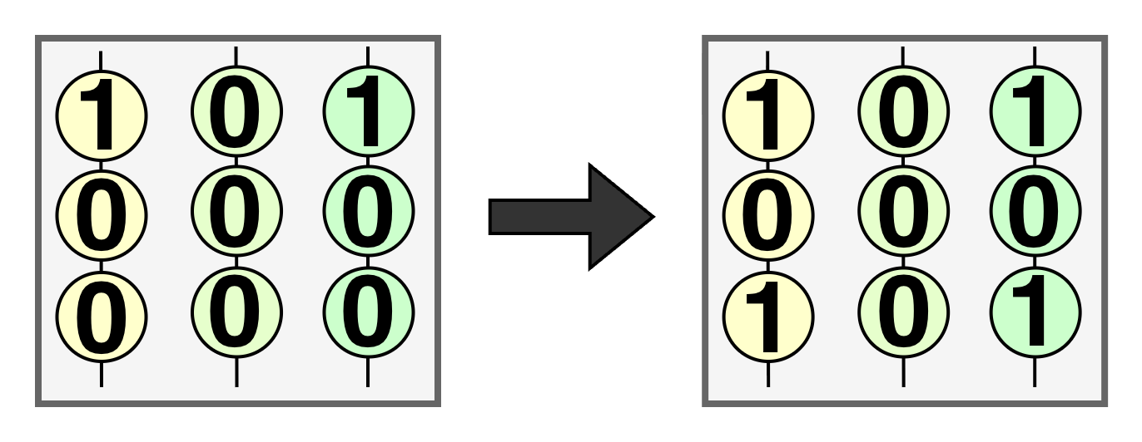
PuD Primitives: RowCopy
RowCopy: transfers data between rows within the same subarray by activating two rows in quick succession, enabling efficient bulk data movement inside DRAM
Columns (e.g. 64K columns / bank)
DRAM Cell
Notes:
Let me introduce the two fundamental PuD primitives, starting with RowCopy.
RowCopy transfers data between rows within the same subarray
[CLICK]
The figure here shows a subarray, where each circle represents a DRAM cell and its 1-bit stored value.
(The DRAM cell array consists of massive parallel columns)

Slide 10
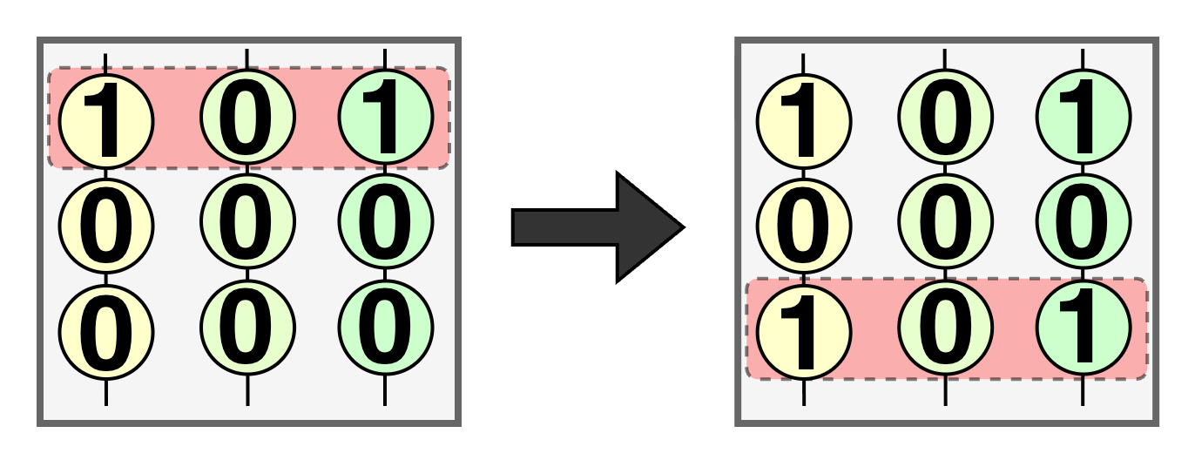
PuD Primitives: RowCopy
RowCopy: transfers data between rows within the same subarray by activating two rows in quick succession, enabling efficient bulk data movement inside DRAM
ACT
Source Row
Notes:
RowCopy works as follows: we first activate a source row,

Slide 11
PuD Primitives: RowCopy
RowCopy: transfers data between rows within the same subarray by activating two rows in quick succession, enabling efficient bulk data movement inside DRAM
ACT
ACT
Destination Row
Notes:
and then activate a destination row in quick succession.
Due to the analog operational principles, the destination row is overwritten with the data from the source row.

Slide 12
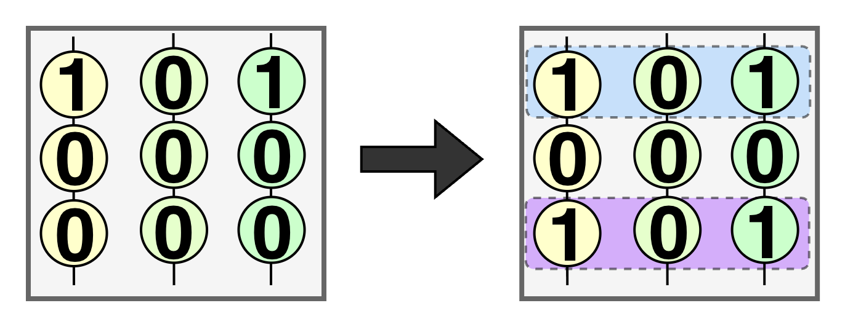

PuD Primitives: RowCopy
RowCopy: transfers data between rows within the same subarray by activating two rows in quick succession, enabling efficient bulk data movement inside DRAM
Source Row
RowCopy
Destination Row
Notes:
In this way, RowCopy efficiently copies an entire row of data from
[CLICK] a source row to
[CLICK] a destination row,
[CLICK]
entirely within the DRAM array.

Slide 13
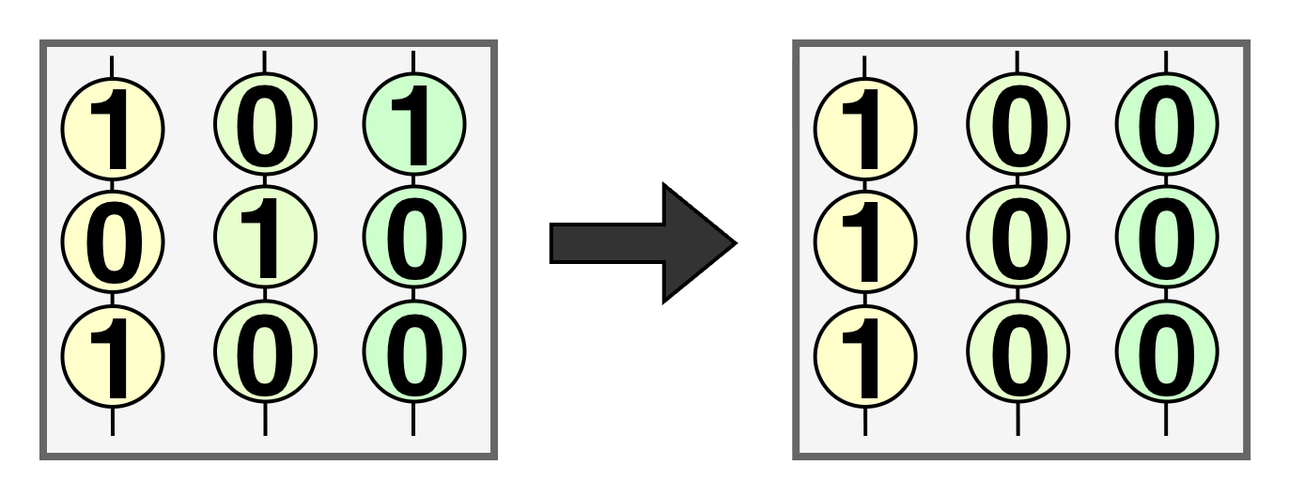
PuD Primitives: MAJ3
MAJ3: activates three rows simultaneously, causing charge sharing on the bitline, such that each column independently computes the majority of the activated cells in that column
Notes:
Next, let me introduce the second primitive, MAJ3

Slide 14
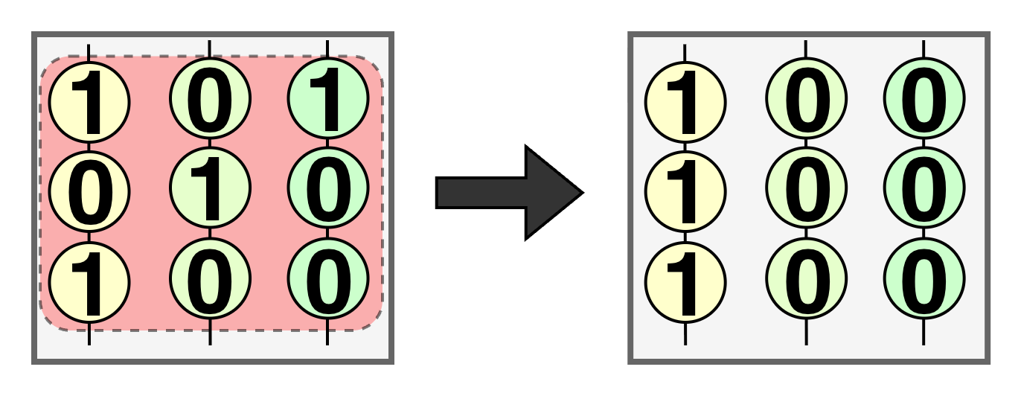
PuD Primitives: MAJ3
MAJ3: activates three rows simultaneously, causing charge sharing on the bitline, such that each column independently computes the majority of the activated cells in that column
Simultaneously
activating
three rows
Notes:
[CLICK]
MAJ3 activates three rows simultaneously.

Slide 15
PuD Primitives: MAJ3
MAJ3: activates three rows simultaneously, causing charge sharing on the bitline, such that each column independently computes the majority of the activated cells in that column
Simultaneously
activating
three rows
Notes:
[CLICK]
This causes charge sharing, such that each column computes the majority of the activated cells in that column.

Slide 16
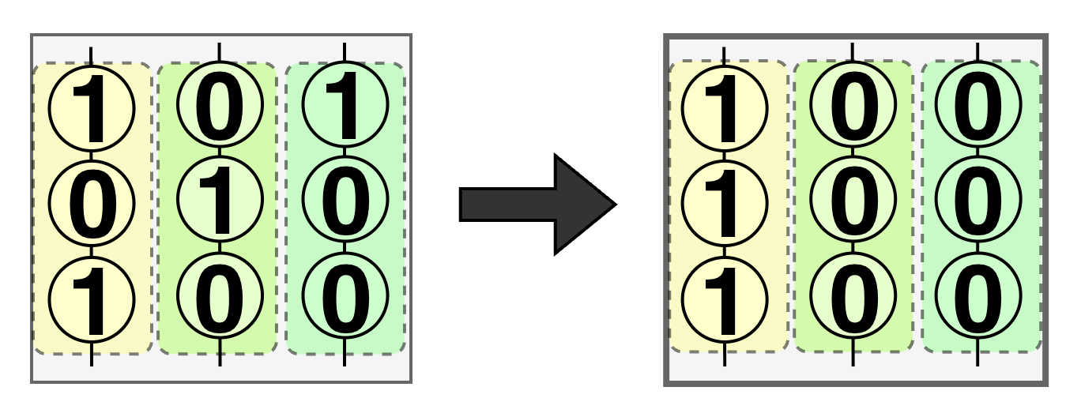
PuD Primitives: MAJ3
MAJ3: activates three rows simultaneously, causing charge sharing on the bitline, such that each column independently computes the majority of the activated cells in that column
MAJ3(1, 0, 1)
= 1
Each column
performs
MAJ3
Notes:
For example,
[CLICK]
as shown in the leftmost column of this figure, the three activated cells store values 1, 0, and 1.
[CLICK]
So, the result in the column is 1.
[CLICK]
In this way, each column performs MAJ3, enabling massive parallelism across all columns

Slide 17
Prior PuD Arithmetic: Bit-Serial Execution
Massive Parallelism
DRAM Cell
0
1
1
1
0
0
1
0
0
1
0
1
0
0
0
1
1
1
Notes:
Now let me explain how prior PuD performs arithmetic.
(The Rectangle represents DRAM subarray and
Each Cell represents DRAM cell)

Slide 18
Prior PuD Arithmetic: Bit-Serial Execution
Computation
Rows
MSB
0
1
1
Operand 0
1
0
0
Binary in
Vertical Layout
LSB
MSB
1
0
0
Operand 1
LSB
1
0
1
Constant
Rows
0
0
0
1
1
1
Notes:
In the PuD architectures,
[CLICK]
Some rows are designated as compute rows, which support MAJ3
[CLICK]
Initially, the bits of two operands are stored vertically in the same column
[CLICK]
For example, in this figure,
[CLICK]
the bits of Operand 0 are stored vertically from MSB to LSB,
[CLICK]
and the bits of Operand 1 are stored in the same column
[CLICK]
Additionally, There are also constant rows, which are filled entirely with either 0s or 1s.

Slide 19
Prior PuD Arithmetic: Bit-Serial Execution
Computation
Rows
MSB
0
1
1
RowCopy
Operand 0
1
0
0
1
0
0
LSB
MSB
1
0
0
Operand 1
RowCopy
1
0
1
LSB
1
0
1
RowCopy
0
0
0
0
0
Constant
Rows
0
1
1
1
Notes:
Prior PuD performs arithmetic by executing PuD operations in a bit-serial manner, from LSB to MSB.
Here, let me walk through the first step of a multiplication
[CLICK]
[CLICK]
First, we use RowCopy to move the LSB bit of one operand into a compute row.
[CLICK]
Next,
[CLICK]
we copy the LSB bit of the other operand into another compute row.
[CLICK]
Then,
[CLICK]
we copy a constant row filled with 0s into the third compute row.

Slide 20
Prior PuD Arithmetic: Bit-Serial Execution
1
0
0
Computation
Rows
1
0
1
MAJ3
0
0
0
MSB
0
1
1
Operand 0
1
0
0
1
0
0
LSB
MSB
1
0
0
Operand 1
1
0
1
LSB
1
0
1
0
0
0
0
0
Constant
Rows
0
1
1
1
Notes:
And then,
[CLICK]
By executing MAJ3 over these three compute rows,

Slide 21
Prior PuD Arithmetic: Bit-Serial Execution
1
0
0
Computation
Rows
1
0
0
MAJ3
1
0
0
MSB
0
1
1
Operand 0
1
0
0
1
0
0
LSB
MSB
1
0
0
Operand 1
1
0
1
LSB
1
0
1
0
0
0
0
0
Constant
Rows
0
1
1
1
Notes:
we obtain the AND operation of the two LSB bits, which corresponds to the LSB bit of the multiplication.
By repeating this process in a bit-serial manner,
PuD ultimately performs the full arithmetic operation.

Slide 22
Outline
Background
Motivation: PuD for Vector-Scalar Comparison
Limitation of Prior PuD Approaches
Clutch: Lookup Table-Based Comparison
Clutch: Divide-and-Conquer Approach
Evaluation
Conclusion
Notes:
Now, let me move on to the Motivation and Opportunity for Processing-using-DRAM

Slide 23
Motivation: PuD for Vector-Scalar Comparison
Problem of Processor-Centric Execution:
Vector–scalar comparison has low computational intensity, making execution main-memory bandwidth-bound
Opportunity for PuD:
Due to the arithmetic nature of vector–scalar comparison, PuD can explicitly reduce
off-chip data movement
Notes:
(In this slide, we discuss why PuD is particularly promising for vector–scalar comparison.)
[CLICK]
Vector–scalar comparison has low computational intensity, which makes processor-centric execution main-memory bandwidth-bound, as the processor must continuously fetch large amounts of data from DRAM.
[CLICK]
This suggests a key opportunity for PuD. In particular, due to the arithmetic nature of vector–scalar comparison, PuD can explicitly reduce off-chip data movement.

Slide 24
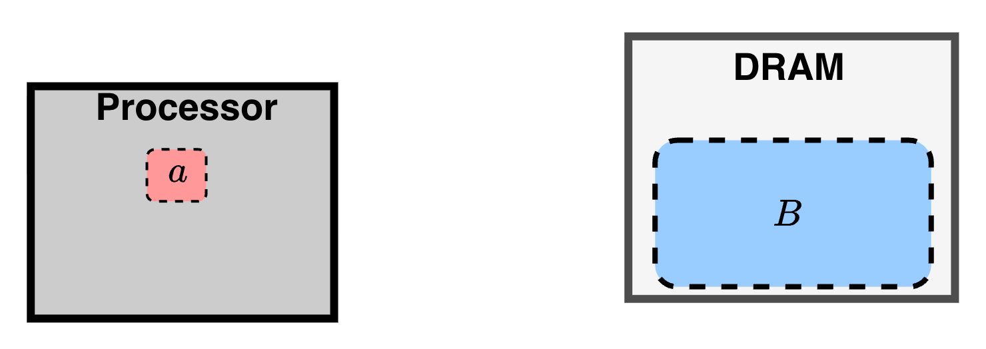
Data Movement Reduction via PuD Execution
Processor-Centric Paradigm
Vector of
n-bit elements
n-bit Scalar
Notes:
Here, we discuss why PuD is particularly promising for vector–scalar comparison.
Now let compares the two execution models: processor-Centric Paradigm and Processing-using-DRMA
In both cases,
[CLICK]
the n-bit vector B is stored in DRAM,
[CLICK]
and the processor holds a scalar value a.
(The goal is for the processor to obtain the 1-bit comparison result bitmap Y.)

Slide 25
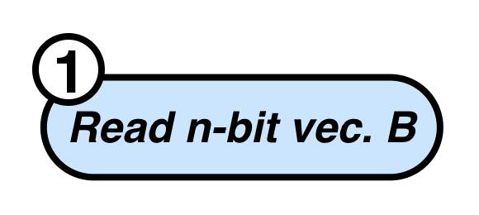
Data Movement Reduction via PuD Execution
Processor-Centric Paradigm
Notes:
In the processor-centric case,
[CLICK]
the processor must first read the entire n-bit vector B from DRAM.

Slide 26

Data Movement Reduction via PuD Execution
Processor-Centric Paradigm
Notes:
[CLICK]
This involves large off-chip data movement.

Slide 27
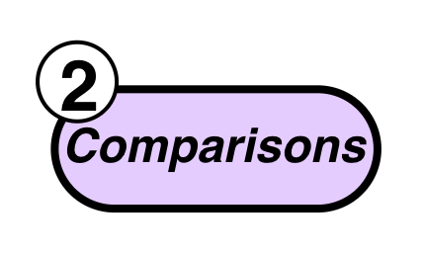
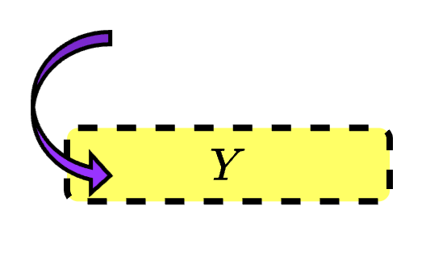
Data Movement Reduction via PuD Execution
Processor-Centric Paradigm
Notes:
The processor then compares each element of B against the scalar a
[CLICK]
[CLICK]
, obtaining the 1-bit bitmap Y.

Slide 28
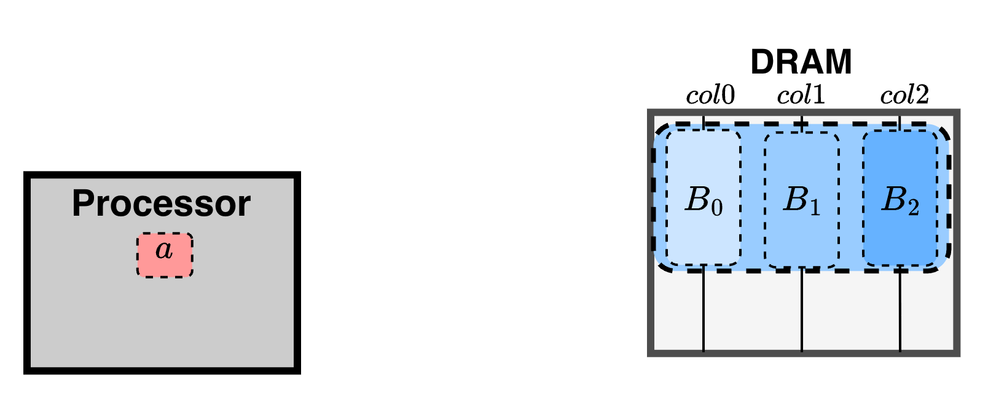
Data Movement Reduction via PuD Execution
Processor-Centric Paradigm
Processing-using-DRAM
Notes:
In contrast,
In PuD, the elements of vector B are stored vertically across columns in the DRAM subarray.

Slide 29
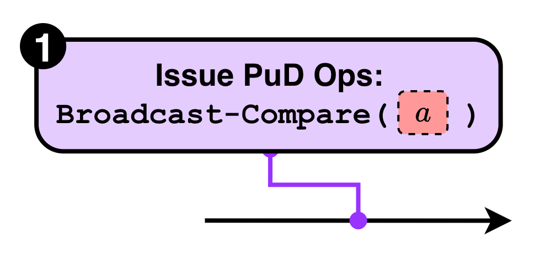
Data Movement Reduction via PuD Execution
Processor-Centric Paradigm
1) The scalar value a
is shared across all elements
Processing-using-DRAM
Notes:
[CLICK]
Then, the processor issues PuD operations based on the scalar value A,
performing the comparison entirely inside DRAM
(without reading the vector from DRAM.)
[CLICK]
This is possible because the scalar value A is shared across all elements, allowing the same operation to be applied to every column.

Slide 30
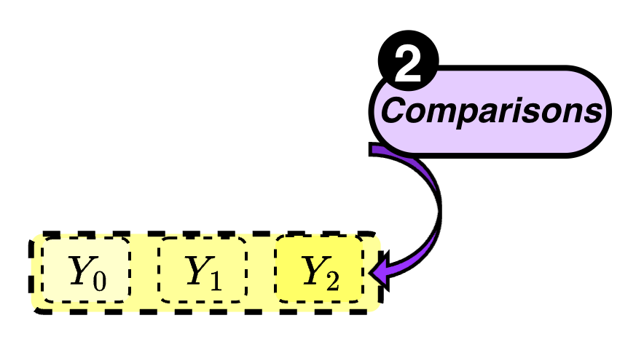
Data Movement Reduction via PuD Execution
Processor-Centric Paradigm
Processing-using-DRAM
Notes:
As a result,
[CLICK]
the 1-bit bitmap Y is produced directly inside DRAM.

Slide 31



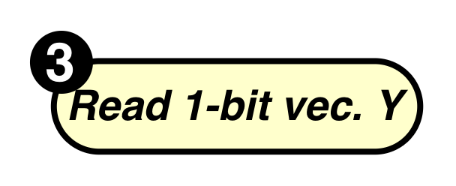
Data Movement Reduction via PuD Execution
Processor-Centric Paradigm
Processing-using-DRAM
Notes:
To obtain the result,
[CLICK]
[CLICK]
the processor only needs to read the 1-bit bitmap Y,

Slide 32
Data Movement Reduction via PuD Execution
Processor-Centric Paradigm
2) The output is a 1-bit-per-element bitmap Y, far smaller than
the n-bit input vector B
Processing-using-DRAM
Notes:
[CLICK]
Therefore, PuD exploits the 1-bit nature of the output
to significantly reduce data movement.

Slide 33

Data Movement Reduction via PuD Execution
Processor-Centric Paradigm
3) The output bitmap is often combined with
other bitmaps in
downstream processing
Processing-using-DRAM
Notes:
Furthermore, in many workloads,
[CLICK]
the bitmap Y is combined with other bitmaps in downstream processing.
[CLICK]
In such cases, PuD can reuse Y directly inside DRAM for subsequent PuD operations
(, potentially eliminating even the transfer of Y to the processor.)

Slide 34
Data Movement Reduction via PuD Execution
Processor-Centric Paradigm
Processing-using-DRAM
Notes:
[CLICK]
(In summary, while processor-centric execution requires reading at least the full n-bit vector B,
PuD requires at most reading the 1-bit bitmap Y. )
(This reduces the data transfer volume by a factor of n or more.)

Slide 35
Outline
Background
Motivation: PuD for Vector-Scalar Comparison
Limitation of Prior PuD Approaches
Clutch: Lookup Table-Based Comparison
Clutch: Divide-and-Conquer Approach
Evaluation
Conclusion
Notes:
Now let me discuss the limitation of prior bit-serial-based Processing-using-DRAM for vector–scalar comparison.

Slide 36
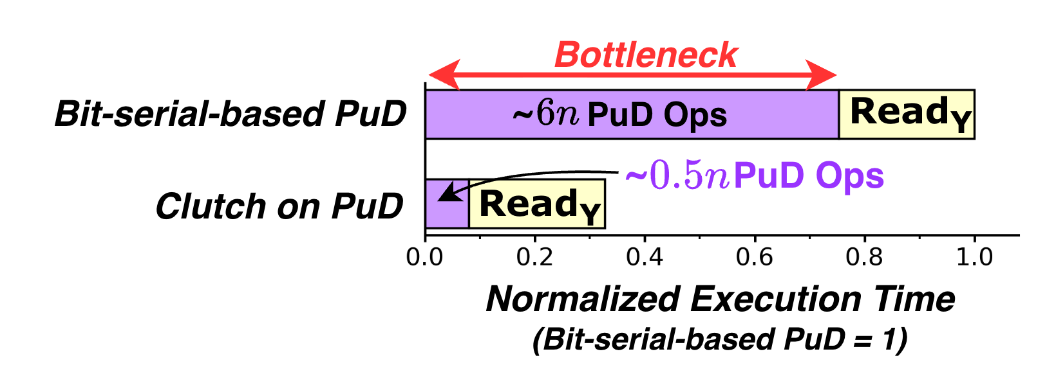
Limitation of Bit-Serial PuD
Prior PuD¹ arithmetic relies on bit-serial execution, requiring many PuD operations for comparison
PuD operation latency dominates total comparison latency
  accounting for up to 76% of total latency
  in comparisons in our evaluation
Notes:
[CLICK]
Prior Bit-serial-based PuD algorihtms requires many PuD operations
[CLICK]
There are two main sources of latency: the PuD operations, and reading the output bitmap Y.
In our evaluation PuD operations become the major bottleneck,
[CLICK]
accounting for 76% of total latency in 32-bit comparisons.
(This large operation count makes it difficult to outperform processor-centric execution, especially when parallelism is limited.)

Slide 37
Limitation of Bit-Serial PuD
Prior PuD¹ arithmetic relies on bit-serial execution, requiring many PuD operations for comparison
PuD operation latency dominates total comparison latency
  accounting for up to 76% of total latency
  in comparisons in our evaluation
Key Challenge:
Reducing the number of PuD operations
for comparison is critical to unlocking
PuD’s performance potential
Notes:
Therefore,
[CLICK]
the key challenge is: reducing the number of PuD operations is critical
to unlocking the full performance of PuD

Slide 38
Our Goal
Our Goal:
Design a comparison algorithm that significantly reduces the number of
PuD operations
Notes:
[CLICK]
So, our goal is to design a comparison algorithm that minimizes the number of PuD operations.

Slide 39
Our Goal
Our Goal:
Design a comparison algorithm that significantly reduces the number of
PuD operations
Notes:
[CLICK]
Then, our proposed method, Clutch, significantly reduces the number of PuD operations
(required for comparison.)

Slide 40
Clutch: Overview
Clutch (Comparison Algorithm using Lookup Table with Chunked Temporal Coding)
Temporal Coding: Encodes operands so that
a comparison reduces to a single lookup
Divide-and-Conquer: Decomposes operands into multiple smaller chunks,
significantly reducing memory footprint
Notes:
[CLICK]
Now let me give an overview of Clutch
Clutch introduces two key ideas
[CLICK]
The first idea is Temporal Coding. Clutch encodes vector elements using temporal coding, so that a comparison reduces to a single row lookup.
[CLICK]
The second idea is Divide-and-Conquer to address the large memory footprint of the lookup table

Slide 41
Outline
Background
Motivation: PuD for Vector-Scalar Comparison
Limitation of Prior PuD Approaches
Clutch: Lookup Table-Based Comparison
Clutch: Divide-and-Conquer Approach
Evaluation
Conclusion
Notes:
I will start with the first key idea: the lookup table-based comparison using temporal coding.

Slide 42
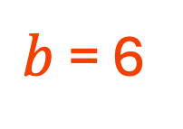

Clutch: Lookup Table-Based Comparison
Key Idea: Instead of bit-serial execution, Clutch encodes vector elements using temporal coding
Key property: The $i$-th bit of the encoded value $b$ equals the truth value of $i$ < $b$
$b$ = 6
MSB
LSB
Binary
1
1
0
index
0
1
2
3
4
5
6
Temporal
1
1
1
1
1
1
0
Notes:
The key idea is
[CLICK]
to encode vector elements using temporal coding instead of binary representation.
[CLICK]
Let me give an example using B equals 6.
[CLICK]
In Clutch, we adopt temporal coding.
[CLICK]
In temporal coding, b is represented as b leading ones
So b equals 6 is encoded as six ones followed by one zero.
[CLICK]
Here, there is a key property between the index i of the temporal coding and the comparison operation.
The i-th bit of the encoded value b equals the truth value of “”i is less than b.””

Slide 43

Clutch: Lookup Table-Based Comparison
index
0
1
2
3
4
5
6
other vector
elements
$b$ = 6
1
1
1
1
1
1
0
$$b$$
index
0
1
1
1
2
1
3
1
4
1
5
1
6
0
Notes:
By leveraging this key property of temporal coding, comparison can be executed on PuD in significantly fewer steps.
[CLICK]
First, each vector element B is stored in a vertical layout, using temporal coding.
[CLICK]
Similarly, other vector elements are stored vertically in their respective columns

Slide 44

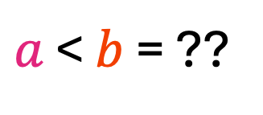
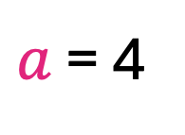
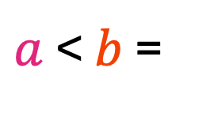
Clutch: Lookup Table-Based Comparison
index
0
1
2
3
4
5
6
$b$ = 6
1
1
1
1
1
1
0
$$b$$
index
0
1
1
1
Lookup
2
1
$a$ = 4
$a$-th Row
3
1
Row
Copy
1
$a$ < $b$ = ??
4
1
5
1
6
0
$a$ < $b$ =
Notes:
Now, let us perform a vector–scalar comparison with a scalar value A equals 4.
Due to the key property of temporal coding,
[CLICK]
we can execute the vector–scalar comparison simply by looking up the row at index A.
[CLICK]
Since A equals 4, we simply look up row 4.
[CLICK]
That is, we issue a single RowCopy from row 4.
[CLICK]
And the resulting bitmap is produced directly inside DRAM.

Slide 45

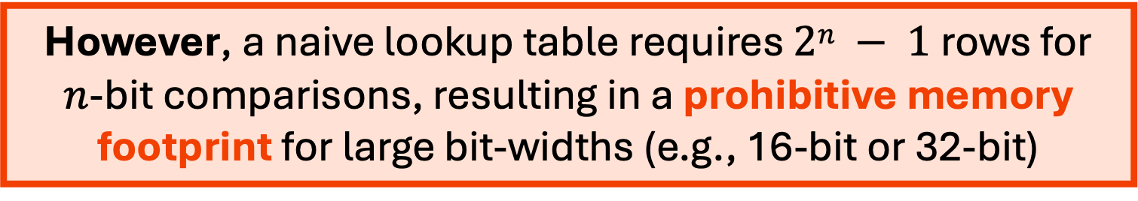
Clutch: Lookup Table-Based Comparison
index
0
1
2
3
4
5
6
$b$ = 6
1
1
1
1
1
1
0
$$b$$
index
The lookup table-based approach significantly reduces PuD operation count
0
1
1
1
Lookup
2
1
$a$ = 4
$a$th Row
3
1
Row
Copy
However, a naive lookup table requires $2n − 1$rows for
$n$-bit comparisons, resulting in a prohibitive memory footprint for large bit-widths (e.g., 16-bit or 32-bit)
1
$a$ < $b$ = ??
4
1
5
1
6
0
$a$ < $b$ =
Notes:
Therefore,
[CLICK]
the lookup table-based approach significantly reduces PuD operation count.
[CLICK]
However, a naive lookup table requires two to the n rows for n-bit values.
This results in a prohibitive memory footprint
( such as 16-bit or 32-bit, making it impractical for real DRAM subarrays.)

Slide 46
Outline
Background
Motivation: PuD for Vector-Scalar Comparison
Limitation of Prior PuD Approaches
Clutch: Lookup Table-Based Comparison
Clutch: Divide-and-Conquer Approach
Evaluation
Conclusion
Notes:
To address this, Clutch introduces the second key idea: the divide-and-conquer approach.

Slide 47
Clutch: Chunked Divide-and-Conquer
$a$ = 5
$b$ = 6
MSB
LSB
MSB
LSB
0
1
0
1
<
0
1
1
0
= ?
Notes:
Let me give an example, using a comparison of A equals 5 and B equals 6.
Each square represents a 4-bit binary representation

Slide 48
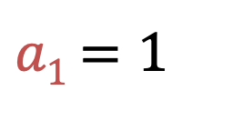
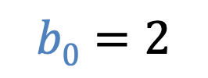
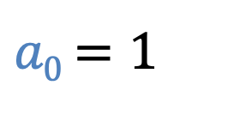

Clutch: Chunked Divide-and-Conquer
$a$ = 5
$b$ = 6
MSB
LSB
MSB
LSB
0
<
0
1
1
0
= ?
0
1
1
0
0
1
1
0
1
1
0
Chunk1
Chunk0
Chunk1
Chunk0
$a1$ $=1$
$a0$ $=1$
$$b1=1$$
$$b0=2$$
<
= False
Divide
<
= True
How to Conquer?
Notes:
In the divide-and-conquer approach, we split the binary operands into several smaller bit chunks.
In this example, we divide each operand into two chunks
[CLICK]
For operand A, the MSB-side chunk A1 represents the value 1 in two bits, and the LSB-side chunk A0 is also the value 1.
[CLICK]
Similarly, B1 is the value 1 and B0 is the value 2.
[CLICK][CLICK]
In Clutch's divide-and-conquer approach,
[CLICK] [CLICK]
[CLICK] [CLICK]
we perform comparisons on a per-chunk basis.
[CLICK]
In this example, we compare A1 with B1, and A0 with B0,
[CLICK]
[CLICK]
But how do we actually conquer — that is, how do we derive the final comparison result from these per-chunk results?

Slide 49
Clutch: Divide-and-Conquer
$$a < b$$
$a$ = 5
MSB
LSB
=
0
0
1
1
0
0
1
1
$a1$ $=1$
$a0$ $=1$
$b$ = 6
MSB
LSB
0
1
1
0
0
1
1
0
$$b1=1$$
$$b0=2$$
Notes:
To derive the full comparison result of A less than B, we reformulate the comparison expression step by step.

Slide 50
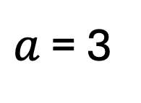
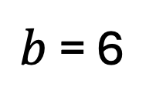

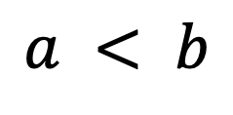

Clutch: Divide-and-Conquer
$$a < b$$
$a$ = 5
$a1$ $<b1$
MSB
LSB
=
$$or$$
0
0
1
1
0
0
1
1
$a1$ $=1$
$a0$ $=1$
$a$ = 3
$b$ = 6
$b$ = 6
MSB
LSB
0
0
0
0
0
1
1
0
1
1
0
1
1
0
0
1
1
0
0
1
1
0
0
1
1
0
$$b1=1$$
$$b0=2$$
$$<$$
$$⟹$$
$$a < b$$
Notes:
First,
[CLICK]
we focus on the MSB chunk
[CLICK]
[CLICK]
[CLICK]
If the MSB-chunk comparison holds,
[CLICK]
then obviously, the full comparison is also true.
[CLICK]
and then

Slide 51

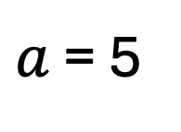
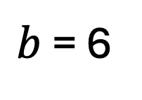


Clutch: Divide-and-Conquer
$$a < b$$
$a$ = 5
(
$a1$ $≤b1$
)
$a1$ $<b1$
$a0$ $<b0$
MSB
LSB
=
$$or$$
$$and$$
0
0
1
1
0
0
1
1
$a$ = 5
$b$ = 6
$a1$ $=1$
$a0$ $=1$
0
1
0
1
0
1
1
0
0
1
0
1
0
1
1
0
$b$ = 6
MSB
LSB
$≤$
0
1
1
0
0
1
1
0
$$and$$
$$b1=1$$
$$b0=2$$
$$<$$
$$⟹$$
$$a < b$$
Notes:
Conversely, if A1 is greater than B1, the full comparison is obvisouly false.
Otherwise,
[CLICK]
when A1 is less than or equal to B1,
[CLICK] [CLICK] [CLICK]
the comparison result [CLICK(and)]
carries over to
[CLICK]
the LSB chunk.
[CLICK] [CLICK][CLICK]
And if the LSB-chunk comparison holds,
[CLICK]
the full comparison is also true.

Slide 52
Clutch: Divide-and-Conquer
$$a < b$$
$a$ = 5
(
$a1$ $≤b1$
)
$a1$ $<b1$
$a0$ $<b0$
MSB
LSB
=
$$or$$
$$and$$
0
0
1
1
0
0
1
1
$a1$ $=1$
$a0$ $=1$
$b$ = 6
MSB
LSB
0
1
1
0
0
1
1
0
$$b1=1$$
$$b0=2$$
Notes:
[CLICK]

Slide 53






Clutch: Divide-and-Conquer
$$a < b$$
$a$ = 5
(
$a1$ $≤b1$
)
$a1$ $<b1$
$a0$ $<b0$
MSB
LSB
=
$$or$$
$$and$$
0
0
1
1
0
0
1
1
$a1$ $=1$
$a0$ $=1$
)
$a1$ $<b1$
$a1$ $−1<b1$
$a0$ $<b0$
=
$$or$$
(
$$and$$
$b$ = 6
MSB
LSB
$a1$ $≤b1$
$2$ $≤2$
0
1
1
0
0
1
1
0
$$b1=1$$
$$b0=2$$
$$⟺$$
$a1$ $−1<b1$
$2−1<2$
Notes:
Next, [CLICK]
let us focus on this term:
Now, [CLICK]
since A1 is an integer,
[CLICK]
this term is rewritten
as
[CLICK] [CLICK]
A1 minus 1 is less than B1.
This is convenient because it allows us to evaluate this term using the same lookup table of the MSB-chunk.

Slide 54
Clutch: Divide-and-Conquer
$$a < b$$
$a$ = 5
(
$a1$ $≤b1$
)
$a1$ $<b1$
$a0$ $<b0$
MSB
LSB
=
$$or$$
$$and$$
0
0
1
1
0
0
1
1
$a1$ $=1$
$a0$ $=1$
)
$a1$ $<b1$
$a1$ $−1<b1$
$a0$ $<b0$
=
$$or$$
(
$$and$$
$b$ = 6
MSB
LSB
0
1
1
0
=
0
1
1
0
$$b1=1$$
$$b0=2$$
Notes:
Finally, let us consider whether this expression can be further simplified.

Slide 55


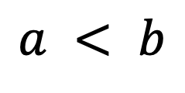

Clutch: Divide-and-Conquer
$a1$ $<b1$
$a1$ $−1<b1$
$a0$ $<b0$
$$a < b$$
$$a < b$$
True
True
X
True
$a$ = 5
(
$a1$ $≤b1$
)
$a1$ $<b1$
$a0$ $<b0$
MSB
LSB
=
$$or$$
$$and$$
False
True
True
True
0
0
1
1
0
0
1
1
$a1$ $=1$
$a0$ $=1$
)
$a1$ $<b1$
$a1$ $−1<b1$
$a0$ $<b0$
=
$$or$$
(
$$and$$
$b$ = 6
MSB
LSB
)
=
(
$a1$ $<b1$
$a1$ $−1<b1$
$a0$ $<b0$
0
1
1
0
MAJ3
,
,
0
1
1
0
$$b1=1$$
$$b0=2$$
Notes:
[CLICK]
When the full comparison result is true, one case is
[CLICK]
when the MSB-chunk comparison is true.
In this case,
[CLICK]
A1 minus 1 less than B1 is also trivially true, and
[CLICK]
the LSB-chunk result can be ignored.
[CLICK]
In the other case, the MSB-chunk comparison is false,
In this case, the full comparison result is true
[CLICK]
if and only if both the second and third terms are true.
[CLICK]
Now, looking at the full truth table, when two or more terms are true, the full comparison result is true.
Therefore,
[CLICK]
perhaps surprisingly, this boolean expression turns out to be equivalent to a single MAJ3 operation.

Slide 56

Clutch: Divide-and-Conquer
$$a < b$$
$a$ = 5
(
)
$a1$ $<b1$
$a1$ $≤b1$
$a0$ $<b0$
MSB
LSB
=
$$or$$
$$and$$
0
0
1
1
0
0
1
1
$a1$ $=1$
$a0$ $=1$
)
$a1$ $<b1$
$a1$ $−1<b1$
$a0$ $<b0$
=
$$or$$
(
$$and$$
$b$ = 6
MSB
LSB
)
=
(
$a1$ $<b1$
$a1$ $−1<b1$
$a0$ $<b0$
0
1
1
0
MAJ3
,
,
0
1
1
0
$$b1=1$$
$$b0=2$$
Notes:
This is the overview of reformulations.

Slide 57

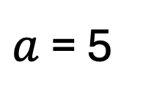


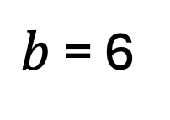

Clutch: Lookup Table & Divide-and-Conquer
$$a < b$$
)
$a1$ $<b1$
$a1$ $−1<b1$
$a0$ $<b0$
=
(
MAJ3
,
,
$a$ = 5
MSB
LSB
$$b$$
other vector
elements
0
0
1
1
0
0
1
1
1
$a0$ $=1$
Table for
Chunk 1
$a1$ $=1$
0
$b$ = 6
0
MSB
LSB
1
0
1
1
0
0
1
1
0
Table for
Chunk 0
1
$$b1=1$$
$$b0=2$$
0
1
0
0
1
1
0
$$b1=1$$
$$b0=2$$
Chunked Temporal
Notes:
Now let me explain how this divide-and-conquer approach is combined with temporal coding and executed on PuD.
[CLICK]
as shown in the bottom-left figure,
The vector elements B
[CLICK] [CLICK]
[CLICK][CLICK]
are encoded with temporal coding on a per-chunk basis
[CLICK]
By storing these chunks in a vertical layout in DRAM,
[CLICK] [CLICK]
each chunk naturally forms a compact lookup table inside DRAM.
[CLICK]
Similarly, the other columns store the remaining vector elements in the same format

Slide 58
Clutch: Lookup Table & Divide-and-Conquer
$$a < b$$
)
$a1$ $<b1$
$a1$ $−1<b1$
$a0$ $<b0$
=
(
MAJ3
,
,
$a$ = 5
MSB
LSB
$$b$$
0
0
1
1
0
0
1
1
1
1
$a0$ $=1$
Table for
Chunk 1
$a1$ $=1$
0
0
$b$ = 6
0
MSB
LSB
1
0
1
1
0
0
1
1
0
Table for
Chunk 0
1
1
$$b1=1$$
$$b0=2$$
0
1
0
0
1
1
0
$$b1=1$$
$$b0=2$$
Chunked Temporal
Notes:
We first need the three per-chunk comparison results.
[CLICK]
[CLICK]
[CLICK]
Each of these can be obtained by referencing the appropriate row of the corresponding per-chunk lookup table
that is
[CLICK]
doing RowCopy from the corresponding rows to compute rows.

Slide 59
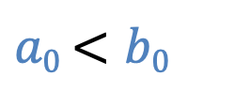
Clutch: Lookup Table & Divide-and-Conquer
$$a < b$$
)
$a1$ $<b1$
$a1$ $−1<b1$
$a0$ $<b0$
=
(
MAJ3
,
,
$a$ = 5
MSB
LSB
$$b$$
0
0
1
1
0
0
1
1
1
1
$a0$ $=1$
Table for
Chunk 1
$a1$ $=1$
0
0
$b$ = 6
0
MSB
LSB
1
0
1
1
0
0
1
1
0
Table for
Chunk 0
1
1
$$b1=1$$
$$b0=2$$
0
1
0
0
1
1
0
0
MAJ3
$$b1=1$$
$$b0=2$$
Chunked Temporal
1
1
Notes:
[CLICK]
Then, as shown in the expression above, we apply MAJ3
[CLICK]
over these three results

Slide 60
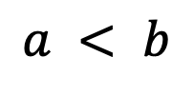
Clutch: Lookup Table & Divide-and-Conquer
$$a < b$$
)
$a1$ $<b1$
$a1$ $−1<b1$
$a0$ $<b0$
=
(
MAJ3
,
,
$a$ = 5
MSB
LSB
$$b$$
0
0
1
1
0
0
1
1
1
1
$a0$ $=1$
Table for
Chunk 1
$a1$ $=1$
0
0
$b$ = 6
0
MSB
LSB
1
0
1
1
0
0
1
1
0
Table for
Chunk 0
1
1
$$b1=1$$
$$b0=2$$
0
1
0
0
1
1
0
1
MAJ3
$$b1=1$$
$$b0=2$$
Chunked Temporal
1
Results of
1
$$a < b$$
Notes:
and
[CLICK]
we derive the final comparison result within DRAM.

Slide 61
Clutch: Scalability via Chunk Count
The divide-and-conquer approach can be
applied recursively from the LSB side,
generalizing to any number of chunks
By adjusting the number of chunks,
Clutch provides a flexible tradeoff
between latency and memory footprint
Notes:
[CLICK]
this divide-and-conquer approach can be applied recursively from the LSB side, generalizing to any number of chunks.
[CLICK]
By adjusting the number of chunks, Clutch provides a flexible tradeoff between latency and memory footprint.

Slide 62
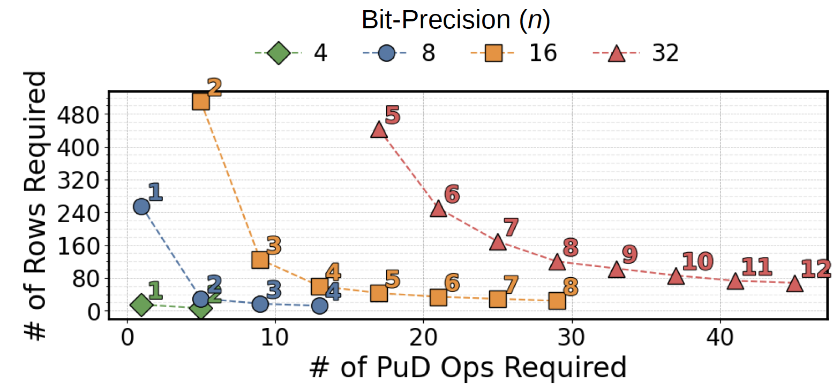
Clutch: Scalability via Chunk Count
# of DRAM Rows
# of PuD Operations
5 Chunks
11x faster than bit-serial PuD with 432 rows
8 Chunks
6.4x faster than bit-serial PuD with 120 rows
vs.
Notes:
This figure illustrates this tradeoff.
[CLICK]
The x-axis shows the number of PuD operations, and
[CLICK]
the y-axis shows the required number of DRAM rows. (Each line represents a different operand bit-precision.)
For example,
[CLICK] [CLICK]
for 32-bit comparisons,
[CLICK][CLICK]
using 5 chunks
produces 11 times faster than bit-serial approach with around 400 rows,
while using 8 chunks
[CLICK]
achieves 6 times faster than bit-serial approach with only around 100 rows.
(By simply adjusting the number of chunks, users can flexibly navigate this tradeoff depending on their application's requirements.)

Slide 63
Outline
Background
Motivation: PuD for Vector-Scalar Comparison
Limitation of Prior PuD Approaches
Clutch: Lookup Table-Based Comparison
Clutch: Divide-and-Conquer Approach
Evaluation
Conclusion
Notes:
Lets move on to our evaluation

Slide 64
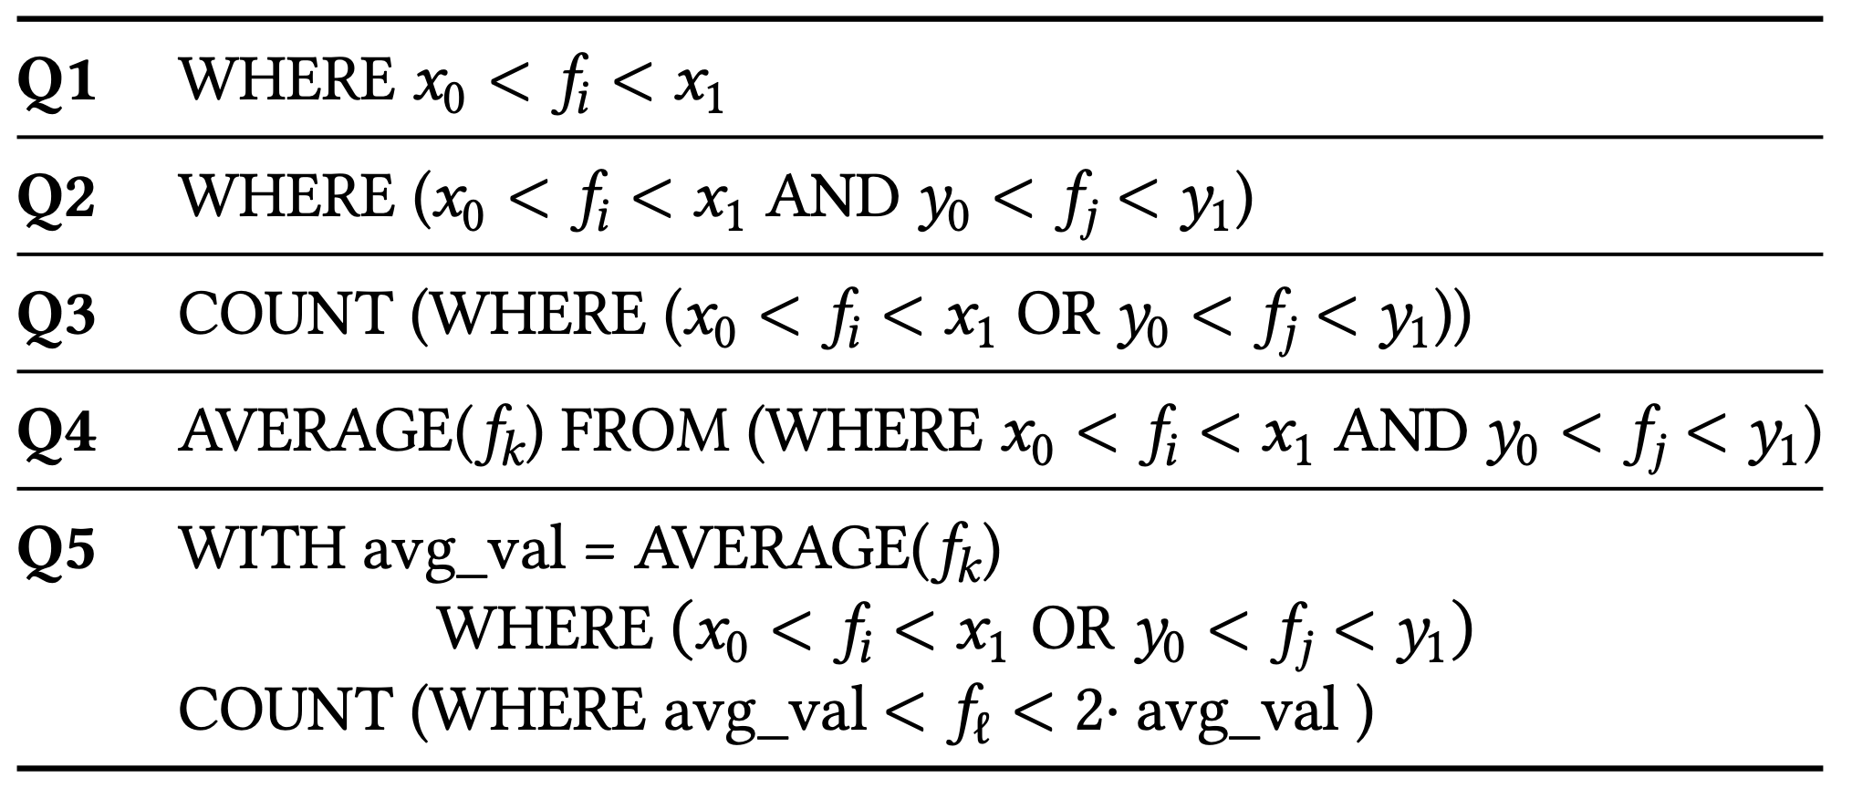
Evaluation: Methodology Overview
Evaluation Setup
  4 × 16 GB DDR4, dual-channel
  CPU: Intel Core i7-9700K
  PuD: Unmodified PuD², SIMDRAM³
Workloads
  Predicate Evaluation
  Decision Tree Inference
  8-bit, 16-bit, 32-bit
Main Metrics
  CPU-Normalized Throughput (CPU: BitWeaving-V⁴)
    Real Hardware, In-House Cycle-Accurate Simulator for PuD
  CPU-Normalized Energy Efficiency
    Intel RAPL, CACTI
Notes:
[CLICK]
For the evaluation setup, we use a real system with an Intel Core i7.
For PuD, we evaluate two different PuD architectures: Unmodified PuD, which is modeled after commercial off the shelf DRAM, and SIMDRAM, the most representative architecture
[CLICK]
For workloads, we evaluate on predicate evaluation and Decision Tree inference.
[CLICK]
In this talk, we focus on predicate evaluation.
[CLICK]
For predicate evaluation, we use five queries, as shown in this table,
[CLICK]
across three operand bit-precisions
[CLICK]
Our main metrics are CPU-normalized throughput and CPU-normalized energy efficiency.
For the CPU, we utilize BitWeaving-V, the state of the art CPU implementation
(For PuD, we develop a cycle-accurate simulator to obtain precise throughput estimates.)
(Energy is estimated using Intel RAPL for the CPU and CACTI for DRAM.)

Slide 65

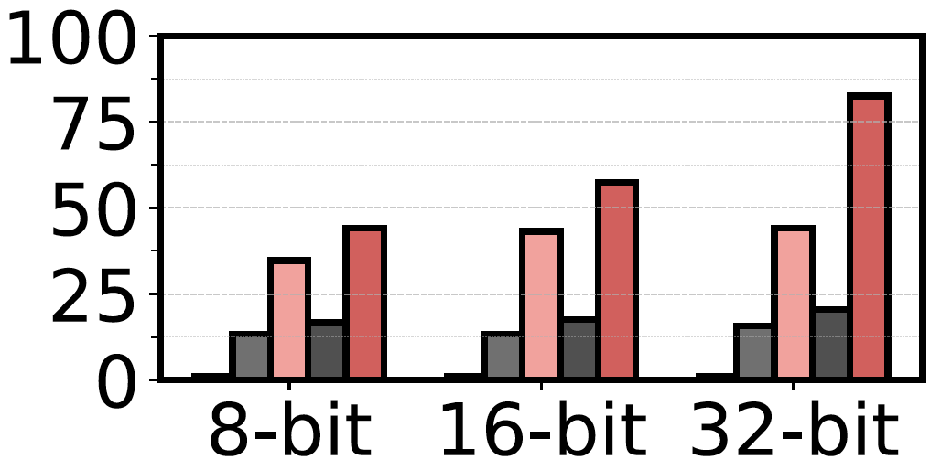
Evaluation: Throughput
Unmodified PuD
SIMDRAM
Bit-Precisions of the Operands
Notes:
For clarity, here we present the results for Q2.
This figure shows the results across the CPU and two PuD architectures.
[CLICK]
The first architecture is Unmodified PuD,
[CLICK]
The second is SIMDRAM.
For each architecture, we show results for both bit-serial execution and Clutch.
[CLICK]
xaxis shows the three different bit-precisions
[CLICK]
yaxis shows the throughput normalized to the optimized CPU implementation

Slide 66
Evaluation: Throughput
Clutch provides up to 83× (50× on average) higher throughput over CPU, and up to 4.0× (3.1× on average) over bit-serial PuD
Notes:
[CLICK]
The results show Clutch significantly improves performance over both baselines.
[CLICK]
Specifically, Clutch provides 50 times on average, higher throughput over CPU, and 3.1 times over bit-serial PuD.

Slide 67
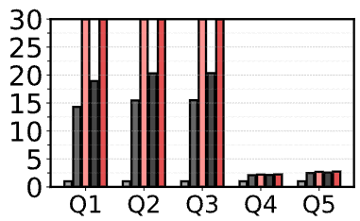
Evaluation: Throughput
On average, Clutch provides 28× higher throughput over CPU and 2.2× higher throughput over bit-serial PuD across Q1 through Q5.
Notes:
In addition, Clutch's advantage is consistent across all five queries.
[CLICK]
On average, Clutch provides 28× higher throughput over CPU and 2.2× higher throughput over bit-serial PuD
(across Q1 through Q5.)

Slide 68

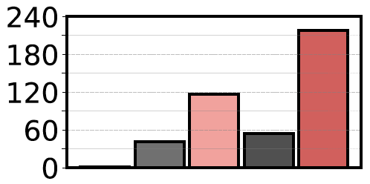
Evaluation: Energy Efficiency
Five Different Implementations
Notes:
Next, let me show the energy efficiency results, again for Q2.
[CLICK]
The x-axis shows five different implementations: CPU, followed by bit-serial and Clutch for each of the two PuD architectures.
[CLICK]
the y axis shows energy efficiency normalized to the optimized CPU implementation.

Slide 69
Evaluation: Energy Efficiency
Clutch provides up to 218× (135× on average) higher energy efficiency over CPU, and up to 4.2× (3.1× on average) over bit-serial PuD
Notes:
[CLICK]
The results show
Clutch significantly improves energy efficiency over both baselines.
Specifically, Clutch provides around 130 times on average, better energy efficiency over CPU, and around 3 times, over bit-serial PuD.

Slide 70
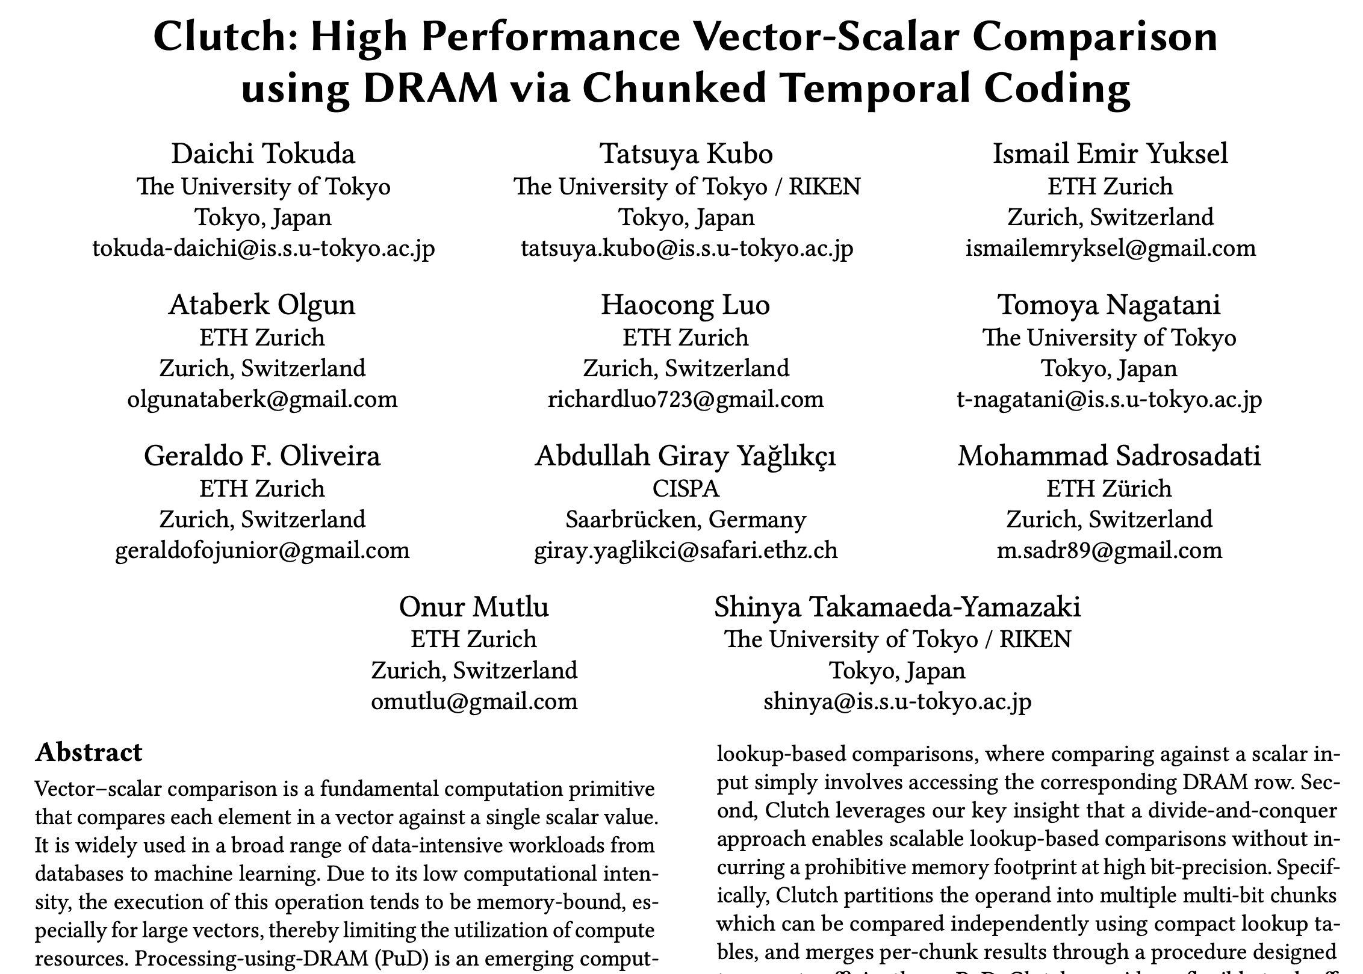
Available on arXiv
https://arxiv.org/abs/2606.22812
Notes:
Our paper is also available on arXiv,

Slide 71
More in the Paper
Decision Tree Inference on PuD
  Novel mapping on Decision Tree inference to PuD, including detailed algorithm design
  End-to-end throughput and energy efficiency evaluation
More Application-Level Evaluation
  Detailed evaluation setups
  End-to-end evaluation on GPU-based systems
Details on Overhead Analysis
  Analysis on throughput–memory footprint tradeoff across different chunk configurations
  Analysis on data conversion overhead for temporal coding
Notes:
In thins paper we have many discussions we can not cover in this talk
Most notably, we present a novel mapping of Decision Tree inference to PuD, including detailed algorithm design and end-to-end evaluation.
We also provide detailed evaluation setups and overhead analyses.
(For more application-level evaluation, the paper provides detailed evaluation setups, a novel mapping of Decision Tree inference to PuD with detailed algorithm design, and end-to-end evaluation on GPU-based systems.)
(For details on overhead analysis, the paper includes analysis on the throughput–memory footprint tradeoff across different chunk configurations, as well as data conversion overhead for temporal coding.
Please refer to the paper for more details.)

Slide 72
Outline
Background
Motivation: PuD for Vector-Scalar Comparison
Limitation of Prior PuD Approaches
Clutch: Lookup Table-Based Comparison
Clutch: Divide-and-Conquer Approach
Evaluation
Conclusion
Notes:
Let me conclude this talk

Slide 73
Conclusion
We present Clutch, a PuD-oriented algorithm and
data representation for accelerating vector-scalar comparison, combining temporal coding and
divide-and-conquer approach
Clutch achieves 12× higher throughput and 69× better energy efficiency over optimized CPU execution, and 2.9×/3.0× over the bit-serial PuD approach
Clutch demonstrates that DRAM can serve as
a high-performance computing substrate
for comparison-intensive workloads
Notes:
In this talk,
[CLICK]
we presented Clutch, a PuD-oriented algorithm and data representation combining temporal coding and divide-and-conquer
[CLICK]
Clutch significantly improves both throughput and energy efficiency over CPU and bit-serial PuD
(Clutch achieves 12 times higher throughput and 69 times better energy efficiency over optimized CPU execution, and 2.9 times and 3.0 times over the state-of-the-art bit-serial PuD approach in throughput and energy efficiency, respectively.)
[CLICK]
These results demonstrate that DRAM can serve as a high-performance and energy-efficient computing substrate for comparison-intensive workloads.

Slide 74
Clutch
High Performance Vector-Scalar Comparison using DRAM via Chunked Temporal Coding
Daichi Tokuda
T. Kubo I. E. Yuksel A. Olgun H. Luo
T. Nagatani G. F. Oliveira A. G. Yağlıkçı M. Sadrosadati
O. Mutlu S. Takamaeda-Yamazaki
Notes:
Today I will present PuDGhost:
Experimental Analysis of Computation Result Corruption
in Processing-using-DRAM Operations
on Real DRAM Chips
and Implications for Future Systems

Slide 75
Backup Slides

Slide 76

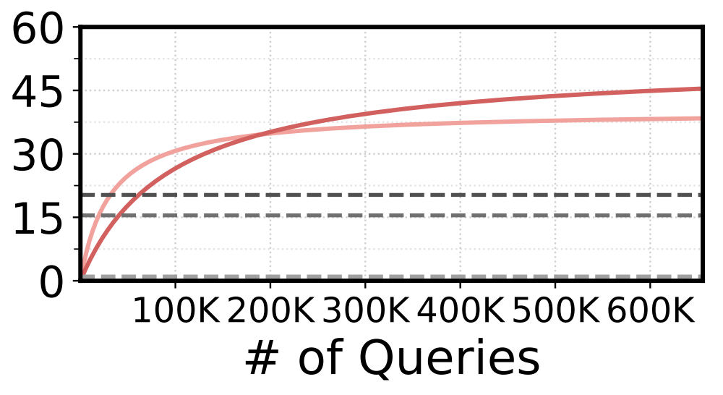
Data Conversion Overhead
Clutch surpasses CPU throughput after ~2K queries, and bit-serial PuD after ~50K–60K queries
Notes:
let me briefly discuss the data conversion overhead.
Clutch requires a one-time conversion of vector data from binary to chunked temporal coding before execution begins.
Since this conversion cost is fixed, it is amortized over subsequent queries.
As shown in this figure, Clutch surpasses CPU throughput after approximately 2 thousand queries, and outperforms bit-serial PuD after approximately 50 thousand to 60 thousand queries. If this amortization is insufficient, the conversion can be performed offline in advance, eliminating the runtime overhead entirely.

Slide 77
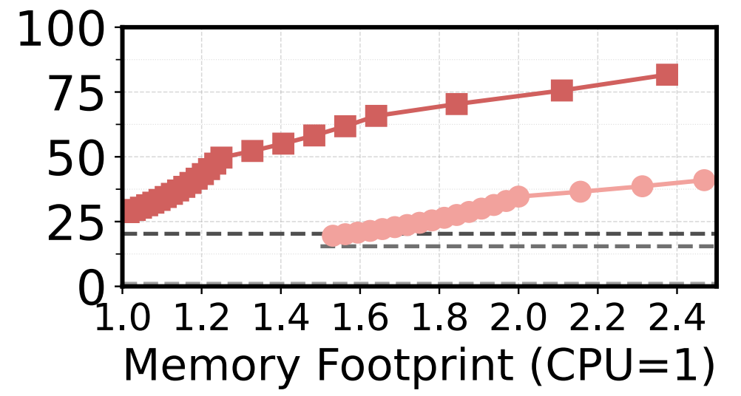

Tradeoff: Throughput vs. Memory Footprint
Within 1.5× memory footprint of CPU: up to 58× (44× on average) higher throughput over CPU
Notes:
Clutch provides a flexible tradeoff between throughput and memory footprint by adjusting the chunk count.
This figure illustrates this tradeoff space for Q2. Within 1.5 times the memory footprint of CPU execution, Clutch achieves up to 58 times, 44 times on average, higher throughput over CPU. Within 2.0 times the memory footprint, this improves to up to 70 times, 53 times on average.
Compared to bit-serial PuD, Clutch achieves up to 2.9 times, 2.4 times on average, higher throughput within 1.5 times the memory footprint, and up to 3.5 times, 2.9 times on average, within 2.0 times.

Slide 78
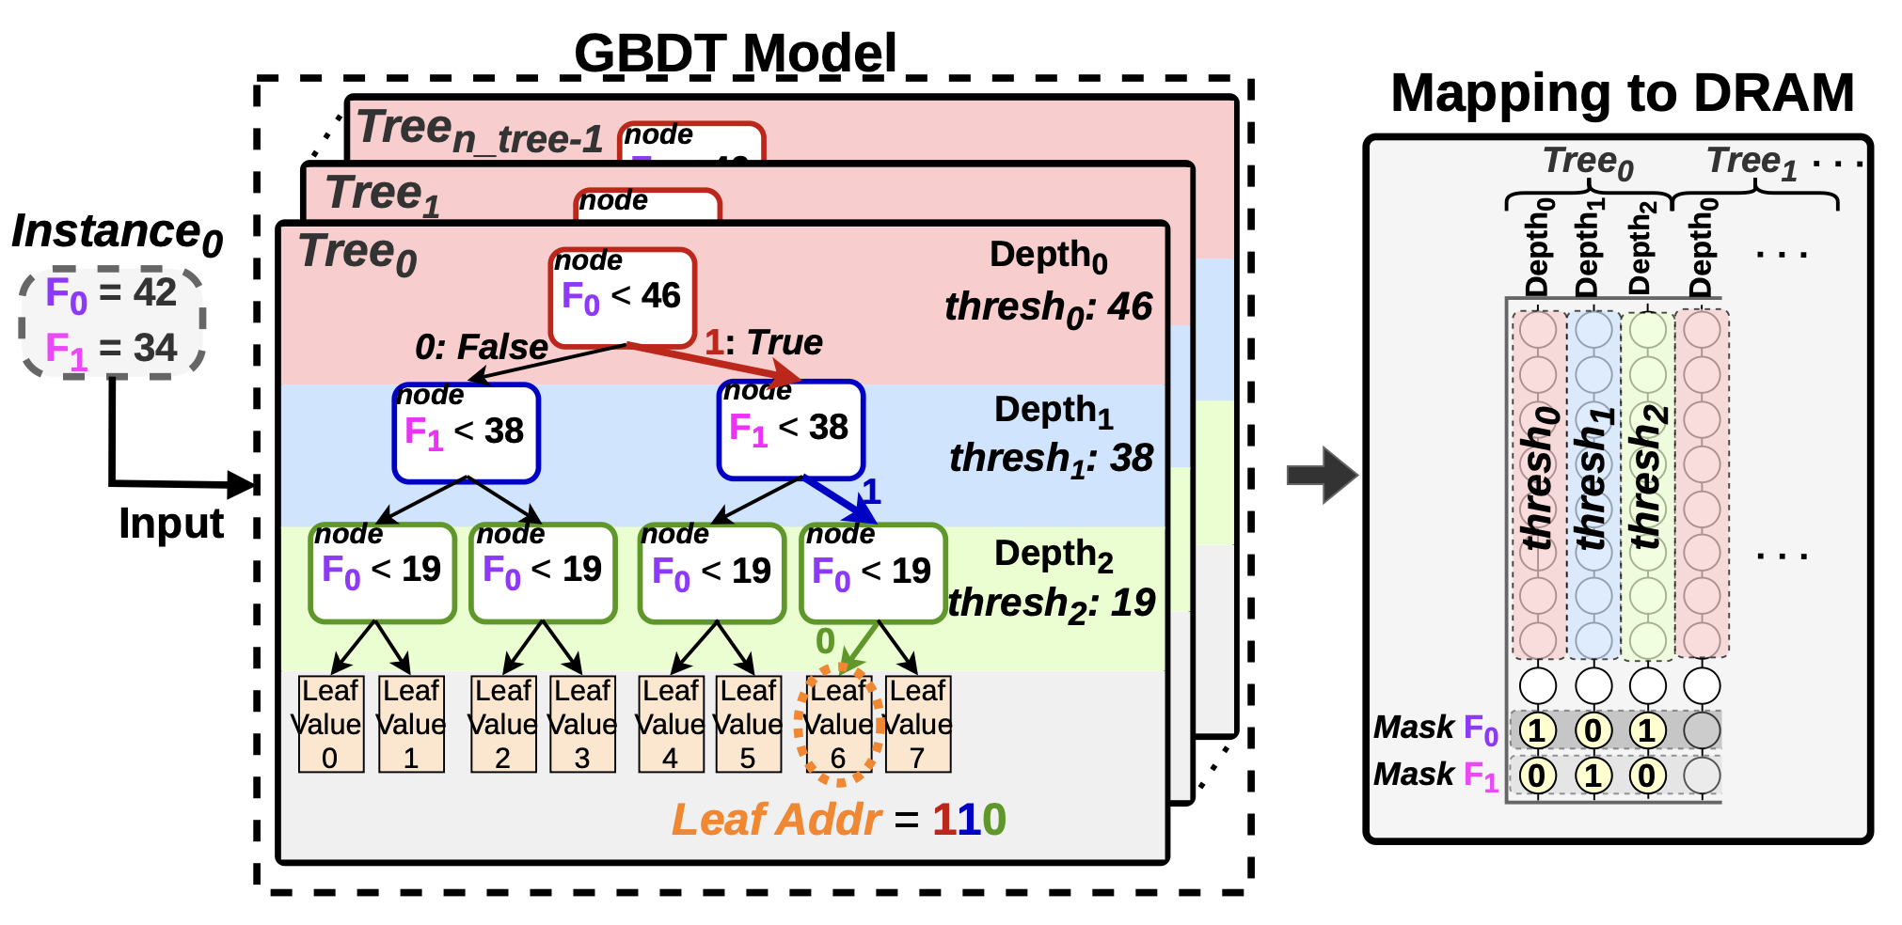
Decision Trees

Slide 79
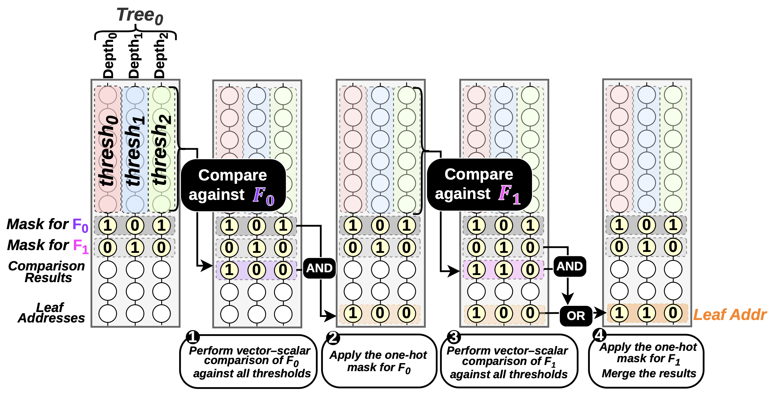
Decsion Tree Inferece on PuD
Notes:
Figure 13 shows the proposed execution flow for CatBoost inference on PuD. The algorithm processes one feature at a time using a two-stage process. In the first stage of processing a feature, the host processor issues PuD operations based on the current feature value to perform a vector–scalar comparison against all node thresholds across all columns.
This comparison is applied uniformly to all columns, regardless of which feature each node actually uses, yielding a 1-bit result for "(feature value) < (node threshold)" in each column.
In the second stage of processing a feature, the one-hot mask for the current feature is applied via a bitwise AND, so that only columns whose nodes use the current feature retain their comparison result; all others are cleared to zero.
The masked result is then merged into the accumulated leaf address bitmap using a bitwise OR.
The algorithm repeats this twostage process for every feature used by the model. Each DRAM bank processes one input instance, and multiple banks operate concurrently.

Slide 80
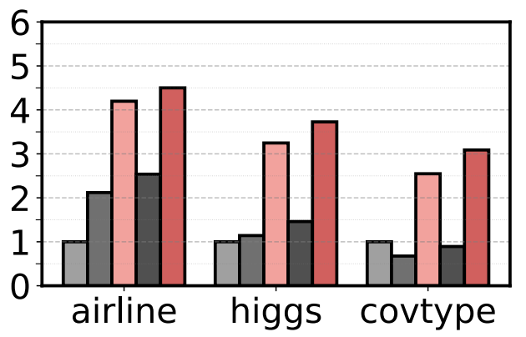

Results: Decision Tree Inference
Clutch provides up to 4.5× (3.5× on average) higher throughput over CPU, and up to 3.8× (2.2× on average) over bit-serial PuD

Slide 81
Applications of Vector–Scalar Comparison
Decision Tree Inference
  Delivers state-of-the-art accuracy on tabular data with low inference cost
  Particularly important for edge AI applications, including anomaly detection, remote sensing, and IoT analytics
Predicate Evaluation
  A fundamental operation in database query processing
  Filters irrelevant data early, reducing data movement and accelerating downstream operations

