Slide 1




Cleaning up the Mess
Re-Evaluating the Real-System
Modeling Accuracy of Ramulator 2.0
F. Nisa Bostancı* Haocong Luo* Ataberk Olgun*
Maria Makeenkova Geraldo F. de Oliveira
A. Giray Yağlıkçı Onur Mutlu
* Equal Contribution
Notes:
Hi everyone, I am Nisa and
Today Haocong and I are going to present our work called
Cleaning up the Mess
Re-Evaluating the Real-System Modeling Accuracy of Ramulator 2.0

Slide 2
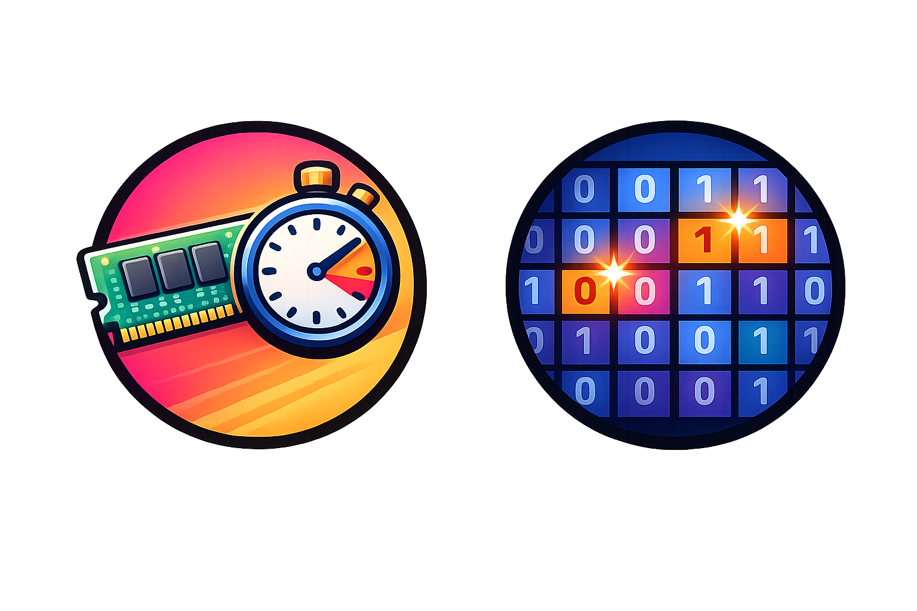

DRAM and Memory System Simulation
Cycle-level DRAM simulators provide accurate and
flexible models for DRAM and memory controller operations
Enable research on current and future memory systems
Critical for improving the performance, efficiency,
and robustness (security, safety, reliability) of
memory systems
DRAM performance and latency
Solutions for robustness issues
Emerging architectures
Notes:
Cycle-level DRAM simulators provide accurate and flexible models for DRAM and memory controller operations
And doing so, they enable research on current and future memory systems in various areas
Such as improving DRAM latency, developing solutions for robustness issues such as retention and read disturbance
And evaluating various systems like emerging processing-in-memory architectures
Therefore, these simulators are critical for improving the performance, efficiency and robustness of memory systems

Slide 3
Mess: A MICRO'24 Best Paper Runner-Up
"A Mess of Memory System Benchmarking, Simulation
and Application Profiling", MICRO'24
  A best paper runner-up with all 3 artifact badges
  (including "Reproducible")
Proposes a new benchmark to evaluate the real and simulated memory system performance
Makes strong negative claims about two of our simulation infrastructures, Ramulator 2.0 and DAMOV,
and shows unexpected results
  Contending that they "poorly resemble the actual system performance"
Notes:
A MICRO 2024 best paper runner-up publication with all 3 artifact badges, titled "A Mess of Memory System Benchmarking, Simulation and Application Profiling", which we call the Mess paper,
[CLICK] proposes a new benchmark to evaluate the real and simulated memory system performance
[CLICK] while doing so, it also makes some strong negative claims about two of our simulation infrastructures: Ramulator 2.0 and DAMOV and shows unexpected results
[CLICK] concluding that they poorly resemble the actual system performance

Slide 4
Cleaning up the Mess
We demonstrate that these claims and results are incorrect
and are due to configuration and simulator usage errors
made in the Mess paper
We describe four best practices
to aid users and developers of simulation tools
To facilitate transparency and reproducibility,
we open source all our code and results:
https://github.com/CMU-SAFARI/Cleaning-up-the-Mess
Notes:
[CLICK] In this work, we demonstrate that these claims and results are incorrect and are due to configuration and simulator usage errors
Made in the Mess paper.
We describe four best practices
to aid users and developers of simulation tools
To facilitate transparency and reproducibility,
we open source all our code and results:
https://github.com/CMU-SAFARI/Cleaning-up-the-Mess

Slide 5
Cleaning up the Mess
Analysis of the Evaluation of Ramulator 2.0
in the Mess Paper
Analysis of the Evaluation of DAMOV
in the Mess Paper
Ramulator 2.0 and DAMOV Best Practices
Notes:
To demonstrate that these results and claims are incorrect, [CLICK] we first analyze the evaluation of Ramulator 2.0 and DAMOV in the Mess paper
[CLICK] and then describe best practices for these tools for users to avoid such issues in the future
[CLICK] Now lets talk about our analysis of the evaluation of Ramulator 2.0 in the mess paper

Slide 6
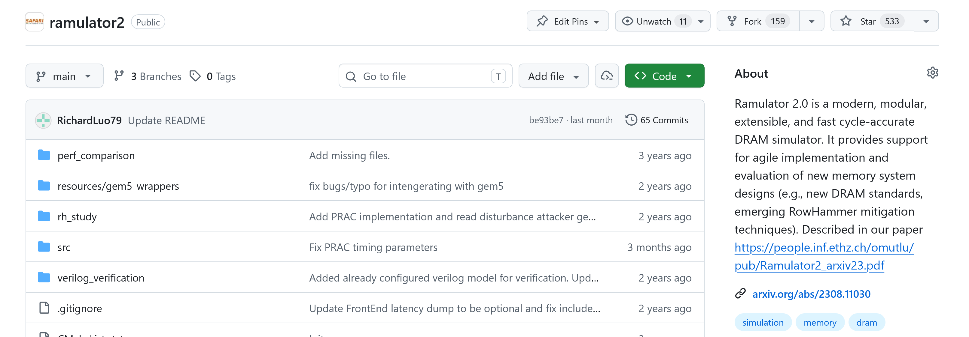
Ramulator 2.0: A Modern, Modular, and Extensible DRAM Simulator
Ramulator 2.0 [Luo+, CAL'24] models a wide range of DRAM standards
and memory controller functionalities
  Modular and extensible software architecture
Enables fine-grained modeling of DRAM operation (cycle-level)
Used in a wide range of research works
https://github.com/CMU-SAFARI/ramulator2
Notes:
Ramulator 2.0 is a modern modular and extensible DRAM simulator
[CLICK] that models a wide range of DRAM standards and memory controller functionalities, which are easy to extend
[CLICK] It enables fine-grained modeling of DRAM operation and [CLICK] is used by many research works since its release
[CLICK] It is open sourced and freely available on GitHub

Slide 7
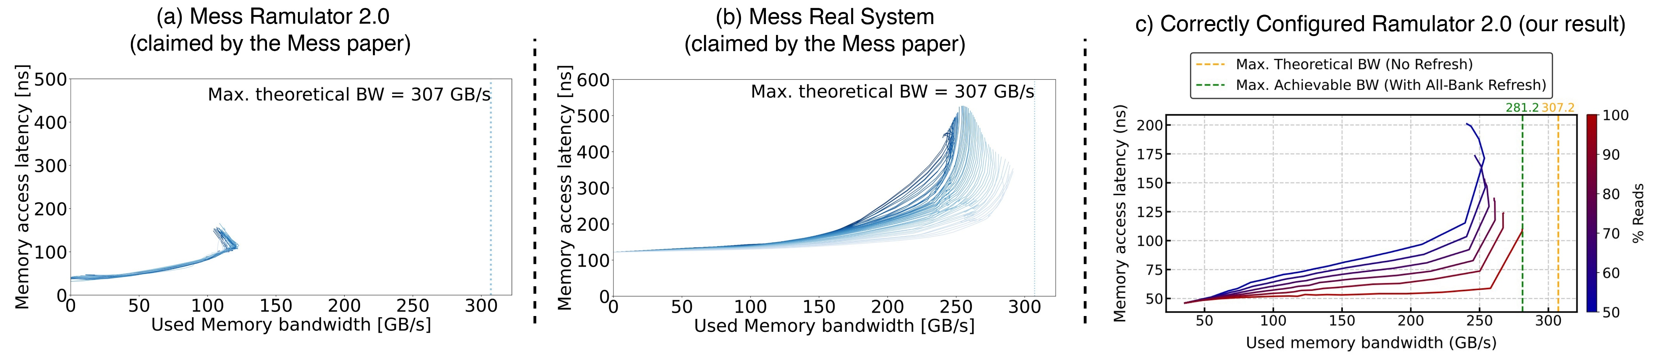
High-Level Memory System
Performance Evaluation & Reasoning
The Mess benchmark aims to characterize a memory system
based on a set of latency-throughput ("used bandwidth") curves
Consists of two concurrently running workloads:
Streaming and Pointer-Chasing patterns
  Varies the memory intensity using NOPs between requests
  Evaluates a sweep of read/write intensities
  (from 50% to 100% reads)
increasing memory intensity
50%
Memory Access Latency (ns)
100%
1 experiment
Used Memory Bandwidth (GB/s)
Notes:
The Mess paper evaluates memory system performance by proposing the mess benchmark:
The Mess benchmark aims to characterize a memory system, using a set of latency-throughput, or "used bandwidth" curves
[CLICK] These curves are plotted as a line figure,
[CLICK] where each data point is an experiment that performs two types of accesses concurrently : streaming and pointer-chasing patterns
[CLICK] plots the measured average memory access latency and [CLICK] the used memory bandwidth
[CLICK] The Mess benchmark then varies the memory intensity by adding NOPs between subsequent memory requests which creates "a single curve"
[CLICK] And evaluating a sweep of read write operation intensities from 50% to 100% reads
[CLICK] creates different curves

Slide 8
The Mess Paper's Evaluation of Ramulator 2.0
2
smaller
latency
1
smaller bandwidth
Contending that Ramulator 2.0 "poorly resembles
the actual system performance"
Ramulator 2.0 simulation results in the Mess paper are incorrect
and, at the time of the publication of the Mess paper, irreproducible
Notes:
The Mess paper comments on the accuracy of Ramulator 2.0 by first evaluating a real DDR5 system with the Mess benchmark,
[CLICK] which results in these curves in the first figure
[CLICK] and then compares them against the Ramulator 2.0 curves that it obtains
[CLICK] The Mess paper observes that Ramulator 2.0's curves show 1) smaller used memory bandwidth and [CLICK] 2) smaller memory access latency compared to the real system curves
[CLICK] And contends that Ramulator 2.0 poorly resembles the actual system performance
[CLICK] However, Ramulator 2.0 results in the Mess paper are incorrect and at the time of the publication of the paper, *were* irreproducible

Slide 9
Analysis of the Evaluation of Ramulator 2.0 in the Mess Paper
1
Reproducibility Issues:
It was not possible to reproduce any Ramulator 2.0 result from the Mess paper artifacts available at the time of publication and artifact evaluation of the paper
The missing source codes were uploaded to the Mess GitHub repository
10 months after the artifact evaluation badges
2
Fundamental Configuration Errors:
The Mess paper effectively compares an 8-channel DDR5 memory
system in Ramulator 2.0 against a 16-channel real DDR5 memory system
The Mess paper uses unrealistically low cache latency configurations
that lead to low memory access latency
3
Scholarship Issues:
The Mess paper does not disclose
1) modifications to the cache latency configurations, and
2) differences in evaluation methodology between simulation and
real system results (identified via email exchange with Mess paper's authors)
Notes:
We analyze the Mess paper and its open-sourced artifact and identify various issues in three categories:
[CLICK] First, it was not possible to reproduce any of the Ramulator 2.0 results from the Mess paper artifacts available due to missing source codes
[CLICK] The missing source codes were uploaded only after our contact, 10 months after the artifact evaluation badges were awarded
Second,
[CLICK] We identify that Ramulator 2.0's evaluation suffers from fundamental configuration errors as
[CLICK] the Mess paper compares an 8-channel memory system in Ramulator 2.0 against a 16-channel real memory system.
[CLICK] and configures the system to have unrealistically low cache latency configurations that lead to low memory access latency
Lastly,
[CLICK] We also identified scholarship issues as the paper does not disclose
[CLICK] these modifications to the source code of Ramulator 2.0
[CLICK] and differences in evaluation methodologies of real and simulated memory systems that we will not cover in this presentation but explained in detail in our paper
In the interest of time, we will focus on the fundamental configuration errors

Slide 10
Fundamental Configuration Errors
The Mess paper's configuration errors result in
the claimed Ramulator 2.0 inaccuracies
2
1
smaller
latency
smaller bandwidth
Notes:
The Mess paper's configuration errors result in the claimed inaccuracies, and lead to incorrect claims.
"
The mess paper's configuration errors result in incorrect claims about Ramulator 2. now we will describe how they lead to smaller bandwidth and smaller latency
"

Slide 11
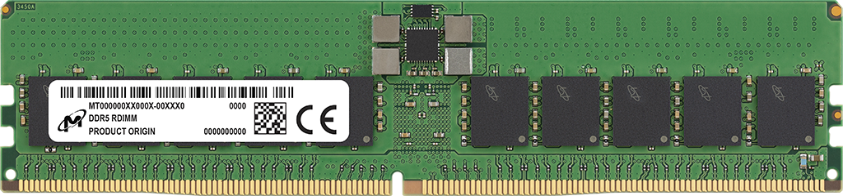
Fundamental Configuration Errors:
Smaller Used Bandwidth
Mess Paper’s
Ramulator 2.0 Configuration
Mess Paper’s
Real System Configuration
channel: 8
“8 x DDR5”
Channel A
Channel B
8 DDR5 channels
16 DDR5 channels
Notes:
First, the smaller used bandwidth results are caused by the difference in numbers of channels available [CLICK] in simulation and in real system evaluations
[CLICK] Mess Paper's Ramulator 2.0 configuration specifies 8 channels with this configuration line.
And the paper specifies the real system configuration as "8 X DDR5"
This leads to Ramulator 2.0 instantiating 8 independent DDR5 channels
Whereas the real system configuration has 8 DDR5 DIMMS each of which containing 2 channels. Meaning that there are actually 16 independent DDR5 channels in the Mess paper’s real system configuration
[CLICK] And because of this mismatch,

Slide 12
Fundamental Configuration Errors:
Smaller Used Bandwidth
Mess Paper’s
Ramulator 2.0 Configuration
Mess Paper’s
Real System Configuration
8 DDR5 channels
16 DDR5 channels
The Mess paper incorrectly assumes a DDR5 channel in
Ramulator 2.0 is 64-bit, instead of the actual width of 32-bit
that is consistent with JEDEC DDR5 standards (JESD79-5)
Notes:
Ramulator 2.0 results show around half the used bandwidth of real system measurements, as it has half the number of channels.
We identify that this is because, the mess paper incorrectly assumes a DDR5 channel in Ramulator 2 is 64 bits wide
Whereas the implementation clearly states a channel as 32 bits wide, which is the consistent value with the JEDEC DDR5 standards

Slide 13
Fundamental Configuration Errors:
Smaller Used Bandwidth
Mess Paper’s
Ramulator 2.0 Configuration
Mess Paper’s
Real System Configuration
8 DDR5 channels
16 DDR5 channels
The Mess paper incorrectly assumes a DDR5 channel in
Ramulator 2.0 is 64-bit, instead of the actual width of 32-bit
that is consistent with JEDEC DDR5 standards (JESD79-5)
The Mess paper configures Ramulator 2.0 with half the channels of
a real system, and thus, results in smaller used bandwidth
Notes:
Because of this configuration error, the mess paper configures Ramulator 2 with half the channels of a real system and thus results in smaller used bandwidth

Slide 14
Fundamental Configuration Errors:
Smaller Memory Access Latency
The Mess paper's artifact hardcodes
  the cache latency as 0 cycles
  the number of miss-status holding registers (MSHRs)
  per CPU as 1024
This leads to significantly smaller DRAM round-trip latency
and queueing delays, thus smaller memory access latency
The Mess paper uses unrealistically low cache latency configurations
resulting in the low memory access latency
that it attributes to Ramulator 2.0
Notes:
The second issue, smaller memory access latency is due to the unrealistic cache latency configurations
The mess paper's artifact hardcodes the cache latency as 0 cycles and instantiates a high number of miss-status holding registers
This configuration leads to significantly smaller DRAM round-trip latency and queueing delays, thus a low memory access latency compared to a real system
so, The Mess paper uses unrealistically low cache latency configurations
resulting in the the low memory access latency
that it attributes to Ramulator 2.0
Transition:
Now lets hear from Haocong about how *we* evaluate Ramulator 2.0

Slide 15
Our Evaluation Methodology
We independently evaluate the Mess benchmark
by executing the same access pattern
  Streaming and Pointer-Chasing access patterns
  Sweeping memory intensity
We correctly configure Ramulator 2.0
  Provide the same number of channels as the real system
  Evaluate the memory access latency from the memory controller
  to isolate the DDR5 model's simulation accuracy
Notes:
To this end,
[CLICK]
we independently evaluate the Mess benchmark by executing the same access pattern
[CLICK]
And configure Ramulator 2.0 correctly:
We instantiate a 16-channel DDR5 memory system
And measure the memory access latency from the memory controller

Slide 16
Our Key Results
Ramulator 2.0's memory model achieves high used memory bandwidth, close to the achievable bandwidth value,
as opposed to the claims of the Mess paper
https://github.com/CMU-SAFARI/ramulator2/tree/mess
Notes:
Now lets see our results
[CLICK]
On the X axis, we see the used memory bandwidth and on the y-axis, the memory access latency.
[CLICK]
We show the maximum theoretical bandwidth as the yellow line
[CLICK]
Since this does not account for periodic refresh, we draw a second line to show the maximum achievable bandwidth that accounts for refreshes.
[CLICK]
These are our results,
We make two key observations
[CLICK]
First, Ramulator 2.0's memory model
[CLICK]
achieves a high used memory bandwidth, close to the achievable bandwidth value, as opposed to the claims of the Mess paper.

Slide 17
Our Key Results
The memory access latency of Ramulator 2.0’s model increases
as the used memory bandwidth and the write ratio increases
https://github.com/CMU-SAFARI/ramulator2/tree/mess
Notes:
Second, the memory access latency [CLICK] of Ramulator 2.0’s DRAM model increases as as the used memory bandwidth and the write ratio increases

Slide 18
Our Key Results
When correctly configured, Ramulator 2.0’s simulated memory system performance resembles real system characteristics
https://github.com/CMU-SAFARI/ramulator2/tree/mess
Notes:
We conclude that
When correcty configured,
Ramulator 2.0's simulated memory system performance
Resembles real system characteristics

Slide 19
Cleaning up the Mess
Analysis of the Evaluation of Ramulator 2.0
in the Mess Paper
Analysis of the Evaluation of DAMOV
in the Mess Paper
Ramulator 2.0 and DAMOV Best Practices
Notes:
Now lets look at the analysis of the evaluation of DAMOV in the Mess paper

Slide 20
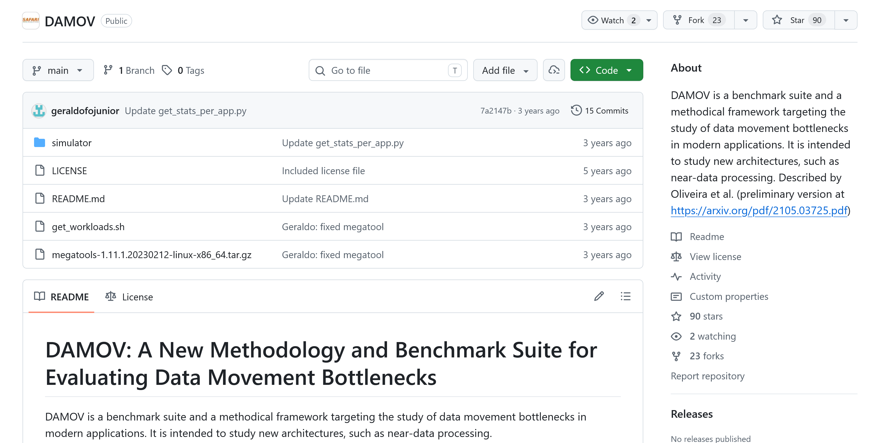
DAMOV: A Simulation Framework for PiM
DAMOV integrates ZSim [Sanchez+, ISCA'13] with Ramulator [Kim+, CAL'15]
  Enables evaluating emerging processing-in-memory architectures
https://github.com/CMU-SAFARI/DAMOV
Notes:
DAMOV is another simulation framework that integrates a core model, Zsim with an earlier version of Ramulator for evaluating emerging processing-in-memory architectures
=========================
second point could come later?

Slide 21
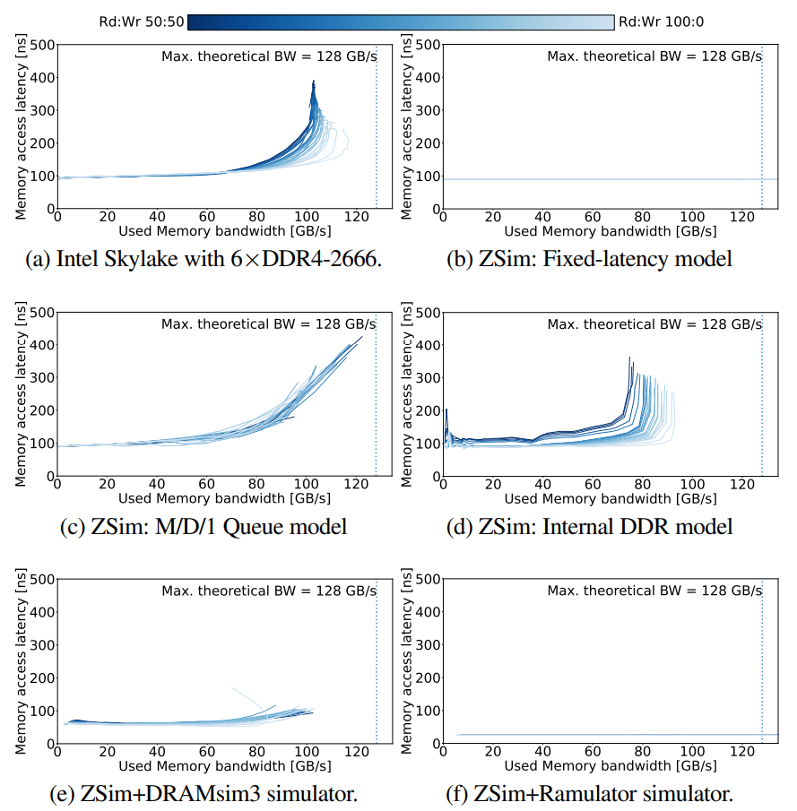
The Mess Paper's Evaluation of DAMOV
Mess Real System
(claimed by the Mess paper)
Mess DAMOV
(claimed by the Mess paper)
constant latency
DAMOV results in the Mess paper use incorrect simulation statistics
that are unrelated to the simulated DRAM performance
Notes:
The Mess paper evaluates a real DDR4 system as shown on the left
For DAMOV, the Mess paper’s results are on the right, which shows a constant memory access latency
We identify that DAMOV results in the Mess paper use wrong simulation statistics that are unrelated to the simulated DRAM performance

Slide 22
Analysis of the Evaluation of DAMOV in the Mess Paper
Reproducibility Issues:
We could not reproduce any DAMOV results in the Mess paper, using the Mess paper's artifact due to:
​Missing source code and configurations of Ramulator
Rigid assertion failure according to the ZSim configurations
1
Technical Simulator Usage Errors:
Uses two ZSim statistics for DRAM latency: latGETnl and mGETs
from the L1-D cache
These statistics are not Ramulator statistics and
does not reflect simulated DRAM latency from Ramulator
2
We independently evaluate DAMOV by executing the Mess benchmark
and adding missing pieces to the artifact in a best-guess manner
and measure the used bandwidth statistics reported by Ramulator
Notes:
We analyzed the Mess paper and its artifact and identified 2 key issues
[CLICK]
First, we could not reproduce any DAMOV results in the Mess paper due to missing source code and configurations in their artifact
[CLICK]
Second, we identify that the Mess paper's scripts use statistics from Zsim to calculate the memory latency, but these stats are not related to DRAM latency modeled by Ramulator.
[CLICK]
Due to these issues, we independently evaluate DAMOV by executing the Mess benchmark by adding missing resources in a best-guess manner

Slide 23
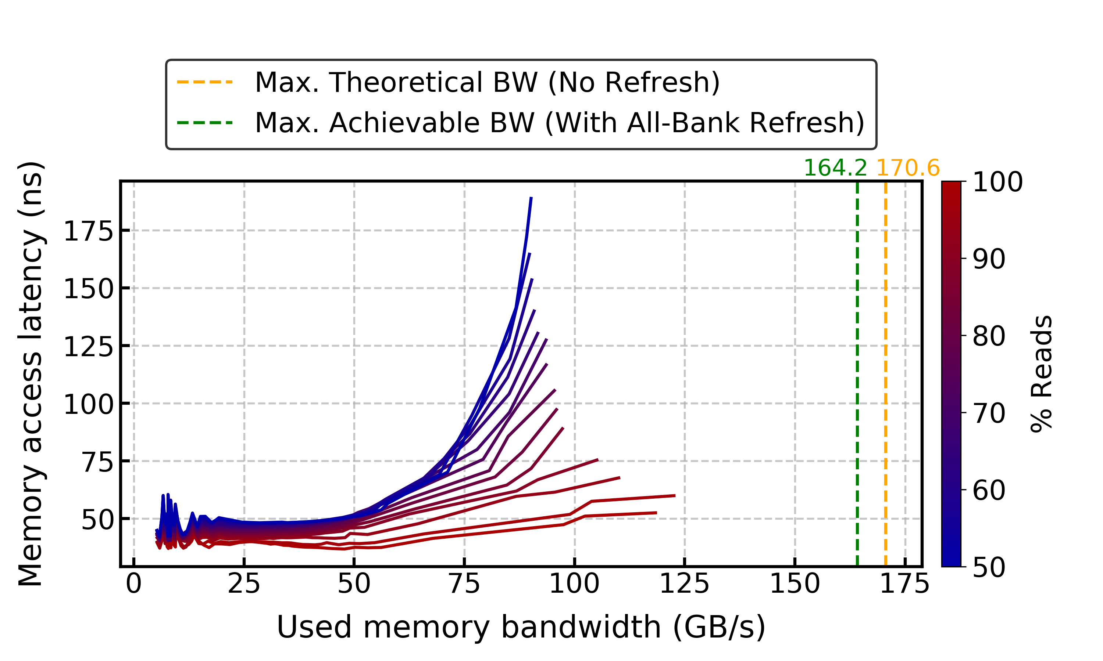
Our Key DAMOV Results
When correct statistics are used, DAMOV's memory access latency
is not constant, in contrast to the claims of the Mess paper
Notes:
Here is our results
[CLICK]
We observe that when correct statistics are used DAMOV's memory access latency is not constant,
In contrast to the claims of the Mess paper

Slide 24
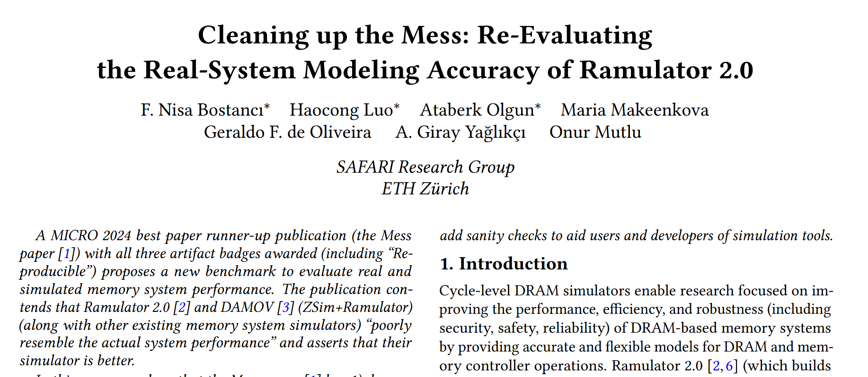
More in the Paper
* Equal contribution
https://arxiv.org/pdf/2510.15744
Notes:
There are even more details and analyses in the extended version of our paper on arxiv which you can access it with this link

Slide 25
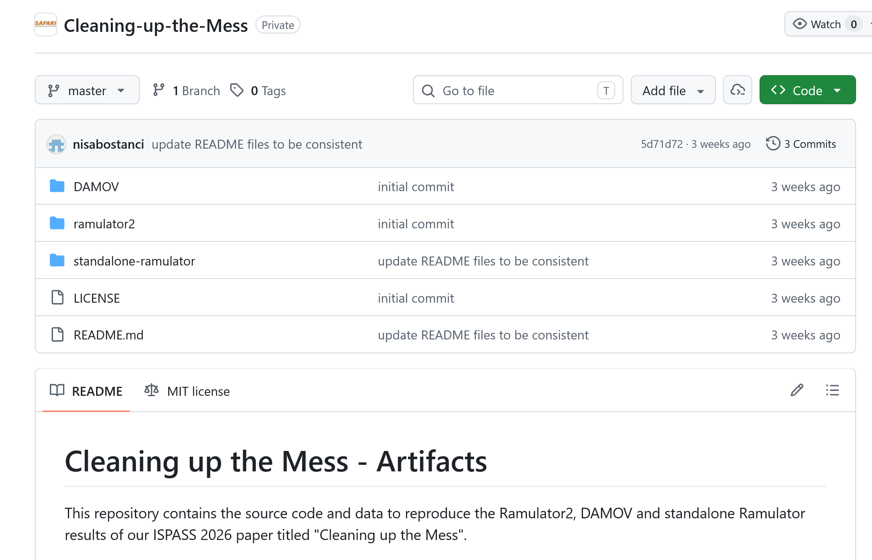
Cleaning up the Mess is Open Source
https://github.com/CMU-SAFARI/Cleaning-up-the-Mess
Notes:
All our source code and scripts are open sourced and artifact evaluated which you can check from the Github repo

Slide 26
Cleaning up the Mess
Analysis of the Evaluation of Ramulator 2.0
in the Mess Paper
Analysis of the Evaluation of DAMOV
in the Mess Paper
Ramulator 2.0 and DAMOV Best Practices
Notes:
Lastly, based on these analyses, we identify best practices for Ramulator 2 and DAMOV

Slide 27
Ramulator 2.0 and DAMOV Best Practices
Be familiarized with JEDEC standard documents
instead of relying on information other than the official standard
or the simulator documentation
1
2
Understand Ramulator 2.0’s
memory organization and configurations,
which are documented in the code and in the repository
3
Understand simulation methodology and simulator implementations
sufficiently to use the correct statistics
Communicate with the simulator developers
or user community when unexpected results are observed
to ensure correct simulator usage
4
Notes:
To avoid such configuration and usage errors,
[CLICK] First, the users should be familiarized with JEDEC standard documents
[CLICK] Second, they should understand the simulators memory organization and configurations
These two best practices would help avoiding the Ramulator 2.0 configuration error in the Mess paper
[CLICK] Third, they should understand simulation methodology and simulator implementations sufficiently to use the correct statistics
This would help avoiding the statistics usage errors in the Mess paper
[CLICK] Lastly, the users should communicate with the simulator developers or user community when unexpected results are observed to ensure correct simulator usage
This best practice would help avoid all errors in the Mess paper.

Slide 28
Conclusion
A recent paper, "A Mess of Memory System Benchmarking, Simulation and Application Profiling", MICRO'24 makes strong negative claims
about Ramulator 2.0 and DAMOV and shows unexpected results
We demonstrate that these claims and results are incorrect
and are due to configuration and simulator usage errors made
in the Mess paper
We strongly encourage the computer architecture community to consider
our corrections to the Ramulator 2.0 and DAMOV results of the Mess paper
to prevent the propagation of inaccurate and misleading results
To facilitate transparency and reproducibility, we open source all our
code and results: https://github.com/CMU-SAFARI/Cleaning-up-the-Mess
Notes:
Now, let us conclude our talk.

Slide 29
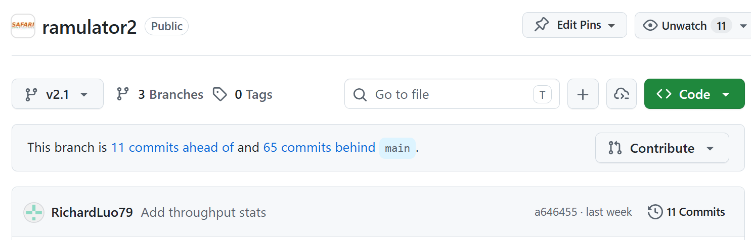
Ramulator 2.1
Major overhaul of Ramulator 2.0
Currently available as a pre-release in the v2.1 branch
Welcomes your use, contribution, and feedback!
  We will be making v2.1 the default branch soon
https://github.com/CMU-SAFARI/ramulator2/tree/v2.1
Notes:
We also take this chance to introduce ramulator 2.1, which is a major overhaul of Ramulator 2.0, which you can access at the v2.1 branch
And if you want to learn more about it
You can come to our workshops in ISCA and ICS

Slide 30

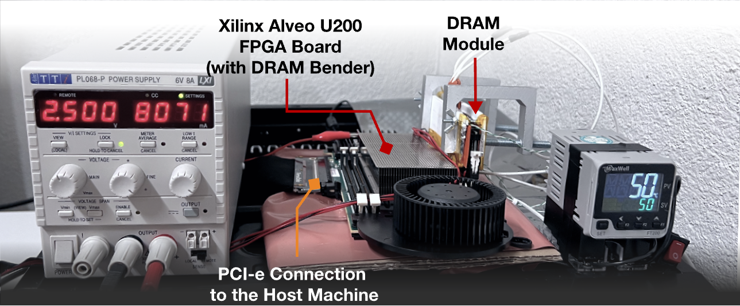

Join us at ISCA 2026!
2nd Tutorial on Ramulator & DRAM Bender:
Cutting-Edge Infrastructures for Real and Future Memory System Evaluation
R&DB:
A full-day tutorial @ ISCA 2026, Raleigh, USA
27 June 2026 (Saturday)
Organizers: Nisa Bostanci, Ataberk Olgun, Ismail Yuksel, Haocong Luo, Prof. Onur Mutlu
ISCA 2026
Evaluating memory performance, emerging memory technologies, and architectural mechanisms
Real DRAM device characterization studies
New features, extensions, and enhancements
Cross-layer research that combines memory system simulation with real-chip DRAM characterization
More information &
call for presentation:
https://events.safari.ethz.ch/isca26-ramulator-drambender/

Slide 31


Join us at ICS 2026!
3rd Tutorial on Ramulator & DRAM Bender:
Cutting-Edge Infrastructures for Real and Future Memory System Evaluation
R&DB:
Included in
Proceedings!
A half-day tutorial @ ICS 2026, Belfast, Northern Ireland, United Kingdom, 6th July 2026 (Monday)
Organizers: Nisa Bostanci, Ataberk Olgun, Ismail Yuksel, Haocong Luo, Prof. Onur Mutlu
ICS 2026
Evaluating memory performance, emerging memory technologies, and architectural mechanisms
Real DRAM device characterization studies
New features, extensions, and enhancements
Cross-layer research that combines memory system simulation with real-chip DRAM characterization
More information &
call for presentation:
https://events.safari.ethz.ch/ics26-ramulator-drambender/
Notes:
Note: For this one we will accept submissions that will be included in the proceedings could be good to mention

Slide 32
Cleaning up the Mess
Re-Evaluating the Real-System
Modeling Accuracy of Ramulator 2.0
F. Nisa Bostancı* Haocong Luo* Ataberk Olgun*
Maria Makeenkova Geraldo F. de Oliveira
A. Giray Yağlıkçı Onur Mutlu
* Equal Contribution

Slide 33


Cleaning up the Mess
Re-Evaluating the Real-System
Modeling Accuracy of Ramulator 2.0
Paper
GitHub
F. Nisa Bostancı* Haocong Luo* Ataberk Olgun*
Maria Makeenkova Geraldo F. de Oliveira
A. Giray Yağlıkçı Onur Mutlu
* Equal Contribution

Slide 34
Cleaning up the Mess
Re-Evaluating the Real-System
Modeling Accuracy of Ramulator 2.0
Backup Slides
F. Nisa Bostancı* Haocong Luo* Ataberk Olgun*
Maria Makeenkova Geraldo F. de Oliveira
A. Giray Yağlıkçı Onur Mutlu
* Equal Contribution

Slide 35
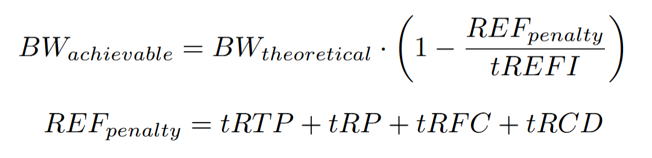
Maximum Achievable Bandwidth

Slide 36
Further Evaluation of DAMOV Results
The bandwidth gap can be caused by a combination of workload characteristics, system configuration, and the integration of the core and memory models
  E.g., DRAM address mapping, core model optimizations

Slide 37
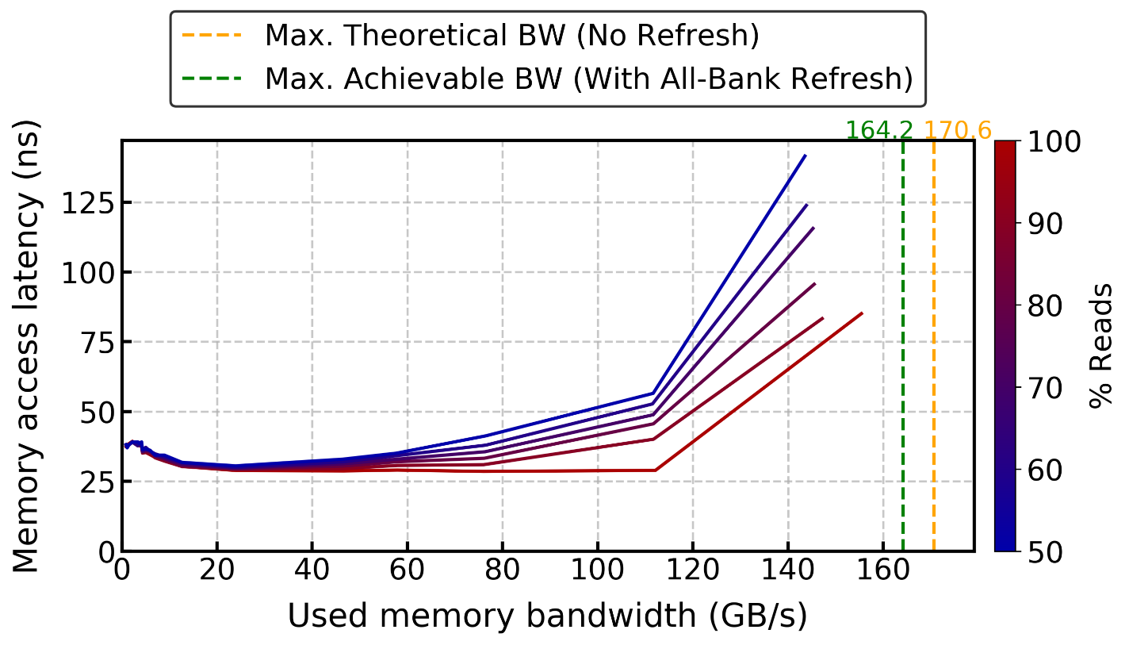
Ramulator (v1) – Mess Benchmark

Slide 38
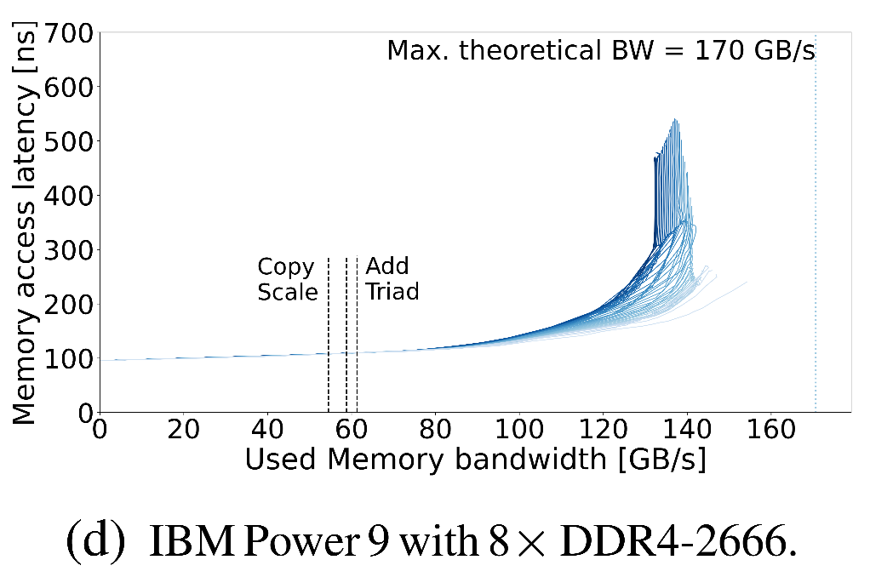
Another DDR4 Real System Result from the Mess Paper

Slide 39
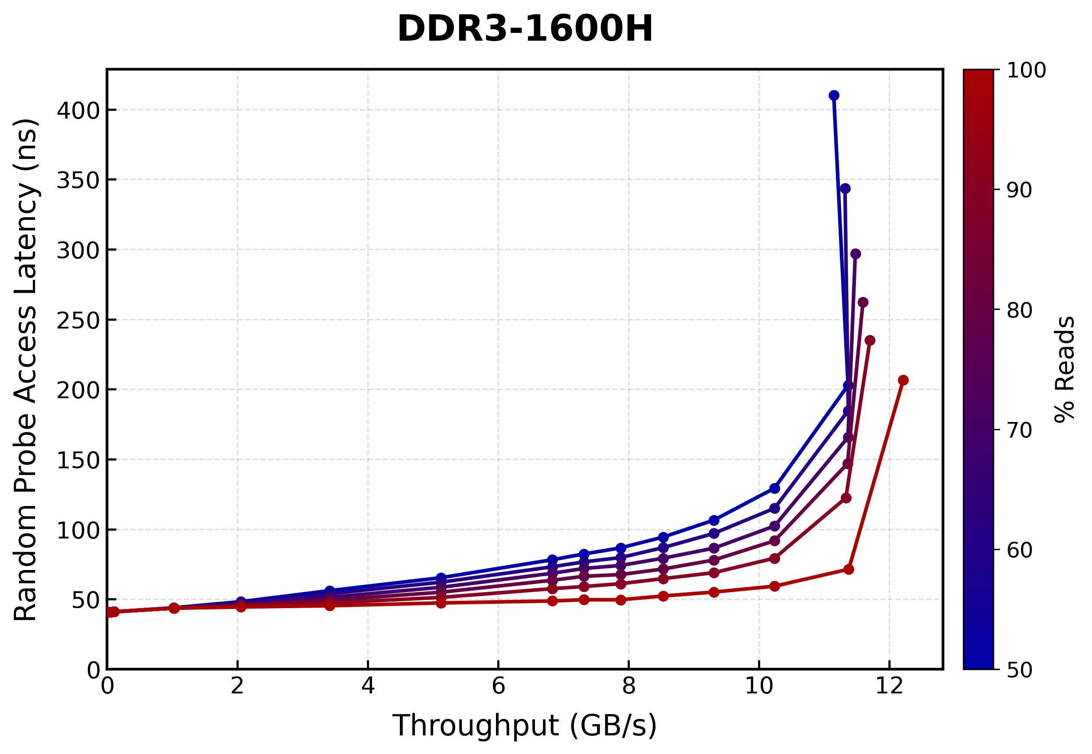
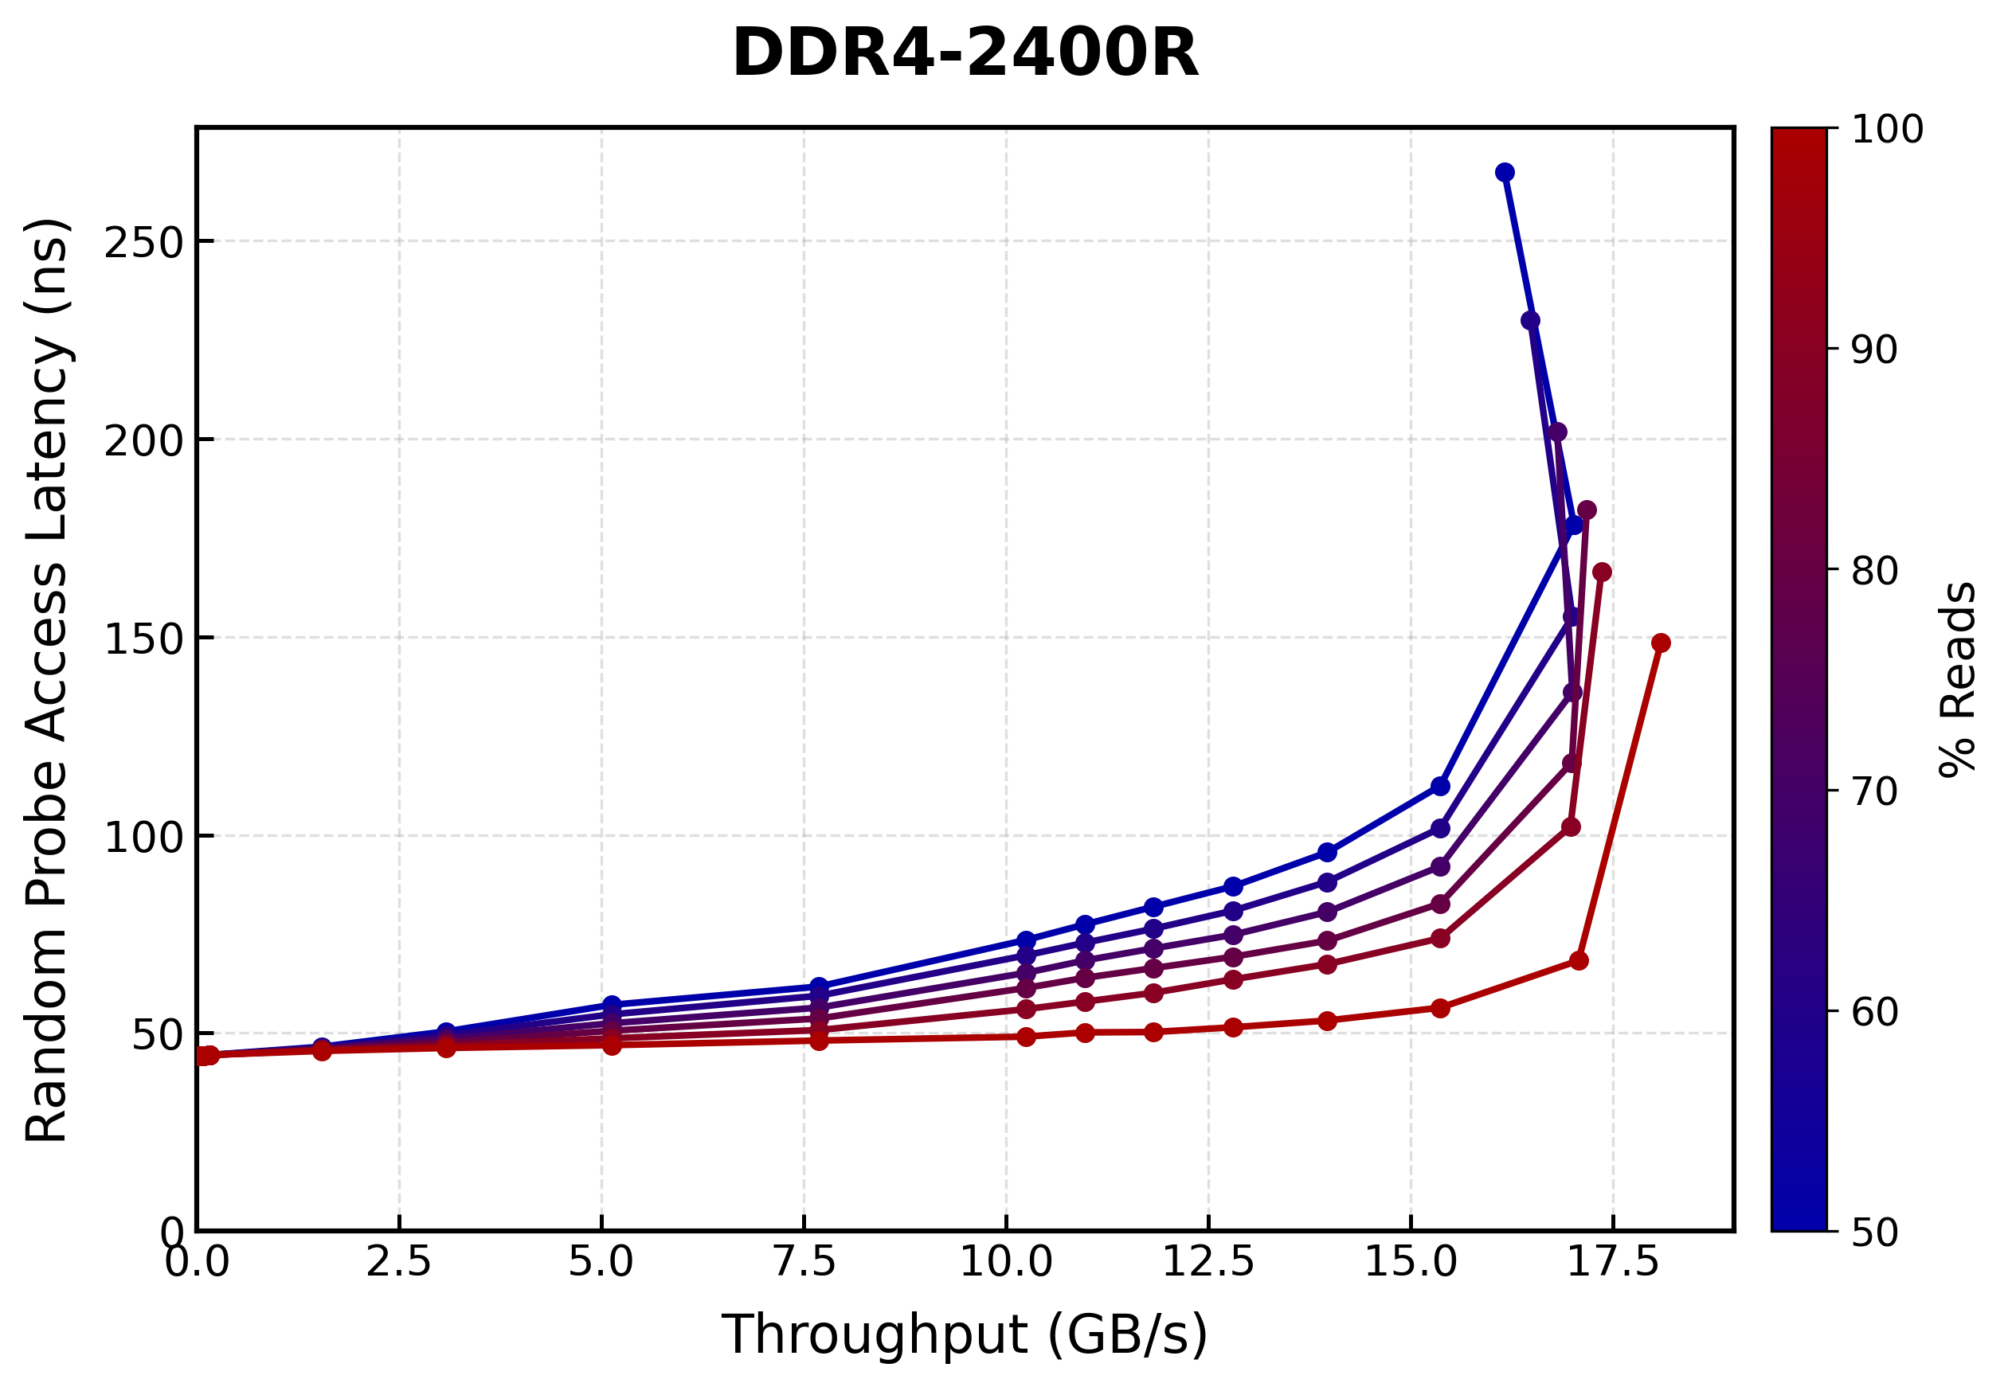
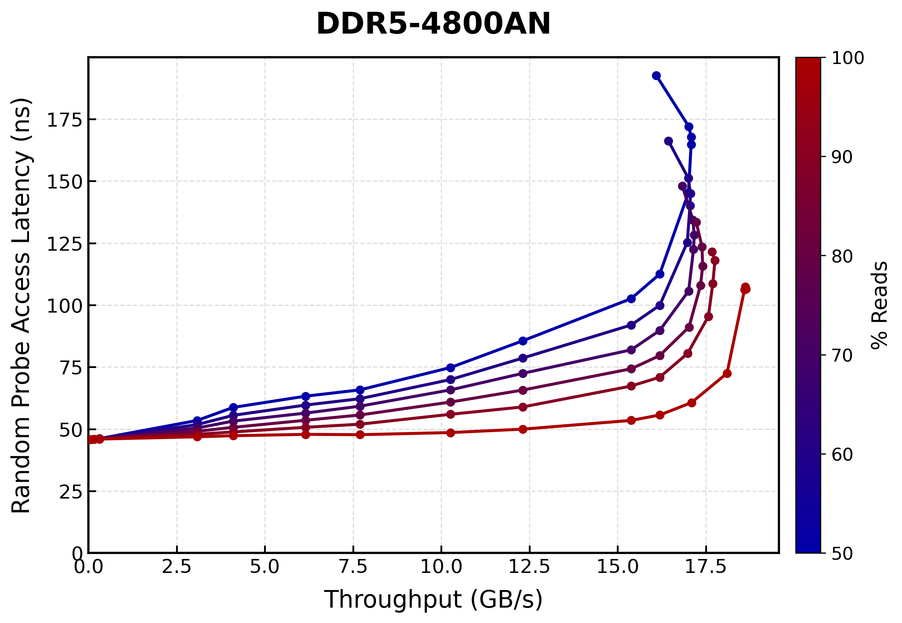
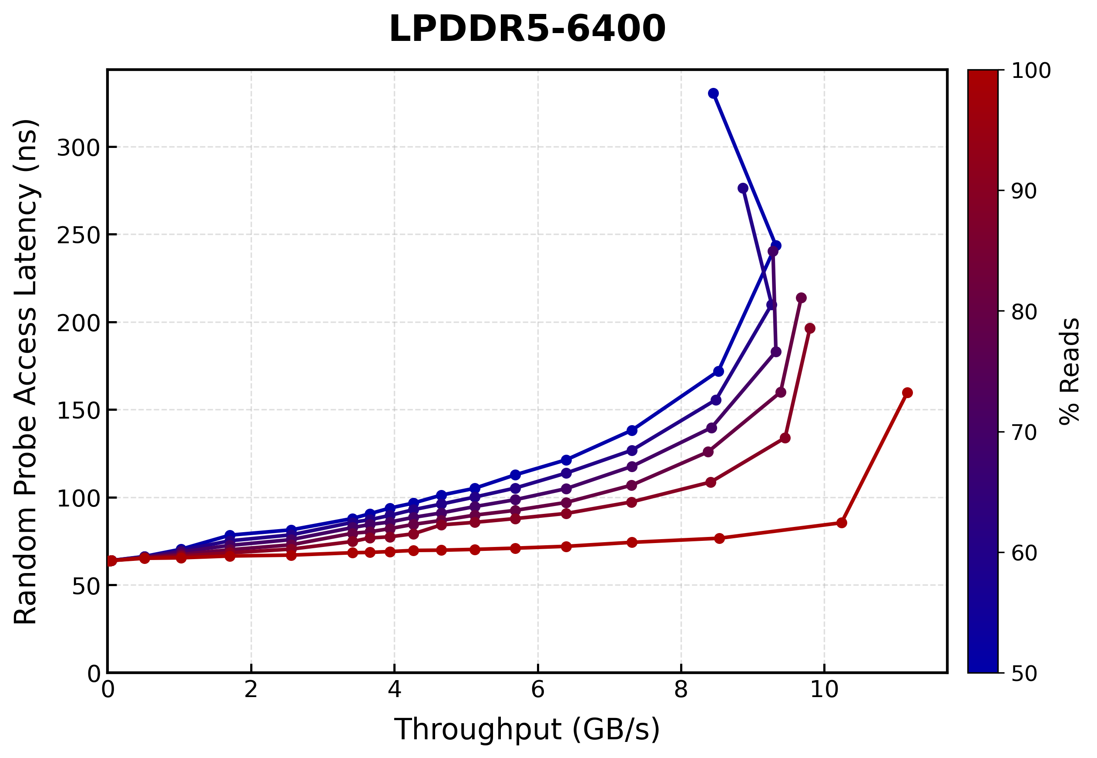
Ramulator 2.1 DRAM Standards Lat-Tp Plots

Slide 40
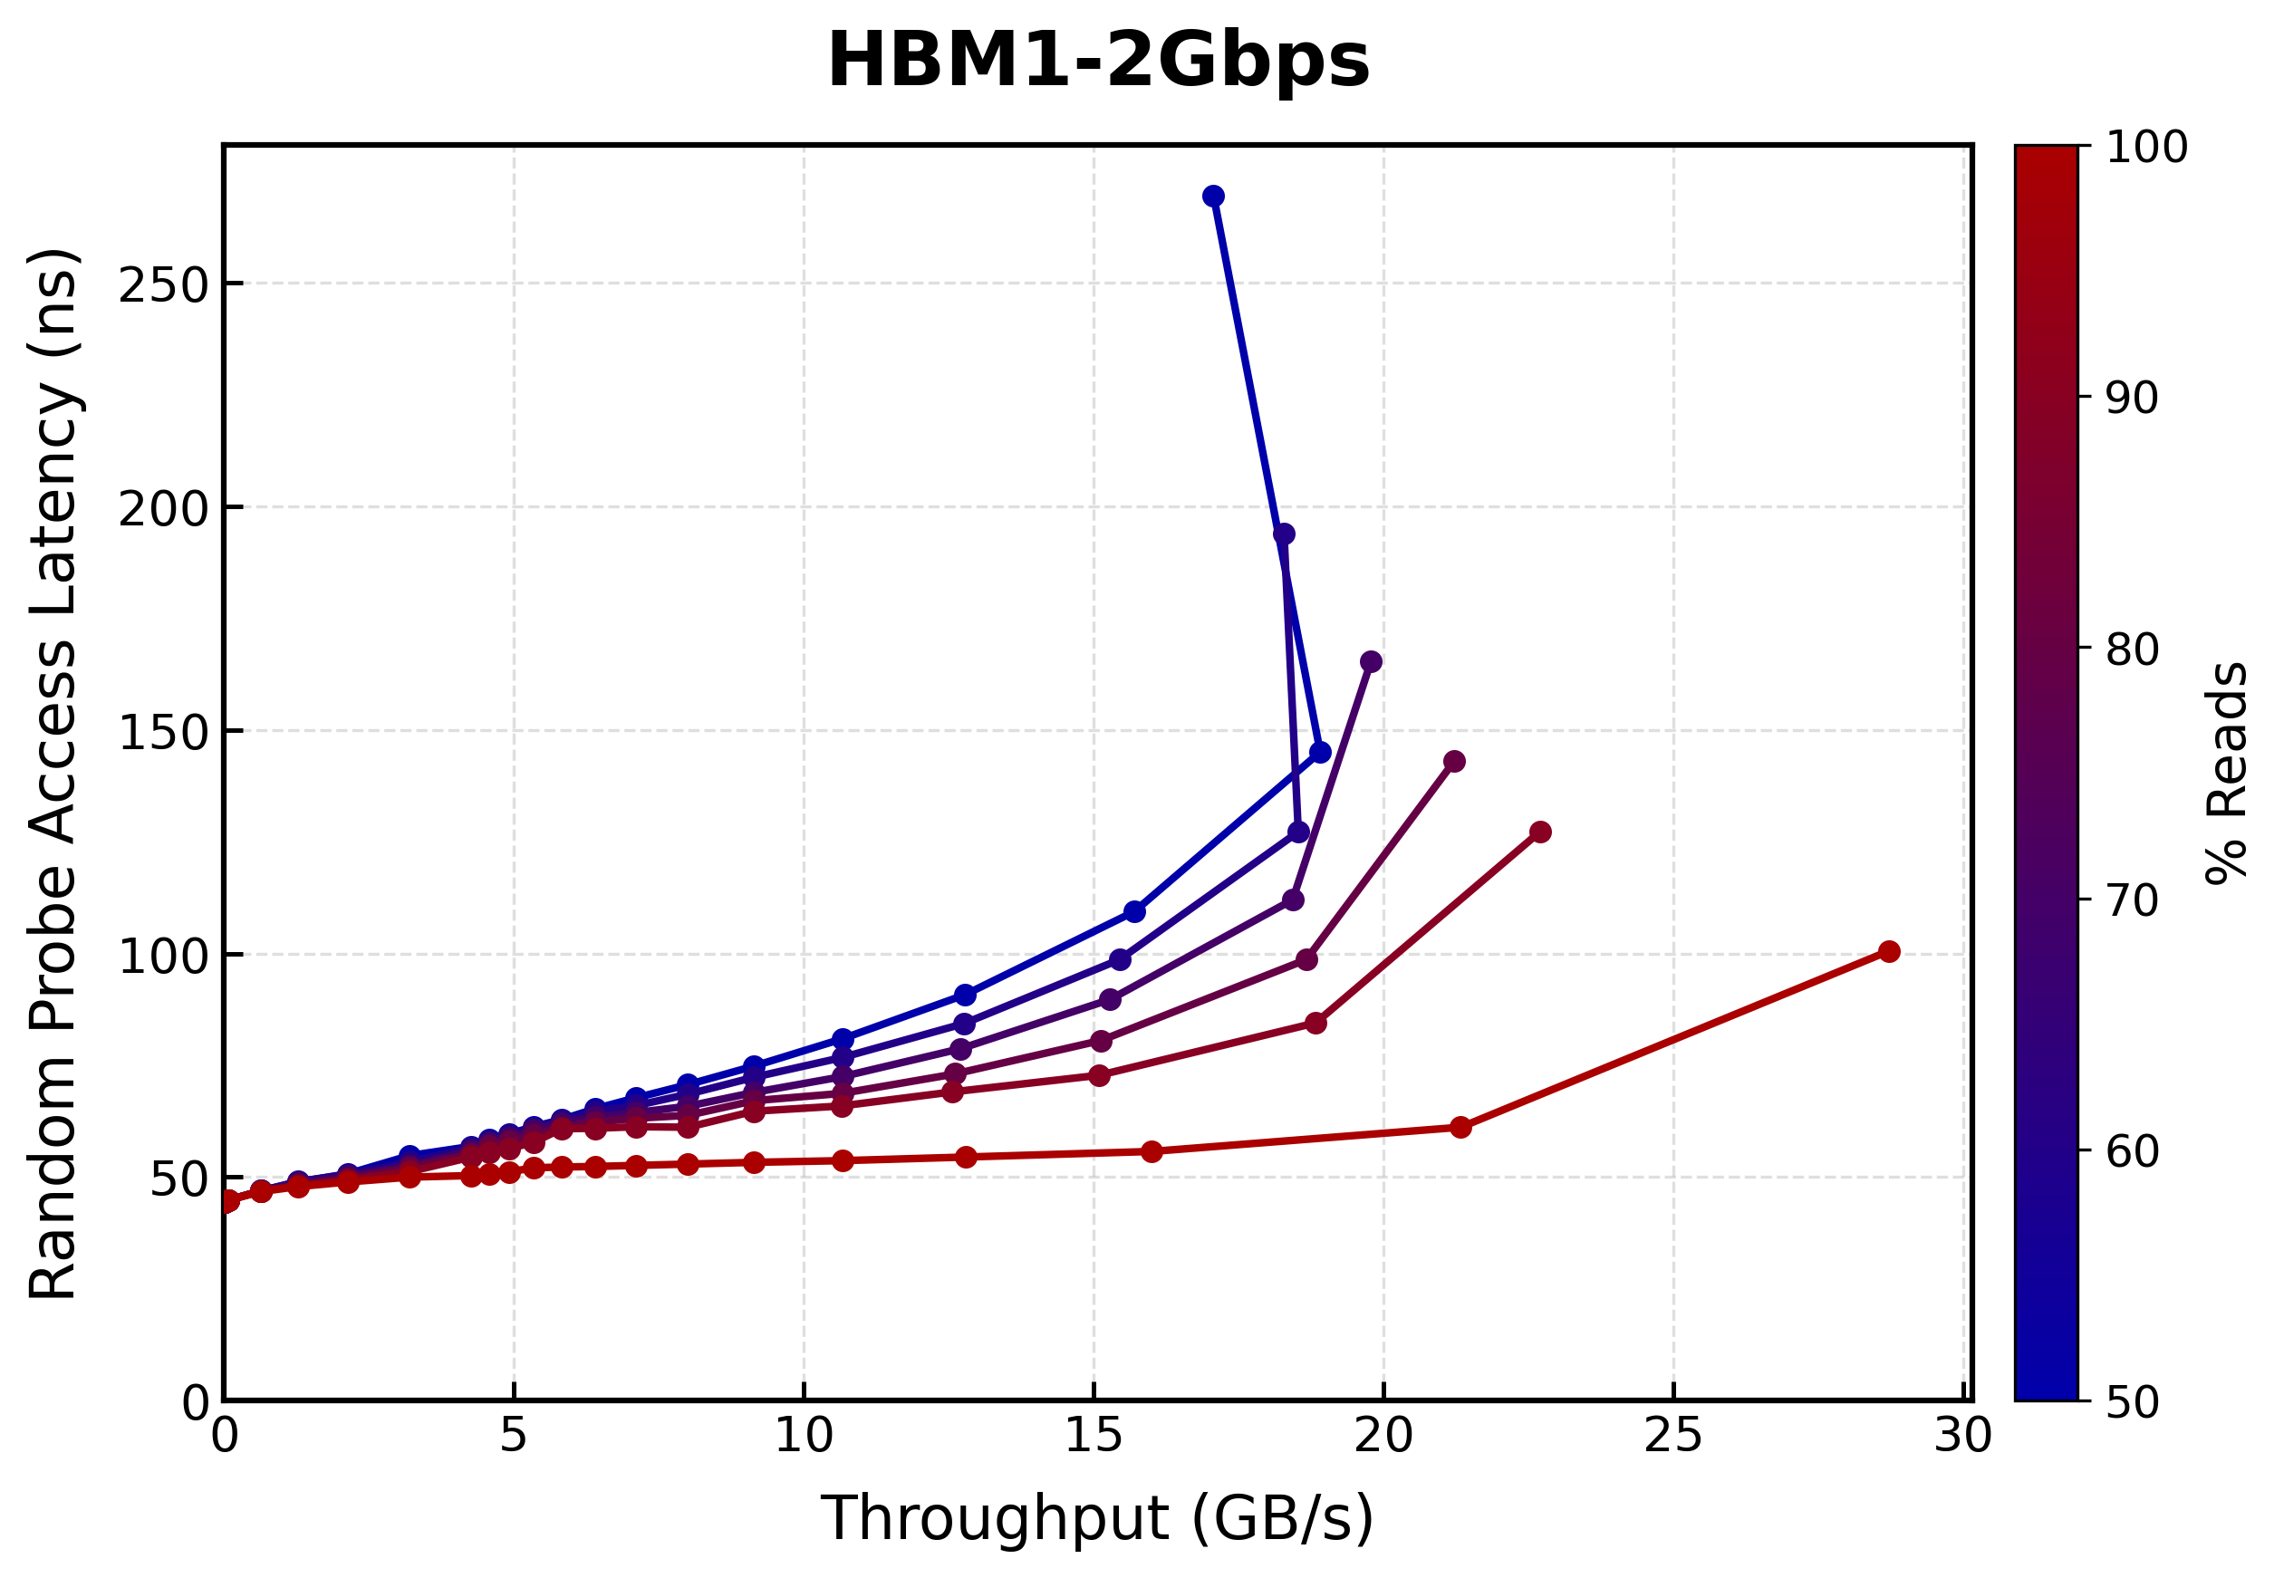
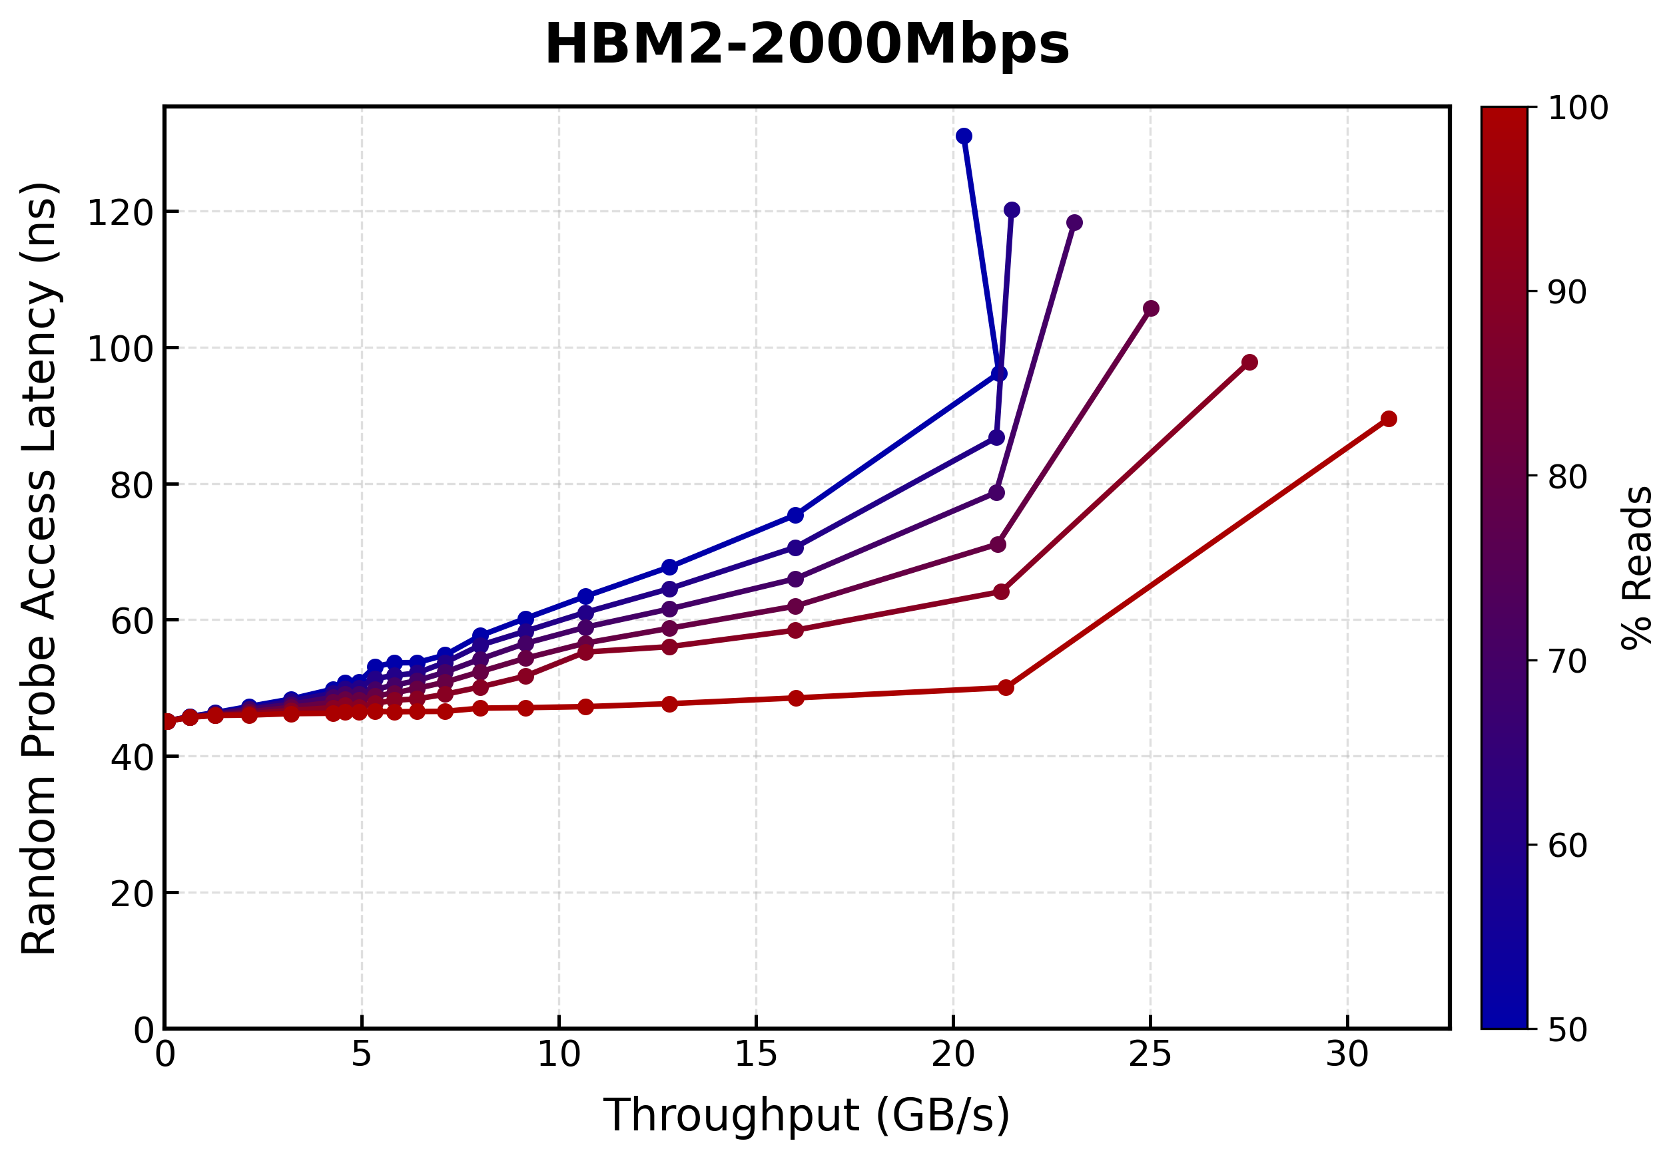
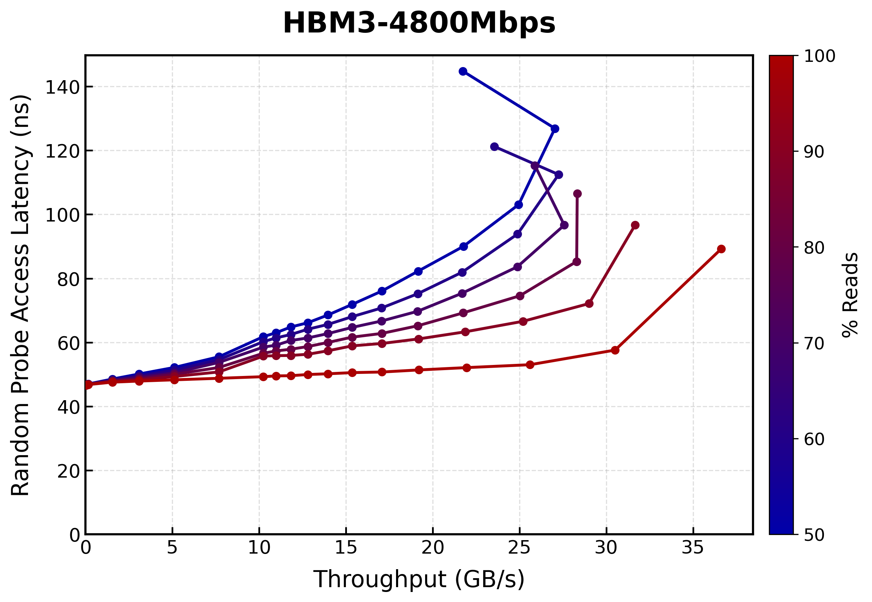
Ramulator 2.1 DRAM Standards Lat-Tp Plots
* HBM timings are guestimates

Slide 41
Ramulator 2.1
Major overhaul of Ramulator 2.0 that includes
  Aggregated bug fixes and code quality improvements
  Better support of newer DRAM and controller features, e.g.,
    Row-Col command dual issue controller for HBM2+
    WCK2CK sync and expiry tracking and ACT-1/ACT-2 split with tAAD
    deadline aware scheduling for LPDDR5
  Significantly improved ease-of-use, configuration, and extension
  More comprehensive test suite
  More comprehensive documentation
Currently available as a pre-release in the v2.1 branch
Welcomes your use, contribution, and feedback!
  We will be making v2.1 the default branch soon
https://github.com/CMU-SAFARI/ramulator2/tree/v2.1
Notes:
Add screenshot, reduce information
and font sizes
We take this opportunity to introduce ramulator 2.1, which is a major overhaul of Ramulator 2.0
..
And if you want to learn more about it
You can come to our workshops in ICS and ISCA
And advertise proceedings
can be a separate slide for workshops?
A lot of info in points, might not be necessary

Slide 42
Fundamental Configuration Errors:
Smaller Used Bandwidth
The Mess paper's evaluation:
Ramulator 2.0
Real System
8 DDR5 channels
16 DDR5 channels
The Mess paper incorrectly assumes a DDR5 channel in
Ramulator 2.0 is 64-bit, instead of the actual width of 32-bit
that is consistent with JEDEC DDR5 standards (JESD79-5)
Notes:
Ramulator 2.0 results show around half the used bandwidth of real system measurements, as it has half the number of channels.
We identify that this is because, the mess paper incorrectly assumes a DDR5 channel in Ramulator 2 is 64 bits wide
Whereas the implementation clearly states a channel as 32 bits wide, which is the consistent value with the JEDEC DDR5 standards

Slide 43
Fundamental Configuration Errors:
Smaller Used Bandwidth
The Mess paper's evaluation:
Ramulator 2.0
Real System
8 DDR5 channels
16 DDR5 channels
The Mess paper incorrectly assumes a DDR5 channel in
Ramulator 2.0 is 64-bit, instead of the actual width of 32-bit
that is consistent with JEDEC DDR5 standards (JESD79-5)
The Mess paper configures Ramulator 2.0 with half the channels of
a real system, and thus, results in smaller used bandwidth
Notes:
Because of this configuration error, the mess paper configures Ramulator 2 with half the channels of a real system and thus results in smaller used bandwidth

Slide 44
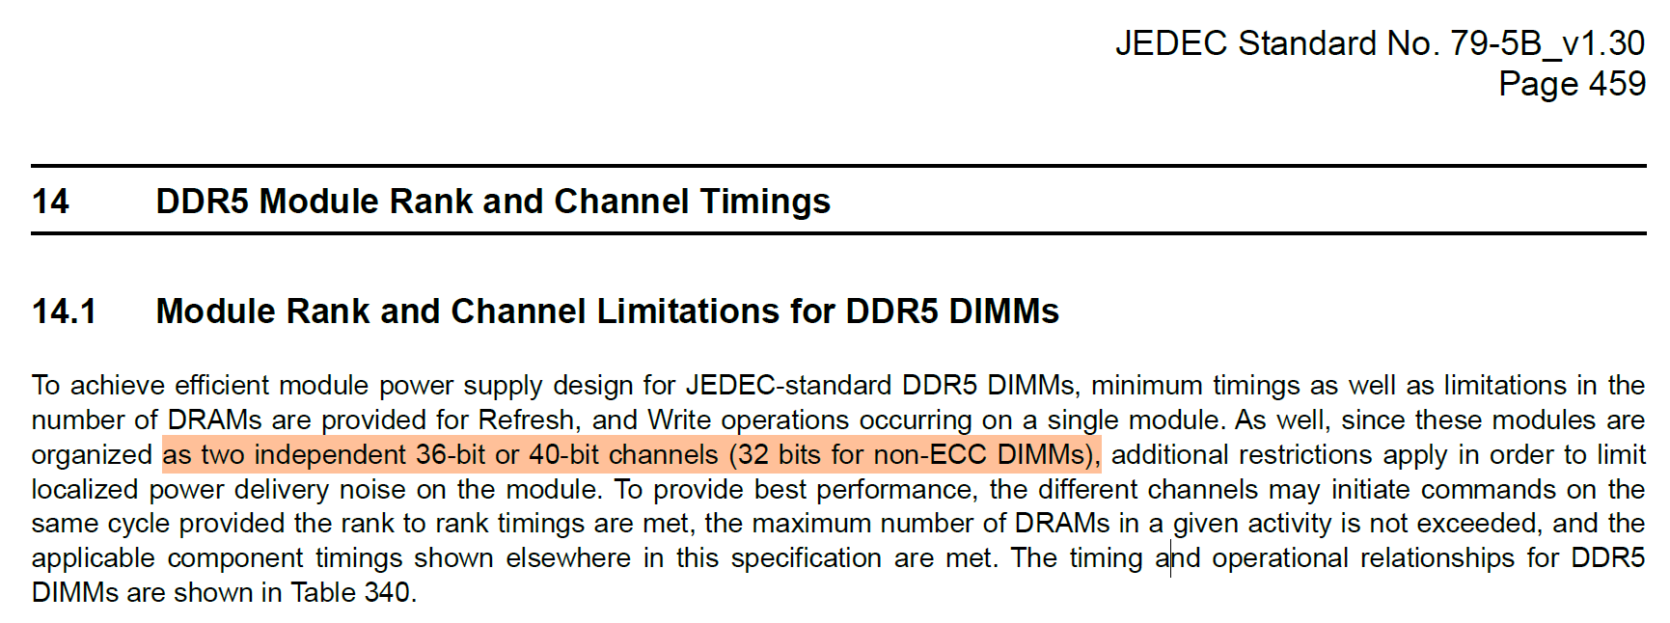
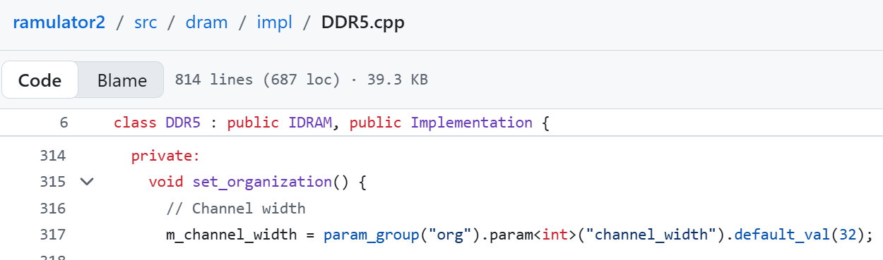
DDR5 Channel Terminology
Notes:
Add screenshot, reduce information
and font sizes
We take this opportunity to introduce ramulator 2.1, which is a major overhaul of Ramulator 2.0
..
And if you want to learn more about it
You can come to our workshops in ICS and ISCA
And advertise proceedings
can be a separate slide for workshops?
A lot of info in points, might not be necessary

Slide 45
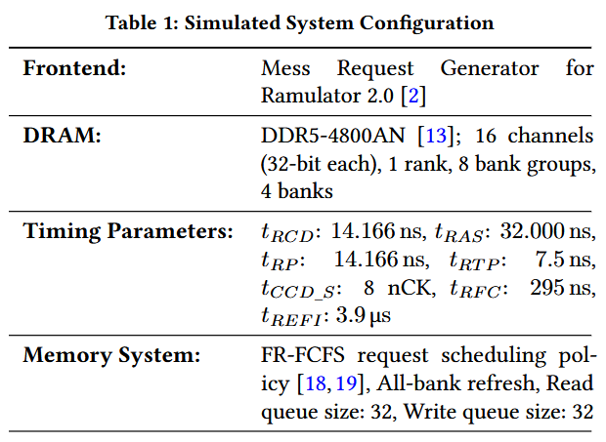
Ramulator 2.0 Simulation Configurations

Slide 46
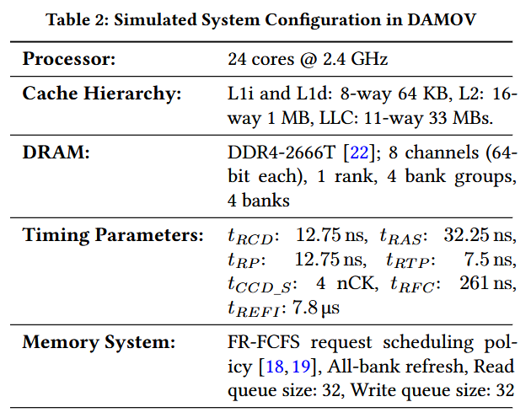
DAMOV Simulation Configurations

