Slide 1










COSM: A Cooperative Scheduling Framework for Concurrent PIM and CPU Execution on Mobile Devices
ISCA 2026
June 27– July 1, 2026
Raleigh, USA
Yilong Zhao(Speaker)*, Fangxin Liu*, Onur Mutlu, Mingyu Gao, Jian Liu,
Haibing Guan, Li Jiang†
sjtuzyl@sjtu.edu.cn , liufangxin@sjtu.edu.cn, ljiang_cs@sjtu.edu.cn
Shanghai Jia Tong University | Shanghai Qi Zhi Institute
ETH Zurich | Tsinghua University | Beihang University
ISCA’ 2026
August 2, 2026
* Co-first Author
† Corresponding Author
Notes:
Thank you for the introduction. hello everyone.
I am delighted to present our work COSM.

Slide 2
Overview
Background: LLM inference with PIM on mobile devices
Notes:
This is an overview of our work. We focus on large model inference with PIM on mobile devices.

Slide 3
Overview
Background: LLM inference with PIM on mobile devices
Insight: Complementary Bandwidth Occupation
  CPU/PIM workload: High/Low External BDW; Low/High Internal BDW
Goal：Co-scheduling CPU & PIM to maximize overall bandwidth utilization
→ Cooperative scheduling framework – Interface + Scheduling
Notes:
Our key insight is that CPU and PIM workloads have complementary bandwidth occupation. Therefore, our goal is to co-schedule these two workloads to maximize overall bandwidth utilization.

Slide 4
Overview
Background: LLM inference with PIM on mobile devices
Insight: Complementary Bandwidth Occupation
  CPU/PIM workload: High/Low External BDW; Low/High Internal BDW
Goal：Co-scheduling CPU & PIM to maximize overall bandwidth utilization
→ Cooperative scheduling framework – Interface + Scheduling
Challenges → Solutions：
1 The dilemma of fixed-length PIM execution command Interface
1 Low-interference Interface
  1.1 Preemptable PIM Execution
  1.2 Bandwidth-decoupled Data Transfer
2 PIM data transfers starve CPU access under conventional scheduling
2 Idleness-aware Memory Scheduling
2.1 Idle time window estimate
2.2 Scheduling strategy
3 Achieve high CPU & PIM performance
Notes:
To achieve this, we design a cooperative scheduling framework with both interface and scheduling policy optimizations. We address three key challenges on the interference of the interface and the scheduling policy, and give solutions in our framework.

Slide 5
Overview
Background: LLM inference with PIM on mobile devices
Insight: Complementary Bandwidth Occupation
  CPU/PIM workload: High/Low External BDW; Low/High Internal BDW
Goal：Co-scheduling CPU & PIM to maximize overall bandwidth utilization
→ Cooperative scheduling framework – Interface + Scheduling
Challenges → Solutions：
1 The dilemma of fixed-length PIM execution command Interface
1 Low-interference Interface
  1.1 Preemptable PIM Execution
  1.2 Bandwidth-decoupled Data Transfer
2 PIM data transfers starve CPU access under conventional scheduling
2 Idleness-aware Memory Scheduling
2.1 Idle time window estimate
2.2 Scheduling strategy
3 Achieve high CPU & PIM performance
Evaluation：Ramulator2 simulation | 2-Channel LPDDR5 | Mobile APP + LLM
Results：2.8x PIM Throughput with only 2% CPU Degradation.
Notes:
We evaluate on the Ramulator2 simulator, our design achieves a 2.8x PIM speedup with only 2% CPU degradation.

Slide 6
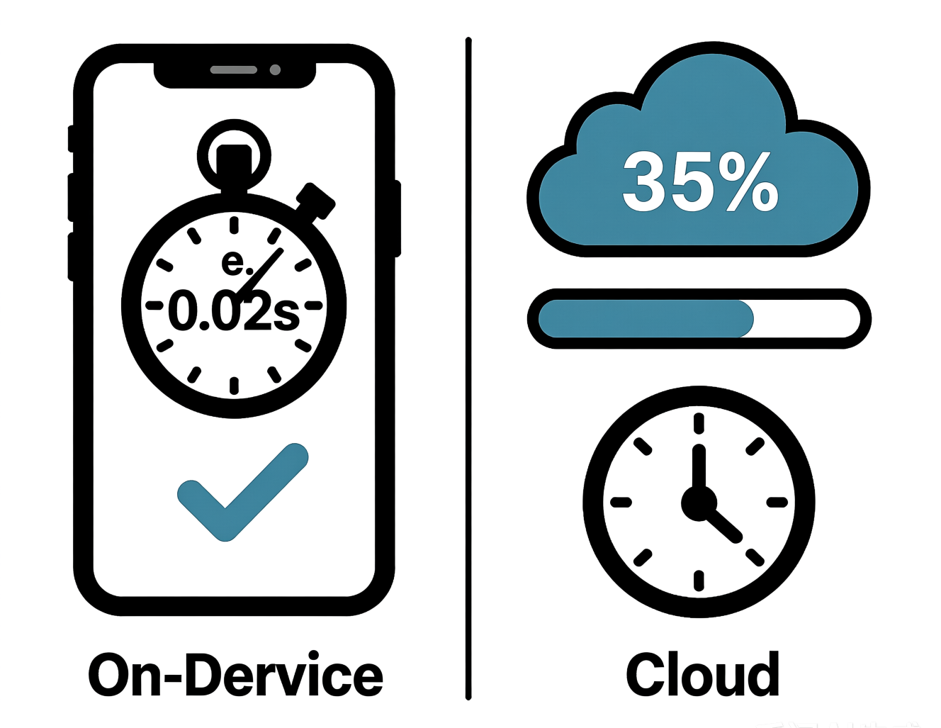
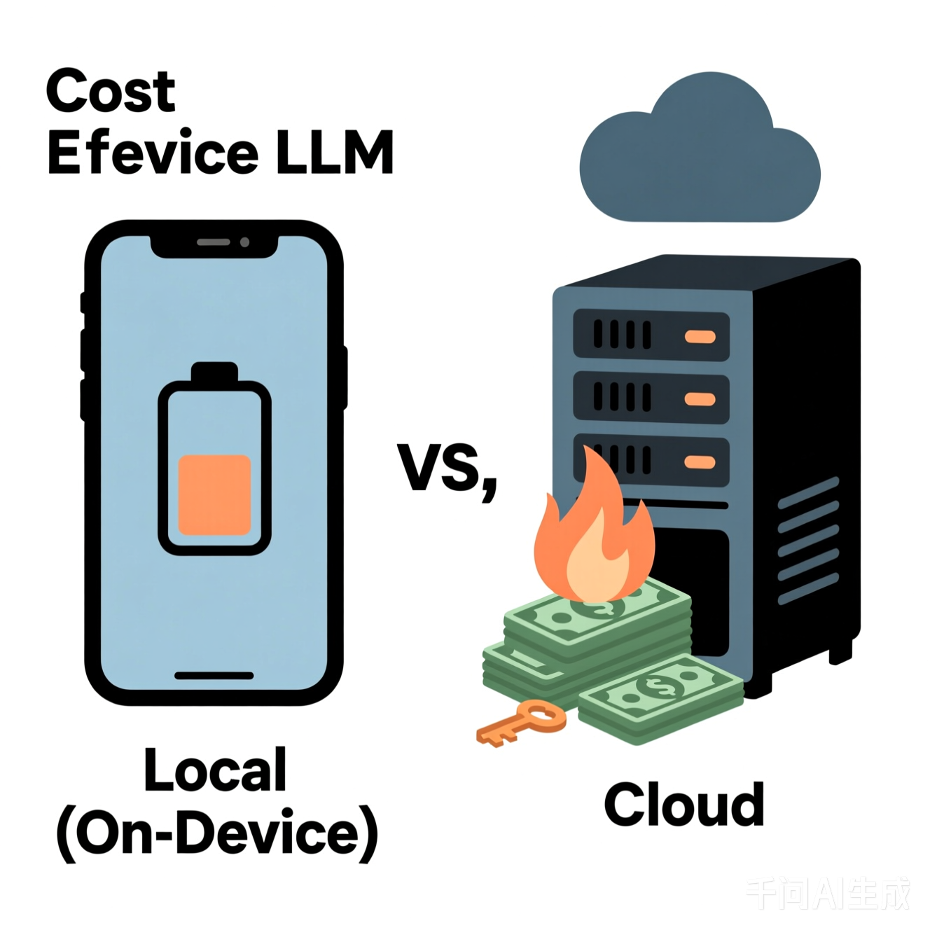

LLM Inference on Mobile
Privacy &
Data Sovereignty
Cost Efficiency & Scalability
Real-time Response
These Requirements Demand Mobile LLM Inference
Notes:
Then I will go through our work, starting with the background. The requirement of Privacy, Latency, and Cost Requirements demand Mobile LLM Inference

Slide 7
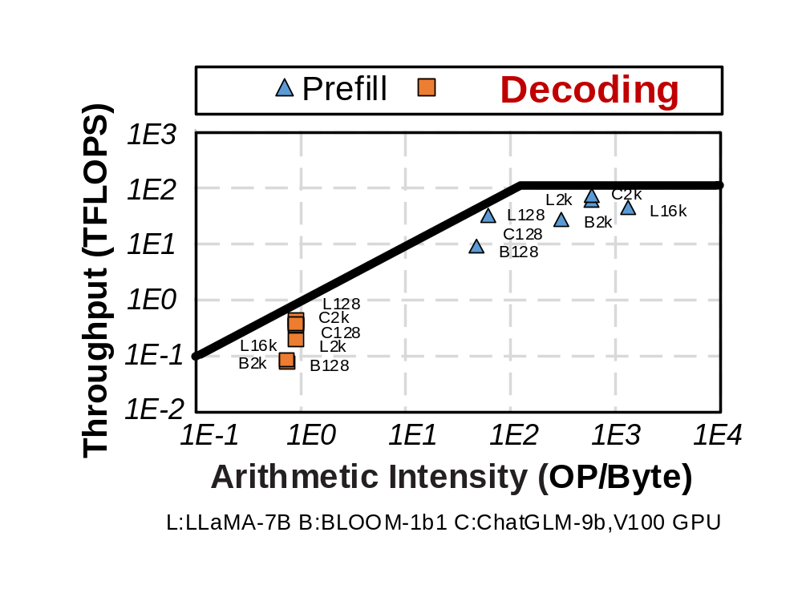
LLM Decoding is Memory Bound
Limited resource on mobile → Batch size =1 → Decoding is memory bound
>80% time
>70% energy
on data transfer
Samsung [HCS’23]
Memory Bound
LLM decoding is inefficient on NPU/GPU because of limited bandwidth!
Notes:
Due to the limited resources, the batch size of the inference always be one, so the the decoding phase is memory-bound.
Technique reports shows most of the time and energy are on data transfer

Slide 8
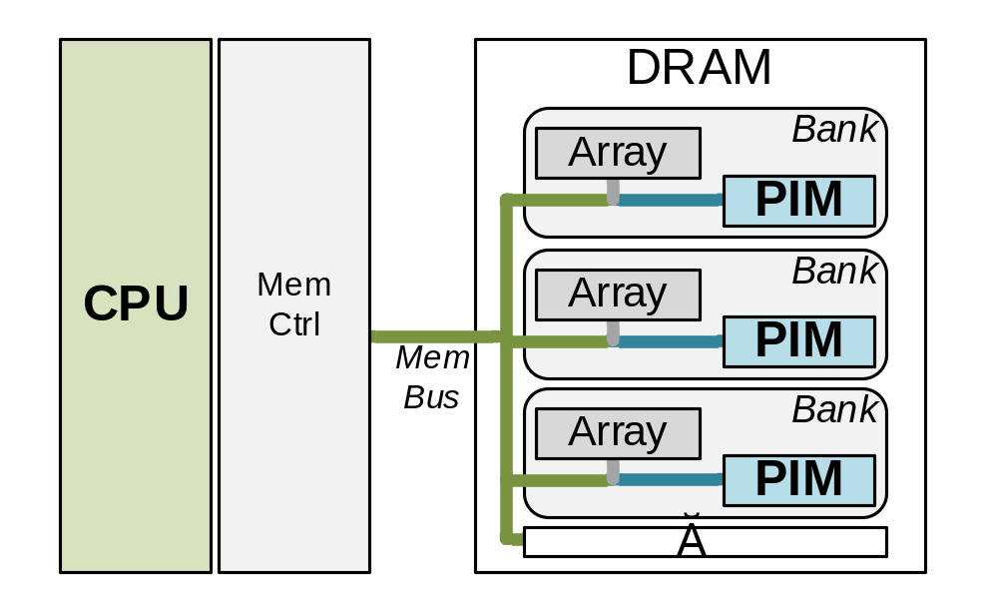
DRAM-based Processing-in-Memory (PIM)
PIM: Integrate Computing Units in DRAM Banks
8~16x Bandwidth
Data source: Samsung
Serialized
Parallel
PIM achieve high bandwidth through parallel access
Notes:
Processing-in-Memory, or PIM, provides a solution. Computing units are integrated into DRAM banks, so they can access banks in parallel. PIM have high memory bandwidth, and fit for large model inference.

Slide 9
CPU-PIM Memory Contention
Mobile device faces limited resource
→ CPU & PIM should share memory
Notes:
Due to the limited resources, CPU and PIM should share the DRAM memory on mobile device.

Slide 10




CPU-PIM Memory Contention
Mobile device faces limited resource
→ CPU & PIM should share memory
CPU & PIM face memory access contention
Voice Assistant (PIM APP)
Contention
Game (CPU APP)
DRAM Memory
Significant performance degradation is unacceptable
Notes:
So CPU and PIM will face memory access contention.
Under contention, any significant performance degradation is unacceptable, particularly for native CPU applications.

Slide 11
CPU-PIM Memory Contention
Mobile device faces limited resource
→ CPU & PIM should share memory
CPU & PIM face memory access contention
Voice Assistant (PIM APP)
Contention
Game (CPU APP)
DRAM Memory
Significant performance degradation is unacceptable
How to maximize the utilization of available bandwidth resources?
Notes:
So how can we maximize the utilization of bandwidth under this situation?

Slide 12
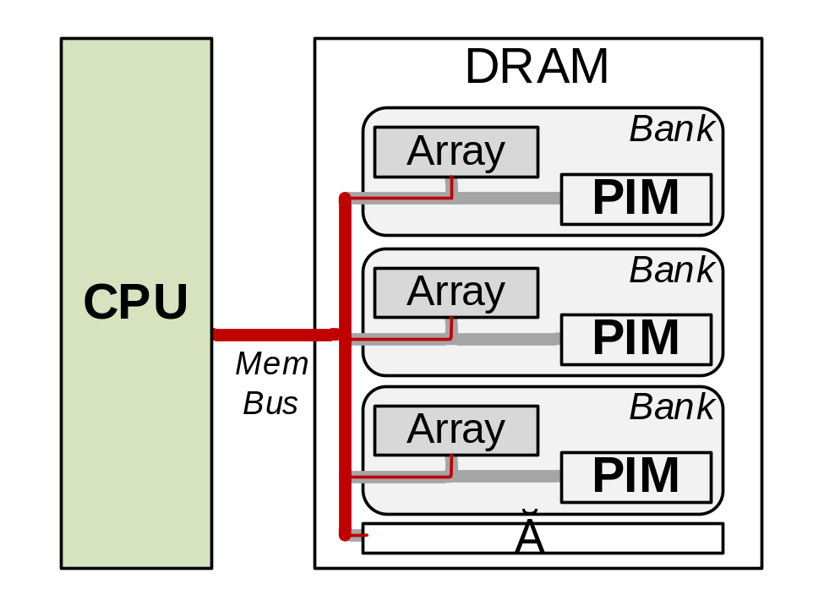
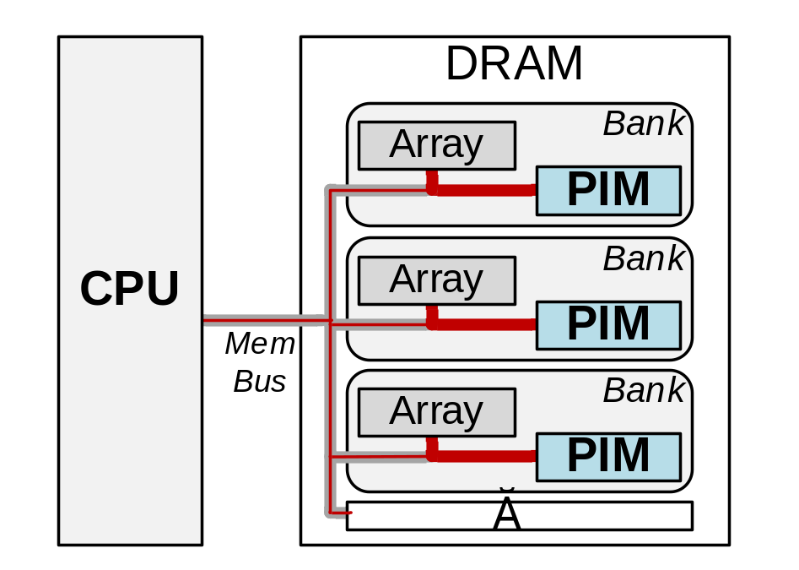
PIM & CPU Workload: Inefficient Bandwidth Use
External bandwidth: memory bus bandwidth | Internal bandwidth: aggregated bank bandwidth
CPU Workload:
Only accesses
PIM Workload:
A few accesses + Massive executions
High External Bandwidth ↑
Low Internal Bandwidth ↓
Low External Bandwidth ↓
High Internal Bandwidth ↑
Notes:
On the left, During CPU accesses, data from all banks goes serially through the external memory bus. So, even when the external memory bus bandwidth is saturated, internal bank bandwidth remains underutilized.
In contrast, on the right, PIM workload consumes more internal bandwidth. This indicate a complementary bandwidth occupation.

Slide 13
PIM & CPU Workload: Inefficient Bandwidth Use
External bandwidth: memory bus bandwidth | Internal bandwidth: aggregated bank bandwidth
Goal: Co-scheduling CPU & PIM workloads to exploit both internal & external bandwidth
CPU Workload:
Only accesses
PIM Workload:
A few accesses + Massive executions
High External Bandwidth ↑
Low Internal Bandwidth ↓
Low External Bandwidth ↓
High Internal Bandwidth ↑
Notes:
So we can co-schedule these two workloads to fully exploit both internal and external memory bandwidth

Slide 14
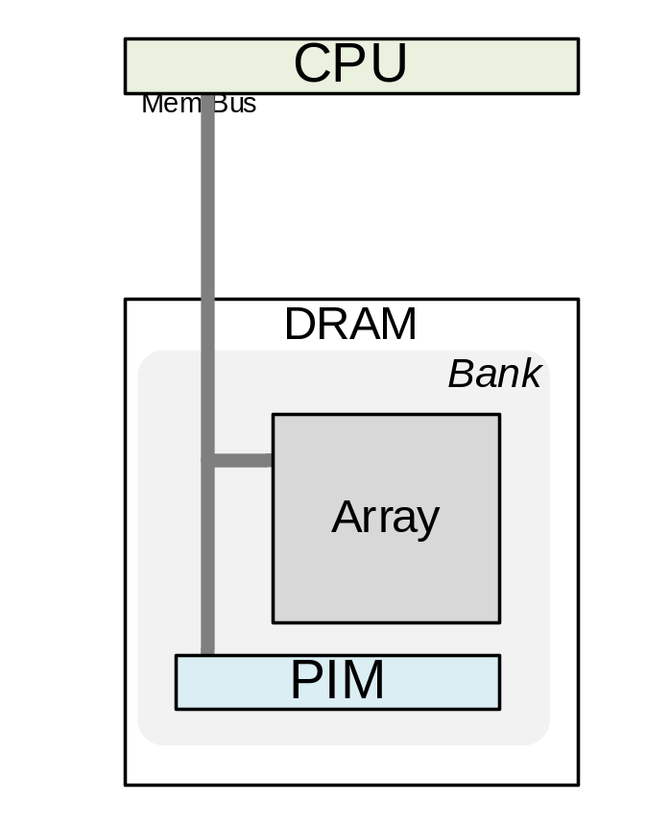
PIM Command Support
PIM units can only access local bank
PIM Execution
PIM Data Transfer (between Banks)
via
extended DRAM command
via
normal read/write command
Results
Weights
weight
Vectors
Results
Notes:
Since PIM can only access local bank, a PIM system needs two types of commands, PIM execution and PIM data transfer.
PIM execution is implemented via extended DRAM command, while PIM data transfer are normal read/write access.

Slide 15
Interface Analysis I:
Interference between PIM Execution & CPU Access
Notes:
To achieve our goal, we first made key observations to identify design constraints. We first analysis the interference between PIM Execution and CPU access.

Slide 16
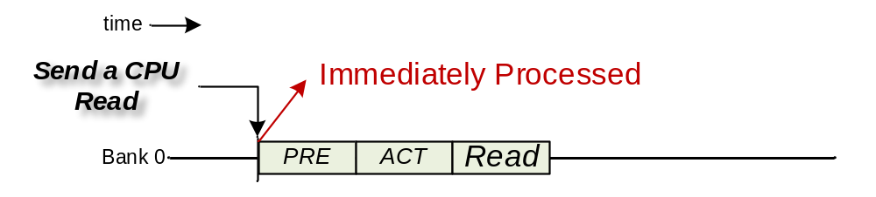
Observation 1
PIM interference on CPU access latency:
CPU access only:
Define Command Length: # Cycles of PIM Execution
Notes:
When there is only CPU, CPU access is processed immediately when it comes.

Slide 17
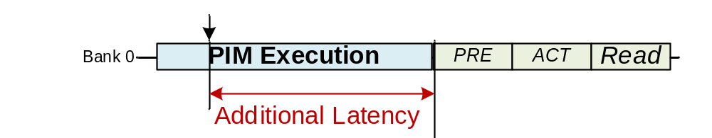
Observation 1
PIM interference on CPU access latency:
CPU access only:
With PIM execution:
Define Command Length: # Cycles of PIM Execution
Notes:
However, with PIM in the system, if a PIM execution is still running when the access comes, there will be an additional read latency.

Slide 18
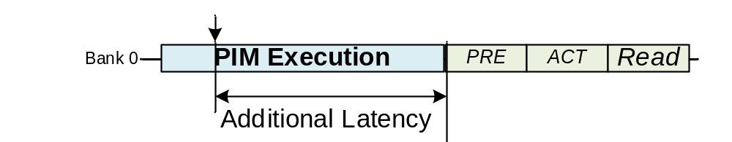
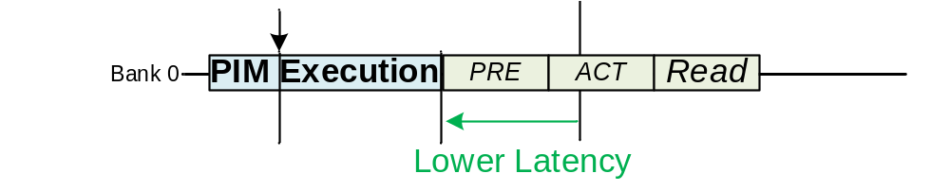

Observation 1
PIM interference on CPU access latency:
CPU access only:
With PIM execution:
With a Shorter
PIM Execution:
Define Command Length: # Cycles of PIM Execution
Notes:
and, shorter PIM execution will lead to lower latency.

Slide 19
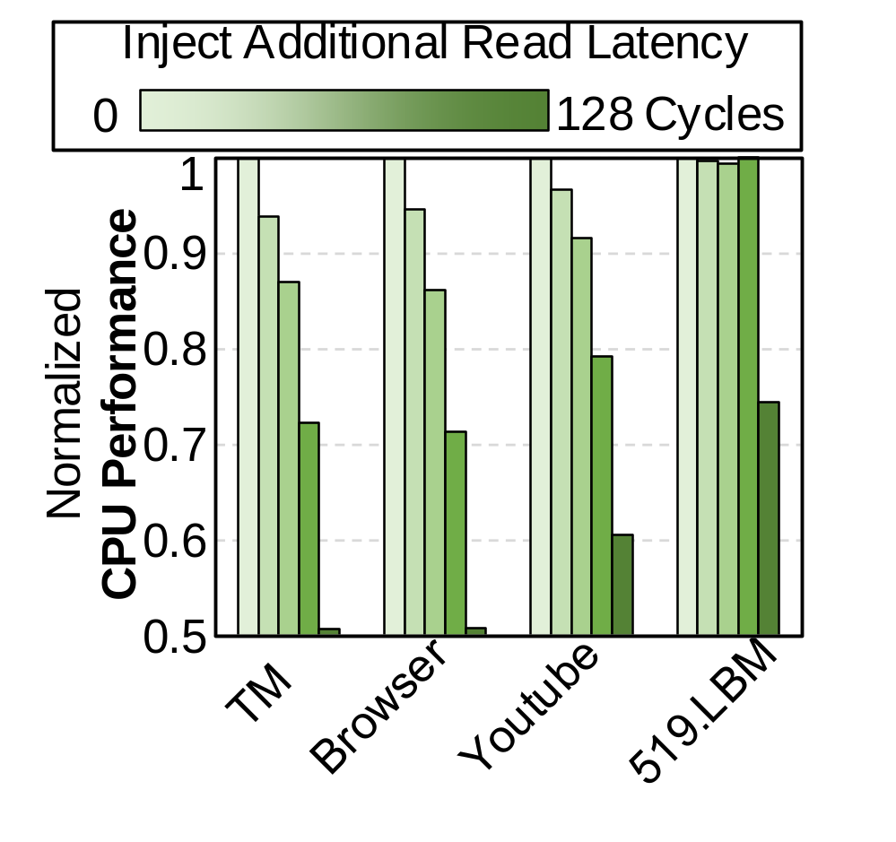
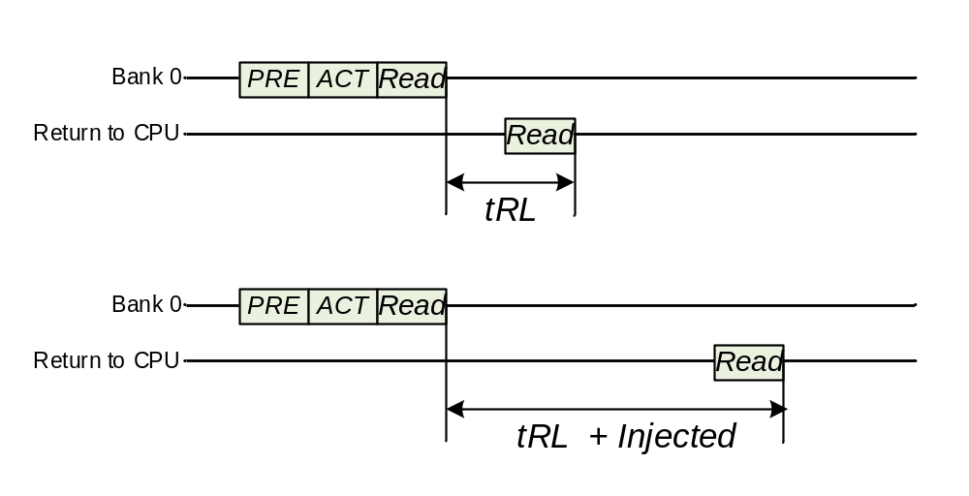
Observation 1
Experimental Setup:
Inject Additional Read Latency in Ramulator2 Simulator
Performance ↓
Latency ↑
CPU Workloads
CPU workload is sensitive to read latency
PIM execution should be Short
Notes:
To see how this latency affects CPU workload, we injected read latencies to see the CPU performance.
As shown in the right figure, Even a moderate 128-cycle delay severely degrades CPU performance. So, CPU workload is sensitive to read latency, PIM execution must be short

Slide 20
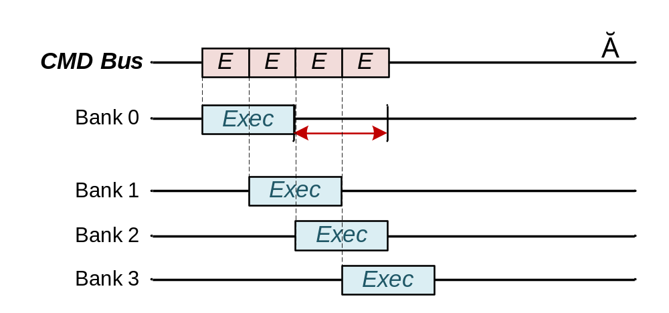
Observation 2
PIM underutilization due to bus pressure:
Short PIM execution command:
Idle before rounded back
Notes:
While the command length also affects PIM's performance.
The memory controller needs to sequentially issue PIM execution to each bank. As shown in this figure, if it is too short, a bank finishes and stay idle before the memory controller can round back to it.

Slide 21
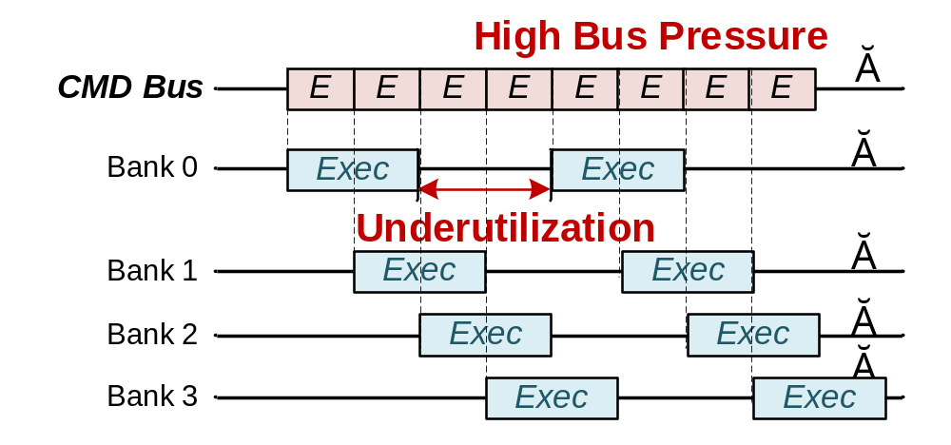

Observation 2
PIM underutilization due to bus pressure:
Short PIM execution command:
Notes:
This creates a contention on the command bus, leaving internal bandwidth underutilized.

Slide 22
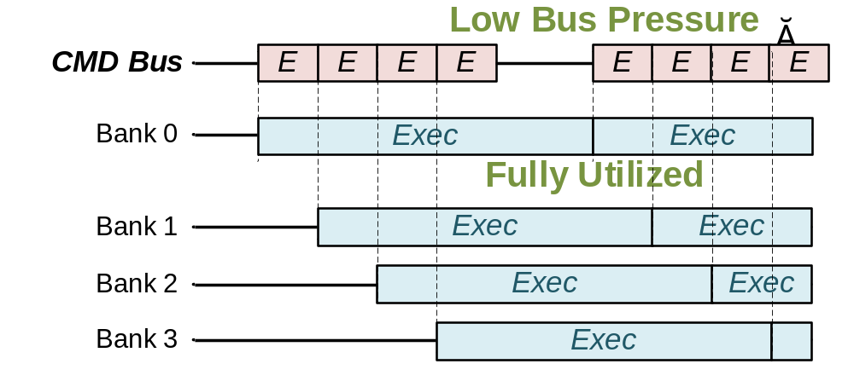
Observation 2
PIM underutilization due to bus pressure:
Short PIM execution command:
Long PIM execution command:
Notes:
In contrast, longer command is better: it keep the banks busy, and avoid bus contention.

Slide 23
Challenge 1
Challenge 1: Dilemma of fixed-length commands
Command Length | CPU | PIM
Short | Low latency √ | Bus Contention×
Long | High Latency× | High Throughput√
Notes:
In summary: CPU workloads prefer shorter PIM executions, while PIM workloads prefer longer ones. This is the dilemma of conventional, fixed-length PIM execution designs

Slide 24
Interface Analysis II:
Interference between PIM Data Transfer & CPU Access
Notes:
Our next observation focuses on interference between PIM data transfer and CPU access,

Slide 25
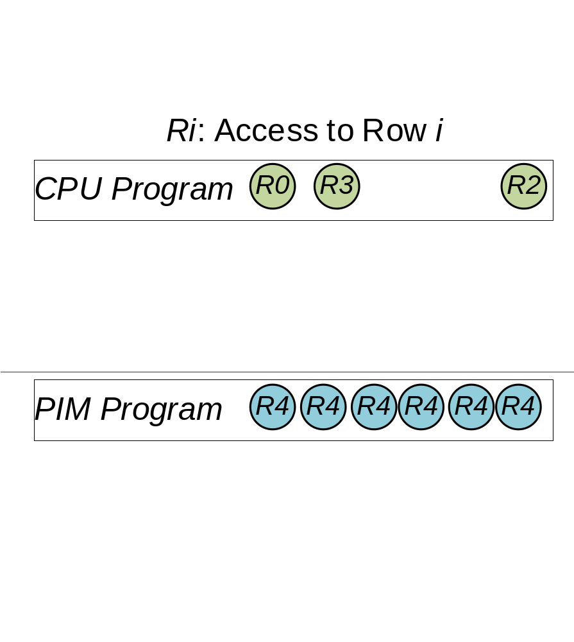
Observation 3
Co-schedule PIM data transfer and CPU access:
CPU Access v.s. PIM Transfer
CPU access:
Random, Sporadic
PIM data transfer:
Contiguous, Bursty
Notes:
So CPU accesses are usually random and sporadic. But PIM data transfers are typically contiguous and bursty, so it have a high row-hit rate.

Slide 26
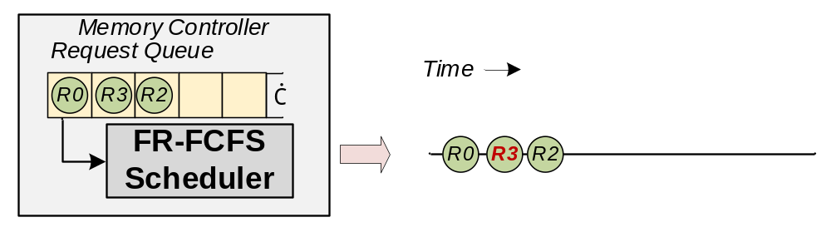
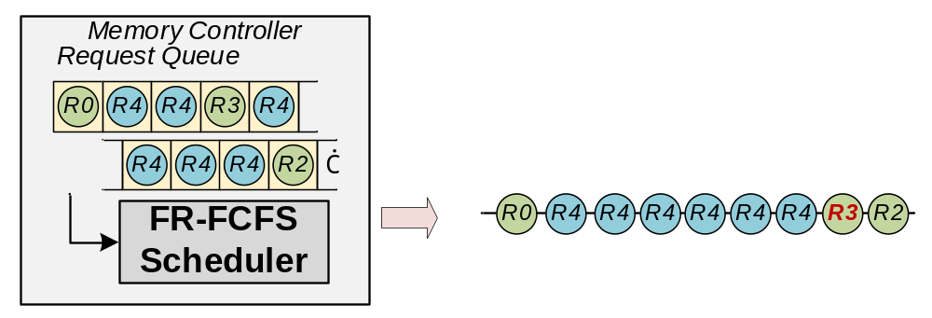
Observation 3
Co-schedule PIM data transfer and CPU access:
FR-FCFS:
(First-ready, First-Come First-Serve)
A conventional memory scheduling policy
Only CPU
CPU Access v.s. PIM Transfer
CPU access:
Random, Sporadic
Co-schedule CPU & PIM
Always Row Hit!
PIM data transfer:
Contiguous, Bursty
Starved!
Notes:
So, if we co-schedule them using a conventional FR-FCFS scheduler, this high row-hit rate of PIM data transfers will starve CPU accesses. As shown in this figure, the CPU's read request, R3, is delayed compared to the CPU only case, because the memory controller prioritizes the row hit.

Slide 27
Observation 3
Co-schedule PIM data transfer and CPU access:
FR-FCFS:
(First-ready, First-Come First-Serve)
A conventional memory scheduling policy
Case1: CPU Only
CPU Access v.s. PIM Transfer
CPU access:
Random, Sporadic
Challenge 2: PIM Data transfers starve CPU access
Case2: Co-schedule
Always Row Hit!
PIM data transfer:
Contiguous, Bursty
Starved!
Notes:
So this is our second major challenge

Slide 28
Scheduling Analysis III:
Unbalanced CPU Access & PIM Execution
Notes:
Next, I will analyze two previous scheduling methods that fails to balance CPU and PIM performance.

Slide 29
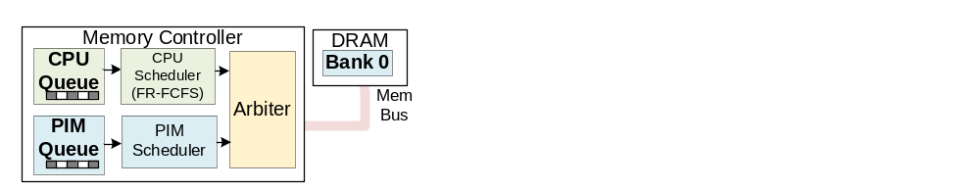
Previous Work 1
Row-hit-aware Scheduling:
Switch between CPU/PIM queue when row close
Notes:
So this method is row-hit-aware scheduling. This method only switches between CPU and PIM queues only when row closed.

Slide 30
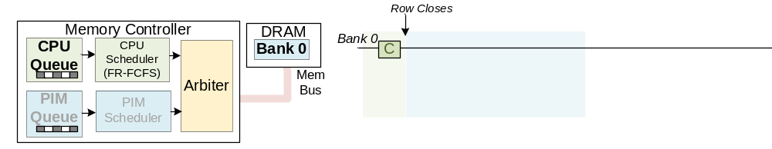
Previous Work 1
Row-hit-aware Scheduling:
Switch between CPU/PIM queue when row close
Not Hit! Row Close
→ Switch to PIM Queue
CPU Access:
Low row hit rate
Notes:
In this case, If a access did not hit the row, then the row is closed and switch to PIM queue.

Slide 31
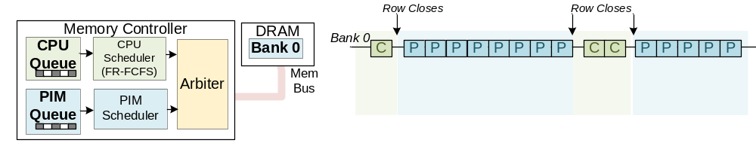
Previous Work 1
Row-hit-aware Scheduling:
Switch between CPU/PIM queue when row close
PIM Execution:
High row hit rate
CPU Access:
Low row hit rate
CPU Stalled
Notes:
But PIM execution also have high row-hit rate. So we always issues more PIM execution.

Slide 32
Previous Work 1
Row-hit-aware Scheduling:
Switch between CPU/PIM queue when row close
PIM Execution:
High row hit rate
CPU Access:
Low row hit rate
CPU Stalled
Biased to PIM Performance
Notes:
So this method is biased to PIM.

Slide 33
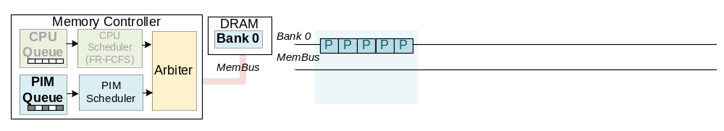
Previous Work 2
CPU-first Scheduling:
Only switch to PIM queue when CPU queue is empty
Notes:
On the other extreme is CPU-first scheduling. It only switches to PIM when the CPU queue is empty.

Slide 34
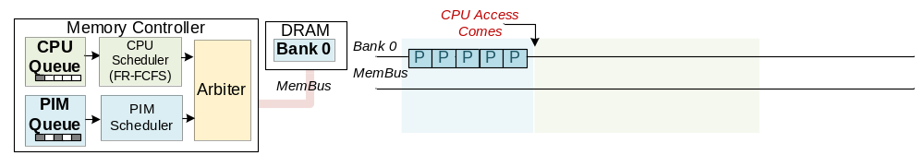
Previous Work 2
CPU-first Scheduling:
Only switch to PIM queue when CPU queue is empty
Switch to CPU Queue
Notes:
When a CPU access comes, it immediately switched to CPU Queue

Slide 35
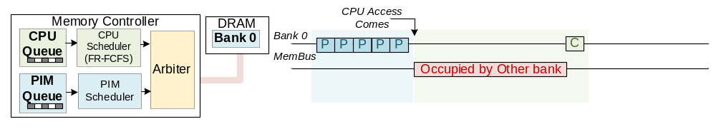
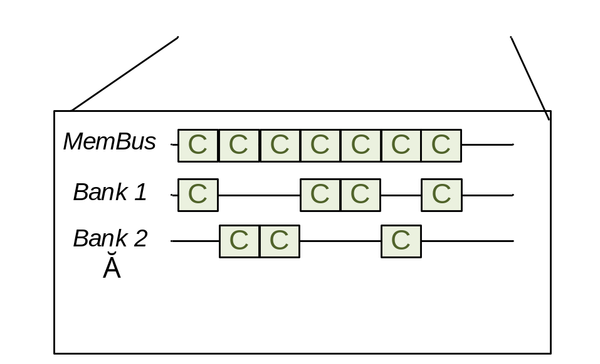
Previous Work 2
CPU-first Scheduling:
Only switch to PIM queue when CPU queue is empty
Underutilized
Processing earlier accesses from other banks
Notes:
However, if the memory bus is still busy processing earlier accesses from other banks,
when switched to CPU, that CPU read is delayed anyway, and internal bandwidth is underutilized.

Slide 36
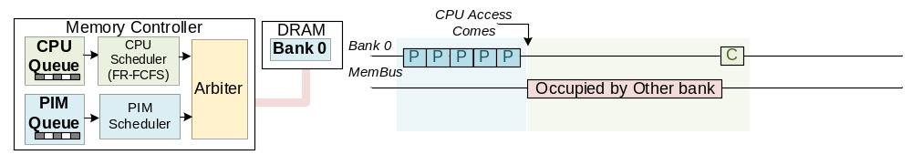
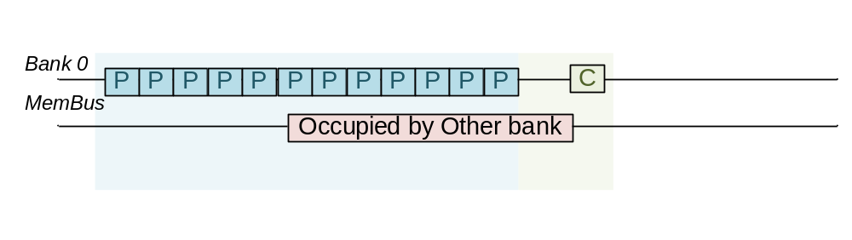
Previous Work 2
CPU-first Scheduling:
Only switch to PIM queue when CPU queue is empty
Delayed Switch is Better
Issue more PIM executions
Notes:
A better way is to delay the switch and issue more PIM commands.

Slide 37
Previous Work 2
CPU-first Scheduling:
Only switch to PIM queue when CPU queue is empty
Biased to CPU Performance
Notes:
So in summary, this method is too biased toward CPU.

Slide 38
Challenge 3
Row-hit-aware:
Biased to PIM
CPU-first:
Biased to CPU
Challenge 3: Simultaneously achieve high CPU & PIM performance
Notes:
This leads to our third challenge: how to achieve high performance for both CPU and PIM.

Slide 39
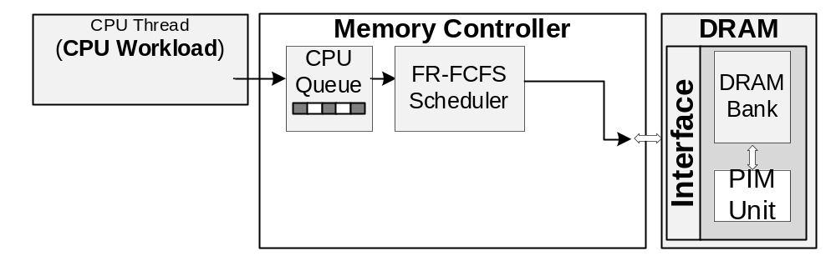
COSM: A Cooperative Scheduling Framework
Co-optimize Interface & Scheduling
Challenge
Solution
Notes:
In our proposed framework COSM, we co-optimize the interface and scheduling to solve the three challenges.

Slide 40
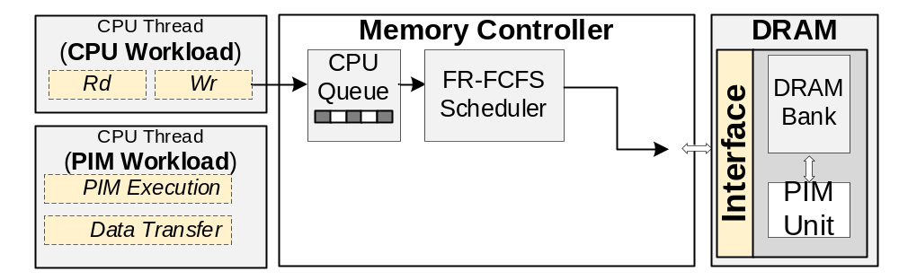
COSM: A Cooperative Scheduling Framework
Co-optimize Interface & Scheduling
Challenge
Solution
 |  | Low-interference Interface
1 Dilemma of fixed-length commands | → | Preemptable PIM Execution
2 PIM data transfers starve CPU access | → | Bandwidth-decoupled Data Transfer
Notes:
For the first two challenges, we design a low-interference interface.

Slide 41
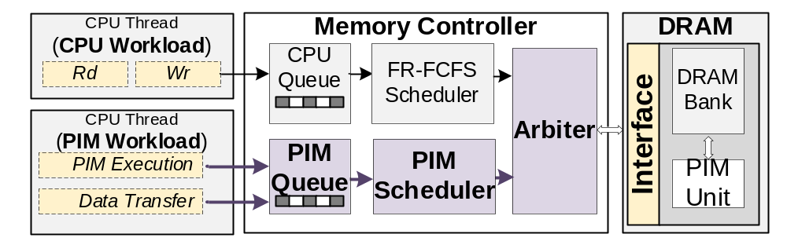
COSM: A Cooperative Scheduling Framework
Co-optimize Interface & Scheduling
Challenge
Solution
 |  | Low-interference Interface
1 Dilemma of fixed-length commands | → | Preemptable PIM Execution
2 PIM data transfers starve CPU access | → | Bandwidth-decoupled Data Transfer
3 Balance CPU & PIM performance | → | Idleness-aware Memory Scheduling
Notes:
For the third challenge, we propose an idleness-aware memory scheduling to balance both CPU and PIM performance.

Slide 42
Interface— 1.1 Preemptable PIM Execution (1)
Solution of Challenge 1: Fixed-length → Preemptable
Notes:
This is our solution for Challenge 1. The challenge is due to the fixed-length, So our solution is to make it preemptable.

Slide 43
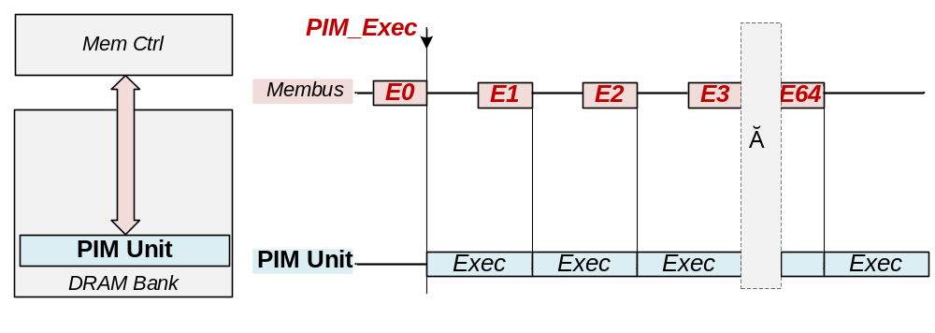
Interface— 1.1 Preemptable PIM Execution (1)
Solution of Challenge 1: Fixed-length → Preemptable
Notes:
This shows the current fix-length design, with short PIM execution, results in high bus occupation.

Slide 44
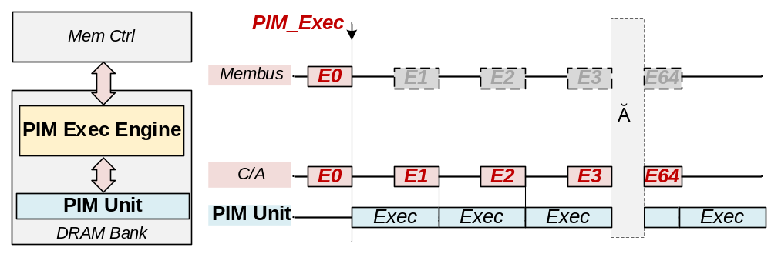
Interface— 1.1 Preemptable PIM Execution (1)
Solution of Challenge 1: Fixed-length → Preemptable
Memory Bus is released
New module in PIM:
PIM Exec Engine (PEE)
PEE take over and send PIM execution
Notes:
While in the preemptable PIM execution, we introduce a PIM Execution Engine inside the PIM. when a PIM task arrives, the engine takes over and automatically issues commands to the PIM units. And the memory bus is released.

Slide 45
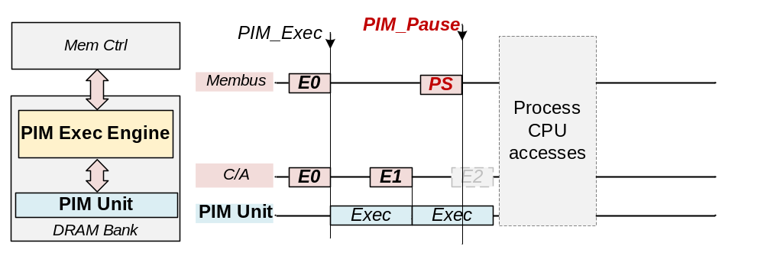
Interface— 1.1 Preemptable PIM Execution (2)
CPU access preempts PIM execution
1. Memory controller send a PIM_Pause to freeze PEE
Timely CPU Access
PEE is frozen,
stop issuing
Notes:
if a CPU access arrives for example at this tick at this red line, the memory controller sends a PIM pause command, The execution engine stops, allowing timely CPU access

Slide 46
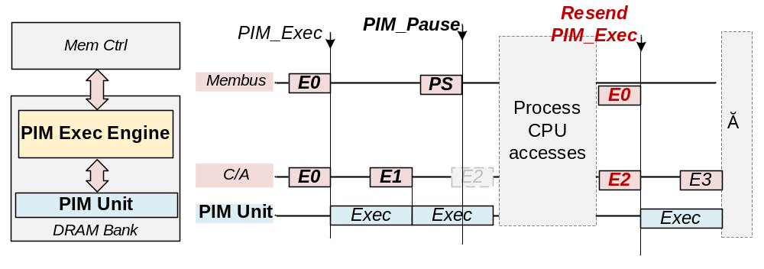
Interface— 1.1 Preemptable PIM Execution (2)
CPU access preempts PIM execution
1. Memory controller send a PIM_Pause to freeze PEE
After CPU accesses are done:
2. Memory controller resend PIM_Exec to resume PEE
Resume from the frozen counters
Notes:
Once CPU access finished, the engine resumes and finish the execution.

Slide 47
Interface— 1.2 Bandwidth-decoupled Data Transfer (1)
Should prioritize CPU access over PIM data transfer to avoid CPU access starving
Notes:
Now for the 2nd, Challenge We should prioritize CPU accesses to avoid them starving

Slide 48
Interface— 1.2 Bandwidth-decoupled Data Transfer (1)
Should prioritize CPU access over PIM data transfer to avoid CPU access starving
But using normal access command for PIM data transfer is NOT efficient.
Because it requires strict timing synchronization:
1 The external bus must be idle
2 AND the target row of internal bank must be pre-opened
→ Missing any window leads to transfer failure.
Notes:
However, such a priority rule is inefficient because conventional PIM transfers requires strict timing synchronization. The bus should be idle and the target row of the internal bank must be pre-opened.

Slide 49
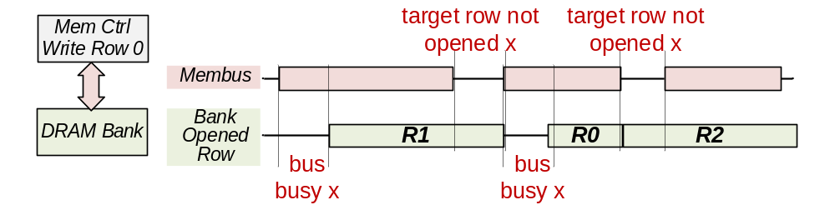
Interface— 1.2 Bandwidth-decoupled Data Transfer (1)
Should prioritize CPU access over PIM data transfer to avoid CPU access starving
But using normal access command for PIM data transfer is NOT efficient.
Because it requires strict timing synchronization:
1 The external bus must be idle
2 AND the target row of internal bank must be pre-opened
→ Missing any window leads to transfer failure.
Numerous idle windows exist, but they are scarcely concurrent.
Notes:
and like this figure shows, Numerous idle windows exist, but they are scarcely concurrent.

Slide 50
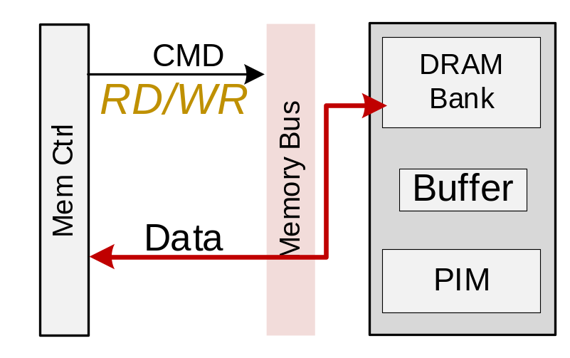
Interface— 1.2 Bandwidth-decoupled Data Transfer (2)
Solution: Decouple internal (bank) & external (bus) bandwidth occupation
Conventional
(through normal access)
Occupy both external & internal
Notes:
Our solution is to eliminate this constraint by decoupling the internal and external bandwidth occupation.
In the conventional method, each data transfer command occupies both external and internal bandwidth

Slide 51
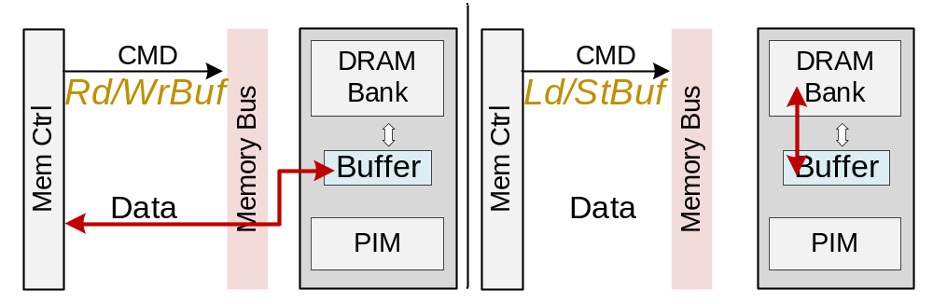
Interface— 1.2 Bandwidth-decoupled Data Transfer (2)
Solution: Decouple internal (bank) & external (bus) bandwidth occupation
Conventional
(through normal access)
Bandwidth-decoupled Data Transfer
Occupy both external & internal
External only
Host <->PIM Buffer
Internal only
PIM Buffer<-> Bank
Notes:
Our design decouples these two stages: We first write data into a buffer, which only occupies external bandwidth.

Slide 52
Interface— 1.2 Bandwidth-decoupled Data Transfer (2)
Solution: Decouple internal (bank) & external (bus) bandwidth occupation
Conventional
(through normal access)
Bandwidth-decoupled Data Transfer
Occupy both external & internal
External only
Host <->PIM Buffer
Internal only
PIM Buffer<-> Bank
Notes:
Then, data is transferred from the buffer to the bank, which only occupies internal bandwidth.

Slide 53
Interface— 1.2 Bandwidth-decoupled Data Transfer (2)
Solution: Decouple internal (bank) & external (bus) bandwidth occupation
Conventional
(through normal access)
Bandwidth-decoupled Data Transfer
Effect: Decouple external bus traffic from internal bank traffic,
enabling opportunistic scheduling
Occupy both external & internal
External only
Host <->PIM Buffer
Internal only
PIM Buffer<-> Bank
Notes:
By decoupling them, we enable opportunistic scheduling: we transfer externally when the bus is idle, and internally when the bank is idle. This maximizes overall bandwidth utilization."

Slide 54
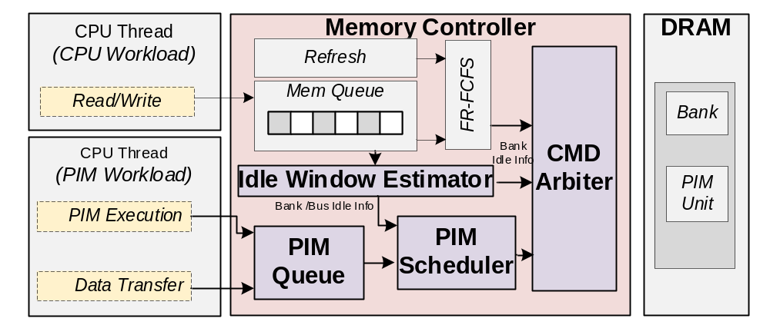
2 Idleness-aware Memory Scheduling (1)
Locate CPU access idle windows, insert PIM command into the windows
Notes:
To achieve high CPU and PIM performance, we propose an idleness-aware memory scheduling policy. this policy estimates idle time windows between CPU accesses and insert PIM commands into them.

Slide 55
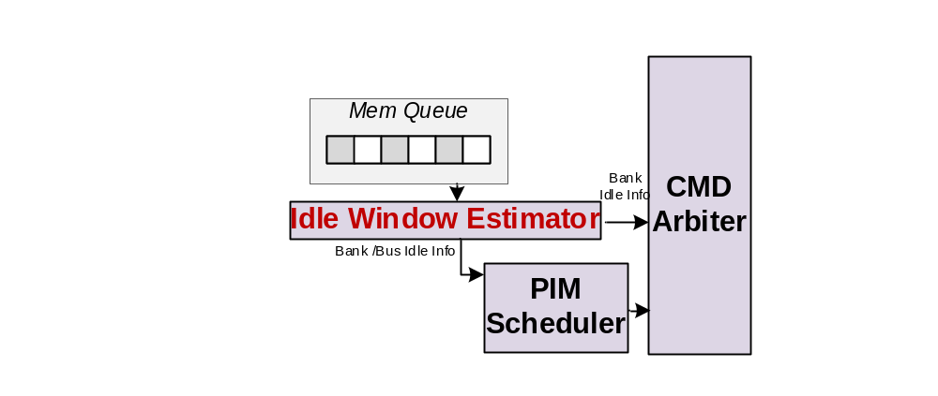
2 Idleness-aware Memory Scheduling (1)
Locate CPU access idle windows, insert PIM command into the windows
IWE: Analysis Mem Queue, estimate idle windows
Notes:
The key component is the Idle Window Estimator. It analyzes the CPU queue to estimate upcoming idle windows

Slide 56
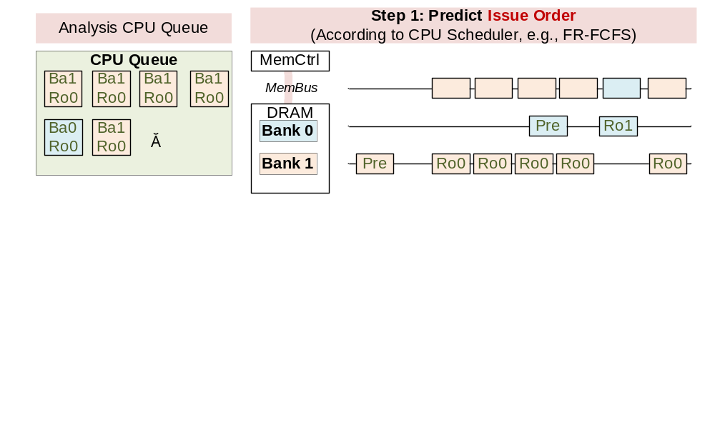
Idle Window Estimator (IWE)
5
7
1
2
3
4
6
8
Notes:
This shows how it works. Given a CPU queue, the IWE first predict the issue order of the current CPU accesses. Note that we do not need to really simulate the CPU scheduler, we only predict according to the feature of scheduler, for example, FR-FCFS prefers how hit and rank hit.

Slide 57
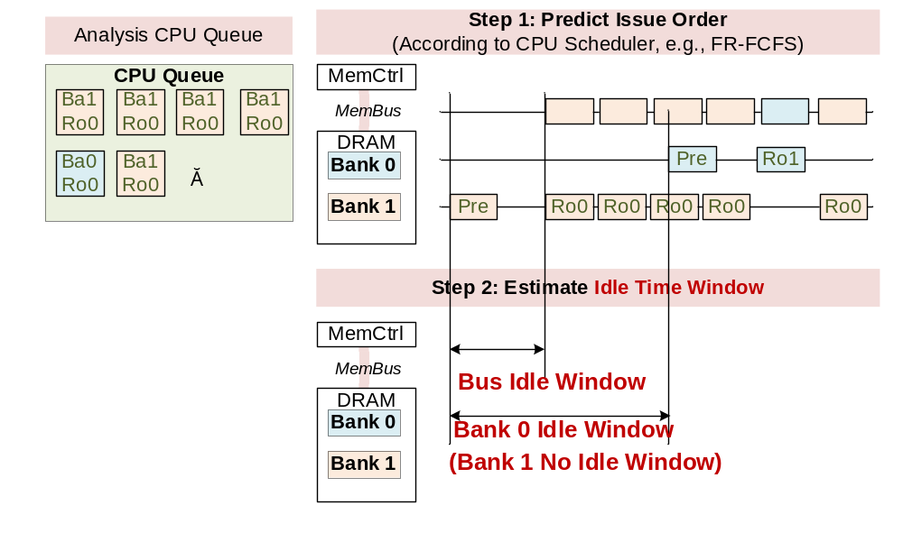
Idle Window Estimator (IWE)
Notes:
With the order, we can estimate the idle time window of memory bus and every bank.

Slide 58
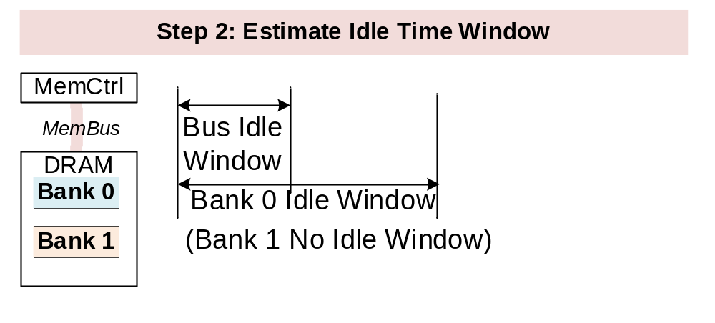
Idle Window Estimator (IWE)
Use these information
If the window is larger than a threshold, scheduler will
Insert PIM commands exactly to the idle time window (Avoid bias to PIM)
Delay CPU Pre-charge and send more PIM Execution (Avoid bias to CPU)
Notes:
With this information ,the scheduler will insert PIM commands only to the idle time window to avoid bias to PIM, or delay CPU precharge and send more PIM execution to avoid bias to CPU

Slide 59
More in the Paper
Extended analysis of related work (All-bank PIM interface)
In-depth details on idleness-aware scheduling, including:
  Algorithm for estimating idle time windows
  Overlapped execution phase to better utilize idle time windows
Discussion on the implications for the software stack
Notes:
You can find these details in the paper, including extended analysis of more previous work, and more details on some tricks of memory scheduling.

Slide 60
Experimental Setup
Benchmarks:
  PIM Benchmarks: BLOOM-1B1, DeepSeek-R1-1.5B, and Qwen2-0.5B.
  CPU Benchmarks: 6 mobile APPs, 3 PolyBench (contiguous access), 3 SPEC 2017
Baselines:
ASYNCDIMM [HPCA’25]:row-hit-aware scheduling
Chopim [ISCA’20]: CPU-first scheduling
System Configuration:
Simulation:
CPU model: collect trace on a mobile phone
DRAM model: Ramulator2
Proposed Scheduling Modules: Synopsys DC
System Configuration
CPU | 8 cores @2.1Hz on average (Follow Xiaomi 11 Pro)
DRAM | LPDDR5, 2 Channel*2 Ranks
PIM | 32GOPS, 64 per Rank (Follow Samsung LPDDR5-PIM)
Notes:
This is the experimental setup. We use mobile appes and large language models as CPU and PIM benchmarks, and compare COSM against the two baseline scheduling method. We simulated with ramulator2 simulator and the system configuration follows a mobile phone,

Slide 61
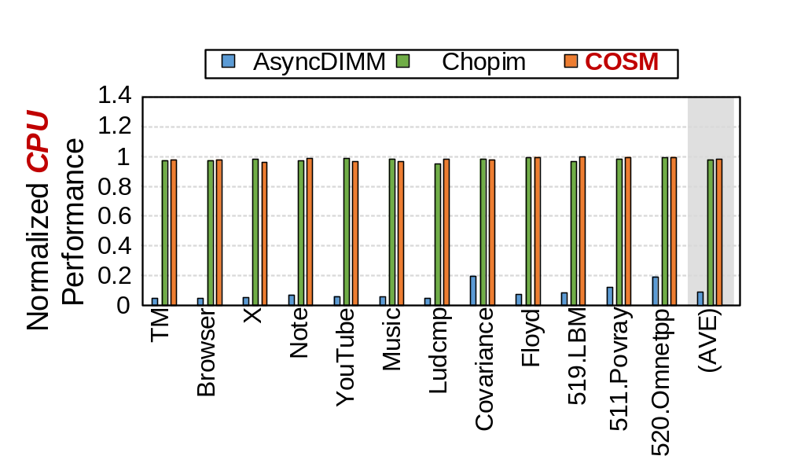
Result: CPU Performance
CPU Degradation:
COSM: 2.0%
Chopim(CPU-first): <3%
AsyncDIMM
(Row-hit-aware): > 90%
LLM: BLOOM 1b1
More results in paper: Results on other LLM models
Notes:
This is the CPU performance, the Row-hit-aware scheduling have more than 90% degradation on CPU performance. While CPU-first scheduling have only 3% degradation. Thanks to the scheduling framework, COSM have only 2% CPU degradation.

Slide 62
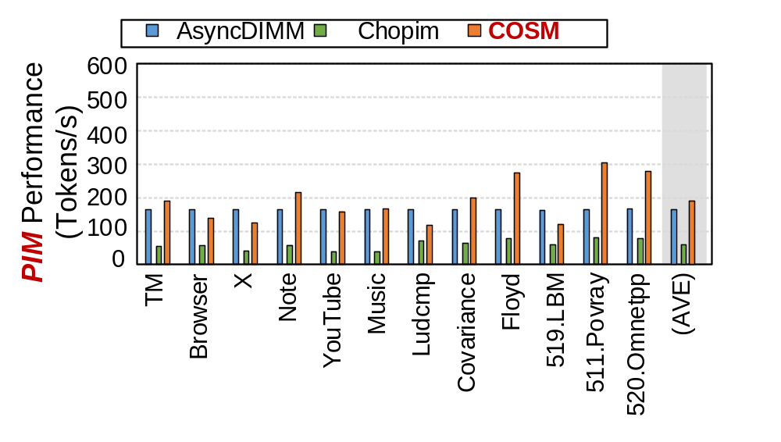
Result: PIM Performance
PIM Performance:
COSM
1.4x over AsyncDIMM
(Row-hit-aware)
2.8x over Chopim
(CPU-first)
COSM achieves 2.8x PIM Throughput with only 2% CPU Degradation.
LLM: BLOOM 1b1
More results in paper: Results on other LLM models
Notes:
For PIM performance, COSM achieve 2.8x over CPU-first scheduling. So COSM achieve a balance between CPU and PIM performance.

Slide 63
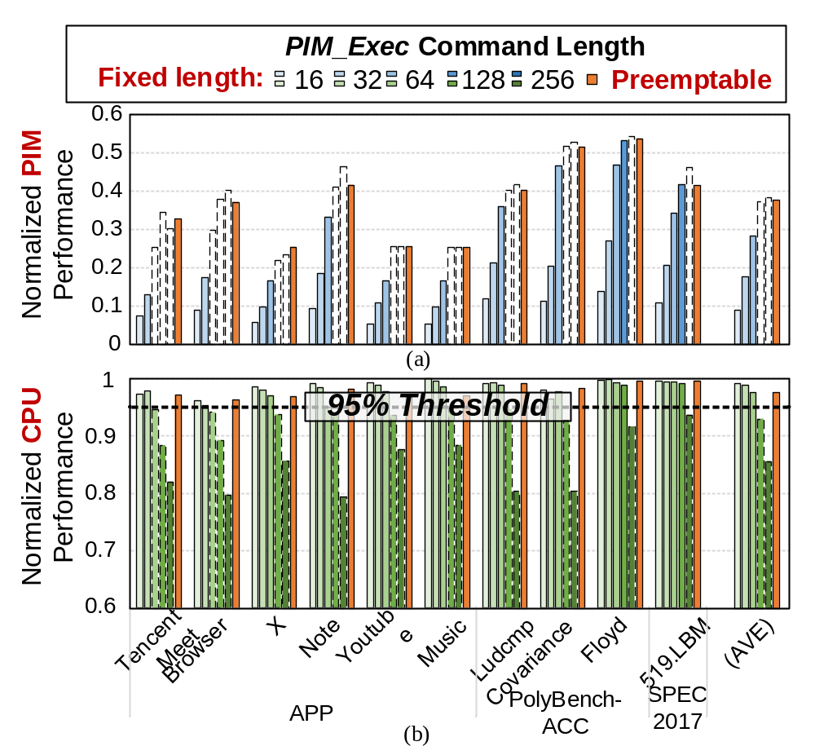
Result: The Effect of Preemptable Execution
PIM workload: KQV gen of DeepSeek (Exclude data transfer)
0.7x Performance
(length=32)
Fixed-length commands:
Length = 32:
0.7 x Max PIM Performance
CPU Degradation < 5%
Length = 64:
Max PIM Performance
CPU Degradation > 5%
-- Trade-off
Degradation > 5%
(length=64)
Notes:
This experiment compare the fixed-length command and our preemptable interface. For fixed-length commands, the PIM performance saturates when > 64, but CPU performance declines > 5% at this length.

Slide 64
Result : The Effect of Preemptable Execution
PIM workload: KQV gen of DeepSeek (Exclude data transfer)
Max PIM Performance
Preemptable commands:
Max PIM Performance
CPU Degradation < 5%
Degradation < 5%
Breaks the CPU-PIM trade-off
More results in paper: Results on other LLM models
Notes:
While our preemptable commands can achieve the maximized PIM performance, while CPU performance declines is smaller than 5%. So our, Preemptable Execution breaks the CPU-PIM trade-off.

Slide 65
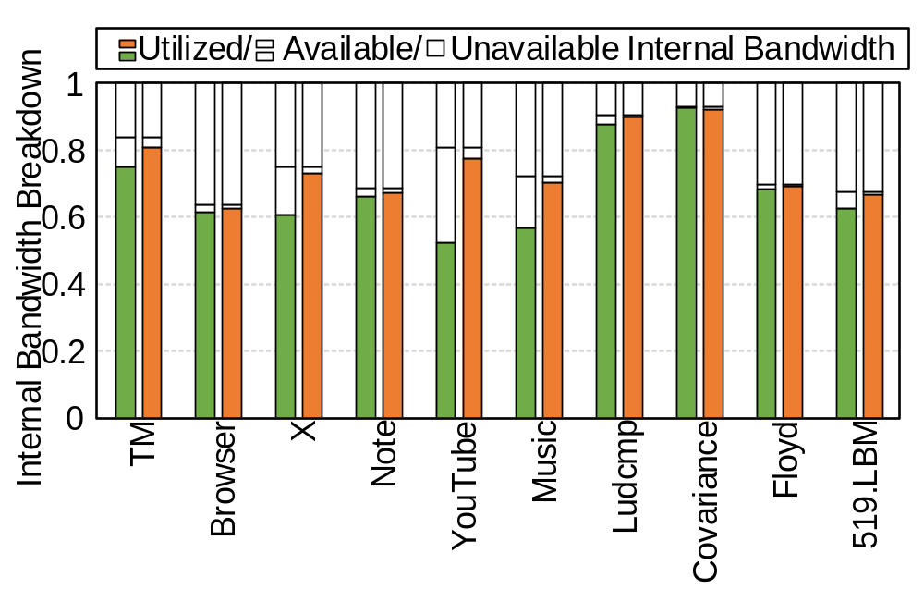

Result: Effect of Idleness-aware Scheduling
PIM workload: Attention of DeepSeek，only PIM Execution
Unavailable bandwidth: too short to be utilized
Available bandwidth: usable idle time windows
Utilized bandwidth: utilized for PIM execution by scheduler
Result:
COSM leaves < 1% available bandwidth unused
COSM can better utilize the idle time windows
Notes:
This experiment plots the effectiveness of idleness-aware scheduling. The scheduling leaves only 1% available bandwidth unused.

Slide 66
Area
Synthesized with Synopsys Design Compiler; scaled to 5nm
Components | Area | Overhead
Original Memory Controller | ~0.93mm² | -
PIM Scheduler | 0.014 mm²
Idle Time Estimator | 0.0085 mm²
Command Arbiter | 0.0054 mm²
PIM Queues | 0.041 mm²
Total | 0.069 mm² | 7.4%
Notes:
The area overhead of the modules in memory controller is around 7.4%. which is moderate.

Slide 67

Conclusion
A Cooperative Scheduling Framework for Concurrent PIM & CPU Execution on Mobile Devices.
Critical contributions：
  Low-interference Interface
  Idleness-aware Memory Scheduling
Results： 2.8x PIM Throughput with only 2% CPU Degradation.
Artifacts Available
Artifacts Evaluated - Functional
Results Reproduced
Notes:
This is the summary We propose a cooperative scheduling framework for concurrent CPU and PIM execution. The framework co-optimize both interface and scheduling policy.
Results shows 2.8x PIM speedup with only 2% CPU performance degradation.

Slide 68
Thank You!

Slide 69
COSM: A Cooperative Scheduling Framework for Concurrent PIM and CPU Execution on Mobile Devices
ISCA 2026
June 27– July 1, 2026
Raleigh, USA
Yilong Zhao(Speaker)*, Fangxin Liu*, Onur Mutlu, Mingyu Gao, Jian Liu,
Haibing Guan, Li Jiang†
sjtuzyl@sjtu.edu.cn , liufangxin@sjtu.edu.cn, ljiang_cs@sjtu.edu.cn
Shanghai Jia Tong University | Shanghai Qi Zhi Institute
ETH Zurich | Tsinghua University | Beihang University
ISCA’ 2026
August 2, 2026
* Co-first Author
† Corresponding Author
Notes:
Hello everyone, today I'm going to present COMET, a cooperative scheduling framework for concurrent PIM and CPU execution on mobile devices.

