Slide 1


Agentic, Reference-Calibrated,
Tree-Guided, System-Software-Level
Bottleneck Localization
Argus
Vlad-Petru Nitu
Harsh Songara Konstantinos Sgouras Spiros Galanopoulos
Konstantinos Kanellopoulos Onur Mutlu
Notes:
Hello, I am Vlad-Petru Nitu, a Master student from ETH Zurich working in the SAFARI Research Group under the supervision of Professor Onur Mutlu.
Today, I will be presenting our work, Argus[..]

Slide 2
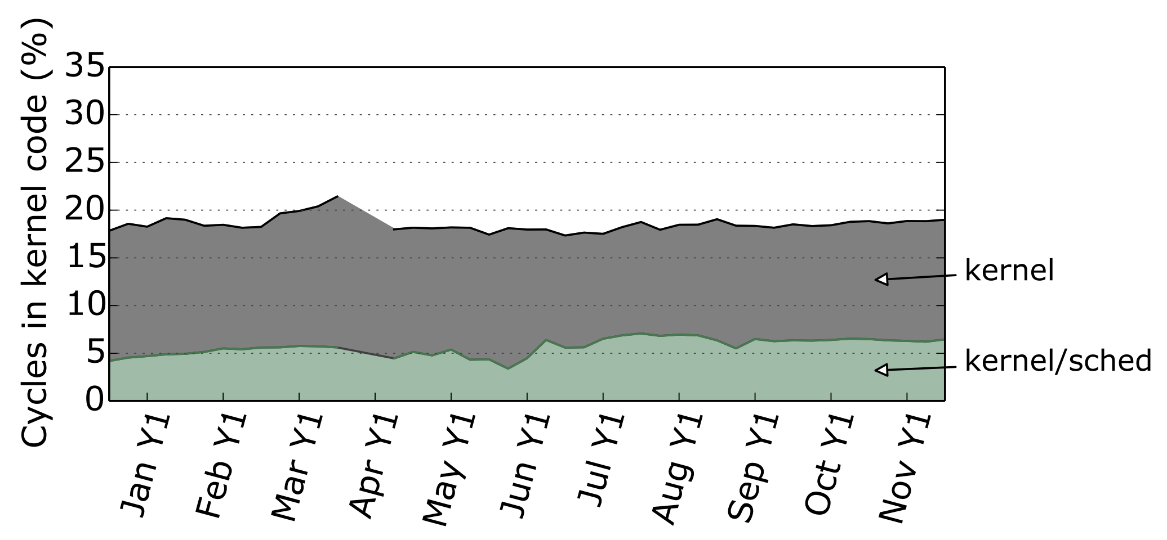
Operating System Routines Consume Many CPU Cycles
Kanev et al., “Profiling a Warehouse-scale Computer”, ISCA 2015
On average ~20% of cycles spent
on executing kernel code
Notes:
It is well known that OS routines consume many CPU cycles
[CLICK]
A ISCA 2015 paper showed that on average, ~20% of cycles are spent on executing kernel code

Slide 3
Operating System Overheads
Keep Increasing
1
An increasing number of applications
is offloaded to specialized compute units
Notes:
These OS overheads keep increasing [CLICK]
First, more and more applications are offloaded to specialized compute units

Slide 4

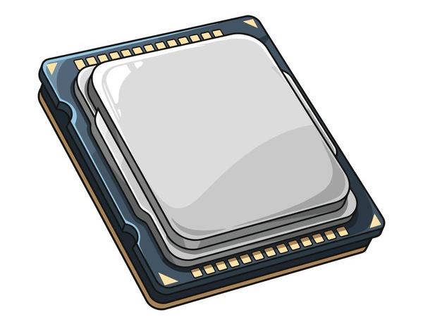

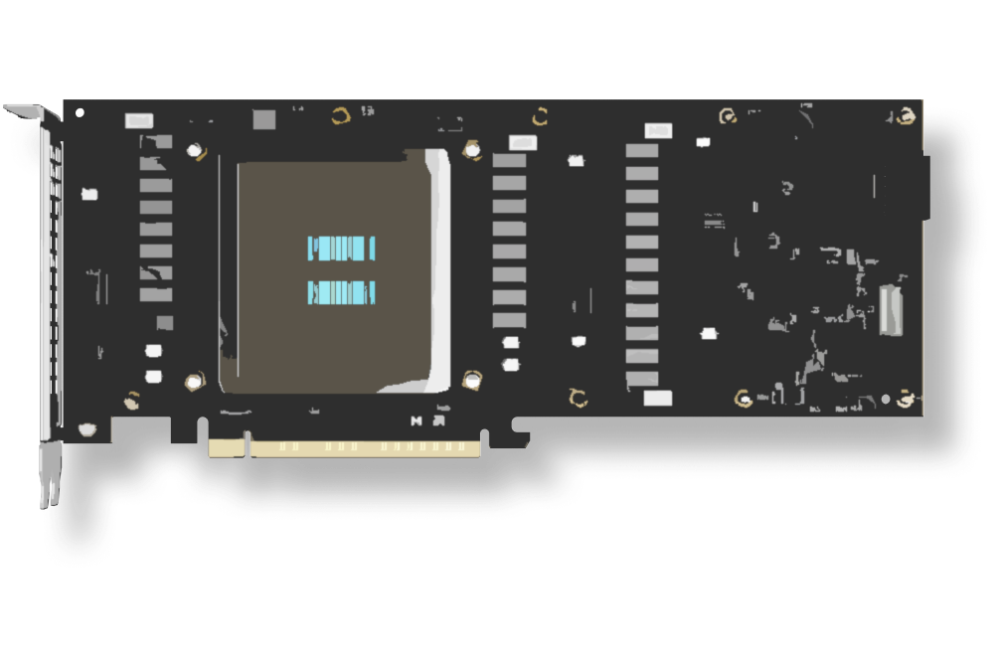
Operating System Overheads
Keep Increasing
GPUs
OS running
on CPUS
Offload code
AI Accelerators
Configure &
Offload computation
Notes:
For example, [CLICK]
The OS code running on CPUs [CLICK]
Offloads code to GPUs, [CLICK]
As well as configures & offloads computation to AI accelerators

Slide 5

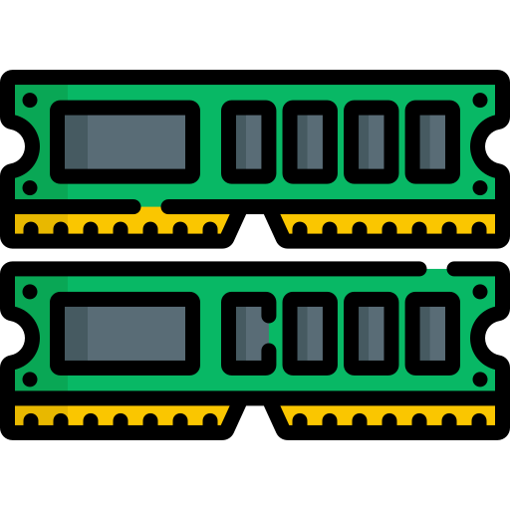
Operating System Overheads
Keep Increasing
OS running
on CPUS
GPUs
Manage Memory
AI Accelerators
Notes:
[CLICK]
The OS is also responsible for managing memory not only for CPUs, [CLICK] but also for hardware accelerators

Slide 6

Operating System Overheads
Keep Increasing
CPU spends an increasing fraction of time
executing OS routines, acting like an orchestrator
Notes:
[CLICK]
Thus, CPU spends an increasing fraction of time executing OS routines, acting as an orchestrator in the system

Slide 7
Operating System Overheads
Keep Increasing
1
An increasing number of applications
is offloaded to specialized compute units
2
System software is becoming
more complex and relies
on general-purpose compute units
Notes:
[CLICK]
Second, System Software becomes more complex and relies on general-purpose compute units

Slide 8
Operating System Becomes More and More Complex
Memory Management
GPU Driver
Block I/O
Network Driver
TPU Driver
Scheduler
Resource Management
Notes:
[CLICK]
The Linux Kernel comprises of many kernel subsystems, spanning from Memory management, to GPU/NW/TPU drivers, Scheduler and so on.
Each of these subsystems becomes more complex,
as well as more subsystems are being added as time passes.

Slide 9
Operating System Becomes More and More Complex
Existing routines require the flexibility
that a general-purpose core provides
at a cost..
Notes:
The OS becomes more and more complex, [CLICK]
running many different types of routines.
Such heterogeneity requires general purpose cores, [CLICK]
Which come at a cost.

Slide 10
Example: Scaling CPU Resources
Average Minor Page
Fault Latency (cycles)
ROB Size
Beyond 1024 ROB entries,
minor page fault latency does not improve
Notes:
For example, when scaling CPU resources [CLICK]
We observe that the Minor Page Fault Latency doesn’t reduce beyond 1024 ROB entries

Slide 11

Performance overheads
caused by the OS are increasing
We need intelligent profilers to detect and eventually alleviate the overheads
Notes:
As performance overheads caused by the OS are increasing [CLICK],
We need intelligent profilers to detect & alleviate these overheads

Slide 12
We Want an OS-level Profiler that is …
Low overhead: to not distort the measurements
Full kernel visibility: instrument arbitrary kernel code paths
Does not require manual instrumentation
Does not require manual reasoning about profiling data
Notes:
Ideally, we want a profiler to have the following characteristics: [CLICK]
Low-overhead: to not distort measurements [CLICK]
Full kernel visibility: instrument arbitrary kernel code paths [CLICK]
It should not require manual instrumentation (~authoring gap) [CLICK]
It should not require manual reasoning about profiling data (~interpretation gap) [CLICK]

Slide 13
Existing Profilers
Profiler Category
Low Overhead
Full Kernel Visibility
No Manual Instrumentation
No Manual Reasoning
Expertise
Time-based samplers
✓
✗
✓
✗
★☆☆☆
Hardware-event samplers
✓
✗
✓
✗
★★★☆
Tracepoint-based profilers
✗
✗
✓
✗
★★☆☆
Continuous sampling profilers
✓
✗
✓
✗
★☆☆☆
Profilers for accelerators (e.g. GPUs)
✗
✗
✓
✗
★★★☆
Dynamic instrumentation profilers
✓
✓
✗
✗
★★★★
eBPF-based profilers
✓
✓
✗
✗
★★★★
Notes:
We categorise existing profilers in 7 categories, based on their capabilities.
For example, Low Overhead column indicates whether the specific category introduces low or high profiling overhead
And the Expertise column rates how much kernel expertise the user needs.
[CLICK]
(1) Time-based samplers have low overhead and require no manual instrumentation, but do not have full kernel visibility and need manual reasoning over the profiling data. [CLICK]
(2) Hardware-event samplers exhibit similar behavior as time-based samplers [CLICK]
(3) Tracepoint-based profilers do not require manual instrumentation [CLICK]
(4) Continuous-sampling profilers have low overheads and do not require manual instrumentation [CLICK]
(5) Profilers that target accelerators such as GPUs do not require manual instrumentation [CLICK]
(6) Dynamic instrumentation profilers have low overhead and full kernel visibility, while requiring both manual instrumentation and reasoning over results [CLICK]
(7) eBPF-based profilers have similar characteristics as dynamic instrumentation ones [CLICK]

Slide 14
Existing Profilers
Profiler Category
Low Overhead
Full Kernel Visibility
No Manual Instrumentation
No Manual Reasoning
Expertise
eBPF-based profilers
✓
✓
✗
✗
★★★★
What is eBPF?
Notes:
Based on the requirements of an OS-level Profiler,
This leads us to choosing between Dynamic Instrumentation profilers and eBPF-based ones. [CLICK]
We chose to enhance eBPF-based profilers since [CLICK]
eBPF runs arbitrary user-defined code safely in kernel space: compute, filter, and aggregate at the hook point, not just emit raw events [CLICK]
and because
2) eBPF-based profilers are more flexible than dynamic instrumentation, since they support bounded loops and in-kernel logic [CLICK]
However, both profilers still require manual instrumentation and manual reasoning over the profiling data. [CLICK]

Slide 15

eBPF (Extended Berkeley Packet Filter)
Linux mechanism for running
sandboxed programs inside the kernel
eBPF Programs
Collect & aggregate hardware-sampled metrics
Export the aggregated result to user-space
eBPF Verifier
Checks eBPF programs at load-time to ensure safety (e.g., to avoid infinite loops)
Notes:
Let’s see a primer about eBPF
eBPF stands for Extended Berkely Packet Filter. It is a Linux mechanism that allows sandboxed programs to be run inside the kernel [CLICK]
Developers can write eBPF programs to [CLICK]
Collect & aggregate hardware-sampled metrics [CLICK]
And then: Export the aggregated result to user-space, minimizing communication between the kernel and user-space [CLICK]
Each eBPF program is verified by an eBPF verified at load-time (before being injected into the kernel). [CLICK]
Some verifier checks include: ensuring loops are bounded, to prevent infinite loops. [CLICK]

Slide 16
Existing Profilers
Profiler Category
Low Overhead
Full Kernel Visibility
No Manual Instrumentation
No Manual Reasoning
Expertise
eBPF-based profilers
✓
✓
✗
✗
★★★★
eBPF runs arbitrary user-defined code safely in kernel space: compute, filter, and aggregate at the hook point
eBPF-based profilers are more flexible than dynamic instrumentation, since they support bounded loops and in-kernel logic
Still require
manual code writing and
manual reasoning over the profiling data
Notes:
Based on the requirements of an OS-level Profiler,
This leads us to choosing between Dynamic Instrumentation profilers and eBPF-based ones. [CLICK]
We chose to enhance eBPF-based profilers since [CLICK]
eBPF runs arbitrary user-defined code safely in kernel space: compute, filter, and aggregate at the hook point, not just emit raw events [CLICK]
and because
2) eBPF-based profilers are more flexible than dynamic instrumentation, since they support bounded loops and in-kernel logic [CLICK]
However, both profilers still require manual instrumentation and manual reasoning over the profiling data. [CLICK]

Slide 17


LLM-based Coding Agents create an opportunity
Claude Code
Gemini
OpenAI Codex
Enable quick and accurate code production
Enable autonomous reasoning
Notes:
[CLICK]
Coding Agents are autonomous LLM-based tools that author code on their own, as well as autonomously interpret results.
They have the potential to close both gaps eBPF-based profilers suffer from.
[CLICK]
Examples of mainstream Coding Agents include: Claude Code, Gemini, and OpenAI Codex

Slide 18
Opportunity
LLMs can now... | … which unlocks | ... closing the following gap
Author eBPF code | Automated eBPF code generation | Authoring Gap: Expertise
Interpret results (e.g., which subsystem causes the bottleneck) | Automated reasoning | Interpretation Gap: Human-in-the-loop
Notes:
[CLICK] As just stated, Coding Agents create an opportunity to close both gaps we identified earlier.
[CLICK] First, agents can now author eBPF code autonomously, which unlocks automated eBPF code generation, closing the authoring gap by removing the need for deep kernel expertise.
[CLICK] Second, agents can now interpret results (for example, reasoning about which kernel subsystem causes a bottleneck), which unlocks automated reasoning and removes the human from the loop, closing the interpretation gap.

Slide 19
Using Agents Out-of-the-Box is Challenging
1
Cannot localize bottlenecks
without a reference measurement
2
Lack kernel knowledge:
oscillates between hypotheses and hallucinating function names
Notes:
However, by using these coding agents out-of-the-box,
We observe that they
cannot localize bottlenecks without a reference measurement, and
lack prior kernel knowledge, which leads to oscillating between hypotheses and hallucinating function names

Slide 20
Using Agents Out-of-the-Box is Challenging
Out-of-the-Box Agent fails to
localize bottlenecks 45% of the time
Notes:
TODO

Slide 21

Our Goal
Design an LLM-based agentic profiler that
Autonomously authors profiling code
Autonomously reasons about bottlenecks
Profile fast and minimize hallucinations
Notes:
Our goal in this work is to [CLICK]
Design an LLM-based agentic profiler that [CLICK]
1) Autonomously authors instrumentation code
2) Autonomously reasons about bottlenecks

Slide 22
Argus
An LLM-based agentic profiler that
autonomously discovers OS-level bottlenecks
and relies on two components:
1
Reference calibration provides a baseline measurement to confirm bottlenecks
2
Tree-based data structure creates
a structured view of the kernel codebase
22
Notes:
[CLICK]
We introduce Argus, which guides an LLM-based agent with two components: [CLICK]
Reference Calibration provides a baseline measurement to confirm bottlenecks [CLICK]
Tree-based data structure creates a structured view of the kernel codebase to autonomously reason over potential OS-level bottlenecks [CLICK]

Slide 23
Terminology
Perturber
Workload or system configuration
that stresses a specific code path
Victim
Workload that we profile under perturbation
Notes:
Before we dive into the Overview, let’s discuss some Terminology [CLICK]
We define a perturber as a co-runner or system config that stresses a specific code path [CLICK]
We define a victim the workload whose performance we profile under perturbation [CLICK]

Slide 24
Argus – Reference Calibration
On an idle system
reference profile
Reference Measurement Vector (RMV)
Minor Page Fault
CoW
…
# Cycles
500 cycles
…
LLC Misses
200
…
…
Notes:
The 1st component of Argus is Reference Calibration [CLICK]
This component: Compares workload profile under perturbation against profile on an idle system [CLICK]
If it encounters significant deviations, it then flags a potential bottleneck [CLICK]

Slide 25
Argus – Reference Calibration
Under perturbation
Perturbed Measurement Vector (PMV)
Minor Page Fault
CoW
…
# Cycles
600 cycles
…
LLC Misses
200
…
…
Notes:
The 1st component of Argus is Reference Calibration [CLICK]
This component: Compares workload profile under perturbation against profile on an idle system [CLICK]
If it encounters significant deviations, it then flags a potential bottleneck [CLICK]

Slide 26
Argus – Reference Calibration
On an idle system
reference profile
RMV
Δ
Significant
deviation?
Under perturbation
PMV
Bottleneck
flagged
Notes:
The 1st component of Argus is Reference Calibration [CLICK]
This component: Compares workload profile under perturbation against profile on an idle system [CLICK]
If it encounters significant deviations, it then flags a potential bottleneck [CLICK]

Slide 27
Argus – Reference Calibration
What should the profiler measure?
Notes:
However, we still don’t know what we want to measure;
Should we measure # minor page faults, # context switches, or any other Linux kernel subsystem?

Slide 28
Argus – Tree of Kernel Code Paths
Argus Root
…
Kernel Paging
Level 1
…
file_fault
anon_fault
TLB
Shootdown
Level 2
…
CoW
minor
THP
Level 3
The tree provides context for bottleneck localization to constrain exploration to valid code paths.
Notes:
This brings us to
The 2nd component component of Argus: Tree of kernel code paths [CLICK]
2) Tree of kernel code paths,
which gives a map of how Linux kernel code is structured [CLICK]
This tree guides the bottleneck localization decisions (i.e., which subparts of the tree to explore further),
By constraining the agent's exploration to this kernel code paths tree built offline.

Slide 29
Example - 3rd Tree level
 | Minor Page Fault | Copy On Write | THP Collapse
RMV | 50k | 250 | 50
PMV | 100k | 250 | 50
Δ | 4σ > ε | 0 | 0
i | 0 | 1 | 2
Notes:
Let’s look at a specific example at the last level of the tree.
Argus measures Minor Page Faults, COW and THP Collapse
The reference shows: 50k Minor PFs and 100k Minor PFs
There is a significant deviation in this metric, which is above our threshold.
Thus, Argus flags Minor PFs path as a bottleneck;
Note that the other 2 dimensions stay unchanged.

Slide 30
Argus: End-to-End Flow
❸ Agent authors eBPF instrumentation code
❶ Select​ benchmark
❷ Profile benchmark
on idle system
❹ Profile benchmark
on perturbed system
RMV
PMV
❺ Compute Δi = PMVi - RMVi
Else continue
profiling deeper
in the tree
If Δi ≤ ε 0r
last tree level
❻ Localize Bottleneck
Anonymous, Minor Page-Fault
kernel code-path
Notes:
[major revision]
This is the Argus’ pipeline
[EXPLAIN EACH COMPONENT SIMPLY]
(3) LLM-Generated eBPF code is injected into the Kernel

Slide 31
Case Study #1: Overheads caused by THP
THP Aggressor
fragments physical memory and then forces compaction by demanding huge pages, stressing specific code paths
(e.g., THP allocation, compaction, etc.)
What we study
How Argus localizes the kernel code path through which
a single aggressor slows down diverse victim workloads.
Why we study
To validate that Argus produces different diagnoses
for different victims under the same aggressor
To show Argus can correctly abstain when there's no bottleneck
Notes:
We will now present how we use Argus in 1 case study. Note that in the paper we have 2 such studies, but I today I present only 1 due to the interest of time
In the 1st case study, [CLICK]
we use as perturber a THP aggressor that fragments physical memory and then forces compaction by demanding huge pages, stressing specific code paths (i.e., THP allocation, compaction, etc.) [CLICK]
In this experiment, we study: how Argus localizes the kernel code path through which a single aggressor slows down diverse victim workloads. [CLICK]
We do this because we want to [CLICK] 1) To validate that Argus produces different diagnoses for different victims under the same aggressor,
and [CLICK] 2) To show Argus can correctly abstain when there's no bottleneck.

Slide 32
Evaluation Methodology
System configurations:
CPU: Intel i9-14900K (workloads pinned to P-cores)
DRAM: 32 GB DDR5
OS: Linux 6.17, Ubuntu 24.04 LT
LLM-based agent: Gemini 2.5 Flash
Workloads
GUPS, Stream, llama.cpp, fork_storm
Each workload run for N repetitions, where
the ground truth bottleneck is known
Aggressor
Microbenchmark that:
  allocates 1 GB
  fragments memory in a checkerboard pattern
  randomly touches 512 MB on the fragmented region
Notes:
Read the slide

Slide 33
Case Study #1: Overheads caused by THP
GUPS and Stream do not perform many allocations, so the THP aggressor should not cause overheads
Argus always reports no bottleneck
1
2
llama.cpp suffers from a high number of page faults
Argus is always partially correct, flagging file and anonymous page fault code paths
3
fork_storm stresses the Scheduler subsystem
Argus is always partially correct, finding a fine-grained bottleneck 66% of the time
Notes:
TODO

Slide 34
Comparison Points
We use 4 comparison points in our evaluation
1
B-LLM-Prior: naïve agent that decides
based on LLM’s prior knowledge
2
B-LLM-Prior-Tree: B-LLM-Prior
augmented with the Tree-based data structure
3
B-LLM-Prior-Tree-Probes:
B-LLM-Prior-Tree augmented with
LLM-authored eBPF instrumentation code
4
Argus: B-LLM-Prior-Tree-Probes augmented with the reference calibration component
Notes:
We use 4 comparison points in our evaluation
B-LLM-Prior: naïve agent that decides based on LLM’s prior knowledge (i.e., without measuring time spent in kernel)
B-LLM-Prior-Tree: B-LLM-Prior augmented with the Tree-based data structure
B-LLM-Prior-Tree-Probes: B-LLM-Prior-Tree augmented with LLM-authored eBPF instrumentation code
Argus: B-LLM-Prior-Tree-Probes augmented with the reference calibration component
2 vs. 3: 2 uses LLM prior (knowledge), whereas 3 collects actual measured counters at each level in the Kernel tree

Slide 35
Evaluation Metrics
1
Hallucation Rate
2
Time-to-Diagnosis (TtD)
Notes:
We consider 2 evaluation metrics [CLICK]

Slide 36
Evaluation Metrics
1
Hallucation Rate
Percentage of deep diagnoses
(path depth ≥ 2) that did not match the
ground-truth bottleneck
Notes:
The Agent’s Hallucination Rate [CLICK]

Slide 37
Measuring Accuracy
Argus hallucinates 16× less,
compared to the best-performing baseline
Notes:
On the OX axis: we depict the 4 measurement points [CLICK]
On the OY axis: we depict the hallucination rate of Argus. Lower is better [CLICK]
We conclude that: Argus is 16× more accurate, compared to the best-performing baseline

Slide 38
Evaluation Metrics
2
Time-to-Diagnosis (TtD)
Wall-clock time from workload start to
bottleneck diagnosis
Notes:
Time-to-Diagnosis represents the end-to-end time it takes to localize bottlenecks

Slide 39
Time-to-Diagnosis (TtD)
Argus incurs no measurable TtD increase over the LLM-prior baselines
Notes:
On the OX axis: we depict the 4 measurement points [CLICK]
On the OY axis: we depict the time-to-diagnosis (TtD) metric, in seconds. Lower is better [CLICK]
We conclude that: Argus incurs no measurable TtD increase over the LLM-prior baselines,

Slide 40
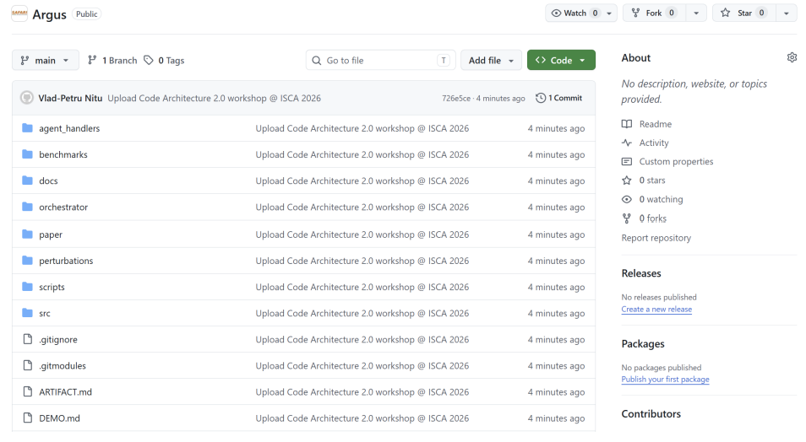
Argus is Open-Source
https://github.com/CMU-SAFARI/Argus
Notes:
Argus is open-source, and we invite you to check our artifact for more details

Slide 41
Conclusion
Prior profiling methodologies require tedious, manual effort to
author instrumentation code, and
interpret the profiling data to reason about bottlenecks
We propose Argus, an autonomous profiling methodology that guides an LLM agent to close the authoring and interpretation gaps via
reference calibration to confirm real bottlenecks
tree-guided traversal over a tree of kernel code paths
Argus localizes OS bottlenecks accurately at low cost
16× higher localization accuracy than the best LLM baseline,
at comparable time-to-diagnosis (~31 s)
We hope Argus inspires future work on autonomous, agentic profiling

Slide 42
Agentic, Reference-Calibrated,
Tree-Guided, System-Software-Level
Bottleneck Localization
Argus
Vlad-Petru Nitu
Harsh Songara Konstantinos Sgouras Spiros Galanopoulos
Konstantinos Kanellopoulos Onur Mutlu
Notes:
Hello, I am Vlad-Petru Nitu, a Master student from ETH Zurich working in the SAFARI Research Group under the supervision of Professor Onur Mutlu.
Today, I will be presenting our work, Argus[..]

Slide 43
Backup Slides
Argus
Vlad-Petru Nitu
Harsh Songara Konstantinos Sgouras Spiros Galanopoulos
Konstantinos Kanellopoulos Onur Mutlu
Notes:
Hello, I am Vlad-Petru Nitu, a Master student from ETH Zurich working in the SAFARI Research Group under the supervision of Professor Onur Mutlu.
Today, I will be presenting our work, Argus[..]

Slide 44
Executive Summary
Problem: Existing OS-level profilers
report profiling data without reasoning about bottlenecks (e.g., perf),
identify bottlenecks only at coarse granularity (e.g., VTune),
distort the measurement of microsecond-scale operations (e.g., ftrace), or
demand kernel expertise to write instrumentation code (e.g., eBPF-based profilers).
Motivation: Localizing bottlenecks in OS routines is a tedious, manual process limited by two gaps:
authoring gap: writing complex instrumentation code requires kernel expertise
interpretation gap: reasoning over profiling data to reason about bottlenecks requires manual effort
Opportunity:
LLM-based agents can autonomously close both gaps
Challenges of LLM-based Agents:
cannot localize bottlenecks without a reference measurement, and
lacks prior kernel knowledge, which leads to oscillating between hypotheses and hallucinating function names
Goal: Develop an autonomous OS-level profiling methodology which closes
the authoring and interpretation gaps
Argus: guides an LLM-based agent with
reference calibration, which provides a baseline measurement to confirm bottlenecks, and
tree-based data structure, which creates a structured view of the kernel code
to autonomously reason over potential OS-level bottlenecks
Key Results: Argus yields 16× higher localization accuracy than the best LLM baseline,
at comparable time-to-diagnosis (~31 seconds)
Notes:
Let me start with the executive summary. [CLICK]
The problem we tackle is that existing profilers fall short in four ways: tools like perf report raw counters without reasoning over them; VTune identifies bottlenecks only at coarse granularity; ftrace distorts the very microsecond-scale operations it tries to measure; and eBPF-based profilers offer flexibility but demand expert-authored instrumentation code. [CLICK]
This matters because localizing OS bottlenecks today is a tedious, manual process, held back by two gaps:
an authoring gap, since writing kernel instrumentation requires deep expertise;
and an interpretation gap, since reasoning over raw counters to pinpoint fine-grained bottlenecks is hard. [CLICK]
LLM-based agents are an opportunity to close both gaps autonomously. [CLICK]
However, barebones agents: 1) hallucinates kernel function names, 2) lack a baseline to flag bottlenecks, and 3) oscillate between hypotheses, without a structured view of the kernel. [CLICK]
Our goal is an autonomous, low-overhead, programmable profiling methodology that closes both the authoring and interpretation gaps. [CLICK]
We propose Argus, which guides an LLM agent with two mechanisms. First, reference calibration: a baseline measurement from an idle system used to confirm bottlenecks. Second, a tree-based data structure that gives the agent a structured view of kernel code paths.
Together, these let Argus autonomously reason over OS bottlenecks. [CLICK]
Argus achieves 16× higher localization accuracy than the best LLM baseline, at comparable time-to-diagnosis of around 31 seconds. [CLICK]

Slide 45
Problem
OS Routines consume up to 30% of datacenter CPU cycles
The problem is getting worse as
The CPU becomes the orchestrator, as apps
increasingly offload code to accelerators
CPU-bound workloads drive frequent kernel events, such as
page faults and context switches

Slide 46

Argus – Reference Calibration (I)
3
Agent authors
eBPF instrumentation code
Profile M
on perturbed system
Profile M
on idle system
4
Continue
profiling deeper
in the tree
Reference Measurement Vector
(RMV)
Perturbed
Measurement Vector
(PMV)
Compute Δi = PMVi - RMVi
else …
5
if (Δi ≤ ε) OR
(Last Tree Level)
Localize Bottleneck
6
Notes:
Argus is enhancing an LLM with two complementary key components
1) Reference Calibration = the comparison of a workload's profile under perturbation against the same workload's profile on an idle system, treating significant deviations from the idle baseline as evidence of a bottleneck.
Harsh: use better visualization here; something simple, less cluttered.

Slide 47
Argus – Reference Calibration (II)
Compares workload profile under perturbation (PMV)
against profile on an idle system (RMV)
3
Agent authors
eBPF instrumentation code
Profile M
on perturbed system
Profile M
on idle system
4
Continue
profiling deeper
in the tree
Reference Measurement Vector
(RMV)
Perturbed
Measurement Vector
(PMV)
Compute Δi = PMVi - RMVi
else …
5
if (Δi ≤ ε) OR
(Last Tree Level)
Localize Bottleneck
6
Notes:
Argus is enhancing an LLM with two complementary key components
1) Reference Calibration = the comparison of a workload's profile under perturbation against the same workload's profile on an idle system, treating significant deviations from the idle baseline as evidence of a bottleneck.

Slide 48
Argus – Reference Calibration (III)
Significant deviation ➔ bottleneck
3
Agent authors
eBPF instrumentation code
Profile M
on perturbed system
Profile M
on idle system
4
Continue
profiling deeper
in the tree
Reference Measurement Vector
(RMV)
Perturbed
Measurement Vector
(PMV)
Compute Δi = PMVi - RMVi
5
if (Δi ≤ ε) OR
(Last Tree Level)
Localize Bottleneck
6
Notes:
Argus is enhancing an LLM with two complementary key components
1) Reference Calibration = the comparison of a workload's profile under perturbation against the same workload's profile on an idle system, treating significant deviations from the idle baseline as evidence of a bottleneck.

Slide 49
Example
Notes:
Moved to Backup Slides

Slide 50
1. Reference Profiling
3
1
Agent authors
eBPF instrumentation code
User selects​ benchmark M
Profile M
on perturbed system
Continue
profiling deeper
in the tree
Profile M
on idle system
4
2
Reference Measurement Vector
(RMV)
Perturbed
Measurement Vector
(PMV)
Example: 3rd tree level
else …
Minor
Page
Faults
Compute Δi = PMVi - RMVi
5
CoW
THP
Collapse
RMV
if (Δi ≤ ε) OR
(Last Tree Level)
50k
250
50
PMV
100k
250
50
Localize Bottleneck
Anonymous,
Minor Page-Fault
kernel code-path
6
Δ
4σ > ε
0
0
i
0
1
2
50

Slide 51
1. Reference Profiling
Measure
an idle system
using a reference profiler (e.g., perf)
M
Reference Measurement Vector (RMV)
Input Feature Vector (IFV)​
Input Code Path Vector L2 (ICPV-L2)​
1.2M
180K
340
...
150k
1k
0
10
#PTWs
#LLC misses
#CSs
anon_fault
file_fault
swap_in
TLB shootdown
Input Code Path Vector L3 (ICPV-L3)​
100k
1k
0
minor
cow
THP collapse
Notes:
Depending on the level, the RMV has a different structure: IFV, ICPV-L2 or ICPV-L3

Slide 52
2. Agentic Profiling
3
1
Agent authors
eBPF instrumentation code
User selects​ benchmark M
Profile M
on perturbed system
Continue
profiling deeper
in the tree
Profile M
on idle system
4
2
Reference Measurement Vector
(RMV)
Perturbed
Measurement Vector
(PMV)
Example: 3rd tree level
else …
Minor
Page
Faults
Compute Δi = PMVi - RMVi
5
CoW
THP
Collapse
RMV
if (Δi ≤ ε) OR
(Last Tree Level)
50k
250
50
PMV
100k
250
50
Localize Bottleneck
Anonymous,
Minor Page-Fault
kernel code-path
6
Δ
4σ > ε
0
0
i
0
1
2
52
Notes:
This is the Argus’ pipeline

Slide 53
2. Agentic Profiling
Rejected
a perturbed system
using an agentic profiler
3
Measure
2
1
Generate
eBPF probe
Verify & Load
Perturbed Measurement Vector (PMV)
Output Feature Vector (OFV)​
Output Code Path Vector L2 (OCPV-L2)​
3.8M
195K
352
...
150k
1k
0
10
#PTWs
#LLC misses
#CSs
anon_fault
file_fault
swap_in
TLB shootdown
Output Code Path Vector L3 (OCPV-L3)​
100k
1k
0
minor
cow
THP collapse
4
Localize Bottleneck

Slide 54
4. Bottleneck Detection (L1)
# LLC
misses
# Context Switches
# PTWs
Input Feature Vector (IFV)​
1.2M
180K
340
...
Output Feature Vector (OFV)​
3.8M
195K
352
...
Δ per metric
52σ
1.9σ
0.8σ
...
Kernel Paging is a high-level bottleneck
Notes:
Per-metric 3σ threshold — |OFV[i] − µ[i]| > 3σ[i] ⇒ flag metric i; simple, falsifiable, no hyperparameters to tune

Slide 55
4. Bottleneck Detection (L2)
anon_fault
file_fault
swap_in
TLB
shootdown
Input Code Path Vector L2 (ICPV-L2)
100k
1k
0
10
Code Path Vector L2 (CPV-L2)
150k
1k
0
10
Δ per metric
5σ
0σ
0σ
0σ
Anonymous page-fault path is a middle-level bottleneck
Notes:
Per-metric 3σ threshold — |OFV[i] − µ[i]| > 3σ[i] ⇒ flag metric i; simple, falsifiable, no hyperparameters to tune

Slide 56
4. Bottleneck Detection (L3)
THP Collapse
Minor
CoW
Input Code Path Vector L3 (ICPV-L3)
50k
250
50
Code Path Vector L3 (CPV-L3)
100k
250
50
Δ per metric
4σ
0σ
0σ
🚨 Final Diagnosis
Anonymous, Minor page-fault path is the fine-grained bottleneck

Slide 57
Case Study #2: Page-fault disambiguation
Key Takeaway #2
Major page faults stress the file_fault kernel code path
substantially more than page-cache faults,
separating disk-I/O-bound from cache-resident file faults

Slide 58
Case Study #2: Page-fault disambiguation
Key Takeaway #3
Significantly lower deviations in the tlb_flush kernel code path,
Since TLB invalidations are secondary events that fire only on
CoW and major-fault remappings

Slide 59
Limitations of existing profilers (I)
Time-based samplers (e.g., gprof, perf record)
  Periodic PC/stack capture → flame graphs.
  Sees where CPU time is spent, but not why
Hardware-event samplers (PMC) (e.g., Intel VTune, AMD uProf, perf stat)
  PMU counter overflow → attribute microarchitecture events (LLC, TLB, stalls).
  Reveals microarchitecture bottlenecks, but does not capture OS contention (e.g., lock waits)
Tracepoint-based profilers (e.g., ftrace)
  Pre-instrument kernel/USDT hooks fire on every event.
  Stable, cheap, but limited visibility (can only observe the kernel events that maintainers predefine)
Notes:
Name is shit.
Create a table with transition one row appearing at a time.
Ticks, Xes of what they can do
I want only 1 slide/page for the cluster taxonomy
Harsh Title idea: “Limitations of existing profilers”
Add in the paper: Motivate why profilers are important; 1 slide before the current slide

Slide 60
Limitations of existing profilers (II)
Dynamic instrumentation-based profilers (e.g., DTrace, SystemTap)
  Can hook arbitrary kernel locations
  Fine-grained, no recompilation needed, but expert-only scripting (e.g., stap).
Continuous sampling profilers (e.g., Datadog Profiler, Google Cloud Profiler)
  Fleet-wide stack sampling.
  Low overhead, but too coarse OS bottleneck attribution (e.g., kernel subsystem granularity)
Profilers for accelerators (e.g., NVIDIA Nsight, AMD Omniperf)
  Detailed accelerator-side execution: CPU-GPU timeline, kernel launches, memory copies, etc.
  Mature toolbox, but treats the host OS as black-box
Programmable kernel tracing (eBPF-based) (e.g., bcc, bpftrace, libbpf, eunomia-bpf)
  Verifier-checked programs run inside the kernel and collect hardware-sampled metrics
  Most flexible + low overhead , but writing eBPF code requires kernel expertise
Notes:
Align and add more space.

Slide 61
Contributions
Contribution #1 – Argus
The first autonomous OS-level profiler that employs an LLM agent to localize fine-grained bottlenecks in the OS code
Contribution #2 – Ablation study
Isolate the contribution of Argus’s two key components: reference calibration and tree-guided traversal, showing that removing either component
increases hallucinations by 16−26×
Contribution #3 – Case Studies
Use Argus to autonomously discover bottlenecks in
two memory-management case studies

