Slide 1


3rd Workshop on
Architecture for Health
(Arch4Health)
In Conjunction with ICS 2026
Belfast, Northern Ireland
Nika Mansouri Ghiasi, Konstantina Koliogeorgi, Onur Mutlu
Notes:
Hi, I’m Nika, and today I will introduce GenStore: A High-Performance In-Storage Processing System
for Genome Sequence Analysis

Slide 2
Opportunities
Recent biotechnological advances enable high-throughput, low-cost, and accurate biological data generation
  Genome sequencing
  Continuous wearable sensing
  Medical imagining
  …
This wealth of data enables unique opportunities for advancing healthcare
  Precision medicine
  Bedside personalized care
  Discovering early warning signs of communicable diseases
  Continuous physiological tracking
  Enhanced diagnostic capabilities
  …

Slide 3
Challenges
Efficiently analyzing large-scale biological data
poses significant challenges
for conventional computing systems
Performance & Scalability
Energy Efficiency
Privacy & Security
Cost Effectiveness

Slide 4
Goals of Arch4Health
Exploring the key computational challenges
in health-related applications
&
The vital role of computer architecture
in overcoming them to advance healthcare

Slide 5







Example Areas
Computational Biology
Genomics
Metagenomics
Gene Editing
Drug Discovery
Proteomics
Other Areas
in Precision Medicine
Neuroscience
Brain-Machine Interfaces
Prosthetics
Wearable Systems & Bio-Sensors
Medical Robotics
& More…
Medical Imaging
Brain Scans
Radiology
Single-Cell Analysis
Agent-Based Simulation
Mental Health

Slide 6


New Paper on the Arch4Health Initiative
https://arxiv.org/pdf/2606.22685

Slide 7
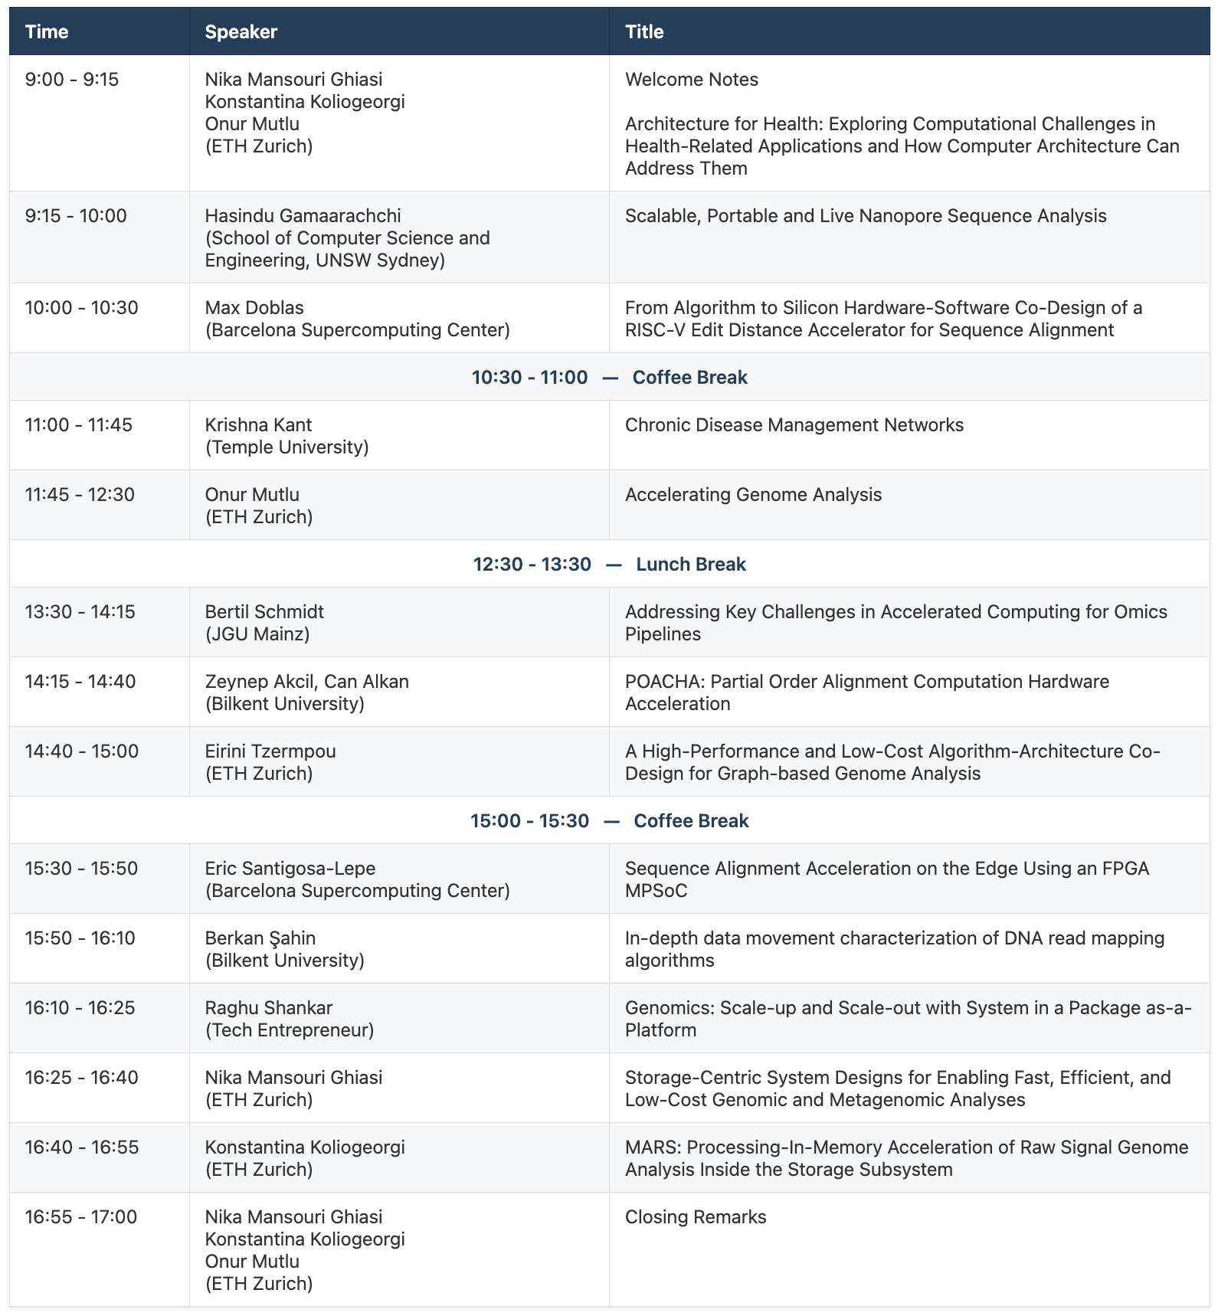
Agenda

Slide 8

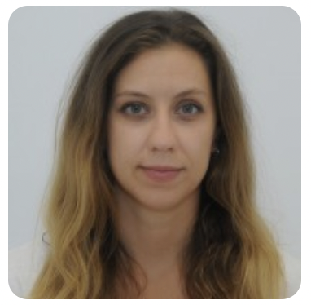
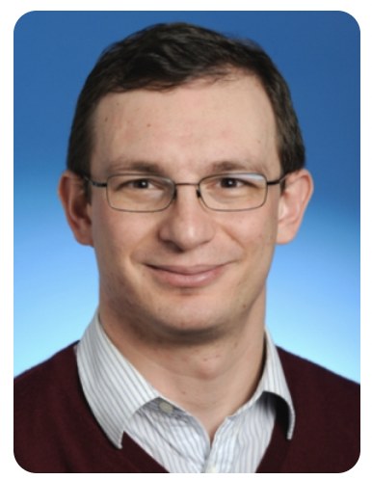
Organizers
Nika Mansouri Ghiasi
Recently defended PhD, currently researcher and lecturer in the SAFARI Research Group at ETH Zurich
https://sites.google.com/view/nikamansourighiasi
Dr. Konstantina Koliogeorgi
Postdoctoral Researcher and Lecturer in the SAFARI Research Group at ETH Zurich
https://bit.ly/konkoliogeorgi-linkedin
Prof. Onur Mutlu
Professor of Computer Science at ETH Zurich
https://people.inf.ethz.ch/omutlu/

Slide 9

More Info
https://events.safari.ethz.ch/ics26-arch4health/

Slide 10
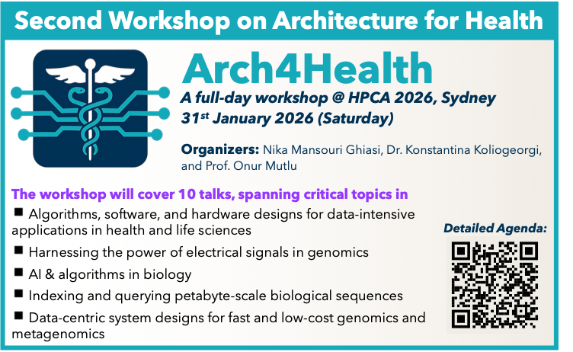
More Info on the 2nd Arch4Health

Slide 11
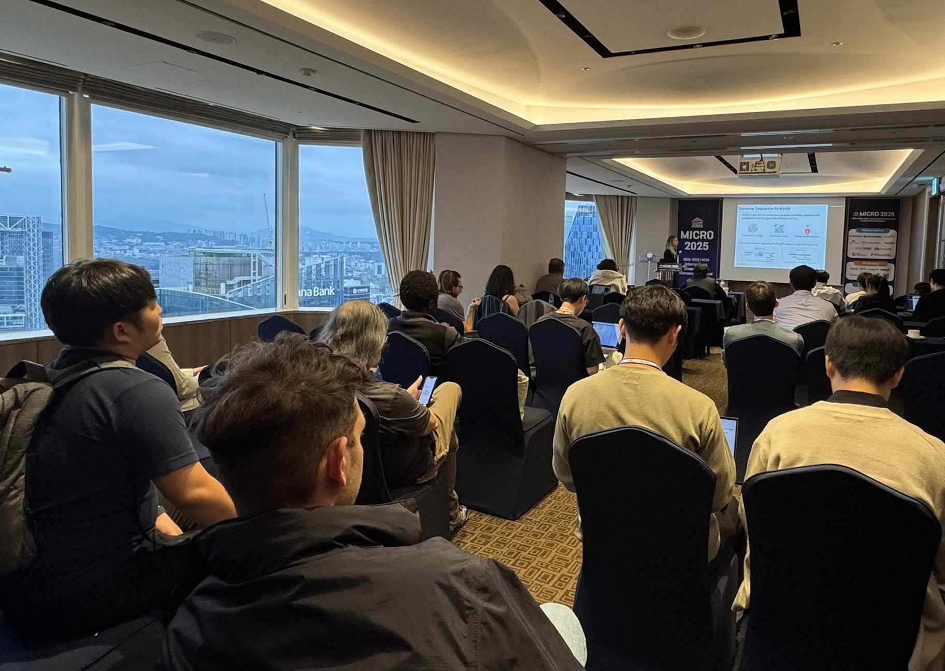
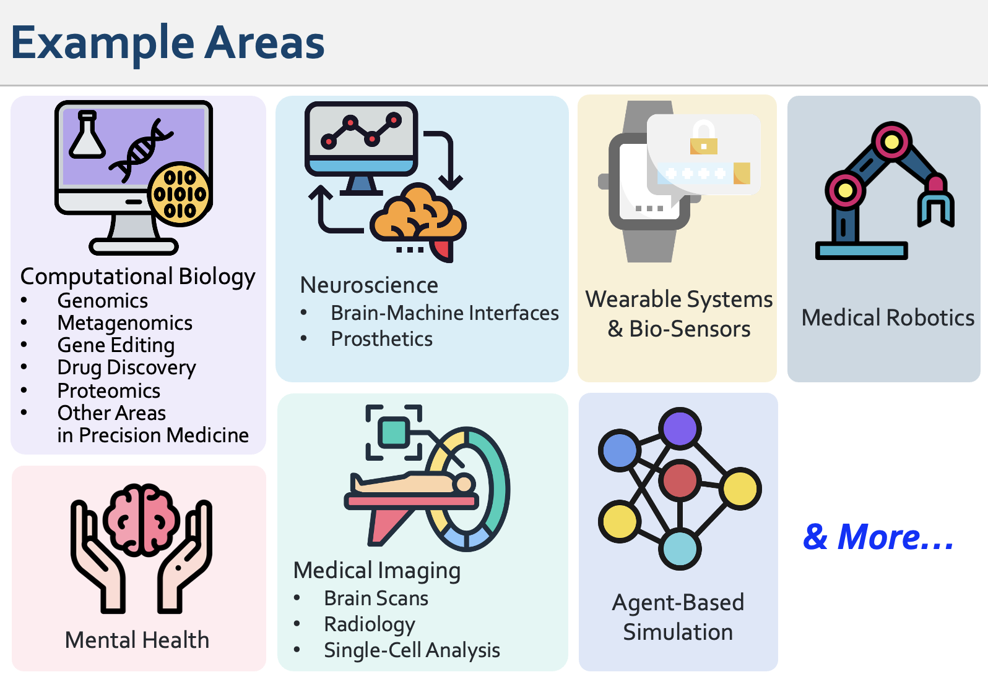
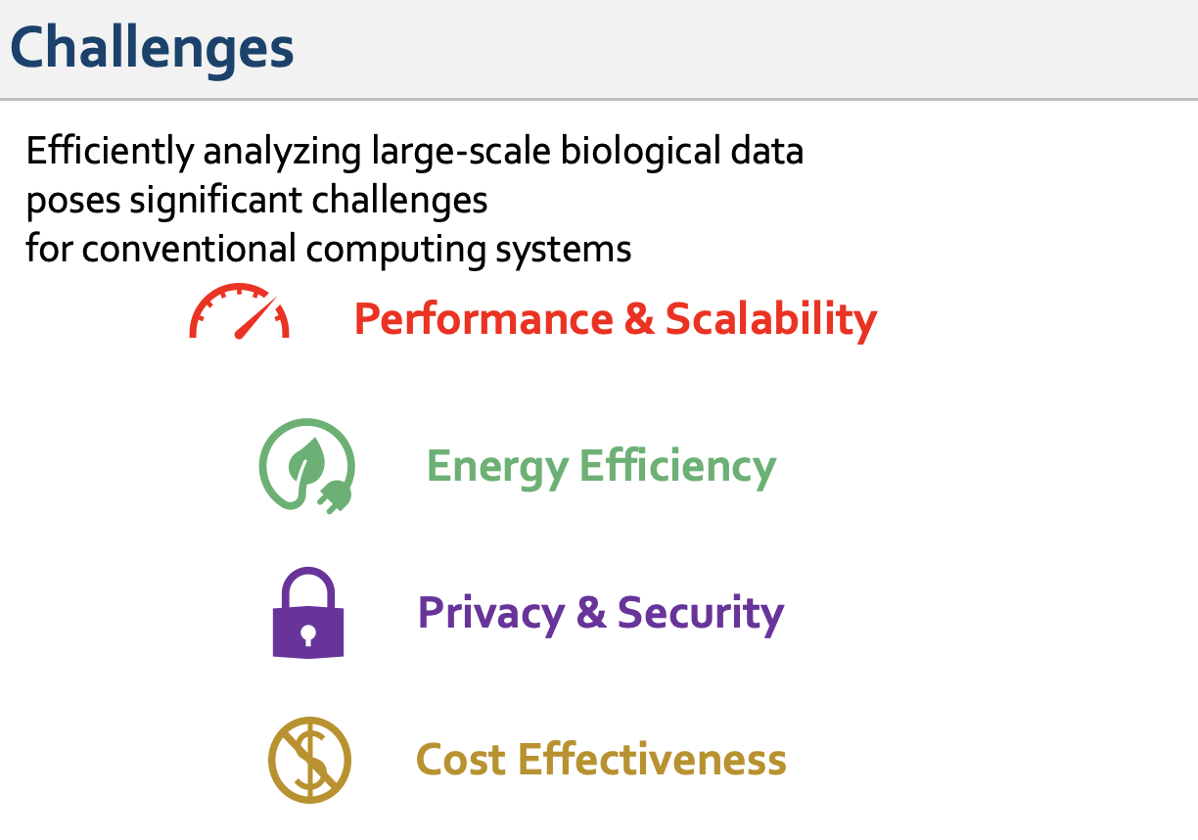

Arch4Health
@ MICRO 2025
More Info:
YouTube:

Slide 12
3rd Workshop on
Architecture for Health
(Arch4Health)
In Conjunction with ICS 2026
Belfast, Northern Ireland
Nika Mansouri Ghiasi, Konstantina Koliogeorgi, Onur Mutlu
Notes:
Hi, I’m Nika, and today I will introduce GenStore: A High-Performance In-Storage Processing System
for Genome Sequence Analysis

Slide 13
3rd Workshop on
Architecture for Health
(Arch4Health)
We will be back at 15.30, Belfast time.
Notes:
Hi, I’m Nika, and today I will introduce GenStore: A High-Performance In-Storage Processing System
for Genome Sequence Analysis

